Slide 1
NICKY FIFTH’S NEW JERSEY
N5NJ
SECONDARY PROGRAM
GEOGRAPHY The Interstate

Slide 2
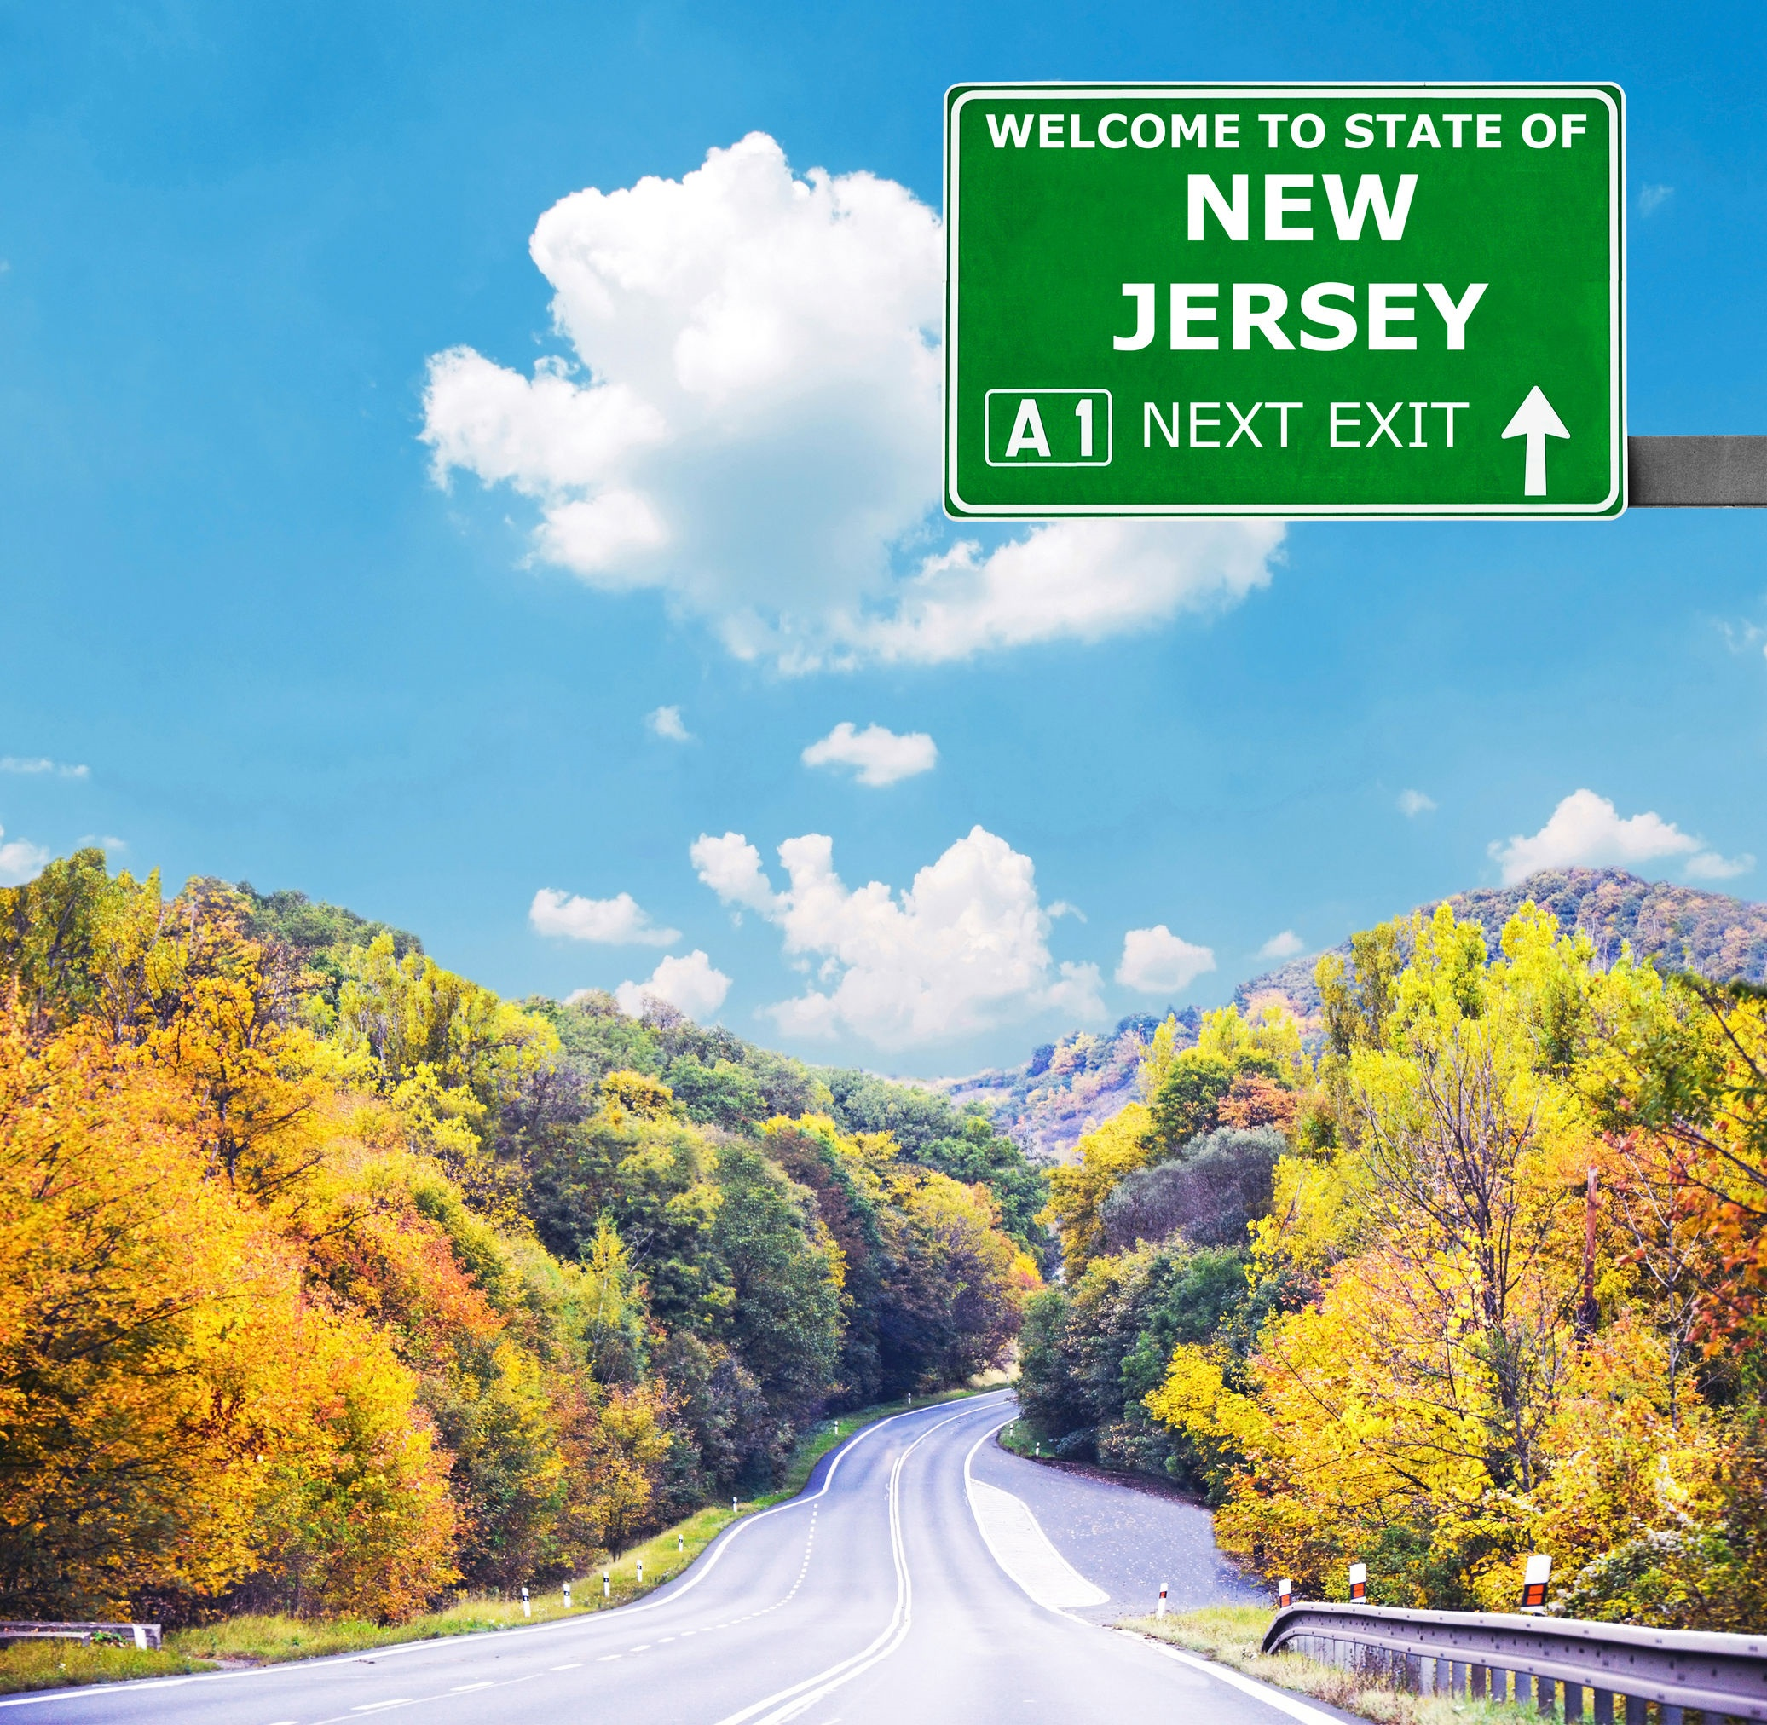
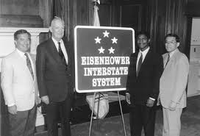
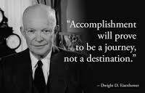
123rf.com
en.wikipedia.org
presidenteisenhower.net
On June 29, 1956, President Dwight Eisenhower signed the Federal-Aid Highway Act of 1956. The bill created a 41,000-mile “National System of Interstate and Defense Highways” that would, according to Eisenhower, eliminate unsafe roads, inefficient routes, traffic jams and all of the other things that got in the way of “speedy, safe, transcontinental travel.” At the same time, highway advocates argued, “in case of atomic attack on our key cities, the road net would permit quick evacuation of target areas.” For all of these reasons, the 1956 law declared that the construction of an elaborate expressway system was “essential to the national interest.”
www.history.com

Slide 3
President Eisenhower’s model for the Interstate System had been Germany’s autobahn: the rural highway network he had seen during and after World War II.
fhwa.dot.gov
The Autobahn, Germany
123rf.com

Slide 4
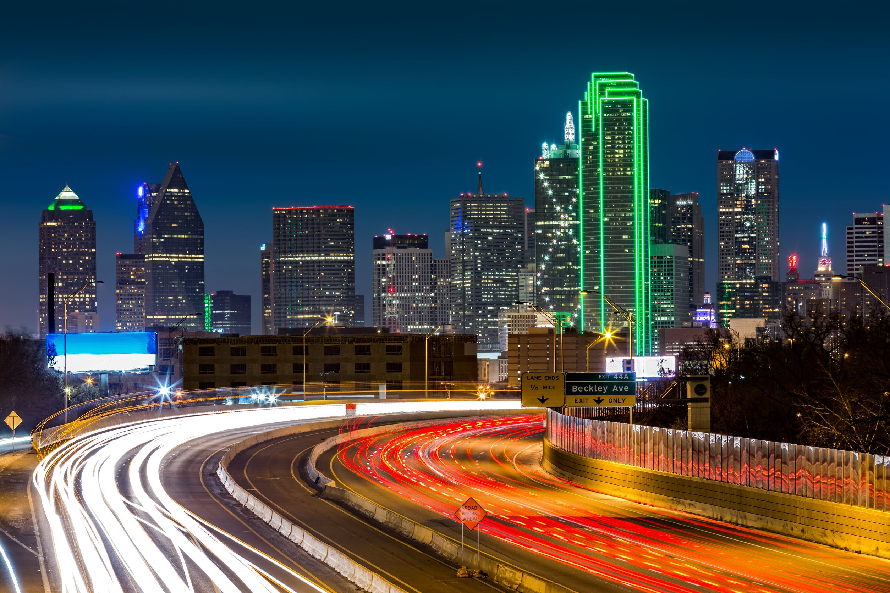
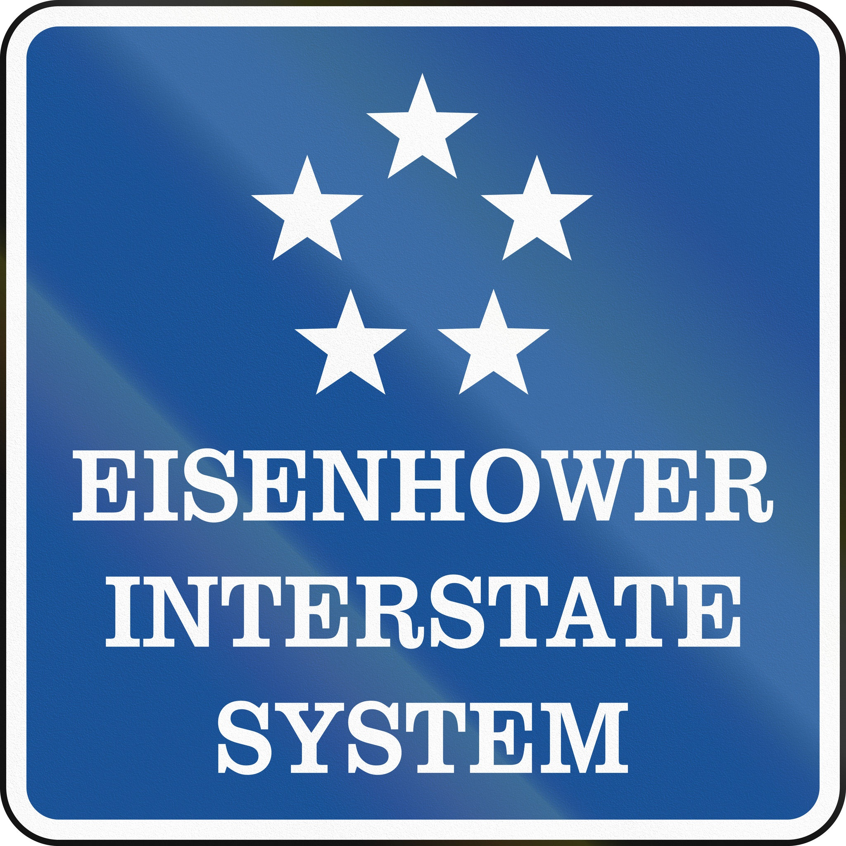
According to the Federal Highway Administration, the Interstate System has been called the Greatest Public Works Project in History. From the day President Dwight D. Eisenhower signed the Federal-Aid Highway Act of 1956, the Interstate System has been a part of our culture as construction projects, as transportation in our daily lives, and as an integral part of the American way of life.
www.fhwa.dot.gov
Interstate Highway in Dallas, Texas
123rf.com

Slide 5
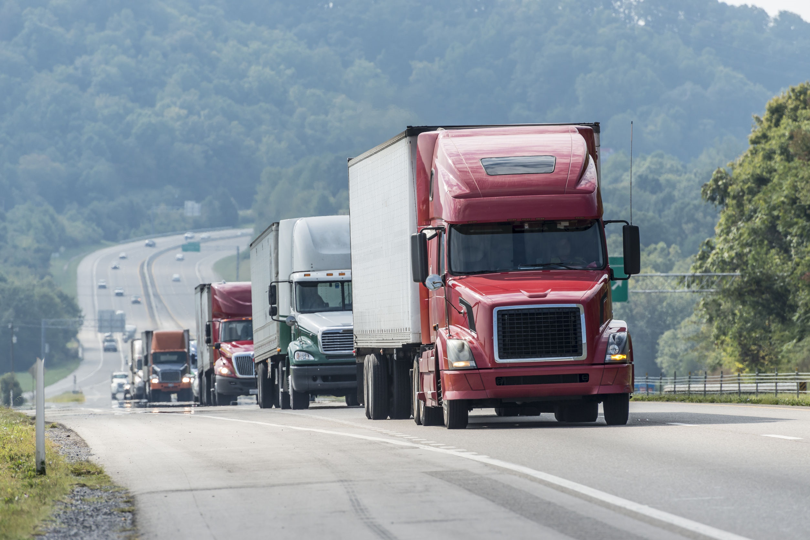
Every citizen has been touched by it, if not directly as motorists, then indirectly because every item we buy has been on the Interstate System at some point. President Eisenhower considered it one of the most important achievements of his two terms in office, and historians agree.
www.fhwa.dot.gov
123rf.com

Slide 6
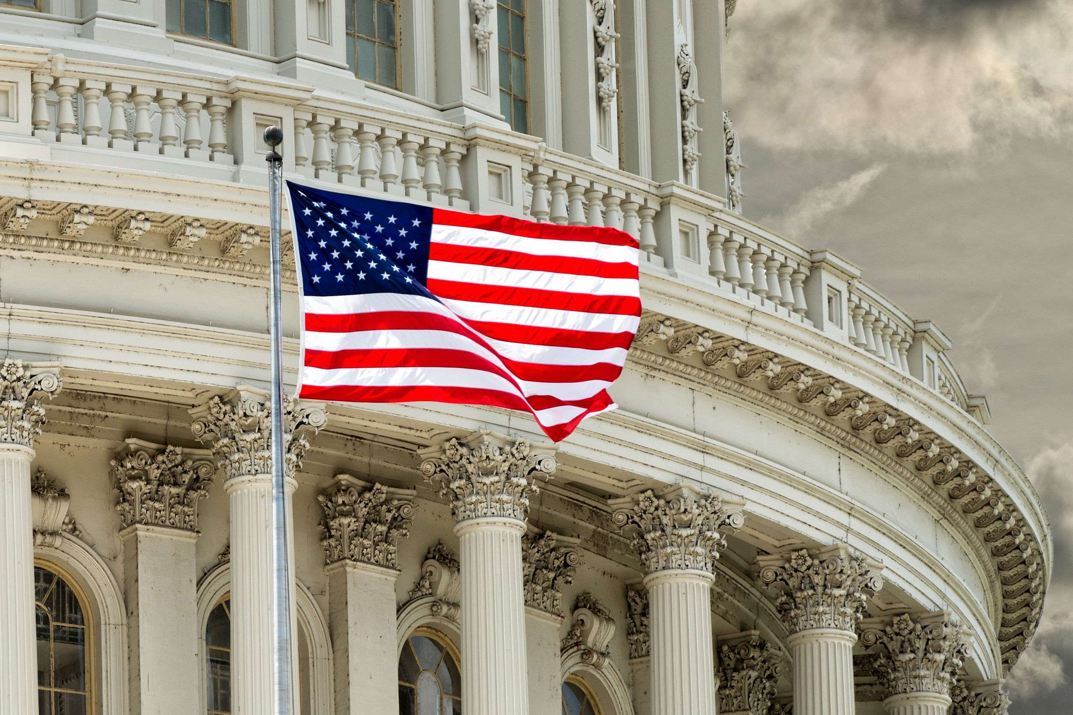
The Interstate System was built under the principles of the Federal-aid highway program, which was established in 1916. The Federal Government made Interstate Construction funds available to the State highway/transportation agencies, which built the Interstates.
www.fhwa.dot.gov
123rf.com

Slide 7
The states own and operate the Interstate highways. The one exception is the Woodrow Wilson Memorial Bridge (I-95/495) over the Potomac River in the Washington area.
The final estimate of the cost of the Interstate System was issued in 1991. It estimated that the total cost would be $128.9 billion, with a Federal share of $114.3 billion. This estimate covered only the mileage, 42,795 miles, built under the Interstate Construction Program. It excluded turnpikes incorporated into the Interstate System.
In all, Federal-aid legislation authorized a total of $119 billion to pay the Federal share of the cost of Interstate construction.
www.fhwa.dot.gov
123rf.com

Slide 8
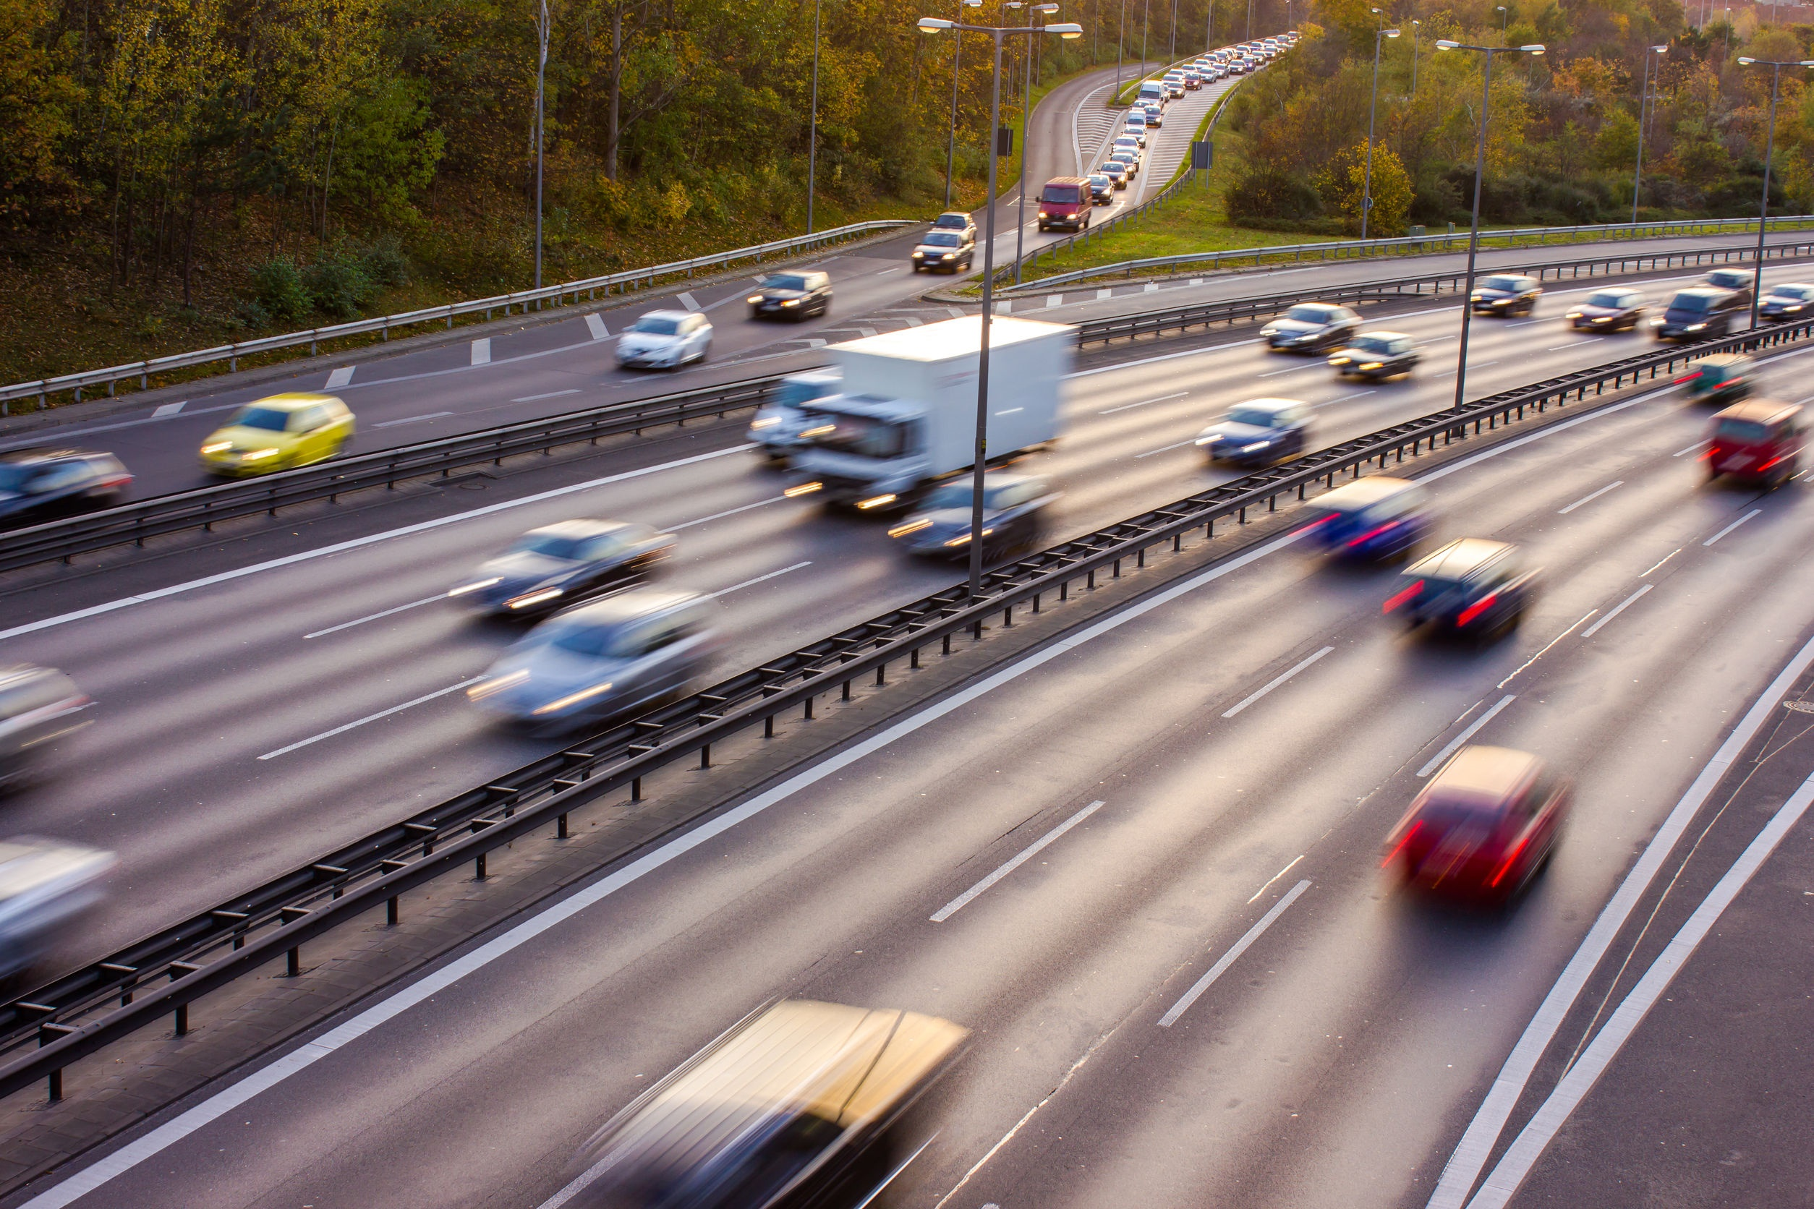
One of the primary reasons for building the Interstate System was to improve the safety of the highway users: drivers, passengers, and pedestrians. Over the past 50 years, the Interstate System has done much to make highway travel safer and more efficient.
Relative safety is measured by the "fatality rate“, which is fatalities per 100 million vehicle miles traveled. It is a measure used so data can be compared as traffic volumes change.
The Interstate System is the safest road system in the country, with a fatality rate of 0.8—compared with 1.46 for all roads in 2004.
www.fhwa.dot.gov
123rf.com
123rf.com

Slide 9
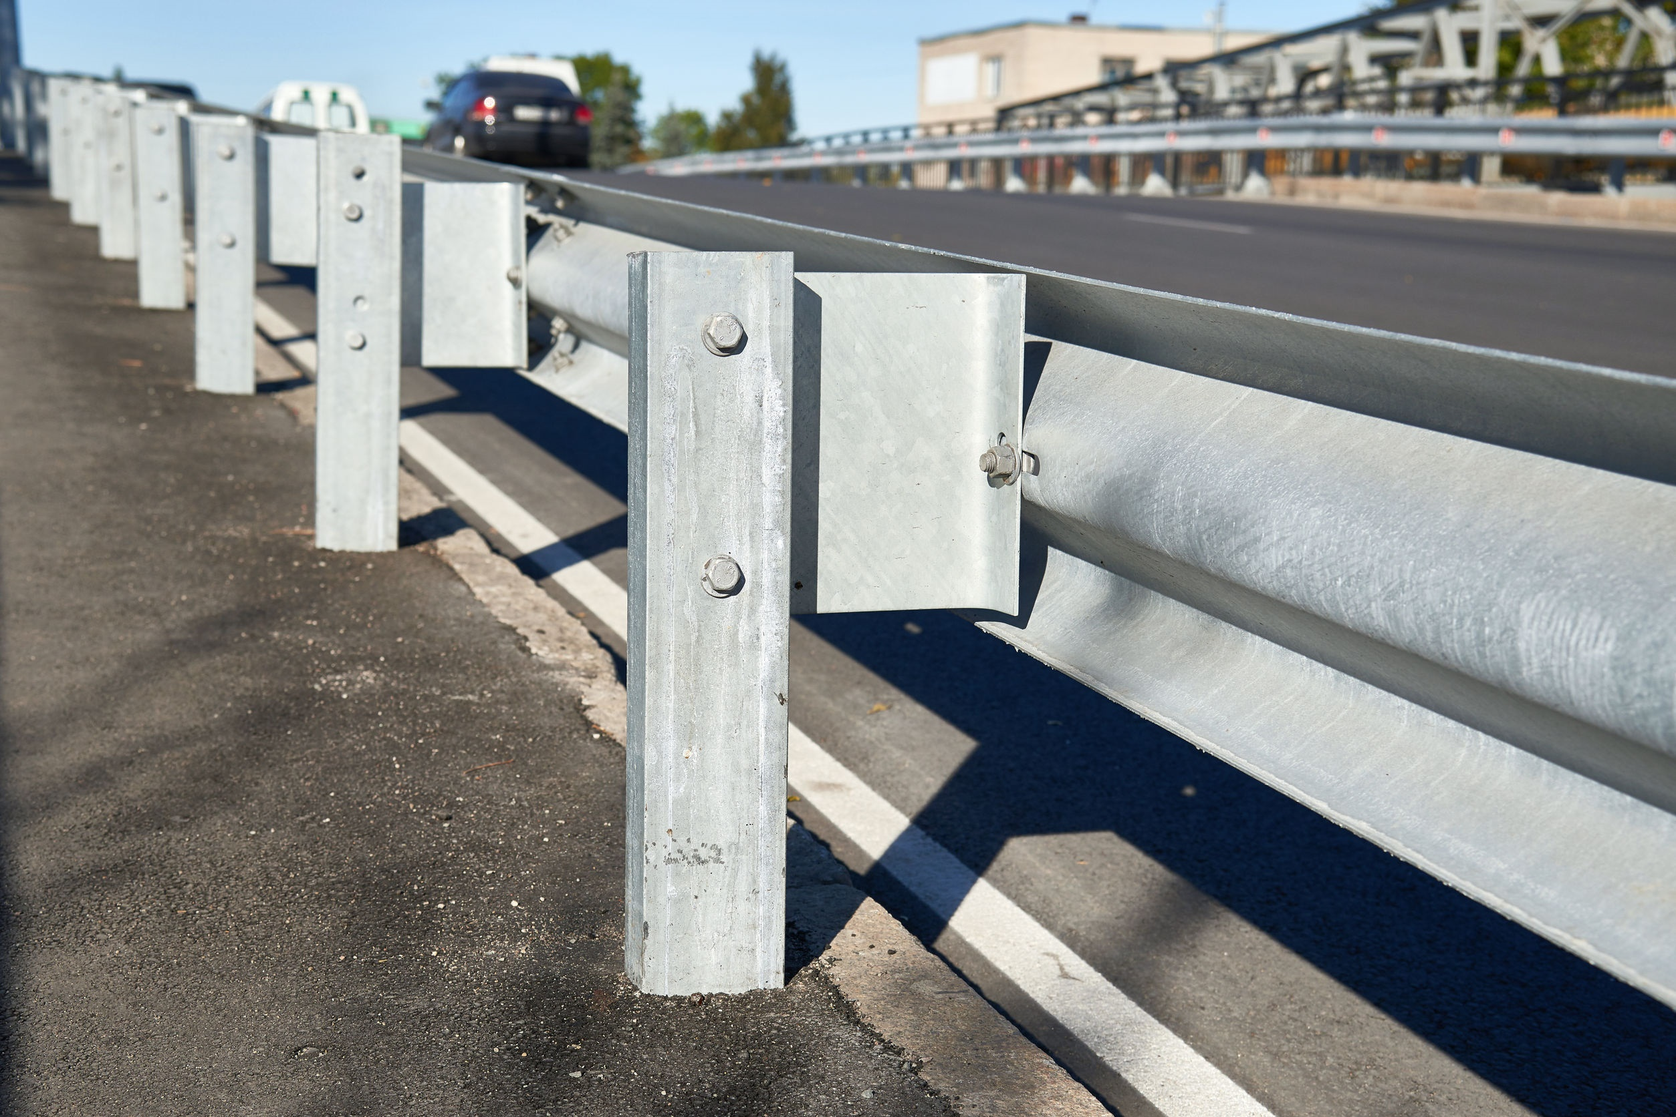
123rf.com
When the Interstate Construction Program began in 1956, the national fatality rate was 6.05. This improvement in safety has been the result of many factors working together: the shifting of traffic onto the safer Interstate highways and technological advances in safety, such as wider shoulders; slid-resistant pavements; better guardrail, signs, and markings; clearer sight distances; and breakaway sign posts and utility poles. In addition, many other factors have contributed to improved safety on the Nation's highway system, including new vehicle safety features, such as shatter proof glass, padded interiors, safety belts and air bags; programs to reduce impaired driving; and the combined, coordinated efforts of many private organizations and public agencies working together to make the Nation's highways ever safer.
fhwa.dot.gov

Slide 10
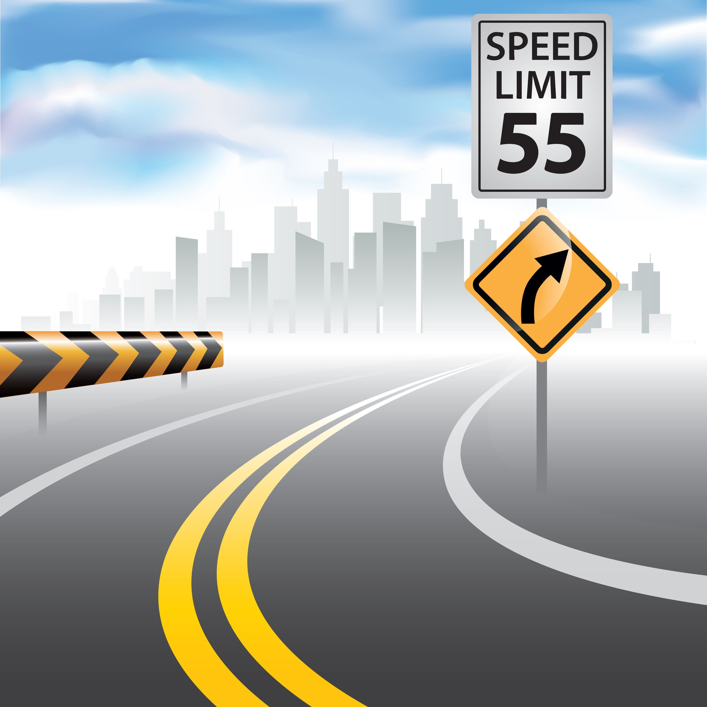
In the 1970's, the Federal Highway Administration (FHWA) considered converting highway signs, such as speed limit signs, to metric units of measurement.
After the proposal was made public, the agency received an unusually high number of comments—more than 5,000 comments, about 98 percent of which were negative. The idea was soon dropped.
fhwa.dot.gov
123rf.com

Slide 11
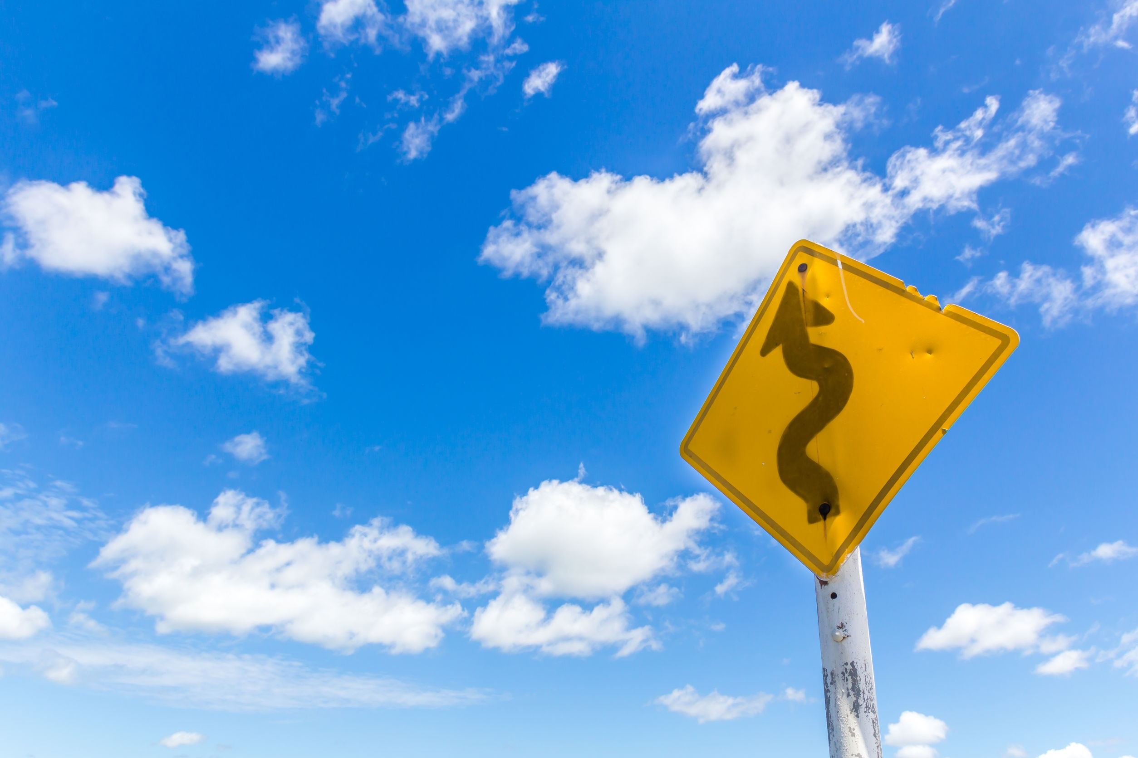
123rf.com
Design standards don’t require curves to keep drivers from falling asleep, but that is one reason curves may be included.
Although design standards don’t require curves at specific distances in the alignment of an Interstate highway, curves are introduced for a variety of reasons.
The reasons include: taking advantage of the terrain along the route; avoiding obstacles or cultural development in the path; and, accommodating environmentally sensitive areas or mitigating impacts on them.
A curvilinear alignment does, however, reduce the boredom of driving along extremely long tangent sections (engineer speak for “straight roads”), keeping the driver alert.
fhwa.dot.gov

Slide 12
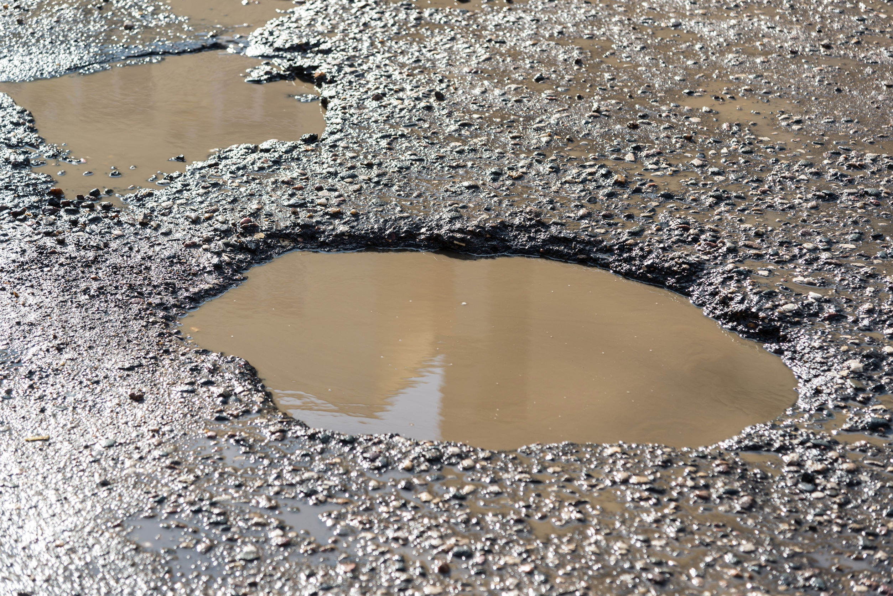
At home, however, a national report confirms what New Jersey commuters experience daily, that our interstate highways are among those with the worst traffic and roughest pavement in the country. New Jersey ranked ninth for having 19 percent of interstate highway pavement rated in poor or mediocre condition, according to TRIP, a national transportation research group. Hawaii and California were ranked numbers one and two on the list of states with the worst pavement. TRIP's findings are based on Federal Highway Administration data for 2014.
www.nj.com – Larry Higgs

Slide 13
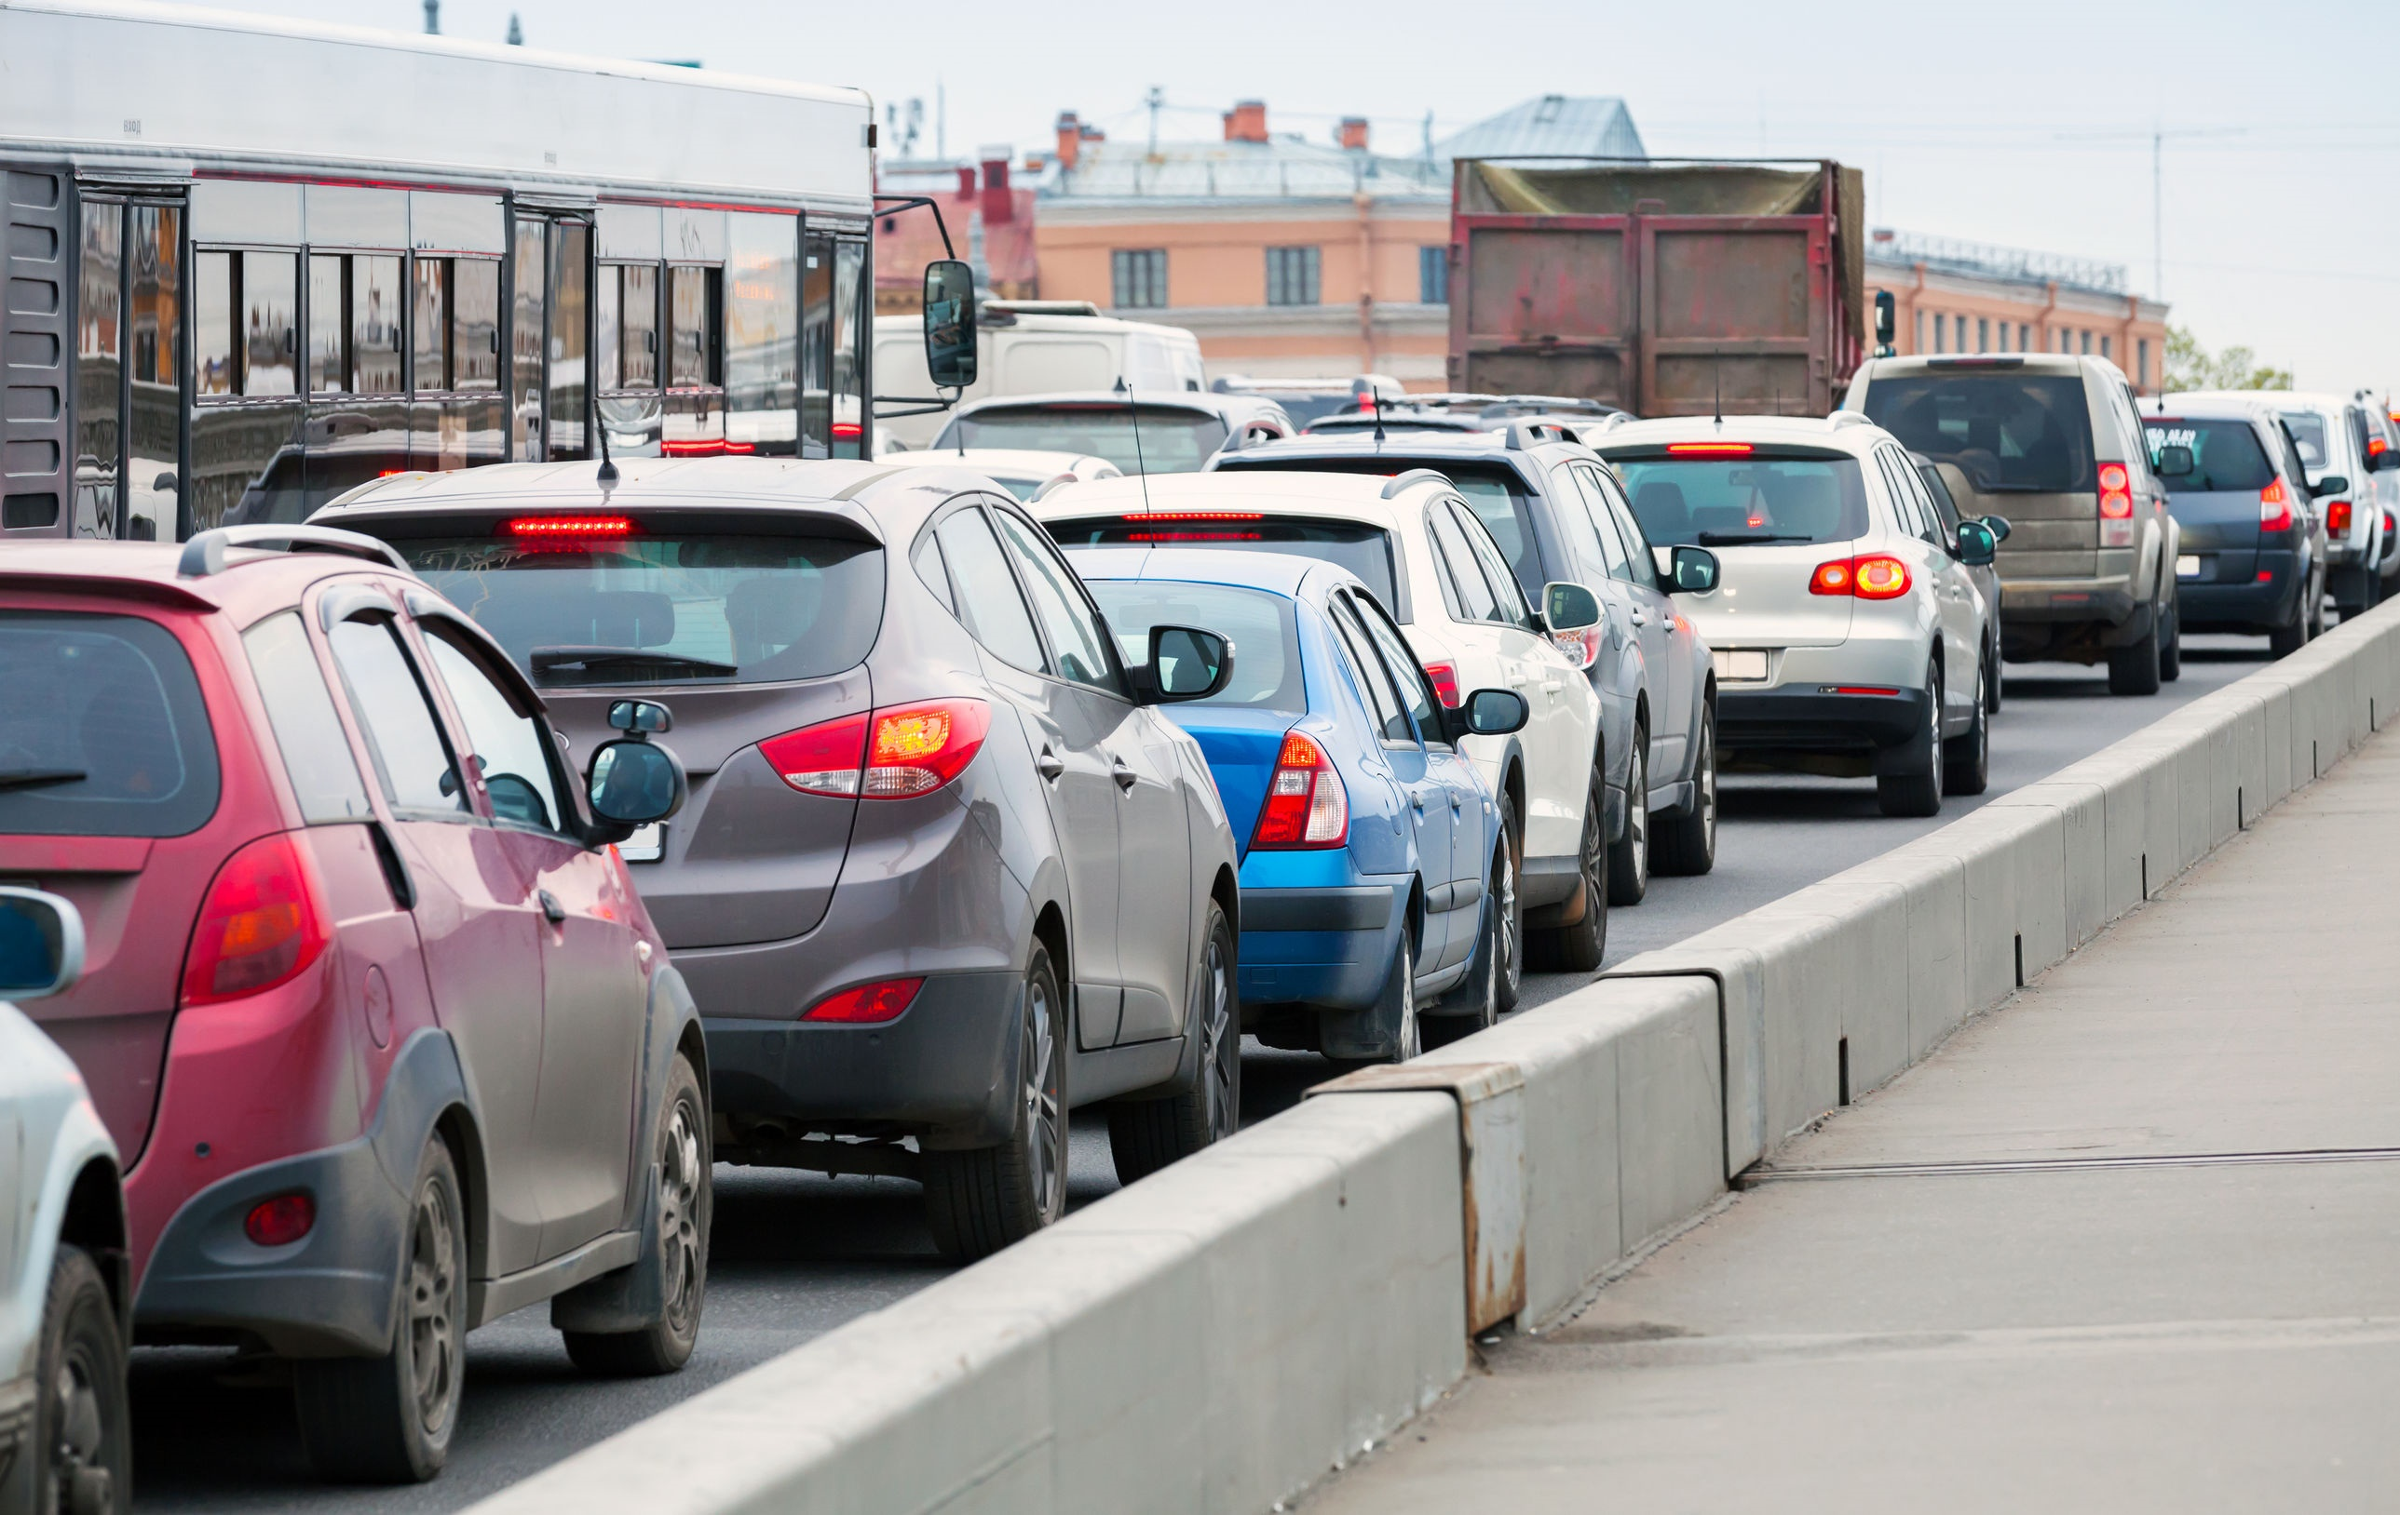
What's driving the bad news? New Jersey's interstates are taking a beating from traffic and the state is ranked among the 10 states with the highest congestion rates and the highest traffic volumes. New Jersey ranked third for the amount of urban interstate congestion, with 73 percent of those highways considered congested, and for where drivers experience traffic delays during peak commuting periods. The state saw a 21 percent increase in the amount of vehicle miles traveled between 2000 and 2014, ranking New Jersey tenth. The interstates carry an average traffic volume of 14,000 vehicles per mile each day, ranking it ninth for states with the most daily travel.
www.nj.com – Larry Higgs
123rf.com

Slide 14
New Jersey Interstate Highways
I-76
123rf.com

Slide 15
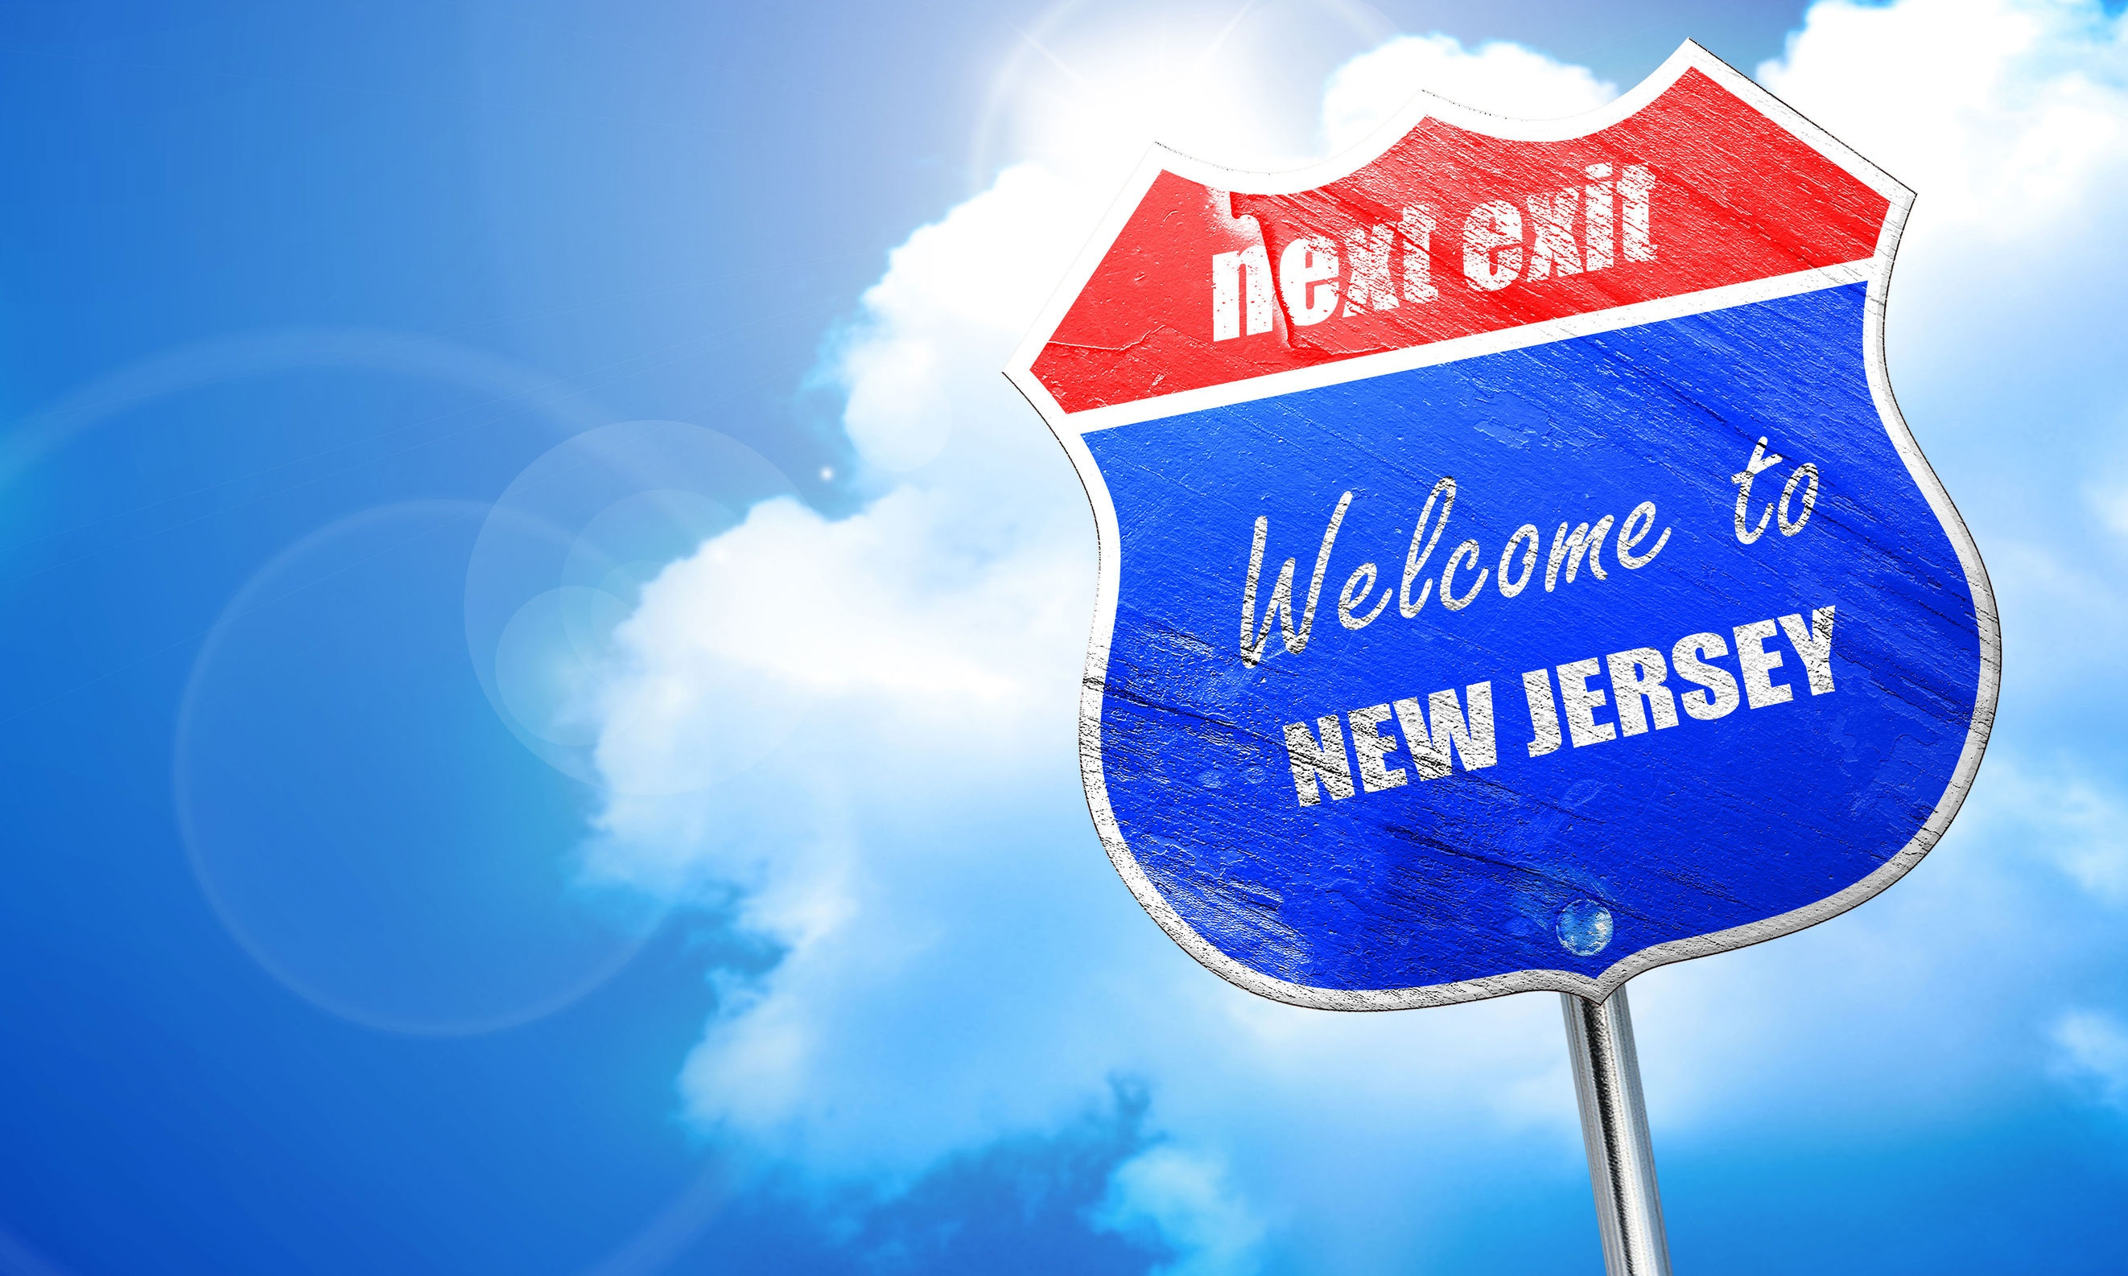
Key Words
transcontinental Interstate advocates
public works transportation congestion
motorists Federal share agencies
fatality rates pedestrian proposal
sight distances tangent sections commuters
123rf.com

