Slide 1
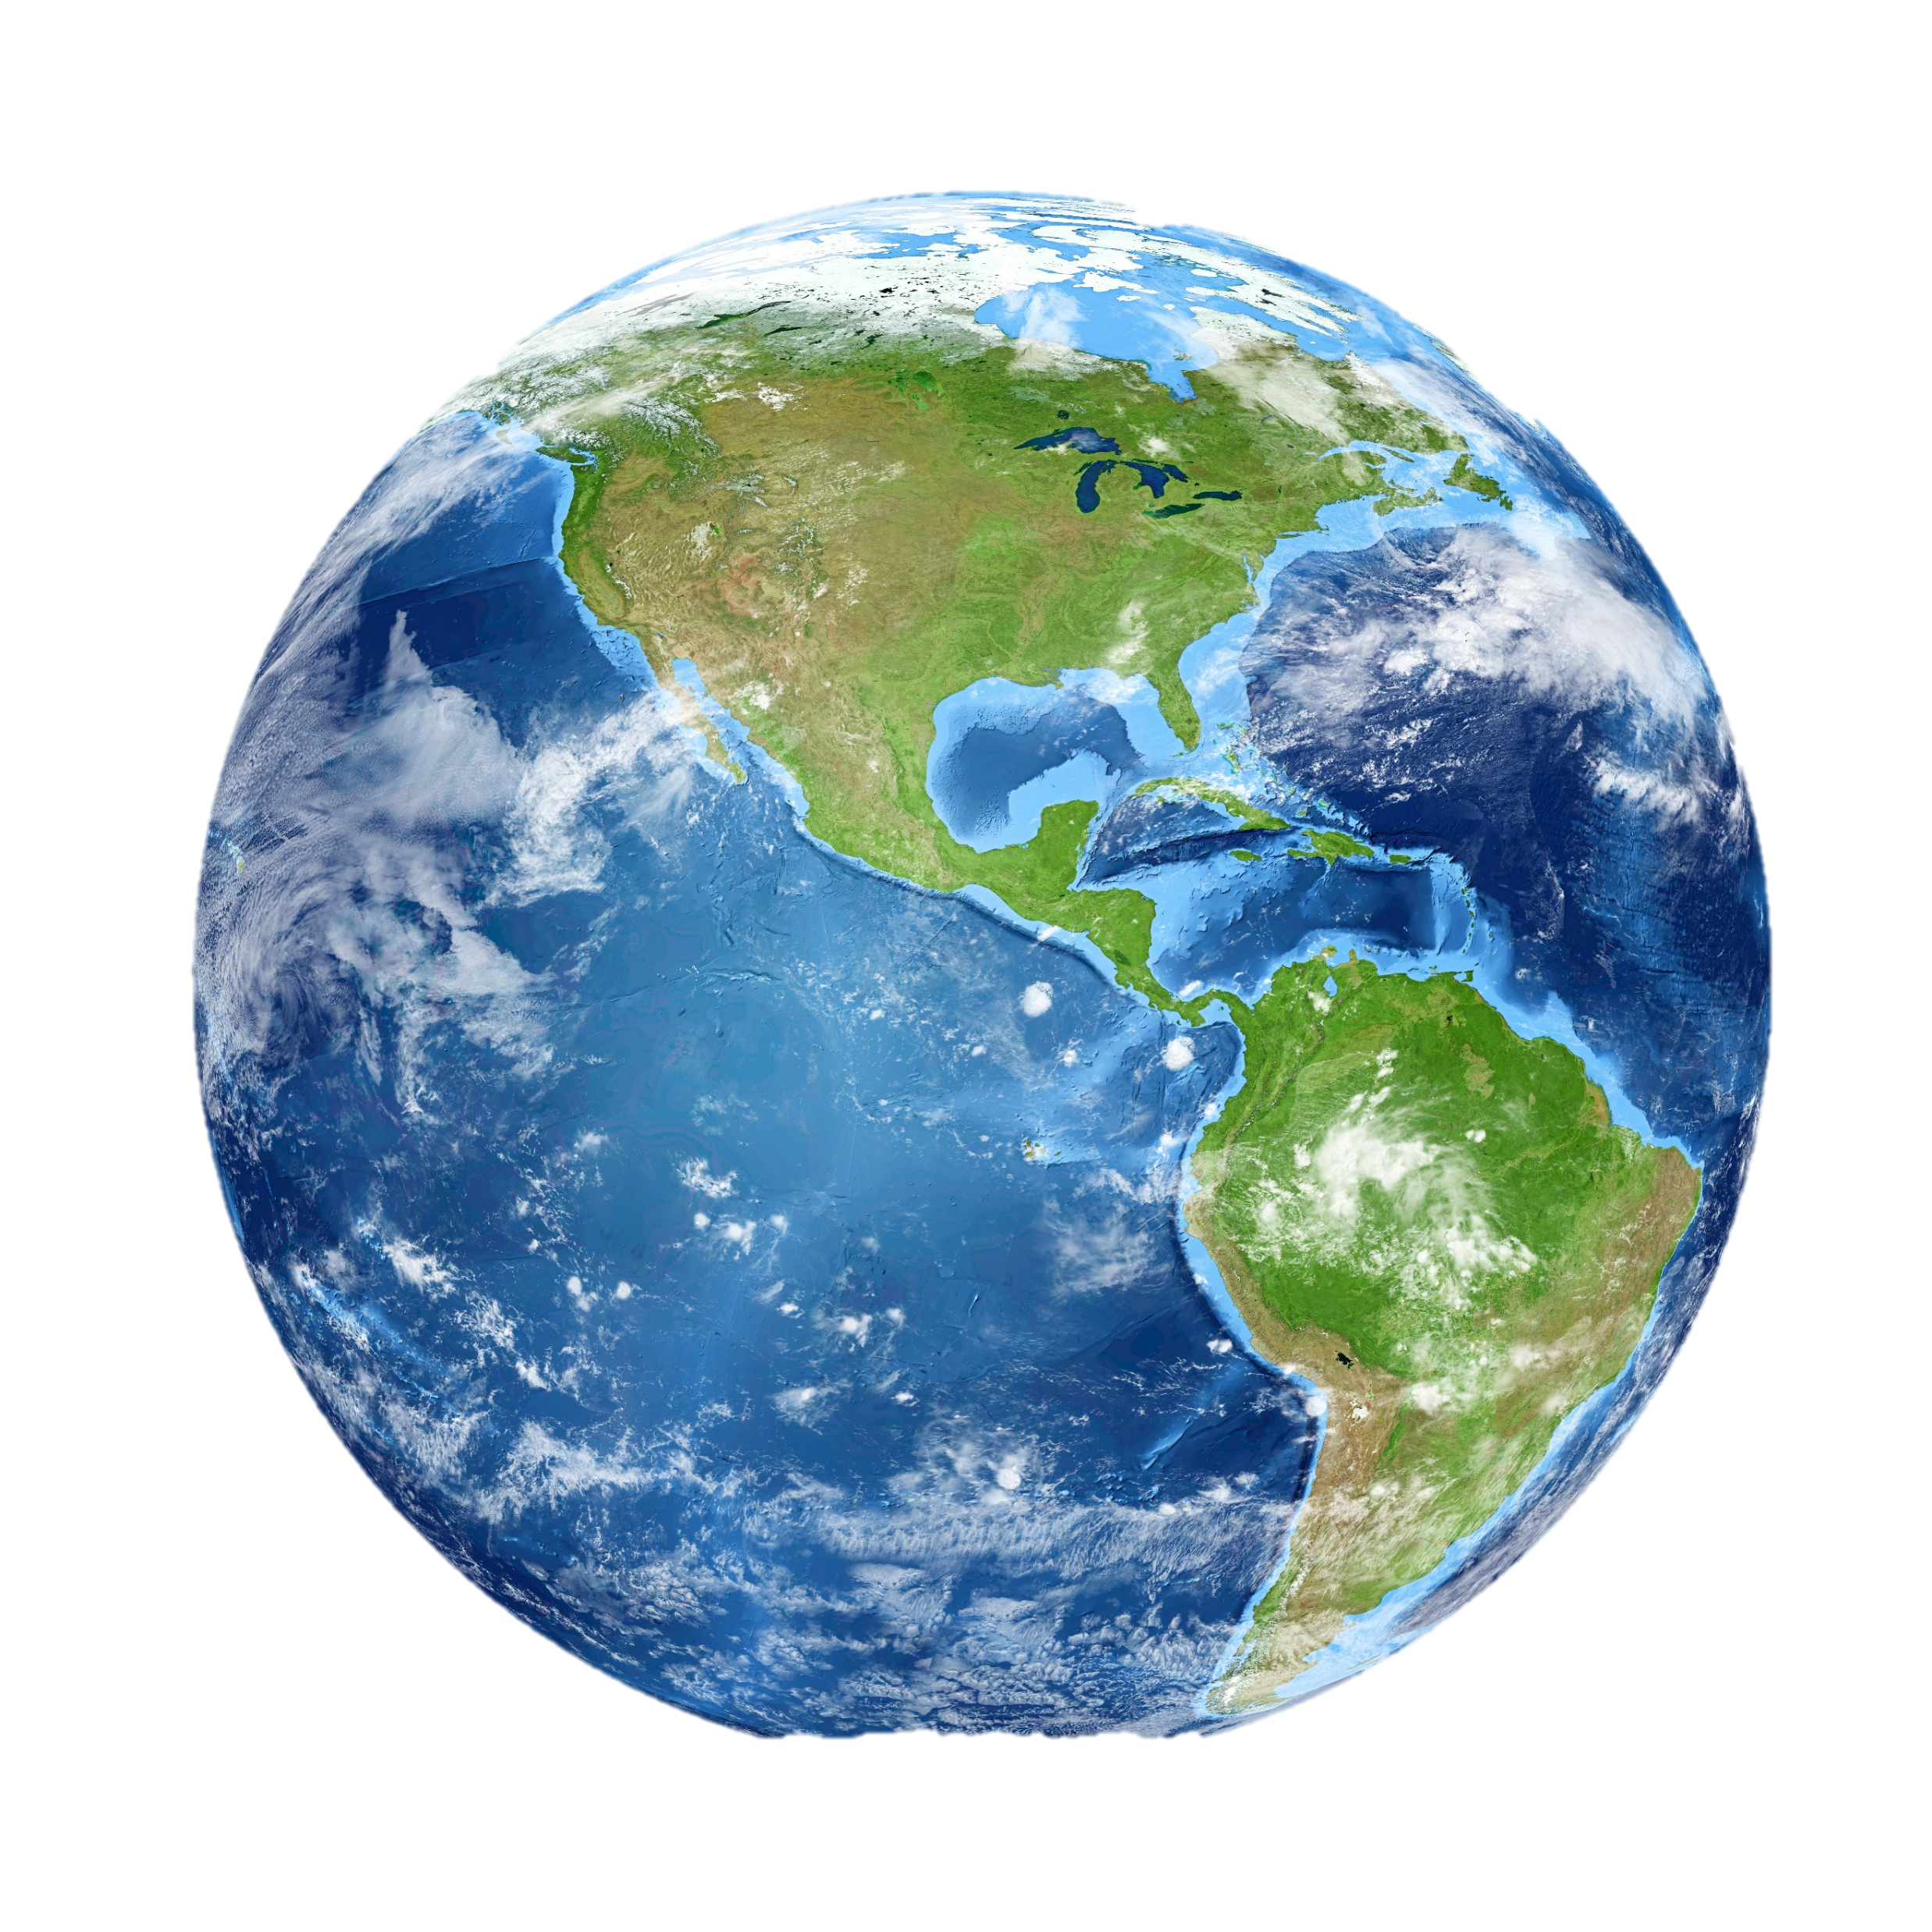
NICKY FIFTH’S NEW JERSEY
N5NJ
SECONDARY PROGRAM
GEOGRAPHY
Water, Water, Everywhere

Slide 2
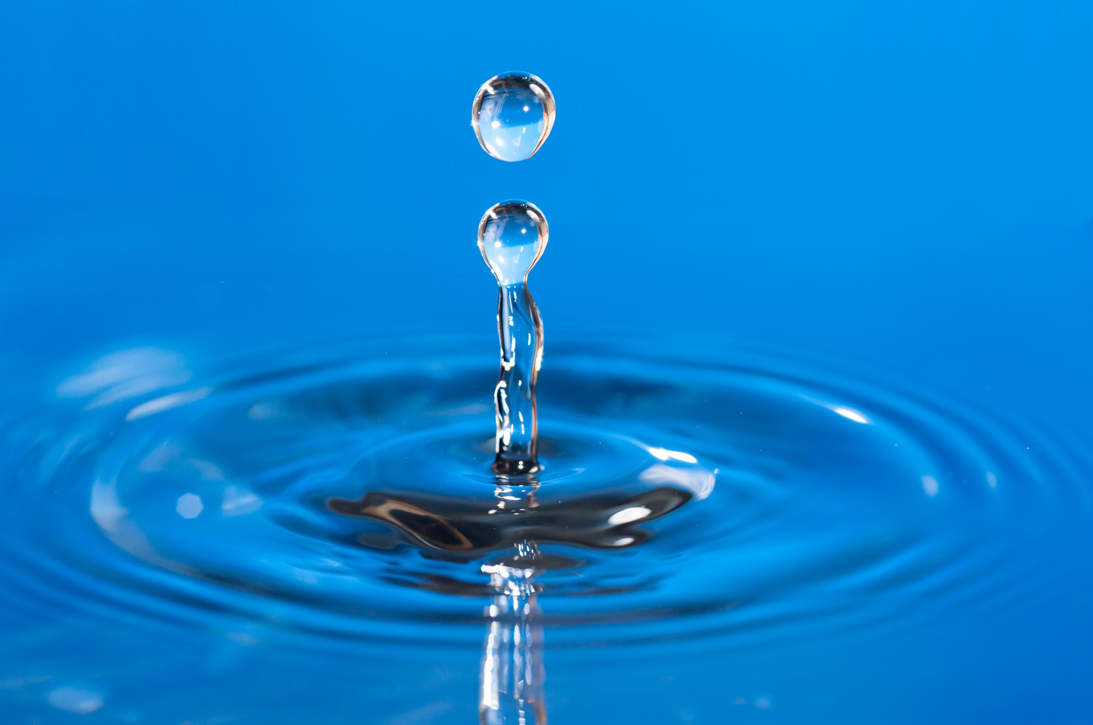
With an average rainfall of 45 inches per year, New Jersey is often considered a “water rich” state. However, when considering that New Jersey is also the most densely populated state in the country, our current and future demands are likely to exceed the sustainable supply of our water resources.
http://njwatersavers.rutgers.edu
123rf.com

Slide 3
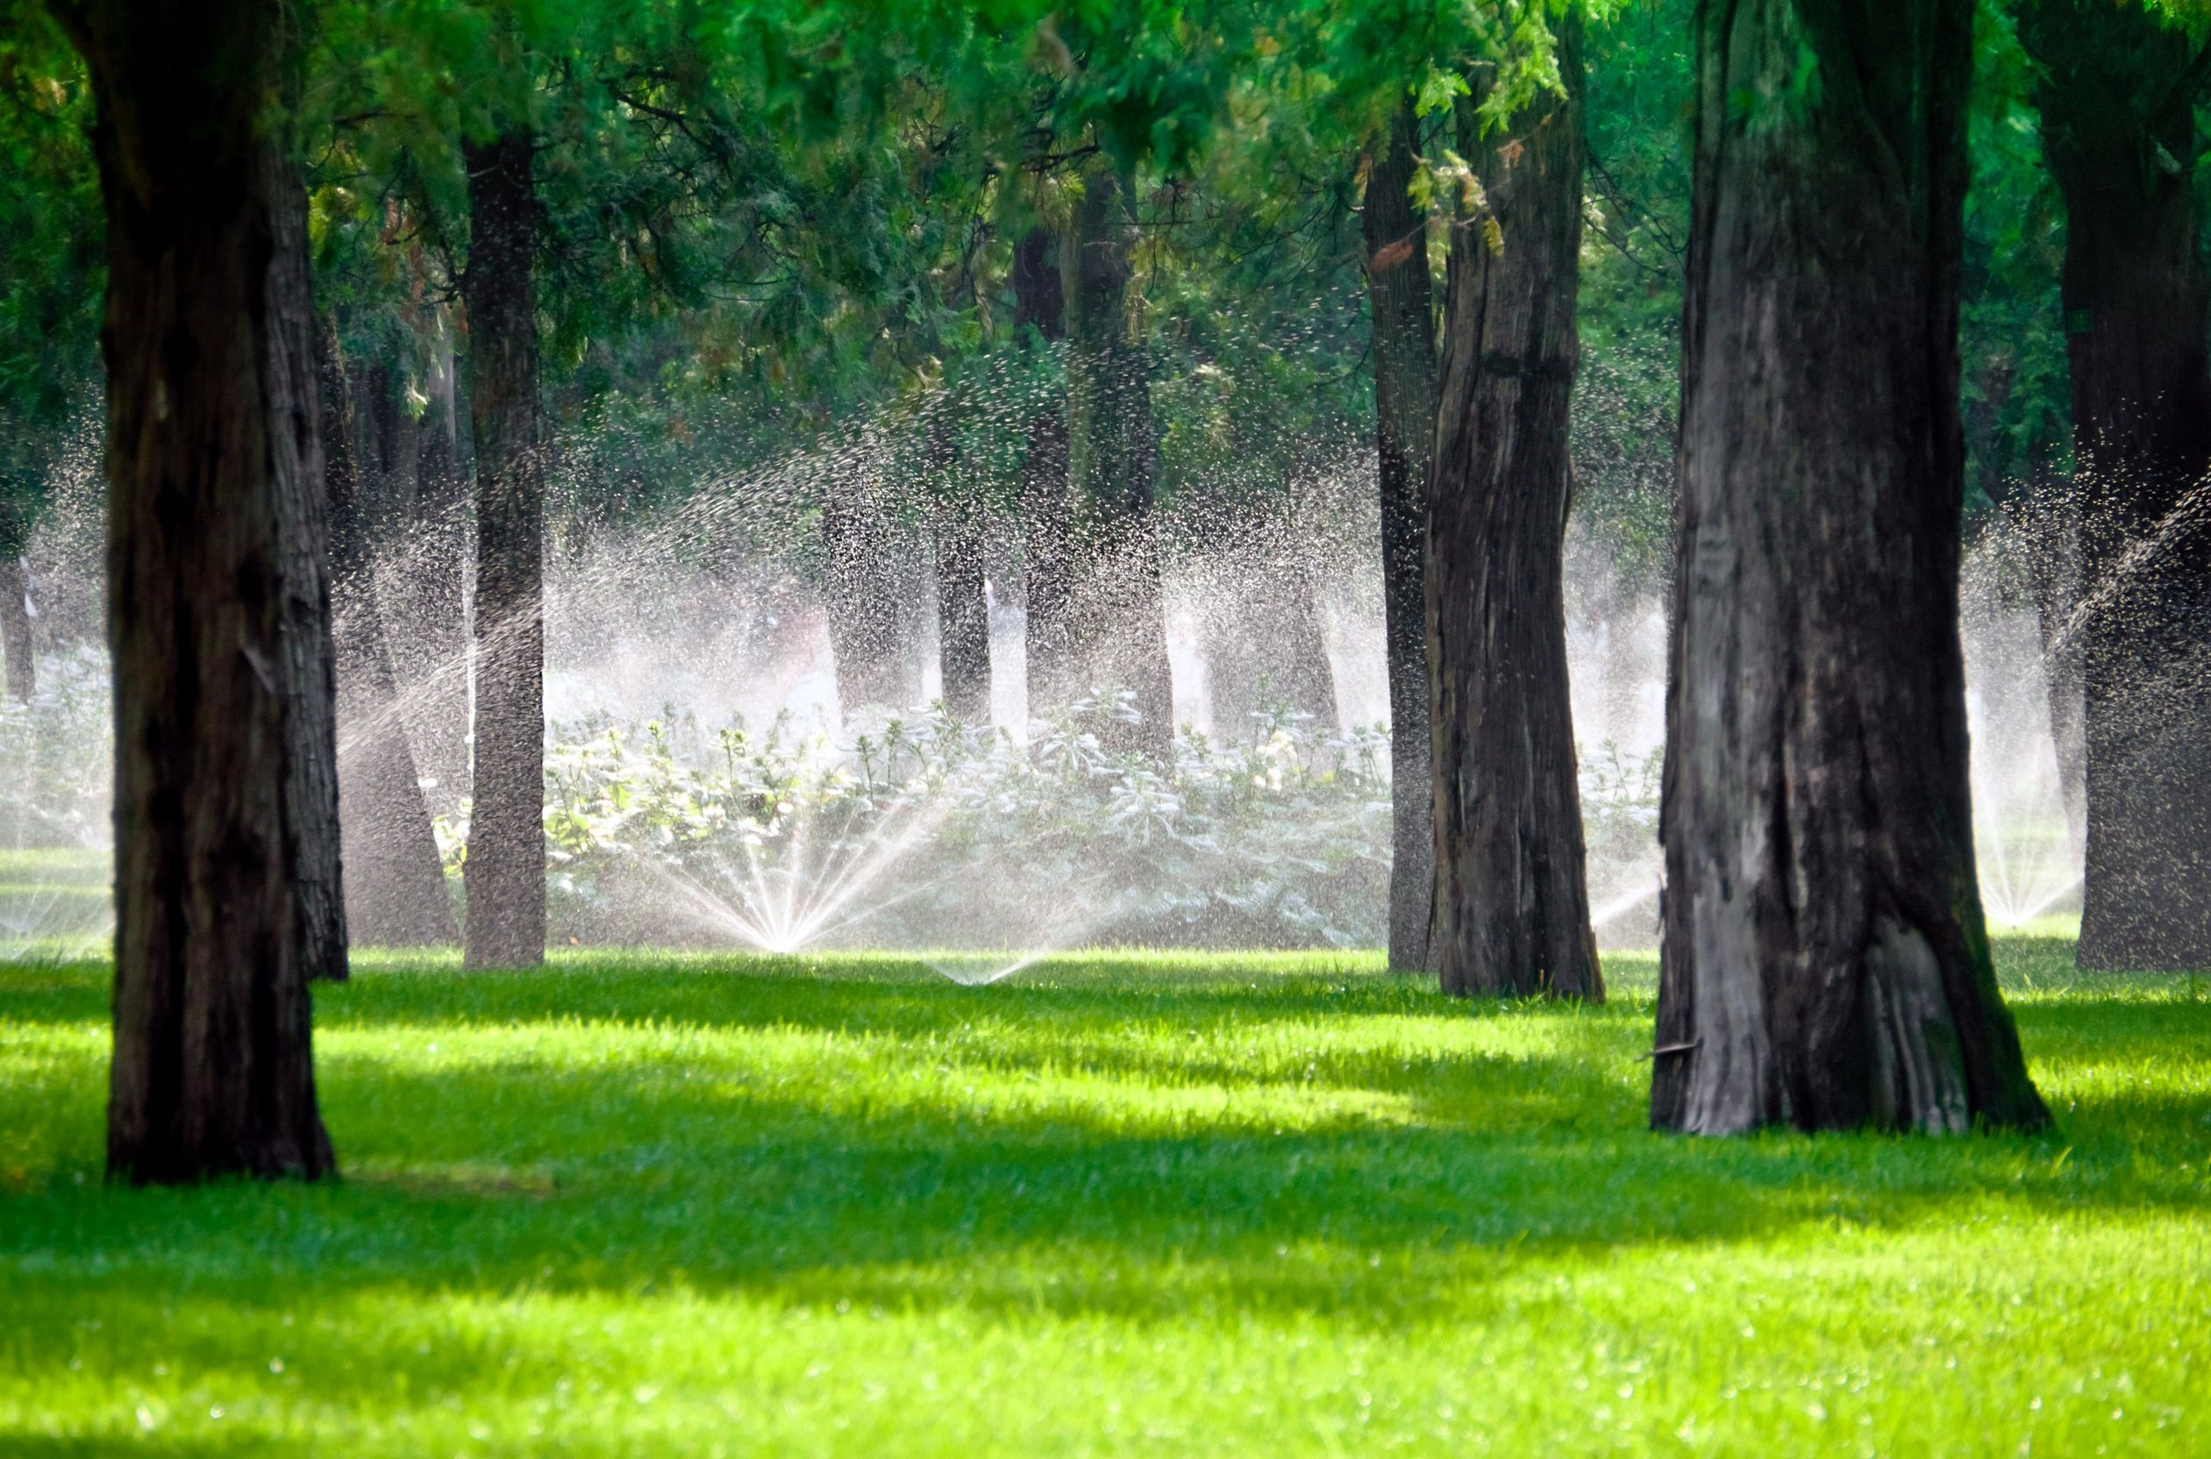
The average New Jersey resident uses 100 gallons of water per day, a number which increases dramatically during the summer months. In fact, in some cases, New Jersey communities that engage in outdoor irrigation increase their average water use by up to 85 gallons per day in the summer months.
http://njwatersavers.rutgers.edu
123rf.com

Slide 4
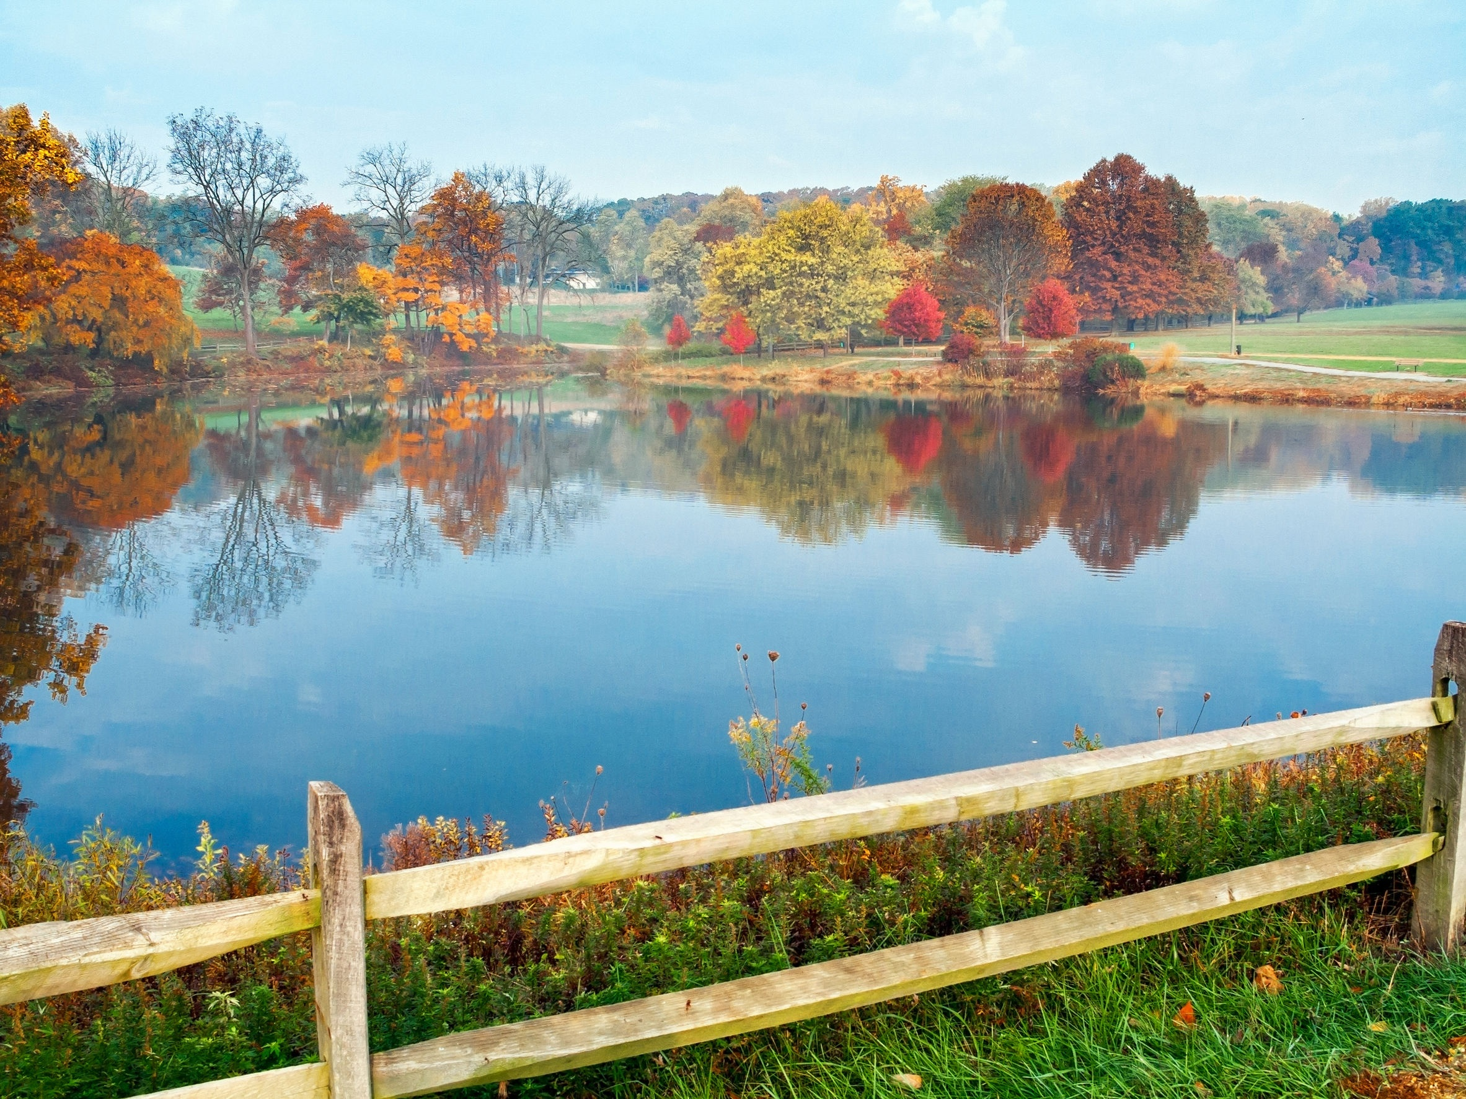
Holmdel, NJ
Even in areas where water seems abundant, water conservation is important. In addition to saving money on utility bills, water conservation helps prevent water pollution in nearby lakes, rivers, and local watersheds.
http://njwatersavers.rutgers.edu
123rf.com

Slide 5
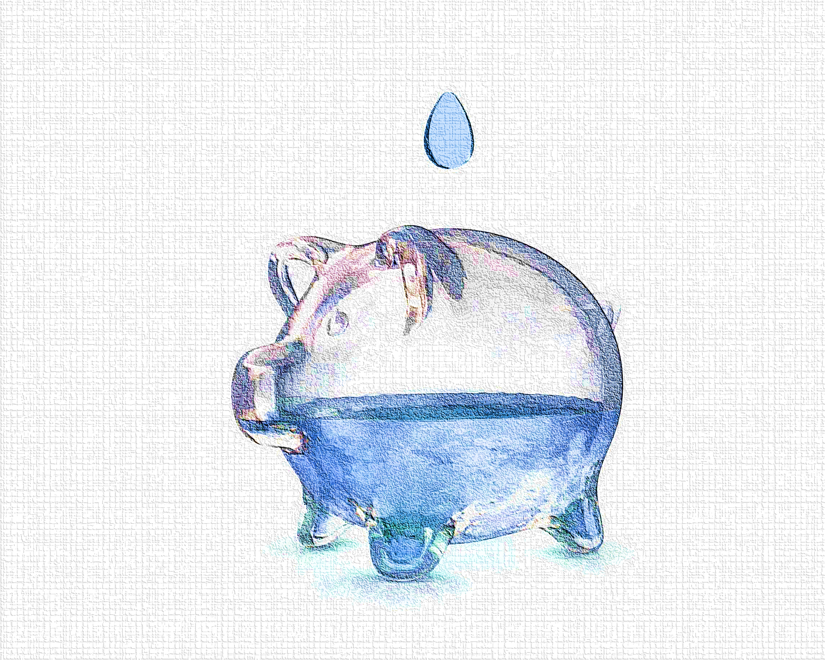
Water conservation extends the life and reliability of septic systems, public and private infrastructure and prevents or postpones the need to fund and build expanded public works systems.
http://njwatersavers.rutgers.edu

Slide 6
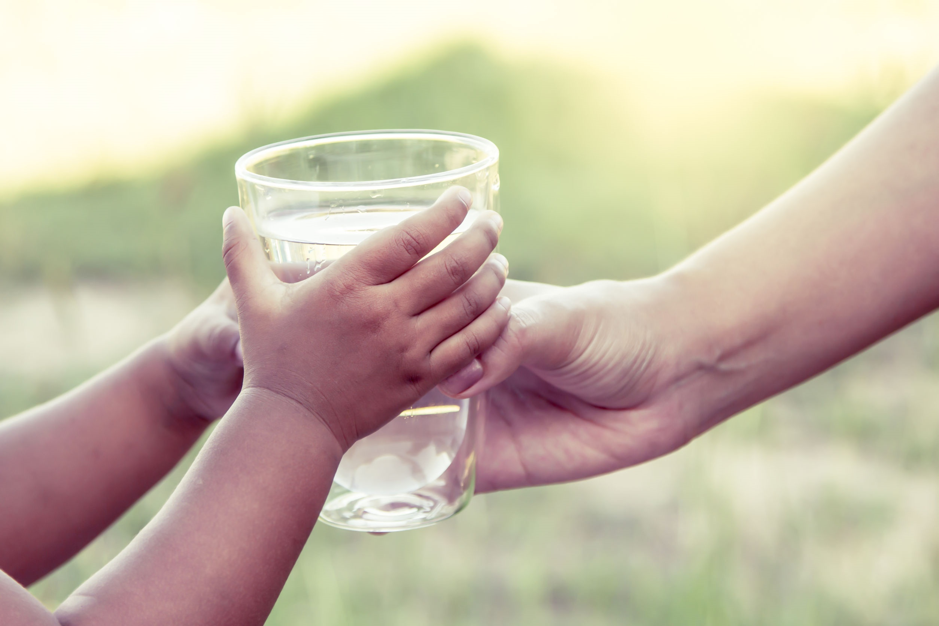
New Jersey’s water demands are quickly approaching the resource’s limits. Water will likely influence the future of New Jersey in regard to the natural environment, the overall landscape, statewide development, local zoning, and the State's economy. Watch the video, Water, a Matter of Importance at the website below.
http://njwatersavers.rutgers.edu
123rf.com

Slide 7
123rf.com
The Census Bureau projects the state’s population will increase by nearly 1 million people by 2020.
This population growth in New Jersey will place additional demand on the state’s water resources and infrastructure, particularly in areas that have not experienced high water demand before.
In addition to population growth straining water supplies, a recent National Resources Defense Council report states seven counties in New Jersey should expect high to extremely high risks for water shortages by 2050 as a result of climate change.
www3.epa.gov/watersense

Slide 8
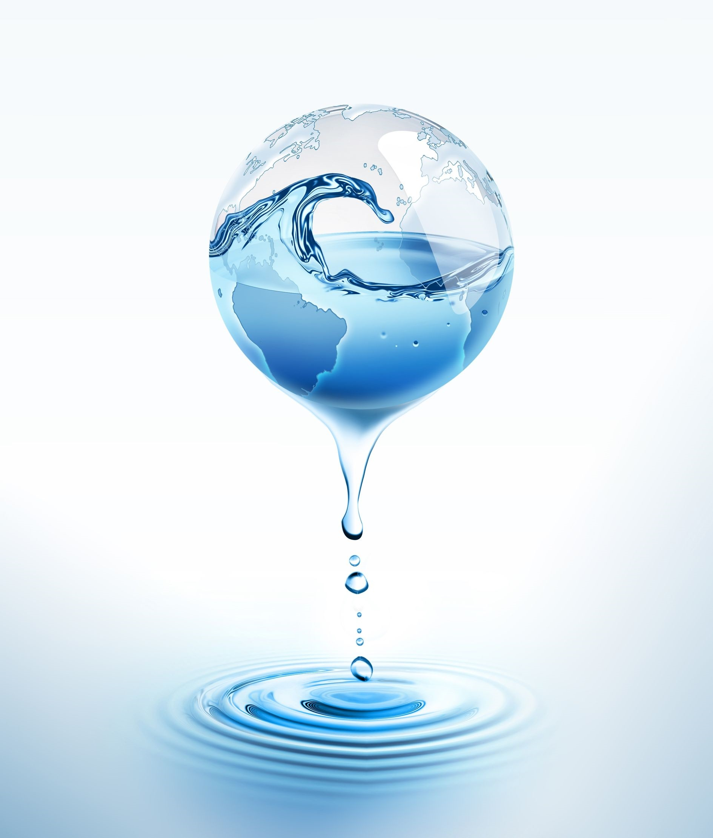
Between 2000 and 2010 the total amount of water used by homes, businesses, and the state’s two nuclear plants surged by 40 billion gallons a year.
The average person uses from 80 to 200 gallons of water a day. To translate that into cubic feet you would divide by 7.5 which calculates to 11 to 27 cubic feet per day. For a billing quarter, it equates to 990 to 2,430 cubic feet per person.
www.keyportonline.com
123rf.com

Slide 9
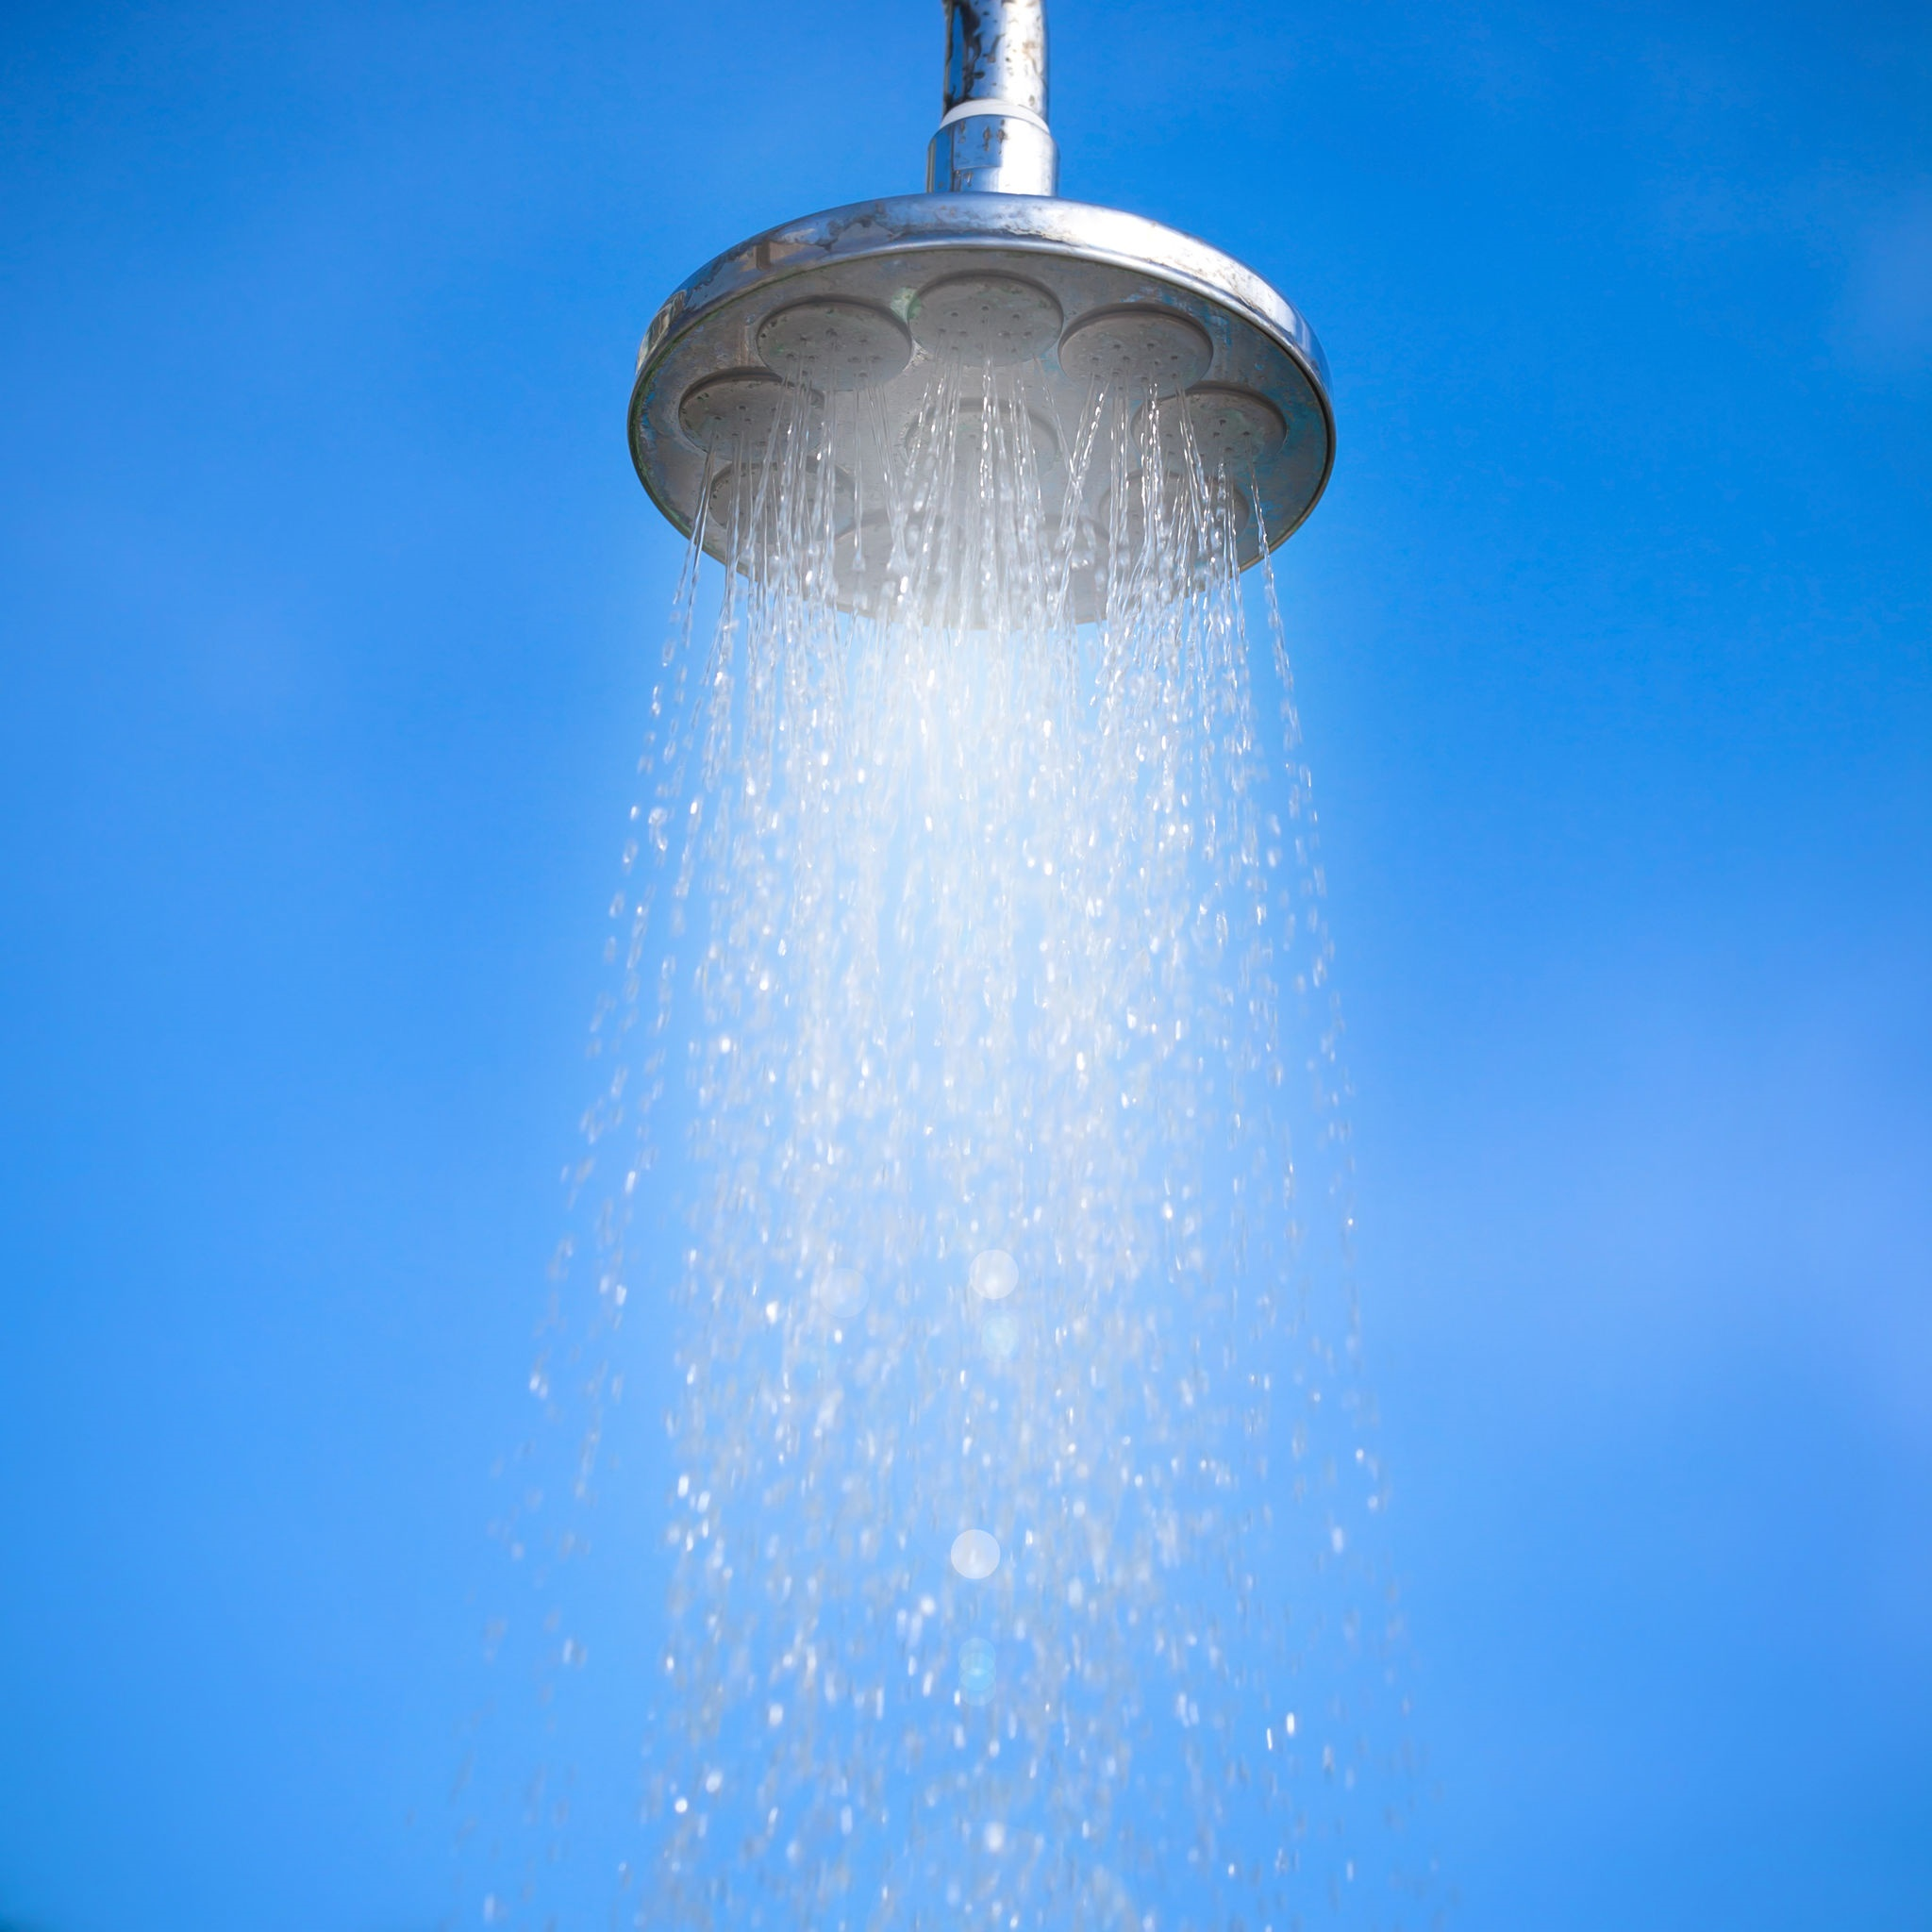
Saving water can also save energy and money. For example, if every household in New Jersey replaced its inefficient showerheads with ones labeled Water Sense, it could save 7.6 billion gallons of water each year—that’s enough to supply the daily water needs of every household in Newark, New Jersey. It would also save about $70 million in energy costs from heating, treating, and distributing less water. For more information and water-saving tips, visit www.epa.gov/watersense.

Slide 10
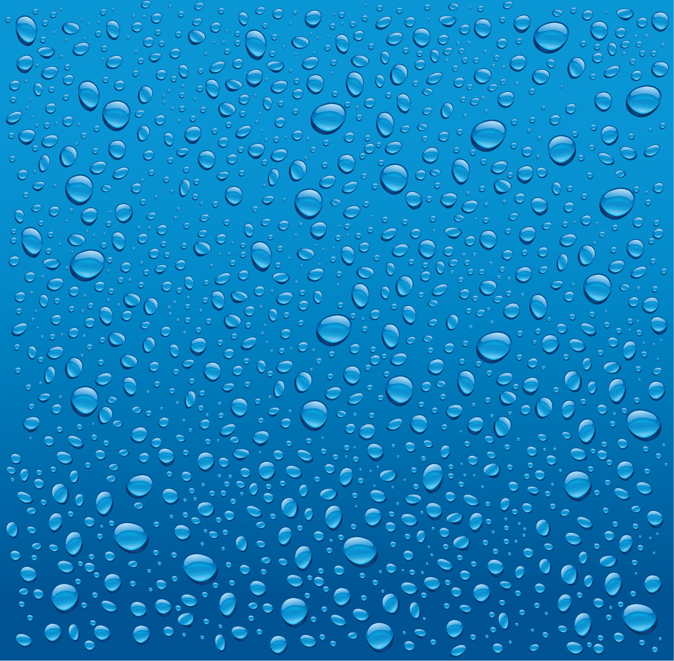
The average person uses from 80 to 200 gallons of water a day. To translate that into cubic feet you would divide by 7.5 which calculates to 11 to 27 cubic feet per day. For a billing quarter it equates to 990 to 2,430 cubic feet per person. www.keyportonline.com
Typical Water Usages | Non-Conserving | Conserving Activities
Shower (5 minutes) | Regular Shower head 30 gallons / 4 cu. ft. | Low-flow shower head 15 gallons / 2 cu. ft.
Toilet Flushing | Conventional toilet 4-7 gallons per flush .53-.93 cu. ft. per flush | Ultra-low flush toilet 1.5 gallons per flush .2 cu. ft. per flush
Tub Bath | Full 20–50 gallons 2.66-6.66 cu. ft. | Minimal water level Less than 20 gallons Less then 2.66 cu. ft.
Shaving | Tap running 2 gallons or more .26 cu. ft. | Fill basin 1 gallon / .13 cu. ft.
Washing Hands/Face | Tap running 2 gallons or more .26 cu. ft. | Soap and rinse 1 gallon / .13 cu. ft.
Dishwashing | Tap running 30 gallons / 4 cu. ft. | Wash and rinse in sink 5 gallons / .66 cu. ft.
Automatic Dishwasher | Full Cycle 20 gallons / 2.66 cu. ft. | Short Cycle 11 gallons / 1.46 cu. ft.
Washing Machine | Full cycle, top water level 40 gallons / 5.33 cu. ft. | New efficient clothes washers 16-25 gallons / 2.13-3.33 cu. ft.

Slide 11
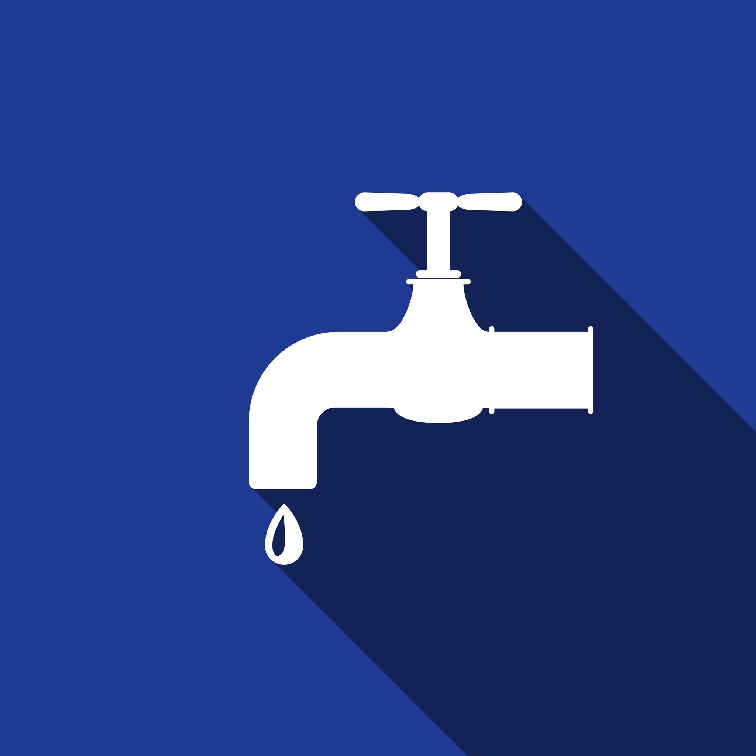
What About Leaks?
An average of more than eight percent of residential water use is lost through leaking fixtures or pipes. You can check to see if you have any leaks by turning off all water fixtures both inside and outside the house and check the reading on your water meter. Wait one hour, making sure that no one uses water, then check the meter reading. If the meter number has increased you have a leak somewhere. How much water is lost through leaks? If the leak is 1/16” you can lose 655 gallons per day (87.33 cubic feet). Or you can count the number of drips from the leak per minute.
www.keyportonline.com
30 drops per minute | 54 gallons per month (7.2 cubic feet)
60 drops per minute | 113 gallons per month (15.06 cubic feet)
120 drops per minute | 237 gallons per month (31.60 cubic feet)
½” stream of water | 1,014 gallons per month (135.20 cubic feet)
1½” stream of water | 2, 202 gallons per month (293.60 cubic feet)
123rf.com

Slide 12
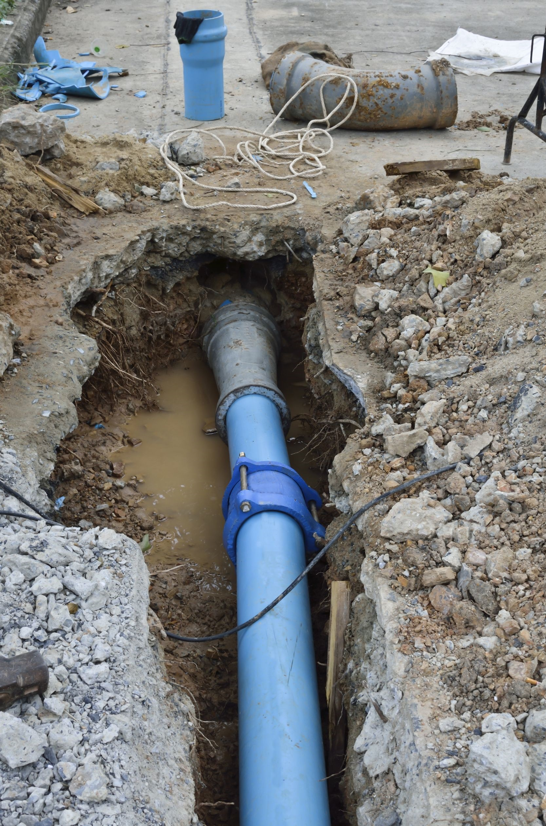
123rf.com
Water related issues:
Lead in water in public schools.
Potentially harmful contaminants found in drinking water, without suitable standards to act on.
An aging infrastructure leaking water before it ever gets to consumers.
There is no shortage of issues facing policymakers charged with overseeing proper management of New Jersey’s drinking water, but in this age of information, maybe the biggest concerns have to do with what we do not know, according a panel at a NJ Spotlight roundtable on "New Jersey’s Hidden Water Crisis.“
www.njspotlight.com

Slide 13
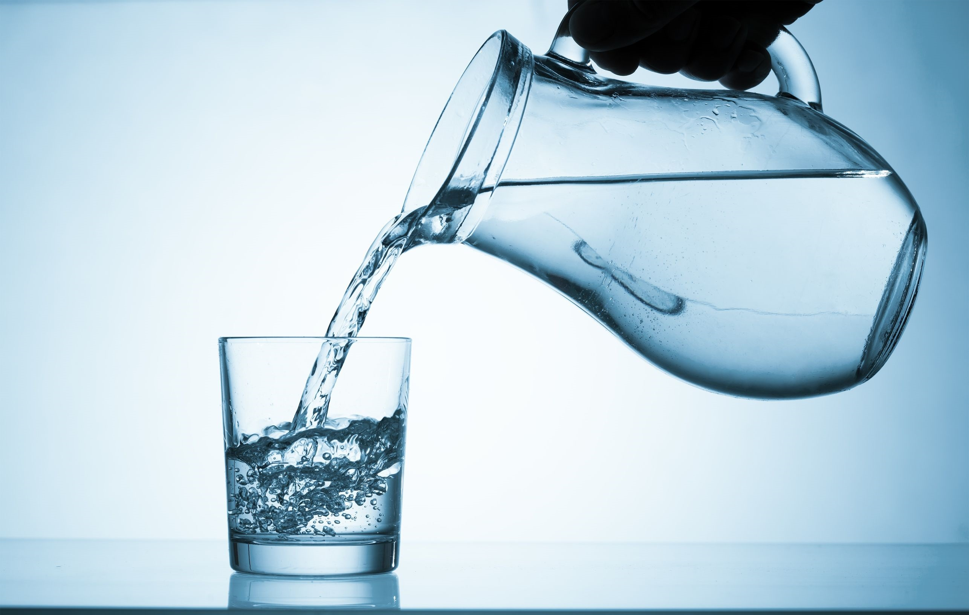
123rf.com
The lead crisis in Flint, Michigan, as well as Newark, New Jersey and across the country, signals a serious need to re-examine national and state drinking water policies, repair and update our crumbling water infrastructure, and make sure we reduce lead at the tap, especially where children are concerned. Clean Water Action believes that if we truly want to protect our water, we need to put drinking water first. This has guided us for more than 40 years as we have partnered with communities and government at all levels to find solutions to our most pressing challenges, including lead and drinking water.
(www.cleanwateraction.org)

Slide 14
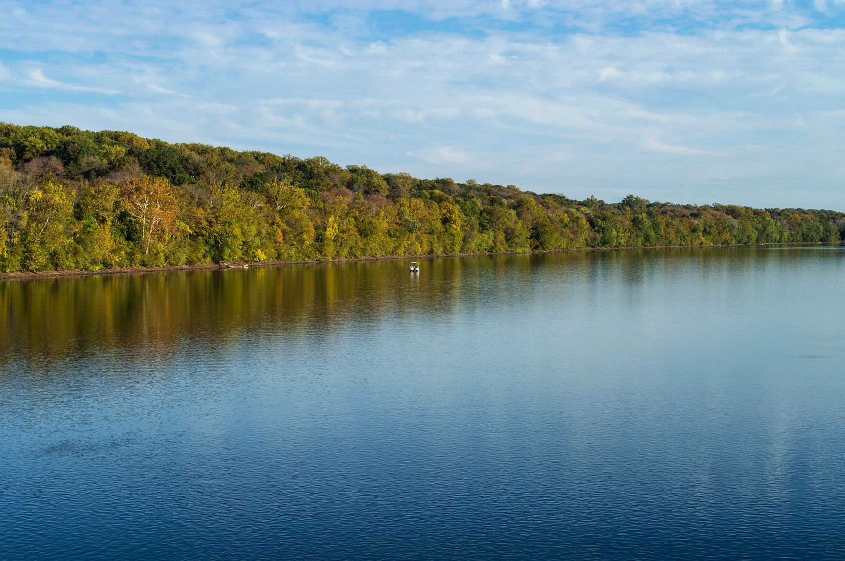
123rf.com
NJ has many beautiful rivers, from the Delaware River running down our western border to the Raritan River which runs across the central part of our state. Our waterways provide recreational hotspots for fishing, canoeing, crabbing, and swimming. Unfortunately, NJ’s waterways are threatened. In fact, over 75% of NJ's rivers and streams are too polluted for fishing and swimming. This is due to rampant overdevelopment, our legacy of industrial pollution, and aging infrastructure.
njpirgstudents.org

Slide 15
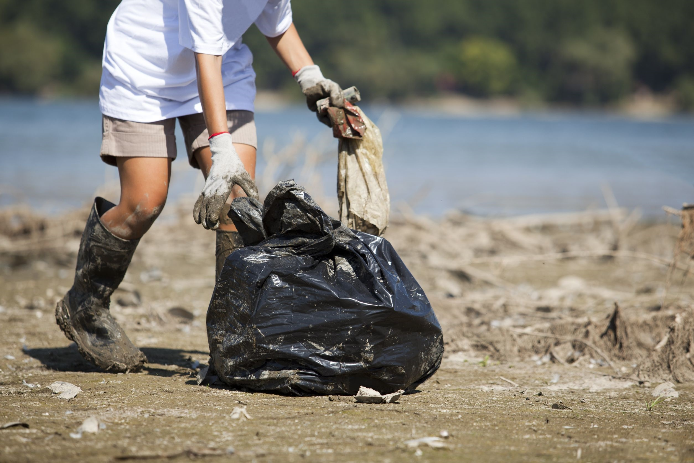
123rf.com
Water Watch focuses on three main tactics:
Community Cleanups
Cleanups bring people together to take community action and highlights the need to cleanup and protect our precious waterways. Every year we mobilize hundreds of volunteers and remove tons of trash from our waterways. Through our cleanups, we engage local community groups and leaders, student groups and leaders, decision makers, and the media.
We organize several cleanup events each year, including around Earth Day.
www.njpirgstudents.org

Slide 16
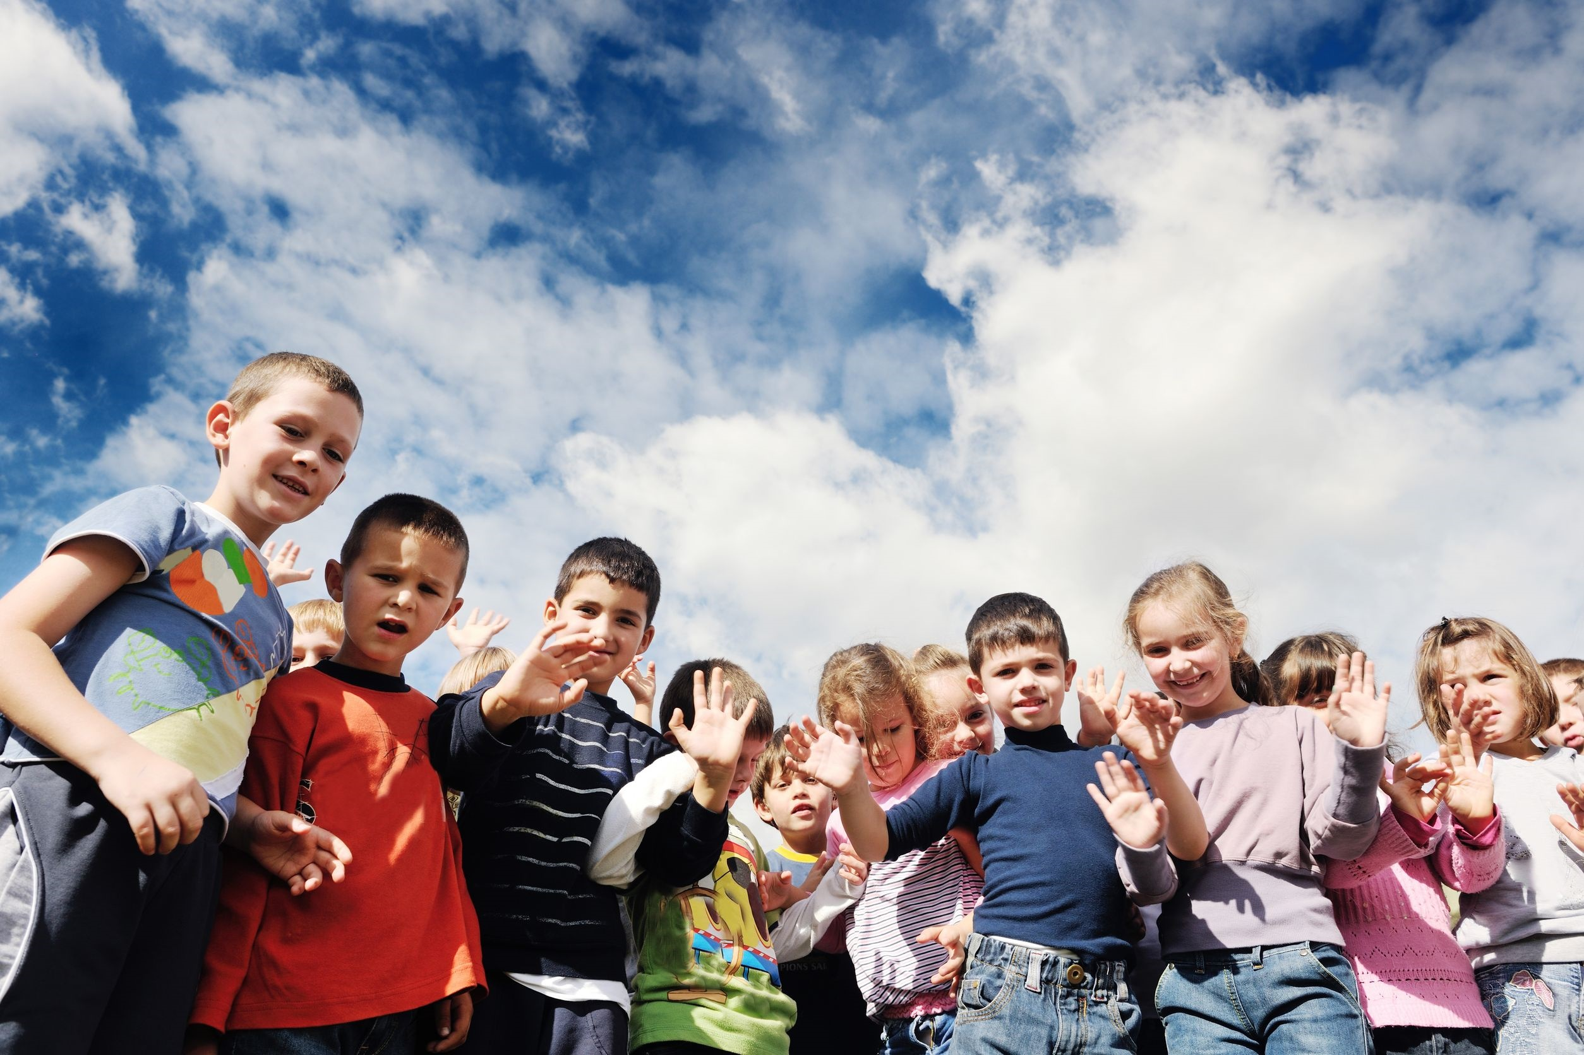
123rf.com
Education
Educating the public is an important step to getting people actively involved in solving the problem of water pollution. We teach members of the community about urban water pollution problems. We organize forums in the community to educate the public about current and pressing water quality issues, including toxic levels of mercury or other industrial pollutants in our water ways, the local impacts of development, and rules and regulations around storm water and household runoff. As always, we present the public with problems, and offer them tangible, applicable solutions based on our research.
njpirgstudents.org

Slide 17
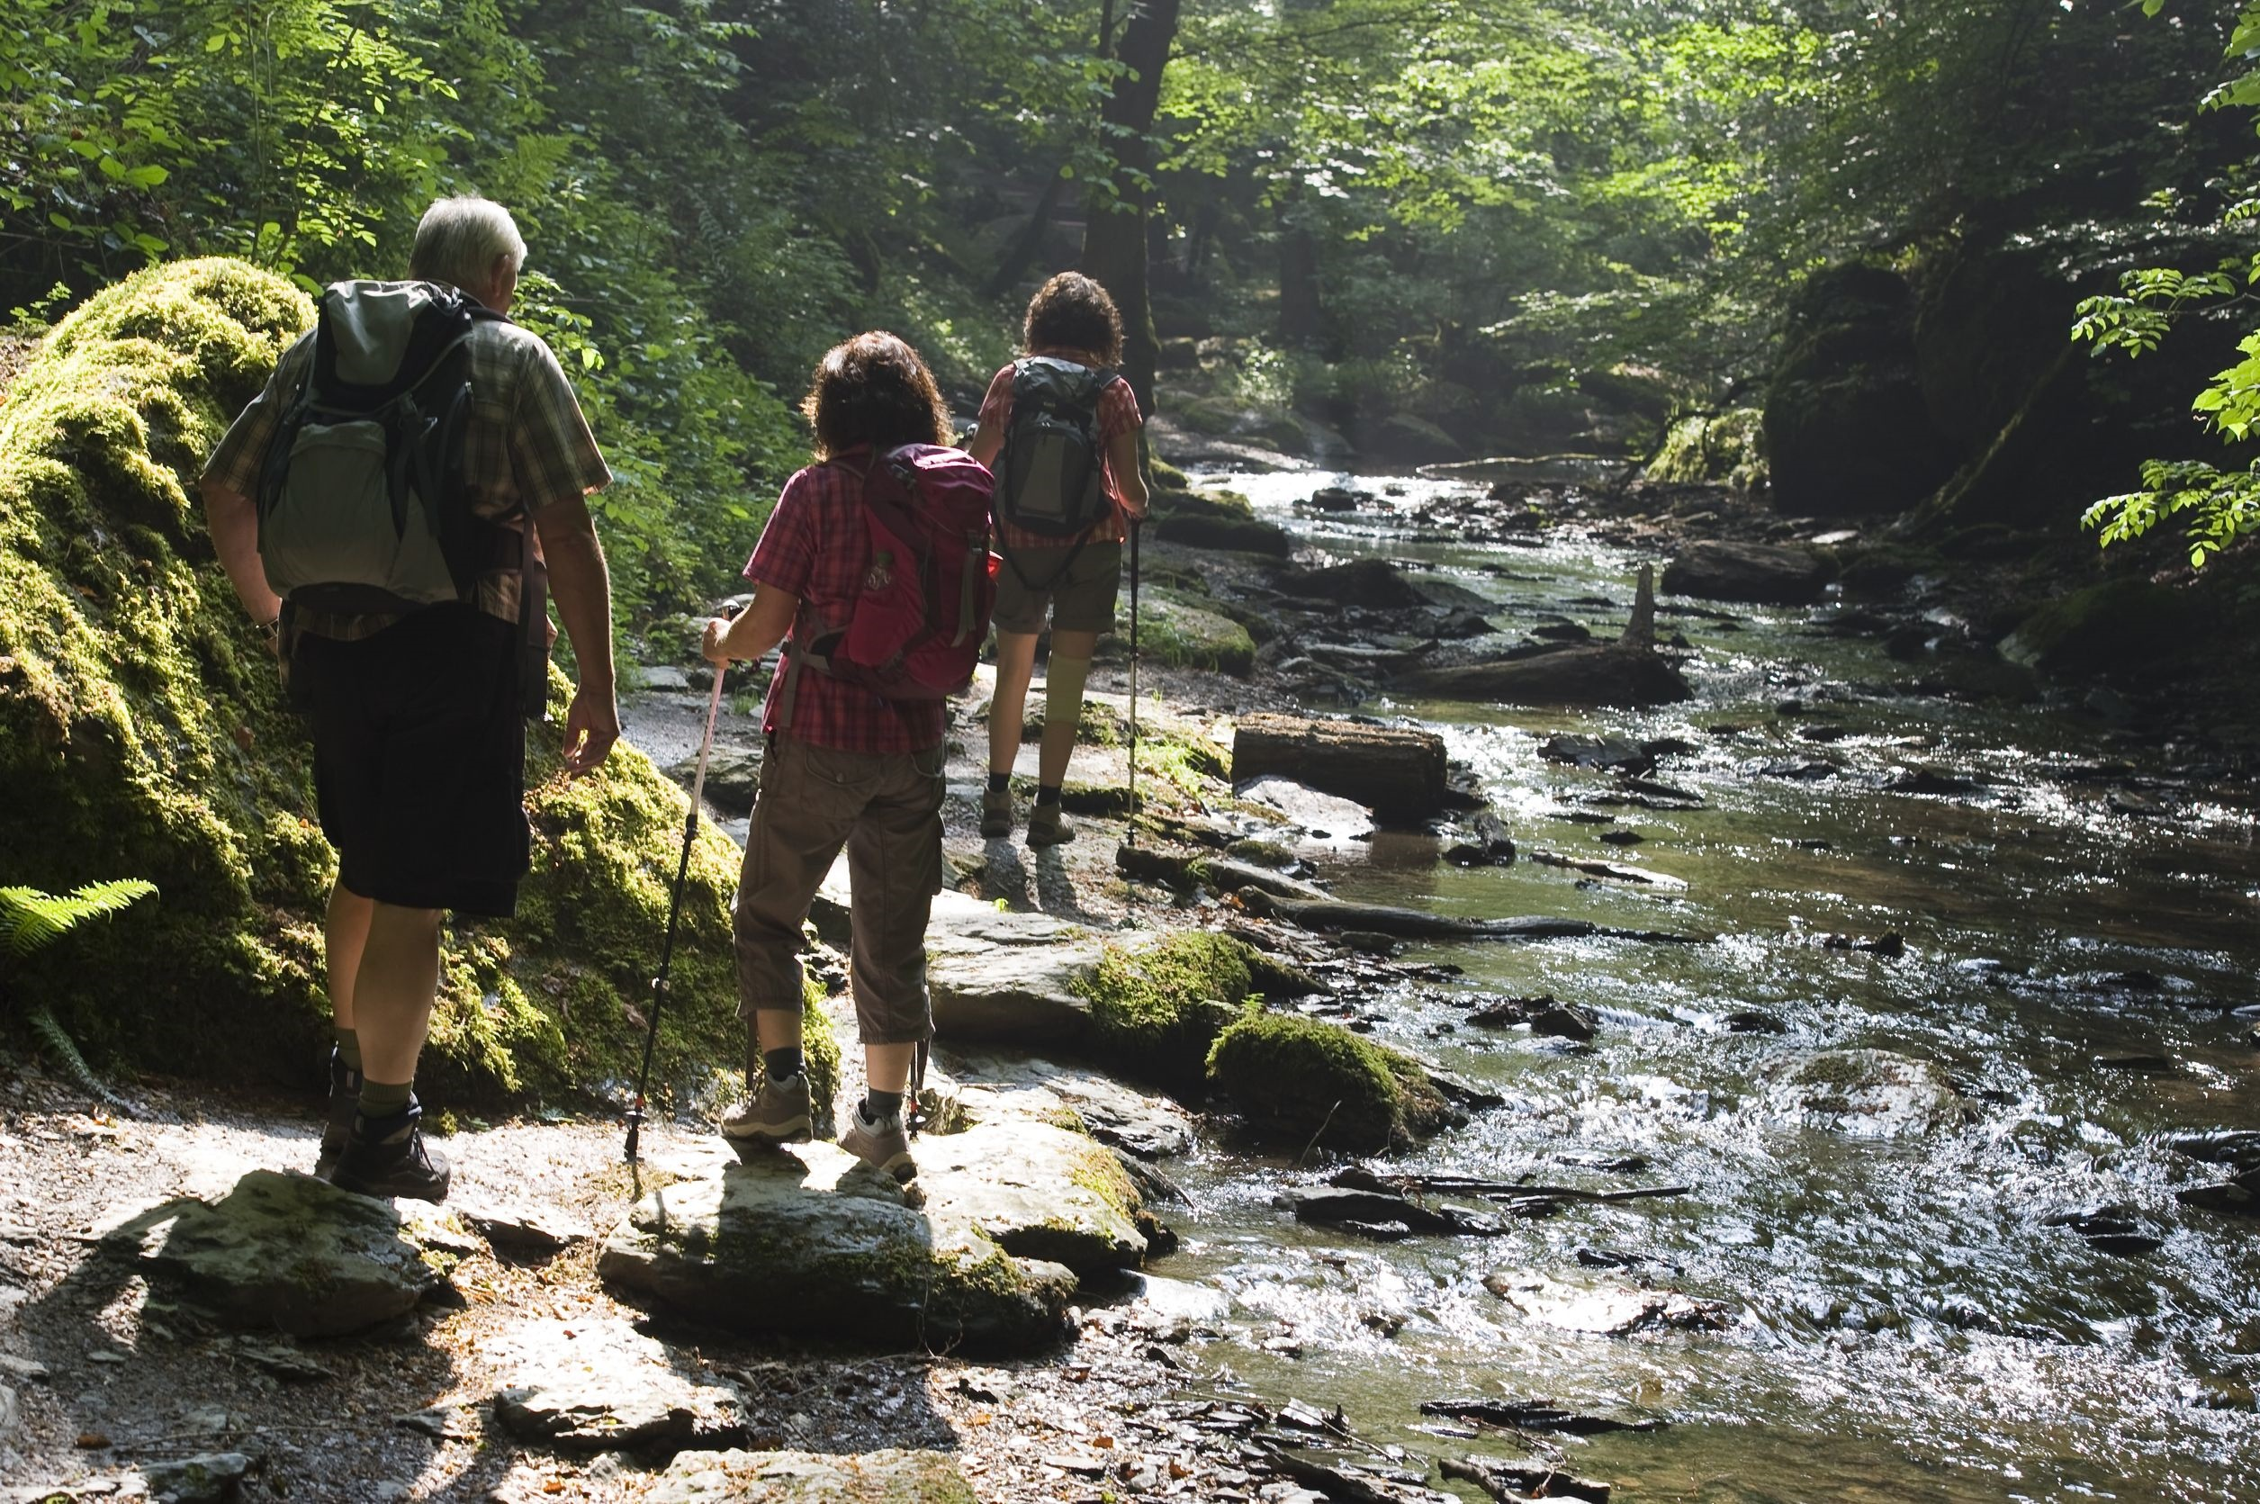
123rf.com
Streamwalking
Volunteers patrol the banks of rivers, lakes and streams each year. We map local water resources, test water quality and check for evidence of illegal pollution discharges. Many times, it is this type of citizen monitoring effort which uncovers potentially dangerous pollution problems first. Once detected, these incidents are reported to state agencies. In addition, monthly monitoring walks show the gradual changes that may be happening in the water system, as well as provide more insight into the impact the waterway has on the community.
Besides being, a great educational tool, streamwalking allows volunteers to get to know their local waterways pretty intimately. It's a time you set aside to walk along the banks looking for signs of life or pollution.
njpirgstudents.org

Slide 18
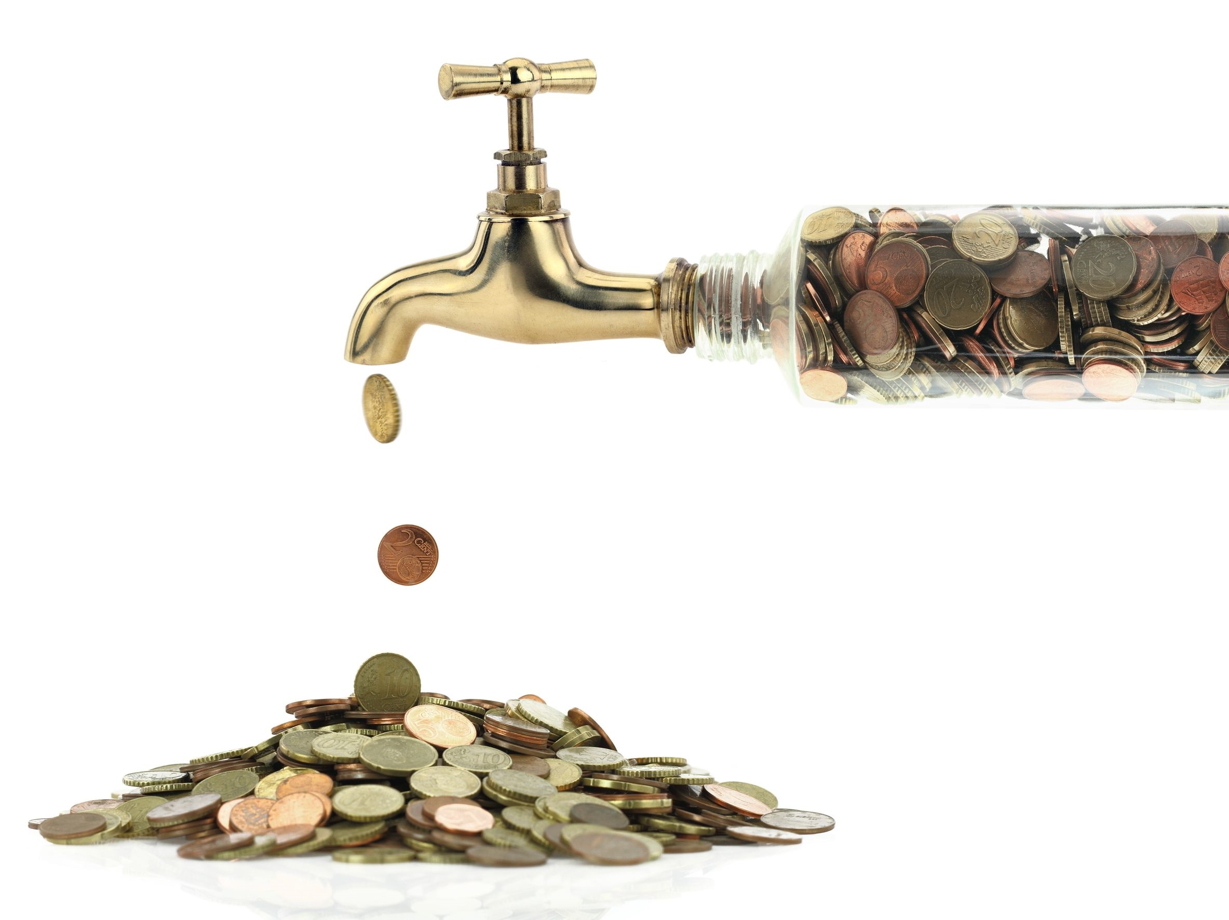
123rf.com
As New Jersey’s population continues to grow and water reserves are further constrained, more must be done to safeguard an adequate water supply. Luckily, we can all reduce our water use by as much as 30 percent by taking a few simple steps, such as installing high-efficiency plumbing fixtures and using water more efficiently in our yards.
nj.gov/dep
The question isn’t if we can afford to address our water issues, the question is if we can afford NOT to address them.

Slide 19
Key Words
sustainable irrigation abundant
septic system infrastructure local zoning
climate change cubic feet inefficient
residential policymakers mobilize
Lead crisis recreational toxic
123rf.com

