Slide 1
NICKY FIFTH’S NEW JERSEY
N5NJ
SECONDARY PROGRAM
GEOGRAPHY
Pinelands

Slide 2
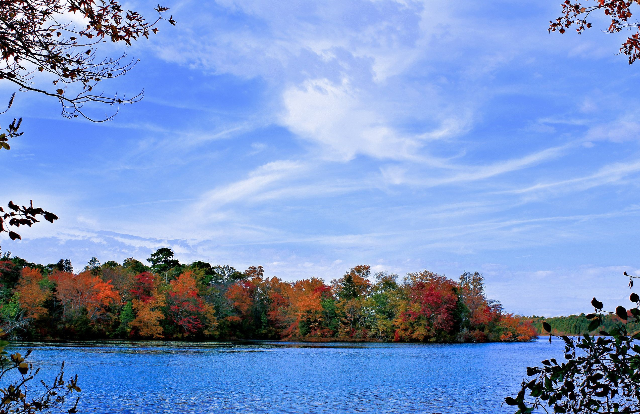
Stretching across southern New Jersey is a vast expanse of protected forest known as the Pinelands. Encompassing nearly 25% of the total land mass in the state, the Pinelands includes portions of seven counties (Atlantic, Burlington, Camden, Cape May, Cumberland, Gloucester, and Ocean) and over 50 municipalities. When Brendan Byrne became governor in 1974, protecting the Pinelands was not a major issue, nor was it something that Byrne himself was advocating. As development of the area increased rapidly, however, and motivated in part by John McPhee’s book The Pine Barrens, Byrne became a champion of protecting the area.
http://governors.rutgers.edu/on-governors/nj-governors/governor-brendan-t-byrne-administration/governor-brendan-t-byrne-issues-the-pinelands/
123rf.com

Slide 3
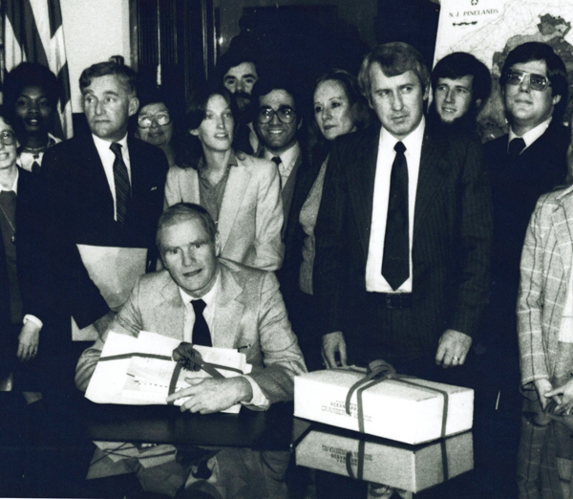
On May 28, 1977, Byrne issued Executive Order #56, creating a Pinelands Review Committee to begin planning future development in the area. Two years later, Byrne followed with a second executive order (#71), halting all development in the region until the legislature enacted a permanent plan. This action is widely viewed as one of the farthest reaches of executive power ever taken by an American governor. All development in the Pinelands ceased until the legislature passed legislation protecting the Pinelands in June of 1979.
http://governors.rutgers.edu/on-governors/nj-governors/governor-brendan-t-byrne-administration/governor-brendan-t-byrne-issues-the-pinelands/

Slide 4
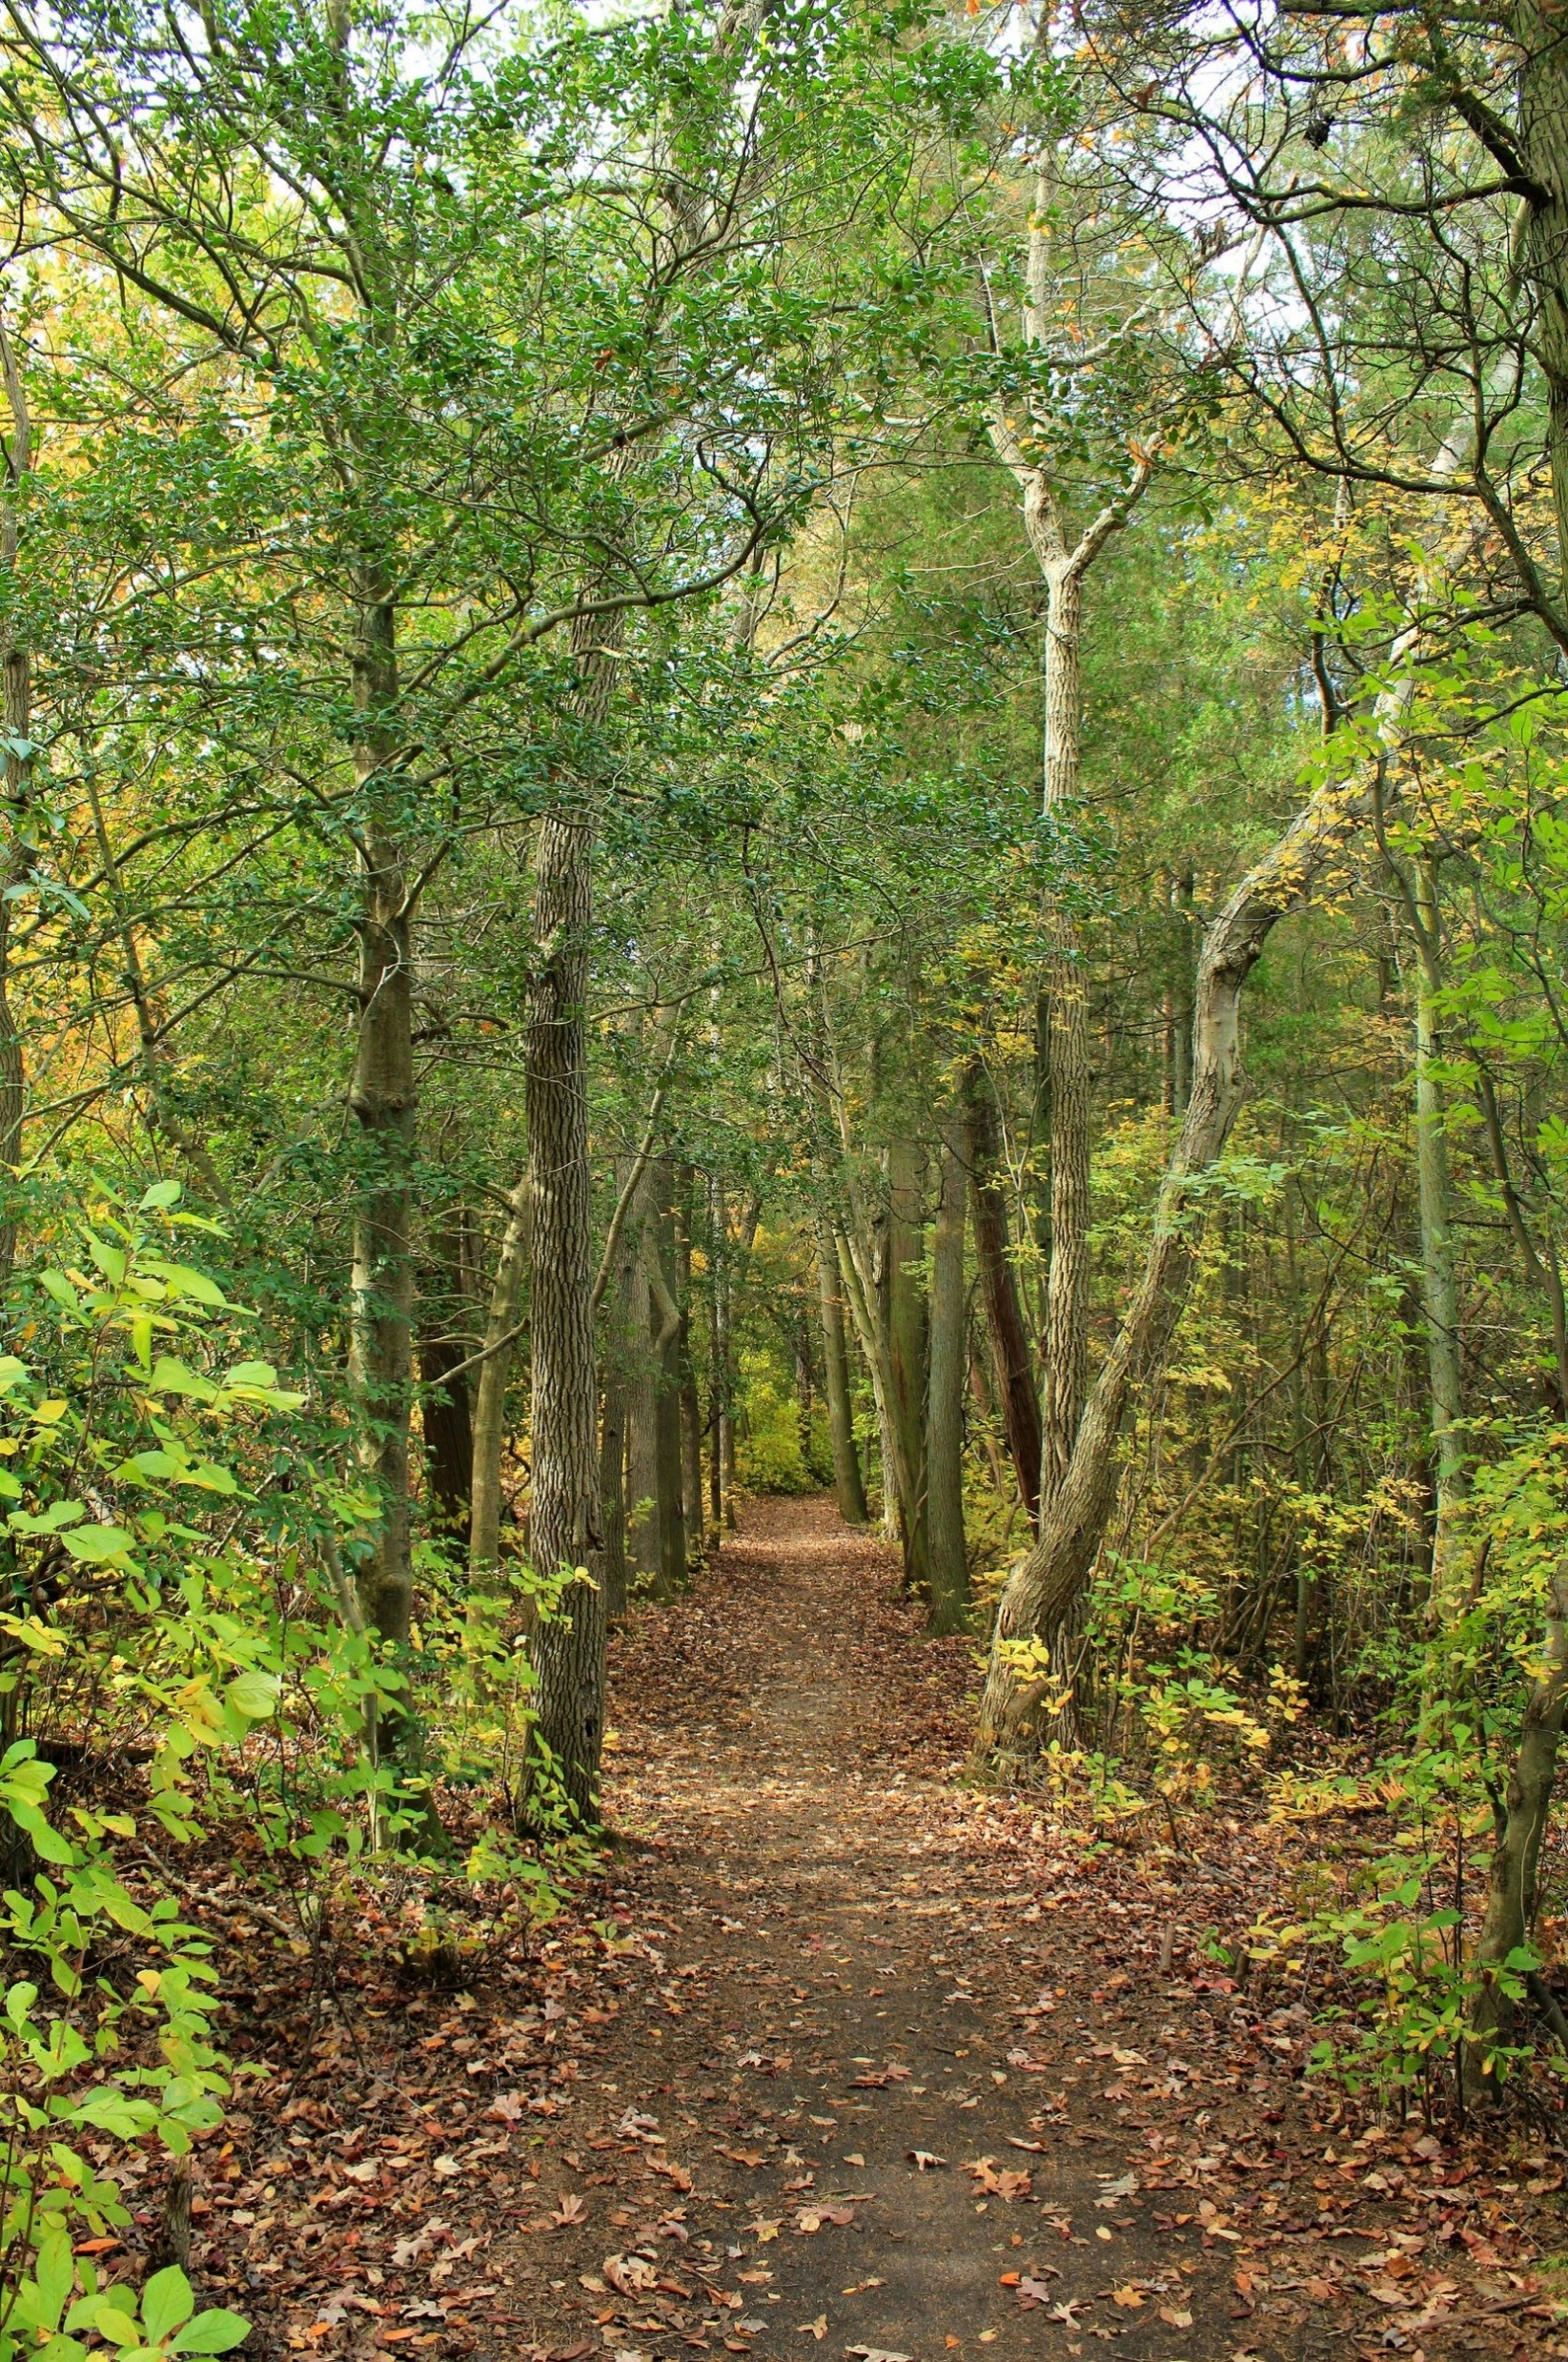
By the end of his second term, Byrne declared the Pinelands Preservation Act the single most important accomplishment of his administration, and the issue that is most central to his legacy as governor.
http://governors.rutgers.edu/on-governors/nj-governors/governor-brendan-t-byrne-administration/governor-brendan-t-byrne-issues-the-pinelands
123rf.com

Slide 5
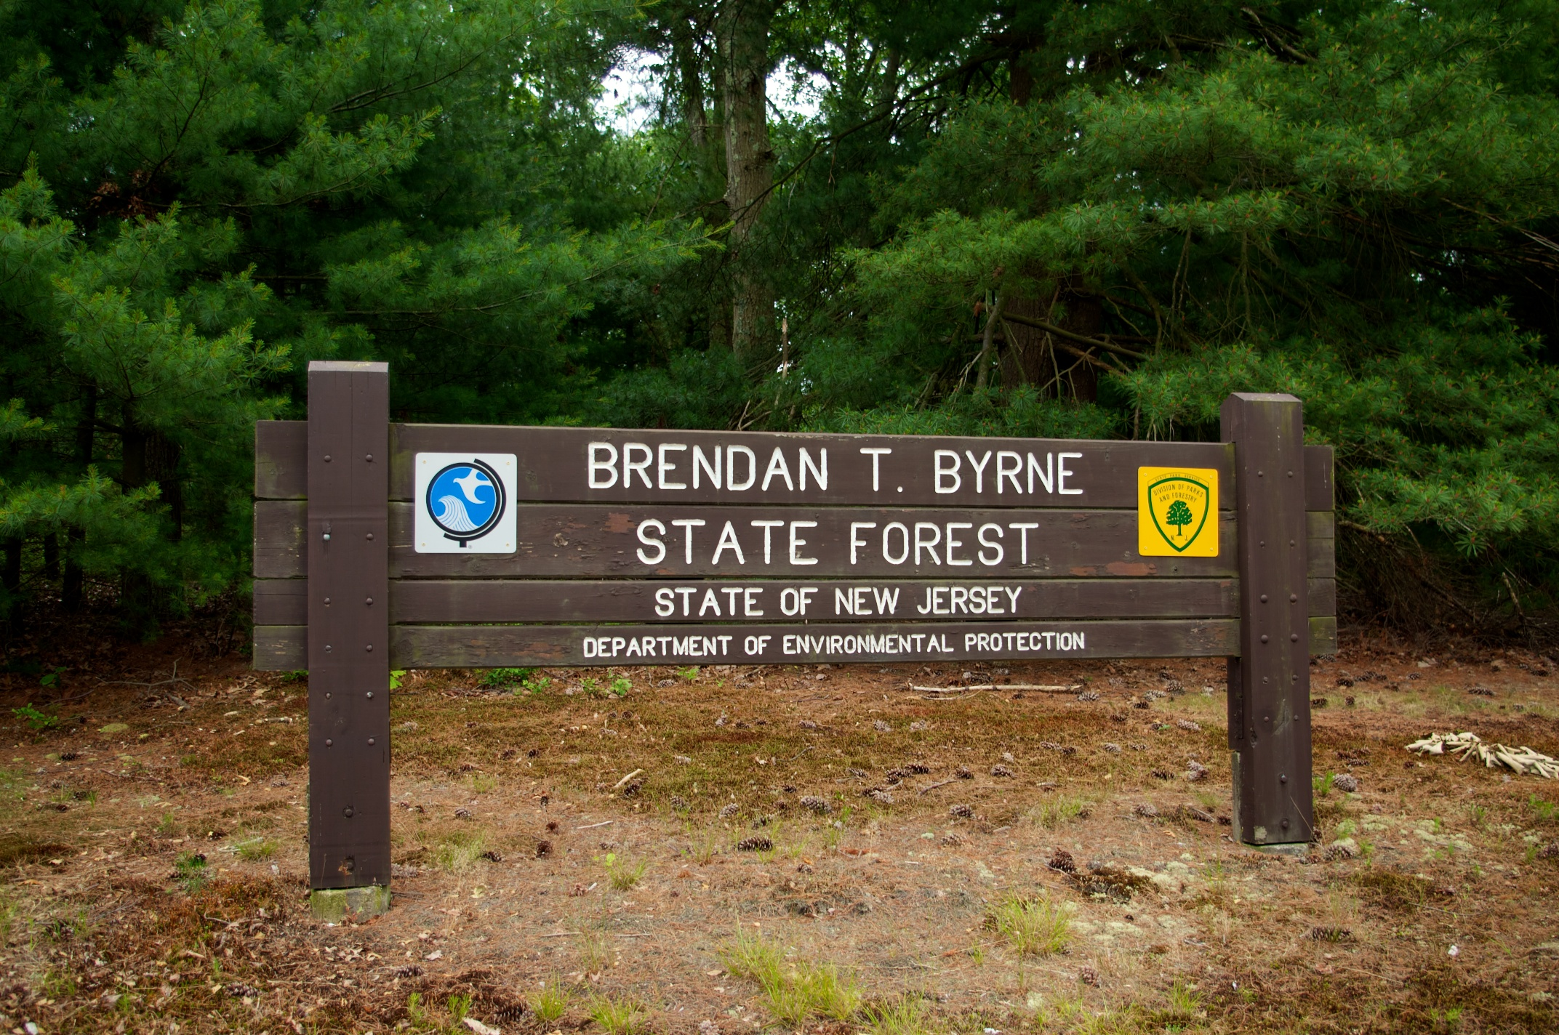
The Brendan T. Byrne State Forest is the state's second largest state forest (after Wharton State Forest). There are 25 miles (40 km) of hiking trails and a camping area. The park is operated and maintained by the New Jersey Division of Parks and Forestry. Originally named for the Lebanon Glassworks, which operated in the 1850s and 1860s, it was renamed for Brendan Byrne in 2004. Byrne served as governor of New Jersey from 1974 to 1982. He championed and signed the Pinelands Protection Act in February 1979 which preserved thousands of acres in southern New Jersey. The park was renamed for him during the 25th anniversary of the Pinelands legislation by then Governor James McGreevey.
http://governors.rutgers.edu/on-governors/nj-governors/governor-brendan-t-byrne-administration/governor-brendan-t-byrne-issues-the-pinelands

Slide 6
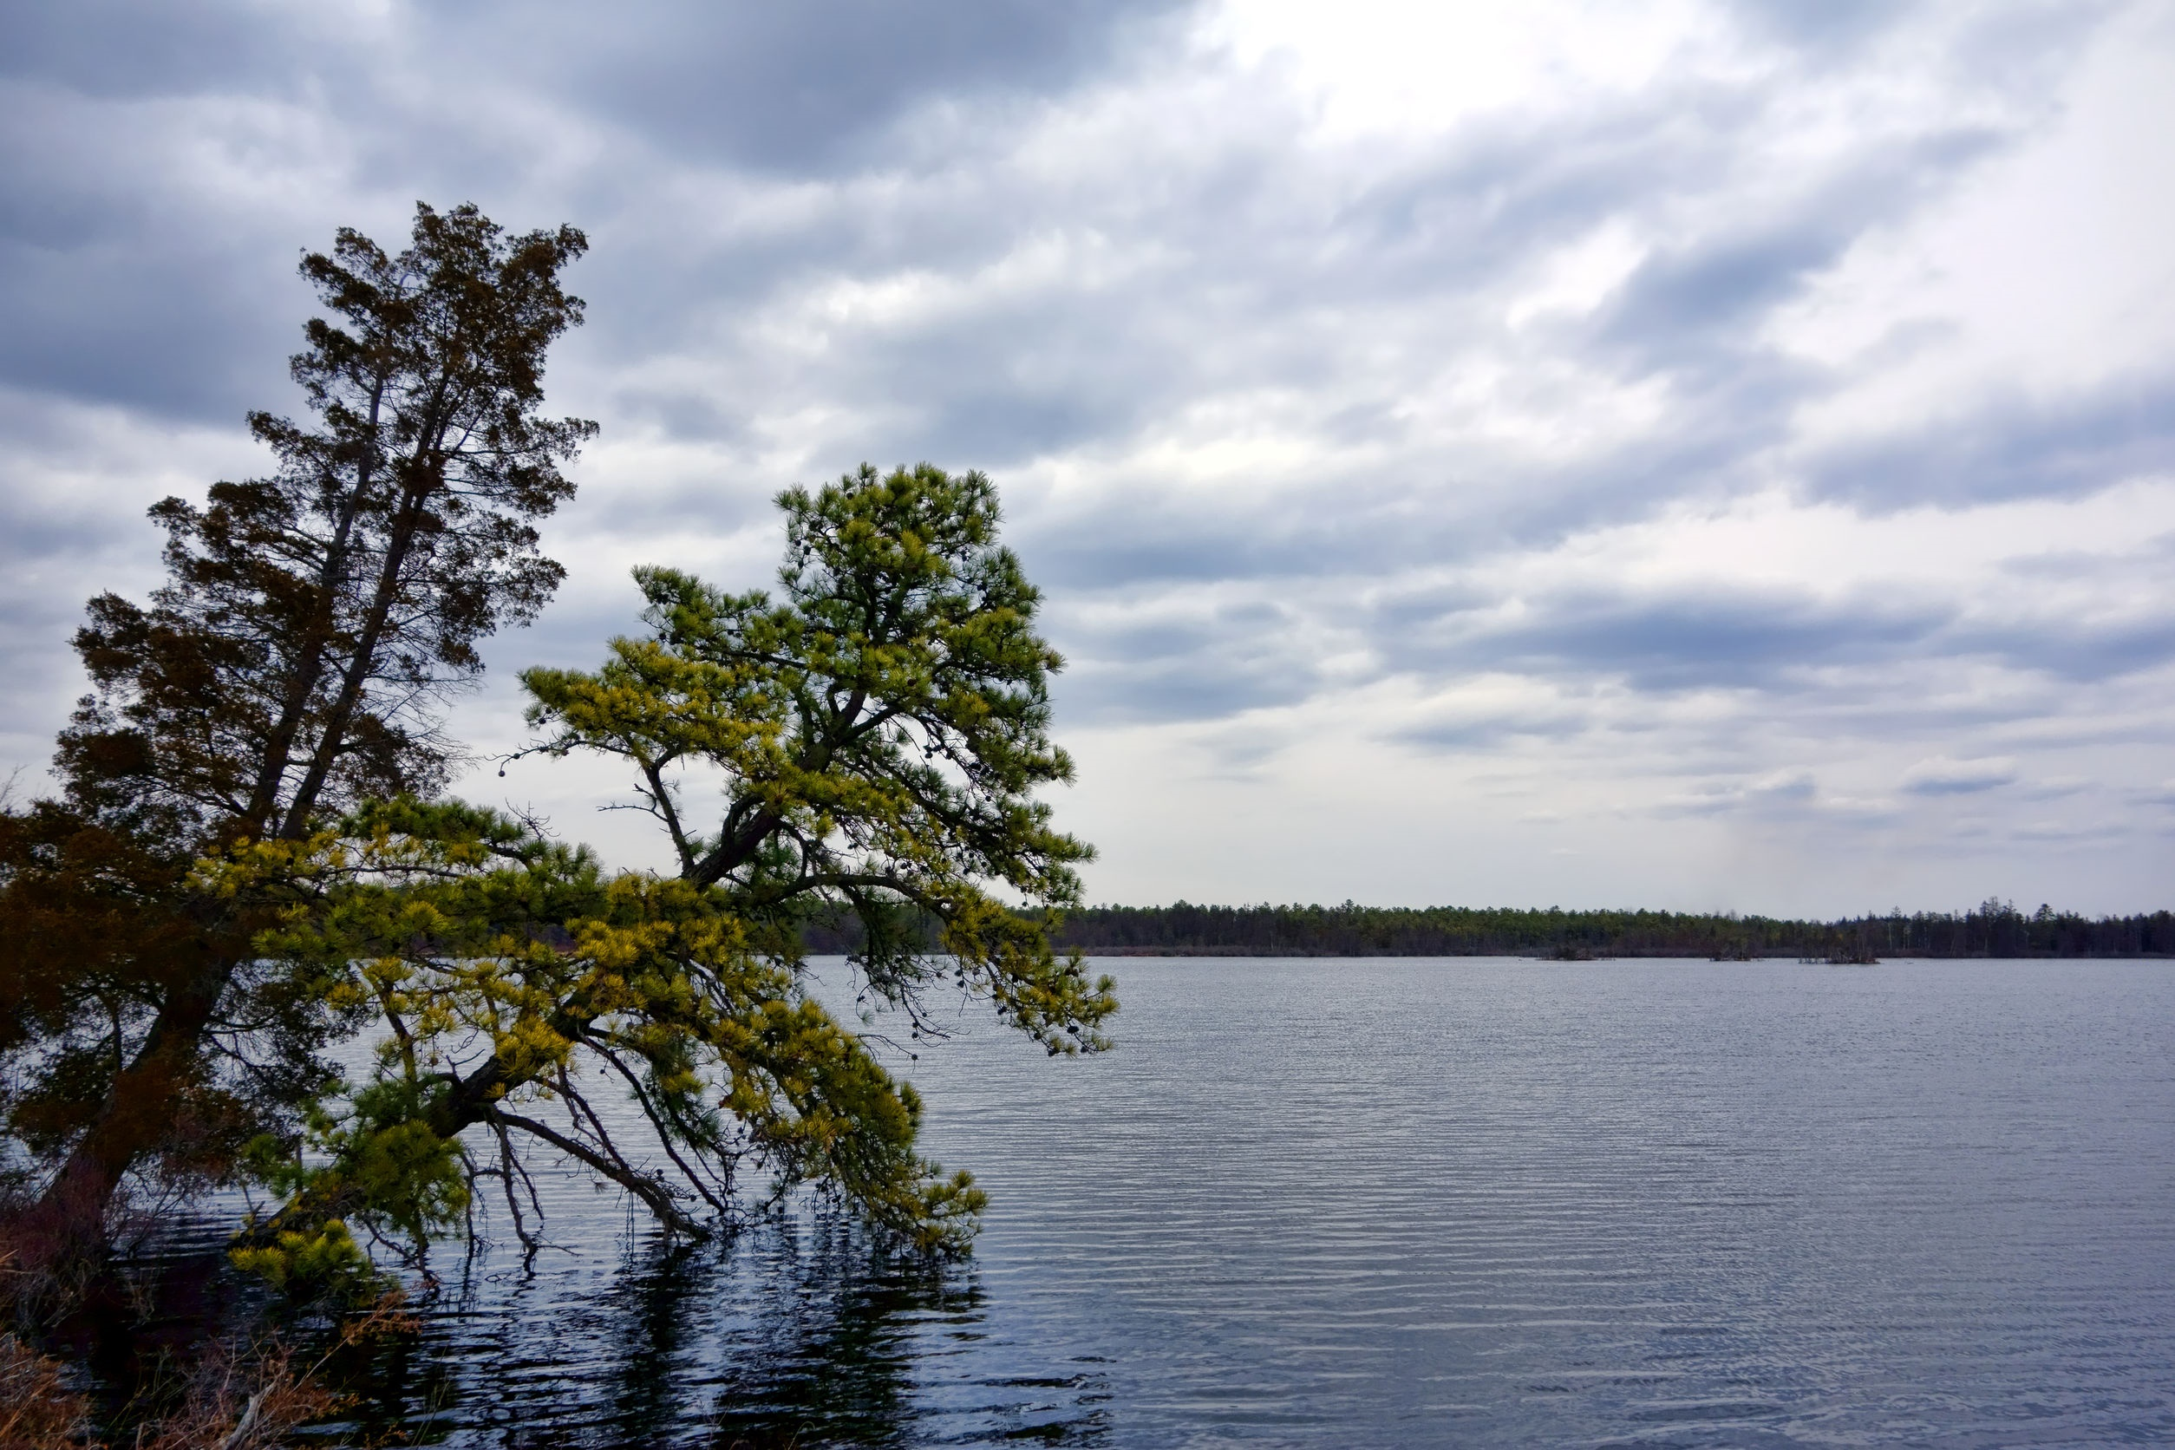
Congress created the Pinelands National Reserve (PNR) through the passage of the National Parks and Recreation Act of 1978. The PNR is the first National Reserve in the nation. http://www.nj.gov/pinelands/reserve
123rf.com

Slide 7
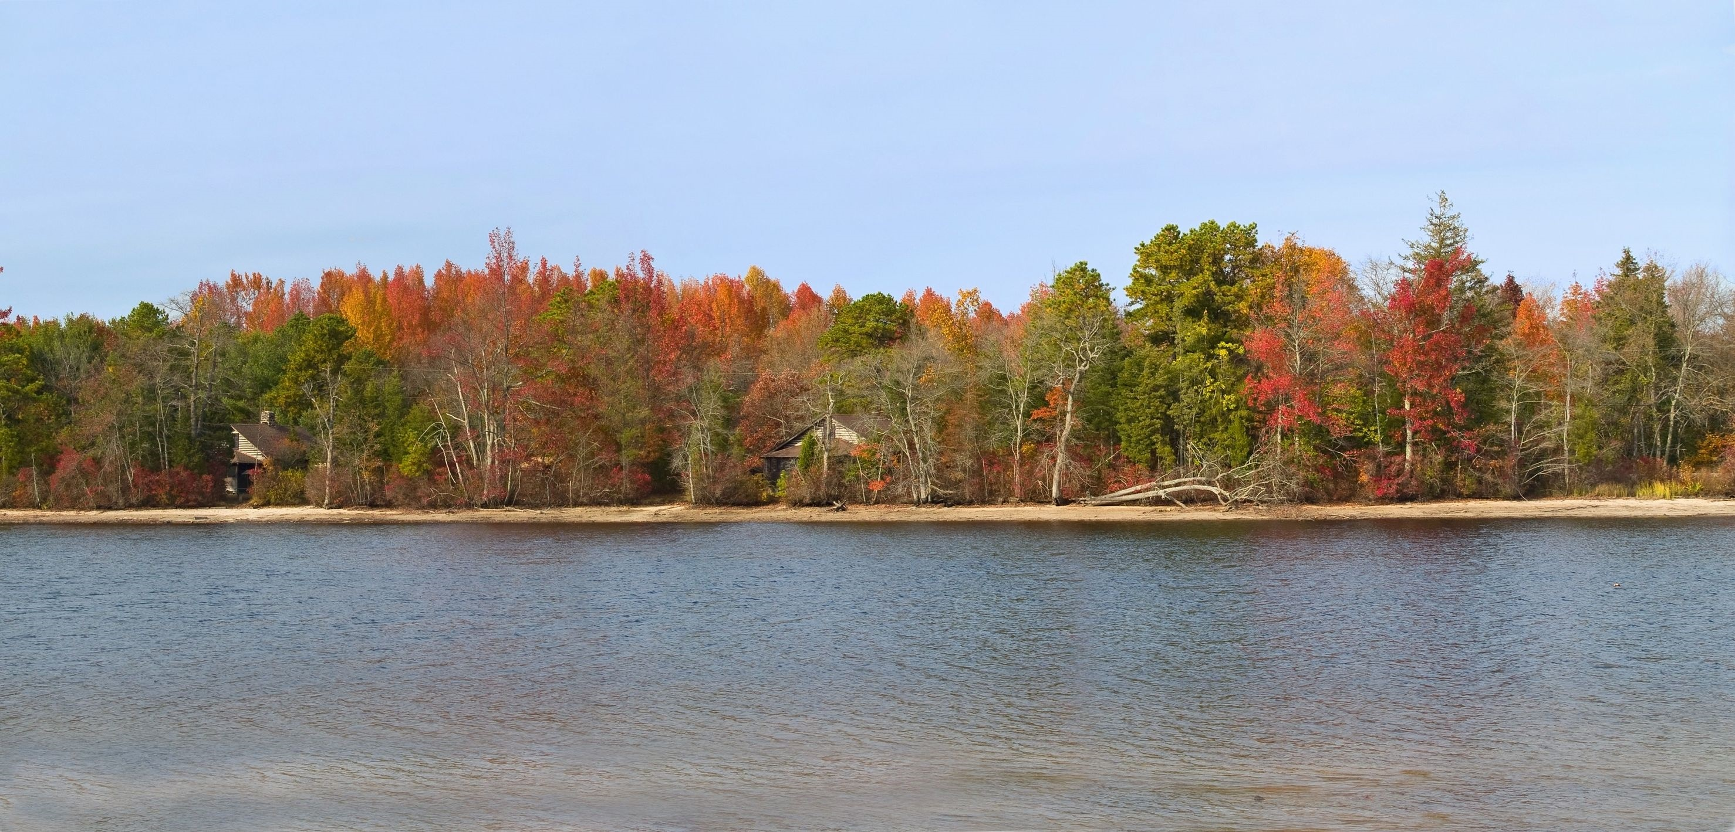
The PNR is approximately 1.1 million acres and spans portions of seven counties and all or part of 56 municipalities. The reserve occupies 22% of New Jersey's land area and it is the largest body of open space on the Mid-Atlantic seaboard between Richmond and Boston.
http://www.nj.gov/pinelands/reserve
123rf.com

Slide 8
The reserve is home to dozens of rare plant and animal species and the Kirkwood-Cohansey aquifer system, which contains an estimated 17 trillion gallons of water.
http://www.nj.gov/pinelands/reserve
123rf.com

Slide 9
In 1979, New Jersey formed a partnership with the federal government to preserve, protect and enhance the natural and cultural resources of this special place. Through its implementation of the Pinelands Comprehensive Management Plan, the New Jersey Pinelands Commission protects the Pinelands in a manner that maintains the region's unique ecology while permitting compatible development.
http://www.nj.gov/pinelands/reserve
123rf.com

Slide 10
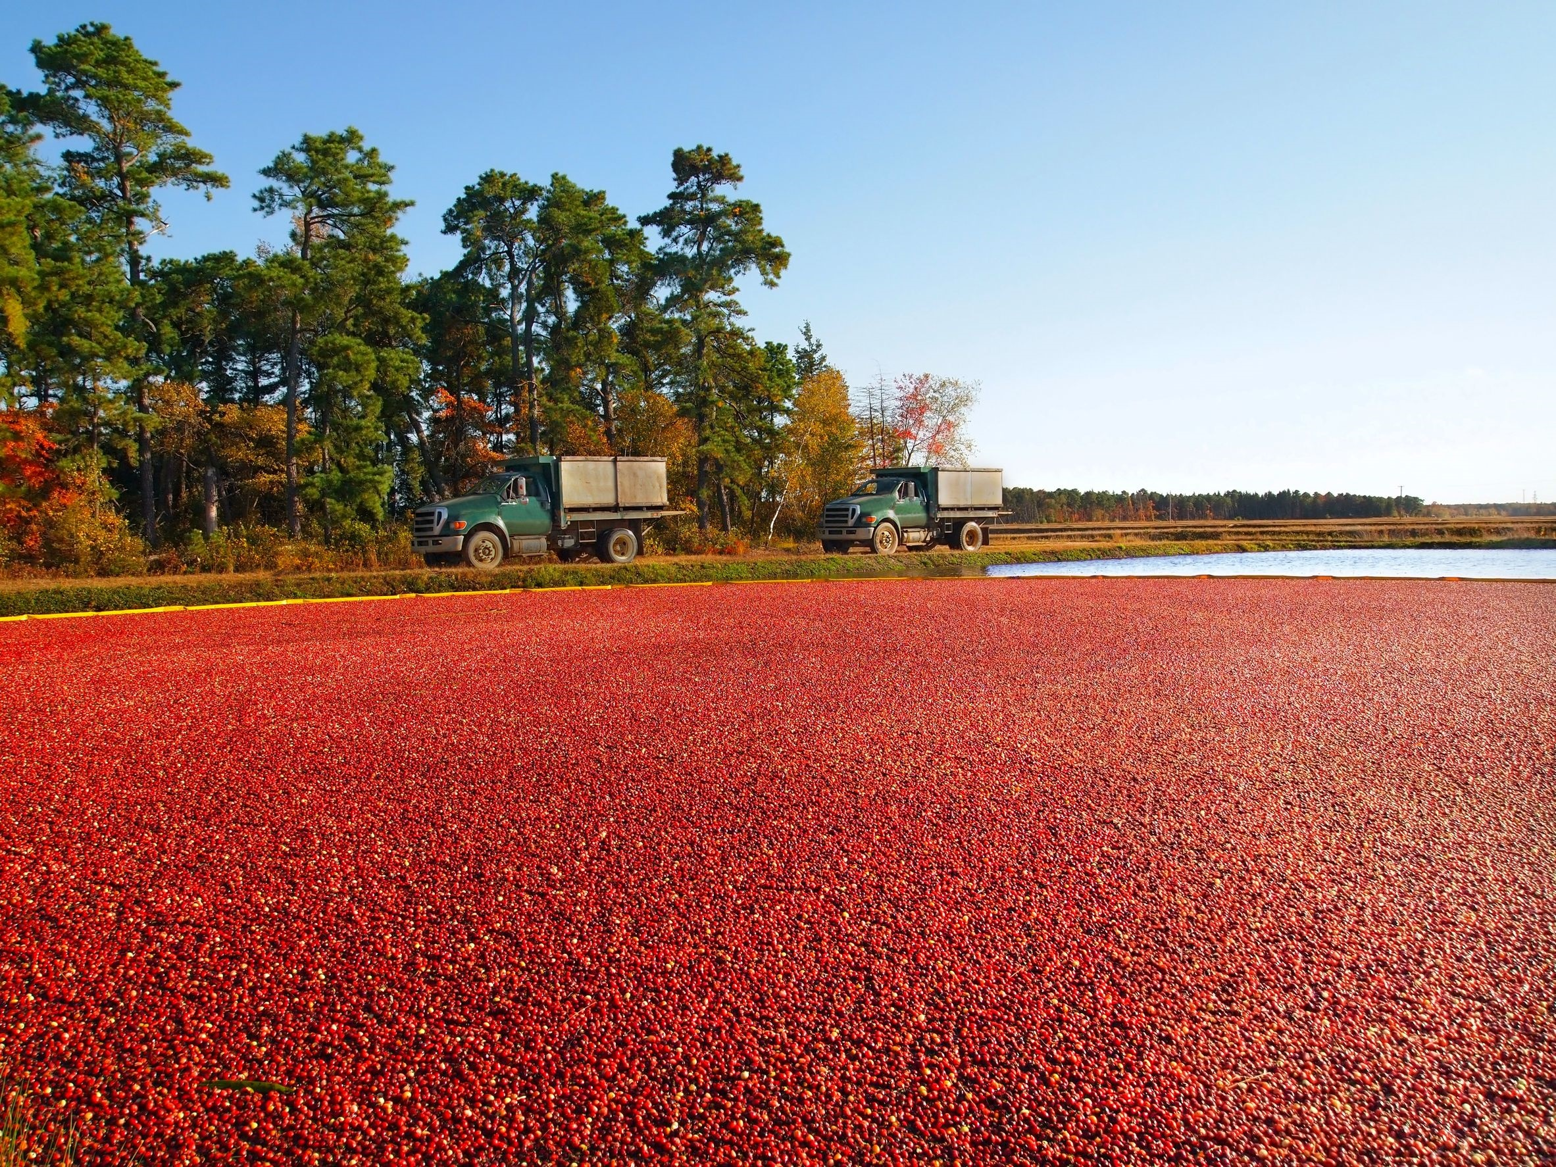
Featuring 1.1-million acres of dense forests, serene rivers, picturesque parks, rare plants and animals, miles of blueberry fields and cranberry bogs, and a rich heritage dating from prehistoric times, the New Jersey Pinelands is a prime recreational destination.
http://www.nj.gov/pinelands/home/visit/index.shtml
123rf.com

Slide 11
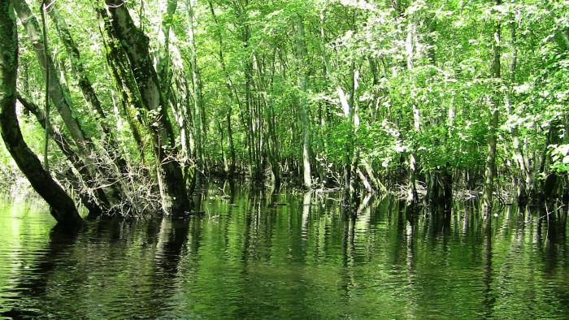
Residents and visitors alike have come to discover that the Pinelands, or Pine Barrens, is both an ecological and recreational gem located within a close driving distance to Philadelphia, New York, Baltimore, Washington and the Jersey Shore.
Day-trippers can partake in a wide-range of activities, depending on the season. However, visitors are encouraged to spend several days to gain a full-appreciation of the region and its vast natural, cultural and historic resources.
http://www.nj.gov/pinelands/home/visit/index.shtml
123rf.com

Slide 12
• This region features some of the largest unbroken tracts of forest in the eastern U.S.
• Unique ecological features of the New Jersey Pinelands include acidic and nutrient-poor stream systems fed by the shallow, underlying aquifer.
• Supports acid-tolerant fish, frog and toad, and plant communities. Native soils are sandy, acidic, and nutrient-poor.
http://www.nj.gov/pinelands/infor/fact/Pinelands%20Facts.pdf
123rf.com

Slide 13
• Wetlands comprise approximately 35 percent of the Pinelands National Reserve: 380,400 acres, including Atlantic White Cedar swamps, hardwood swamps, pitch pine lowlands, savannahs, and coastal marshes.
• Pinelands lie above the Kirkwood-Cohansey aquifer, which contains an estimated 17.7 trillion gallons of water -- enough water to cover all of New Jersey 10 feet deep, and equal to nearly half the water consumed each year in the U.S.
http://www.nj.gov/pinelands/infor/fact/Pinelands%20Facts.pdf
123rf.com

Slide 14
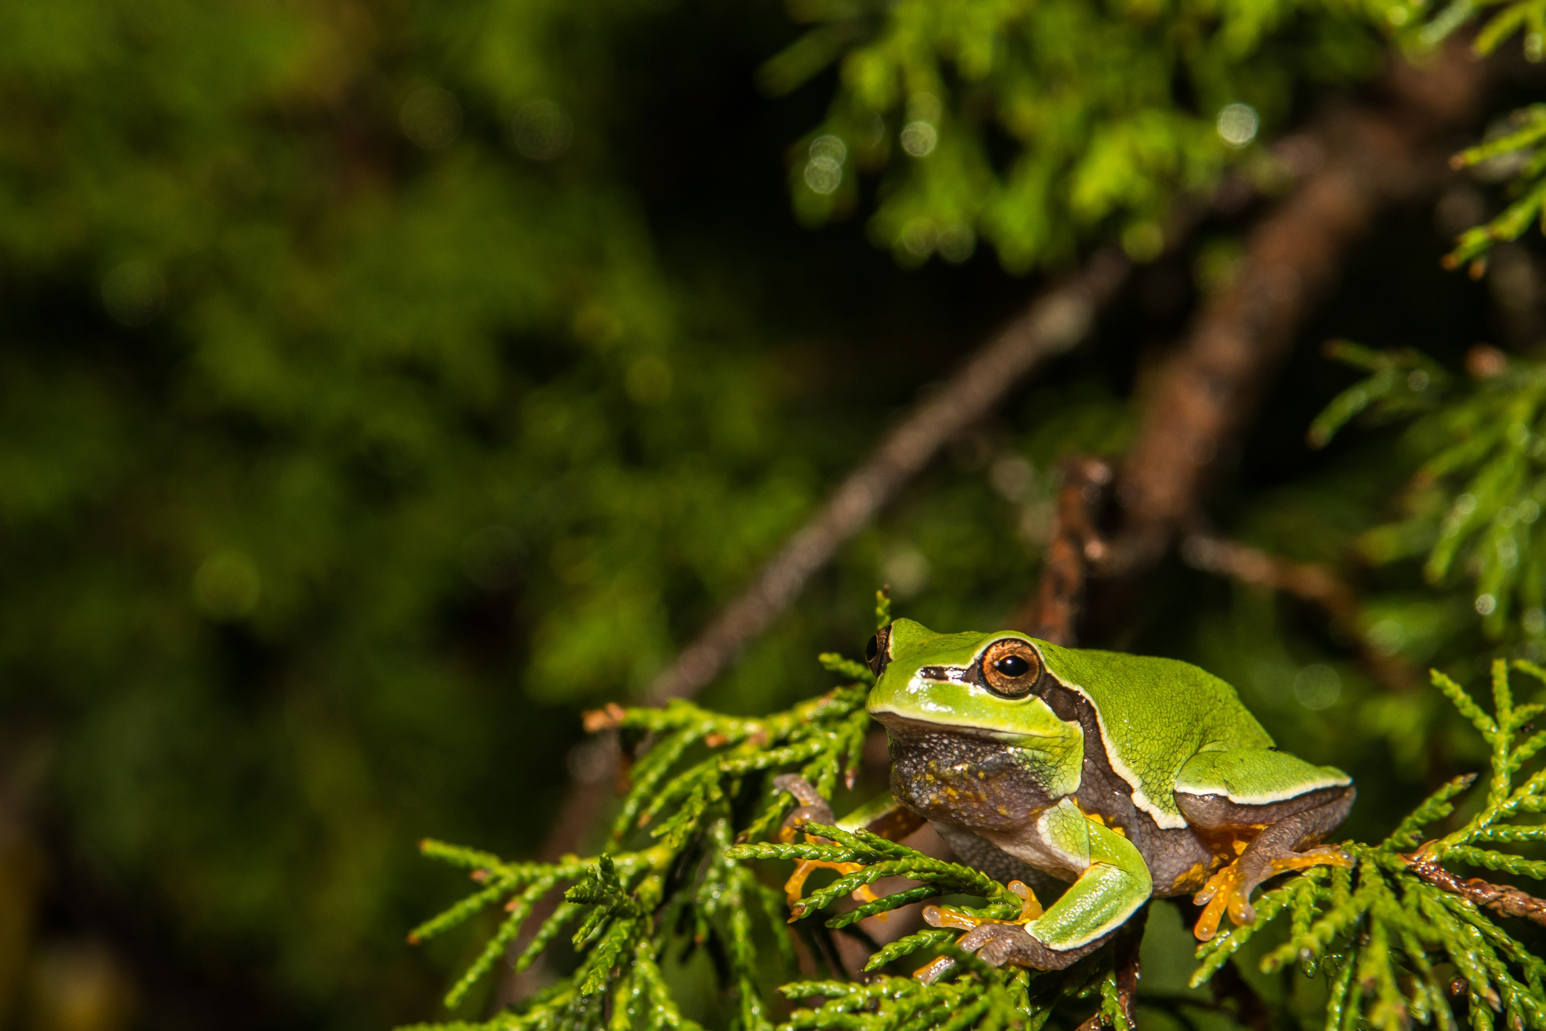
• Home to many rare and unusual plants and animals, some of which reach their northern or southern geographic limits in the Pinelands.
• Pinelands National Reserve is home to 43 threatened or endangered animal species.
• The colorful Pine Barrens Tree frog (Hyla andersonii), a species widely associated with the unique natural history of the Pinelands, is found in very few places outside of the Pinelands.
http://www.nj.gov/pinelands/infor/fact/Pinelands%20Facts.pdf
Shutterstock.com

Slide 15
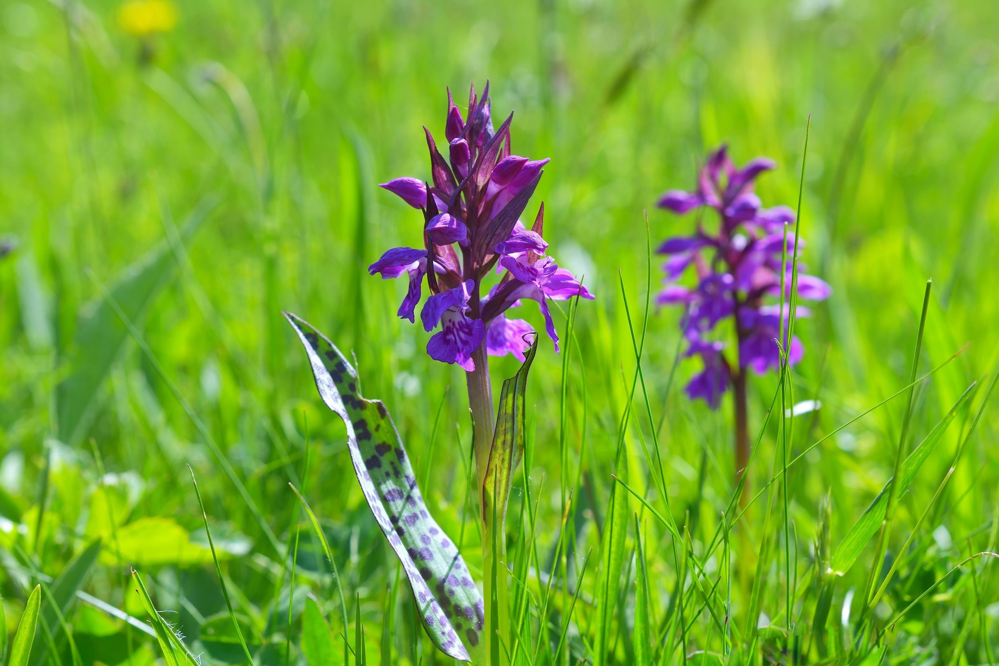
• Noted by botanists worldwide for its unique native flora, including 27 wild orchid species and several insectivorous plant species.
• 92 threatened and endangered plant species known to occurr in the Pinelands are protected under the Pinelands Comprehensive Management Plan.
• Some species of Pinelands plants, including Knieskern’s Beaked Rush (Rhynchospora knieskernii), Pickering’s Morning Glory (Breweria pickeringii var. caesariensis), and Bog Asphodel (Narthecium americanum) are currently found nowhere outside of the Pinelands.
• 15,000-acre Pine Plains are the most extensive pygmy forest of its type in the Country.
http://www.nj.gov/pinelands/infor/fact/Pinelands%20Facts.pdf
123rf.com

Slide 16
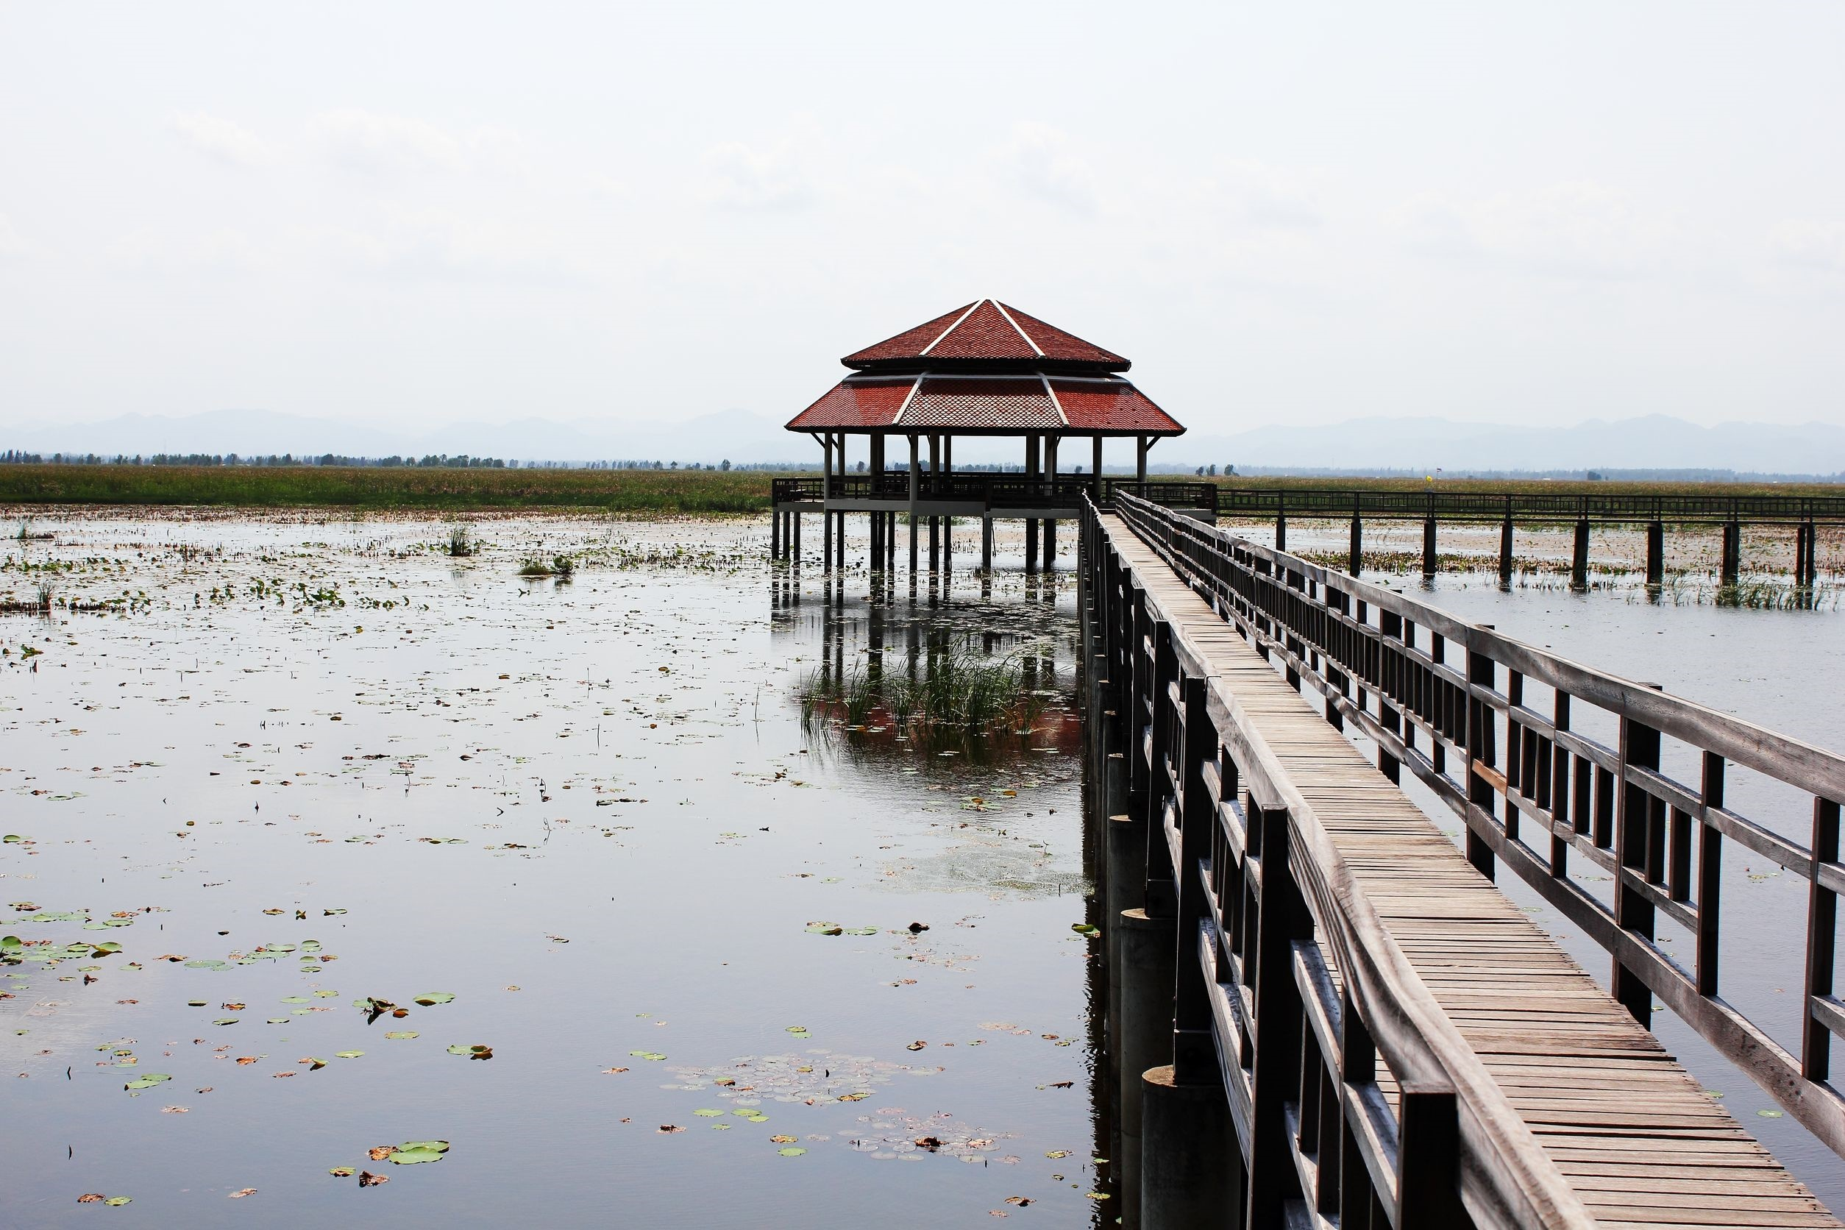
The Pinelands National Reserve was the first National Reserve in the nation. The Pinelands were designated in 1988 as the New Jersey Pinelands Biosphere Reserve by the United Nations Educational, Scientific and Cultural Organization.
http://www.nj.gov/pinelands/infor/fact/Pinelands%20Facts.pdf
123rf.com

Slide 17
Two Pinelands river systems are part of the National Wild and Scenic River System – The Great Egg Harbor River National Scenic and Recreational River and the Maurice National Scenic and Recreational River. Some 165 linear miles of the two rivers and their tributaries have the designation.
http://www.nj.gov/pinelands/infor/fact/Pinelands%20Facts.pdf
Great Egg Harbor River
123rf.com

Slide 18
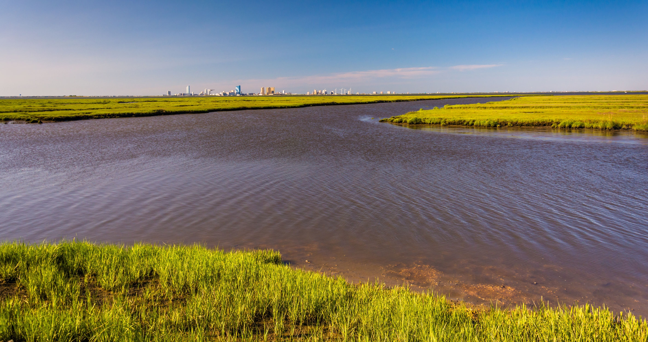
Edwin B. Forsyth N.W.R.
In 1986, the Edwin B. Forsyth National Wildlife Refuge was designated as a “wetland of international importance” under the Ramsar Convention Treaty of 1971. Forsythe is one of only 17 such sites in the United States. Ramsar was established to protect globally significant waterfowl habitat. In 1975, Congress designated 6,600 acres of the Forsythe National Wildlife Refuge as the Brigantine Wilderness Area, managed under the federal Wilderness Act of 1964.
http://www.nj.gov/pinelands/infor/fact/Pinelands%20Facts.pdf
123rf.com

Slide 19
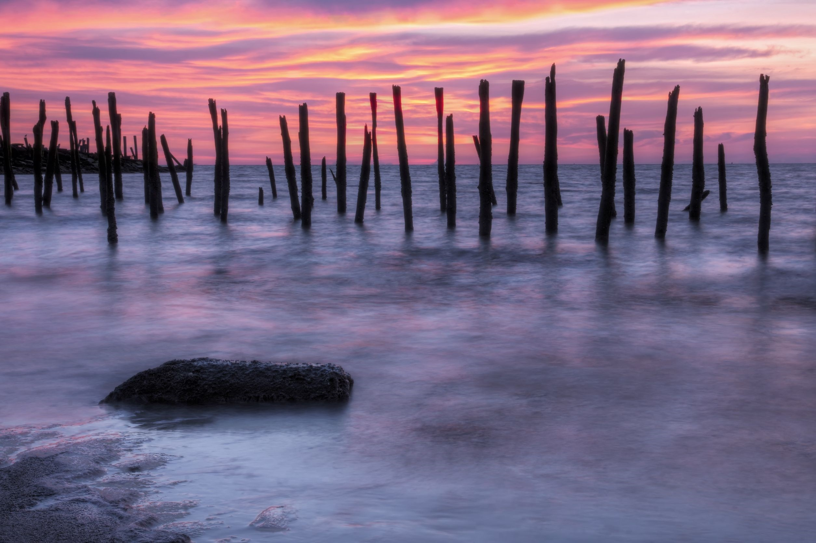
Delaware Bay
About 10 miles of Delaware Bay shoreline at the southern end of the Pinelands National Reserve, was designated as a Hemispheric Reserve in 1985 by the Western Hemisphere Shorebird Reserve Network. Forsythe National Wildlife Refuge received the Hemispheric Shorebird Reserve designation in 2001.
http://www.nj.gov/pinelands/infor/fact/Pinelands%20Facts.pdf
123rf.com

Slide 20
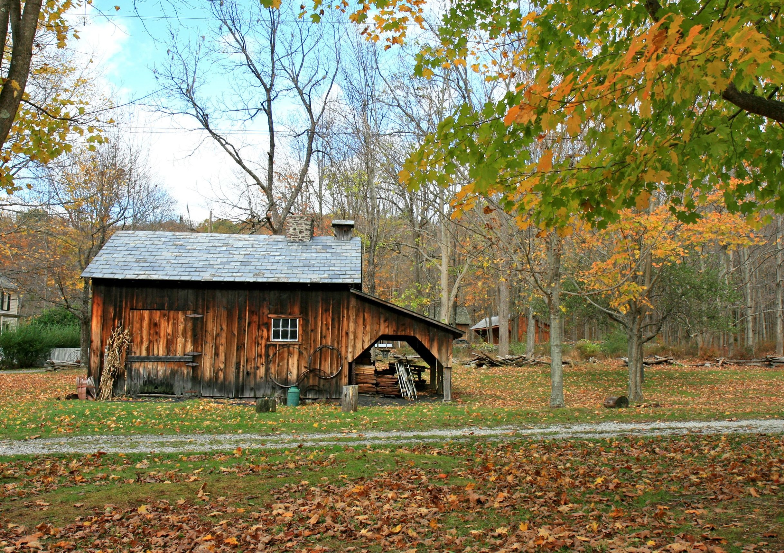
There are numerous Pinelands sites on the National Register of Historic Places, including restored historic villages and settlements, town historic districts, and historic structures and ruins.
http://www.nj.gov/pinelands/infor/fact/Pinelands%20Facts.pdf
Allaire State Park
123rf.com

Slide 21
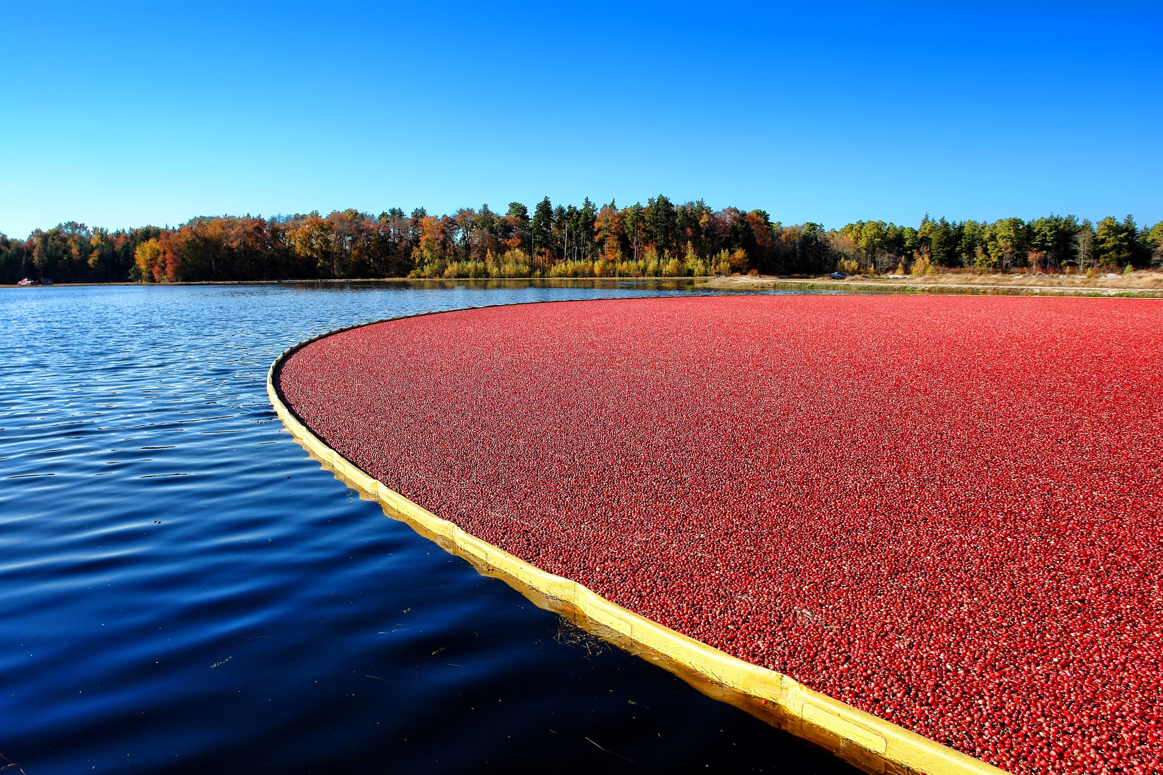
Preservation Area District – 295,000 acres. The heart of the Pinelands.
Virtually no development allowed except strictly limited uses in designated infill areas, or special cases under cultural housing provisions of the Pinelands Comprehensive Management Plan.
• Special Agricultural Production Area – 37,500 acres. Berry agriculture and related development.
• Agricultural Production Area - 68,500 acres. Upland agricultural uses and related development.
• Forest Area – 257,000 acres. Low density residential development and limited roadside retail.
• Rural Development Area - 109,500 acres. Moderate density residential and business development.
• Regional Growth Area - 76,500 acres. Moderately high density residential development with commercial and industrial development. Serves as the receiving area for the transfer of development rights (see below).
• Military and Federal Installation Area - 47,000 acres. Federal enclaves where existing uses are recognized.
• Pinelands Towns (21,500 acres) and Villages (26,000 acres) - 54 spatially discrete settlements interspersed throughout Pinelands Area; development consistent with existing character.
http://www.nj.gov/pinelands/infor/fact/Pinelands%20Facts.pdf
123rf.com

Slide 22
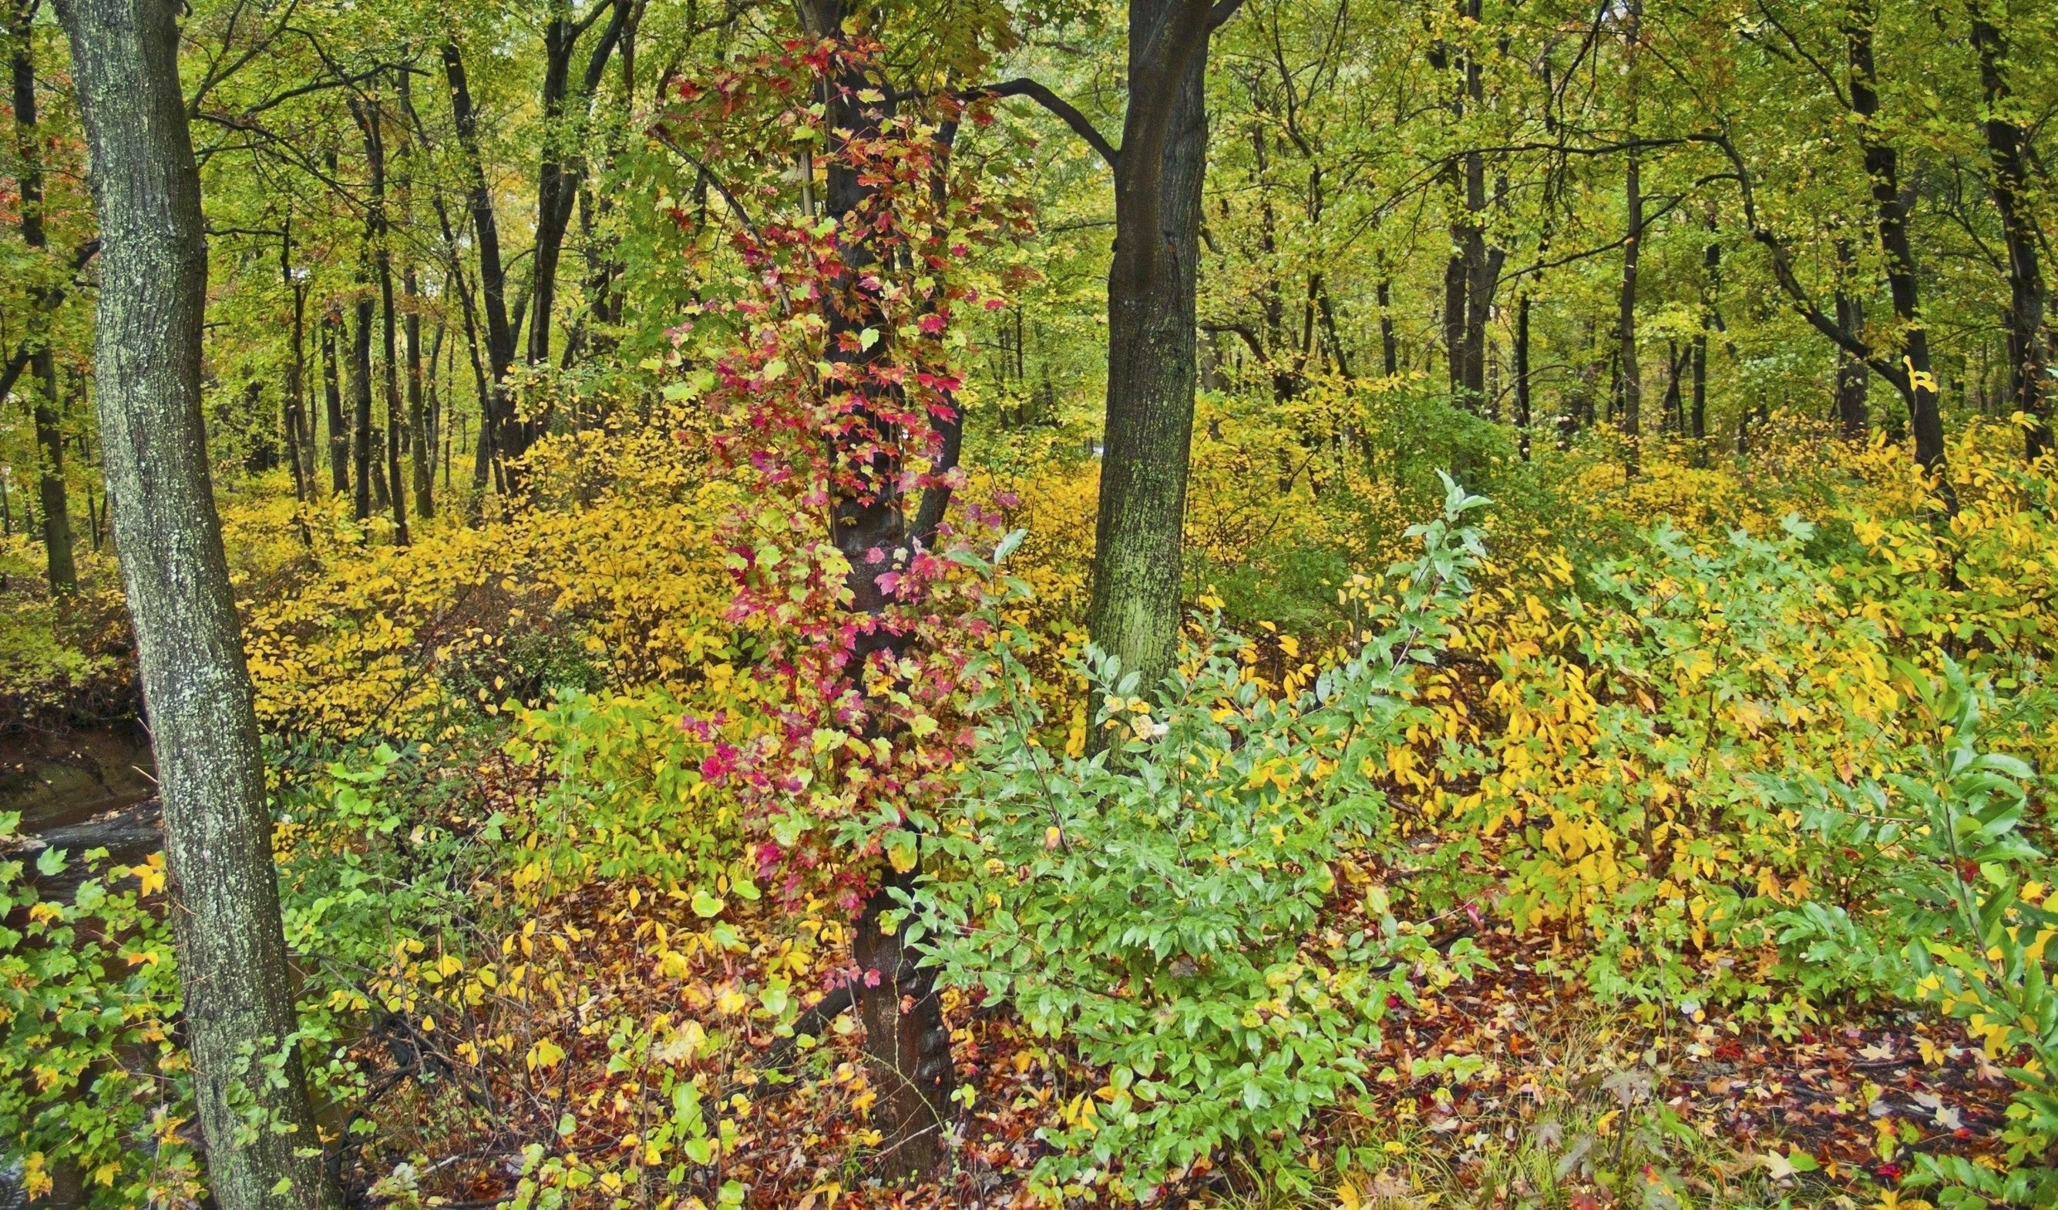
Wildlife Refuges & Wildlife Management Areas
Edwin B. Forsythe National Wildlife Refuge Cape May National Wildlife Refuge State Wildlife Management Areas located in the Pinelands
County Parks
Atlantic County Division of Parks and Recreation Estell Manor Weymouth Furnace Burlington County Division of Parks Rancocas Creek Canoe Trail Ocean County Parks & Recreation Jakes Branch (Berkeley Twp.) Wells Mills County Park (Ocean Twp.)
NJ State Parks & Forests
Allaire State Park
Bass River State Forest
Brendan T. Byrne State Forest
Belleplain State Forest
Double Trouble State Park
Forest Resources Education Center
Island Beach State Park
Penn State Forest
Wharton State Forest
123rf.com

Slide 23
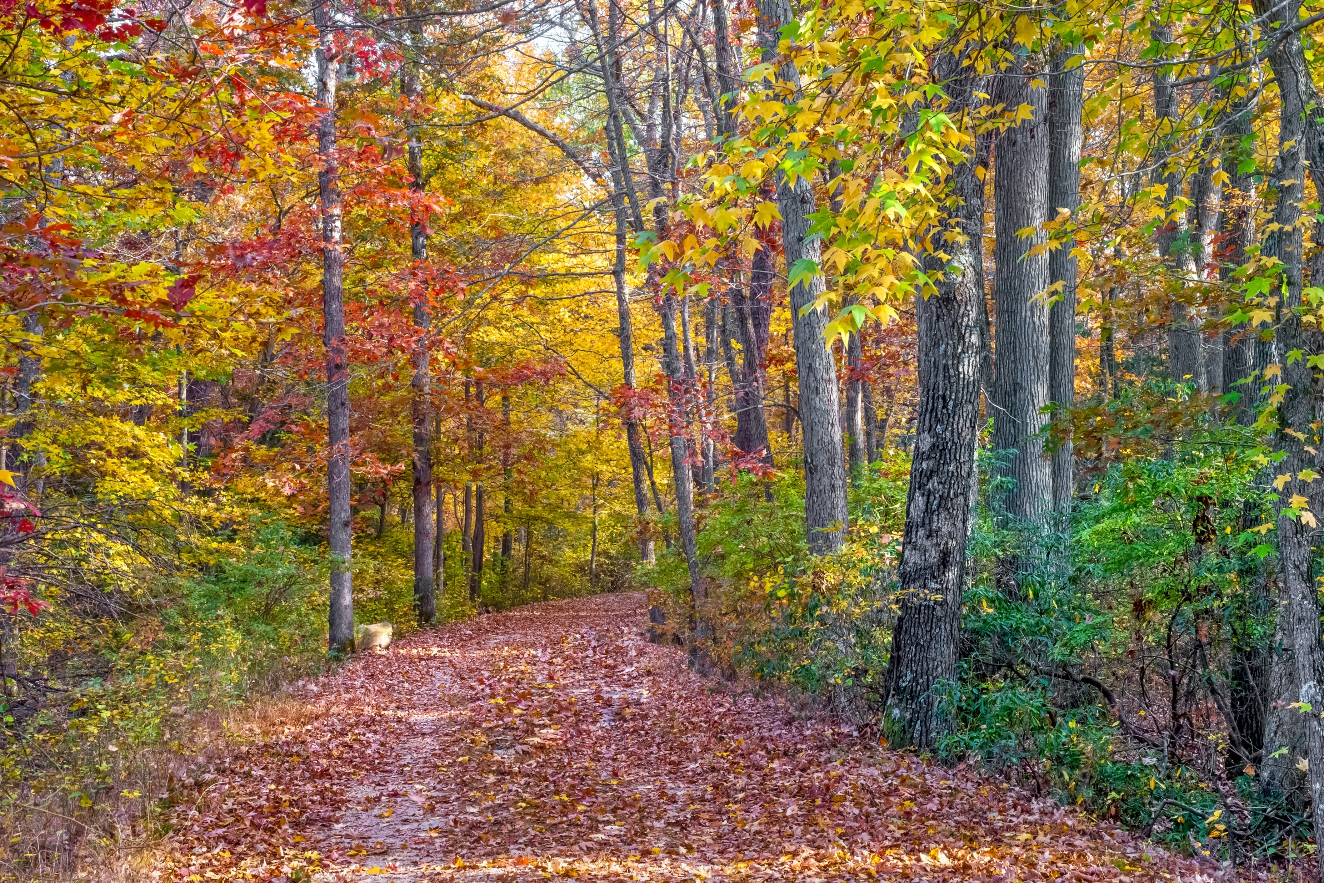
Educational Facilities & Nonprofit Organizations
Lighthouse Center for Natural Resource Education
The Nature Conservancy New Jersey Conservation Foundation (Franklin Parker Preserve)
Pinelands Preservation Alliance Pinelands Institute for Natural & Environmental Studies (P.I.N.E.S.)
Rancocas Nature Center
Tuckerton Seaport
The Wetlands Institute
Whitesbog Preservation Trust
Woodford Cedar Run Wildlife Refuge
Historic Sites
Allaire Village (Allaire State Park)
Atsion Village (Wharton State Forest)
Batsto Village (Wharton State Forest)
Whitesbog Village (Brendan T. Byrne State Forest)
123rf.com

Slide 24
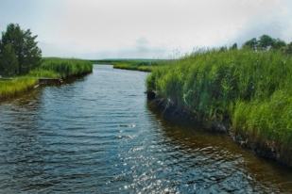
Municipalities of the Pine Barrens
Atlantic County (13)
Buena Borough
Buena Vista Township
Corbin City (b)
Egg Harbor City (a)
Egg Harbor Township
Estell Manor City (b)
Folsom Borough (a)
Galloway Township
Hamilton Township
Hammonton Town (a)
Mullica Township (a)
Port Republic City
Weymouth Township
123rf.com
Mullica River

Slide 25
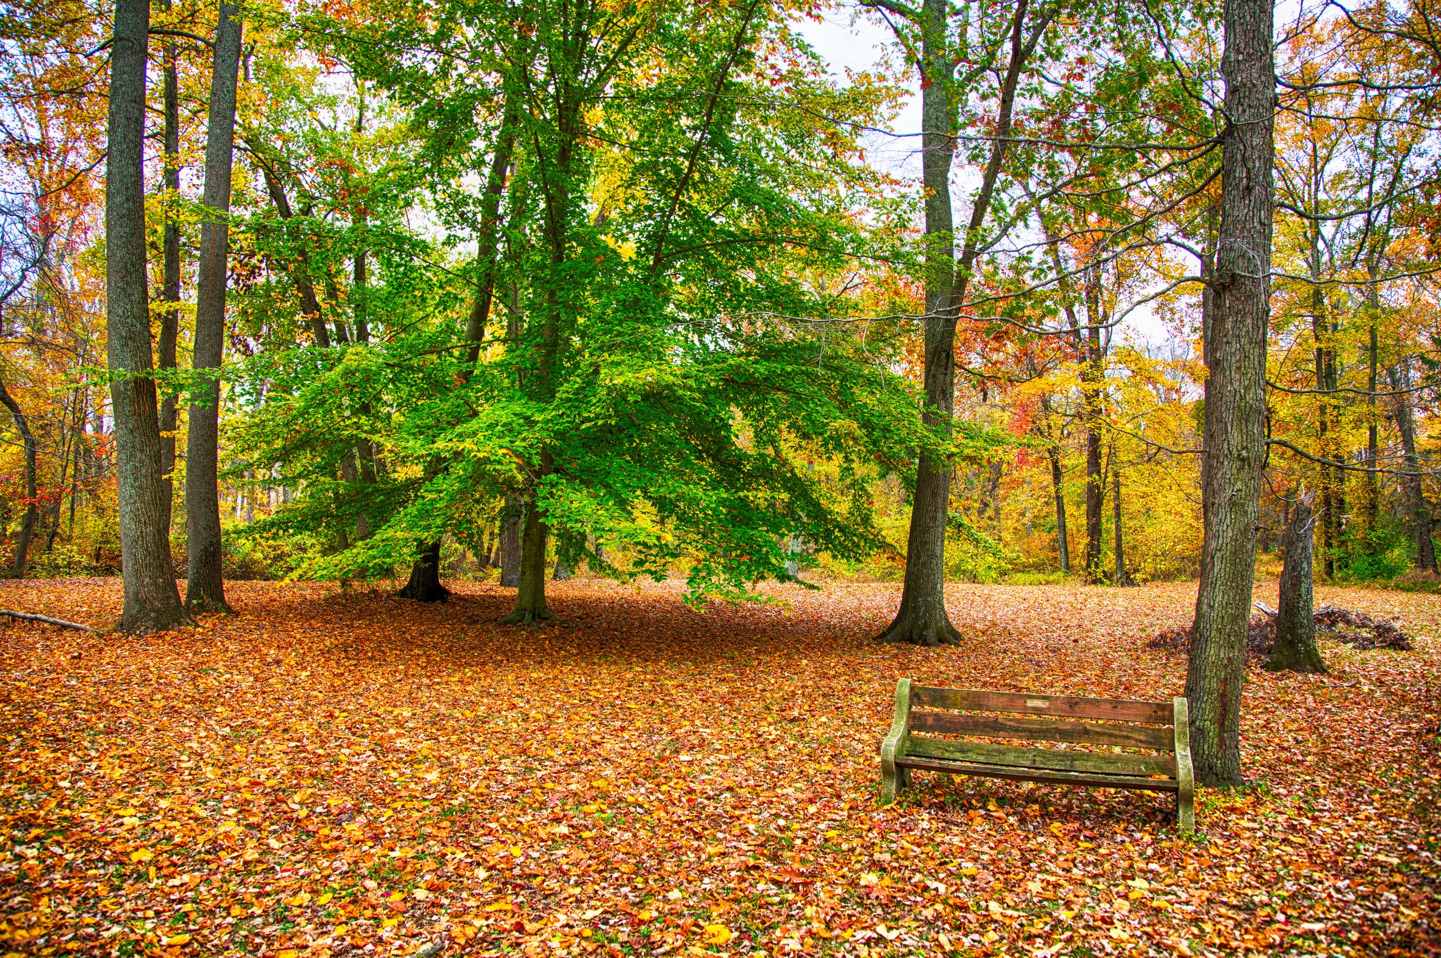
Burlington County (14)
Bass River Township (b)
Evesham Township
Medford Lakes Borough (a)
Medford Township
New Hanover Township
North Hanover Township
Pemberton Township
Shamong Township (a)
Southampton Township
Springfield Township
Tabernacle Township (a)
Washington Township (a)
Woodland Township (a)
Wrightstown Borough
123rf.com
Medford

Slide 26
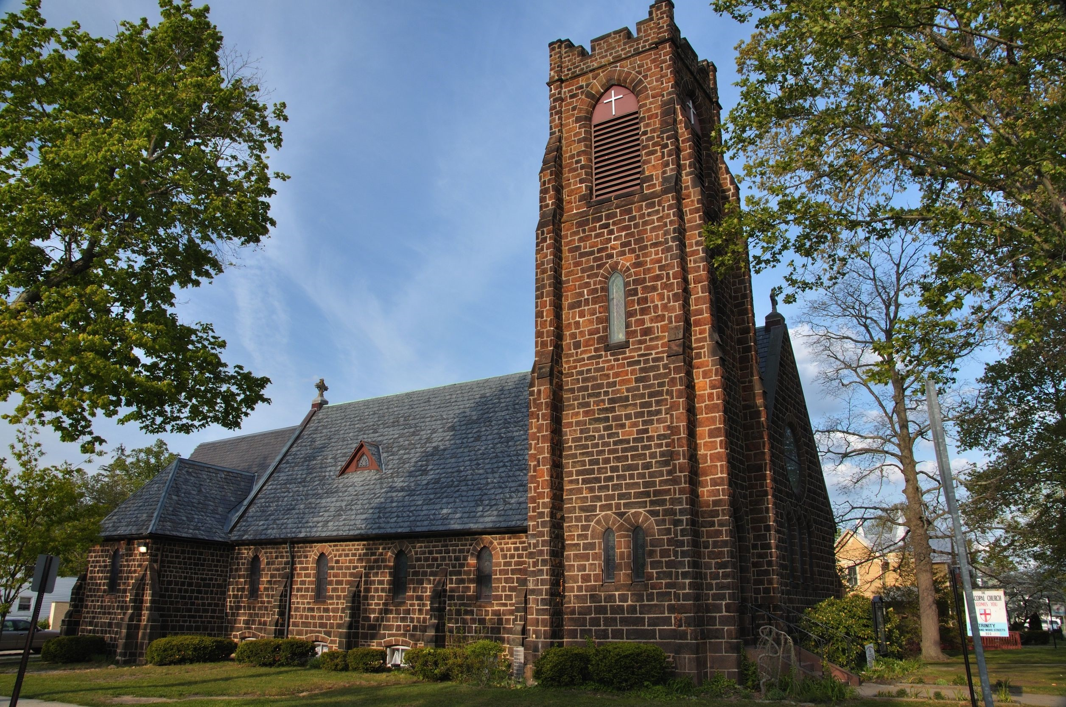
Vineland City
Cape May County (3)
Dennis Township (b)
Upper Township
Woodbine Borough (b)
Cumberland County (2)
Maurice River Township (b)
Vineland City
Gloucester County (2)
Franklin Township
Monroe Township
123rf.com

Slide 27
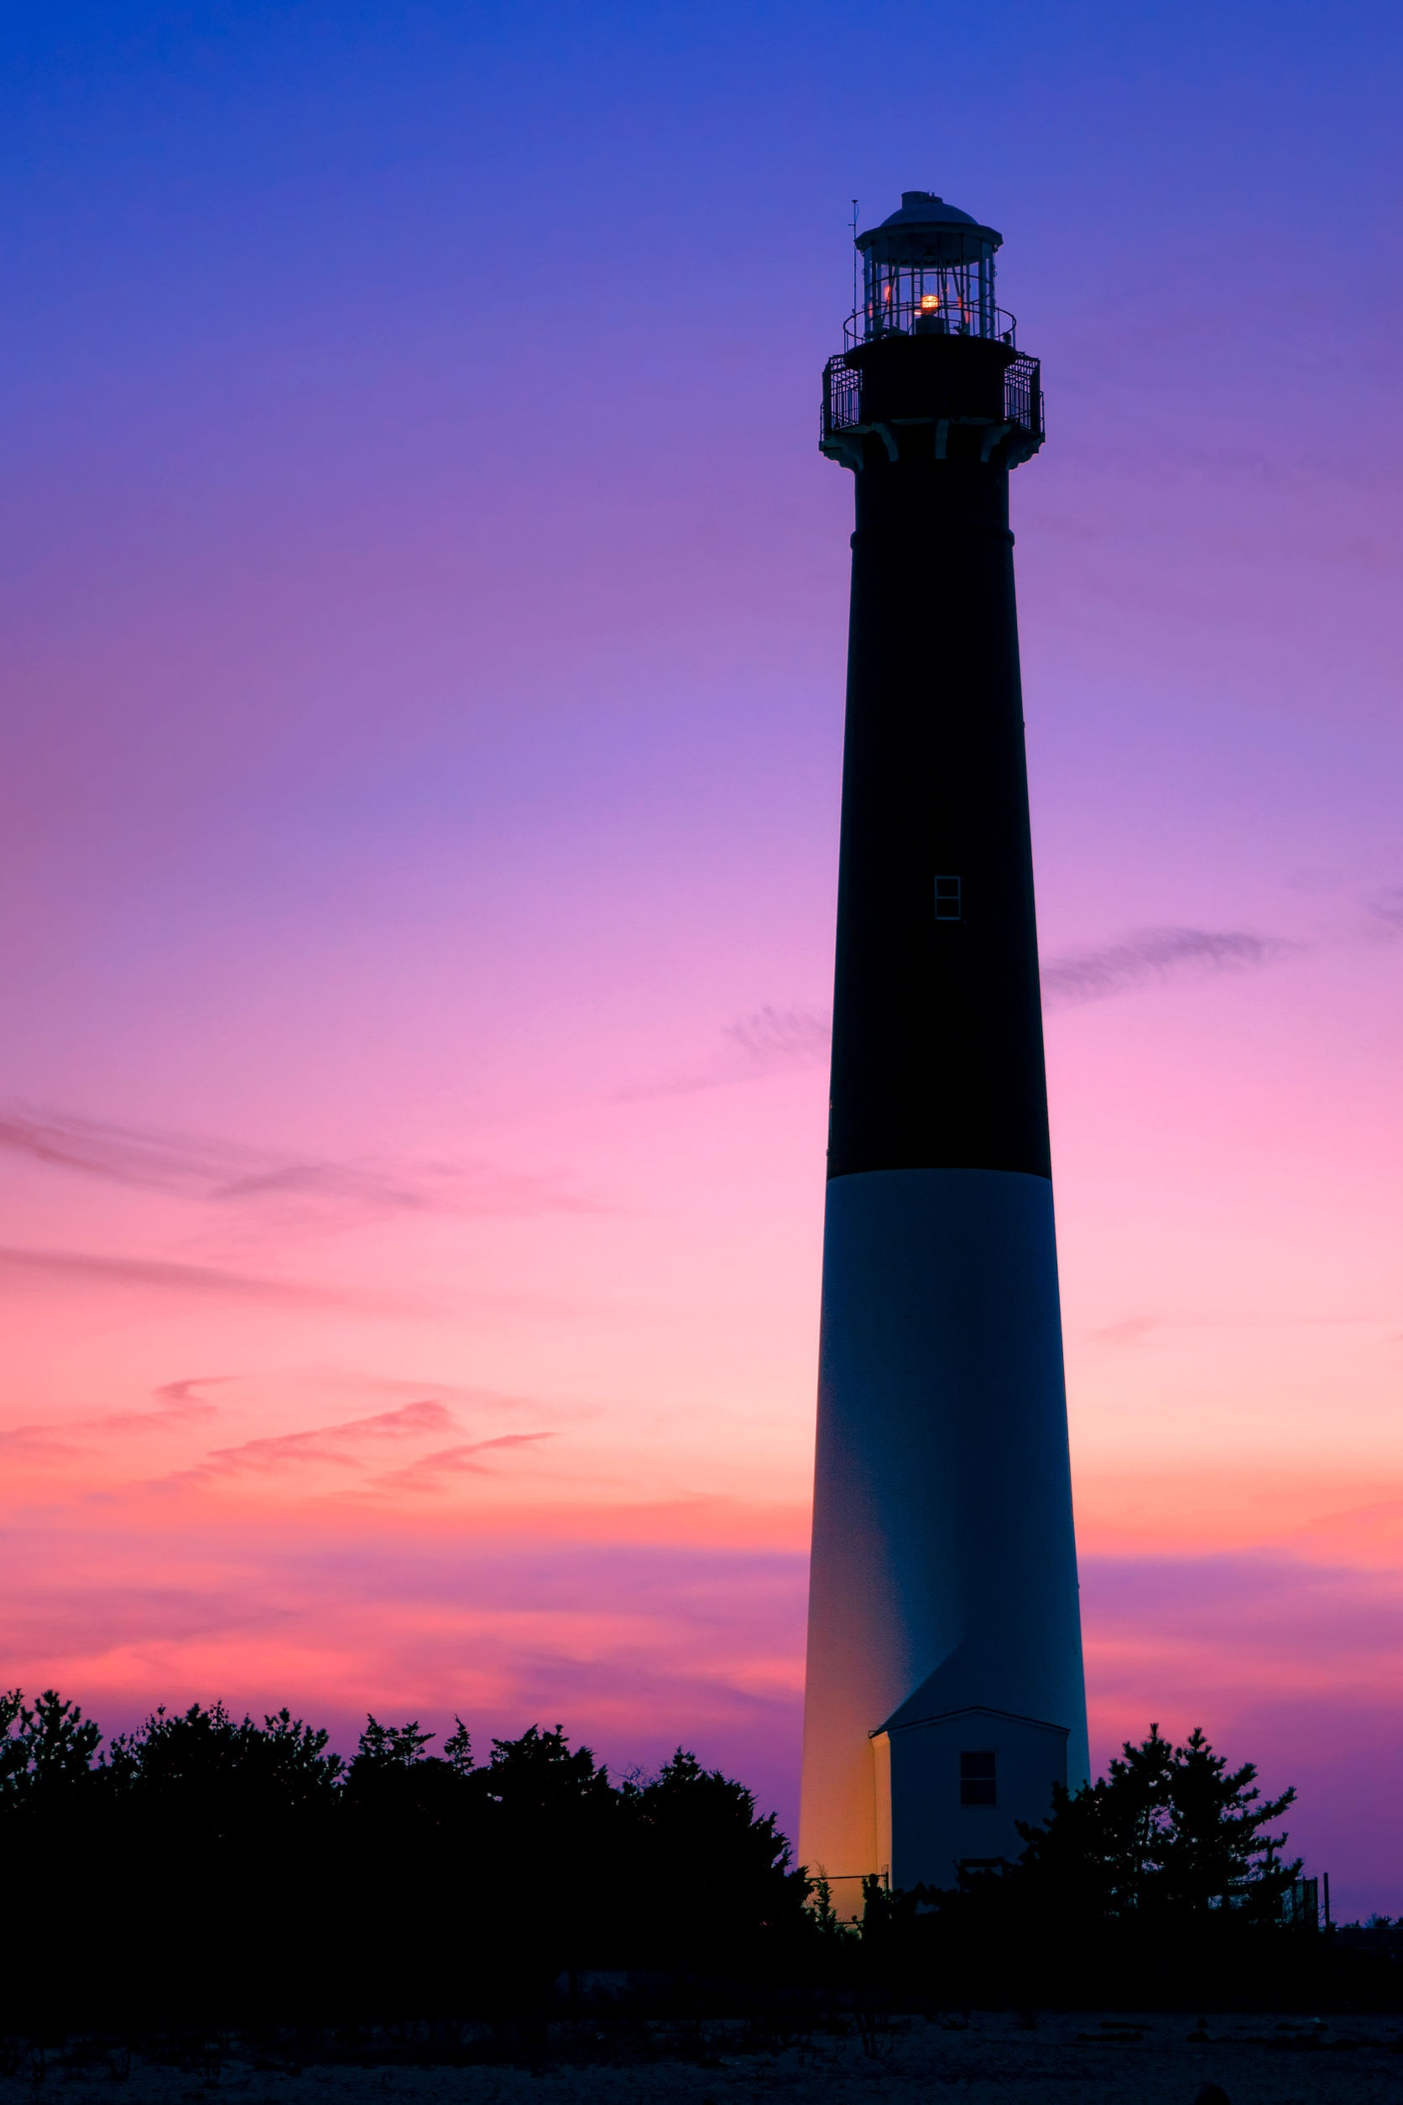
Gloucester County (2)
Franklin Township
Monroe Township
Ocean County (14)
Barnegat Township (b)
Beachwood Borough
Berkeley Township
Dover Township
Eagleswood Township (b)
Jackson Township
Lacey Township (b)
Lakehurst Borough
Little Egg Harbor Township (b)
Manchester Township
Ocean Township (b)
Plumsted Township
South Toms River Borough
Stafford Township (b)
Barnegat Lighthouse

Slide 28
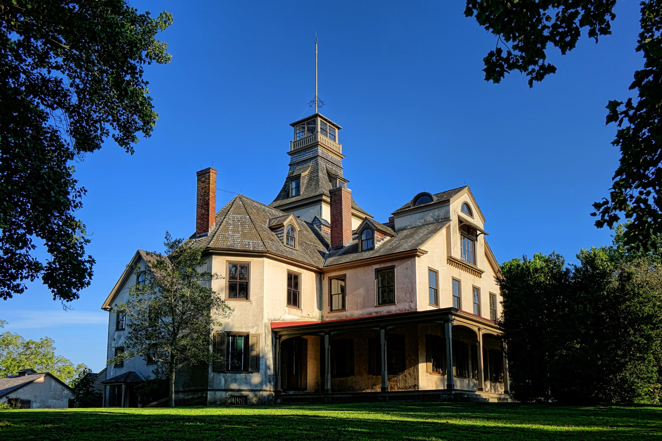
Key Words
agricultural production advocating ceased
Pinelands Preservation Act legacy legislation
National Reserve championed preservation
Kirkwood-Cohansey aquifer commodity tracts
recreational destination Pine Barrens discrete
Batsto Village Mansion
123rf.com

