Slide 1
NICKY FIFTH’S NEW JERSEY
N5NJ
SECONDARY PROGRAM
GEOGRAPHY
Solar, Wind, Geothermal

Slide 2
Like other states in the Northeast, New Jersey has some of the most expensive electricity prices in the United States.
http://instituteforenergyresearch.org/media/state-regs/pdf/New%20Jersey.pdf
123rf.com

Slide 3
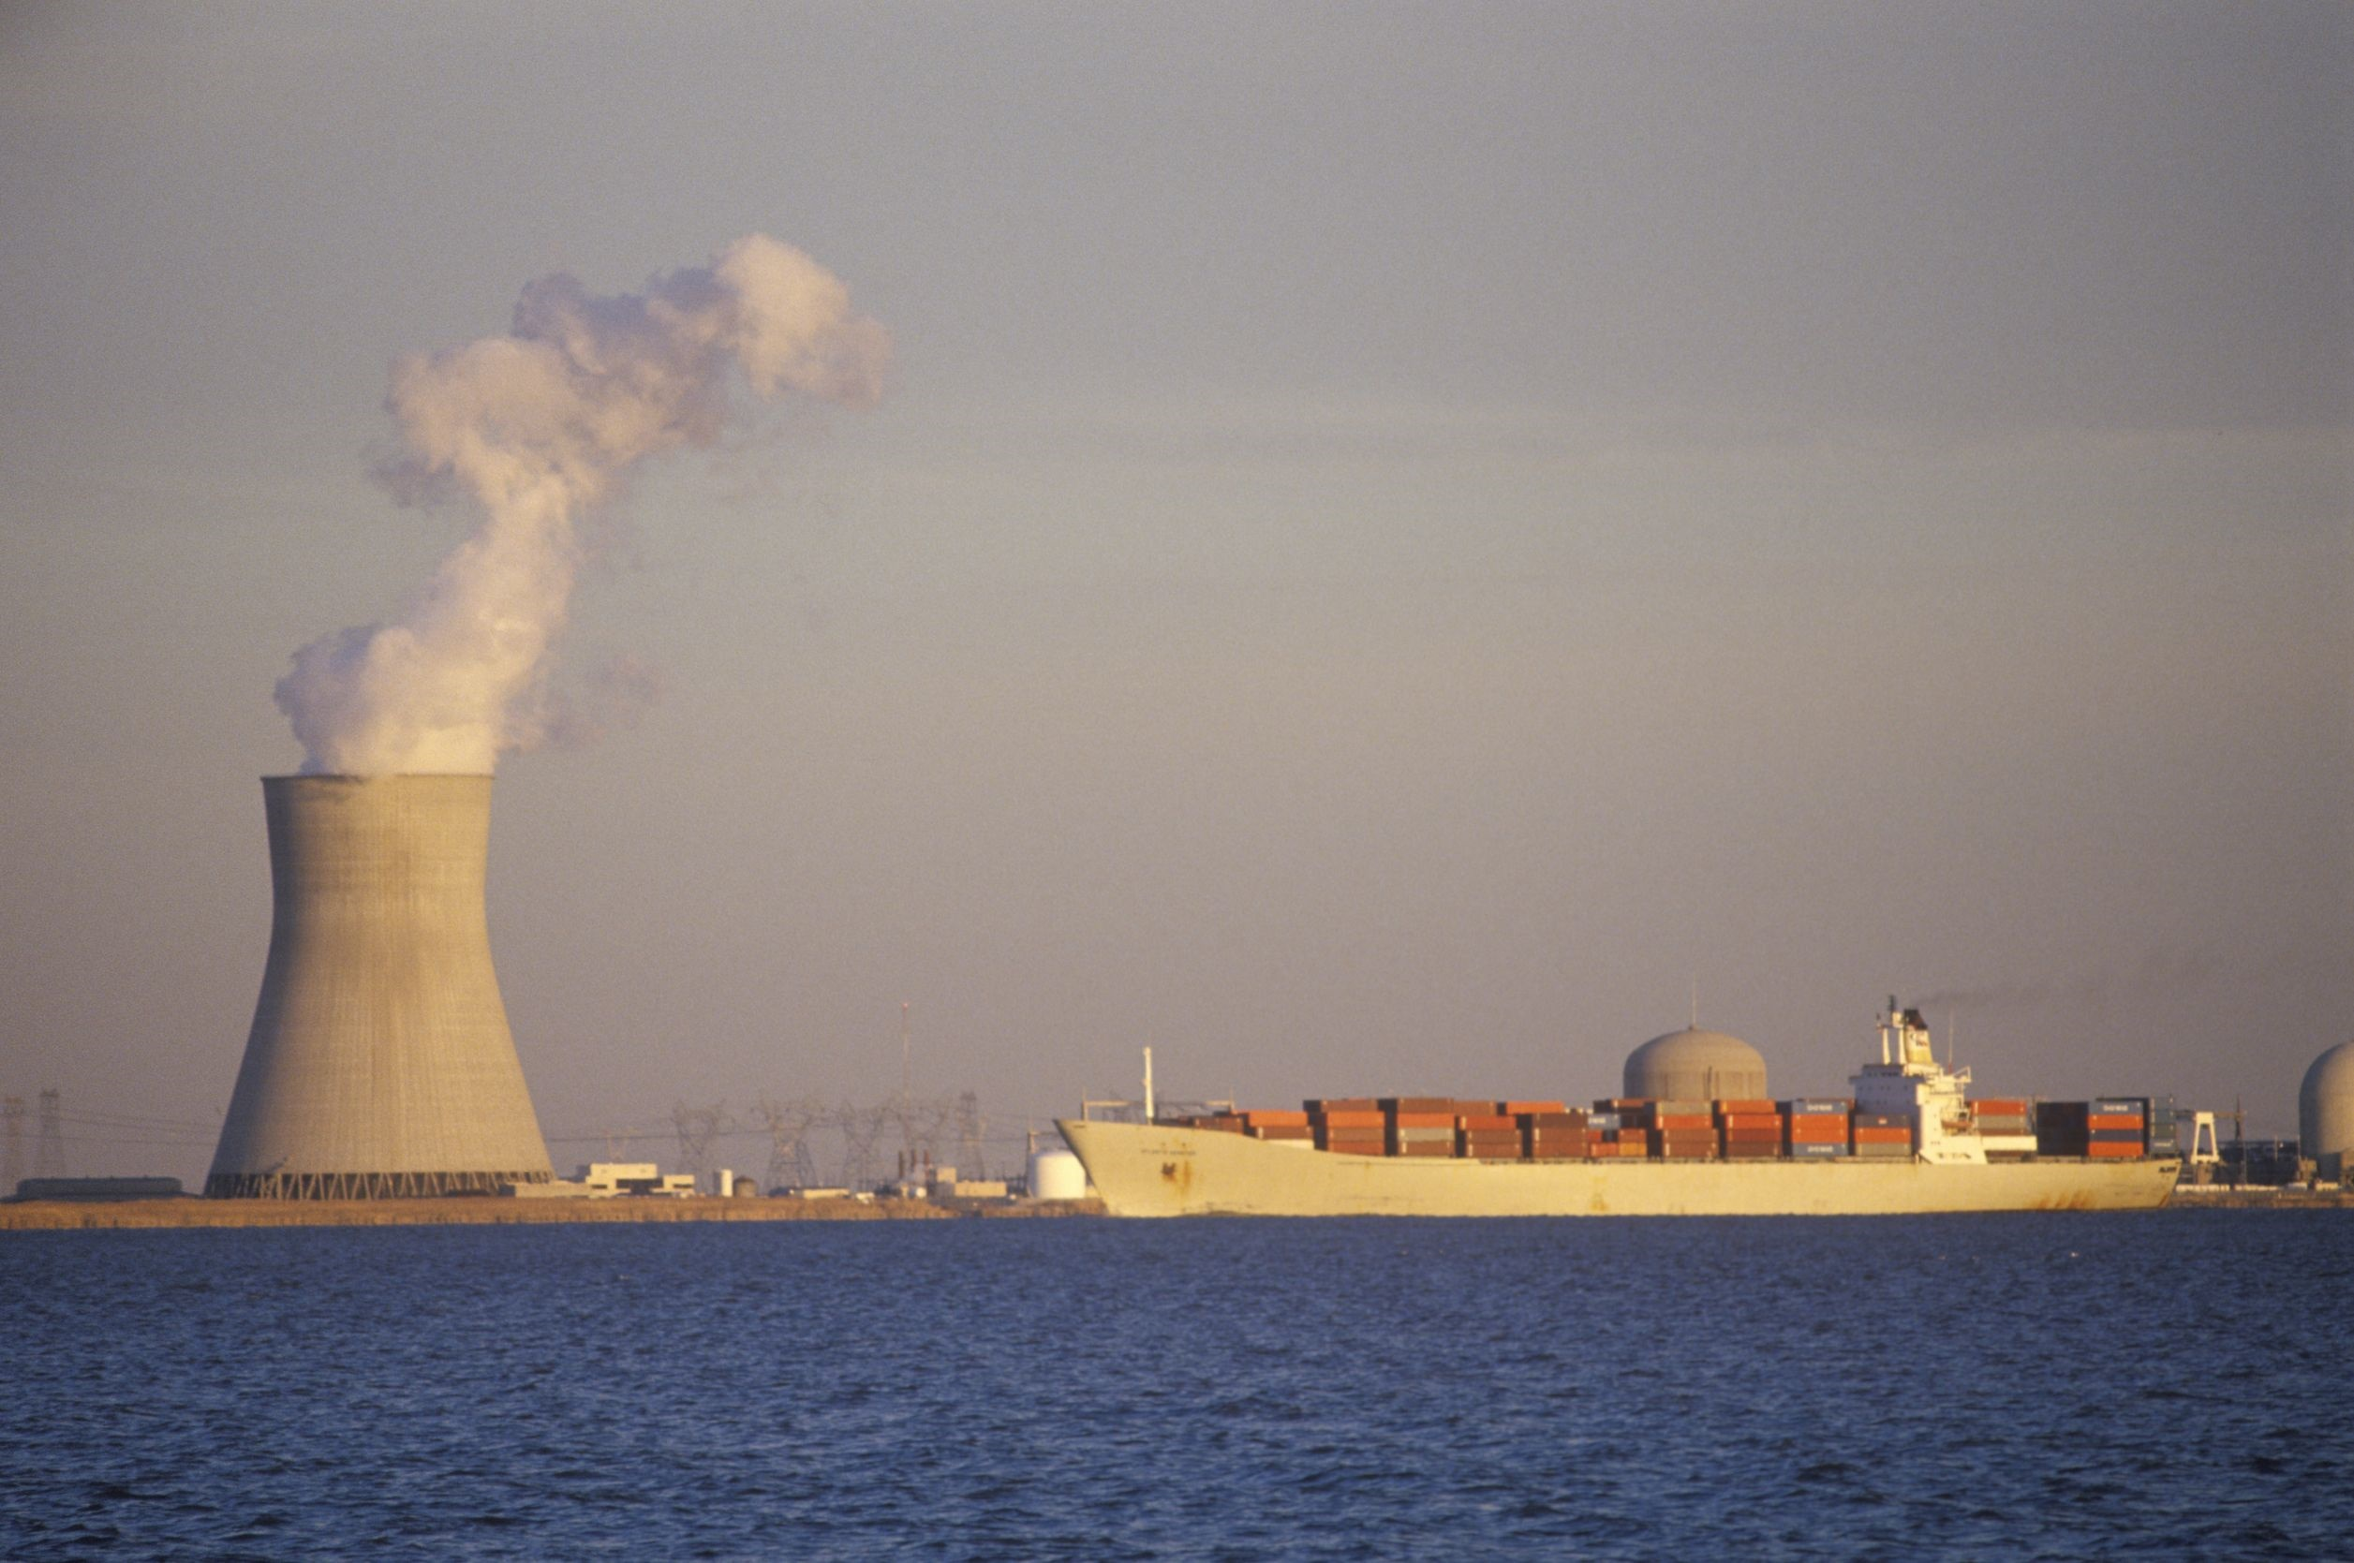
Typically, New Jersey receives more than half of its electricity from nuclear power, while natural gas meets almost a third of the state’s demand.
http://instituteforenergyresearch.org/media/state-regs/pdf/New%20Jersey.pdf
123rf.com

Slide 4
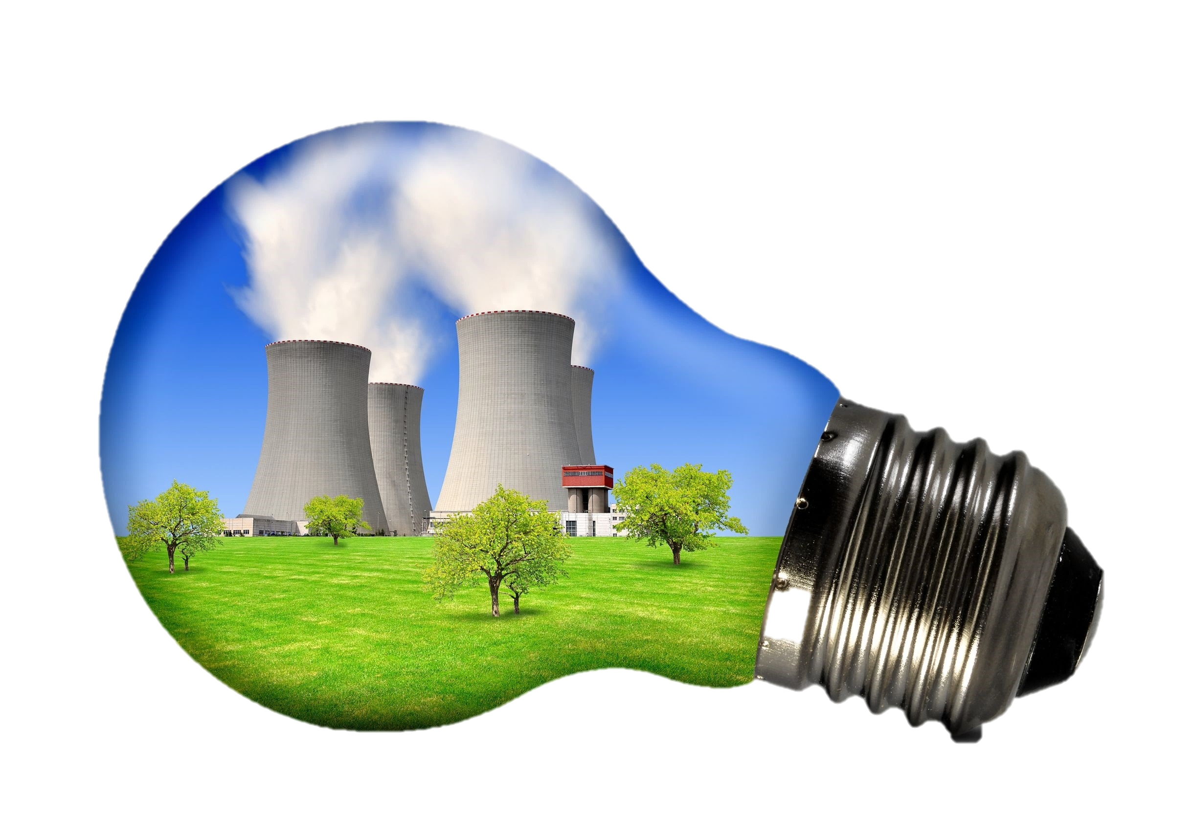
New Jersey has three nuclear power plants. One of those, the Oyster Creek Nuclear Generating Station, first came online in 1969 and is the oldest operating nuclear power plant in the United States.
http://instituteforenergyresearch.org/media/state-regs/pdf/New%20Jersey.pdf
123rf.com

Slide 5
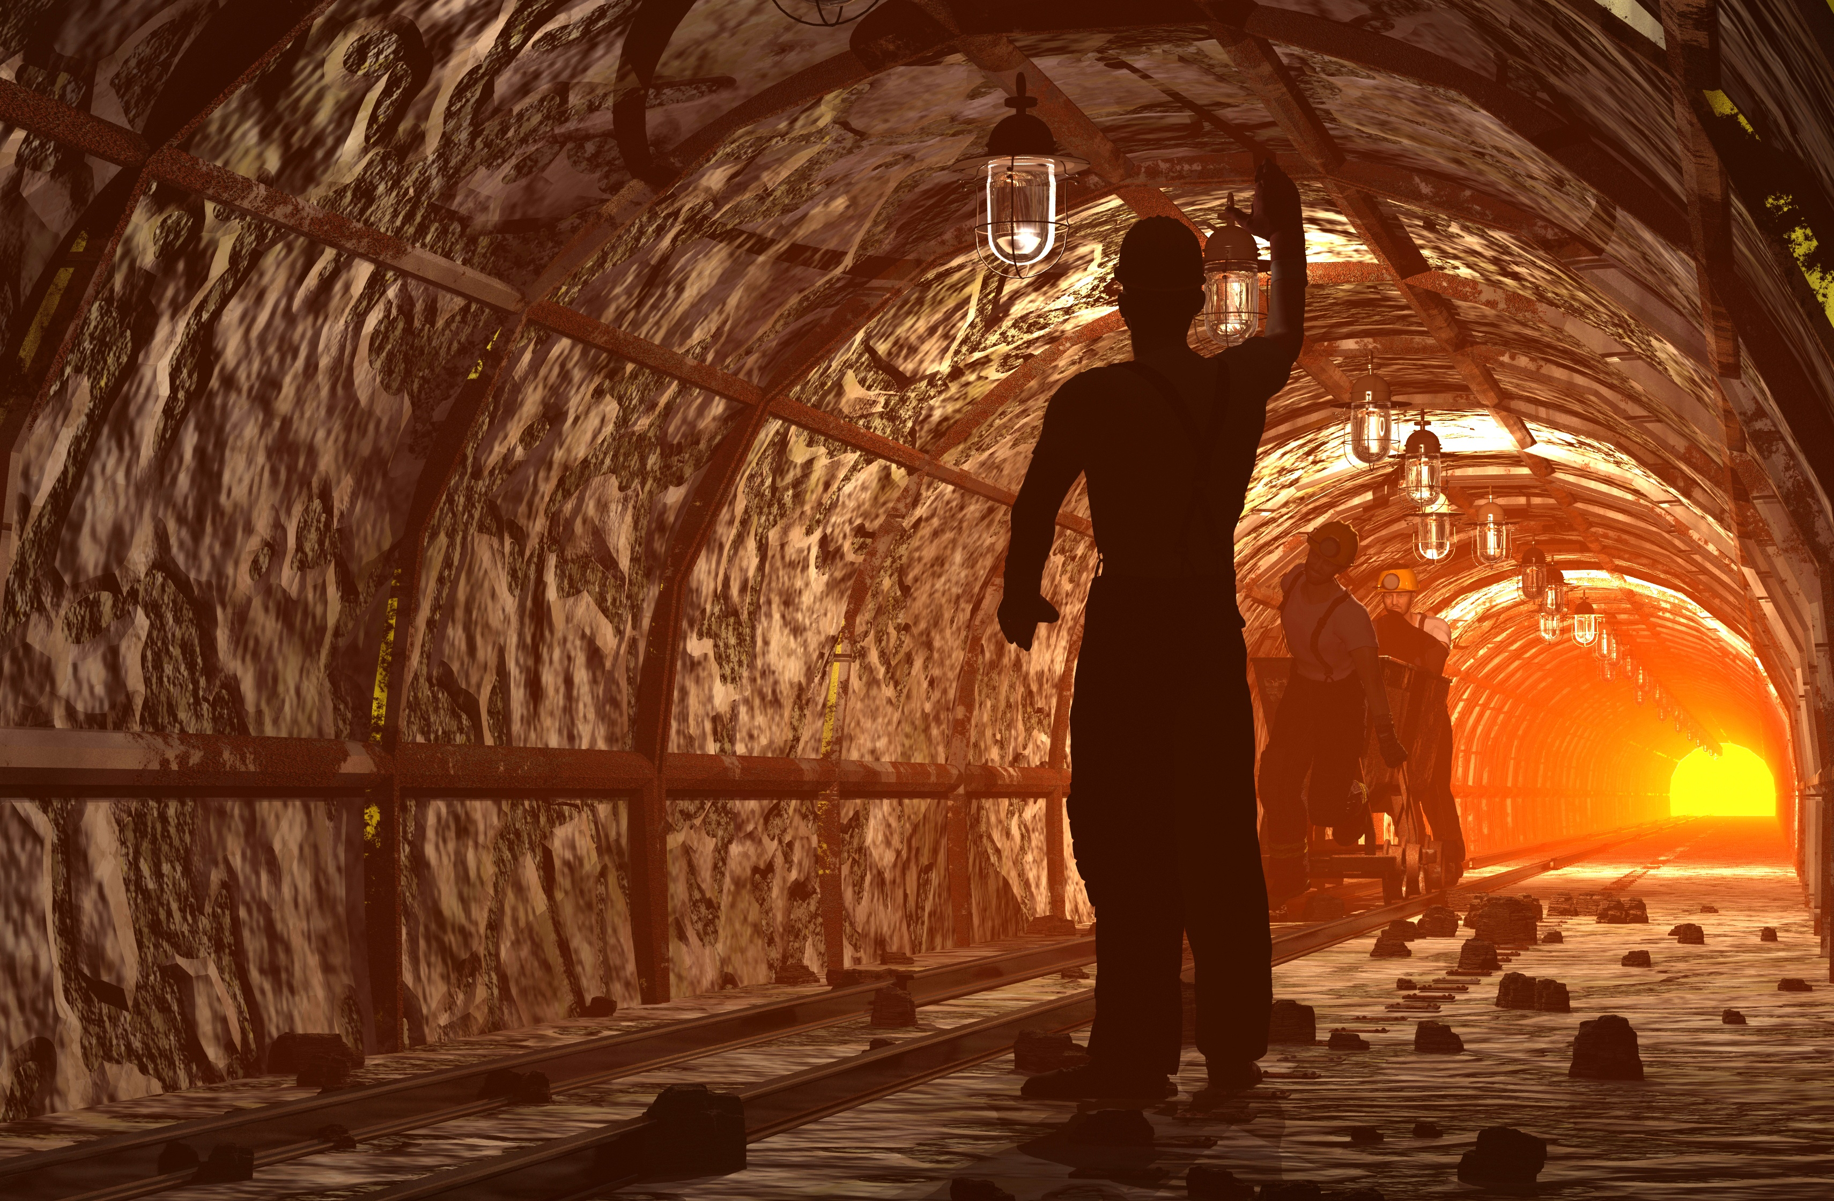
New Jersey has no fossil fuel reserves, so its natural gas arrives through pipelines from Pennsylvania, while coal is shipped to the state from West Virginia, Pennsylvania, and Virginia.
http://instituteforenergyresearch.org/media/state-regs/pdf/New%20Jersey.pdf
123rf.com

Slide 6
In a state with some of the nation’s highest energy costs, how people and businesses use and pay for electricity and other types of energy is always a top priority for policymakers.
It has led to initiatives to encourage more power plants to be built in New Jersey, to develop renewable resources like solar, and to reduce energy consumption by customers of the state’s gas and electric utilities.
http://www.njspotlight.com/stories/14/04/14/the-list-10-facts-about-household-energy-usage-in-new-jersey
123rf.com

Slide 7
Regarding energy consumption in New Jersey, transportation ranks first, at 39.1 %. This is hardly surprising, given that New Jersey has the longest average commute in the country. The commercial sector accounts for 25.9 %; the industrial community, 11.3 %.
http://www.njspotlight.com/stories/14/04/14/the-list-10-facts-about-household-energy-usage-in-new-jersey
123rf.com

Slide 8
Household consumption ranks third when it comes to total energy usage in the state, accounting for 23.7 % overall, according to the U.S. Energy Information Administration. Households rely on a mix of fuels, including electricity, natural gas, and petroleum products, among others.
http://www.njspotlight.com/stories/14/04/14/the-list-10-facts-about-household-energy-usage-in-new-jersey
123rf.com

Slide 9
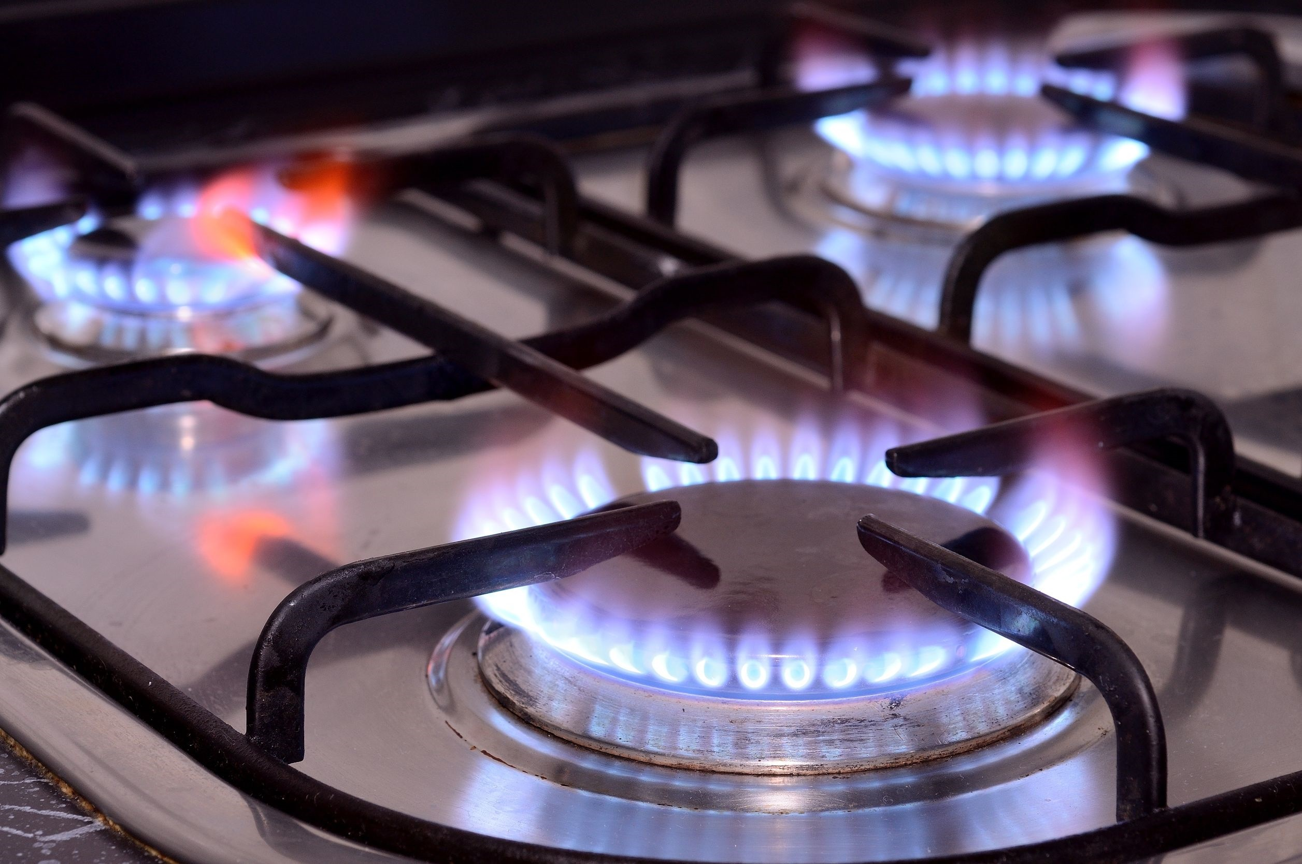
In 2015, for the first time, natural gas generated more electricity in New Jersey than nuclear power did. Together, the two fuels provided more than 90% of the state's net electricity generation.
http://www.eia.gov/state/?sid=NJ
123rf.com

Slide 10
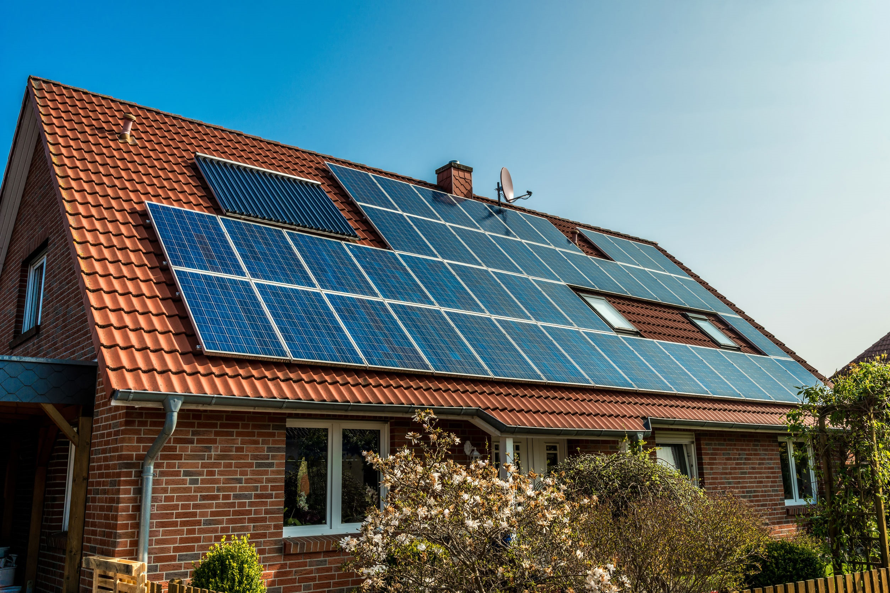
In 2015, solar power became New Jersey's largest source of renewable electricity; three-fifths of solar electricity came from customer-sited solar panels.
http://www.eia.gov/state/?sid=NJ
123rf.com

Slide 11
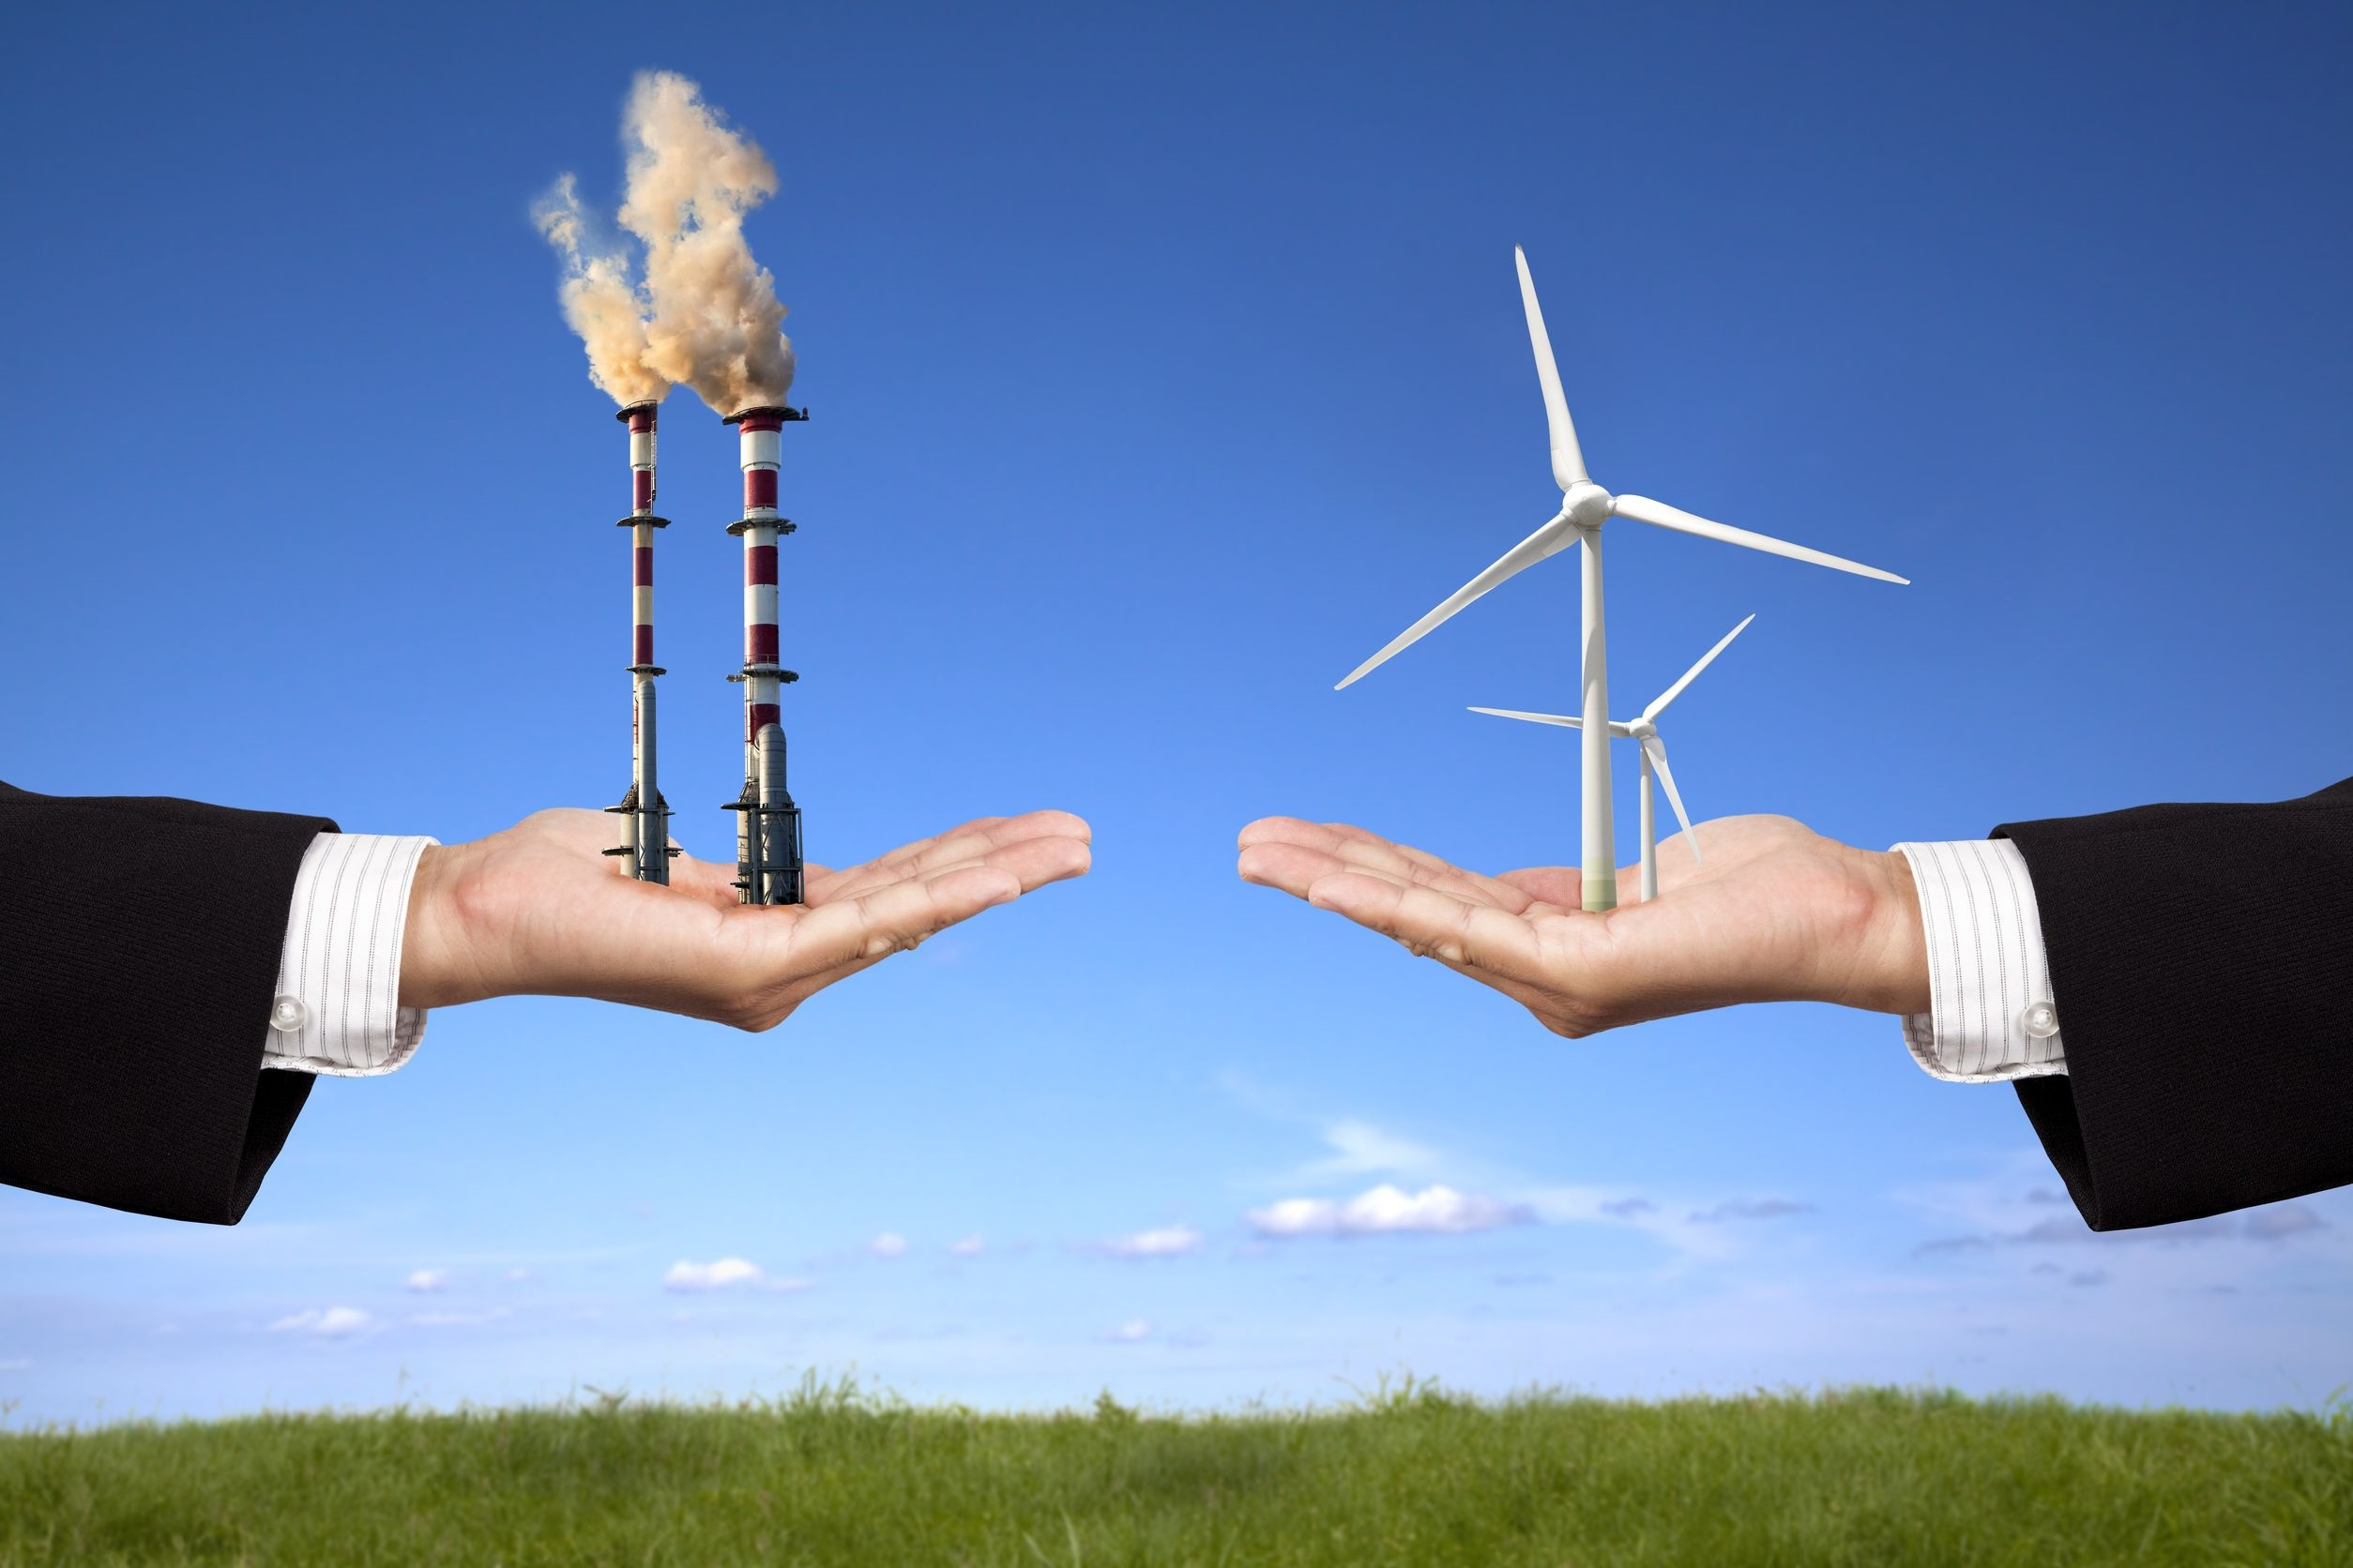
Though the state reportedly has significant wind energy potential, wind currently makes a negligible contribution to New Jersey’s electricity supply.
http://www.eia.gov/state/?sid=NJ
123rf.com

Slide 12
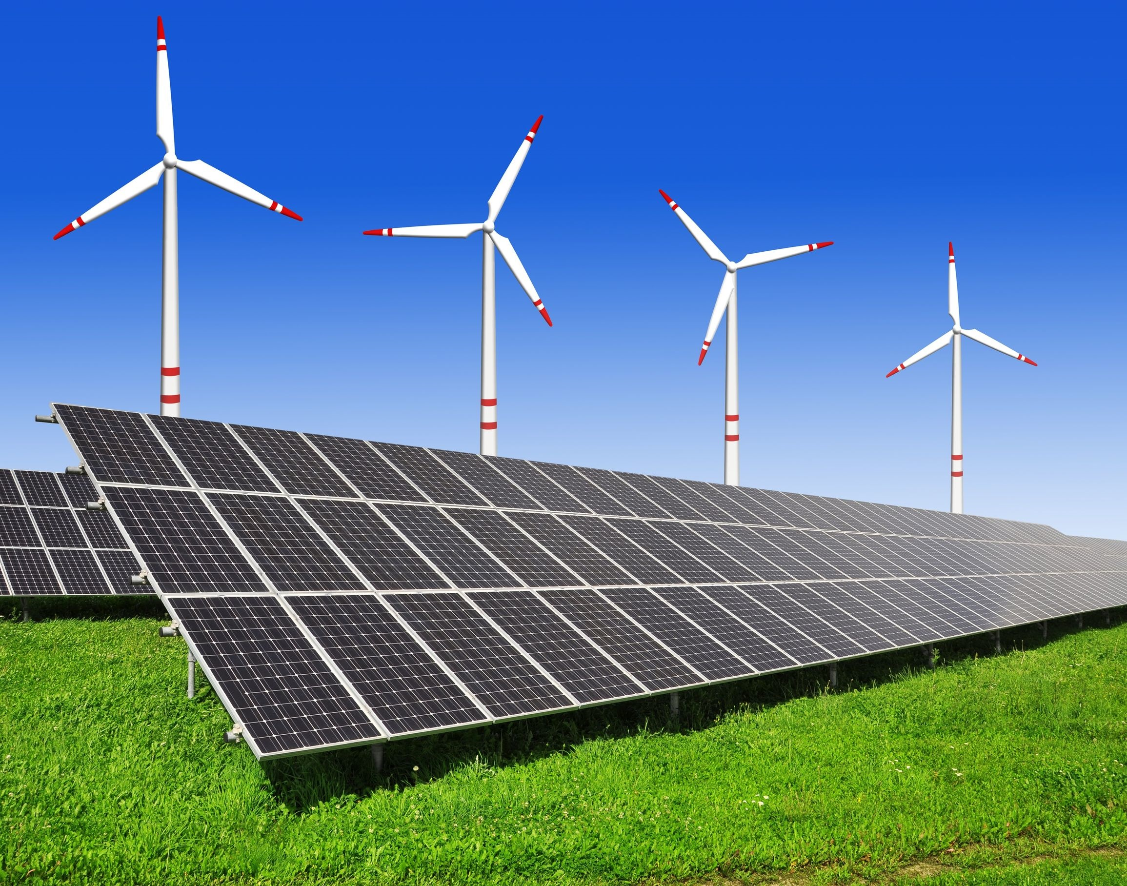
The use of renewable sources of energy is a growing trend that will improve the environment, the economy, and national security.
Renewable energy comes from sources that can be regenerated or naturally replenished. The main sources of renewable energy are:
- Water (hydropower and hydrokinetic)
- Wind
- Solar
- Biomass (biofuel and biopower)
- Geothermal
http://www.c2es.org/energy/source/renewables
123rf.com

Slide 13
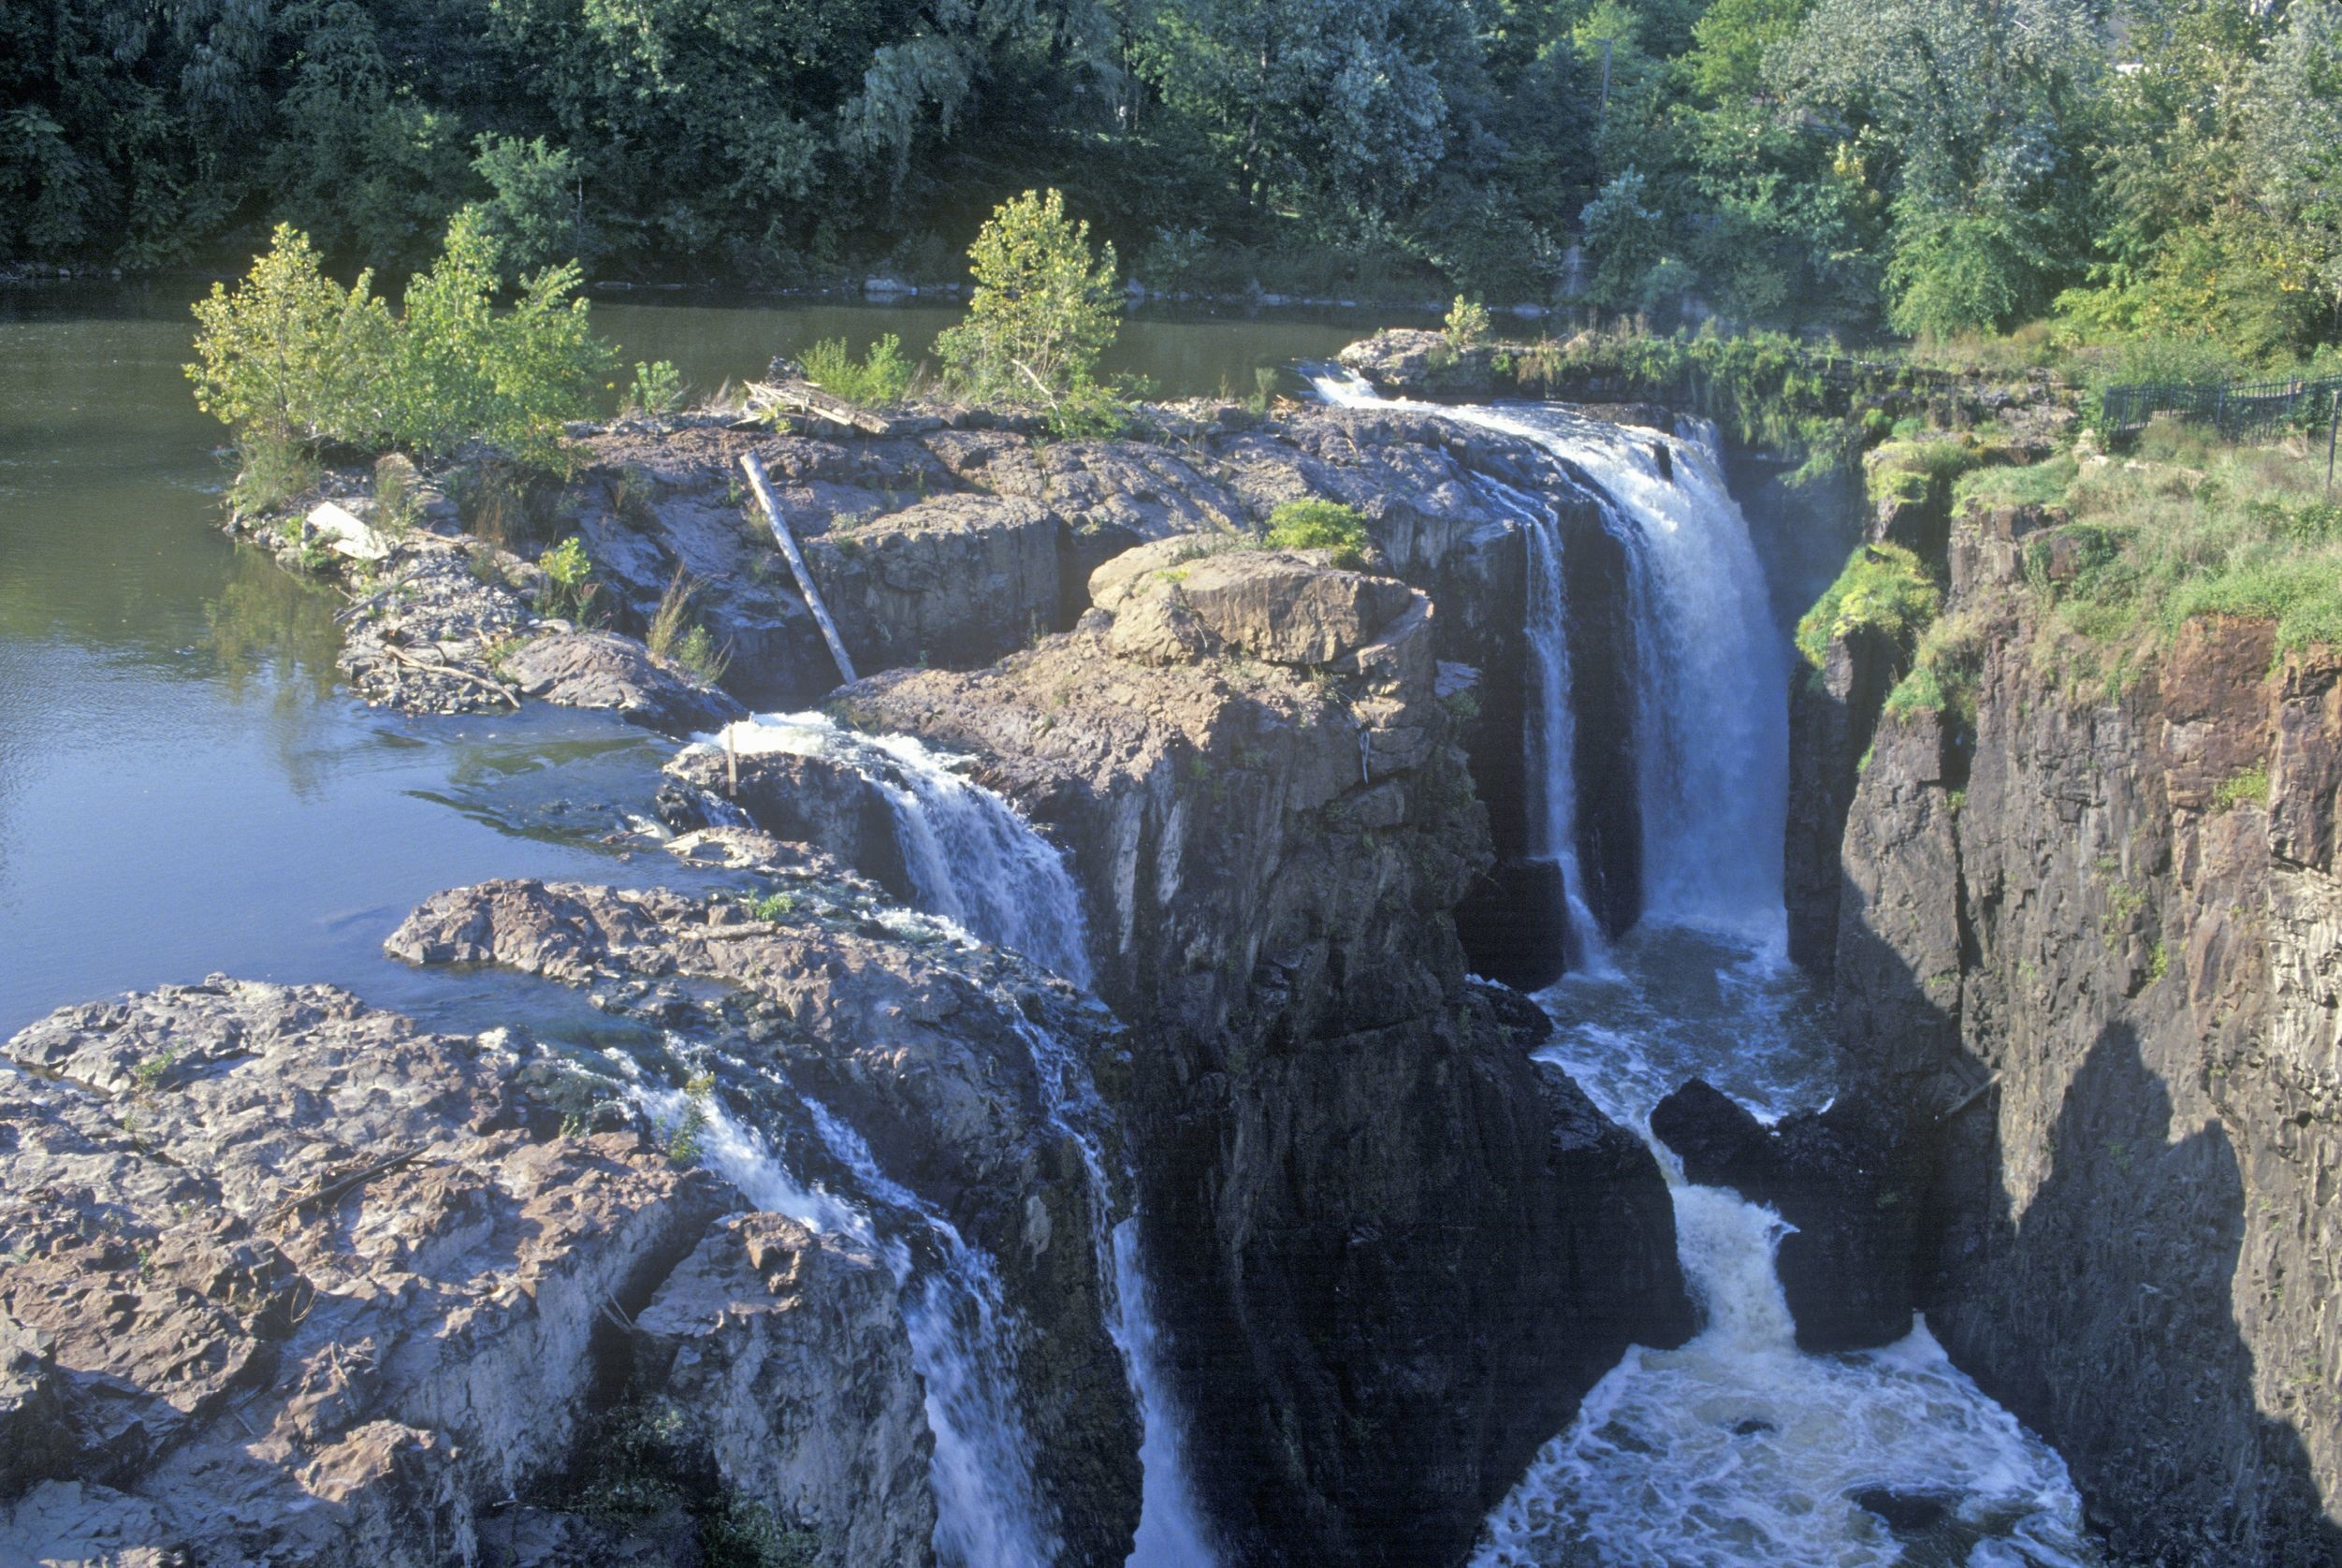
Water
Water power captures the energy of flowing water in rivers, streams and waves to generate electricity. Conventional hydropower plants can be built in rivers with no water storage (known as “run-of-the-river” units) or in conjunction with reservoirs that store water, which can be used on an as-needed basis. As water travels downstream, it is channeled down through a pipe or other intake structure in a dam (penstock). The flowing water turns the blades of a turbine, generating electricity in the powerhouse, located at the base of the dam.
http://www.c2es.org/energy/source/renewables
123rf.com

Slide 14
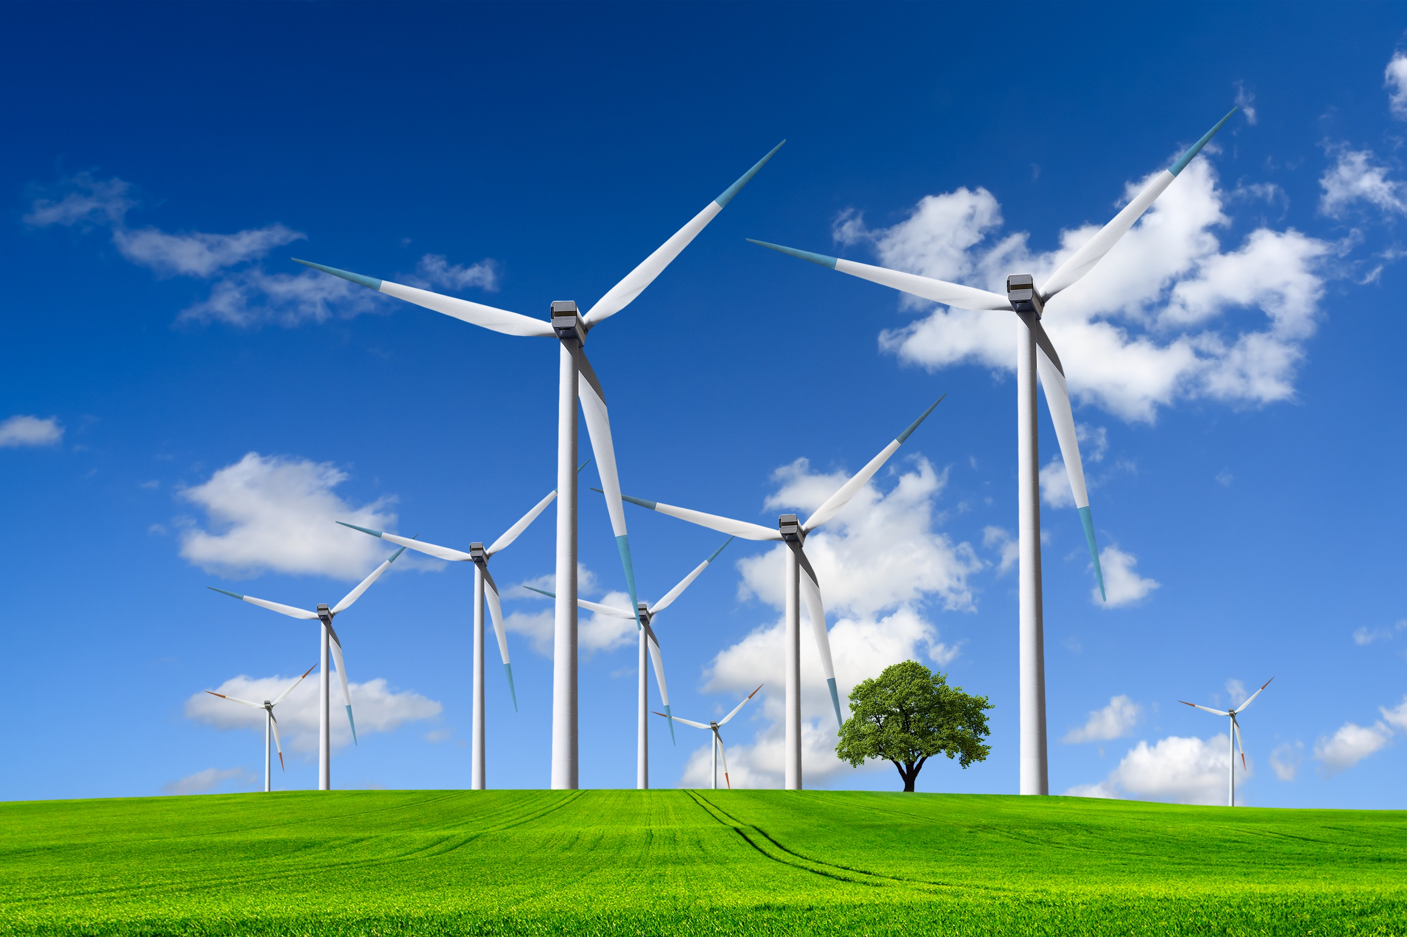
Wind
Wind power harnesses the energy generated by the movement of air in the earth’s atmosphere to drive electricity-generating turbines. Although people have used wind power for hundreds of years, modern turbines reflect significant technological advances over early windmills and even over turbines from just 10 or 20 years ago. Generating electric power using wind turbines creates no greenhouse gases, but since a wind farm includes dozens or more turbines, widely-spaced, it requires thousands of acres of land. For example, Lone Star is a 200 MW wind farm located in Texas on approximately 36,000 acres.
After hydropower, wind was the next largest renewable energy source used for power generation with 318 GW of global capacity at the end of 2013, producing 2.9 percent of global electricity. Capacity is indicative of the maximum amount of electricity that can be generated when the wind is blowing at sufficient levels for a turbine. Because the wind is not always blowing, wind farms do not always produce as much as their capacity. With more than 91 MW, China had the largest installed capacity of wind generation in 2013, and the United States with 62 GW had the second-largest capacity; Texas, Iowa, California, Oklahoma and Illinois were the top five wind power producing states.
(http://www.c2es.org/energy/source/renewables)
123rf.com

Slide 15
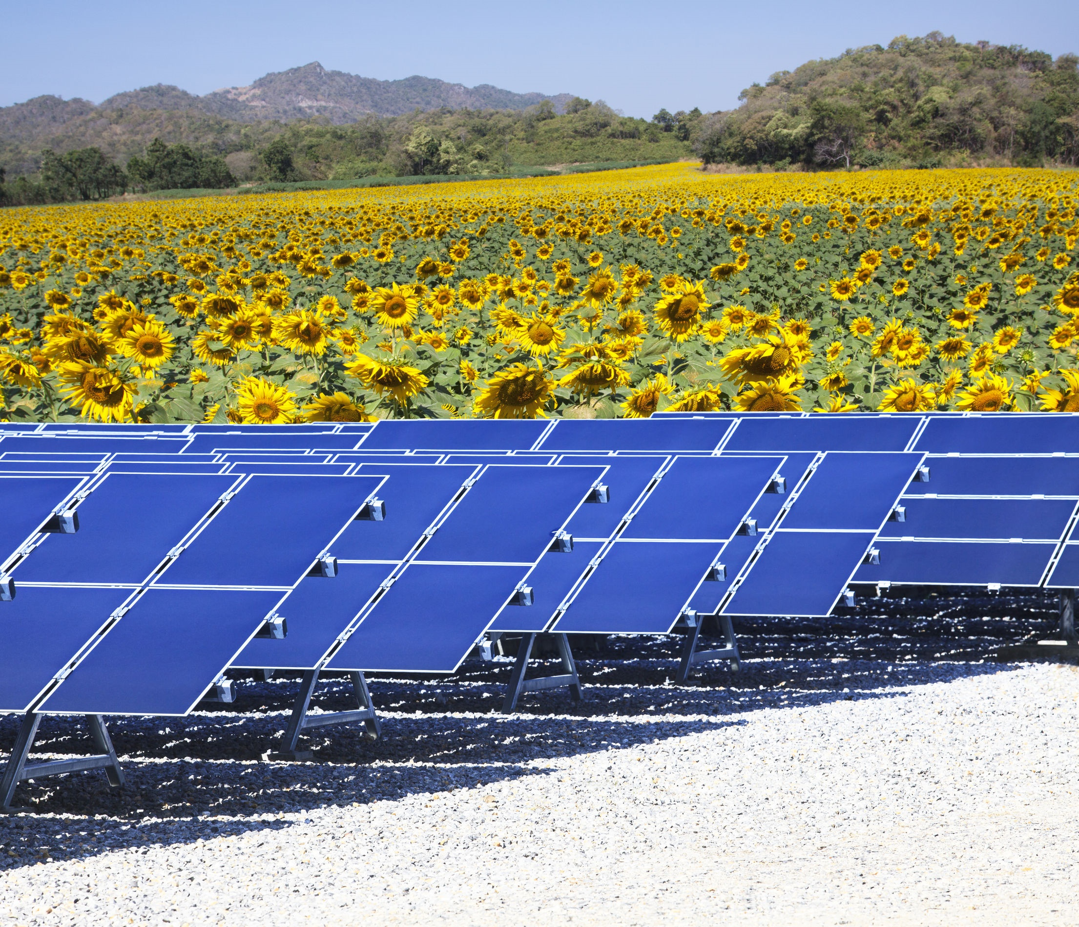
Solar
Solar power harnesses the sun’s energy to produce electricity as well as solar heating and cooling. Solar energy resources are massive and widespread, and they can be harnessed anywhere that receives sunlight. The amount of solar radiation, also known as insolation, reaching the earth’s surface every hour is more than all the energy currently consumed by all human activities each year. A number of factors, including geographic location, time of day, and current weather conditions, all affect the amount of energy that can be harnessed for electricity production or heating purposes.
Solar energy can be captured for electricity production using solar photovoltaics and concentrating solar power. A solar or photovoltaic cell converts sunlight into electricity using the photoelectric effect. Typically, photovoltaic is found on the roofs of residential and commercial buildings. Concentrating solar power uses lenses or mirrors to concentrate sunlight into a narrow beam that heats a fluid, producing steam to drive a turbine, generating electricity. Concentrated solar power projects are larger-scale than residential or commercial PV and are often owned and operated by electric utilities. http://www.c2es.org/energy/source/renewables
123rf.com

Slide 16
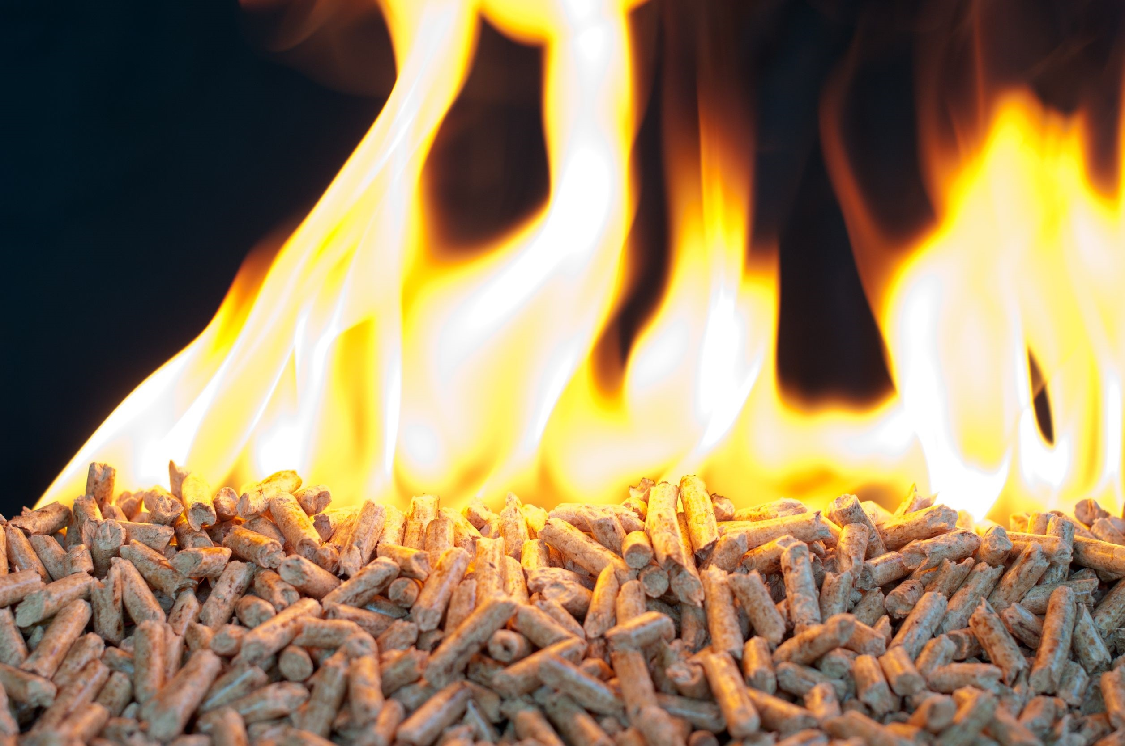
Biomass
Biomass energy sources are used to generate electricity, provide direct heating and can be converted into biofuels as a direct substitute for fossil fuels used in transportation. Unlike intermittent wind and solar energy, biomass can be used continuously or according to a schedule. Biomass is derived from wood, waste, landfill gas, crops and alcohol fuels. Traditional biomass, including waste wood, charcoal and manure has been a source of energy for domestic cooking and heating throughout human history. In rural areas of the developing world, it remains the dominant fuel source. Globally in 2010, traditional biomass accounted for about 8.5 percent of total energy consumption. The growing use of biomass has resulted in increasing international trade in biomass fuels in recent years; wood pellets, biodiesel, and ethanol are the main fuels traded internationally.
http://www.c2es.org/energy/source/renewables
123rf.com

Slide 17
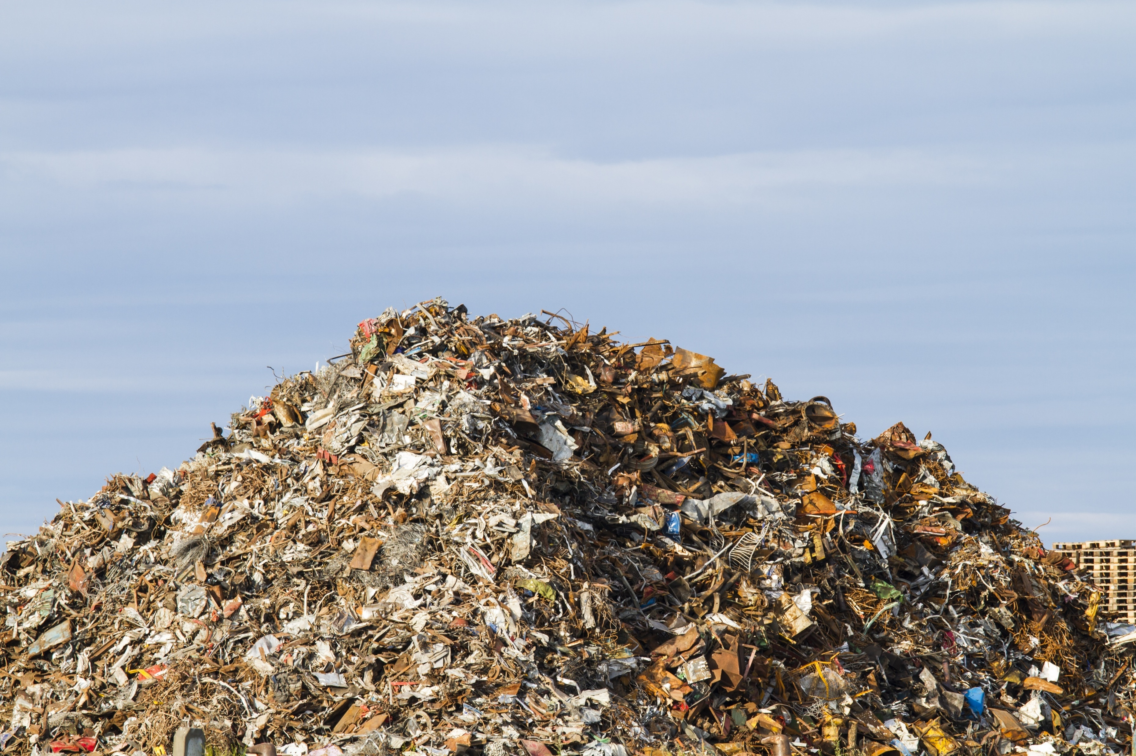
Biomass
In 2013, global biomass electric power capacity stood at 88 GW. In 2011, the United States had 11.5 GW of installed biomass-fueled electric generation capacity. In the United States, most of the electricity from wood biomass is generated at lumber and paper mills using their own wood waste; in addition, wood waste is used to generate the heat for drying wood products and other manufacturing processes. Biomass waste is mostly municipal solid waste, i.e., garbage, which is burned as a fuel to run power plants. On average, a ton of garbage generates 550 to 750 kWh of electricity. Landfill gas contains methane that can be captured, processed and used to fuel power plants, manufacturing facilities, vehicles and homes. In the United States, there is currently nearly 2 GW of installed landfill gas-fired generation capacity at more than 600 projects.
http://www.c2es.org/energy/source/renewables
123rf.com

Slide 18
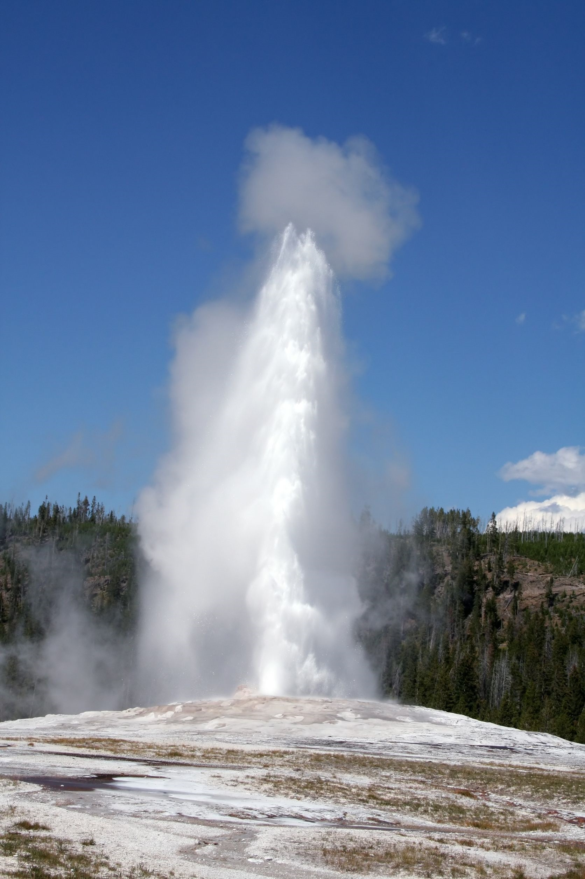
123rf.com
Geothermal
Traditional geothermal energy exploits naturally occurring high temperatures, located relatively close to the surface of the earth in some areas, to generate electric power and for direct uses such as heating and cooking. Geothermal areas are generally located near tectonic plate boundaries, where there are earthquakes and volcanoes. In some places, hot springs and geysers naturally rise to the surface. These have been used for bathing, cooking and heating for centuries. At least 78 countries used direct geothermal power in 2011.
http://www.c2es.org/energy/source/renewables

Slide 19
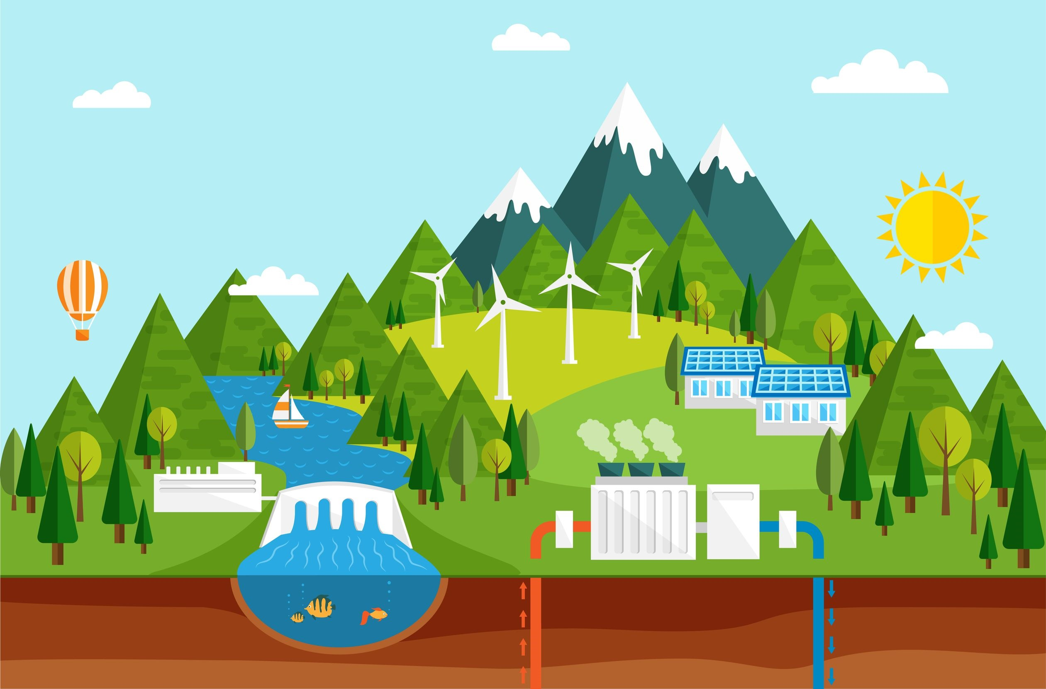
Generating geothermal electric power typically involves the drilling of well, perhaps a mile or two in depth, in search of rock temperatures in the range of 300 to 700°F. Water is pumped down this well, where it is reheated by hot rocks. It travels through natural fissures and rises up a second well as steam, which can be used to spin a turbine and generate electricity or it can be used for heating or other purposes. Note that drilling a suitable injection well is by no means a certain task; several wells may have to be drilled before a suitable one is in place and the size of the resource cannot be confirmed until after the drilling takes place. Additionally, some water is lost to evaporation in this process, so new water is added to maintain the continuous flow of steam. Like bio-power and unlike intermittent wind and solar power, geothermal electricity can be used continuously. Note that very small quantities of carbon dioxide trapped below the earth’s surface are released during this process.
http://www.c2es.org/energy/source/renewables
123rf.com

Slide 20
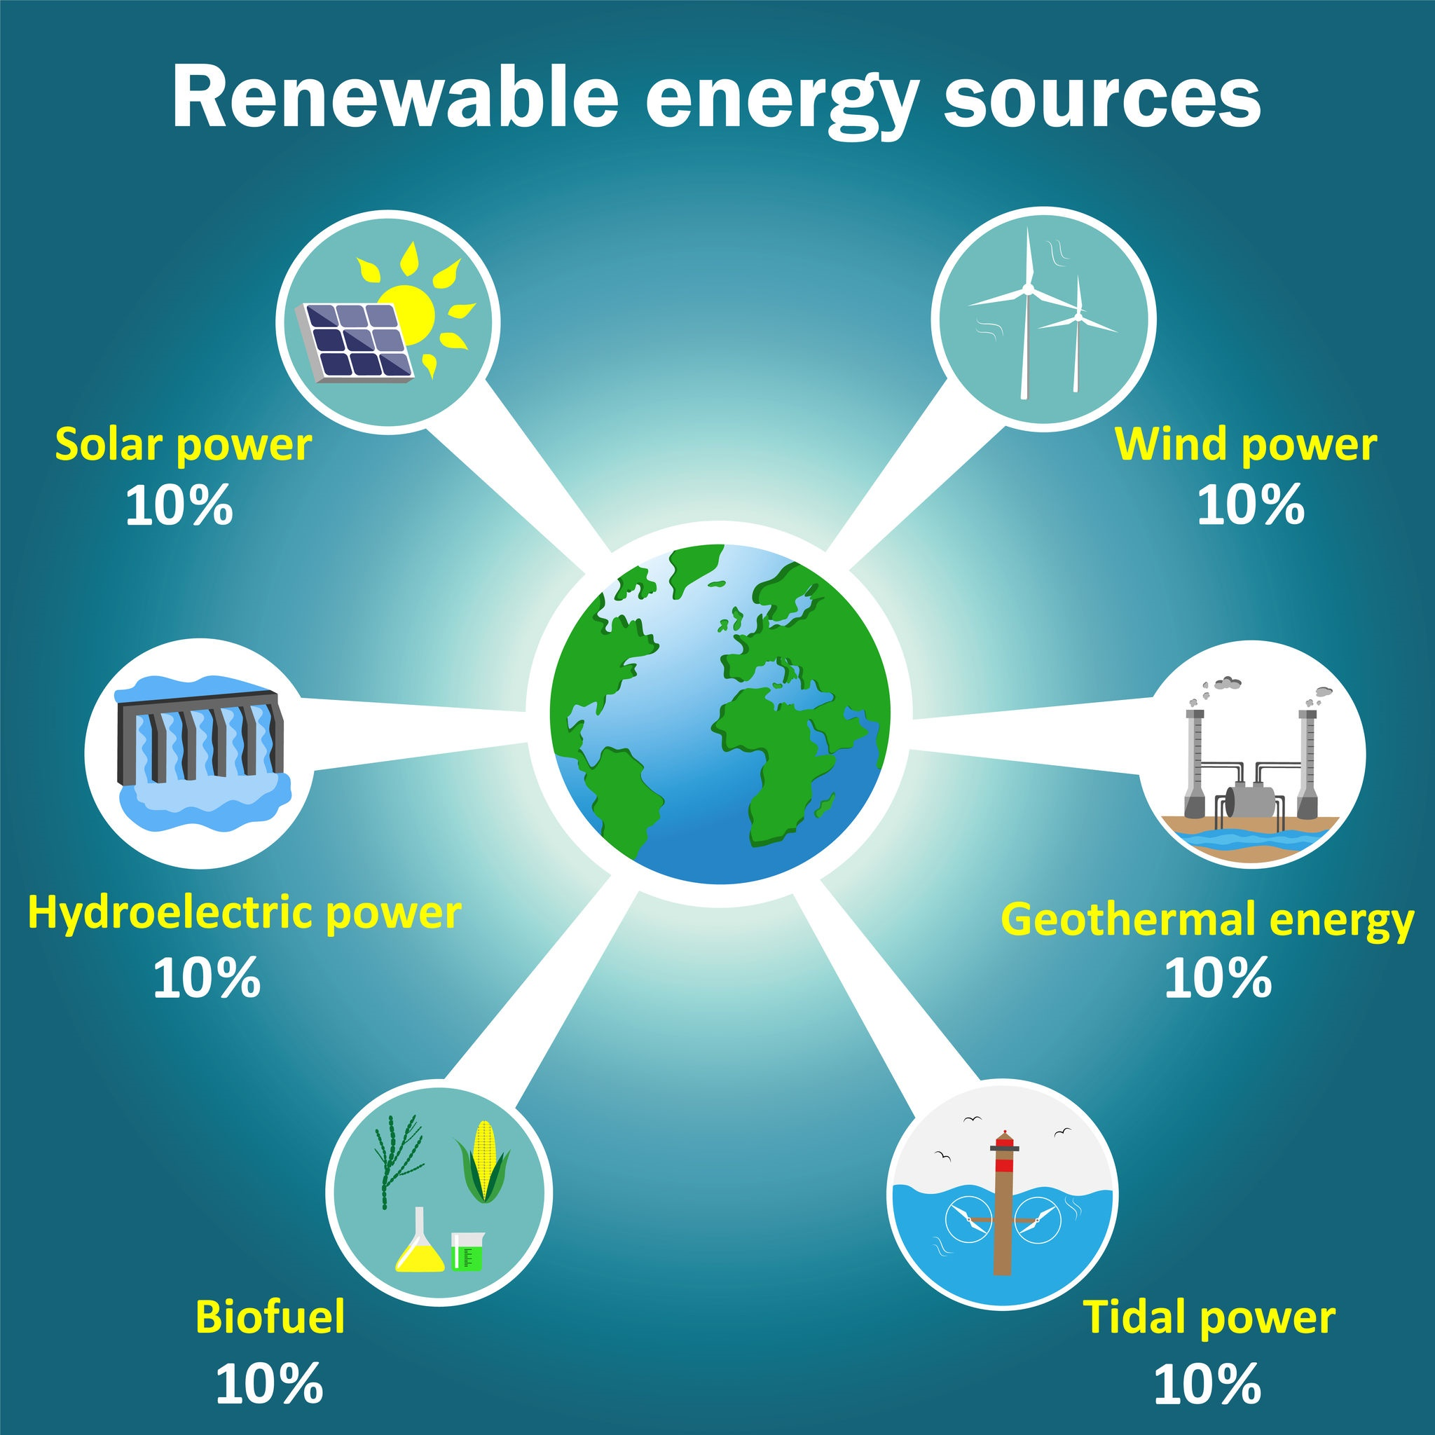
Renewable Energy Drivers
There are several factors that determine which renewable technologies are adopted. These include:
-market drivers like cost, diversity, proximity to demand or transmission, resource availability
-policy decisions like tax credits and renewable portfolio standards
-specific regulations.
At least 144 countries, more than half of which are developing, had renewable energy policy targets in place by the end of 2013.
http://www.c2es.org/energy/source/renewables

Slide 21
As the world’s population and needs continue to grow, it will be imperative to meet those needs as economically, safely, and efficiently as possible. States that have the vision and foresight to take the lead on clean, renewable energy will become global leaders, leaving a viable planet for generations to come.
123rf.com

Slide 22
Key Words
nuclear power pipelines initiatives
fossil fuel reserves policymakers hydropower
commercial sector consumption biomass
industrial community renewable turbine
petroleum products negligible geothermal
123rf.com

