Slide 1
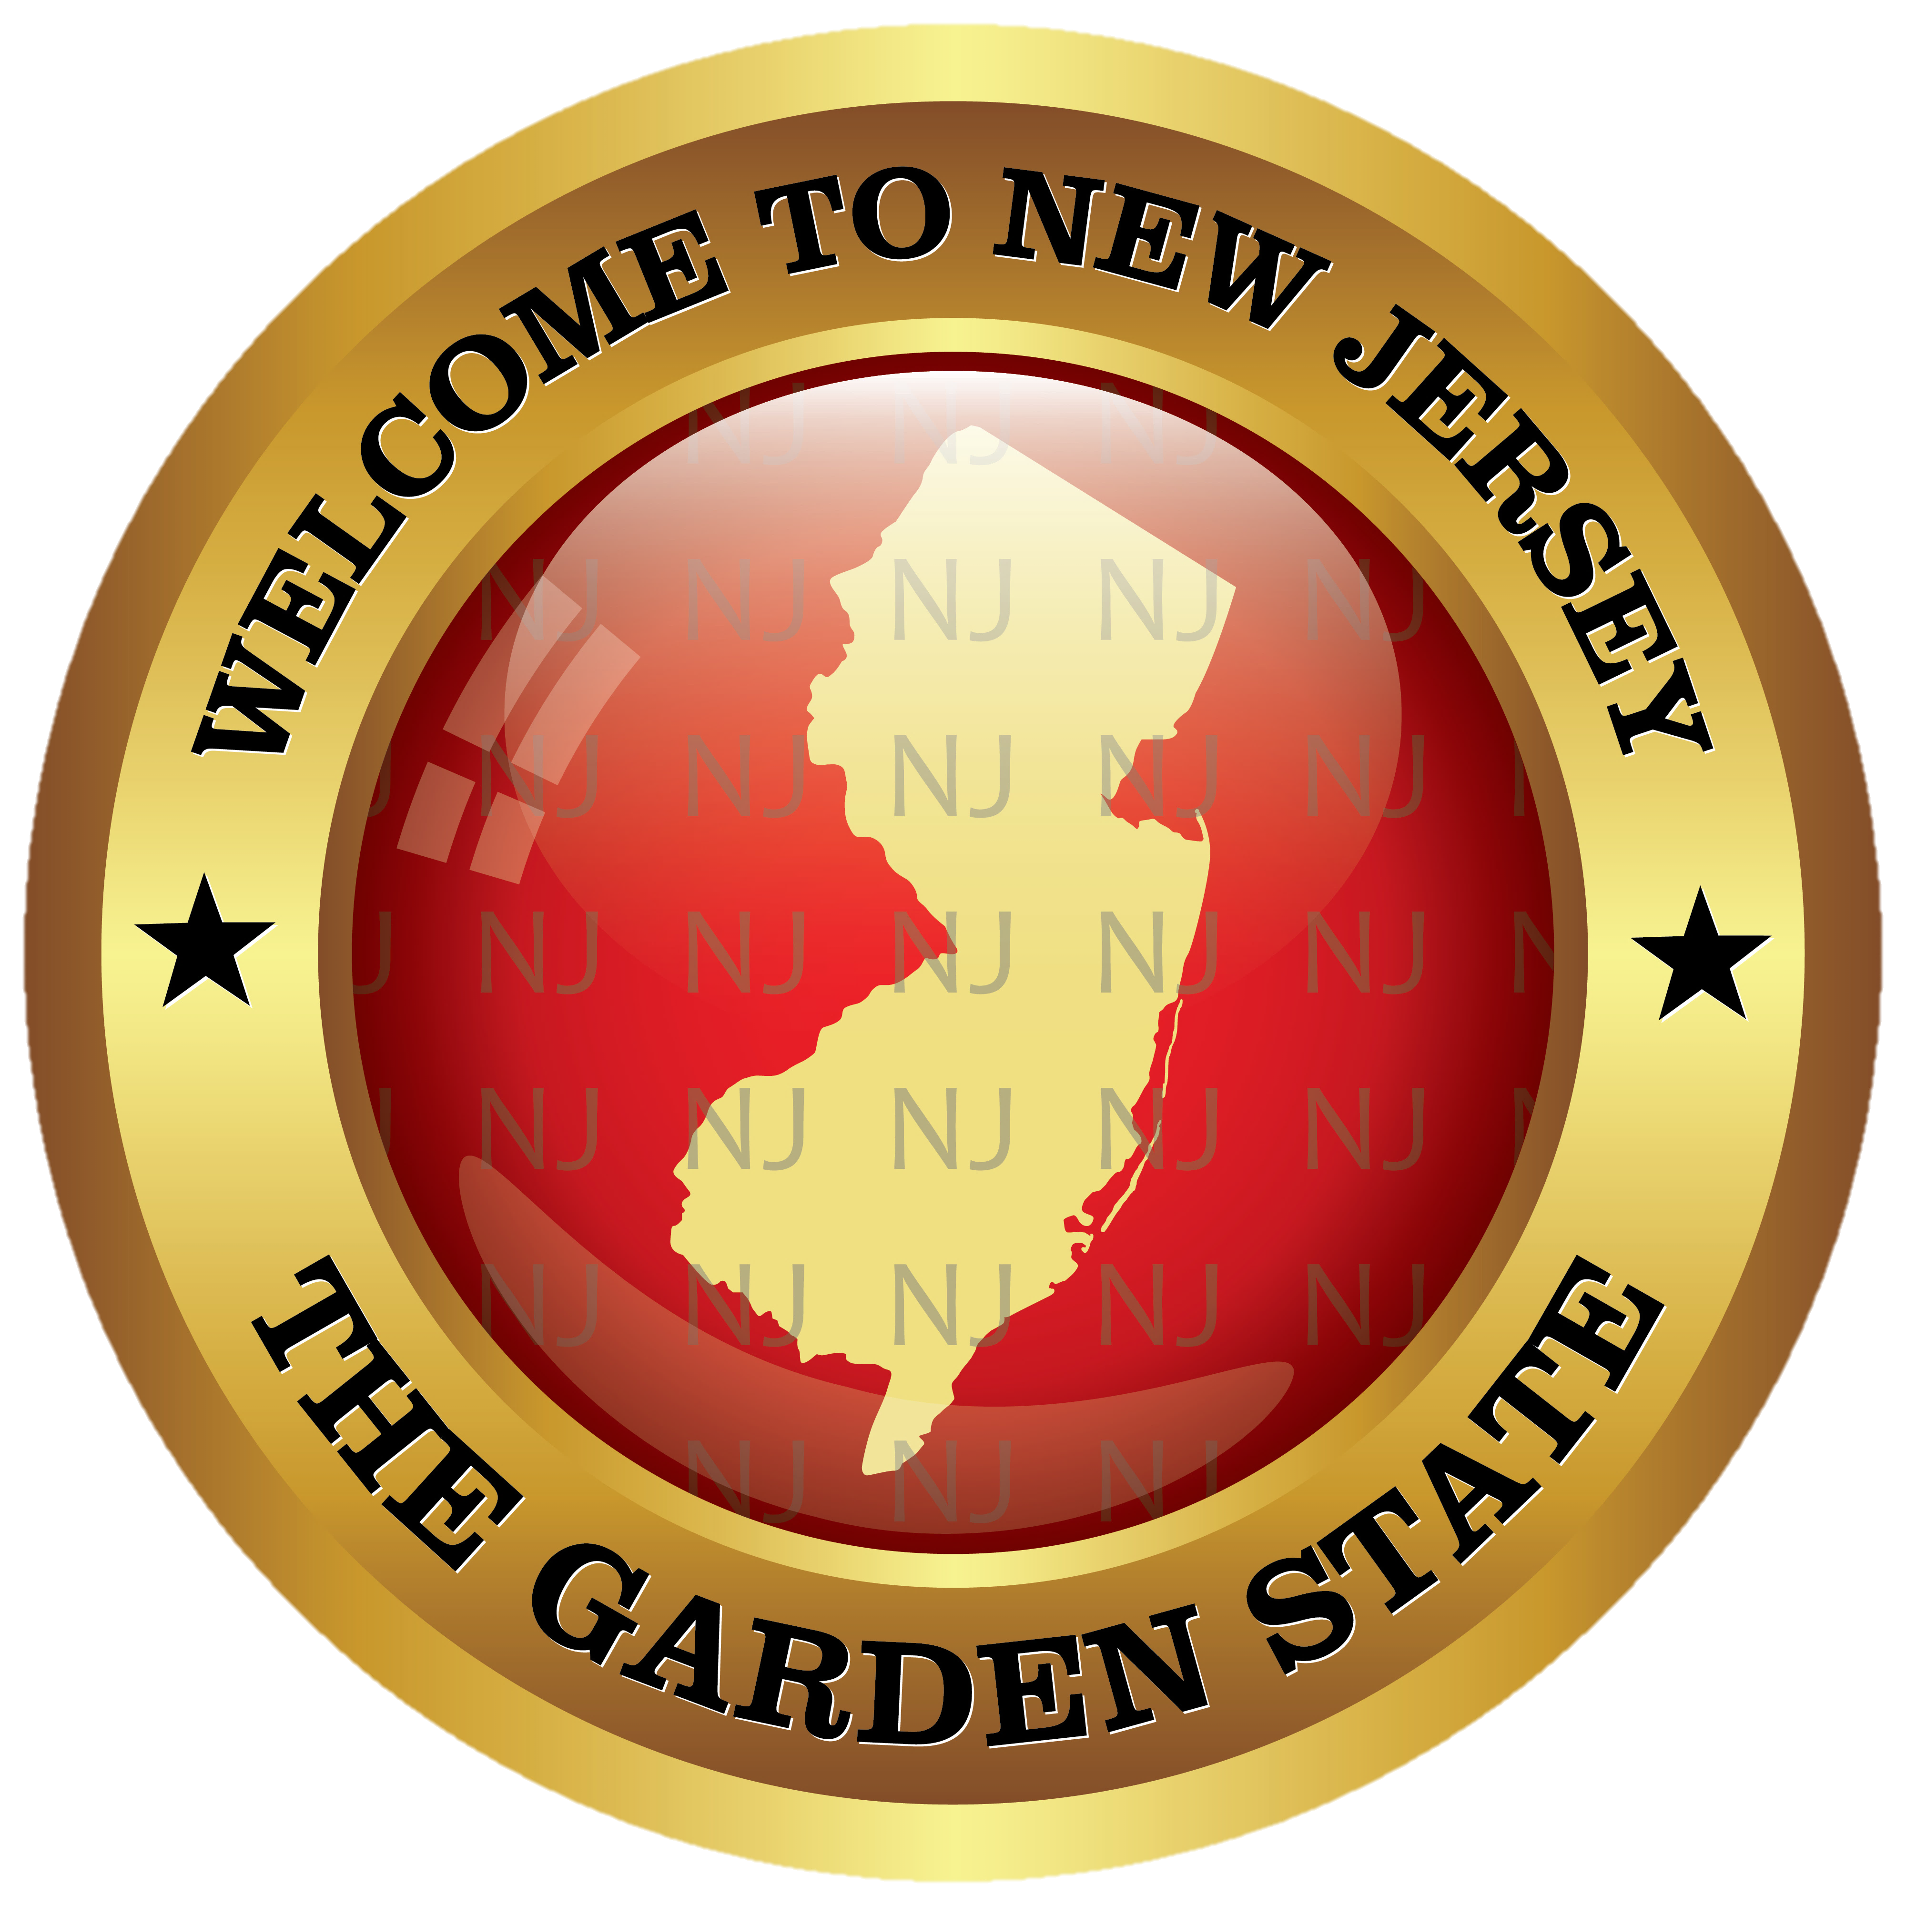
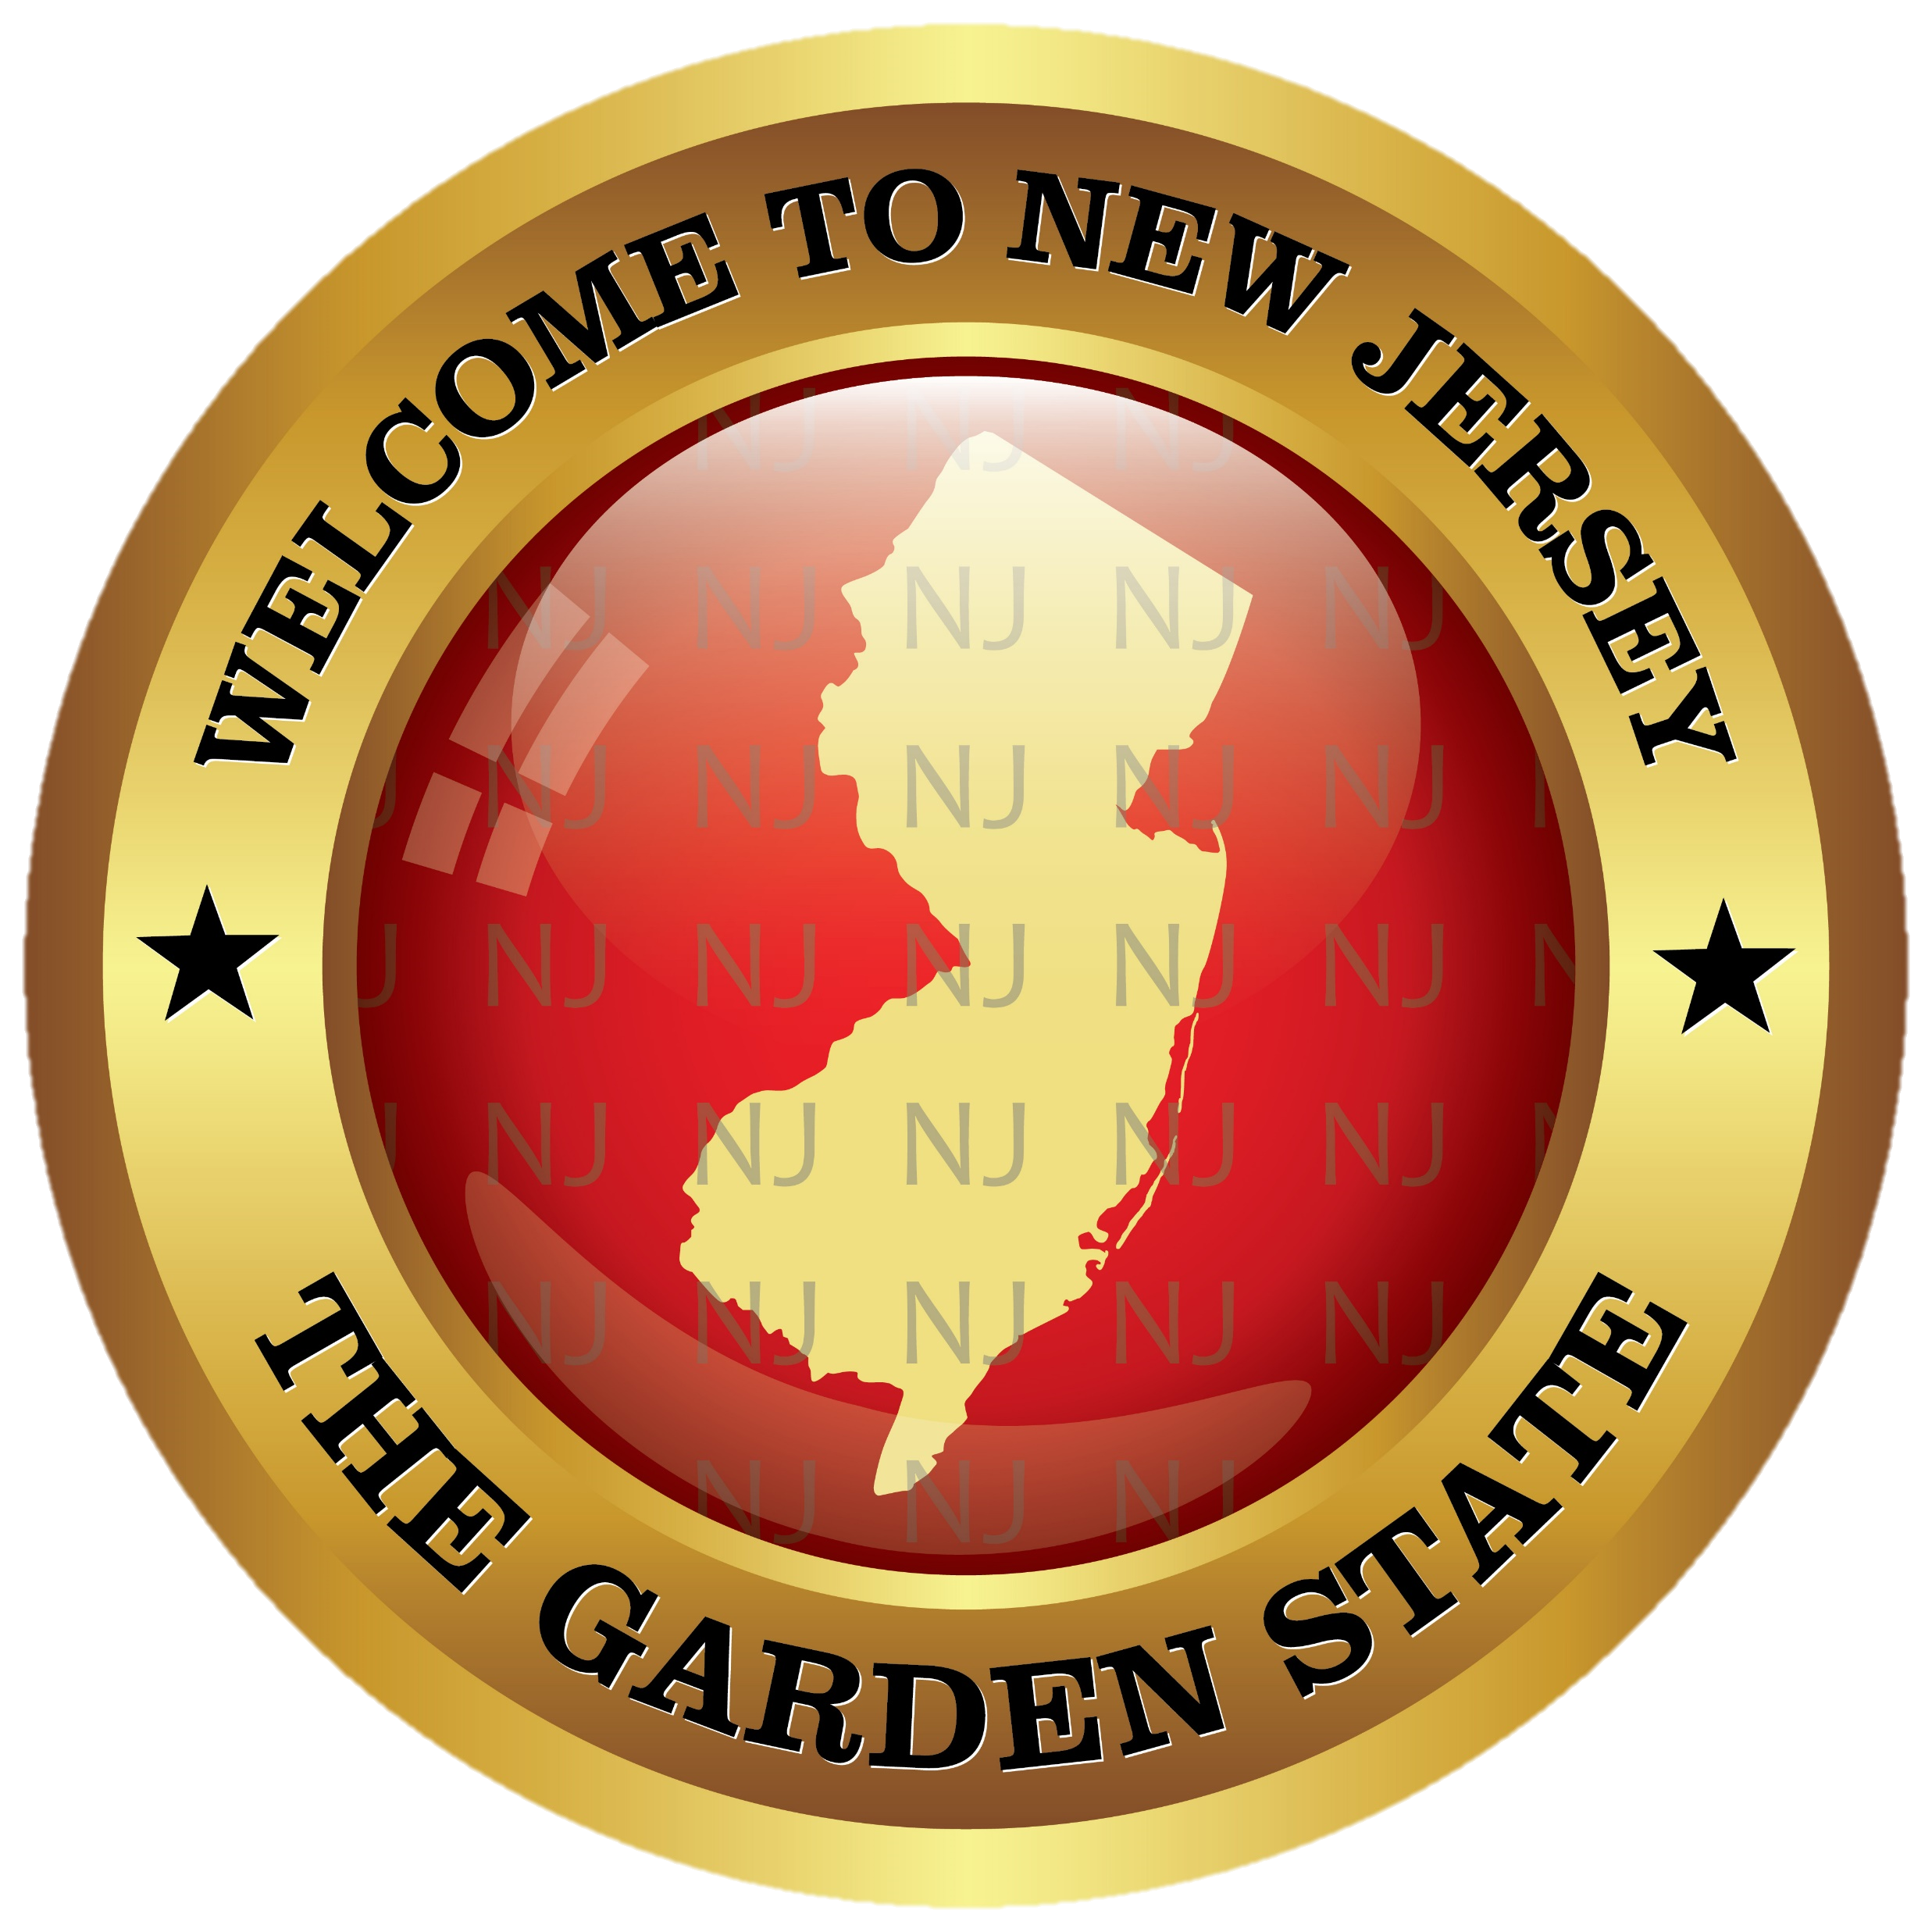
NICKY FIFTH’S NEW JERSEY
N5NJ
SECONDARY PROGRAM
HISTORY
Thomas Edison

Slide 2
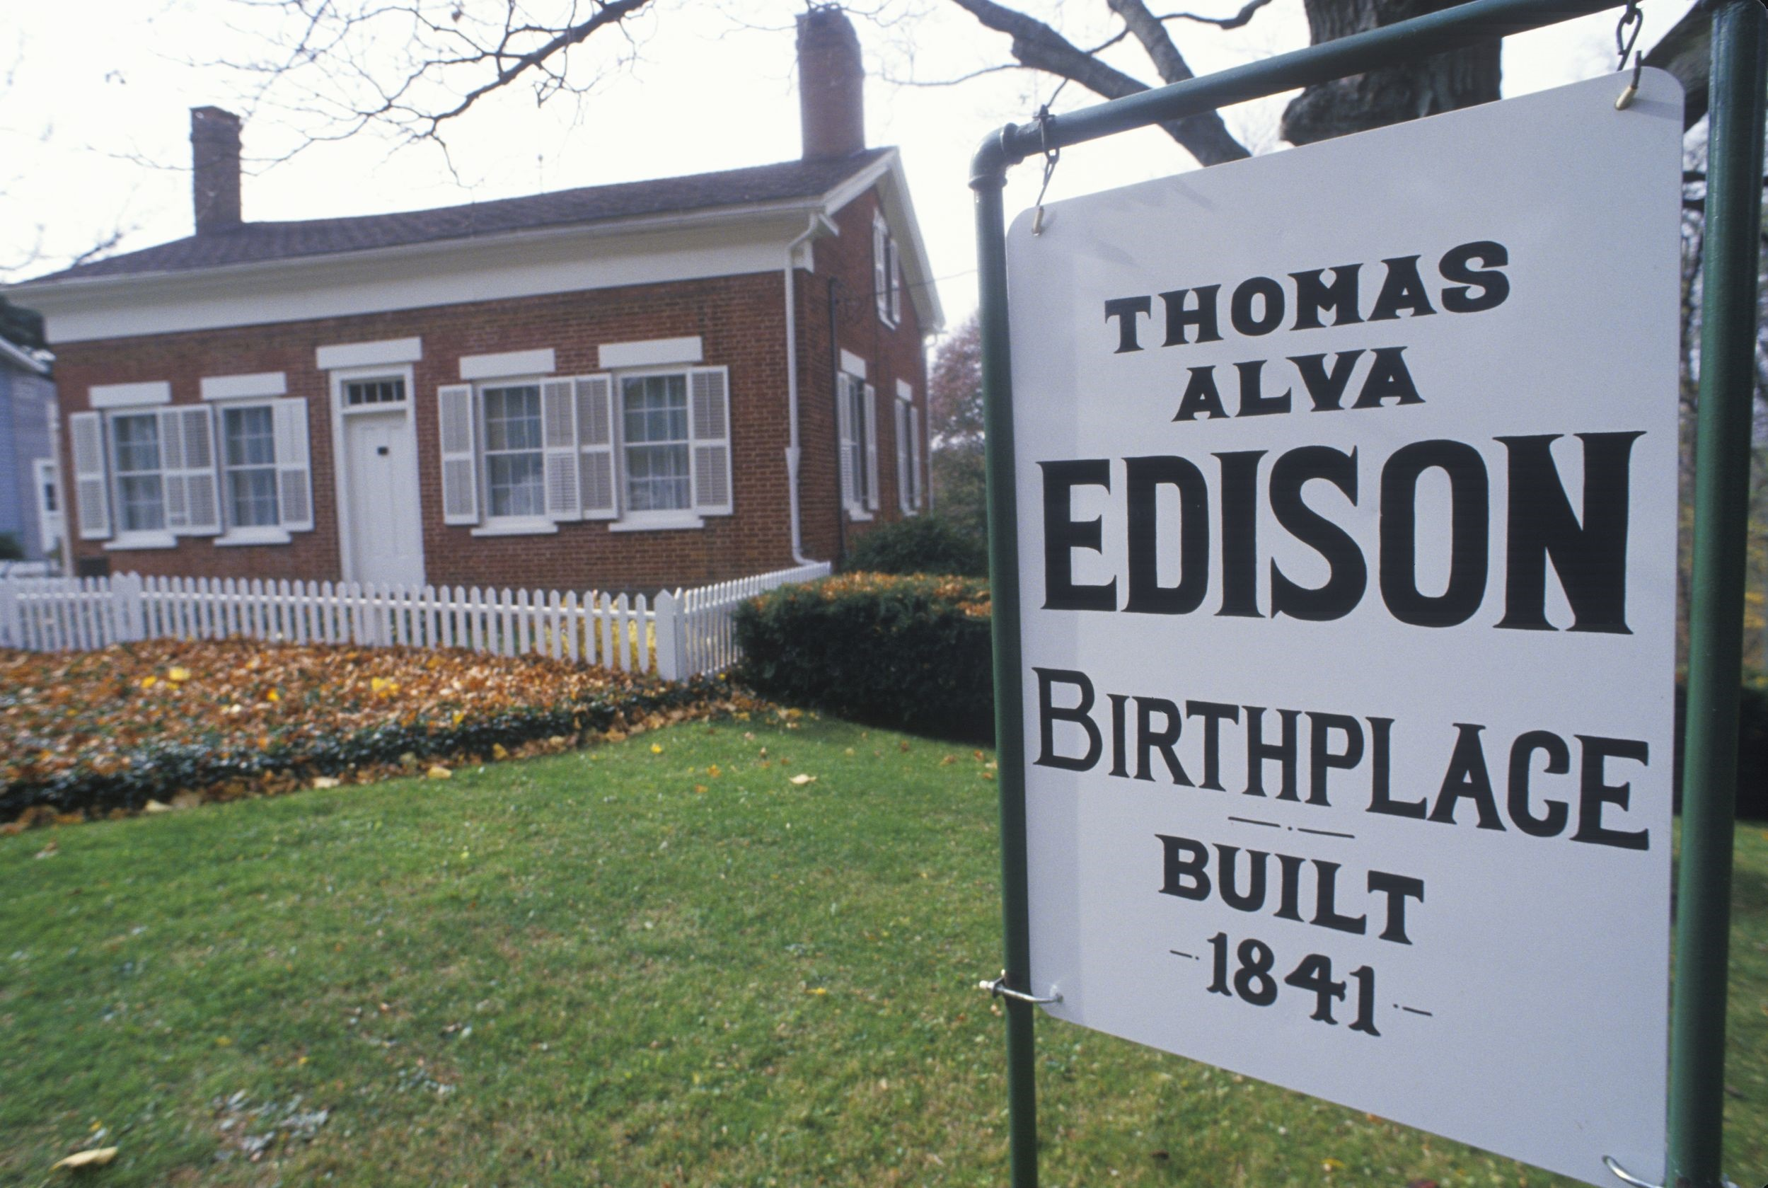
Thomas Alva Edison was born on February 11, 1847 in the town of Milan, Ohio. His parents, Sam and Nancy Edison, were of Canadian origin and had six children prior to Thomas, only three of whom survived. Edison’s family moved to Port Huron, Michigan in 1854. Throughout his childhood, Thomas Edison was full of curiosity about how things worked and always asked a lot of questions. He didn’t do very well in a traditional school setting, and often got punished for annoying the teacher with too many questions.
http://www.menloparkmuseum.org/history/thomas-edison-and-menlo-park

Slide 3
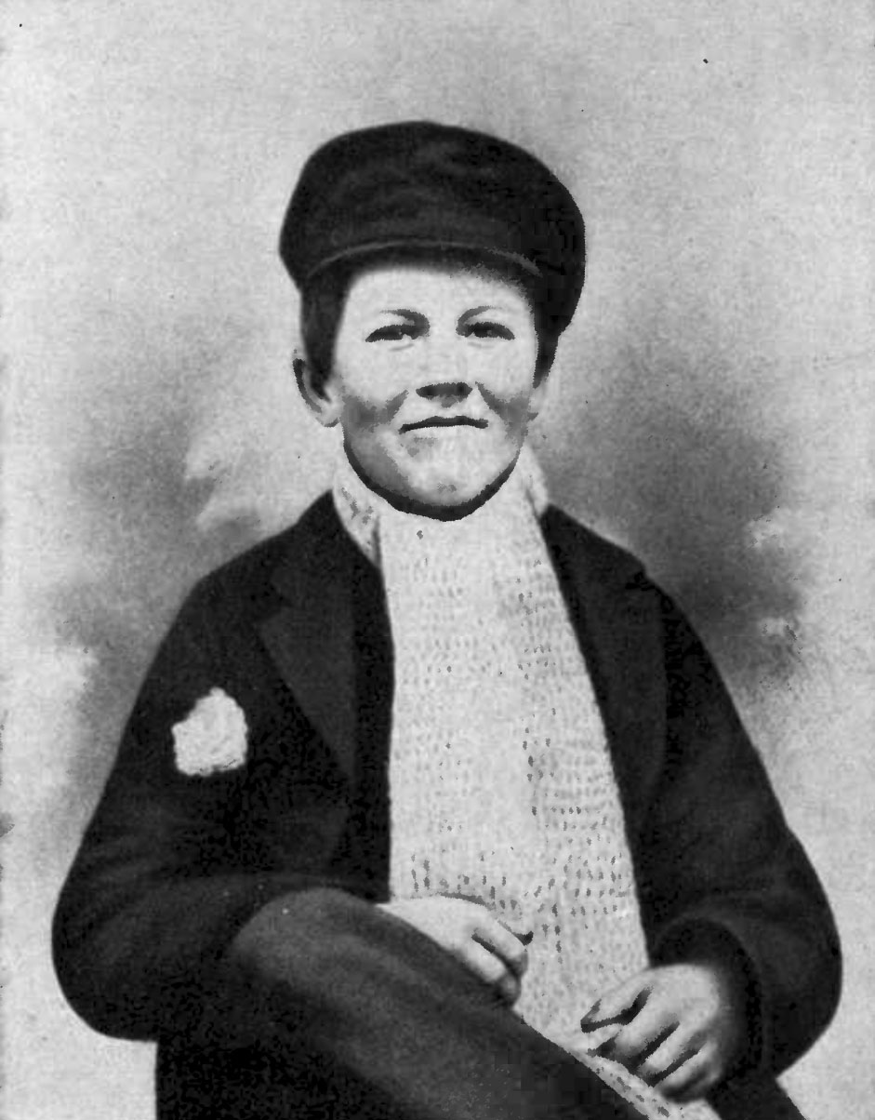
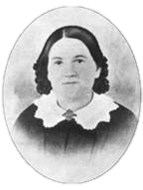
As a result, after the age of twelve, he was home-schooled by his mother. His interest in science was first sparked when his mother bought him his first scientific book, The School of Natural Philosophy. He thoroughly studied the book and performed all the experiments described in it at home. He soon set up his own laboratory in his room and began performing original experiments. After a few disasters, he was asked by his parents to move his laboratory to the basement. The explosions from the basement constantly shook the house, often upsetting his father.
http://www.menloparkmuseum.org/history/thomas-edison-and-menlo-park

Slide 4
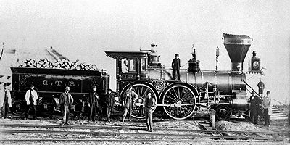
To fund his experiments, Edison took a job as a newsboy on the new Grand Trunk Railway service that had recently begun operating between Port Huron and Detroit, selling candy and refreshments. He made good use of his free time in Detroit by reading at the public library. He had set up a laboratory in the baggage car of the train where he performed experiments during his free time. An accidental fire on the train caused by one of his experiments led to his firing.
http://www.menloparkmuseum.org/history/thomas-edison-and-menlo-park

Slide 5
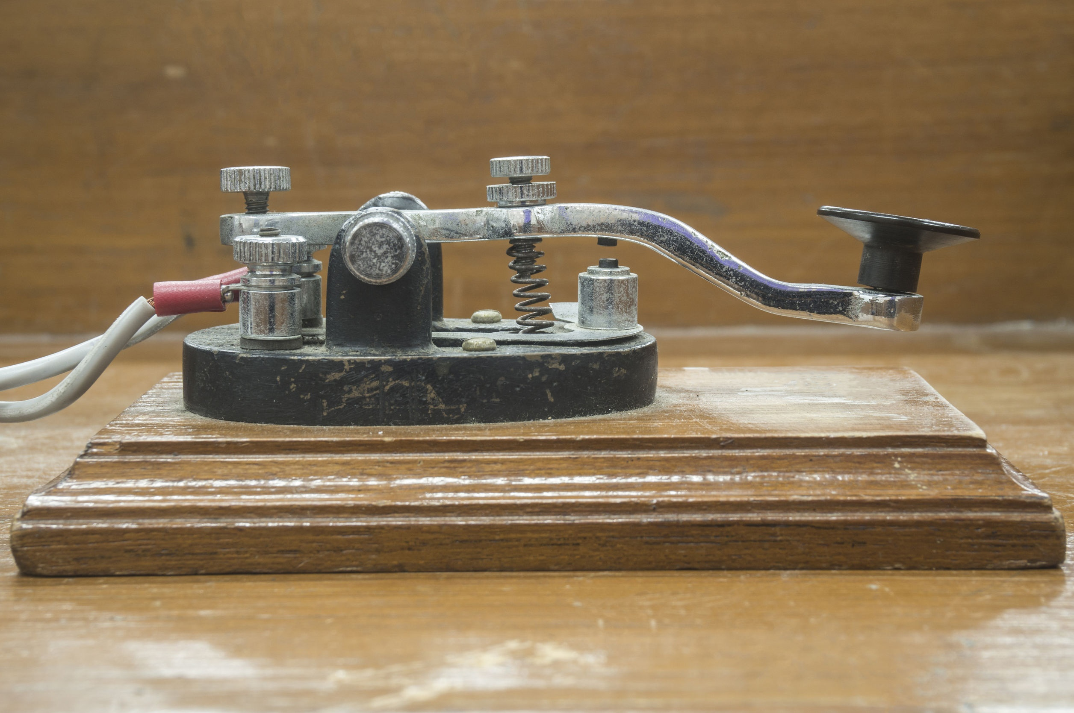
123rf.com
Edison was so interested in the working of the telegraph, which had been in use for about forty years, that he built one of his own in his home.

Slide 6
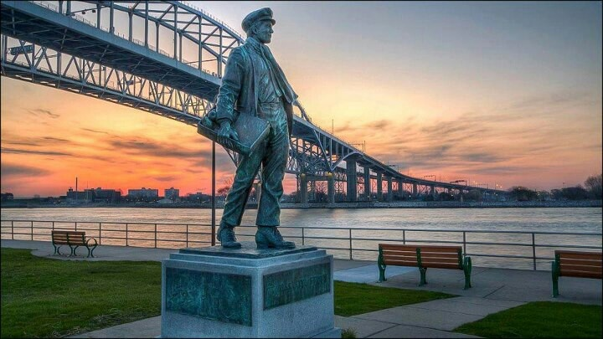
Young Thomas Edison at Port Huron
At the age of sixteen he became a telegraph operator at the telegraph office in Port Huron. Like most of his other ventures, this job also ended when Edison almost blew up the office while experimenting with the equipment. After that he traveled around the country for five years, mostly working as a telegraph operator at different offices.
http://www.menloparkmuseum.org/history/thomas-edison-and-menlo-park

Slide 7
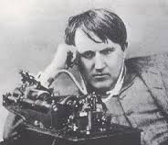
Although he was moderately deaf as a teenager, he was able to do his job as a telegraph operator because the sharp clicks of the telegraph machine were clearer to him than other ambient sounds.
Finally, after being demoted and quitting his job at the Western Union Telegraph office in Boston for a prank he played on his bosses in December of 1868, he decided to quit working as a telegraph operator and decided to devote himself to his inventions.
http://www.menloparkmuseum.org/history/thomas-edison-and-menlo-park

Slide 8
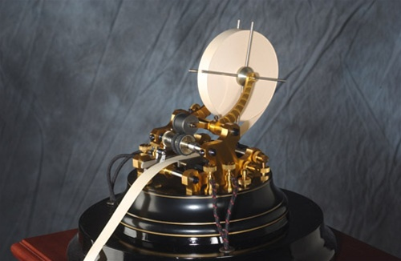
123rf.com
Edison stayed in Boston for a while and used his salesmanship skills to convince investors to finance his inventions. In 1869, he patented the Electrical Vote Recorder.
Another one of his earliest successful inventions was an improvisation of the “stock ticker” which received up-to-date stock price information from the stock exchange and displayed it at various locations. But after a few failures, he lost the faith of his investors.
http://www.menloparkmuseum.org/history/thomas-edison-and-menlo-park

Slide 9
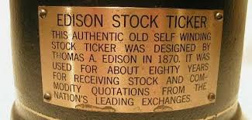
123rf.com
Broke, Edison moved to New York where he befriended a top telegraph engineer, Franklin L. Pope, who worked for Dr. S. S. Laws, the inventor of the earlier version of the stock ticker and who now owned New York Gold Indicator Company. Pope gave Edison some space to board at the company’s Wall Street headquarters. Within a few days, the master ticker tape machine had a major breakdown throwing the entire office and many New York businesses in turmoil. Since Edison was always around the office, he offered to fix the machine. When he did so within two hours, he was offered a job the following day as Pope’s assistant. After working for Dr. Laws, Edison set up his own engineering business and was soon hired by Western Union to be in charge of all of their equipment. Within a short span of time, his boss at Western Union offered to buy out all his new inventions and improvements to the equipment for a lump sum price of $40,000.
http://www.menloparkmuseum.org/history/thomas-edison-and-menlo-park

Slide 10
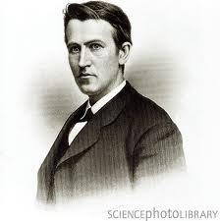
An awestruck Edison took the money and invested it in an empty factory building in Newark where he set up his first workshop.
Two of Edison’s earliest and most important assistants were John Kreusi, a Swiss-trained clockmaker and machine shop foreman, and Charles Batchelor, Edison’s chief mechanical assistant from England.
Edison immersed himself in his work with new inventions, but at the same time, his factory continued to produce constantly improved stock tickers and telegraphic equipment.
All of Edison’s employees willingly worked long hours because they respected and trusted Edison’s commitment to science.
http://www.menloparkmuseum.org/history/thomas-edison-and-menlo-park

Slide 11
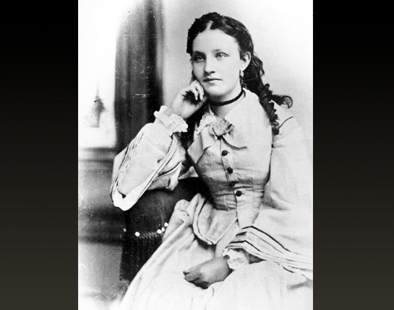
In 1871, Edison, then twenty-four, fell in love with sixteen-year-old Mary Stilwell, who was one of his employees at the time. He married her on Christmas day that same year.
Their first child was Marion Estelle, born on February 18, 1873, who Edison affectionately called “Dot”.
They had two other children after Marion, Thomas Alva Jr. born January 10, 1876, called “Dash,” and William Leslie born October 26, 1878.
By 1876, Edison decided to move away from the city and into a larger space where he could expand his operations to include a large scale inventions workshop.
http://www.menloparkmuseum.org/history/thomas-edison-and-menlo-park

Slide 12
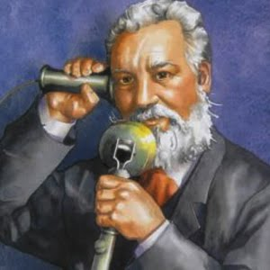
During the same time, Alexander Graham Bell invented the first version of the telephone which created waves throughout the scientific and engineering communities.
Western Union commissioned Edison to improve upon the primitive telephone to put it into practical use.
http://www.menloparkmuseum.org/history/thomas-edison-and-menlo-park

Slide 13
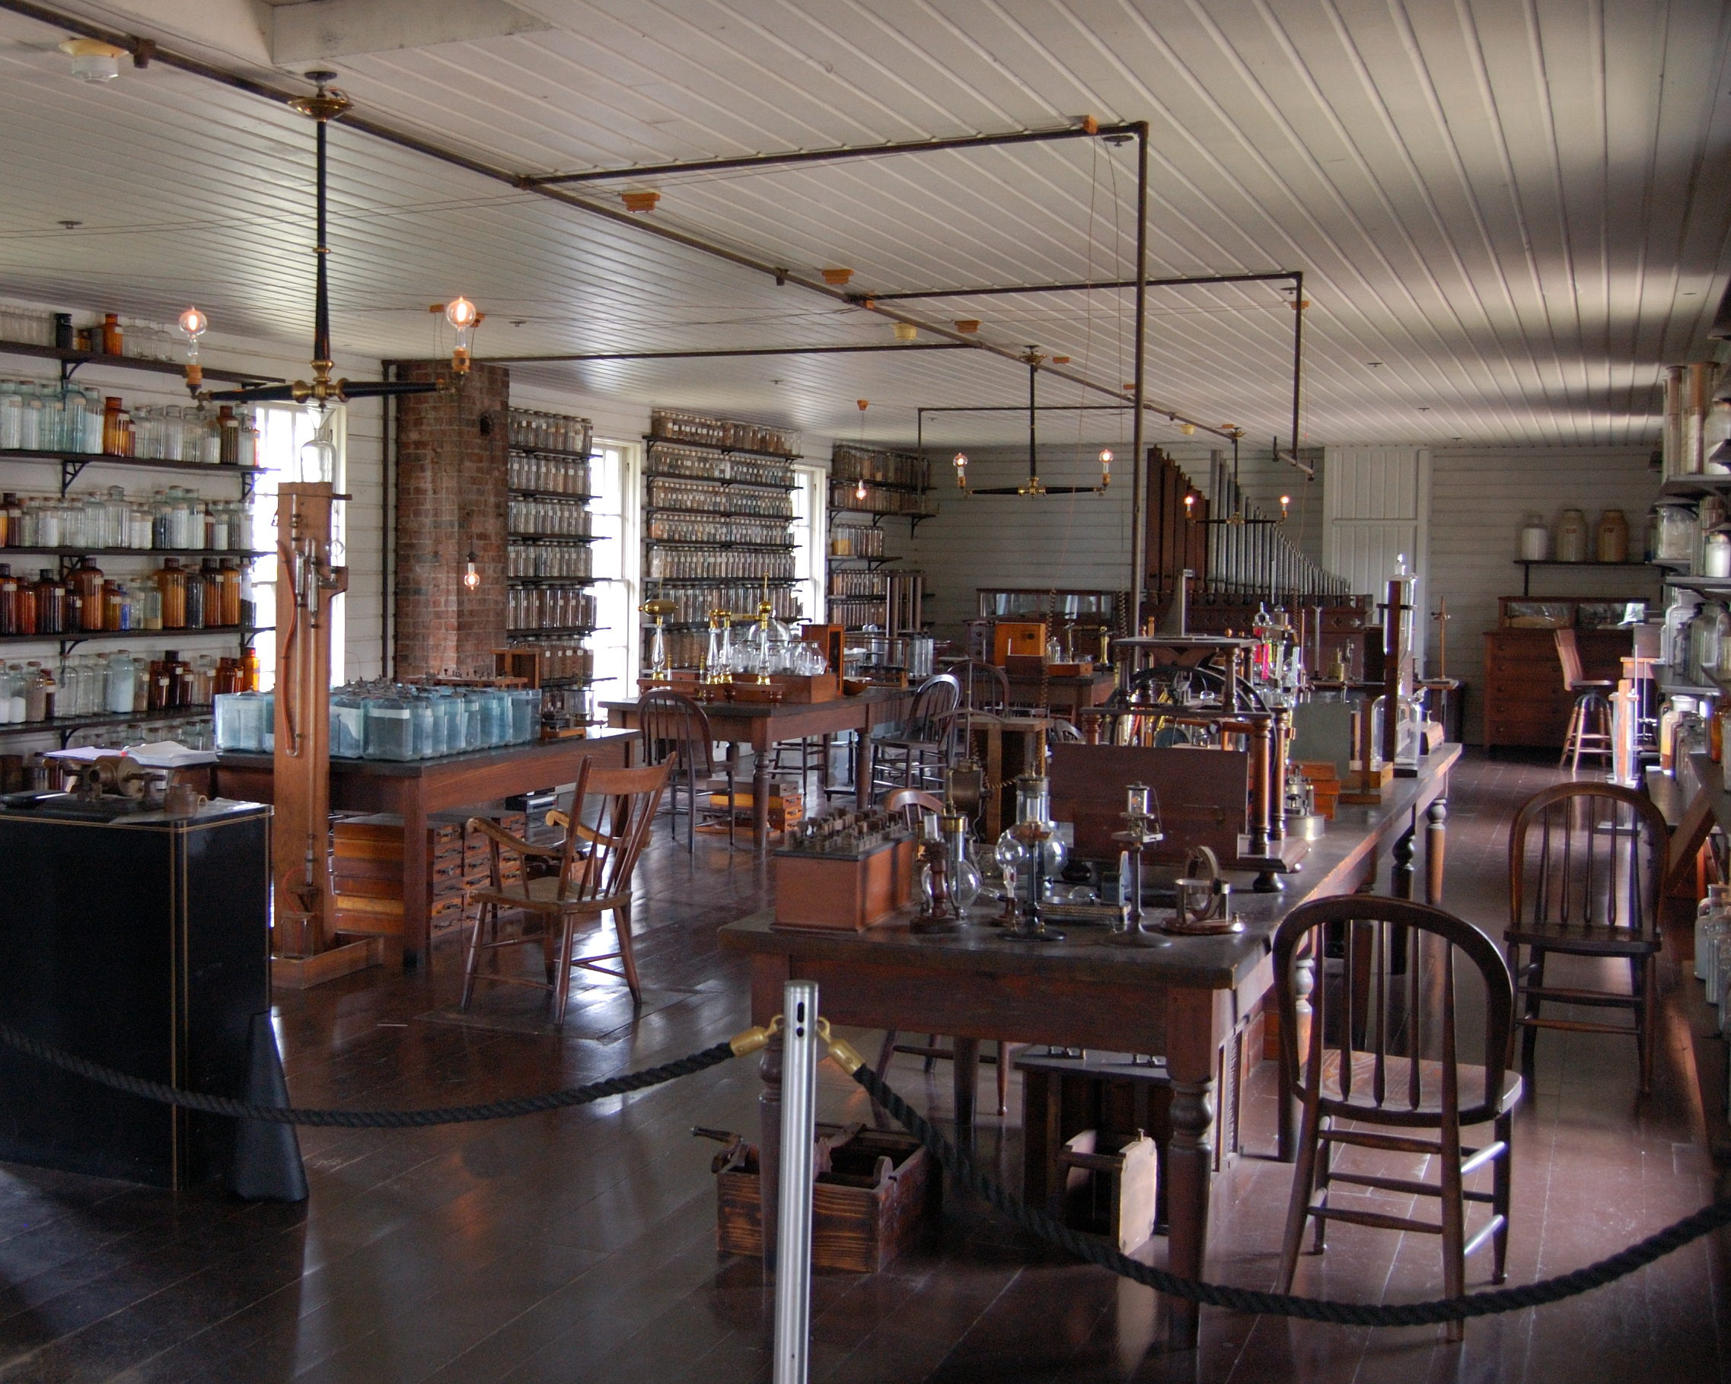
Menlo Park was one of the six neighborhoods that formed Raritan Township. It was a very sparsely populated rural area and the site of a failed residential development in the early 1870s.
Edison purchased two parcels of land measuring approximately 34 acres from the family of William Carman who was one of his employees at Newark, in late 1875. The office of the real estate development company, Menlo Park Land Company, at the corner of Lincoln Highway and Christie Street, became Edison’s home.
Edison’s father built the main laboratory building on the block south of Christie Street between Middlesex and Woodbridge (now Tower) Avenues. Edison also built other ancillary buildings including the glass house, a carpenters’ shop, a carbon shed, and a blacksmith shop.
By the Spring of 1876, Edison moved his operations to Menlo Park. Edison’s Menlo Park laboratory was the world’s first such research and development facility. While Edison was working on perfecting the telephone, he started experimenting with the idea of being able to record the sound of the human voice.
http://www.menloparkmuseum.org/history/thomas-edison-and-menlo-park

Slide 14
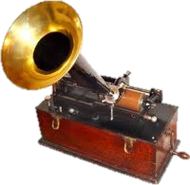
In November 1877, one of Edison’s first major inventions at Menlo Park was the phonograph, which was a basic machine that allowed a person to speak into a diaphragm that was attached to a pin that made indentations on a paper wrapped around wood.
The first words Edison successfully recorded on the phonograph were “Mary had a Little Lamb”. By 1878, this invention was known all around the world and Edison soon earned the title of “The Wizard of Menlo Park.” Menlo Park was suddenly known worldwide and started attracting visitors to see demonstrations of the phonograph.
For his expanding inventions factory, Edison commissioned the engineering firm of Babcock & Wilcox from New York City to build a machine shop behind the laboratory building in 1878. In that same year, Edison also constructed an office and library for himself at the corner of Christie Street and Woodbridge (Tower) Avenue.
In this same year, Edison coined the name “Invention Factory” for the Menlo Park site.
http://www.menloparkmuseum.org/history/thomas-edison-and-menlo-park

Slide 15
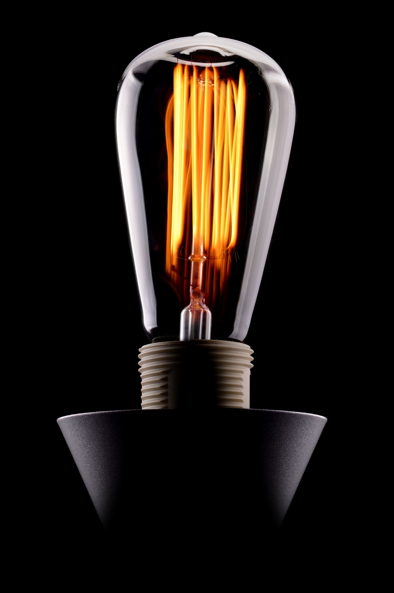
Edison did not linger over the success of his phonograph. He quickly moved on to other inventions. His next big breakthrough came when he invented a bamboo filament to create a successful incandescent lightbulb.
Other people had been working on the making of light bulbs in the past, but none of the earlier bulbs was ever able to work for more than a few minutes.
Finally, on October 21, 1879, Edison’s light bulb burned for a continuous thirteen and a half hours. The following bulbs lasted for 40 hours and Edison and his team worked hard to light the laboratory and his home with several of the new light bulbs for Christmas.
On New Year’s Eve of the same year, Christie Street became the world’s first street to be lit by incandescent light bulbs with the help of a power system designed by Edison.
By the summer of 1880, Edison had perfected the incandescent bulb enough to be able to produce and sell it in large quantities.
http://www.menloparkmuseum.org/history/thomas-edison-and-menlo-park

Slide 16
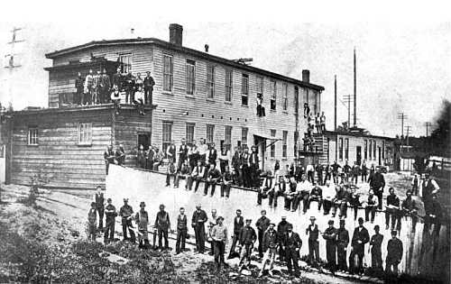
He remodeled the wooden building on the east side of the Pennsylvania Railroad tracks and Lincoln Highway to serve as a Lamp Factory.
Edison also laid down an experimental underground system and put up several lampposts in Menlo Park and successfully tested the first underground electrical system in November 1880.
The first two homes to be lit by Edison’s incandescent lights were the home of Francis Upton (a mathematician who worked for Edison) located at Frederick Street at the corner of Woodbridge Avenue, and Sarah Jordan’s boarding house. Sarah Jordan was the widow of one of Edison’s associates from Newark, who Edison brought to Menlo Park to setup the boarding house for his single employees.
This was also a place where the entire team gathered for social events during their free time.
http://www.menloparkmuseum.org/history/thomas-edison-and-menlo-park

Slide 17
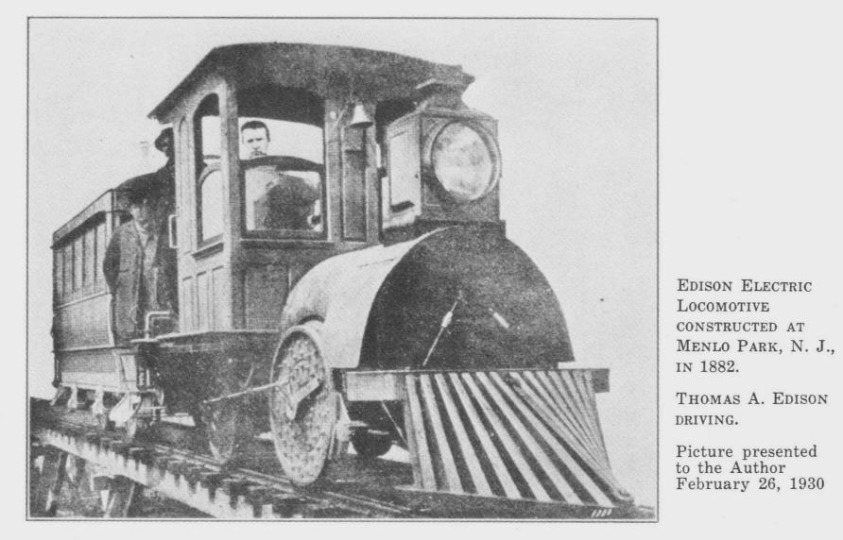
Edison established the Edison Electric Light Company and began working on using electricity for other purposes.
He built an experimental train running on electricity at Menlo Park that started from the west side of the Machine Shop at the corner Christie Street and Middlesex Avenue and ran about three blocks north to a copper mine called “Mine Gully”. http://www.menloparkmuseum.org/history/thomas-edison-and-menlo-park

Slide 18
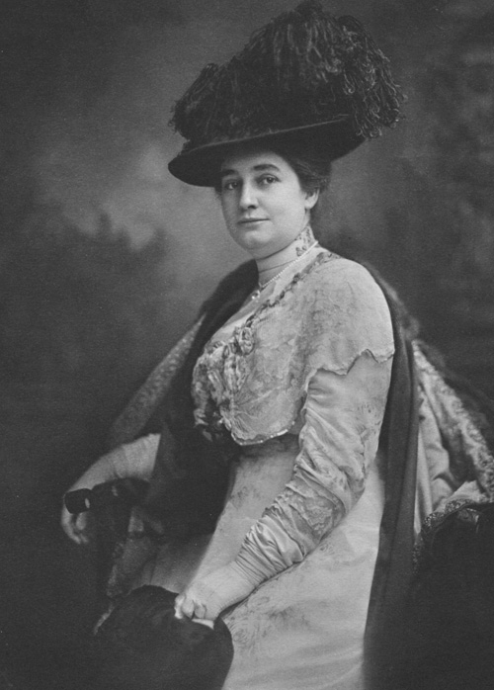
Mina Miller
[By the early 1880s] Edison felt the need to be closer to where the business was in New York City, and his operations were quickly outgrowing the existing facilities at Menlo Park.
The family moved into a house at 25 Gramercy Park in New York City but spent their summers in the Menlo Park home.
On August 9, 1884 Edison’s wife, Mary, died of typhoid fever. Edison was devastated.
In the summer of 1885, he met Mina Miller, a music student in Boston at a dinner party at a mutual friend’s residence. After months traveling between Boston and New York, Edison married Mina Miller in her hometown of Akron, Ohio on February 24, 1886.
Together, they had three children, Madeline, born May 31, 1888; Charles, born August 3, 1890; and Theodore, born July 10, 1898. http://www.menloparkmuseum.org/history/thomas-edison-and-menlo-park

Slide 19
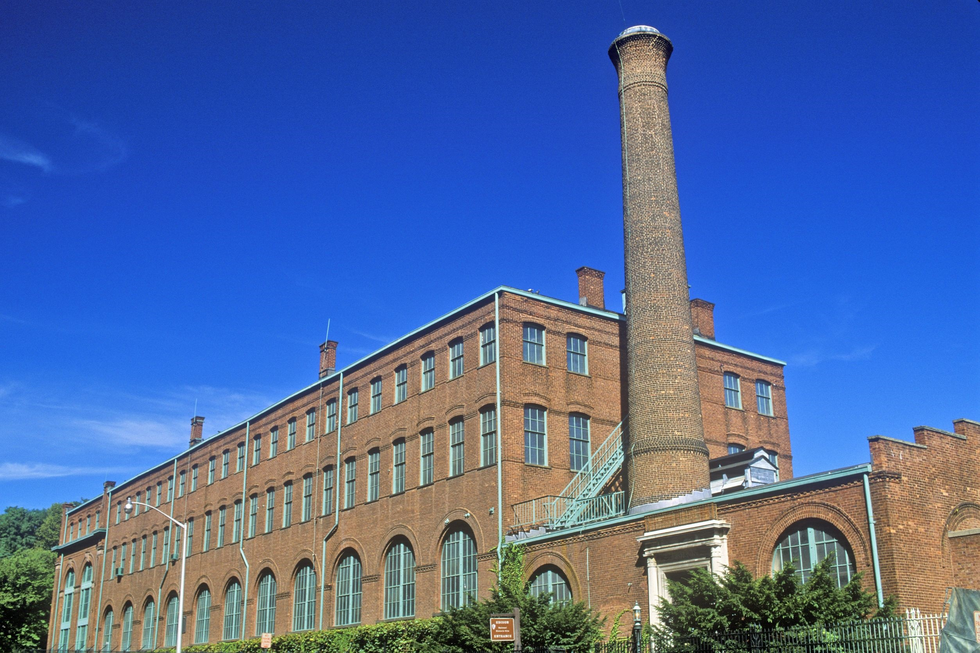
123rf.com
In 1886, Edison started building a new facility in West Orange, New Jersey. In 1887, his laboratory moved out of Menlo Park and into the new, much larger laboratory in West Orange.
http://www.menloparkmuseum.org/history/thomas-edison-and-menlo-park

Slide 20
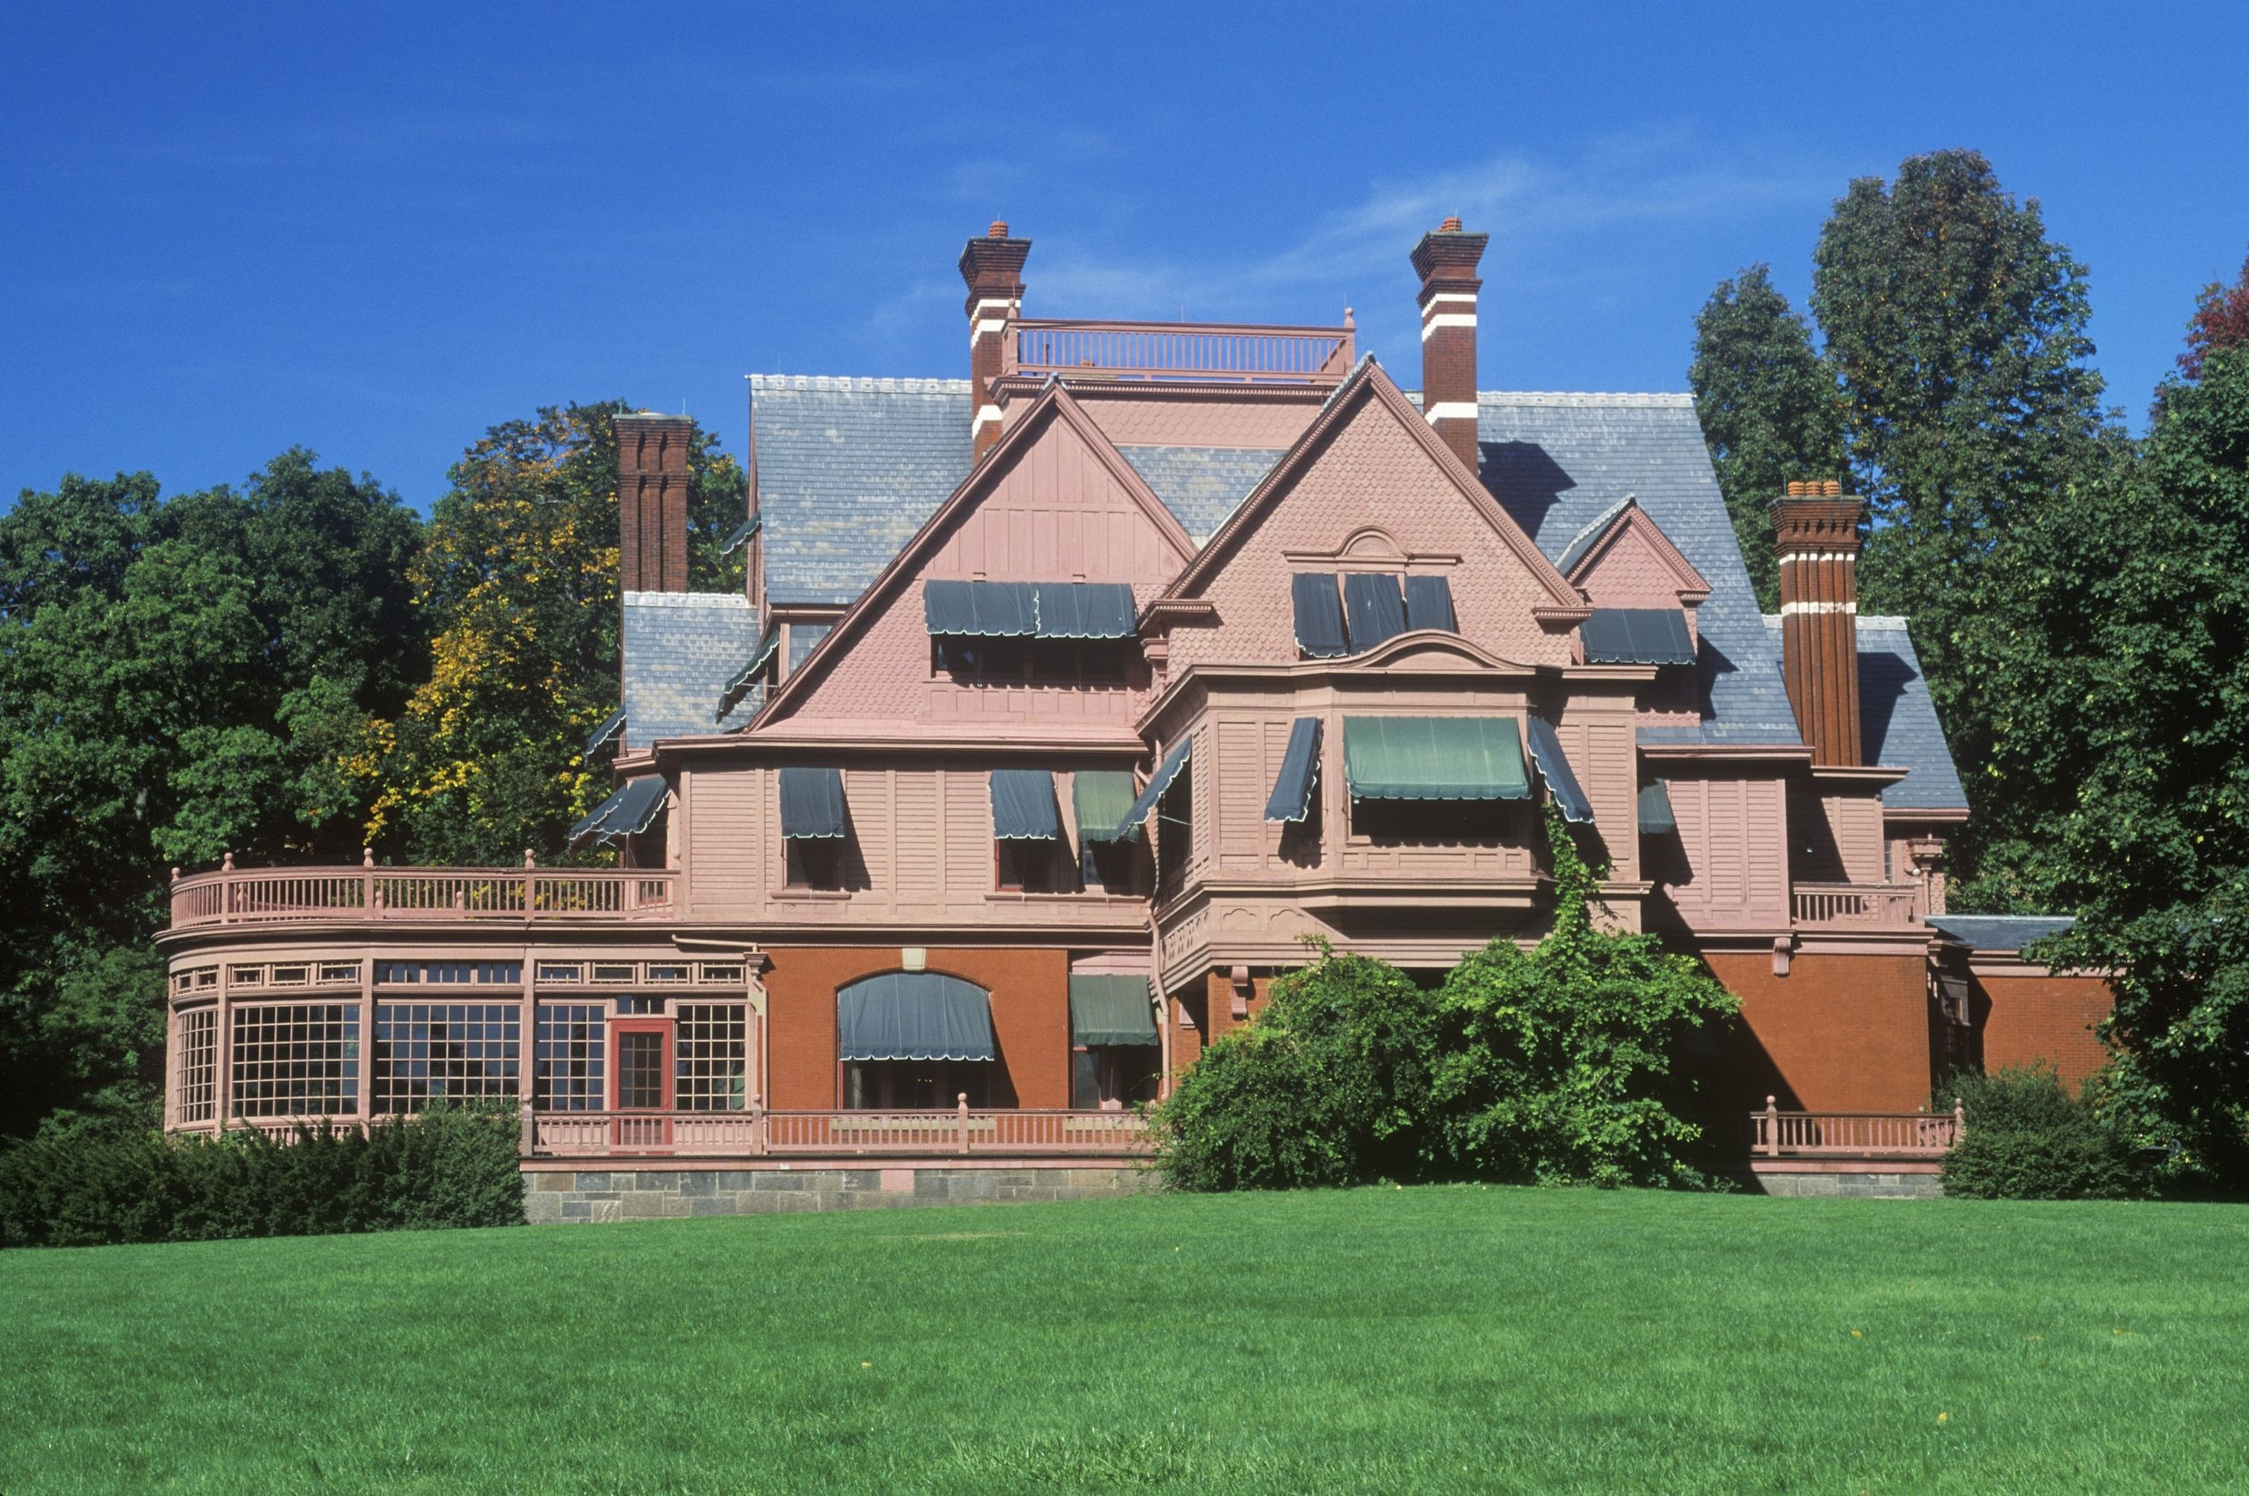
123rf.com
This is where Edison spent the remaining forty-four years of his life, continuing to improve his earlier inventions and creating new inventions such as the motion picture camera.
http://www.menloparkmuseum.org/history/thomas-edison-and-menlo-park

Slide 21
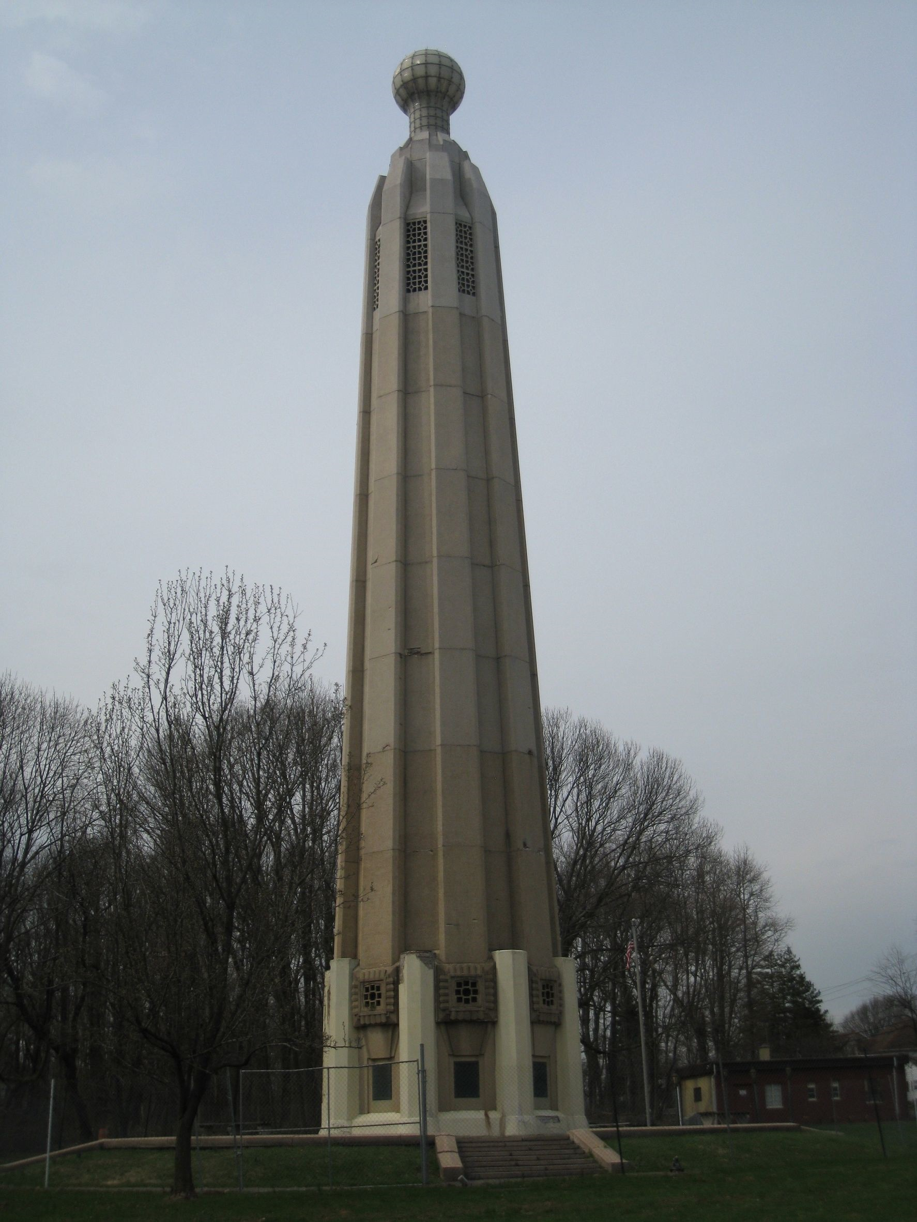
Other important achievements and inventions that Edison created at Menlo Park included:
a carbon button transmitter (aka microphone) and the induction coil that greatly improved the telephone
an improved bulb filament and successful incandescent lightbulb
the first underground electrical system
a prototype electric railway was constructed at Menlo Park
the founding of the Edison Electric Light Company
Christie Street in Menlo Park became the world's first street to be lit by incandescent lightbulbs
In fact, Menlo Park became a tourist attraction because of the novelty of lighting
Edison applied for over 400 patents for inventions made at Menlo Park
http://inventors.about.com/od/mstartinventions/a/Menlo_Park.htm
123rf.com

Slide 22
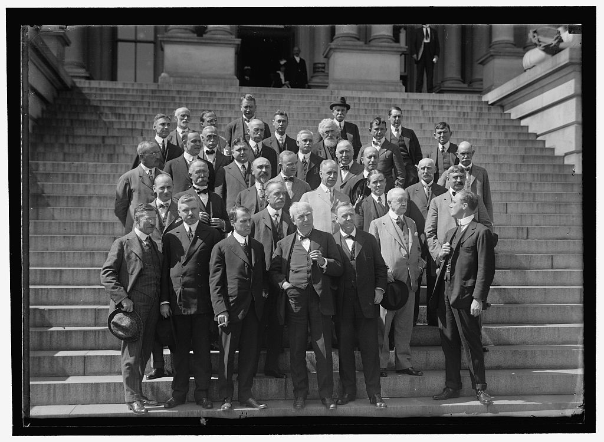
During World War I, the U.S. government asked Thomas Edison to head the Naval Consulting Board, which examined inventions submitted for military use.
Edison worked on several projects, including submarine detectors and gun-location techniques.
However, due to his moral indignation toward violence, he specified that he would work only on defensive weapons, later noting, "I am proud of the fact that I never invented weapons to kill.“
http://www.biography.com/people/thomas-edison-9284349#industrialist-and-business-manager

Slide 23
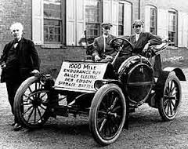
As the automobile industry began to grow, Edison worked on developing a suitable storage battery that could power an electric car. Though the gasoline-powered engine eventually prevailed, Edison designed a battery for the self-starter on the Model T for friend and admirer Henry Ford in 1912. The system was used extensively in the auto industry for decades.
http://www.biography.com/people/thomas-edison-9284349#industrialist-and-business-manager

Slide 24
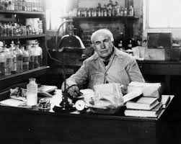
By the end of the 1920s Thomas Edison was in his 80s and he slowed down somewhat, but not before he applied for the last of his 1,093 U.S. patents, for an apparatus for holding objects during the electroplating process.
He died on October 18, 1931 at the age of 84.
http://www.biography.com/people/thomas-edison-9284349#industrialist-and-business-manager

Slide 25
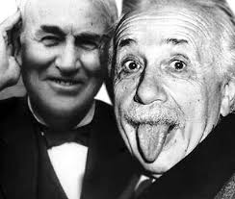
Key Words
traditional school setting experiments military use
School of Natural Philosophy suitable storage battery telegraph
parcels of land West Orange U.S. patents
research and development tourist attraction basement
The Wizard of Menlo Park Mary Stilwell Mina Miller

