Slide 1
NICKY FIFTH’S NEW JERSEY
N5NJ
SECONDARY PROGRAM
HISTORY
Religion

Slide 2
Religion and Politics are probably the two topics that most people avoid discussing at all costs. These discussions can be so volatile that you might occasionally see signs that forbid them.
The logic is simple: for many people, religious and political beliefs are so deeply engrained that merely discussing them can evoke robust emotions. And, since a simple conversation will more than likely fail to persuade someone to change their beliefs or positions, the common theory has been to simply avoid it.
123rf.com

Slide 3
Unfortunately, the two topics we gingerly tip-toe around and take great pains to dodge, happen to be the two topics that have initiated more wars and more conflicts than almost anything, ever.
It appears that not talking and not understanding one another is not the answer. Maybe, just maybe, the real answer is actually…
talking.
And maybe the way to avoid the conflict is to teach people to listen to others and respect what they have to say. If we understand that other people feel as strongly about their religious and political belief as we do, we can adjust our expectations from persuasion to…
understanding.
And maybe, just maybe, we should start teaching the art of listening and respecting others as early as possible. Maybe that should be the…
message.
123rf.com

Slide 4
So, what is religion, anyway?
Simple Definition of religion
: the belief in a god or in a group of gods
: an organized system of beliefs, ceremonies, and rules used to worship a god or a group of gods
: an interest, a belief, or an activity that is very important to a person or group
http://www.merriam-webster.com/dictionary/religion
123rf.com

Slide 5
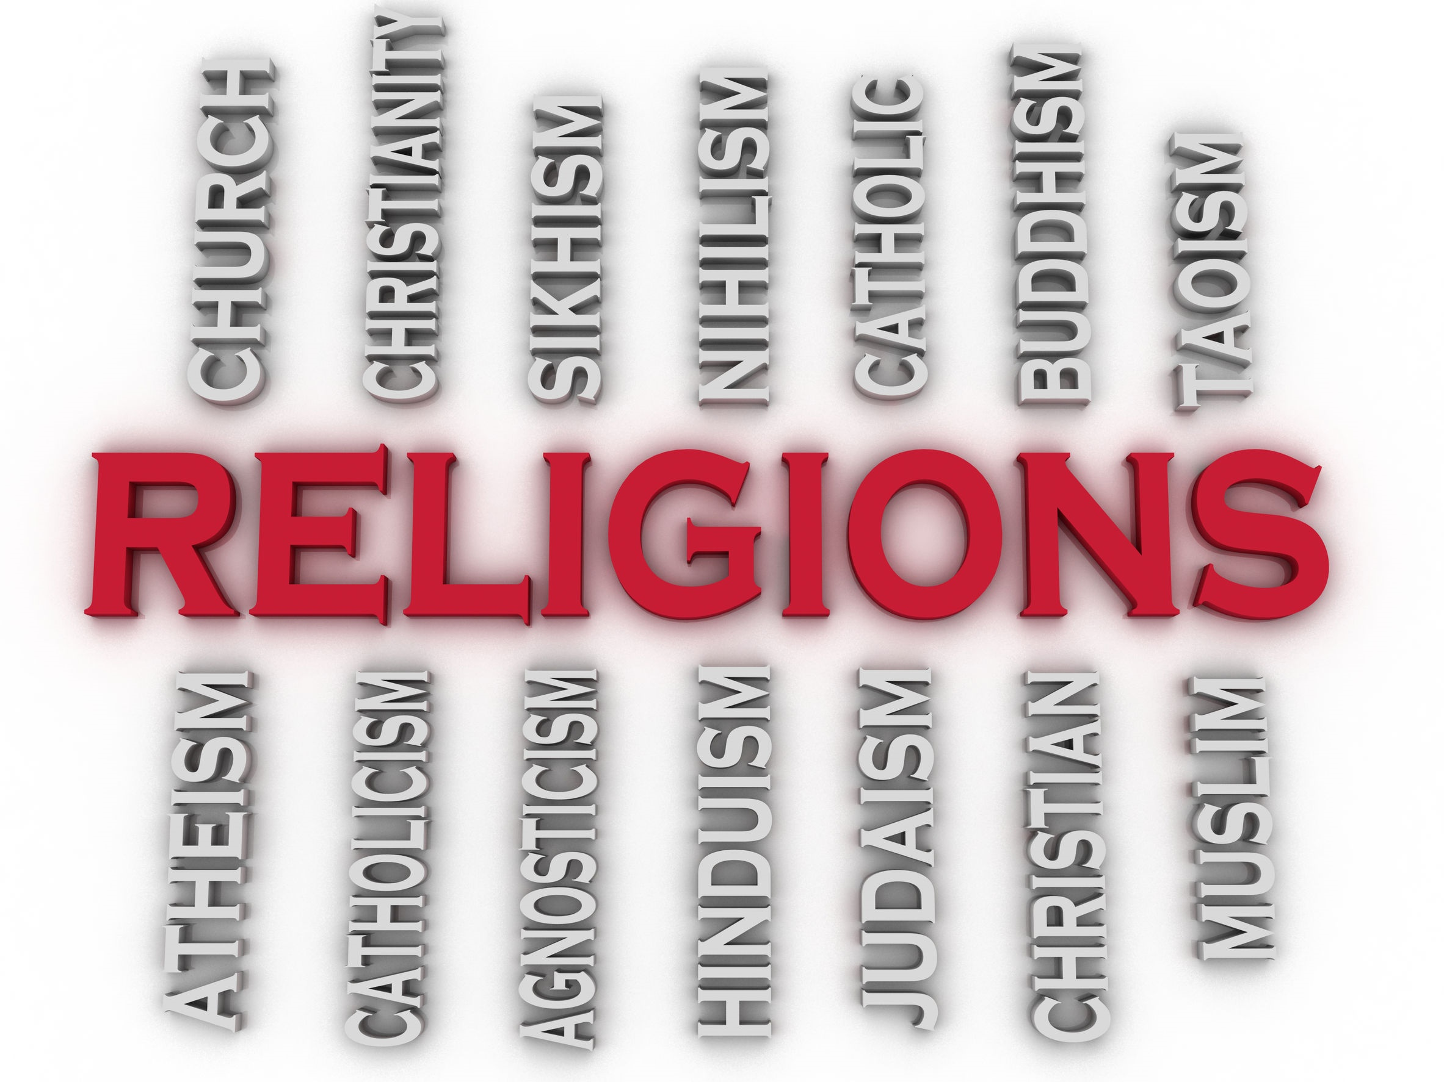
Now that you know the definition, you should know there are many, many, many religions in this world. There are just as many beliefs, traditions, and customs.
The list on the right is just a small sampling of major religions.

Slide 6
While there are countries that do not permit the freedom to practice the religion of your choice, the United States Constitution guarantees Freedom of Religion.
123rf.com

Slide 7
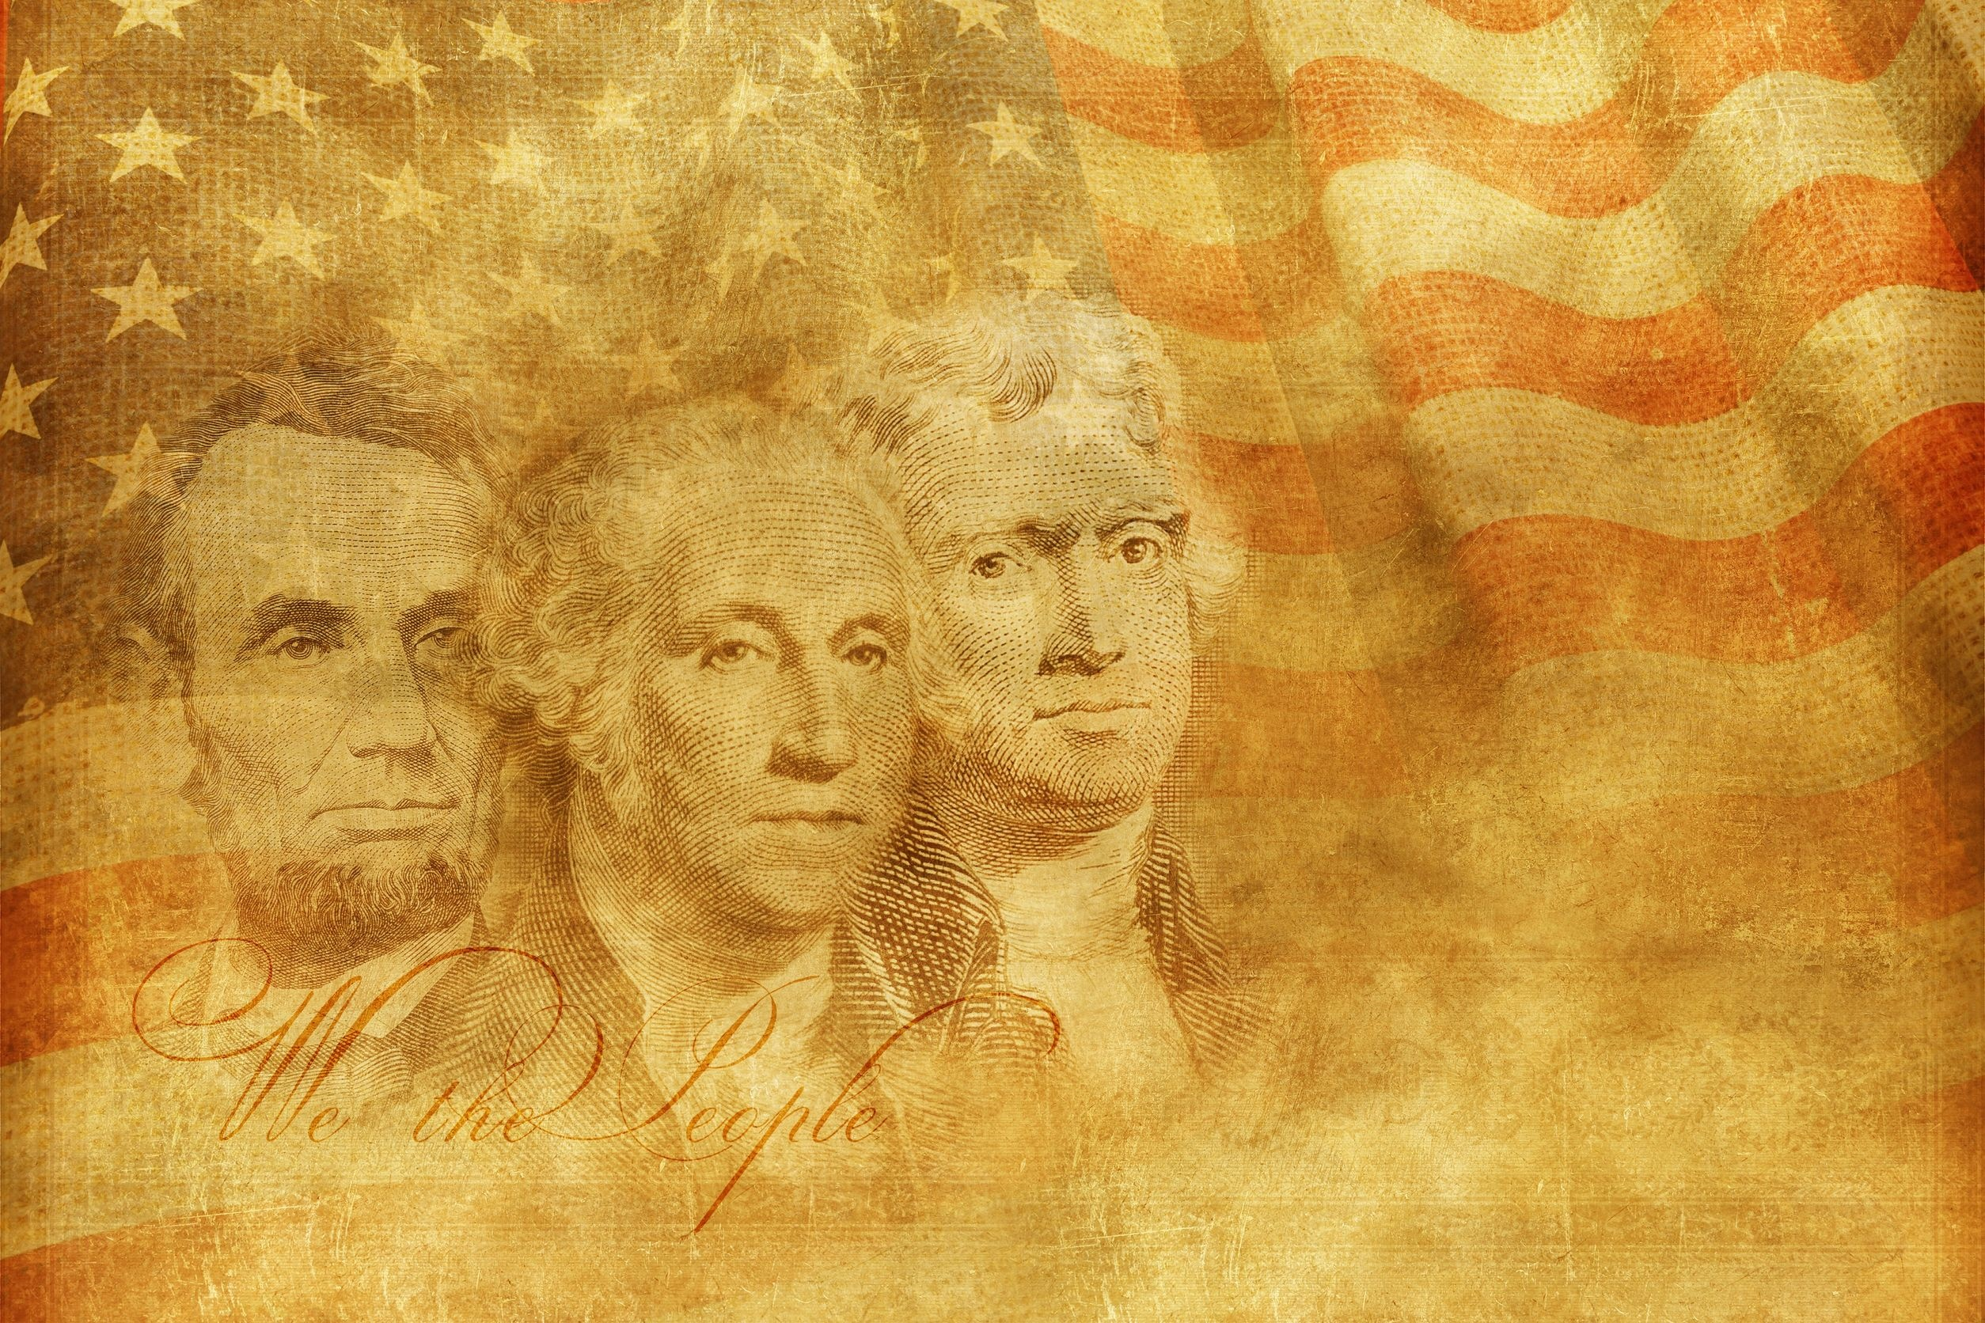
The First Amendment to the U.S. Constitution says that everyone in the United States has the right to practice his or her own religion, or no religion at all.
Our country's founders -- who were of different religious backgrounds themselves -- knew the best way to protect religious liberty was to keep the government out of religion. So they created the First Amendment -- to guarantee the separation of church and state.
This fundamental freedom is a major reason why the U.S. has managed to avoid a lot of the religious conflicts that have torn so many other nations apart.
www.aclu.org/your-right-religious-freedom
123rf.com

Slide 8
The Establishment Clause of the First Amendment prohibits government from encouraging or promoting ("establishing") religion in any way.
That's why we don't have an official religion of the United States. This means that the government may not give financial support to any religion.
The Free Exercise Clause of the First Amendment gives you the right to worship or not as you choose.
The government can't penalize you because of your religious beliefs.
www.aclu.org/your-right-religious-freedom
123rf.com

Slide 9
When it comes to the most religious states in the US, New Jersey isn’t very high on the list. According to a 2014 Gallup poll, New Jersey is the 34th most religious state in the country, with 34% of residents identifying as “very religious.” In comparison, 48% of Americans overall consider themselves to be very religious. Mississippi is the most religious state, with 59% of residents considering themselves “very religious.”
Though our state as a whole may not be particularly pious, several New Jersey counties rank high on the list.
http://www.onlyinyourstate.com/new-jersey/most-religious-counties-nj

Slide 10
The following are the 10 most religious counties in New Jersey.
1. Union County 66.16 % of residents identify as being religious.
2. Bergen County 64.46 % of residents identify as religious.
3. Morris County 59.70 % of residents consider themselves to be religious
4. Hudson County 58.43 % of residents report being religious
5. Passaic County 57.71 % of residents consider themselves to be religious.
6. Monmouth County 57.17 % of residents consider themselves to be religious.
7. Essex County 56.72 % of residents identify as religious.
8. Middlesex County 56.23 % of residents consider themselves to be religious.
9. Cape May County 54.63 % of residents identify as religious.
10. Camden County 53.63 % of residents identify as religious.
http://www.onlyinyourstate.com/new-jersey/most-religious-counties-nj

Slide 11
Another fun fact – the predominant religion in the United States is Protestant, but the predominant religion in New Jersey is Catholic. Here’s the how the rest of the state breaks down.
http://www.onlyinyourstate.com/new-jersey/most-religious-counties-nj
RELIGION | New Jersey | United States
Percent Religious | 54.70% | 48.78%
Catholic | 37.62% | 19.43%
LDS | 0.37% | 2.03%
Baptist | 2.33% | 9.30%
Episcopalian | 0.86% | 0.63%
Pentecostal | 0.94% | 1.87%
Lutheran | 0.92% | 2.33%
Methodist | 2.12% | 3.93%
Presbyterian | 1.64% | 1.63%
Other Christian | 2.81% | 5.51%
Jewish | 2.47% | 0.73%
Eastern | 0.82% | 0.53%
Islam | 1.83% | 0.84%
123rf.com

Slide 12
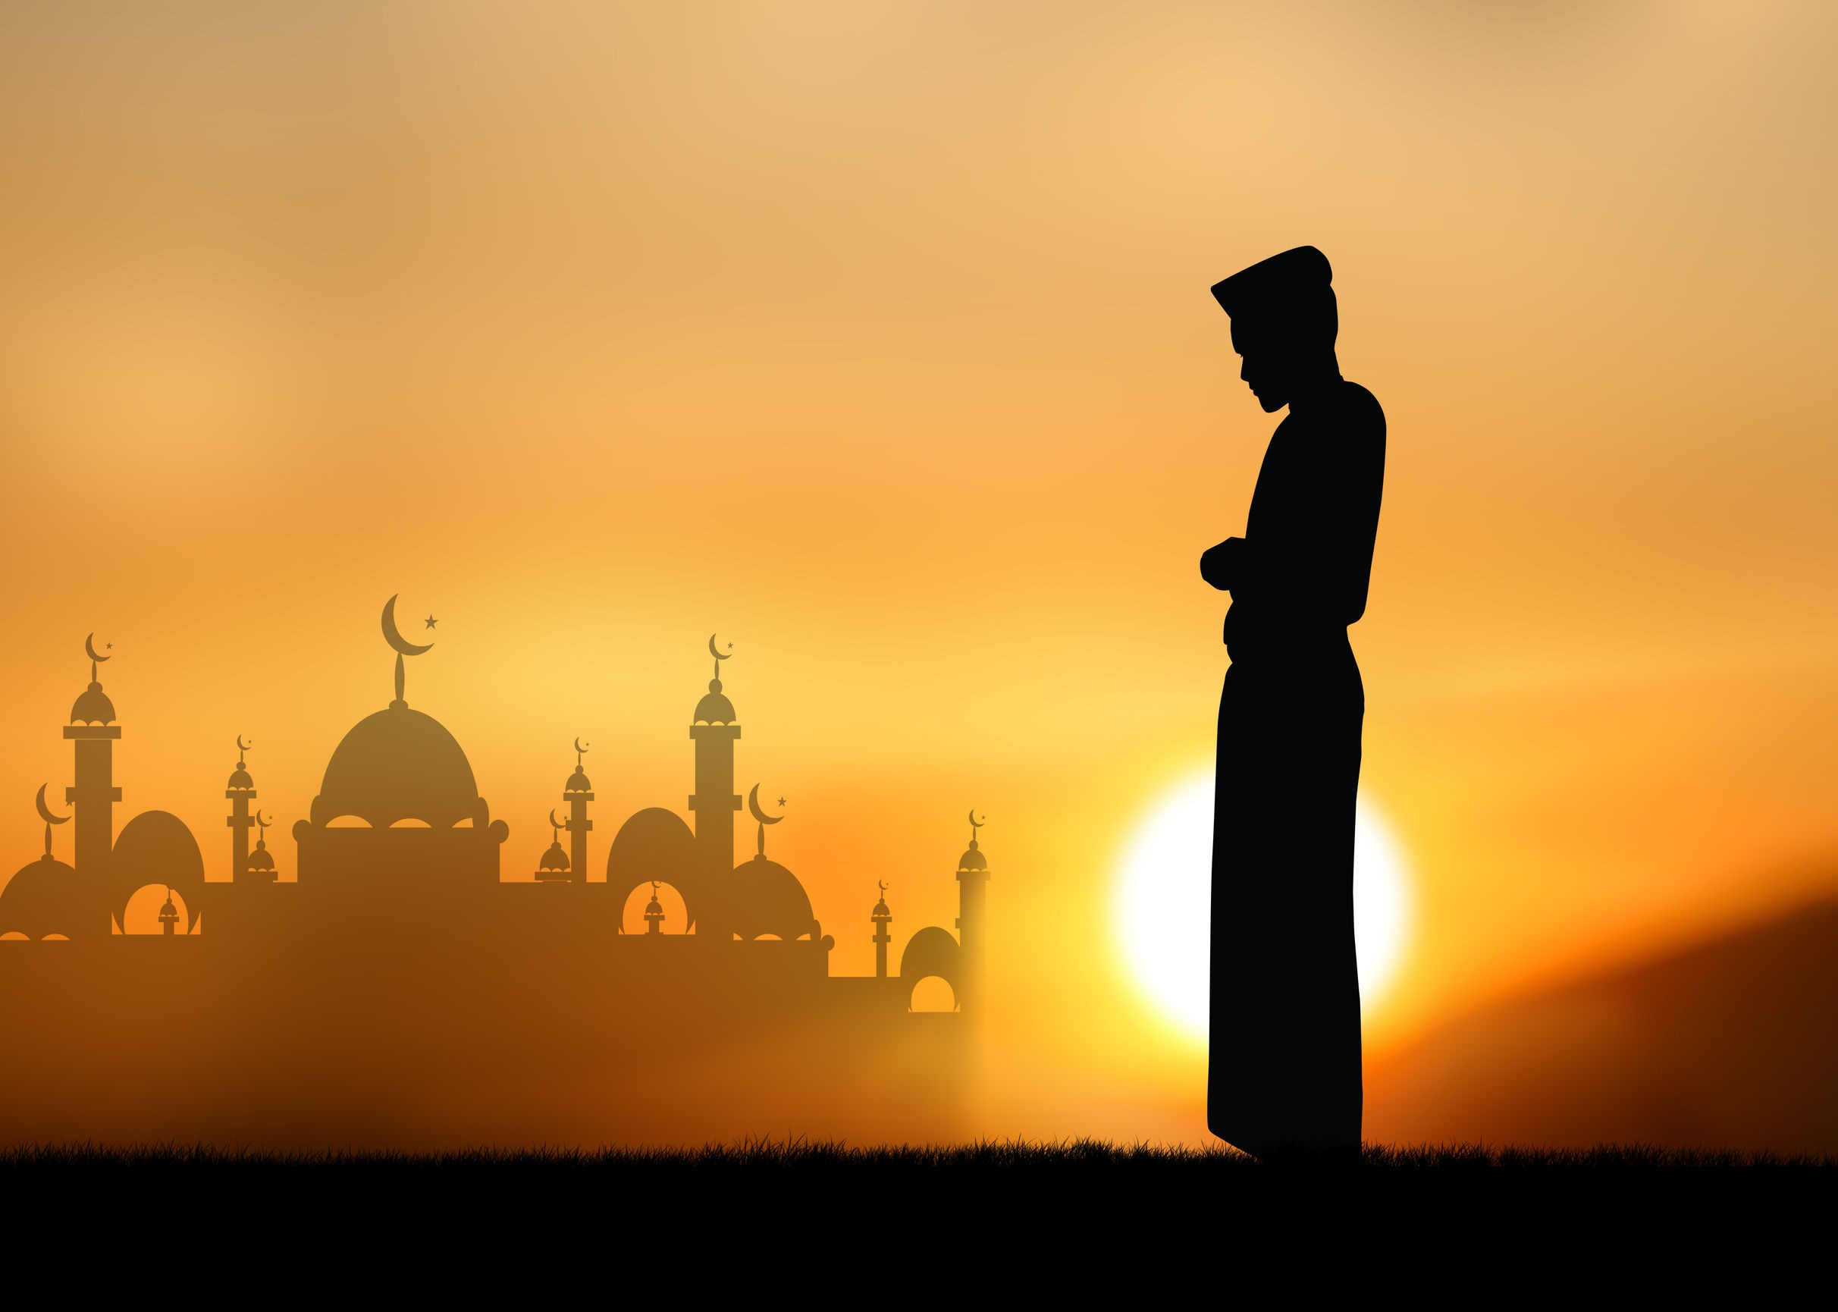
So if you live in a country with no established religion and so many different religions, how can you avoid conflict?
Religion is Personal
Approach religion as the personal set of beliefs of another person. The point isn’t to agree, the point is to accept. Just because it is personal, you should never take the religion of another person personally.
By the same token, you shouldn’t take a lack of religion personally, either. Throughout the course of each life, comes various evolutions of our thought process. As we get older and experience more of life, our perspective also evolves. For some, it results in less religion and compromised faith, for others, they seek a deeper connection.
123rf.com

Slide 13
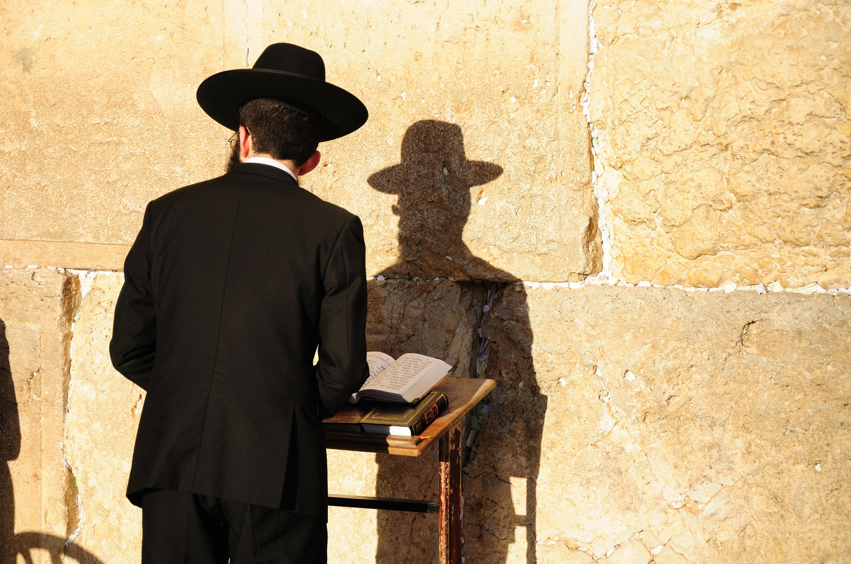
There Is No Point In Arguing
Faith, religion, and spirituality are held very deeply and arguing to convince someone to share your perspective is futile. Discussing religion to learn is so important. Discussing religion to prove you are right is foolish.
123rf.com

Slide 14
Learn About Other Religions
If someone you know practices a different religion, ask questions. Refrain, however, from making comments. Remember, the point is to learn.
Read books and articles or visit websites about religions. You live in a digital information age and anything you could ever want to know is just a few keystrokes and a few seconds away.
Watch documentaries. There are amazingly interesting documentaries available. The more you know, the better you can understand.
123rf.com

Slide 15
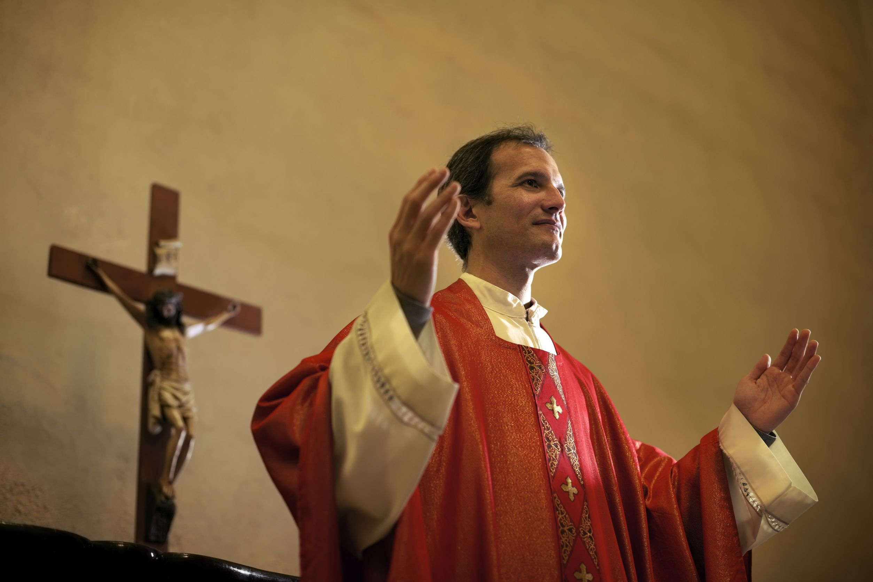
Be An Example of Tolerance
Wherever you go, avoid describing people by their religion as it is just one aspect of who they are. And, live by the rules of kindergarten which clearly state, if you have nothing nice to say, say nothing at all.
You now live in a global world where you will have increased interactions with people abroad. Respect others as you wish to be respected.
Do not make assumptions about a religion based upon extremists, or those who commit crimes in the name of religion. Those behaviors do not make them religious, they make them criminals.
Finally, refrain from judging a person based upon their religion. Instead, judge a person by their actions and their character. If you practice a religion, it should make you a better person which includes your treatment of other religions.

Slide 16
Key Words
Religion Politics volatile
understanding beliefs conflicts
respect expectations persuasion
organized system of beliefs ceremonies worship
Freedom of Religion First Amendment pious

