Slide 1
NICKY FIFTH’S NEW JERSEY
N5NJ
SECONDARY PROGRAM
HISTORY
Washington’s Crossing

Slide 2
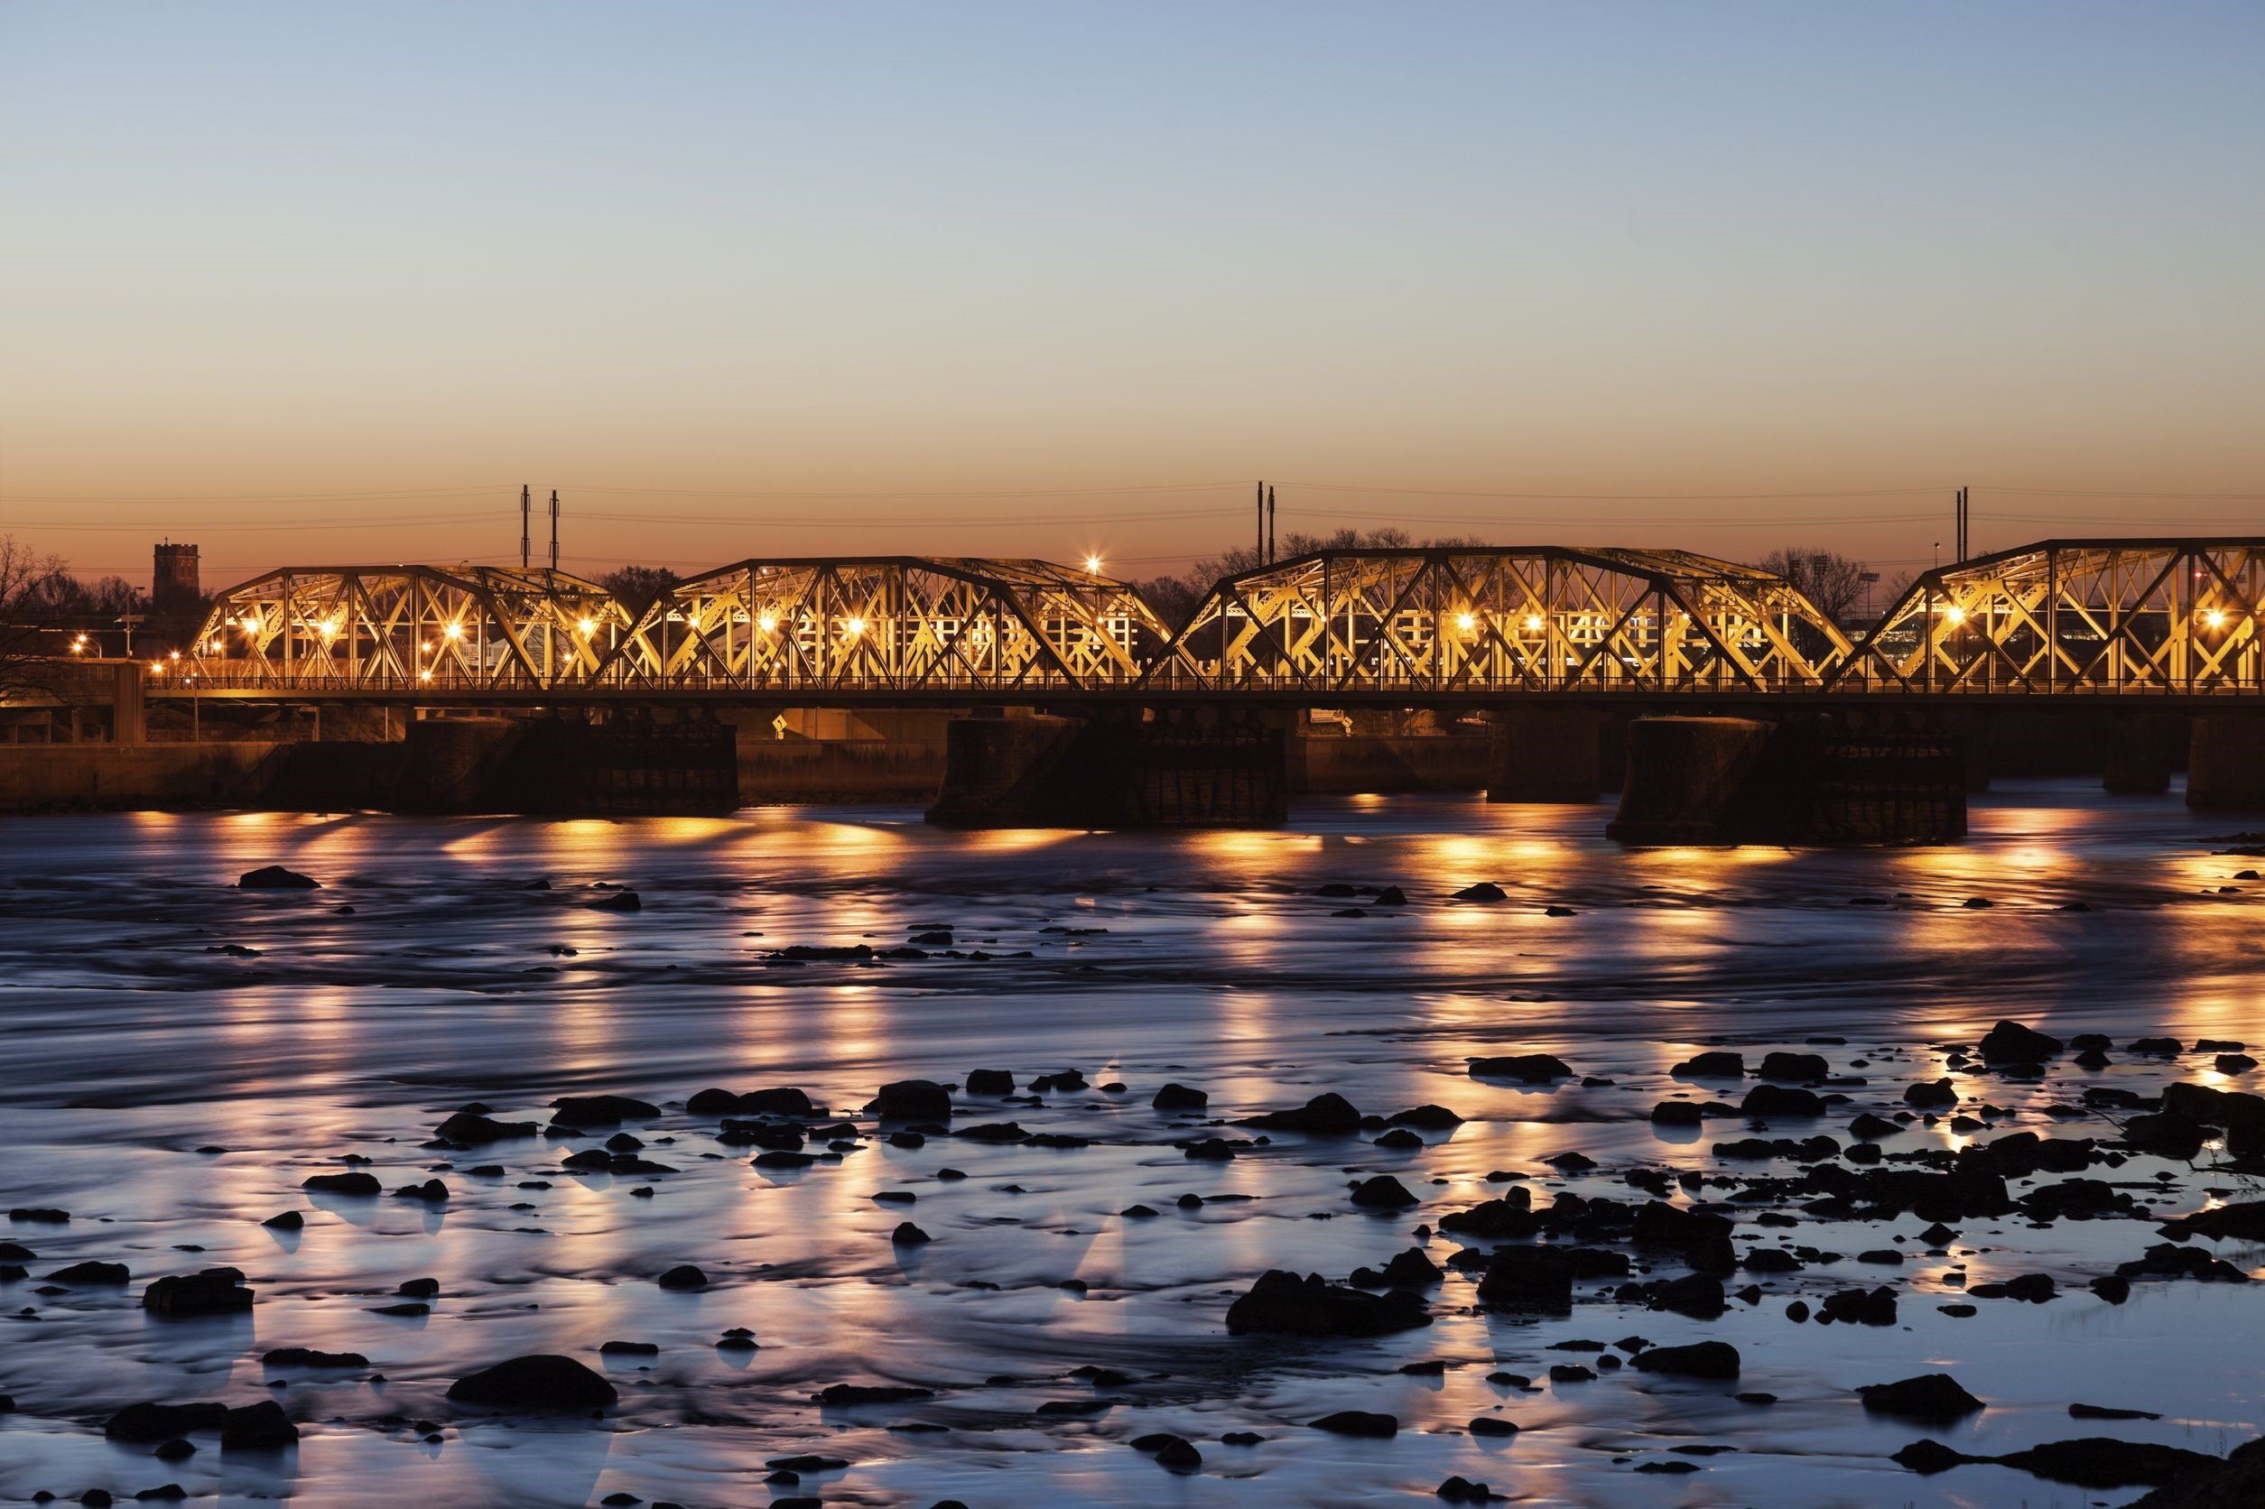
Trenton Makes, The World Takes
Bridge
Trenton, the Capital City of New Jersey, is often referred to as the Turning Point of the American Revolution as a result of the events that transpired on Christmas night, 1776.
123rf.com

Slide 3
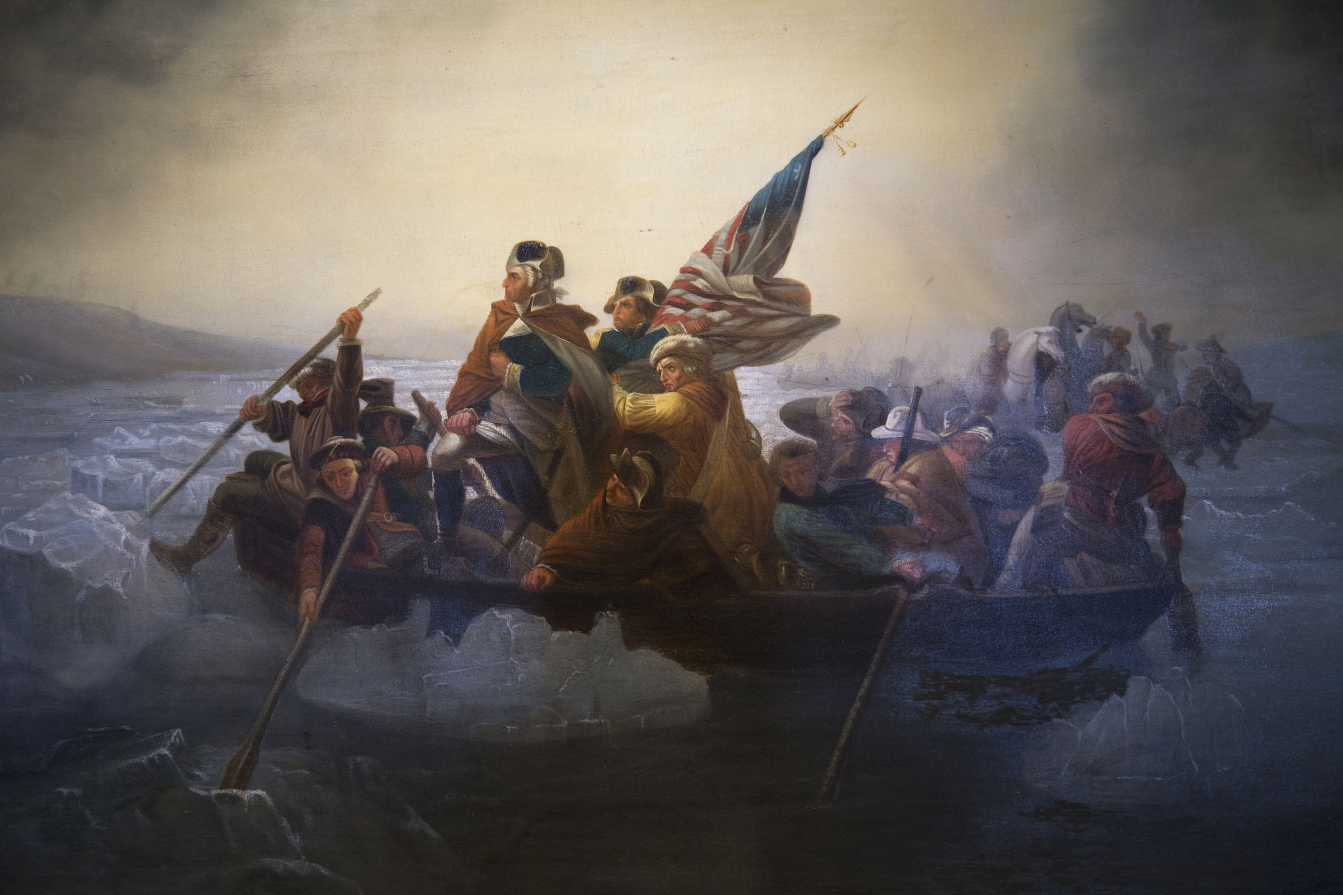
George Washington
Crosses the Delaware
123rf.com
General George Washington’s army crossed the icy Delaware on Christmas Day 1776 and, over the course of the next 10 days, won two crucial battles of the American Revolution. In the Battle of Trenton (December 26), Washington defeated a formidable garrison of Hessian mercenaries before withdrawing.
A week later he returned to Trenton to lure British forces south, then executed a daring night march to capture Princeton on January 3rd. The victories reasserted American control of much of New Jersey and greatly improved the morale and unity of the colonial army and militias.
http://www.history.com/topics/american-revolution/battles-of-trenton-and-princeton

Slide 4
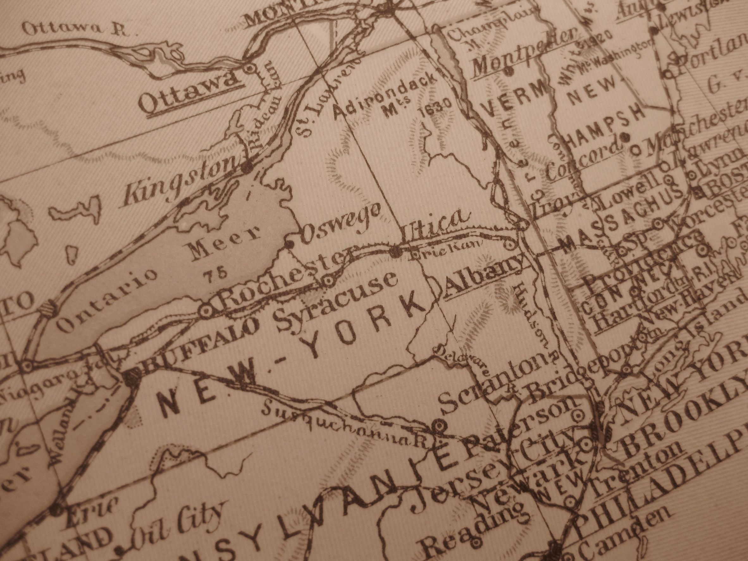
Since August 1776, British forces under General William Howe had been driving the Continental Army south out of New York. On November 16th, the British overran Fort Washington in Manhattan, taking 2,000 Americans prisoner.
http://www.history.com/topics/american-revolution/battles-of-trenton-and-princeton
123rf.com

Slide 5
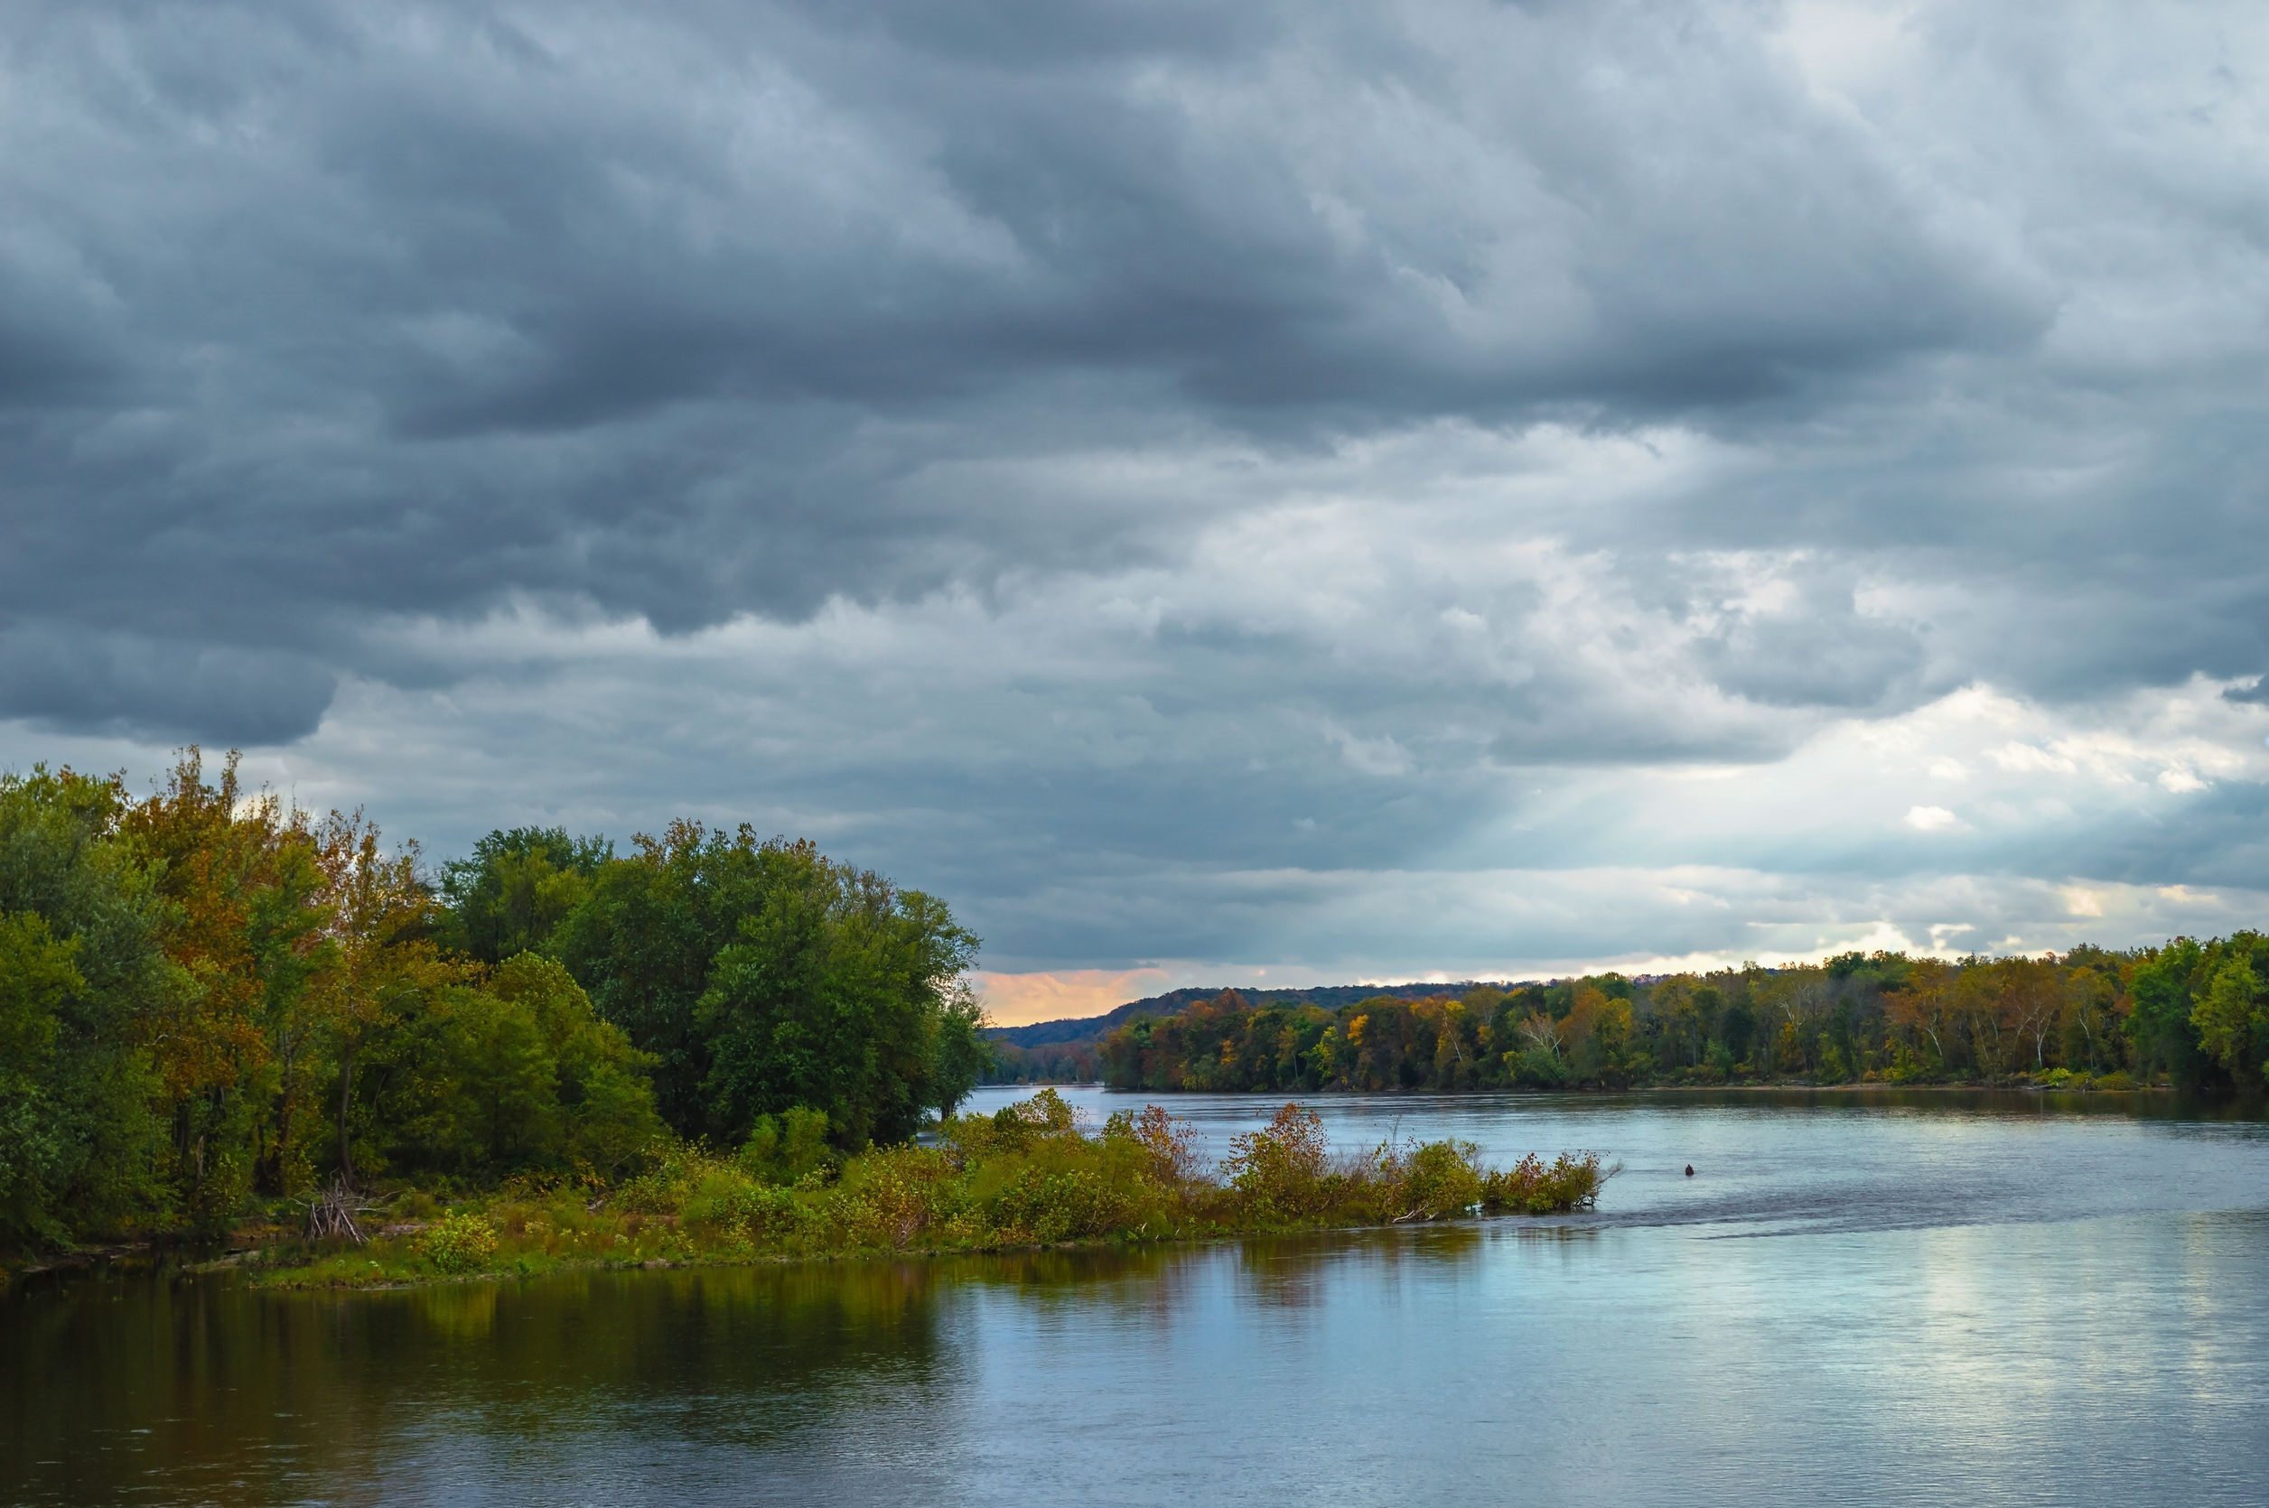
Delaware River
The British then pursued the Americans across New Jersey.
In mid-December Washington led his army south across the Delaware River.
They camped on the Pennsylvania side, short of food, ammunition and supplies.
http://www.history.com/topics/american-revolution/battles-of-trenton-and-princeton
123rf.com

Slide 6
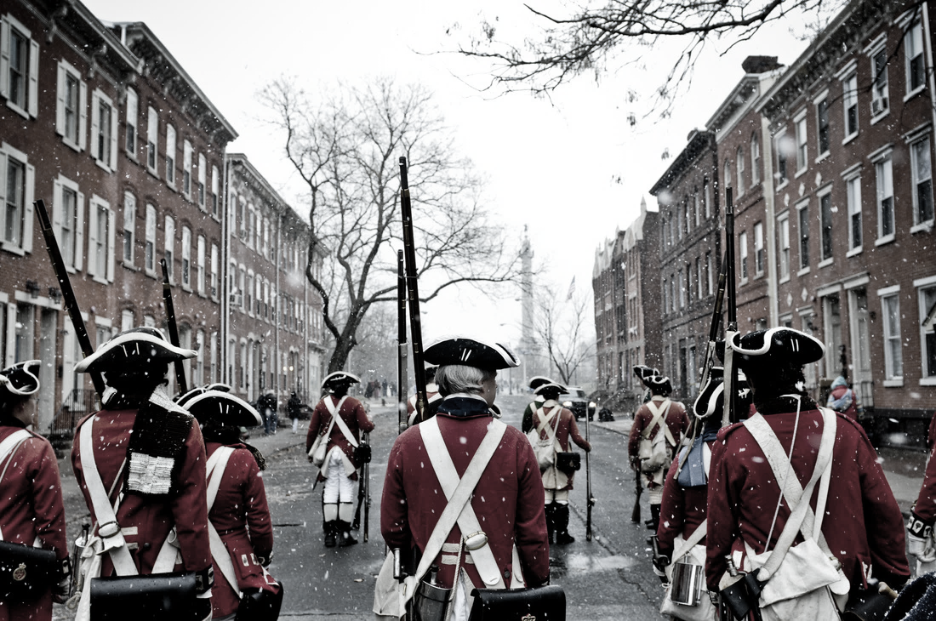
Washington planned a daring assault on the Hessian garrison at Trenton.
He envisioned a three-pronged attack, with his army of 2,400 flanked by a 1,900-man diversionary force under Colonel John Cadwalader and a blocking move by General James Ewing’s 700 men.
http://www.history.com/topics/american-revolution/battles-of-trenton-and-princeton
123rf.com

Slide 7
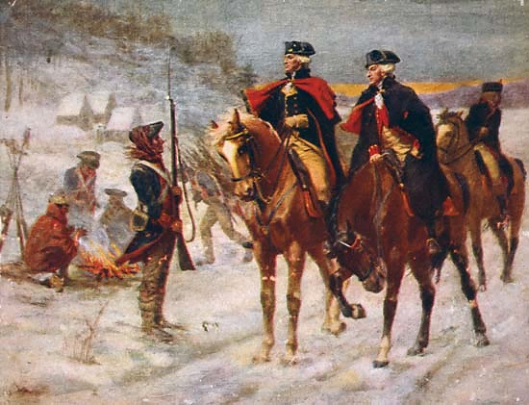
Washington's decision was based on strategic motivation, understanding that the Continental Army desperately needed a victory after months of intense fighting with several significant defeats and no major victories.
Washington also understood that the element of surprise was the only way that he and his army stood a chance of defeating the highly trained Hessian mercenaries.
http://www.mountvernon.org/digital-encyclopedia/article/crossing-of-the-delaware

Slide 8
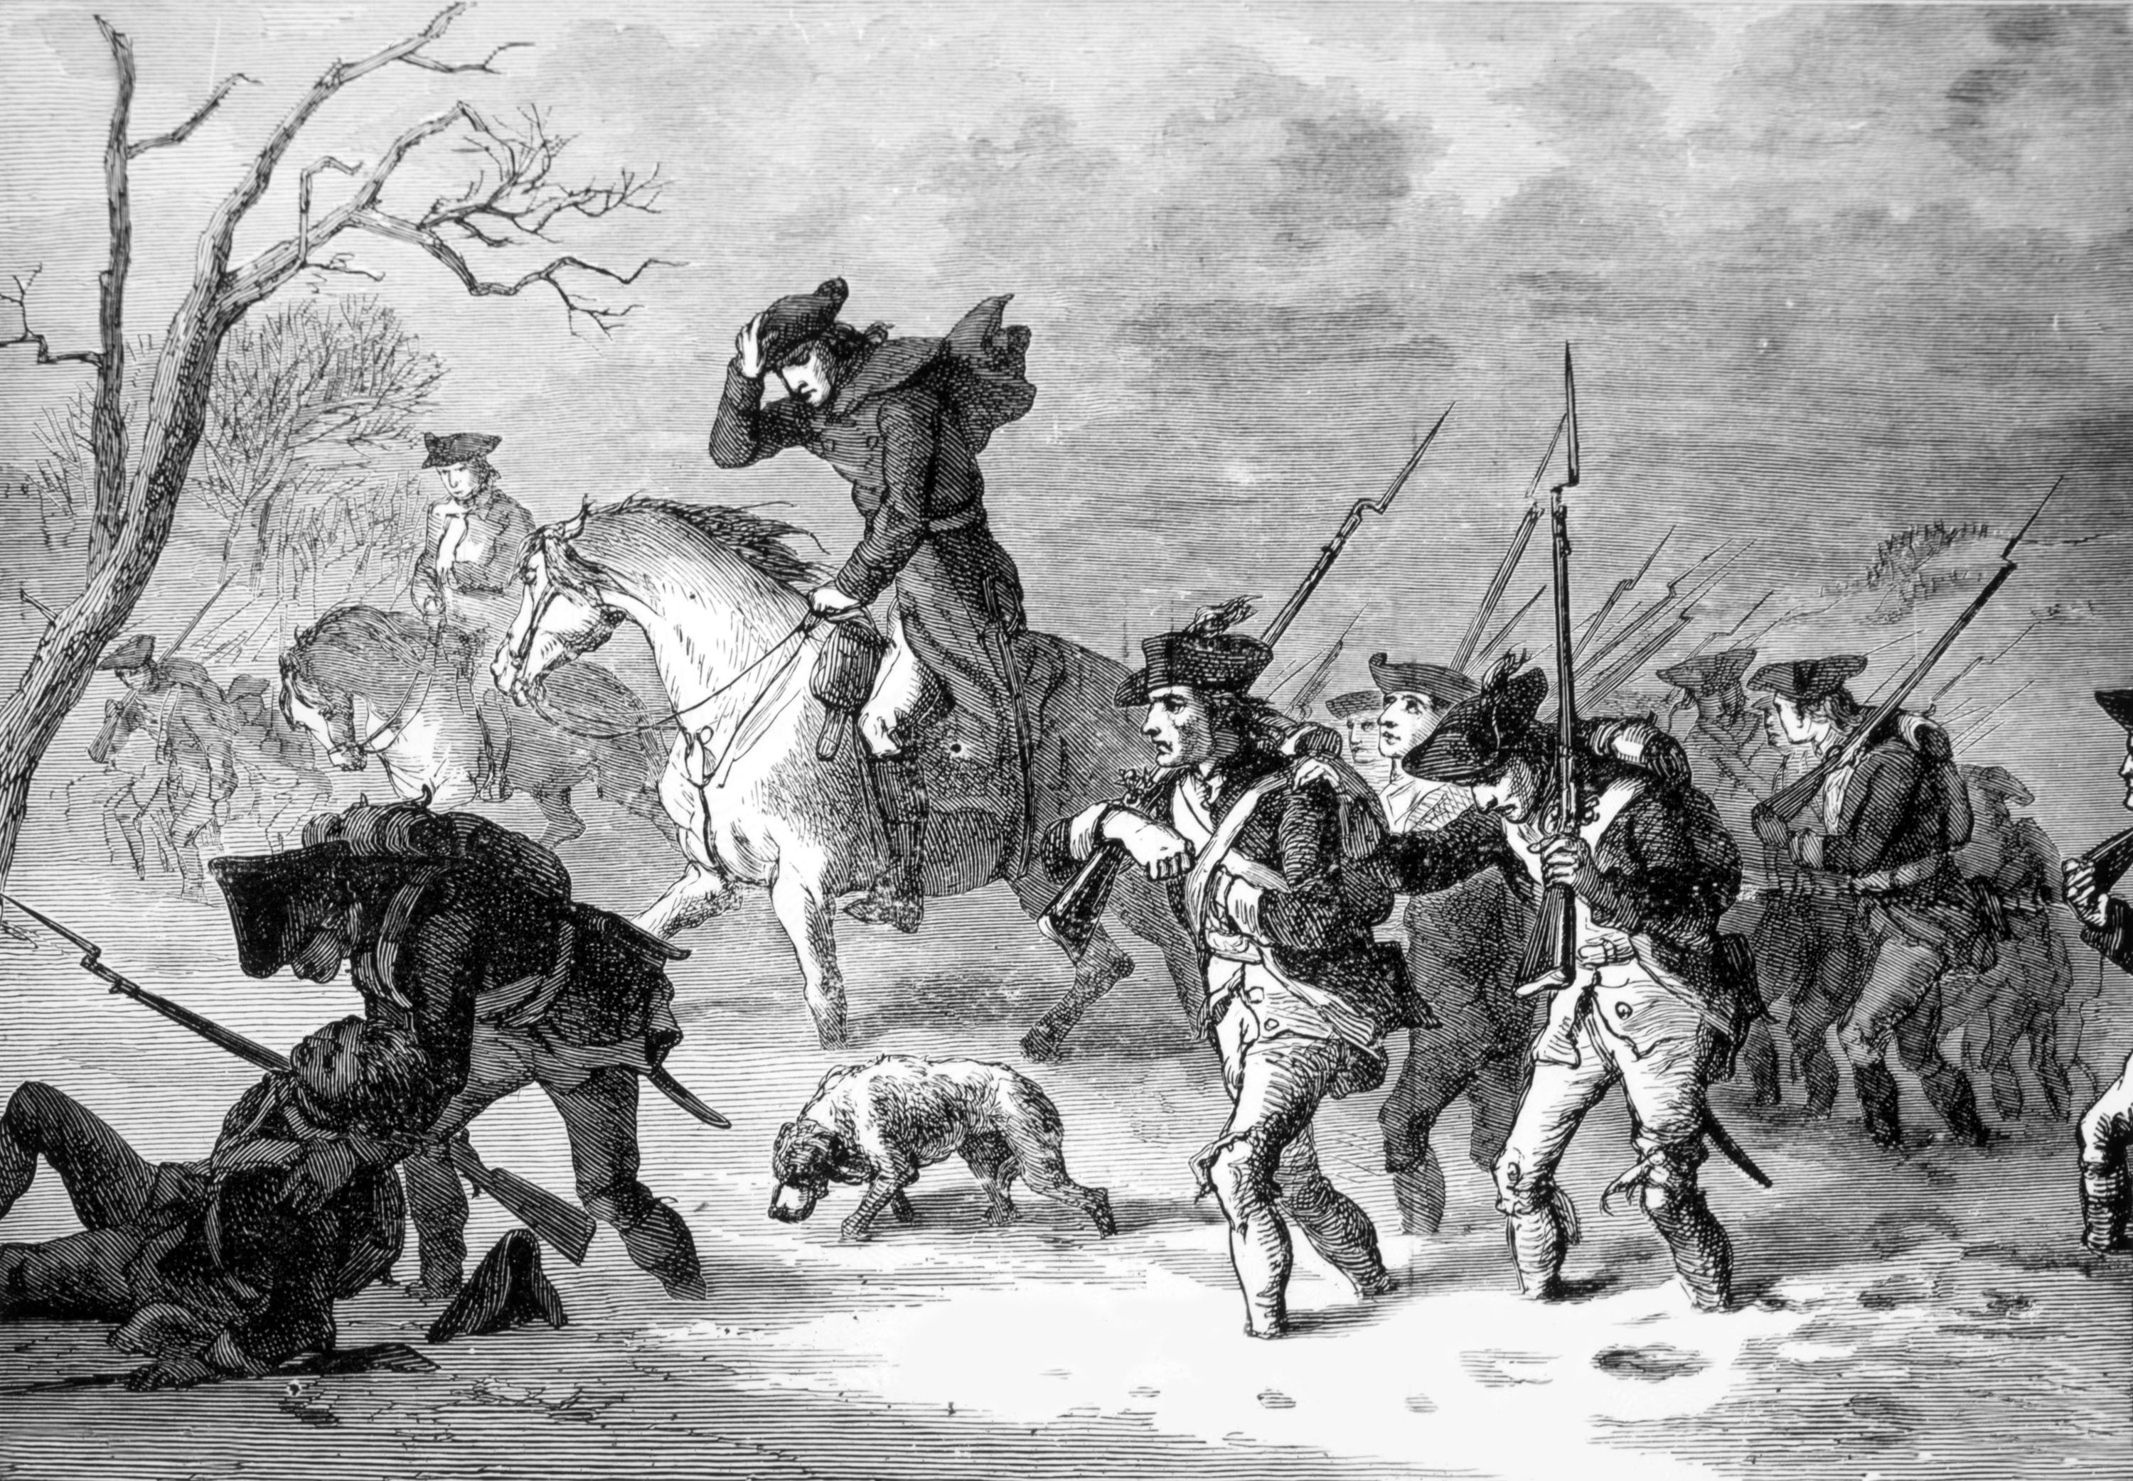
SHUTTERSTOCK.COM
On the morning of December 25, 1776, Continental soldiers woke up in their camps along the Delaware River to a frozen, snowy covered ground. Weather conditions worsened and temperatures continued to drop throughout the day. Late in the afternoon, the Continentals left their tents and began to form along the river in anticipation of the night's events. Washington kept almost all of the details of the crossing a secret; as a result, none of the soldiers knew anything about their upcoming mission.
http://www.mountvernon.org/digital-encyclopedia/article/crossing-of-the-delaware

Slide 9
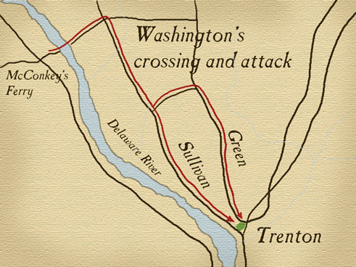
Washington's plan was to cross the river at night, march to the nearby town of Trenton, New Jersey, and attack the Hessian garrison right before dawn.
Time was Washington's greatest enemy; to combat it his orders called for the various regiments to assemble at their designated crossing points no later than sunset. The close proximity to the crossing points allowed the soldiers to begin the journey immediately after nightfall struck and complete the crossing no later than midnight.
Once across, Washington intended for the armies to reassemble and march approximately ten miles to Trenton, arriving there no later than five o'clock in the morning to achieve surprise. Despite his meticulous planning, the schedule failed almost before it began.
http://www.mountvernon.org/digital-encyclopedia/article/crossing-of-the-delaware

Slide 10
Many of the regiments did not arrive at the river until well after dark. Additionally, a severe winter storm that included wind, rain, snow, hail, and sleet met the soldiers at the banks of the river significantly slowing their crossing. Many of the boats had to combat ice jams and unfavorable currents. To make matters even worse, the extreme darkness caused by the storm made it hard for the boatmen to see the opposite shore.
http://www.mountvernon.org/digital-encyclopedia/article/crossing-of-the-delaware

Slide 11
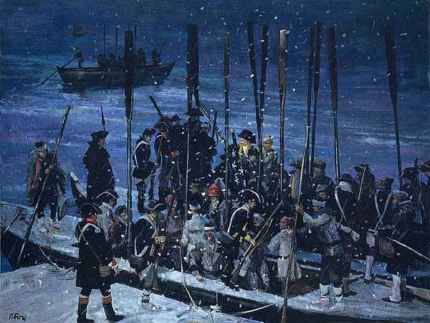
The necessity of using larger ferries to carry pieces of artillery across the river caused even more delays. Washington crossed the river with John Glover's Marblehead mariners and upon arrival debated whether or not to cancel the entire operation because it was more than three hours behind schedule.
Washington decided it was too costly to retreat and he painfully watched as his army continued to trickle across the river.
http://www.mountvernon.org/digital-encyclopedia/article/crossing-of-the-delaware
By Mort Kunstler

Slide 12
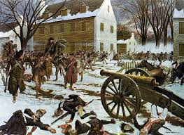
The Hessian force at Trenton numbered 1,400 under the leadership of Colonel Johann Rall. Although Rall had received warnings of colonial movements, his men were exhausted and unprepared for Washington’s attack.
As he approached the town, Washington divided his men, sending flanking columns under General Nathaniel Greene and General John Sullivan.
Meanwhile, Colonel Henry Knox’s cannons fired on the garrison. Rall attempted to rally his troops but was never able to establish a defensive perimeter, and was shot from his horse and fatally wounded.
The Hessians quickly surrendered. All told, 22 were killed, 92 wounded, 918 captured and 400 escaped. The Americans suffered two frozen to death and five wounded.
http://www.history.com/topics/american-revolution/battles-of-trenton-and-princeton

Slide 13
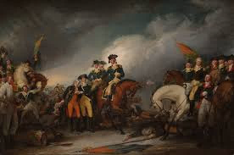
It was there, at Trenton, that Washington secured the Continental Army's first major military victory of the war.
Without the determination, resiliency, and leadership he exhibited while crossing the Delaware River the victory at Trenton would not have been possible.
http://www.mountvernon.org/digital-encyclopedia/article/crossing-of-the-delaware

Slide 14
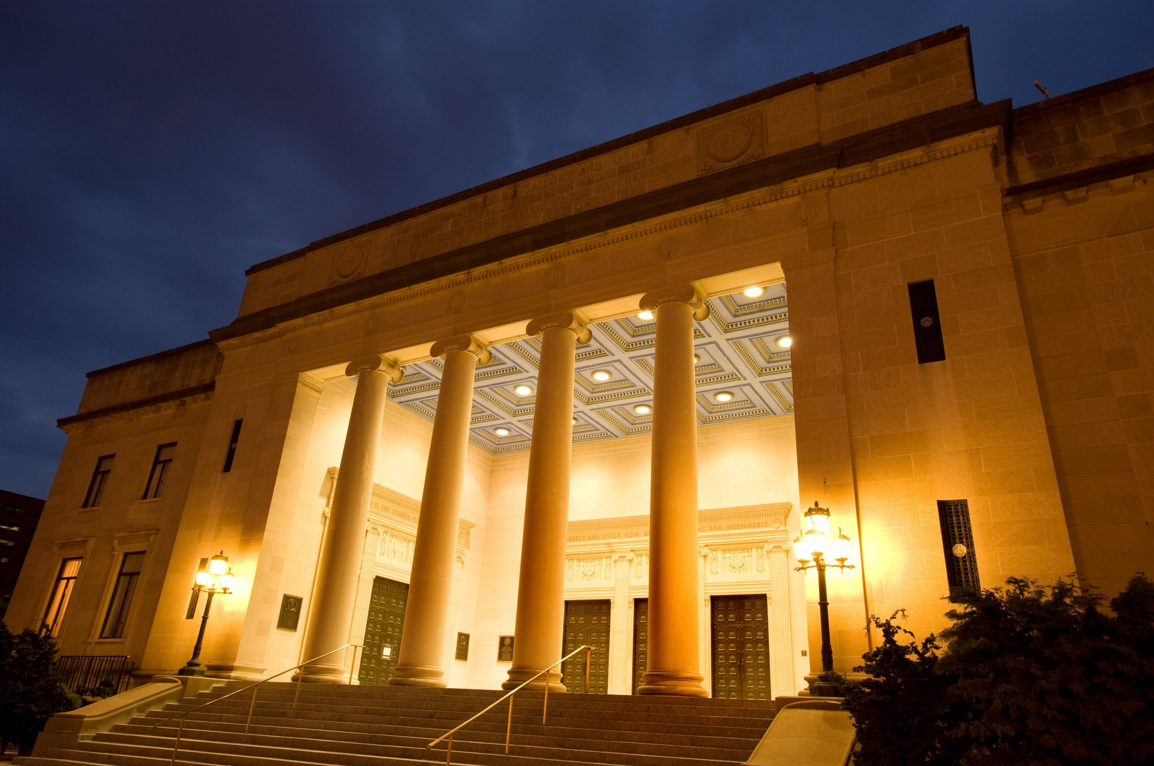
Trenton War Memorial Building
With enlistments in the Continental Army about to expire at the end of the year, Washington risked everything in a surprise attack on Trenton on the morning of 26 December 1776.
Many historians consider the resulting Battle of Trenton a major turning point of the American Revolution.
http://www.kean.edu/~NJHPP/americanRevolution/theWar/lesson/theWarLesson.pdf
123rf.com

Slide 15
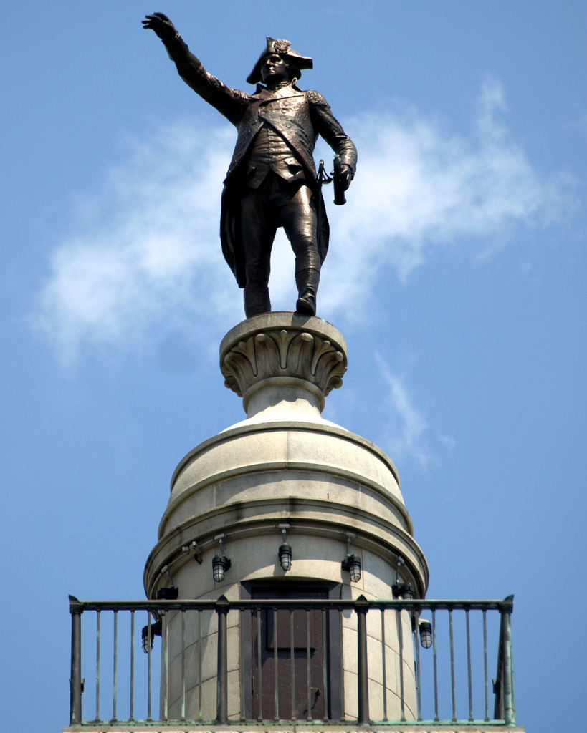
Key Words
formidable garrison pursued
Continental Army ammunition Hessian
diversionary force mercenaries anticipation
strategic motivation regiments proximity
defensive perimeter ice jams artillery

