Slide 1
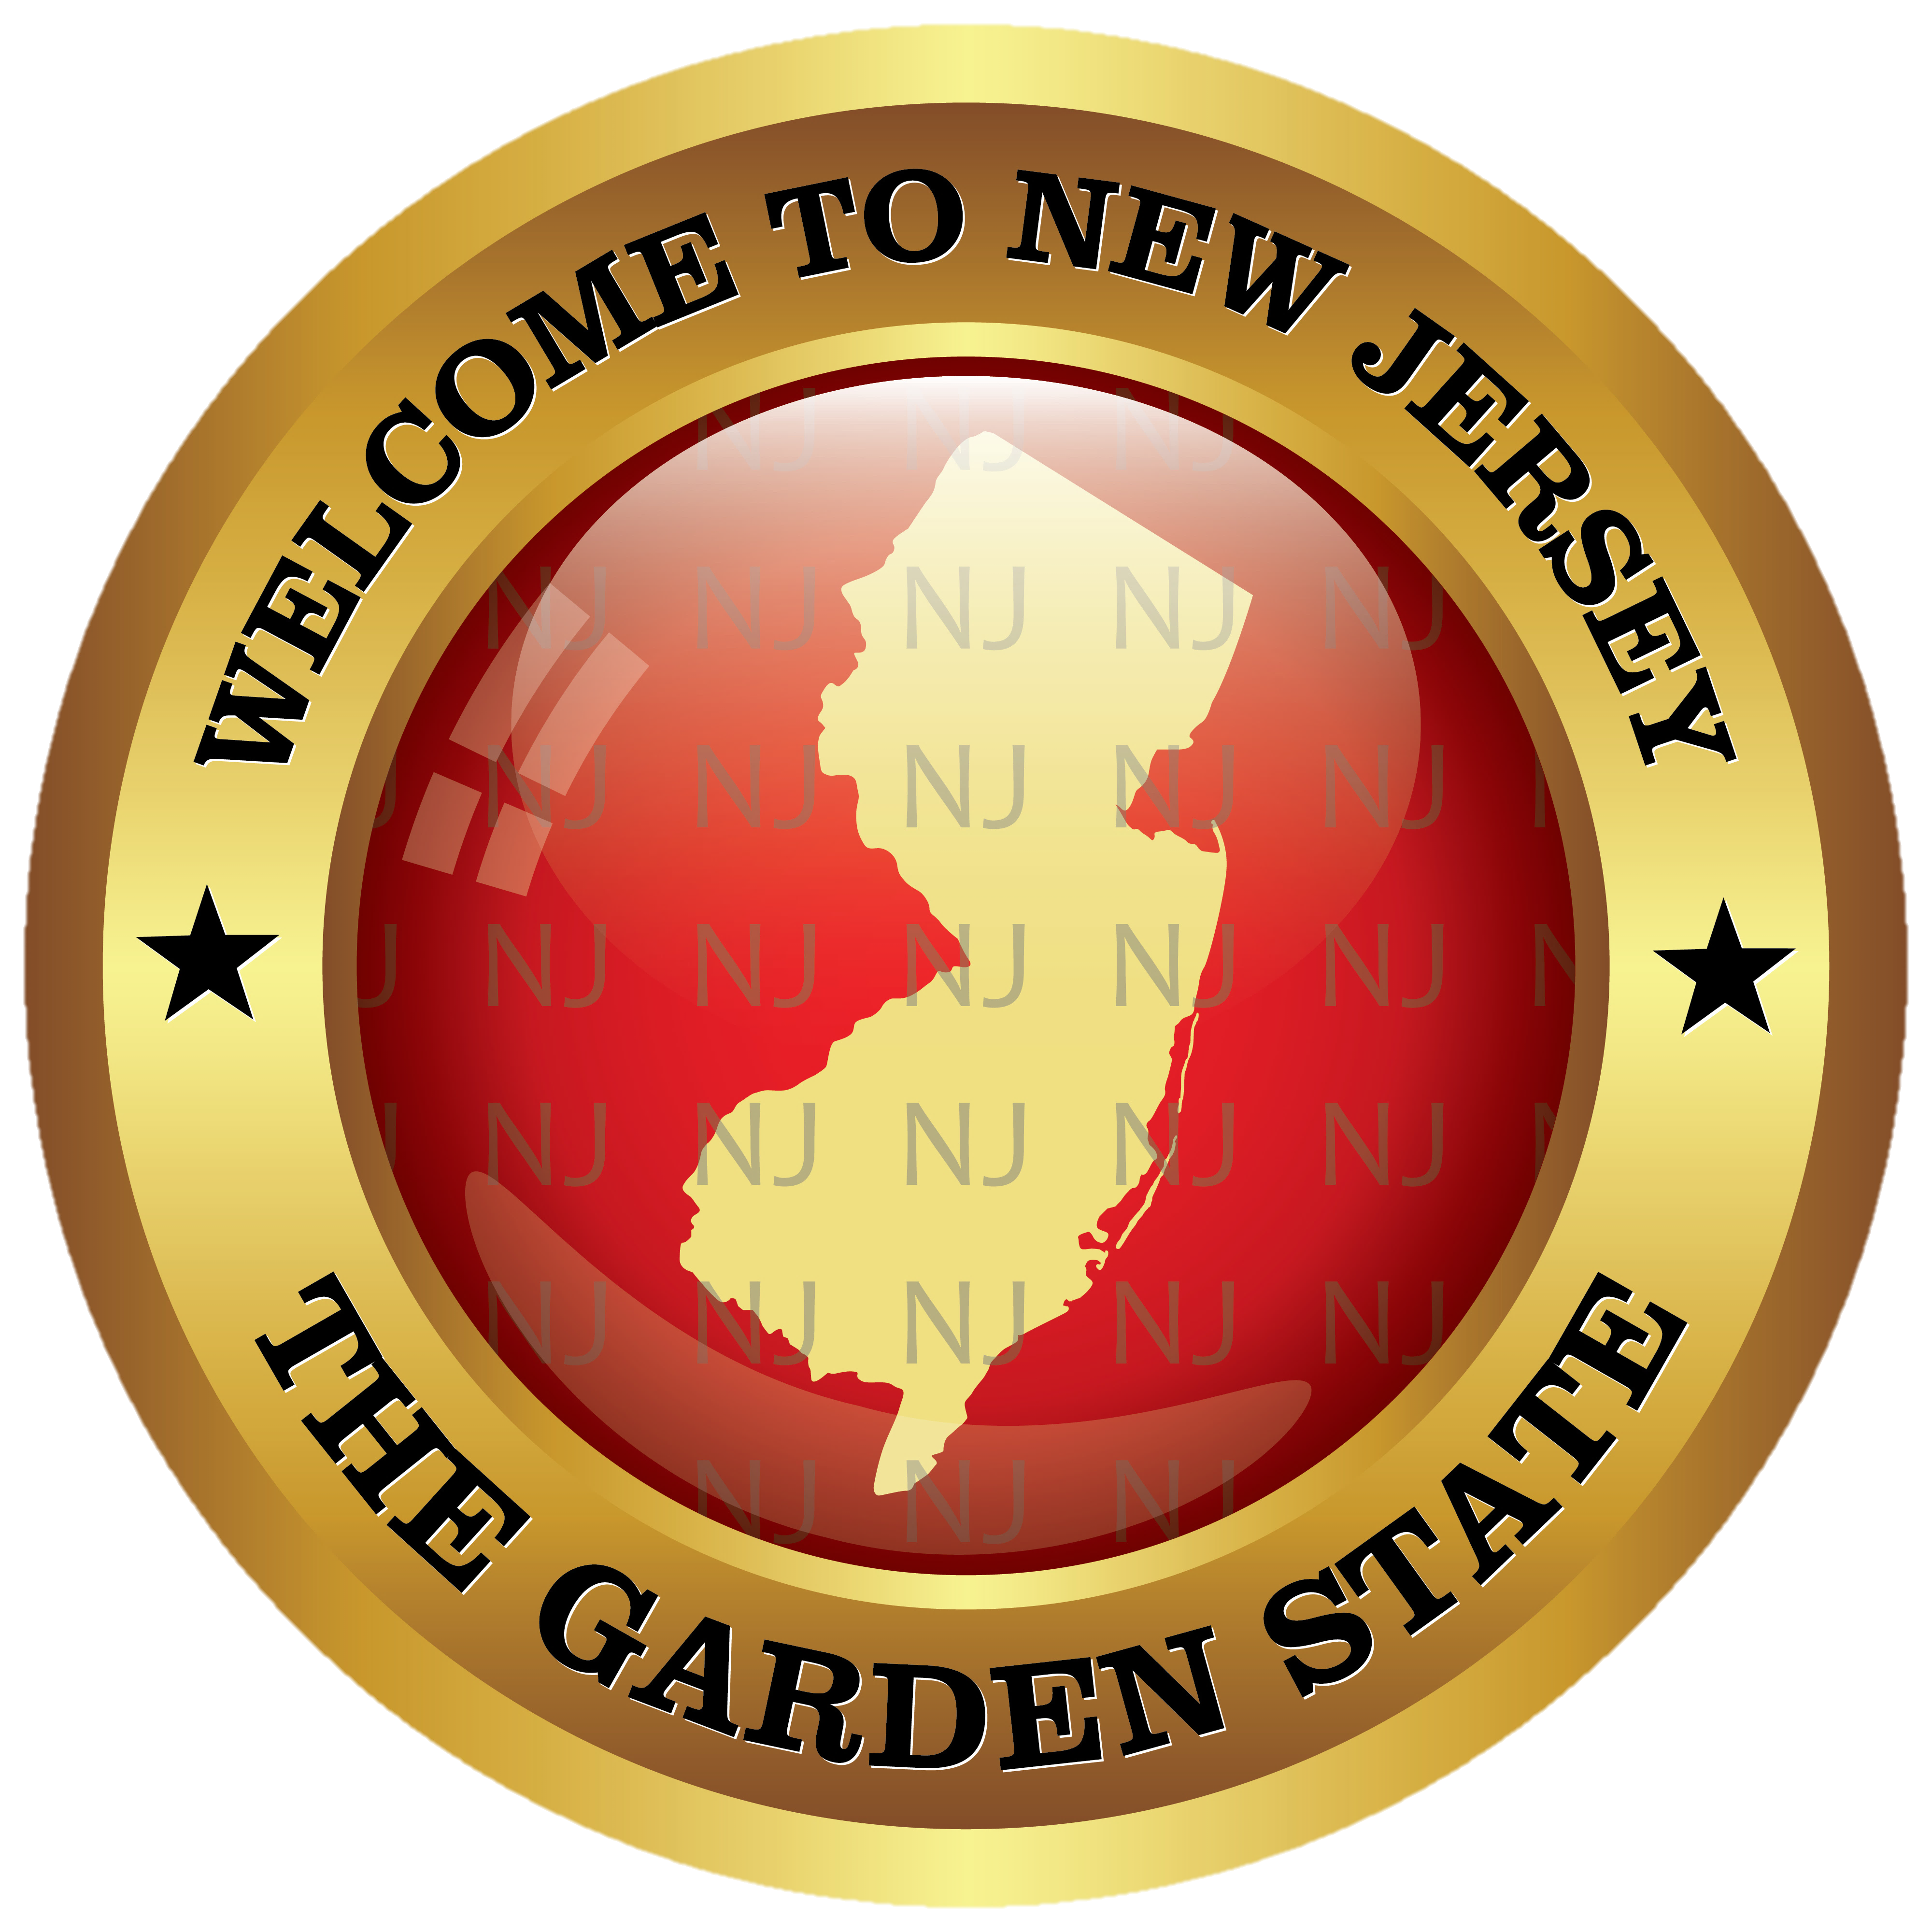
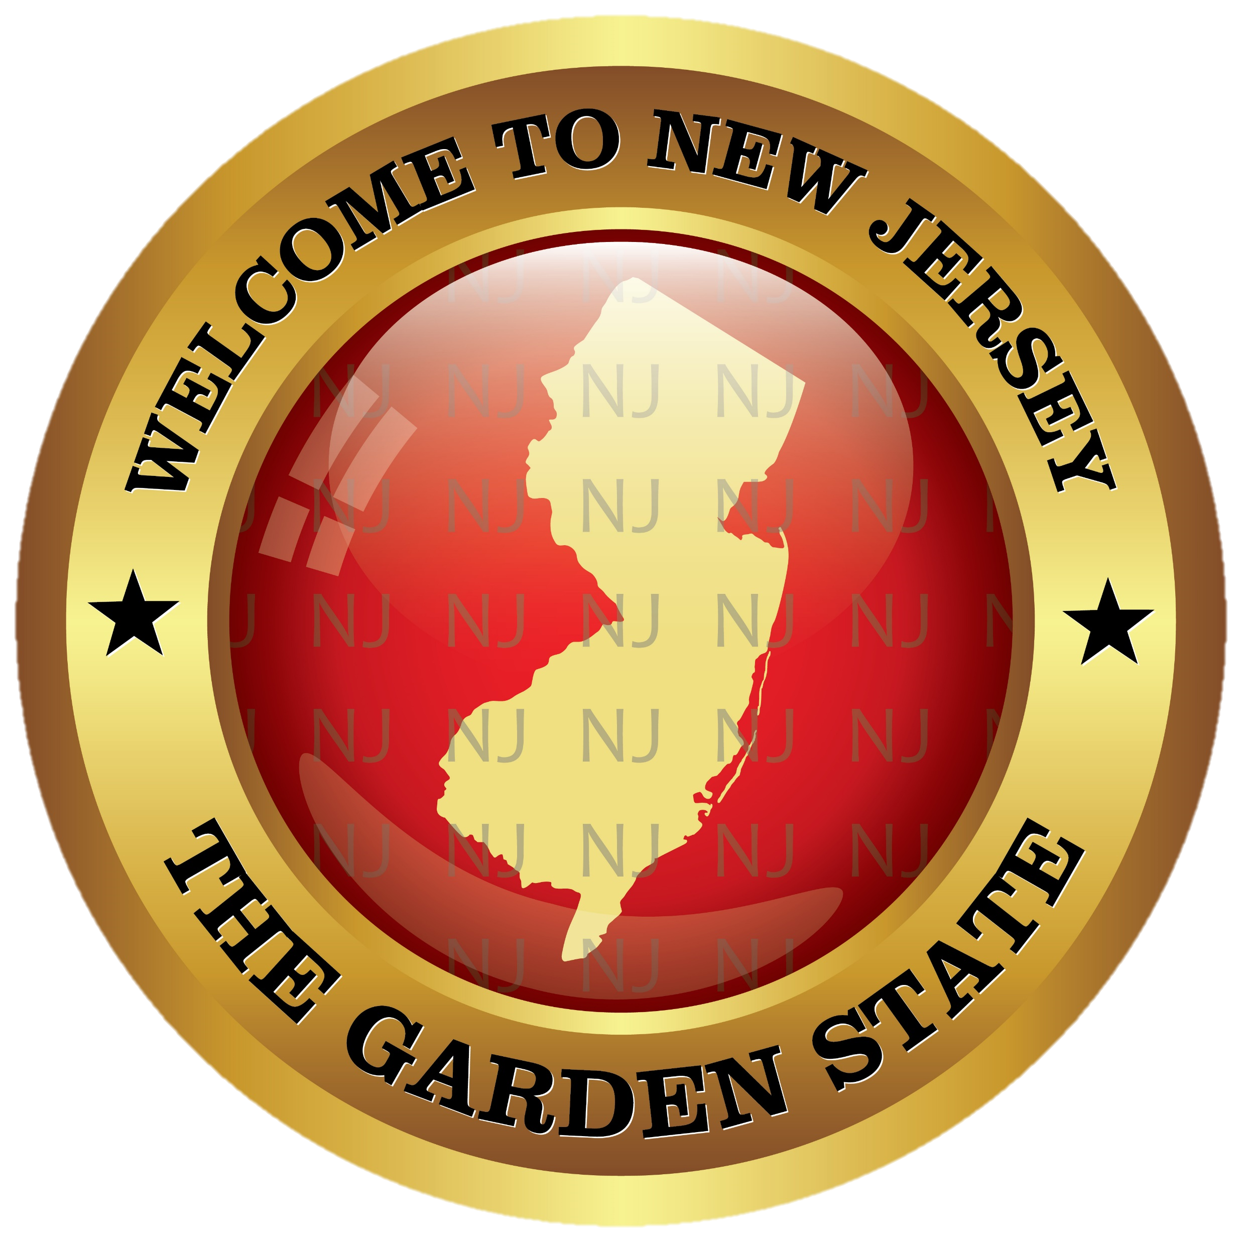
NICKY FIFTH’S NEW JERSEY
N5NJ
SECONDARY PROGRAM
HISTORY
Civil War

Slide 2
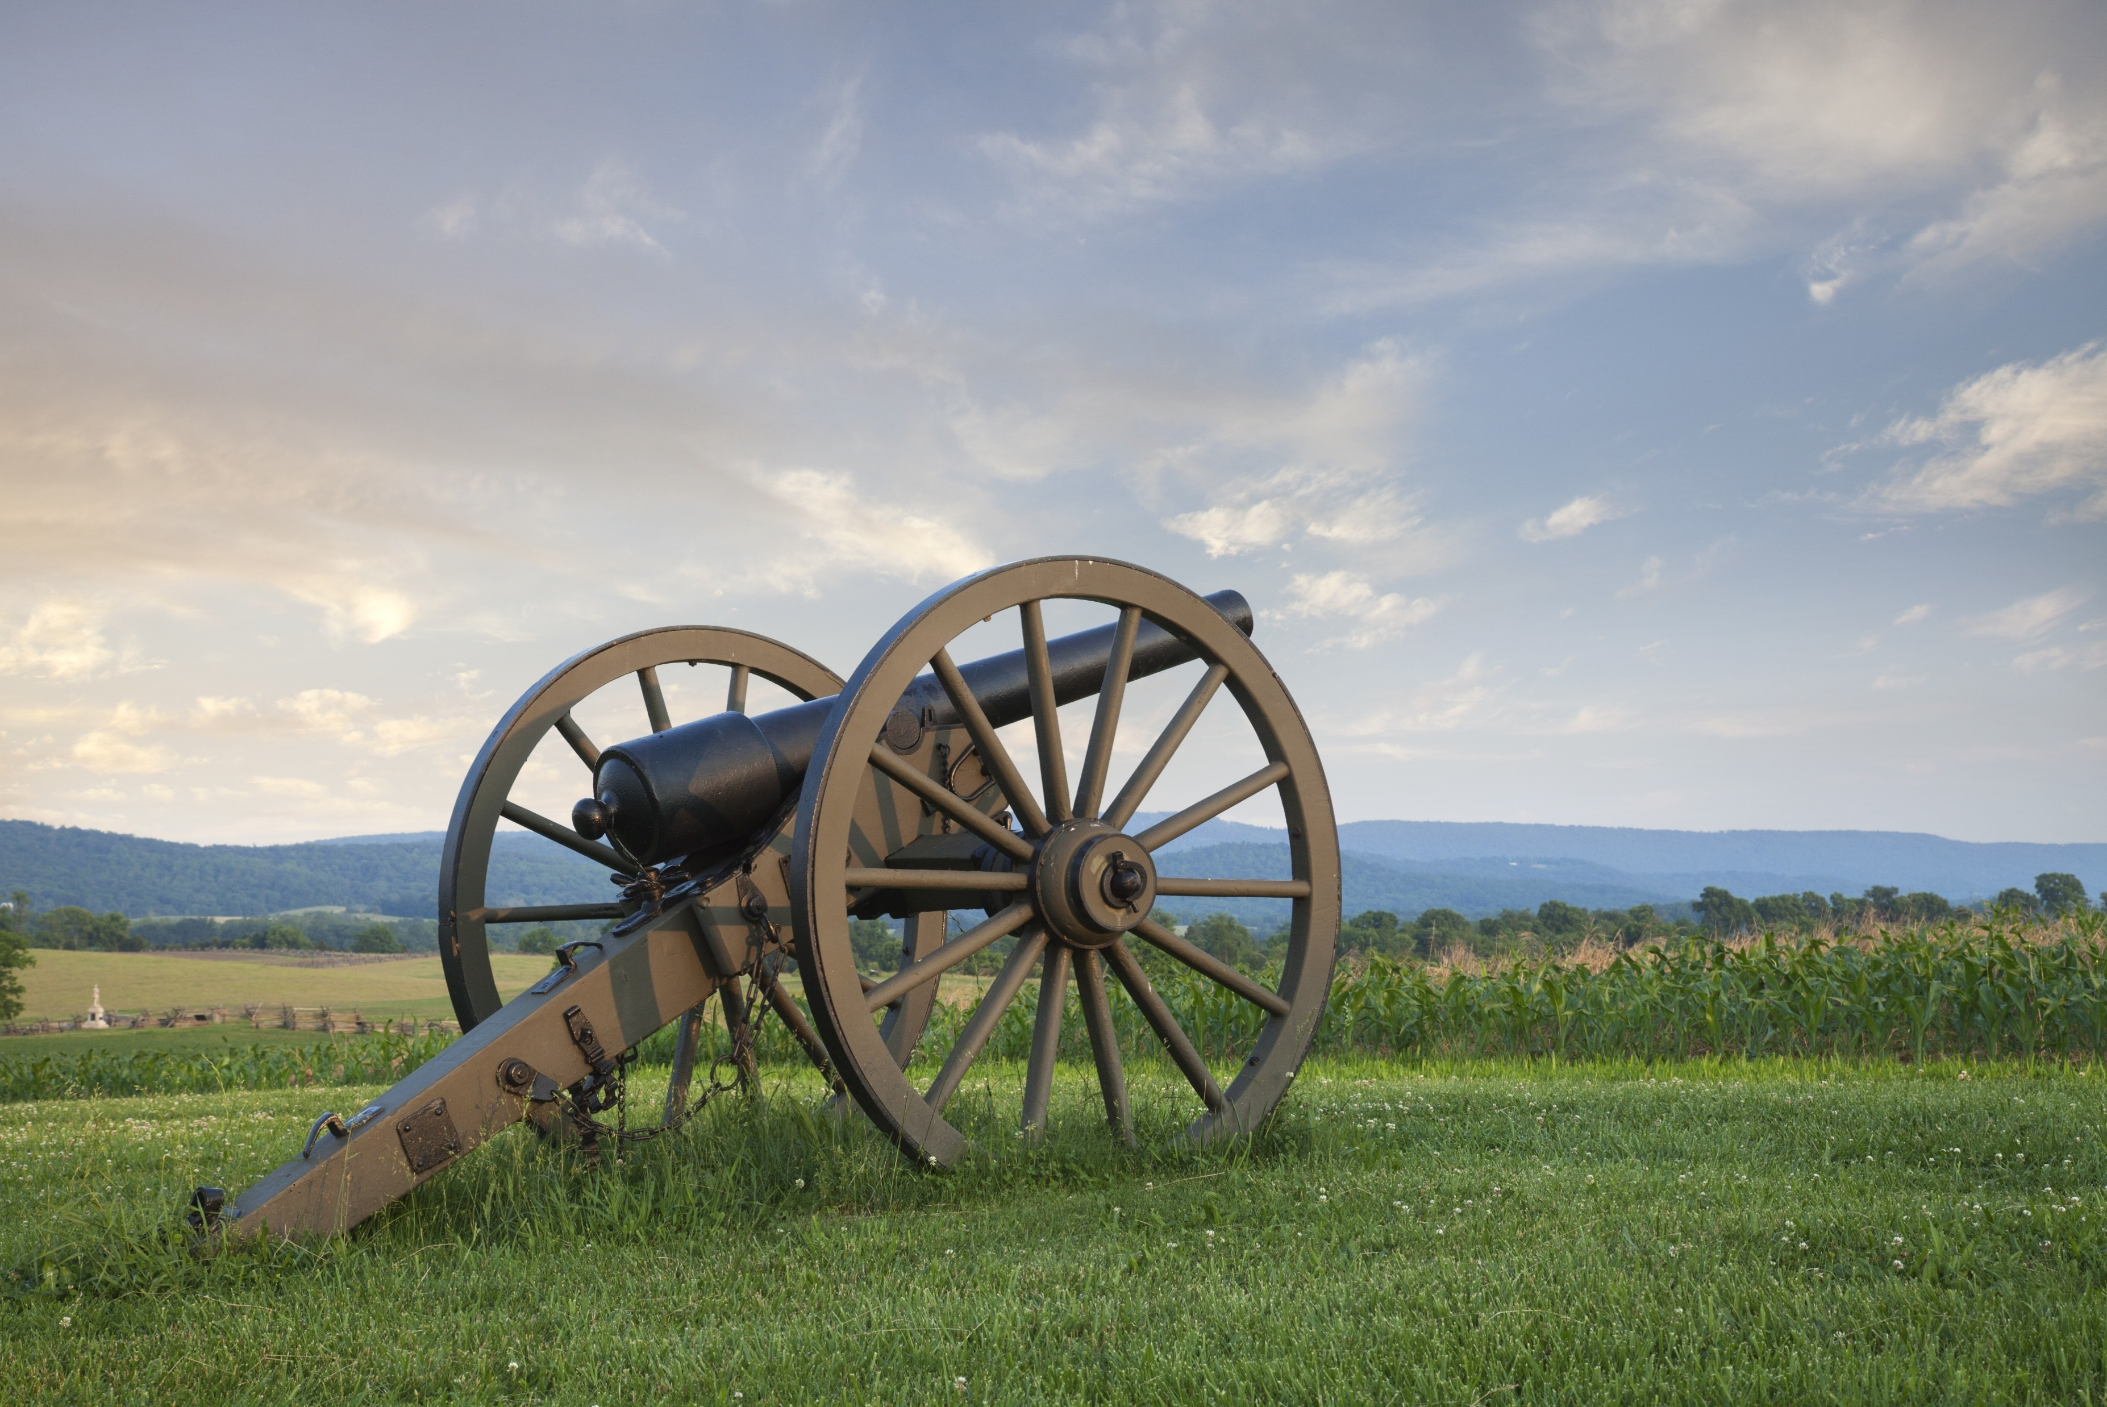
“Oh, for an end to this war!” wrote Frances Cooper of Hoboken to her fiancé, in August 1862, little knowing that the war would continue for almost three more years.
Her statement epitomizes the Civil War in New Jersey, where a conflict that the state entered reluctantly seemed never-ending.
https://www.libraries.rutgers.edu/rul/exhibits/struggle_without_end/struggle_without_end.php#case:1
123rf.com

Slide 3
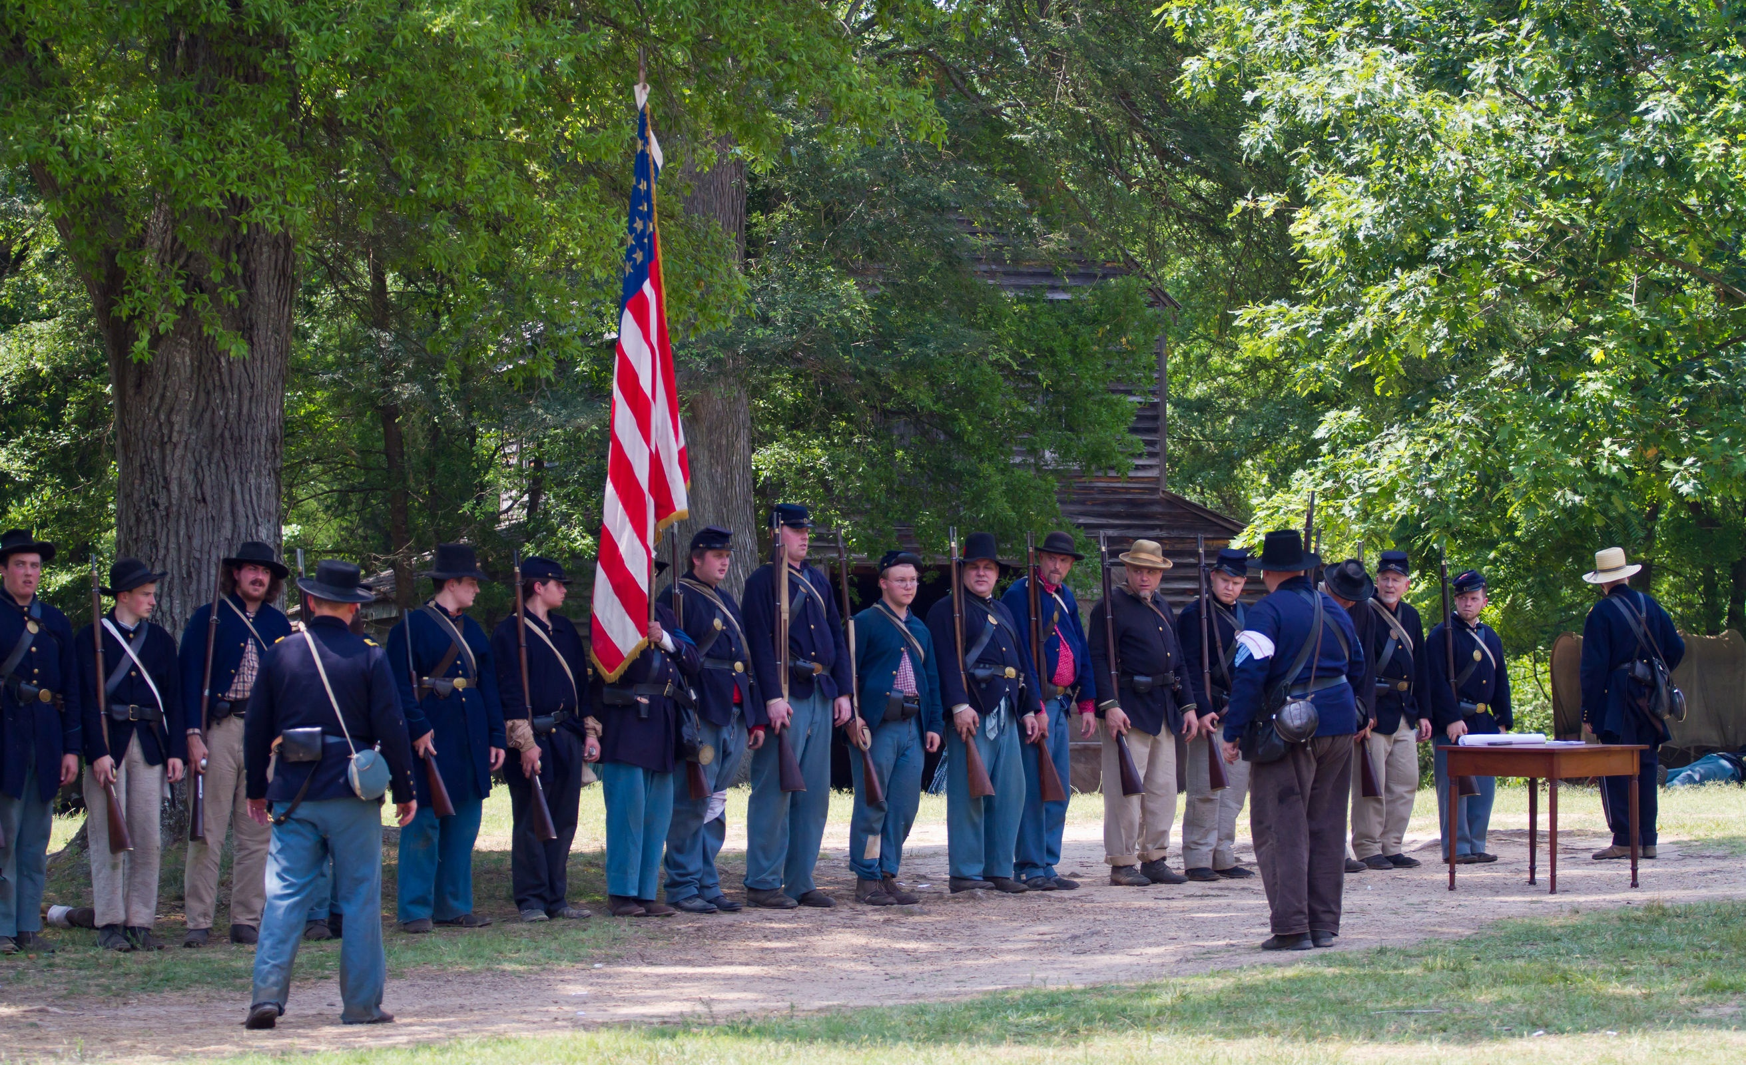
New Jersey, the only free state in the North not to support Abraham Lincoln in the 1860 election, was initially divided over the war, although ultimately most people supported the Union cause.
On the home front, women, children, and the elderly struggled to keep farms and businesses afloat in the absence of husbands and fathers. Women played an important role in raising money for the war, although their participation was limited by the social expectations of the time.
https://www.libraries.rutgers.edu/rul/exhibits/struggle_without_end/struggle_without_end.php#case:1
123rf.com

Slide 4
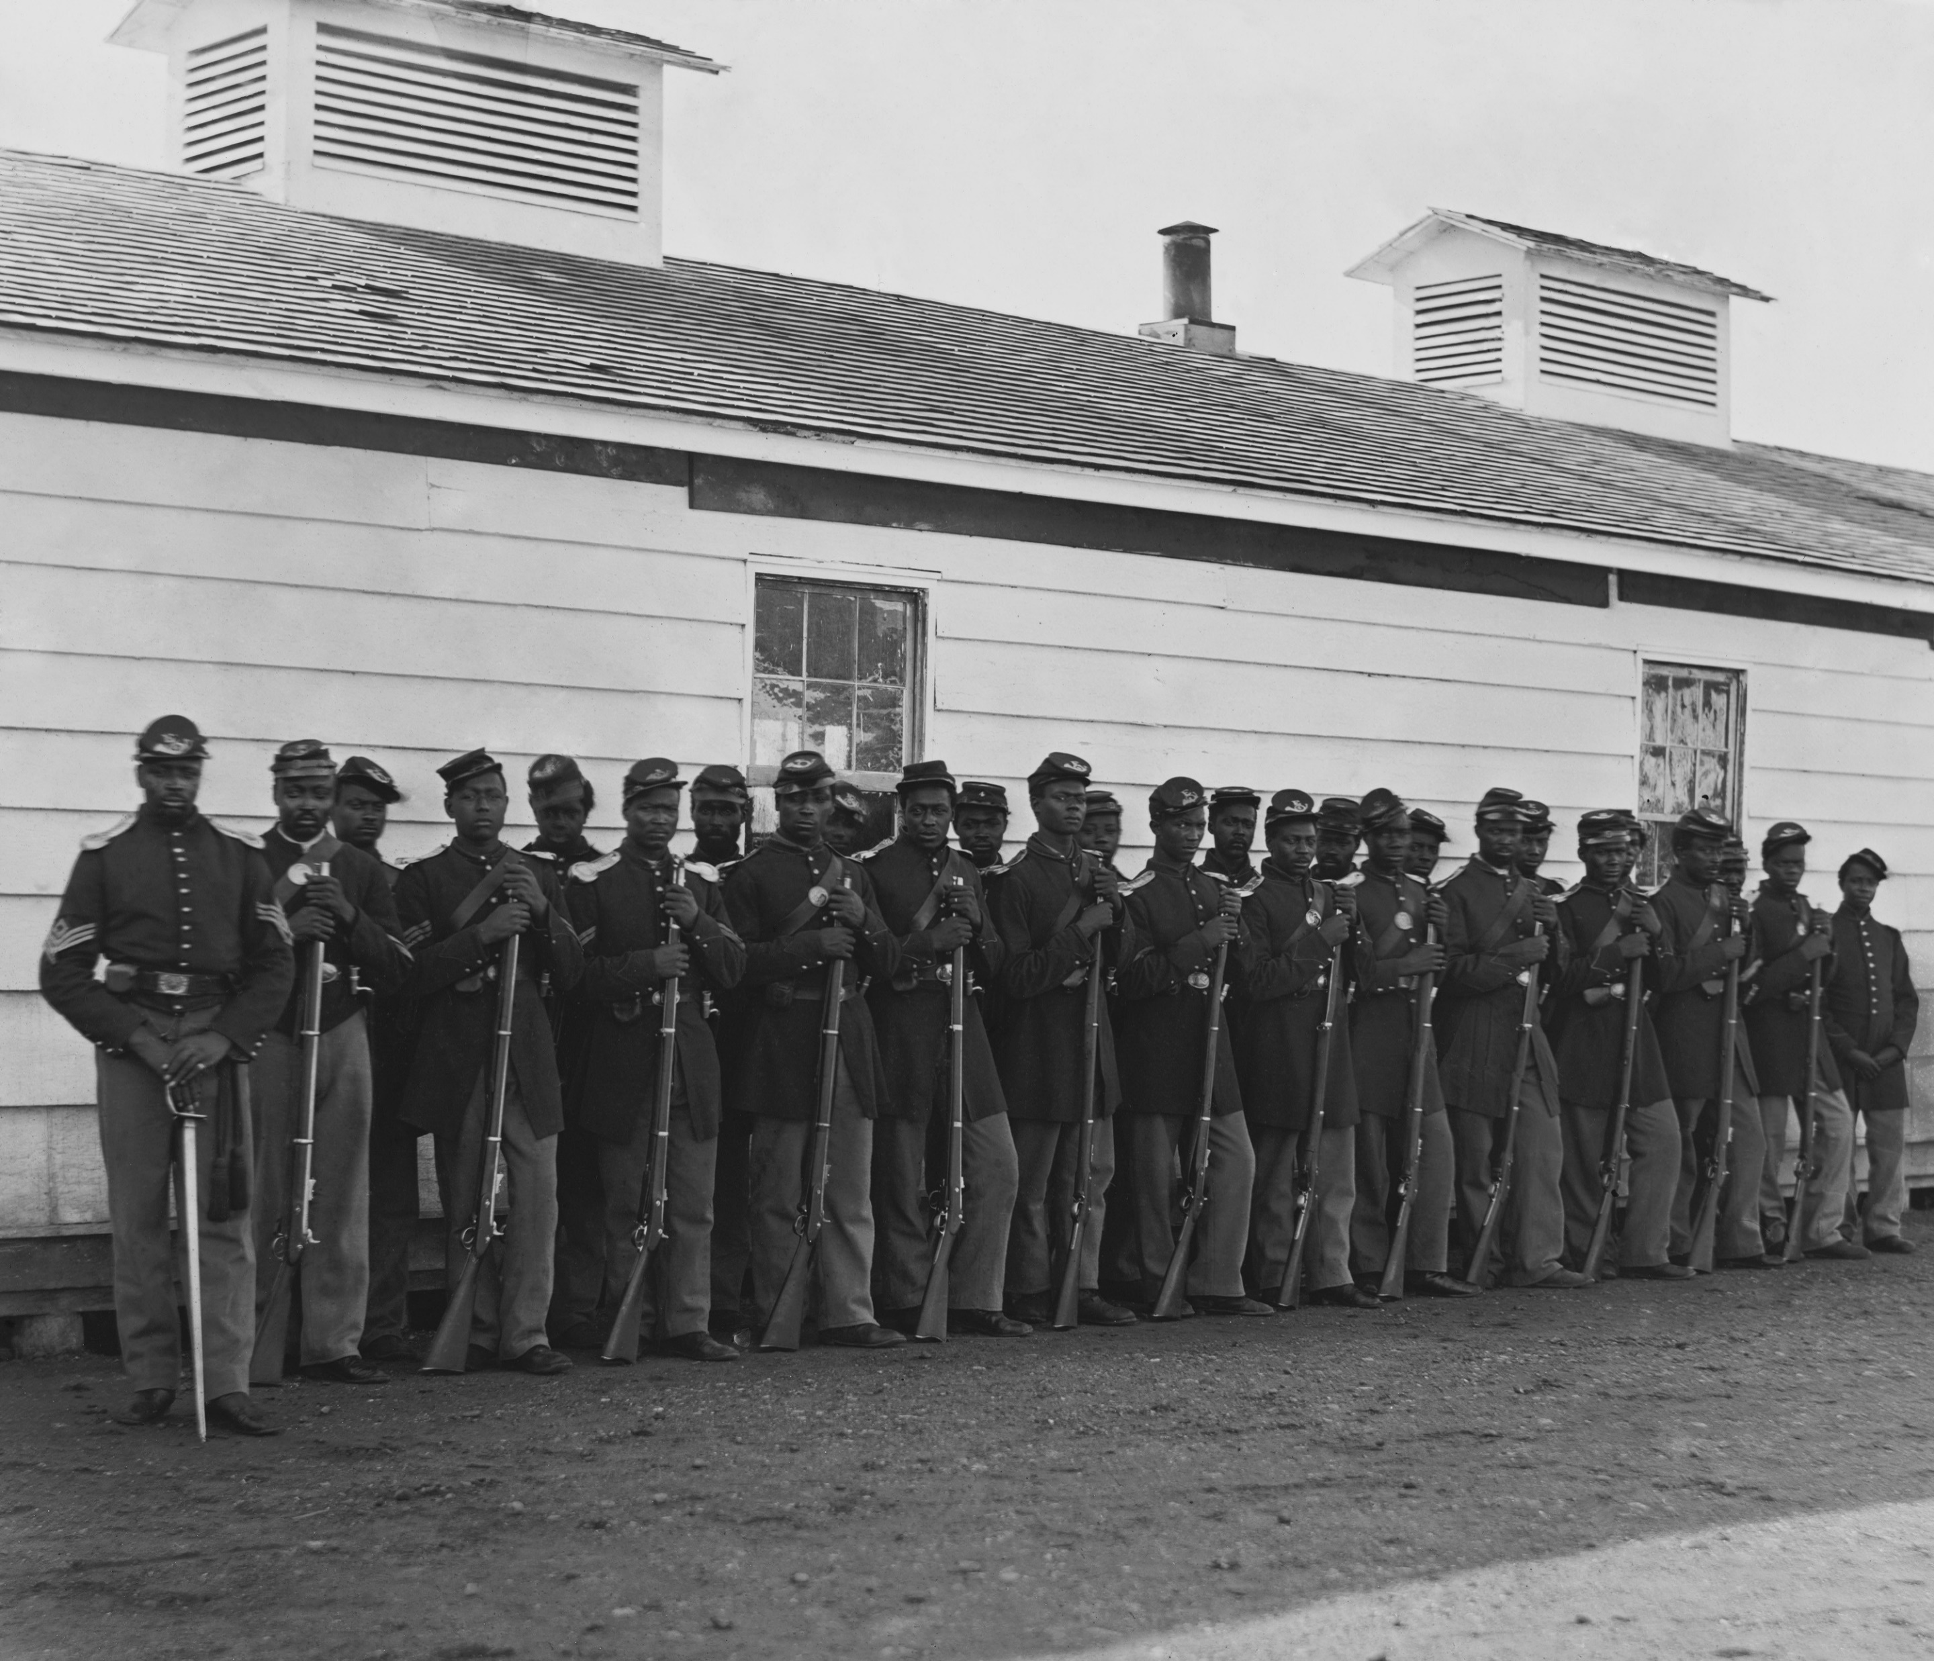
A large and vibrant African-American community lived in New Jersey before the Civil War. On the eve of the conflict, the black population was 25, 336 out of a total of 646,699.
While African Americans welcomed the fight to abolish slavery, they were constrained in their participation in the conflict by the segregated society of the day.
https://www.libraries.rutgers.edu/rul/exhibits/struggle_without_end/struggle_without_end.php#case:1

Slide 5
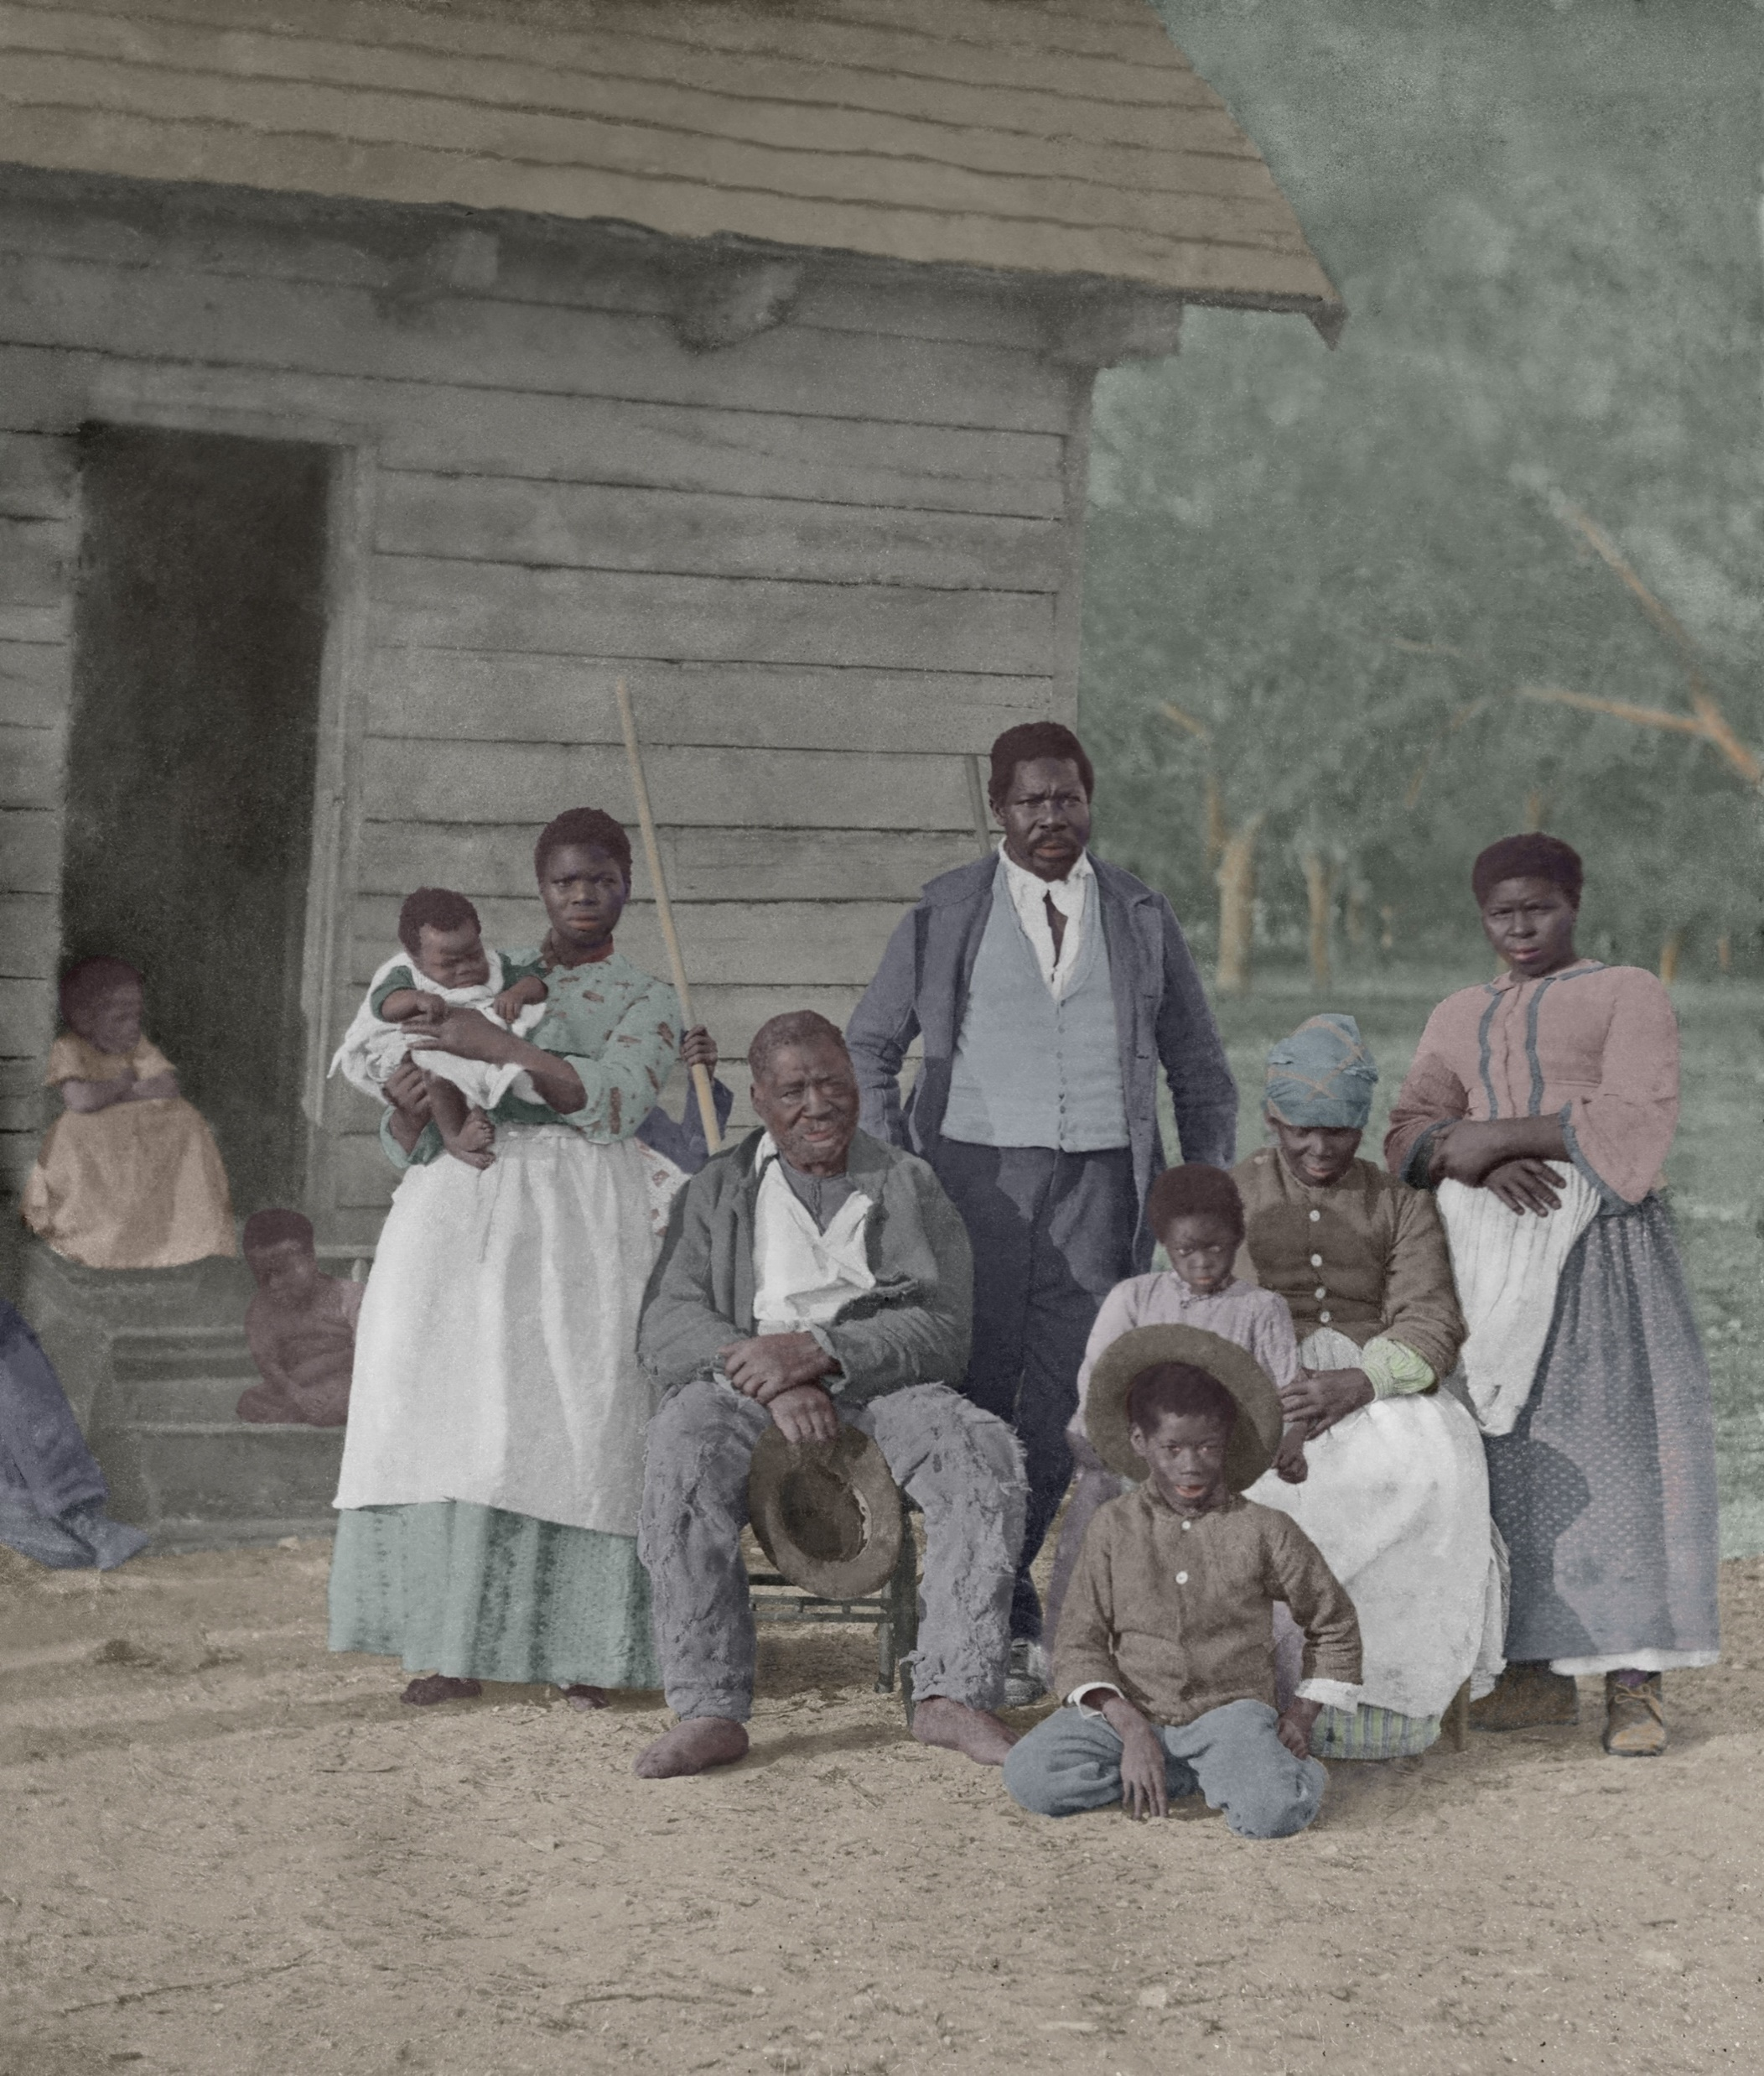
The new state constitution of 1844 restricted voting to white male citizens. African Americans in New Jersey also faced poverty, job discrimination, and racism.
The Fugitive Slave Bill subjected escapees from the South to deportation.
During the tense period leading up to the conflict, African-American community leaders emerged to play important roles in the abolition movement and the Underground Railroad.
https://www.libraries.rutgers.edu/rul/exhibits/struggle_without_end/struggle_without_end.php#case:1
Five generations of a slave family, 1862
Authentic photo, digital re-touched
123rf.com

Slide 6
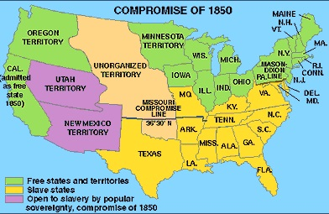
In the late 1850s, the controversy over slavery in the new territories led to political turmoil, out of which emerged the new Republican Party, which was against the expansion of slavery and pro-immigration. Politics at the state level reflected the national turmoil.
The Republicans were challenged by “the Opposition,” made up of former Whigs, the nativist American Party (Know-Nothings), and disaffected Republicans.
https://www.libraries.rutgers.edu/rul/exhibits/struggle_without_end/struggle_without_end.php#case:1

Slide 7
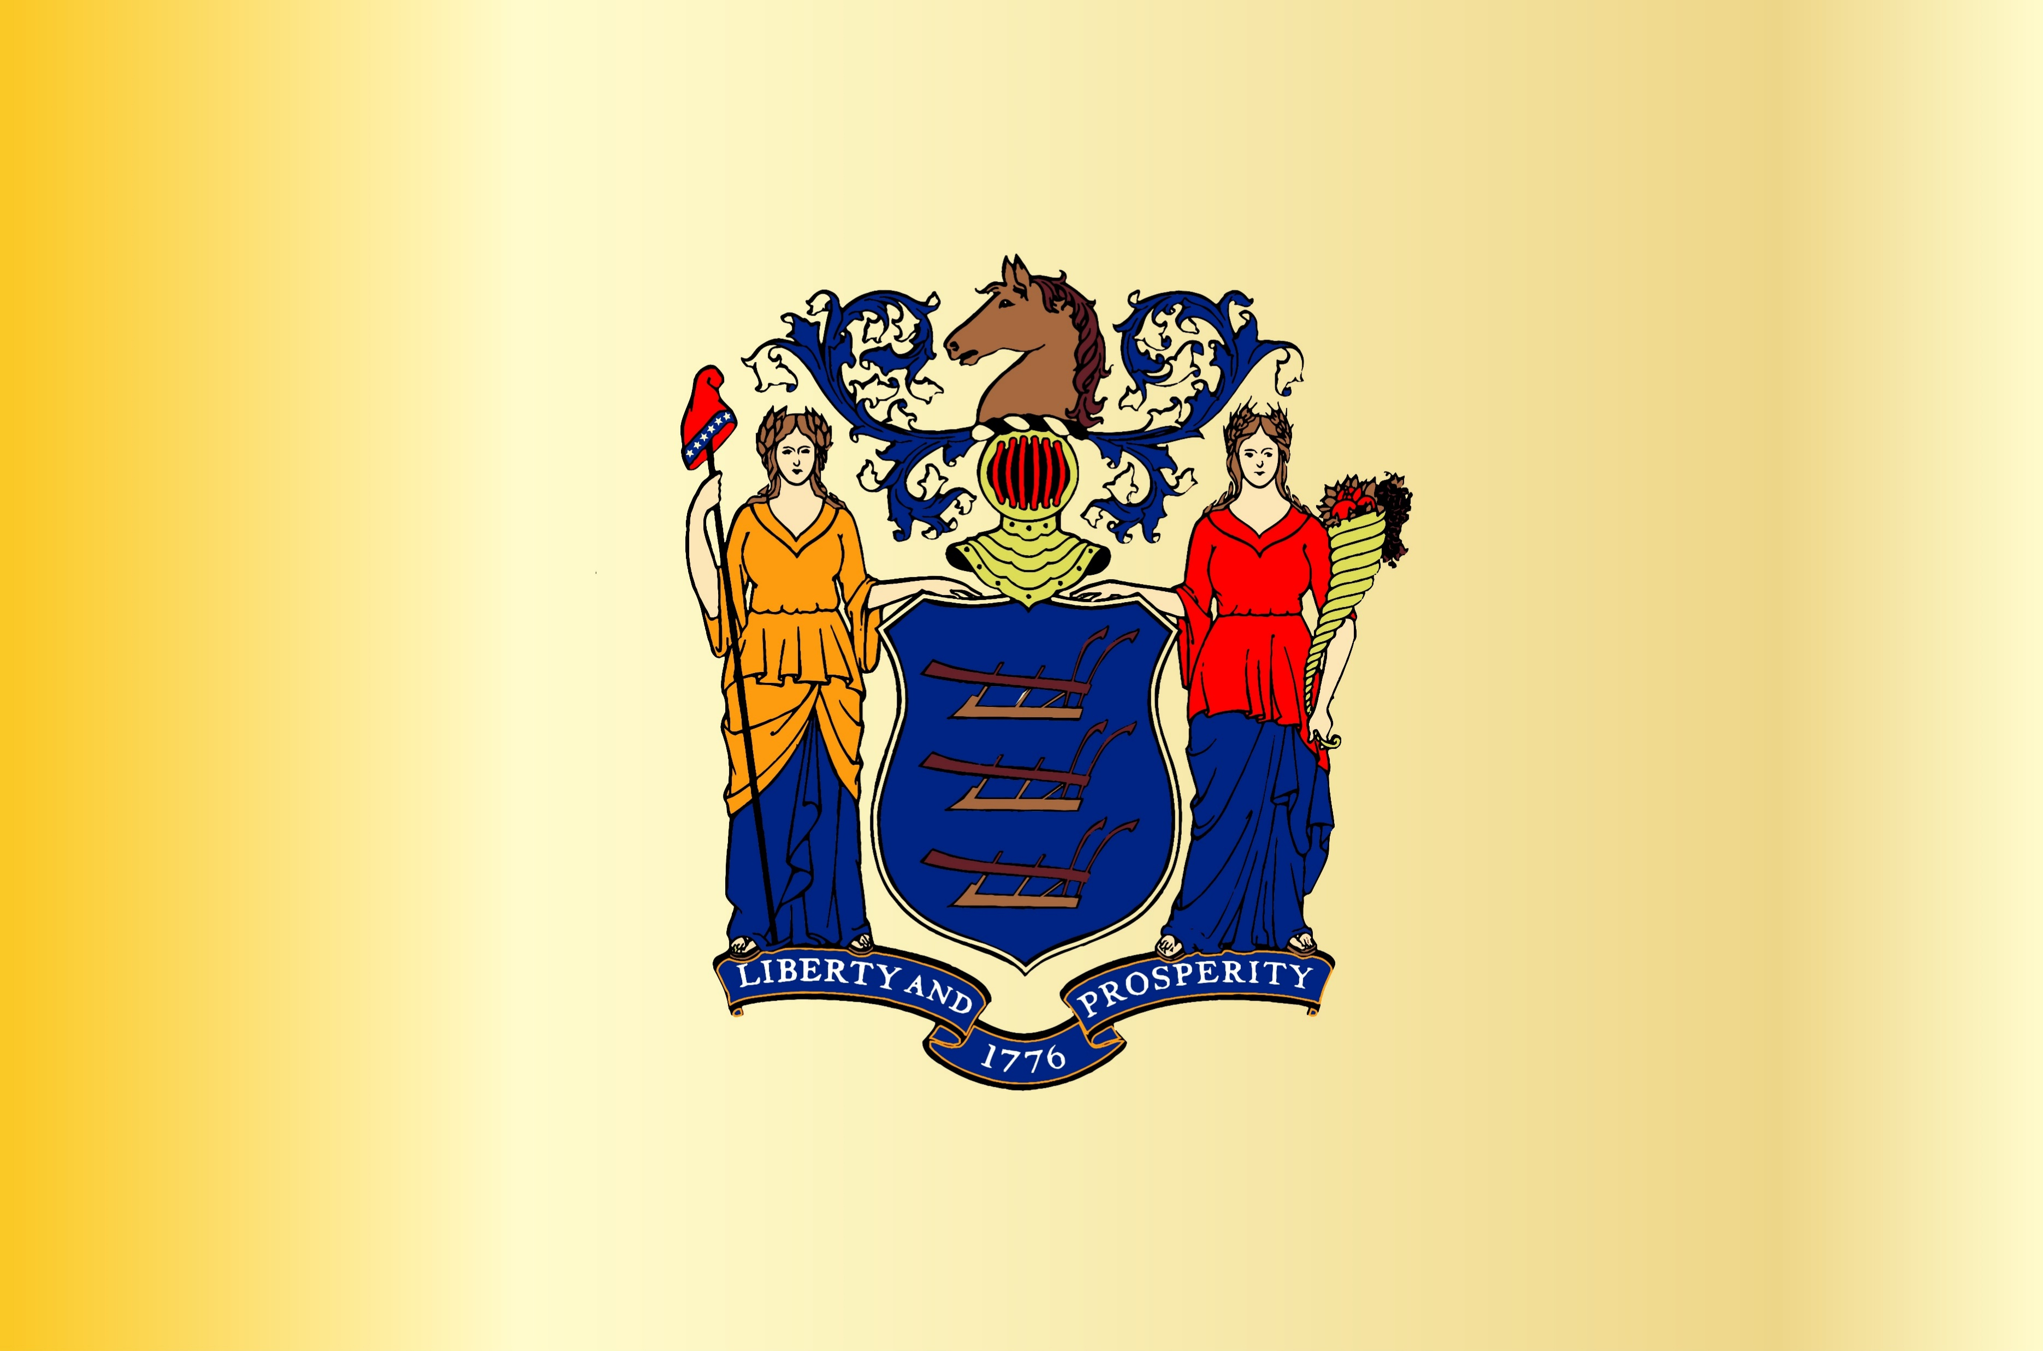
The Opposition was strong enough to elect Charles S. Olden as governor by a small margin in 1859. Although a Quaker, Olden was conservative on slavery issues. This uneasy coalition broke apart in the national elections the following year.
The New York Times described politics in New Jersey in 1860 as “a confused melee.” The Democratic Party split in four: supporters of Stephen Douglas, who was nationalist and neutral on slavery; supporters of the South’s view of slavery and states’ rights; the Constitutional Union, which tried to avoid the issue of slavery altogether; and the remnants of the Opposition. Republican Abraham Lincoln received fewer popular votes than Douglass in New Jersey, but won four of the state’s seven electoral votes.
https://www.libraries.rutgers.edu/rul/exhibits/struggle_without_end/struggle_without_end.php#case:1

Slide 8
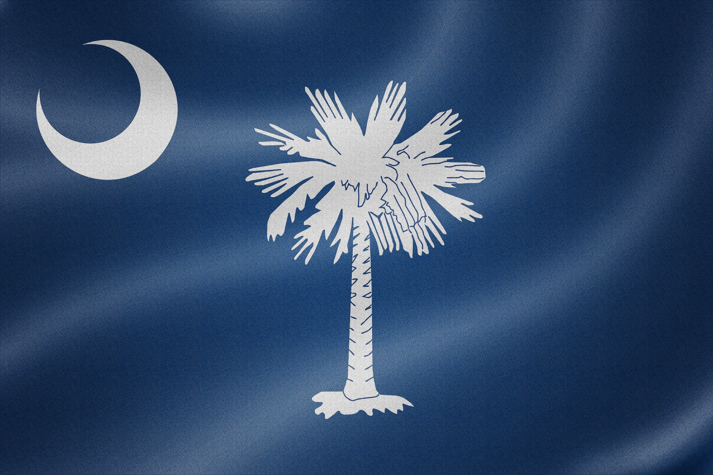
In December 1860, South Carolina rejected the election results and seceded from the Union.
South Carolina was followed by ten other southern states, forming the Confederate States of America in February. In New Jersey, the constitutional crisis created confusion and further division, with many people seeking compromise.
The outbreak of war in April and Lincoln’s call for troops led to an outpouring of patriotism and support for the Union cause in the state. As the months passed, conflict with those who advocated a negotiated peace again surfaced.
https://www.libraries.rutgers.edu/rul/exhibits/struggle_without_end/struggle_without_end.php#case:1
123rf.com
South Carolina Flag

Slide 9
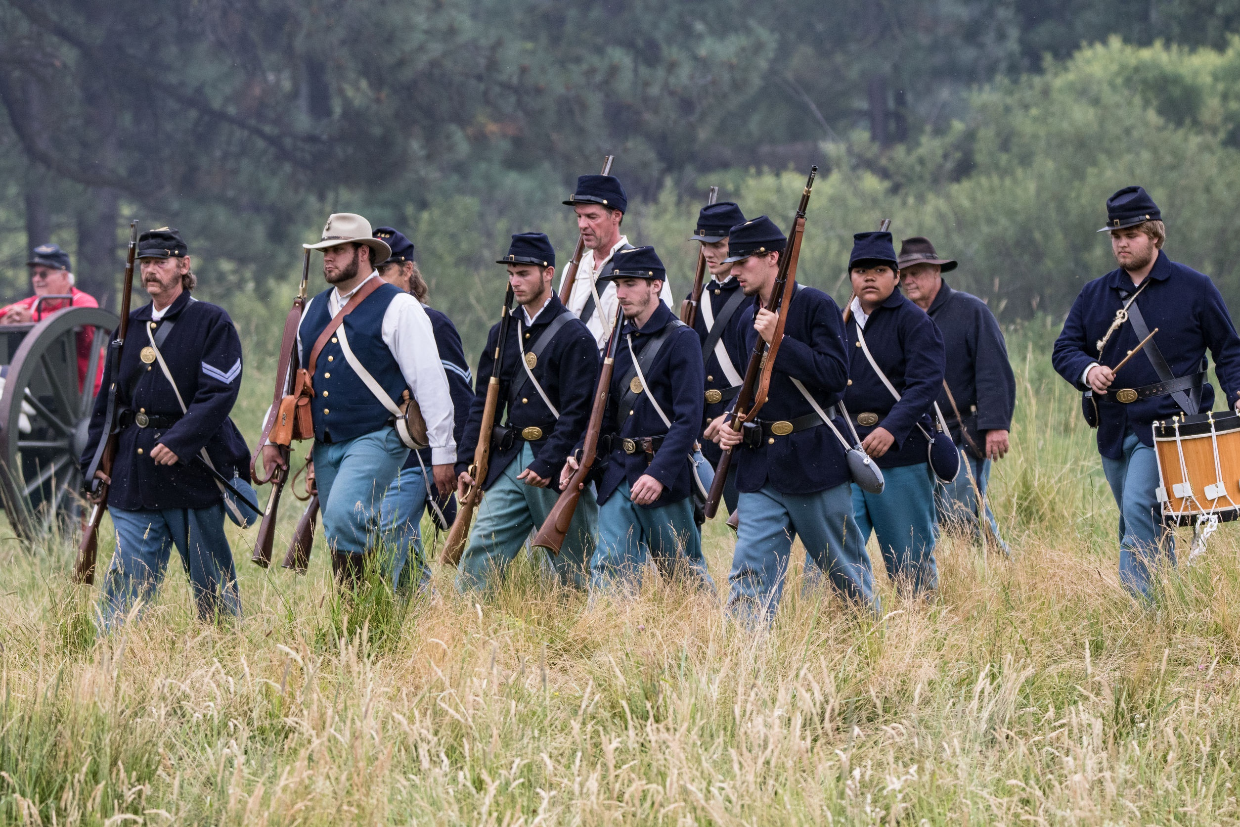
When war broke out, the regular army only had 16,000 men, many of whom were dispersed on the frontier. In calling for troops, Lincoln was relying on the northern state militias and the good will of governors to assist him. In New Jersey, the militia lacked training, arms, and ammunition. Furthermore, New Jersey did not have cavalry or artillery militia. Although young men initially rushed to volunteer, the task of preparing for war was daunting.
When Abraham Lincoln issued a call for troops in April 1861, young men in New Jersey rushed to join up. Recruiters were overwhelmed with volunteers, some of whom turned to regiments in New York and Pennsylvania. By the first week in May, 3,200 New Jersey militiamen became the first full brigade to arrive in Washington, D.C.
https://www.libraries.rutgers.edu/rul/exhibits/struggle_without_end/struggle_without_end.php#case:1
123rf.com

Slide 10
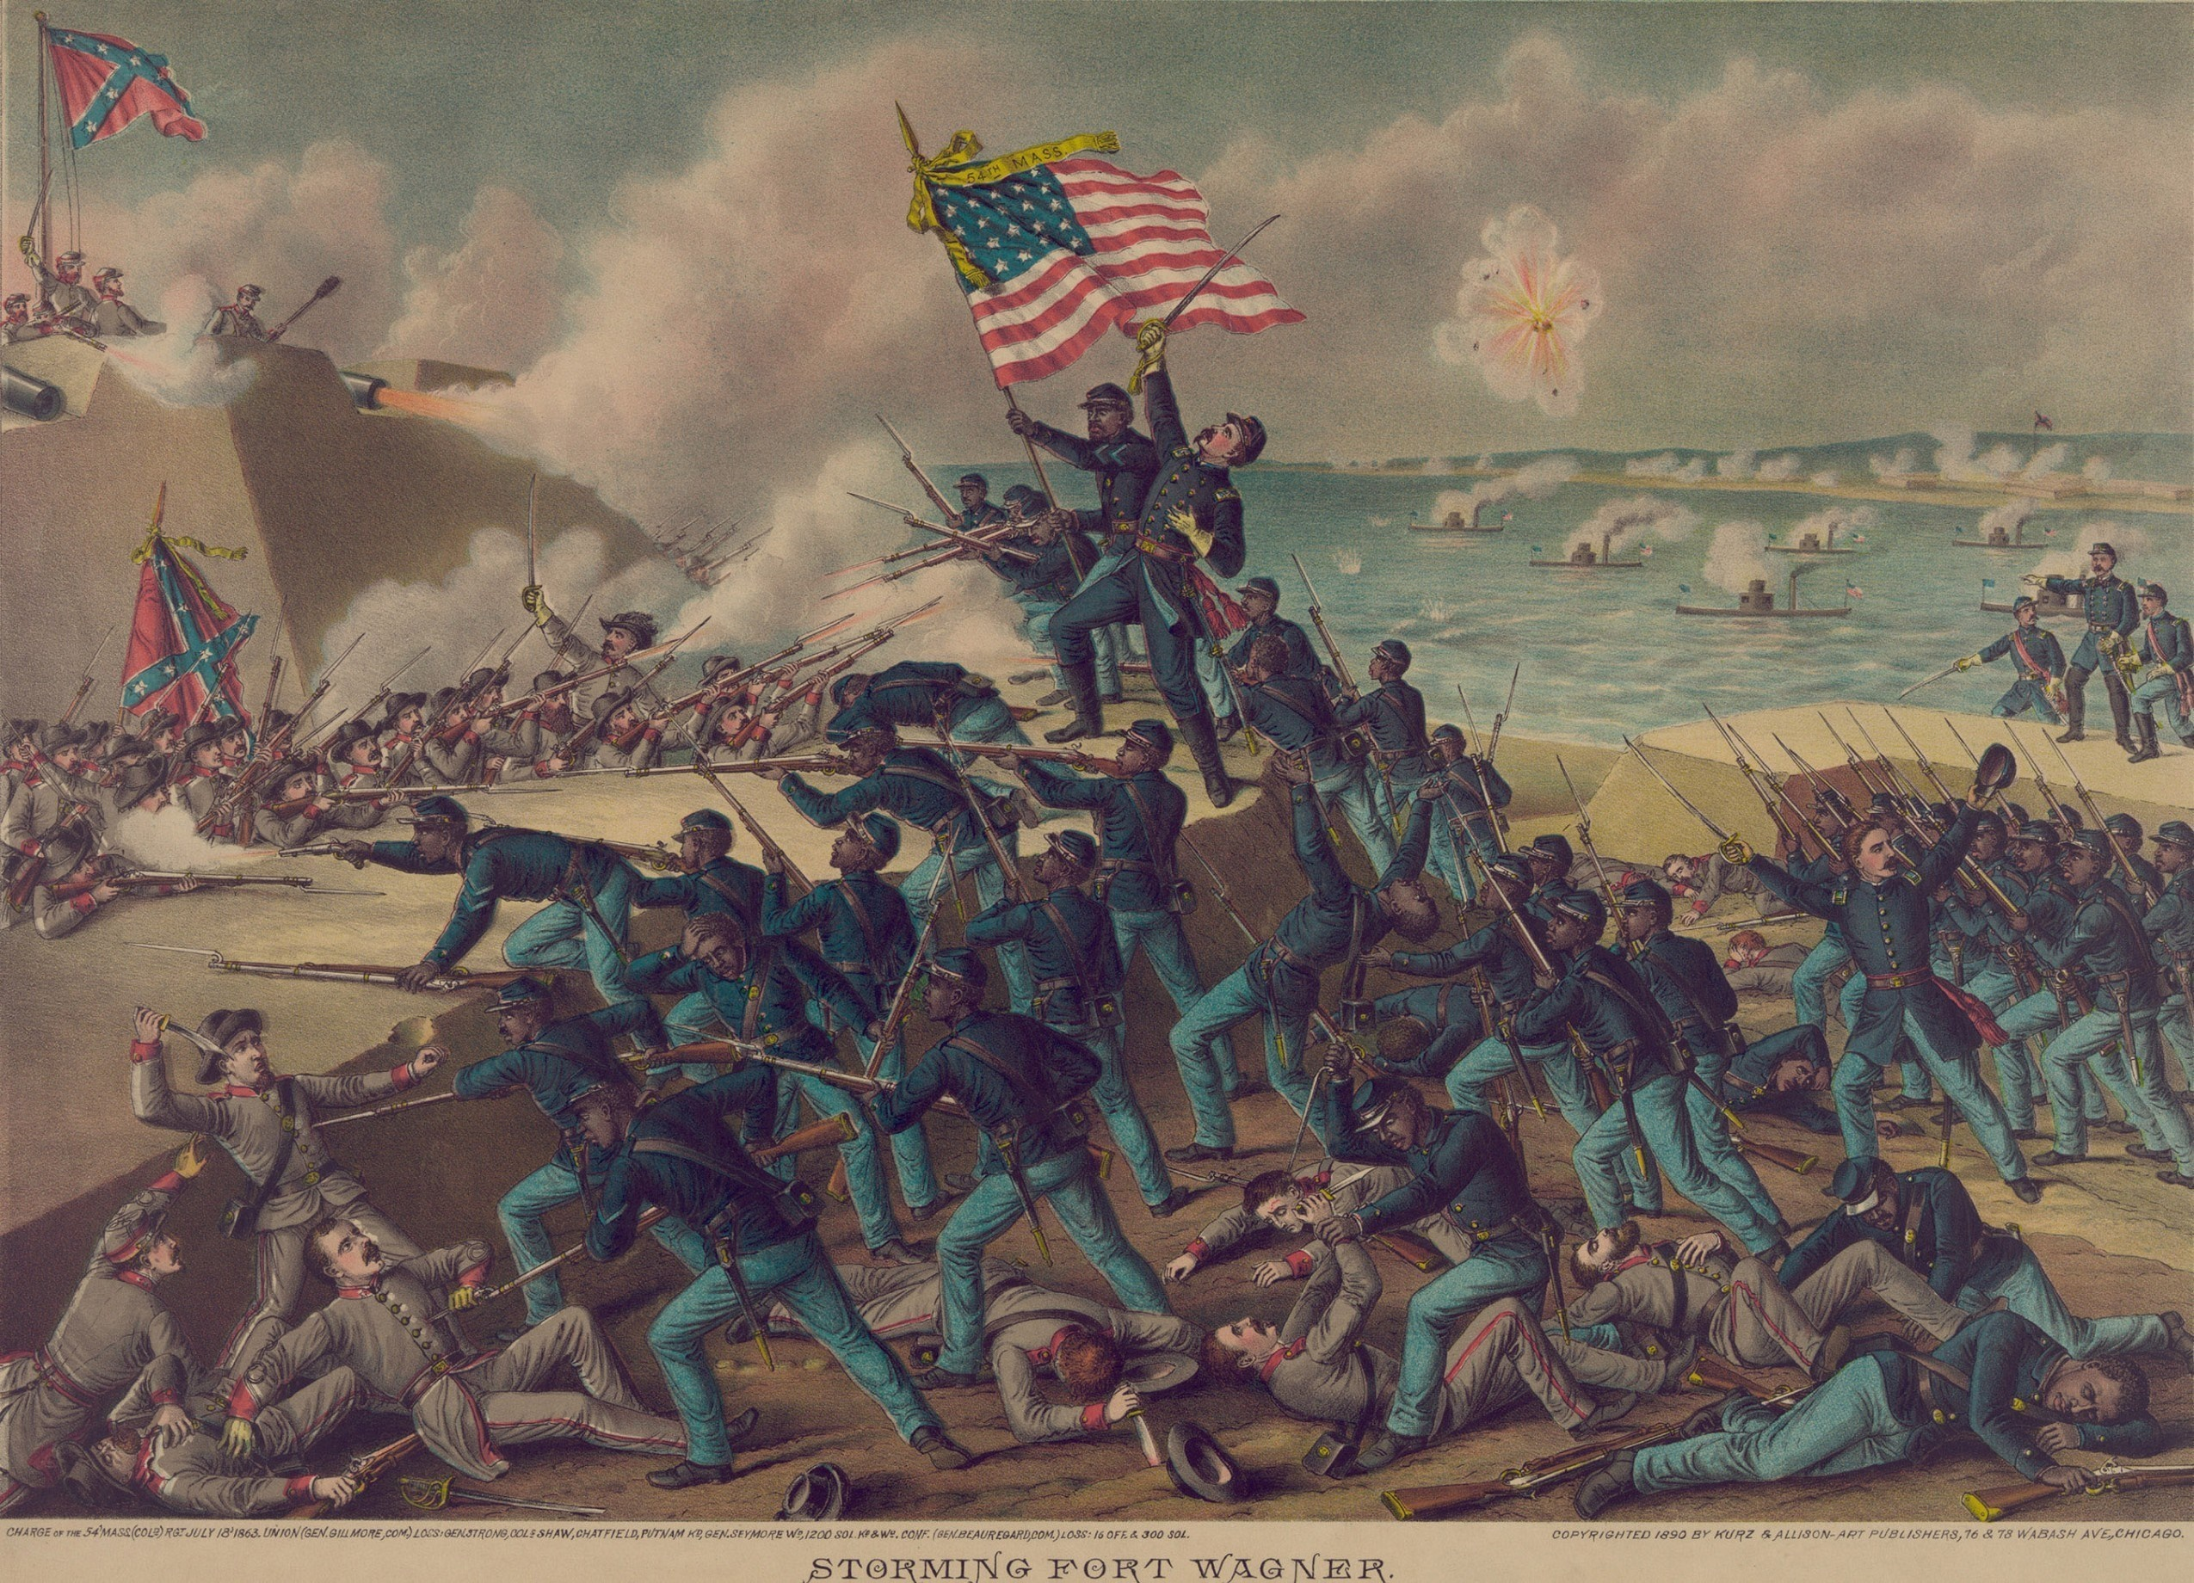
None of the New Jersey units saw much action in the first year of the war. In August, 1861, they became part of the Army of the Potomac, the new designation for units stationed around Washington under the command of General George B. McClellan.
The New Jersey troops began fighting in earnest in the winter and spring of 1862, when McClellan pursued the strategy of trying to capture Richmond by an invasion of the Peninsula of Virginia.
By early summer, it became clear that the plan was not a success. Robert E. Lee’s Confederates pushed McClellan’s forces back with heavy casualties, including the loss of New Jersey’s most renowned war hero, Major General Philip Kearny.
The campaign ended with the Union’s near rout at the Second Battle of Bull Run in August 1862.
https://www.libraries.rutgers.edu/rul/exhibits/struggle_without_end/struggle_without_end.php#case:1
shutterstock.com

Slide 11
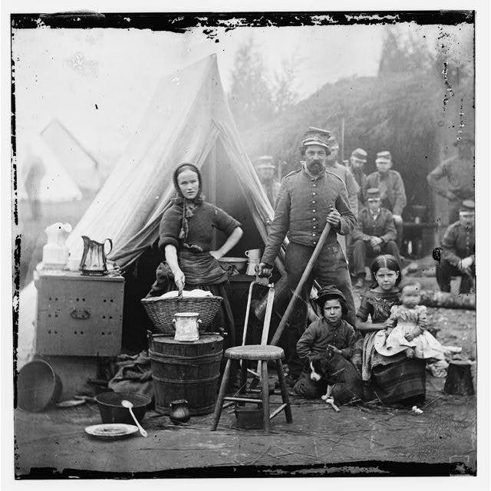
New Jersey women quickly mobilized to support the war effort. They raised money, collected food, clothing, sheets, and blankets to ship to the troops, who often lacked needed supplies.
Many towns organized ladies aid societies and church groups held fundraising bazaars. Other women struggled to keep farms and businesses afloat in the absence of male breadwinners, or labored for low wages in factories to support the war machine.
Women often expressed their patriotism and suffering through poetry, songs, letters, and diaries.
https://www.libraries.rutgers.edu/rul/exhibits/struggle_without_end/struggle_without_end.php#case:1
shutterstock.com

Slide 12
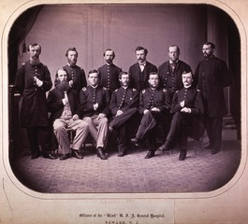
US Army
Medical Group
shutterstock.com
After the First Battle of Bull Run on July 21, 1861, it was clear that the war would be longer and more brutal than previously imagined. This reality was commonly experienced in battlefield hospitals - makeshift hospitals comprised of tents or borrowed houses that were overcrowded and unsanitary. In order to alleviate congestion and poor conditions, military hospitals on the home front were instituted. These hospitals were equipped with experienced doctors, modern medical supplies, and amenities such as bathing facilities and full kitchens. Soldiers who suffered from injury or illness (including gunshot wounds, gangrene, typhoid fever, malaria, tuberculosis, and camp diarrhea) were sufficiently treated and sometimes even had the convenience of being close to home. By the war’s end, 192 general hospitals existed in the United States. One such hospital was Ward’s U.S. General Hospital located in Newark, New Jersey.
https://www.libraries.rutgers.edu/rul/exhibits/struggle_without_end/struggle_without_end.php#case:1

Slide 13
Ward’s U.S. General Hospital opened in May of 1862. Named after its founder, Marcus L. Ward, a New Jersey businessman, governor, and advocate for soldiers and their families, it was one of three in the state (including those in Jersey City and Beverly) to accommodate sick and injured soldiers.
Initially paid for by a loan secured by Ward from the state government, the hospital was located in a four-storied building between the railroad tracks and the Passaic River at the foot of Centre Street.
This location made it easy for soldiers to be transported by car or by boat. When the secretary of war allocated additional funding in 1864, the hospital expanded into several factory and warehouse buildings east of Centre Street and had room for 1,400 patients.
By the time the hospital was decommissioned in 1865, staff members had treated roughly 80,000 military patients.
https://www.libraries.rutgers.edu/rul/exhibits/struggle_without_end/struggle_without_end.php#case:1

Slide 14
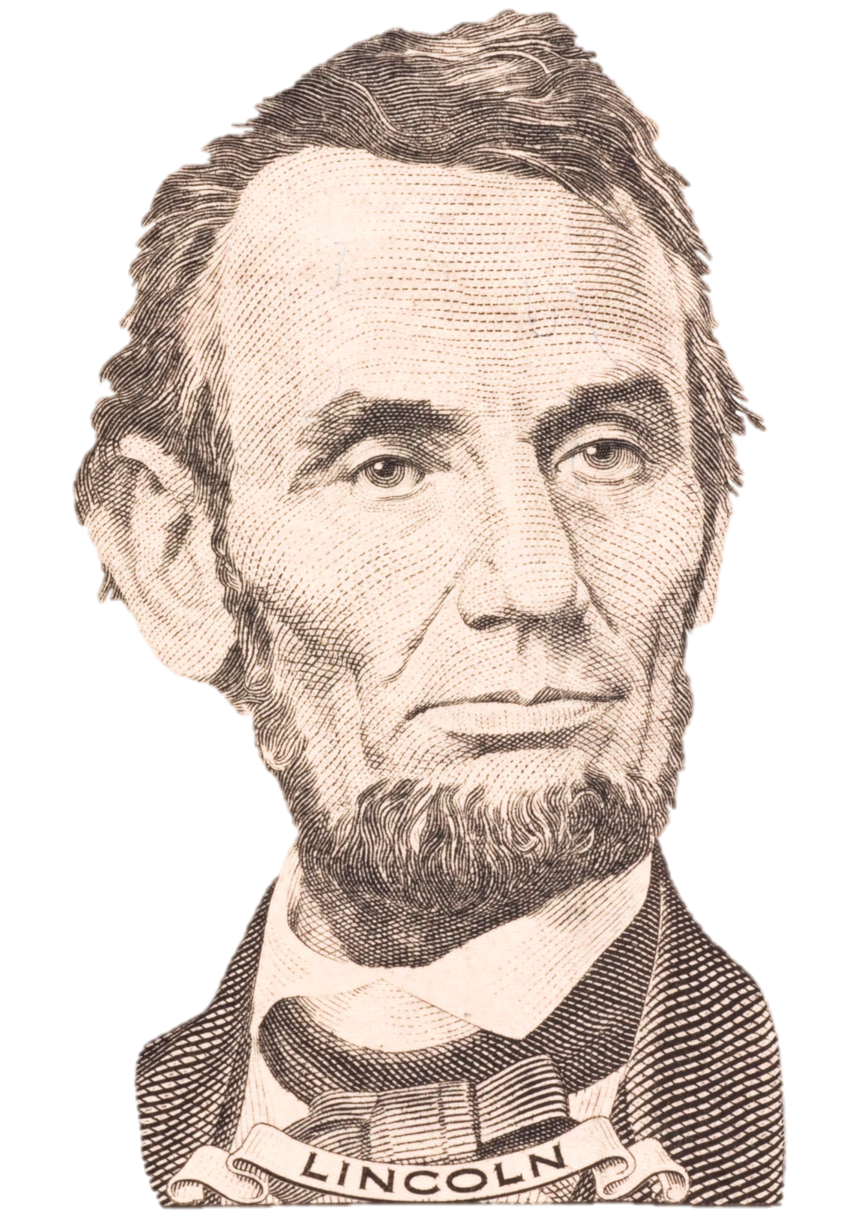
On September 22, 1862, Abraham Lincoln issued the Preliminary Emancipation Proclamation: as of New Year’s Day 1863, all slaves in rebel territory or those who could reach the Union lines would be free.
The reaction to the Emancipation Proclamation in New Jersey was mixed. African Americans and many Republicans supported it, while many Democrats opposed it because it deprived slaveholders of their property without their consent and represented a massive interference in states’ rights.
Racists feared an influx of southern blacks into New Jersey who would compete for jobs with whites. In his inaugural address in early 1863, New Jersey’s newly-elected Democratic governor Joel Parker criticized the timing and constitutionality of the proclamation.
The Democrat-dominated state assembly passed bills preventing the immigration of African Americans into the state and prohibiting mixed marriage, both of which died in the state senate. Meanwhile, Quakers in New Jersey and Pennsylvania raised money to help freedmen in the South.
https://www.libraries.rutgers.edu/rul/exhibits/struggle_without_end/struggle_without_end.php#case:1

Slide 15
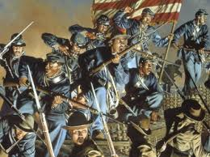
At a meeting in Jersey City to honor the Emancipation Proclamation, black religious leader Henry Highland Garnet encouraged African Americans to enlist in the military.
Although New Jersey did not give its name to any black regiments, it can be estimated that a few thousand African Americans from New Jersey served with the U.S. Colored Troops, in regiments from other states, or in the navy.
Recruiters soon discovered that a black soldier fulfilled a quota as well as a white one. Traces of African-American soldiers can be found in Rutgers’ Civil War manuscript collections.
https://www.libraries.rutgers.edu/rul/exhibits/struggle_without_end/struggle_without_end.php#case:1

Slide 16
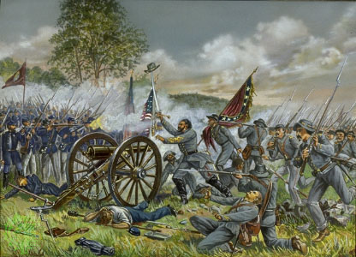
Gettysburg, the most famous battle of the Civil War, was fought July 1 through 3, 1863, in and around the town of Gettysburg, Pennsylvania.
It was the battle with the largest number of casualties in the Civil War and is often described as the war's turning point.
New Jersey troops were heavily engaged at Gettysburg, while doctors, nurses, and other volunteers were among those who flocked to the battlefield to care for the wounded and dying.
https://www.libraries.rutgers.edu/rul/exhibits/struggle_without_end/struggle_without_end.php#case:1

Slide 17
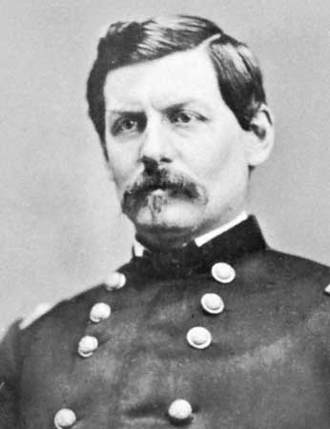
By 1863, the continuing carnage on the battlefield and the dominance of the Democratic Party led to a unique political situation in the state. In March, the state legislature passed a set of resolutions protesting the continuation of the war and calling for a negotiated peace.
The Democrats were angry at what they saw as attacks on constitutional and states’ rights, including the Lincoln administration’s decision to suspend habeas corpus in early 1863 and proposals to create a federally-run railroad through the state to expedite the passage of troops and supplies.
The resolutions were condemned by the opposition Unionists and divided the Democratic Party. The Peace Democrats, known derogatorily as “copperheads,” were unsuccessful, however, in attracting support for the proposals from other states.
Public support for the war was growing as well, as evidenced by the popularity of the Union League movement, which took hold in New Jersey in spring 1863. In the 1864 presidential election, New Jersey joined Delaware and Kentucky as the only states to cast their electoral votes for favorite son General George McClellan, who won the state popular vote by a narrow margin.
https://www.libraries.rutgers.edu/rul/exhibits/struggle_without_end/struggle_without_end.php#case:1
General George McClellan

Slide 18
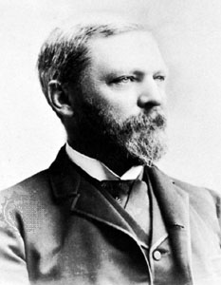
Washington Roebling of Trenton, son of engineer John A. Roebling and future builder of the Brooklyn Bridge, enlisted as a private in Company A of the New Jersey State Militia in April 1861, resigning a few months later to enlist in the Sixth New York Independent Battery.
He was later promoted to the rank of sergeant, and then to second lieutenant in January 1862.
During the war, he built suspension bridges, made maps, and did reconnaissance from a hot-air balloon. He saw action at the battles of Second Bull Run, Antietam, Chancellorsville, and Gettysburg, where he helped to secure Little Round Top, as well as the Battle of the Wilderness, Spotsylvania Court House, and the Crater.
In 1865, he was commissioned Colonel, U.S. Volunteers, by brevet for "gallant and meritorious services during the war.“
https://www.libraries.rutgers.edu/rul/exhibits/struggle_without_end/struggle_without_end.php#case:1
Washington Roebling

Slide 19
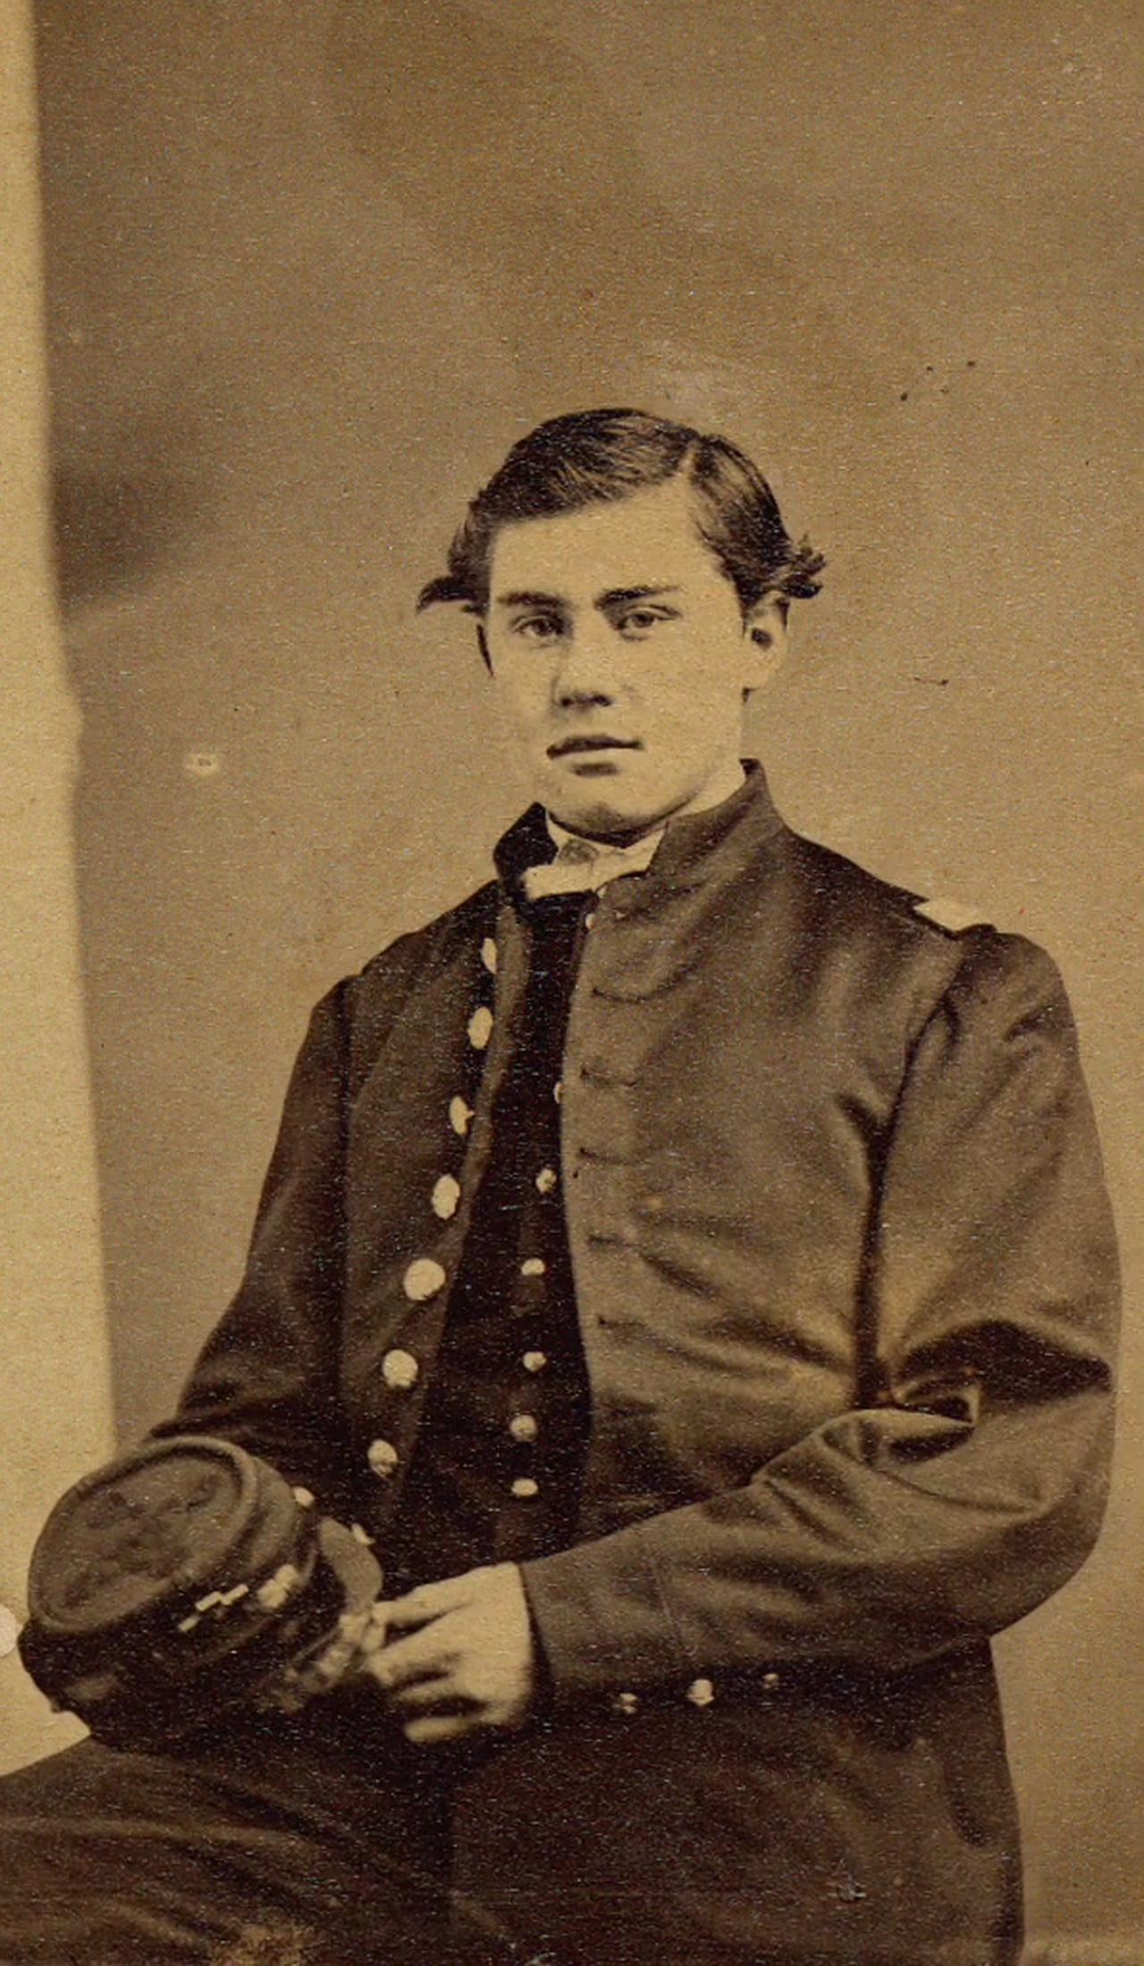
Ellis Hamilton of Camden, New Jersey, the son of a prominent newspaper editor, had been active in the local militia since his early teens.
At the age of sixteen, he became a lieutenant in Co. E of the Fifteenth New Jersey Volunteers. He was the youngest officer to be commissioned in the Union army.
After intense fighting at Fredericksburg, Gettysburg, and Salem Church in Virginia, he was promoted to captain of Co. F, in November 1863, at the age of seventeen. On May 6, 1864, he was seriously wounded at the Battle of the Wilderness when a single bullet passed through both his legs. Taken to Seminary Hospital in Georgetown, he died on May 16th at the age of nineteen. He was buried in Trenton’s Mercer Cemetery.
https://www.libraries.rutgers.edu/rul/exhibits/struggle_without_end/struggle_without_end.php#case:1
Ellis Hamilton

Slide 20
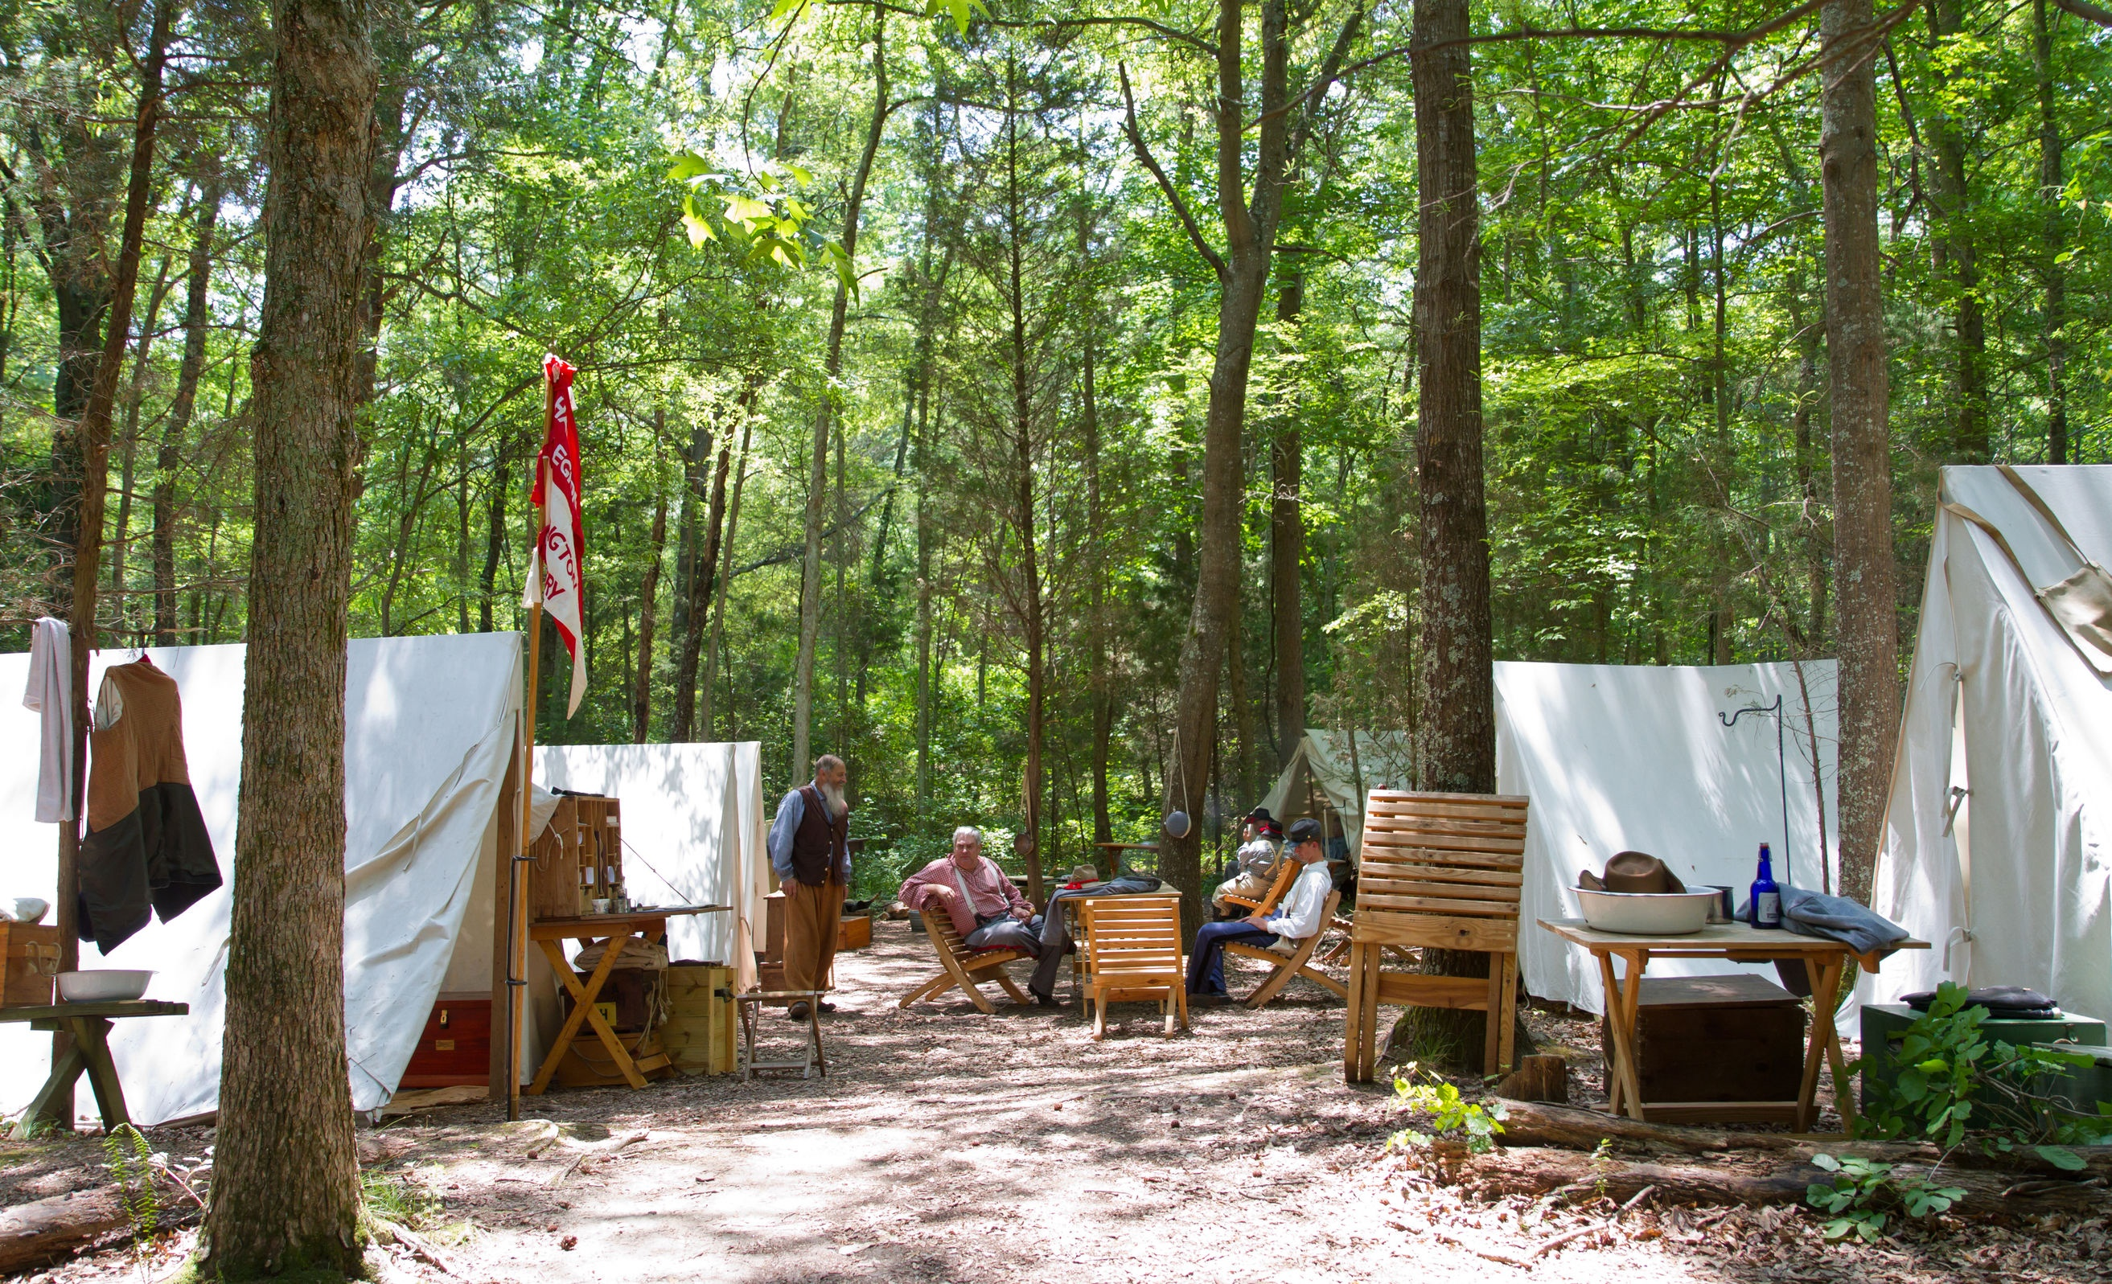
Despite divisions over the war and a reluctance to enter, citizens of the State of New Jersey played a crucial role in the war between the states.

Slide 21
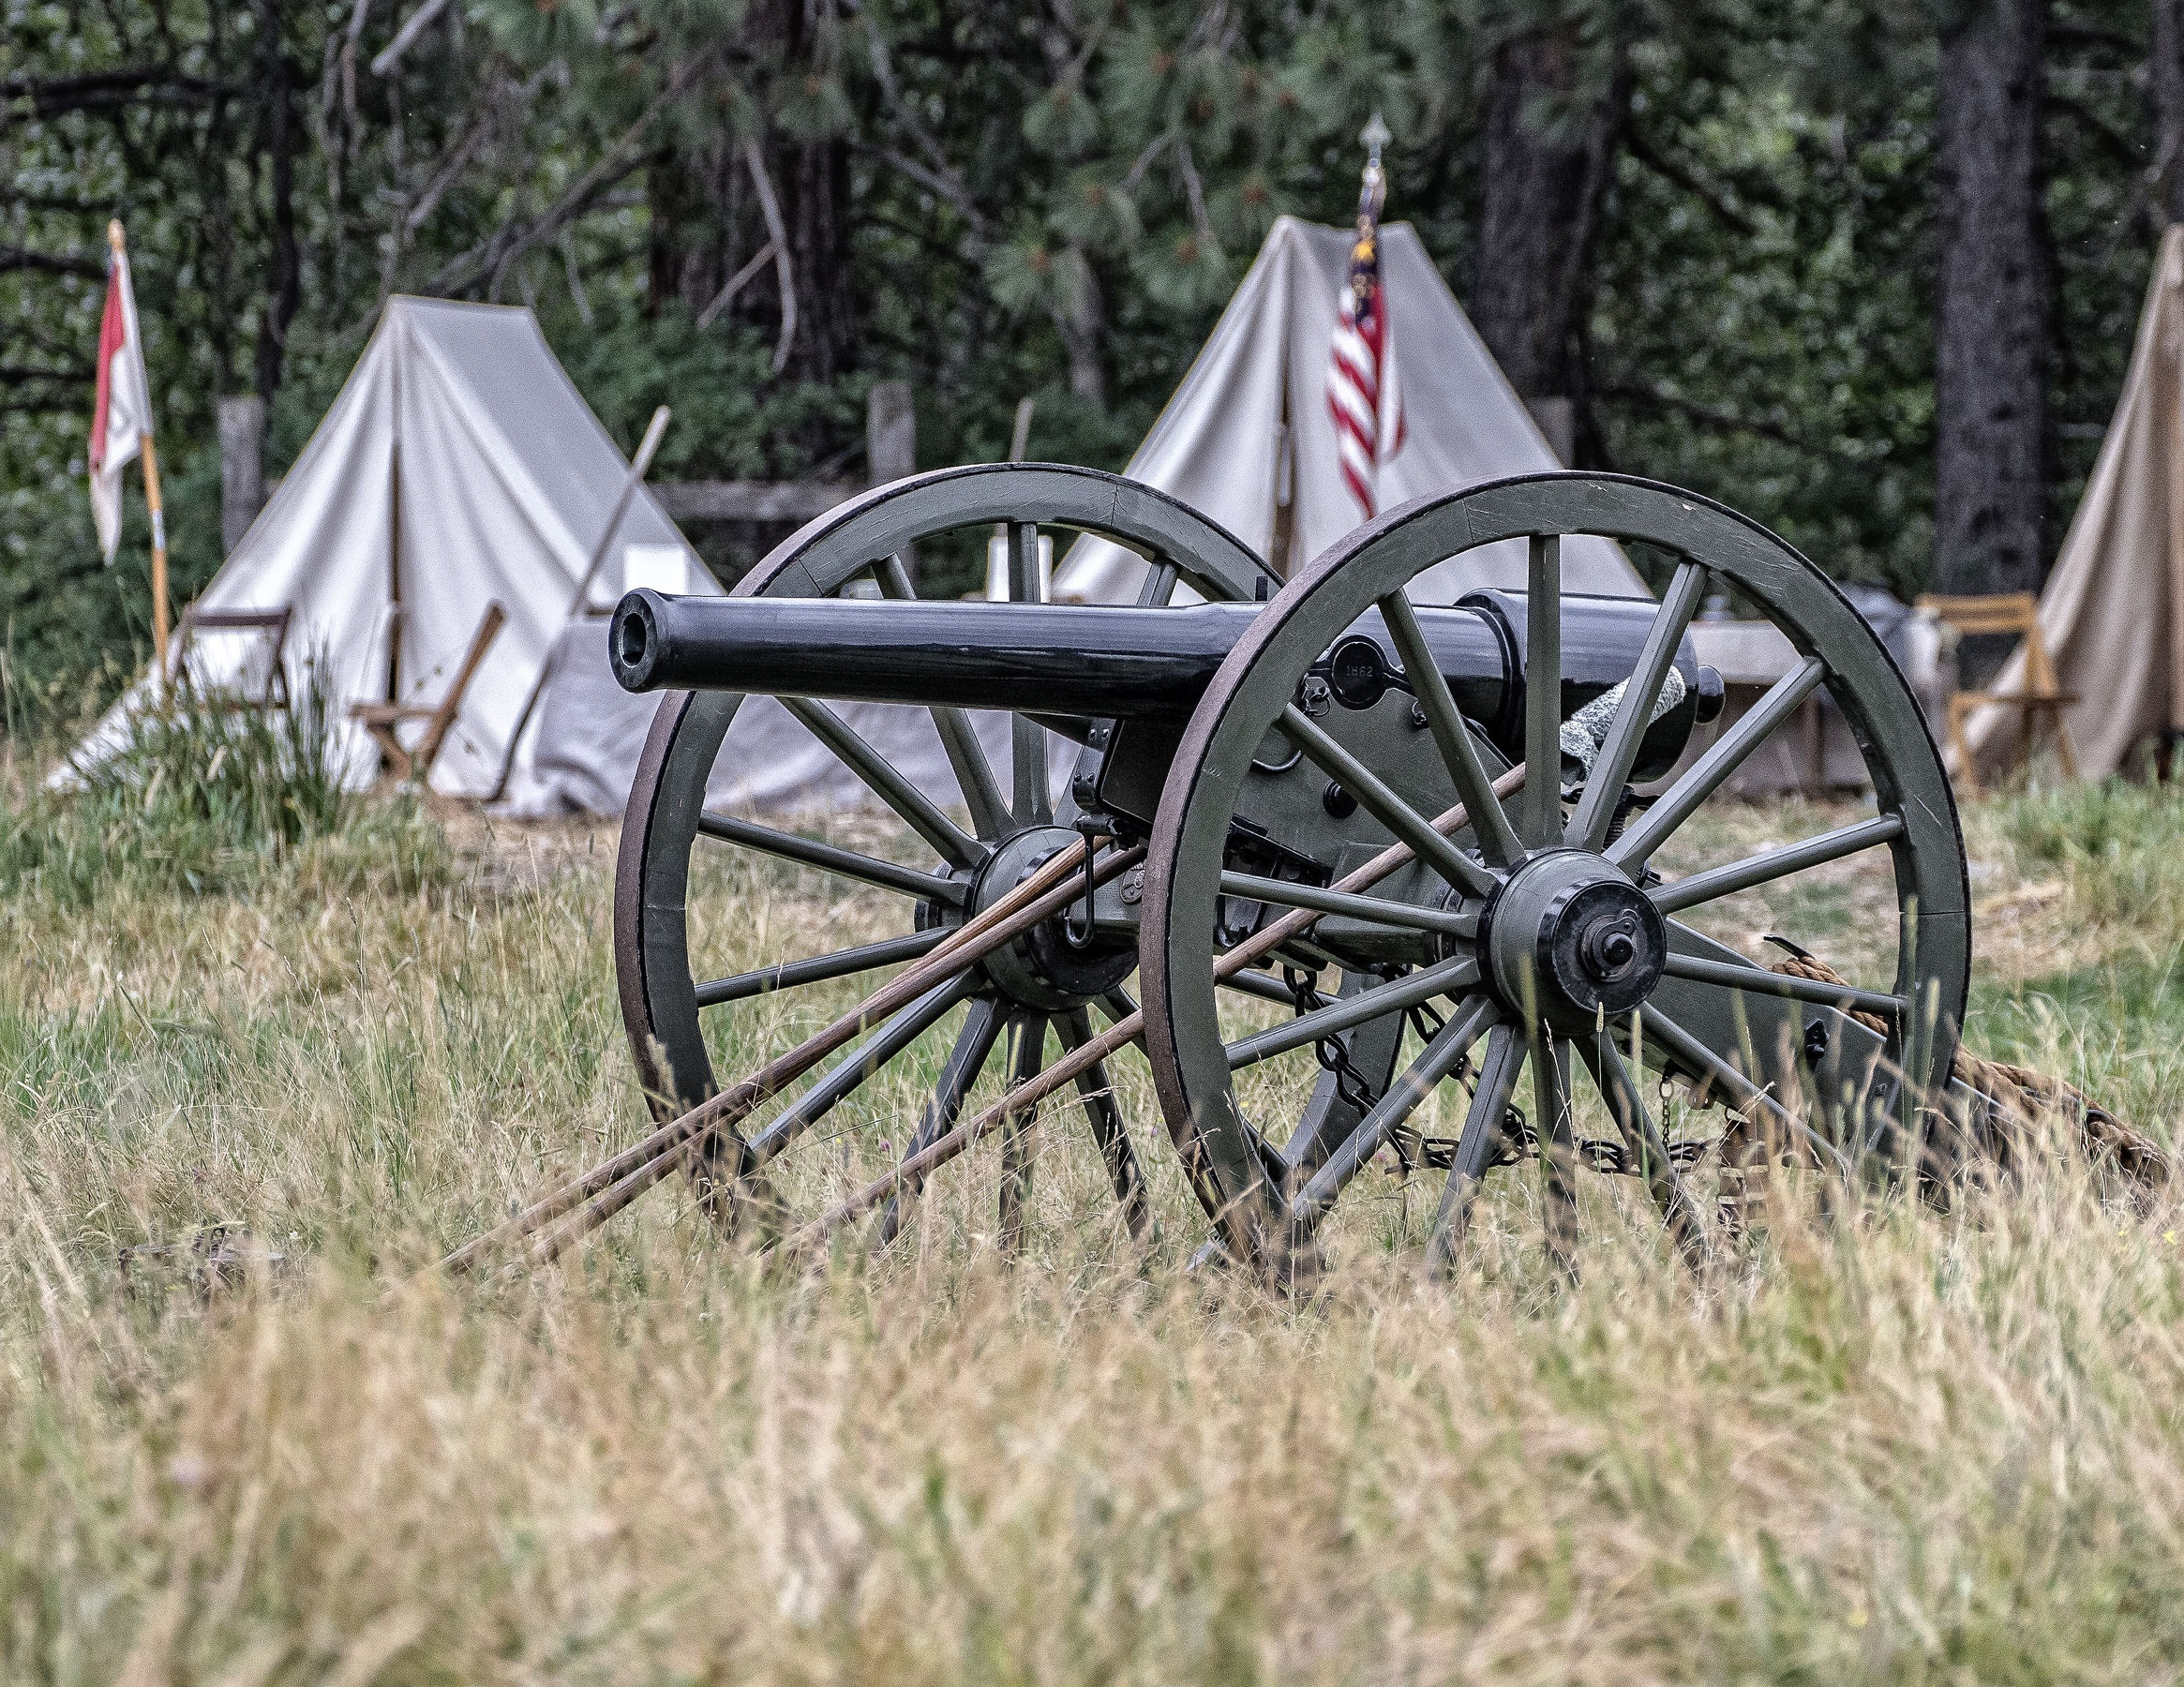
Key Words
Civil War Union cause turmoil
abolish slavery Republican Party coalition
restricted voting The Opposition electoral votes
Fugitive Slave Bill Confederate States militiamen
Abolition movement mobilized constitutionality

