Slide 1
NICKY FIFTH’S NEW JERSEY
N5NJ
SECONDARY PROGRAM
CIVICS AND GOVERNMENT
NJ Laws

Slide 2
123rf.com
As citizens of a state, in a nation of laws, New Jerseyans must follow many different types of laws: federal, state, and local. While we are aware that laws exist, we are not always aware as to why we have specific laws or the process necessary to create them.

Slide 3
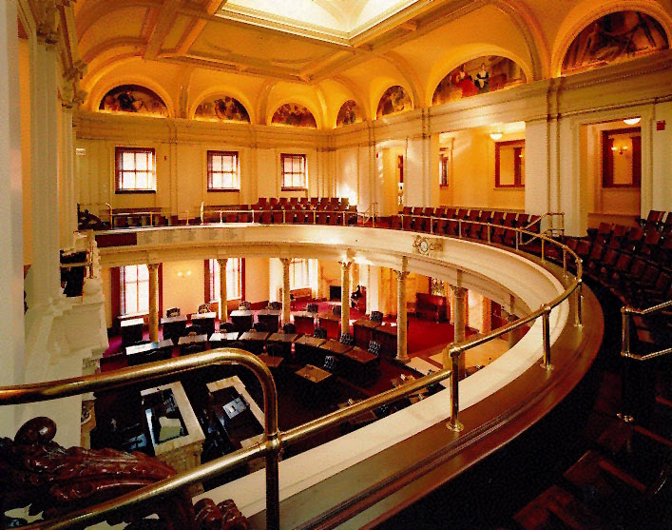
For state laws, any Senator or General Assembly member may propose or sponsor a new law. Ideas for laws can come from many sources such as citizens, interest groups, public officials or the Governor.
http://www.njleg.state.nj.us/kids/howbill1.asp

Slide 4
At the legislator's direction, the idea is drafted as a bill. The legislator may ask other legislators to become co-sponsors.
http://www.njleg.state.nj.us/kids/howbill1.asp
123rf.com

Slide 5
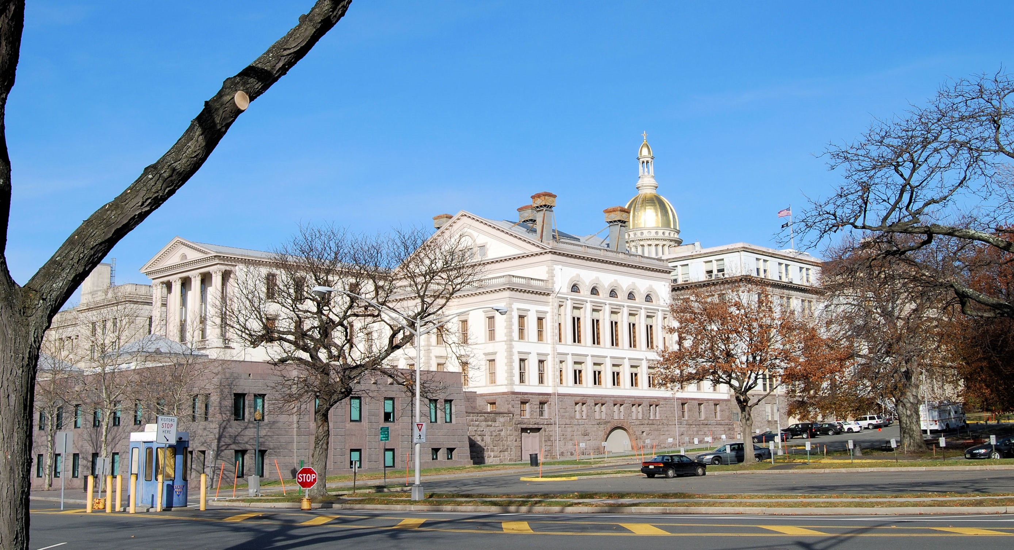
The bill is introduced when the Senate Secretary or General Assembly Clerk reads aloud the bill's number, sponsor and title during a legislative session.
http://www.njleg.state.nj.us/kids/howbill1.asp
123rf.com

Slide 6
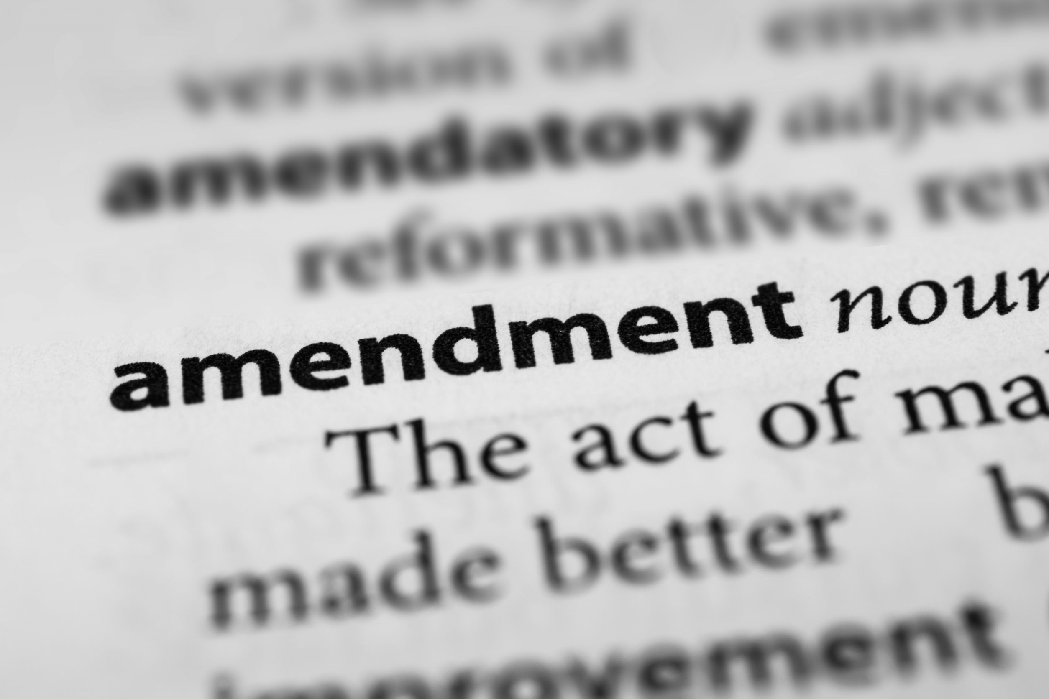
The bill is usually sent to a committee which studies it and makes changes, if needed.
These changes are called amendments. Committees have open meetings where the public may speak about the bill.
http://www.njleg.state.nj.us/kids/howbill1.asp

Slide 7
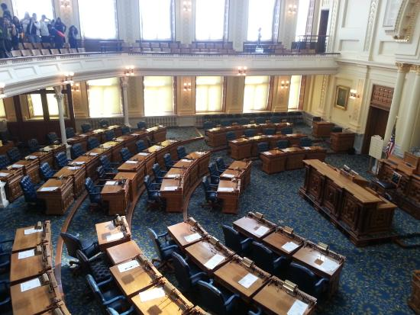
If the committee approves the bill, it is reported to the House and its title is read again.
This is the bill's second reading.
http://www.njleg.state.nj.us/kids/howbill1.asp

Slide 8
When scheduled by the Senate President or Assembly Speaker, the bill's title is read for the third time, and it is debated and voted on.
A bill passes if it receives a majority of votes (at least 21 in the Senate or 41 in the General Assembly).
http://www.njleg.state.nj.us/kids/howbill1.asp
123rf.com

Slide 9
The bill follows a similar path of first reading, committee consideration, second reading, third reading and final passage in the second house.
After both houses agree on the bill, it is sent to the Governor. In most cases, the bill becomes law when signed by the Governor.
http://www.njleg.state.nj.us/kids/howbill1.asp
123rf.com

Slide 10
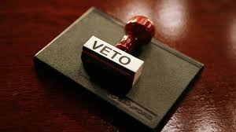
123rf.com
The Governor may veto a bill by refusing to sign it and returning it to the Legislature with noted objections or proposed changes. There are several types of vetoes. Sometimes, a vetoed bill can still become law.
http://www.njleg.state.nj.us/kids/howbill1.asp

Slide 11
While not everyone agrees with every law, there are some laws that most agree are silly, outdated, or bordering on ridiculous. Ironically, these laws are still on the books. The following presents some of these laws.
It is against the law for a man to knit during fishing season.
http://www.onlyinyourstate.com/new-jersey/weird-laws-nj/
123rf.com

Slide 12
2. It is illegal to slurp your soup.
http://www.onlyinyourstate.com/new-jersey/weird-laws-nj/
123rf.com

Slide 13
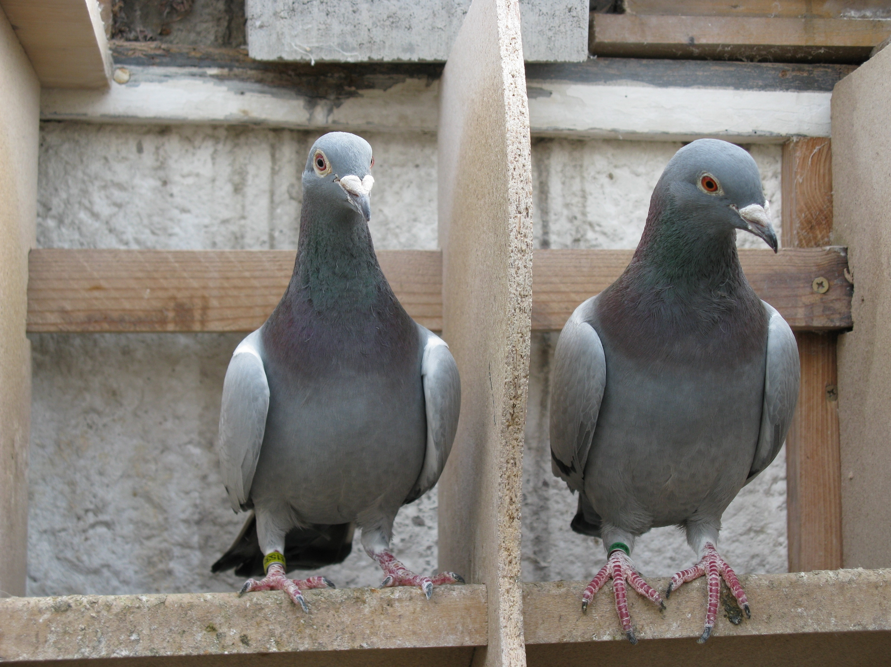
3. It is illegal to delay or detain a homing pigeon.
http://www.onlyinyourstate.com/new-jersey/weird-laws-nj/
123rf.com

Slide 14
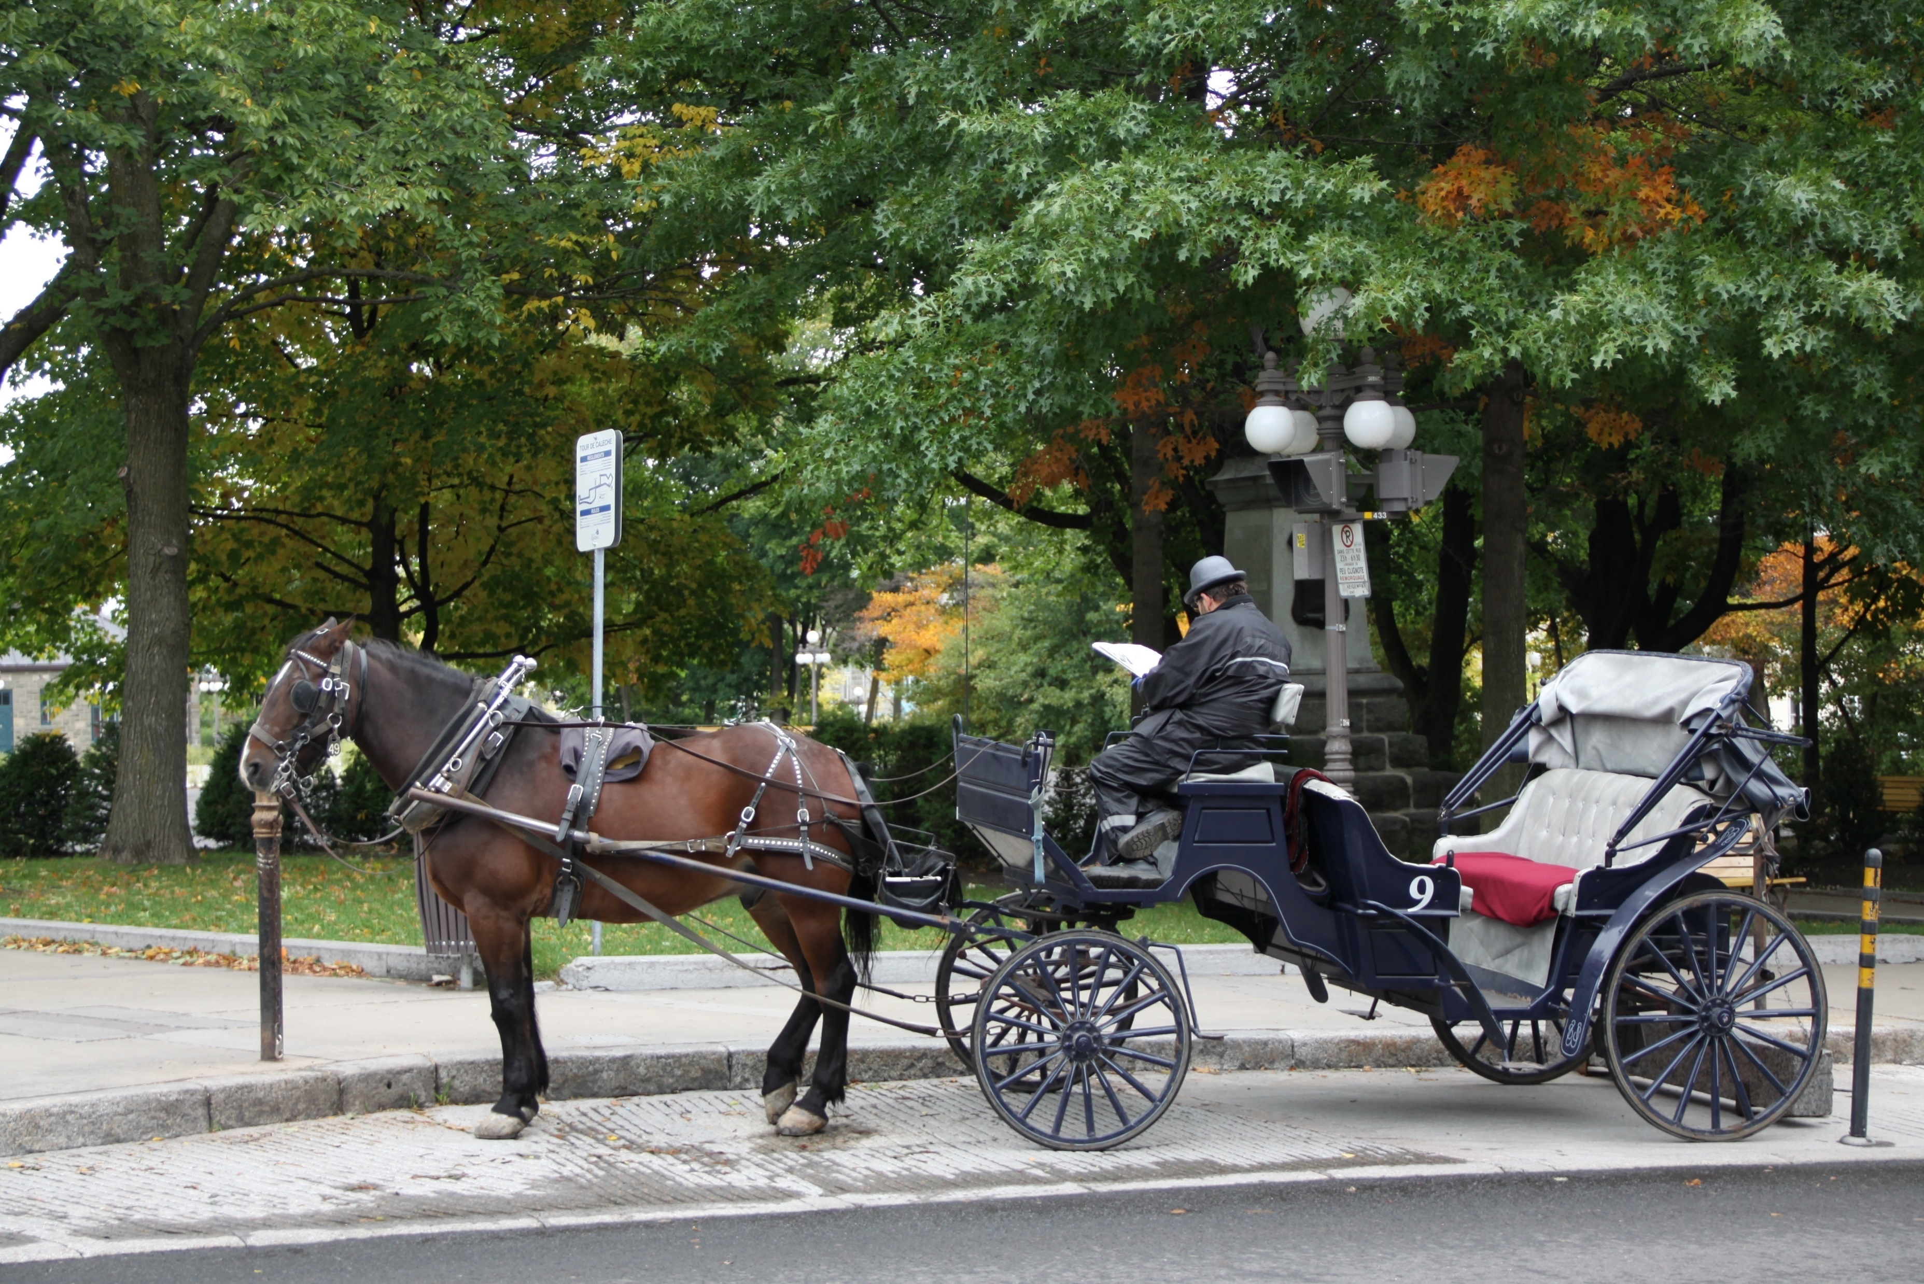
4. It is illegal for a car to pass a horse drawn carriage.
http://www.onlyinyourstate.com/new-jersey/weird-laws-nj/
123rf.com

Slide 15
5. Pickles are outlawed on Sundays in Trenton.
http://www.onlyinyourstate.com/new-jersey/weird-laws-nj/
123rf.com

Slide 16
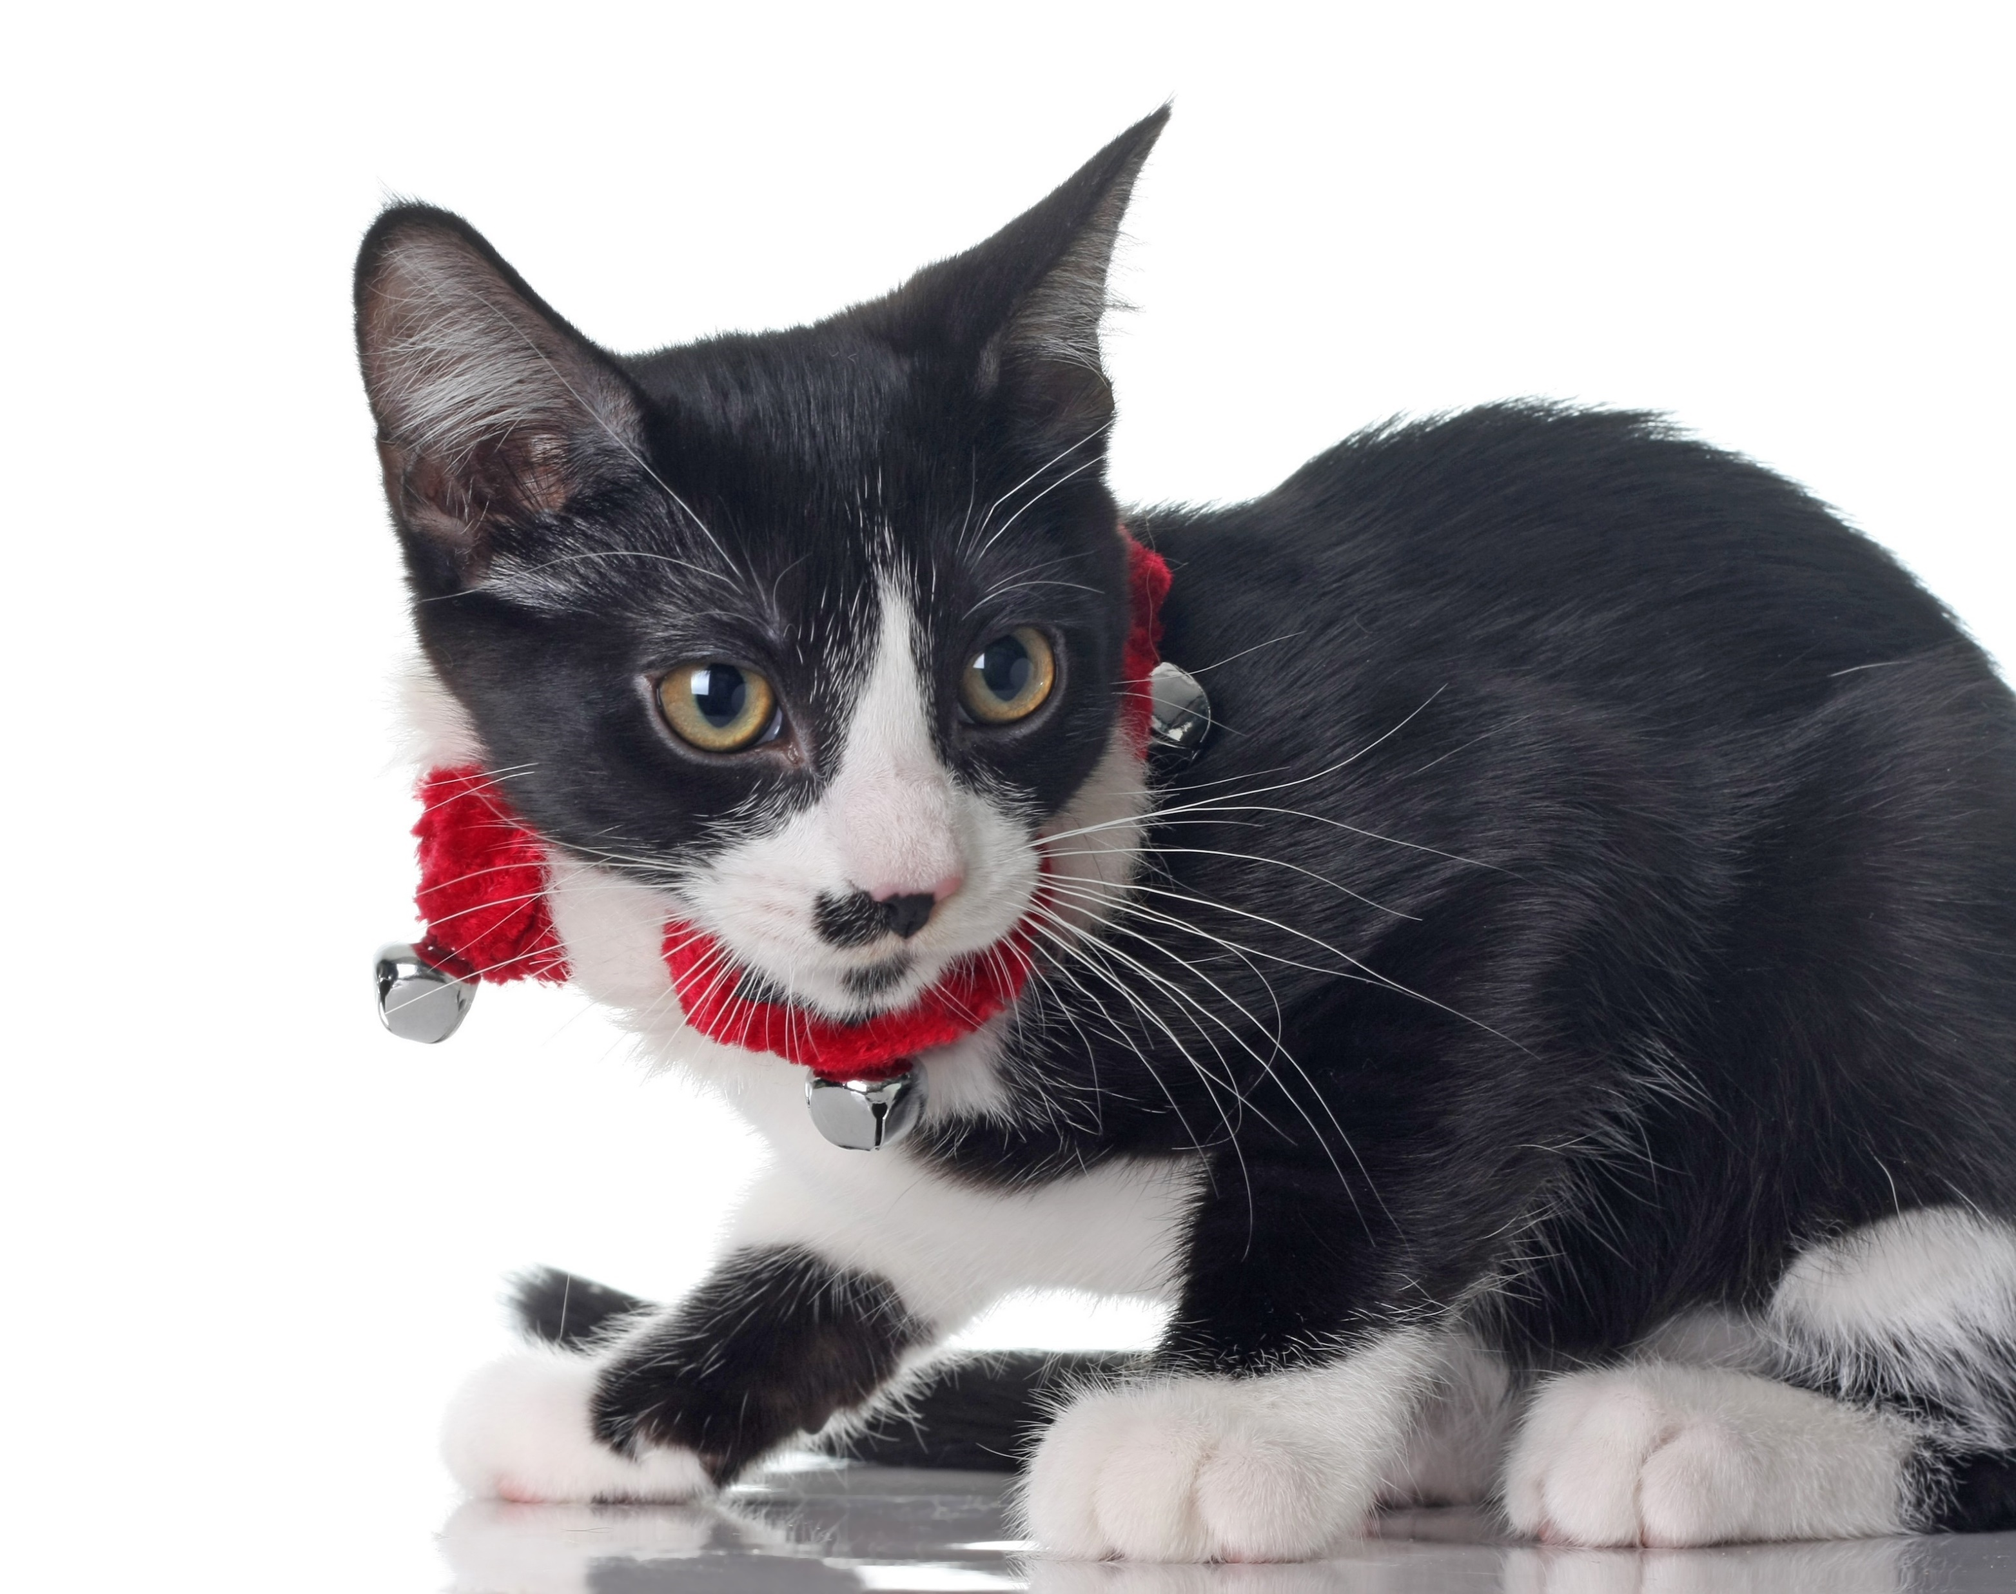
6. Cats must warn birds of their whereabouts in Cresskill.
http://www.onlyinyourstate.com/new-jersey/weird-laws-nj/
123rf.com

Slide 17
7. It is illegal to refuse to yield a phone if it is an emergency.
http://www.onlyinyourstate.com/new-jersey/weird-laws-nj/
123rf.com

Slide 18
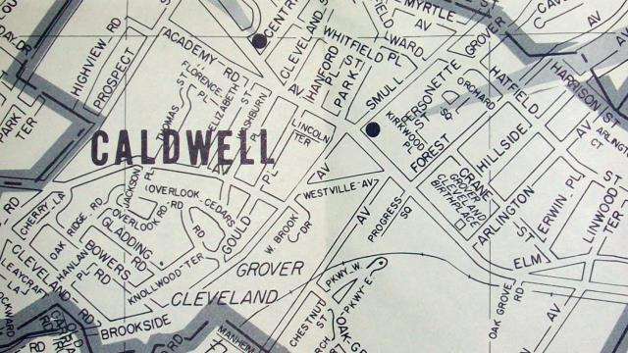
8. In Caldwell, it is illegal to dance on Main Street.
It is also illegal to wear shorts on Main St.
http://www.rantplaces.com/2015/04/03/crazy-laws-in-new-jersey-you-wont-believe-exist/

Slide 19
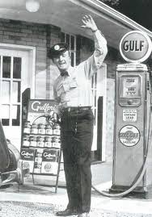
While it is the responsibility of every citizen to follow the laws of the nation, the laws of the state, and the local laws, some laws that remain on the books have become obsolete.
Of course, the law New Jersey is probably most famous for…
It’s still against the law to pump your own gas.
http://www.rantplaces.com/2015/04/03/crazy-laws-in-new-jersey-you-wont-believe-exist/

Slide 20
Key Words
nation of laws General Assembly Senator
public officials interest groups Governor
majority of votes legislator citizen
second reading legislative session title
committee amendments bill
123rf.com

