Slide 1
NICKY FIFTH’S NEW JERSEY
N5NJ
SECONDARY PROGRAM
CIVICS AND GOVERNMENT
Social Programs

Slide 2
123rf.com
If you watch the evening news long enough, you’ll inevitably come across a story about social programs. They are extremely controversial, often a talking point between the major political parties, and more frequently than not, misunderstood. There seems to be confusion as to what they are, who they help, how much they cost, and if they actually help the recipients and the country. There is also confusion as to who pays for these social programs, often referred to as social services.

Slide 3
Shutterstock.com
The U.S. social welfare structure has been shaped both by long standing traditions and by changing economic and social conditions. In its early history, the United States was an expanding country with a vast frontier and a predominantly agricultural economy. Up to 1870, more than half the Nation’s adult workers were farmers.
In the years that followed, however, industry developed rapidly and the economy tended to be increasingly characterized by industrialization, specialization, and urbanization. The result was a Nation of more employees who were dependent upon a continuing flow of money income to provide for themselves and their families.
https://www.ssa.gov/history/pdf/histdev.pdf

Slide 4
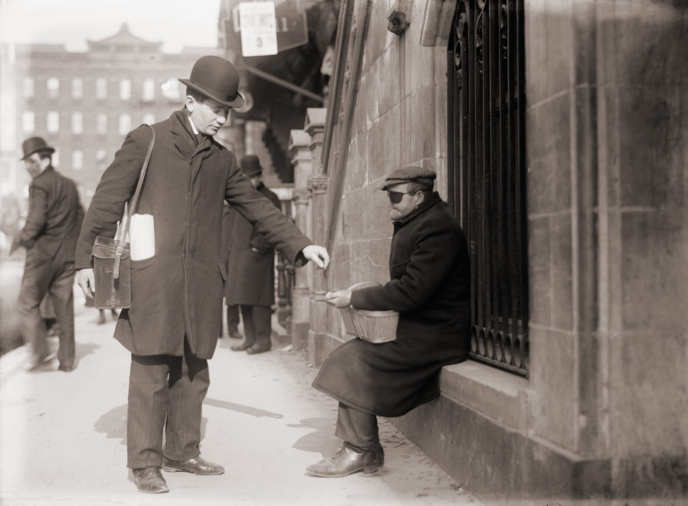
From the earliest colonial times, local villages and towns recognized an obligation to aid the needy when family effort, and assistance provided by neighbors and friends, were not sufficient. This aid was carried out through the poor relief system and almshouses, or workhouses.
Gradually, measures were adopted to provide aid on a more organized basis, usually through cash allowances to certain categories among the poor. Mothers’ pension laws, which made it possible for children without paternal support to live at home with their mothers rather than in institutions or foster homes, were adopted in a number of States even before World War I.
In the mid-1920s, a few States began to experiment with old-age assistance and aid to the blind.
https://www.ssa.gov/history/pdf/histdev.pdf
Shutterstock.com

Slide 5
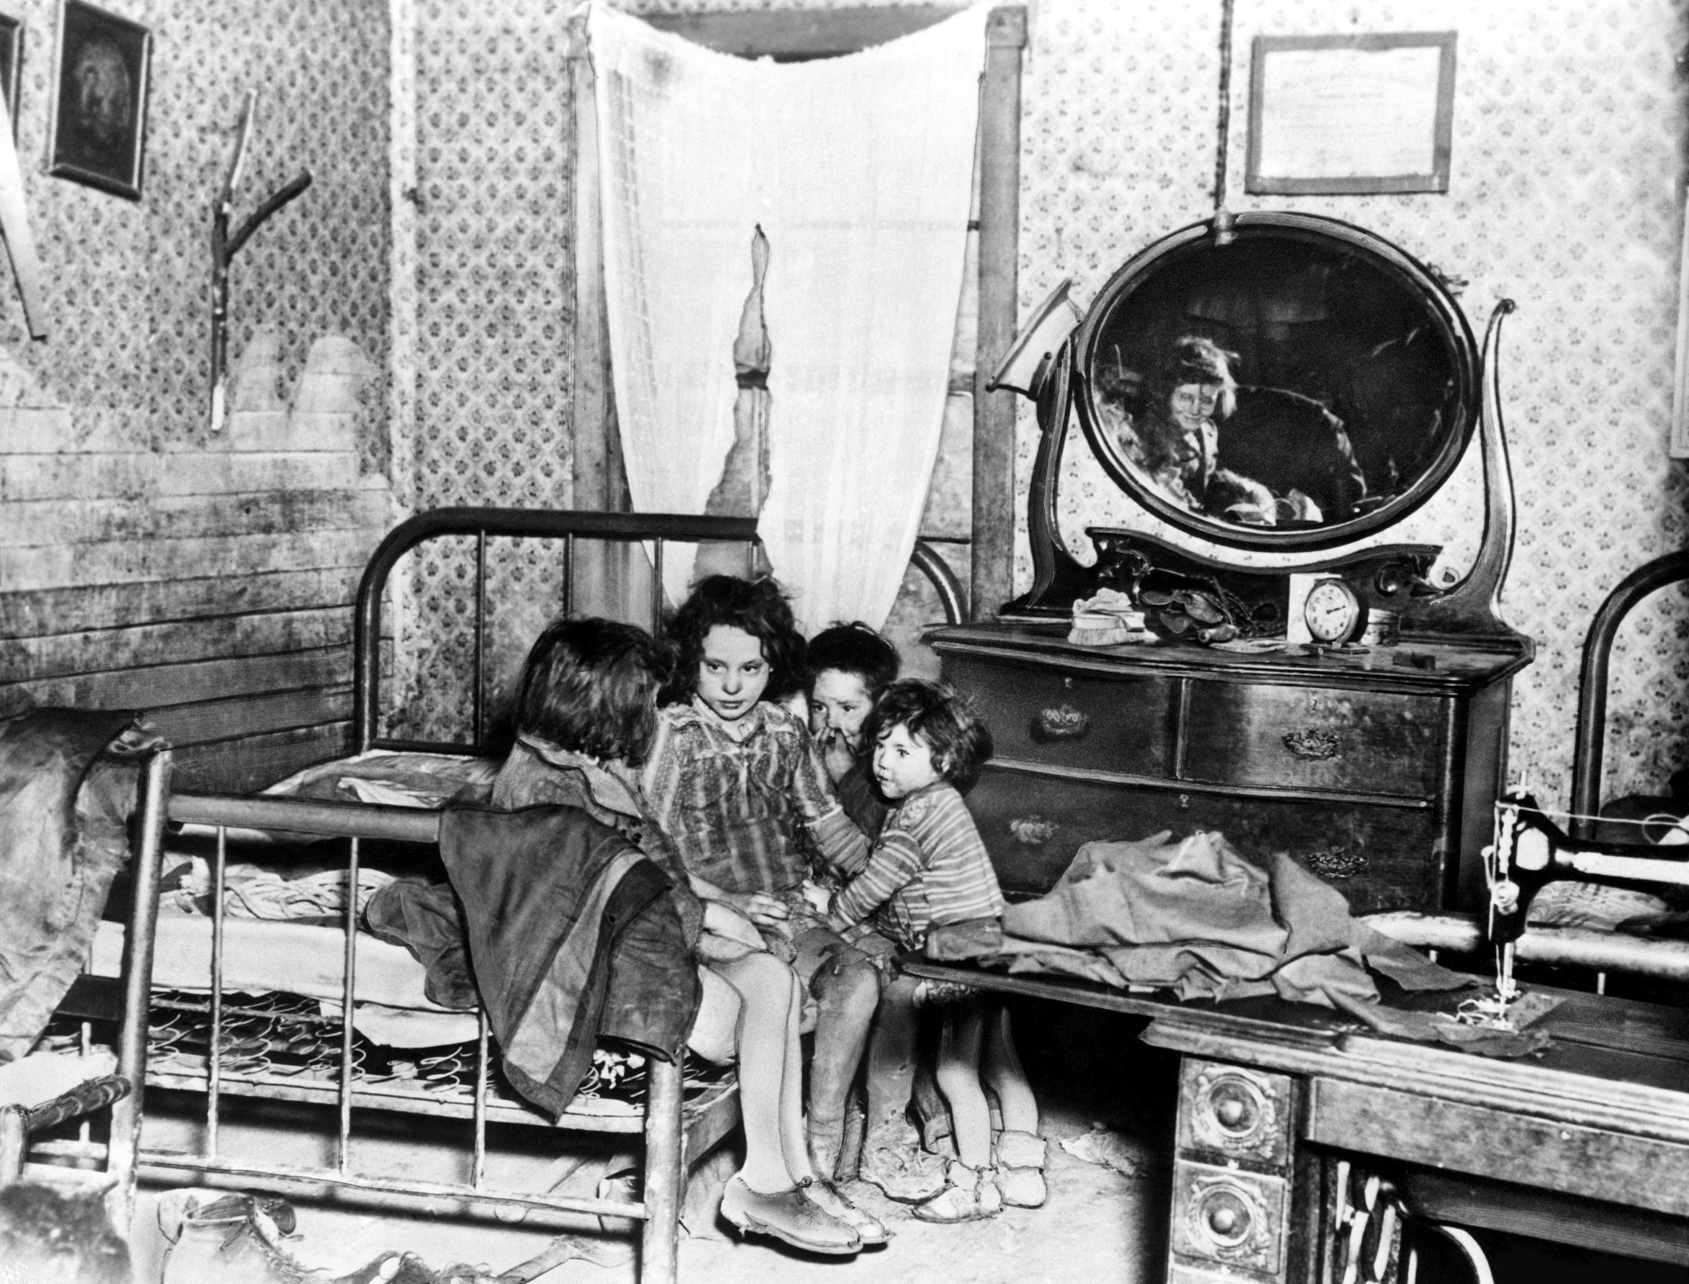
Meanwhile, both the States and the Federal Government had begun to recognize that certain risks in an increasingly industrialized economy could best be met through a social insurance approach to public welfare.
That is, the contributory financing of social insurance programs would ensure that protection was available as a matter of right as contrasted with a public assistance approach whereby only those persons in need would be eligible for benefits.
https://www.ssa.gov/history/pdf/histdev.pdf
123rf.com

Slide 6
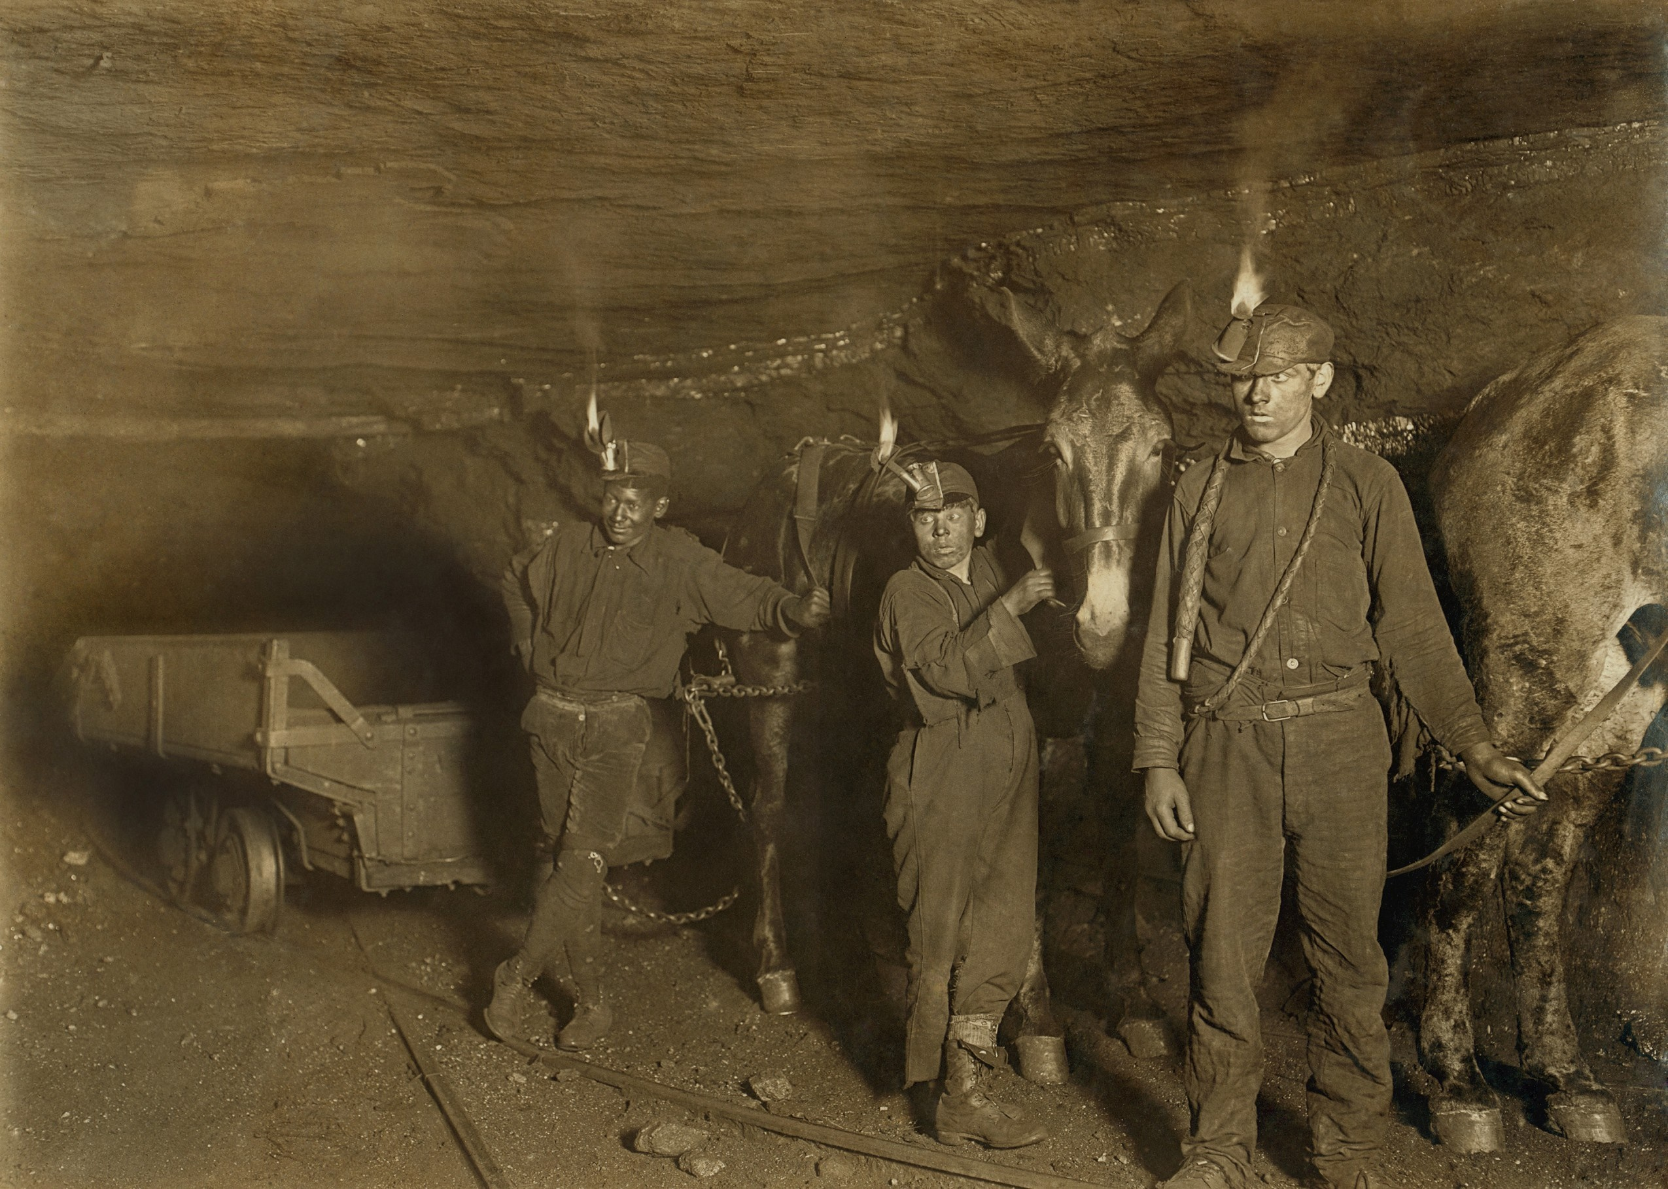
In the United States, as in most industrial countries, social insurance first began with workers’ compensation. A Federal law covering civilian employees of the Government in hazardous jobs was adopted in 1908, and the first State compensation law to be held constitutional was enacted in 1911.
By 1929, workers’ compensation laws were in effect in all but four States. These laws made industry responsible for the costs of compensating workers or their survivors when the worker was injured or killed in connection with his or her job.
https://www.ssa.gov/history/pdf/histdev.pdf
Shutterstock.com

Slide 7
Shutterstock.com
Retirement programs for certain groups of State and local government employees—mainly teachers, police officers, and firefighters—date back to the 19th century. The teachers’ pension plan of New Jersey, which was established in 1896, is probably the oldest retirement plan for government employees. By the early 1900’s, a number of municipalities and local governments had set up retirement plans for police officers and firefighters. New York State and New York City set up retirement systems for their employees in 1920—the same year that the Civil Service Retirement System was set up for Federal employees.
https://www.ssa.gov/history/pdf/histdev.pdf

Slide 8
Shutterstock.com
Another area where the Federal Government accepted an early responsibility was in the provision of benefits and services for persons who served in the Armed Forces. These veterans’ benefits, at first, consisted mainly of compensation for the war-disabled, widows’ pensions, and land grants. Later, emphasis was placed on service pensions and domiciliary care. Following World War I, provisions were made for a full-scale system of hospital and medical care benefits.
The development of social welfare programs has been strongly pragmatic and incremental. Proposals for change are generally formulated in response to specific problems rather than to a broad national agenda.
https://www.ssa.gov/history/pdf/histdev.pdf

Slide 9
123rf.com
A second characteristic of U.S. social welfare policy development is its considerable degree of decentralization. Some programs are almost entirely Federal with respect to administration, financing, or both; others involve only the States (with or without participation of local government); still others involve all three levels of government.
The important role played by the private sector is another aspect of decentralization in the development of American social welfare programs. The private sector shares a large role in the provision of health and medical care and income maintenance benefits in the form of employment related pensions, group life insurance, and sickness payments.
https://www.ssa.gov/history/pdf/histdev.pdf

Slide 10
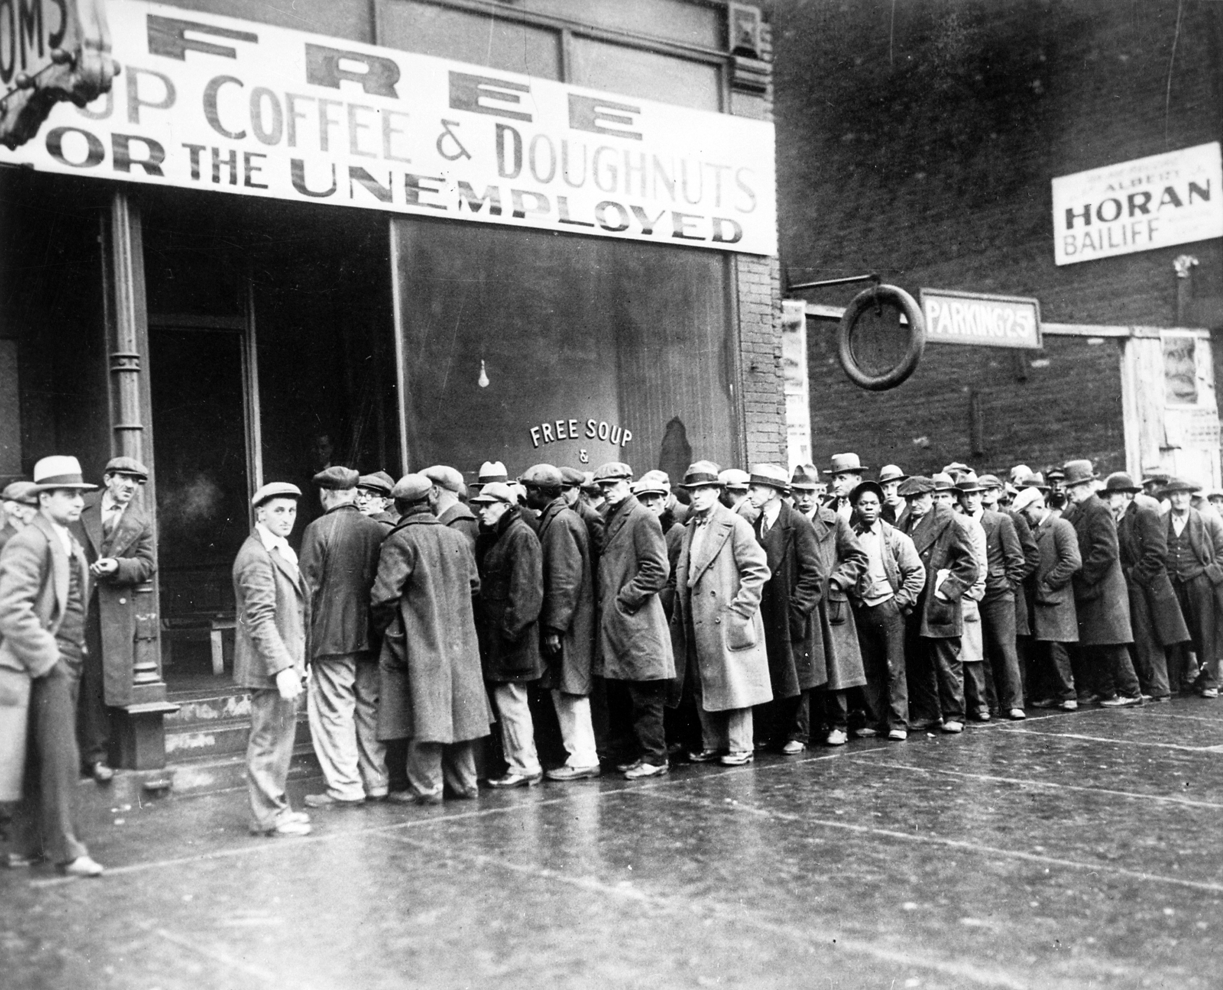
The severe Depression of the 1930’s made Federal action a Security Act necessity, as neither the States and the local communities nor private charities had the financial resources to cope with the growing need among the American people.
Beginning in 1932, the Federal Government first made loans, then grants, to States to pay for direct relief and work relief. After that, special Federal emergency relief and public works programs were started.
In 1935, President Franklin D. Roosevelt proposed to Congress economic security legislation embodying the recommendations of a specially created Committee on Economic Security. There followed the passage of the Social Security Act, signed into law August 14, 1935.
https://www.ssa.gov/history/pdf/histdev.pdf
Shutterstock.com

Slide 11
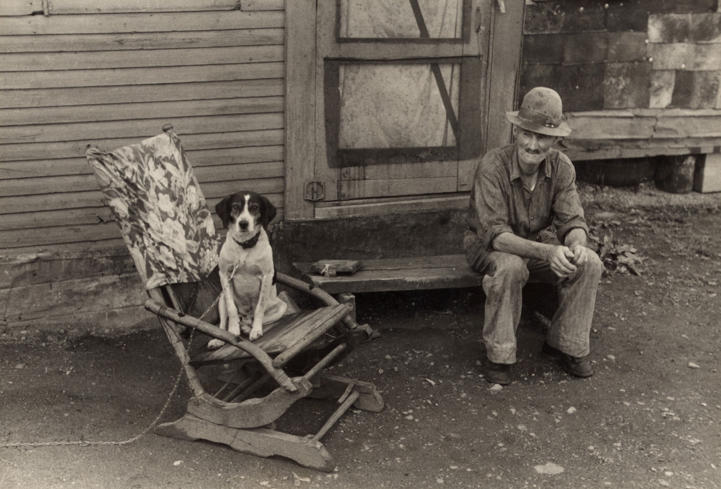
This law established two social insurance programs on a national scale to help meet the risks of old age and unemployment: a Federal system of old-age benefits for retired workers who had been employed in industry and commerce, and a Federal-State system of unemployment insurance. The choice of old age and unemployment as the risks to be covered by social insurance was a natural development, since the Depression had wiped out much of the lifetime savings of the aged and reduced opportunities for gainful employment.
The Act also provided Federal grants-in-aid to the States for the means-tested programs of Old-Age Assistance, and Aid to the Blind. These programs supplemented the incomes of persons who were either ineligible for Social Security (Old-Age and Survivors Insurance) or whose benefits could not provide a basic living. The intent of Federal participation was to encourage States to adopt such programs.
https://www.ssa.gov/history/pdf/histdev.pdf
Shutterstock.com

Slide 12
The law established other Federal grants to enable States to extend and strengthen maternal and child health and welfare services, and these grants became the Aid to Families with Dependent Children program, which has been replaced in 1996 with a new block grant program for Temporary Assistance for Needy Families.
(The Act also provided Federal grants to States for public health services and services of vocational rehabilitation. Provisions for these grants were later removed from the Social Security Act and incorporated into other legislation.)
https://www.ssa.gov/history/pdf/histdev.pdf
123rf.com

Slide 13
The Old-Age Insurance program was not actually in full operation before significant changes were adopted. In 1939, Congress made the Old-Age Insurance system a family program when it added benefits for dependents of retired workers and surviving dependents of deceased workers. Benefits also became first payable in 1940, instead of 1942 as originally planned.
No major changes were made again in the program until the 1950’s, when it was broadened to cover many jobs that previously had been excluded—in some cases because experience was needed to work out procedures for reporting the earnings and collecting the taxes of persons in certain occupational groups.
The scope of the basic national social insurance system was significantly broadened in 1956 through the addition of Disability Insurance. Benefits were provided for severely disabled workers aged 50 or older and for adult disabled children of deceased or retired workers.
In 1958, the Social Security Act was further amended to provide benefits for dependents of disabled workers similar to those already provided for dependents of retired workers. In 1960, the age-50 requirement for disabled-worker benefits was removed. The 1967 amendments provided disability benefits for widows and widowers aged 50 or older.
https://www.ssa.gov/history/pdf/histdev.pdf
123rf.com

Slide 14
One of the most important pieces of social legislation was the establishment of the Medicare program under the Social Security Amendments of 1965. The program provided for the medical needs of persons aged 65 or older, regardless of income. The 1965 legislation also created Medicaid (Federal grants to States for Medical Assistance Programs).
Medicaid provides medical assistance for persons with low incomes and resources. It replaced the former programs of medical vendor payments to public assistance recipients and medical assistance for medically needy persons aged 65 or older. Both Medicare and Medicaid have been subject to numerous legislative changes since 1965. The public assistance provisions of the Social Security Act were also broadened. In 1972, the State-administered cash assistance programs for the aged, blind, and disabled were replaced by the essentially federally administered Supplemental Security Income (SSI) program.
Other assistance programs not included in the Social Security Act were also broadened or new ones added. The Food Stamp program was enacted in 1964 to improve the nutrition of low-income families. Other nutrition programs include the Special Supplemental Food Program for Women, Infants, and Children (WIC) and school breakfasts and lunches. In addition, Federal-State programs provide home energy assistance, and public and subsidized housing.
https://www.ssa.gov/history/pdf/histdev.pdf
123rf.com

Slide 15
While our nation goes to great lengths to support the needs of many of our citizens, there is often criticism that too much of our tax money is allocated toward social programs. The truth, however, is that we actually spend much more on corporate welfare, assistance to corporations, than we do on social welfare, which assists families and individuals.
The combined cost of 10 corporate welfare programs is $1.539 trillion per year.
The three main programs needy families depend upon — Temporary Assistance for Needy Families ($17.3 billion), food stamps ($74 billion), and the Earned Income Tax Credit ($67.2 billion) — cost just $158.5 billion in total.
http://usuncut.com/class-war
Shutterstock.com

Slide 16
CORPORATE WELFARE
1. TAX BREAKS FOR CEO BONUSES
($7 BILLION/YEAR)
2. TAX CUTS FOR LUXURY CORPORATE JETS ($300 MILLION/YEAR)
3. BIG OIL SUBSIDIES
($37.5 BILLION/YEAR)
4. PHARMACEUTICAL SUBSIDIES
($270 BILLION/YEAR)
5. CAPITAL GAINS TAX BREAKS
($51 BILLION/YEAR)
6. CORPORATE TAX SUBSIDIES FROM STATE AND LOCAL GOVERNMENTS
($80.4 BILLION/YEAR)
7. HANDOUTS TO BIG AG
($18 BILLION/YEAR)
8. WELFARE FOR WALL STREET
($83 BILLION/YEAR)
9. EXPORT-IMPORT BANK SUBSIDIES
($112 BILLION)
10. FEDERAL CONTRACTS FOR THE TOP 200 BIGGEST COMPANIES
($880 BILLION/YEAR)
Shutterstock.com

Slide 17
Key Words
social programs Disability Insurance recipient
social welfare structure poor relief system industry
old-age assistance workers’ compensation benefits
retirement programs pension plan disabled
full-scale system Social Security grants
Shutterstock.com

