Slide 1
NICKY FIFTH’S NEW JERSEY
N5NJ
SECONDARY PROGRAM
CIVICS AND GOVERNMENT
>121
<121

Slide 2
As a citizen of the United States, you live in a democracy and, on the federal level, you are represented by 2 Senators and 12 Congressmen and Congresswomen.
They are the elected officials who represent the interests of the citizens of New Jersey, as well as those of the state.
In New Jersey, you are represented by 40 Senators and 80 members of the General Assembly. They are the elected officials who represent the interests of the citizens of New Jersey’s legislative districts, as well as those of the state.
In addition, we have one governor.
This tiny group, consisting of merely 121 citizens, is responsible for creating the laws that govern our state.
123rf.com

Slide 3
The population of New Jersey is about 9 million, a much bigger number than 121. If this were a math lesson, it would look like this: 9,000,000 > 121.
As a civics lesson, however, this equation paints a different picture.
In addition to being citizens, the 9 million of ‘the rest of us’ are also constituents. We are the people the 121 represent. Their job, as elected officials, is to represent the interests of the constituents, not their own.
123rf.com

Slide 4
Today, however, many elected officials serve their own interests or draft and pass laws that benefit special interests. Special interests are the groups, often corporations or organizations, that pay lobbyists, or people to explain their needs to lawmakers. Unfortunately, they use massive campaign contributions and other ‘carrots’ to get the job done. They enjoy access that the rest of us never experience and then they enjoy the results.
123rf.com

Slide 5
Now, to be fair, not all lobbyists are lobbying for selfish purposes. There are some who advocate on behalf of important causes involving children, families, and the environment. But overall, to the average citizen, the presence of special interests feels rather unseemly.
123rf.com

Slide 6
Special interests are just one reason many of the rest of us feel disconnected from our of the people, by the people, for the people democracy. It seems like the people are missing from the equation.
And it’s true. Not many of the rest of us, roughly 9 million minus 121, do our part. Our apathy and lack of participation is the reason things like this are able to occur over and over and over again.

Slide 7
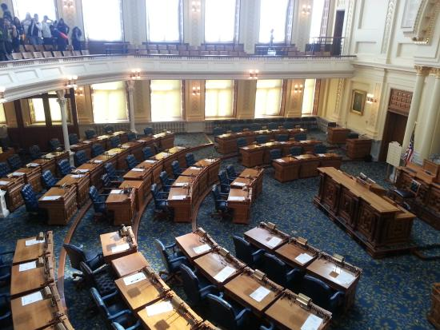
Let’s face it, most New Jerseyans don’t know, without checking their phone, who their representatives are or even what legislative district they live in. Most have never called to lodge a complaint or praise a new law, and many have never even sent a letter.
If the 9 million are only aware of current issues when they directly impact them, if they remain oblivious and ambivalent, and if they feel their only role as a citizen of New Jersey is to point out the flaws, then they are as much a part of the problem as the 121.

Slide 8
Turn on the evening news tonight and, on any given evening, you’ll see half a dozen stories about countries where citizens have no voice. They live under dictators, violent regimes, and have little to no rights.
Then think about where you live. In a democracy, there are four vital components: the Legislature, the Executive Branch, the Supreme Court, and the constituents. Of those four components, the constituents are the most important and least involved.
123rf.com

Slide 9
For three important reasons, constituent involvement needs to change. The first reason is obvious: how can lawmakers represent our interests appropriately if they don’t know what we want.
They may have power, but they don’t have special powers. There is no legislative crystal ball to read the minds of the constituents. It is our duty, as members of a democracy, to participate in our government. If you fail to meet that obligation, you should refrain from complaining.
123rf.com

Slide 10
The other reason for constituent participation is called daylight. Your interest and participation shines daylight on the activities of our lawmakers.
When people know their activities are being monitored, they tend to follow the rules and make better decisions.
123rf.com

Slide 11
The reason is that the majority of lawmakers work very hard for their constituents.
They are as upset, if not more, with the behavior of some of their colleagues. They know that the behavior of a few reflects poorly on the group.
The hardworking, honest Senators and members of the General Assembly would appreciate nothing more than your input, active participation, and interest.
123rf.com

Slide 12
Before you use your voice and reach out to your lawmakers, make sure you are informed about the issues and have referenced multiple sources. It’s your obligation, as a constituent, to be aware of the issues our lawmakers are discussing. That’s an important part of being a constituent.
Once you’ve done your homework, and are aware of the issues, make it a point to share your opinion with your representatives in both chambers.

Slide 13
Active Constituent
Any Street
Any Town, NJ 00000
NJ Lawmaker
State House
125 West State Street
Trenton, NJ 08608
You have several options to use your voice:
Email
Call
Letter
Attend events
Attend legislative sessions
Attend committee hearings
Invite your representatives to school

Slide 14
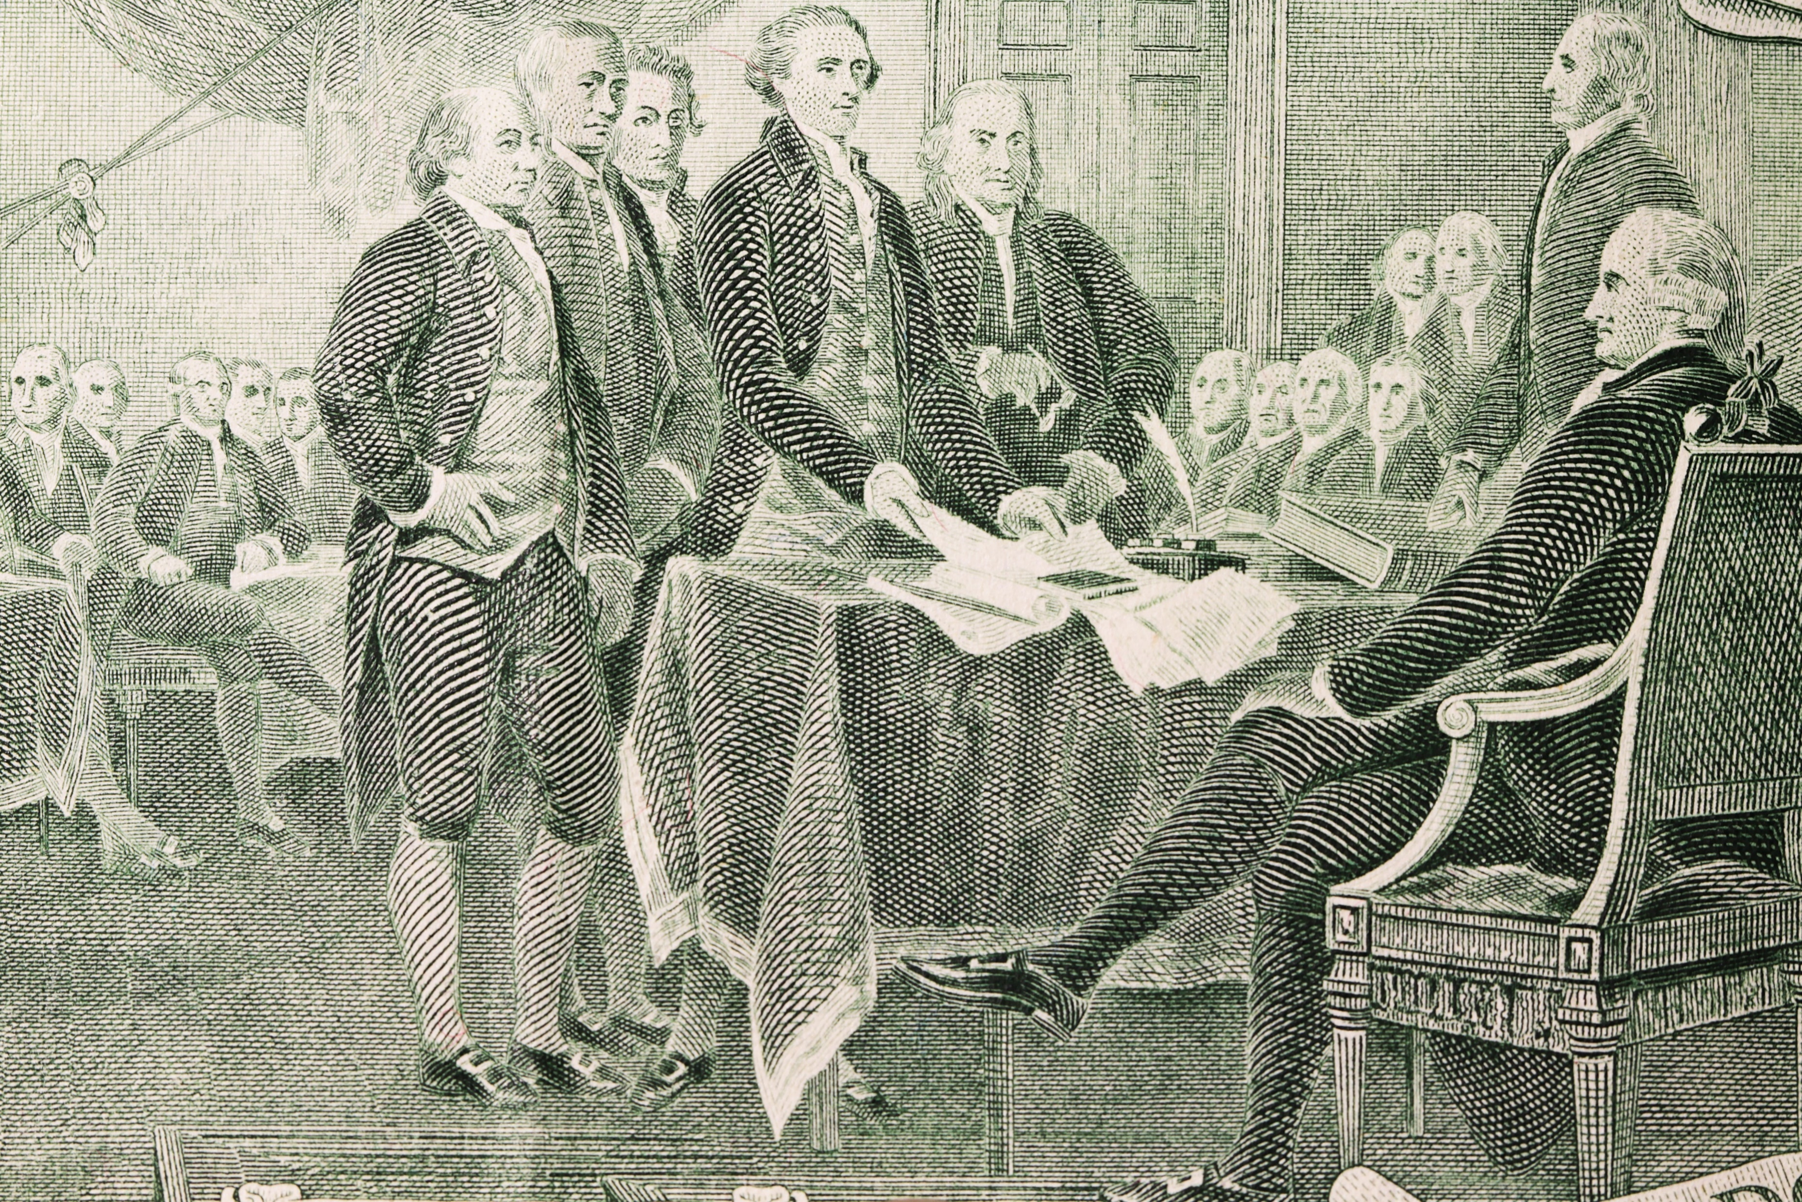
While we may take it for granted at times, our democracy is a remarkable gift from our Founding Fathers. Remember, for a government of the people, by the people, and for the people to function, the people must participate.

Slide 15
Key Words
democracy citizens Senators
constituents General Assembly lobbyist
campaign contributions elected officials advocate
special interests representatives conscripts
share your opinion disconnected enlistee

