Slide 1
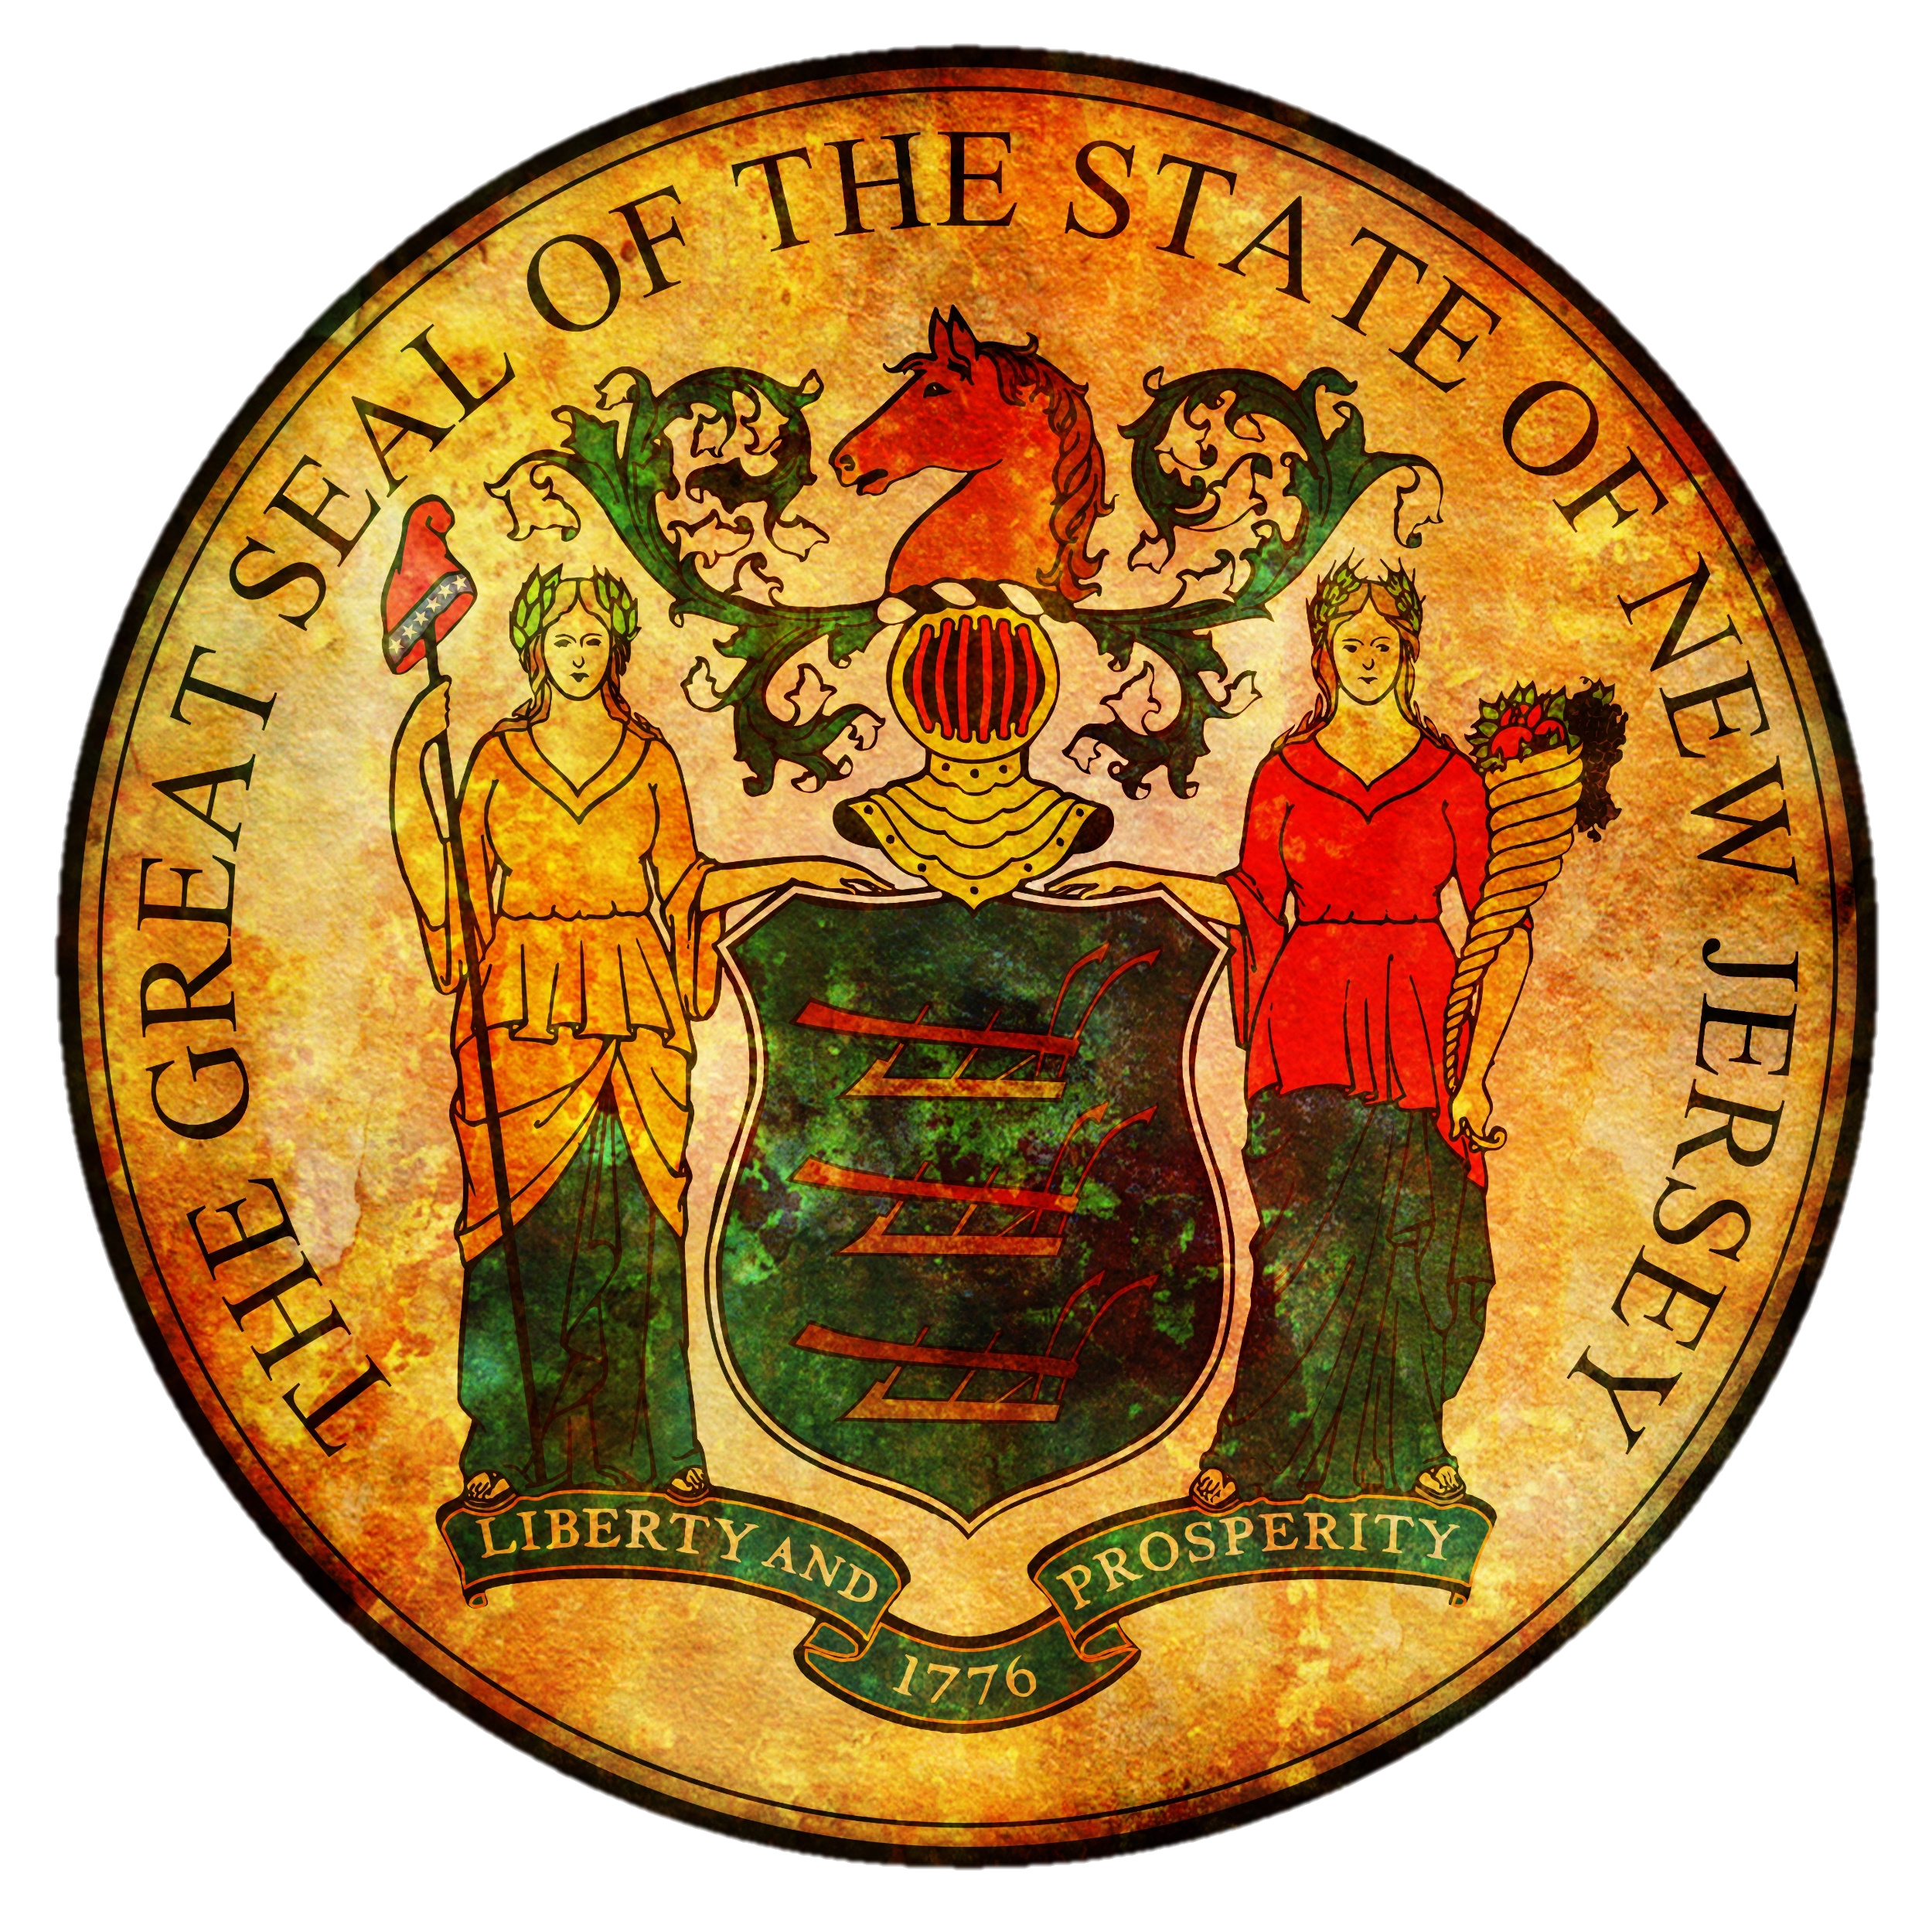
NICKY FIFTH’S NEW JERSEY
N5NJ
SECONDARY PROGRAM
CIVICS AND GOVERNMENT
State vs. Federal

Slide 2
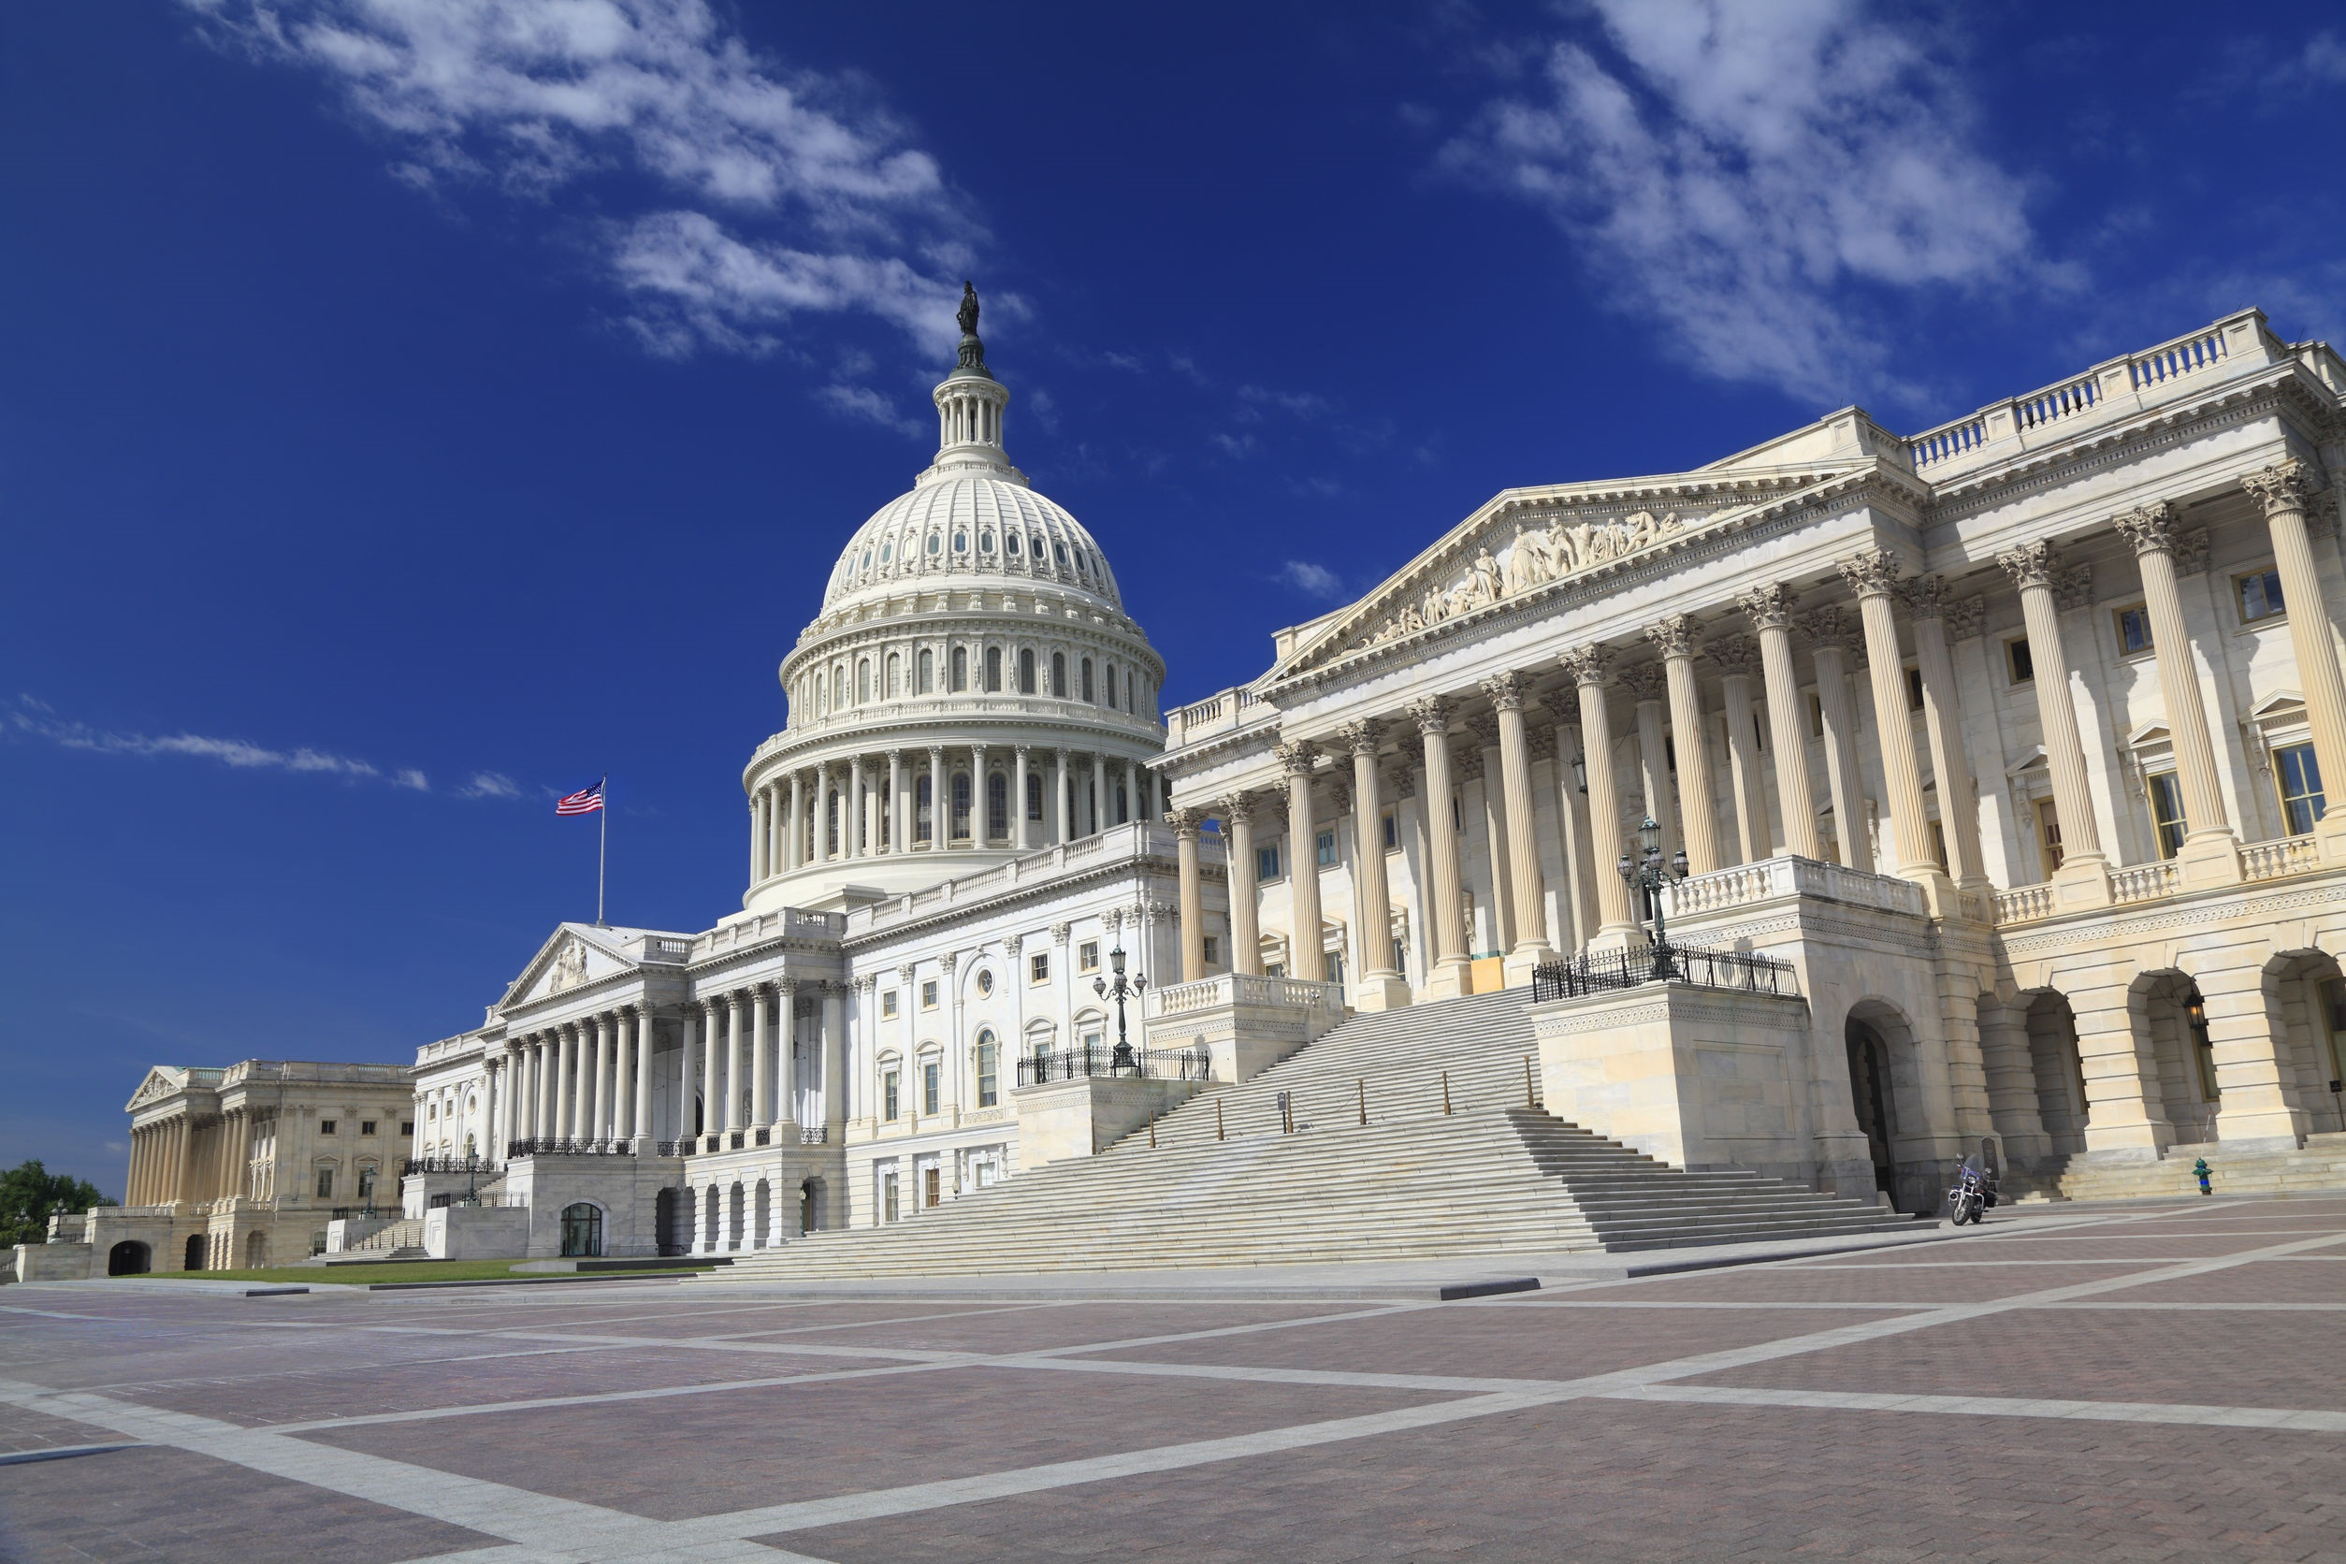
Capitol Building
Washington, DC
If you’re not familiar with how government in the United States works, one reason may be the complex structure. While it will make sense once you understand the various levels and functions, until then, it may seem very confusing. The best place to start, however, is the division of powers.
123rf.com

Slide 3
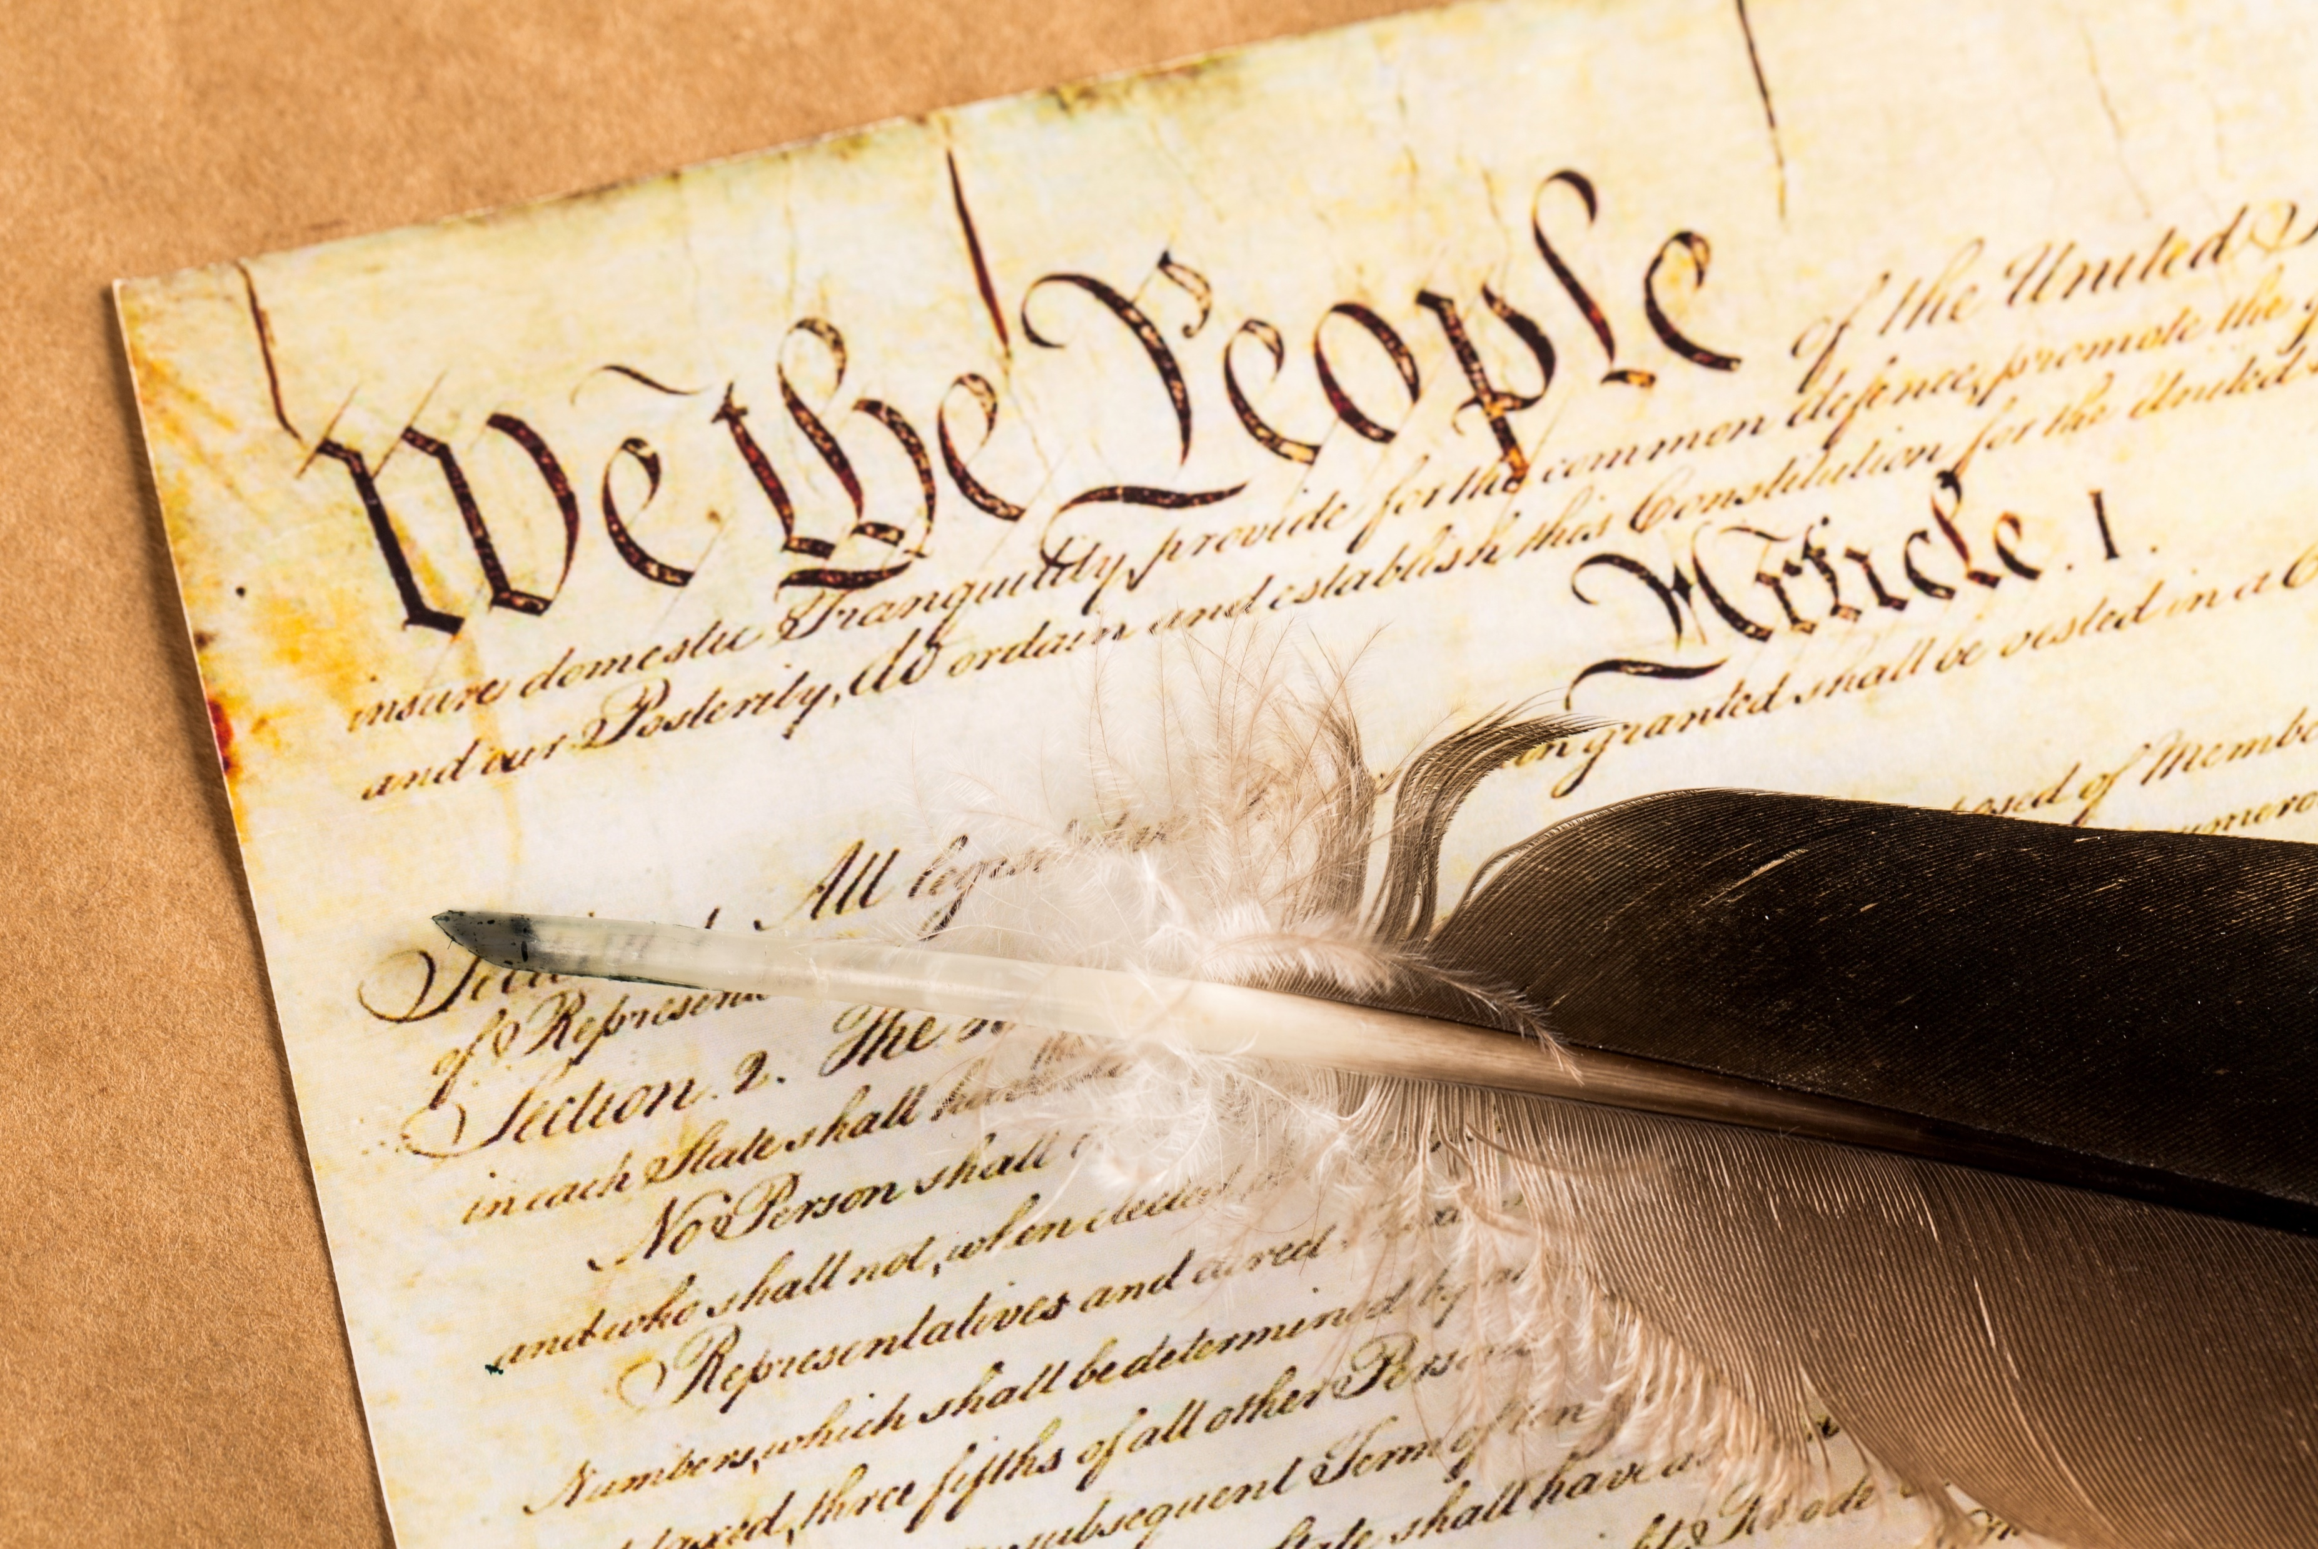
The Constitution was very specific in how the federal government should operate and divide powers.
Shutterstock.com

Slide 4
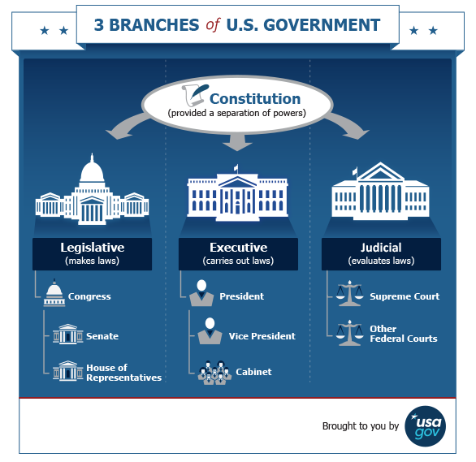
The Constitution of the United States divides the federal government into three branches to ensure a central government in which no individual or group gains too much control:
Legislative – Makes laws (Congress)
Executive – Carries out laws (President, Vice President, Cabinet)
Judicial – Evaluates laws (Supreme Court and Other Courts)
https://www.usa.gov/branches-of-government

Slide 5
Each branch of government can change acts of the other branches as follows:
The president can veto laws passed by Congress.
https://www.usa.gov/branches-of-government

Slide 6
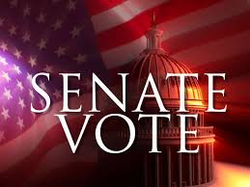
Congress confirms or rejects the president's appointments and can remove the president from office in exceptional circumstances.
https://www.usa.gov/branches-of-government
123rf.com

Slide 7
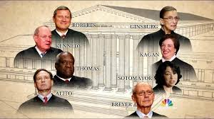
The justices of the Supreme Court, who can overturn unconstitutional laws, are appointed by the president and confirmed by the Senate.
https://www.usa.gov/branches-of-government

Slide 8
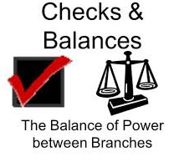
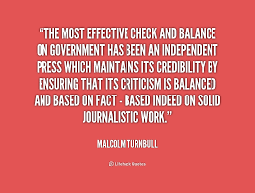
The U.S. federal government seeks to act in the best interests of its citizens through this system of checks and balances.
https://www.usa.gov/branches-of-government

Slide 9
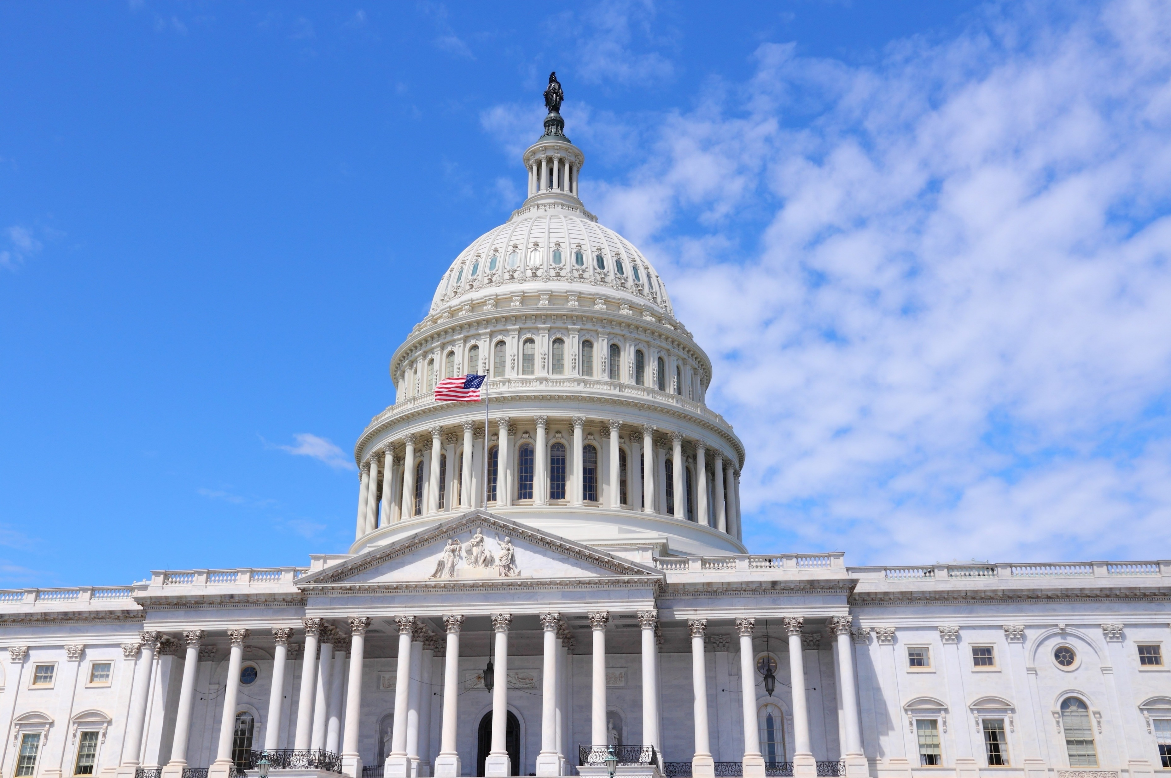
Legislative Branch
The legislative branch enacts legislation, confirms or rejects presidential appointments, and has the authority to declare war.
This branch includes Congress (the Senate and House of Representatives) and several agencies that provide support services to Congress. American citizens have the right to vote for senators and representatives through free, confidential ballots.
Senate - There are two elected senators per state, totaling 100 senators. A senate term is six years and there's no limit to the number of terms an individual can serve.
House of Representatives - There are 435 elected representatives, which are divided among the 50 states in proportion to their total population. There are additional non-voting delegates who represent the District of Columbia and the territories.
A representative serves a two-year term, and there's no limit to the number of terms an individual can serve.
https://www.usa.gov/branches-of-government
123rf.com

Slide 10
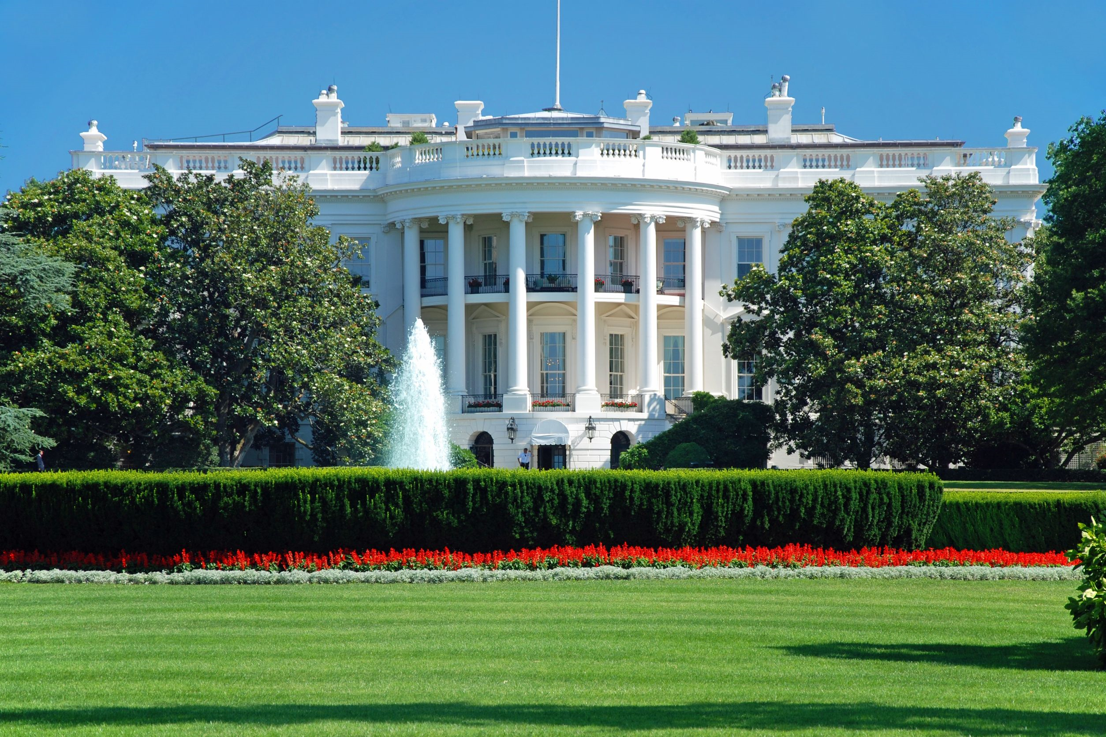
Executive Branch
The executive branch carries out and enforces laws. It includes the president, vice president, the Cabinet, executive departments, independent agencies, and other boards, commissions, and committees.
American citizens have the right to vote for the president and vice president through free, confidential ballots.
Key roles of the executive branch include:
President - The president leads the country. He/she is the head of state, leader of the federal government, and commander-in-chief of the United States Armed Forces. The president serves a four-year term and can be elected no more than two times.
Vice President - The vice president supports the president. If the president is unable to serve, the vice president becomes president. He/she can serve an unlimited number of four-year terms.
The Cabinet - Cabinet members serve as advisors to the president. They include the vice president and the heads of executive departments. Cabinet members are nominated by the president and must be approved by the Senate (with at least 51 votes).
https://www.usa.gov/branches-of-government
123rf.com

Slide 11
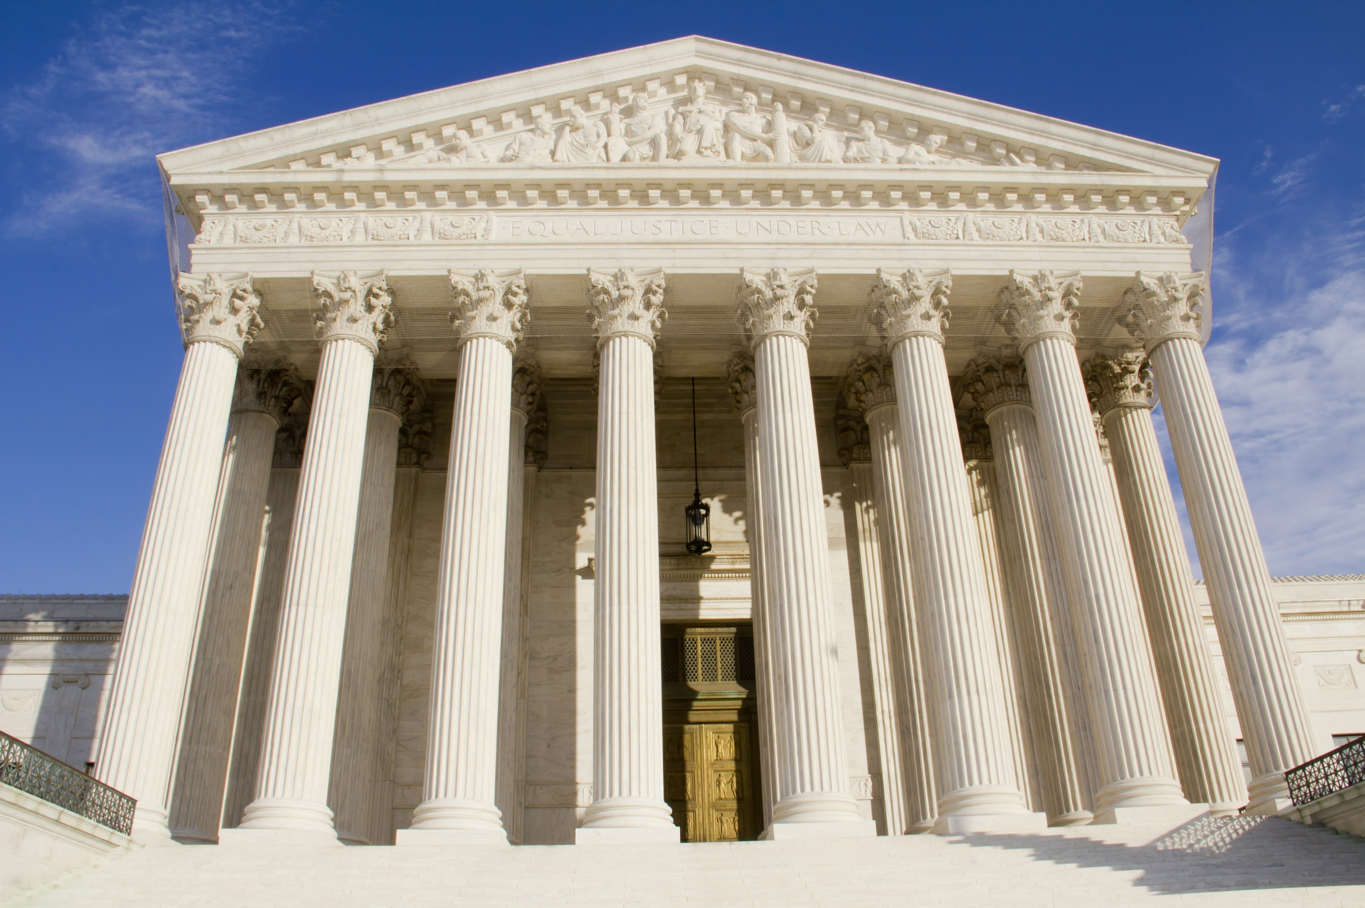
Judicial Branch
The judicial branch interprets the meaning of laws, applies laws to individual cases, and decides if laws violate the Constitution. The judicial branch is comprised of the Supreme Court and other federal courts.
Supreme Court - The Supreme Court is the highest court in the United States. The justices of the Supreme Court are nominated by the president and must be approved by the Senate (with at least 51 votes). Congress decides the number of justices. Currently, there are nine. There is no fixed term for justices. They serve until their death, retirement, or removal in exceptional circumstances.
Other Federal Courts - The Constitution grants Congress the authority to establish other federal courts.

Slide 12
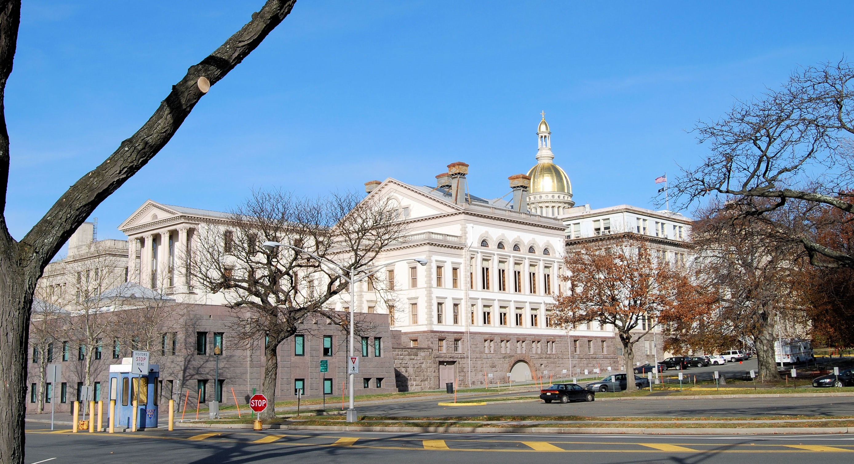
State & Local Government
Powers not granted to the federal government are reserved for states and the people, which are divided between state and local governments.
https://www.whitehouse.gov/1600/state-and-local-government
Much like the federal government, the state government is divided into three branches:
Executive (Governor)
Legislative (Assembly and Senate)
Judicial (New Jersey Supreme Court)
State House
Trenton, NJ
123rf.com

Slide 13
State House
Trenton, NJ
New Jersey Executive Branch
In every state, the executive branch is headed by a governor who is directly elected by the people. In most states, the other leaders in the executive branch are also directly elected, including the lieutenant governor, the attorney general, the secretary of state, and auditors and commissioners. States reserve the right to organize in any way, so they often vary greatly with regard to executive structure. No two state executive organizations are identical.
https://www.whitehouse.gov/1600/state-and-local-government

Slide 14
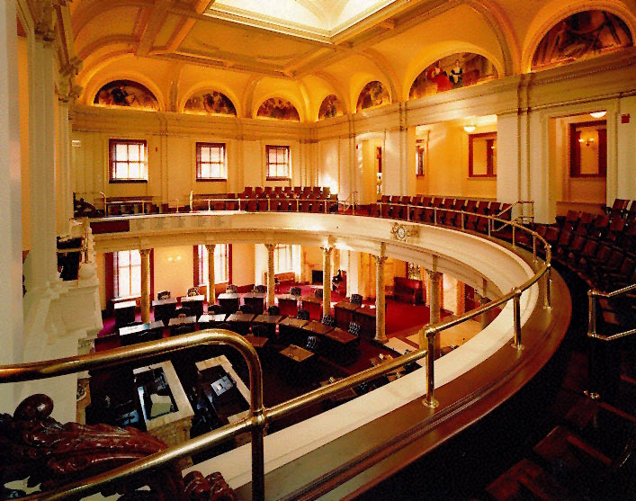
Senate Chamber
(Upper House)
State House
New Jersey Legislative Branch
All 50 states have legislatures made up of elected representatives, who consider matters brought forth by the governor or introduced by its members to create legislation that becomes law. The legislature also approves a state's budget and initiates tax legislation and articles of impeachment. The latter is part of a system of checks and balances among the three branches of government that mirrors the federal system and prevents any branch from abusing its power.
https://www.whitehouse.gov/1600/state-and-local-government

Slide 15
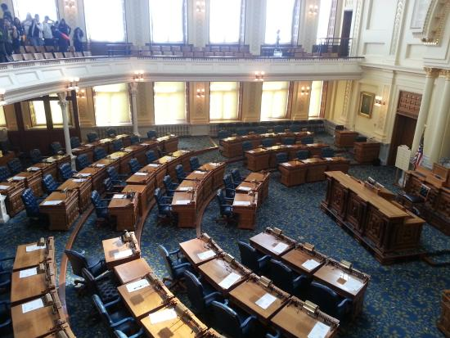
Except for one state, Nebraska, all states have a bicameral legislature made up of two chambers: a smaller upper house and a larger lower house.
Together the two chambers make state laws and fulfill other governing responsibilities. (Nebraska is the lone state that has just one chamber in its legislature.)
The smaller upper chamber is always called the Senate, and its members generally serve longer terms, usually four years.
The larger lower chamber is most often called the House of Representatives, but some states call it the Assembly or the House of Delegates. Its members usually serve shorter terms, often two years.
https://www.whitehouse.gov/1600/state-and-local-government
Assembly Chamber
(Lower House)
State House

Slide 16
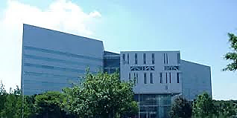
Hughes Justice Complex
Trenton, NJ
New Jersey Judicial Branch
State judicial branches are usually led by the state supreme court, which hears appeals from lower-level state courts. Court structures and judicial appointments/elections are determined either by legislation or the state constitution. The Supreme Court focuses on correcting errors made in lower courts and therefore holds no trials. Rulings made in state supreme courts are normally binding; however, when questions are raised regarding consistency with the U.S. Constitution, matters may be appealed directly to the United States Supreme Court.
https://www.whitehouse.gov/1600/state-and-local-government

Slide 17
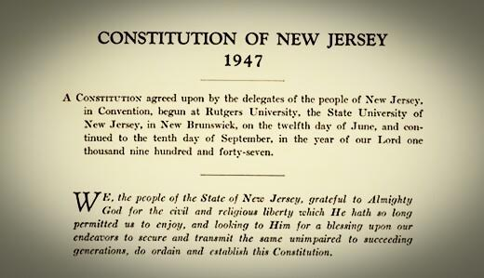
Throughout its history as a state, New Jersey has had three different constitutions. These documents reflect the social and governmental conditions of the state at the time they were written. Of the three constitutions the first, the Constitution of 1776, is most directly a product of the time in which it was written. This document, for better or worse, has had a profound effect on the development of democratic government in the Garden State.
The two governing documents that followed this original constitution took their form largely as a response to governmental problems created by the deficiencies of the Constitution of 1776.One of the most remarkable aspects of this first constitution is that it remained the state's foundation of government for over 65 years.
Despite its limitations, this document is at least partially responsible for the creation of many institutions of government that contemporary New Jerseyans consider indispensable.
http://www.state.nj.us/njfacts/njdoc10.htm

Slide 18
While there are disputes from time to time, the framework of our government, established by our Founding Fathers and amended by our elected representatives, has enabled various levels of government to co-exist and establish, evaluate, and enforce the laws of the land.

Slide 19
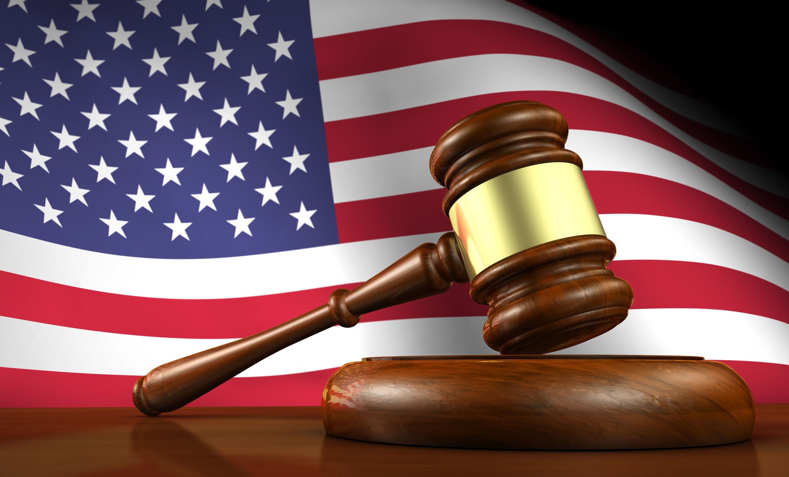
Key Words
division of powers government Constitution
three branches federal government legislative
economic support evaluates laws judicial
makes laws carries out laws executive
Other federal courts Supreme Court chamber

