Slide 1
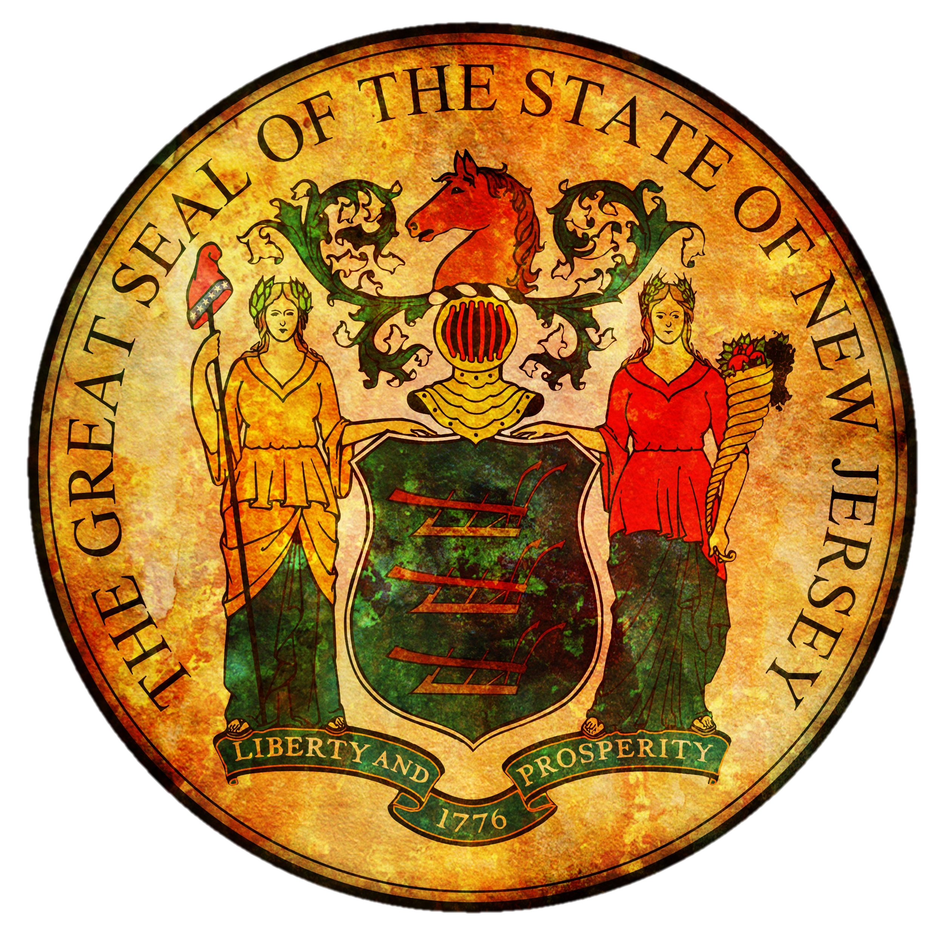
NICKY FIFTH’S NEW JERSEY
N5NJ
SECONDARY PROGRAM
CIVICS AND GOVERNMENT
County Government

Slide 2
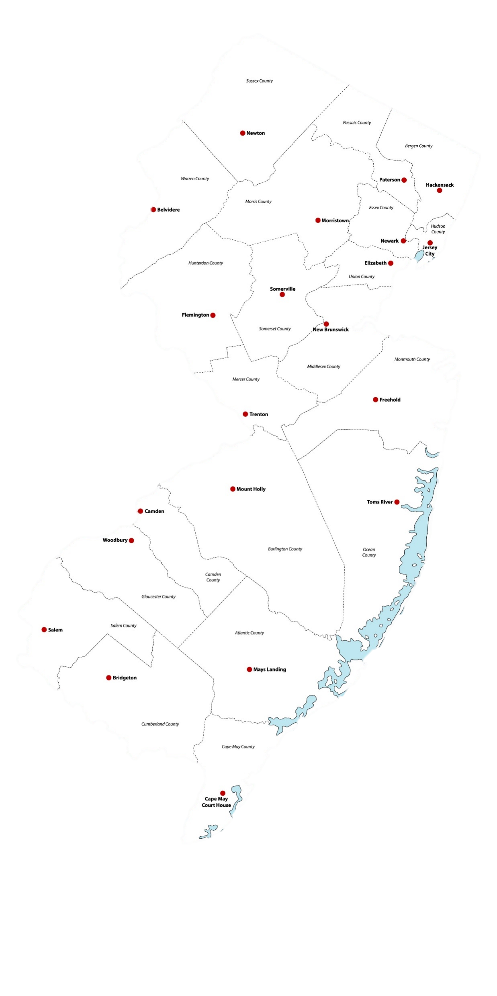
New Jersey is divided geographically into 21 counties that serve as administrative and political units. They range in population from Bergen County, with 934,000 residents, to Salem County with 66,000. Ocean County is the largest at 916 square miles while Hudson County, the smallest, is just 47 square miles.
http://www.njspotlight.com/stories/15/10/26/explainer-what-s-a-freeholder-understanding-nj-s-complex-government-system/
For more information, visit njspotlight.com

Slide 3
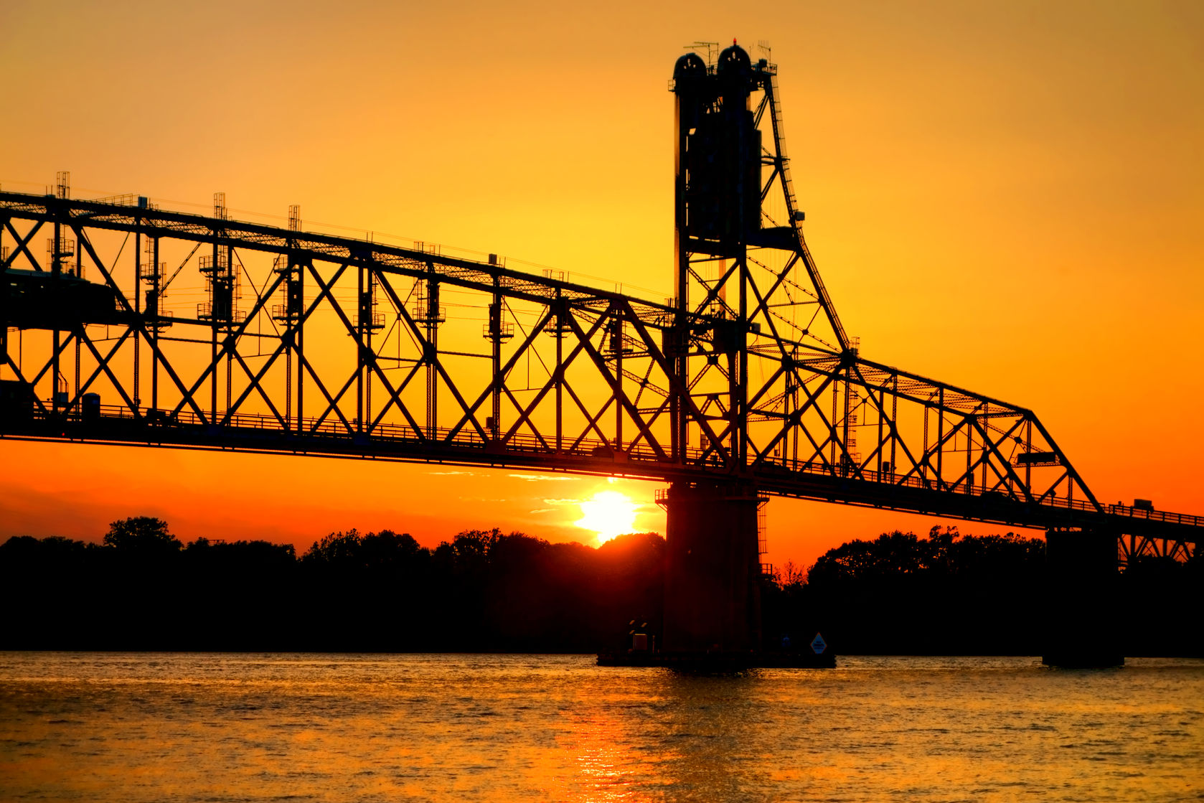
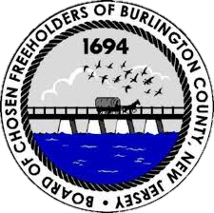
Every county has a legislative body called the board of chosen freeholders. “One person, one vote” decisions by federal and state courts in the mid-1960s led to creation of a uniform system of three to nine freeholders per county, based on population, according to New Jersey Politics and Government: The Suburbs Come of Age, by Barbara Salmore. They are elected at-large in some counties and from districts in others.
http://www.njspotlight.com/stories/15/10/26/explainer-what-s-a-freeholder-understanding-nj-s-complex-government-system/
123rf.com

Slide 4
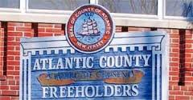
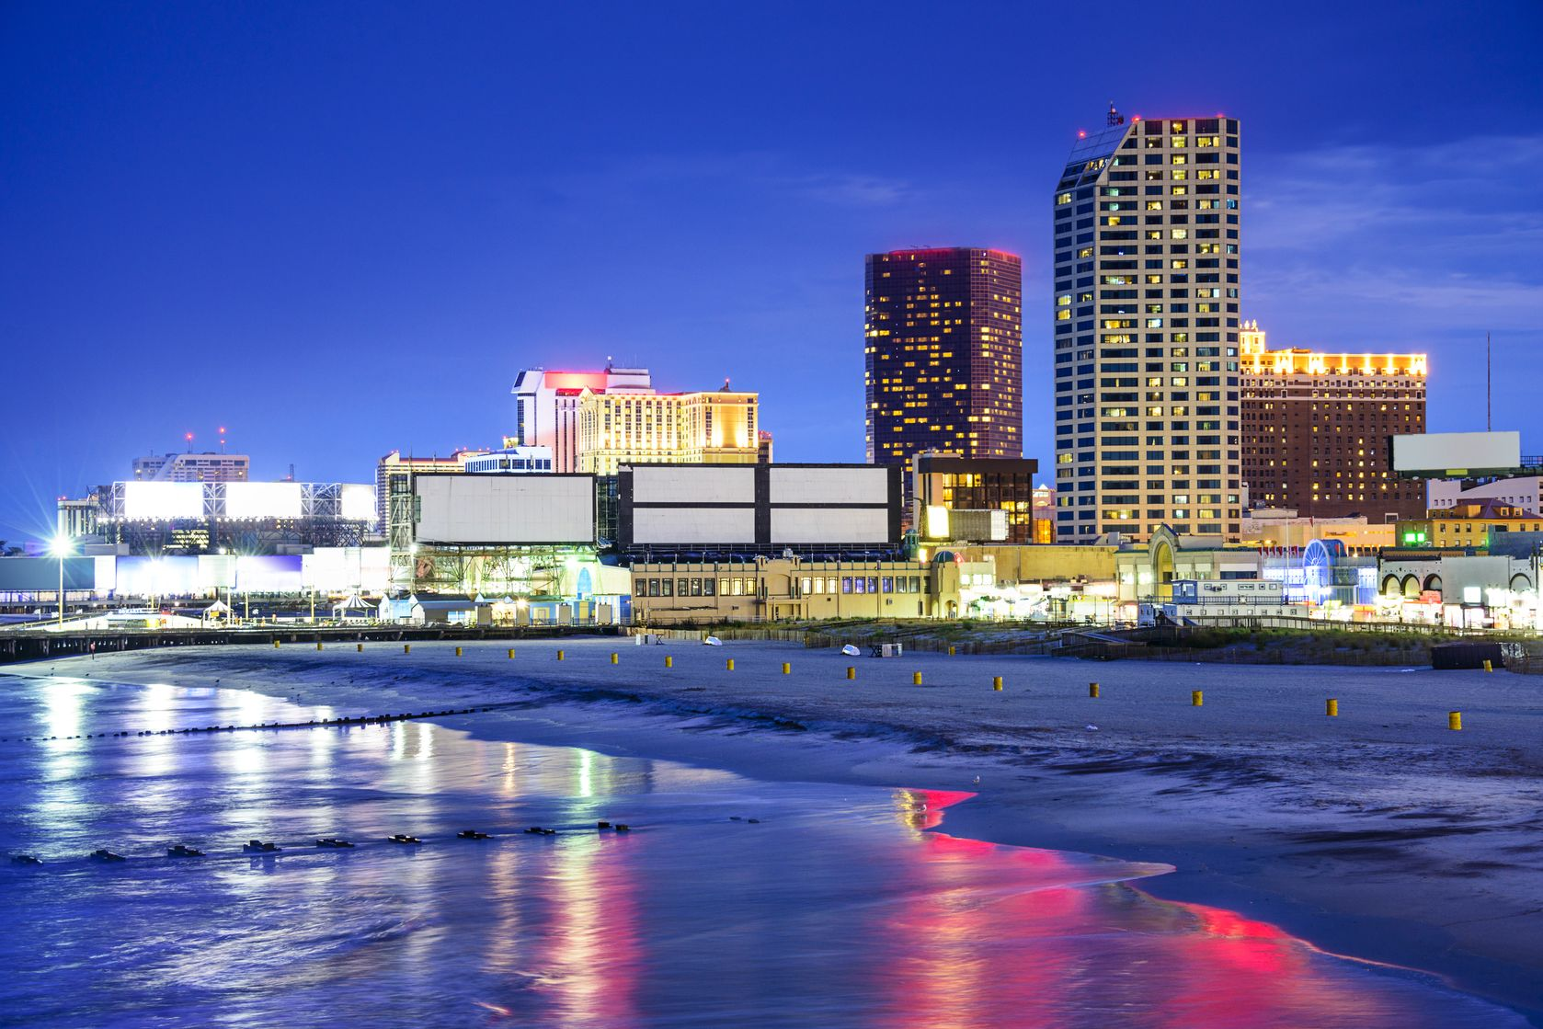
Leadership options: Originally freeholders chose a director to run the county government from among themselves. Two exceptions were Hudson and Essex counties, where voters elected directors for a period in the late 19th century and then county supervisors in the early 20th century, according to the Encyclopedia of New Jersey.
The system was overhauled by the 1972 Optional Charter Law, which creates four alternatives for county governance: a popularly elected county executive, an appointed county manager, an appointed county supervisor, or a board president.
http://www.njspotlight.com/stories/15/10/26/explainer-what-s-a-freeholder-understanding-nj-s-complex-government-system/
123rf.com

Slide 5
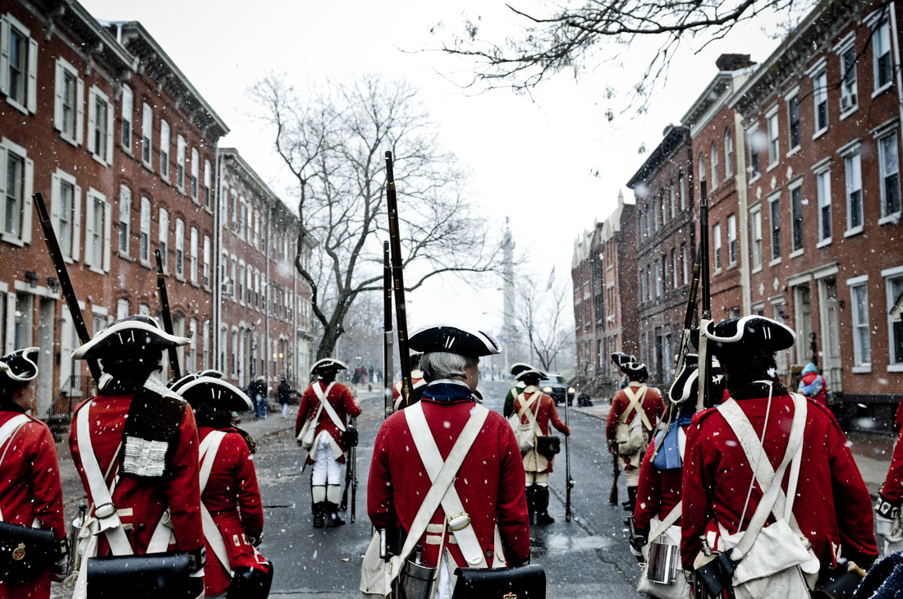
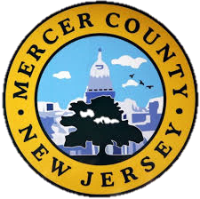
Directors, administrators, executives: In most counties an appointed administrator is in charge of operations, though in a few the freeholders themselves have executive responsibilities over county departments.
Five counties -- Atlantic, Bergen, Essex, Hudson, and Mercer -- opted for popularly elected county executives in addition to freeholder boards. Union has a county manager.
http://www.njspotlight.com/stories/15/10/26/explainer-what-s-a-freeholder-understanding-nj-s-complex-government-system/

Slide 6
Sheriffs and other elected officials: County voters have elected sheriffs since 1776. Their duties were gradually parceled out to other agencies, leaving them to handle prisoner transfers, foreclosure sales, and some law-enforcement functions, though sheriffs still control county jails in 10 counties, according to the Encyclopedia of New Jersey.
The other elected county officials are the county clerk, who maintains records and helps run elections, and the surrogate, who oversees probate of wills and matters concerning orphans. County prosecutors are nominated by the governor and approved by the senate.
http://www.njspotlight.com/stories/15/10/26/explainer-what-s-a-freeholder-understanding-nj-s-complex-government-system/

Slide 7
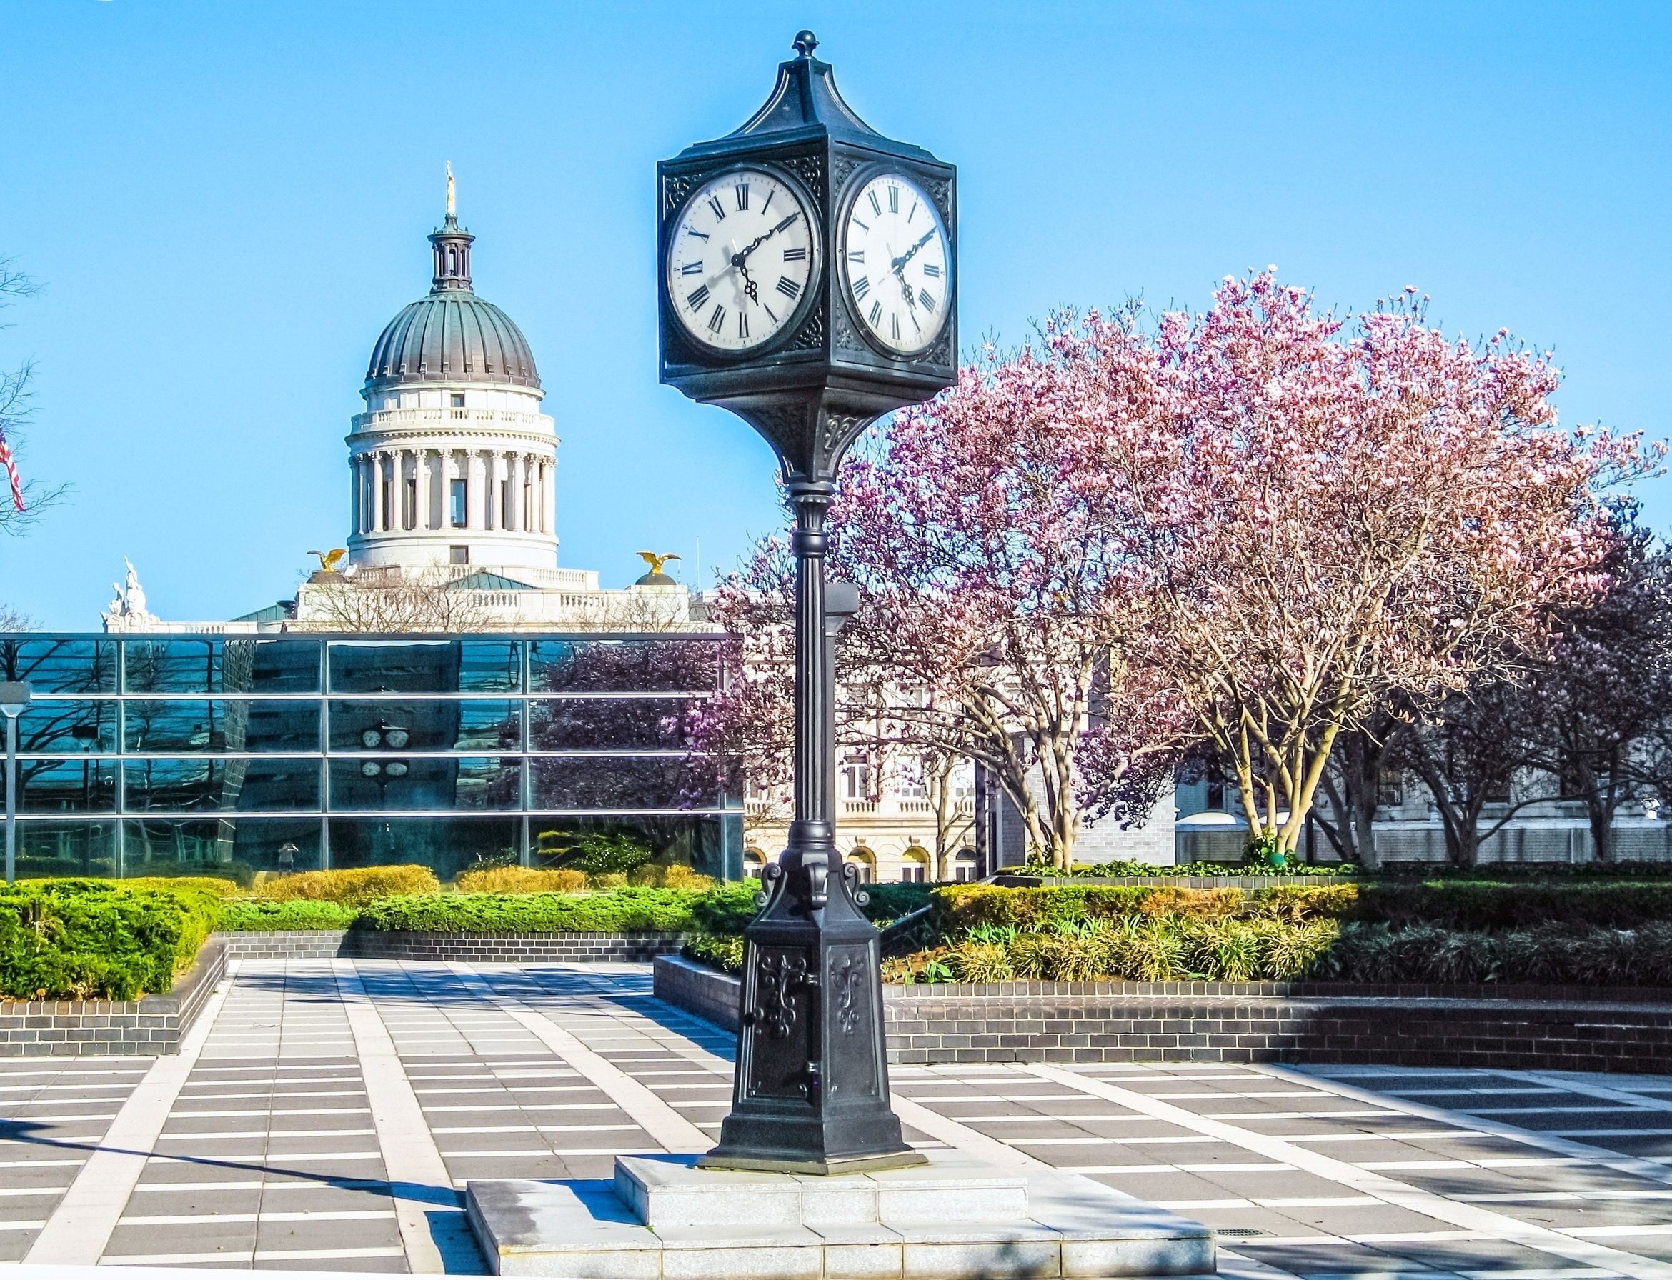
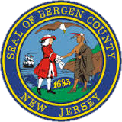
123rf.com
Counties’ role in state elections: From 1776 until 1965, the state Legislative Council and its successor, the state Senate, were composed of one member from each county. Local bosses had considerable sway over statewide politics, and senators from lightly populated rural counties could form blocs to exercise outsized control of state policy.
Only after the U.S. Supreme Court ruled in 1966 that such arrangements violated the principal of “one person, one vote” did the state create the current system of 40 legislative districts that cross county lines.
http://www.njspotlight.com/stories/15/10/26/explainer-what-s-a-freeholder-understanding-nj-s-complex-government-system/

Slide 8
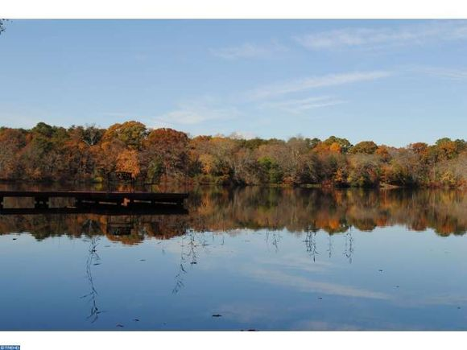
What counties do: Since 1798 counties have gradually taken on more responsibilities, from control of bridges and authority to build almshouses (homes for the poor) to extensive road-building and park systems.
According to the New Jersey Association of Counties (NJAC), they now administer state social-service programs; maintain county jails, most state courts, and most of the state’s bridges; fund county colleges, vocational schools, and prosecutors; manage elections; provide transportation for senior citizens and disabled people; handle trash and recycling; promote economic development; and perform many other functions.
http://www.njspotlight.com/stories/15/10/26/explainer-what-s-a-freeholder-understanding-nj-s-complex-government-system/
123rf.com

Slide 9
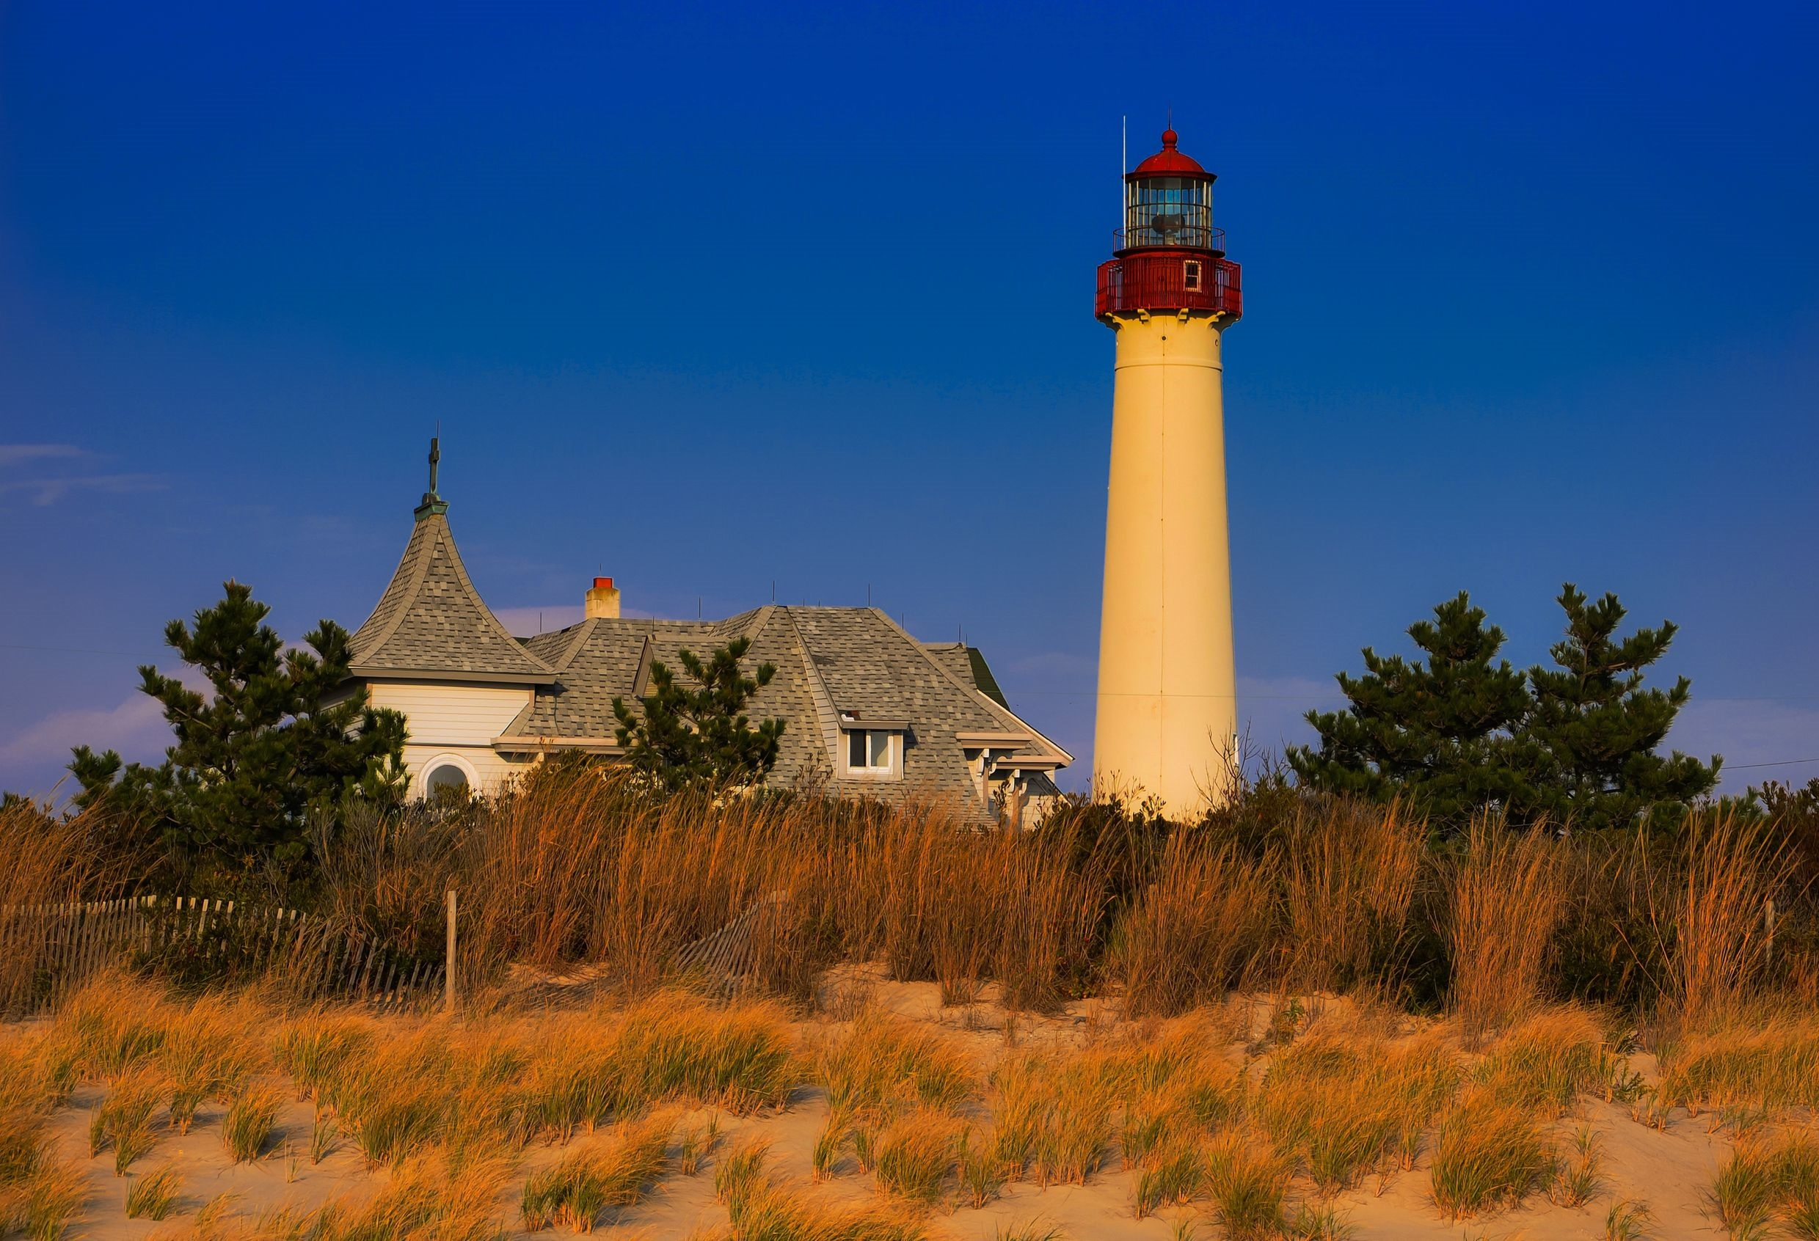
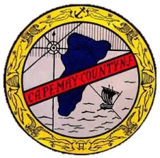
Do we need counties? Critics of New Jersey’s high costs of government often call for consolidation of some of its 565 municipalities, but in February, Assemblyman Robert Auth (R-Bergen) introduced legislation that would eliminate county government.
“The services provided by the counties can be delivered as efficiently -- sometimes at substantial savings -- by state or municipal governments,” Auth wrote.
http://www.njspotlight.com/stories/15/10/26/explainer-what-s-a-freeholder-understanding-nj-s-complex-government-system/
123rf.com

Slide 10
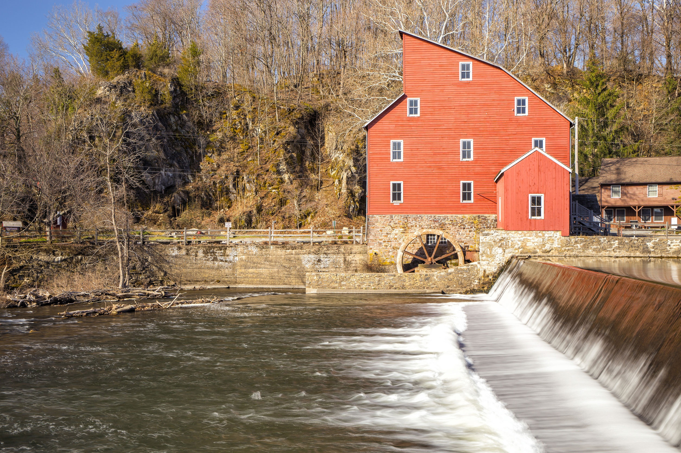
Counties, the backstory: In early English history a unit called the shire or county was an administrative division for royal justice.
After the British seized the area that is now New Jersey from the Dutch in the 17th century, they divided the provinces of East Jersey and West Jersey into large counties: Bergen, Essex, Middlesex, Monmouth, and Somerset counties in East Jersey, and Burlington, Salem, Gloucester, and Cape May counties in West Jersey.
http://www.njspotlight.com/stories/15/10/26/explainer-what-s-a-freeholder-understanding-nj-s-complex-government-system/
123rf.com

Slide 11
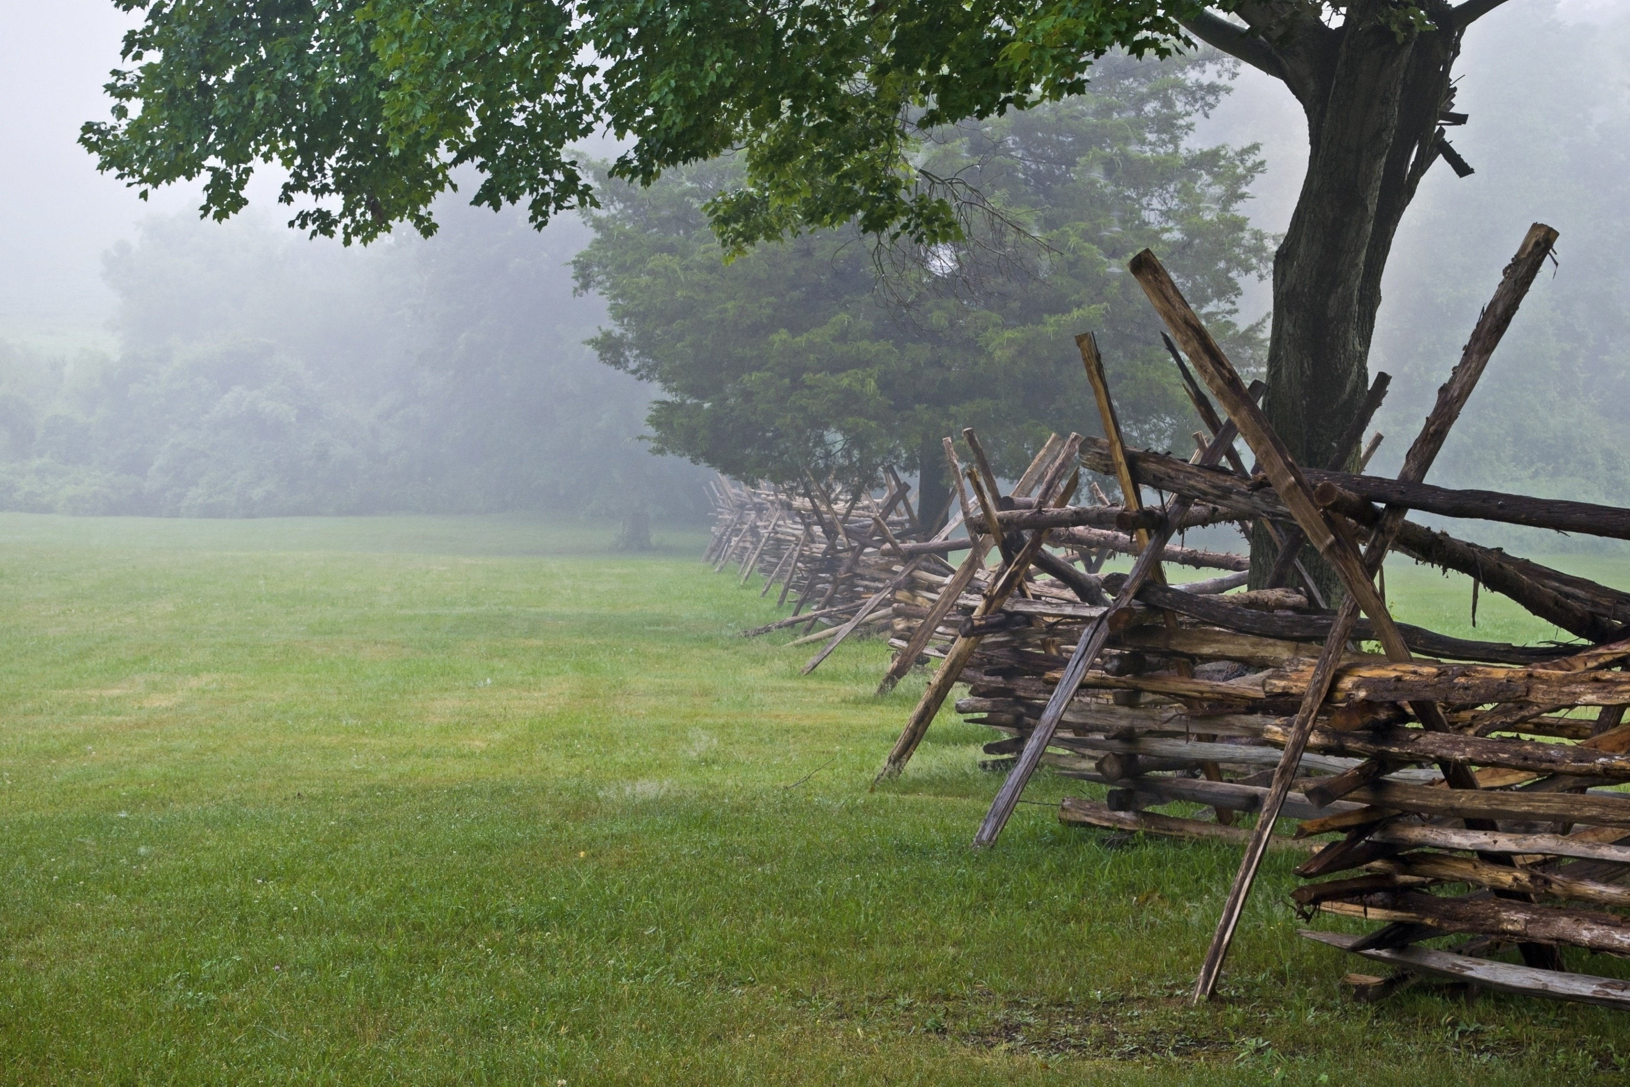
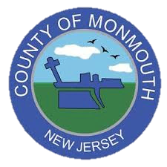
The NJAC responded that the towns and state don’t have the expertise or resources to take on county services, and said that over the past decade counties have saved taxpayers money by taking on more municipal functions, like 911 dispatching, animal control, and even policing in some places, at lower cost.
The association noted that the three states with little or no county government -- Connecticut, Massachusetts, and Rhode Island -- are still on the list of the 10 states with the highest tax burdens (along with New Jersey). Senate President Stephen Sweeney (D-Gloucester), a former freeholder and a leading proponent of shared-services agreements, also opposes the measure.
http://www.njspotlight.com/stories/15/10/26/explainer-what-s-a-freeholder-understanding-nj-s-complex-government-system/
123rf.com

Slide 12
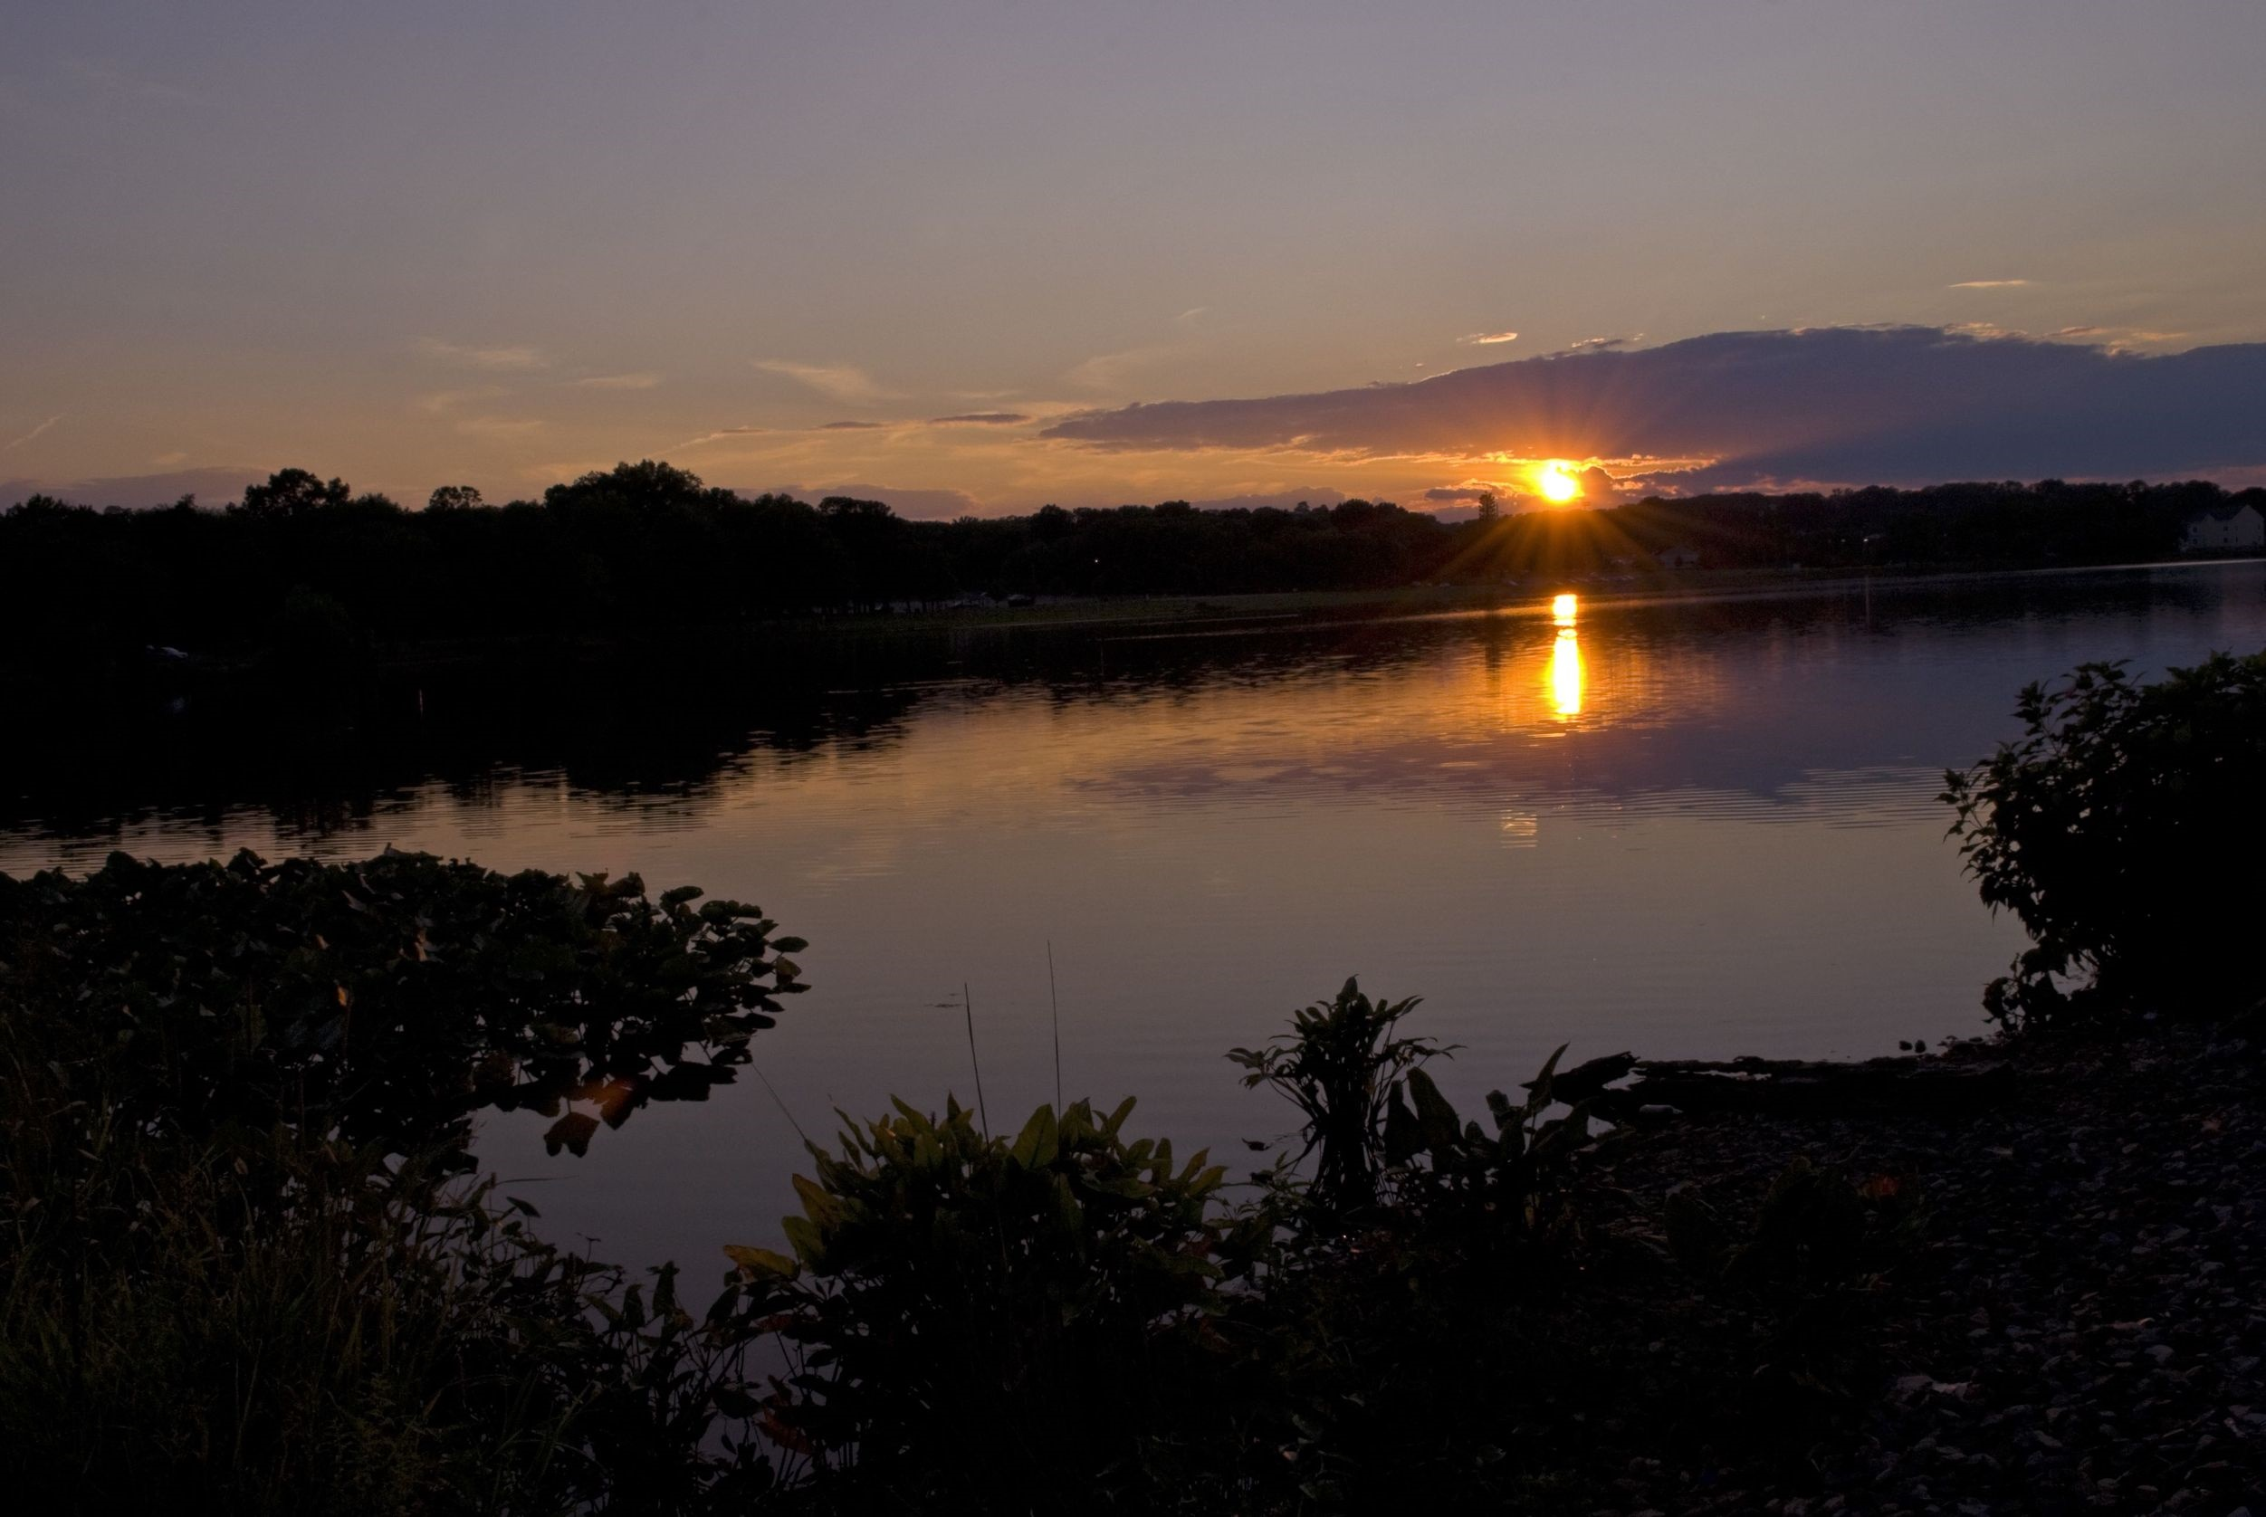
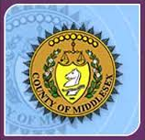
The organizing principle: Initially the counties were provincial administrative units for judicial purposes. The West Jersey legislature, for example, began appointing regional justices, sheriffs, clerks, and recorders in 1682, and in the succeeding years established county lines that defined the courts’ jurisdiction.
Elections were also eventually based around counties, with each sending a number of representatives to the provincial legislature. County borders were often defined by rivers and specific residents’ tracts of land.
http://www.njspotlight.com/stories/15/10/26/explainer-what-s-a-freeholder-understanding-nj-s-complex-government-system/
123rf.com

Slide 13
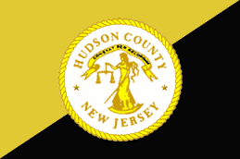
Creating more counties: Getting to a distant county seat for court business could be an arduous process, leading to calls for new counties. In the years leading up to the Revolution in 1776, the existing counties were carved up to create four more: Hunterdon, Morris, Cumberland, and Sussex.
The remaining eight were established between 1824 and 1857, Union County being the last. Each new county brought with it a more conveniently located court, a more prominent center of commerce, and most importantly, a new slate of legislators. “The more counties, the more opportunities to increase a party’s control of the state affairs,” according to the Encyclopedia of New Jersey.
http://www.njspotlight.com/stories/15/10/26/explainer-what-s-a-freeholder-understanding-nj-s-complex-government-system/
123rf.com

Slide 14
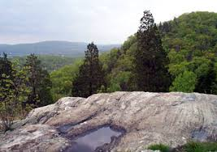
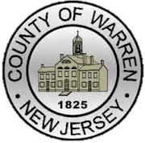
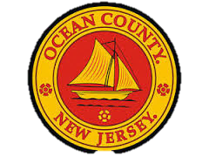
The term “freeholder”: In England a freeholder was a person who owned land free of debts or legal claims, and in the colonies only freeholders could hold office. In pre-Revolutionary New Jersey, appointed or elected freeholders, along with justices of the peace, appointed tax collectors and oversaw county business, including the “killing of wolves, maintaining the poor, and building and repairing the ponds and bridges.”
New Jersey is the only state whose county commissioners are called freeholders.
http://www.njspotlight.com/stories/15/10/26/explainer-what-s-a-freeholder-understanding-nj-s-complex-government-system/

Slide 15
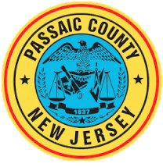
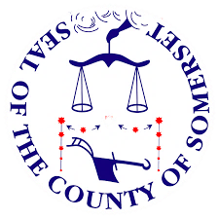
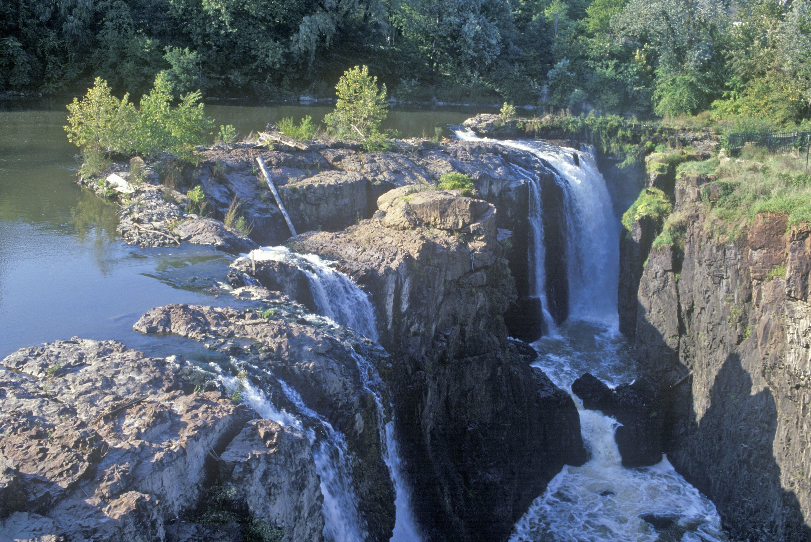
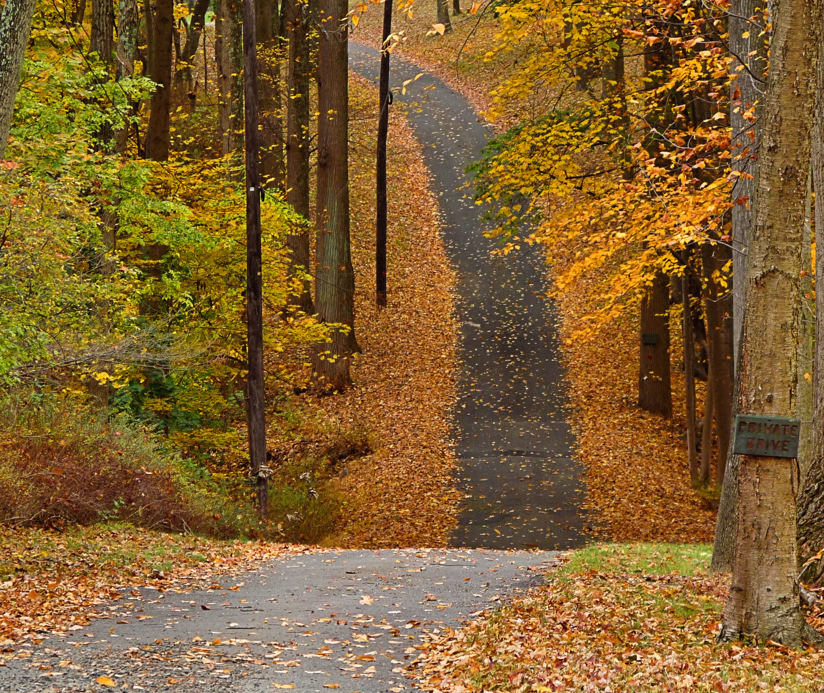
Electing freeholders: After the Revolution, local government was standardized by a 1798 law requiring each county to have a board of chosen freeholders consisting of two elected from each town.
Judges were no longer on the county boards. Over time state election laws were often tweaked for partisan purposes, allowing some municipalities, city wards, and assembly districts to elect additional freeholders, and boards grew huge. Essex had 40 freeholders in 1874, according to the Encyclopedia of New Jersey.
A push for smaller boards began around the turn of the century and concluded with the reforms of the mid-1960s.
http://www.njspotlight.com/stories/15/10/26/explainer-what-s-a-freeholder-understanding-nj-s-complex-government-system/

Slide 16
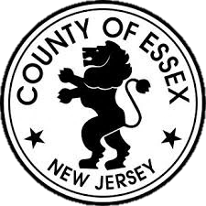
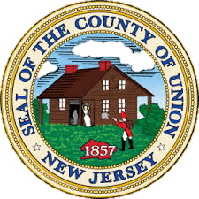
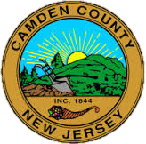
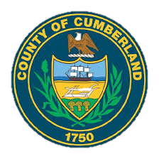
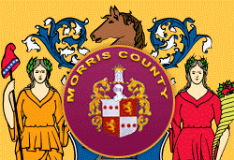
While the debate regarding the future of New Jersey’s 21 counties and 565 municipalities continues, the best course of action for all New Jerseyans is to become familiar with the work of all levels of government. Once you are familiar with the pros and cons, join the conversation.

Slide 17
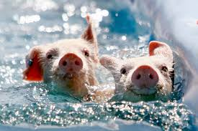
NJ State Fair,
Sussex County
Key Words
geographically population residents
one person, one vote freeholders Sheriffs
county government administrator legislation
county executive county manager appointed
assembly districts county clerk elected

