Slide 1
NICKY FIFTH’S NEW JERSEY
N5NJ
SECONDARY PROGRAM
CIVICS AND GOVERNMENT
Voting in New Jersey

Slide 2
As a citizen of the United States, you enjoy a freedom that people in many countries around the world die for and can only dream of: the right to cast your vote in a democratic process. While voting is a right, guaranteed in the constitution, there are certain responsibilities attached to that right. First and foremost is to inform yourself regarding the issues as well as the candidates.
Your informed participation in the democratic process, as a voter, is a gift provided by our Founding Fathers and protected by our armed forces. Never underestimate the power of your voice and your vote. There is no greater threat to our democracy than apathy.
http://www.state.nj.us/counties/mercer/commissions/pdfs/boe_voterrightshandbook.pdf

Slide 3
Dear Fellow Citizen,
Participating in the democratic process by voting is not only a precious right, it is a civic responsibility. For while we live in a free society, that society still operates on the basis of laws. Only by voting can we have a voice in determining who makes those laws. Public safety. Health care. Equal justice. The cost of goods and services. On a daily basis, these and other issues that help determine our quality of life are influenced by the decisions our elected leaders make. If we do not vote, we allow others to choose those leaders. And, ultimately, we relinquish a vital opportunity – the opportunity to help shape the policies that will guide our future.
If you are a United States citizen, at least 18 years of age, and are registered to vote in accordance with New Jersey law, you have the legal right to vote. I urge you to exercise that right. The Secretary of State is committed to ensuring that the voting process in New Jersey is as accessible and inclusive as possible. Consistent with that goal, this Voter Rights Handbook is filled with useful information including: registration and voting procedures, a glossary of voting terms, tips on how to protect your right to vote from undue interference, and available resources should you require further assistance. An informed electorate is the key to a thriving democracy. Today and in the future, I hope you will participate in the democratic process by voting, and that you will find this Voter Rights Handbook a useful resource.
Nina Mitchell Wells,
Secretary of State
http://www.state.nj.us/counties/mercer/commissions/pdfs/boe_voterrightshandbook.pdf

Slide 4
Quick Fact
Democracy is about Freedom. Voting is Free. It costs no money to register to vote and no money to cast a vote. No one can pay you to register to vote or to vote.
http://www.state.nj.us/counties/mercer/commissions/pdfs/boe_voterrightshandbook.pdf

Slide 5
New Jersey’s Voting Requirements
You can vote if you are:
a U.S. citizen
at least 18 years of age by election day
a New Jersey resident at least 30 days before the election
not in jail, on probation or parole because of a felony conviction
registered to vote at least 21 days before the election
http://www.state.nj.us/counties/mercer/commissions/pdfs/boe_voterrightshandbook.pdf

Slide 6
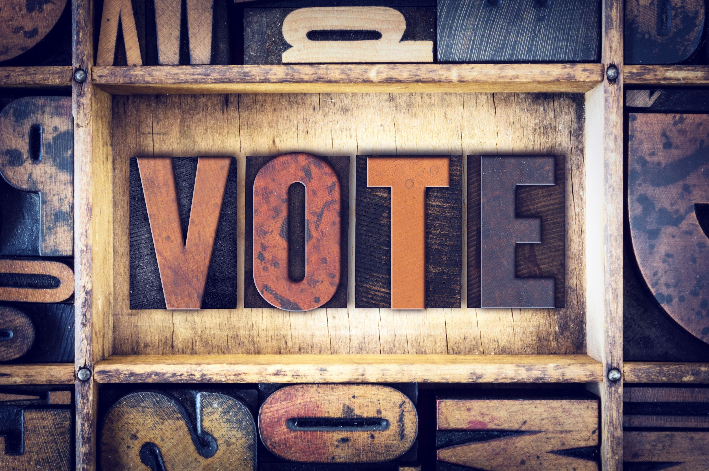
Quick Fact
Special Note for Ex-Felons: In New Jersey, ex-felons can register to vote. Any person who is no longer in prison, or has completed his or her term of probation or parole can register to vote. That is the law.
http://www.state.nj.us/counties/mercer/commissions/pdfs/boe_voterrightshandbook.pdf

Slide 7
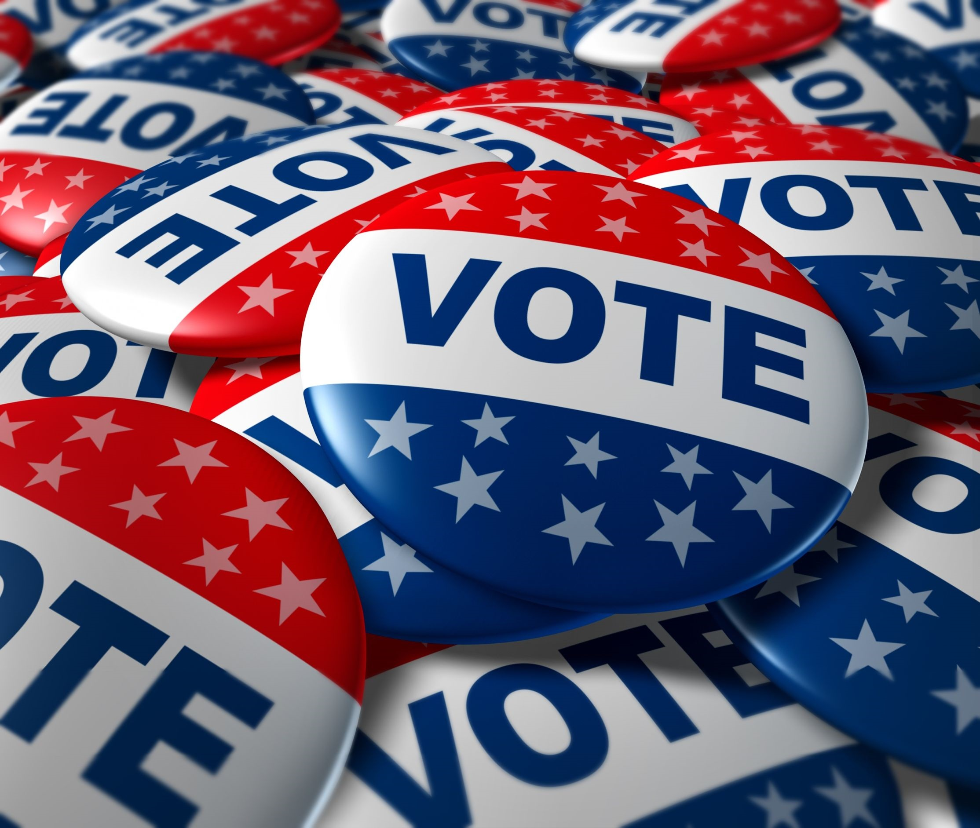
Quick Tip
Voter Registration Forms are available at your Municipal Clerk’s Office, any Motor Vehicle Commission Agency, from your County Commissioner of Registration or online at www.NJElections.org
http://www.state.nj.us/counties/mercer/commissions/pdfs/boe_voterrightshandbook.pdf

Slide 8
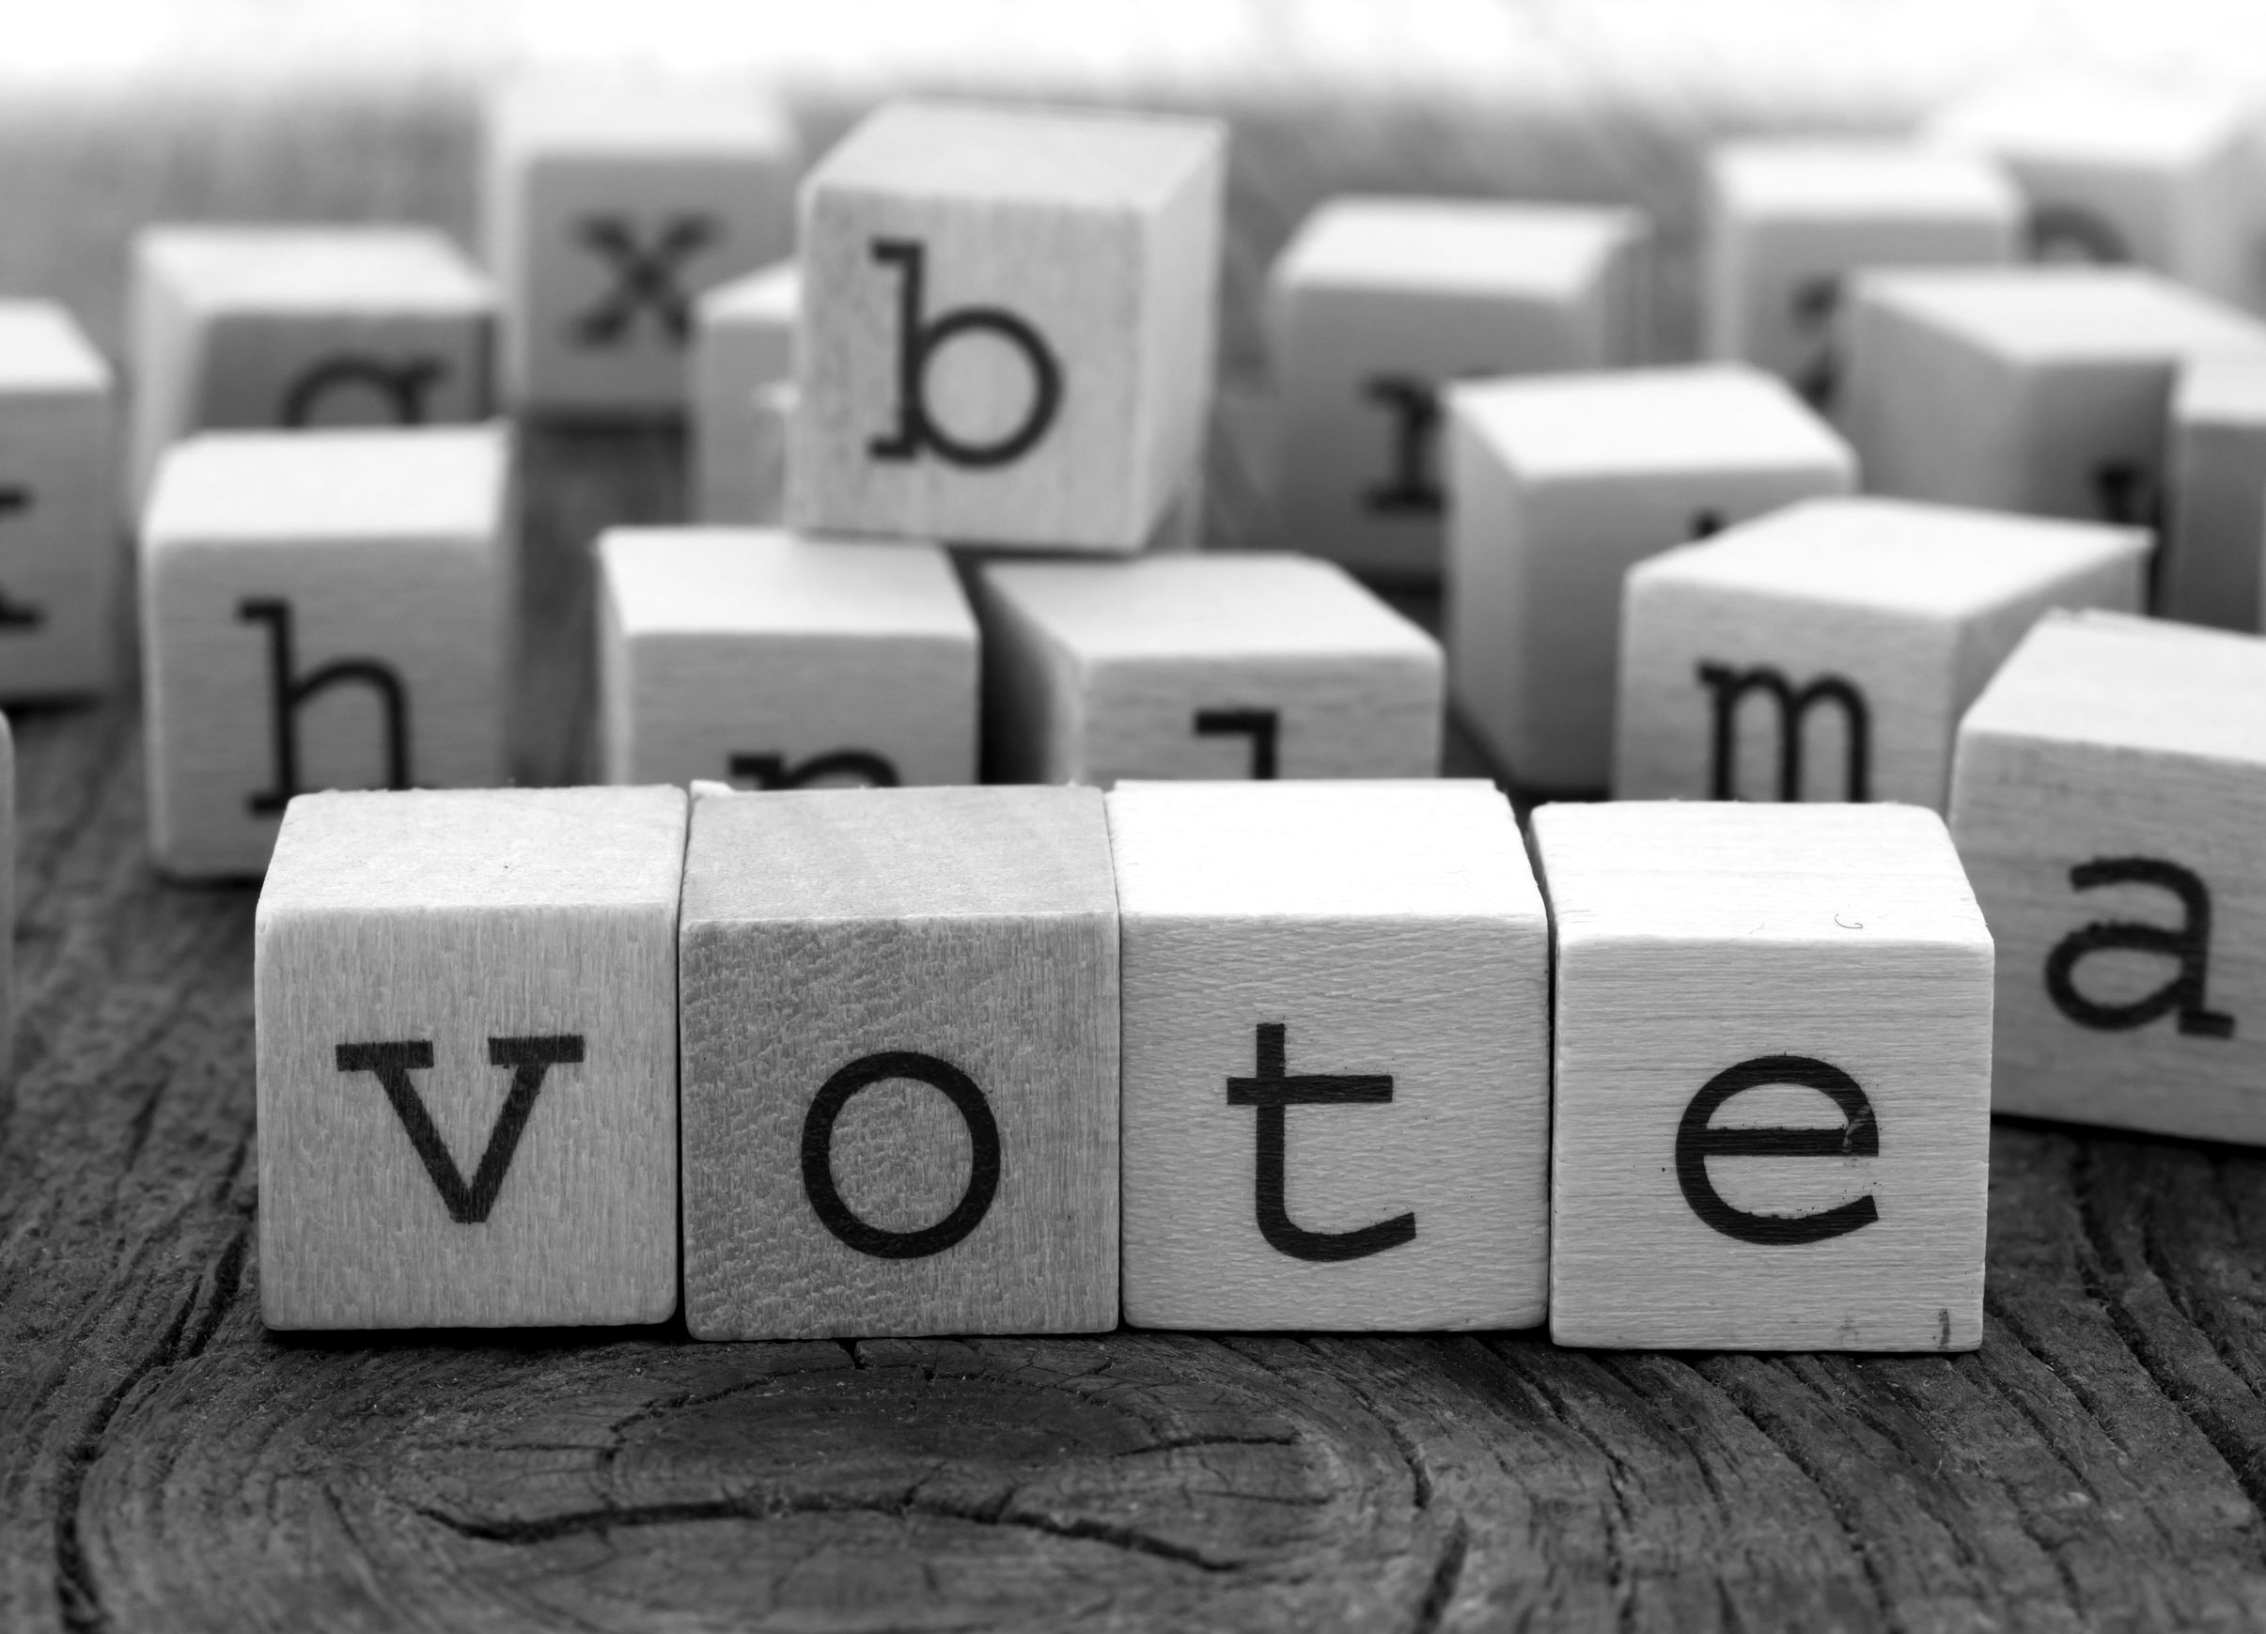
Requirements for your Voter Registration Application:
Print clearly so the form can be read. If it cannot be read, it will be rejected.
Complete the two check-off boxes at the top of the form. Print your full name: first and last, and a middle initial if you have one.
Enter your birth date.
Provide your Driver’s License Number or MVC non-driver ID Number. If you don’t have a Driver’s License or a MVC non-driver ID, provide the last 4 digits of your Social Security Number. If you don’t have a Driver’s License Number, a MVC non-driver ID, or a Social Security Number, check off the box that says “I swear or affirm that I DO NOT have a NJ Driver’s License, MVC non-driver ID, or a Social Security Number.”
NOTE: Driver License and Social Security Numbers are kept strictly confidential and will not be released to the public.
Check off the gender box.
Sign the application.
If assistance in completing the form is given, the name and address of the assistor must be put on the form. You also have the option to: provide your telephone number and declare a political party on the Voter Registration Application.
http://www.state.nj.us/counties/mercer/commissions/pdfs/boe_voterrightshandbook.pdf

Slide 9
Quick Tip
Do not let anyone make you sign a blank or incomplete Voter Registration Application.
Do not let anyone take your Voter Registration Application from you without your permission.
http://www.state.nj.us/counties/mercer/commissions/pdfs/boe_voterrightshandbook.pdf

Slide 10
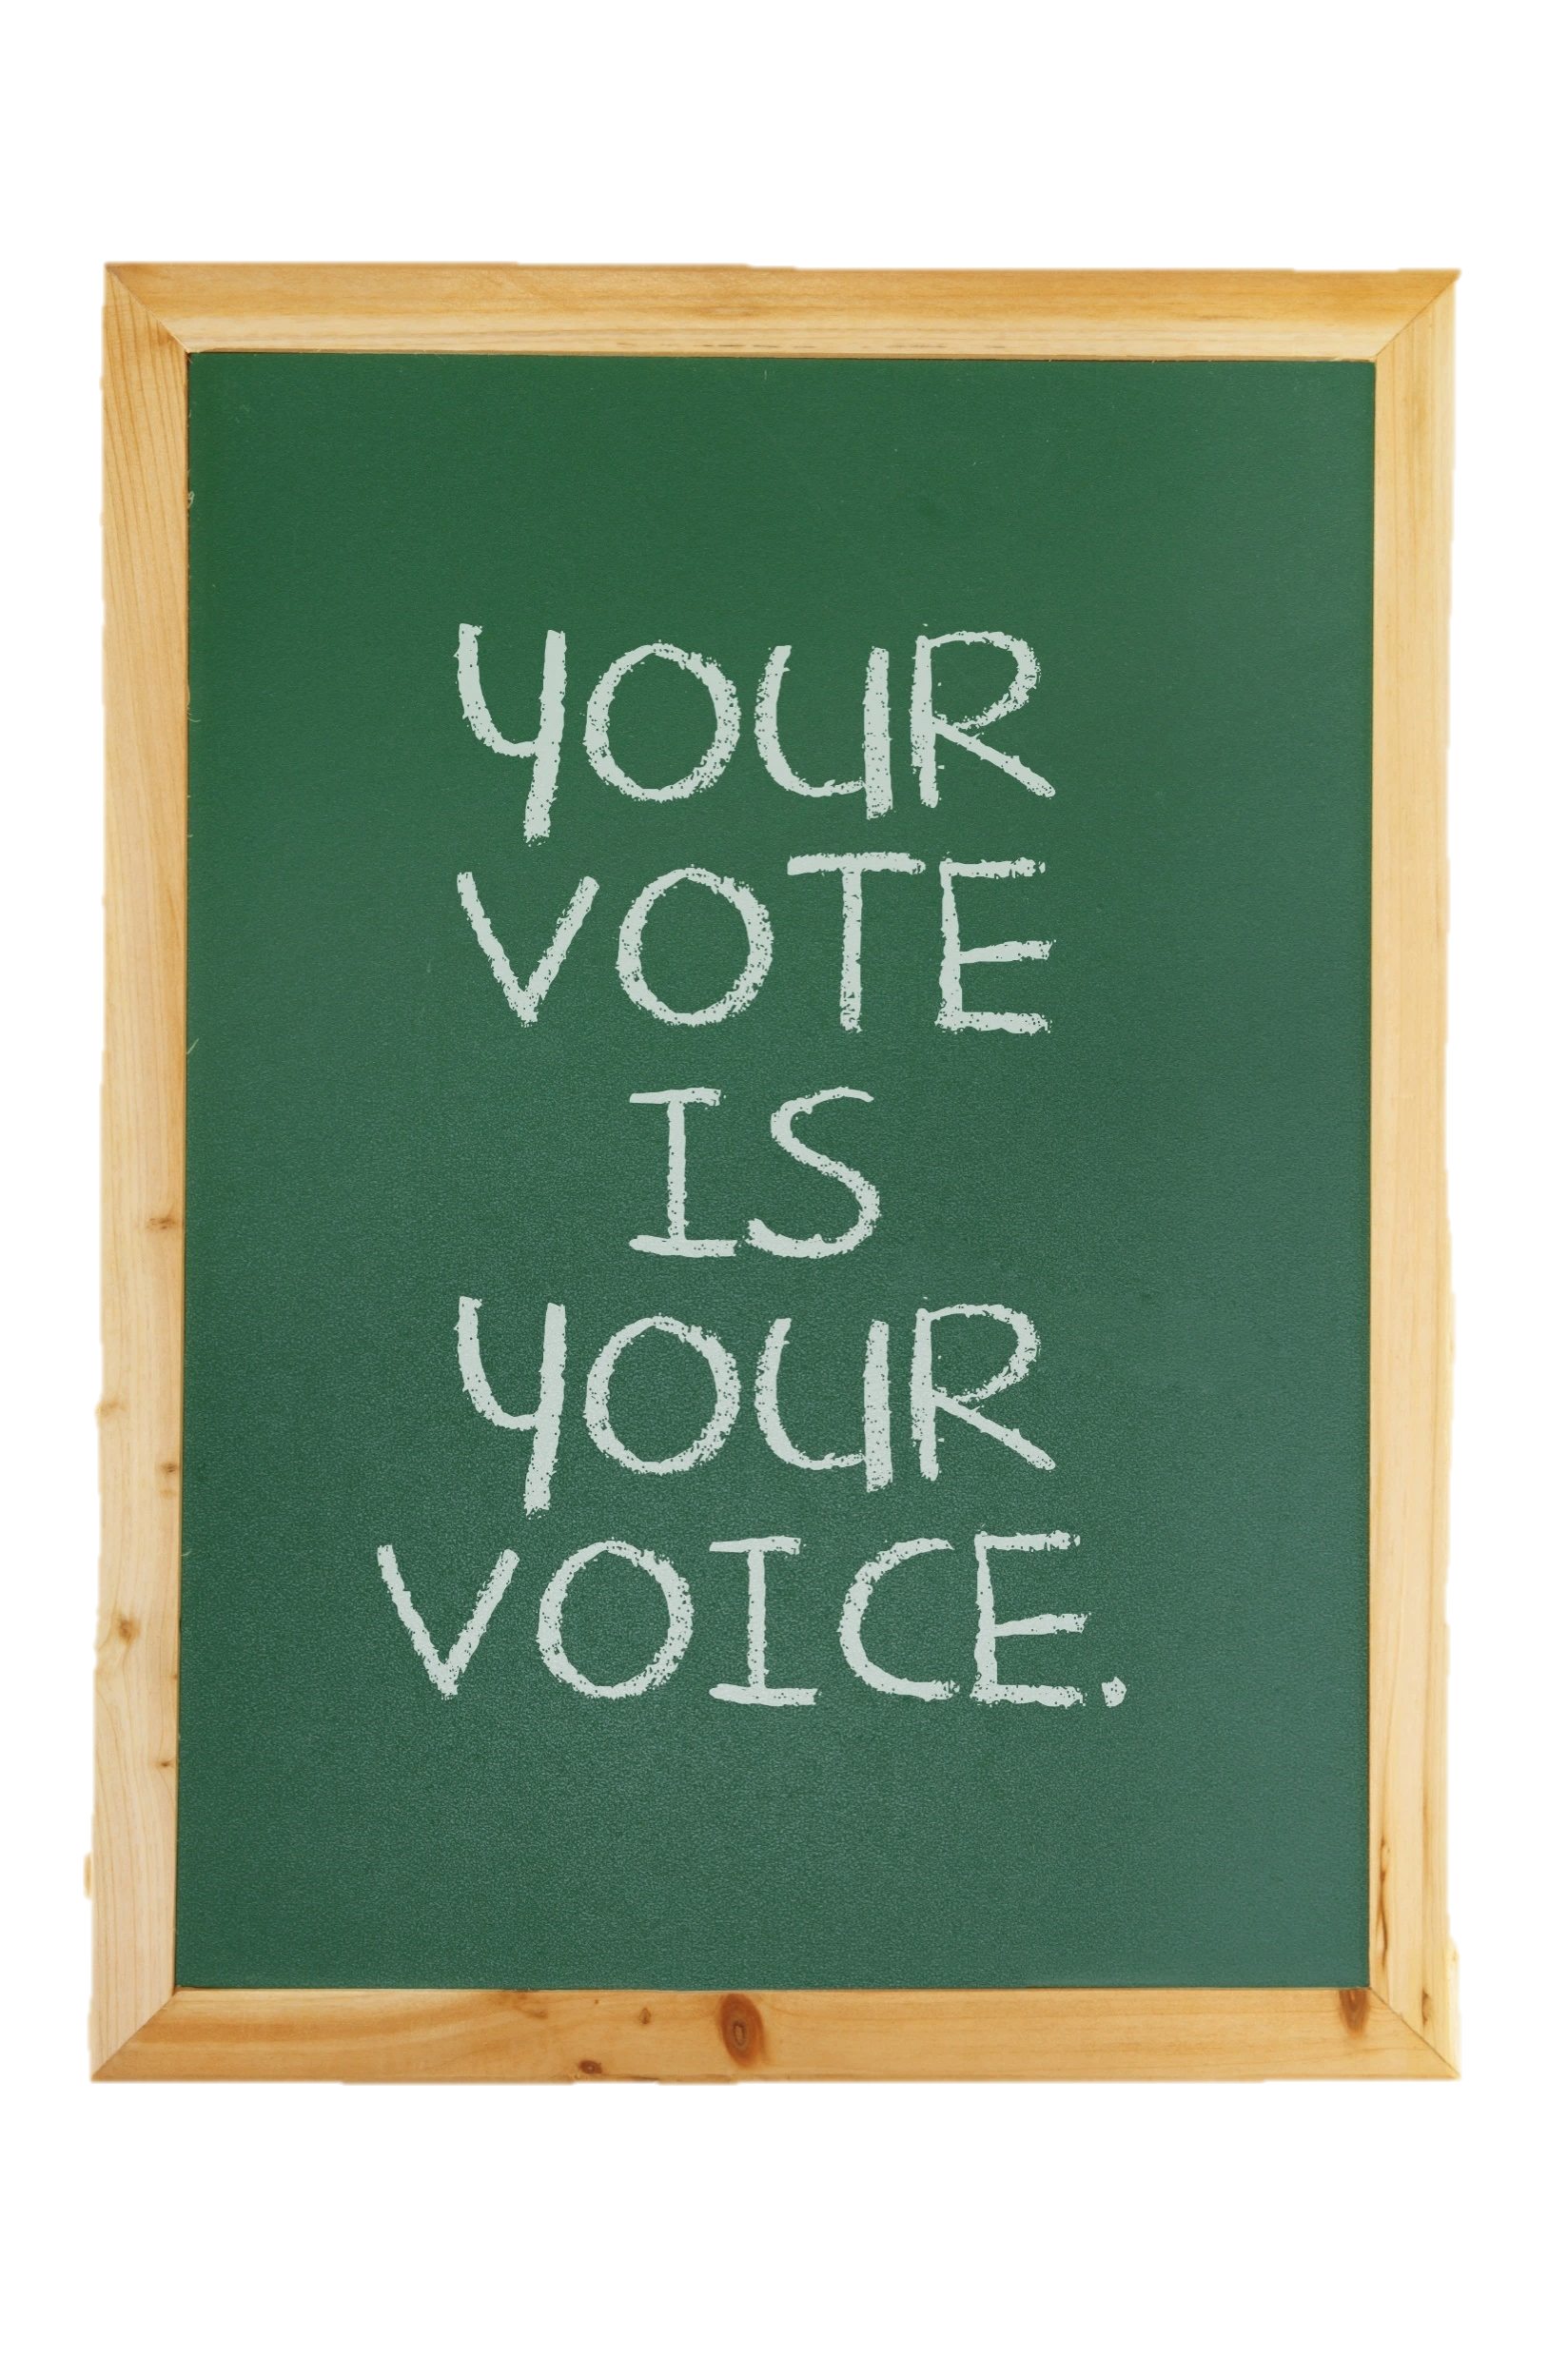
Submitting your Voter Registration Application:
Your Voter Registration Application must go to your County Commissioner of Registration. It is postage paid so it does not cost anything to mail it.
You can also drop it off at the Commissioner’s office or your Municipal Clerk’s Office.
It must be received by a voter registration agency by the 21st day before the election.
http://www.state.nj.us/counties/mercer/commissions/pdfs/boe_voterrightshandbook.pdf

Slide 11
Identification (ID) Requirements
Every person registering to vote must provide his or her NJ driver’s license number or MVC non-driver ID number. If the registrant does not have either a driver’s license or MVC ID, the last four numbers of his or her social security number must be provided. These numbers will be verified by the New Jersey Motor Vehicle Commission.
The registrant will be notified if the numbers cannot be matched. If the registrant does not have a driver’s license, MVC non-driver ID or social security number, the box in section 5 of the Voter Registration Application must be checked off.
If you are a first-time registrant by mail and you do not have a driver’s license number, MVC non-driver ID or a social security number, or the information you provide cannot be verified, you will be asked to provide a copy of a current and valid photo id, or a document with your name and current address on it to avoid having to provide identification at the polling place.
http://www.state.nj.us/counties/mercer/commissions/pdfs/boe_voterrightshandbook.pdf

Slide 12
Here are some examples of an identifying document:
A current and valid photo ID, such as:
NJ driver’s license
US passport military or other government ID
Student or job ID Store membership ID, like a Costco card
Any document with your name and current address:
bank statement
car registration
government check or document
rent receipt
utility bill
any other official document
http://www.state.nj.us/counties/mercer/commissions/pdfs/boe_voterrightshandbook.pdf

Slide 13
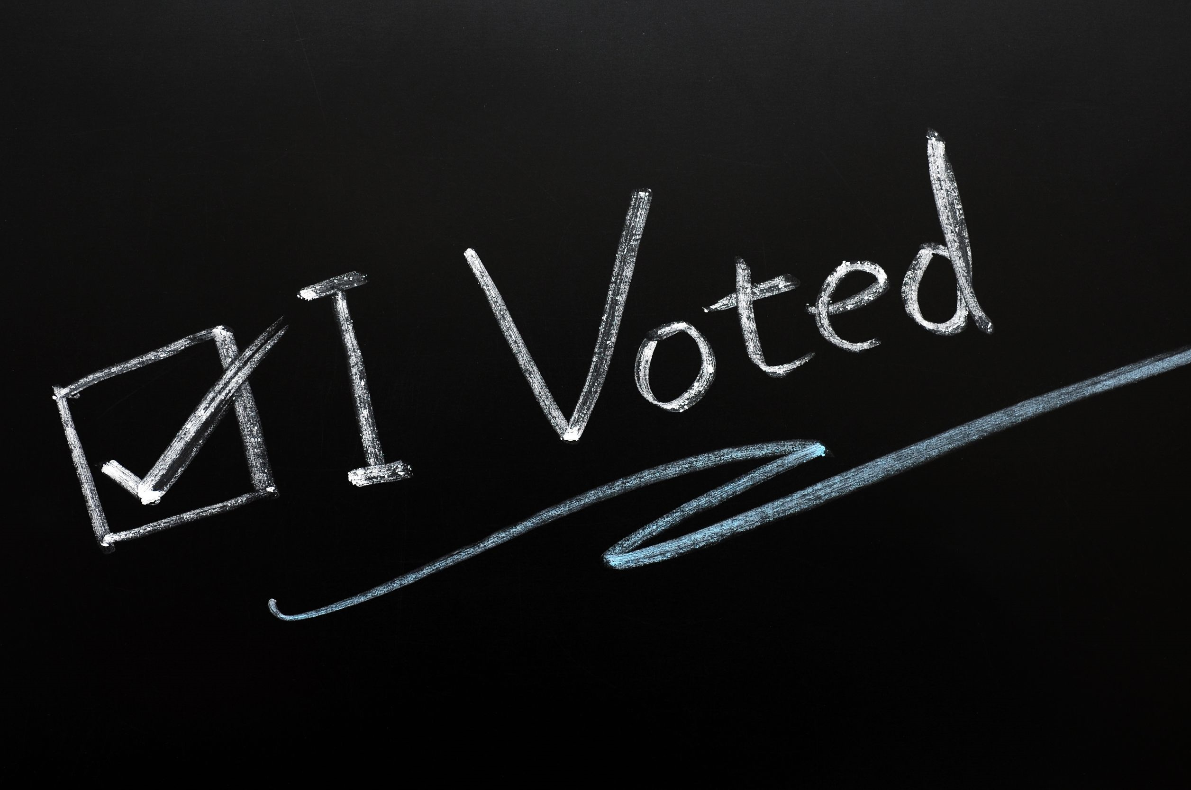
You can a download a copy of the New Jersey Voters Handbook for details regarding all voting issues at: http://www.state.nj.us/counties/mercer/commissions/pdfs/boe_voterrightshandbook.pdf.

Slide 14
Key Words
democratic process candidates citizen
informed electorate Secretary of State election
voting is free Voting Requirements voter
Municipal Clerk’s Office probation or parole photo ID
Voter Registration Application first-time registrant registrant

