Slide 1
NICKY FIFTH’S NEW JERSEY
N5NJ
SECONDARY PROGRAM
ENVIRONMENTAL SCIENCE
Severe Weather

Slide 2
New Jersey is located about halfway between the Equator and the North Pole, on the eastern coast of the United States. Its geographic location results in the State being influenced by wet, dry, hot, and cold airstreams, making for daily weather that is highly variable.
http://climate.rutgers.edu/stateclim_v1/njclimoverview.html

Slide 3
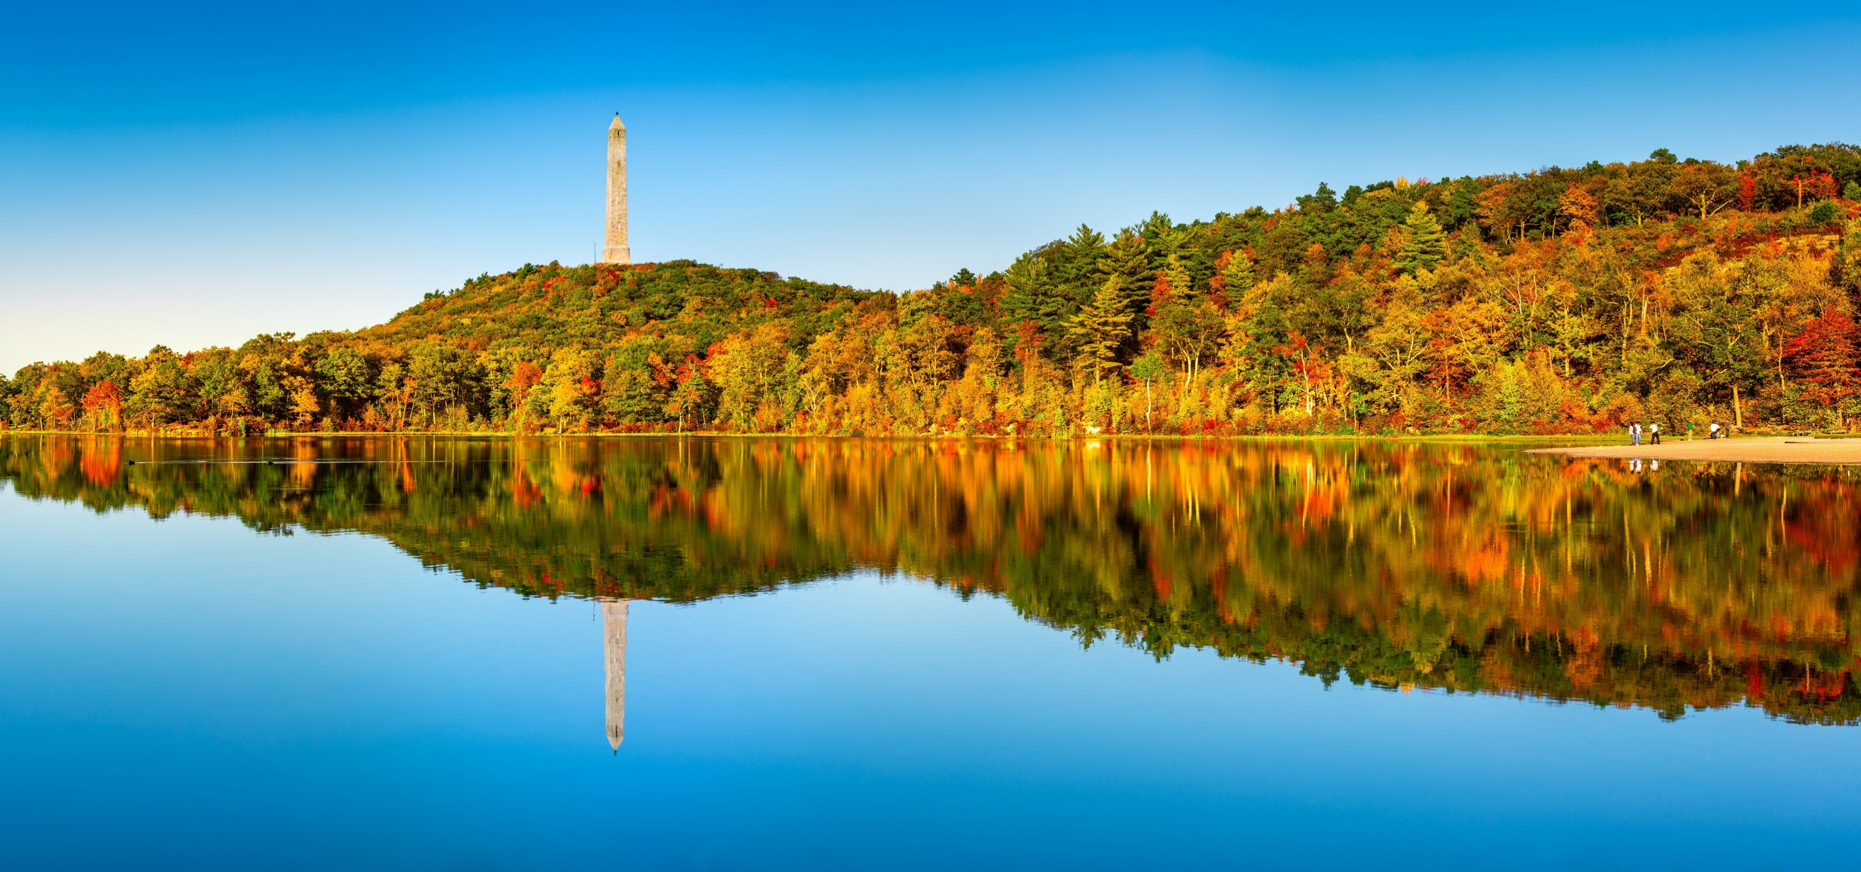
The Garden State is 166 miles long from north to south, and its greatest width is about 65 miles. While this may not seem too large, there is a marked difference in climate between Cape May in the south and the Kittatinny Mountains of northwestern New Jersey.
http://climate.rutgers.edu/stateclim_v1/njclimoverview.html
shutterstock.com

Slide 4
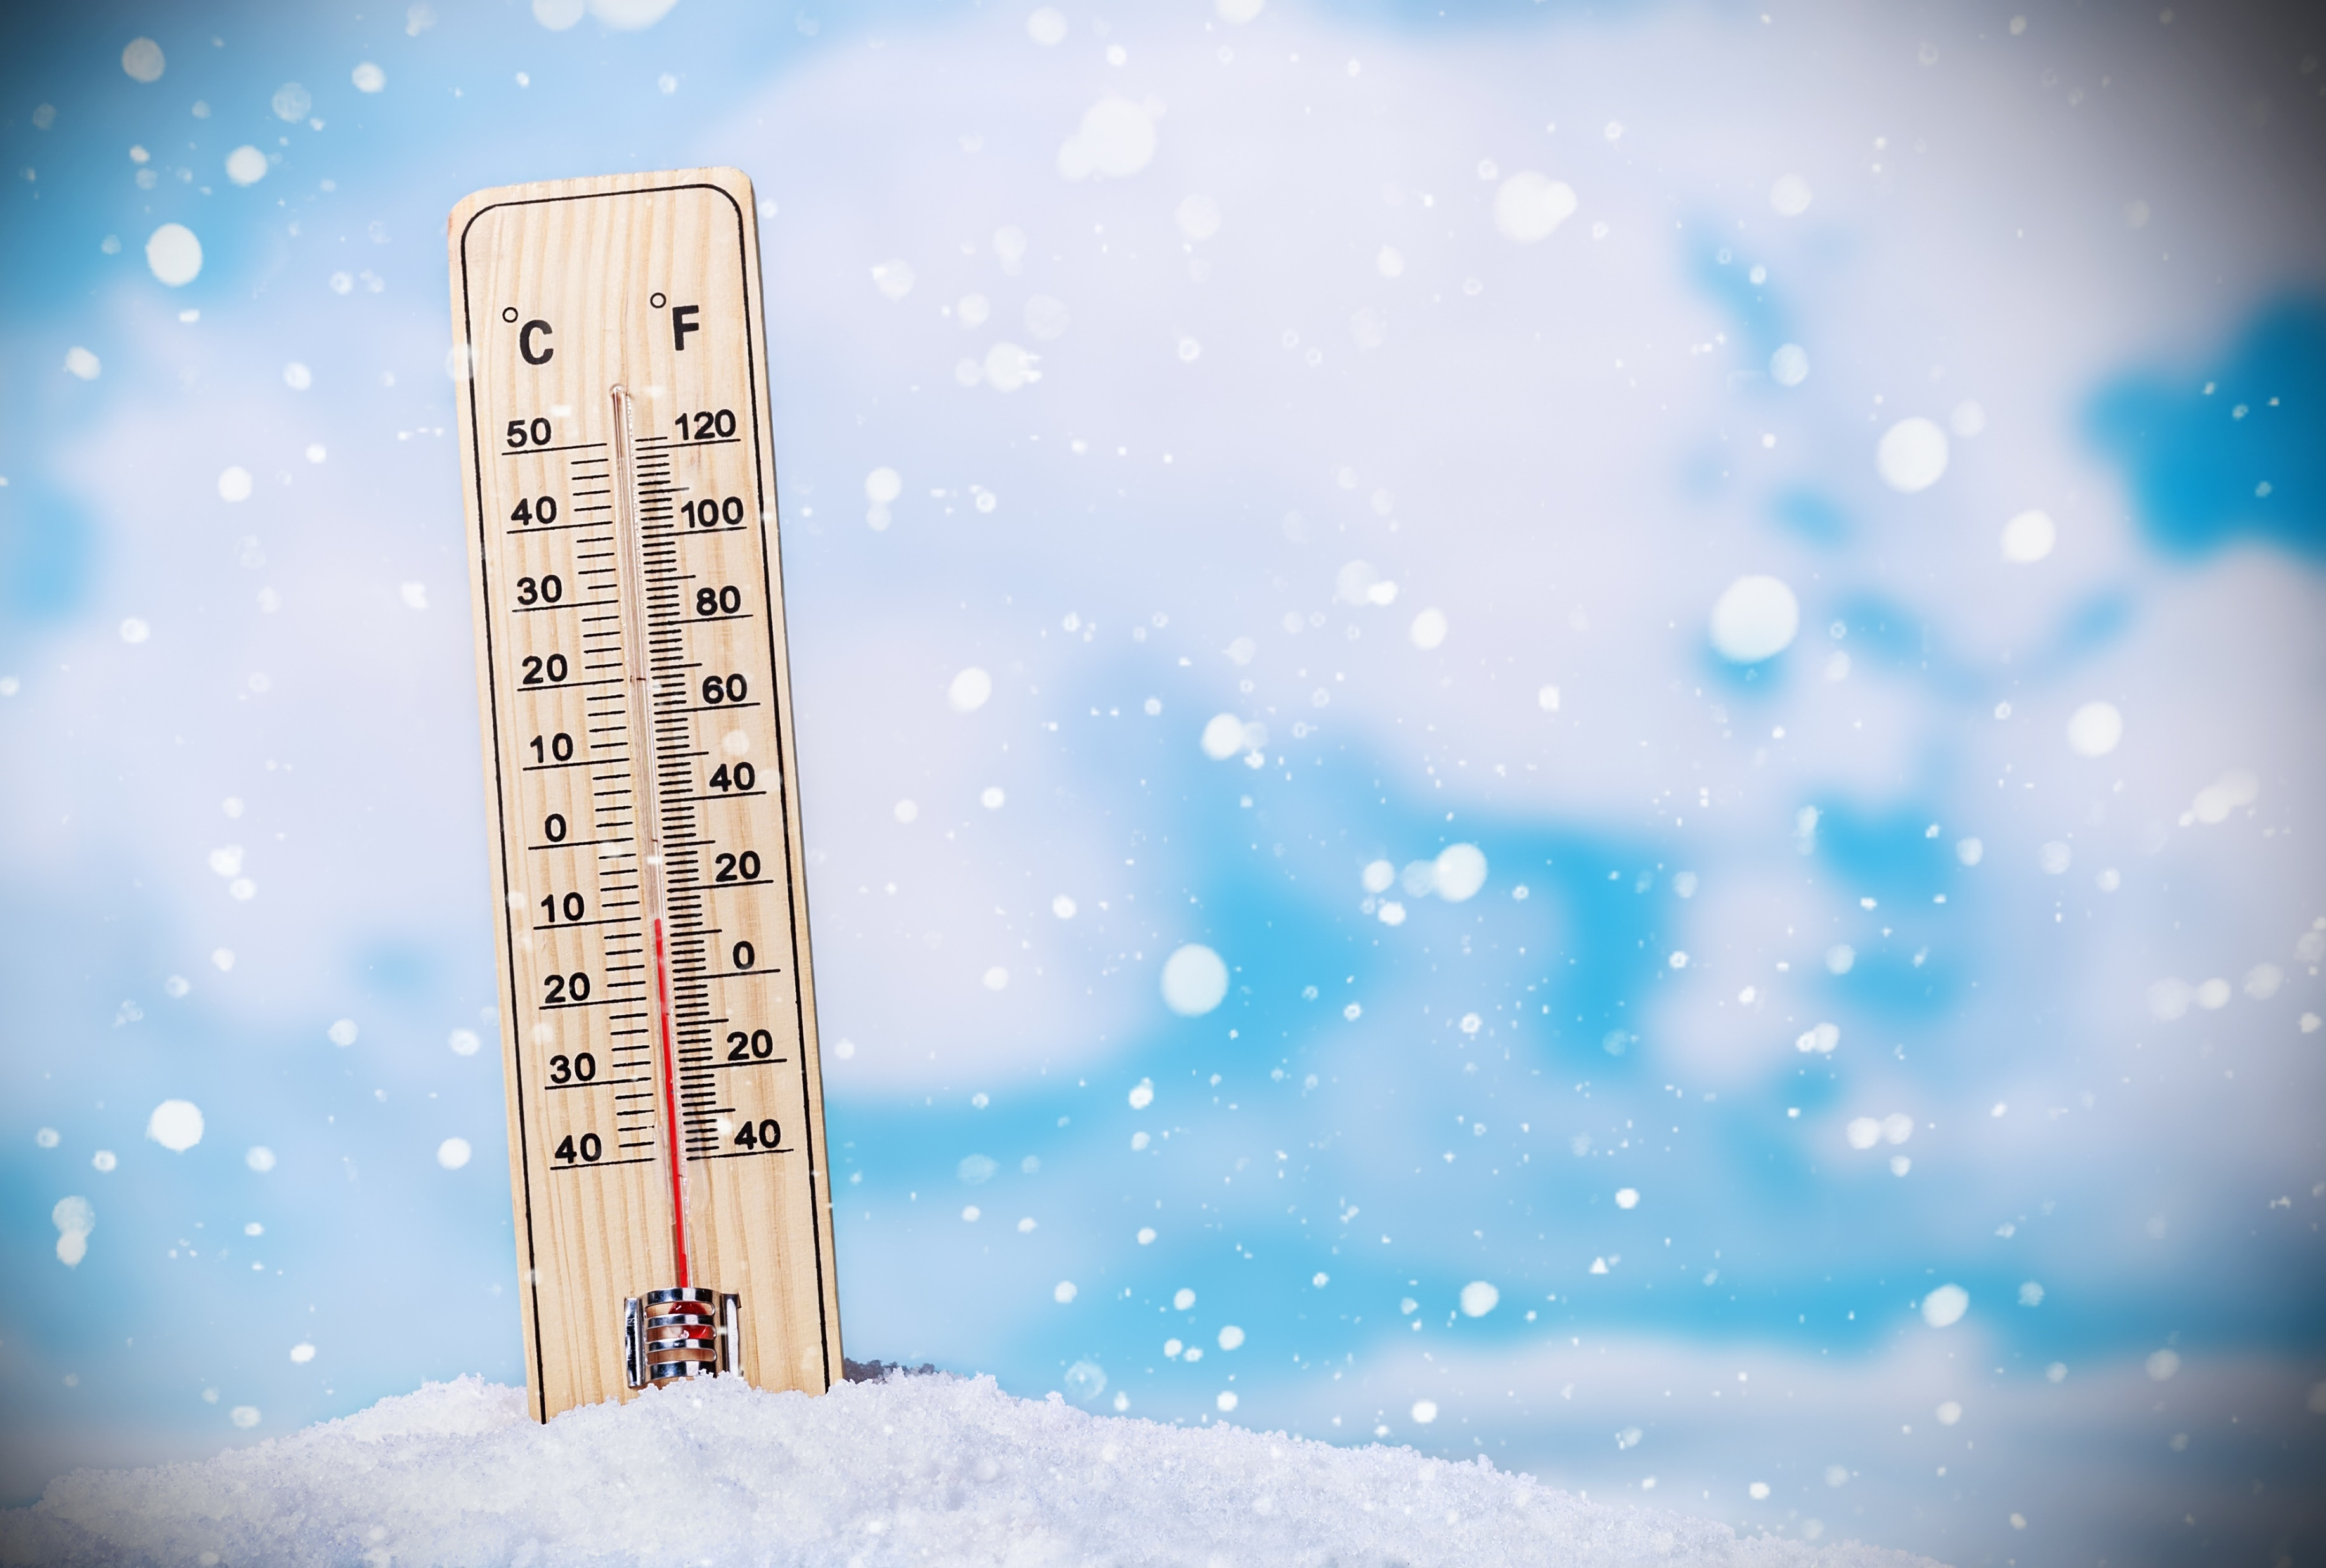
The dominant feature of the atmospheric circulation over North America, including New Jersey, is the broad, undulating flow from west to east across the middle latitudes of the continent. These "prevailing westerlies" shift north and south and vary in strength during the course of the year, exerting a major influence on the weather throughout the State.
Some general observations about the temperature and precipitation in New Jersey include:
Temperature differences between the northern and southern parts of the state are greatest in the winter and least in summer. All stations have registered readings of 100 degrees F or higher and have records of 0 degrees F or below.
http://climate.rutgers.edu/stateclim_v1/njclimoverview.html
shutterstock.com

Slide 5
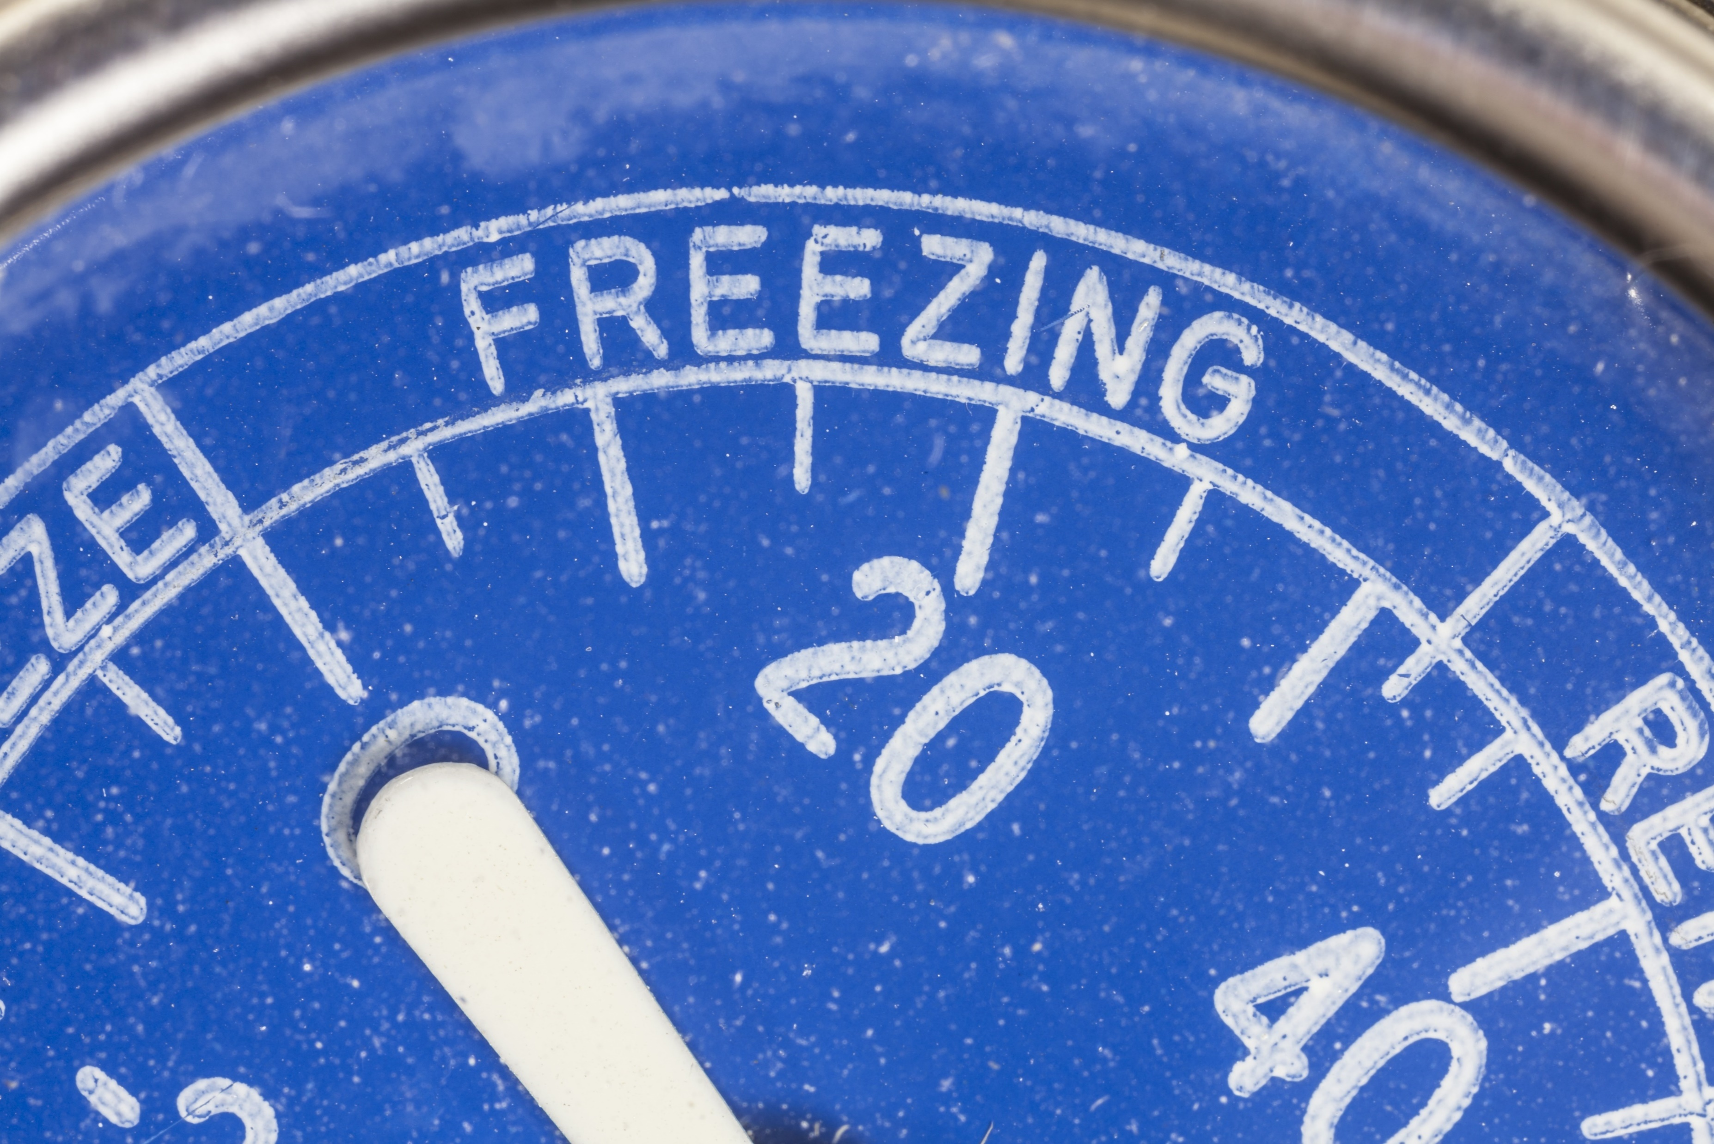
Average number of freeze free days in the northern highlands is 163, 179 in the central and southern interior, and 217 along the seacoast.
http://climate.rutgers.edu/stateclim_v1/njclimoverview.html
shutterstock.com

Slide 6
Average annual precipitation ranges from about 40 inches along the southeast coast to 51 inches in north-central parts of the state. Many areas average between 43 and 47 inches.
http://climate.rutgers.edu/stateclim_v1/njclimoverview.html
shutterstock.com

Slide 7
Snow may fall from about October 15 to April 30 in the highlands and from about November 15 to April 15 in southern counties.
http://climate.rutgers.edu/stateclim_v1/njclimoverview.html
shutterstock.com

Slide 8
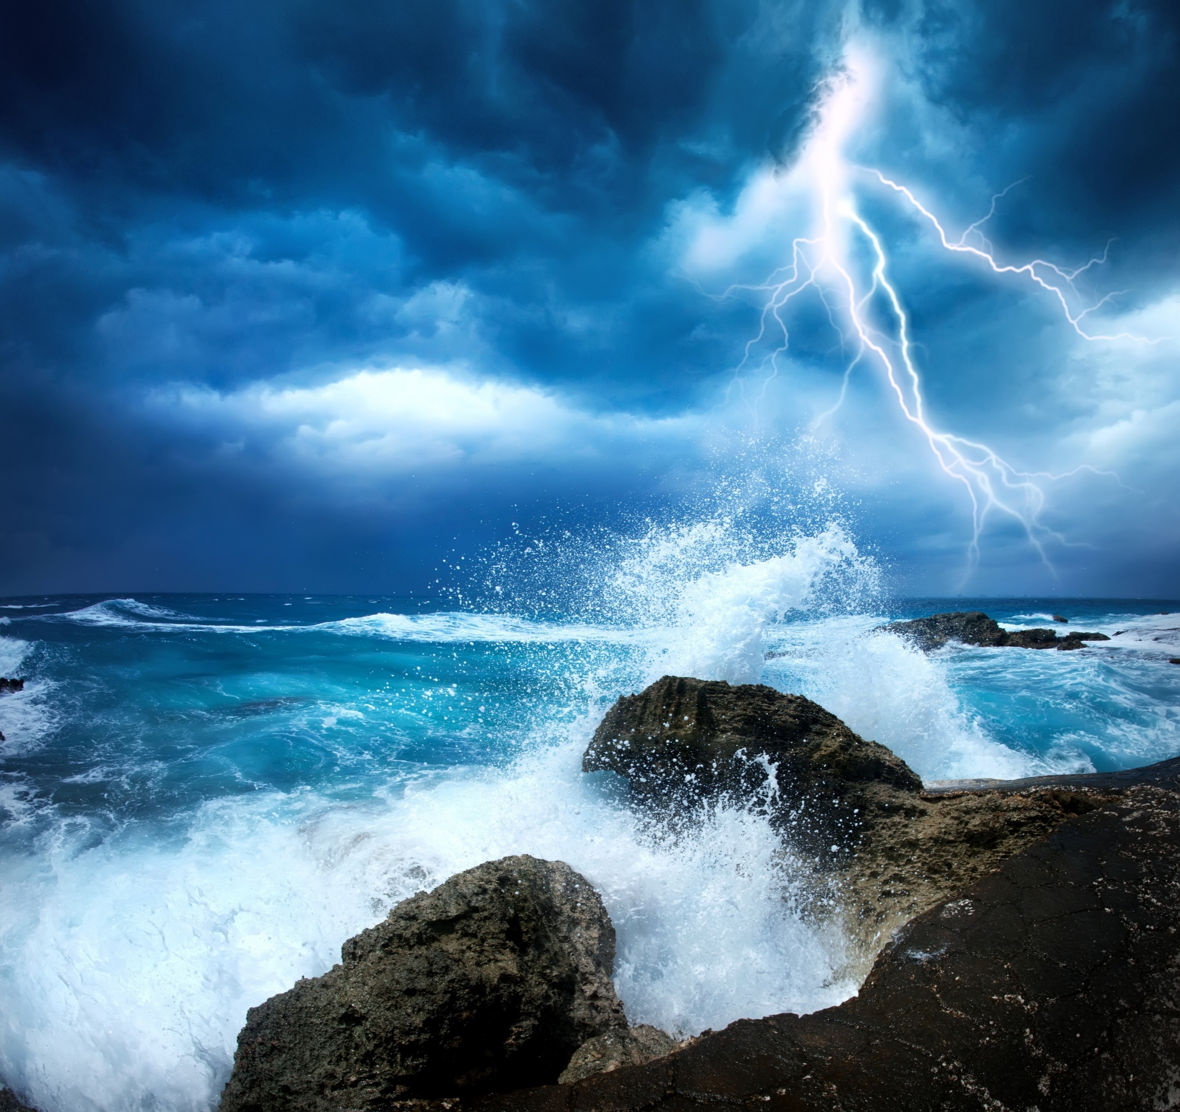
Most areas receive 25 to 30 thunderstorms per year, with fewer storms near the coast than farther inland. Approximately five tornadoes occur each year, and in general, they tend to be weak.
http://climate.rutgers.edu/stateclim_v1/njclimoverview.html
shutterstock.com

Slide 9
Measurable precipitation falls on approximately 120 days. Fall months are usually the driest with an average of eight days with measurable precipitation. Other seasons average between 9 and 12 days per month with measurable precipitation.
http://climate.rutgers.edu/stateclim_v1/njclimoverview.html
shutterstock.com

Slide 10
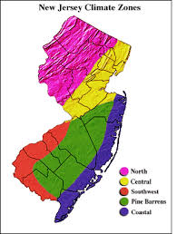
Although New Jersey is one of the smallest states in the Union, with a land area of 7,836 square miles, it has five distinct climate regions. The geology, distance from the Atlantic Ocean, and prevailing atmospheric flow patterns produce distinct variations in the daily weather between each of the regions. The five regions, Northern, Central, Pine Barrens, Southwest, and Coastal, are described below and shown in the accompanying figure.
http://climate.rutgers.edu/stateclim_v1/njclimoverview.html
shutterstock.com

Slide 11
Storms Keep Hitting New Jersey
New Jersey has a reputation for being affected by major storms, and some of the worst storms in our state have been pretty terrible. The following is a short list of some of the most memorable storms.
http://magazine.funnewjersey.com/the-10-worst-storms-to-hit-new-jersey/
shutterstock.com

Slide 12
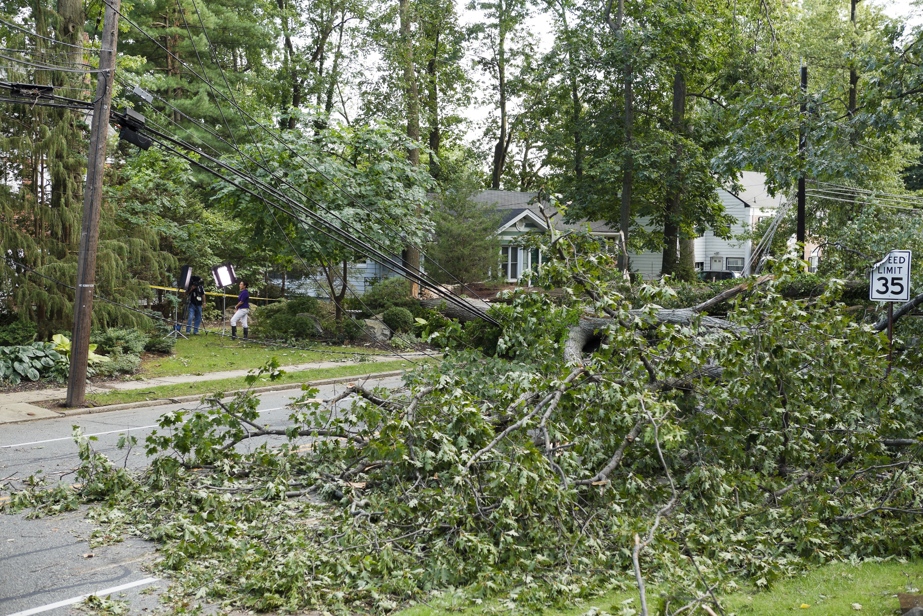
Hurricane Irene, 2011
While Superstorm Sandy was mostly damaging because of the high winds, Hurricane Irene wreaked havoc due to the sheer amount of flooding that ensued. During this massive hurricane, a state of emergency was declared and enacted a mandatory evacuation of all Cape May County and Atlantic County shore towns. However, that alone was not enough to save everyone. In some towns in the Central Jersey region such as Manville and Bound Brook, massive flooding had completely destroyed homes.
Flooding was definitely what this storm was remembered by. In fact, photos of Manville, which had managed to accrue over 20 feet of water thanks to the storm, had gone viral due to the extreme damage, devastation, and apocalyptic mess that they portrayed. Almost every home in Manville was destroyed beyond repair.
http://magazine.funnewjersey.com/the-10-worst-storms-to-hit-new-jersey
shutterstock.com

Slide 13
The Great Blizzard, 1888
Nor’Easters are no laughing matter, and when one of these major snowstorms happens, New Jerseyans know to batten down the hatches. The Great Blizzard of 1888 mostly affected Northern New Jersey and New York City. This terrifying storm had freezing winds, over 2 feet of snow, and some of the iciest conditions in recent history. The frigid cold was so bad, it had snapped elevator lines, telephone lines, and other major links.
In New York City alone, 200 people had died as a direct result of the storm.
Since there were fewer elevators, and less busy streets, Northern Jersey fared slightly better in terms of death rates. However, an estimate 200 people still froze to death during the Great Blizzard of 1888, and many more had found themselves without any means to contact relatives for help if they had run low on food.
http://magazine.funnewjersey.com/the-10-worst-storms-to-hit-new-jersey/
shutterstock.com

Slide 14
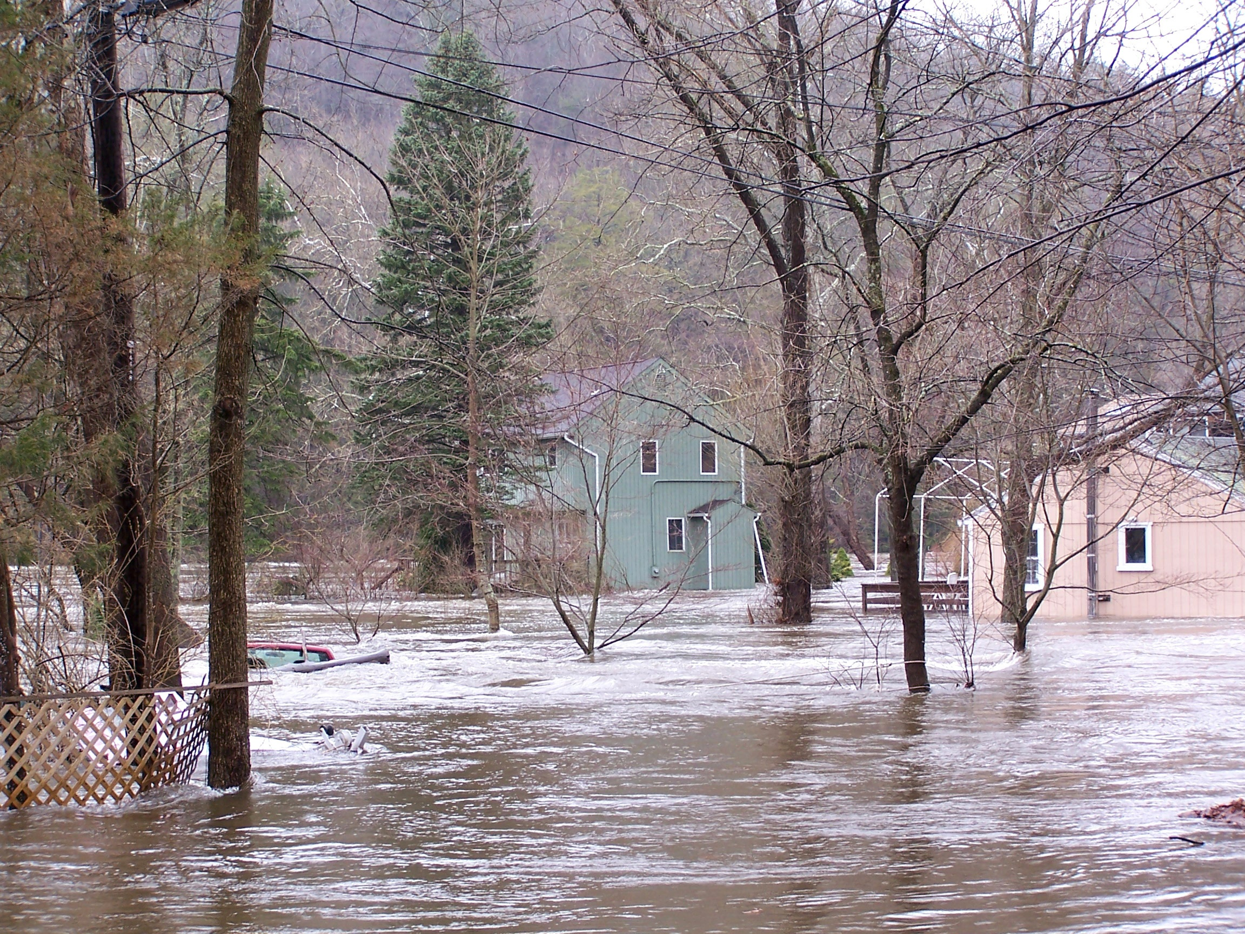
The Storm Of The Century, 1950
This was a Nor’Easter that really lived up to its name! As one of the largest, costliest storms in American history, the Storm of the Century had hit over 24 different states throughout the country. In Ohio, people experienced over 3 feet of snow. In West Virginia, over 5 feet of snow had dropped over the course of the storm. New Jersey experienced both heavy winds and heavy flooding as a result of this massive megastorm, and it had managed to cripple the Northeast section of the United States for weeks.
For most people, they never saw this one coming. Weathermen didn’t see it coming. As a result, no one was really prepared for it. By the end of the megastorm, over 300 people were dead. The storm caused a national damage toll of over $70 million, which would be equal to approximately $700,000,000 in today’s prices. It happened in 1950, and was considered to be the original “Storm of the Century” as rated by newscasters. Those who remember it remember the difficulty they had just trying to reach out to friends and family – and shudder at the thought.
http://magazine.funnewjersey.com/the-10-worst-storms-to-hit-new-jersey/
Gina Jacobs / Shutterstock.com

Slide 15
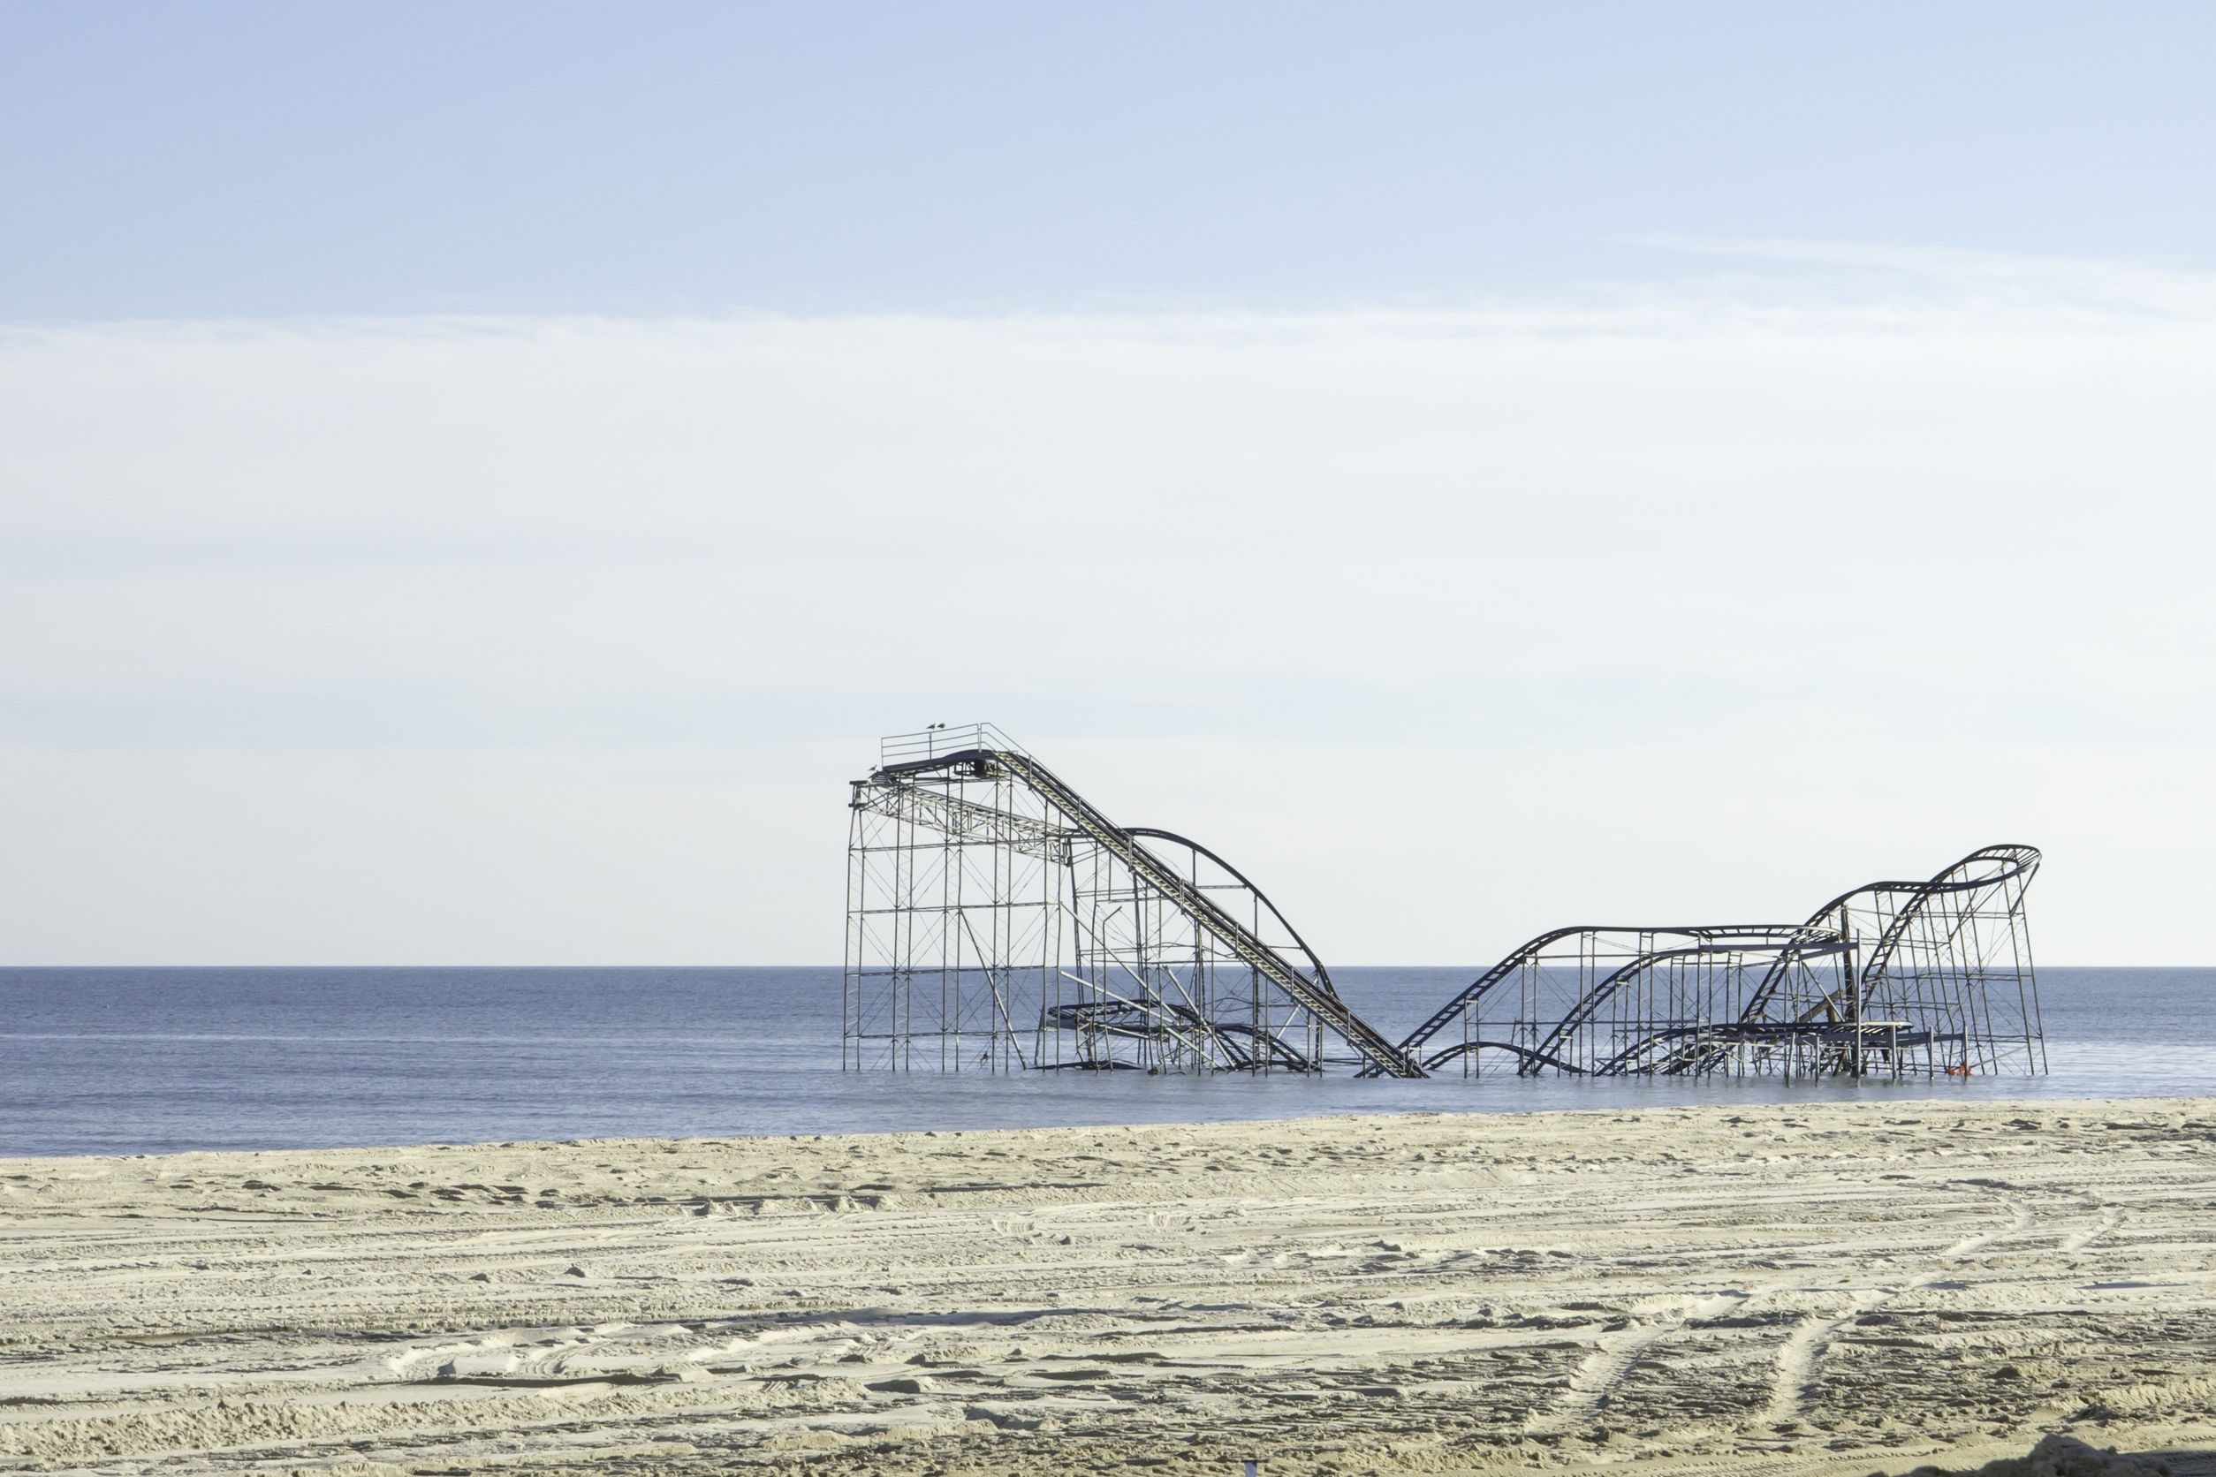
Hurricane Sandy, 2012
We had to put this on the list of the ten worst storms to have happened in New Jersey. We just had to. As you may remember, Superstorm Sandy had annihilated Belmar as well as a number of other popular Jersey Shore towns. During this massive storm, multiple towns were evacuated, some parts of New Jersey were completely cut off from Parkway and Turnpike exits, roads were flooded, and cellphone service dropped.
Hurricane Sandy also dealt a huge blow to NJ Transit and the NJ PATH systems, with subways heading in and out of New Jersey completely cut off. It took years to restore fully operational services, and in the end, Sandy ended up costing the state of New Jersey over $1 billion in damage. Some people are still homeless after the storm, 3 years later. To date, it is one of the costliest storms in American history, and it’s the worst hurricane that New Jersey ever faced.
Because of the damage that had happened to New Jersey’s infrastructure, New Jersey resort towns, and just about every aspect of living near the Jersey Shore, Hurricane Sandy sparked one of the biggest activist movements in recent years. You might have heard of it – “Restore the Shore.” The movement is still quite active, and is still helping families get their homes back after all these years.
http://magazine.funnewjersey.com/the-10-worst-storms-to-hit-new-jersey/
shutterstock.com

Slide 16
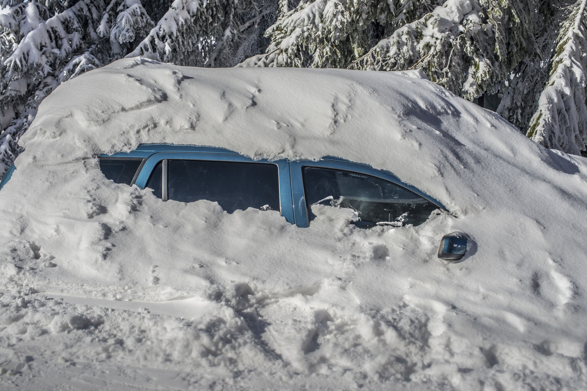
The Storm Of The Century, 1993
This massive blizzard was also known as the “Blizzard of ’93” by New Jersey locals who remember it, and it was the intersection of three different warm/cold fronts that just basically exploded into a massive megastorm. New Jersey locals who were there may remember having to deal with over 3 feet of snow, power outages, flooding, and icy winds. There were a number of people who supposedly froze to death in this storm, however, we weren’t able to find any in our research.
Much like other storms on this list, 1993’s Storm of the Century affected multiple states, and spanned from the Southern parts of Florida all the way up to the Northern areas of Massachusetts. New Jersey was right in the middle of it, and bore a huge portion of the damage. In total, this superstorm amassed $6 billion in damages, and left millions up and down the East Coast without power for weeks.
http://magazine.funnewjersey.com/the-10-worst-storms-to-hit-new-jersey/
shutterstock.com

Slide 17
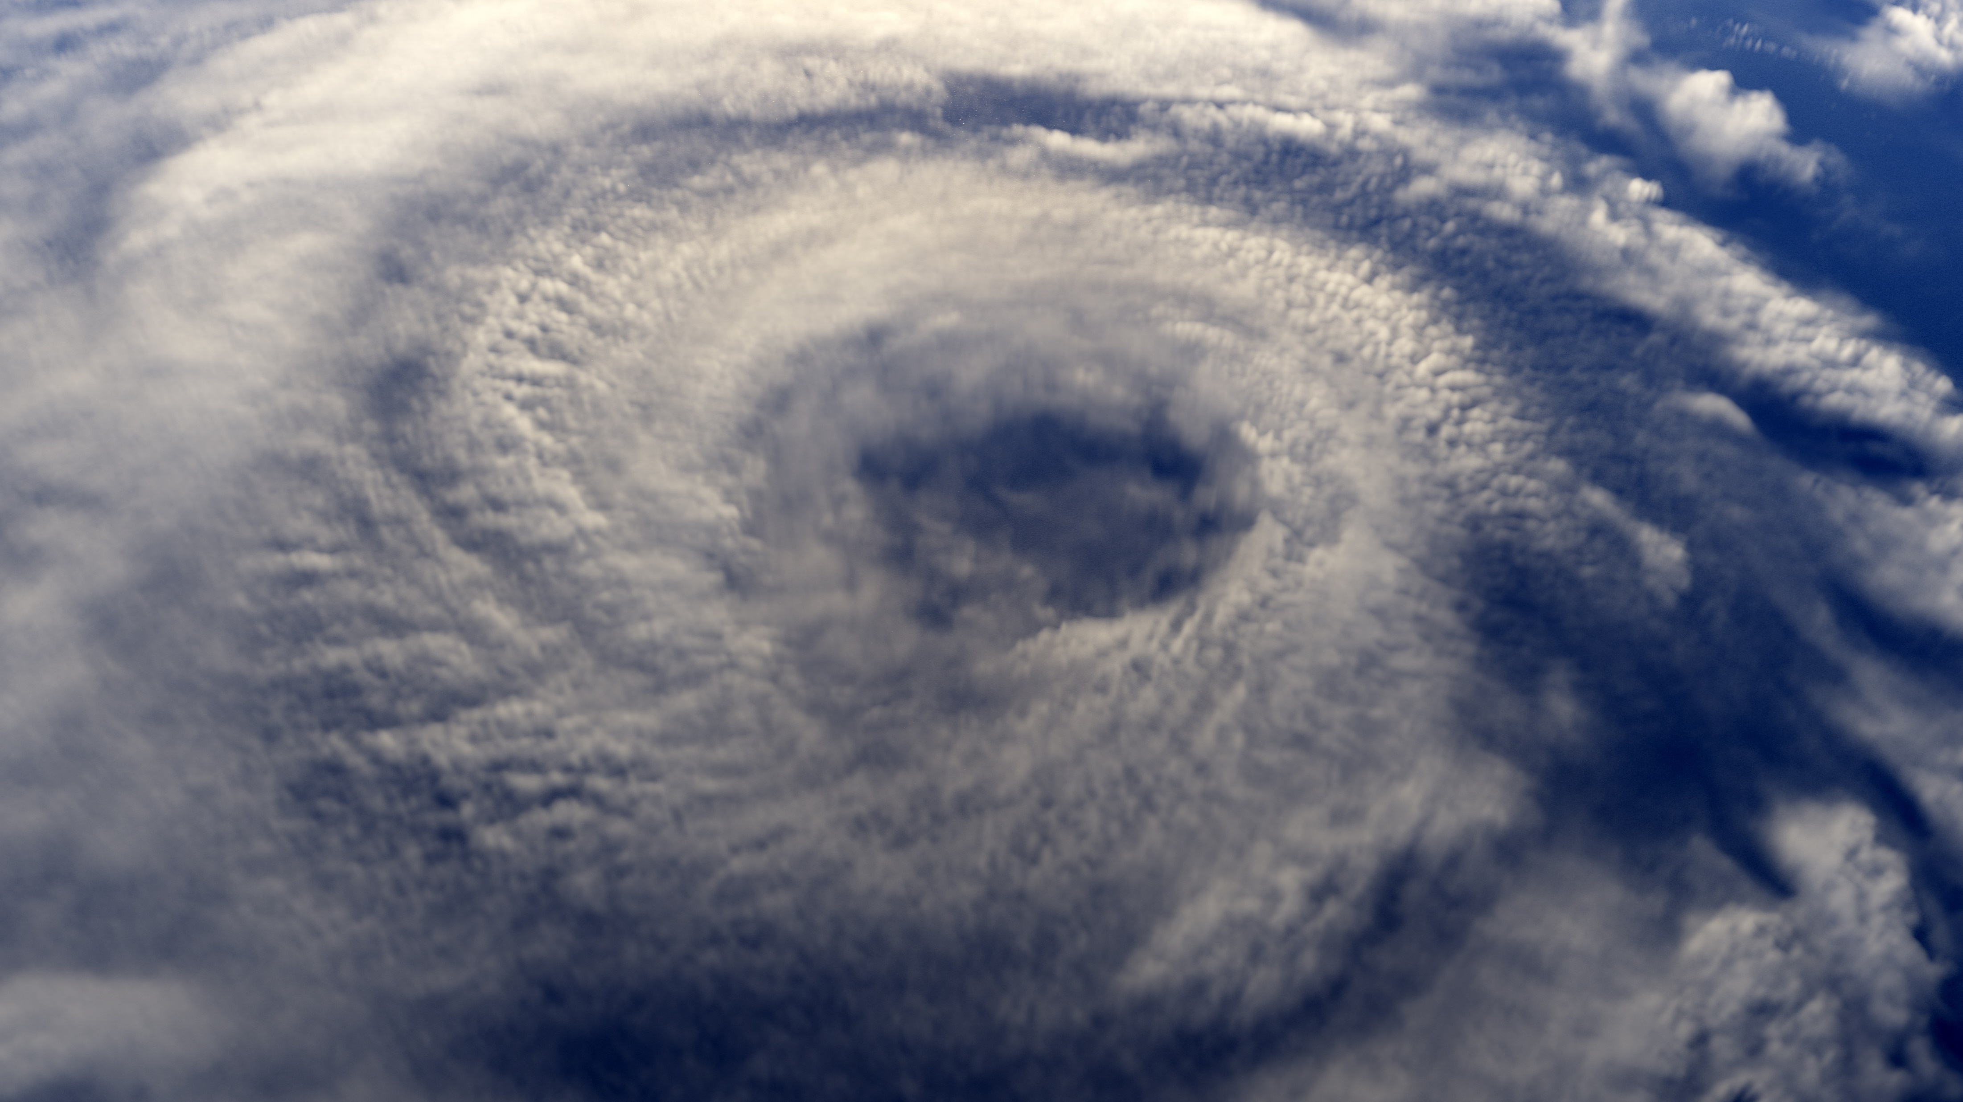
The Great Hurricane Of 1903
To date, we’re pretty sure that this is the only hurricane that had managed to rip railroads out of the ground in New Jersey. This hurricane has been both described as a Category 3 and Category 4 hurricane, and was noted as the reason why the railroad bridge to Brigantine was destroyed. Over 60 homes had their roofs ripped clean off, and every resort town from Cape May to Asbury Park had retained significant damage.
This storm also caused particular damage to the fishing communities of New Jersey, since almost all the fishing piers that were regularly used by locals had been destroyed since the storm had hit. As a result, it took almost a decade for shore towns to actually get back to their old shape. On a random note, this also was one of the storms that destroyed one of the many incarnations of the Atlantic City boardwalk. Amazingly, another hurricane had happened almost exactly 100 years prior – with equally damaging winds.
http://magazine.funnewjersey.com/the-10-worst-storms-to-hit-new-jersey/
shutterstock.com

Slide 18
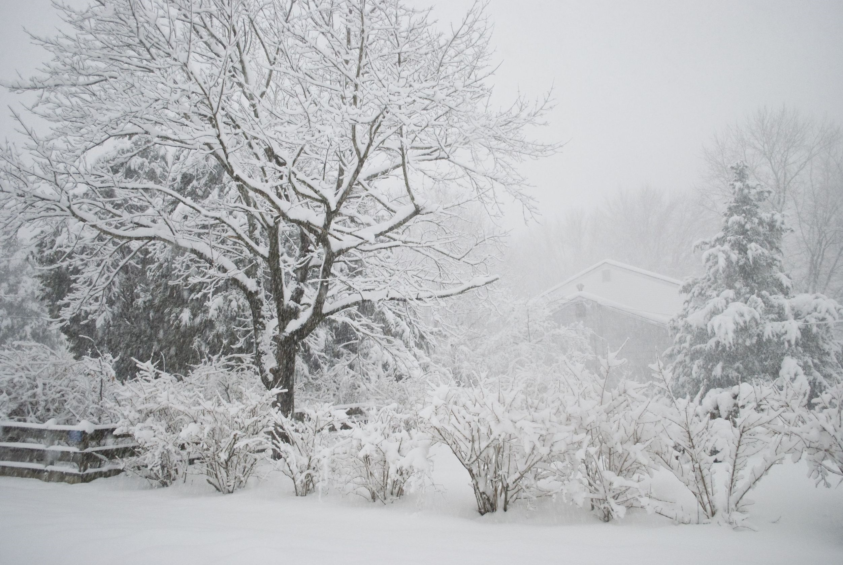
The April 2007 Nor’Easter
To date, we haven’t heard of a single storm that managed to convince the IRS to allow a months-long extension aside from this massive Nor’Easter that happened in 2007. During this unseasonably late Nor’Easter, the states of New Jersey, New York, and New Hampshire were slammed with high winds, massive amounts of flooding, and freezing cold snow. The storm itself lasted only four days, but measured a jaw-dropping 800 miles wide.
The damage it caused in New Jersey was absolutely undeniable. Many Northern Jersey businesses and homes were damaged by heavy flooding – with many damaged beyond repair. Families were quickly made homeless, and traveling alone became too treacherous to risk for several days. Almost all commerce had stopped.
http://magazine.funnewjersey.com/the-10-worst-storms-to-hit-new-jersey/
Shutterstock.com

Slide 19
Key Words
North Pole equator airstreams
atmospheric circulation prevailing westerlies climate
annual precipitation thunderstorms temperature
measurable precipitation climate regions hurricane
Great Blizzard of 1888 major storms Nor’Easter
shutterstock.com

