Slide 1
NICKY FIFTH’S NEW JERSEY
N5NJ
SECONDARY PROGRAM
ENVIRONMENTAL SCIENCE
Garden State

Slide 2
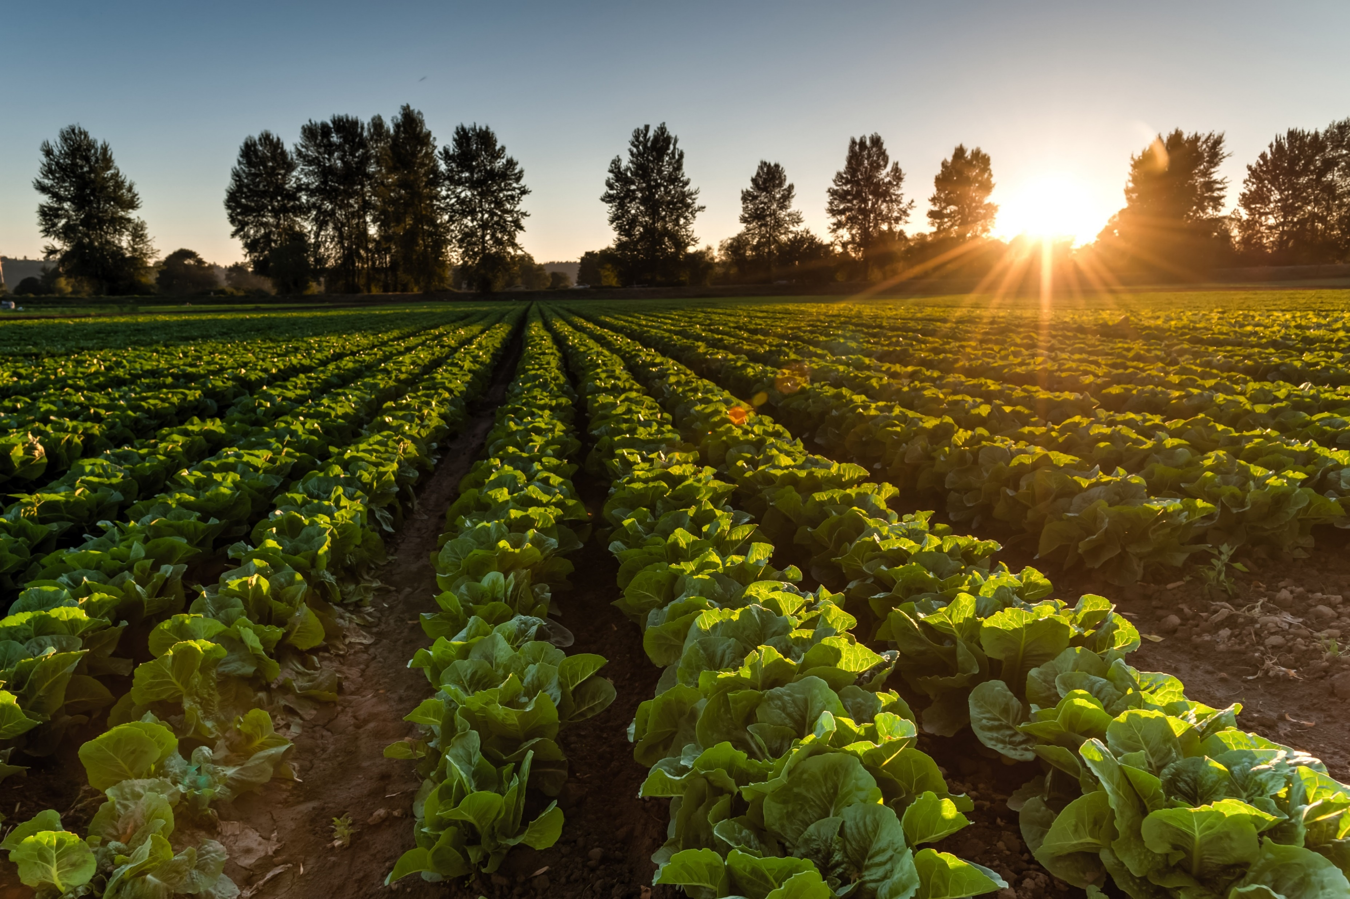
shutterstock.com
Food and agriculture are New Jersey's third largest industry. As of 2015, the state has 9,100 farms covering 715,000 acres. Sales generated in 2014 totaled $1.02 billion.
Retaining productive, taxpaying farmland is critically important to all New Jersey residents since agriculture is the largest single source of the scenic vistas we all enjoy throughout the year.
http://jerseyfresh.nj.gov/facts/

Slide 3
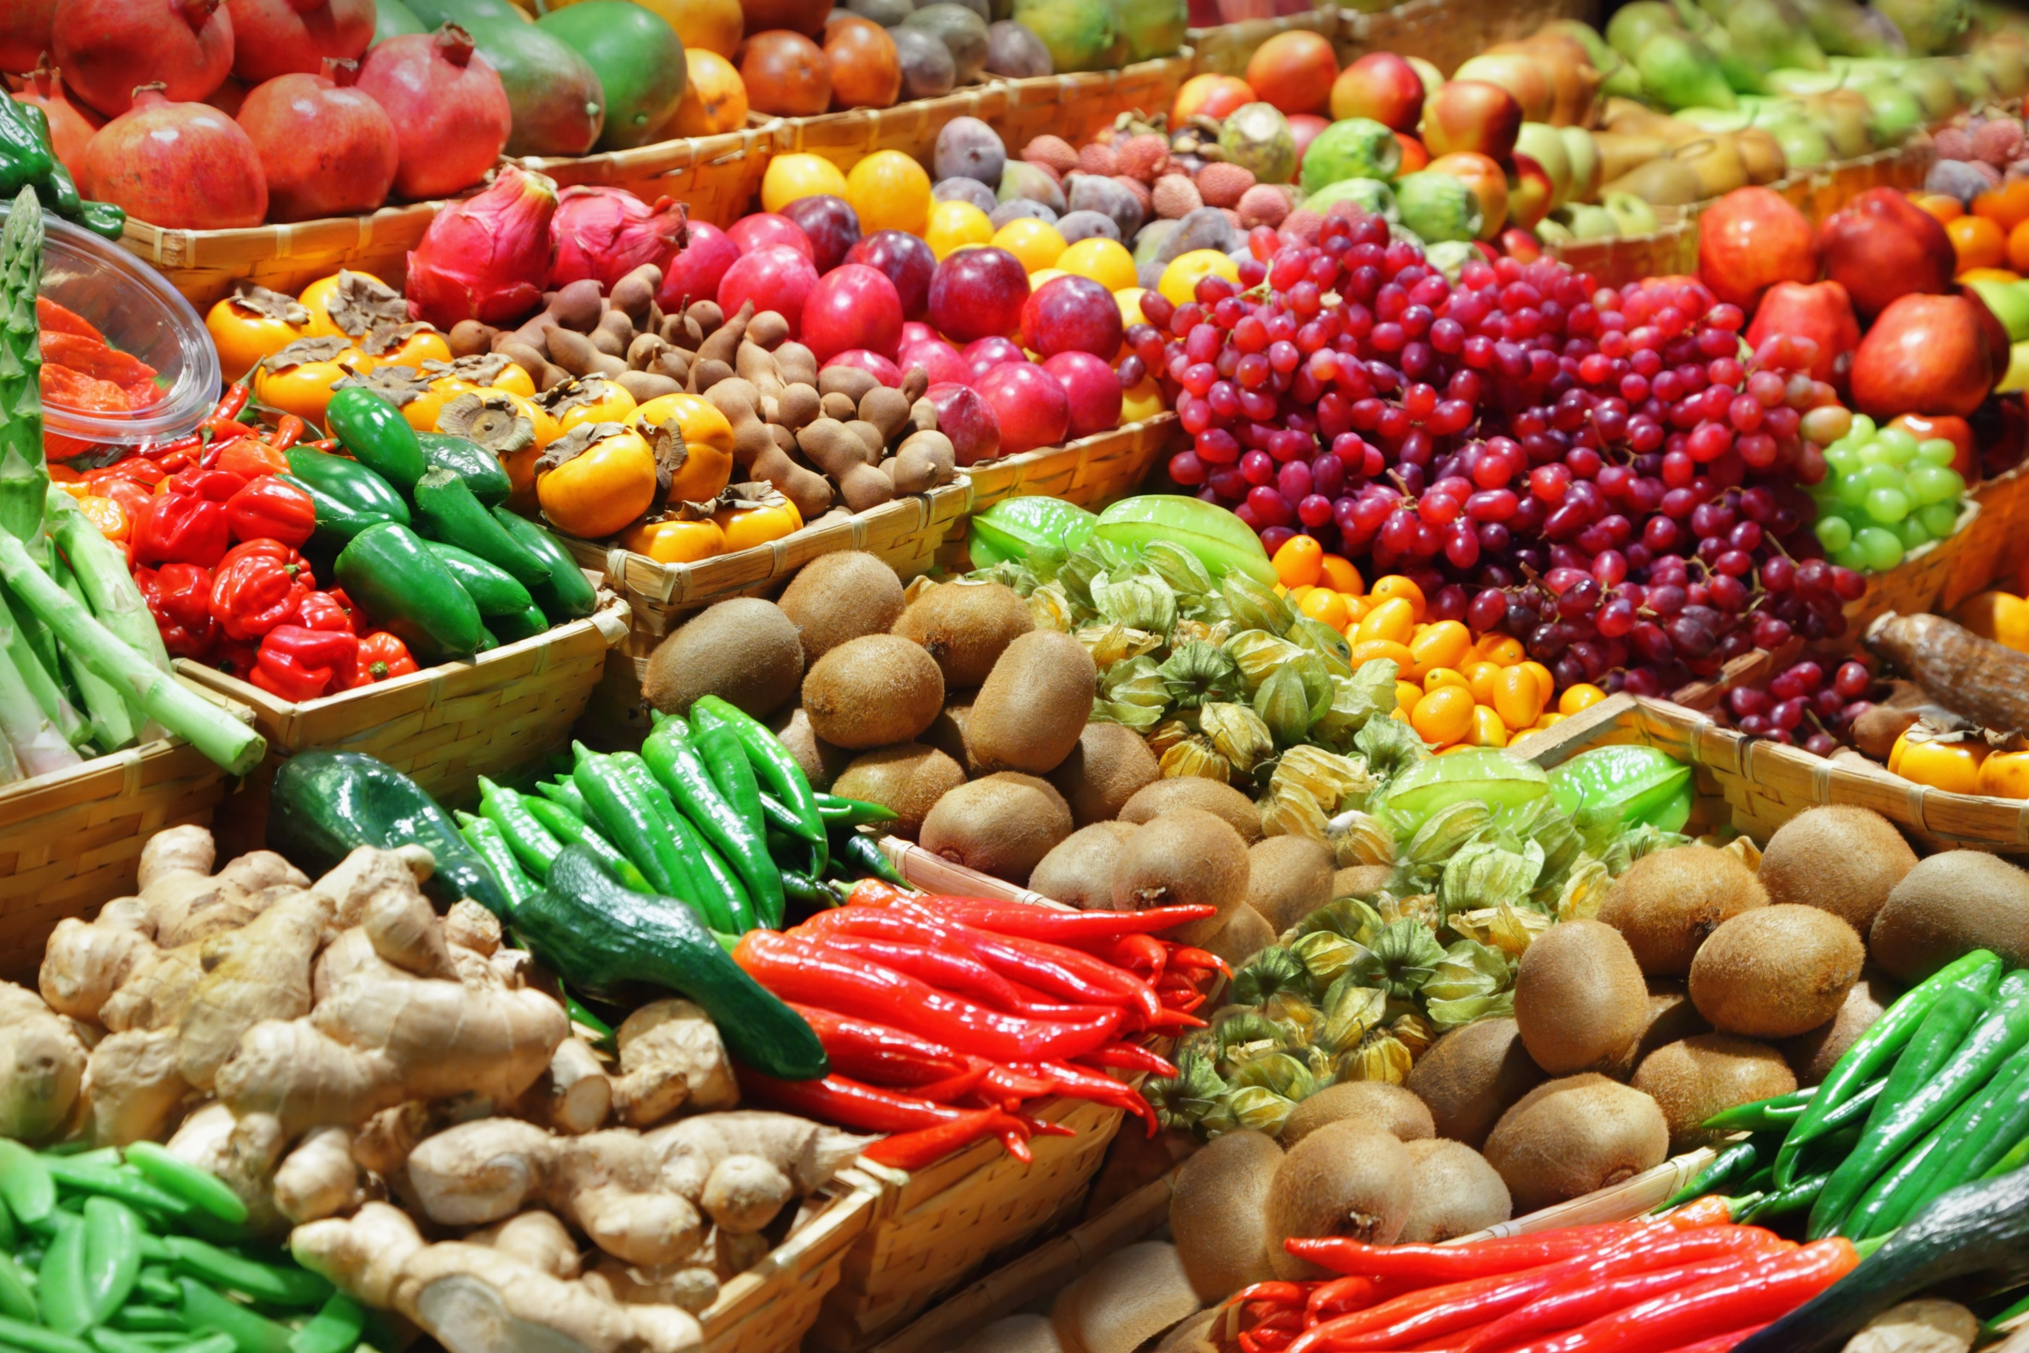
Farmers in the Garden State produce more than 100 different kinds of fruits and vegetables for consumers to enjoy either fresh or processed here in New Jersey and elsewhere in the Northeast, in Canada and in many countries around the world.
In addition, growers also produced hundreds of thousands of dollars worth of specialty crops that added a unique flavor to the Garden State's bounty.
Vineyards, for example, are a growing segment of the industry, enabling the state's vintners to develop a wide variety of award-winning New Jersey wines.
http://jerseyfresh.nj.gov/facts/
shutterstock.com

Slide 4
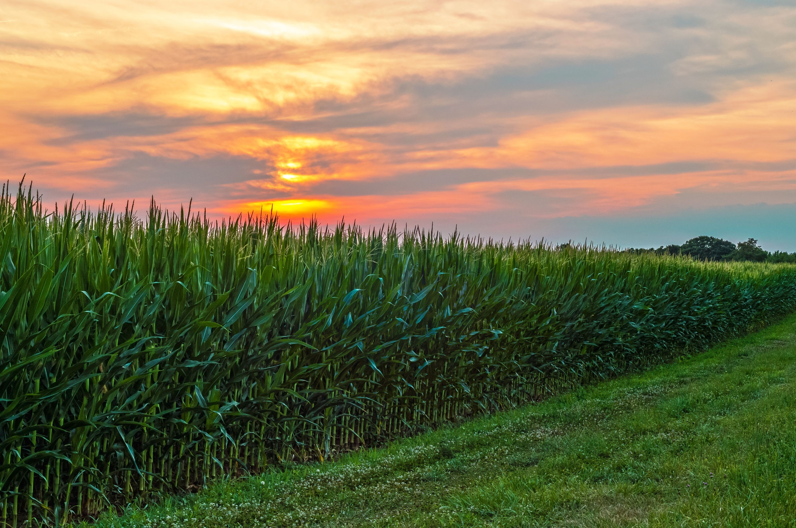
New Jersey Agriculture Statistics
Number of Farms | 9,100
Acres in Farming | 720,000
Preserved Farmland | 213,557 (As of 3/6/15)
Cash Receipts | $1.02 billion (As of 2014)
http://jerseyfresh.nj.gov/facts
shutterstock.com

Slide 5
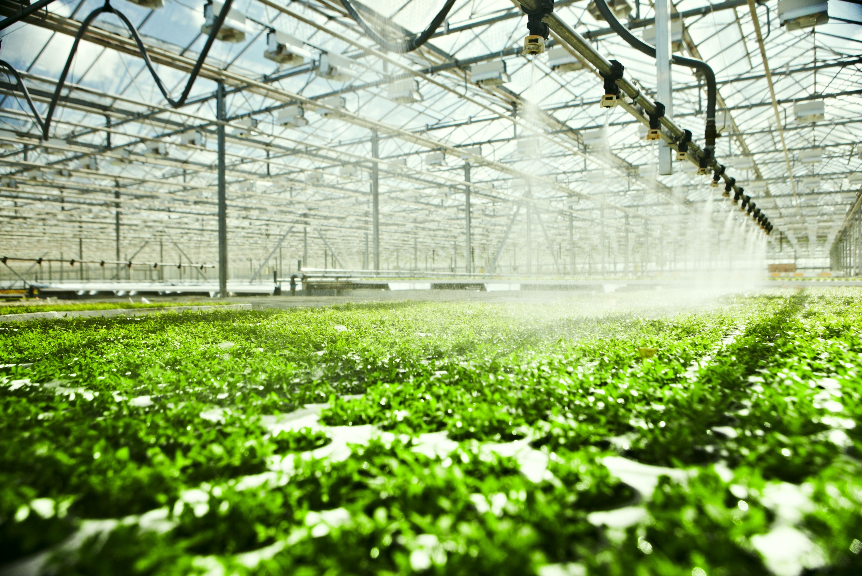
Leading New Jersey Agriculture Sectors
Nursery/Greenhouse/Sod | $444.8 million
Fruits and Vegetables | $462.9 million
Field Crops | $131.6 million
Equine | $46 million
Poultry and Eggs | $32.8 million
Dairy | $24.2 million
http://jerseyfresh.nj.gov/facts
shutterstock.com

Slide 6
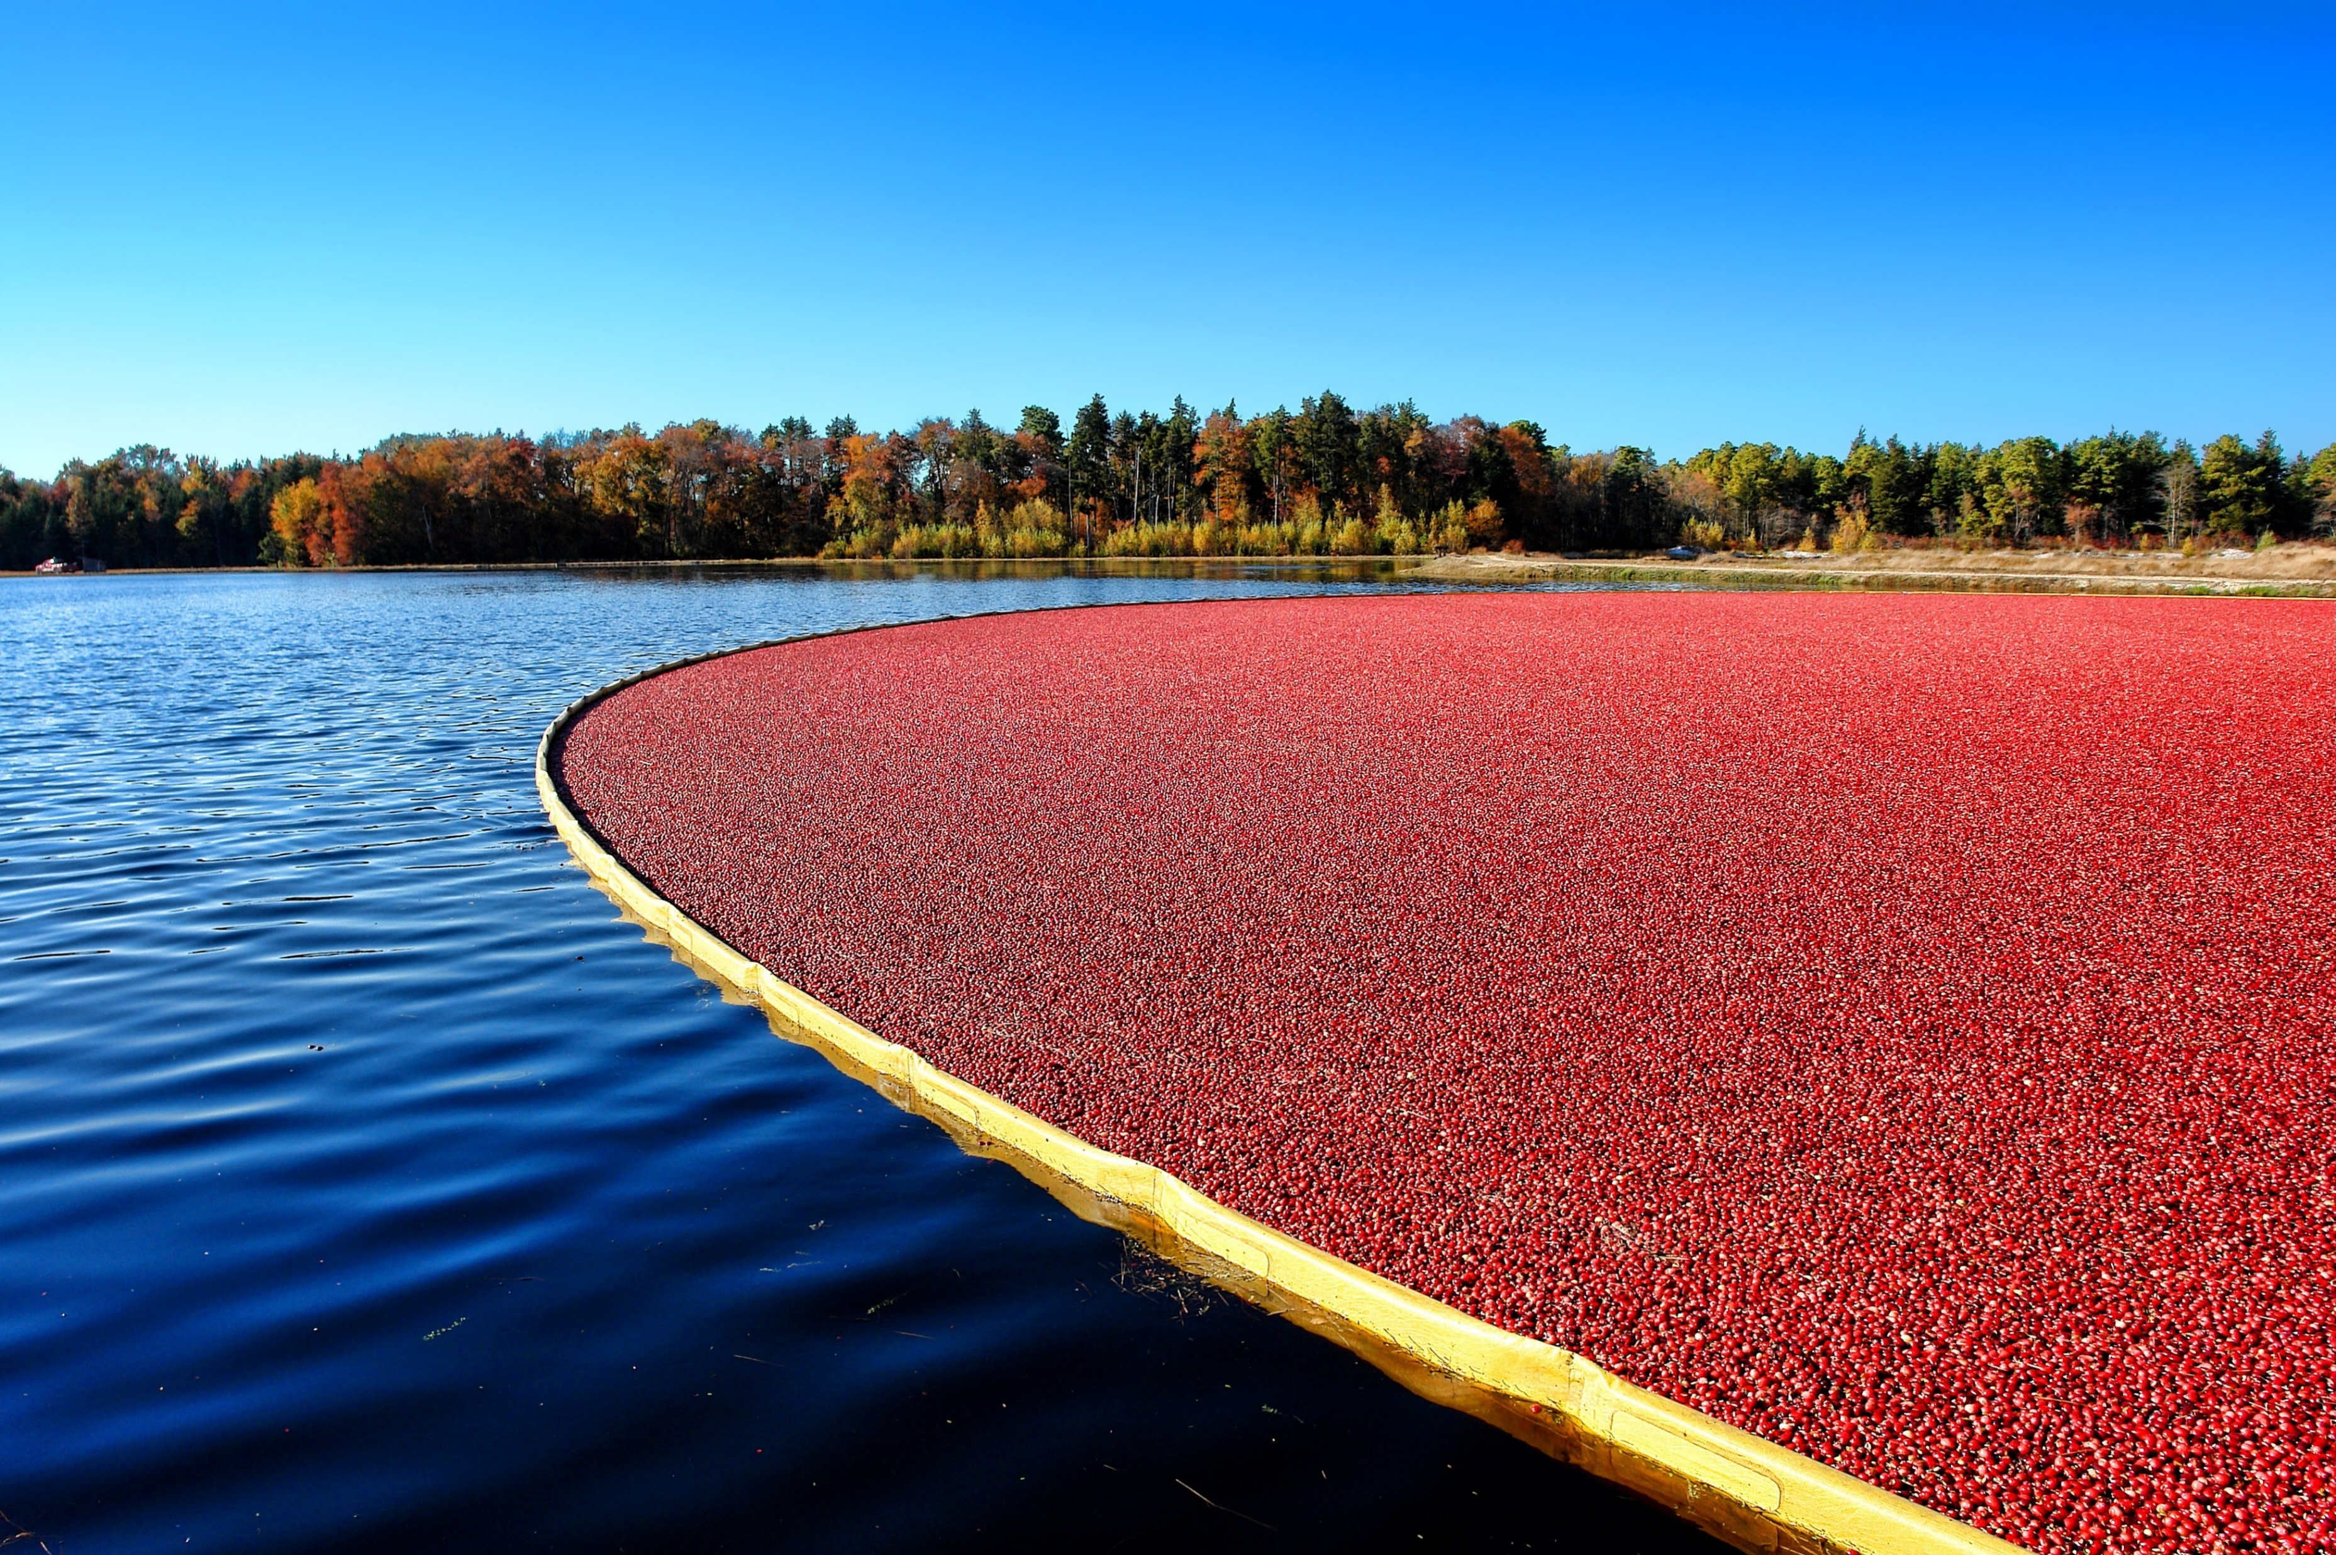
New Jersey is a National Top-Ten Producer of Fruits and Vegetables
2014 Statistics | Rank | Production | Prod. Value | Acres
Cranberries | 3rd | 62.6 mil. lbs. | $21.9 million | 3,000
http://jerseyfresh.nj.gov/facts
shutterstock.com

Slide 7
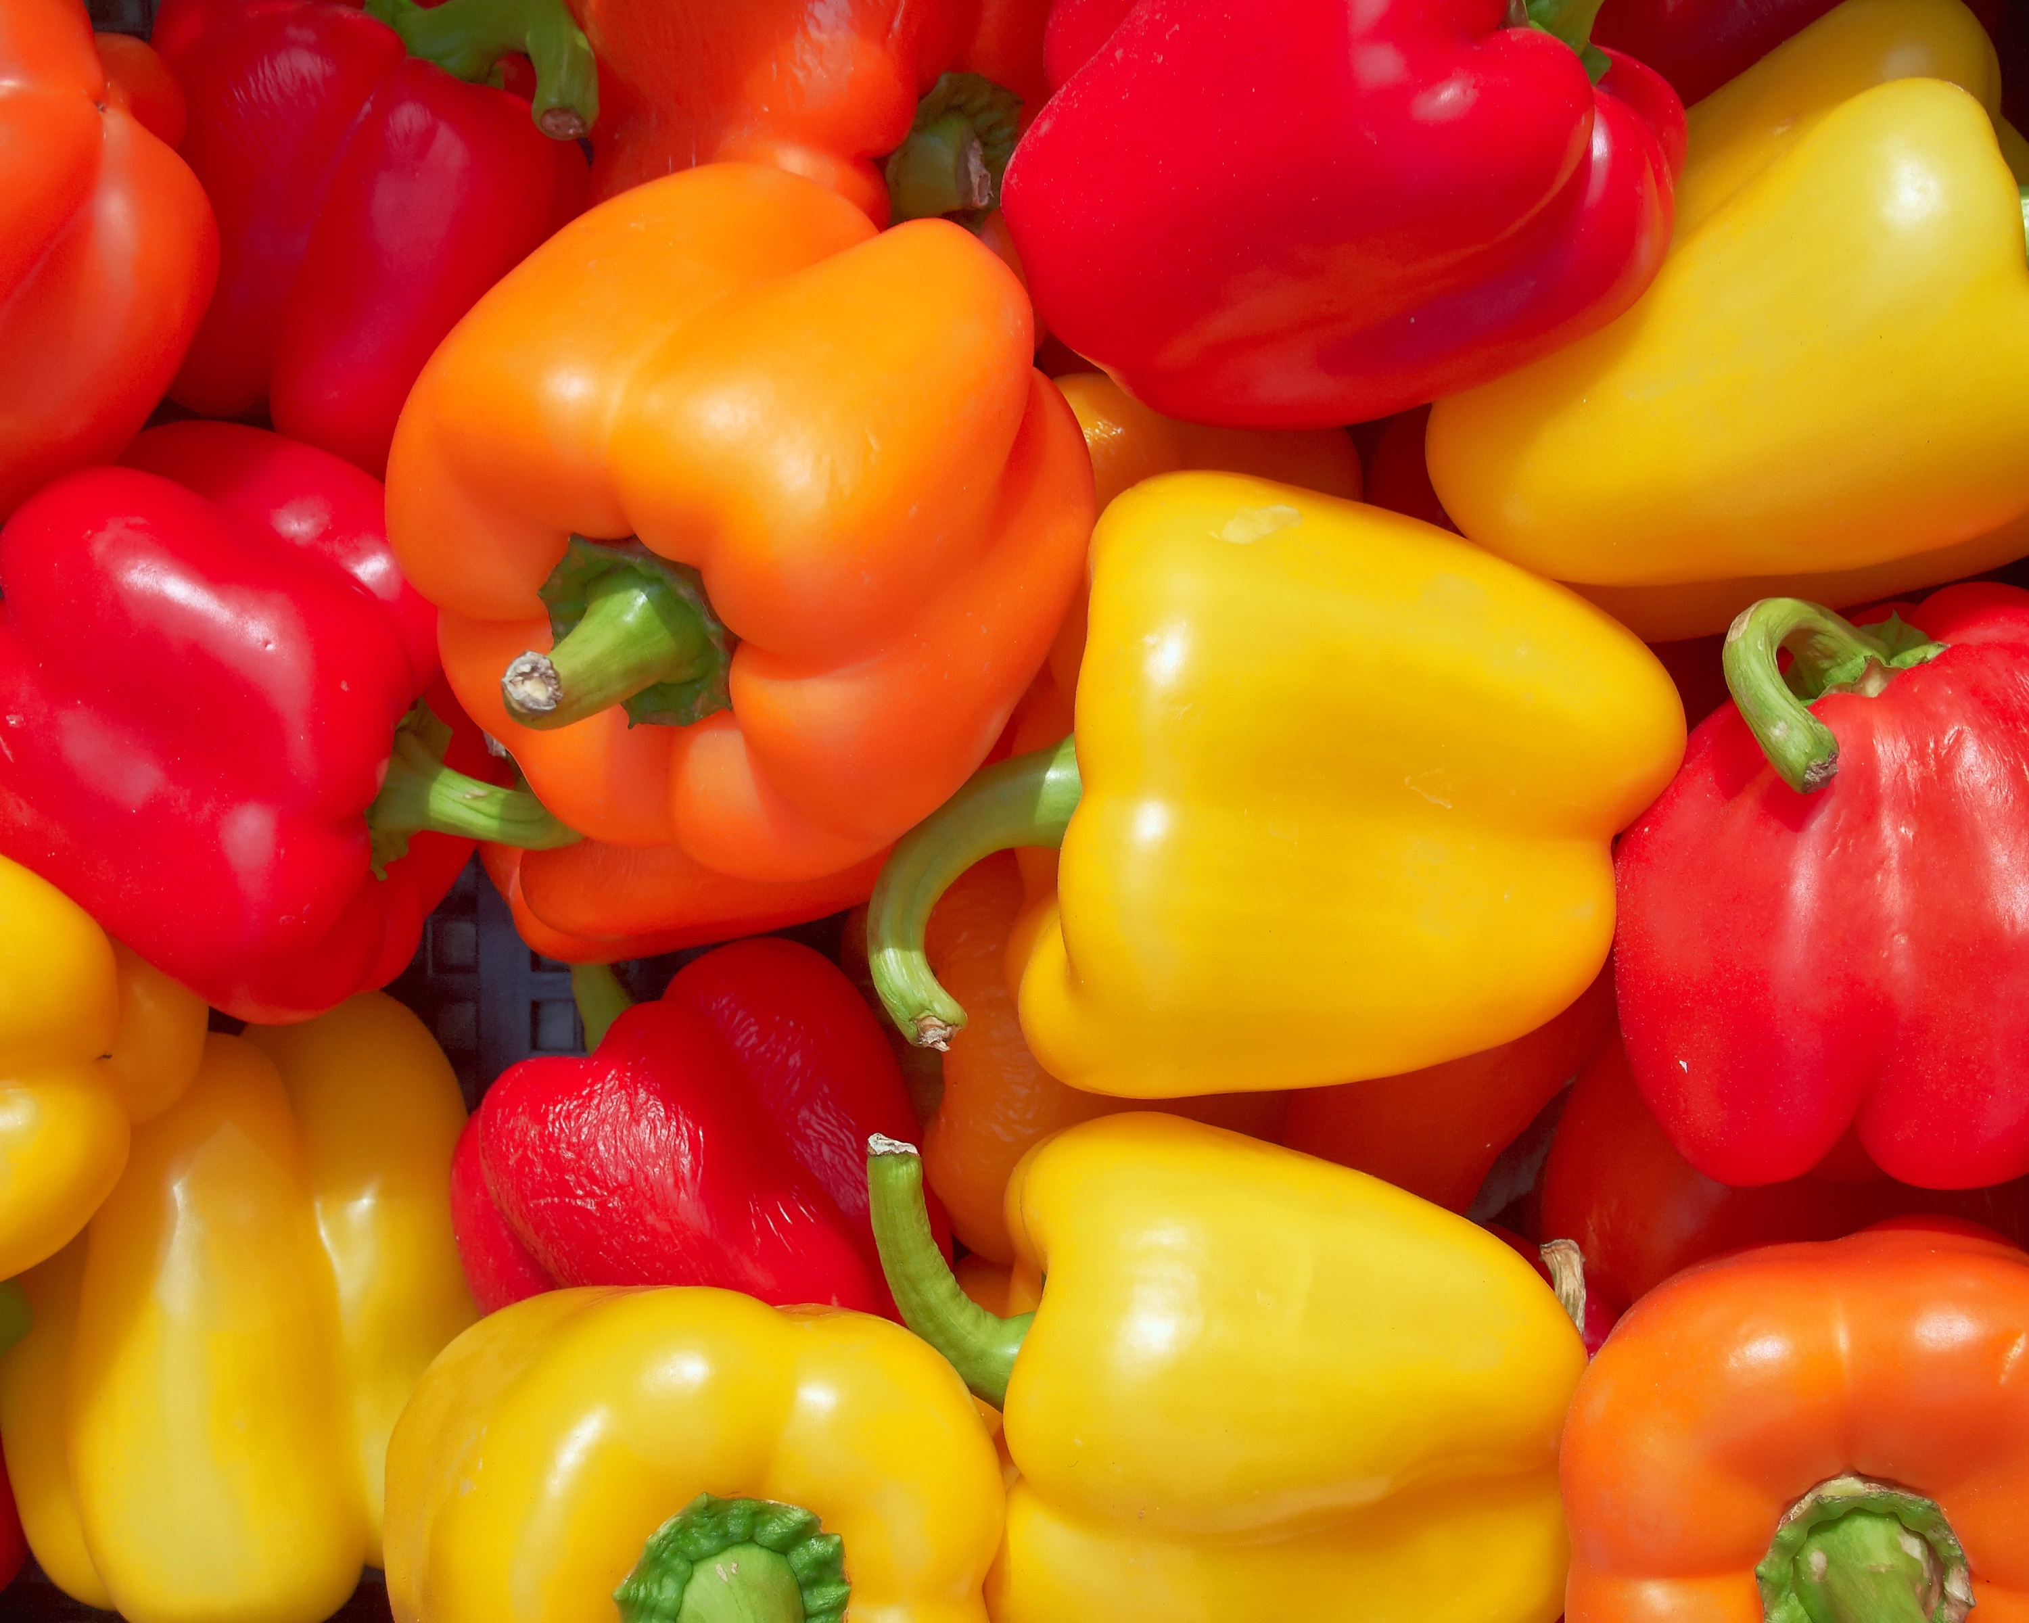
2014 Statistics | Rank | Production | Prod. Value | Acres
Bell Peppers | 3rd | 95.2 mil. lbs. | $29.5 million | 2,800
http://jerseyfresh.nj.gov/facts
shutterstock.com

Slide 8
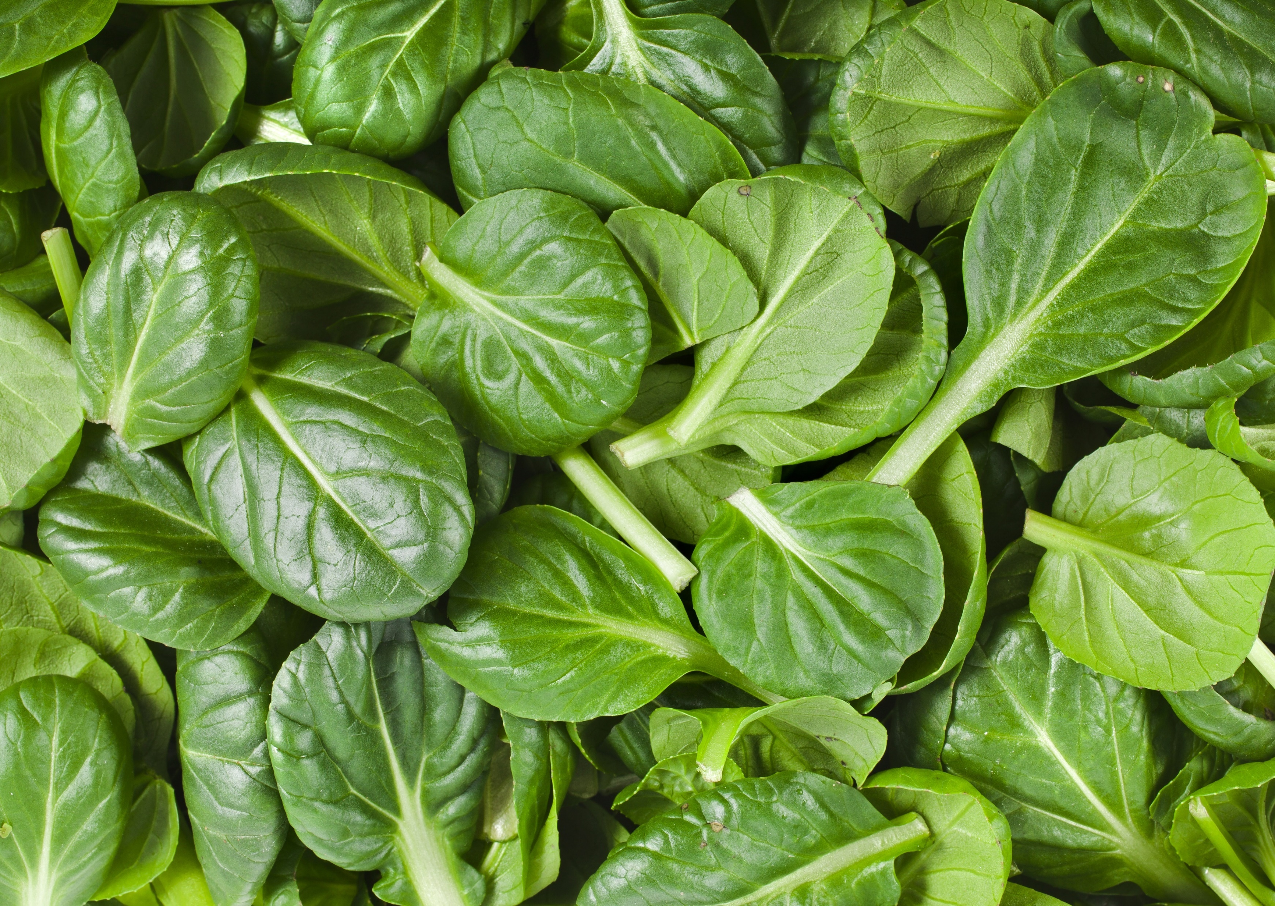
2014 Statistics | Rank | Production | Prod. Value | Acres
Spinach | 4th | 22.1 mil. lbs. | $8.3 million | 1,300
http://jerseyfresh.nj.gov/facts
shutterstock.com

Slide 9
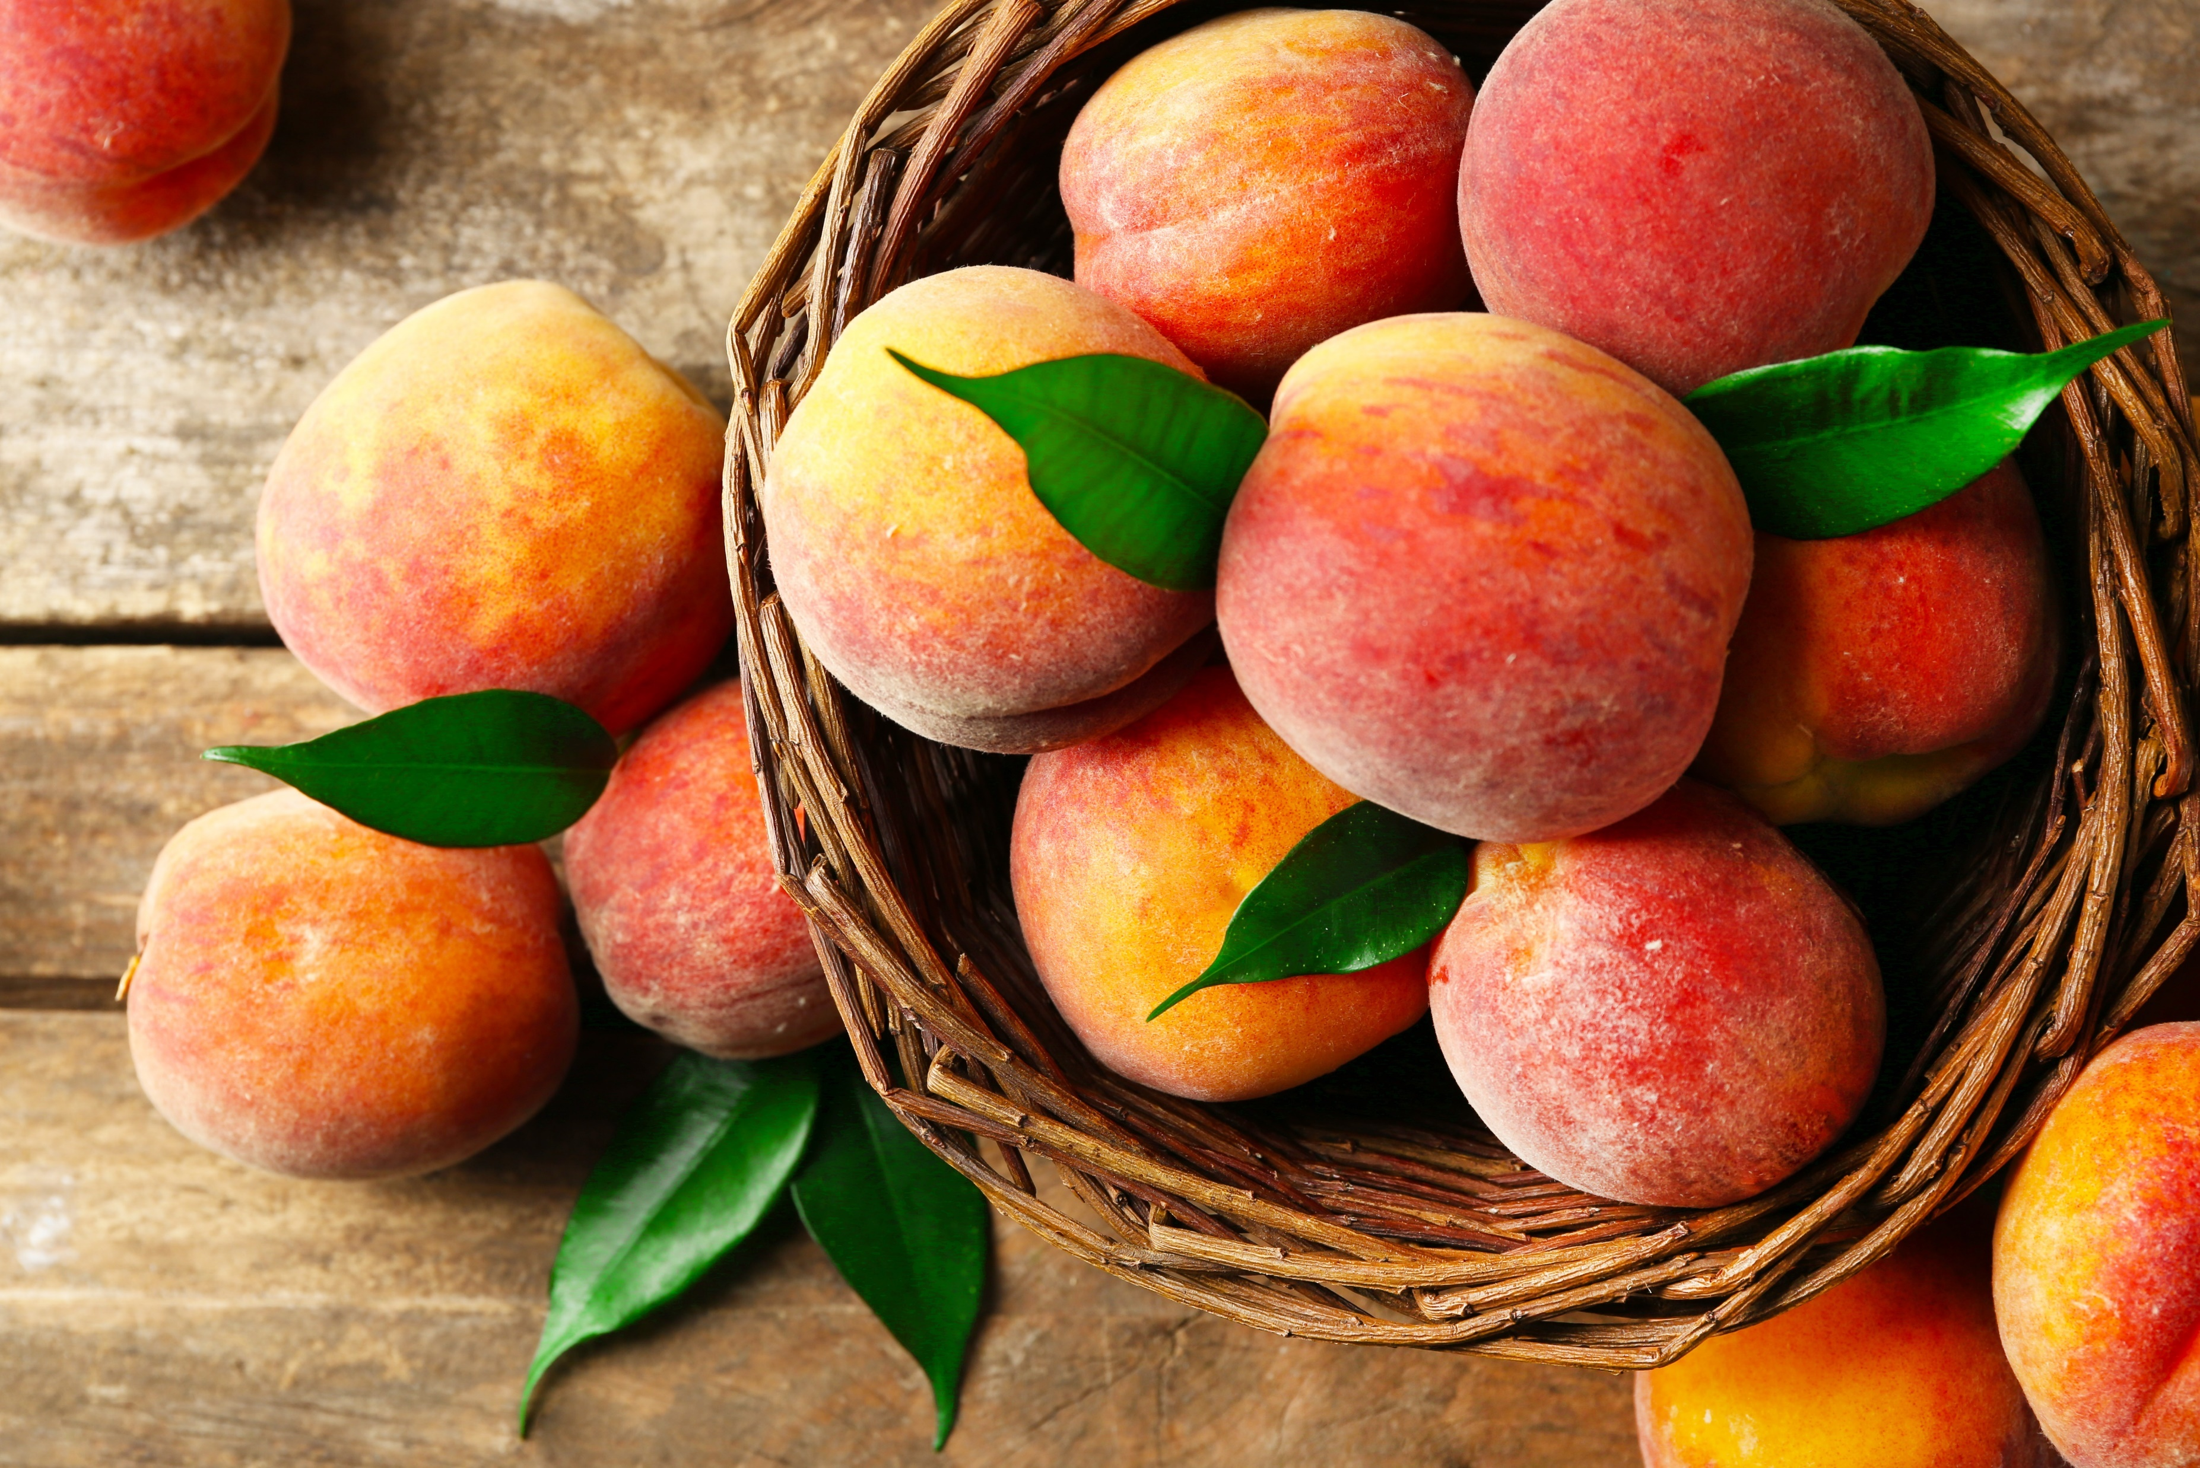
2014 Statistics | Rank | Production | Prod. Value | Acres
Peaches | 4th | 41.2 mil. lbs. | $27.3 million | 4,600
http://jerseyfresh.nj.gov/facts
shutterstock.com

Slide 10
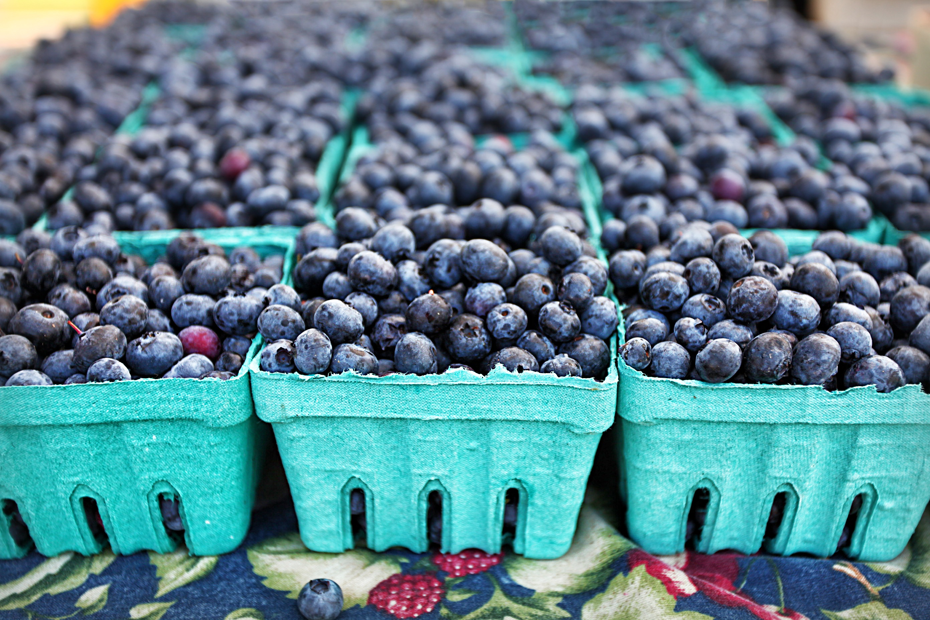
2014 Statistics | Rank | Production | Prod. Value | Acres
Blueberries | 5th | 66.7 mil. lbs. | $79.5 million | 8,800
http://jerseyfresh.nj.gov/facts
shutterstock.com

Slide 11
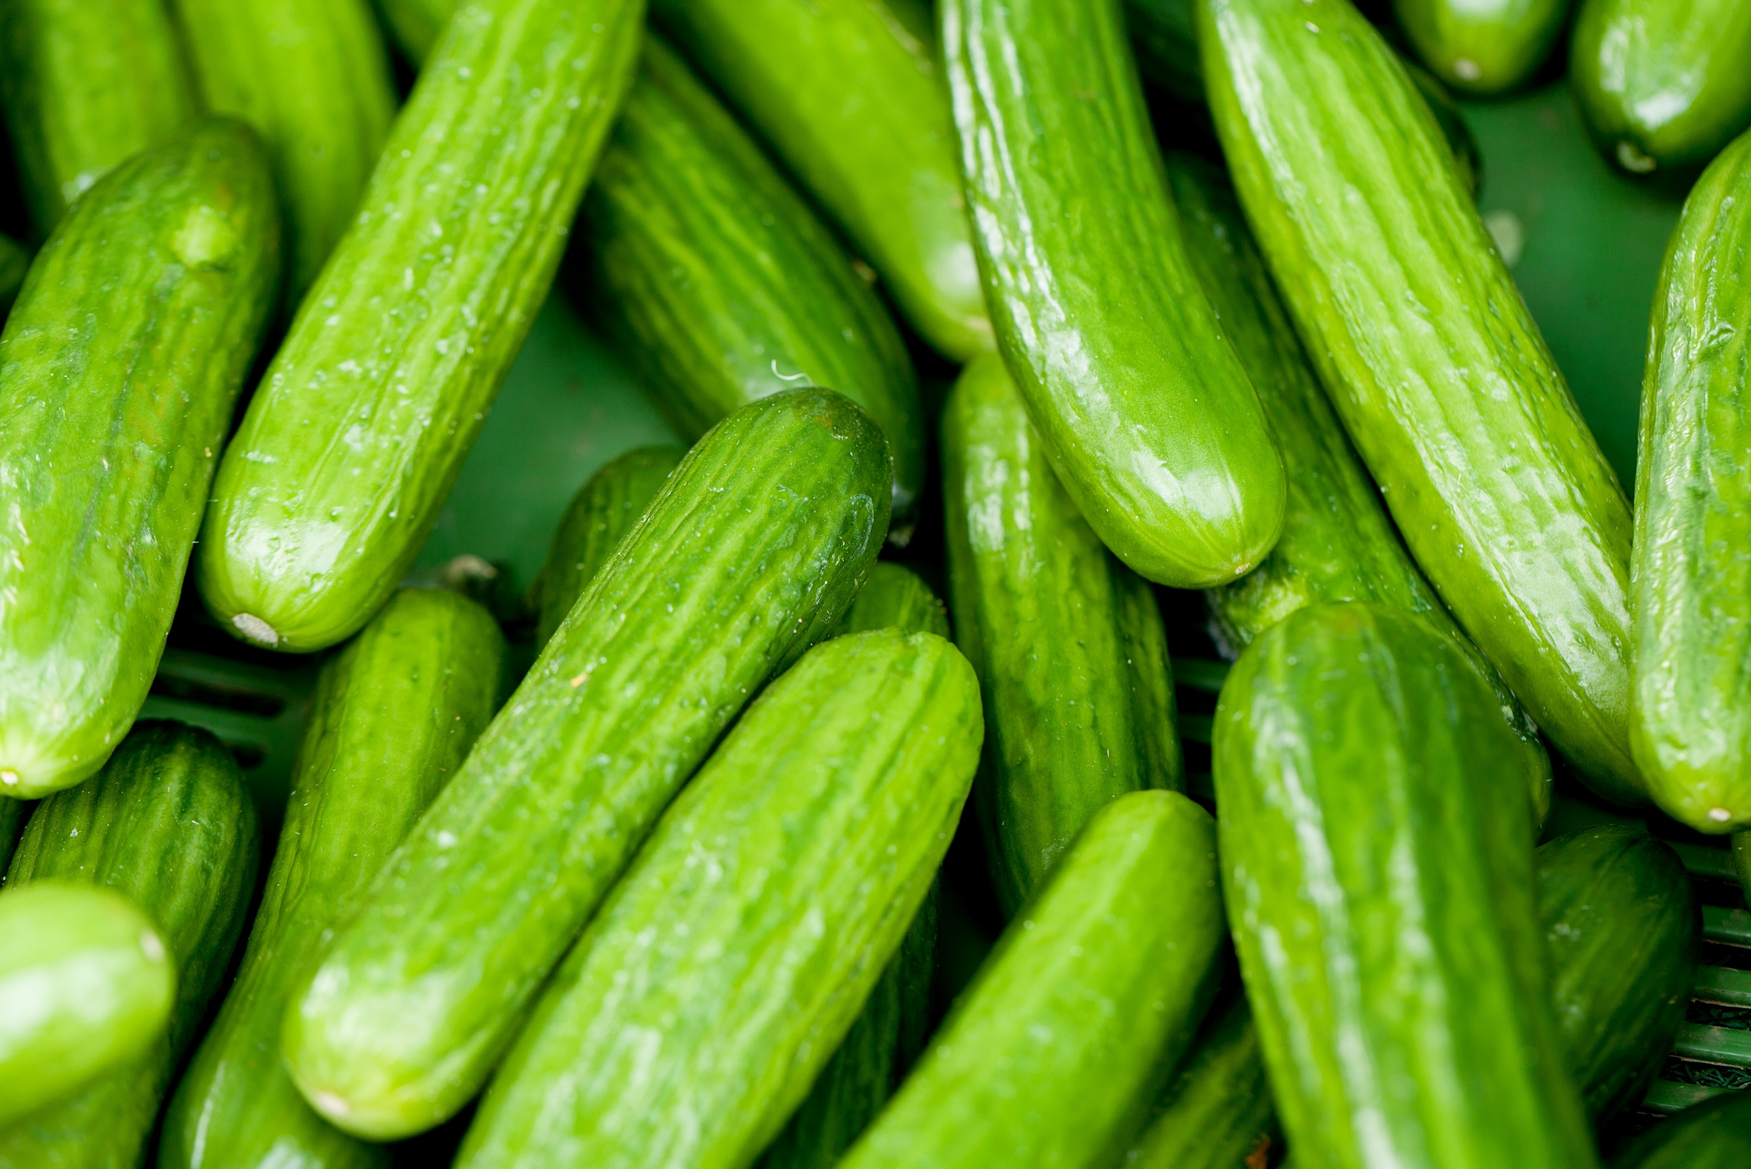
2014 Statistics | Rank | Production | Prod. Value | Acres
Cucumbers | 5th | 57.6 mil. lbs. | $14.9 million | 3,100
http://jerseyfresh.nj.gov/facts
shutterstock.com

Slide 12
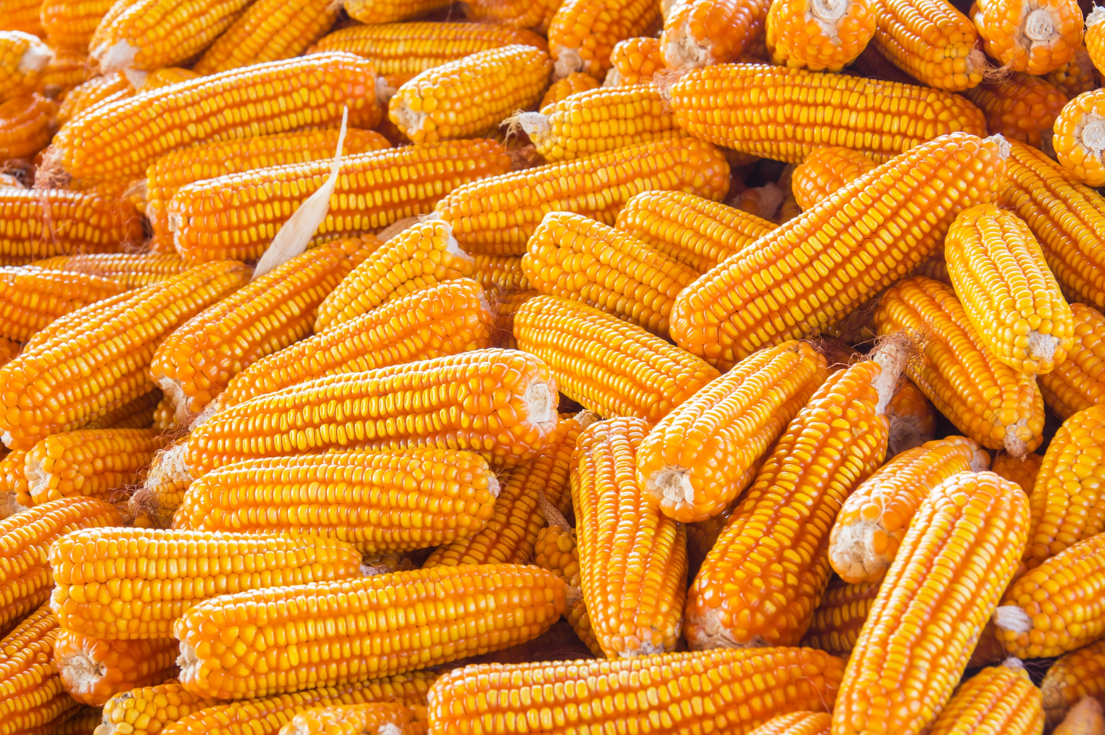
2014 Statistics | Rank | Production | Prod. Value | Acres
Sweet Corn | 6th | 54 mil. lbs. | $16.8 million | 6,000
http://jerseyfresh.nj.gov/facts
shutterstock.com

Slide 13
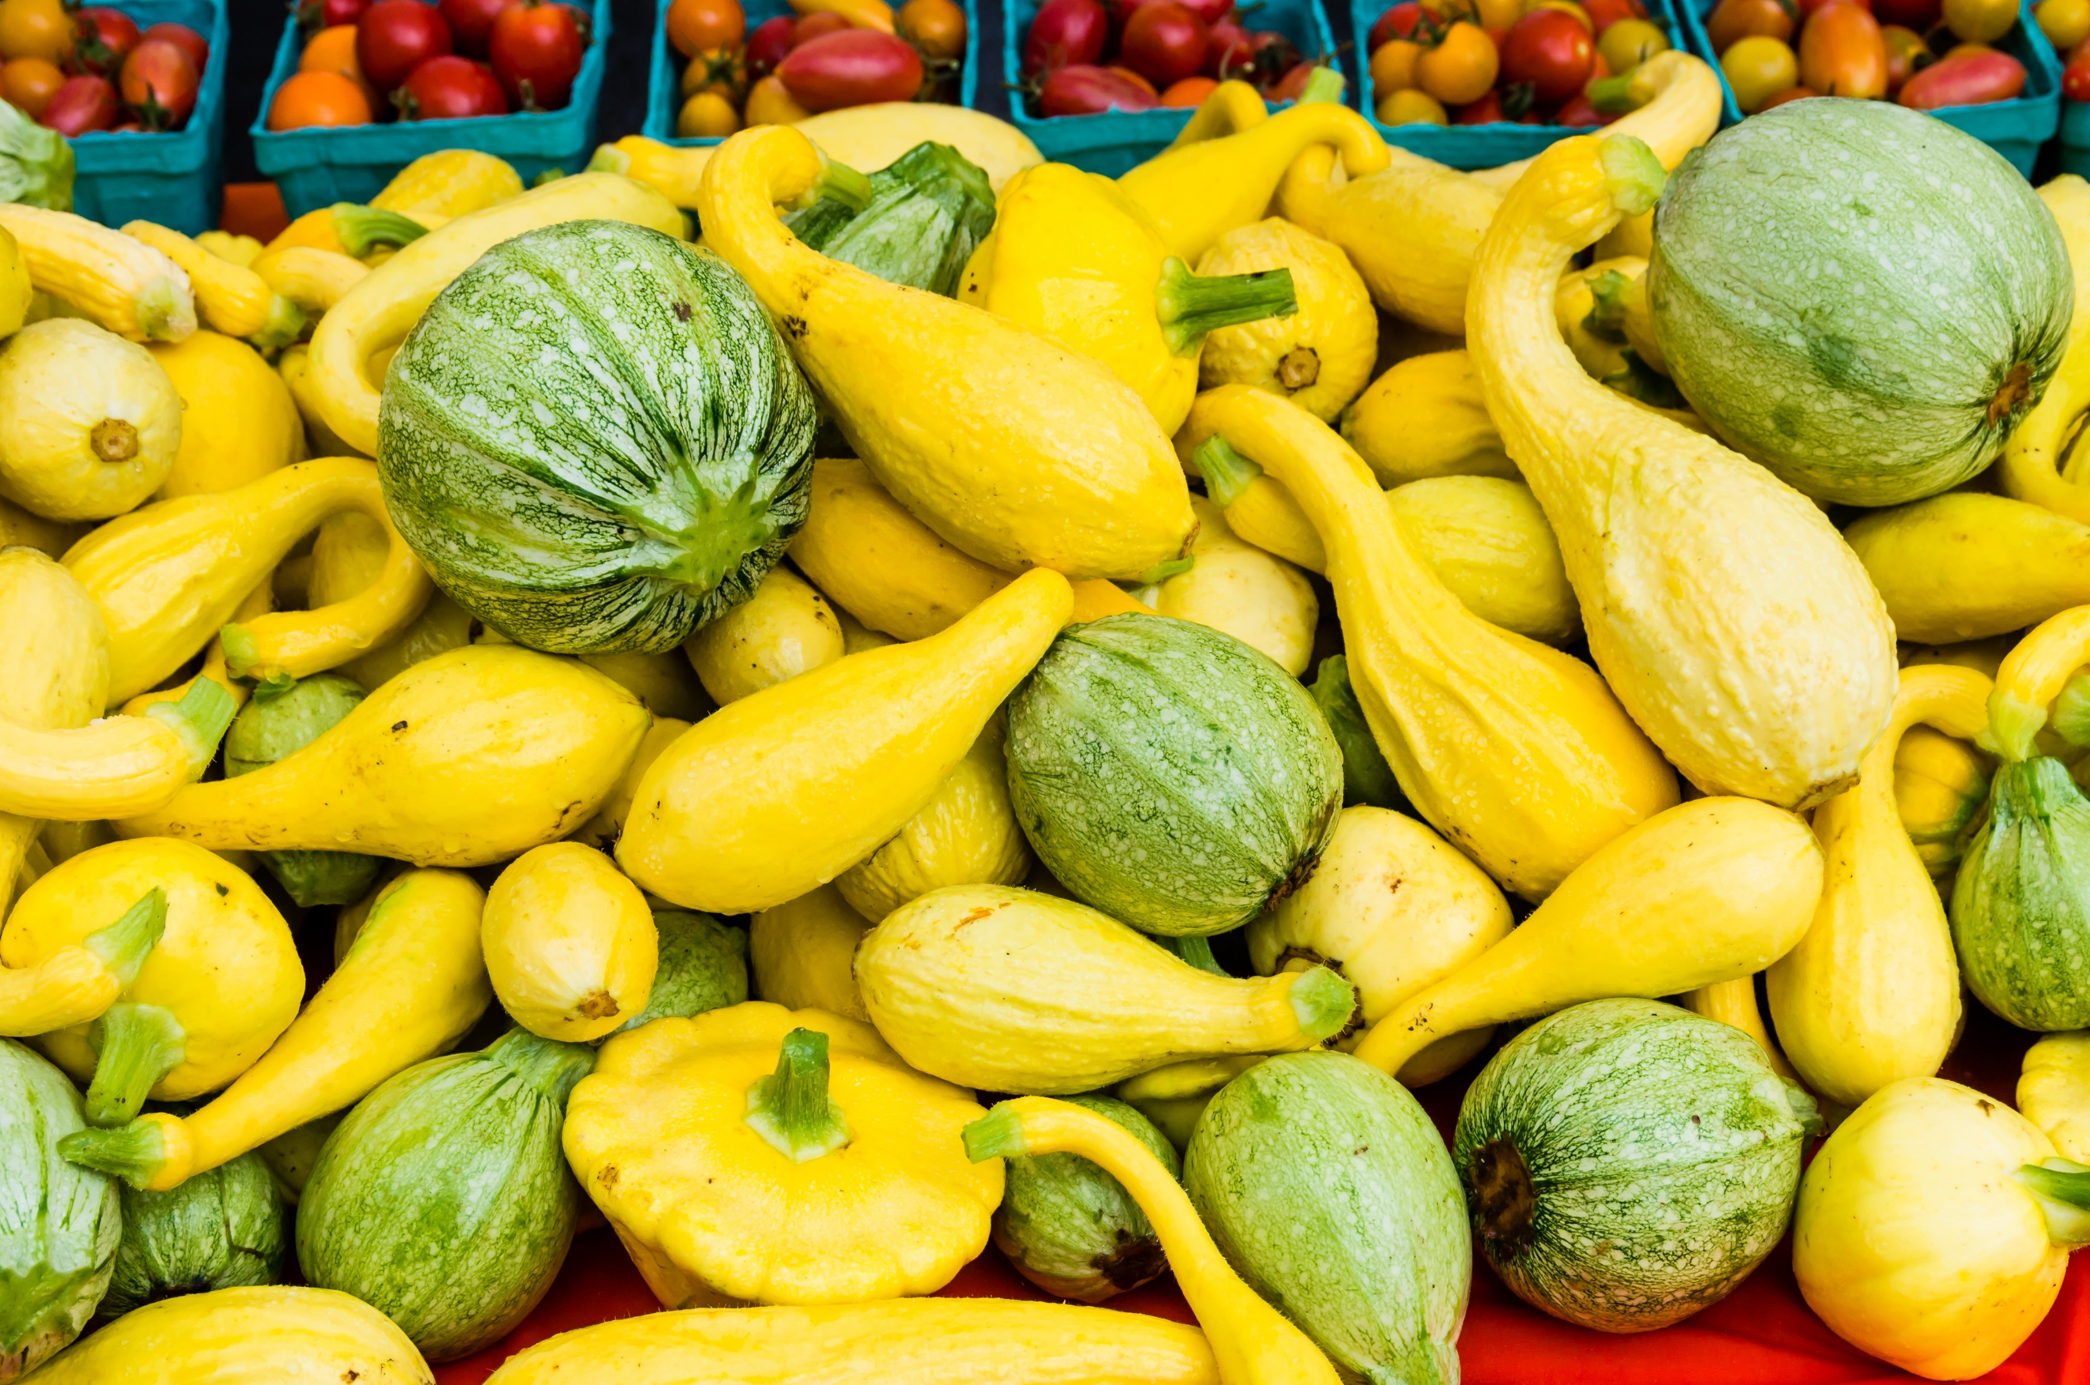
2014 Statistics | Rank | Production | Prod. Value | Acres
Squash | 7th | 35.4 mil. lbs. | $11.6 million | 2,700
http://jerseyfresh.nj.gov/facts
shutterstock.com

Slide 14
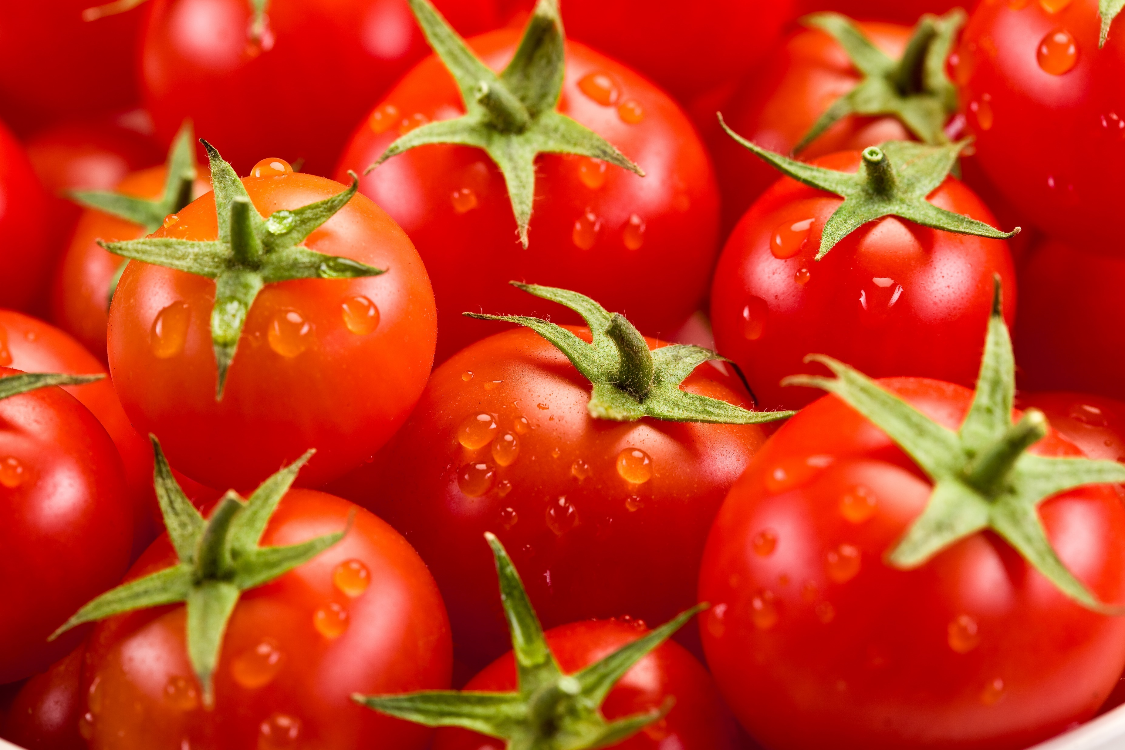
2014 Statistics | Rank | Production | Prod. Value | Acres
Tomatoes | 8th | 62.4 mil. lbs. | $38.1 million | 2,900
http://jerseyfresh.nj.gov/facts
shutterstock.com

Slide 15
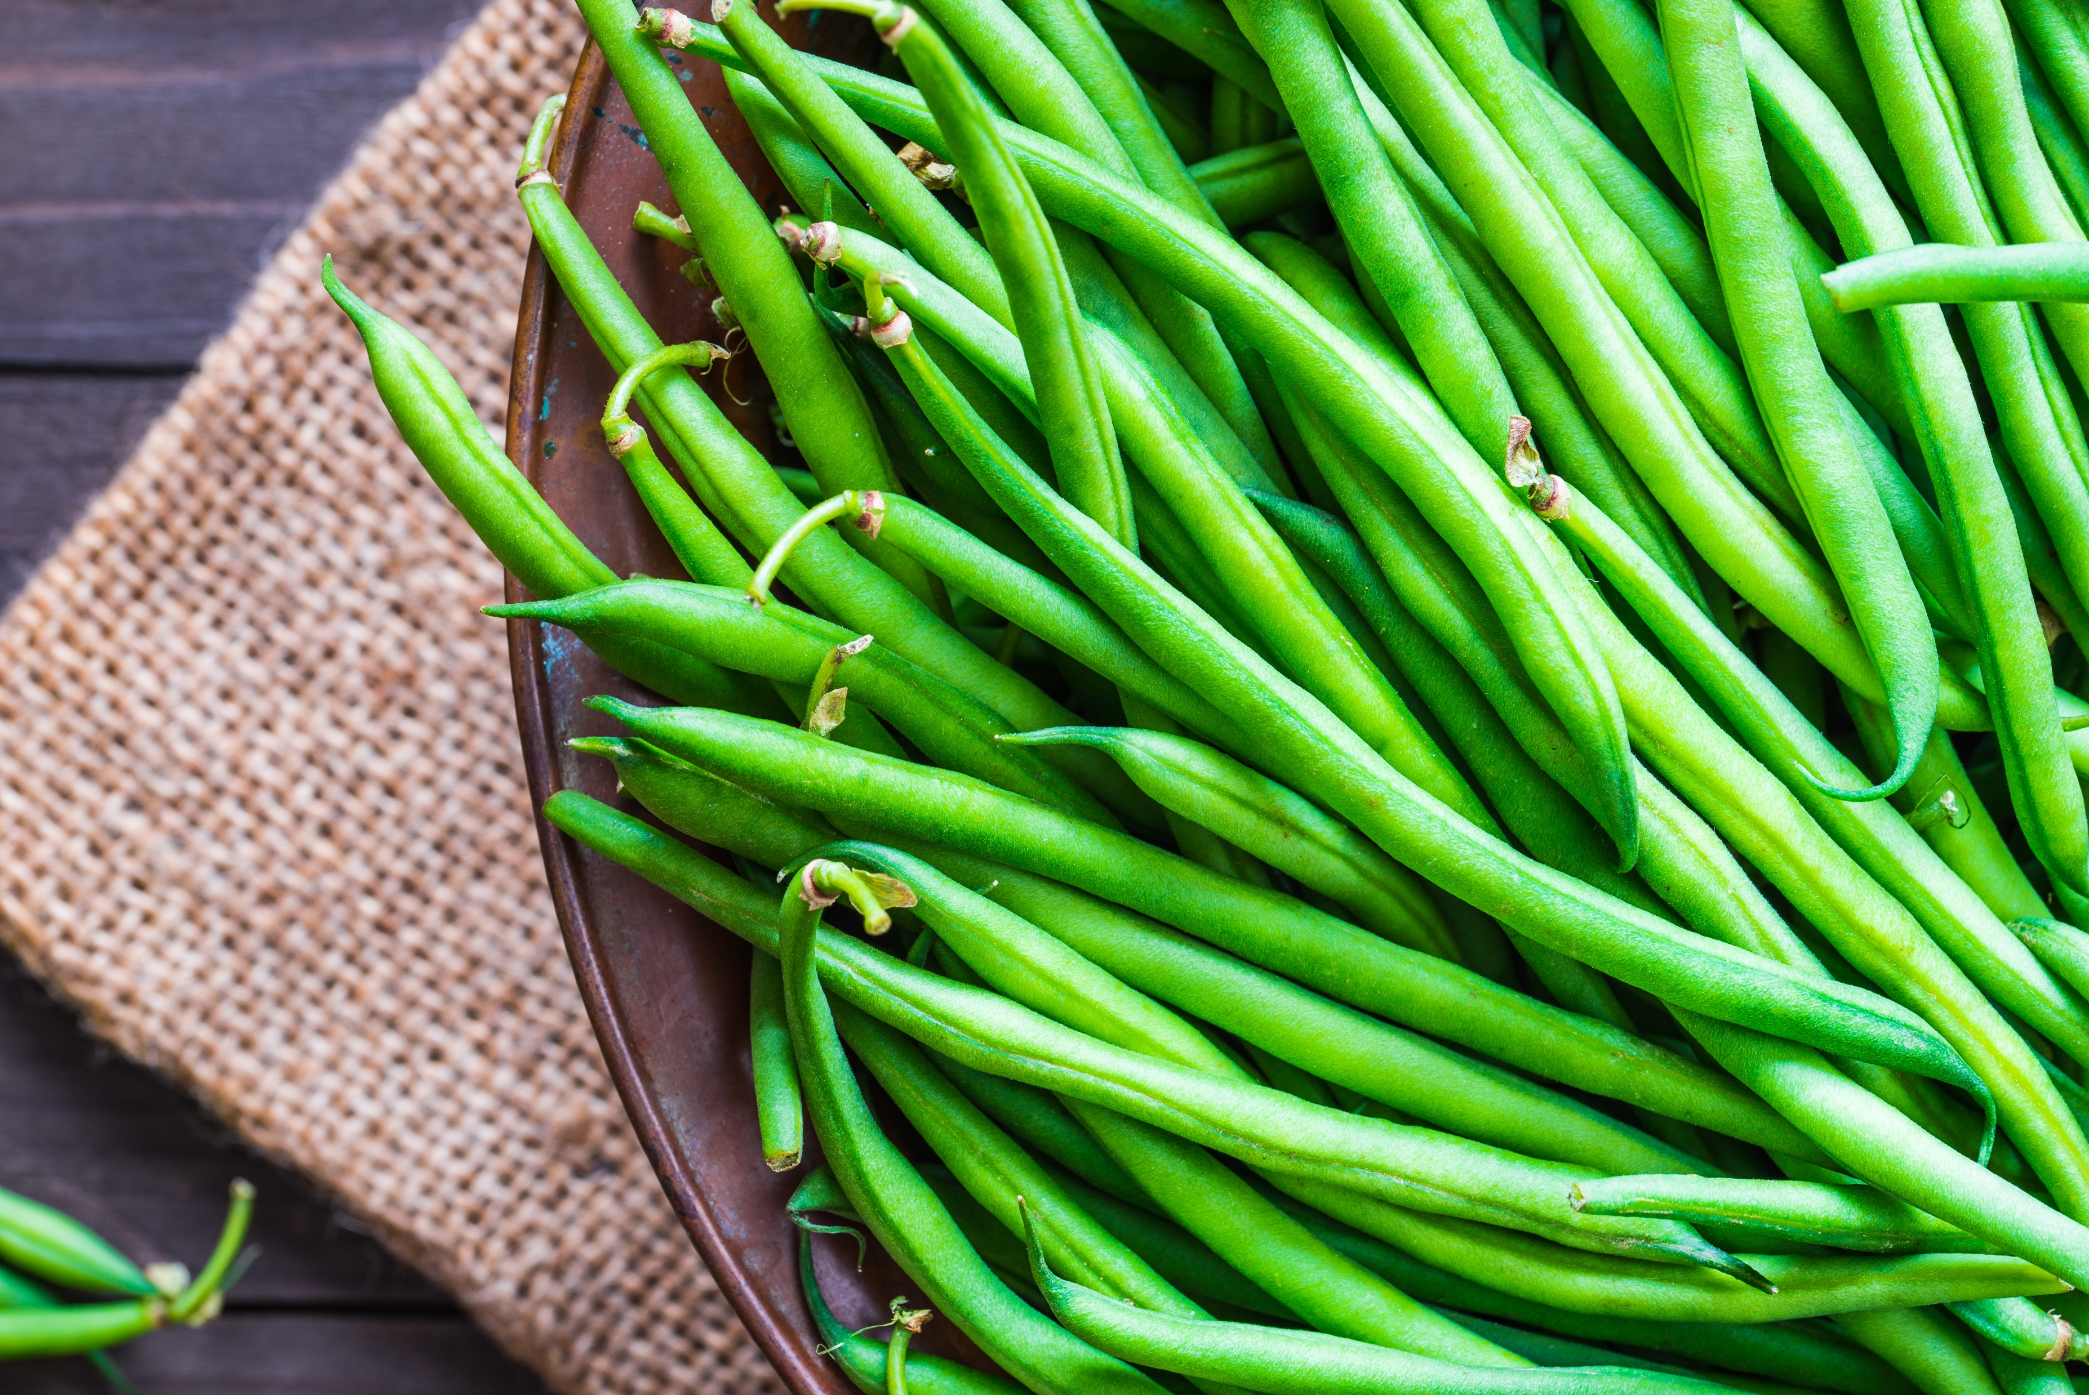
2014 Statistics | Rank | Production | Prod. Value | Acres
Snap Beans | 8th | 8.6 mil. lbs. | $3.3 million | 2,500
http://jerseyfresh.nj.gov/facts
shutterstock.com

Slide 16
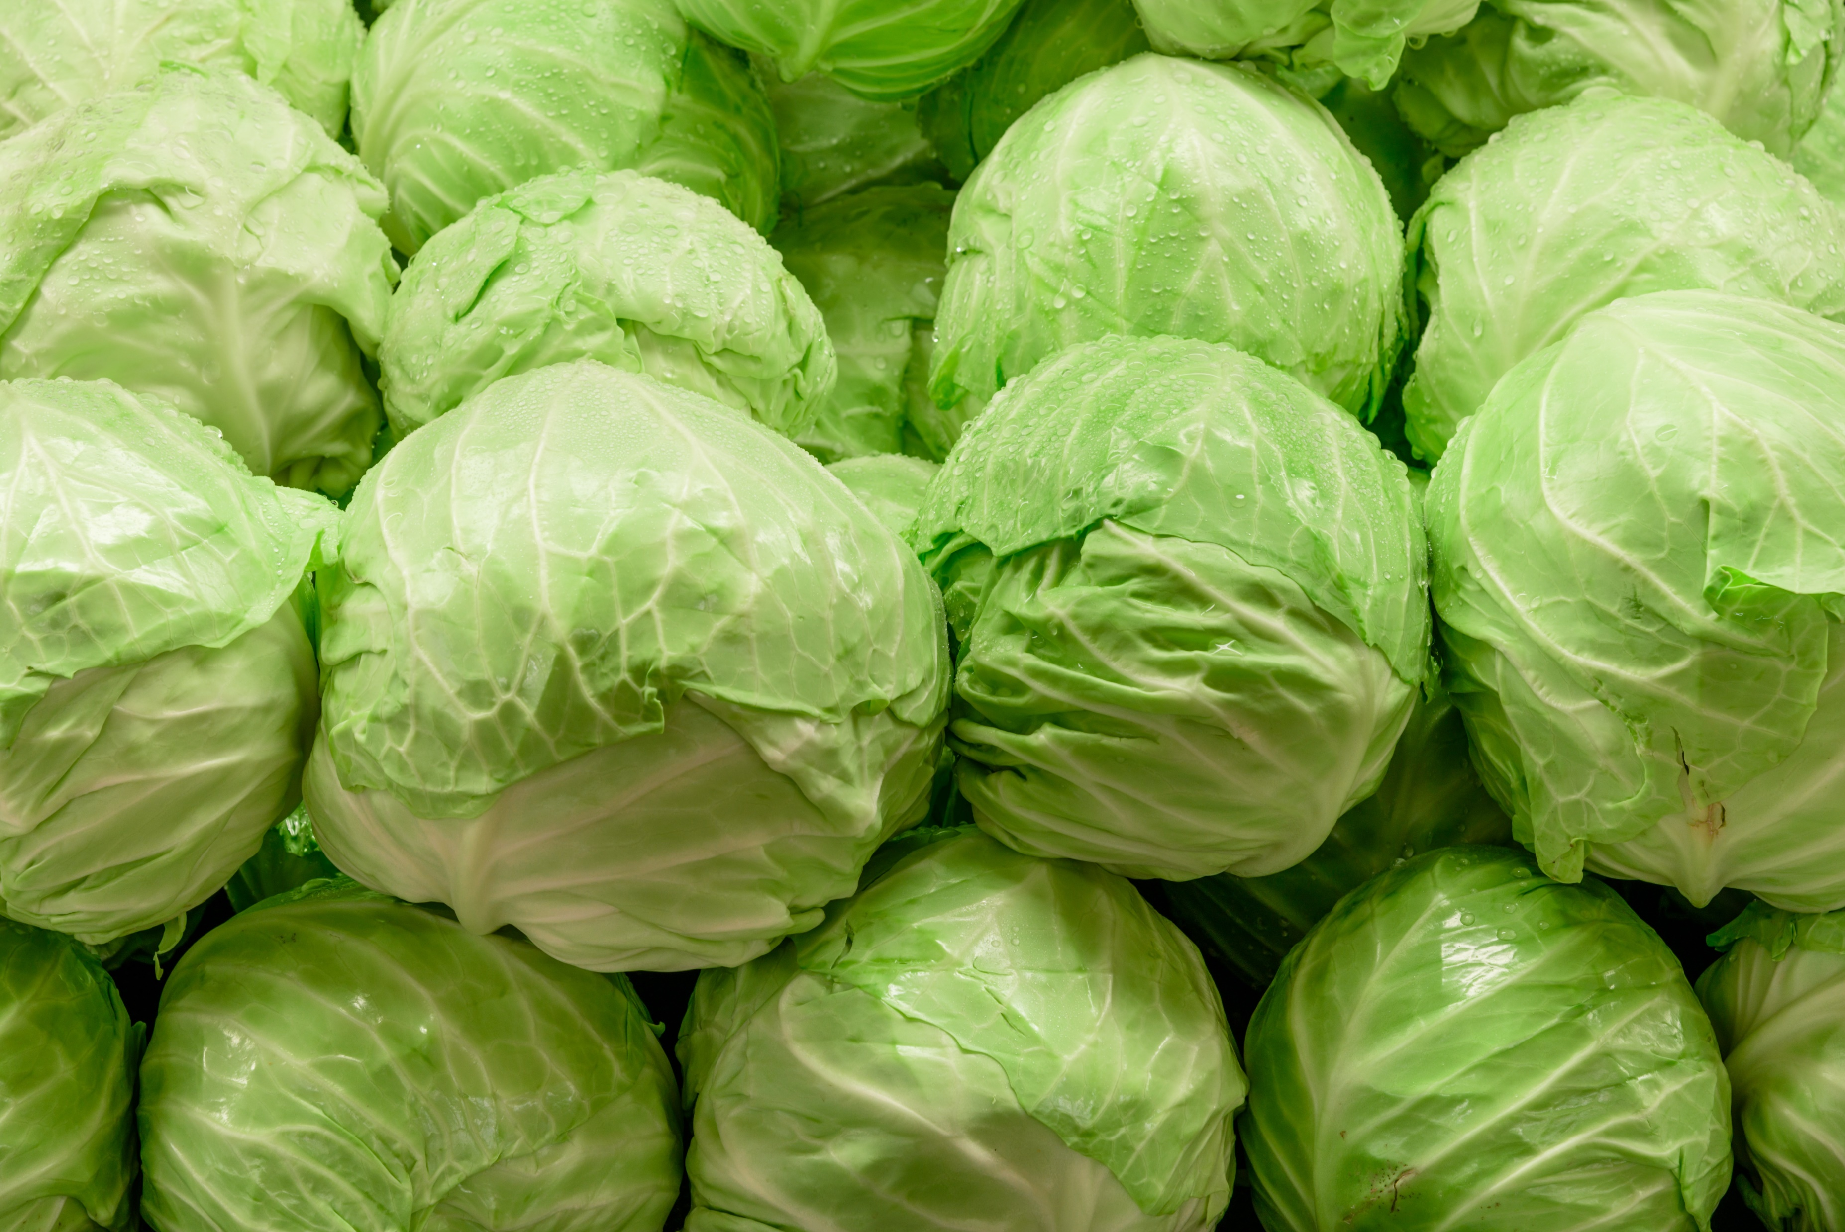
2014 Statistics | Rank | Production | Prod. Value | Acres
Cabbage | 10th | 53.3 mil. lbs. | $9.5 million | 1,500
http://jerseyfresh.nj.gov/facts
shutterstock.com

Slide 17
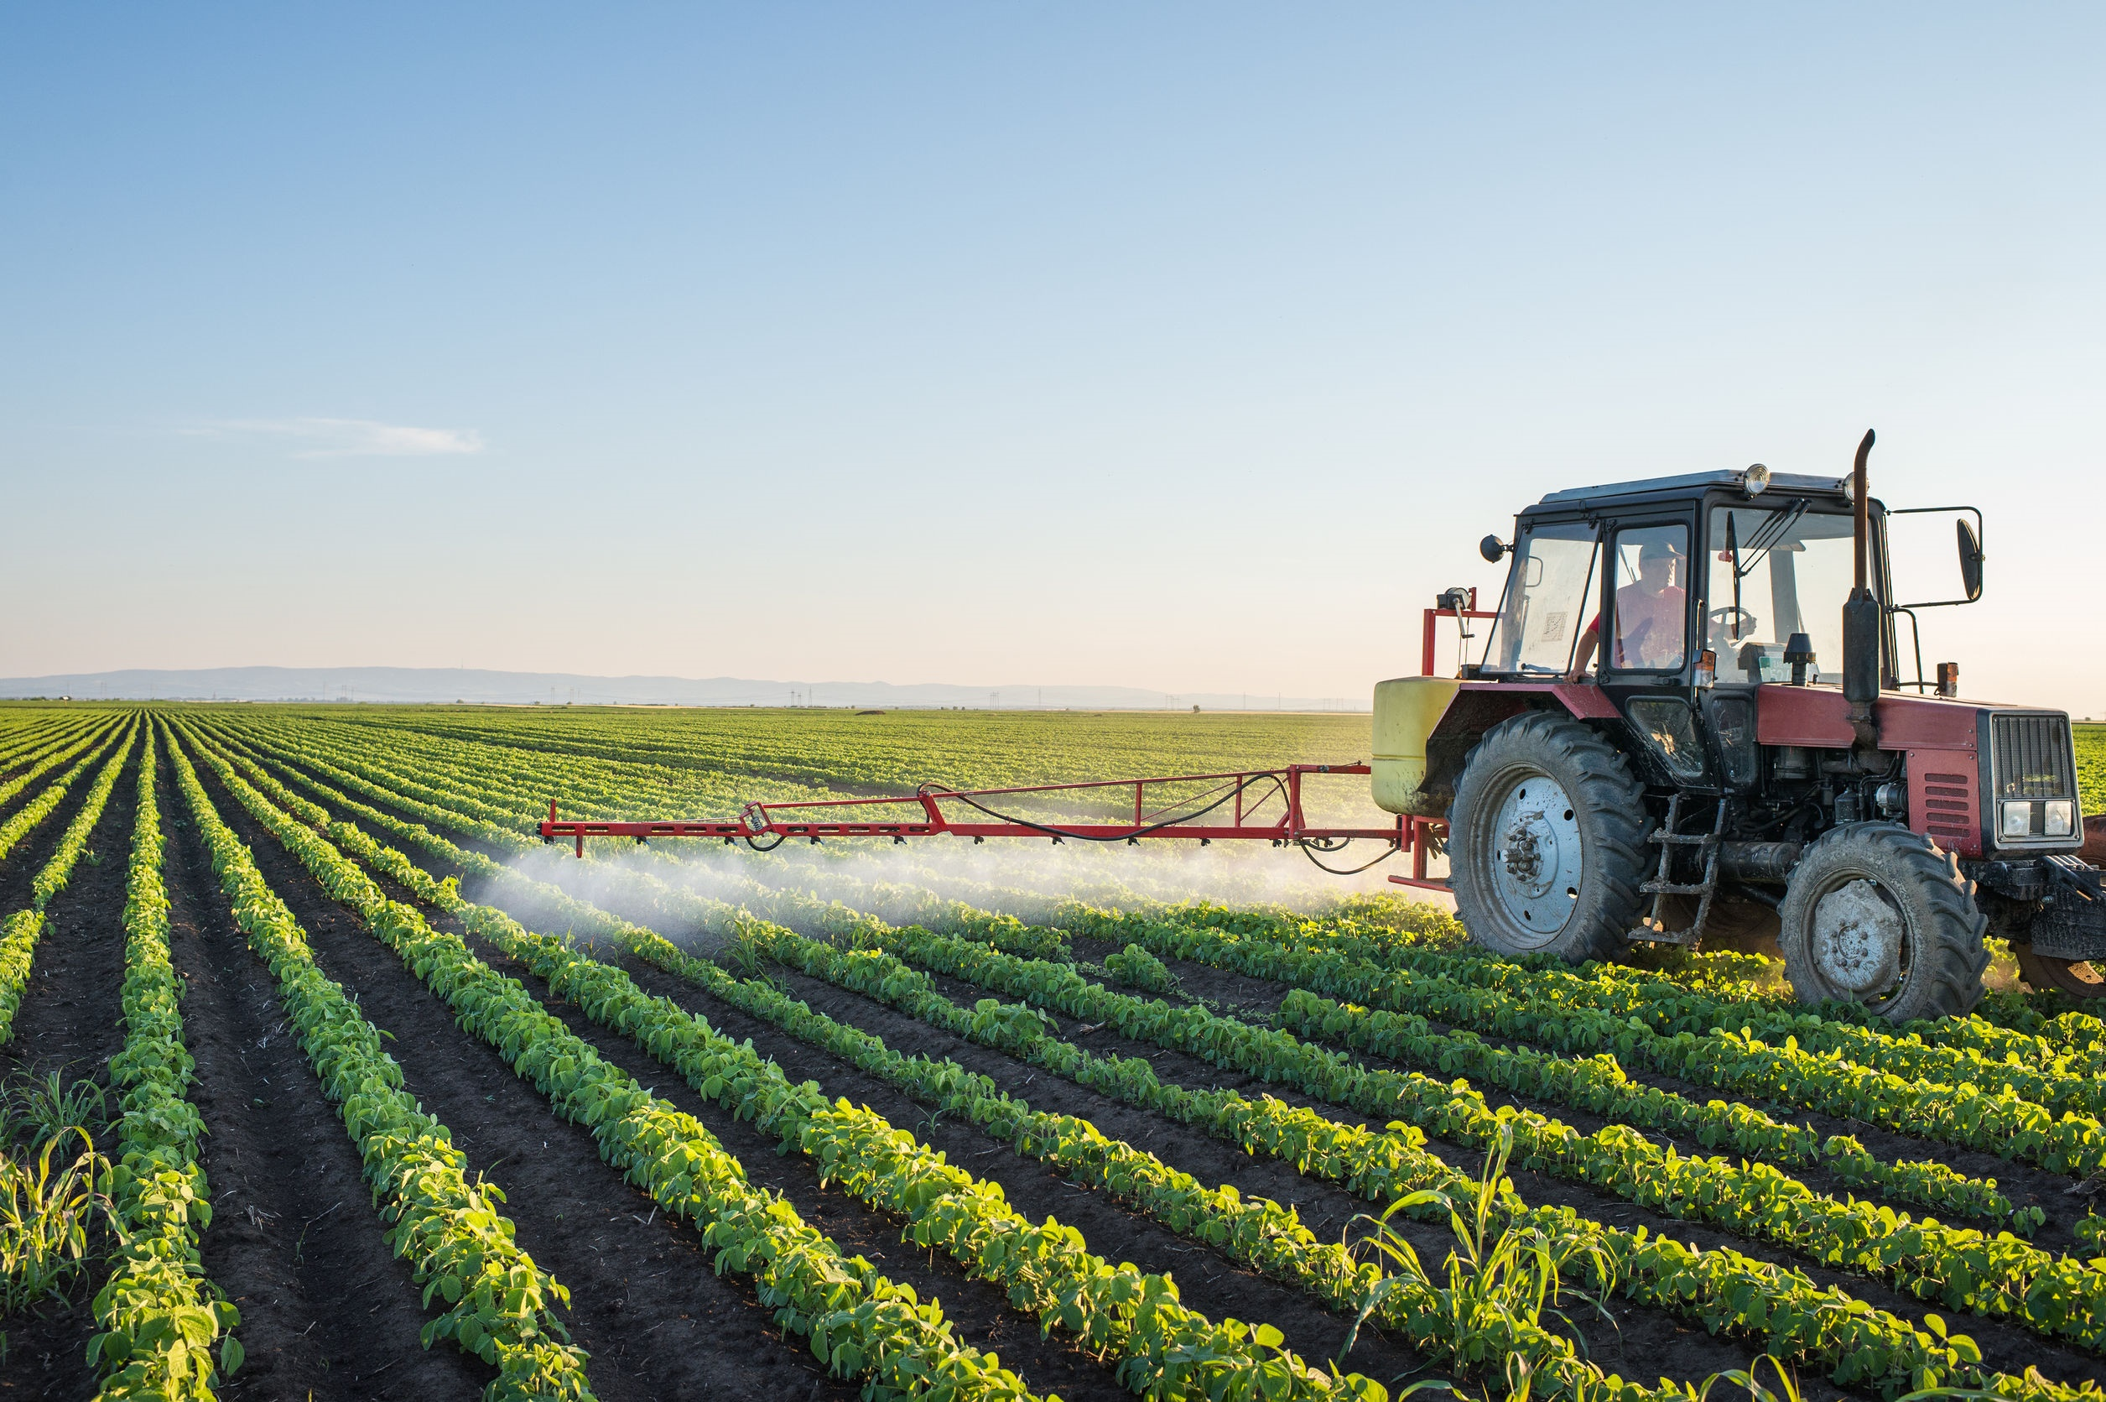
Key Words
third largest industry agriculture acres
taxpaying farmland productive farms
specialty crops scenic vistas fruits
unique flavors vineyards vegetables
Garden State processed growers
shutterstock.com

