Slide 1
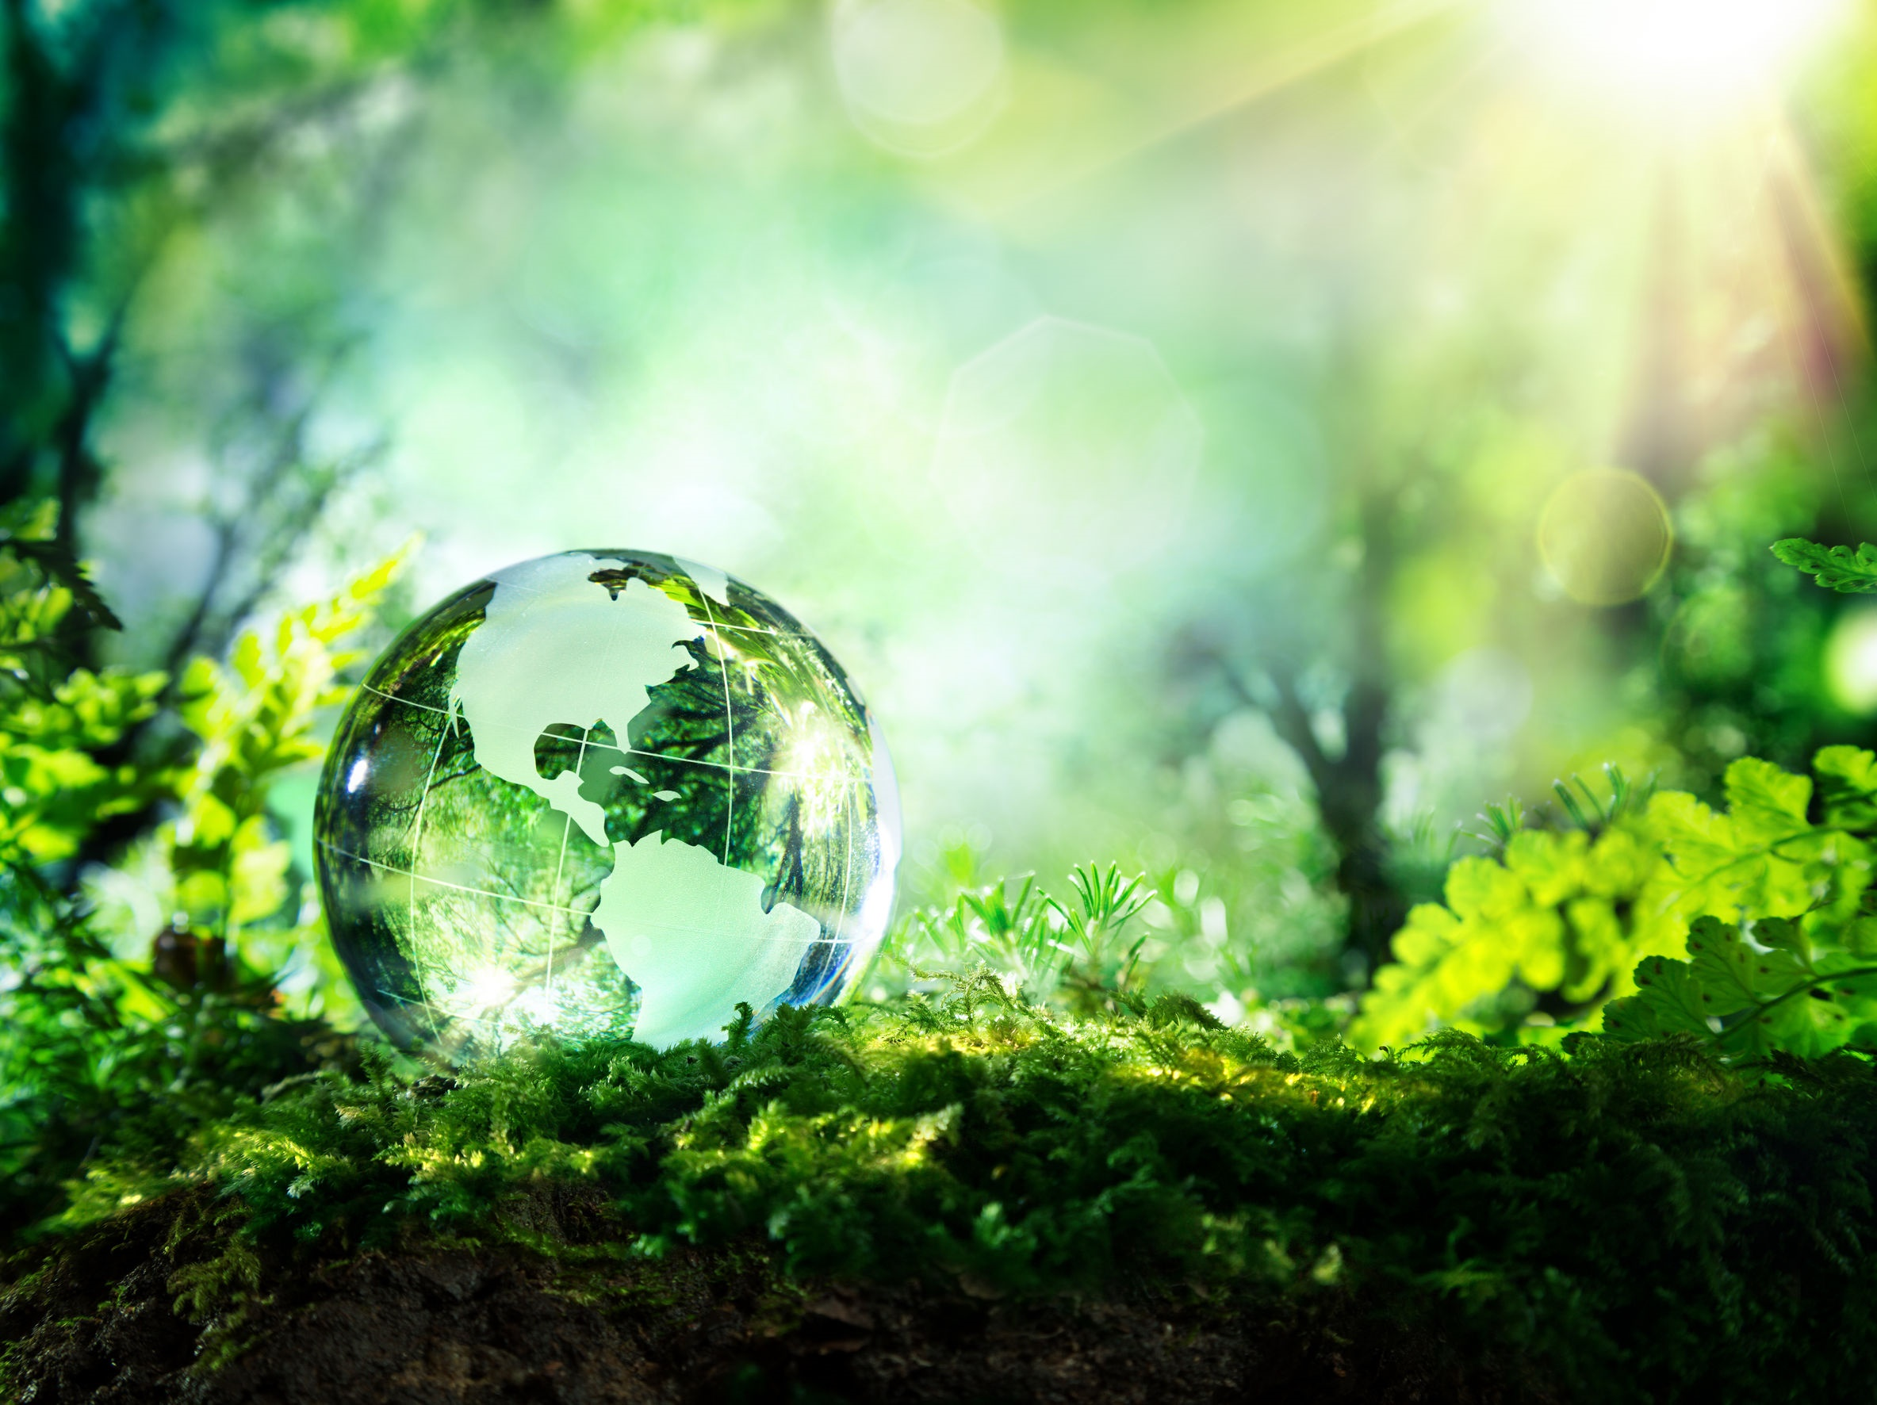
NICKY FIFTH’S NEW JERSEY
N5NJ
SECONDARY PROGRAM
ENVIRONMENTAL SCIENCE
Land

Slide 2
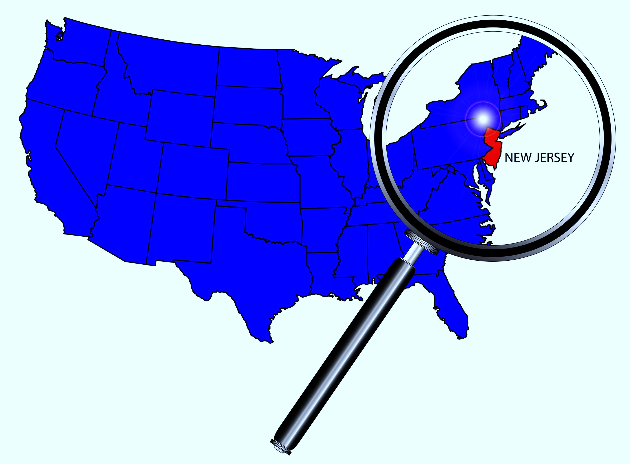
New Jersey
Longitude: 73° 53' 39"W to 75° 35'W Latitude: 38° 55'N to 41° 21' 23"N

Slide 3
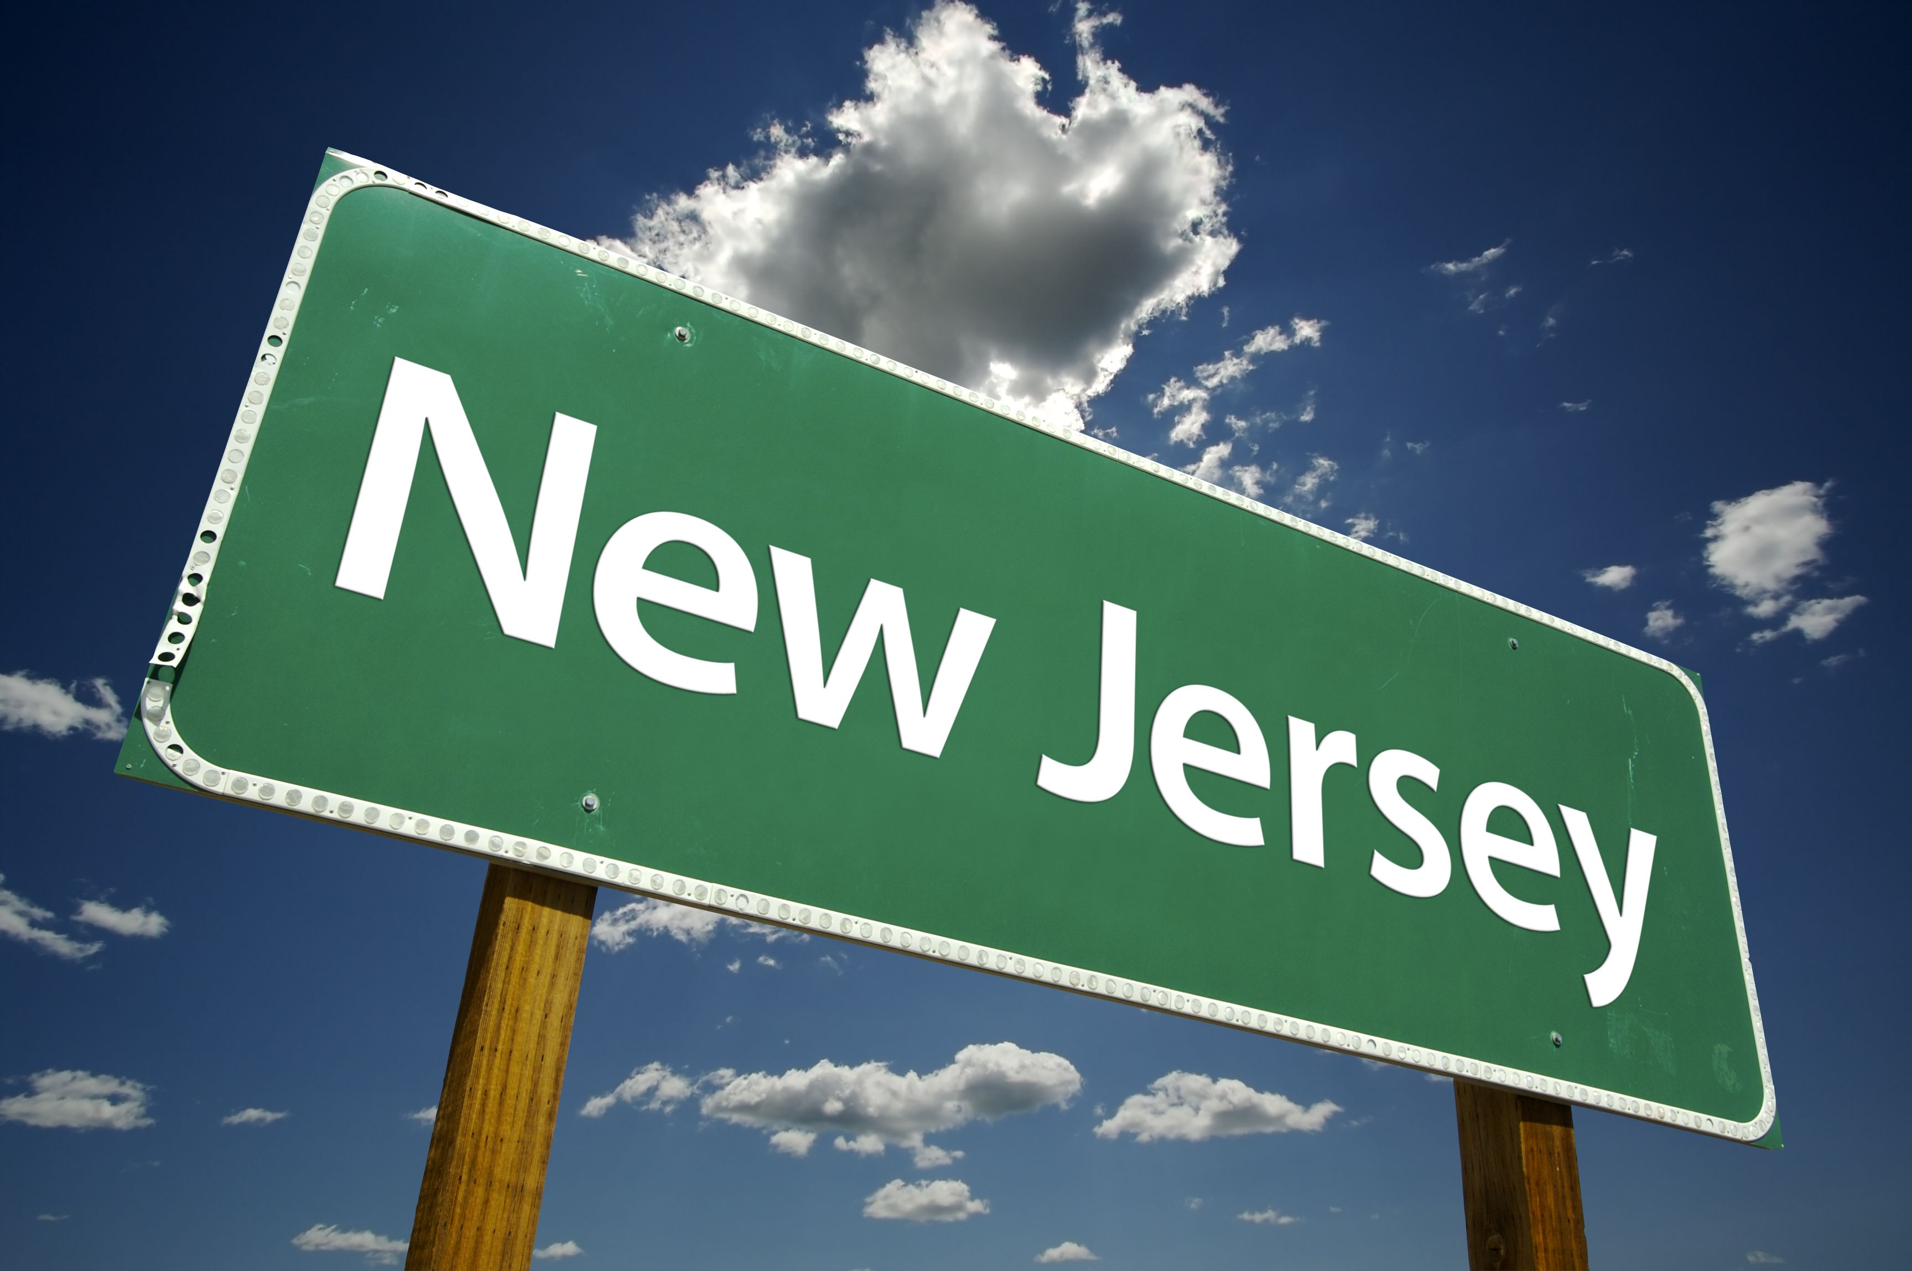
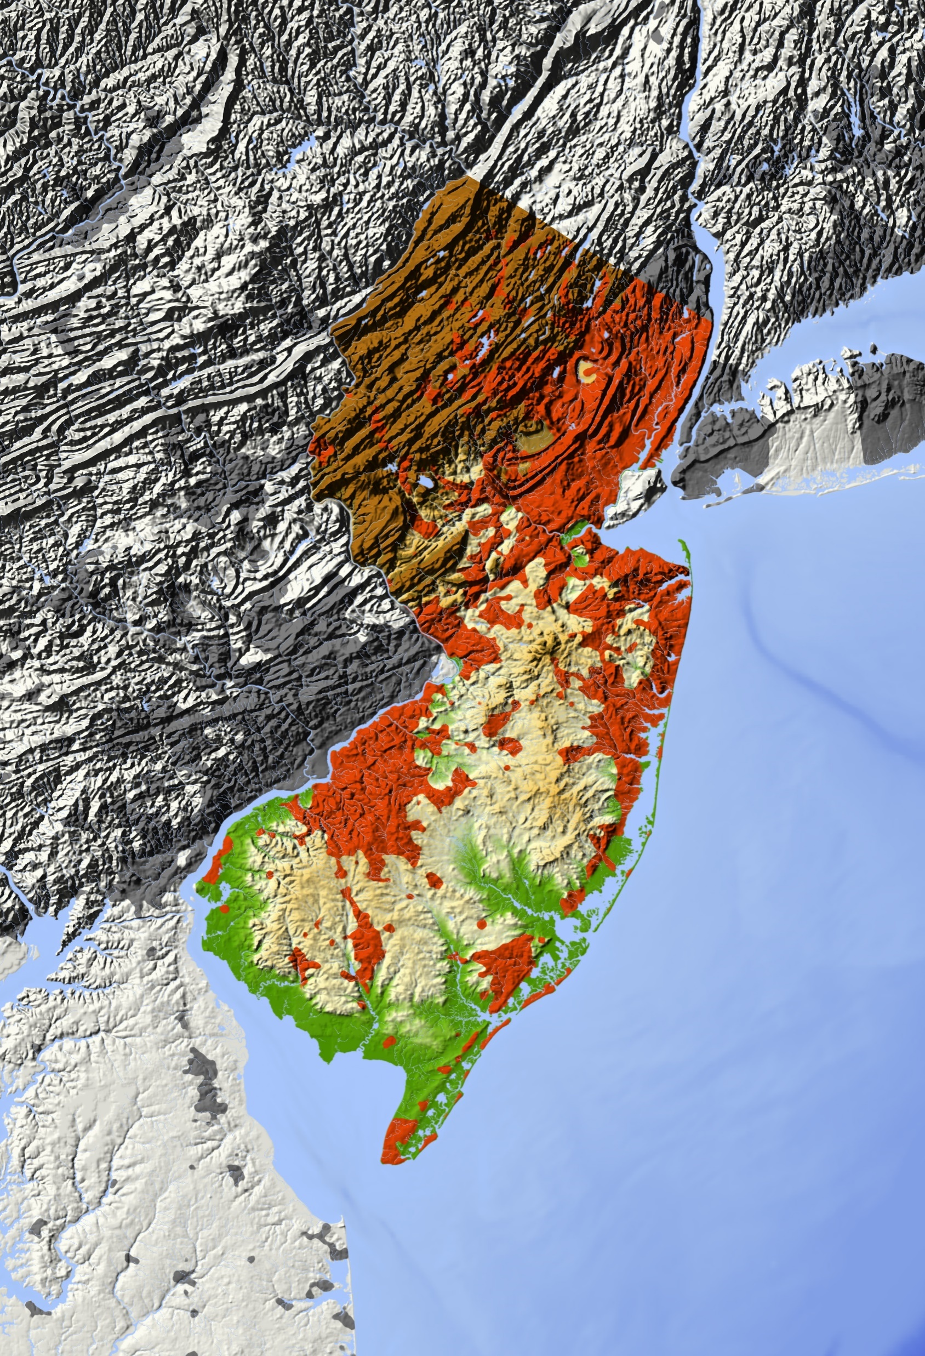
Though not a perfect box, New Jersey is about 150 miles long and 70 miles wide.
123rf.com

Slide 4
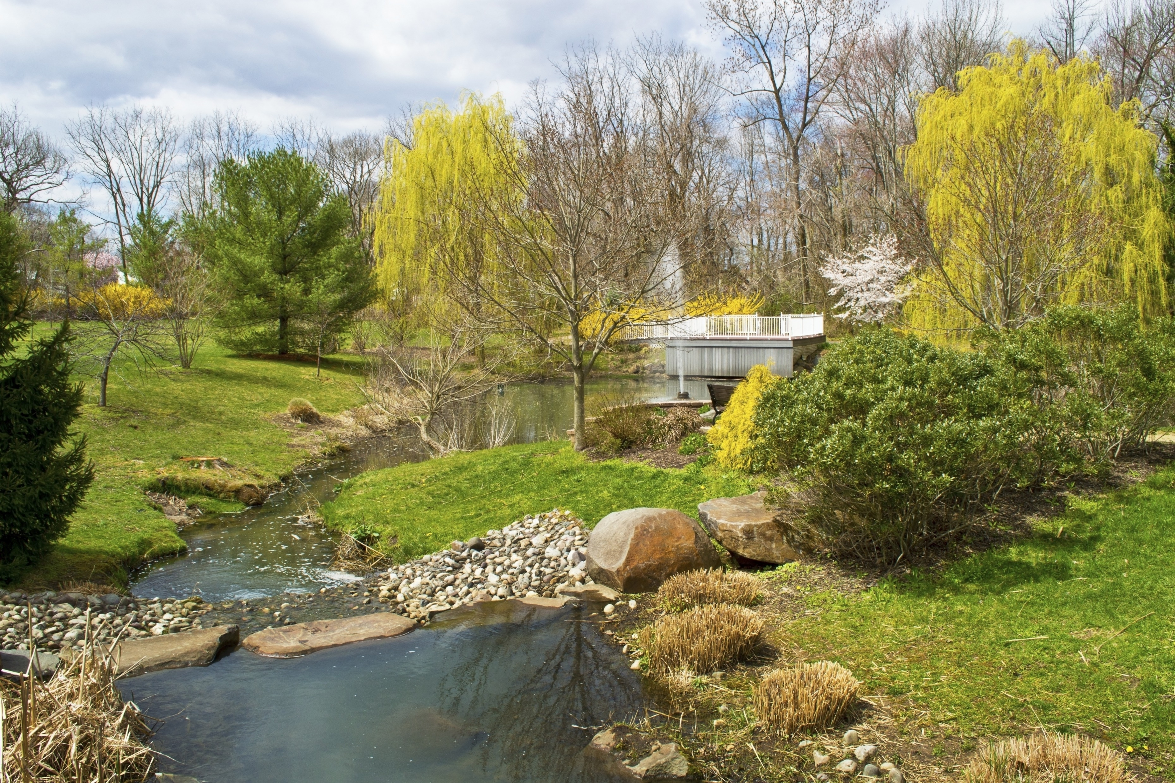
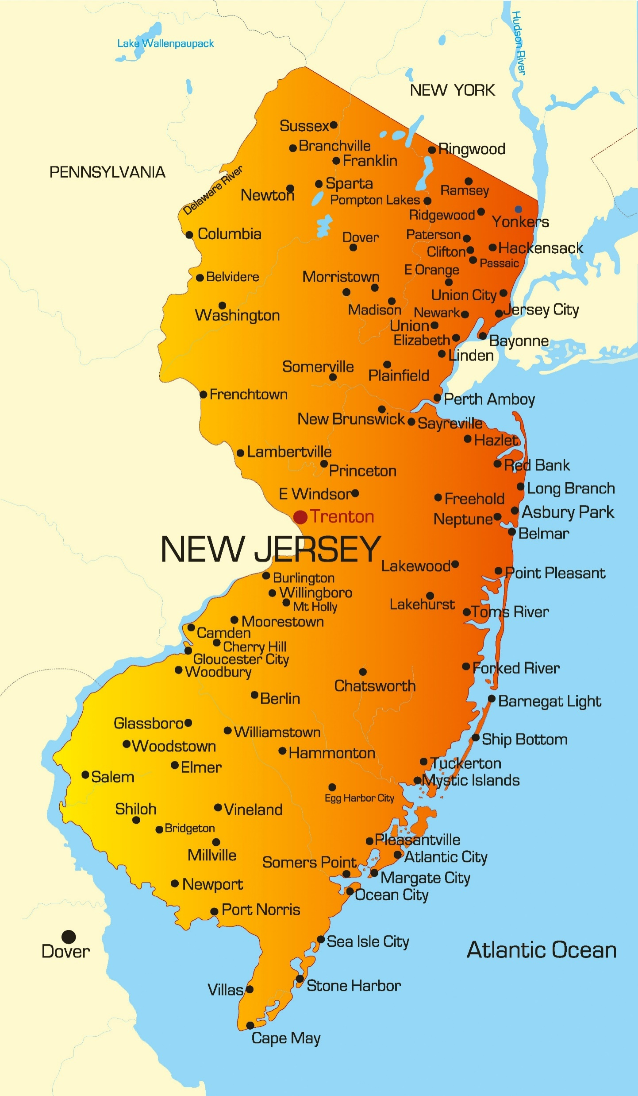
The geographic center of New Jersey is located in Mercer County, 5 miles SE of Trenton.
Longitude: 74° 33.5'W Latitude: 40° 4.2'N
New Jersey is bordered by New York on the north and by the Delaware Bay and Atlantic Ocean on the south.
On the east, New Jersey is again bordered by the Atlantic Ocean.
On the west, New Jersey is bordered by Delaware Bay and Pennsylvania.
New Jersey covers 8,722 square miles, making it the 47th largest of the 50 states.
Sayen Gardens, Hamilton, NJ
123rf.com

Slide 5
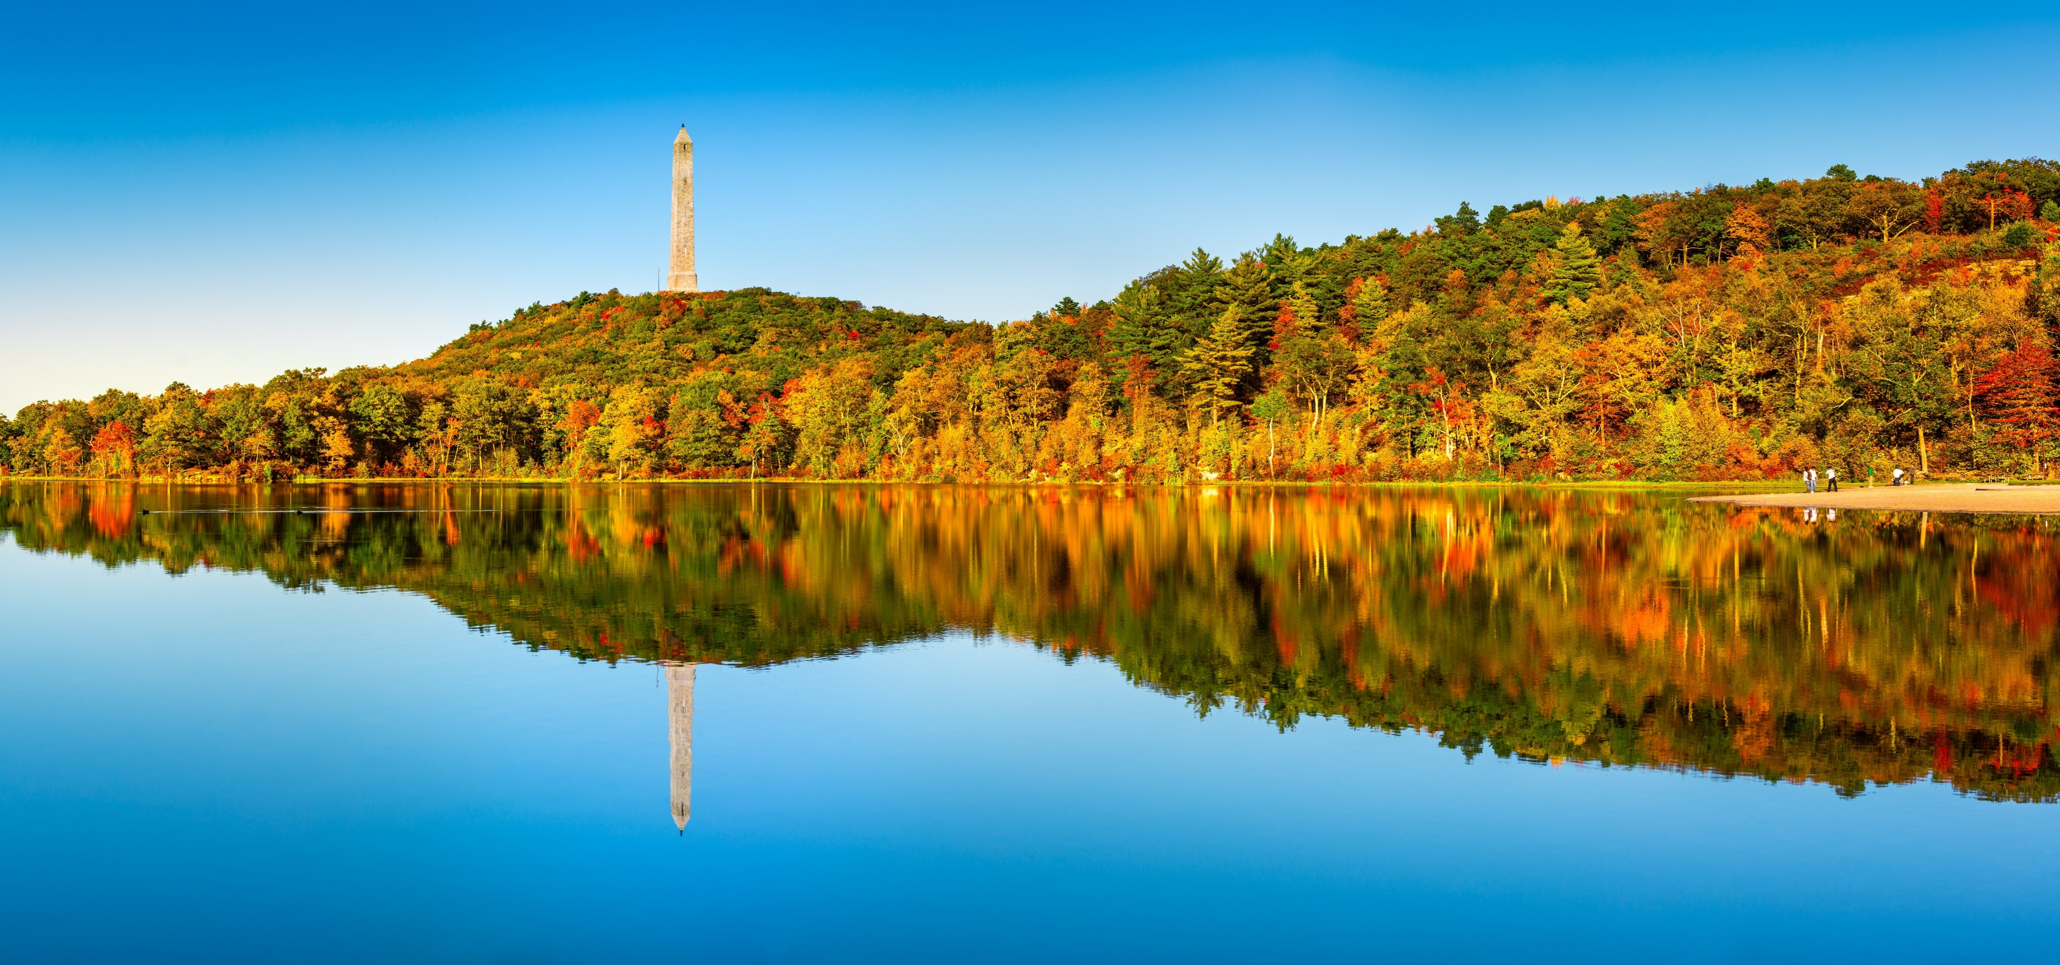
7,419 square miles of New Jersey are land areas.
1,303 square miles of New Jersey are covered by water.
The highest point in New Jersey is aptly named High Point at 1,803 feet above sea level.
123rf.com

Slide 6
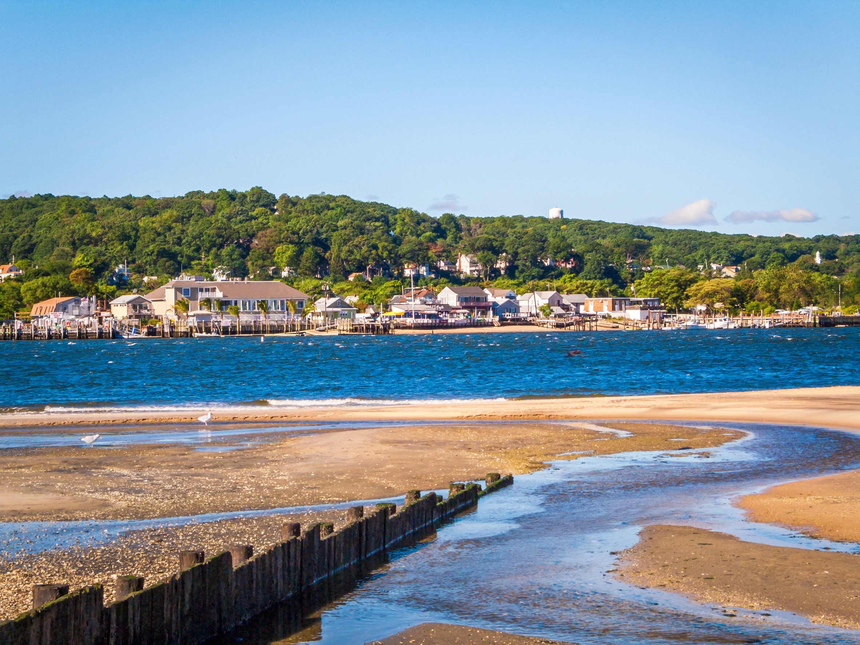
The lowest point in New Jersey is at the Atlantic Ocean; sea level.
The mean elevation of the state of New Jersey is 250 feet above sea level.
123rf.com

Slide 7
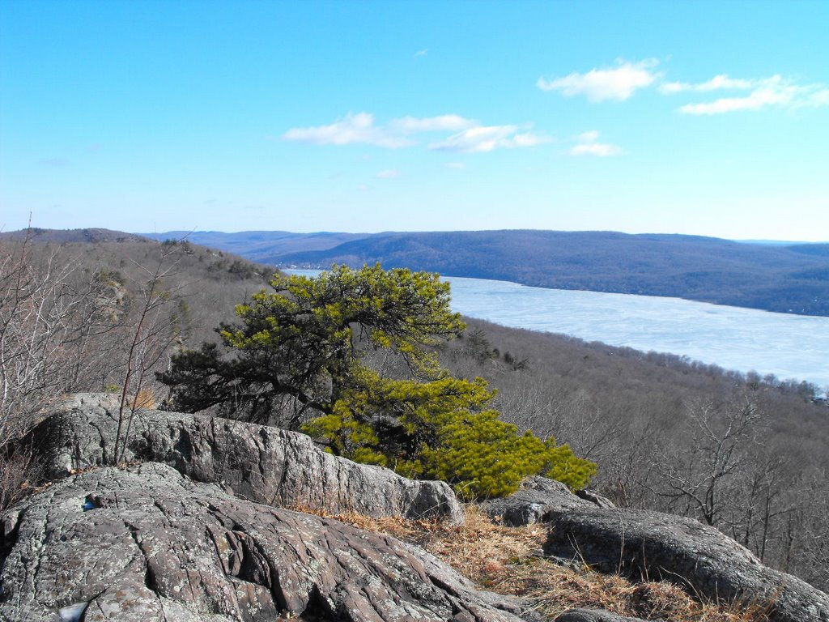
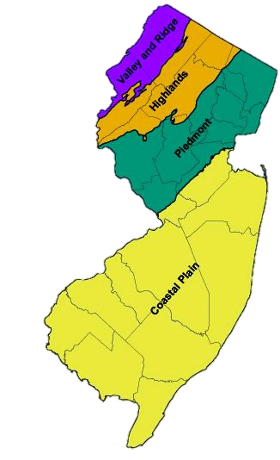
Abraham S Hewitt State Forest
123rf.com

Slide 8
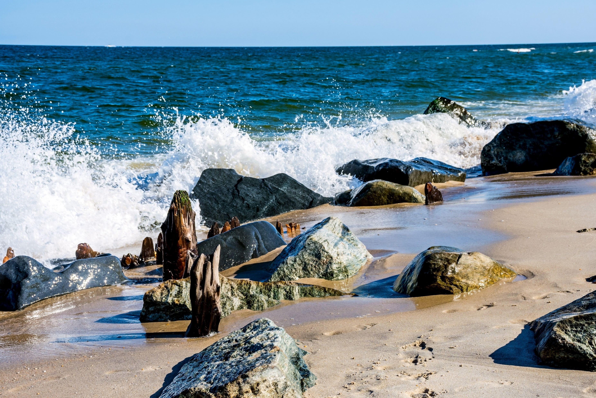
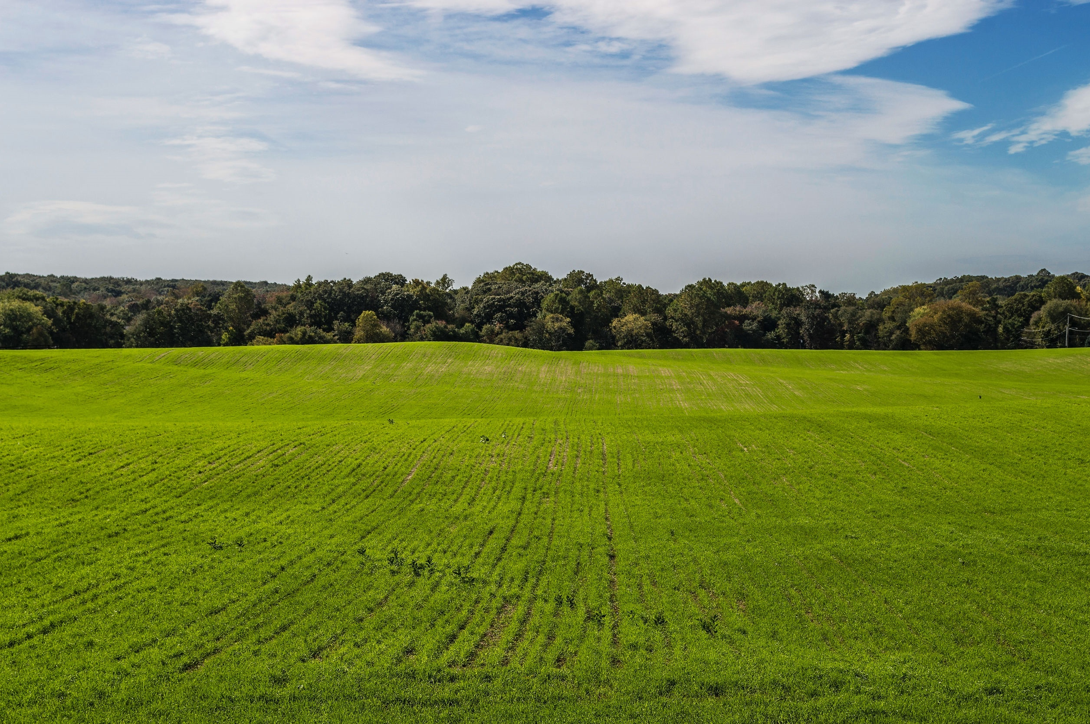
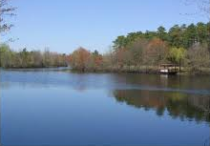
The largest land area, the Atlantic Coastal Plain, covers the southern 3/5 of New Jersey. More than half of this area, characterized by gently rolling hills, is less than 100 feet above sea level. In the east, the landscape consists of pine forests and salt marshes.
Closer to the Atlantic coast, the salt marshes are more plentiful and shallow lagoons and meadows characterize the area. Along the coast, lie New Jersey's resort areas; including Atlantic City, Ocean City, and Cape May. In the west and southwest, along the Delaware River, the fertile soil supports farming.
www.netstate.com
Atlantic Ocean
Corn Field
Pine Barrens

Slide 9
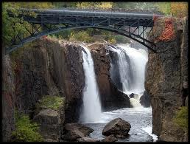
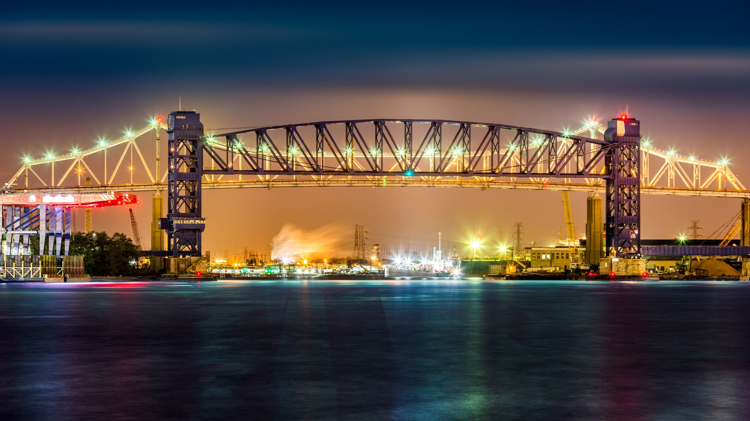
Exchange Place
Jersey City
The Great Falls of Paterson
Goethals Bridge Connecting
Elizabeth and Staten Island
The Piedmont Region lies northeast of the Atlantic Coastal Plain. About 20 miles wide, this area covers only about 1/5 of the state. The Piedmont includes the industrial cities of Elizabeth, Paterson, Jersey City, and Newark. New Jersey's major rivers, the Hudson River, Passaic River, Ramapo River, and Raritan River, are found in this area, supporting the industrial development.
www.netstate.com

Slide 10
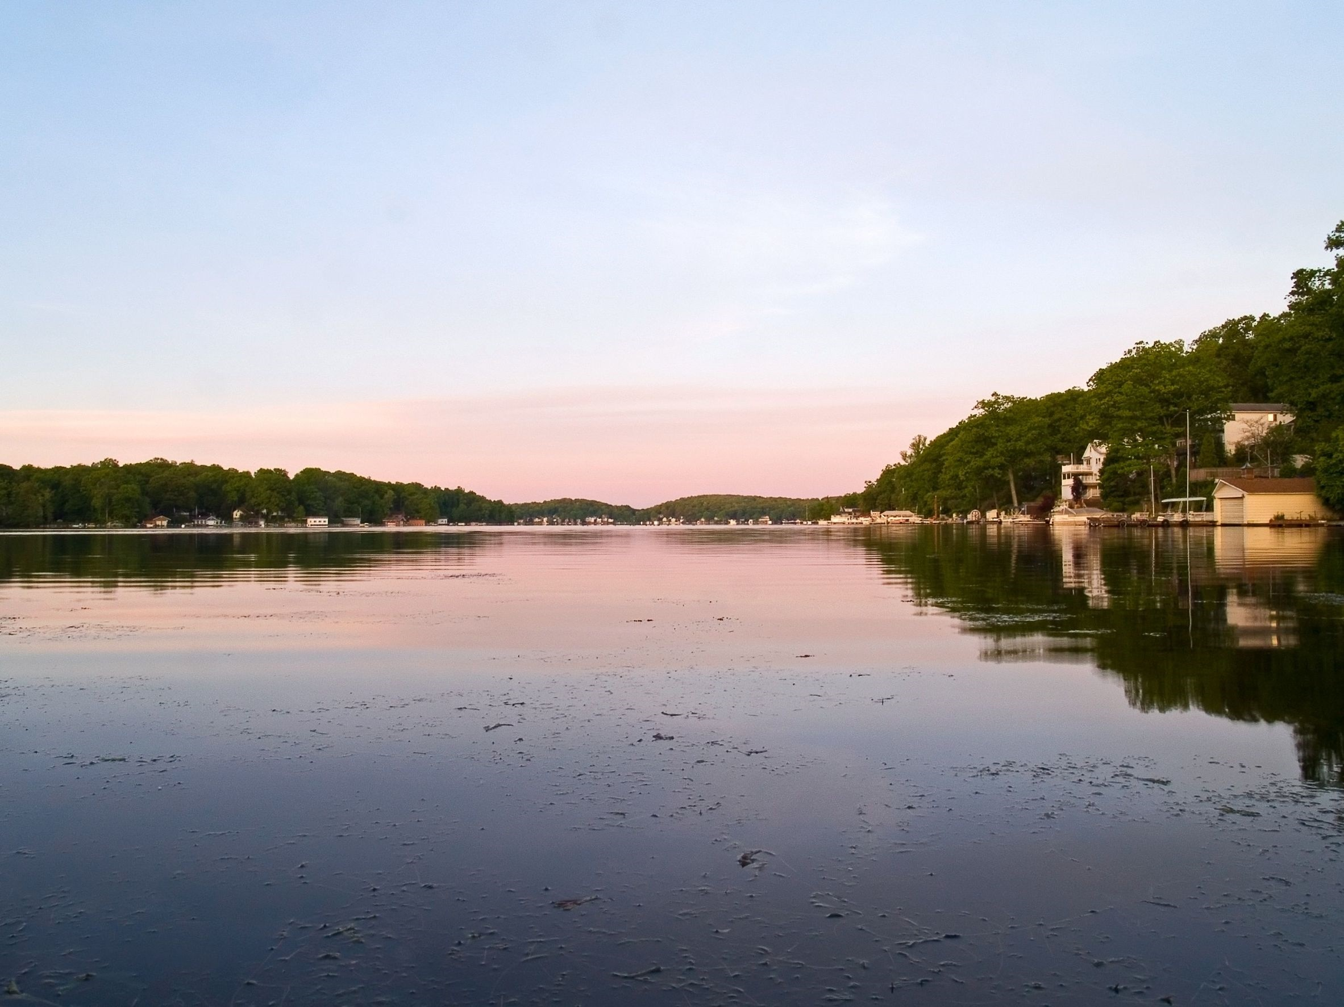
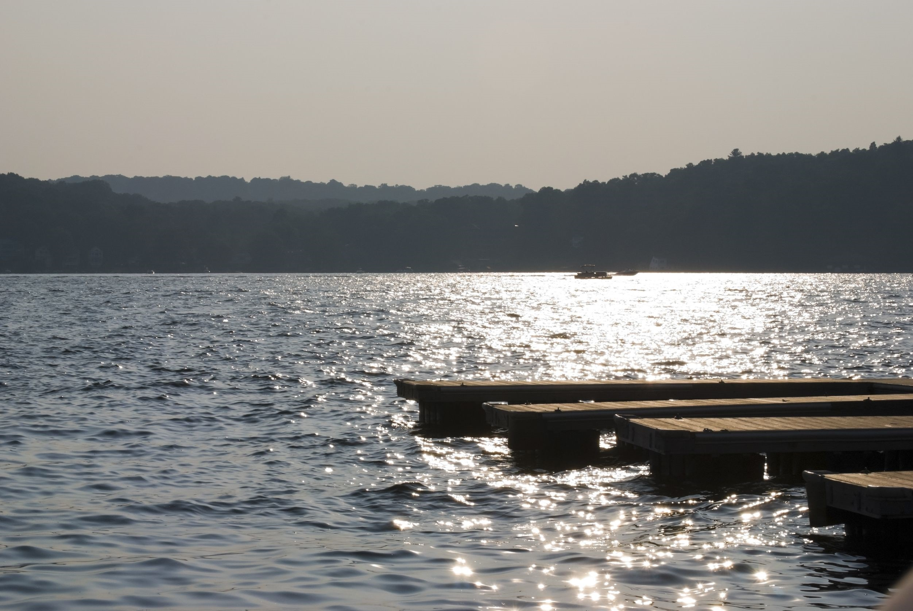
Sunrise at Lake Hopatcong
Sunset on Lake Hopatcong
The Highlands, or the New England Upland, lies south and east of the Appalachian Ridge and Valley Region and west of the Piedmont. They are a series of declining hills consisting of many broad ridges with flat or rounded tops. Narrow valleys separate the ridges.
The state's oldest rocks are found here, as well as most of its lakes and some of its finest scenery. This terrain stretches into Pennsylvania and New York.
www.netstate.com and www.factsfornow.com

Slide 11
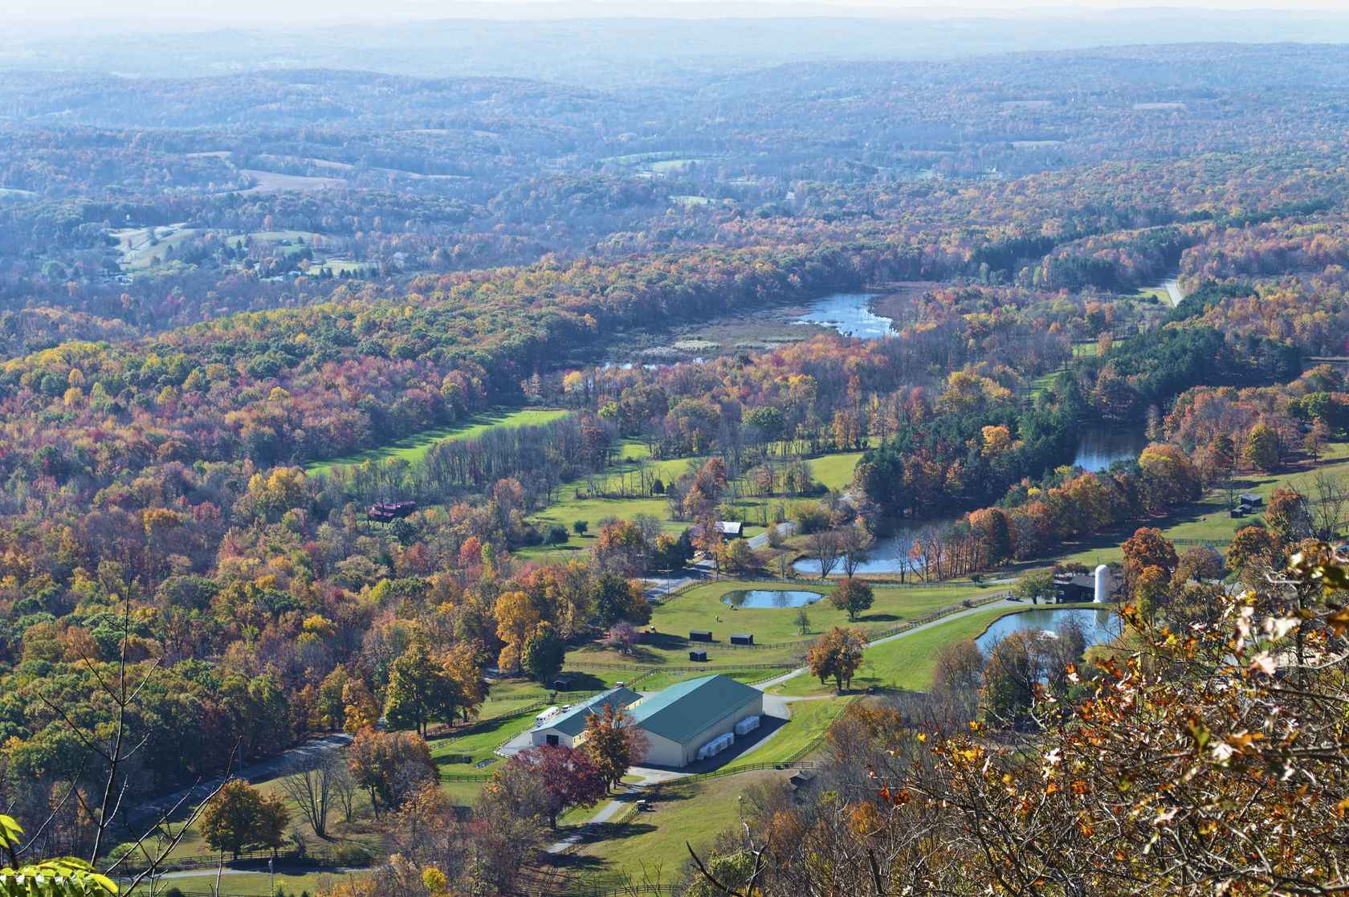
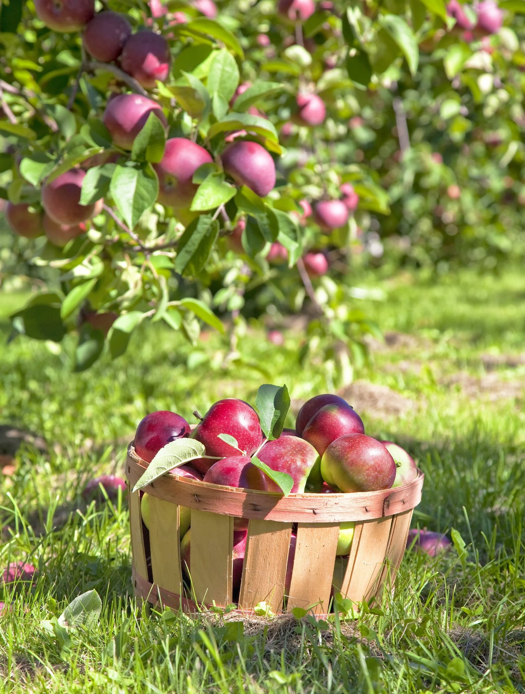
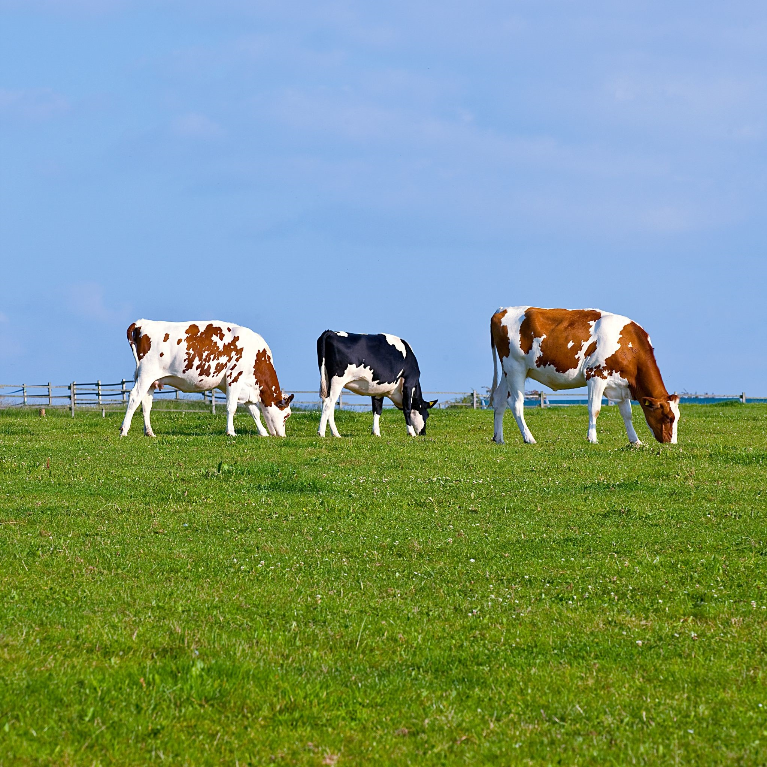
123rf.com
In the northwest corner of the State is the Appalachian Ridge and Valley Region. This mountainous area includes the Kittatinny Mountains that run parallel to New Jersey's northwestern border. The Delaware Water Gap is where the Delaware River has cut through these mountains.
The wide Appalachian Valley lies southeast of the Kittatinny Mountains. Shale and limestone formation can be found in the valley, along with dairy cattle and apple orchards.
(State of New Jersey, OEM)
123rf.com
123rf.com

Slide 12
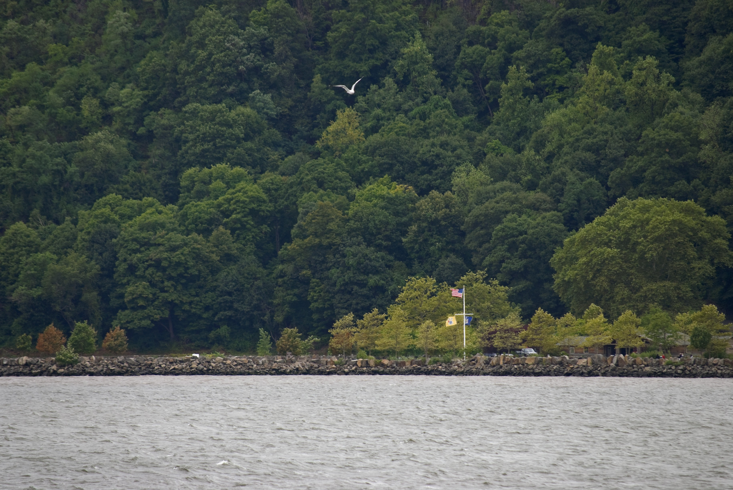
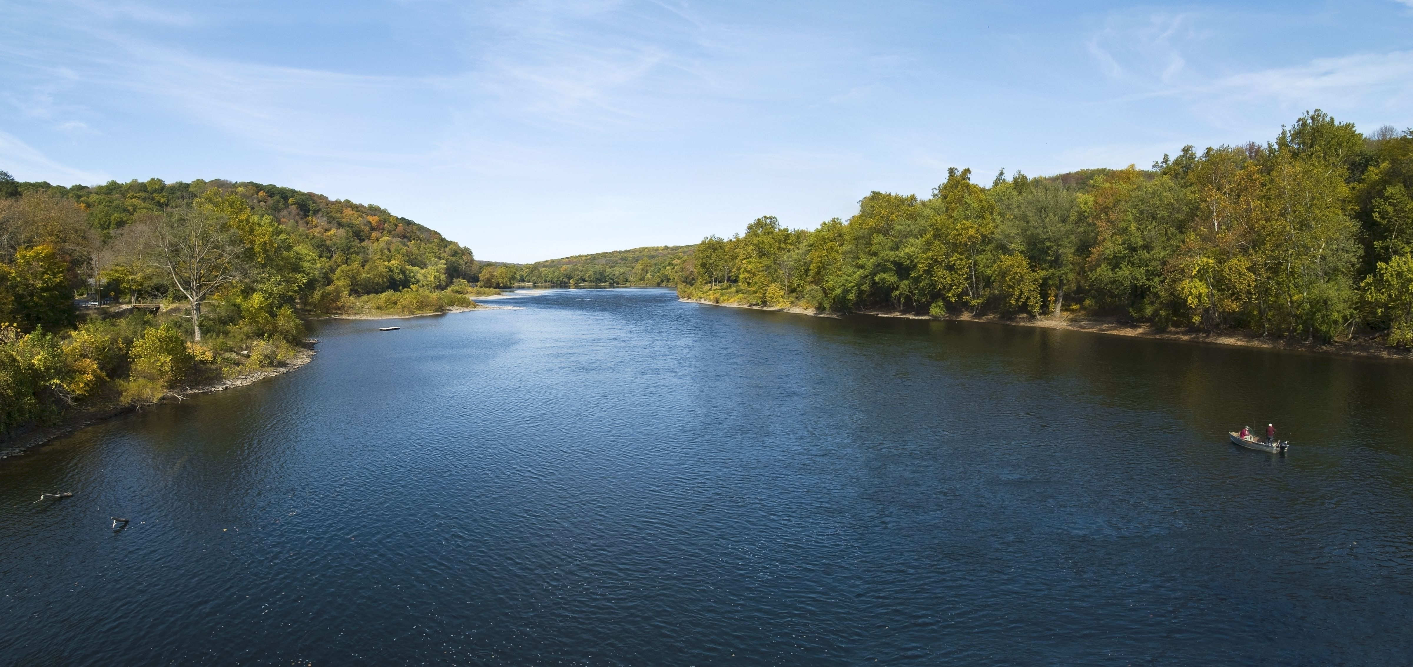
Rivers
The Hudson River
The Delaware River
123rf.com
123rf.com
The most vital New Jersey rivers are the Delaware and the Hudson. While both of these rivers are shared as boundaries with other states, the longest internal rivers are the Raritan and the Passaic. These rivers drain the Highlands and the Piedmont.
Fast-moving streams also flow into the Delaware River from the mountains and highlands. Only one river, however, the Wallkill, flows north. It empties into the Hudson River at Kingston, New York. In southern New Jersey, slow-moving, winding streams move through flatlands and marshes.
www.factsfornow.com

Slide 13
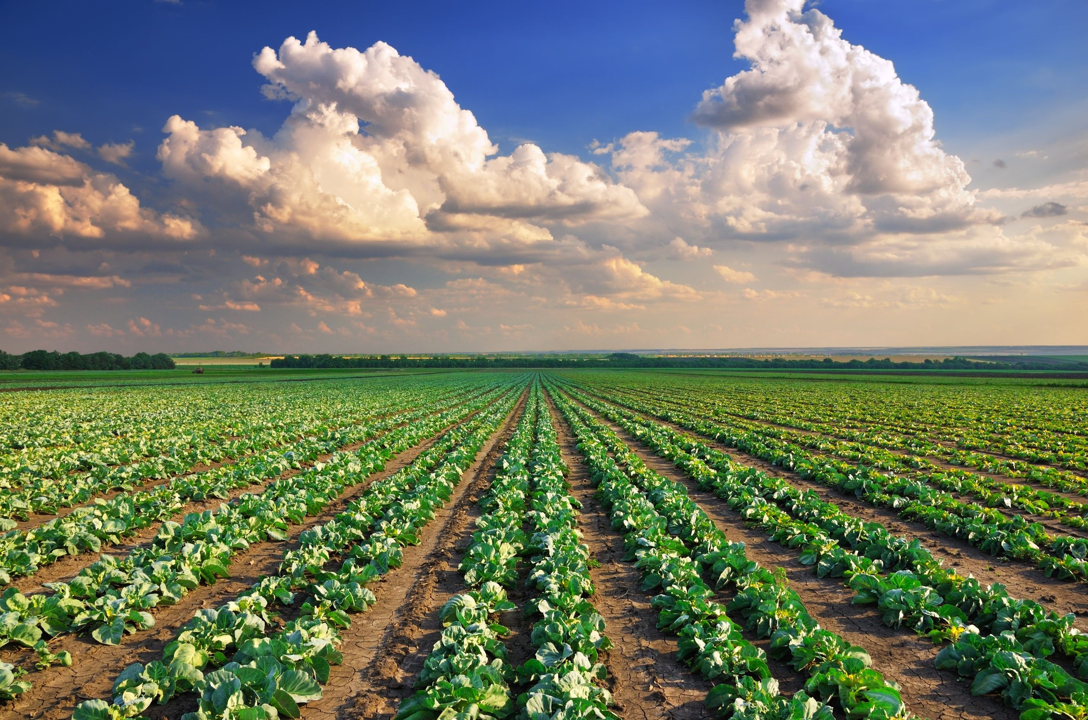
123rf.com
As the Garden State, New Jersey's farmlands are the foundation for a strong agricultural industry and a way of life for generations of farm families.
Scenic landscapes of green, productive fields are an important part of what makes New Jersey a desirable place to live and work.

Slide 14
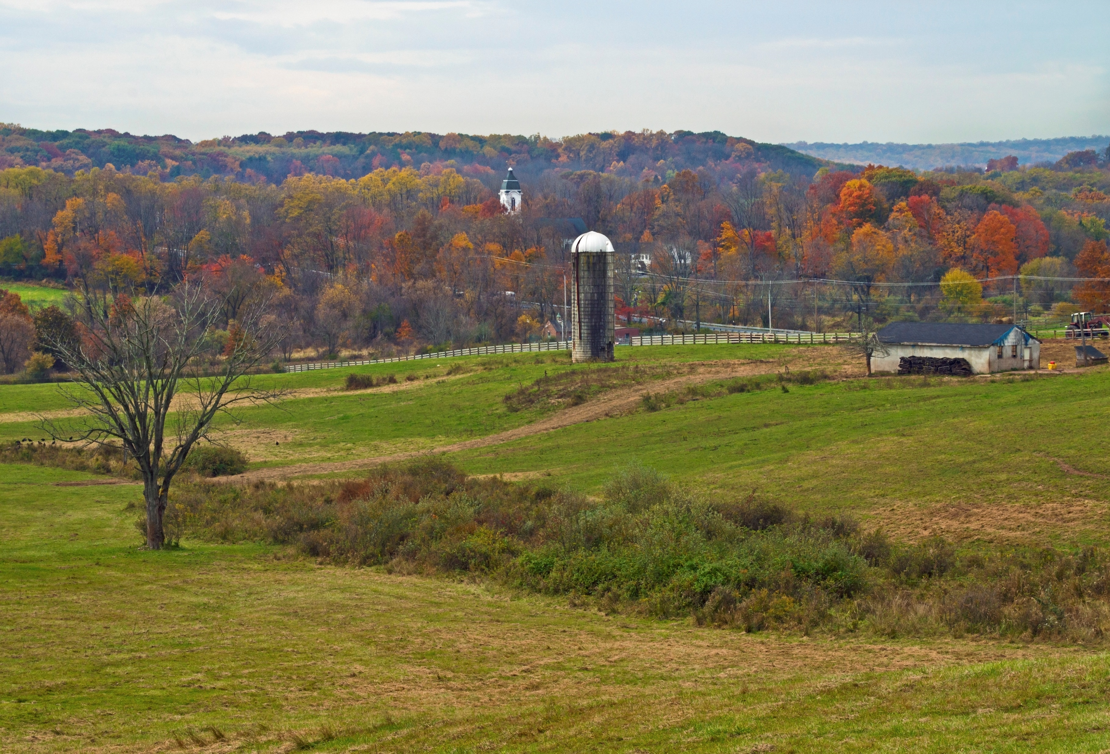
Food and agriculture are New Jersey's third largest industry. As of 2015, the state has 9,100 farms covering 715,000 acres. Sales generated in 2014 totaled $1.02 billion.
Retaining productive, taxpaying farmland is critically important to all New Jersey residents since agriculture is the largest single source of the scenic vistas we all enjoy throughout the year.
http://jerseyfresh.nj.gov/facts/
123rf.com

Slide 15
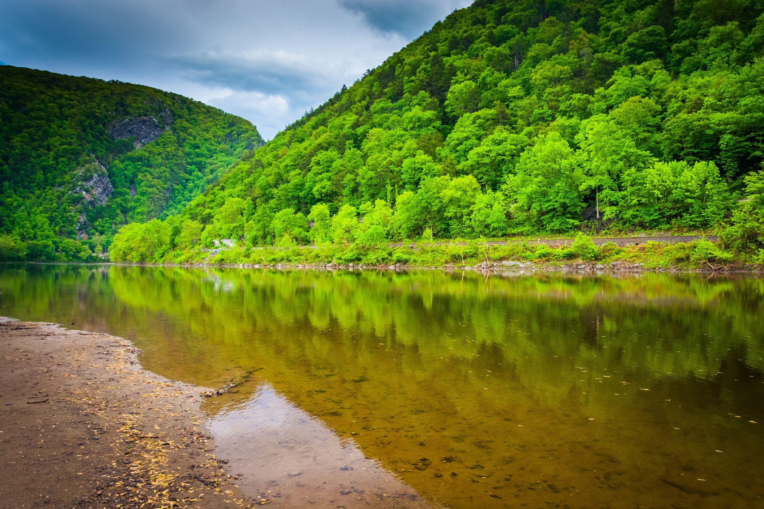
The most prominent geographical features of Northern New Jersey are the Kittatinny Mountains, and its foothills in the NJ Highlands, composed of the Pohchuck, Wawayanda, Bearfort, and Ramapo Ridges.
They are home to some of the most dense hardwood forests in North America. Between the Kittatinnies and Highlands lies the Kittatinny Valley. This area is known for its many rivers, horse ranches, dairy farms, and ski resorts.
http://www.newjerseyscenic.com/nj_mountains.html
123rf.com

Slide 16
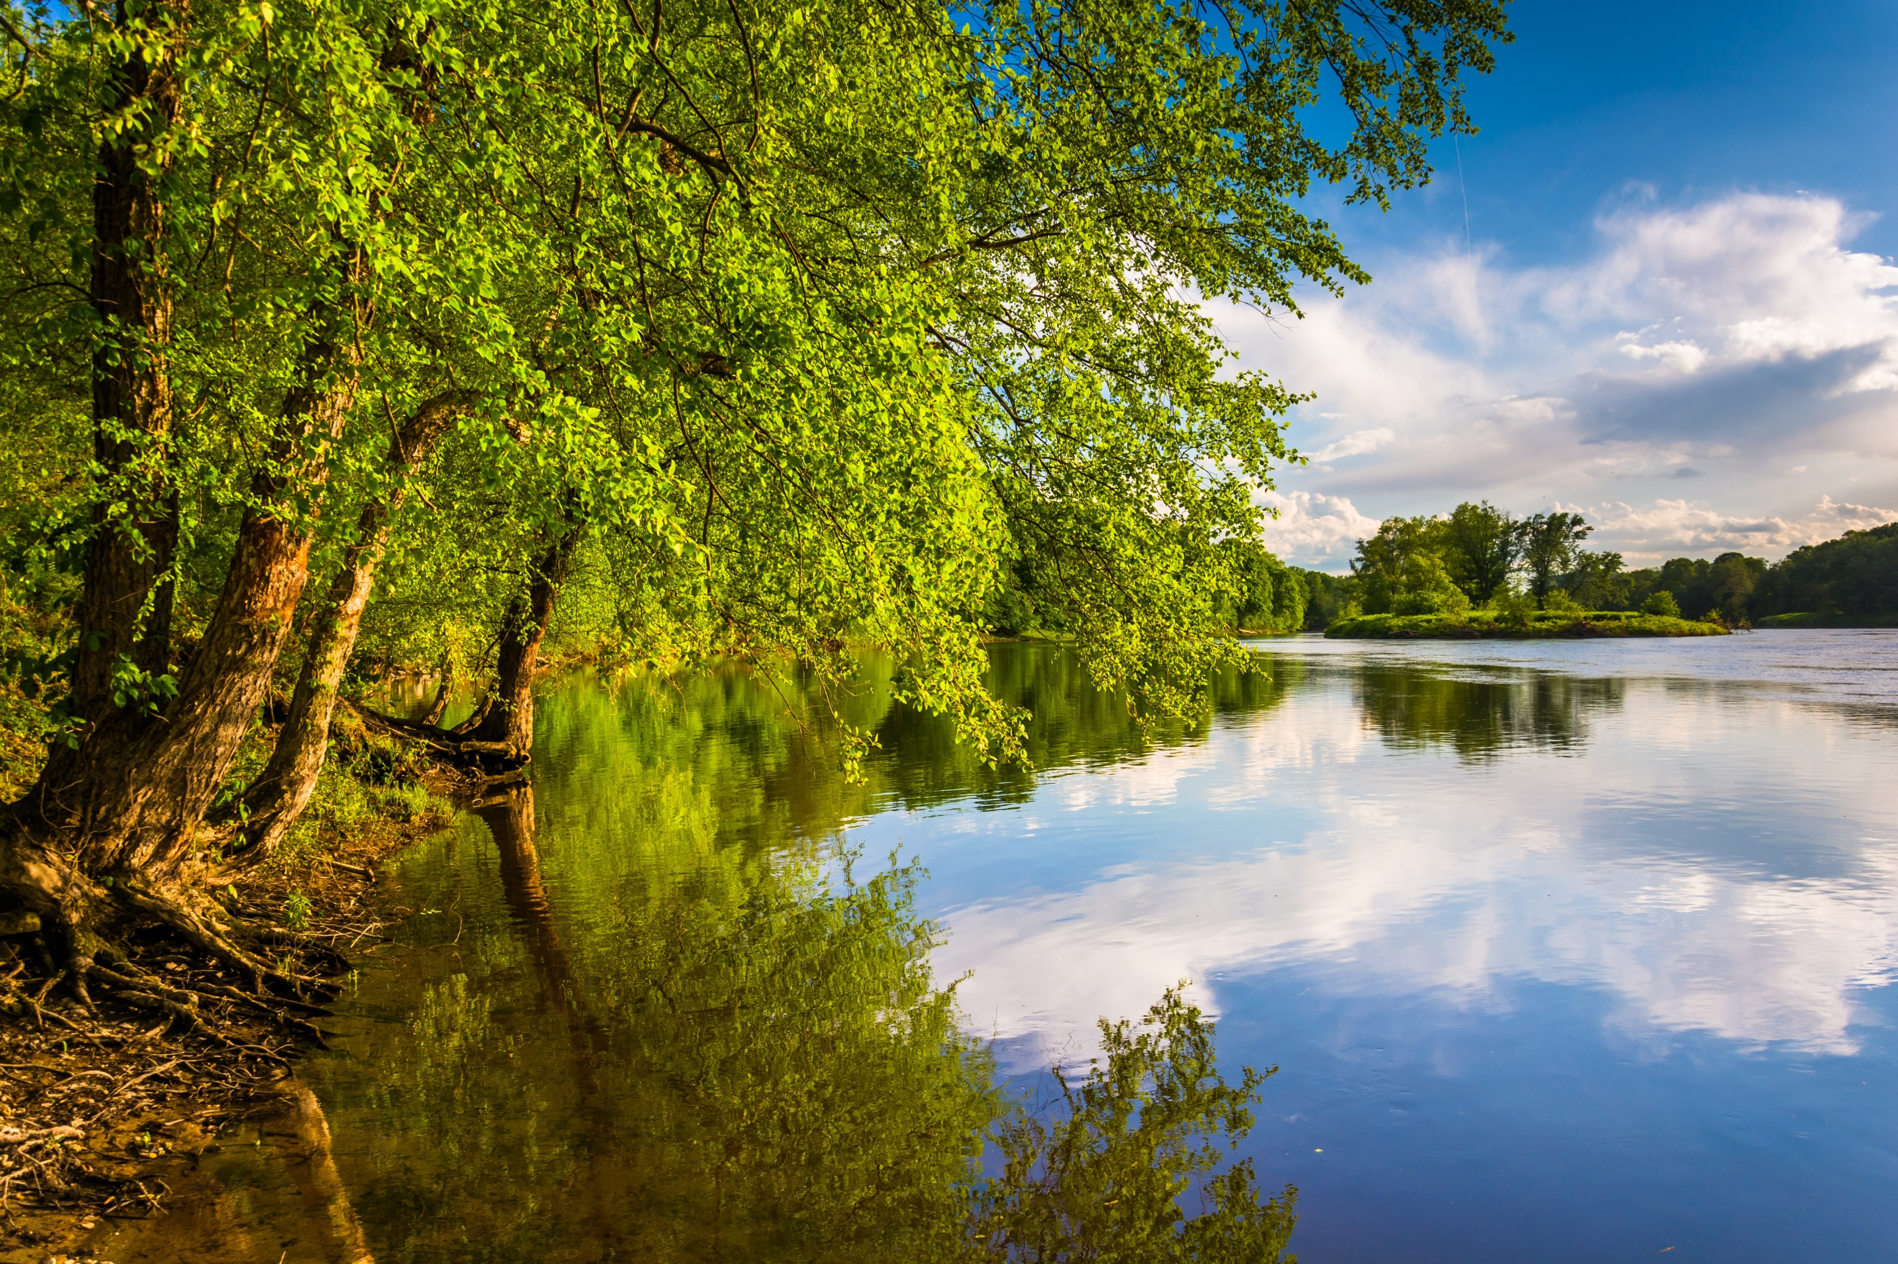
Seventy-two miles of the Appalachian Trail lay in the Northwest corner of New Jersey. It enters the state as it crosses the Delaware Water Gap, near Dunnfield Creek and Mt. Tammany. On its way along the Kittatinny Ridge, the Appalchian Trail runs through Worthington State Forest where it passes by Sunfish Pond and Crater Lake.
It then goes through Stokes State Forest as it crosses through Sunrise Mountain, and continues upward and northeast along the Kittatinny Ridge for about 40 miles. The Kittatinny Valley (also called the Limestone Valley) lies almost directly to the east of the trail, while the Delaware Water Gap lies to its west.
http://www.newjerseyscenic.com/nj_mountains.html
123rf.com

Slide 17
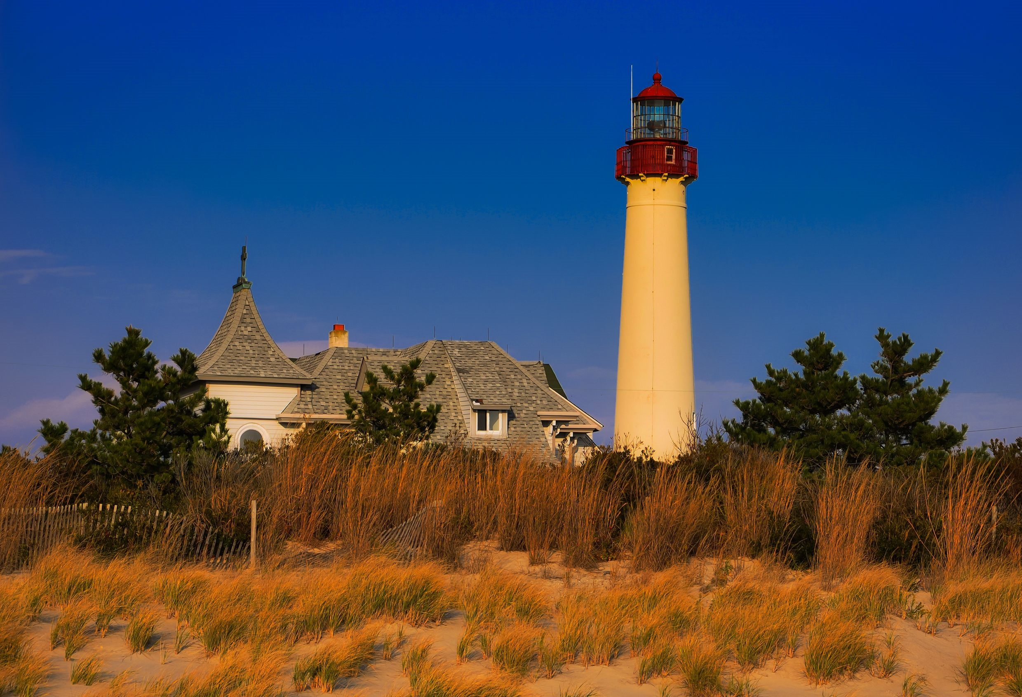
From Sandy Hook to Cape May, New Jersey’s unmatched beaches boast beautiful barrier islands and bays dotted with majestic lighthouses, fishing villages and scenic views.
http://www.visitnj.org/nj
123rf.com

Slide 18
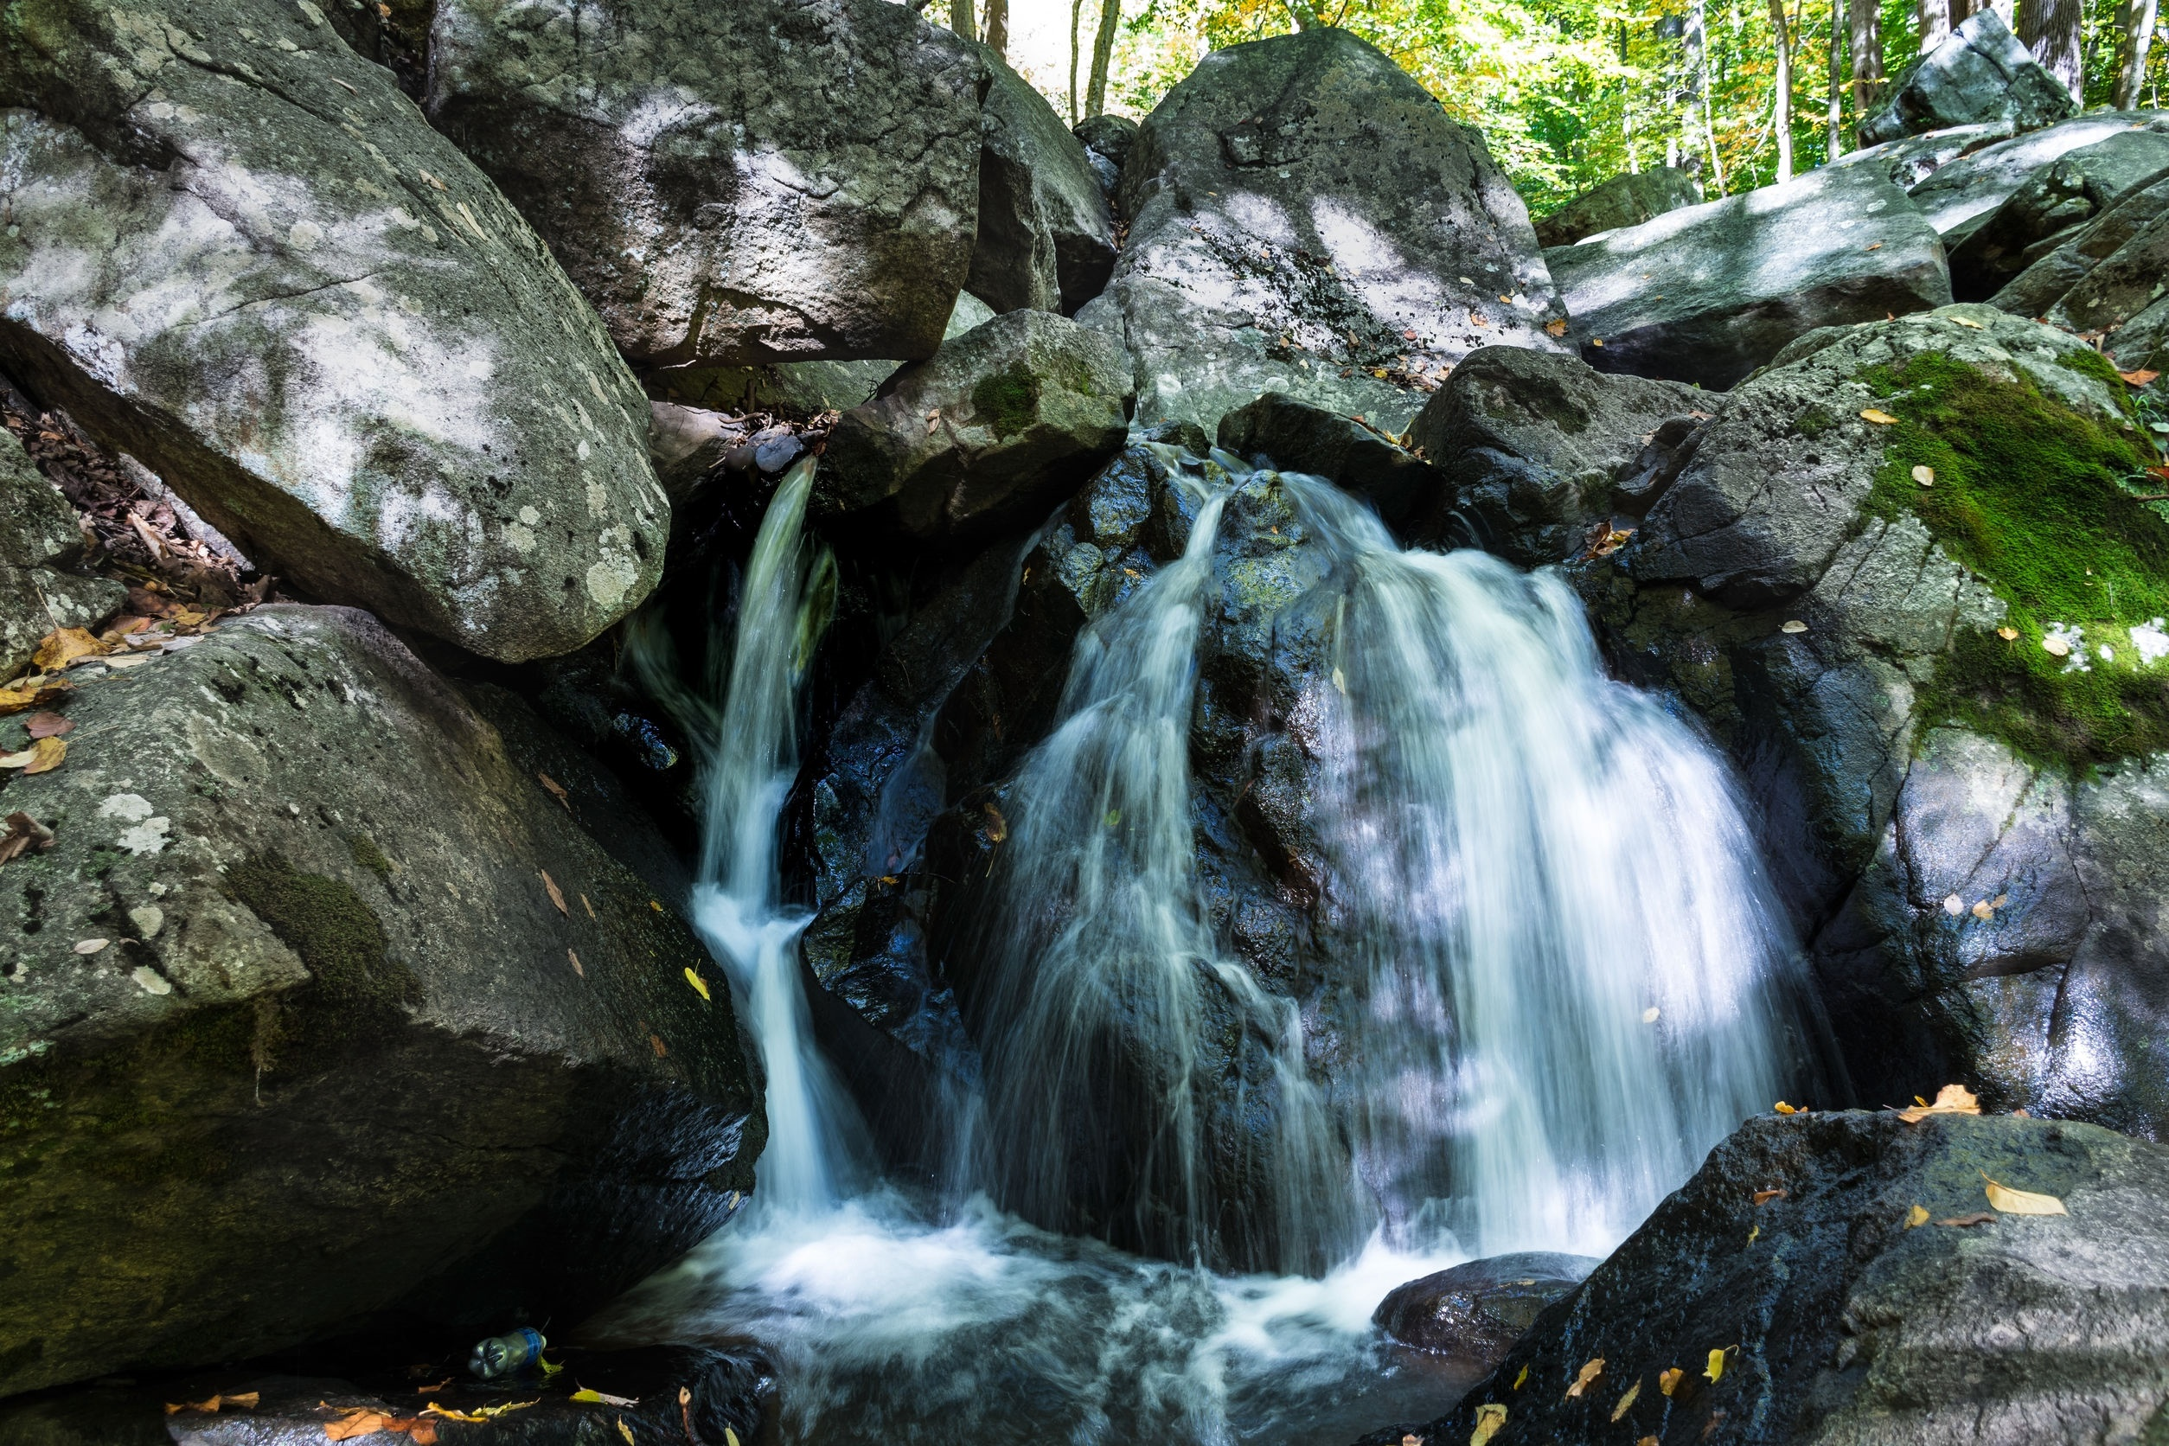
As varied and diverse as our robust population, New Jersey’s land is a diverse mix of mountains, farmlands, rolling hills, and a magnificent coast.
123rf.com

Slide 19
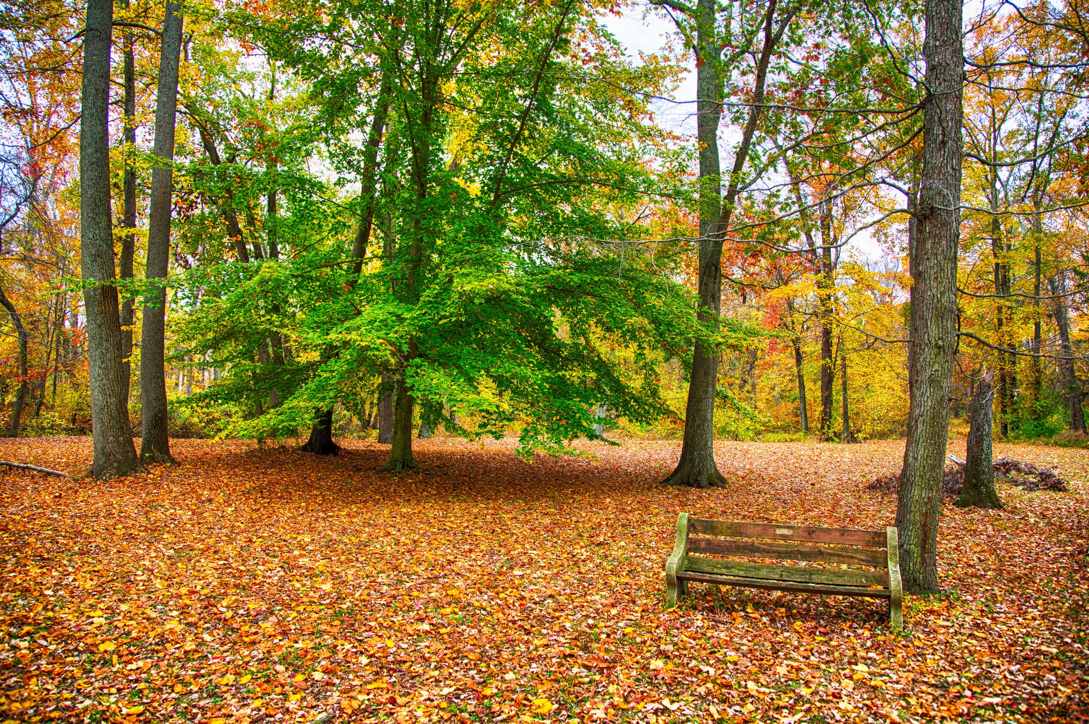
Key Words
geographic center bordered sea level
salt marshes square miles terrain
mean elevation longitude latitude
industrial development internal rivers parallel
Scenic landscapes productive fields agriculture

