Slide 1
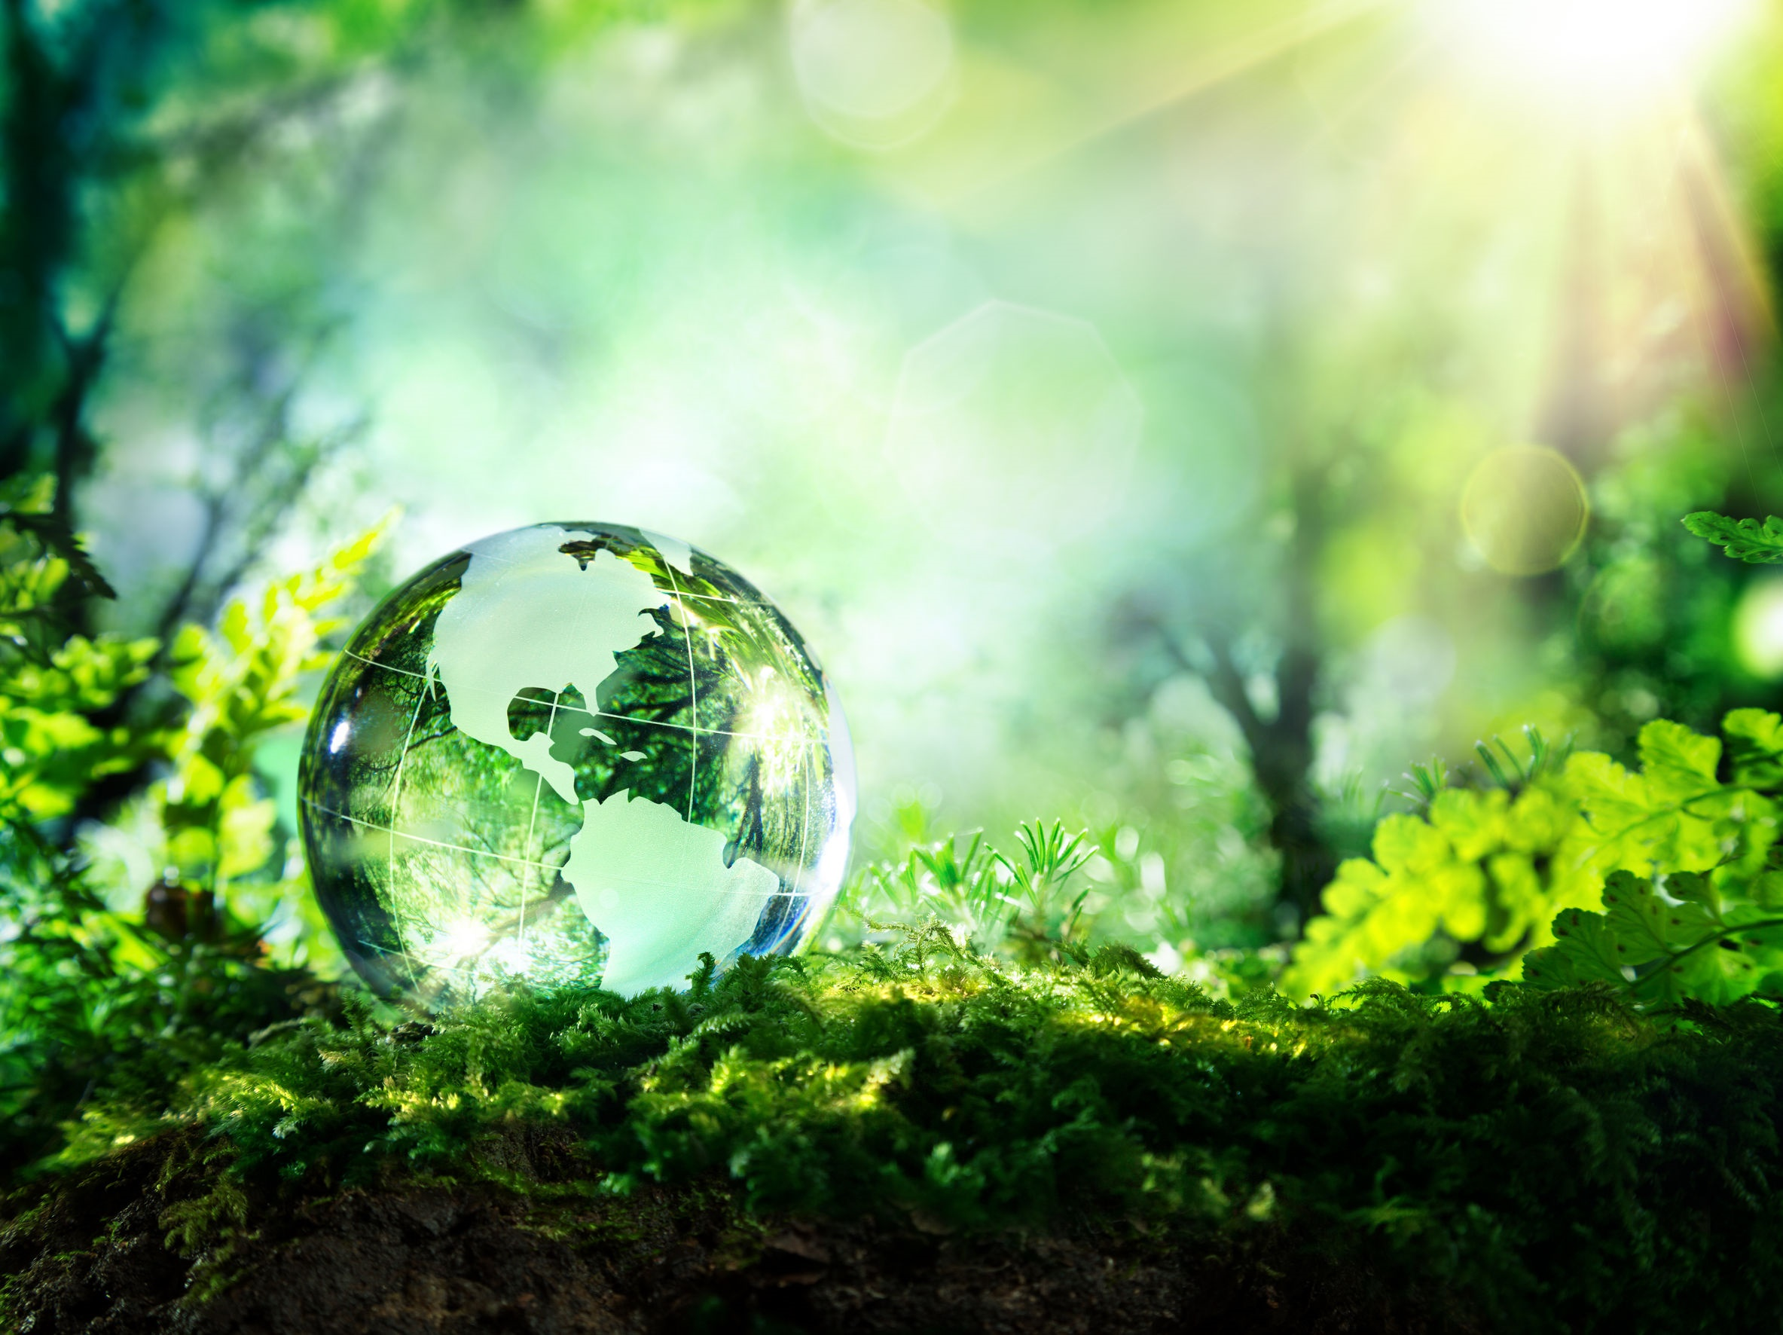
NICKY FIFTH’S NEW JERSEY
N5NJ
SECONDARY PROGRAM
ENVIRONMENTAL SCIENCE
Eco-systems

Slide 2
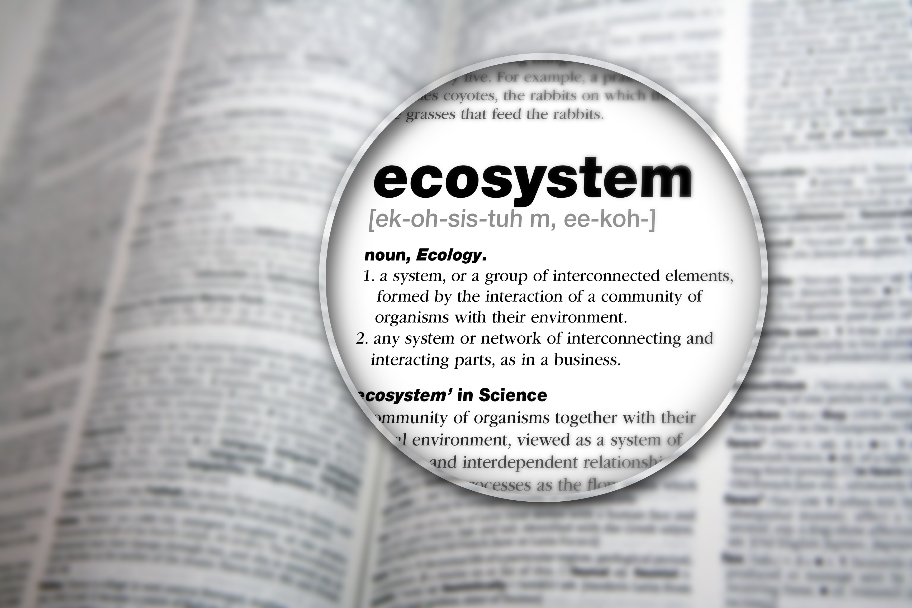
Ecosystems
The plants and animals that are found in a particular location are referred to as an ecosystem. These plants and animals depend on each other to survive. In a delicate balance, these lifeforms help to sustain one another in regular patterns. Disruptions to an ecosystem can be disastrous to all organisms within the ecosystem.
http://www.kidsgeo.com/geography-for-kids/0164-ecosystems.php

Slide 3
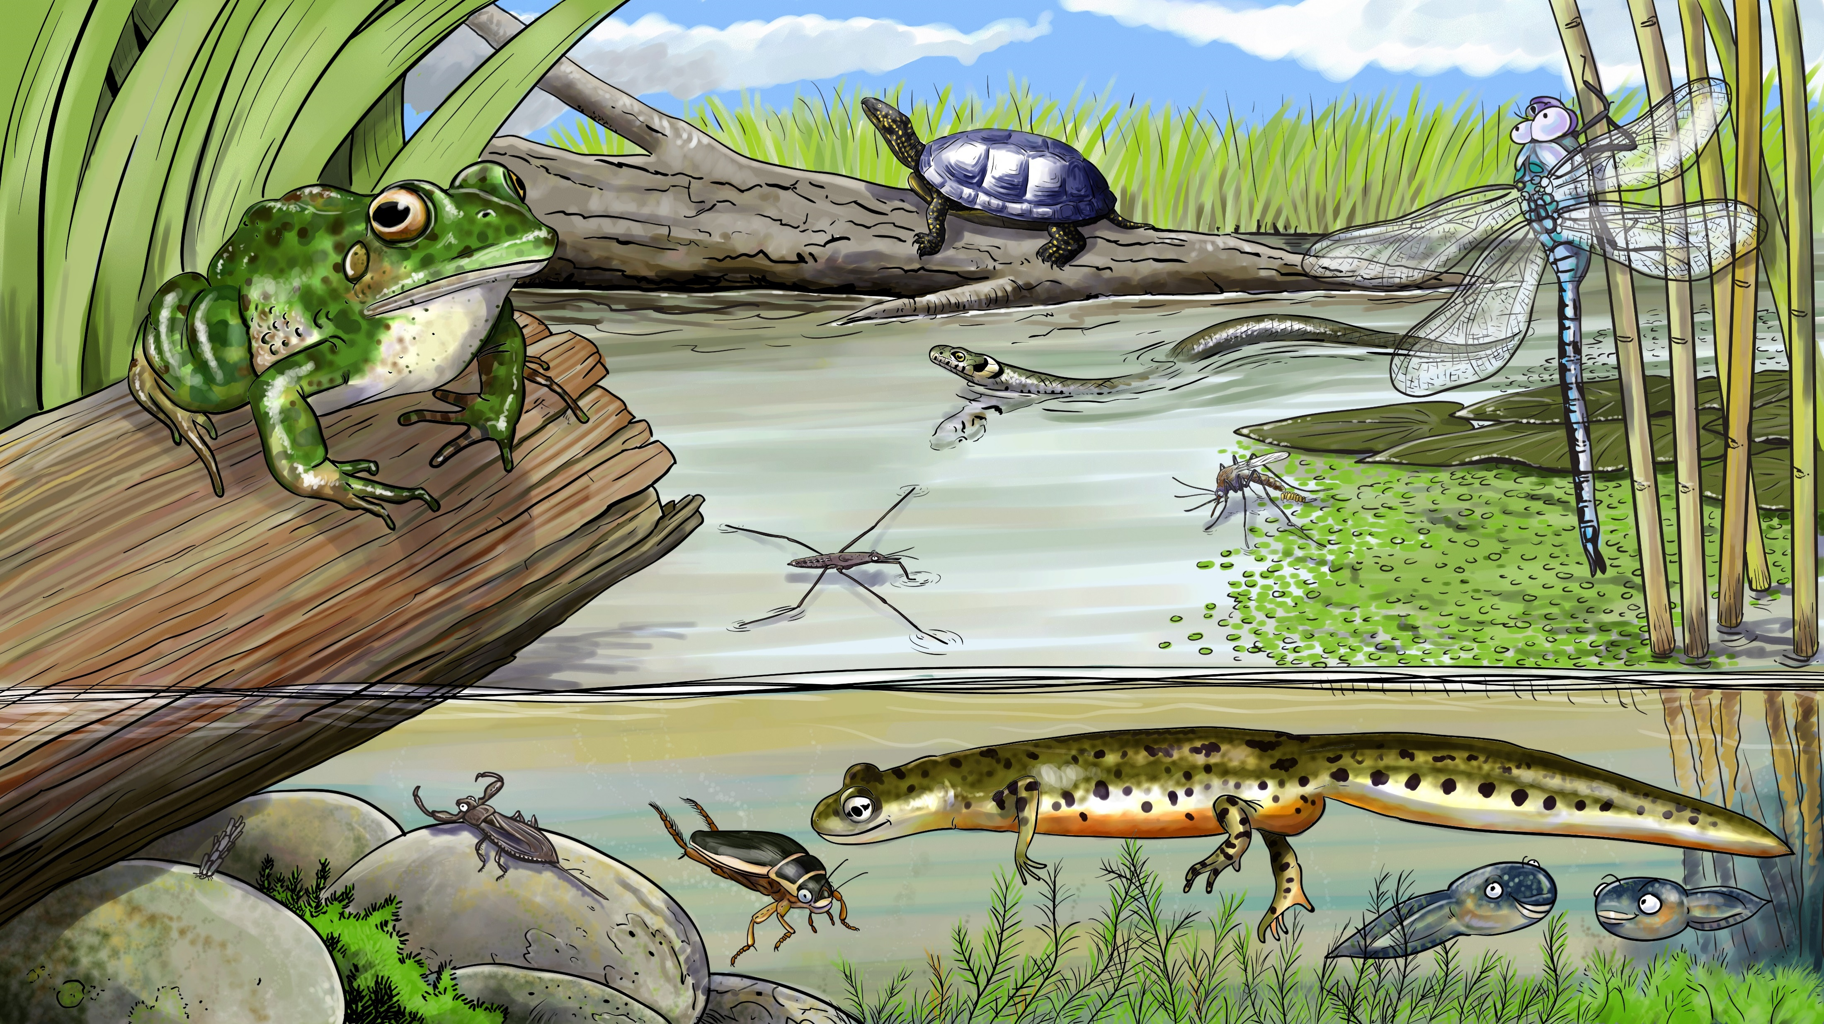
123rf.com
As an example, consider what happens when a new plant or animal is introduced into an ecosystem where it did not before exist. The new organism competes with the natural organisms from that location for available resources. These unnatural strangers can push other organisms out, causing them to become extinct. This can then affect still other organisms that depended on the extinct organism as a source of food.
http://www.kidsgeo.com/geography-for-kids/0164-ecosystems.php

Slide 4
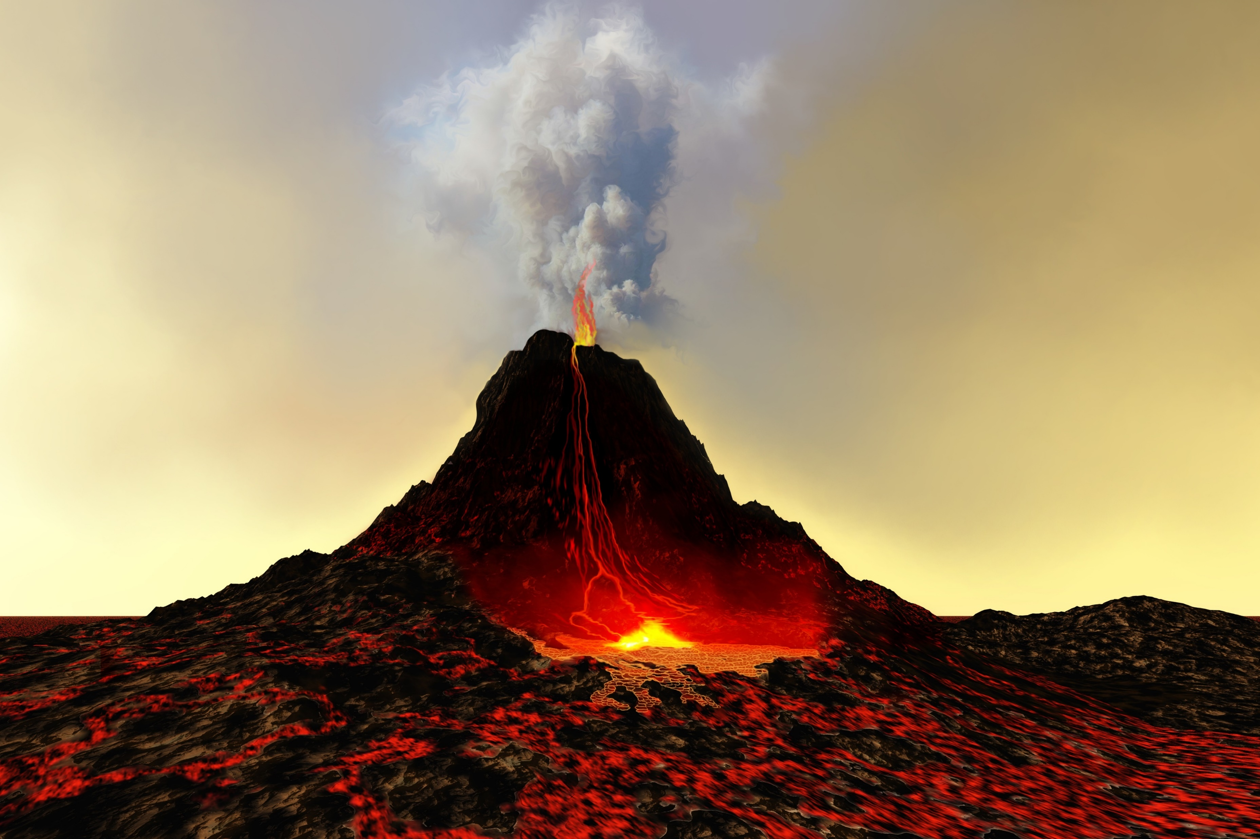
Throughout the history of the Earth, the delicate balance found within ecosystems has been disrupted by natural disasters such as fires, floods, storms, volcano eruptions, and so forth. In recent years, however, mankind has increasingly been affecting the many ecosystems around the world.
http://www.kidsgeo.com/geography-for-kids/0164-ecosystems.php
123rf.com

Slide 5
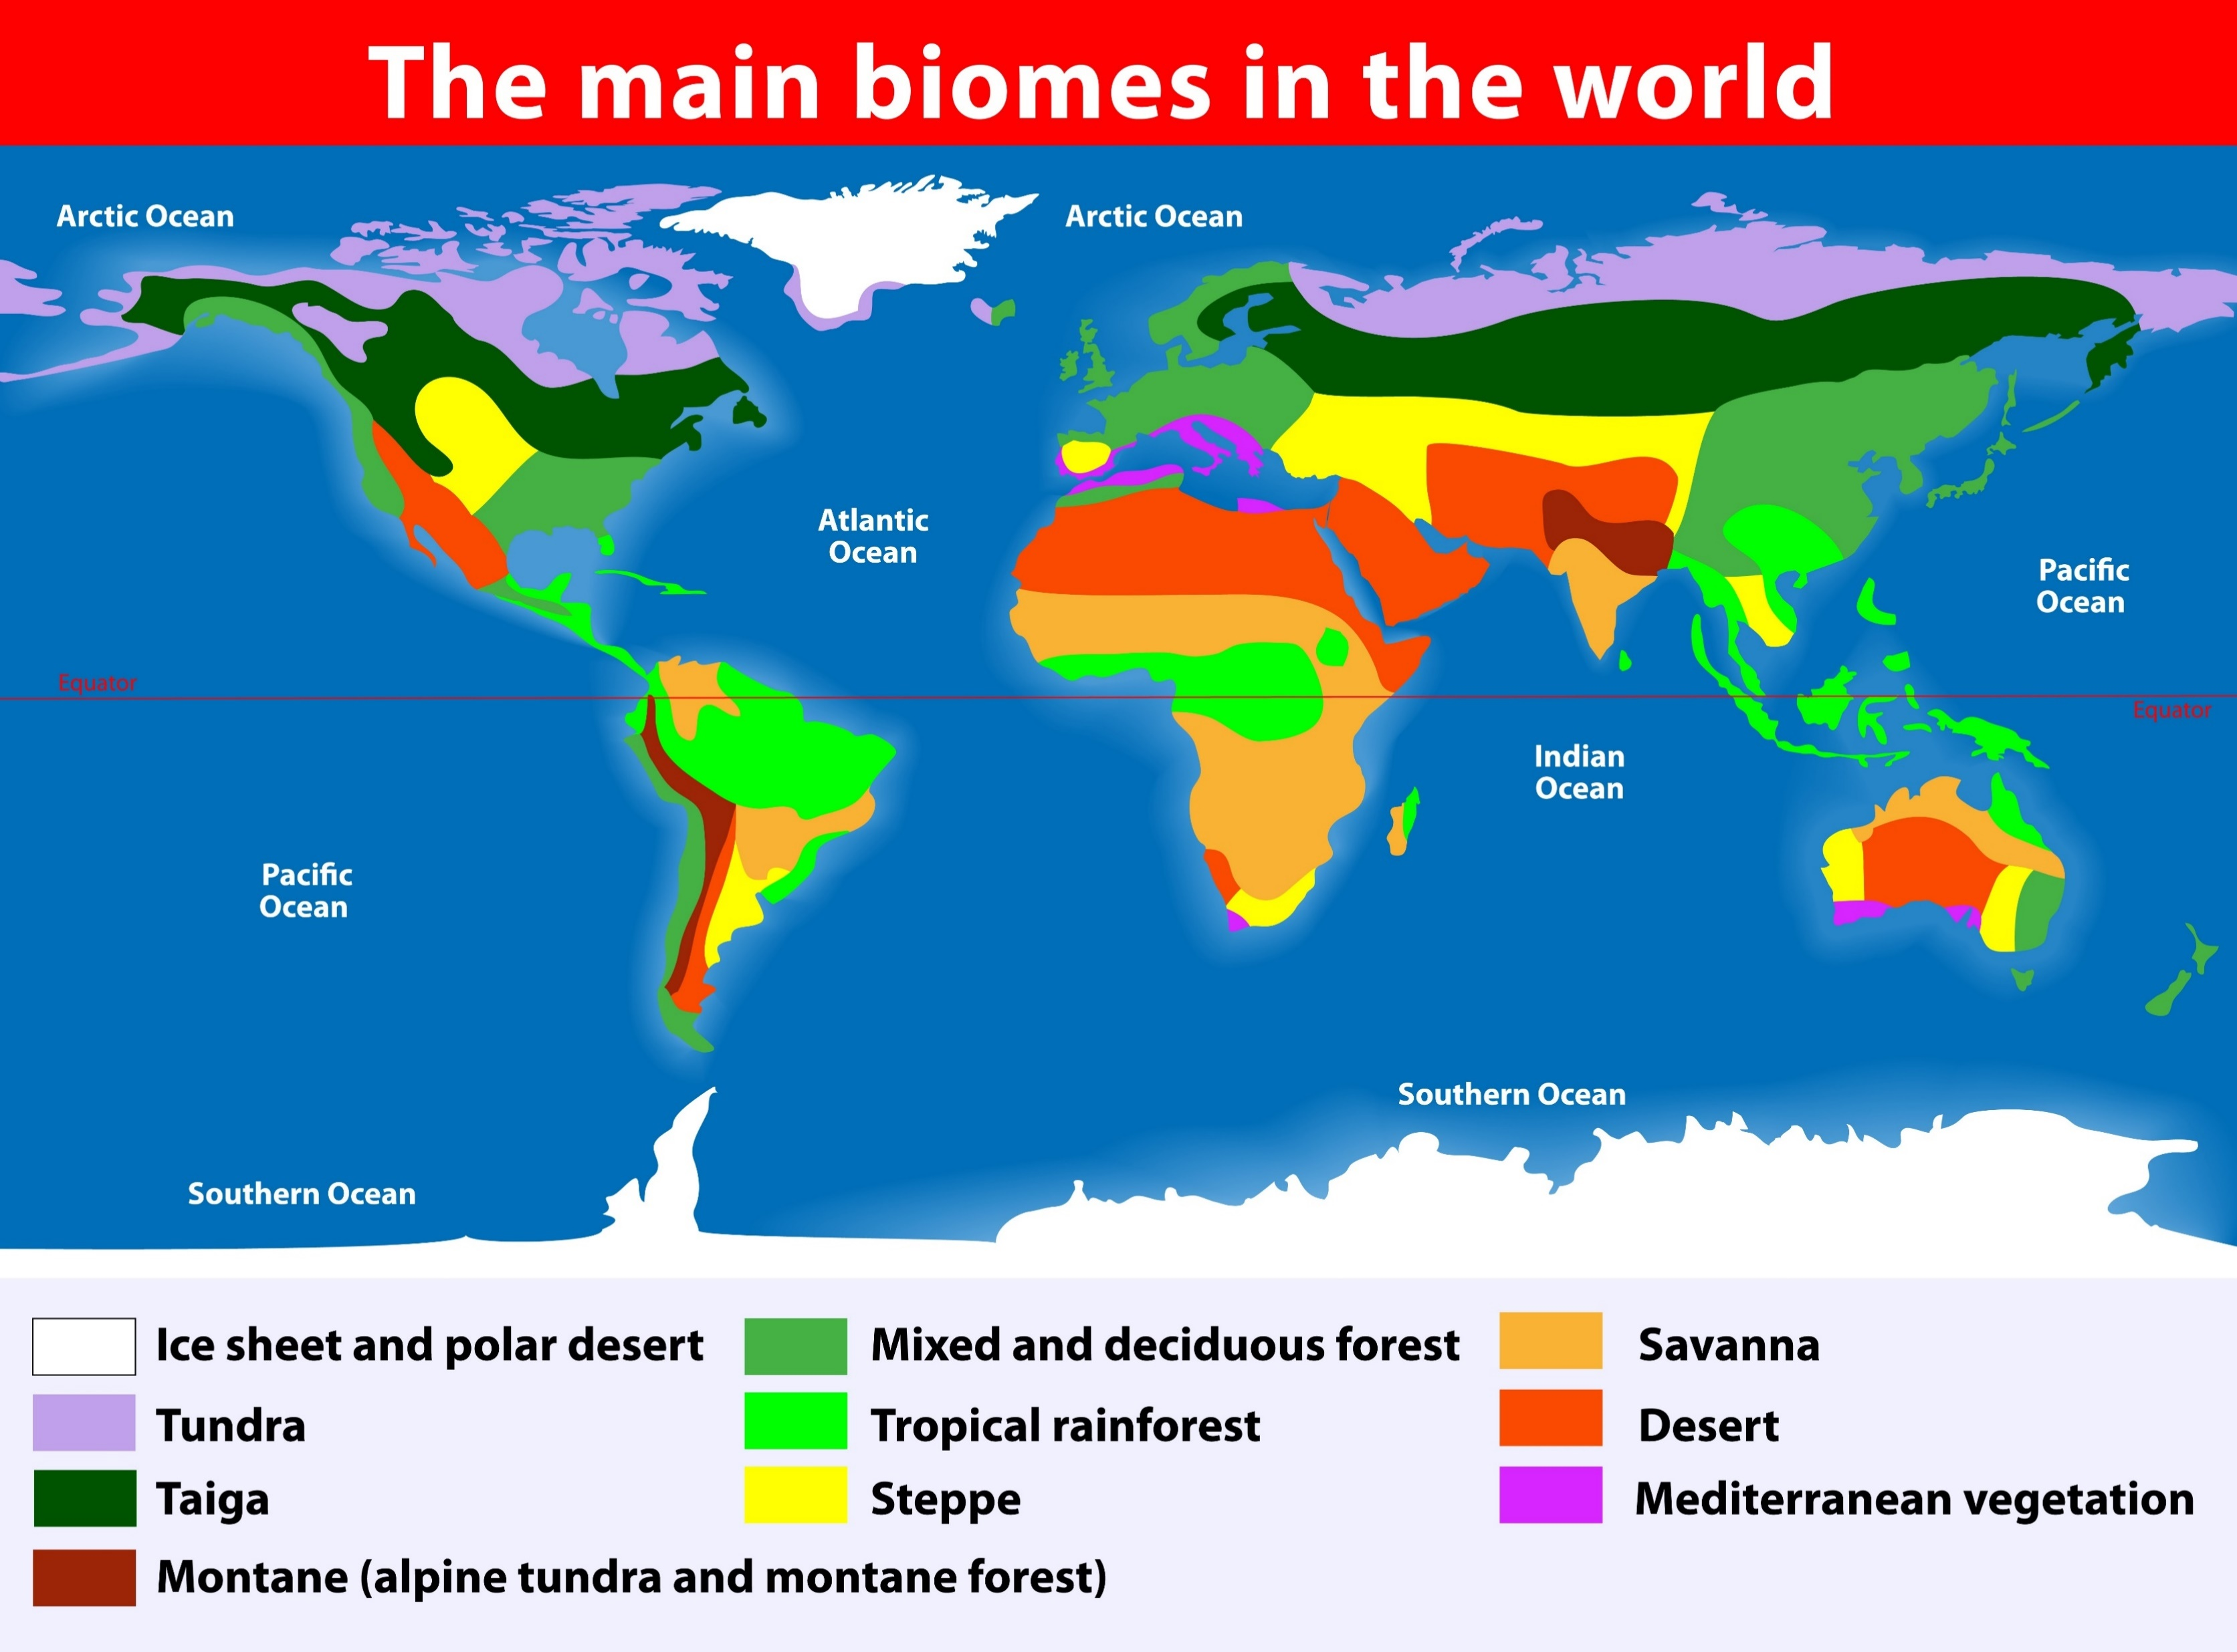
As geographers study the many ecosystems around the world, many similarities or patterns become evident from one ecosystem to another. This allows scientists to group ecosystems into categories called biomes.
http://www.kidsgeo.com/geography-for-kids/0164-ecosystems.php

Slide 6
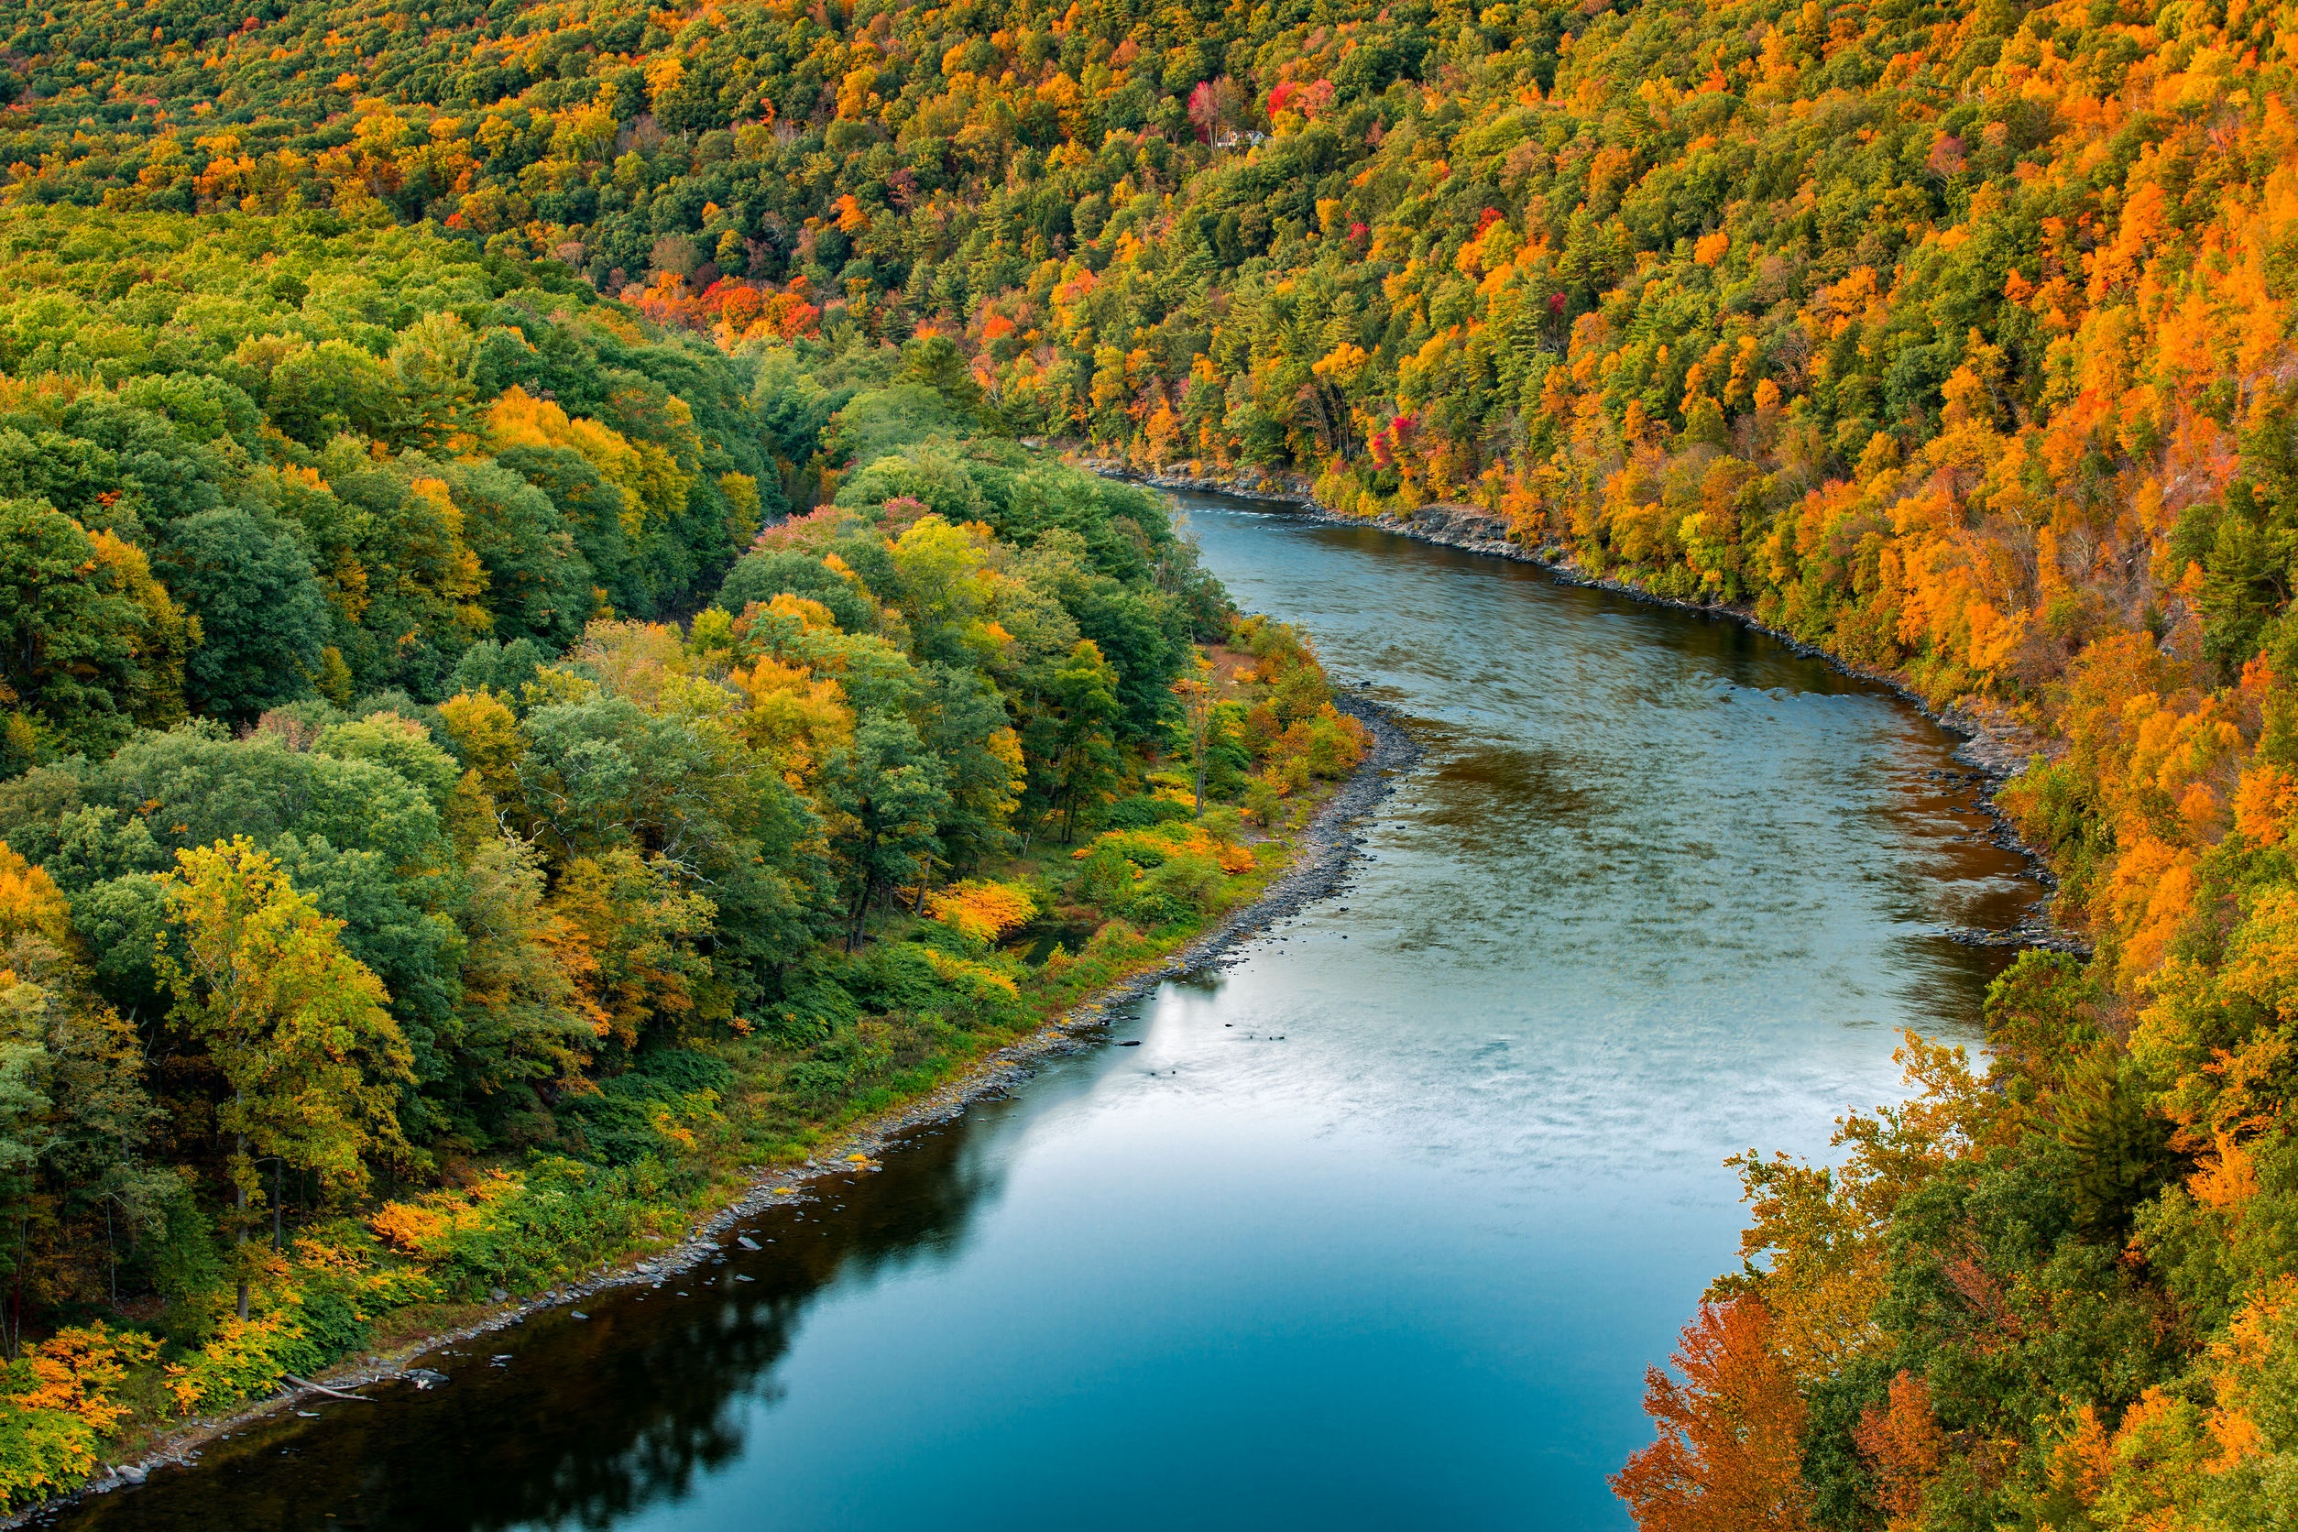
New Jersey enjoys a wealth of breathtaking and highly valuable natural resources. Our beaches, forests, wetlands and other natural resources provide countless benefits to the public.
http://www.nj.gov/dep/dsr/naturalcap
123rf.com

Slide 7
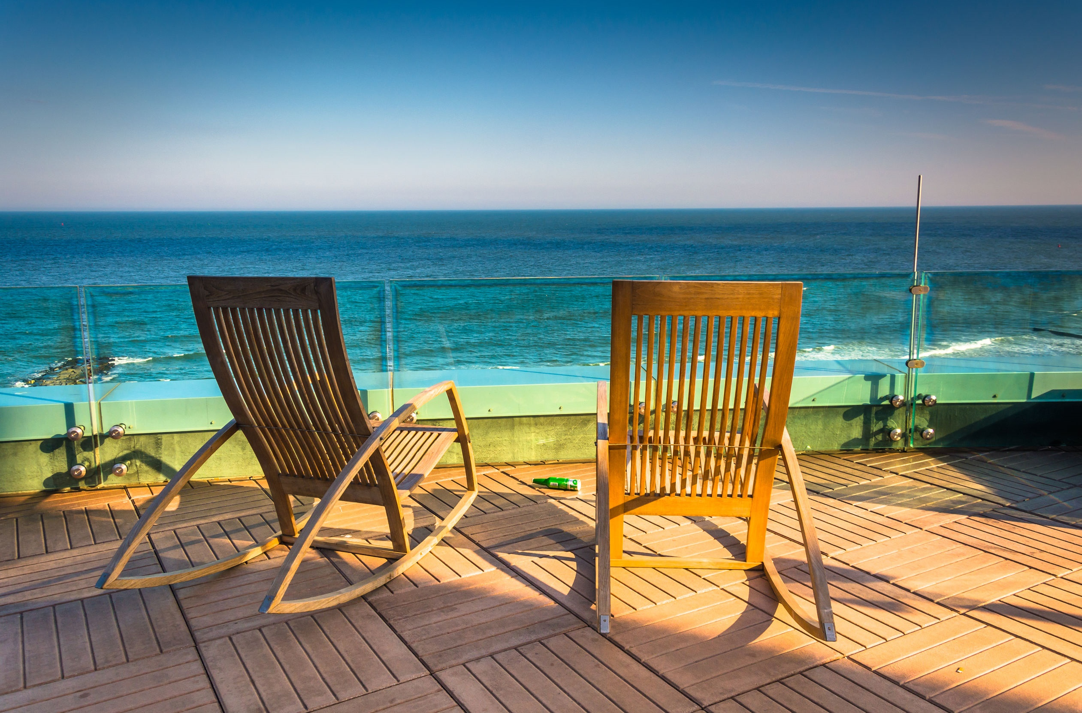
123rf.com
In order to make wise policy, planning, and regulatory decisions, it is important to understand the worth of these resources. A two-year study that aimed to quantify the value of these resources.
http://www.nj.gov/dep/dsr/naturalcap/

Slide 8
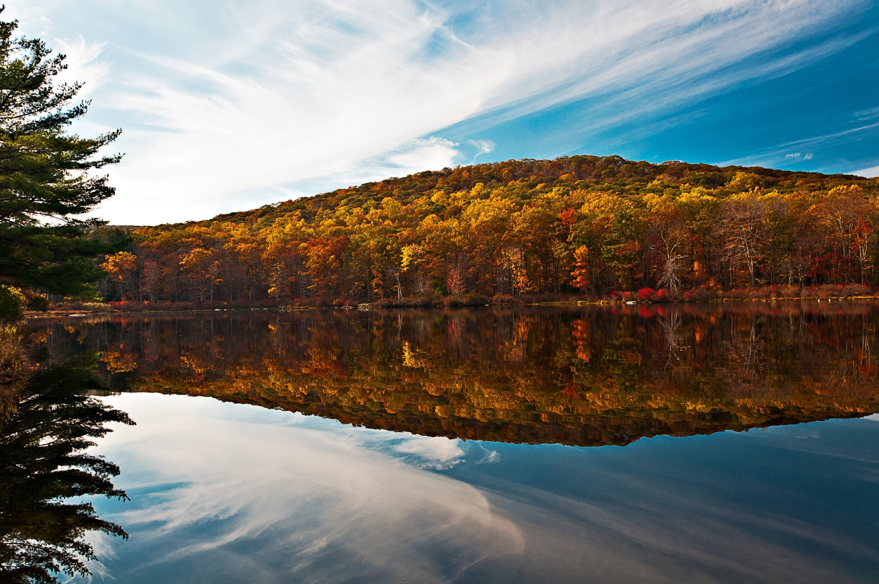
123rf.com
As a way of expressing the value, it estimates the dollar value of the services and goods produced by New Jersey’s natural capital. Natural capital consists of components of the natural environment that provide long-term benefits to society. Many of the benefits provided by natural capital come from ecological systems or ecosystems, a dynamic complex of plant, animal, and microorganism communities and their nonliving environment, all interacting as a functional unit. Forests, wetlands, and lakes are examples of ecosystems.
http://www.nj.gov/dep/dsr/naturalcap/

Slide 9
Taking the estimated values of goods and services together, the total value of New Jersey’s natural capital appears to be about $20 billion per year, plus or minus $9 billion per year.
The annual value of the services provided by New Jersey’s natural capital is conservatively estimated at between $8.6 billion and $19.8 billion.
http://www.nj.gov/dep/dsr/naturalcap
123rf.com

Slide 10
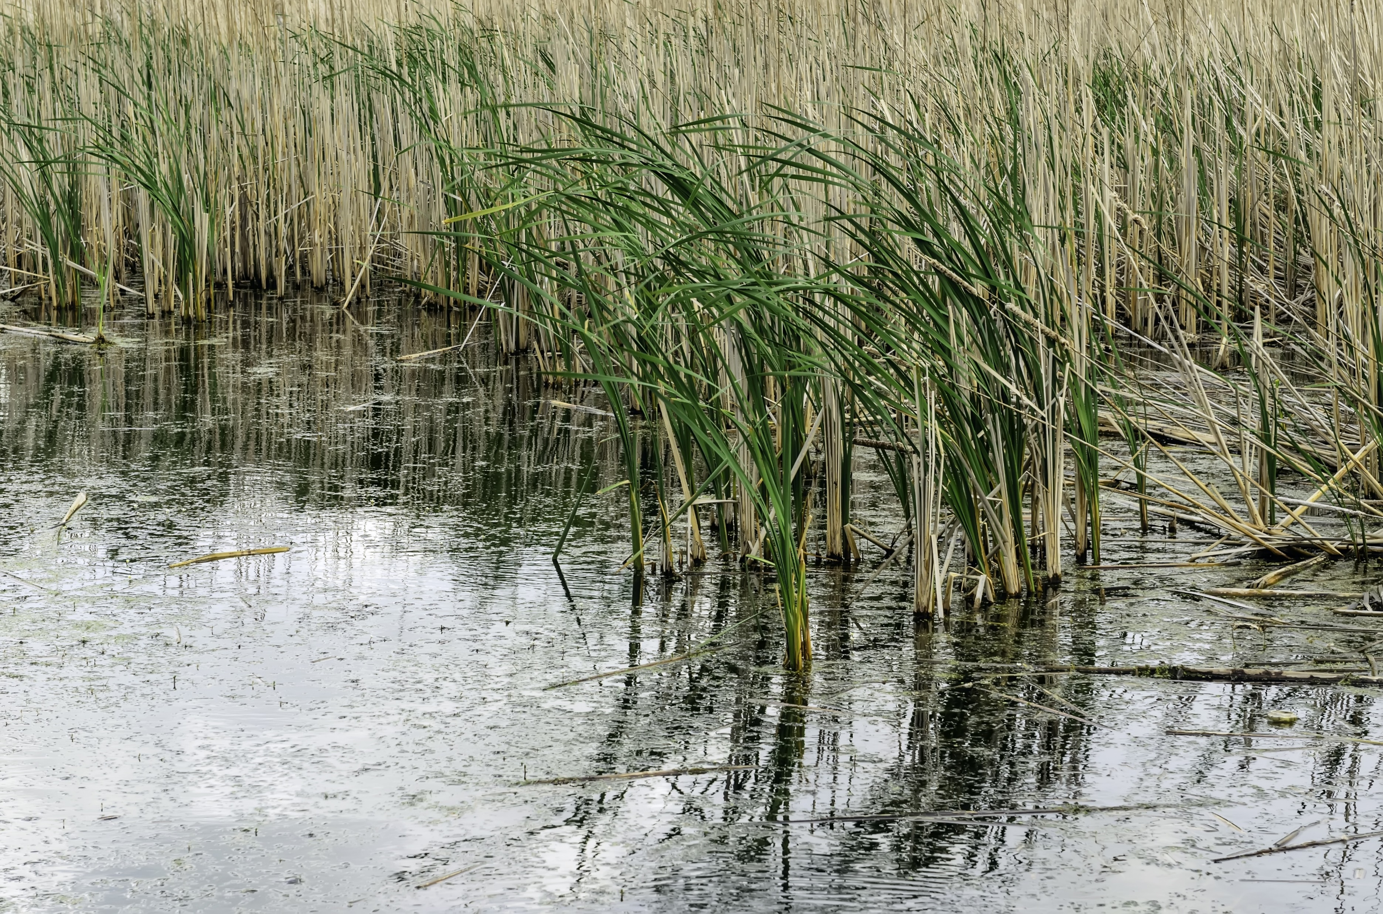
Freshwater wetlands and marine ecosystems have the highest ecoservice values. The annual value of the goods provided by New Jersey’s natural capital is estimated at between $2.8 billion (present value $93 billion) and $9.7 billion (present value $322 billion). Farmland, marine waters, and quarries provide the highest values of goods.
http://www.nj.gov/dep/dsr/naturalcap/
123rf.com

Slide 11
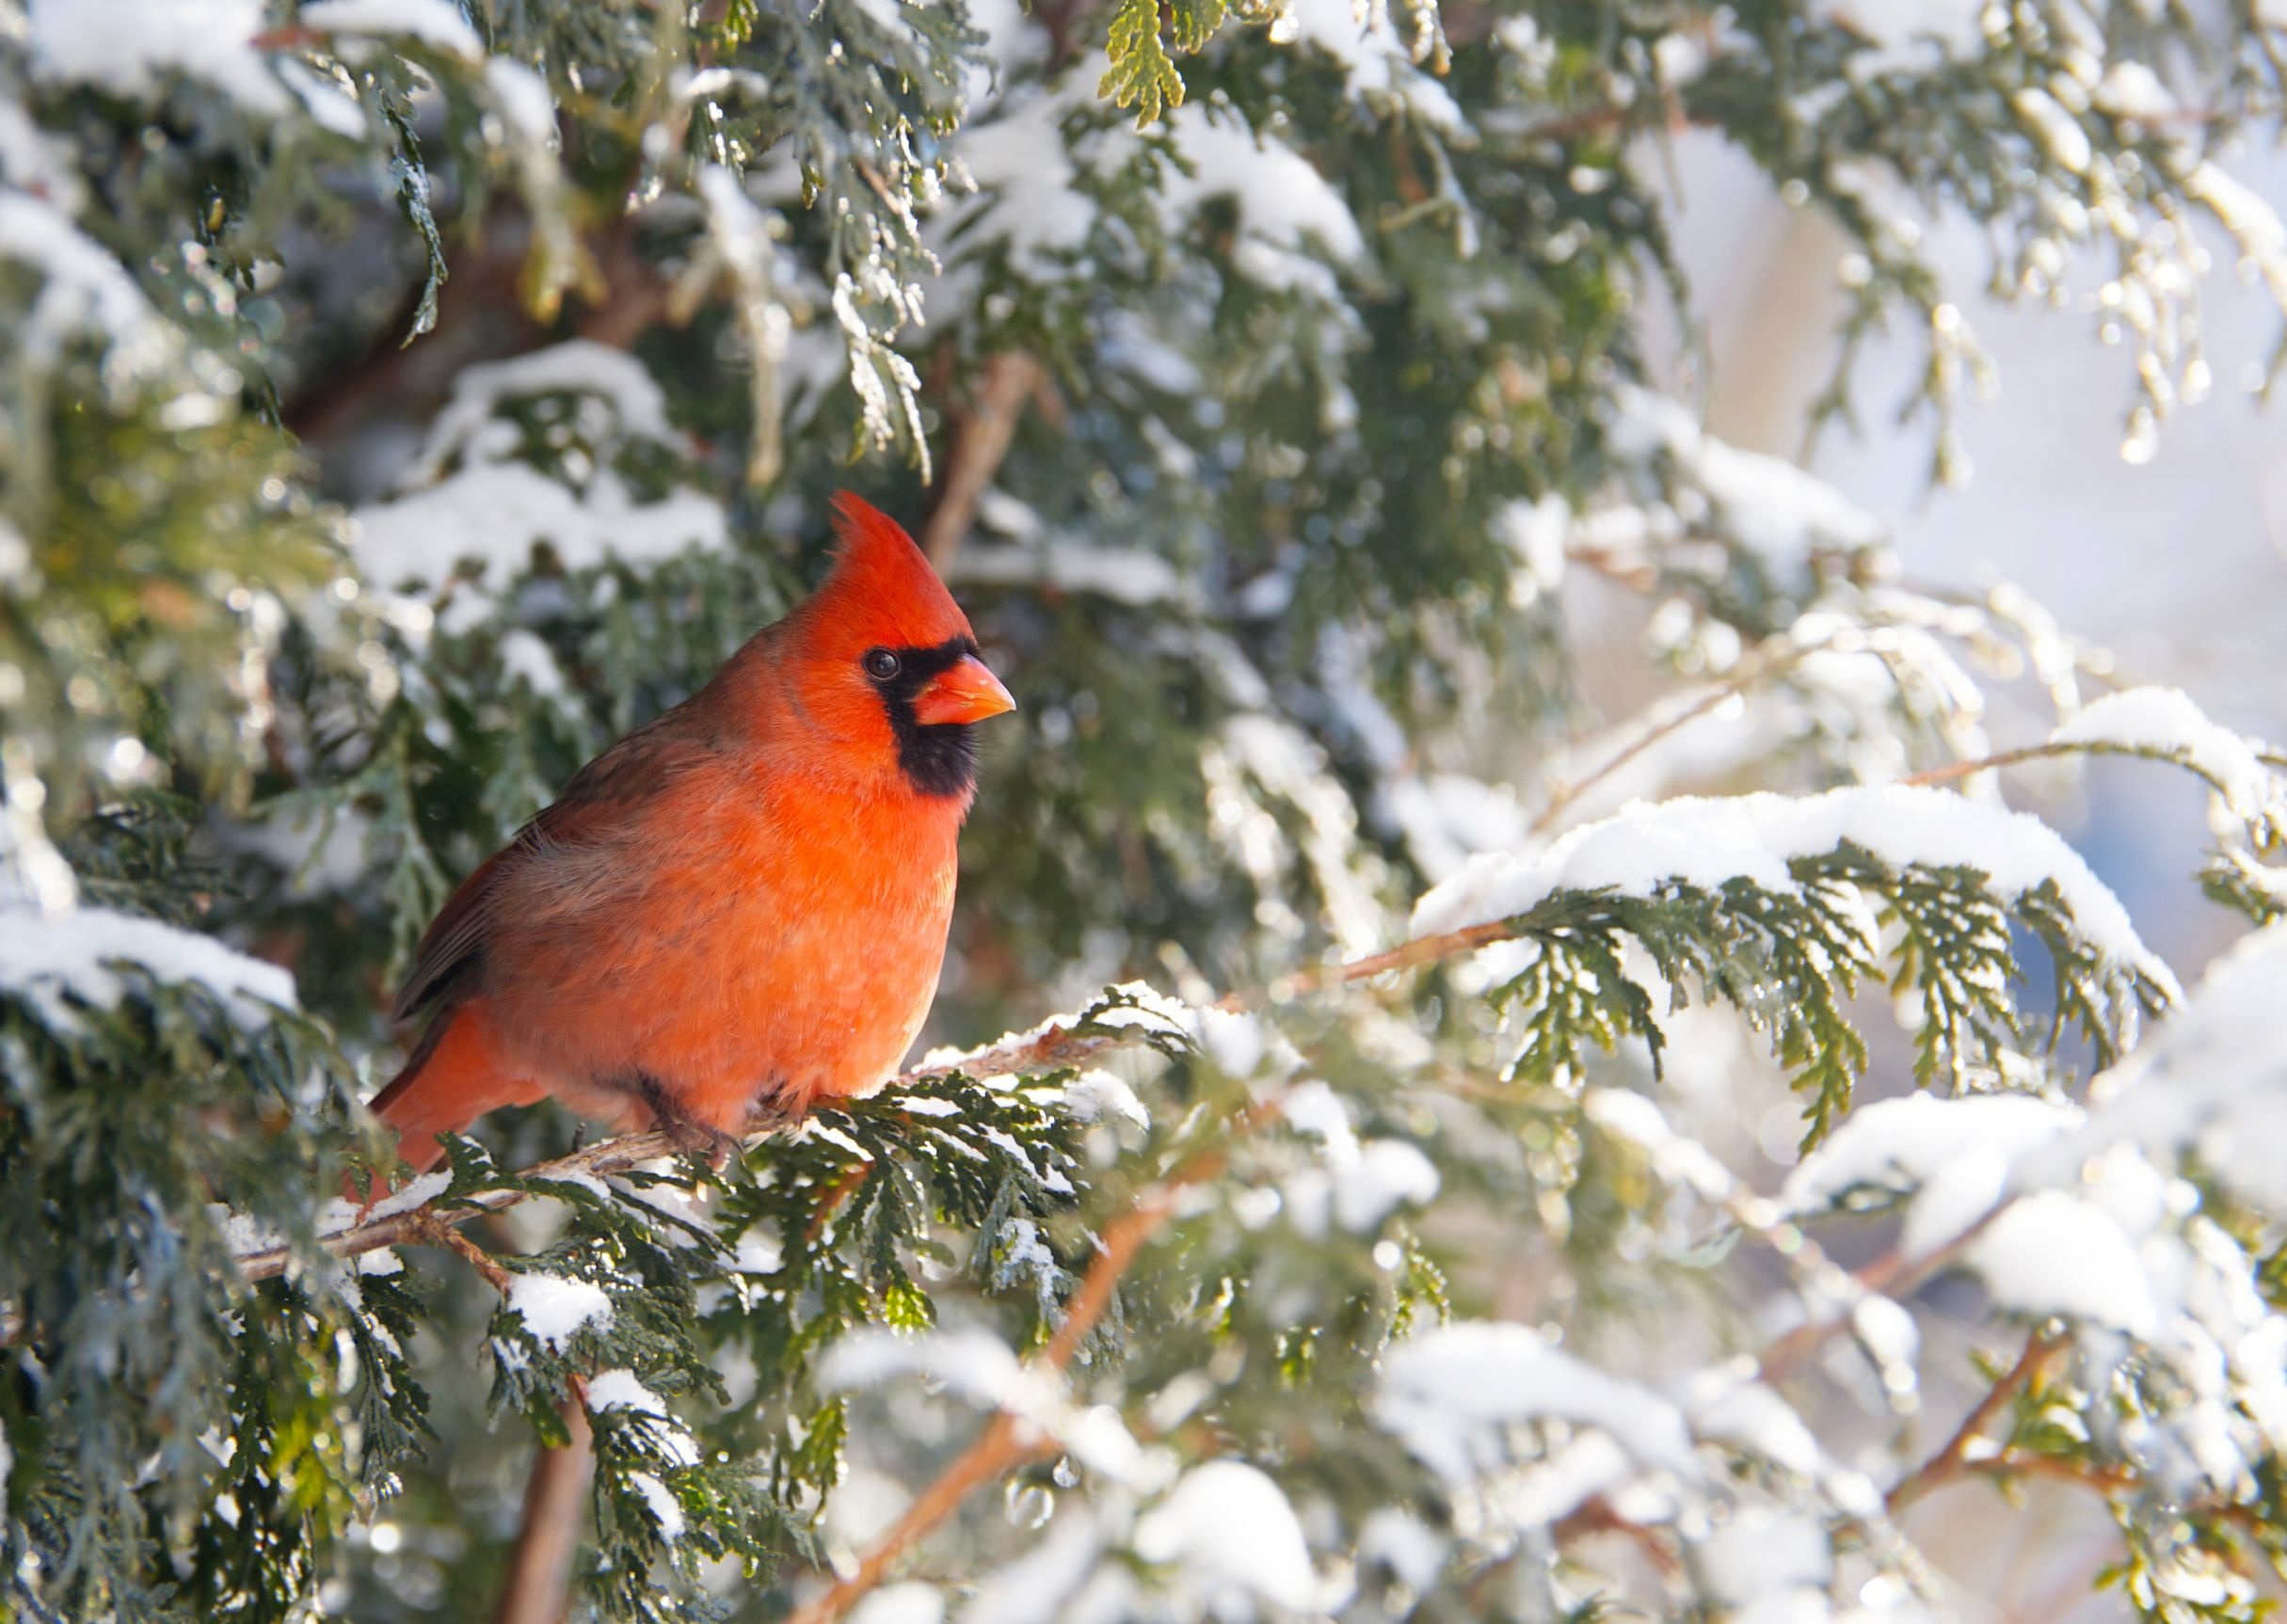
123rf.com
In addition to goods and services provided by our state’s natural capital, wildlife-related tourism is estimated to generate about $3 billion of gross economic activity in New Jersey annually. This activity represents about $1 billion of wage and salary income annually or about 37,000 jobs.
http://www.nj.gov/dep/dsr/naturalcap/

Slide 12
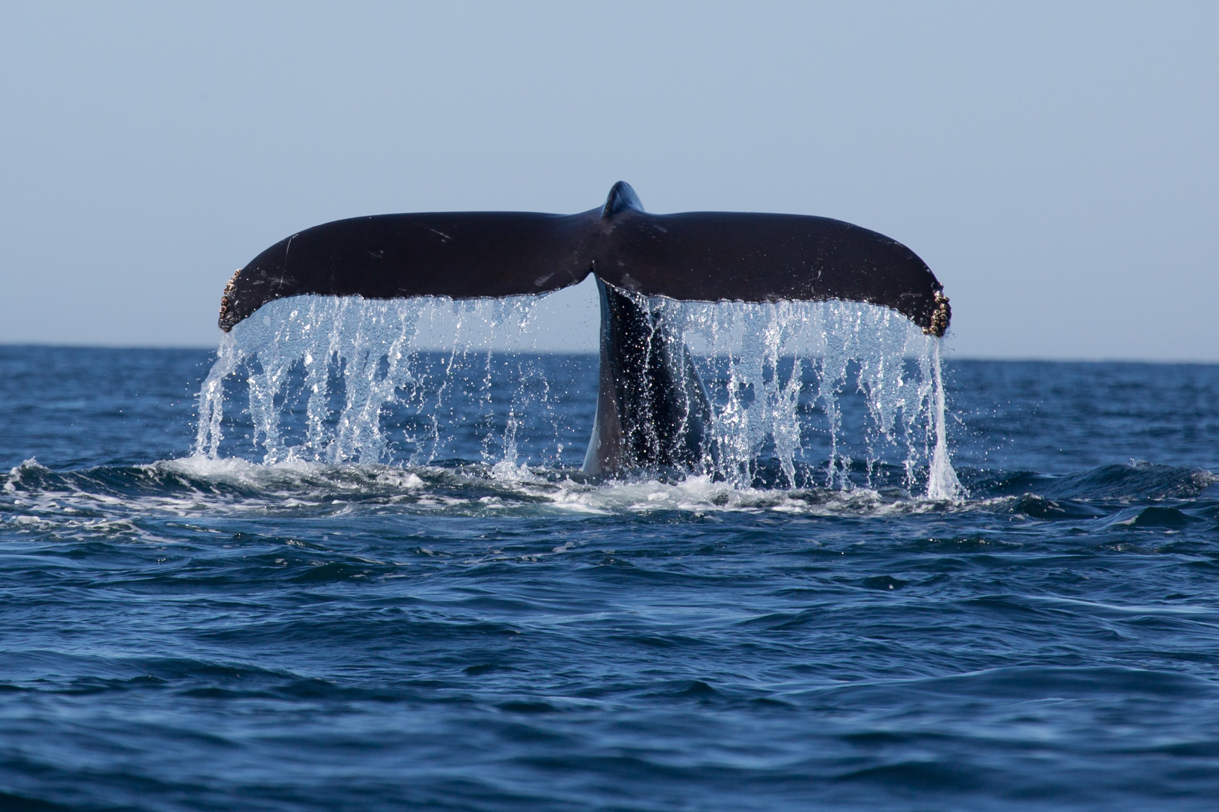
123rf.com
Marine ecosystems provided the second-largest dollar amount of ecosystem services: $5.3 billion per year for estuaries/tidal bays and about $390 million per year for other coastal waters, including the coastal shelf out to the 3-mile limit. Nutrient cycling (i.e., waste dilution and removal) was the most important service provided by marine ecosystems, worth $5.1 billion per year.
http://www.nj.gov/dep/dsr/naturalcap/

Slide 13
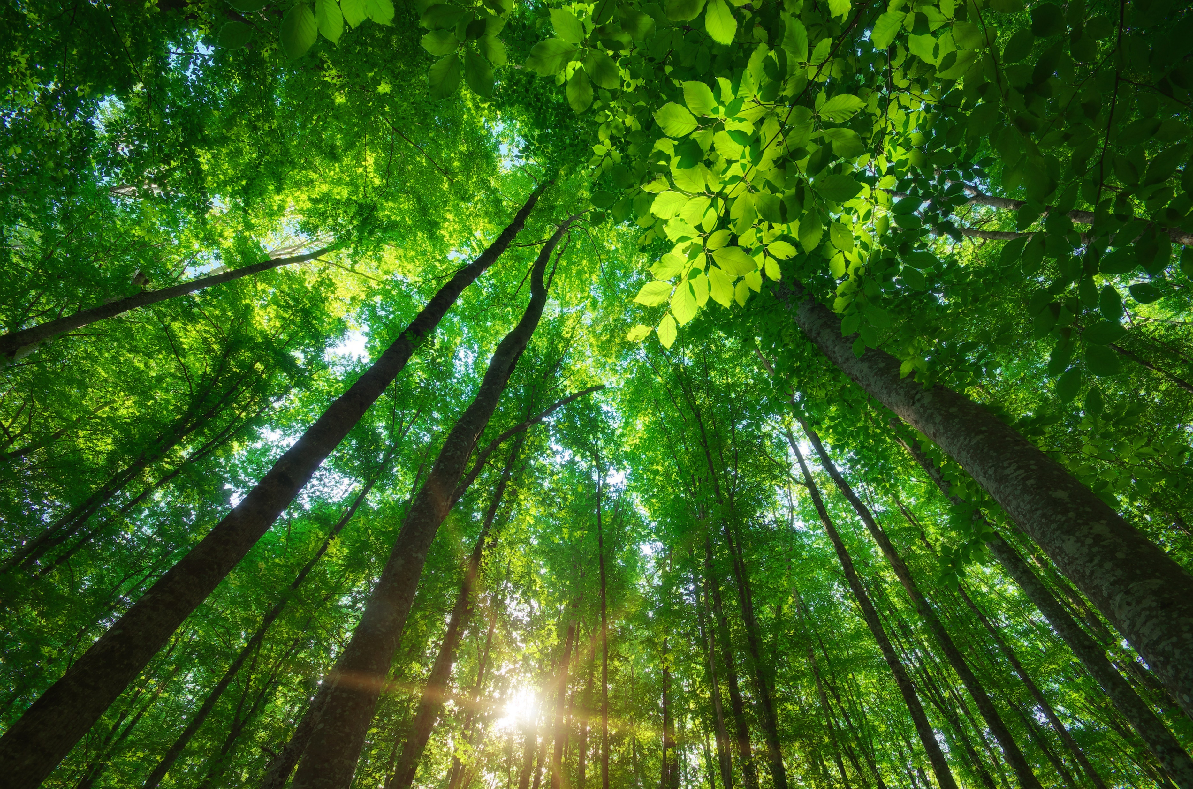
123rf.com
Forest cover is the largest area of any ecosystem type in New Jersey and provides ecosystem services valued at $2.2 billion per year. Habitat services are currently the most important of these services and are valued at $1.4 billion per year. Other important services provided by forests include water supply, pollination and aesthetic and recreational amenities.
http://www.nj.gov/dep/dsr/naturalcap/

Slide 14
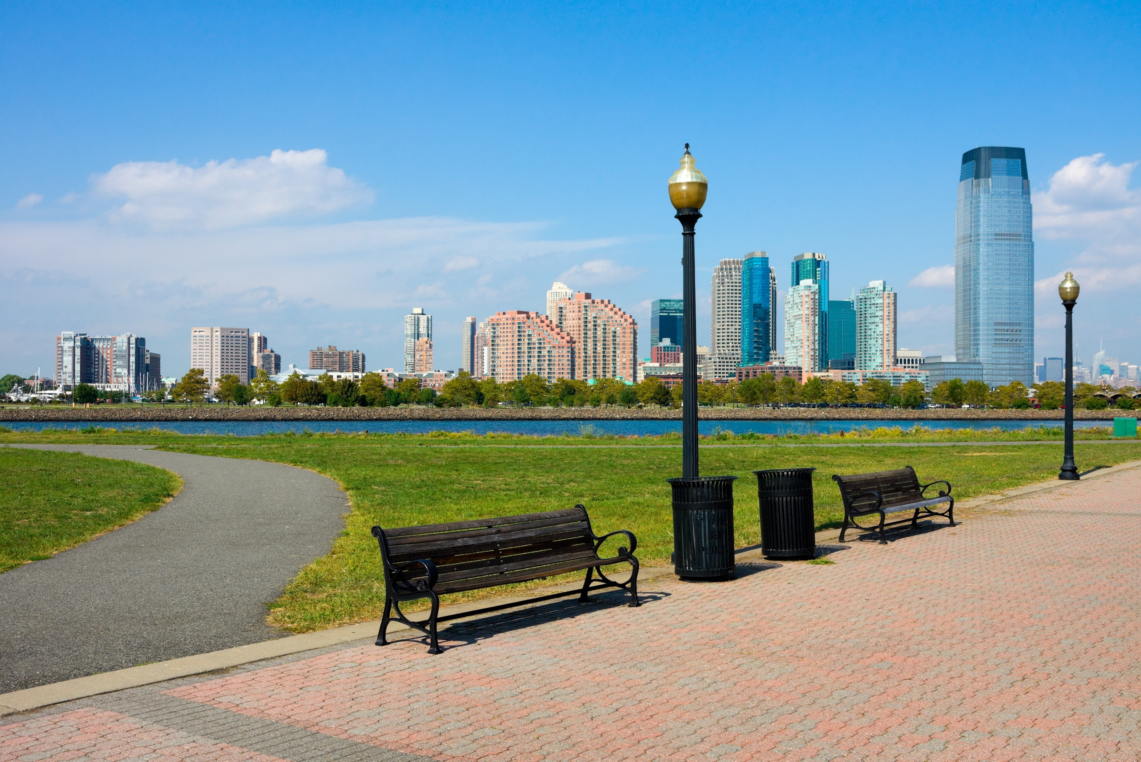
Urban green space covers relatively little of New Jersey but has a relatively high dollar value per acre and provides an estimated $420 million of ecosystem services annually, principally aesthetic and recreational benefits.
http://www.nj.gov/dep/dsr/naturalcap/
123rf.com

Slide 15
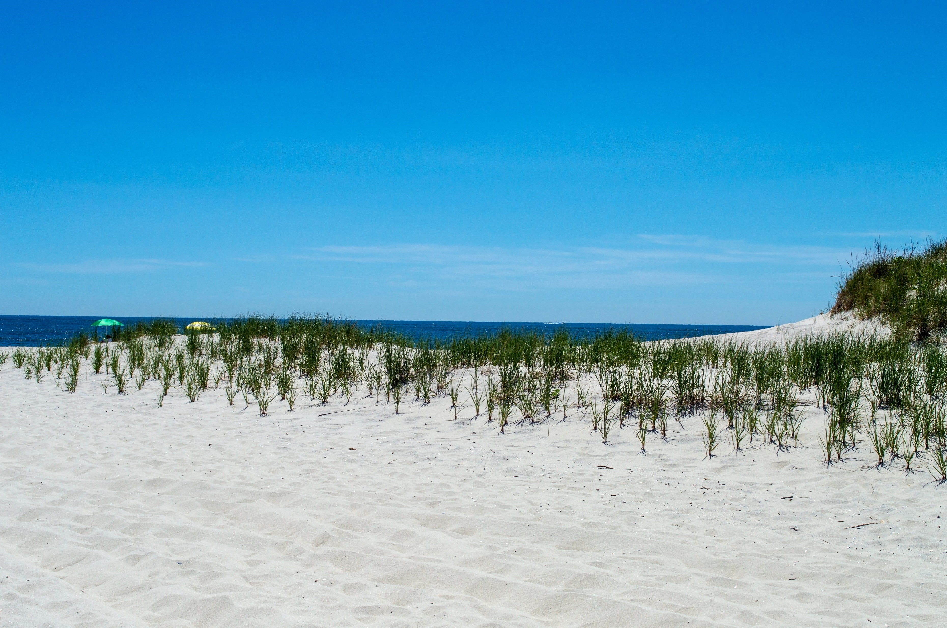
123rf.com
Beaches (including dunes) provided by far the highest ecoservice value per acre. Their small area limited their annual ecoservice value to about $330 million, mainly buffering of floods and storm surges and aesthetic and recreational benefits.
http://www.nj.gov/dep/dsr/naturalcap/

Slide 16
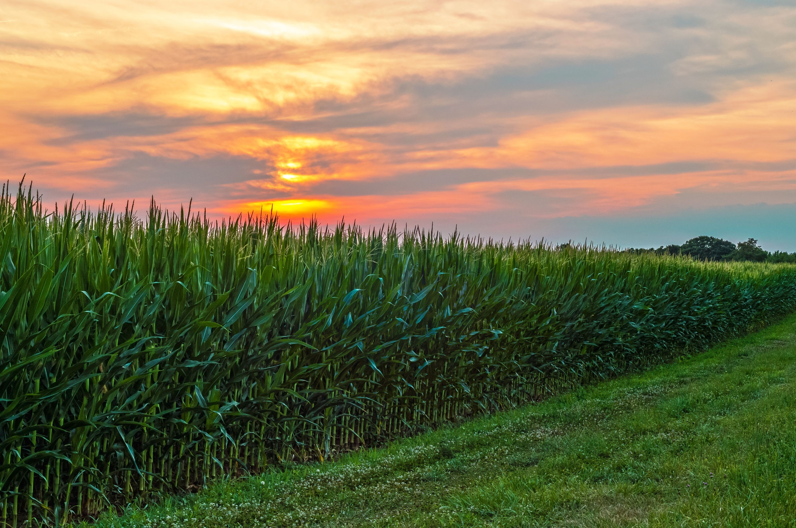
123rf.com
Agricultural land includes both cropland (estimated at $78 million per year of ecosystem services) and pastureland (estimated at $45 million per year). These values relate solely to the services provided by farmland, mainly habitat services from cropland ($75 million per year) and waste treatment services from pasture land ($26 million per year). These figures do not include the value of the food provided by farms.
http://www.nj.gov/dep/dsr/naturalcap/

Slide 17
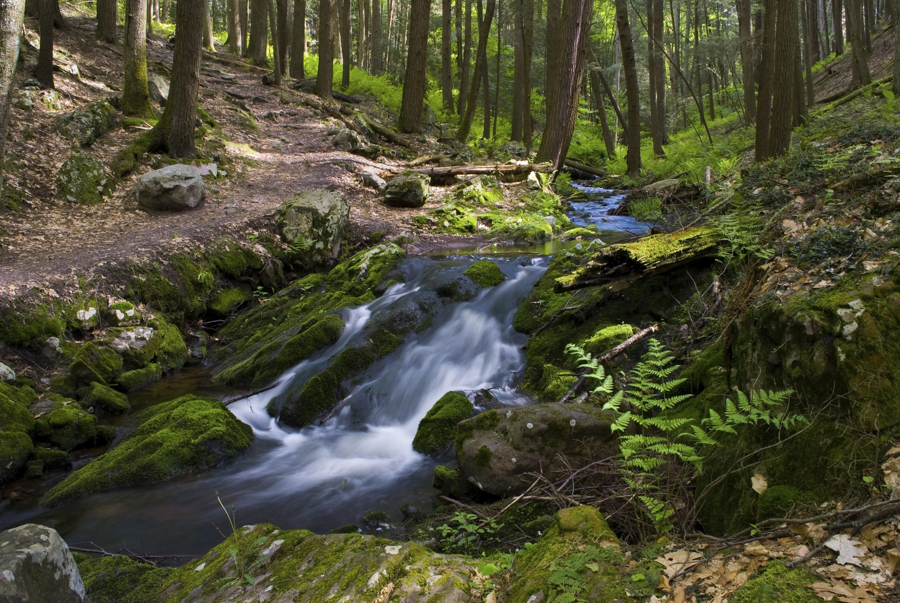
Open fresh water and riparian buffers provide services with an estimated annual value of $66 million and $51 million respectively, mainly water supply and aesthetic and recreational.
http://www.nj.gov/dep/dsr/naturalcap/
123rf.com

Slide 18
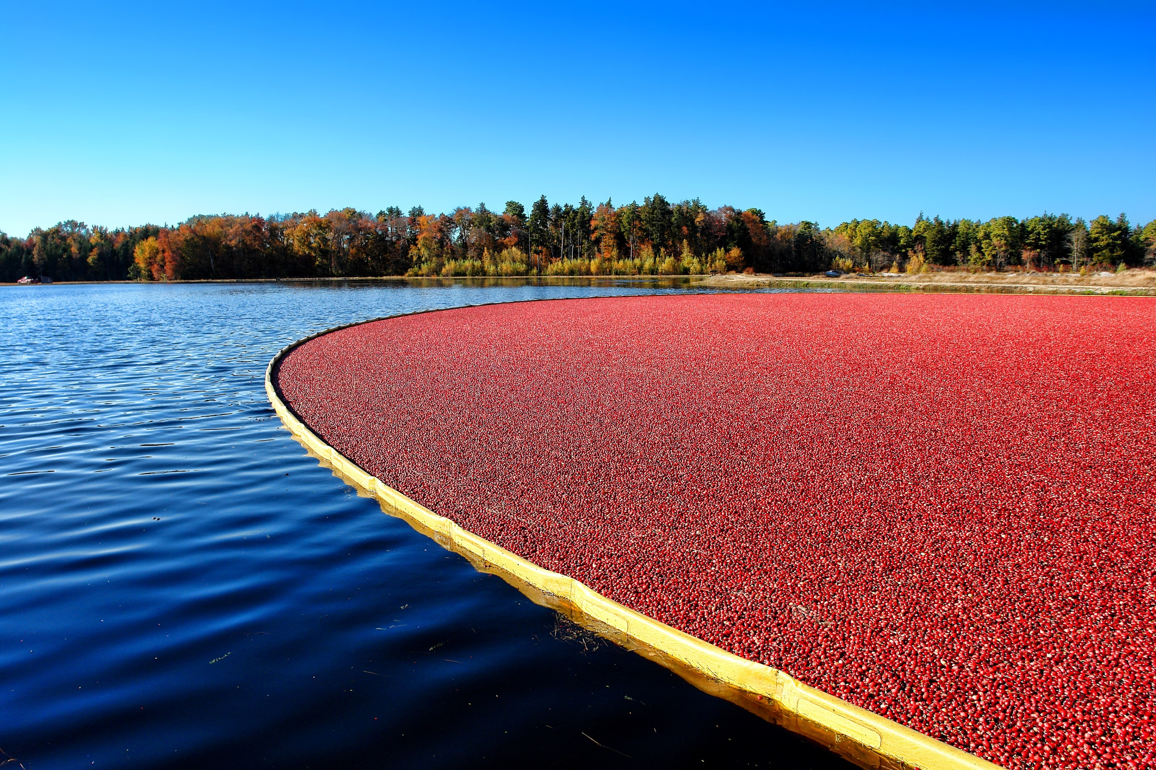
New Jersey’s diverse eco-systems provide much more than beautiful landscapes and recreational opportunities. Their value in both contributions to the protection of our natural resources, as well as their tourism value, make them a critical aspect of our quality of life and our economy. As such, it is imperative that we respect them and ensure our activities protect them.
123rf.com

Slide 19
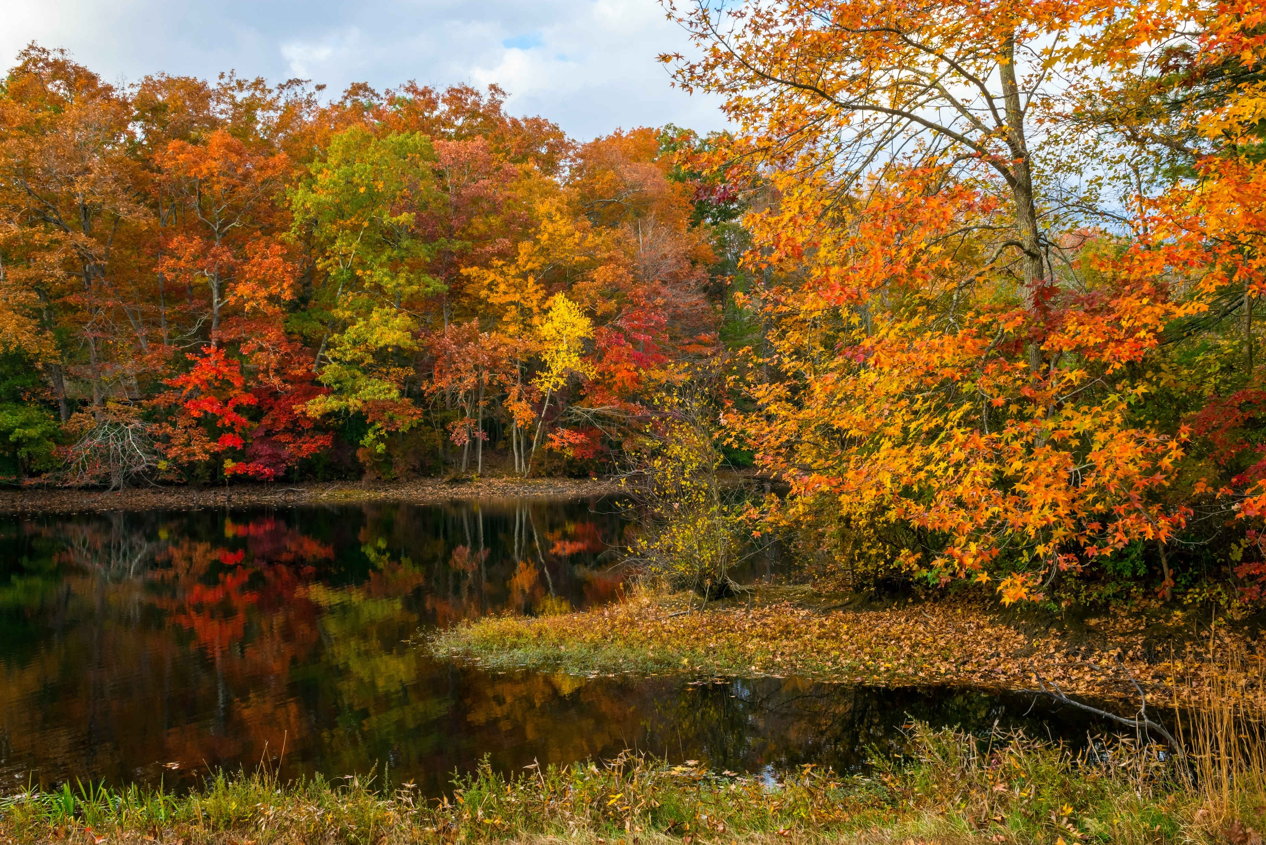
Key Words
natural disasters ecosystem organisms
countless benefits regulatory decisions natural
natural capital annual value resources
gross economic activity ecoservice geographers
marine ecosystems habitat services biomes
123rf.com

