Slide 1
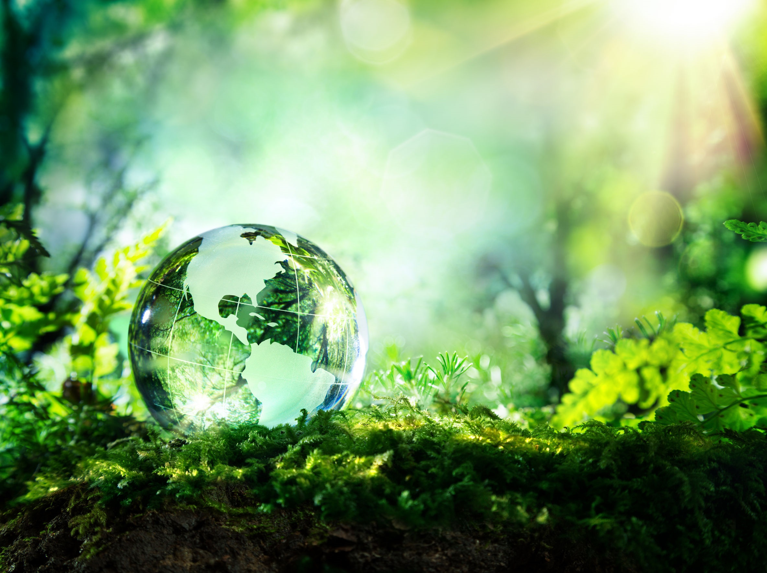
NICKY FIFTH’S NEW JERSEY
N5NJ
SECONDARY PROGRAM
ENVIRONMENTAL SCIENCE
The Ocean

Slide 2
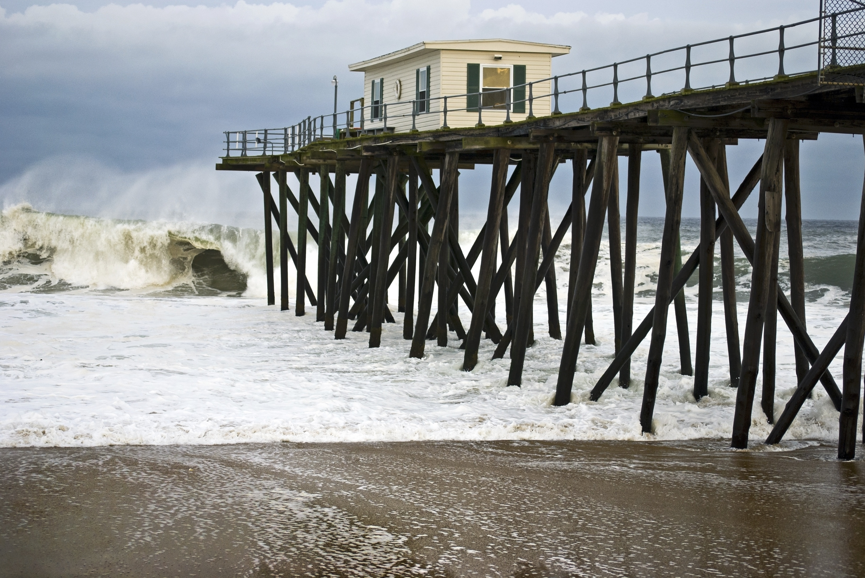
Belmar, New Jersey
Living in New Jersey, we often take our close proximity to the Atlantic Ocean for granted. As one of many places that call the Atlantic Ocean their own, what do we really know about it?
123rf.com

Slide 3
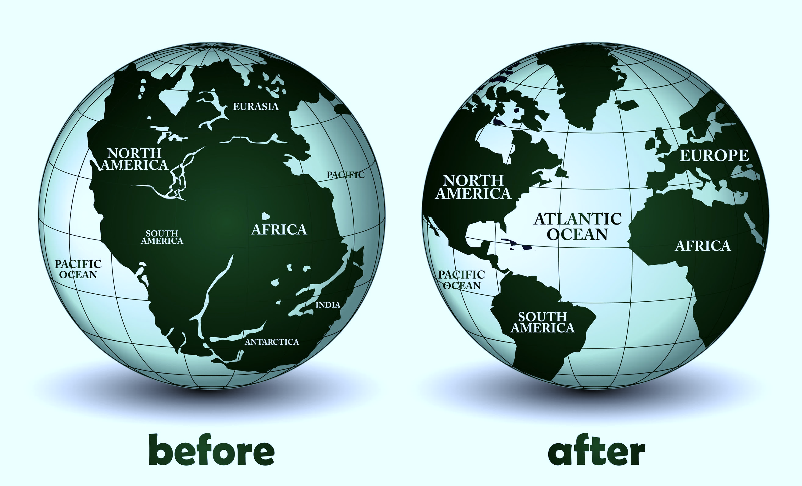
For starters, the Atlantic Ocean appears to be the second youngest of the world's oceans, after the Southern Ocean. Evidence indicates that it did not exist prior to 130 million years ago, when the continents that formed from the breakup of the ancestral super-continent, Pangaea, were being rafted apart by the process of seafloor spreading.
http://www.newworldencyclopedia.org/entry/Atlantic_Ocean

Slide 4
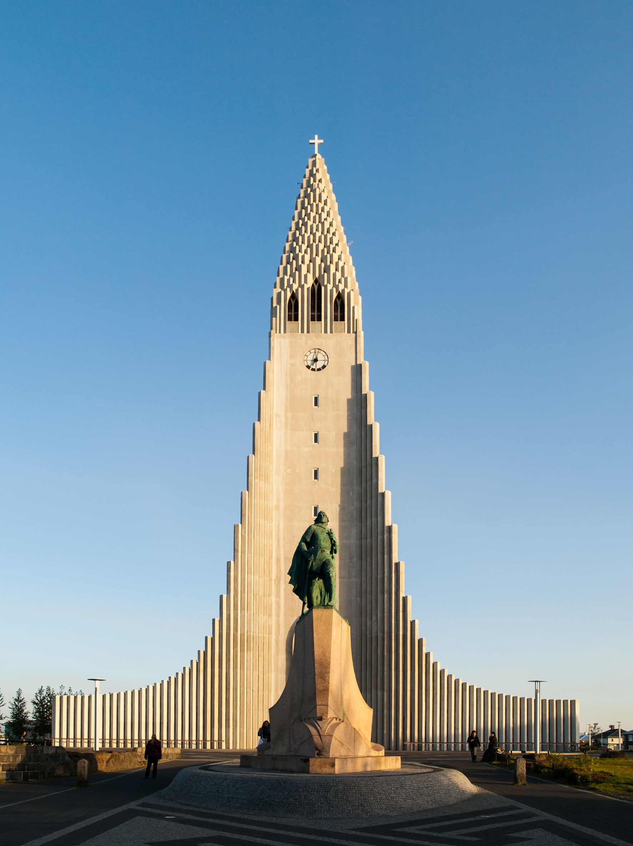
Lief Erikson Cathedral, Reykjavik, Iceland
Leif Erikson (970-1020) is remembered as the first ‘European’ to reach North America more than 500 years before Columbus!
The Icelander is said to have been the first man from Europe to cross the Atlantic Ocean and step onto North American land. He named the eastern coast of Canada ‘Vinland’, which is believed to be what is now called Newfoundland.
http://www.kids-world-travel-guide.com/atlantic-ocean-facts.html
123rf.com

Slide 5
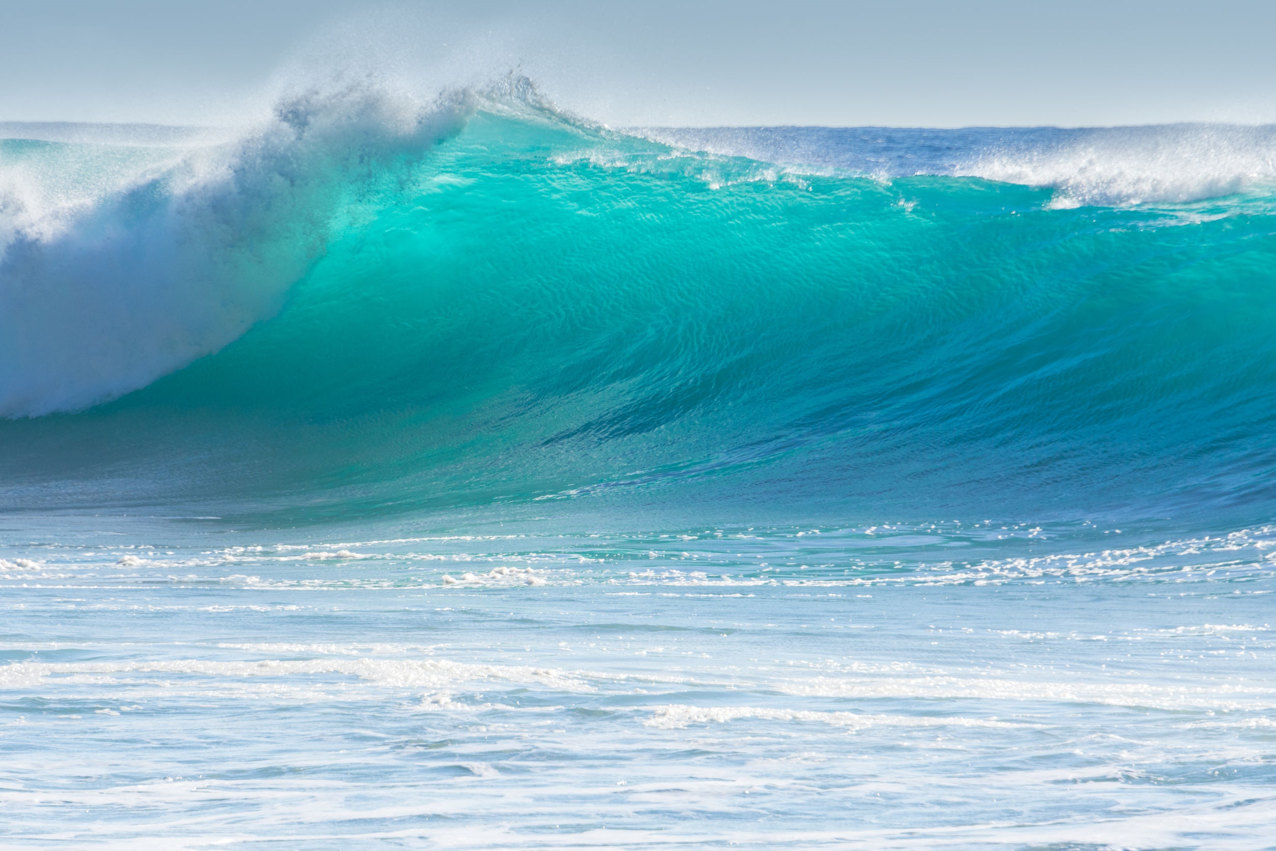
The word ’Atlantic ’ originates from the Greek mythology meaning ‘Sea of Atlas’. Atlas was the titan who had to stand on the edge of the earth and carry the heavens (celestial spheres) on his shoulders, as punishment from Zeus, as Atlas had fought against the Olympian gods for the control of the heavens.
http://www.kids-world-travel-guide.com/atlantic-ocean-facts.html
123rf.com

Slide 6
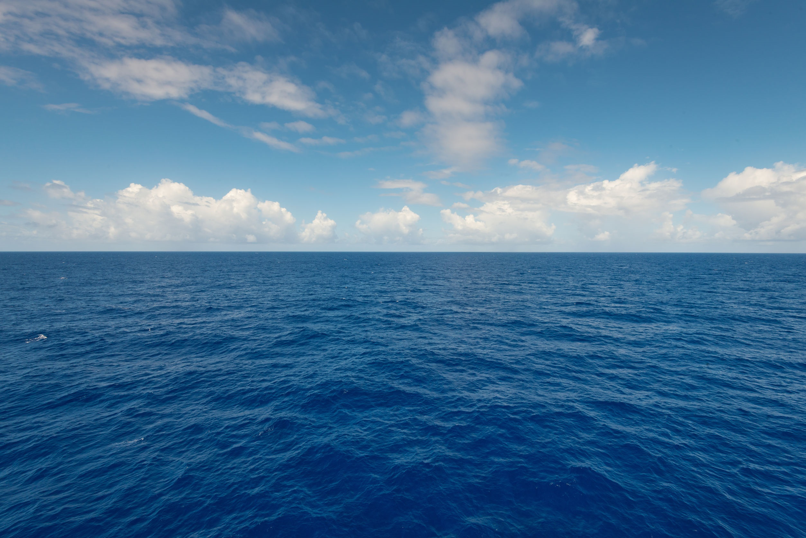
The Atlantic is the world’s second largest ocean, after the Pacific Ocean, and covers 25% of the Earth’s surface. In size, the Atlantic Ocean is comparable with roughly 6.5 times the size of the USA. It is half the size of the Pacific Ocean.
http://www.kids-world-travel-guide.com/atlantic-ocean-facts.html
123rf.com

Slide 7
The Equator divides the Atlantic Ocean into the North Atlantic Ocean and the South Atlantic Ocean and is located between Americas to the West of the Atlantic Ocean basin and the continents of Europe and Africa to the East.
http://www.kids-world-travel-guide.com/atlantic-ocean-facts.html
123rf.com

Slide 8
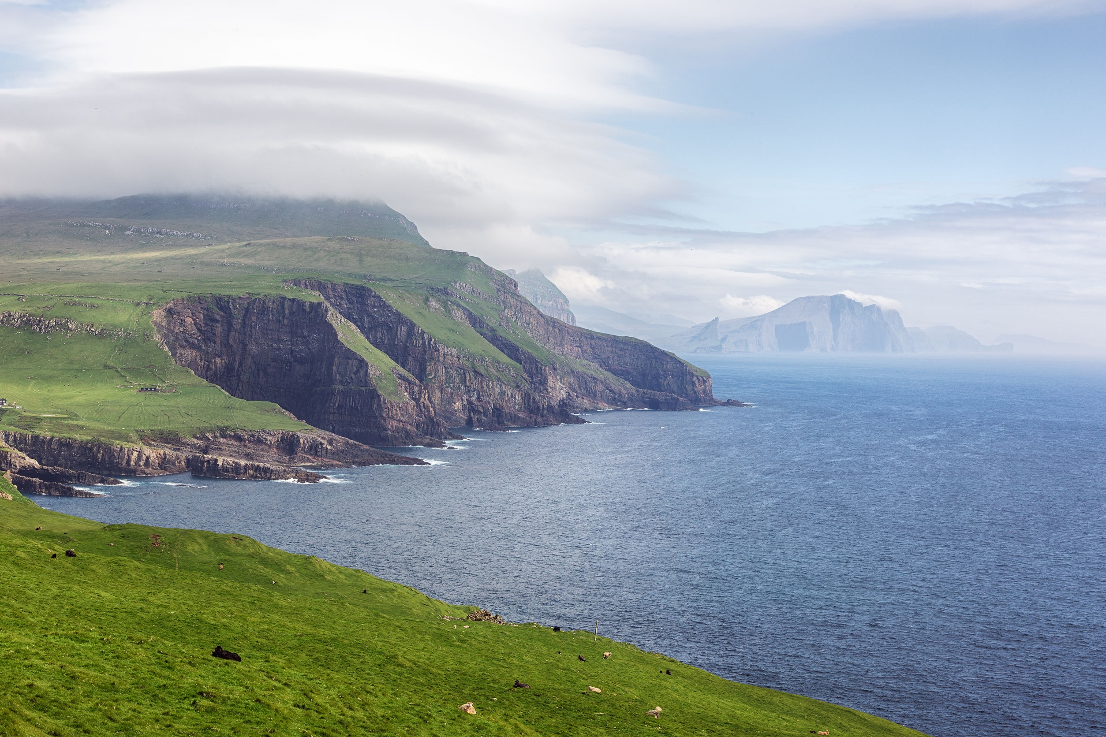
Archipelago of the Faroe Islands, Denmark
There are many islands in the Atlantic Ocean, among the most well-known are:
The Bahamas
Canary Islands (Spain)
Azores (Portugal)
Cap Verde Islands
Greenland, which not only is the largest island in the Atlantic Ocean, but also on earth.
http://www.kids-world-travel-guide.com/atlantic-ocean-facts.html
123rf.com

Slide 9
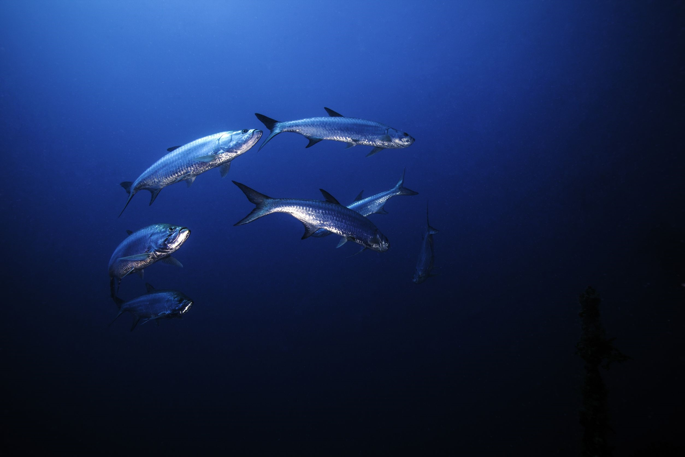
The greatest depth is the Milwaukee Deep in Puerto Rico: 8,605 meters.
The average depth is about 3,339 meters (10,955 ft.)
The Mid-Atlantic Ridge is an underwater (also called submarine) mountain range which extends roughly from Iceland in the north to South Georgia and South Sandwich Island south of Argentina.
The ridge divides the sea into two major basins, which are over 3,000 meters in depth.
http://www.kids-world-travel-guide.com/atlantic-ocean-facts.html
123rf.com

Slide 10
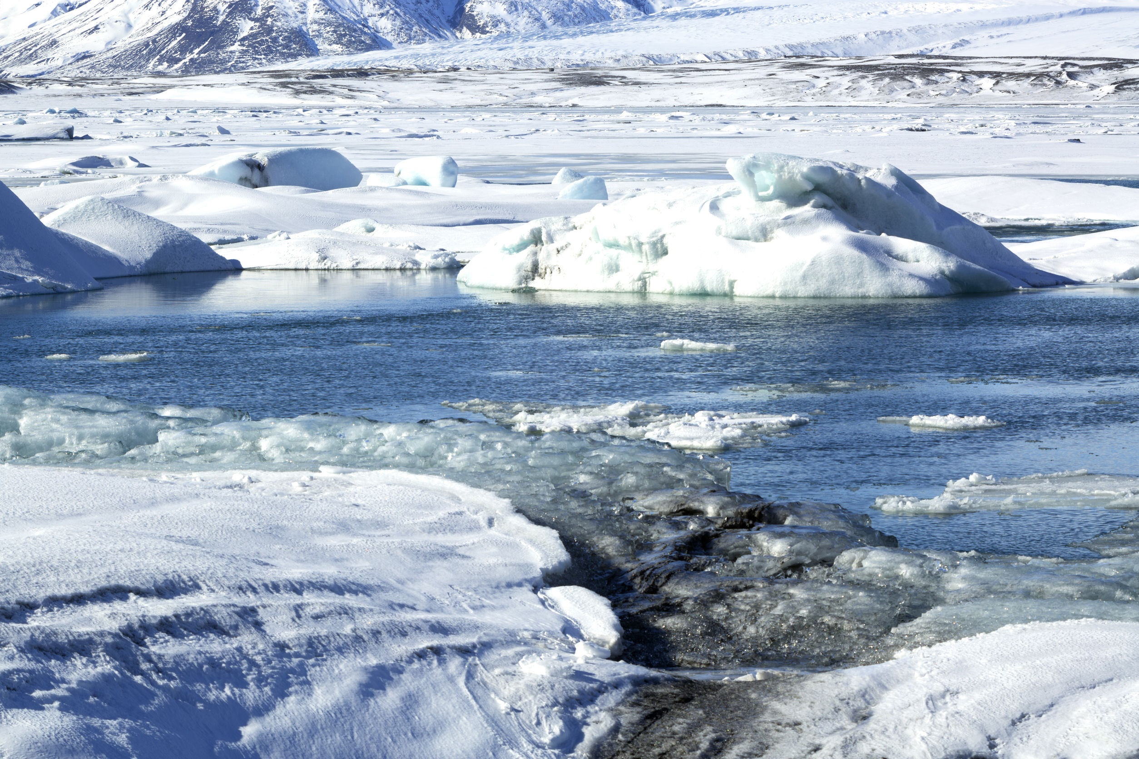
The temperatures of the Atlantic Ocean depend on the location and on the ocean's currents. The nearer to the Equator the warmer the water tends to be. The higher temperature of 28 degrees Celsius/82 degrees Fahrenheit is reached in coastal regions near the equator and the minimum temperatures is around -2 degrees Celsius/28 degrees Fahrenheit in the polar regions.
http://www.kids-world-travel-guide.com/atlantic-ocean-facts.html
Icelandic Coast
123rf.com

Slide 11
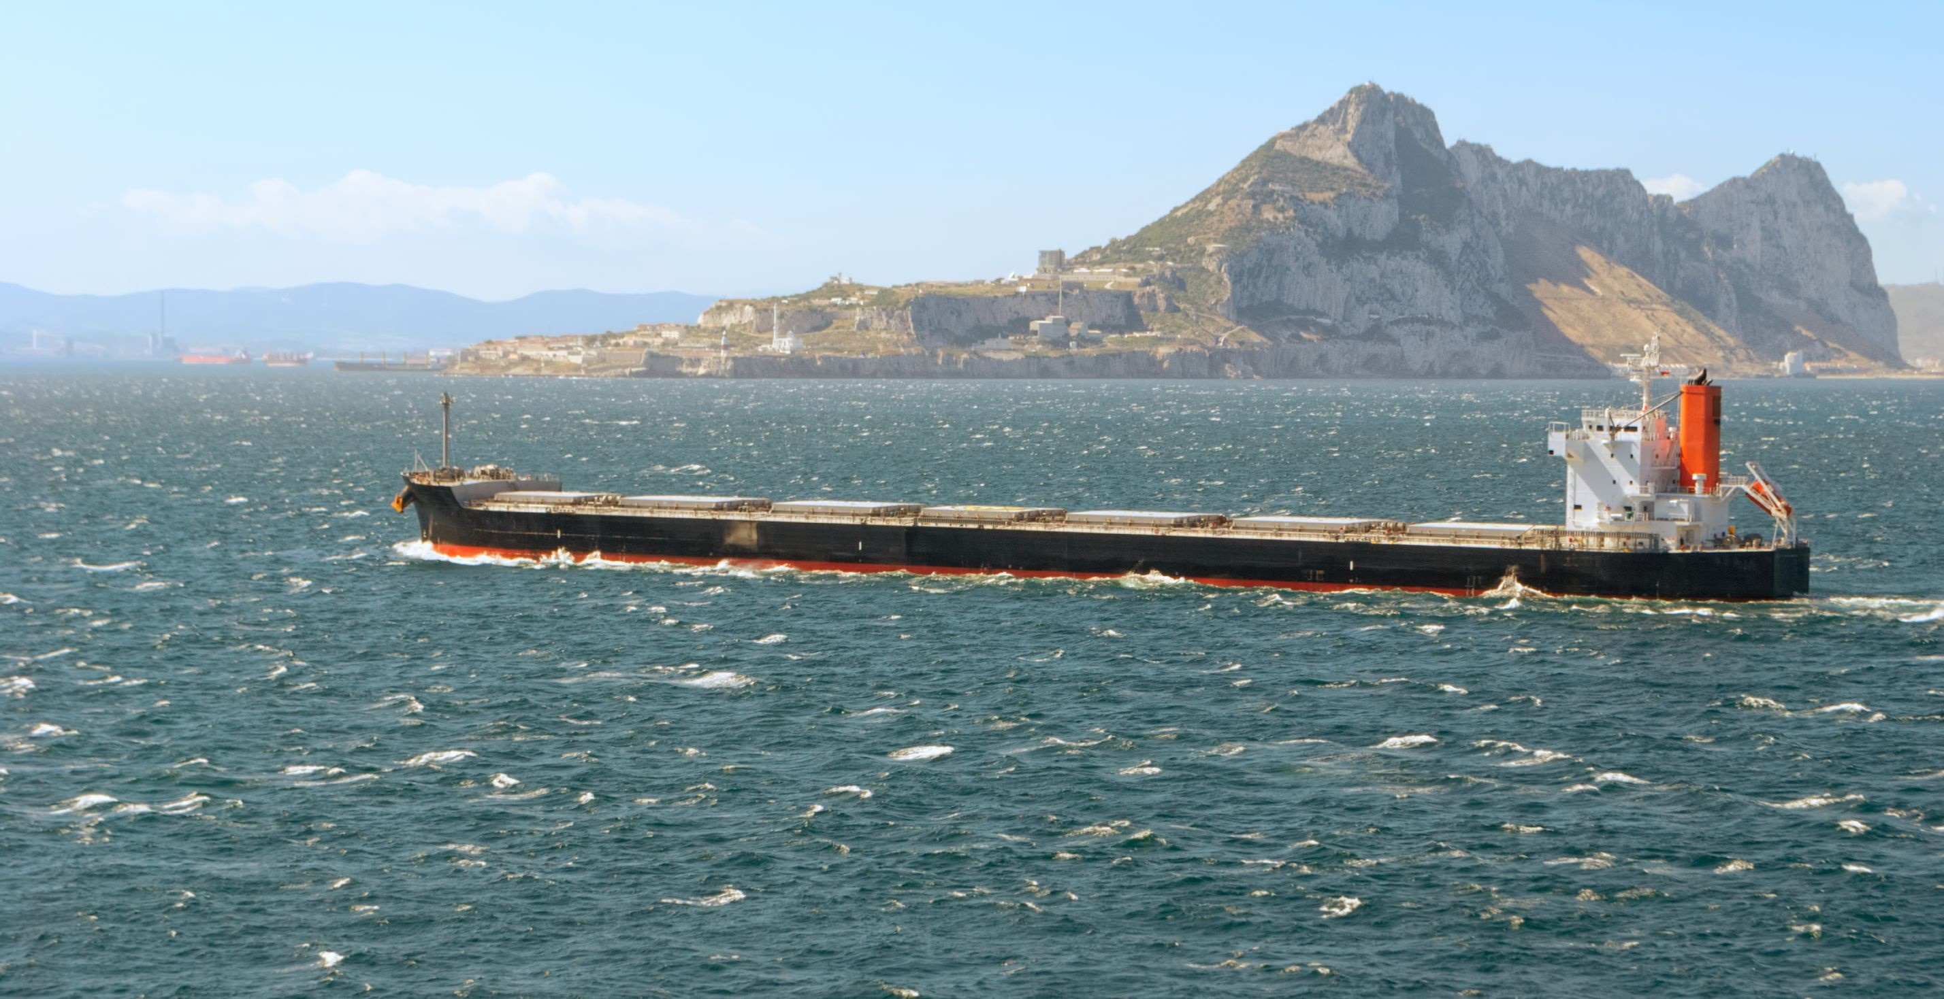
The Straits of Gibraltar between Spain and Morocco and the Bosporus in Turkey are two of the most well known waterways in the Atlantic Ocean.
http://www.kids-world-travel-guide.com/atlantic-ocean-facts.html
Straits of Gibraltar
123rf.com

Slide 12
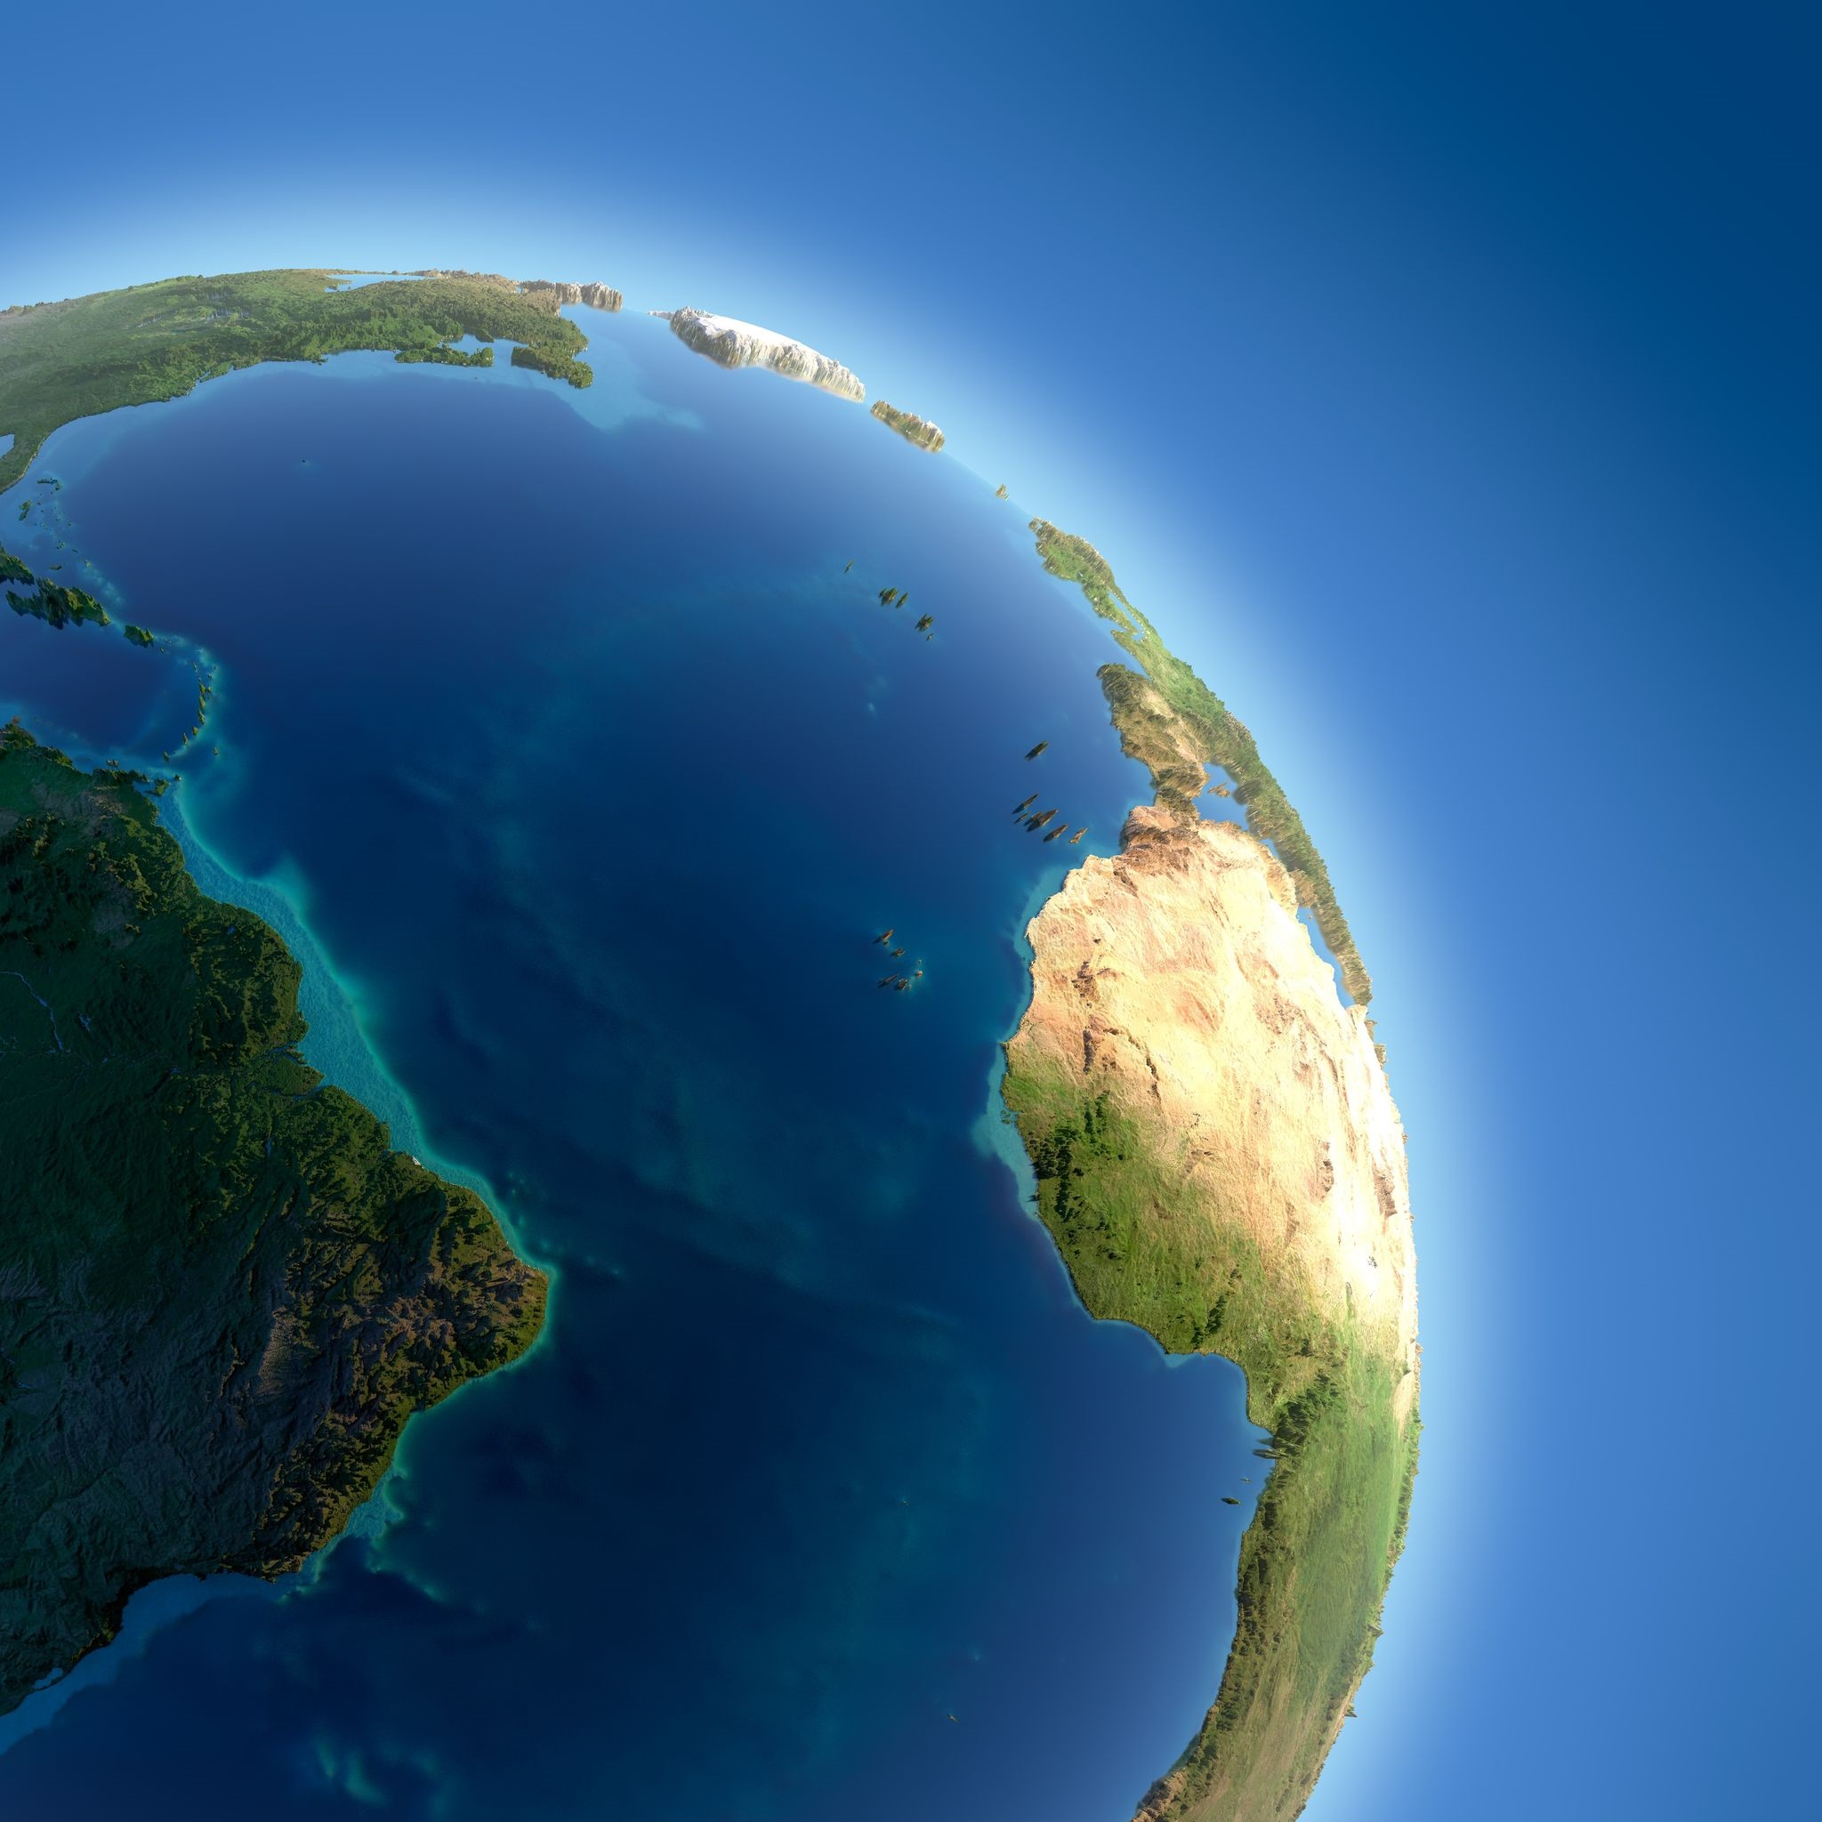
The greatest width of the ocean is between Brazil and Sierra Leone: 2,848 km or 1770 miles.
http://www.kids-world-travel-guide.com/atlantic-ocean-facts.html
123rf.com

Slide 13
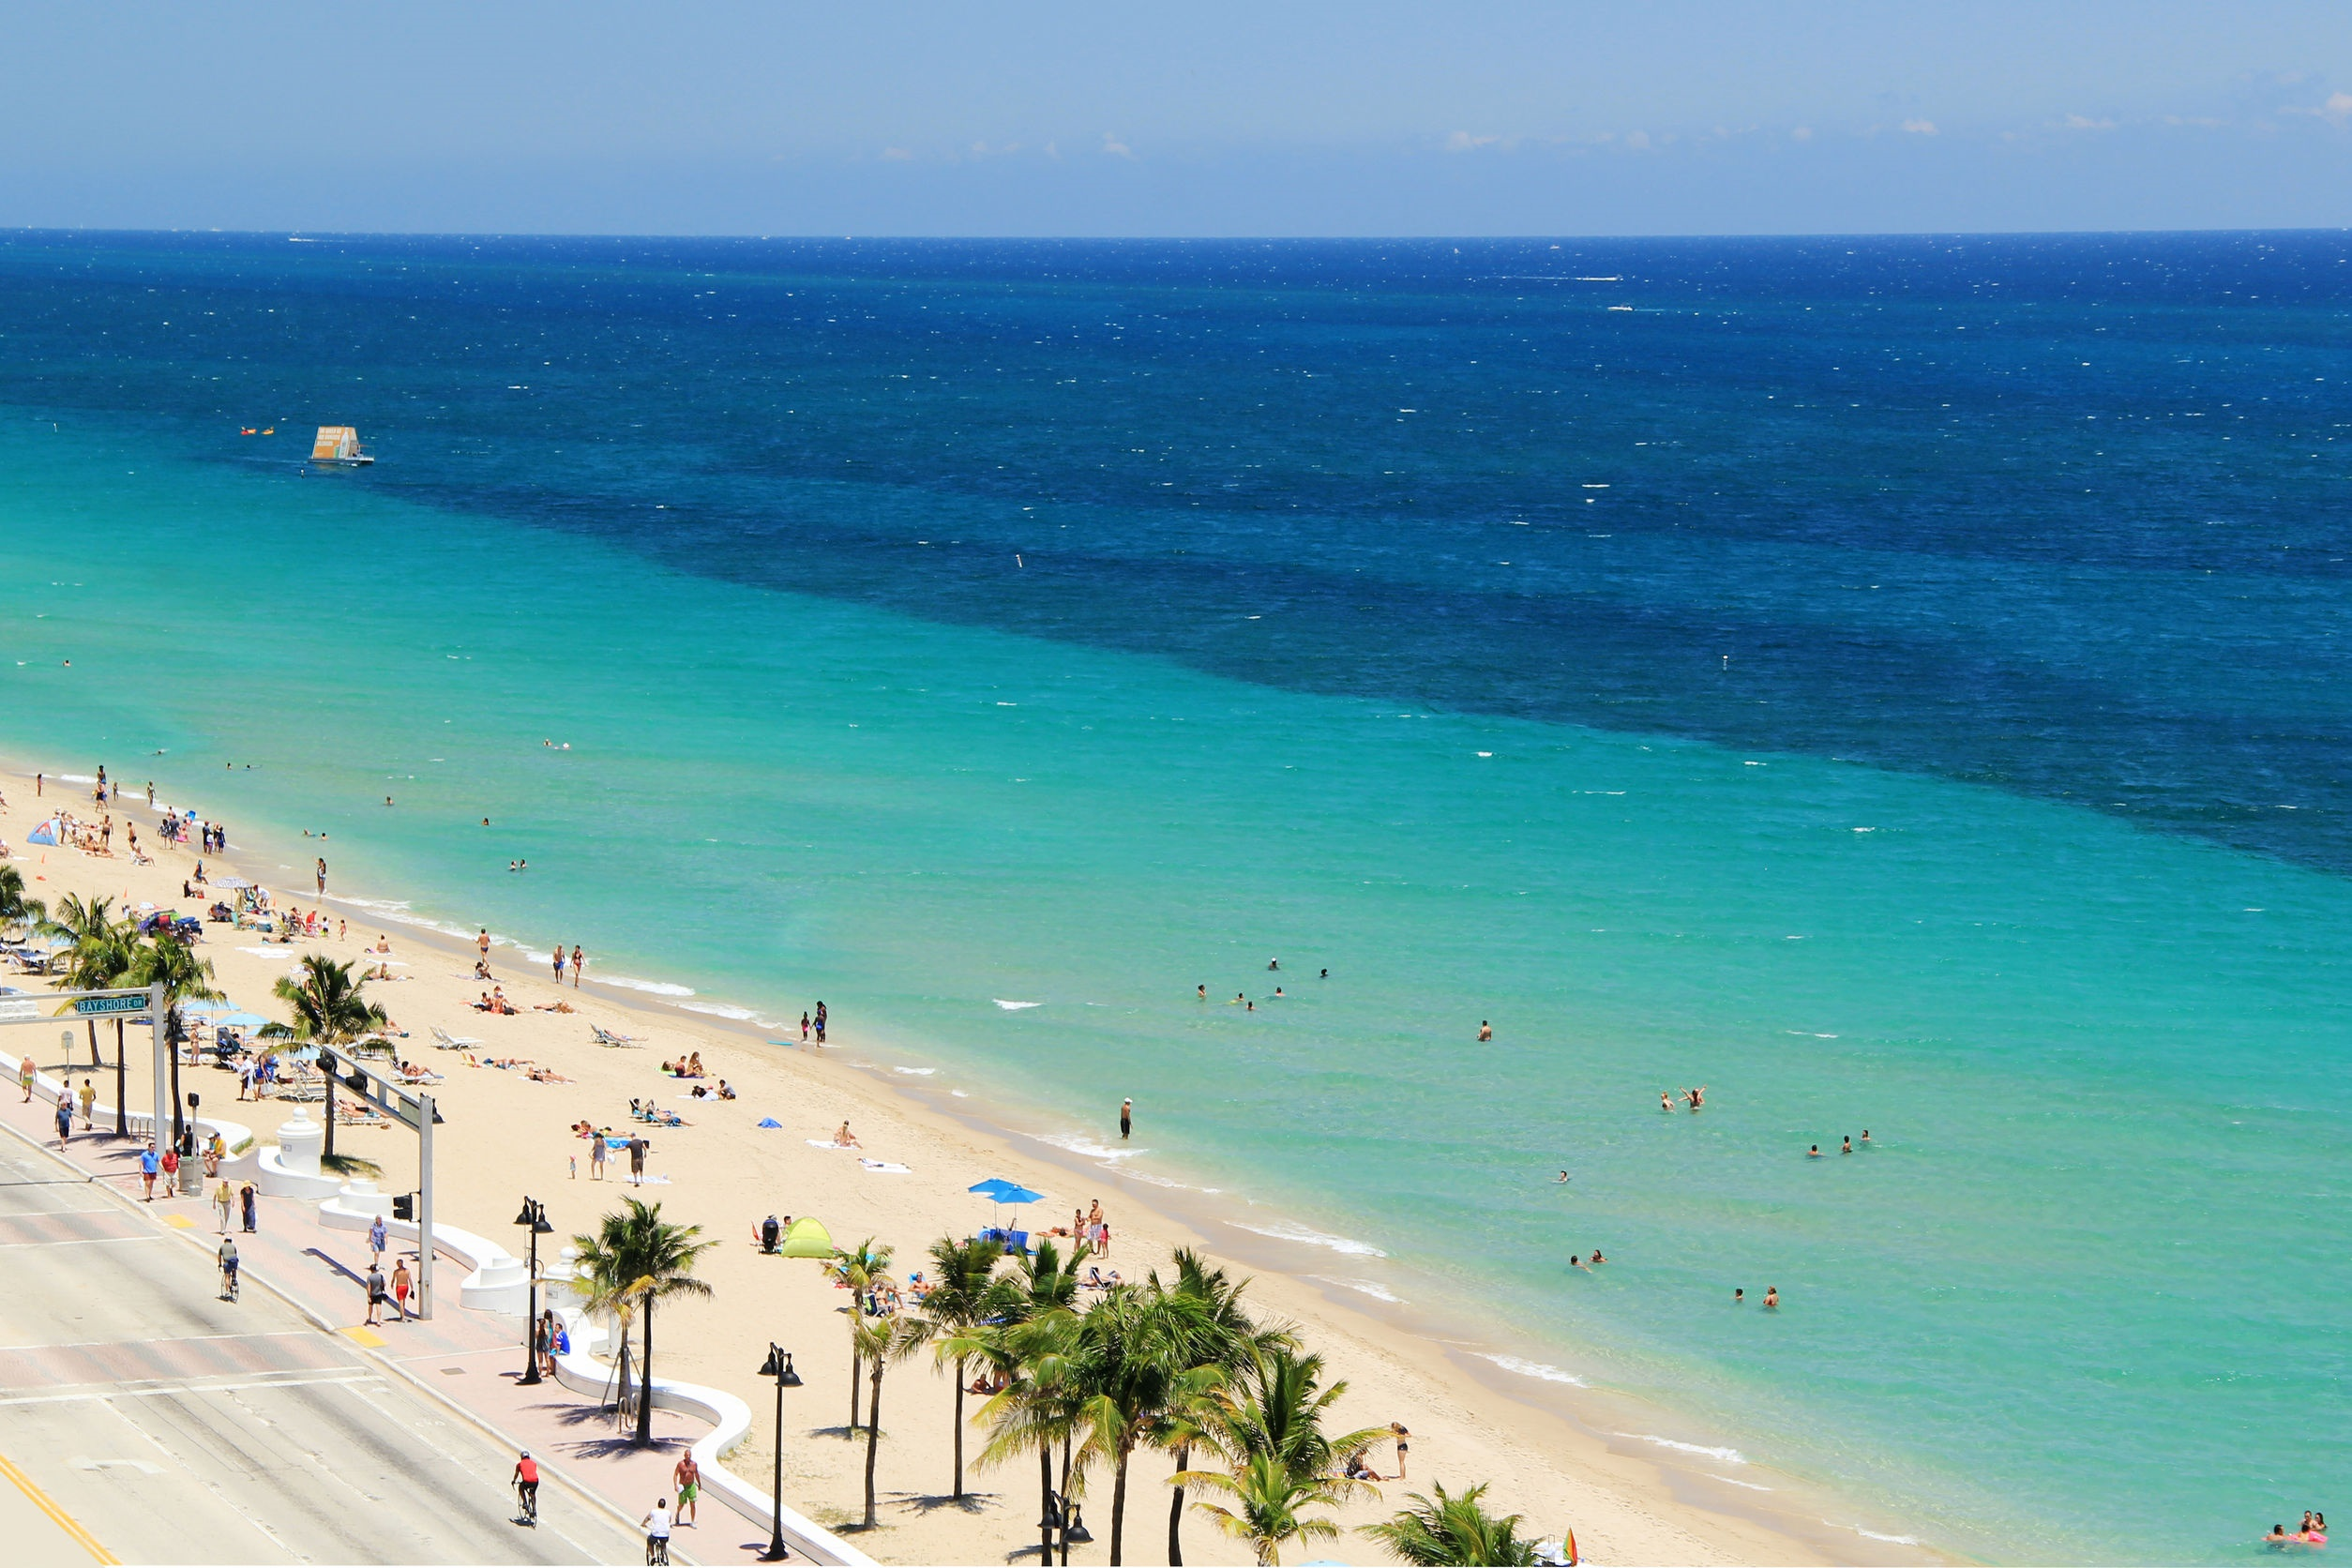
Ft. Lauderdale, Florida
Some other big cities on the Atlantic Ocean are:
Atlantic City (USA)
Miami (USA)
Sao Paolo (Brazil)
Cape Town (South Africa)
Lagos (Nigeria)
Casablanca (Morocco)
Lisbon (Portugal)
London (UK)
Reykjavik (Iceland)
http://www.kids-world-travel-guide.com/atlantic-ocean-facts.html
123rf.com

Slide 14
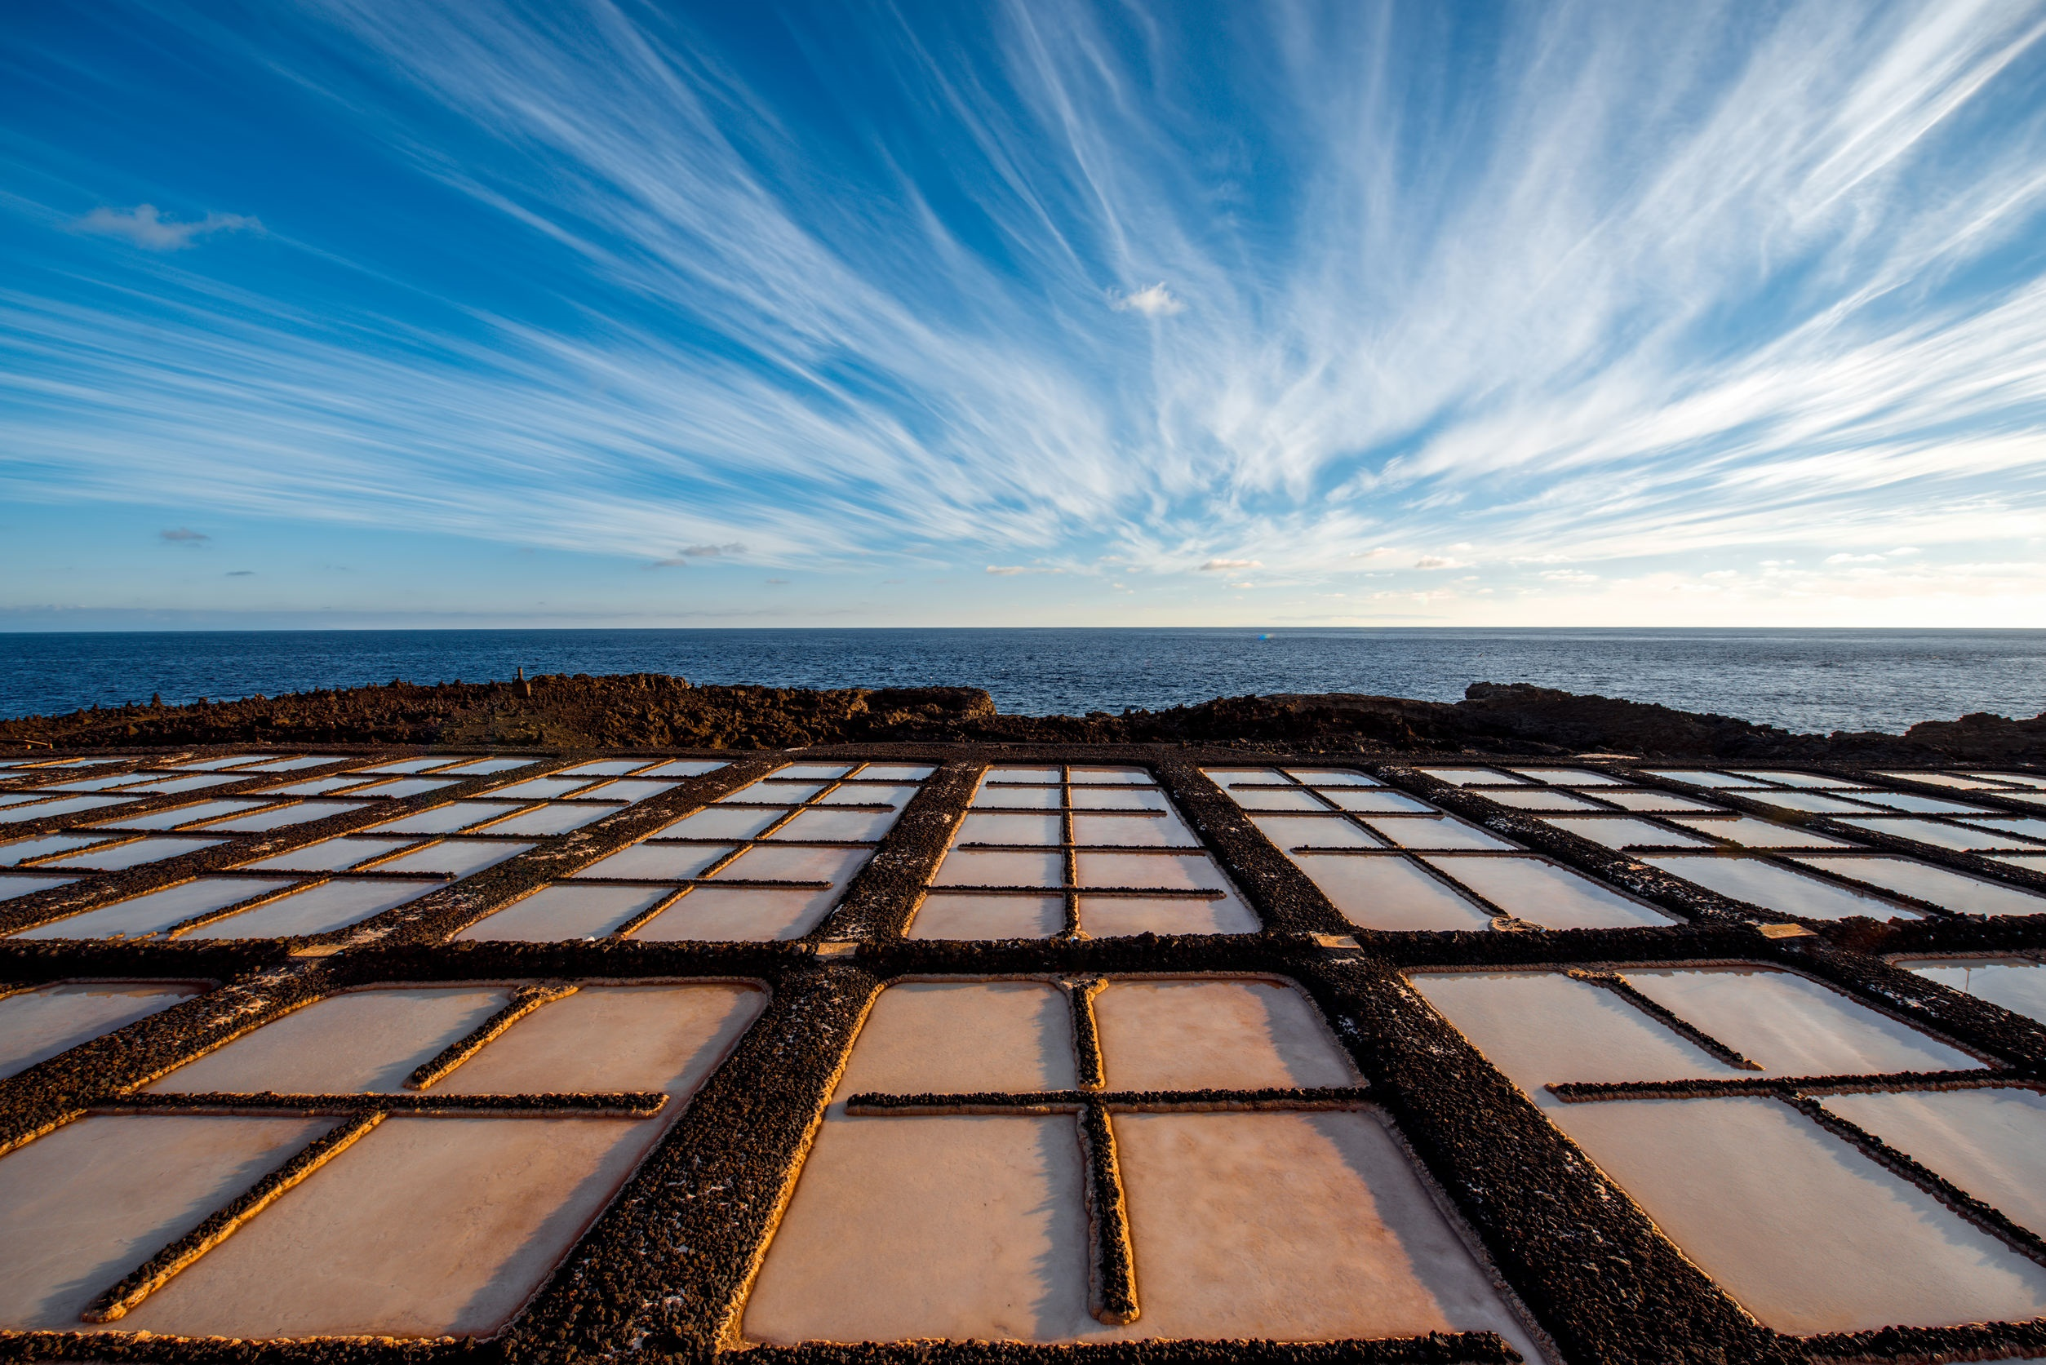
Salt Flat at La Palma Island, Spain
On average, the Atlantic is the saltiest of the world's major oceans; the salinity of the surface waters in the open ocean ranges from 33 to 37 parts per thousand (3.3 - 3.7 percent) by mass and varies with latitude and season.
http://www.newworldencyclopedia.org/entry/Atlantic_Ocean
123rf.com

Slide 15
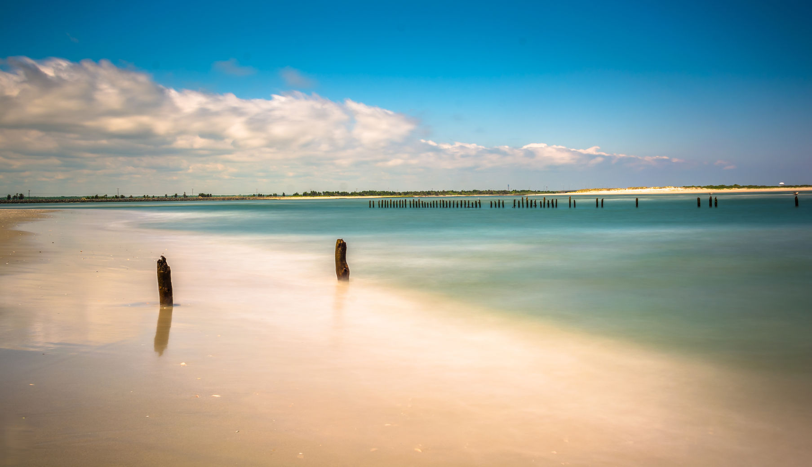
Strathmere Beach, New Jersey
Key Words
super-continent, Pangaea Atlantic Ocean continents
Milwaukee Deep Newfoundland Leif Erikson
Mid-Atlantic Ridge Sea of Atlas Equator
coastal regions second largest islands
Straits of Gibraltar ocean's currents salinity
123rf.com

