Slide 1
NICKY FIFTH’S NEW JERSEY
N5NJ
SECONDARY PROGRAM
EDUCATION
Beyond High School

Slide 2
By the time students reach middle school, many often start thinking about what they would like to do after high school. The options seem endless, overwhelming and a bit confusing. Fifty years ago, there were less options and careers were self-explanatory.
In today’s digital, global, ever-changing economy, things have grown rather complicated.
While many of the careers from yesteryear still exist, many have gone the way of the covered wagon and have been replaced with confusing, new careers.
Today, it isn’t uncommon to ask a person what they do for a living and walk away having no idea what they do for a living.

Slide 3
shutterstock.com
It’s no wonder that students start to feel ‘future stress’ before they even reach high school. In addition to the complex nature of new careers, there’s also to age-old issue of just not knowing what you would like to do.
It’s often hard, even as students graduate from high school, to know exactly what they would like to do for a living. Students often feel pressure from their families and self-conscious when their friends seem to have it all figured out.

Slide 4
To further complicate matters, students are often told to plan for jobs that will be there in the future.
That, however, is a prospect much easier said than done.
Technology’s break-neck pace makes most students feel that they would need a crystal ball to predict what jobs will still be available in thirty, twenty, or even fifteen years.
shutterstock.com

Slide 5
shutterstock.com
Prior to the 1980s, most students attended college with a specific career in mind. College was not the automatic next step after high school, unless you wanted a career that required a college education. If you wanted a career, such as an accountant, a doctor, a teacher, a nurse, an engineer, or a lawyer, you would need to pursue that college degree.

Slide 6
If, however, you wanted a different career, you most likely did not attend college. Students who considered the trades and enjoyed working with their hands, embarked on a different path.
Financially, it makes no sense to spend the time and money on a four year degree if you want a career like carpenter, electrician, plumber, auto mechanic, firefighter, hair stylist, chef, court stenographer, secretary, or mason.
These students took vocational classes in high school, attended trade schools, were accepted to academies, and/or apprenticed.
shutterstock.com

Slide 7
During the 1980s, attitudes began to shift and somewhere along the line, society decided that every student must have a college degree, often referring to it as the new high school diploma. The measuring stick shifted importance from satisfying career to obtaining a college degree.
Everyone was now expected to go to college. Families approached the situation as one-size-fits-all and college became an all-in or all-out proposition. Families who could afford to send their children to expensive four-year schools or families who were willing to mortgage their homes, often did so without a clear understanding of what this meant.
shutterstock.com

Slide 8
Suddenly the career became secondary to the college experience. A nation swept up in the everyone must go to college craze blindly took on massive debt to finance college degrees.
We stopped promoting the arts and the trades and began measuring success with things like salary and power. In the wake of this craze, we devalued our tradesmen and tradeswomen and found ourselves with more college graduates than jobs. To make matters worse, college graduates were carrying excessive debt upon graduation, frequently over $100,000.
shutterstock.com

Slide 9
Yes, somewhere along the way, the message touting the importance of college for specific careers was muddled into every student must attend college. And not just any college.
Parents and students felt pressure to attend expensive four-year institutions, spending weekends college shopping and comparing notes. Many parents were setting up college funds before their children were even born.
Society began defining people by their college degree or lack thereof instead of seeing college for what it is…
a valuable tool to enter specific careers.

Slide 10
In hindsight, it’s clear that this new way of thinking has created numerous problems. First, not every student should go to college. This may be the first time you are hearing those words, so brace yourself. College should be a means to an end.
That means, you should absolutely attend college if the career you desire requires a degree. Unfortunately, since the 1980s, many students selected college based on everything other than future career. However, if you are not a great student, struggle academically, have other interests, or are just not sure what to do, you should know there are other worthy options.
shutterstock.com

Slide 11
Many students struggle to decide what they would like to do, often changing majors several times and at great expense. Many students who would have excelled in the Arts or a Trade, found themselves frustrated, unable to complete their studies, and in debt.
And the irony is that many college graduates are unable to find jobs while those who chose the trades are usually able to find work and often earned a higher income than the college graduates.

Slide 12
shutterstock.com
Luckily, there is a better approach and New Jersey is the perfect place to implement it. The approach begins with serious thought and a solid plan.
Before you consider a college education, you should first ask yourself what type of work you would like to do. While many people eventually end up doing work totally unrelated to their degree, it’s still a good place to start.

Slide 13
If you have no idea what you would like to do, perhaps an expensive four-year school isn’t the right decision, right now.
A better idea would be to get a job and take some courses at your a community college. It’s an inexpensive way to experiment with different career paths.
Working while you do this will also give you some great life experience (handy for selecting a career) as well as a work ethic and independence.
shutterstock.com

Slide 14
Volunteering your services in a field that interests you is also a great way to discover your true interests. And speaking of volunteering, consider volunteering in your community. It will give you a new perspective and could lead to future networking opportunities.
shutterstock.com

Slide 15
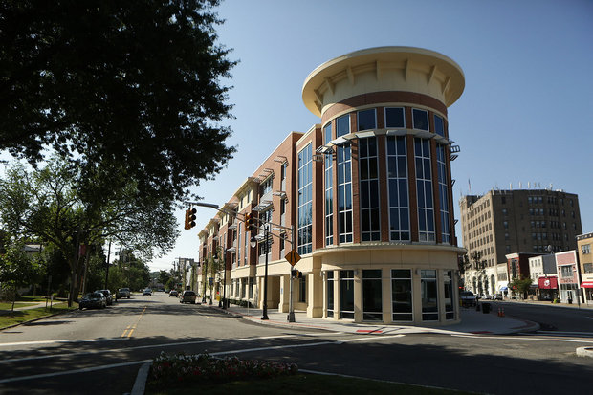
If you have a good idea of what you would like to do (let’s face it, some kids have known what they’d like to be since kindergarten), but money is an issue, start at your local community college.
The first two years of college look pretty similar no matter where you go. Why pay over $50,000 for your freshman year when you can go to a community college and pay less than $10,000?
Financially speaking, community colleges are an amazing opportunity and make financial sense.

Slide 16
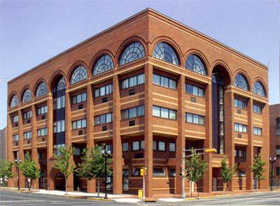
shutterstock.com
Now, there was a time when people often looked down upon community colleges and considered them to be 13th grade. A myth, to be sure and nothing could be farther from the truth. Community colleges offer a solid, affordable college education and are often aligned with major universities. They offer programs with a guaranteed transfer to participating institutions and even online classes to accommodate your schedule.
There are 19 Community Colleges in the Garden State, conveniently located in all areas. Most, accessible by public transportation, offer a cost-effective means to complete an Associates Degree, complete the first two years of a Bachelor’s Degree, or complete a certificate program.
http://www.collegesimply.com/colleges/new-jersey/community-colleges

Slide 17
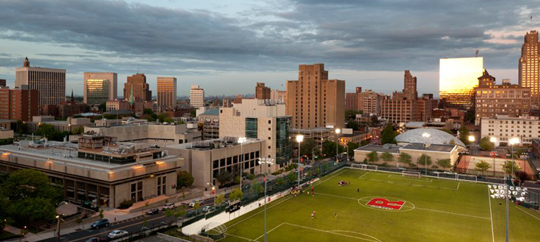
In addition to excellent community colleges, some of the best colleges in the nation are in New Jersey.
From the 2016 #1 school in the nation, Princeton, to the renowned State University of Rutgers, to private schools like Seton Hall and Farleigh Dickinson, to the New Jersey Institute of Technology and Stevens Institute of Technology, New Jersey offers outstanding opportunities.
shutterstock.com

Slide 18
If you decide you are interested in a career that doesn’t require college, look into trade schools and apprenticeships where you can become highly trained through a certificate program, specific to your interests.
Many institutions offer hi-tech certificates without the expense of a four year school and many of these jobs are, and will continue to be, in demand.
And if you decide to own your own business one day, you can head over to your community college and take a few business classes.
shutterstock.com

Slide 19
Finally, never look down upon any career or job that requires honest, hard work. Our society requires much more than college graduates to function.
We need people to build our colleges, homes, schools, cars, and roadways. We need people to repair those items. We need services such as hair stylists and barbers, restaurants, retailers, delivery services, and sanitation services for garbage and recycling, to name a few.
The goal should be to become a contributing member of society and make an honest living. Remember, there are many, many options and many ways to get there.

Slide 20
Key Words
ever-changing economy future stress predict
vocational classes academically career
college degree changing majors college
tradesmen tradeswomen trades
four-year institutions solid plan mortgage

