Slide 1
NICKY FIFTH’S NEW JERSEY
N5NJ
SECONDARY PROGRAM
EDUCATION
Teacher Requirements

Slide 2
The responsibilities of teaching are such that there are numerous studies and steps involved in becoming a teacher. While in college, you will most likely earn practical experience through programs like Junior Practicum and Senior Student Teaching.
These programs are invaluable as they provide a glimpse into the day-to-day operations of teaching while also providing vital experience. There are, however, additional steps before you are eligible to teach.
shutterstock.com

Slide 3
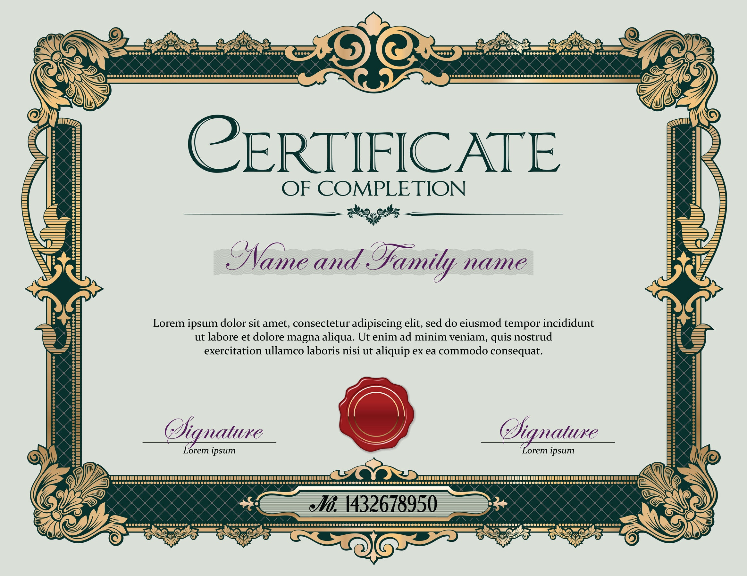
LICENSING AND CERTIFICATION REQUIREMENTS
Teaching is a comprehensive profession requiring practitioners to take on a variety of roles. Teaching qualifications typically involve subject matter expertise, psychological awareness and classroom management.
Qualification details can vary depending on location, but there are core requirements to expect across the board.
http://study.com/qualifications_for_being_a_teacher.html
Brand New Teacher

Slide 4
shutterstock.com
Teachers educate students from preschool to high school, and beyond, in subjects such as mathematics, language arts, social studies, science and more. While most teachers hold a bachelor's degree in education, many colleges offer teaching certification programs for those who already hold a bachelor's degree in another discipline.
http://study.com/qualifications_for_being_a_teacher.html

Slide 5
Elementary school teachers educate their students in subjects, such as mathematics, language arts and social studies. Accordingly, students wanting to become elementary school teachers take courses in how to teach these subjects. These students also take courses in human development, child psychology, curriculum design and literacy instruction, all of which prepare them to teach classes to younger students.
http://study.com/qualifications_for_being_a_teacher.html
shutterstock.com

Slide 6
shutterstock.com
Students who plan on teaching at the middle or high school level generally take major-level courses in the subject they wish to teach, in addition to the required teacher education curriculum.
For example, students wishing to teach economics to high school seniors may major in economics and education, completing both respective requirements to earn their degree. This helps aspiring middle and high school teachers develop skills in lesson planning and curriculum assessment in their field of interest.
http://study.com/qualifications_for_being_a_teacher.html

Slide 7
shutterstock.com
All prospective teachers must participate in professional fieldwork, often included in education degree programs, in which they are assigned to help or teach a class under the supervision of a licensed teacher. This practice helps students gain real world experience as student teachers, monitoring classes and meeting with parents.
http://study.com/qualifications_for_being_a_teacher.html

Slide 8
While licensure may not be necessary for private school teachers, it is required for all public school teachers. State requirements for teaching licenses vary; however, most include:
A bachelor's degree
The completion of a teacher education program
Supervised teaching experience
The completion of basic writing and math skills tests
http://study.com/qualifications_for_being_a_teacher.html
shutterstock.com

Slide 9
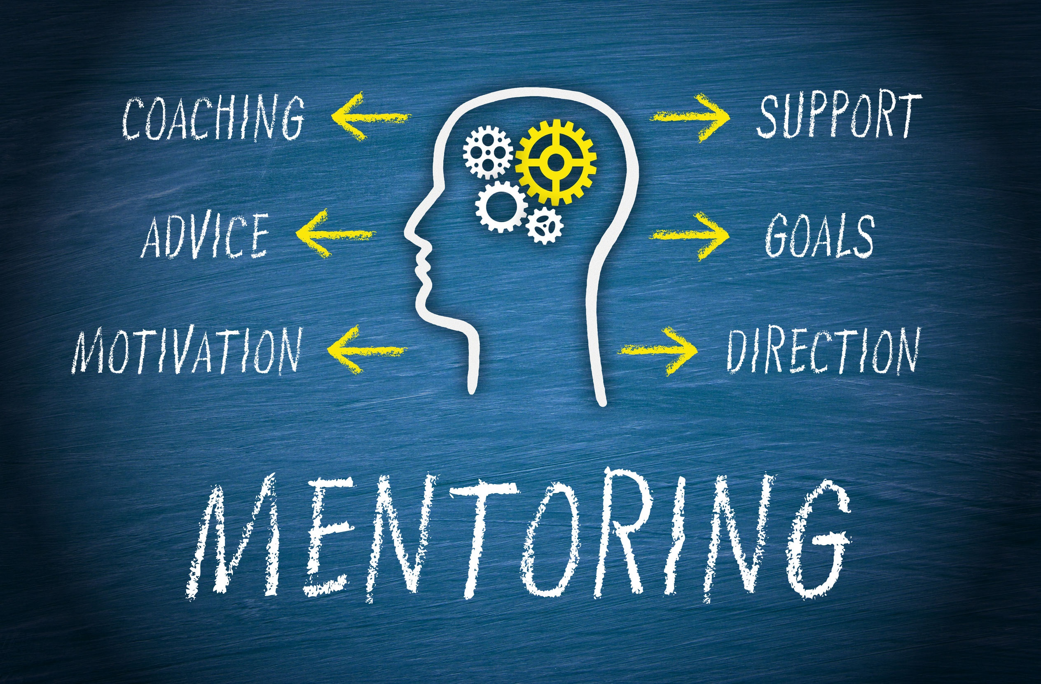
shutterstock.com
STUDENT/MENTORED TEACHING
Many states require student teaching experience and/or first year mentoring of new teachers.
https://www.teach.org/teaching-certification

Slide 10
BACKGROUND CHECK
States conduct criminal background checks and may also confirm citizenship status.
https://www.teach.org/teaching-certification
shutterstock.com

Slide 11
shutterstock.com
TESTING
States require that you complete a general teaching certification exam, such as a Praxis test, as well as a content-specific test for the subject(s) that you want to teach.
https://www.teach.org/teaching-certification

Slide 12
Key Words
Senior Student Teaching Junior Practicum teacher
bachelor's degree certification exam experience
curriculum design literacy instruction practitioners
major-level courses curriculum assessment supervision
prospective teachers lesson planning discipline
shutterstock.com

