Slide 1
NICKY FIFTH’S NEW JERSEY
N5NJ
SECONDARY PROGRAM
LIFE
Savvy Consumers

Slide 2
shutterstock.com
The definition of a consumer is a person who purchases goods and services for personal use. Today, we are also consumers of information that influence the products and services we purchase.
Consumers have an influence on the marketplace. All consumers have rights and responsibilities. One right is to collect information, but you have the responsibility of evaluating that information. Before making a consumer complaint, determine what you want to achieve, whom you will contact, and how.
http://www.worldwar1centennial.org/index.php/nj-wwi-centennial-home.html

Slide 3
Consumers have an influence on the marketplace. All consumers have rights and responsibilities. One right is to collect information, but you have the responsibility of evaluating that information.
http://glencoe.mheducation.com/sites/0078933862/student_view0/unit4/chapter12/chapter_summaries.html
shutterstock.com

Slide 4
Never in human history have there been so many choices as to what to spend your money on. And never have marketing tactics to get you to buy those things been so sophisticated.
Every time you swipe a store loyalty card, use your smart phone, log into Facebook, or surf the net, companies are mining this data, gathering information on your address, family size, education and income level, favorite books, movies, and hobbies, and history of purchasing behavior. This data is then fed into complex algorithms that craft ways to target you with ads and mailings pitched to your specific hopes, dreams, and insecurities. Corporations have you in their sights.
http://www.artofmanliness.com/2012/08/24/heading-out-on-your-own-day-24-how-to-be-a-savvy-consumer

Slide 5
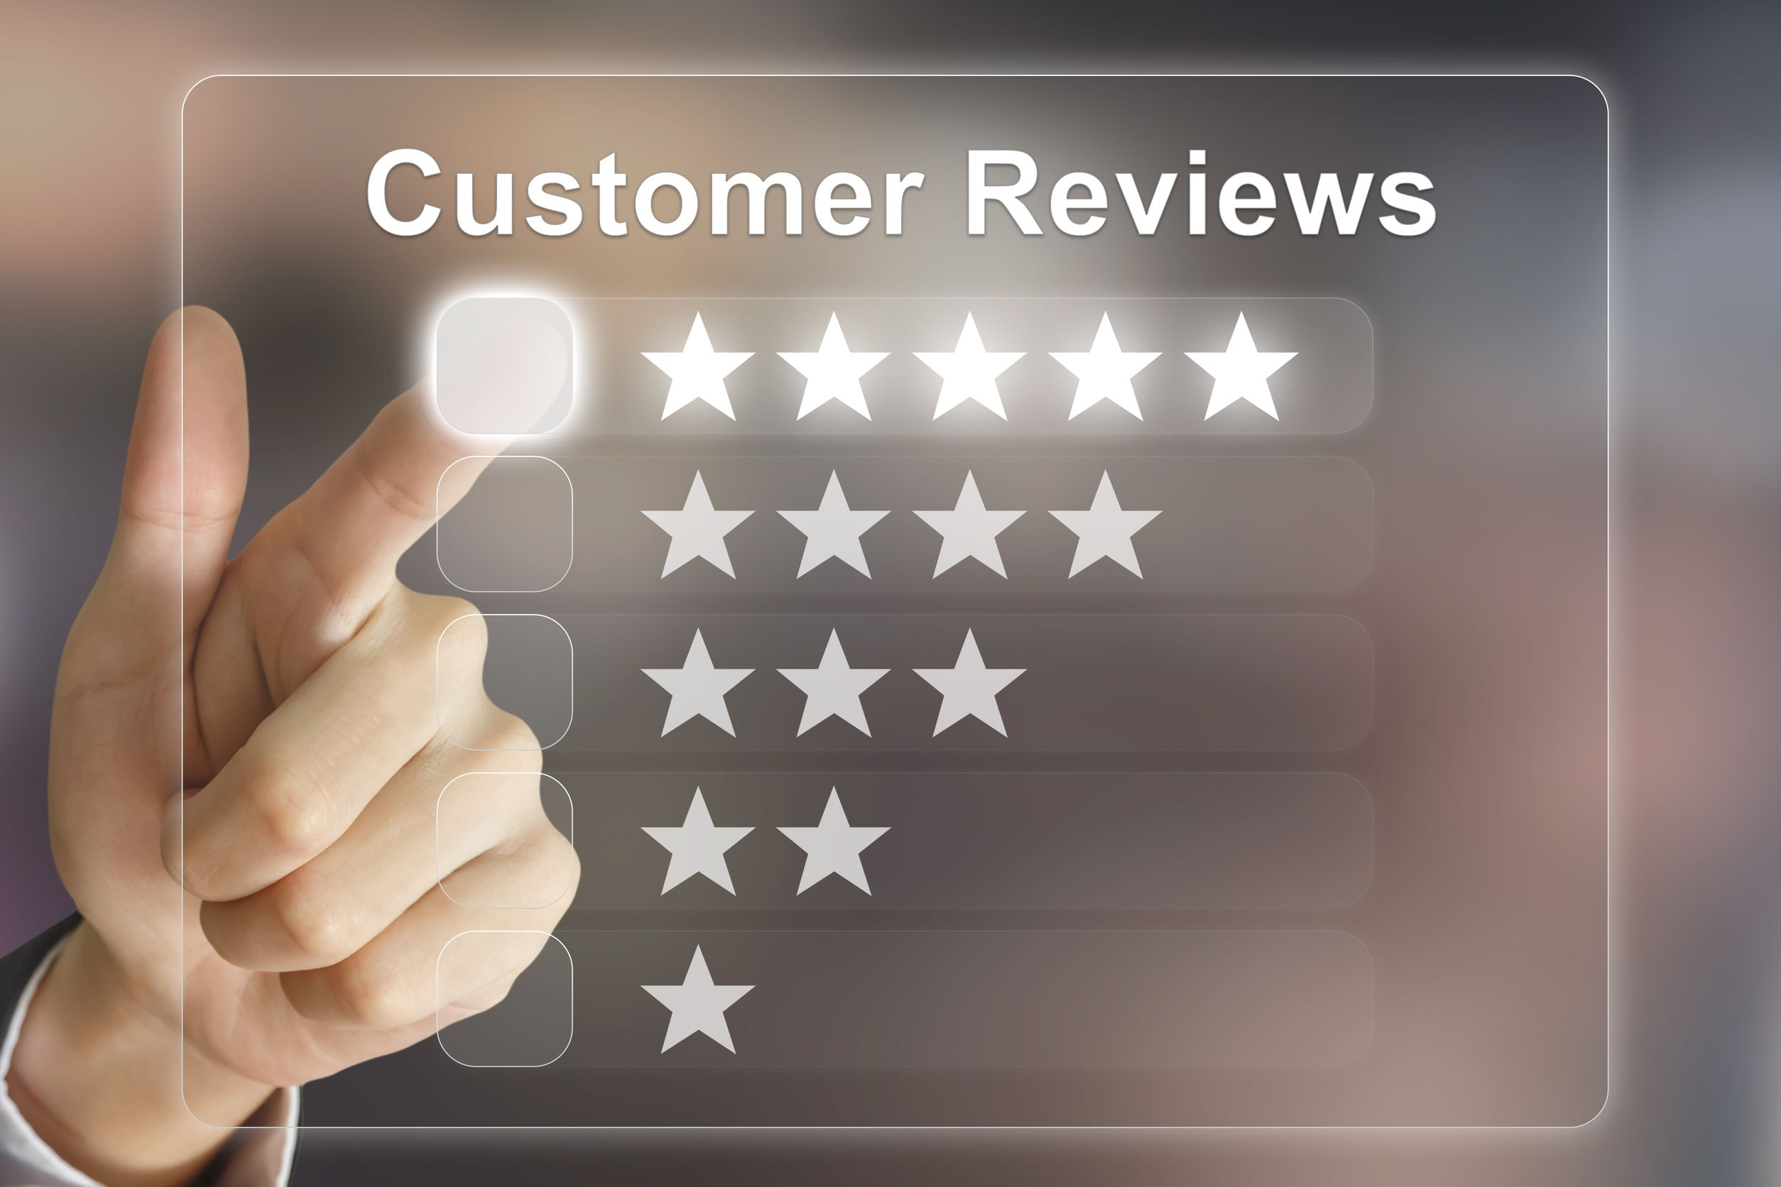
Not to paint too sinister a face on it, but companies are simply offering products and services that people want, but to the degree that marketers track you, they are essentially “predators” on the hunt. They don’t want to eat you, certainly (you’re much more valuable alive!), they just want to burrow into your mind and get you to buy their stuff. They’ve got millions of dollars and sophisticated tools at their disposal, so the playing field is far from level, but as the “prey,” you can definitely put up a fight.
You need to be educated and empowered, an informed savvy consumer who doesn’t buy mindlessly on impulse and end up with a house full of useless or non-functioning junk and a mountain of debt. The informed savvy consumer makes his purchases on his terms and does his homework to make sure he doesn’t get ripped off, receives the most bang for his buck, and only buys what he truly wants and needs.
http://www.artofmanliness.com/2012/08/24/heading-out-on-your-own-day-24-how-to-be-a-savvy-consumer

Slide 6
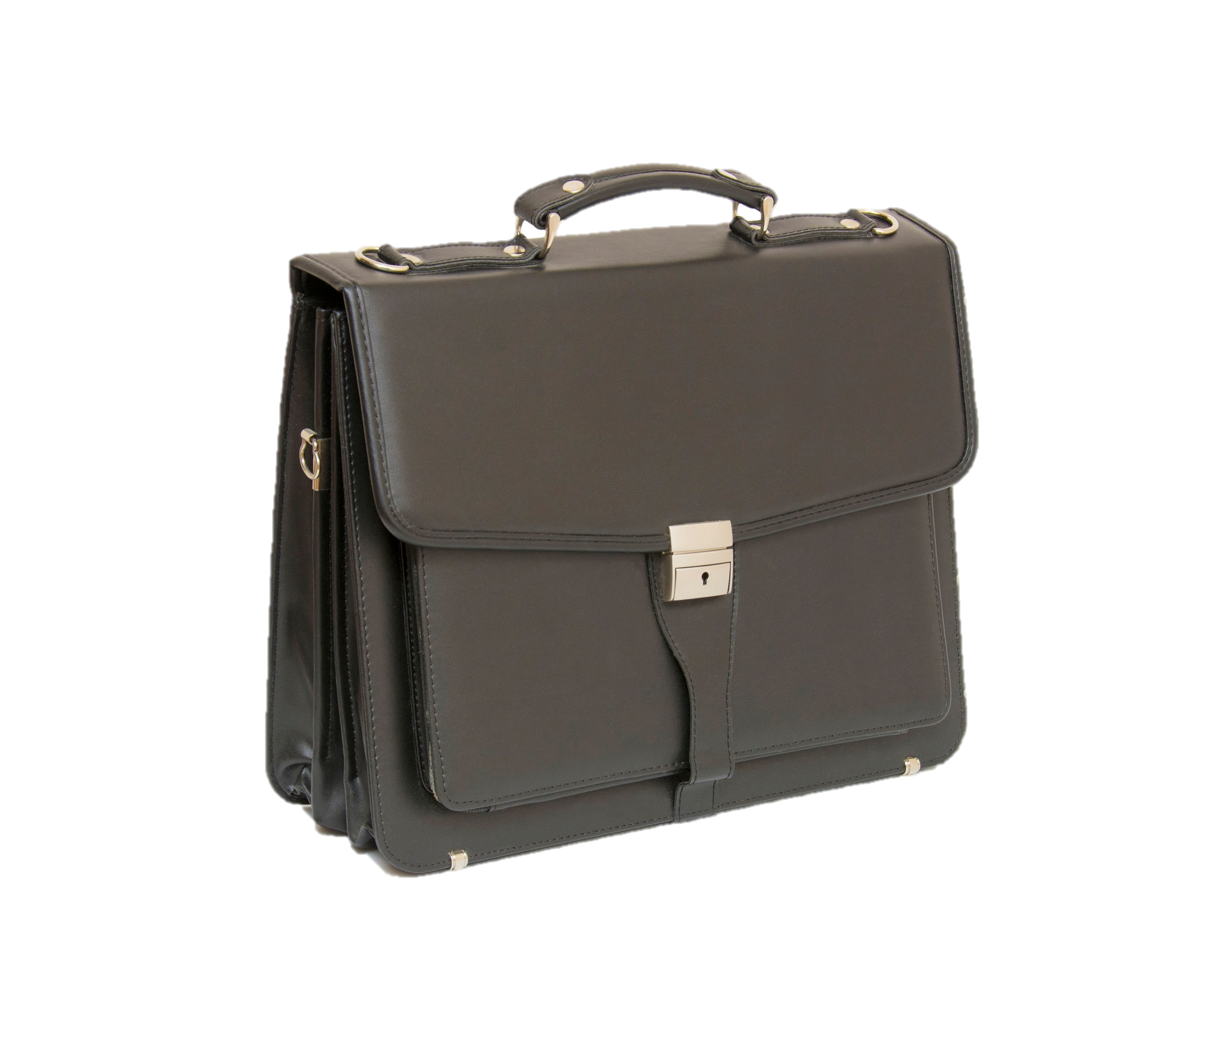
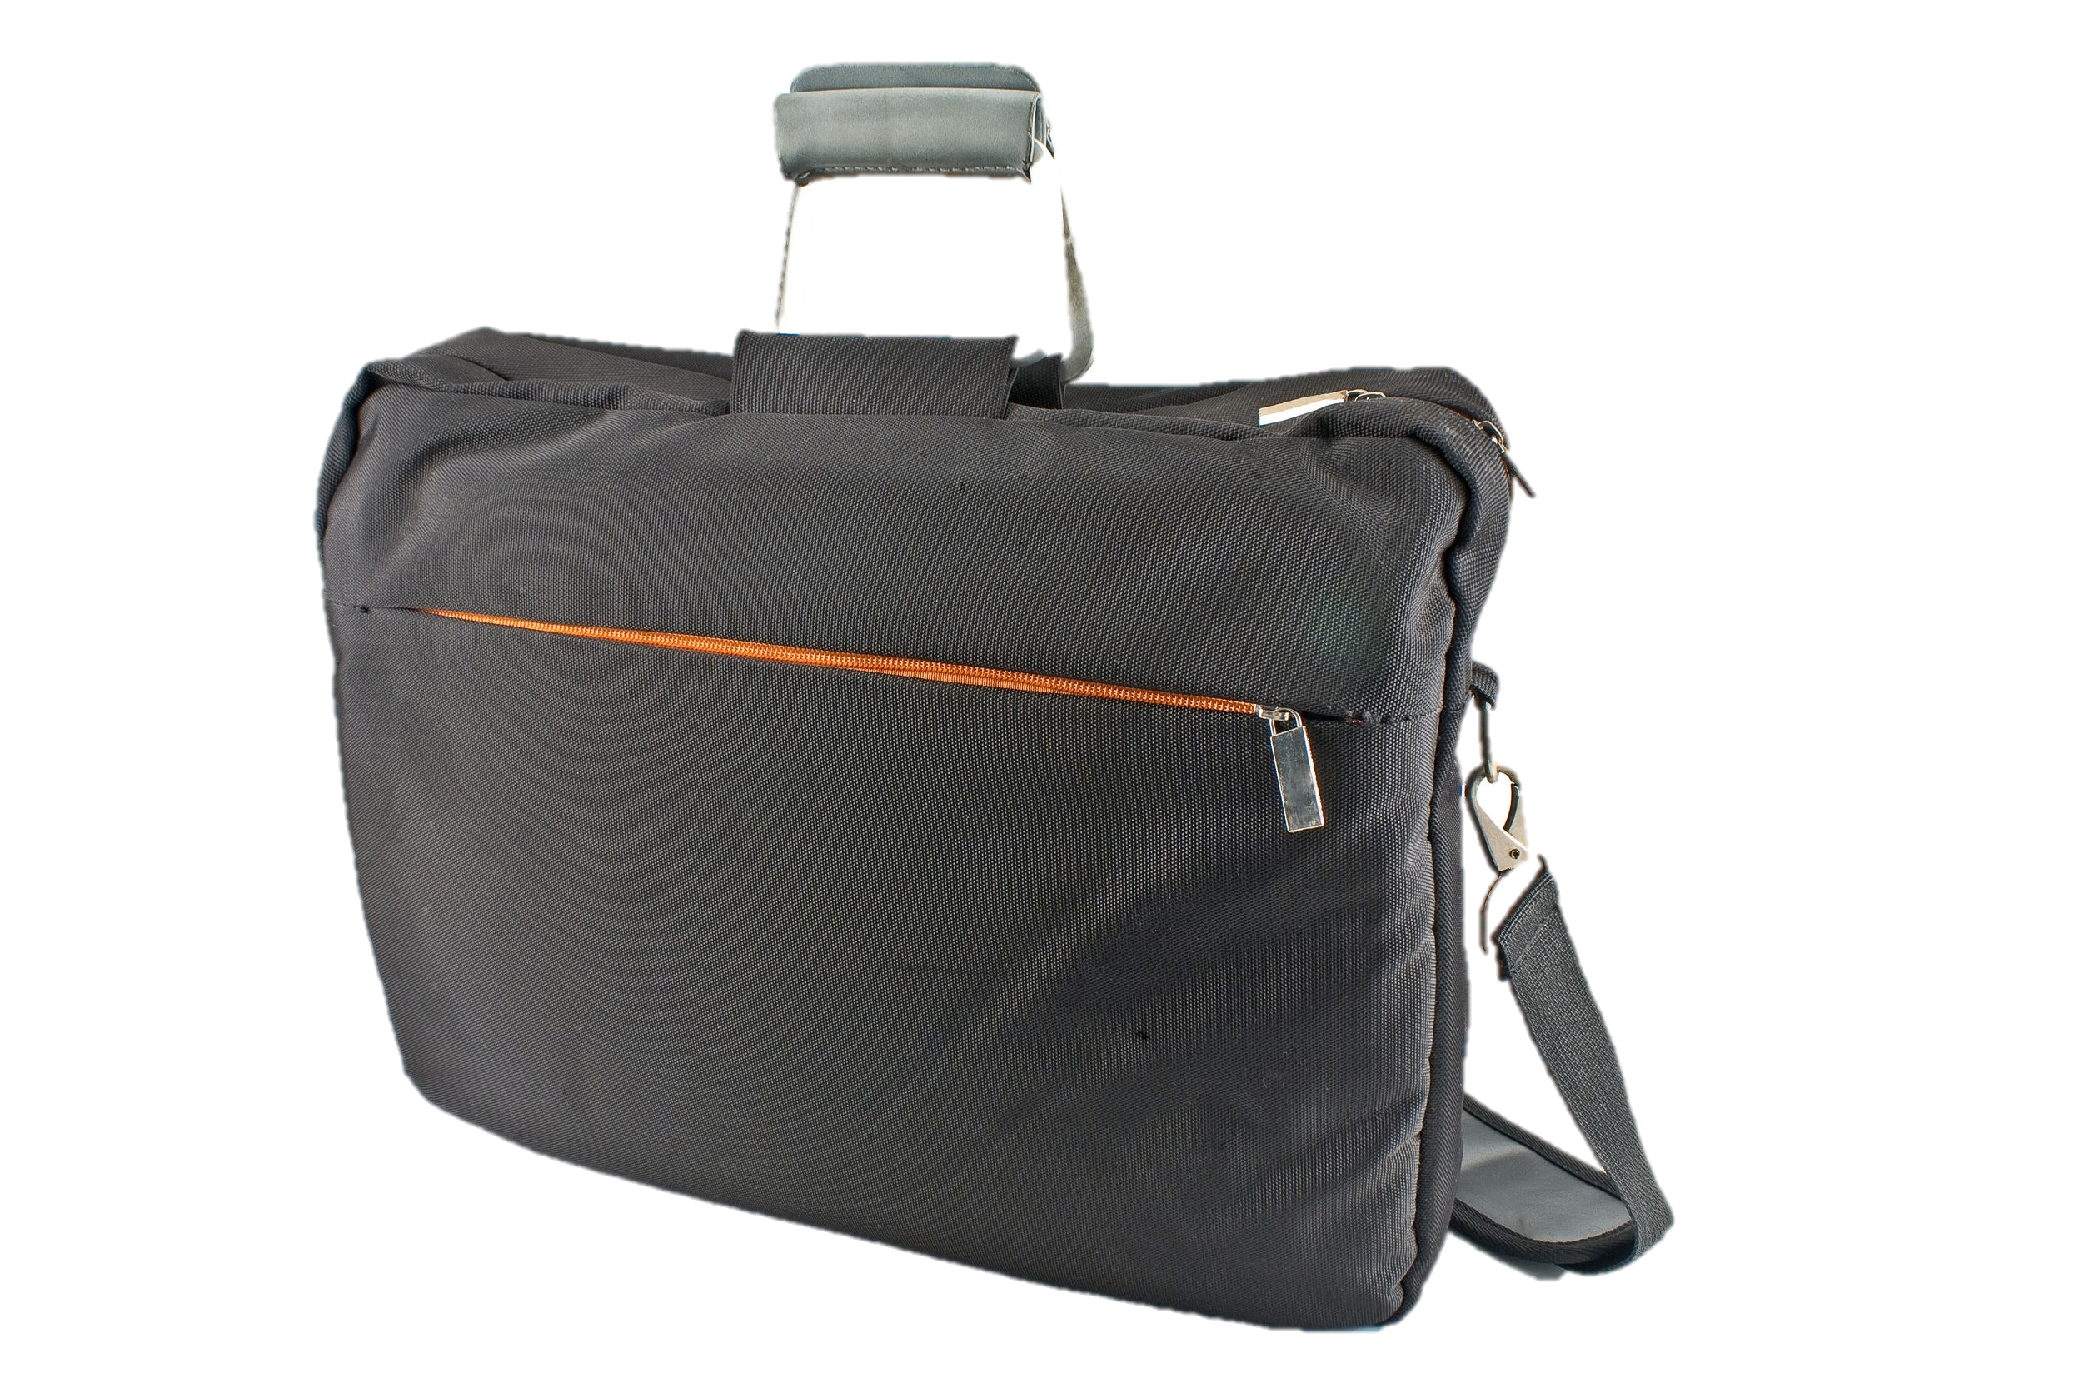
Gauging Price per Use
Let’s start with the example of a leather briefcase. Bob shops on price and buys a nylon messenger bag for $50. Frank, however, buys a leather briefcase with a lifetime warranty for $500. They each use their respective bags 200 times a year. Bob’s cheap bag wears out after three years and he has to replace it. Frank’s leather bag lasts 50 years, and he hands it down to his grandson. In Bob’s case the price per use on his bag was about 8 cents (200 uses a year x 3 years divided into $50). For Frank, his cost per use is 5 cents, which will only go down as his grandson continues to use the bag. So ultimately, while Bob’s bag was initially a whole lot cheaper, in the long run Frank’s purchase will turn out to be the better deal.
http://www.artofmanliness.com/2012/08/24/heading-out-on-your-own-day-24-how-to-be-a-savvy-consumer

Slide 7
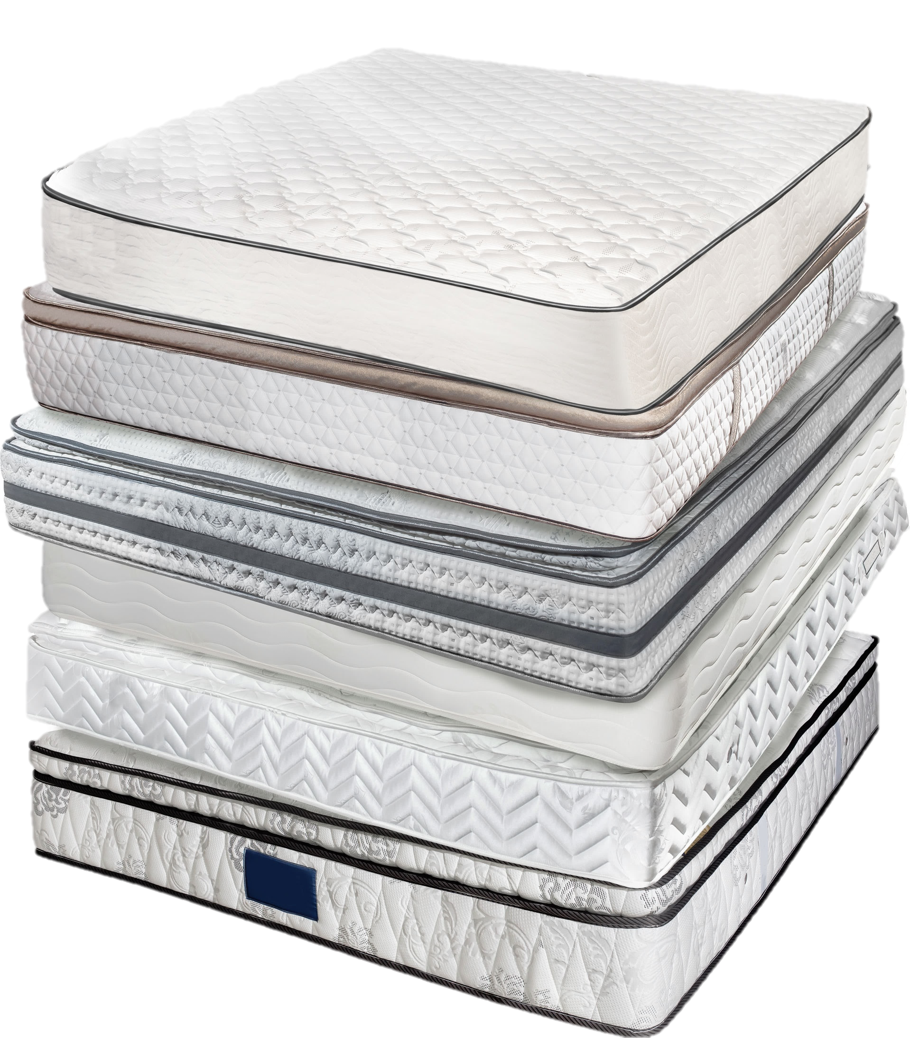
Another good example of this is buying a mattress — you’ll be spending a third of your life on it, so purchasing one that helps you get a deep sleep night after night is an incredible value, even if the mattress you choose is more expensive than a cheaper model that would have left you tossing and turning just to save a few bucks up front.
http://www.artofmanliness.com/2012/08/24/heading-out-on-your-own-day-24-how-to-be-a-savvy-consumer

Slide 8
Generic versus Brand Name
Of course, when determining price versus value, always look into what you’re getting for the higher price. It can equate to higher quality, but certainly not always. The high price might simply go to support a brand name, a celebrity endorsement, or a big advertising budget.
This is why when it comes to buying generic items over brand name ones, you have to experiment to find out what the extra cost of the well-known brand is netting you. Some generic brands are actually made in the same factory as the brand name ones, while some are cheaper because of their inferior quality.
http://www.artofmanliness.com/2012/08/24/heading-out-on-your-own-day-24-how-to-be-a-savvy-consumer
shutterstock.com

Slide 9
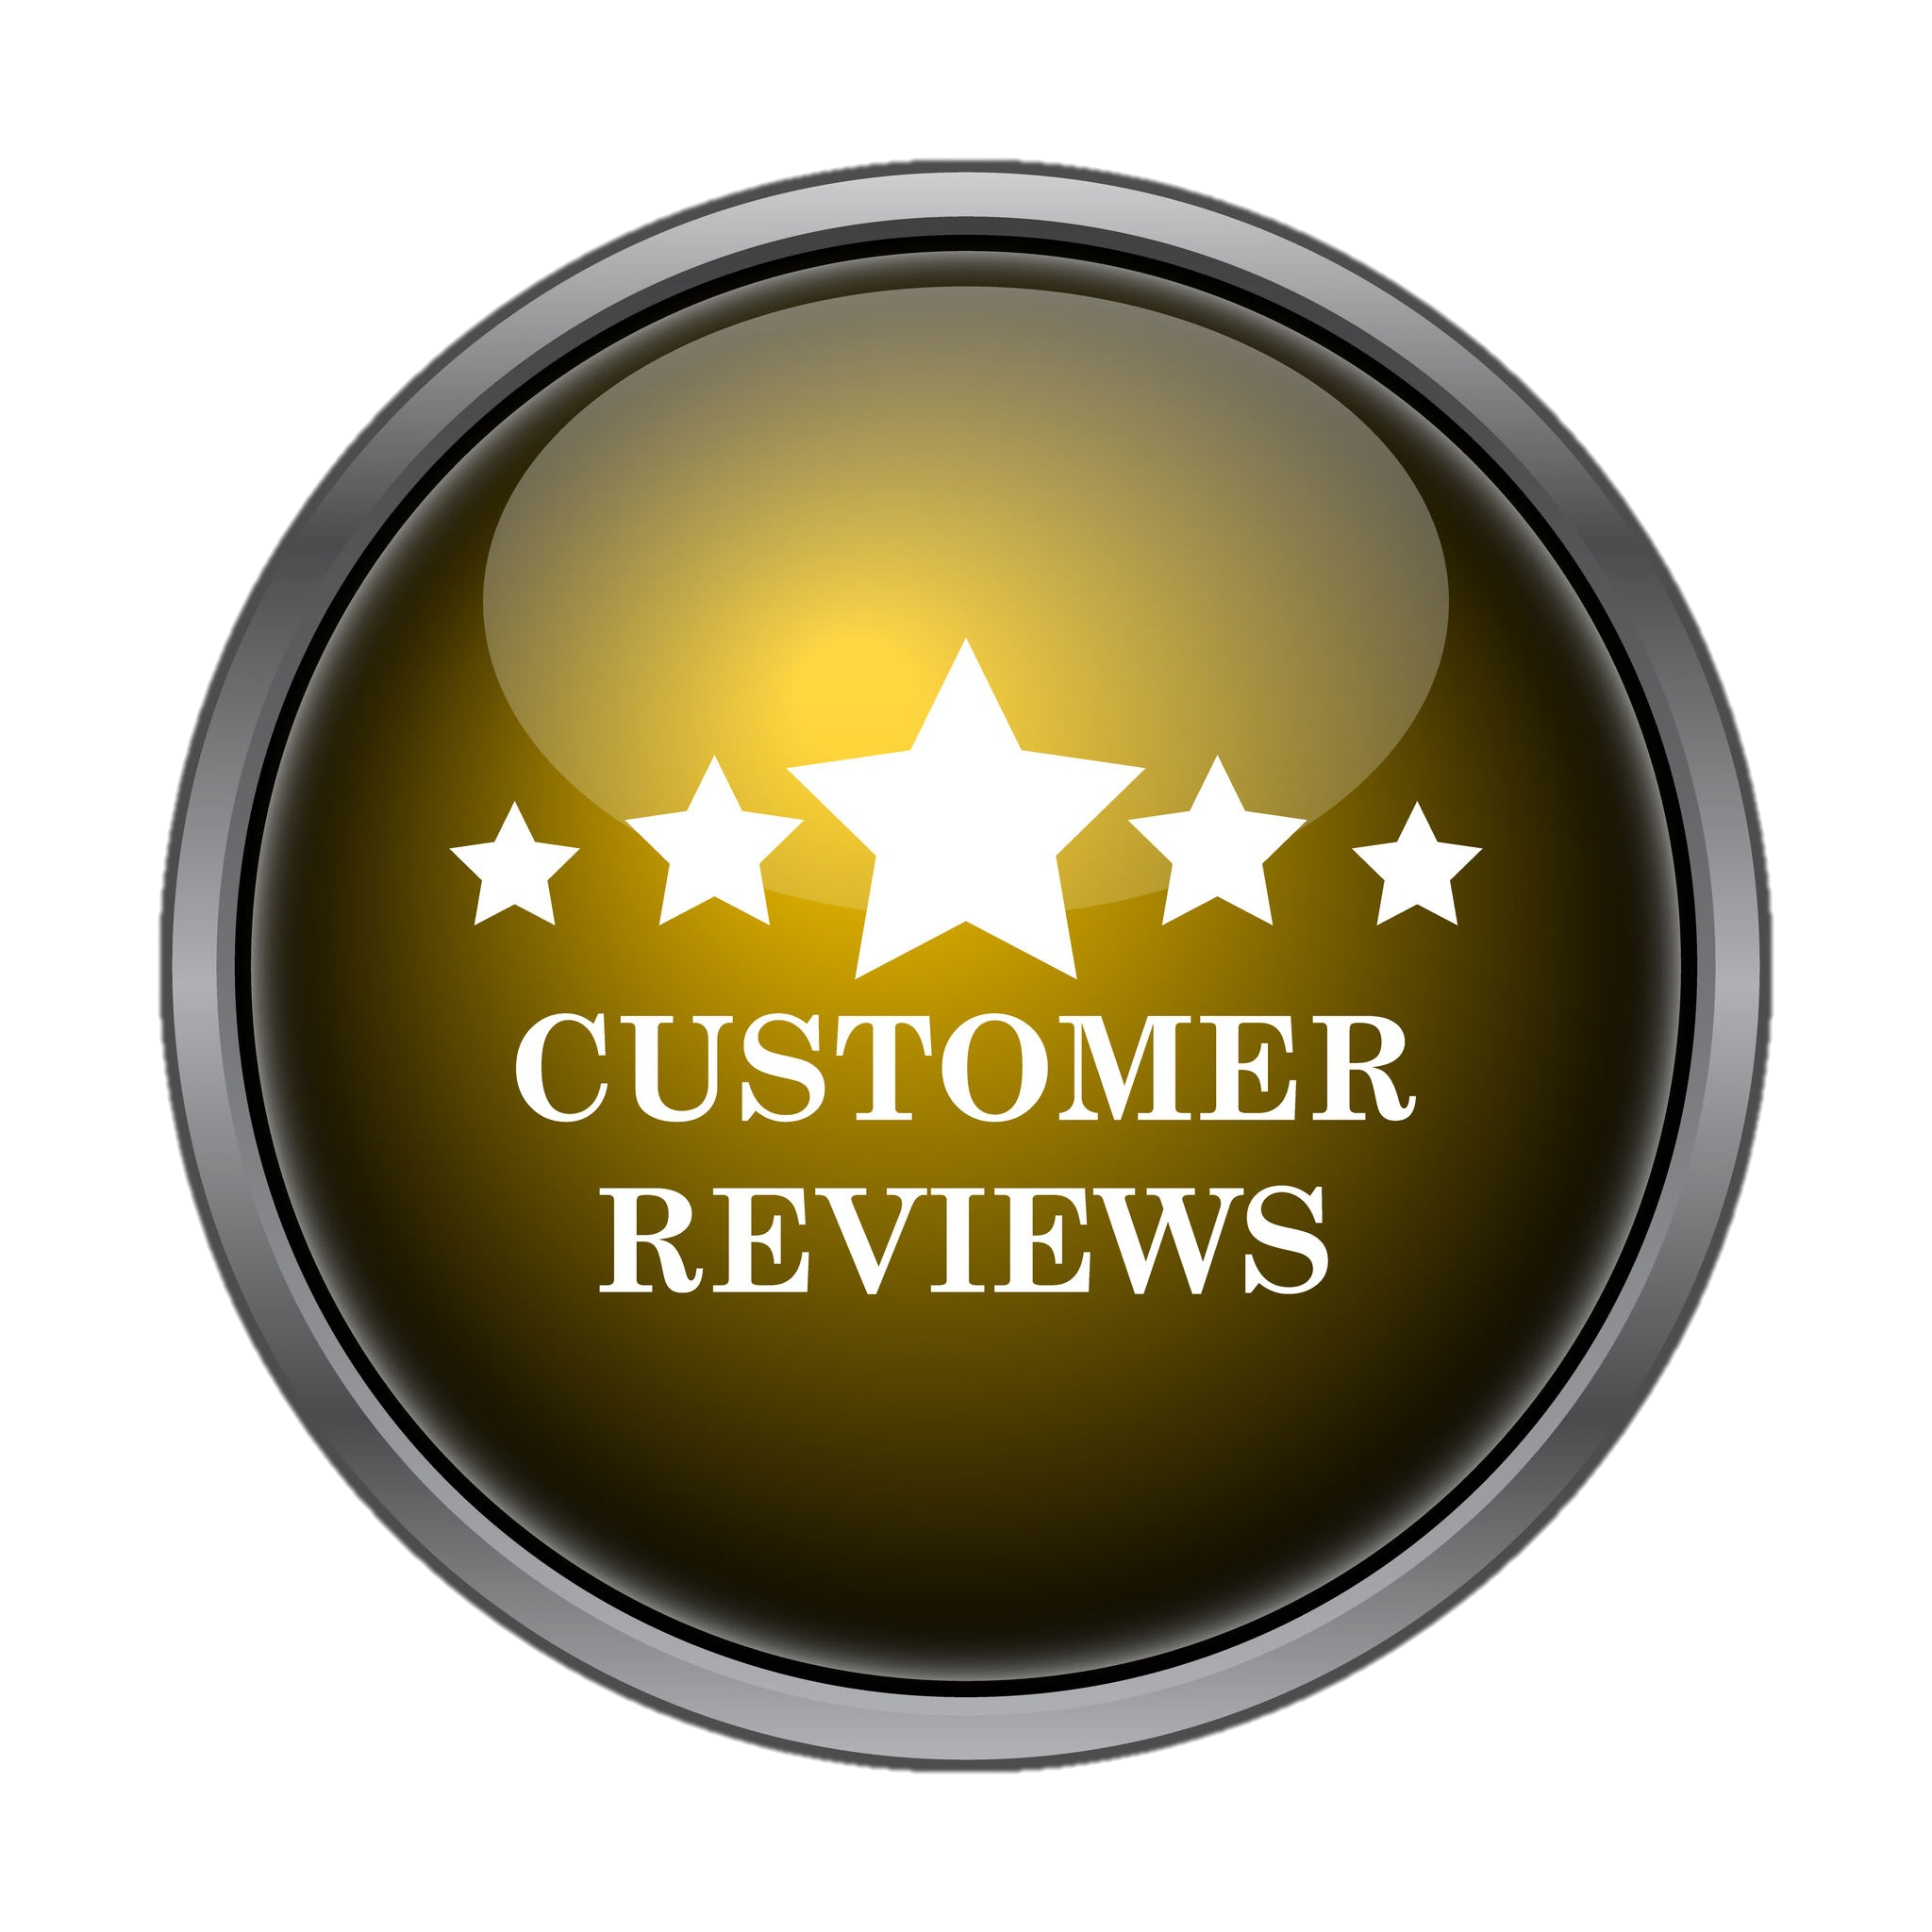
Research, Research, Research
Before making any big purchase or contracting a service, a savvy consumer does as much research as they can. Your goal is to find out if the product will give you the most bang for your buck and will satisfy your demands for quality and safety.
If you’re buying a product, just Google the name of it, as specifically as you can, plus “review.” If you’re buying an appliance, try hopping on Amazon or BestBuy and read the reviews there. For electronics, cnet.com is the place to go. You’ll need to use your discernment and have some patience with reviews offered by the public; up to 30% of the reviews may be fake — created by the company that makes the product or the guy who offers the service.
Also keep in mind that people who were unhappy are more likely to leave a review than those who were pleased. I like to read a few reviews in the highest, lowest, and in-between categories and then kind of average them together in my mind to get an overall feel for how the product most likely really is.
http://www.artofmanliness.com/2012/08/24/heading-out-on-your-own-day-24-how-to-be-a-savvy-consumer

Slide 10
Get a Quote
When it comes to hiring someone to perform a service, it really pays to shop around, as prices can vary widely. Again, a lower price may mean lower quality, while at the same time you don’t want to assume that if something is more expensive, it’s automatically better.
Getting multiple quotes allows you to make service providers compete against each other. If there’s a guy you want to use for various reasons, but another guy gives you a lower price, you can always go back to the first guy and say, “This guy is willing to do it for X, can you match that price?”
Yes, shopping around does take a bit of extra time, but it’s totally worth it if it means you can save hundreds or even thousands of dollars.
http://www.artofmanliness.com/2012/08/24/heading-out-on-your-own-day-24-how-to-be-a-savvy-consumer

Slide 11
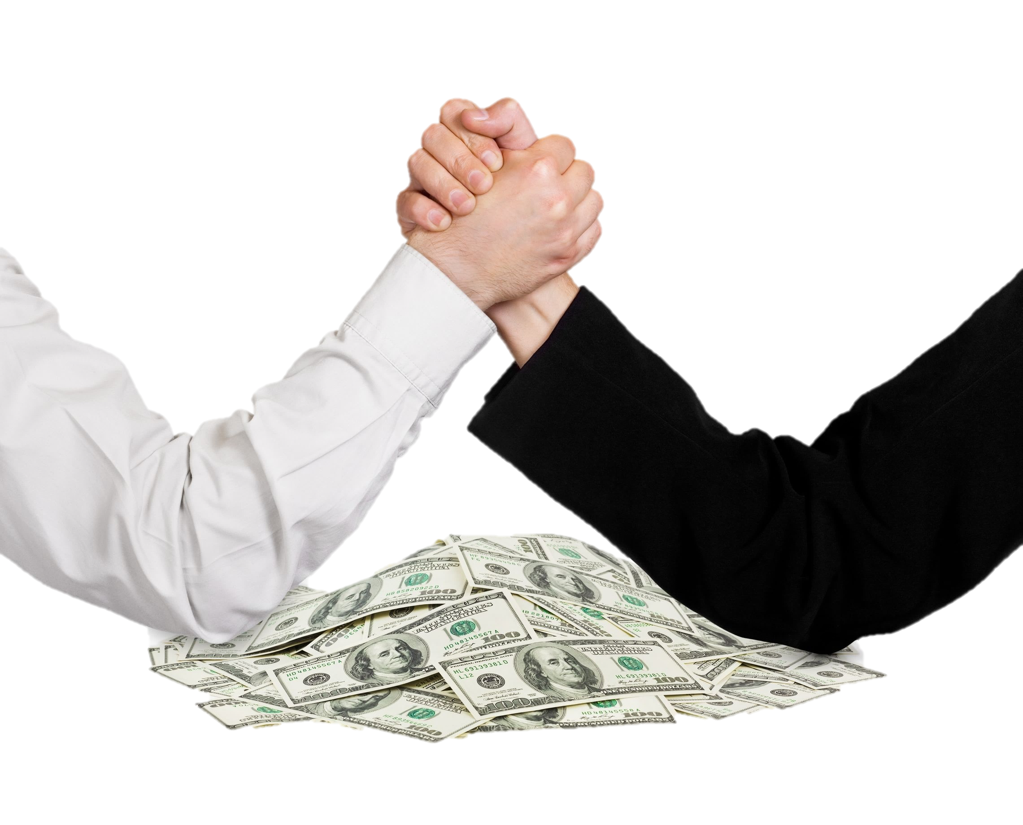
Negotiate, Negotiate, Negotiate
For most young men in America, negotiating is a completely foreign concept. We’re socialized into thinking that you simply pay the price offered and that it’s rude to haggle. But if you want your dollar to go as far as it can, you need to learn how to negotiate.
This skill can save you a ton of money over your lifetime. Is staying in your comfort zone really worth thousands of dollars that you basically threw out the window?
Some of your biggest purchases in your life will require you to negotiate — cars and homes being the most obvious. But even if you’re not in the market yet for these big ticket items, knowing how to negotiate can still serve you well. Everything from your car insurance rate to your gym membership is negotiable.
http://www.artofmanliness.com/2012/08/24/heading-out-on-your-own-day-24-how-to-be-a-savvy-consumer

Slide 12
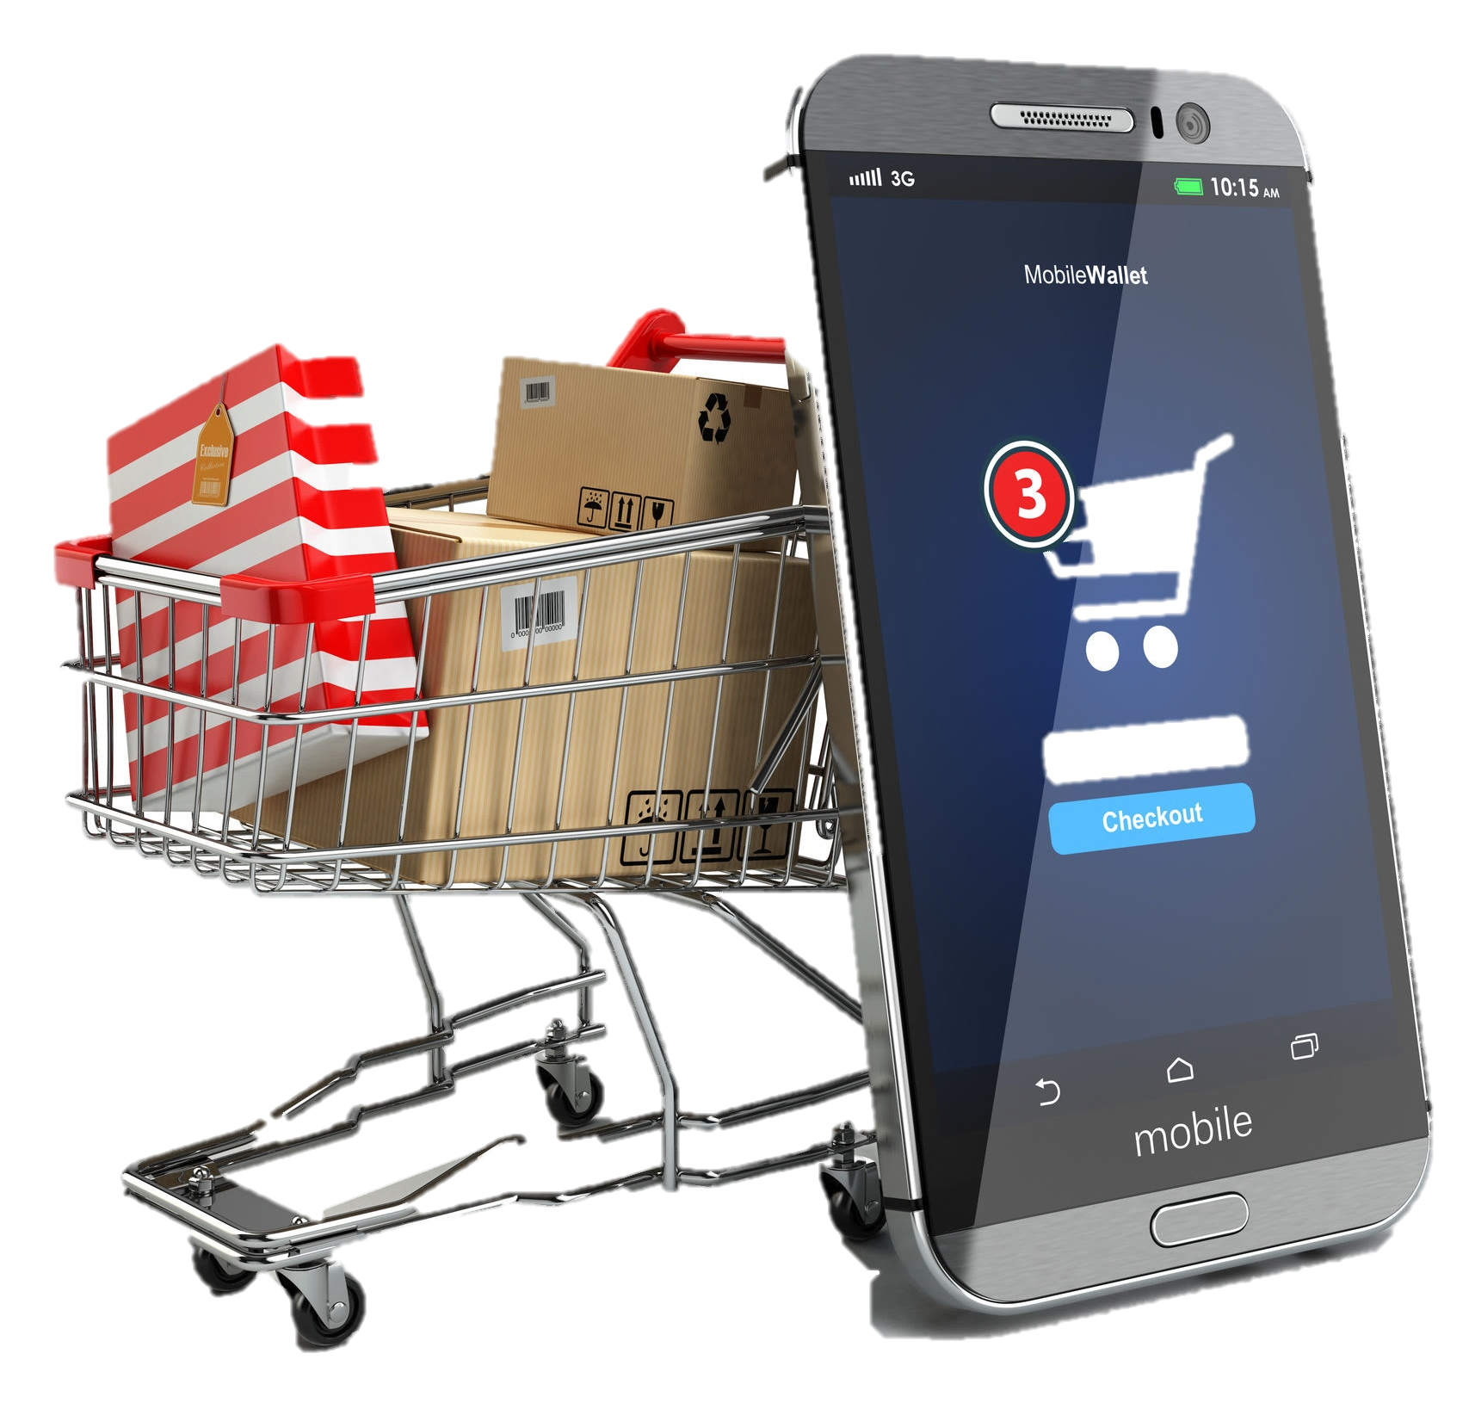
Up-sells
When you walk into a store or even shop online, businesses want you to spend more money than you originally planned on. To encourage you to open your wallet, they use a technique called up-selling. Up-selling means suggesting upgrades, add-ons, and additional services to customers right before they pay for their original purchase. It’s amazingly effective when done right. Studies show that sales can increase by as much as 40% simply by implementing up-selling at the point of purchase.
You encounter up-selling all the time, but may not have known what it was called. It’s especially common practice at restaurants. After she brings out your drinks, the waitress will probably say something like, “Would you gentlemen like to try some of our amazing fried pickles as an appetizer?” You just got up-sold.
Whenever you shop on Amazon.com, you probably see a list of items that other customers bought who also bought the book you’re buying. That’s another example of up-selling.
http://www.artofmanliness.com/2012/08/24/heading-out-on-your-own-day-24-how-to-be-a-savvy-consumer

Slide 13
The up-sells that savvy consumers really need to watch out for usually occur when you buy large appliances or computers.
Think back to the last time you bought a computer or some other expensive gizmo. You’ve got the product at the checkout counter and before the clerk rings you up he asks, “Would you like to buy an extended warranty? It’s only $25 and it will protect you even if you throw your laptop into a volcano as some sort of sacrifice.”
As a general rule, a savvy consumer should decline most extended warranty offers. You probably won’t need it; the manufacturer’s warranty is usually sufficient. Companies know the chances that you’ll actually use the warranty are slim, which is why they push them so hard. In fact, more than 80% of extended warranties go unused. So if a company can sell you one, it’s often pure profit for them.
http://www.artofmanliness.com/2012/08/24/heading-out-on-your-own-day-24-how-to-be-a-savvy-consumer
shutterstock.com

Slide 14
Also, watch out for up-sells in the form of add-ons you really don’t need. For example, whenever you buy an HDTV, you’ll probably be told by the guy at BestBuy that you need to get some special $75 HDTV surge protector as well as diamond encased HDMI cables to ensure the best possible resolution. The profit margins on them are high and that’s why they recommend them.
Bottom line: know exactly what you want before making a purchase, and don’t give in to high pressure up-sells.
http://www.artofmanliness.com/2012/08/24/heading-out-on-your-own-day-24-how-to-be-a-savvy-consumer

Slide 15
Read the Contract
Renting an apartment, joining a gym, getting cell phone service, and purchasing health insurance are just a few of the services and products that require us to sign a contract. These agreements legally obligate you and the other party to fulfill certain terms. Failing to stick to your end of the contract can result in stiff penalties and possibly a lawsuit. That’s why it’s so important to take the time to thoroughly read a contract before you sign your name on the dotted line.
http://www.artofmanliness.com/2012/08/24/heading-out-on-your-own-day-24-how-to-be-a-savvy-consumer

Slide 16
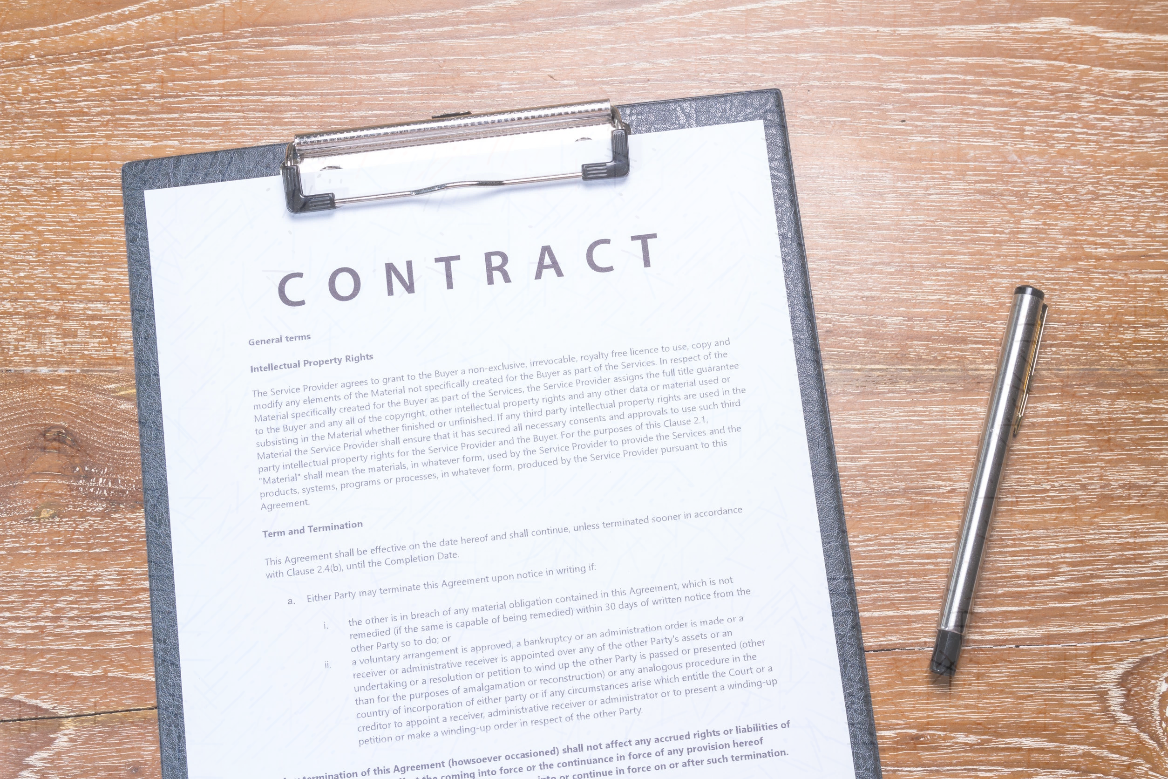
Unfortunately, many people don’t even bother to read contracts because they are long and sometimes overwhelming. While it’s a pain in the rear, get in the habit of reading all contracts before you sign them. If you have to, take it home and read it when you have more time. While you’re reading, look for the following things:
How much and when will you pay?
How long does the contract last?
What are the penalties and consequences if one side doesn’t stick to the agreement?
How does the contract end? Is there an auto-renewal? And if so, how can you stop it if you no longer want the service?
What are the causes of terminating the contract?
How are contract disputes resolved? Arbitration? Mediation? Courts?
Are all the blanks filled in? Oftentimes contracts will have blank spaces where prices and dates are filled in. Make sure those spaces are filled in before signing so that someone can’t make any changes without your knowledge.
http://www.artofmanliness.com/2012/08/24/heading-out-on-your-own-day-24-how-to-be-a-savvy-consumer

Slide 17
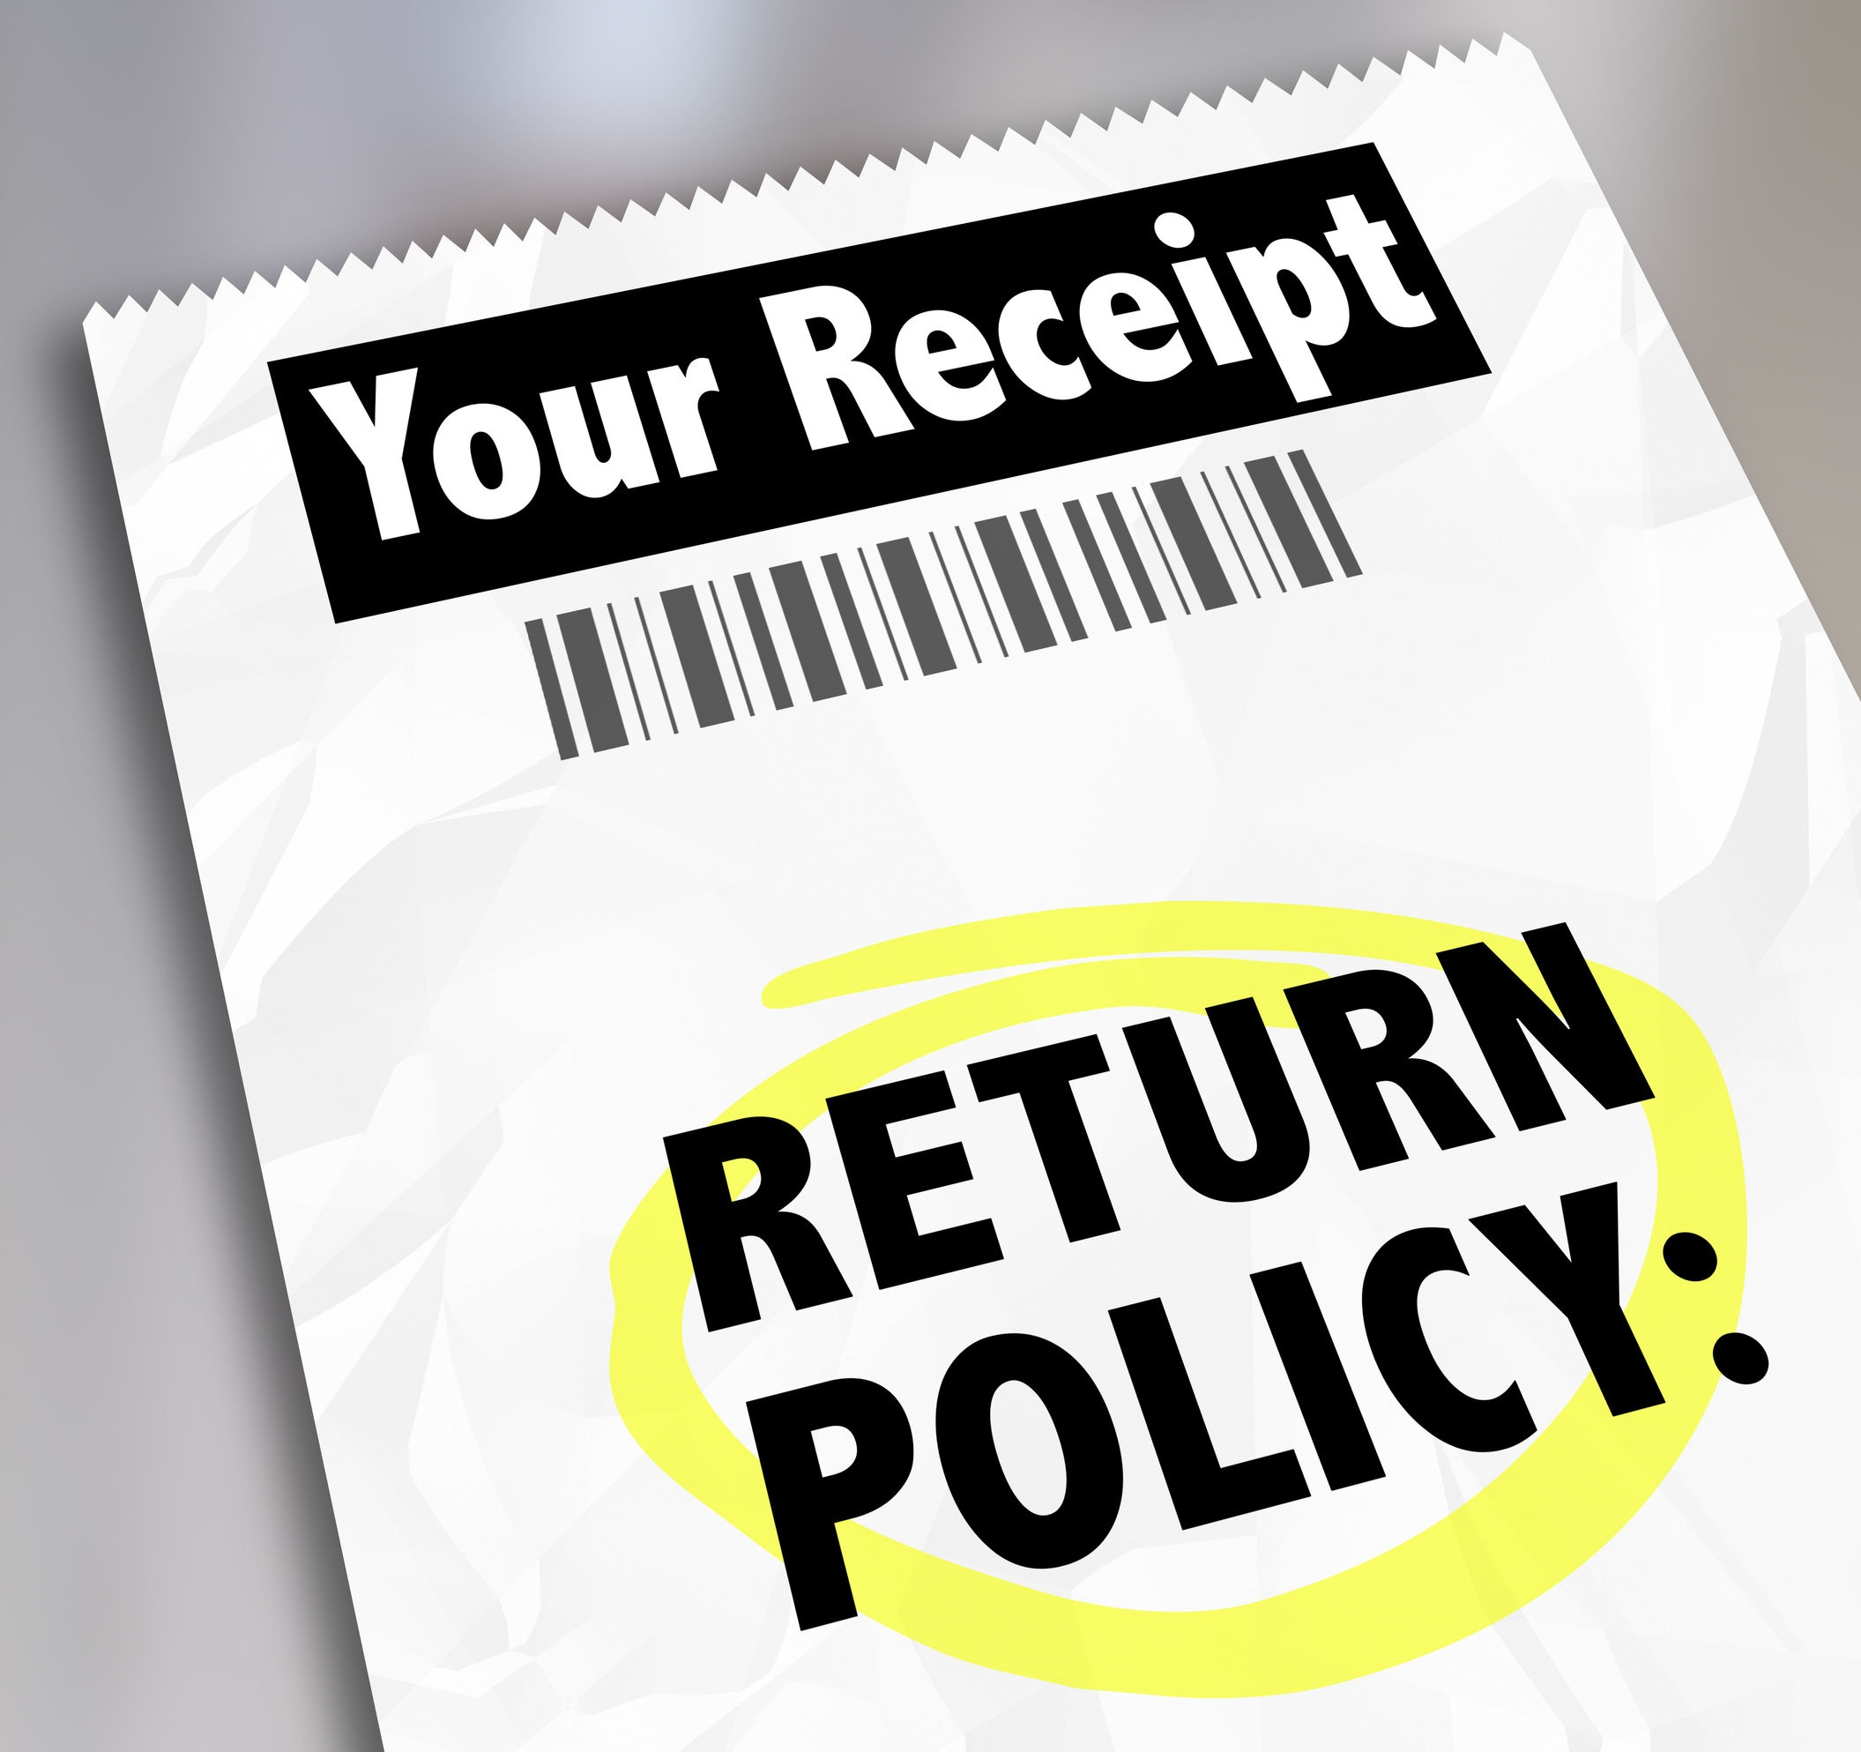
Before you purchase something, you should always find out exactly what the store’s return policy is, and after your purchase, you need to hold onto your receipt. If you ever have a problem with a product or service and want to make a return or complaint, you’ll need it, along with any contracts you may have signed. So get in the habit of putting your receipts and agreements in a folder for safe keeping. Never again will you have to rummage through your car or random drawers looking for the receipt for your defunct TV.
Better yet, digitize all your receipts and contracts and store them in the cloud.
http://www.artofmanliness.com/2012/08/24/heading-out-on-your-own-day-24-how-to-be-a-savvy-consumer
shutterstock.com

Slide 18
Marketing Tricks of the Trade
shutterstock.com

Slide 19
CELEBRITY APPEAL
Celebrity Appeal is where people who are famous advertise/wear the product. Beware, though, most of the time they don't actually use the product and just promote it for the money.
http://guideforteenagerconsumers.weebly.com
shutterstock.com

Slide 20
BEAUTY APPEAL Beauty appeal is when they pay attractive people to promote the product or service, claiming it helped them become so attractive. Look out for this one because they may have never used the product and that’s what they naturally look like.
http://guideforteenagerconsumers.weebly.com
shutterstock.com

Slide 21
BRAND NAME FAMILIARTY
Brand name familiarity is when you know the slogan, image, or name of a product by heart. These are catchy ads, but don't just buy something because of an ad. This is a big part of their tricks.
http://guideforteenagerconsumers.weebly.com

Slide 22
ESCAPISM
Escapism is where they use a background or film in an exotic or interesting/special place where you would feel like you would want to escape or go to on a vacation or holiday to draw you in.
http://guideforteenagerconsumers.weebly.com
shutterstock.com

Slide 23
PEER APPROVAL
Peer approval is where you buy a product because everyone else has it. It is easy to be pressured to buy products because everyone else uses it.
They also might use people like us for the ads and get them to recommend it, although they’ve probably never used it.
http://guideforteenagerconsumers.weebly.com
shutterstock.com

Slide 24
BAND WAGON APPEAL
Band wagon appeal is very similar to peer approval. Many people use something and others feel the need to use it as well. For example, a football team might be doing very well, and then, because everyone else starts supporting the team, you do as well.
http://guideforteenagerconsumers.weebly.com
shutterstock.com

Slide 25
AUTHORITY ENDORSMENT
Authority endorsement is where people who have a high social standing, or a professional career, recommend the product to you. People who might be paid to do things like this are the prime minister, doctors and dentists.
http://guideforteenagerconsumers.weebly.com
shutterstock.com

Slide 26
Advertisers use persuasive techniques just to get their product sold. As teens we need to be aware of all of these techniques and make sure we think 'do we really need what they are advertising or is it just a FAD?’ We don't have to spend so much money on things we really don't need. HERE ARE A FEW HINTS, TIPS AND OR QUESTIONS FOR YOU TO ASK YOURSELF ON HOW TO SURVIVE THIS ADVERTISING WORLD: * Check out where the products are from. * You don't have to have the latest product to be cool. * Do you really need it? * Compare prices from other sources before you buy that product. * Wait a week or so and see if you really need it or will it be an impulse buy. * Research more about the product before buying.
http://consumersavvyforteens.weebly.com
shutterstock.com

Slide 27
Key Words
marketplace consumer marketers
purchasing behavior savvy consumer reviews
multiple quotes negotiating Up-selling
profit margins peer approval digitize
Authority endorsement Celebrity Appeal Escapism

