Slide 1
NICKY FIFTH’S NEW JERSEY
N5NJ
SECONDARY PROGRAM
LIFE
Solutions

Slide 2
If you’re like most people, you don’t think of solutions until you have a problem.
Of course, when a problem arises, depending upon the severity, people sometimes forget every problem solving skill they’ve ever learned.

Slide 3
shutterstock.com
Ironically, you have been solving problems since you were a baby. Remember that super-challenging game of which hand is it in? You sat in your high chair and your mom would grab a tiny object, place it in her hand, make two fists, put her hands behind her back and say, “Which hand is it in?” as her hands re-emerged. The problem was pretty straight forward; one object, two hands. So, you excitedly hesitated and in classic Murphy’s-Law-style, you picked the empty hand.
“Pick again,” your mom exclaimed, as she held out the other hand. Eager to keep solving the problem, you picked the other hand.
Presented with the only other option, you solved a problem. Yes, covered in strained spinach and wearing a diaper, you were about to do a little problem solving. You didn’t give it much thought, but you immediately knew that you needed to find the object, there were two hands, and one was empty. As you slapped the remaining hand, you didn’t get excited because you solved a problem, you were excited because you found the object.

Slide 4
shutterstock.com
Our automatic response to problems occurs all day, every day, without much thought. You may have planned on having pancakes for breakfast, but you slept right through the alarm and woke up late. You didn’t worry about it, though, as you grabbed a protein bar and headed out the door.
You knew you had less time and wouldn’t be able to make and eat pancakes so you automatically shifted your plan. When you arrived at school or work on time, you didn’t applaud your stellar problem solving skills. You just got to work.

Slide 5
shutterstock.com
If only every solution was as simple as picking the other hand or swapping a protein bar for pancakes. Unfortunately, the problems and issues you will face in your life will often be more complicated. The question should never be: if a problem arises, the question should be: when a problem arises.
Having said that, you should have a calm, consistent way of handling these issues to arrive at the best possible solutions.

Slide 6
Also, even though we call it problem solving, get into the habit of calling problems challenges. Problems have a very negative connotation. Challenges, by nature, encourage us to be proactive and are a more positive way of approaching any issue. And, like puzzles, challenges are just waiting to be solved.
shutterstock.com

Slide 7
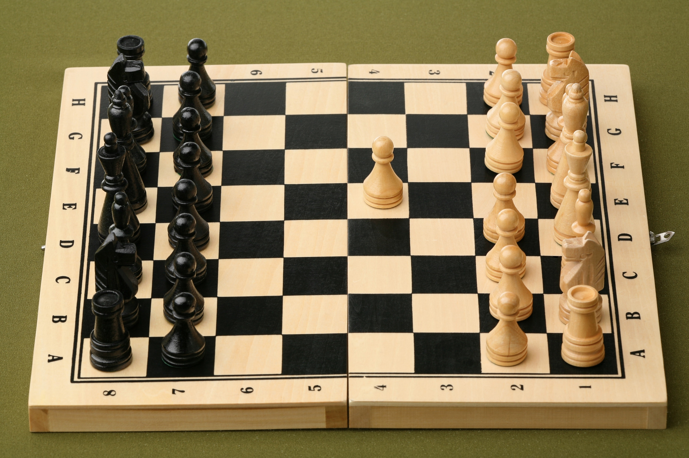
shutterstock.com
The most strategic first step is to logically identify the challenge. The key word here is logically. Sometimes, depending upon when a challenge arises, we are in the middle of doing numerous tasks or already under pressure. Our state of mind, at that moment, affects how we interpret the challenge. Before switching to panic or autopilot, take a deep breath and look at it analytically as opposed to emotionally.
What, exactly, is the challenge? How did it arise? Was it carelessness, bad luck, an oversight, or unavoidable? Is it recurring or an anomaly?
Don’t start thinking about solutions yet. Imagine it as a game of chess and study the situation. Until you have logically determined what’s happening, any possible solution may be wrong one and just compound the issue.

Slide 8
Once you have logically examined the situation, consider the resources available to you. No two people have the same resources, so this must be a personal assessment.
If you have applied to several colleges and have been accepted to many, including your favorite, but you realize you cannot afford the tuition, you will need to examine your resources.
How close are you to affording it? Close enough to get a small loan? Did you apply for financial aid? Can you go to a community college for the first two years and then transfer to your dream school? Have you examined the costs of the other schools that have accepted you?
Of course, this challenge could have been avoided. By investigating the cost to attend the colleges you were applying to and determining which ones you could afford, you could have saved time and money on the application process.
shutterstock.com

Slide 9
Once you have a thorough assessment of the situation, it’s time to think of the realistic options.
If you’re driving on a back road and you get a flat tire, you will have options. Of course, driving on the flat tire is an option, but it will cause extensive damage to your car. Even though it’s technically an option, it’s not a good one. Leaving your car and walking in an area you are not familiar with is an option, but once again, not a safe or good one. Calling a parent or a friend is an option, as is calling for roadside service. If you know how to fix a flat tire and can do it safely, that would probably be your best option.
Thinking about options involves a logical, realistic approach and, like in chess, should involve thinking more than one step ahead.
If you had selected the walk away option, you would have to ask yourself what the next steps would be? No one knows where you are or that you’re stuck, delaying assistance. Would you even know where you were going? You could get lost. Most importantly, how would that action solve the problem?
shutterstock.com

Slide 10
So, you’ve identified the challenge, considered your resources, and assessed the situation. Your next move is to think. Rushing to a solution often leads to additional challenges.
Ask yourself if the solution you are considering has any unintended consequences. Determine if it is realistic and if it will solve the challenge.
Then do it! Action is the next logical step. If you’re confident in your decision, there’s no reason to procrastinate.
shutterstock.com

Slide 11
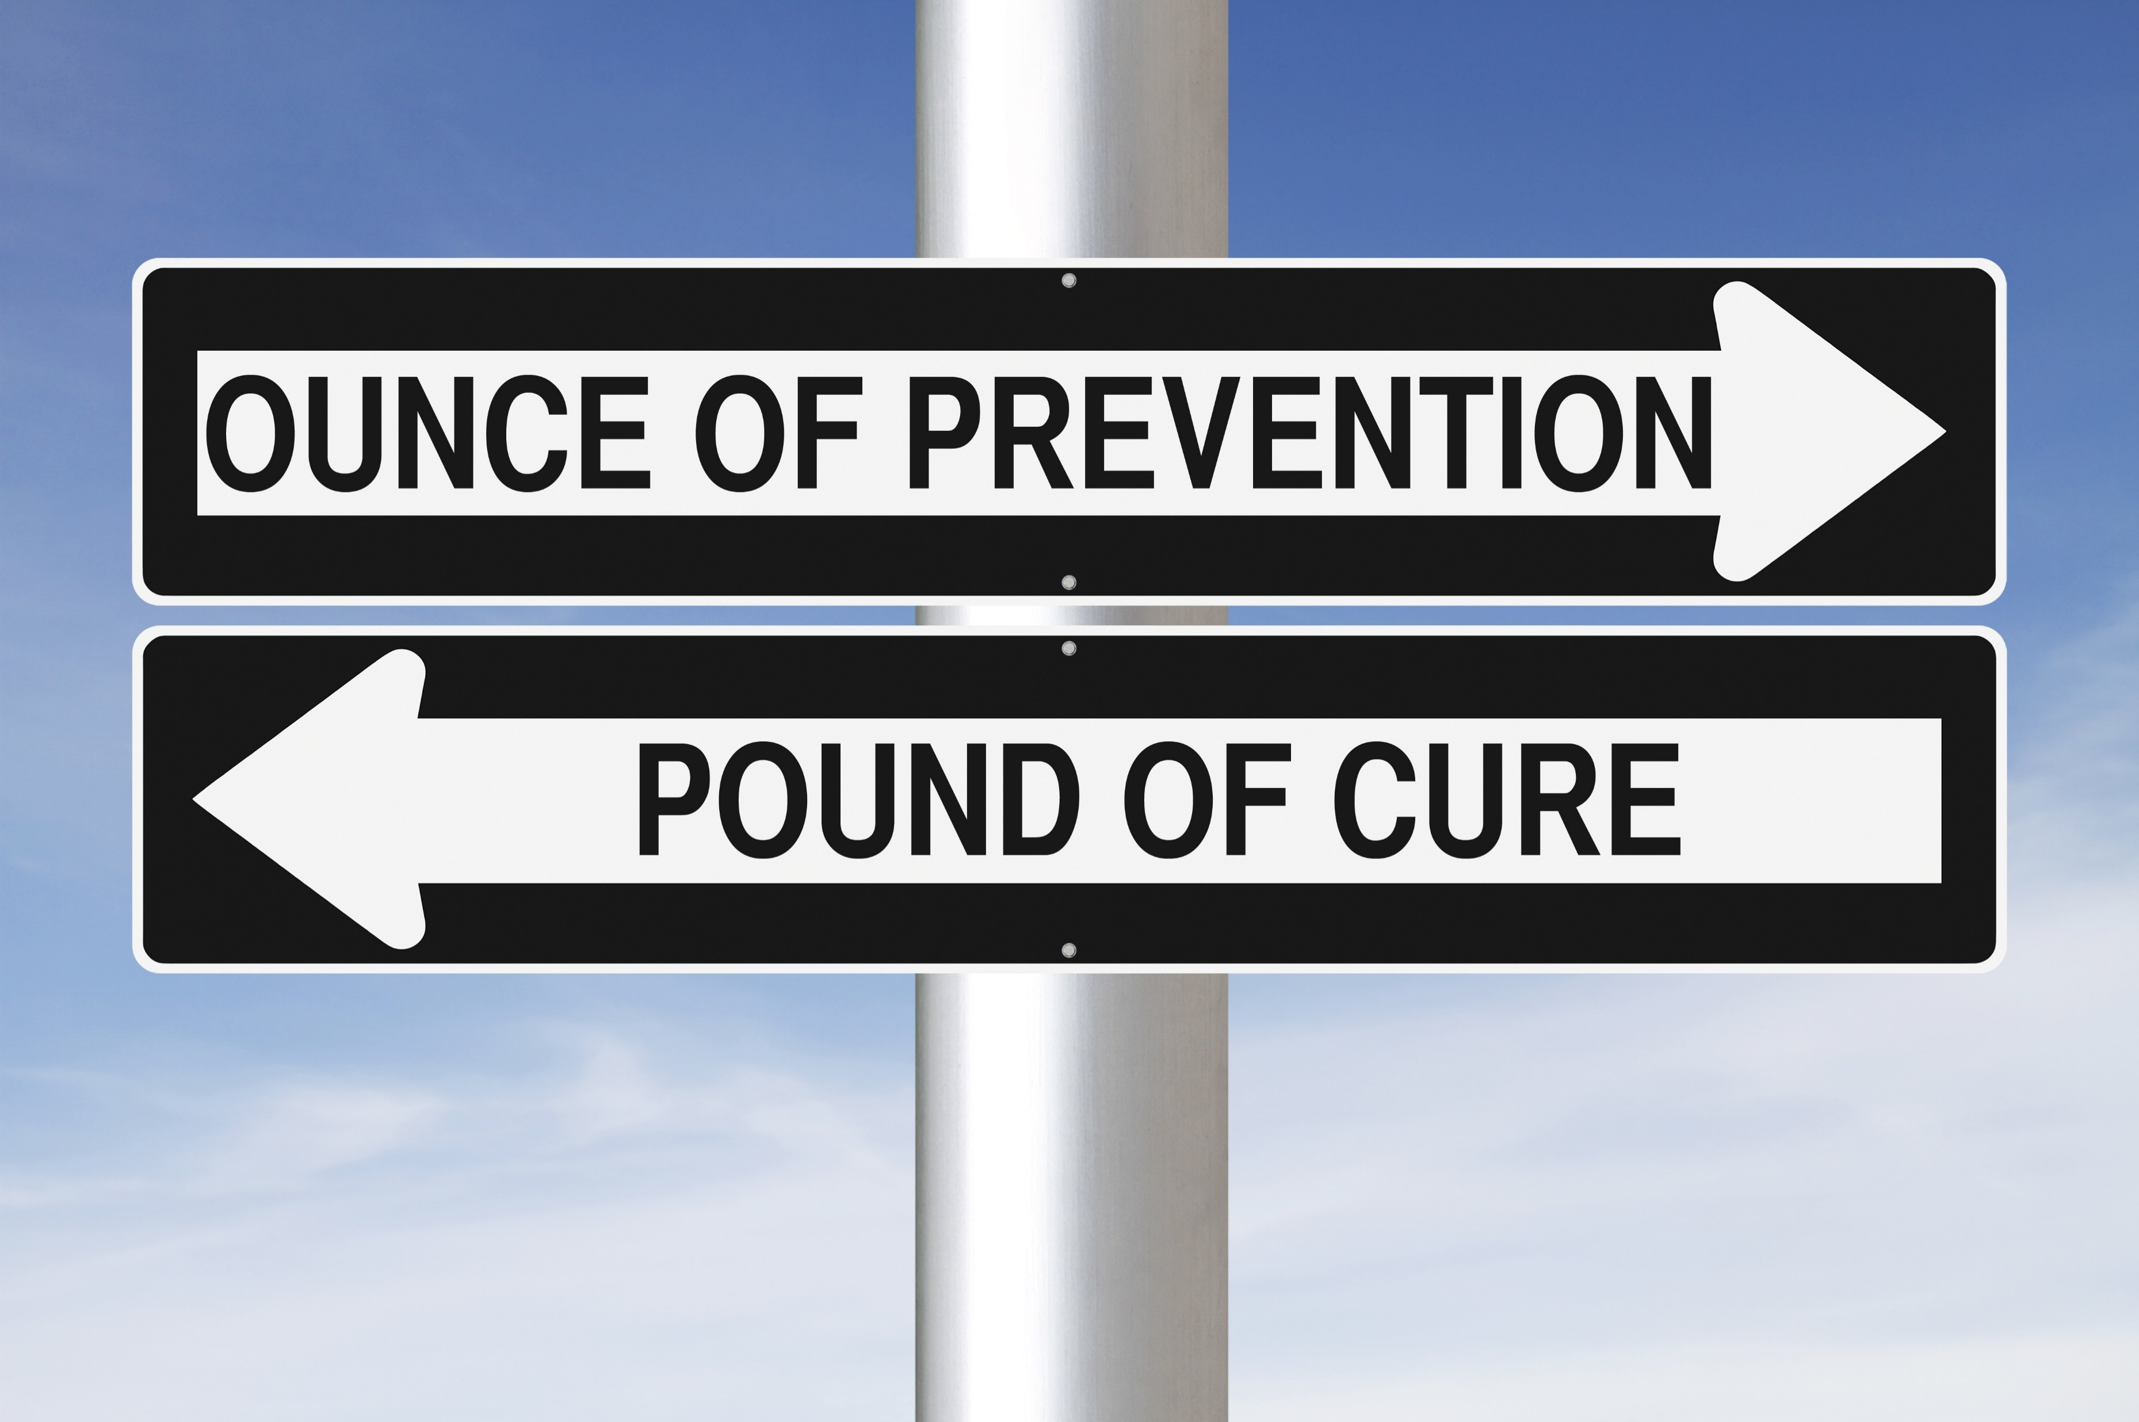
Once you have thoughtfully and carefully solved the challenge, review what happened. Don’t be discouraged by it, learn from it. Figure out why it happened and how to ensure it doesn’t become a recurring challenge.
If the oversleeping occurrence discussed earlier was a one-time occurrence, it probably doesn’t require much thought. If, however, it was the eighth time in one month, preventative actions should be taken. Perhaps going to sleep earlier, setting the alarm earlier, or placing the alarm clock on the other side of the room.
There’s a reason they say an ounce of prevention is worth a pound of cure.

Slide 12
When it comes to challenges, if you remain calm, logical, and strategic, you will have much more successful outcomes and less stress. But even all of the prevention in the world cannot eliminate problems. As you continue to mature, challenges will become more complex and your ability to arrive at a solution even more important.
There are some things you should keep in mind, though.
Not every challenge has a perfect solution. Sometimes you will find yourself picking from the lesser of two evils.
Many challenges are out of your control and you must accept and adjust.
Some solutions have unintended or negative consequences.
Some challenges, by their nature, take longer to solve than others.
The small effort to prevent problems before they arise will save you time, headaches, and even money.
Address challenges immediately. Procrastinating can lead to a domino effect of additional challenges.

Slide 13
Key Words
problem solving skill problem solution
automatic response consistent calm
challenges proactive puzzles
strategic first step logically identify emotionally
compound the issue analytically resources

