Slide 1
NICKY FIFTH’S NEW JERSEY
N5NJ
SECONDARY PROGRAM
LIFE
Best Use of the Internet

Slide 2
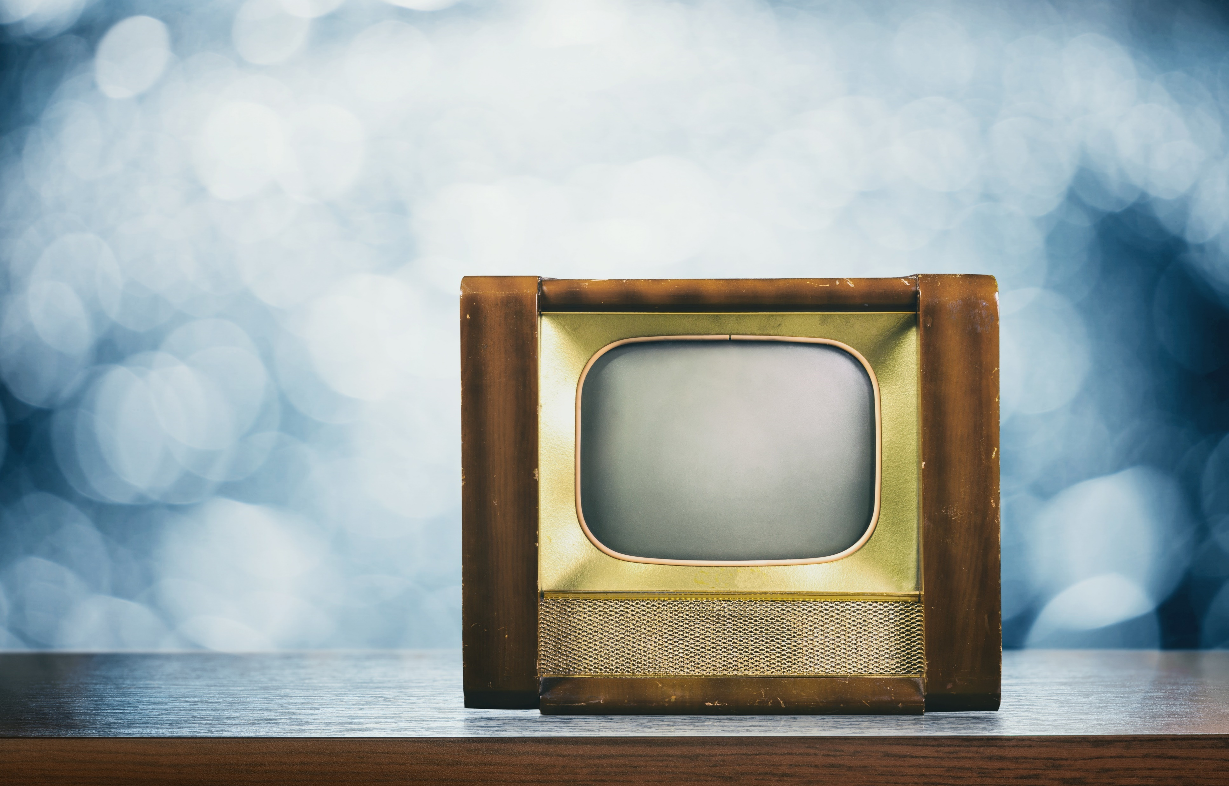
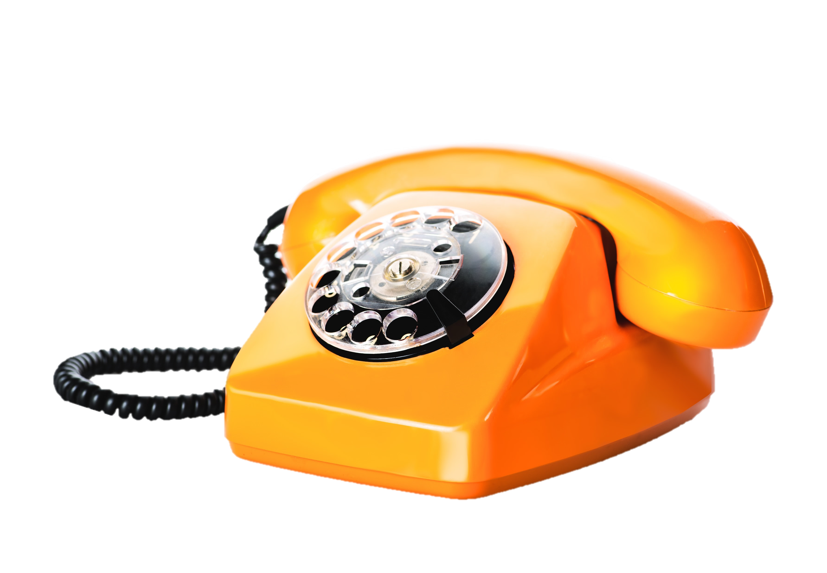
You may not realize it, but there was a time when we looked in the newspaper to see what was coming on television and then had to turn the dial to change the channel or adjust the volume. Every phone call arrived via a corded phone with a rotary or push buttons, no caller ID, no call waiting, and no walking around farther than the super knotted cord allowed.
Shutterstock.com

Slide 3
Back then, most information came from an encyclopedia set –hardcover books filled with information on thousands of topics. Due to the space restrictions of a book, the information was limited and, even with a brand new encyclopedia, it was at least 9-12 months old.
Shutterstock.com

Slide 4
There’s no doubt that the Internet is one of the greatest technological advances of the 20th Century. Never before have people all over the world been so connected.
Shutterstock.com

Slide 5
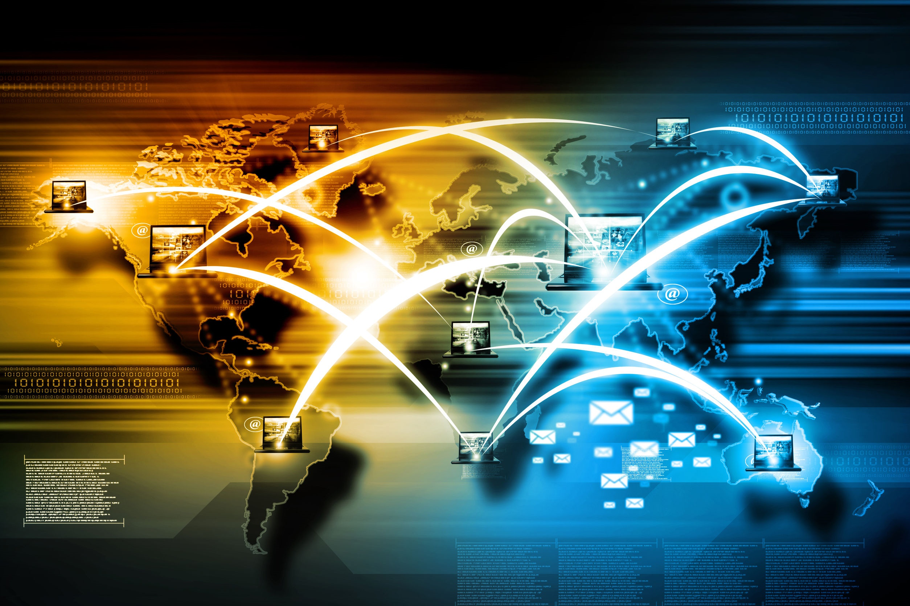
Never before has a generation had such immediate access to so much information. The opportunities to improve yourself, your life, and your future are endless.
Shutterstock.com

Slide 6
Today, with the mobility provided by laptops, mobile phones, and tablets, up-to-the-minute information is available at your fingertips, instantly.
Shutterstock.com

Slide 7
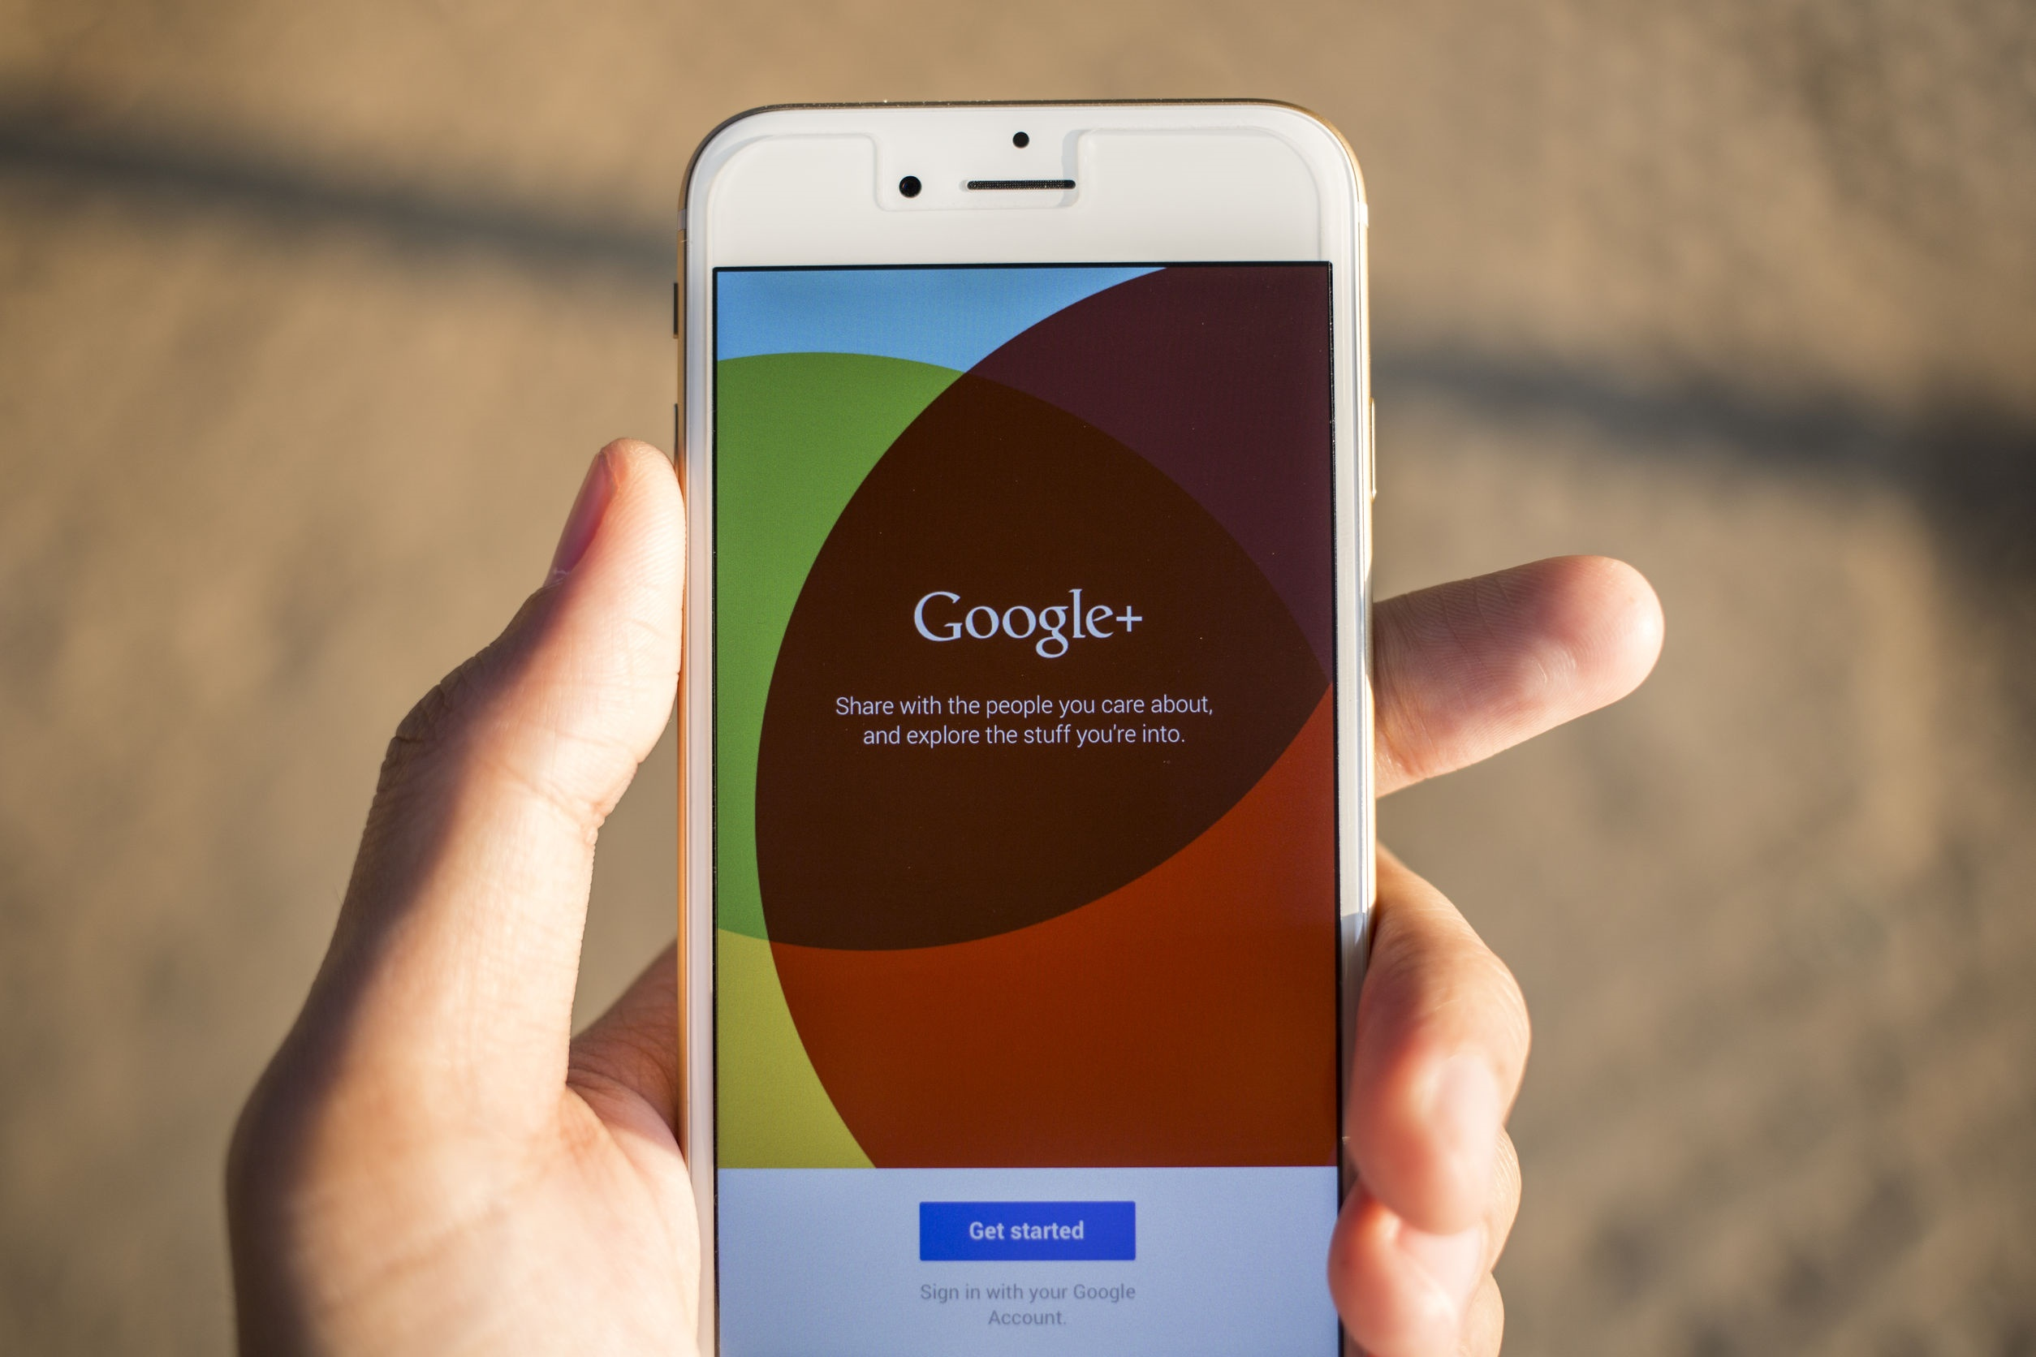
Thanks to the Internet, you never have to wonder about anything anymore. The only draw back is the amount of information available and the accuracy and motives of the providers.
But, what are the best uses of the Internet?
Shutterstock.com

Slide 8
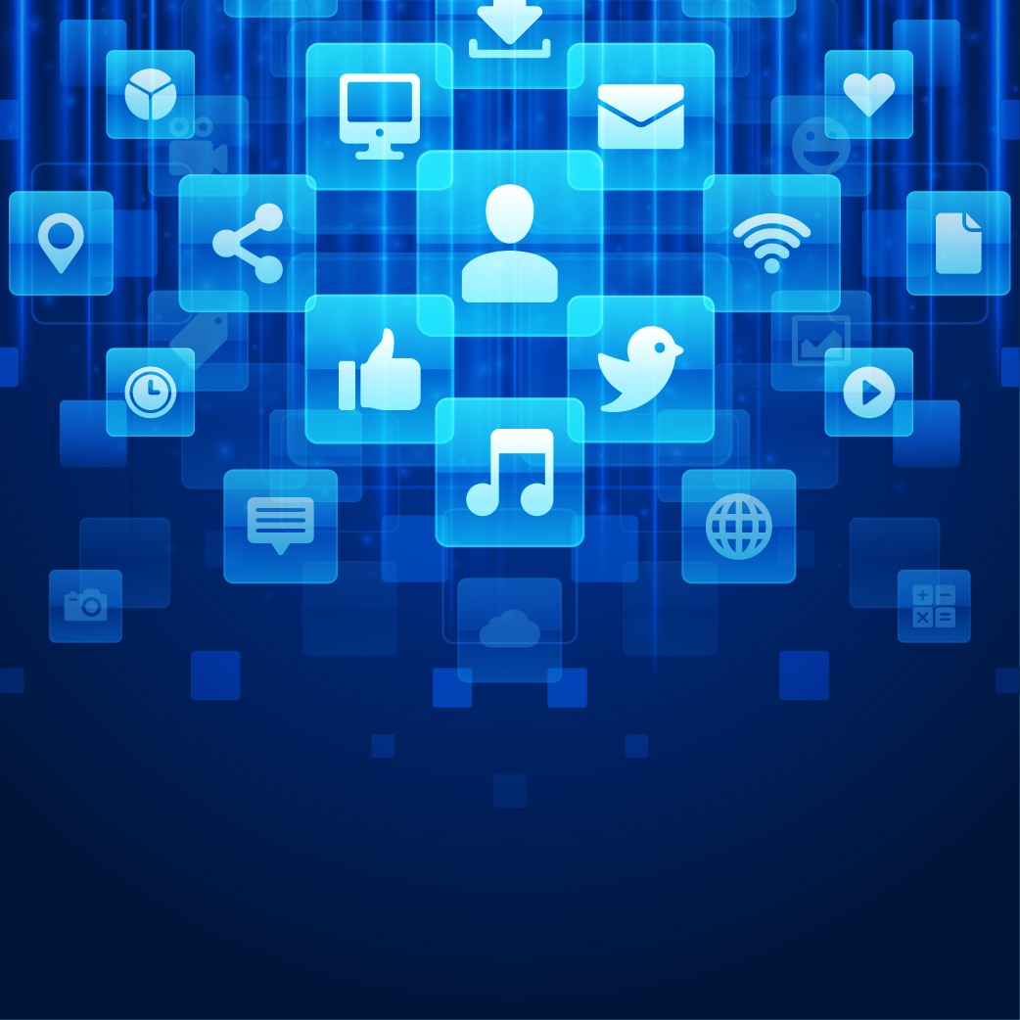
When it comes to spending quality time on your devices, social media and video games aren’t exactly on top of the quality list. In fact, they’re often a distraction that prevents people from searching for quality content.
If you want to get the absolute most out of the internet, try some of the following:
Shutterstock.com

Slide 9
HISTORY
The History of New Jersey and the United States is rich and exciting. Search NJ’s role in various wars and conflicts, important leaders, and notable events. These true stories are fascinating and will provide you with a great background and understanding.
Shutterstock.com

Slide 10
LANGUAGE
Learning a new language has never been easier. There are apps that show you the word and even pronounce the word for you. If you’re serious about learning a new language or reinforcing a language you’re currently studying, the Internet can be an amazing tool.
Shutterstock.com

Slide 11
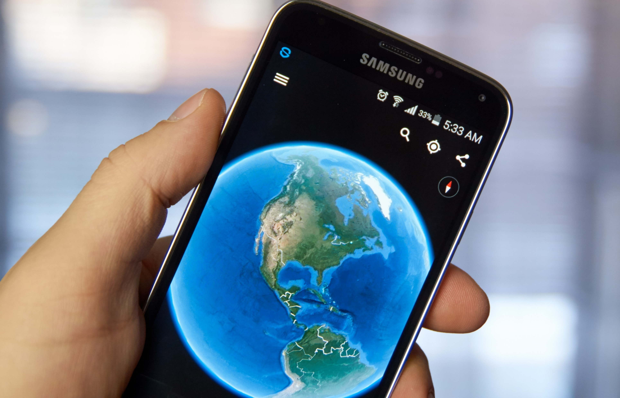
GEOGRAPHY
The Internet is a great way to start learning about other states and countries. With Google Earth and Street View, it’s the next best thing to being there.
Shutterstock.com

Slide 12
CULTURE
Go beyond geography and learn about the culture of other countries. Believe it or not, an average day in many, many places around the world looks nothing like your average day. Reading about other cultures can be some of the most interesting reading you can do.
dennizn / Shutterstock.com

Slide 13
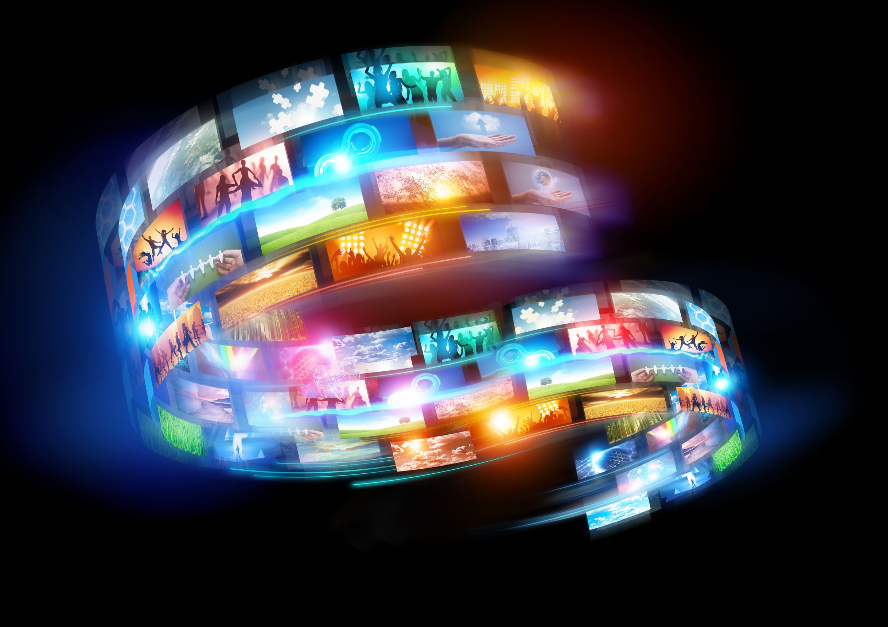
CURRENT EVENTS
The Internet is a valuable tool for following current events, provided you know your sources, use multiple sources, and confirm your information.
123rf.com

Slide 14
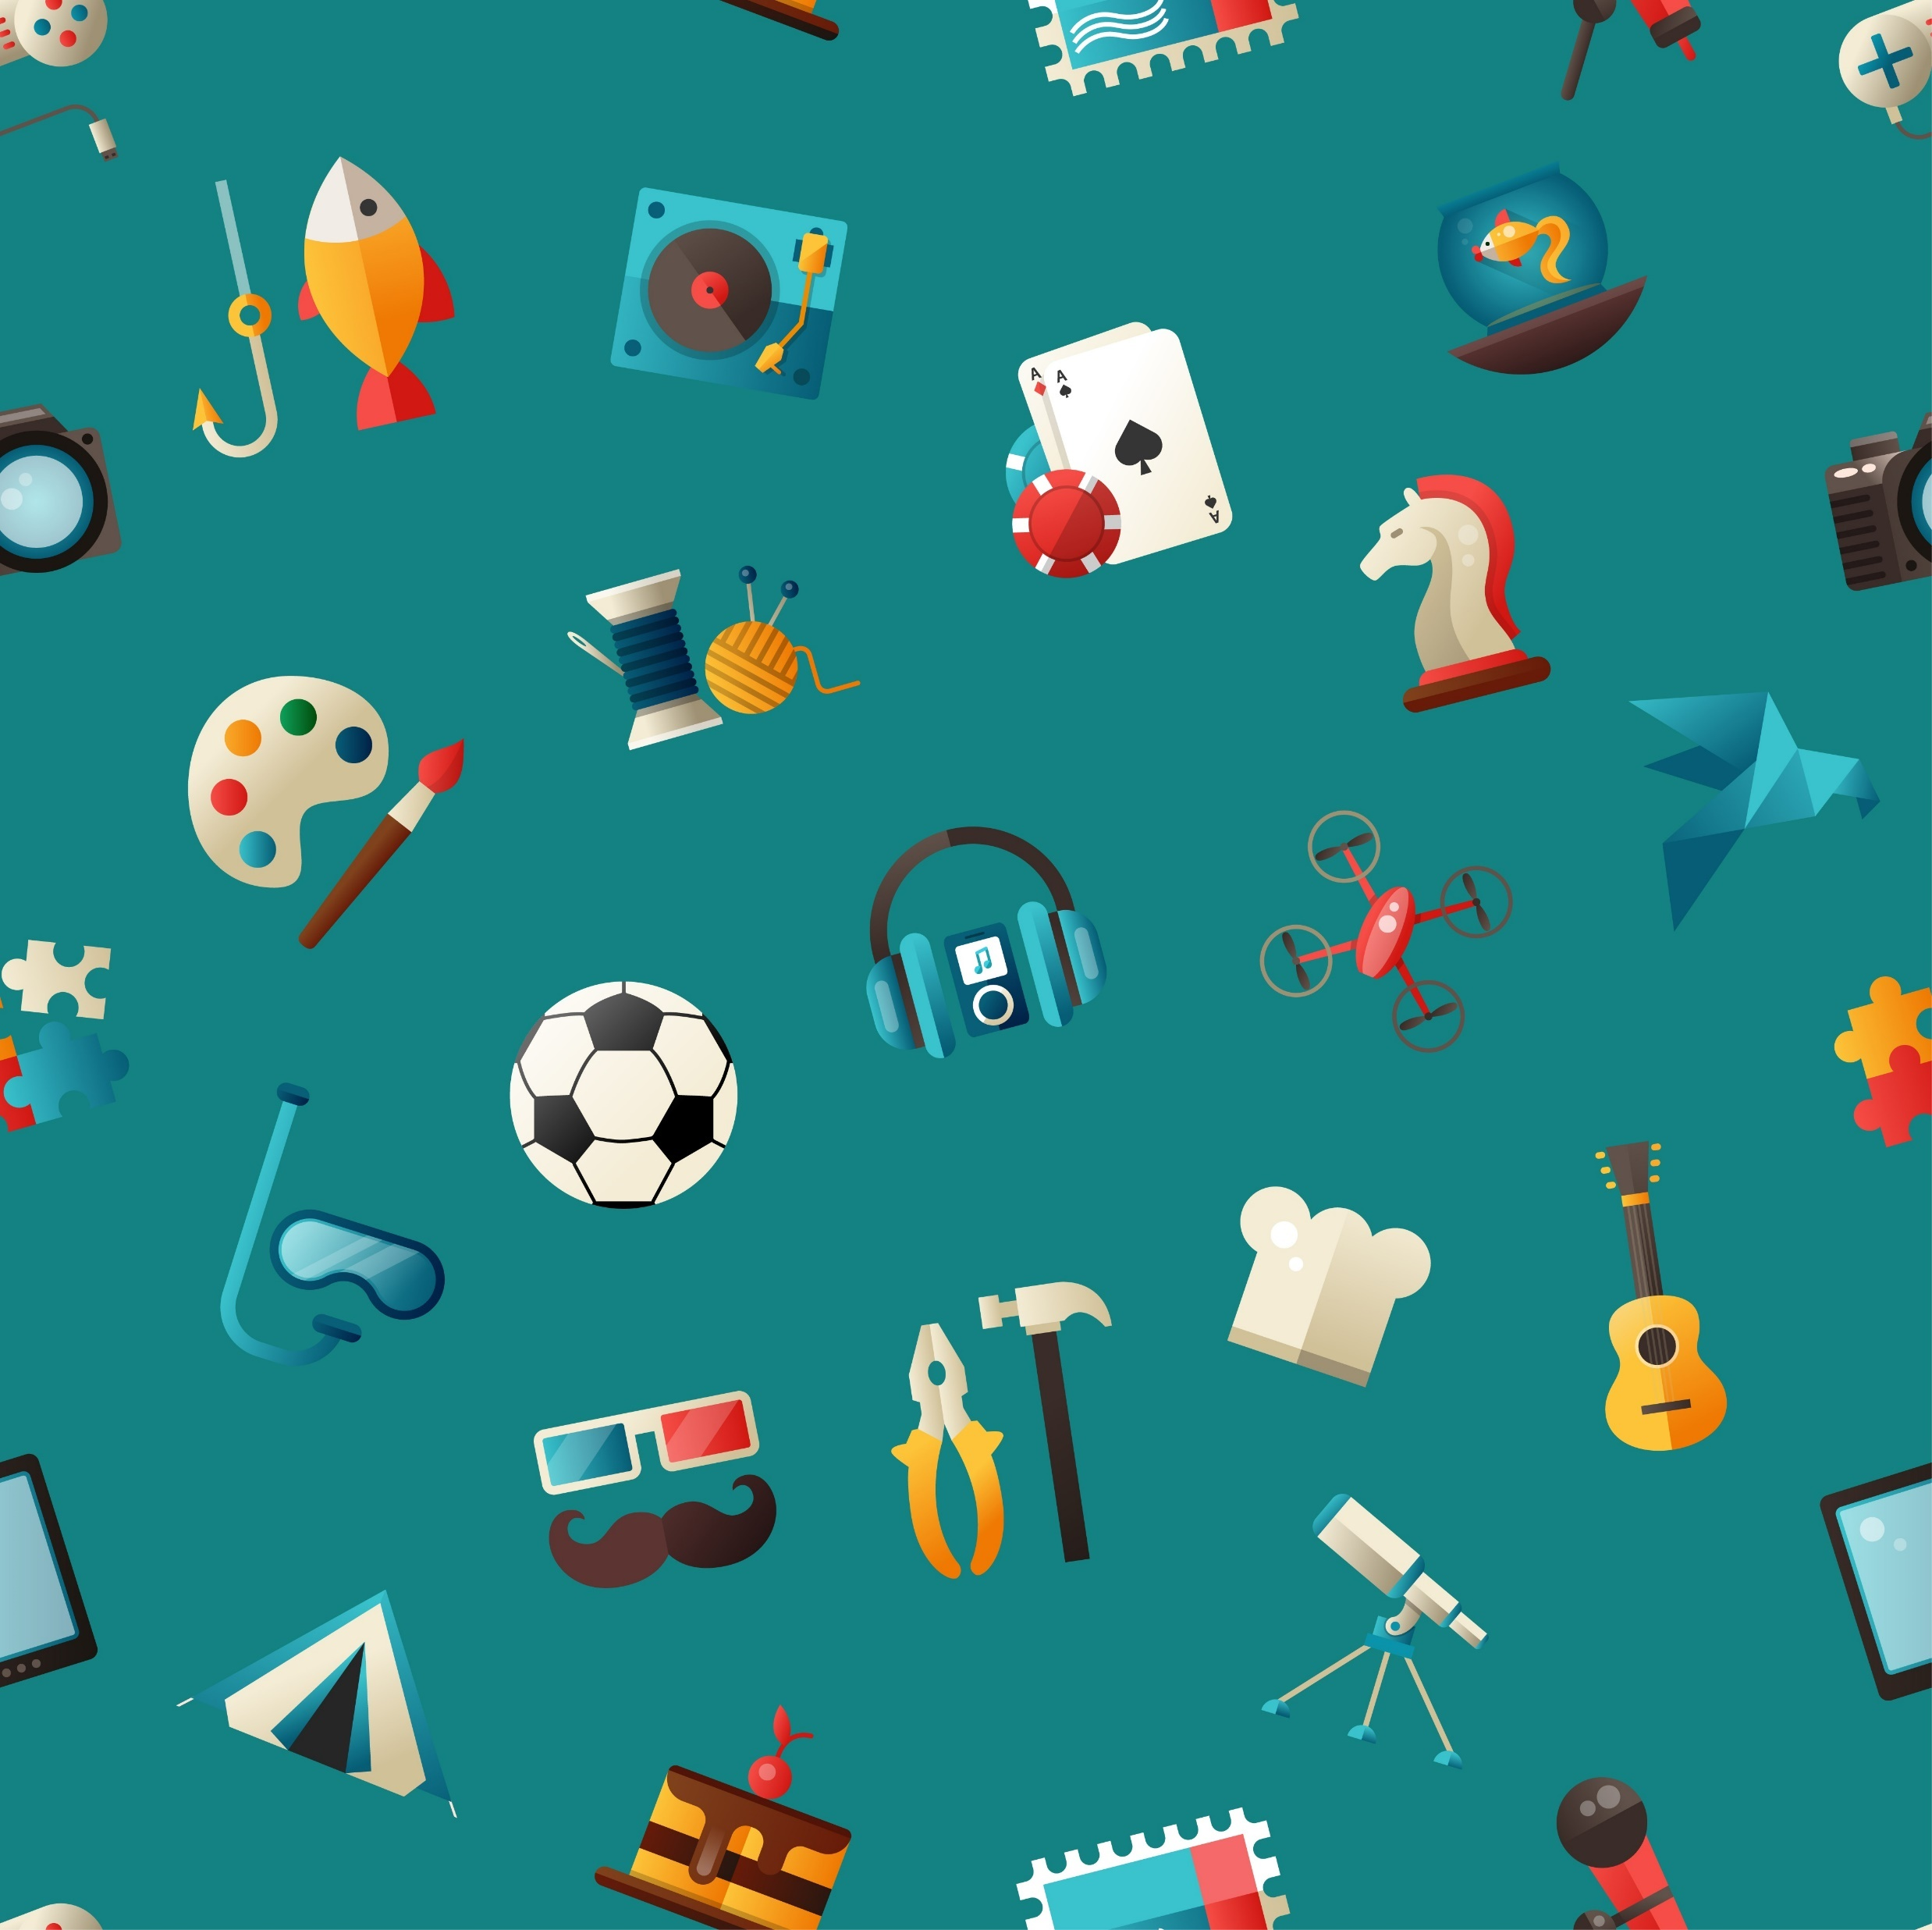
NEW HOBBIES OR INTERESTS
When exploring new hobbies or interests, the internet is a great place to find information and help guide you to new experiences.
Shutterstock.com

Slide 15
GET INVOLVED
The Internet provides you with information regarding volunteer groups and projects in your area and around the world. Use your interests to find ways to get involved and to give back.
Shutterstock.com

Slide 16
Make an effort to limit the purely recreational time you spend online and make a commitment to use this amazing technology to better yourself.
Twenty-years-from-now-you will thank you.
123rf.com

Slide 17
Key Words
technological advances connected generation
immediate access opportunities mobility
up-to-the-minute information Internet
new language social media motives
notable events video games accuracy
Shutterstock.com

