Slide 1
NICKY FIFTH’S NEW JERSEY
N5NJ
SECONDARY PROGRAM
LIFE
Rights vs. Responsibilities

Slide 2
Citizenship is the common thread that connects all Americans. We are a nation bound not by race or religion, but by the shared values of freedom, liberty, and equality. Attached to our citizenship are numerous rights and responsibilities.
https://www.uscis.gov/citizenship/learners/citizenship-rights-and-responsibilities

Slide 3
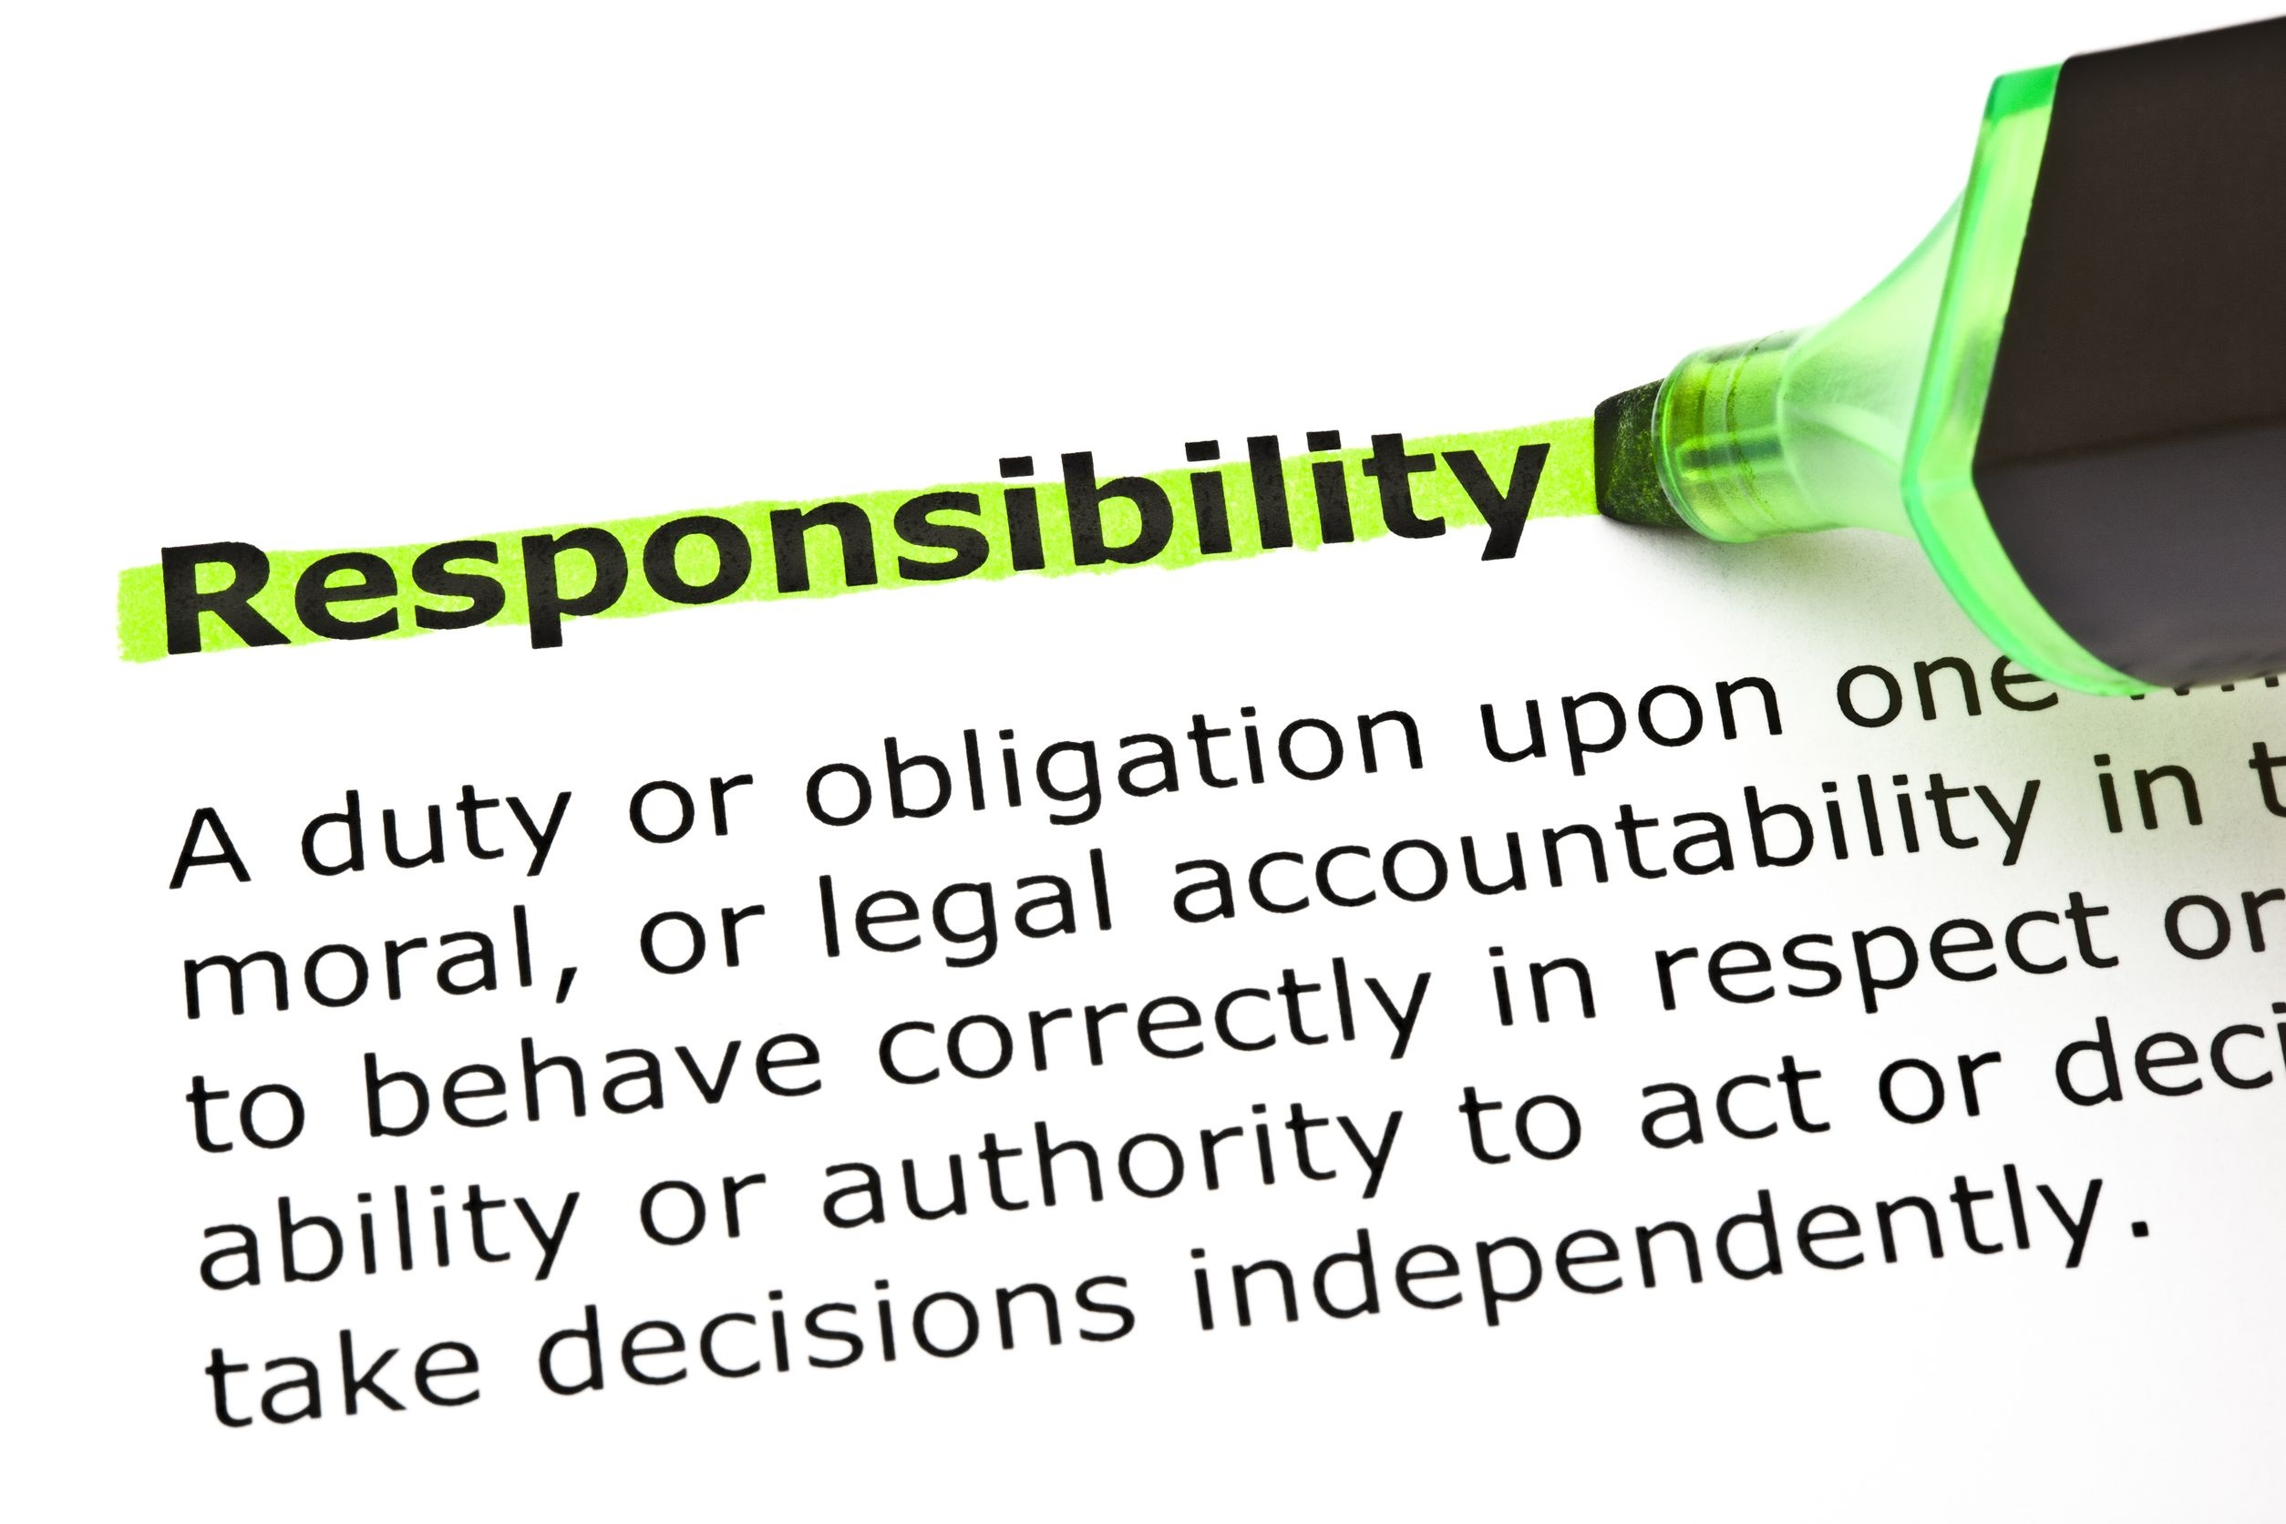
Too often, we hear people declare their rights, loudly and definitively. Rights, it seems, are very easy to remember and even easier to demand. And, while we do enjoy certain unalienable rights as citizens of the United States, there are other rights that impact our lives and change as we grow.
The flip side of the rights we so often take for granted are the responsibilities. For each role in life, we have responsibilities. Whether as a student, a son or daughter, or a citizen of the United States of America, it will serve you best to be as familiar with your responsibilities and rules as you are with your rights.

Slide 4
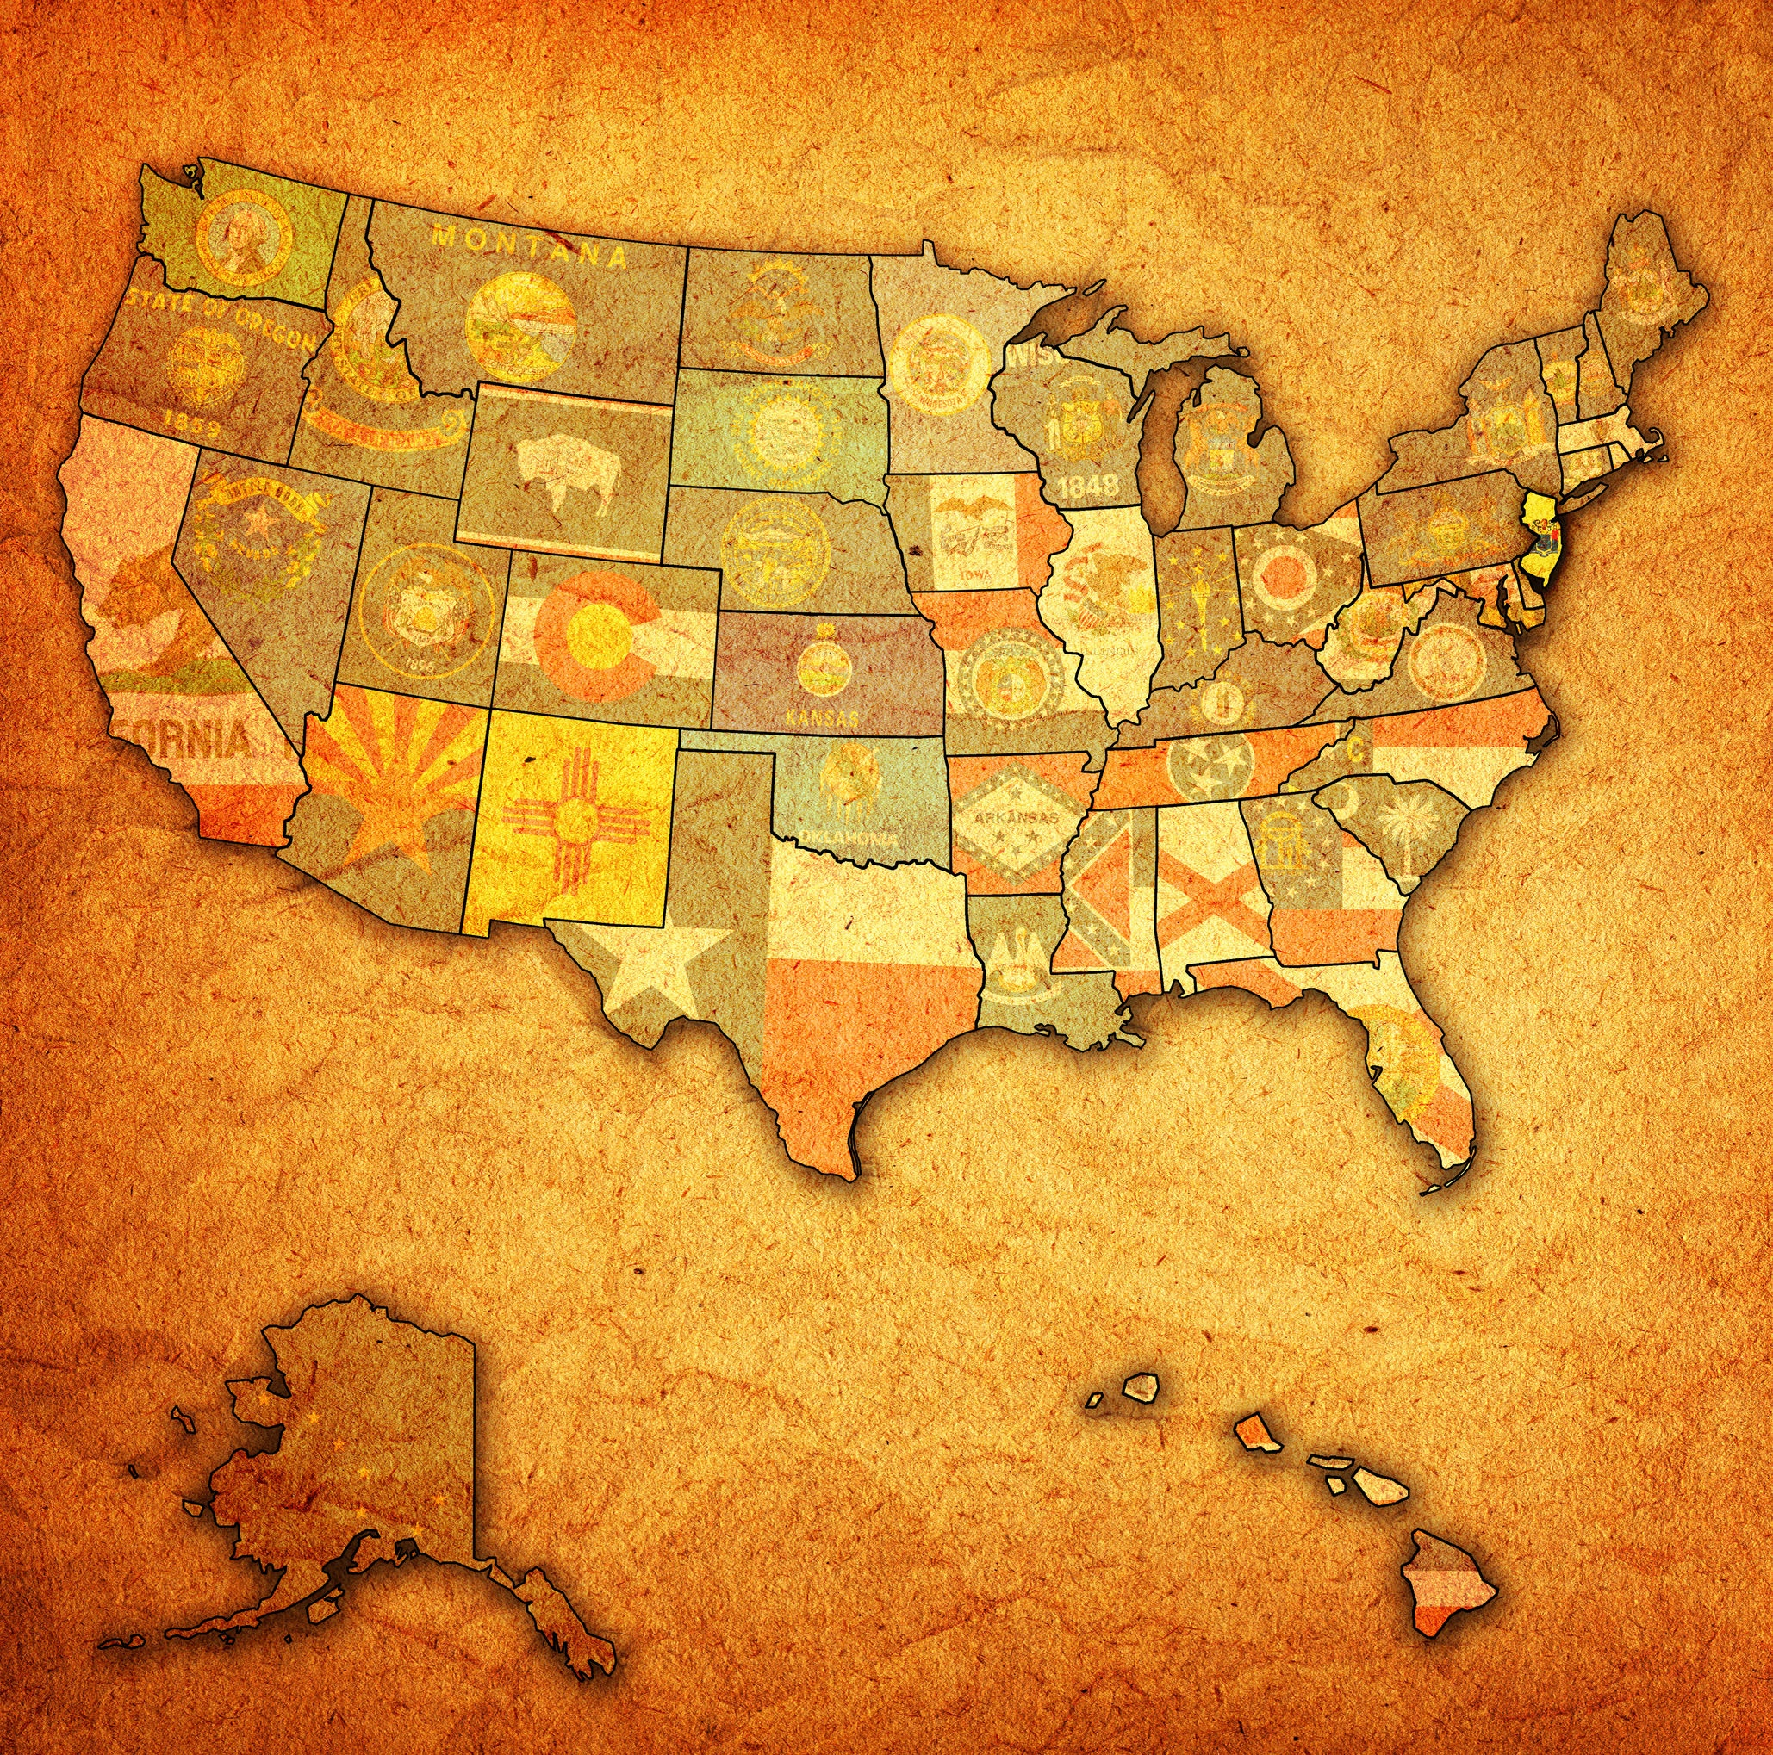
shutterstock.com
As a citizen of the United States, there are several rights and responsibilities that should be exercised and respected. Some of these responsibilities are legally required of every citizen, but all are important to ensuring that America remains a free and prosperous nation.
https://www.uscis.gov/citizenship/learners/citizenship-rights-and-responsibilities

Slide 5
Rights | Responsibilities
Freedom to express yourself. Freedom to worship as you wish. Right to a prompt, fair trial by jury. Right to vote in elections for public officials. Right to apply for federal employment requiring U.S. citizenship. Right to run for elected office. Freedom to pursue “life, liberty, and the pursuit of happiness.” | Support and defend the Constitution. Stay informed of the issues affecting your community. Participate in the democratic process. Respect and obey federal, state, and local laws. Respect the rights, beliefs, and opinions of others. Participate in your local community. Pay income and other taxes honestly, and on time, to federal, state, and local authorities. Serve on a jury when called upon. Defend the country if the need should arise.
https://www.uscis.gov/citizenship/learners/citizenship-rights-and-responsibilities

Slide 6
The Rights and Responsibilities of a citizen of the United States can differ than the rights you enjoy as a student in a school or a child in a family. In those cases, it is parents/guardians and schools/districts that determine the expectations of all parties.
shutterstock.com

Slide 7
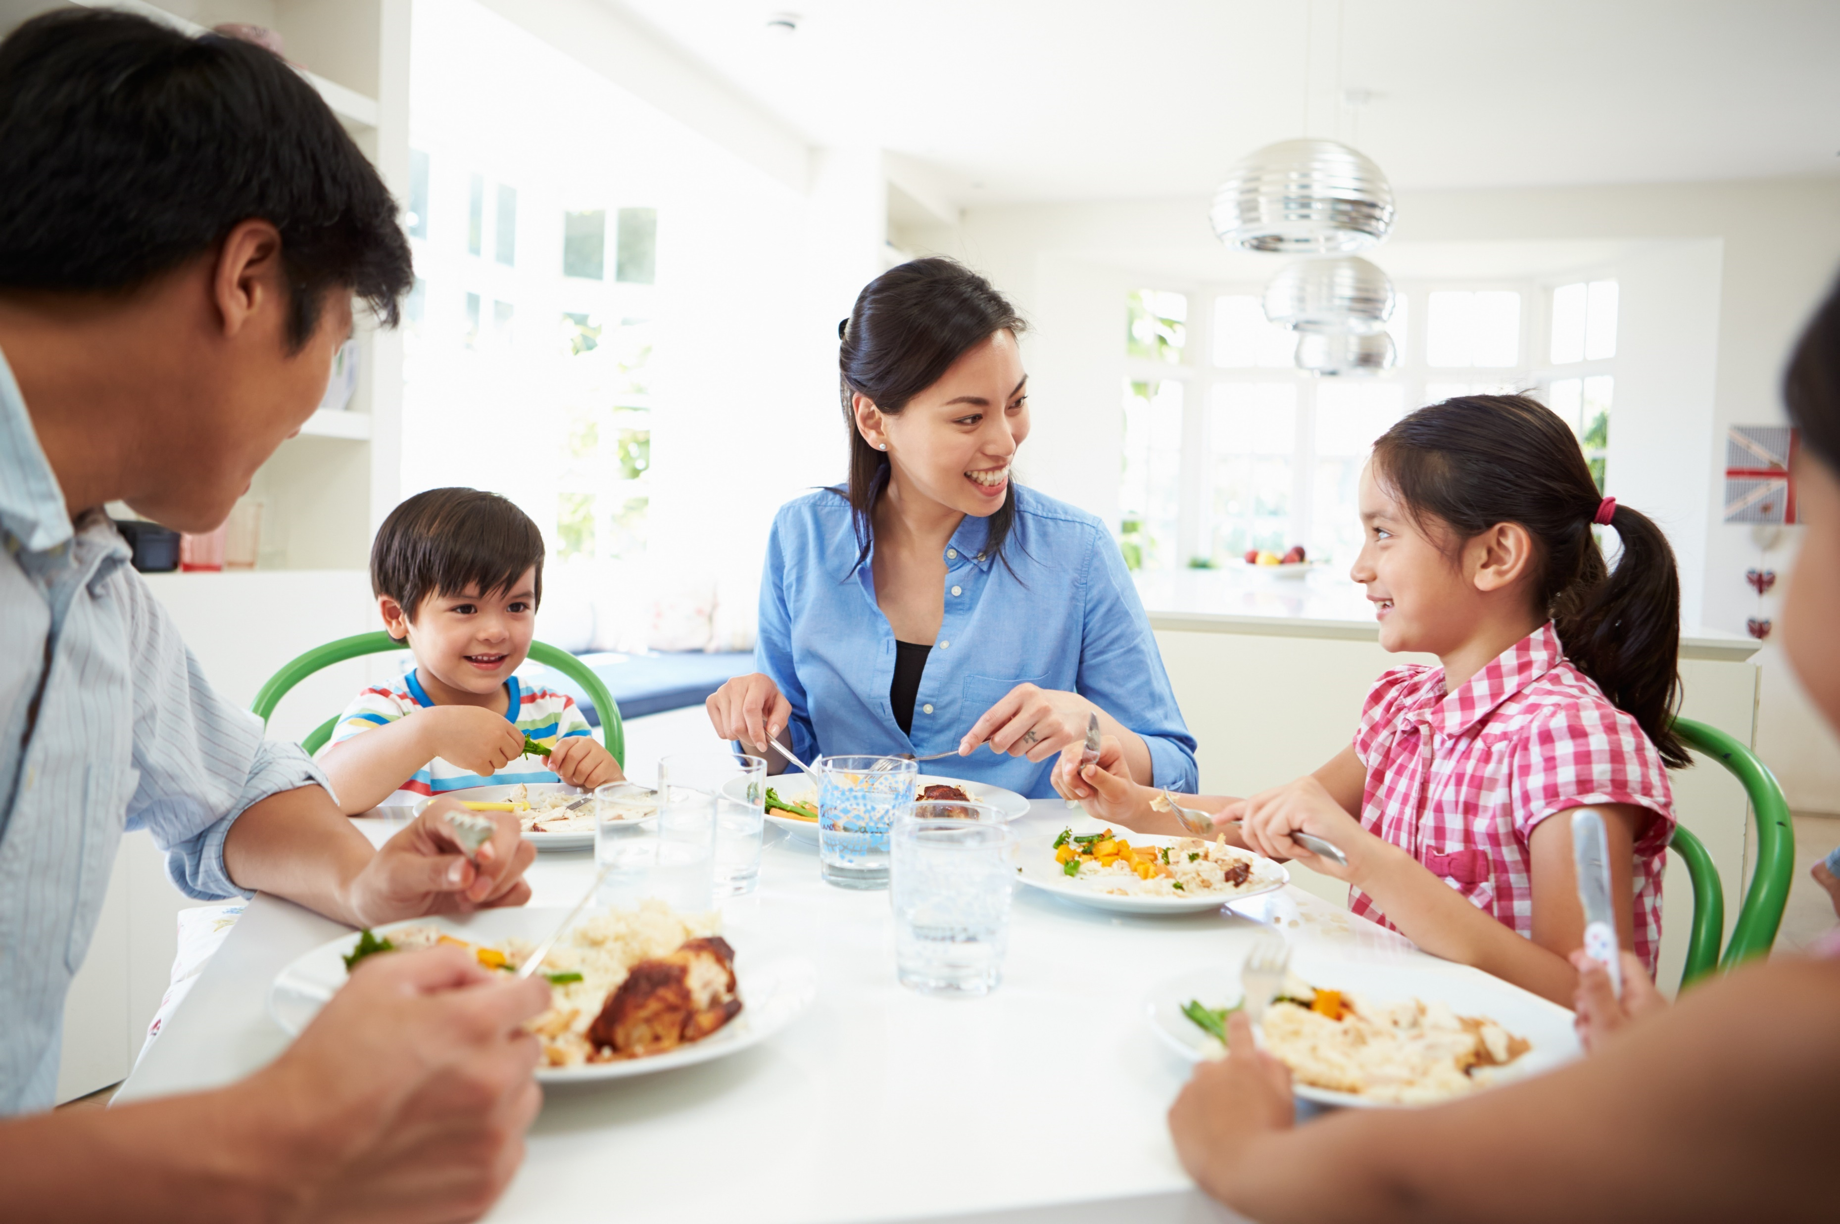
At Home
Rights: Children have the right to the basic needs of life, including food, shelter, and clothing. They also have the right to live in a safe home where they are protected and can receive love, comfort and care. All family members have the right to be treated with courtesy and respect. A healthy lifestyle that includes protection and the right to health and medical care should be the right of every child.
http://www.studyzone.org/testprep/ss5/b/citizrrrl.cfm

Slide 8
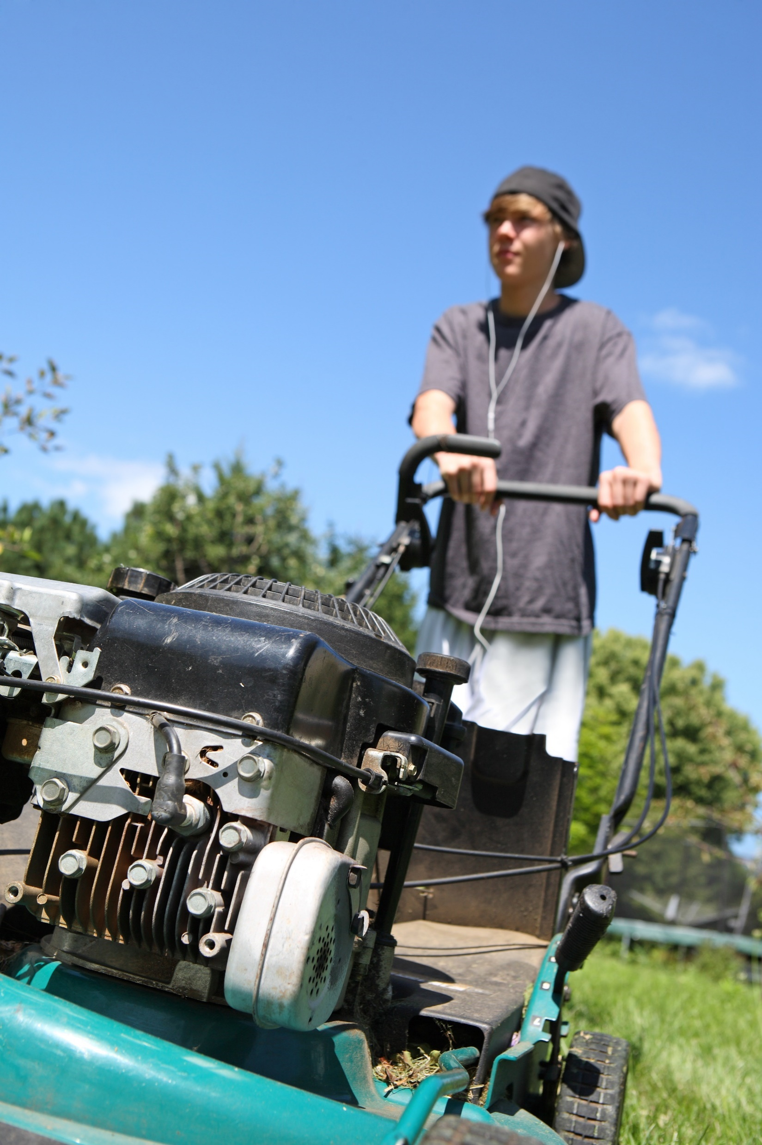
Rules: Families set their own rules for the protection and well-being of each member of the family. Rules are usually set by the adults who want to make sure that their children stay healthy and are safe. Rules help things to run smoothly in the family. Rules change as children get older and have more responsibilities.
Rules may involve bedtimes, household chores, visiting friends, or playing outside. The best rules are those that guide and encourage growing children to make smart decisions.
http://www.studyzone.org/testprep/ss5/b/citizrrrl.cfm
shutterstock.com

Slide 9
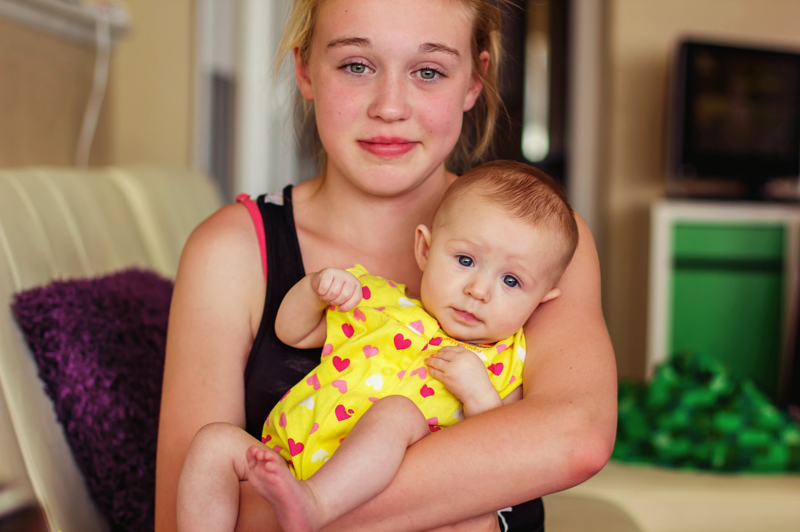
Responsibilities: Being a responsible family member means knowing and following the family's rules.
It means helping parents or care-givers and cooperating with brothers and sisters.
It’s the responsibility of family members to be honest and fair to each other. Families should work together while respecting each member of the family as an individual.
http://www.studyzone.org/testprep/ss5/b/citizrrrl.cfm
shutterstock.com

Slide 10
At School
Rights: All students have the right to be treated fairly and with respect. They have the right to learn in an orderly, safe classroom. Students have the right to be encouraged and challenged to do their best.
http://www.studyzone.org/testprep/ss5/b/citizrrrl.cfm
shutterstock.com

Slide 11
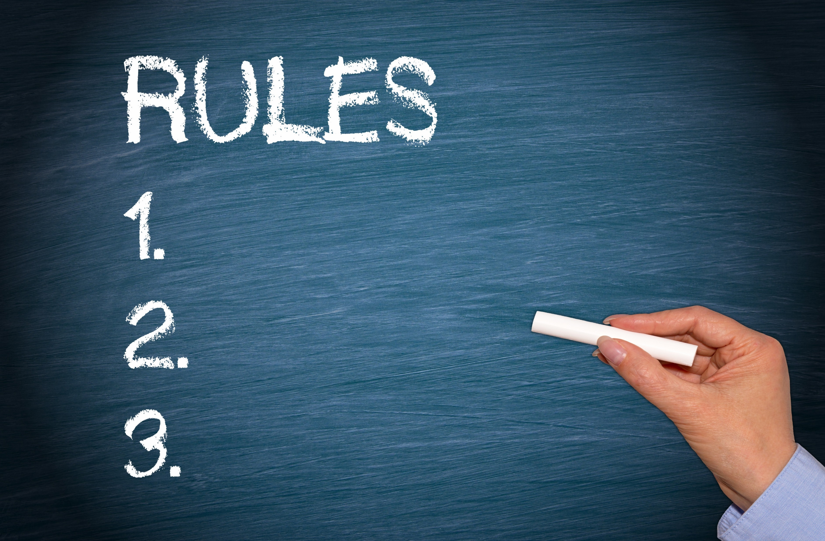
Rules: Our classrooms and schools have rules to keep students and staff members safe and healthy. They help to make it easier for everyone to learn in a pleasant setting. It is important for every student to follow school and classroom rules and not upset other students by interfering with their learning.
http://www.studyzone.org/testprep/ss5/b/citizrrrl.cfm

Slide 12
shutterstock.com
Responsibilities: It is the responsibility of all students to attend school and try their hardest to learn. Being responsible means making decisions about what is right and what is wrong and then choosing to do and say the right thing. It means respecting the rights of other students and listening to their ideas. When we accept individual differences we learn that everyone has something to offer. Students can show respect for others by sharing, and waiting to take their turn. Sometimes respect means making compromises. This means you don't always get your way when solving problems or differences. It means doing what is best for the majority.
http://www.studyzone.org/testprep/ss5/b/citizrrrl.cfm

Slide 13
Myths About Rights
You do not have the right do whatever you want. Regardless of what you have seen or heard, regardless of what your friends are doing, this is not a right.
You don’t get to walk away, stomp away, or sigh away when you don’t get your way. It’s childish and you probably keep saying you don’t want to be treated like a baby. Do the math!
You are not entitled to an endless stream of money, a limitless supply of electronic devices, or a vehicle. These are not rights. There was a time that these were things people saved for. Yes, they found a part-time job and while it took a while, they appreciated these things more.
You have a right to contribute your thoughts and ideas into a family discussion, however, there is no guarantee that you will like or agree with the result. Those reactions are best kept to yourself.
You don’t have a right to go wherever you want, do whatever you want, or hang out with anyone you want.
Those rights are reserved for gainfully employed adults.
You have the right to express how you feel, but a word of caution. Complaining is white noise to a parent. Think of practical solutions and you might get their attention and solve your problem.

Slide 14
Truth About Responsibilities
You have a responsibility to make this world a better place than you found it.
You have a responsibility to contribute. Whether that means a part-time job or
helping around the house, you should be contributing.
You have a responsibility to learn. Yes, with all of your gadgets and instant access to any information, you should be a part of the most knowledgeable generation ever. Use your devices to get smarter and give yourself an advantage.
You have a responsibility to understand and follow current events. A thriving democracy requires full and competent participation from citizens. Competent participation requires knowledge.
You have a responsibility to think before you speak, ensure what you are about to say is 100% accurate, and to avoid contributing to conversations which will cause pain or embarrassment to others.
You have a responsibility to stand up for those being bullied, treated unfairly, or taken advantage of.
You have a responsibility to take care of yourself. You owe it to twenty-years-from-now you to make sure you are as healthy as possible. Fifty-years-from-now you will really be grateful.
You have a responsibility to make good decisions. Period.

Slide 15
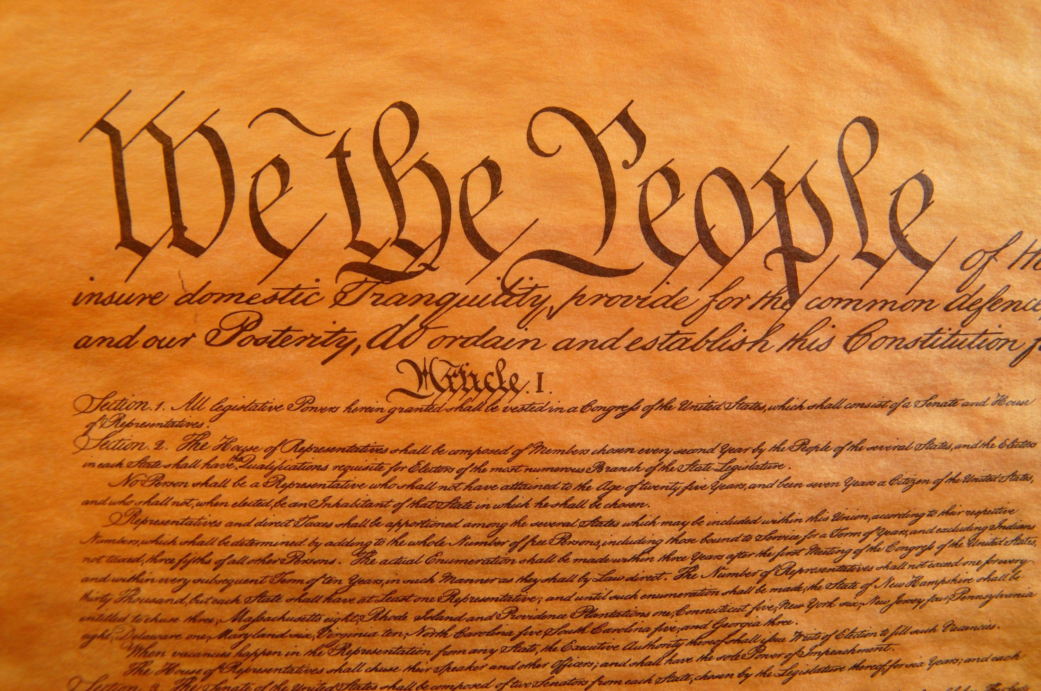
Key Words
citizenship unalienable rights rights
responsibilities federal employment rules
pursuit of happiness democratic process well-being
defend the Constitution serve on a jury challenged
parents/guardians treated fairly decisions
shutterstock.com

