Slide 1
NICKY FIFTH’S NEW JERSEY
N5NJ
SECONDARY PROGRAM
LIFE
If It Sounds Too Good

Slide 2
Shutterstock.com
In a digital, technological, fast-paced world, it’s easy to see something that looks legitimate and forget that there are many scams and even many more attempts to mislead out there.

Slide 3
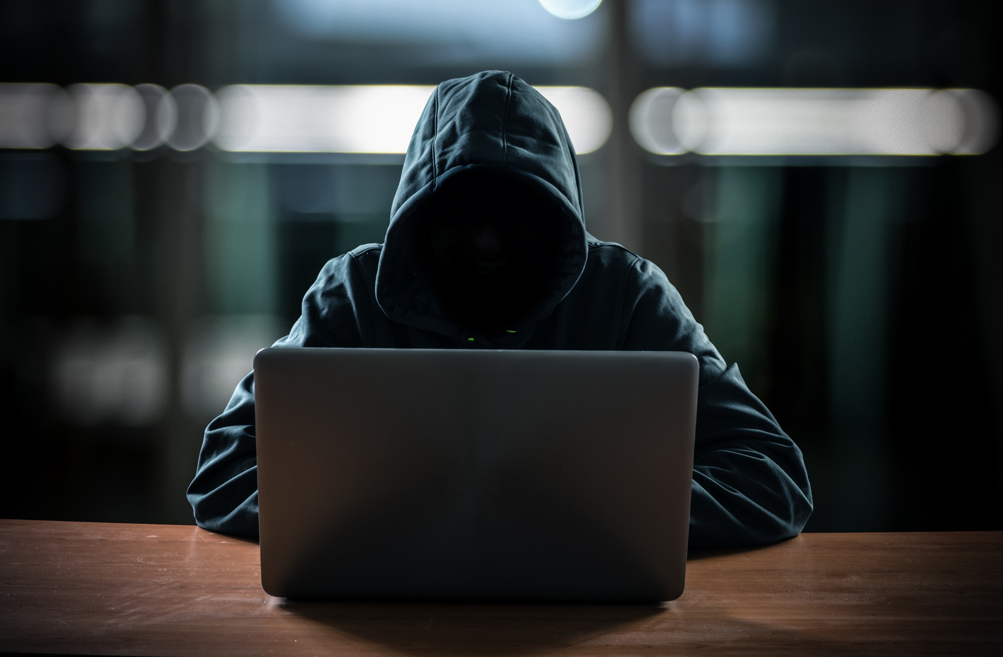
Those who work to mislead you are often very sneaky and creative. They can make websites or advertisements look extremely authentic and confuse even the most savvy individuals. Whether they’re trying to get you to buy something or think a certain way, they have proven methods of manipulating unsuspecting people.
Shutterstock.com

Slide 4
Unfortunately, despite law enforcement’s best efforts to deal with these scammers, new scams pop up every single day. Ultimately, it’s your responsibility to be able to identify and avoid these traps.
Shutterstock.com

Slide 5
Ask yourself: do they require you to pay money up front?
If they are requiring any sort of up front payment to use their services, it is almost always a scam. Many of them will claim that it's for the cost of training, etc. Most of that is just lies. More often than not, the scammer will take your money and run.
http://www.wikihow.com/Spot-an-Online-Scam
Shutterstock.com

Slide 6
Ask yourself: do they promise that you will become rich overnight?
Let's face it. Very, very few of us are ever going to make thousands of dollars each day. However, scammers prey on our hopes and dreams of being rich without moving a finger.
They tell us that our dreams can come true, but only if we do what they tell us to do. Our emotions shove aside logic, and we want to believe what they say, even if they are shady characters.
Thus, the scammer's greatest weapon is you. Always keep your logic handy.
http://www.wikihow.com/Spot-an-Online-Scam
Shutterstock.com

Slide 7
Ask yourself: what's in it for them?
Are they trying to help us out of the goodness of their own hearts? Are they making a selfless sacrifice of their time to help us become rich beyond your wildest dreams? Not likely.
Very few people in the online community are going to volunteer vast amounts of their time and effort just to help someone else succeed. Most of the time, they are doing it for their own benefit.
When we ask this question, we have to see through the lies. We need to recognize the reason behind false statements. For example, when they say that we could earn $1,000/day, they actually just want to draw us into their web. Their ultimate goal is for us to give them money in the form of an up front "registration fee.“
http://www.wikihow.com/Spot-an-Online-Scam
Shutterstock.com

Slide 8
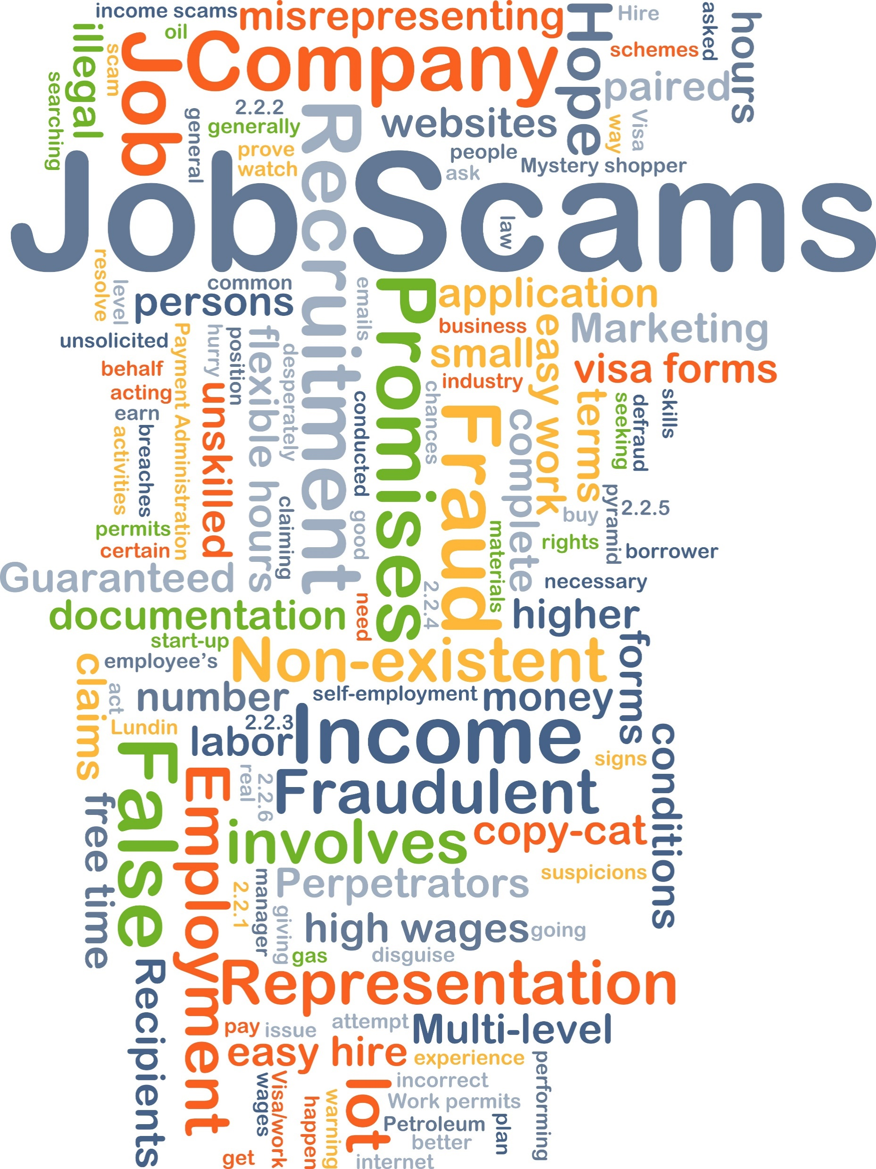
Ask yourself: how are they making money?
There are only two different ways that websites can make money from you: independently of you or dependent on you. In other words, websites making money, independent of you, don't need you to succeed for them to succeed.
On the other hand, websites making money, dependently on you, need you to succeed in order for them to succeed. A website dependent on you for their own well-being is much less likely to be a scam, since they cannot survive if you don't make money. They will have more incentive to help you make money, rather than hurt you.
http://www.wikihow.com/Spot-an-Online-Scam
Shutterstock.com

Slide 9
Another sign of a scam is a buy-now statement like "I can't keep this information online forever, so you have 3 hours to make your choice.
Creating a feeling of scarcity helps make the item seem more valuable. Sometimes the website does go dark after a day or so... but that's probably because it was pulled by the web-host for being an illegal scam.
http://www.wikihow.com/Spot-an-Online-Scam
Shutterstock.com

Slide 10
In almost every single case, if you order the scam, you will discover that you'll get a how-to for creating your own scam, which can open yourself up to legal issues and your internet account being investigated and terminated.
http://www.wikihow.com/Spot-an-Online-Scam
Shutterstock.com

Slide 11
Whether it’s a product, a service, an investment opportunity, or a job, you must always be vigilant. If they are contacting you, that should be a warning. If they make amazing, out-of-the-ordinary promises, that should be a warning. If they request money up front, that should be a warning.
Remember, if it sounds too good to be true, it probably is.
http://www.wikihow.com/Spot-an-Online-Scam
Shutterstock.com

Slide 12
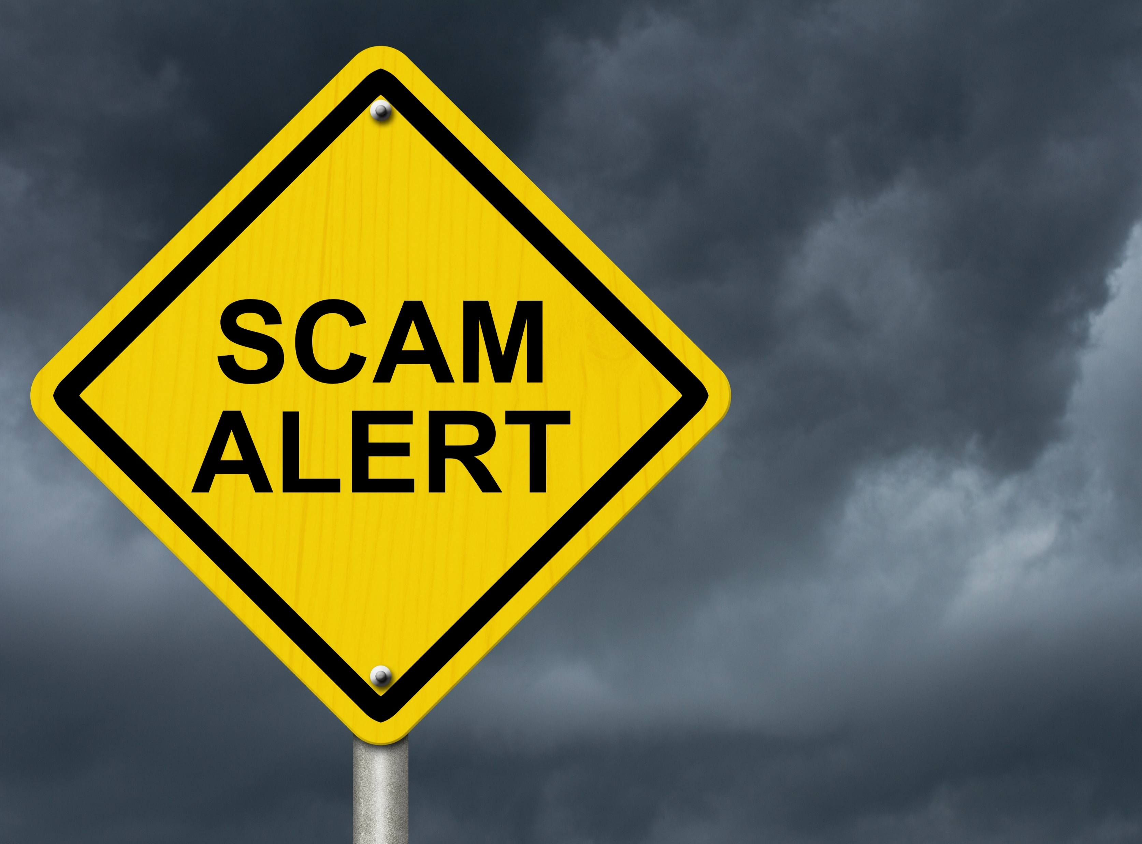
Key Words
fast-paced world technological digital
look extremely authentic manipulating legitimate
unsuspecting people just lies scams
avoid these traps incentive identify
buy-now statement false statements logic
Shutterstock.com

