Slide 1
NICKY FIFTH’S NEW JERSEY
N5NJ
SECONDARY PROGRAM
LIFE
Trajectory

Slide 2
You may have never given much thought to the word trajectory and you may not even be sure of its meaning, but is one of the most important aspects of your life.
In relation to your life, trajectory is the path or direction in which you are heading.

Slide 3
Throughout middle and high school, most students focus on the big choices. Your future is right in front of you and you’ll feel pressure to make some very big post-graduation decisions: college, career, relationships, money. These are all logical considerations and the weight of such big decisions often seems overwhelming. On the surface, it appears that these big decisions will determine our future.

Slide 4
The irony, however, is that the trajectory of your life will be more affected by the thousands of small decisions you make than the big decisions you are facing. While there are matters that are largely out of your control, like health issues, family issues, accidents, and your socio-economic status, there are thousands of decisions that you must make. These decisions range in size and many become habits, going largely unnoticed.

Slide 5
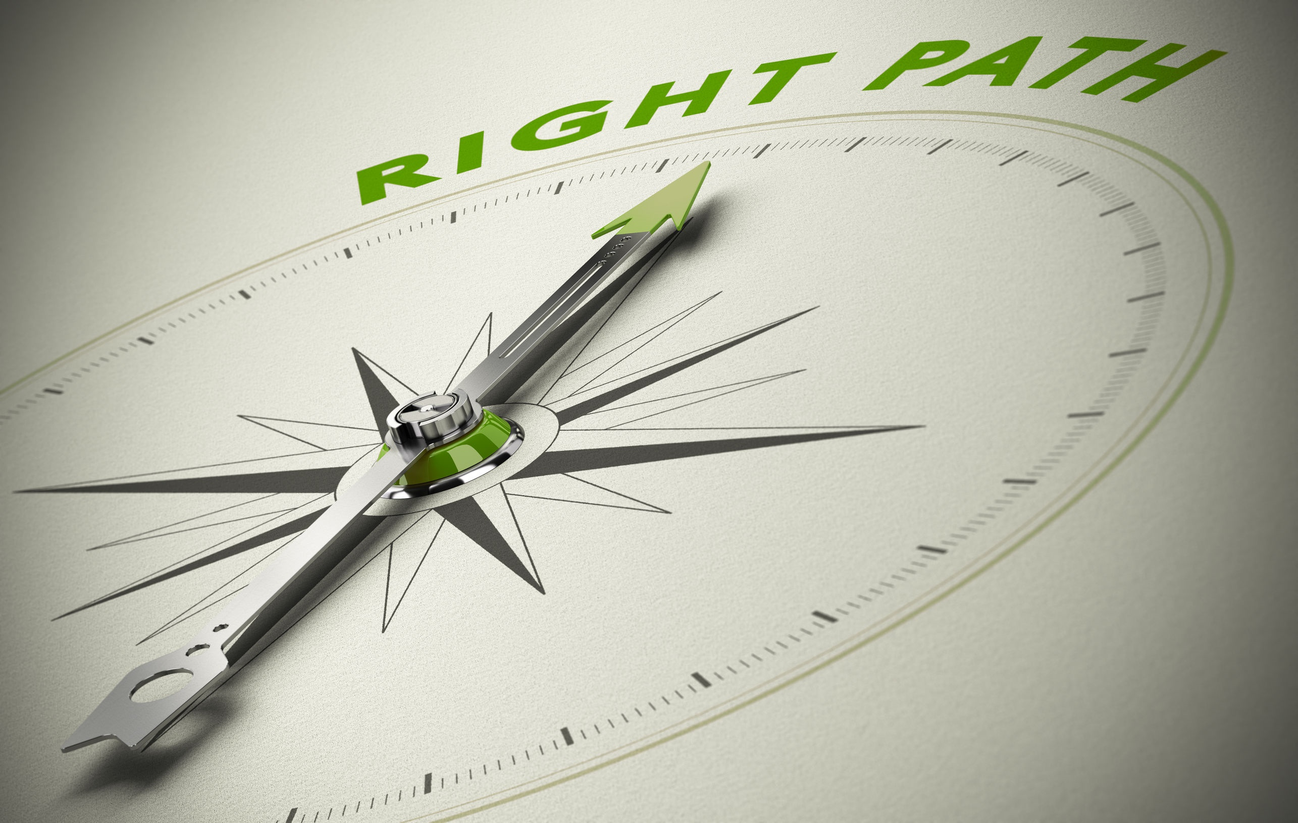
It’s important to know that each decision you make has a consequence and all decisions have the potential to alter your life. While decisions come in all sizes, even the smallest decision can have a major impact. One small tick in any direction can change the trajectory of your future.

Slide 6
While most people focus on the big decisions, it’s the small ones that affect your trajectory more than anything,as they impact your life on a daily basis.
There are five areas that you should focus on to maintain your trajectory or change it for the better.

Slide 7
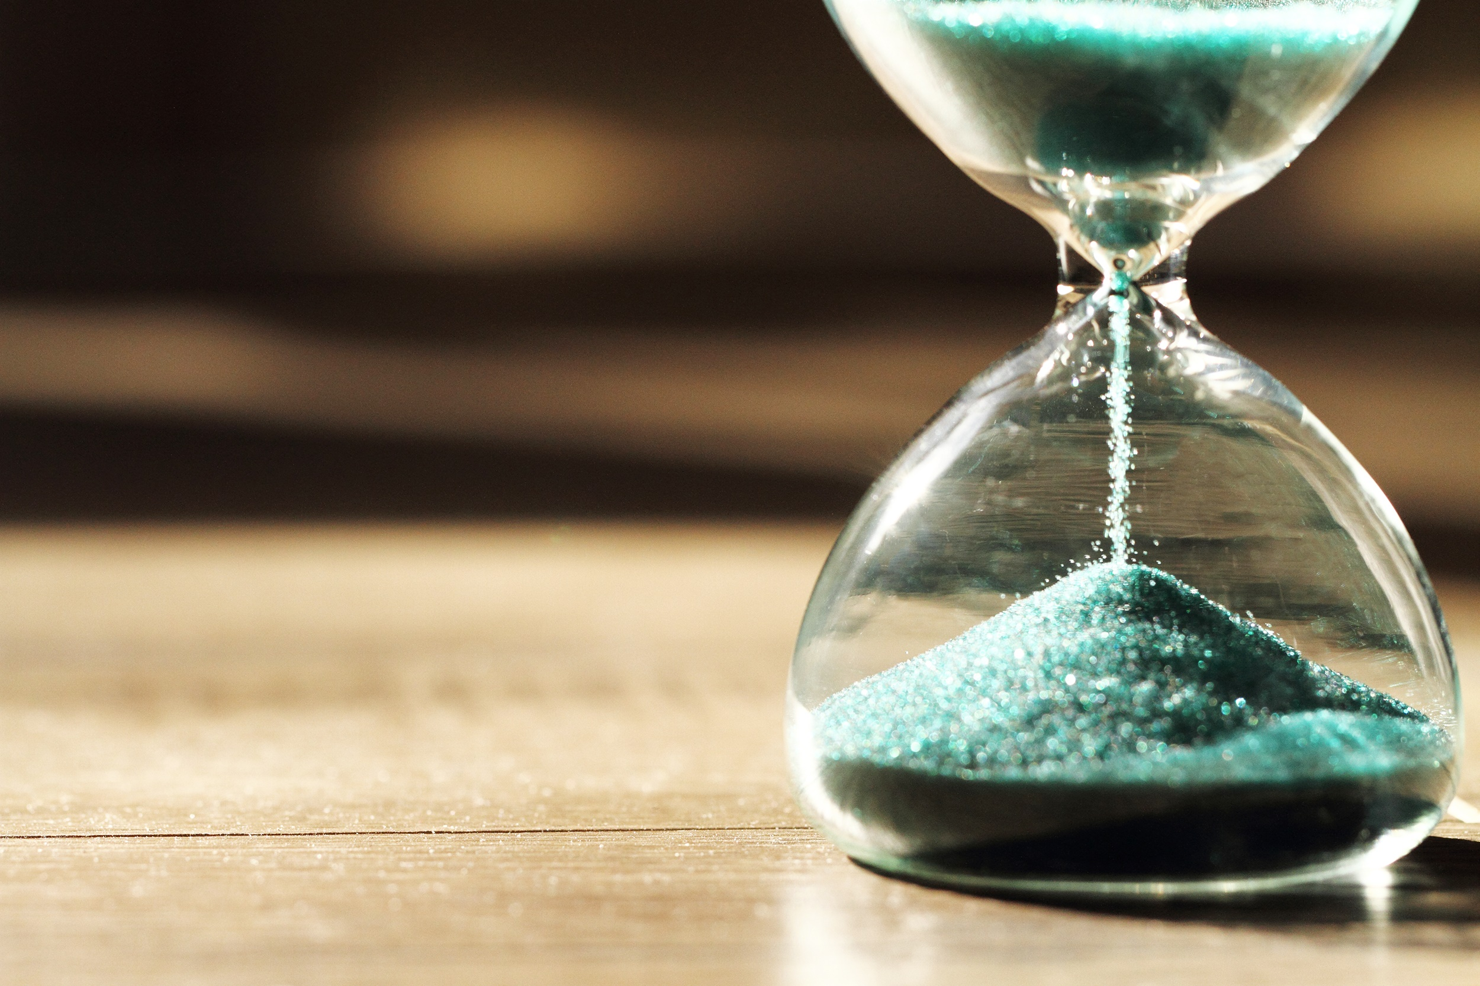
Time
How you spend your time is a series of key decisions that will affect your life. Time is one of those non-negotiables in life. Each person, no matter how rich or powerful, gets the same 24 hours each day. How you spend that time seriously impacts your trajectory.
Hopefully, one of your choices is to spend at least eight of those hours sleeping. The decision to sleep greatly impacts your health and ability to function effectively.

Slide 8
Once you deduct sleep, you still have about sixteen hours. You can divide that into school time and non-school time. Both affect the path of your life. If you waste the time you’re in school, bored and uninterested, you are missing an opportunity to learn.
The lessons you are missing can have a major impact on your future. Your goal should be to maximize your time to your advantage and participating is the best way to achieve that goal.
Your non-school time involves many more choices. Spend your time wisely. It’s limited and irreplaceable.
Imagine what kinds of things future you would prefer you to do. Hours of video games will do nothing for your future. Practice moderation and use your time to advance your goals.

Slide 9
Relationships
As important as how you spend your time is who you spend your time with. The friends you choose have an enormous impact on your trajectory. They have a tremendous influence on how you view the world, how you view yourself, and how you spend your time.
During your life, you will constantly meet new people. Avoid people who are negative or whose behaviors can negatively impact your life.
They say you can judge a person by the company they keep. Be as choosy in who you spend your time with as how you spend your time.

Slide 10
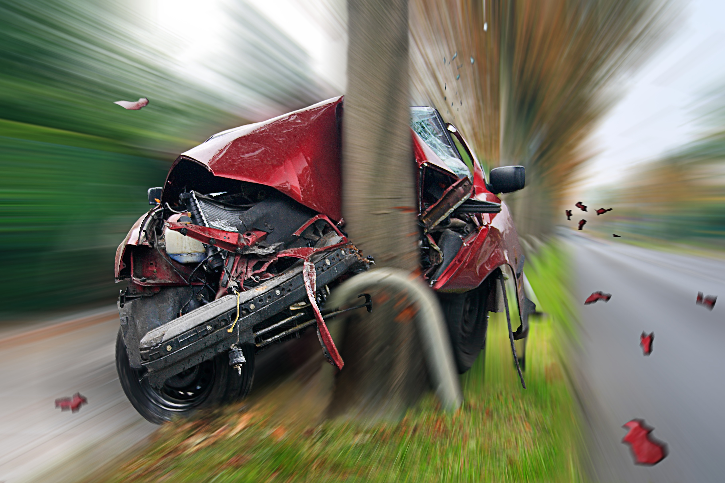
Sometimes, when you are part of a group, you tend to go on crowd autopilot, often sacrificing your own good judgment and instincts to go with the group. This can lead to dangerous situations.
While most teens believe they are invincible, the thousands of teens who die each year, due to drugs, alcohol, and motor vehicle accidents proves otherwise.
The reality is that one small decision, to get into the car with a friend who has been drinking, to try drugs, or to drive excessively fast because you are running late, can be a fatal decision. Sadly, these decisions are often influenced by the people you spend your time with.
The best way to avoid life-changing or life ending consequences is to avoid risky behaviors. Future you will be very grateful.

Slide 11
Well-being
Another important influence on your trajectory is your well-being, or how well you take care of yourself. Again, avoidance is the best protection. Fifty years ago, no one knew cigarette smoking was harmful, sugar was addictive, and that what you eat could be the biggest factor in getting or avoiding diseases throughout the rest of your life.
Today, we know more about what affects our health than ever. We know cigarettes and sugar are as addictive as serious drugs, so don’t start smoking and limit the sugar. We know whole foods are 100% healthier than processed factory foods from bags, boxes, and cans so keep that in mind when you reach for a snack or sit down for a meal.
You may not look at each meal or snack as a big decision, but everything you do is a choice that you are making, regardless of the size. Why stack the deck against yourself?

Slide 12
Today, our nation faces a serious addiction epidemic. Take a good, hard look at pictures of addicts. They’re lives are hardly glamorous and it often takes years to overcome, if they even really want to overcome it. Read the newspaper and use the internet to see the damage drug addiction causes. This is the quickest way to permanently alter, and possibly destroy, the trajectory of your life.
That first decision to try drugs can lead to a sad lifetime of addiction. A decision to drink at a party and drive home can lead to death, injury, or many, many years in prison. Despite seeing teens who have used incredibly poor judgement constantly on the news, most teens think it won’t happen to them. It’s a tragic miscalculation. In 2014, 9,967 people were killed in alcohol-impaired driving crashes, accounting for nearly one-third (31%) of all traffic-related deaths in the United States.
And, going back to who you spend your time with, if you are with people making poor decisions, you risk your life, your safety, and the trajectory of your future. High school is four short years, the rest of your life is much longer. Make sure you’re there for it.

Slide 13
Reactions
They say life isn’t what happens to you, it’s how you react.
Never, have truer words been spoken. You cannot insulate yourself from things happening to you, deserved or undeserved, you have no control over this. What you do have control over is how you react. Your reaction can make the situation better and easier or can severely complicate it. Again, choices you make.
The trajectory of your life will hinge upon how you handle life. Do you immediately lose your temper? Do you become emotional and cry? Do you make rash decisions? These can all negatively affect your future.

Slide 14
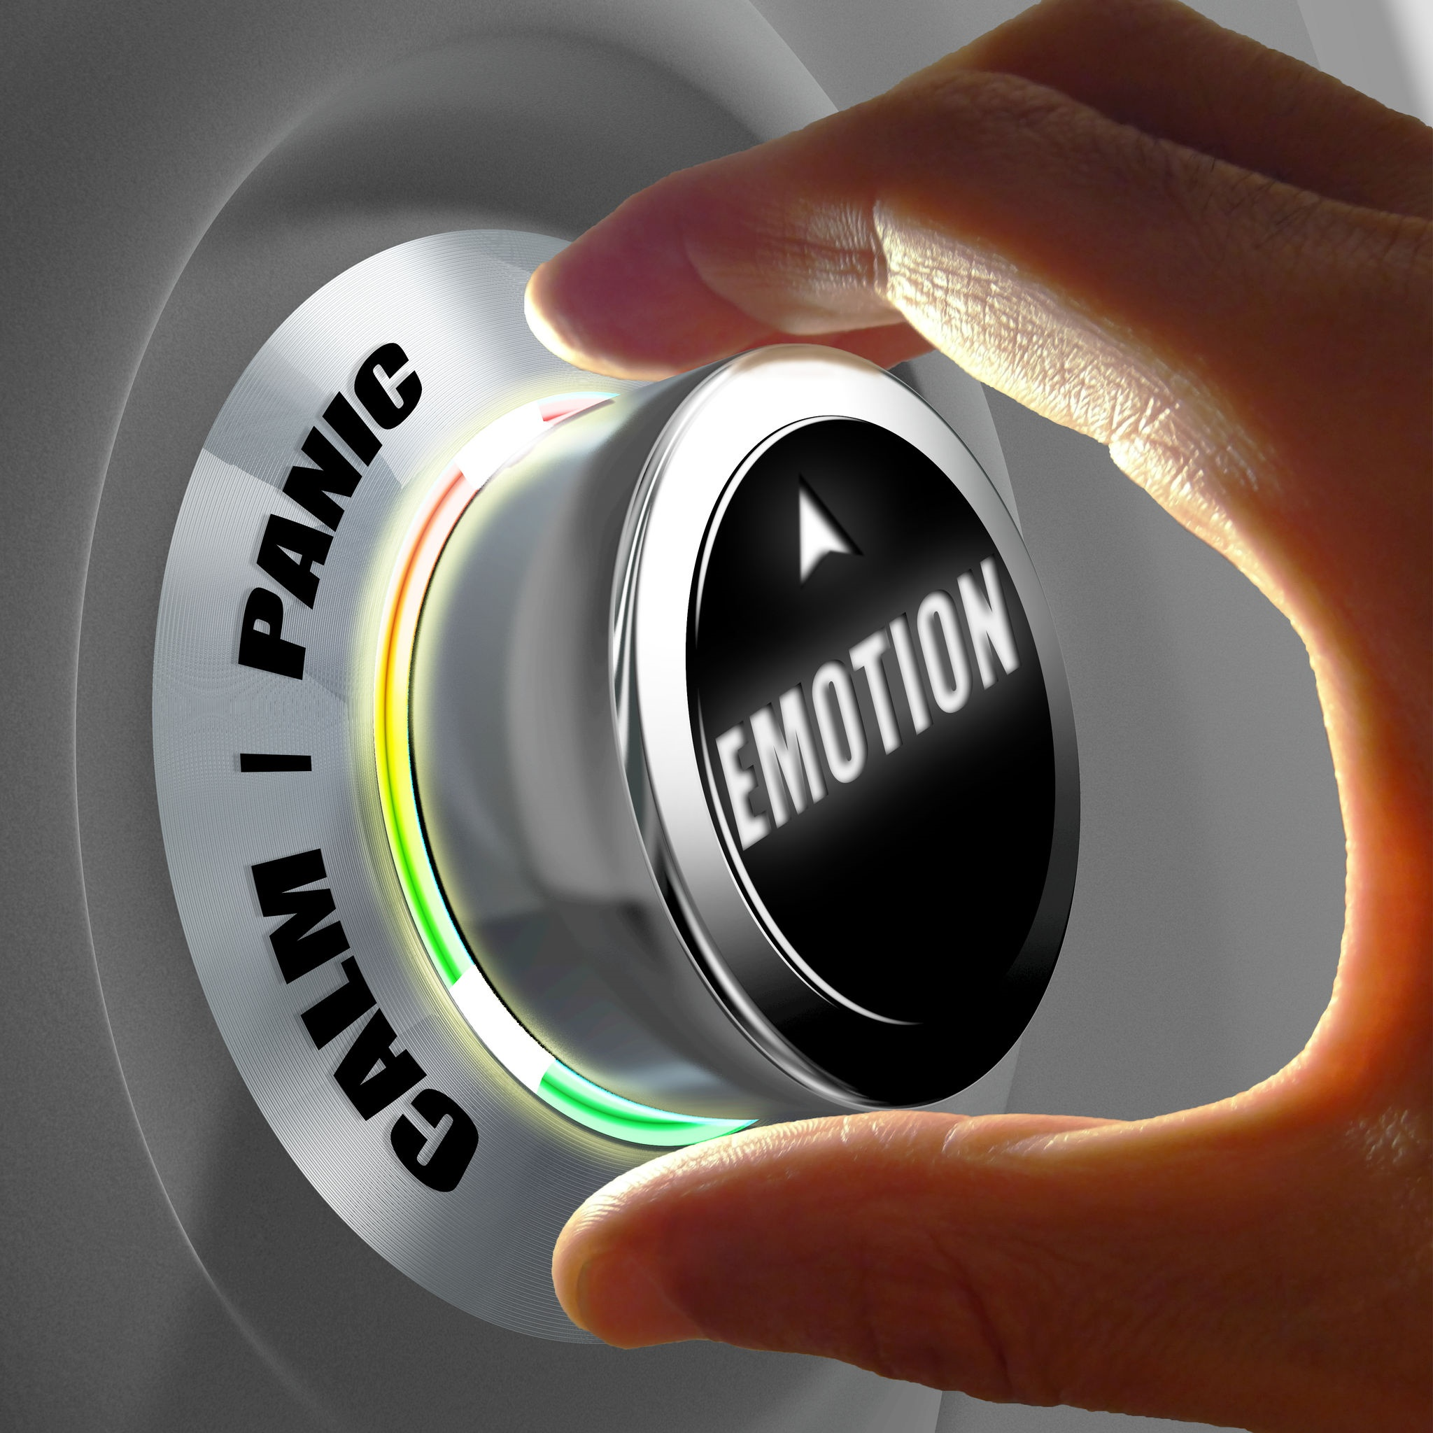
Reactions are often a learned behavior that comes from the way our families react. Regardless of why you react the way you do, if it’s negative, make a choice to address this behavior.
Before the next incident arises, think about how you will react. Perhaps you’ll take some deep breaths and think carefully before you react. Perhaps you’ll give yourself time to digest what’s happening before you form opinions.
You may have noticed that the positive ways to react involve refraining from an immediate reaction. Admittedly, this is not the easiest task, but it will serve you well for your entire life.

Slide 15
What You Know
As you mature, you’ll be exposed to more and more information. Knowledge is power and information is how we gain that knowledge. Unfortunately, not all information is created the same. You’ll start to notice that much of the information available today is motive-inspired. The person or group providing the information has a motive and they have slanted everything to support that motive.
The expression, Buyer Beware, cautions buyers to know exactly what they are buying before the transaction and if they are duped in the process, it is their fault for not being more thorough.
The same concept applies with information. What you know affects how you think and behave, which ultimately affects your trajectory. Be sure you know where your information is coming from and use multiple sources before forming opinions and making decisions.

Slide 16
The trajectory of your life is so important that you should protect it at all costs. Each and every small decision influences how the big decisions work out.
Don’t be a passenger in your own life. Take control, make a habit of making smart decisions and your trajectory will lead you to great places.
One teen, upon learning to drive, was told by her father to stop at each intersection. The teen pointed out that in their neighborhood, all of the streets were one way streets. She insisted she didn’t have to look both ways at each intersection, because cars would only be coming from one direction and she had the right of way. The father calmly looked at her and said, “The cemetery is filled with people who had the right of way.”

Slide 17
Key Words
path or direction trajectory focus
big choices future pressure
non-negotiables in life largely unnoticed potential
major impact smallest decisions daily
immediate reaction well-being motive

