Slide 1
NICKY FIFTH’S NEW JERSEY
N5NJ
SECONDARY PROGRAM
LIFE
Women’s Wages

Slide 2
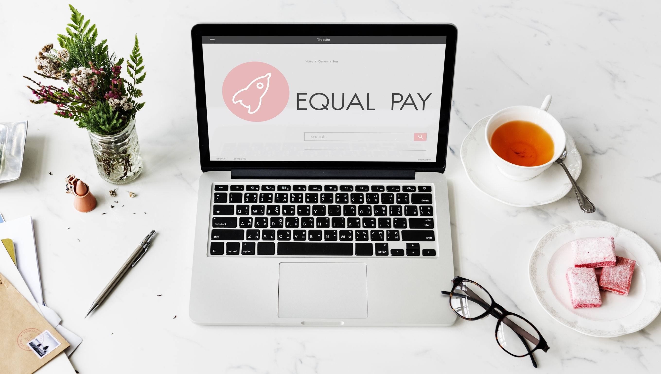
shutterstock.com
The gender wage gap for weekly full-time workers in the United States widened between 2014 and 2015. The median weekly earnings for full-time work increased for both women and men during 2015, but the increase was more substantial for men than women. In 2015, the ratio of women’s to men’s median weekly full-time earnings was 81.1 percent, a decrease of 1.4 percentage points since 2014, when the ratio was 82.5 percent. Women’s median weekly earnings for full-time work were $726 in 2015 compared with $895 for men. Allowing for inflation, women’s earnings increased by 0.9 percent, while men’s earnings increased by 2.6 percent since 2014.
http://iwpr.org/publications/pubs/the-gender-wage-gap-2015-earnings-differences-by-race-and-ethnicity#sthash.1oyo7TNK.dpuf

Slide 3
You’ve probably heard that men are paid more than women are paid over their lifetimes. But what does that mean? Are women paid less because they choose lower-paying jobs? Is it because more women work part time than men do? Or is it because women have more caregiving responsibilities?
The American Association of University Women (AAUW) is the nation’s leading voice promoting equity and education for women and girls.
Since our founding in 1881, AAUW members have examined and taken positions on the fundamental issues of the day — educational, social, economic, and political. AAUW’s The Simple Truth about the Gender Pay Gap succinctly addresses these issues by going beyond the widely reported 79 percent statistic.
The report explains the pay gap in the United States; how it affects women of all ages, races, and education levels; and what you can do.
http://www.aauw.org/research/the-simple-truth-about-the-gender-pay-gap/
shutterstock.com

Slide 4
Quick Facts The pay gap has barely budged in a decade. At the current rate, the gap won’t close for more than 100 years.. In fact, the estimate is at about 136 years.
http://www.aauw.org/research/the-simple-truth-about-the-gender-pay-gap/
shutterstock.com

Slide 5
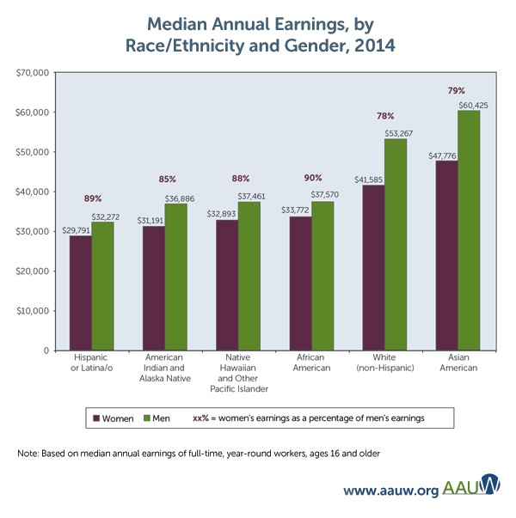
Think 79 cents is bad? The pay gap is worse for women of color.
The pay gap affects women from all backgrounds, at all ages, and of all levels of educational achievement, although earnings and the gap vary depending on a woman’s individual situation.
Among full-time workers in 2014, Hispanic, African American, American Indian, and Native Hawaiian women had lower median annual earnings compared with non-Hispanic white and Asian American women. But within racial/ethnic groups, African American, Hispanic, American Indian, and Native Hawaiian women experienced a smaller gender pay gap compared with men in the same group than did non-Hispanic white and Asian American women.
http://www.aauw.org/research/the-simple-truth-about-the-gender-pay-gap/
shutterstock.com

Slide 6
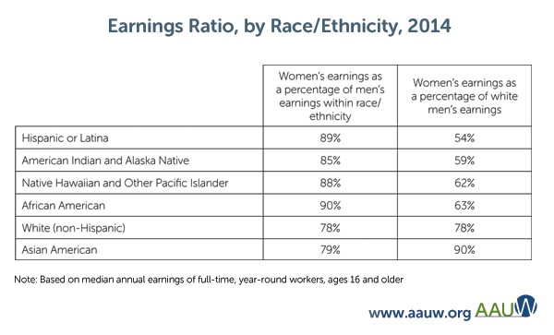
Using a single benchmark provides a more informative picture. Because non-Hispanic white men are the largest demographic group in the labor force, they are often used for that purpose.
Compared with salary information for white male workers, Asian American women’s salaries show the smallest gender pay gap, at 90 percent of white men’s earnings. The gap was largest for Hispanic and Latina women, who were paid only 54 percent of what white men were paid in 2014.
The smaller gender pay gap among African Americans, Hispanics, American Indians, and Native Hawaiians is due solely to the fact that those men of color were paid substantially less than non-Hispanic white men in 2014.
http://www.aauw.org/research/the-simple-truth-about-the-gender-pay-gap/
shutterstock.com

Slide 7
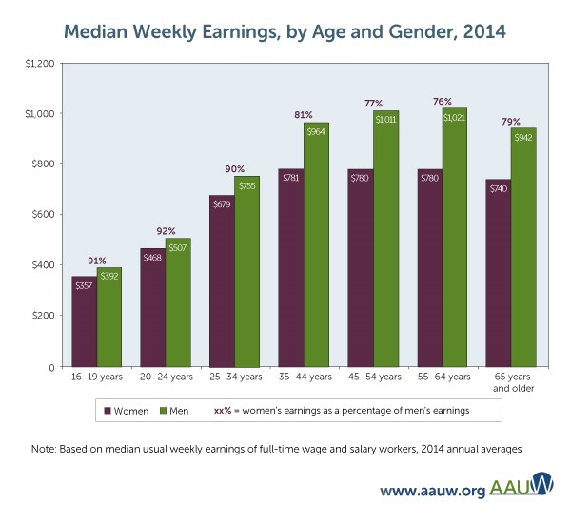
The gender pay gap is worse for mothers, and it only grows with age. Earnings for both female and male full-time workers tend to increase with age, with a plateau after 45 and a drop after age 65. The gender pay gap also grows with age, and differences among older workers are considerably larger than gaps among younger workers. Women typically earn about 90 percent of what men are paid until they hit 35. After that median earnings for women are typically 76–81 percent of what men are paid.
http://www.aauw.org/research/the-simple-truth-about-the-gender-pay-gap/
shutterstock.com

Slide 8
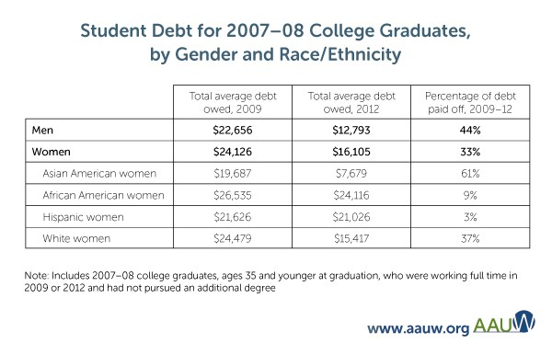
Thanks to the pay gap, women struggle to pay off student loan debt even more than men do. Education improves earnings for women of all races and ethnicities, but earnings are affected by race and ethnicity as well as gender. White women are paid more than African American and Hispanic women at all education levels.
http://www.aauw.org/research/the-simple-truth-about-the-gender-pay-gap
shutterstock.com

Slide 9
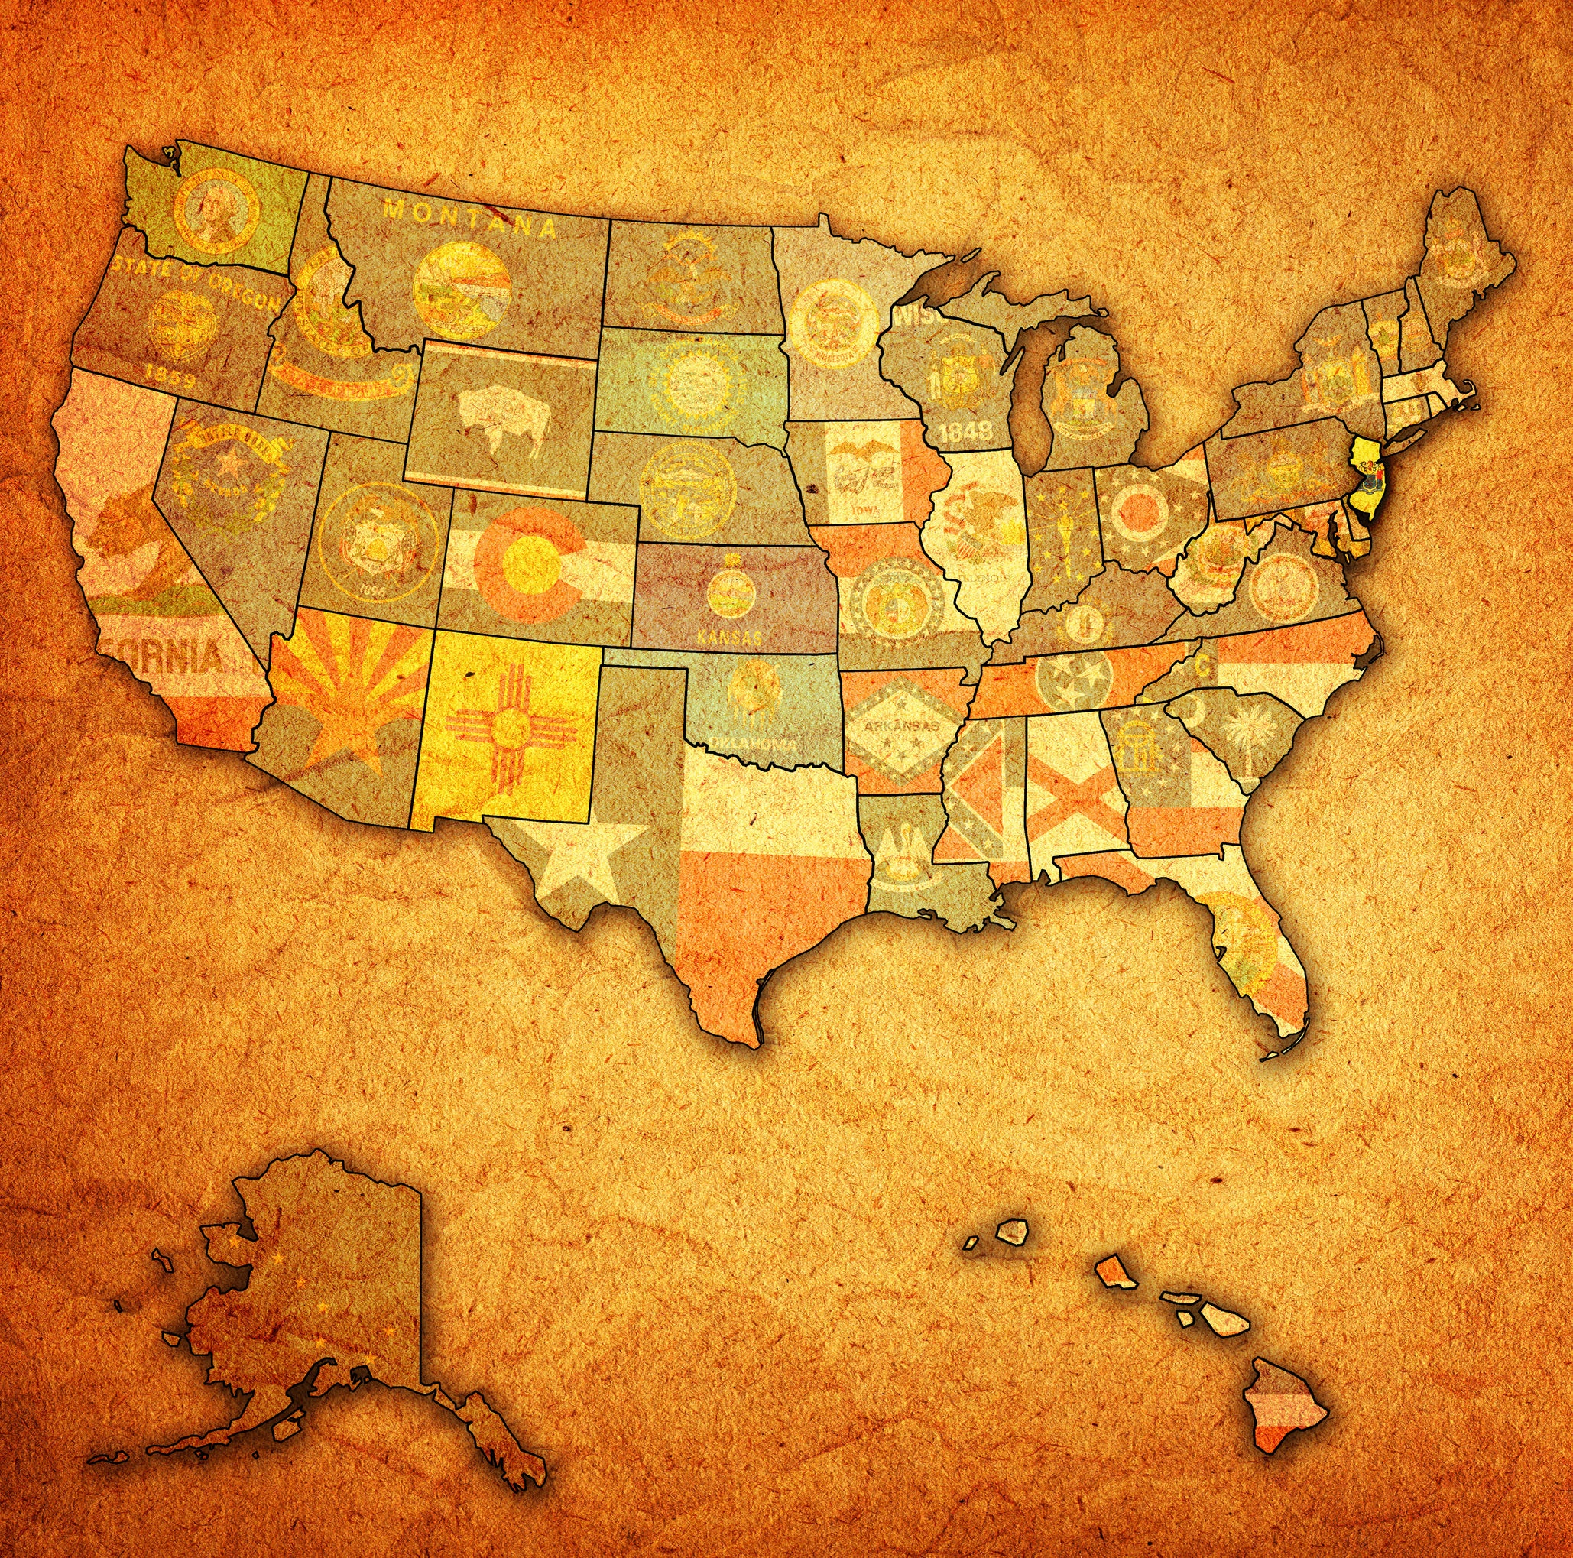
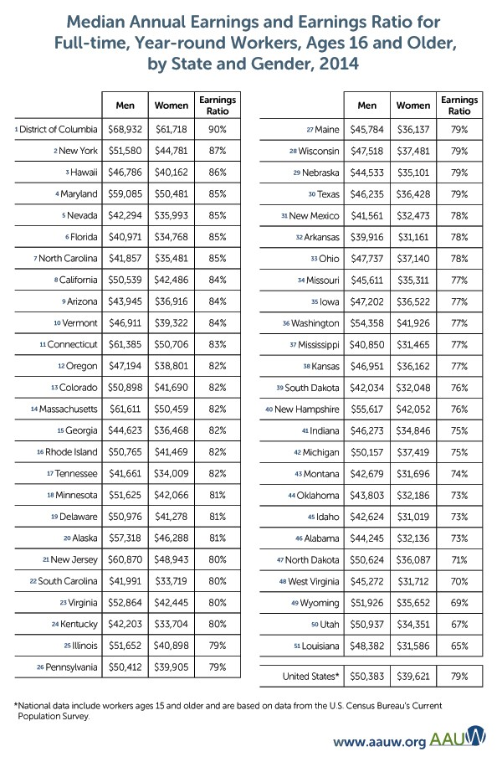
Women in every state experience the pay gap, but in some states it’s worse than others.
Location, Location, Location: Pay Gap by State
Not only is there a national pay gap statistic, the pay gap can also be calculated for each state (Figure 2). According to data from the American Community Survey, in 2014 the pay gap was smallest in Washington, D.C., where women were paid 90 percent of what men were paid, and largest in Louisiana, where women were paid 65 percent of what men were paid.
http://www.aauw.org/research/the-simple-truth-about-the-gender-pay-gap/

Slide 10
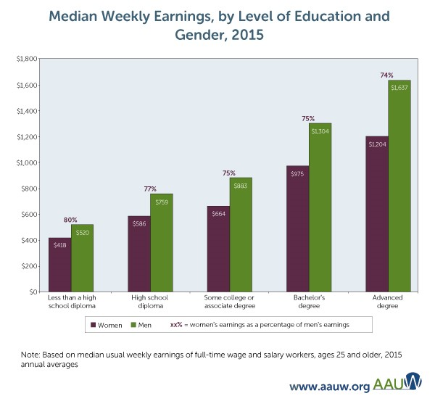
Women face a pay gap in nearly every occupation. There’s no silver bullet to solve the gender pay gap. More education helps increase women’s earnings, but it still doesn’t close the gender pay gap. As a rule, earnings increase as years of education increase for both men and women. However, while more education is a useful tool for increasing earnings, it is not effective against the gender pay gap. At every level of academic achievement, women’s median earnings are less than men’s median earnings, and in some cases, the gender pay gap is larger at higher levels of education.
http://www.aauw.org/research/the-simple-truth-about-the-gender-pay-gap/
shutterstock.com

Slide 11
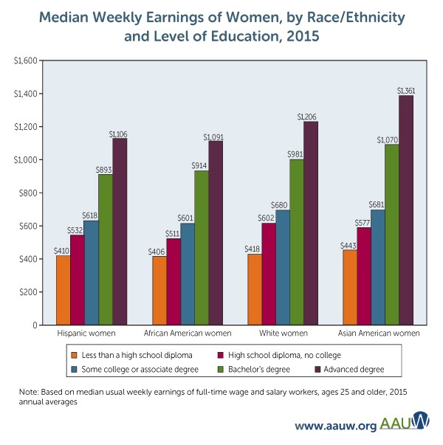
Education improves earnings for women of all races and ethnicities, but earnings are affected by race and ethnicity as well as gender. White women are paid more than African American and Hispanic women at all education levels.
http://www.aauw.org/research/the-simple-truth-about-the-gender-pay-gap/
shutterstock.com

Slide 12
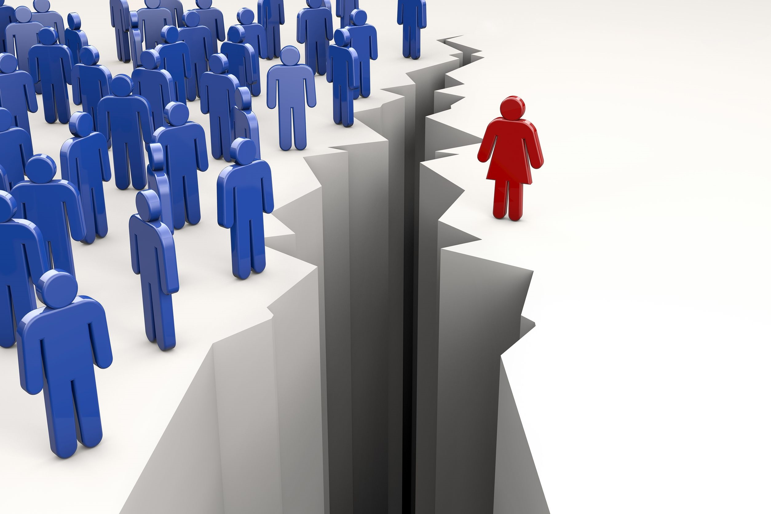
The Big Number: 79 Percent
Did you know that in 2014, women working full time in the United States typically were paid just 79 percent of what men were paid, a gap of 21 percent? The gap has narrowed since the 1970s (Figure 1), due largely to women’s progress in education and workforce participation and to men’s wages rising at a slower rate. But progress has stalled in recent years, and the pay gap does not appear likely to go away on its own.
http://www.aauw.org/research/the-simple-truth-about-the-gender-pay-gap/
shutterstock.com

Slide 13
What Does the Wage Gap Mean for America’s Women?
On average, women employed full time in the United
States lose a combined total of nearly $500 billion
every year due to the wage gap.
These women, their families, businesses and the economy suffer as a result. Lost wages mean families have less money to save for the future or to spend on basic goods and services – spending that helps drive the economy.
http://www.nationalpartnership.org/research-library/workplace-fairness/fair-pay/americas-women-and-the-wage-gap.pdf
shutterstock.com

Slide 14
If the annual wage gap were eliminated, on average, a working woman in the United States would have enough money for approximately:
83 more weeks of food for her family (1.6 years’ worth);
7 more months of mortgage and utilities payments
11 more months of rent
http://www.nationalpartnership.org/research-library/workplace-fairness/fair-pay/americas-women-and-the-wage-gap.pdf
shutterstock.com

Slide 15
Women and Families Cannot Afford Discrimination and Lower Wages
In the United States, mothers are primary or sole breadwinners in nearly 40 percent of families. Yet the wage gap for mothers is larger than for women overall. According to 2013 data, mothers employed full time, year round are paid 71 cents for every dollar paid to fathers. It is worse for single mothers with full-time, year-round jobs, who are paid just 58 cents for every dollar paid to fathers.
More than 15.2 million family households in the United States are headed by women. About 31 percent of those families, or 4,658,047 family households, have incomes that fall below the poverty level. Eliminating the wage gap would provide much-needed income to women whose wages sustain their households.
http://www.nationalpartnership.org/research-library/workplace-fairness/fair-pay/americas-women-and-the-wage-gap.pdf
shutterstock.com

Slide 16
The Wage Gap Cannot Be Explained By Choices
The wage gap persists regardless of industry. In the civilian industries that employ the most full-time employees – health care and social assistance, manufacturing, retail trade and educational services – women are paid less than men. In the health care and social assistance industry, women are paid just 71 cents for every dollar paid to men. In manufacturing, just 75 cents. In retail trade, 78 cents. And in educational
services, 87 cents. Across all industries, women are paid lower salaries than men.
http://www.nationalpartnership.org/research-library/workplace-fairness/fair-pay/americas-women-and-the-wage-gap.pdf
shutterstock.com

Slide 17
The wage gap exists regardless of education level. Women with master’s degrees working full time, year round are paid just 72 cents for every dollar paid to men with master’s degrees. Further, among full-time, year-round workers, women with doctoral degrees are paid less than men with master’s degrees, and women with master’s degrees are paid less than men with bachelor’s degrees.
http://www.nationalpartnership.org/research-library/workplace-fairness/fair-pay/americas-women-and-the-wage-gap.pdf

Slide 18
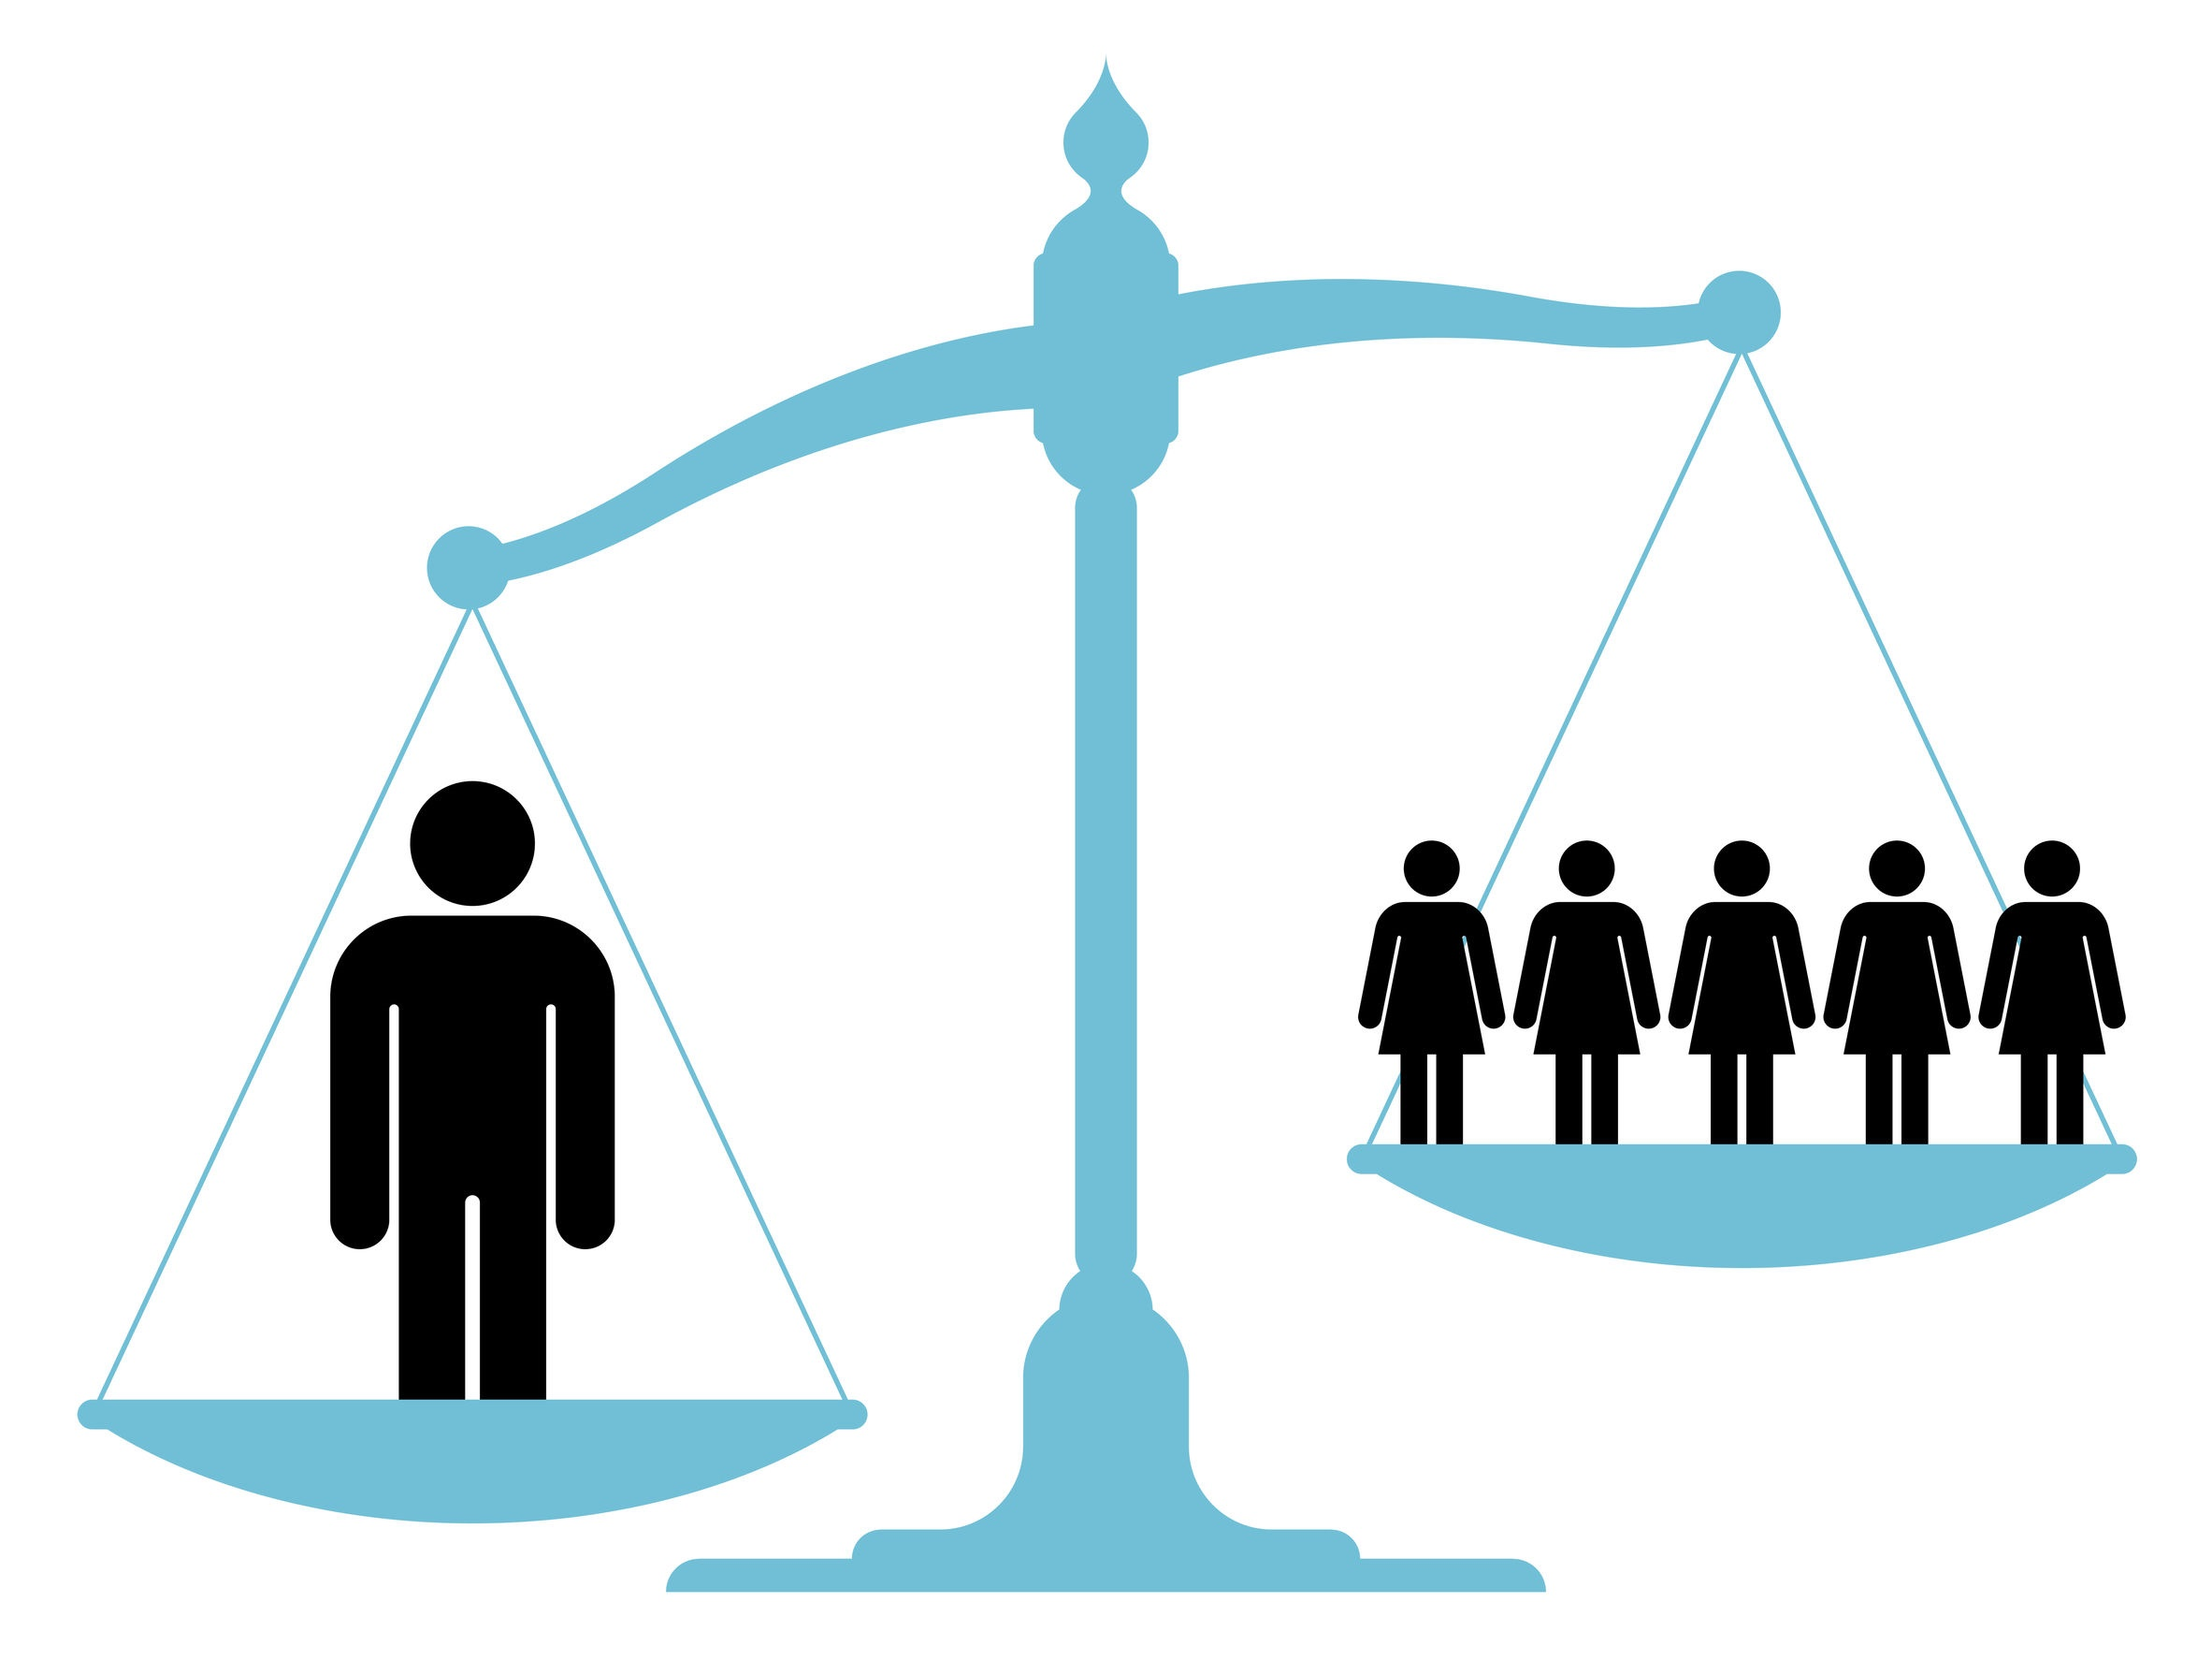
Discrimination and bias still contribute to the wage gap.
Statistical analysis shows that sixty-two percent of the wage gap can be attributed to occupational and industry differences; differences in experience and education; and factors such as race, region and unionization.
That leaves thirty-eight percent of the gap unaccounted for, leading researchers to conclude that factors such as discrimination and unconscious bias continue to affect women’s wages.
http://www.nationalpartnership.org/research-library/workplace-fairness/fair-pay/americas-women-and-the-wage-gap.pdf
shutterstock.com

Slide 19
Today, women make up nearly half of the U.S. labor force and are a growing number of breadwinners in their families.
More women are also working in positions and fields that have been traditionally occupied by men. When women are not paid fairly, not only do they suffer, but so do their families.
shutterstock.com

Slide 20
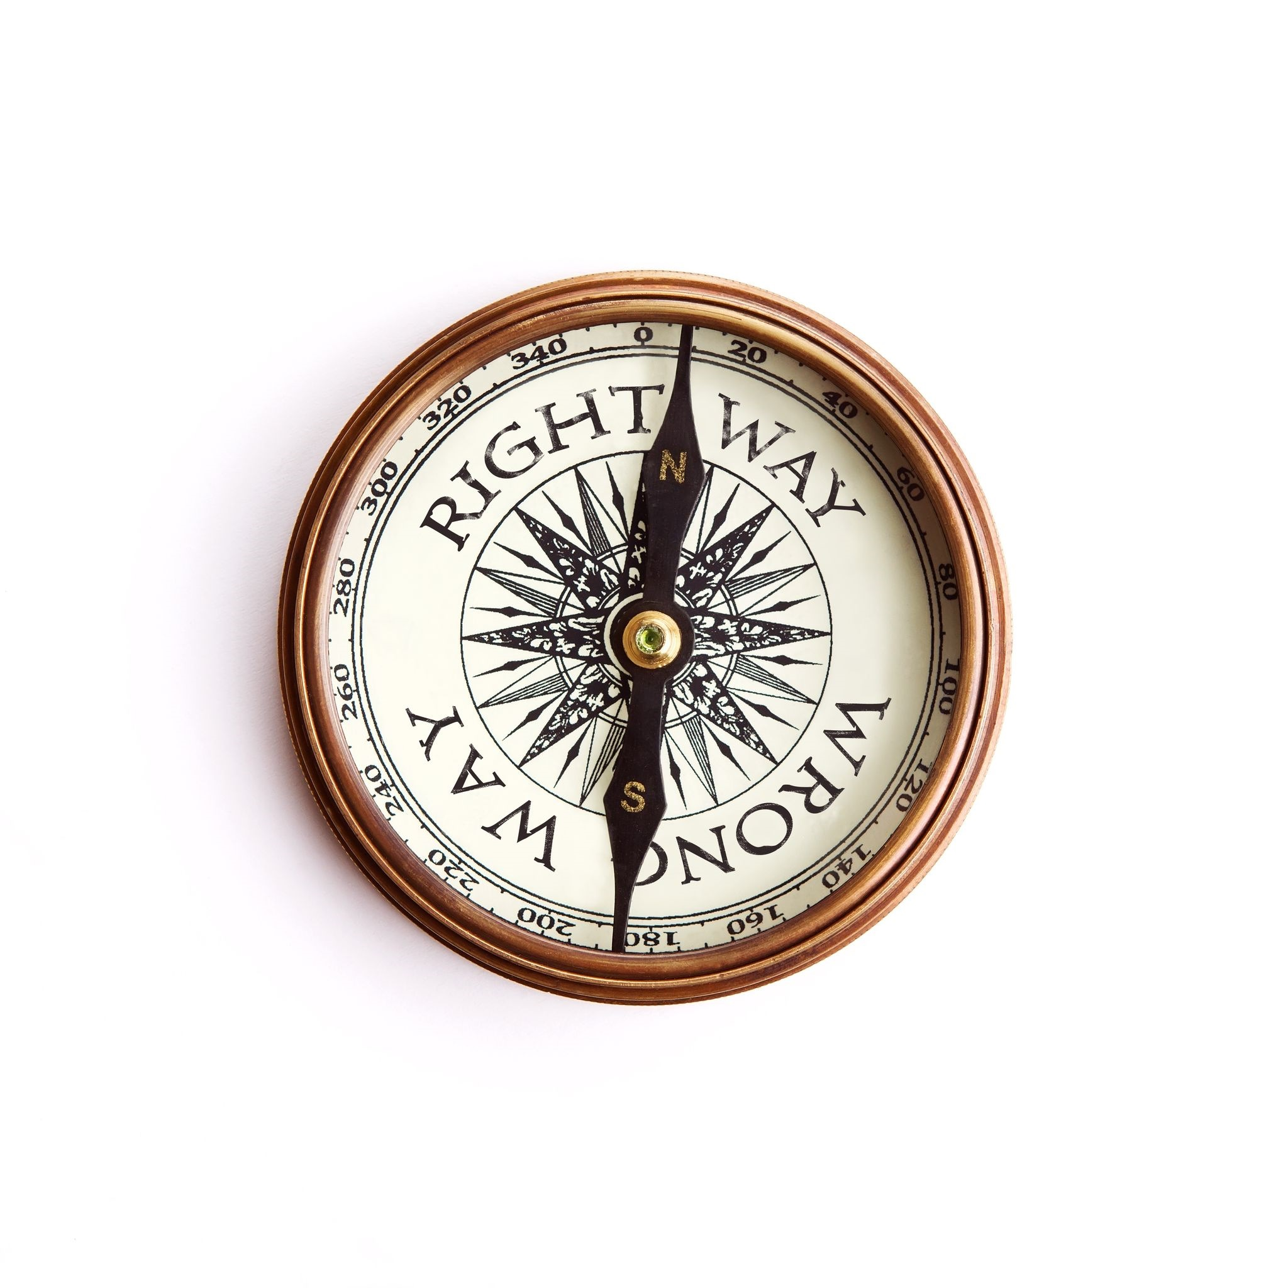
Key Words
gender wage gap breadwinners salary
lower-paying jobs current rate earnings
educational achievement grows with age bias
racial/ethnic groups student loan debt traditionally
at all education levels nearly every occupation persists

