Slide 1
NICKY FIFTH’S NEW JERSEY
N5NJ
SECONDARY PROGRAM
LIFE
Discrimination

Slide 2
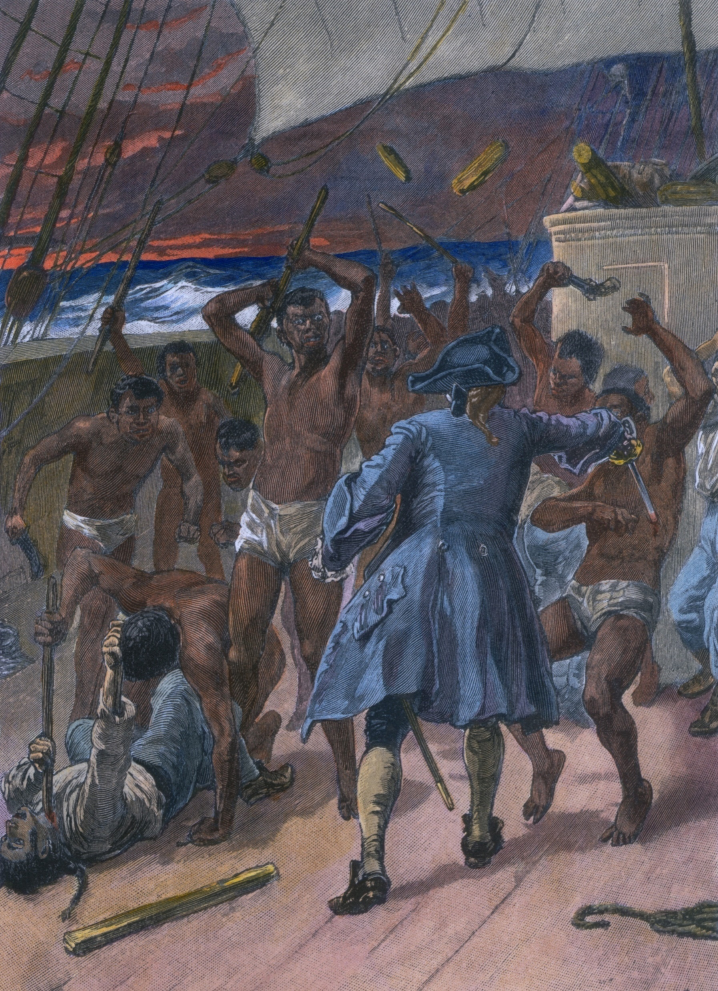
In a nation of such diversity, one might assume that prejudice, bias, and discrimination are non-existent. The unfortunate truth, however, is that they not only exist, but they have become part of our national fabric.
From our treatment of Native Americans to the purchase of African slaves from African slave traders, we have not always lived up to the American ideal that “All men are created equal.”
shutterstock.com

Slide 3
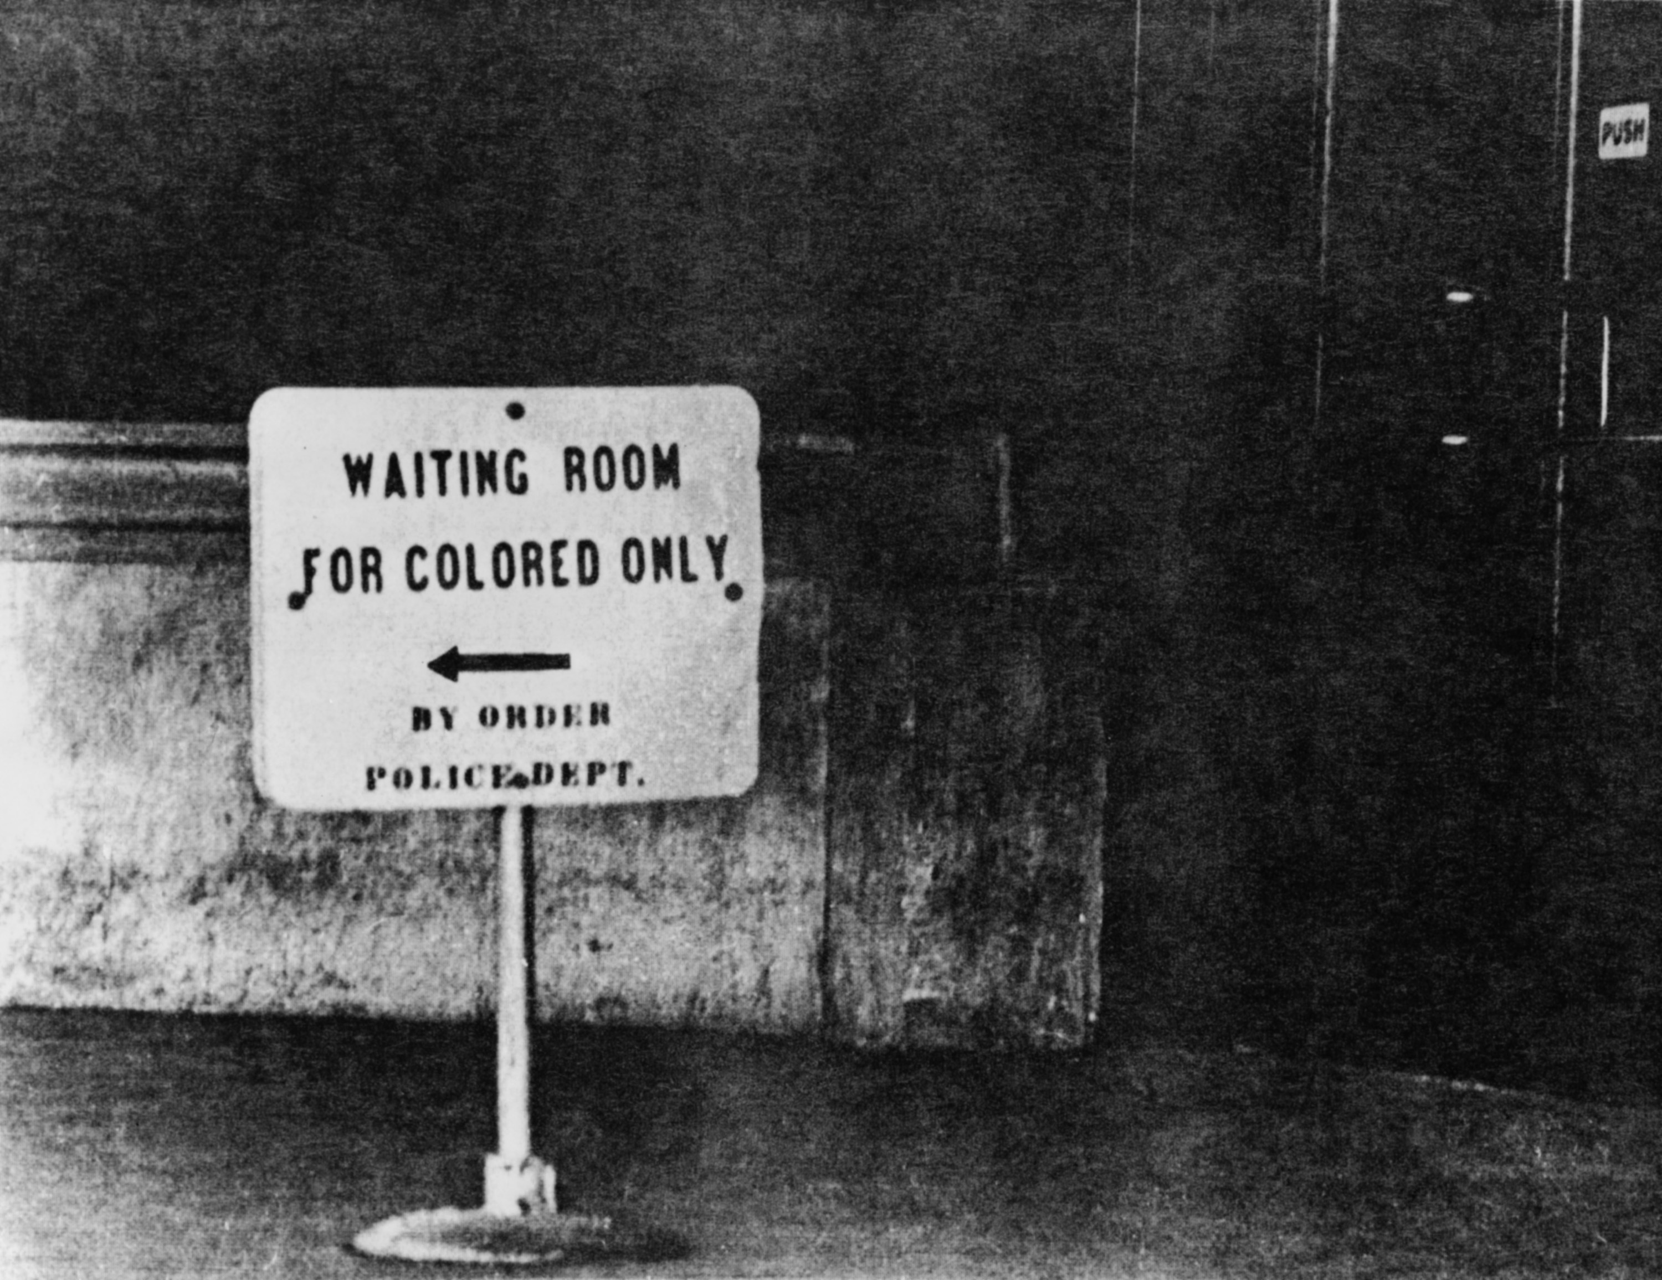
Even after African American slaves were freed, our nation failed to provide the support needed to assimilate to this new freedom. In fact, not only did the United States fail to provide support, unfavorable laws were created and enforced.
Everett Historical / Shutterstock.com

Slide 4
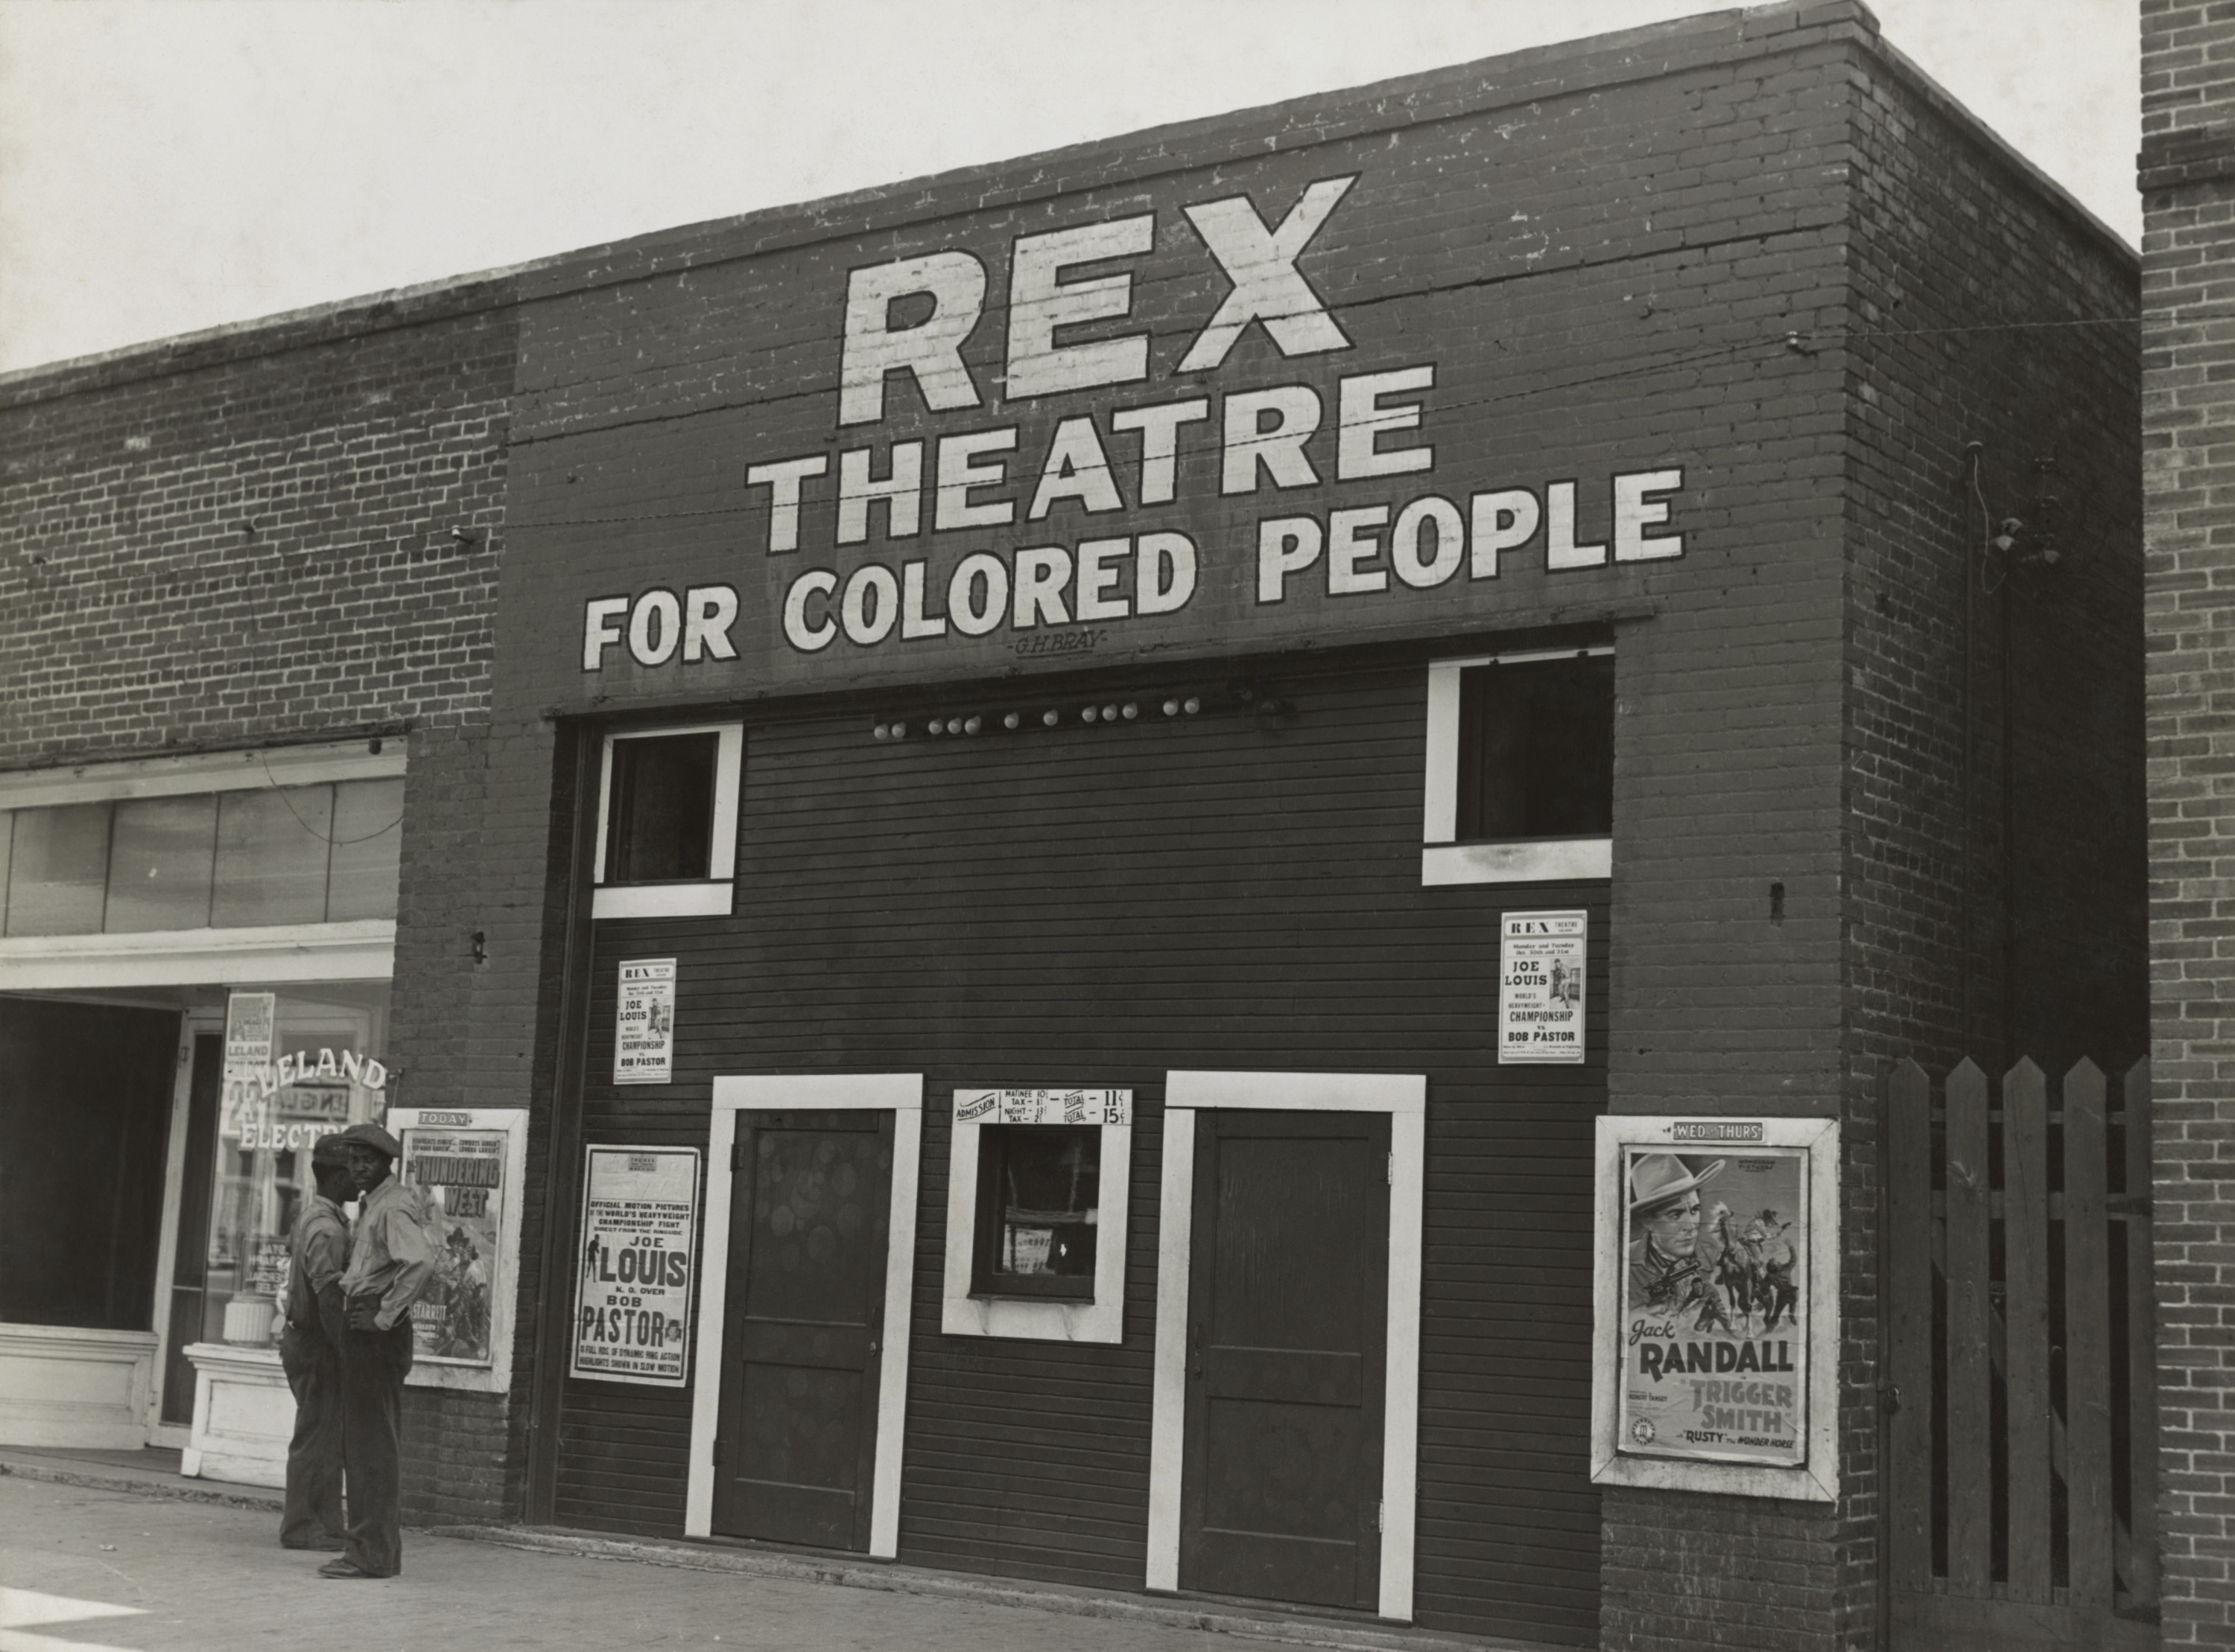
Between 1877 and the mid-1960s, the Jim Crow laws were enforced.
Jim Crow was the name of the racial caste system which operated primarily, but not exclusively in southern and border states. Jim Crow was more than a series of rigid anti-black laws. It was a way of life.
ww.ferris.edu/jimcrow/what.htm
shutterstock.com

Slide 5
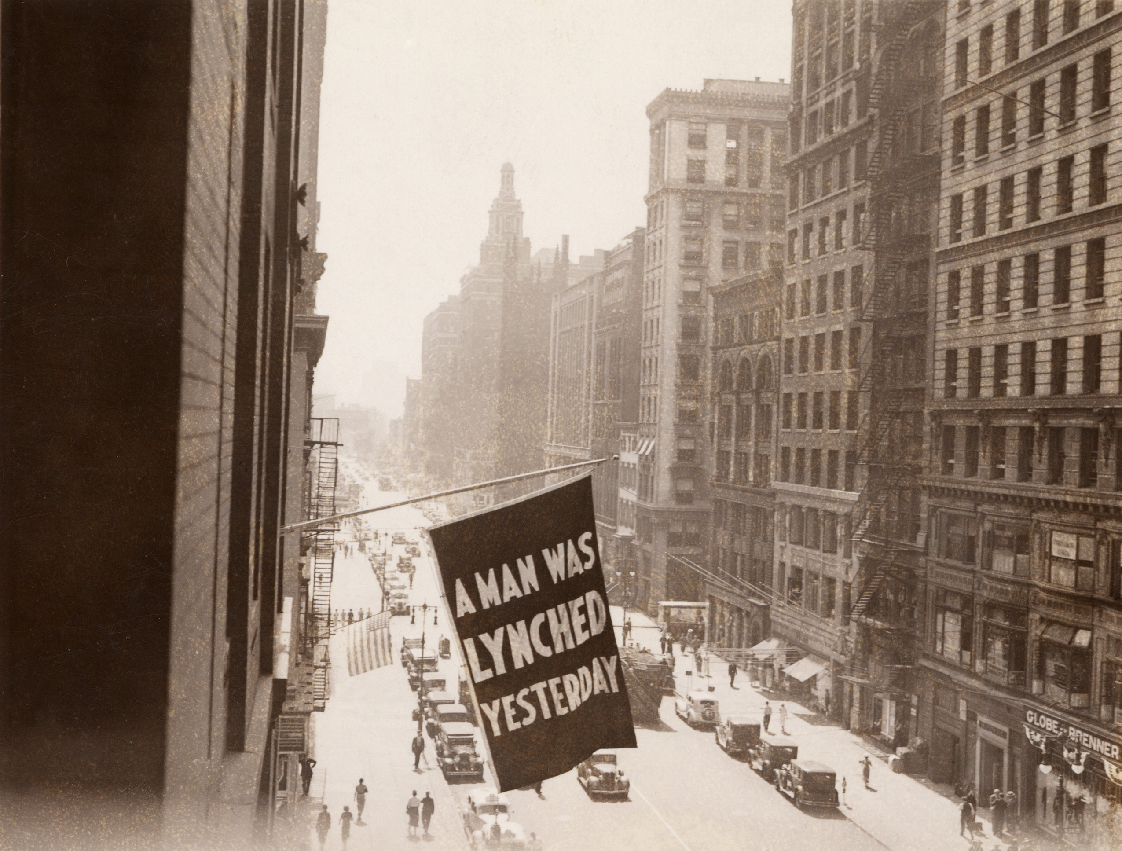
Under Jim Crow, African Americans were relegated to the status of second class citizens. Jim Crow represented the legitimization of anti-black racism. Many Christian ministers and theologians taught that whites were the Chosen people, blacks were cursed to be servants, and God supported racial segregation.
ww.ferris.edu/jimcrow/what.htm
shutterstock.com

Slide 6
Discrimination has also included women, Hispanics, Asians, Catholics, Jews, the LGBT community, the disabled, and the list goes on.
Ironically, members of a group that endures discrimination often discriminate against other groups.
shutterstock.com

Slide 7
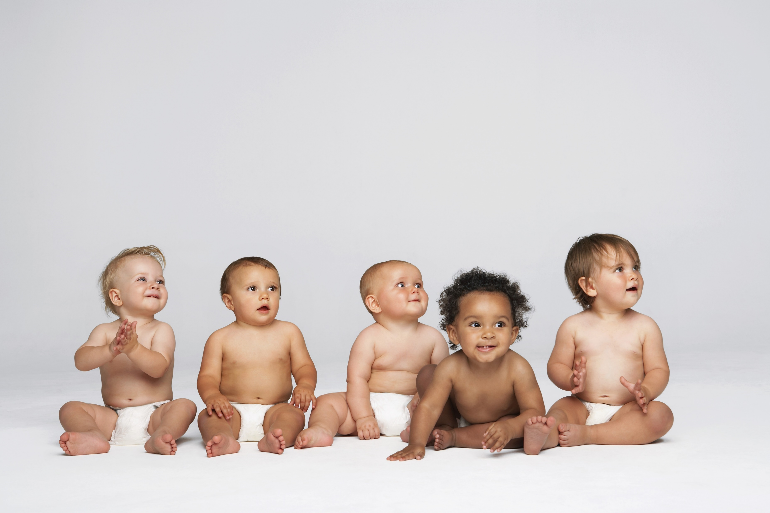
When it comes to racial discrimination, the balance is shifting. According to the U.S. Census Bureau, people of color are expected to grow from 30.9 percent of the population in 2000 to 36.2 percent of the population in 2020. For Americans younger than 40, there are 2 white people for every person of color. Among children younger than 10 years old, the ratio is 1.5 to 1.
http://archive.adl.org/what_to_tell/whattotell_intro.html#.V_6Du_krKM8
shutterstock.com

Slide 8
Thus, our schools are increasingly educating children who come from a wide range of backgrounds, abilities, and experiences. And the workforce of the near future will be composed of a majority of women and people of color.
http://archive.adl.org/what_to_tell/whattotell_intro.html#.V_6Du_krKM8
shutterstock.com

Slide 9
While today's changing demographics are compelling, historically the United States has always been challenged to find effective ways for its diverse populations to live and work well together.
http://archive.adl.org/what_to_tell/whattotell_intro.html#.V_6Du_krKM8
shutterstock.com

Slide 10
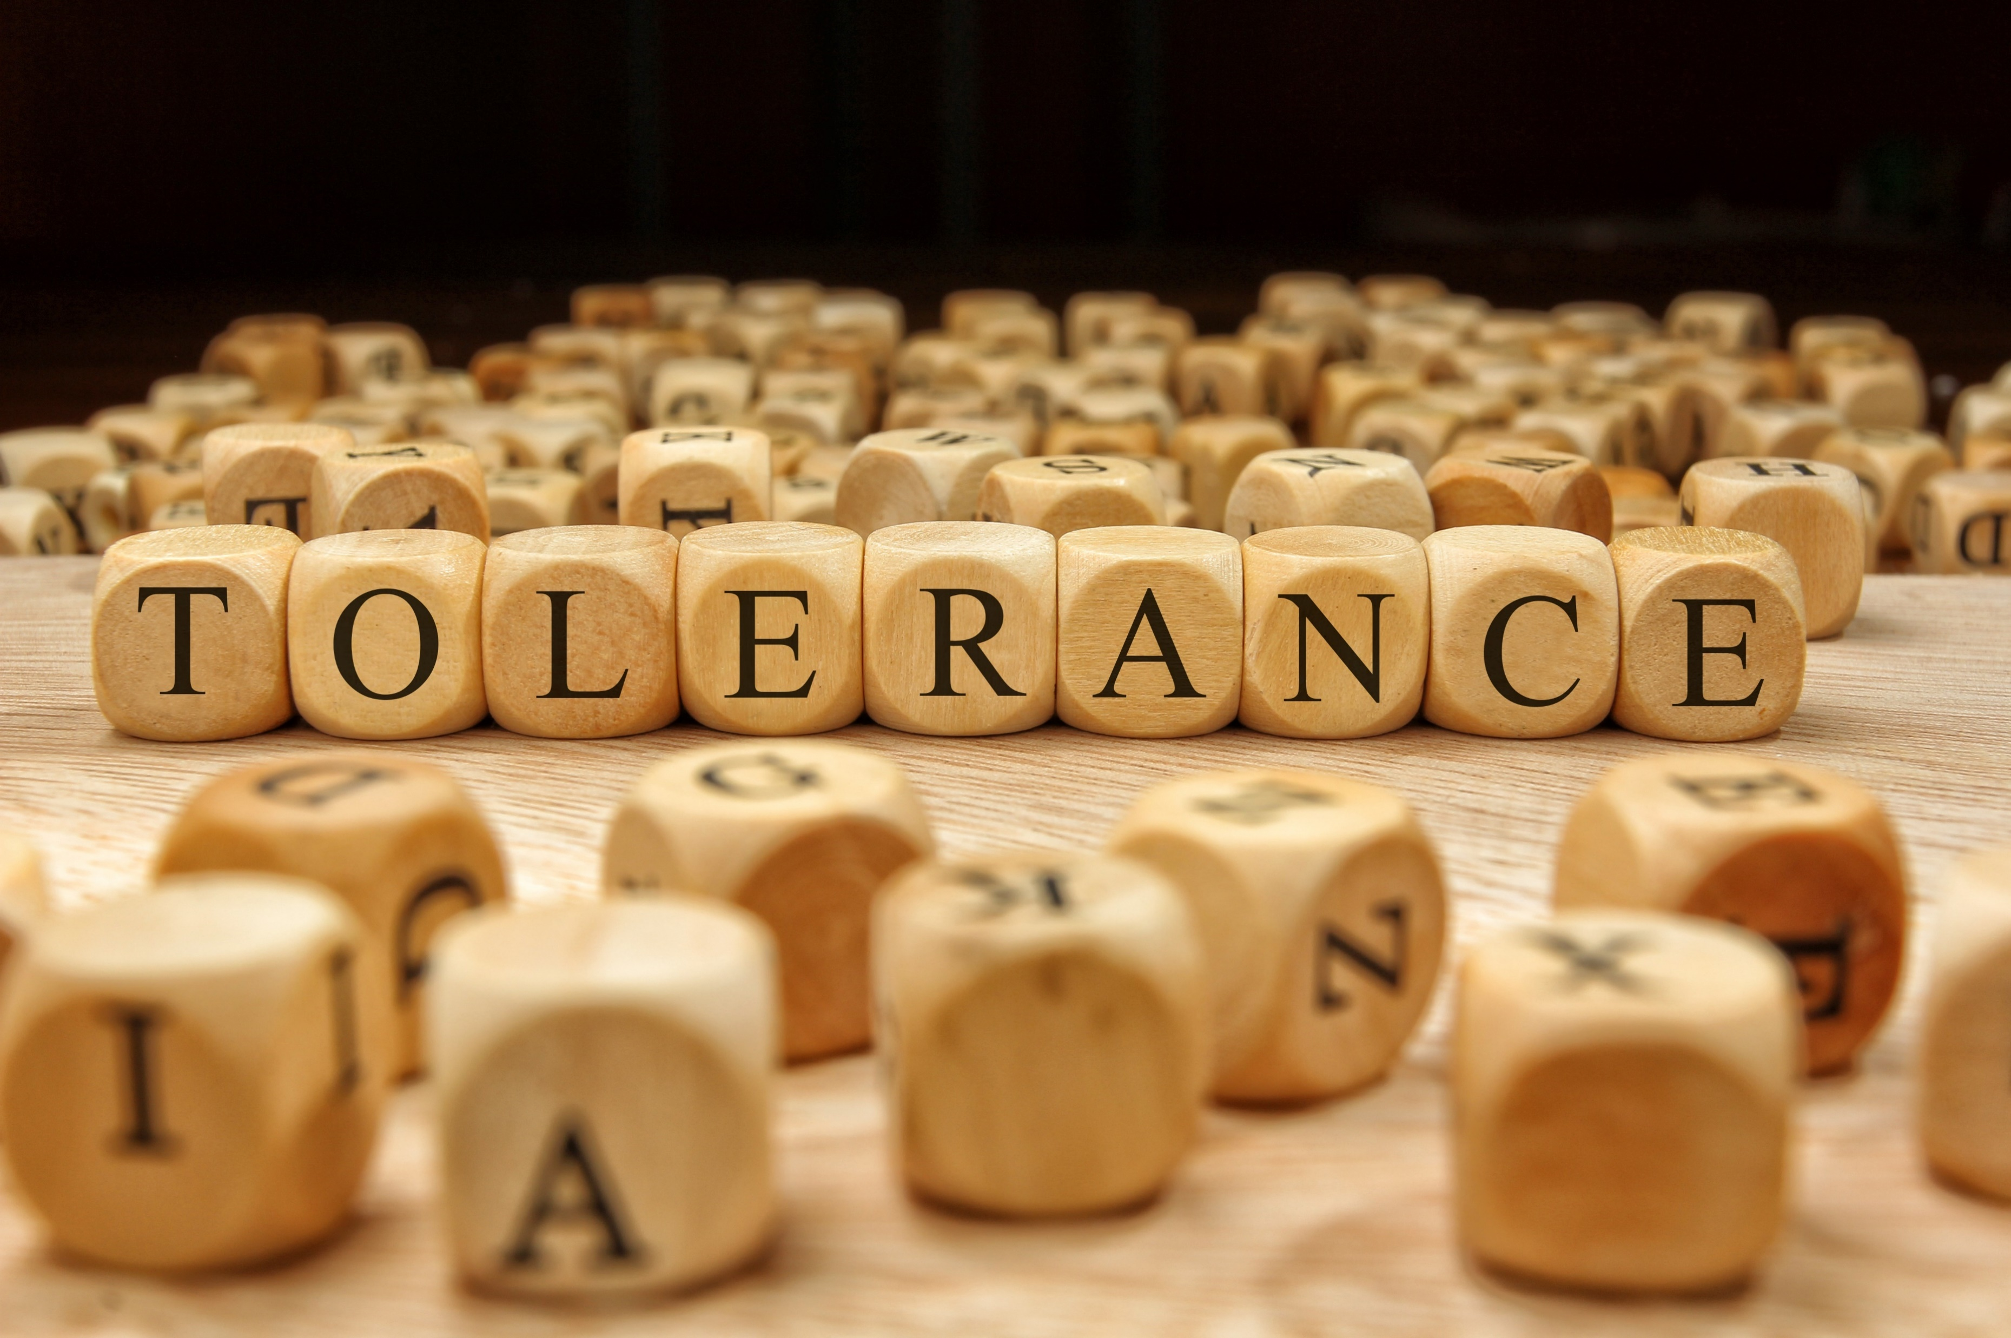
To ensure their potential for success, we must prepare all children to live and work harmoniously and productively alongside others who represent various and many racial and cultural groups, backgrounds and abilities in our society. One of the greatest obstacles to creating such a future is prejudice.
http://archive.adl.org/what_to_tell/whattotell_intro.html#.V_6Du_krKM8
shutterstock.com

Slide 11
What is Prejudice: Attitudes or opinions about a person or group simply because the person belongs to a specific religion, race, nationality, or other group. Prejudices involve strong feelings that are difficult to change. Prejudice is pre-judging. A person who thinks, "I don't want (name of group) living in my neighborhood," is expressing a prejudice.
http://archive.adl.org/what_to_tell/whattotell_intro.html#.V_6Du_krKM8
shutterstock.com

Slide 12
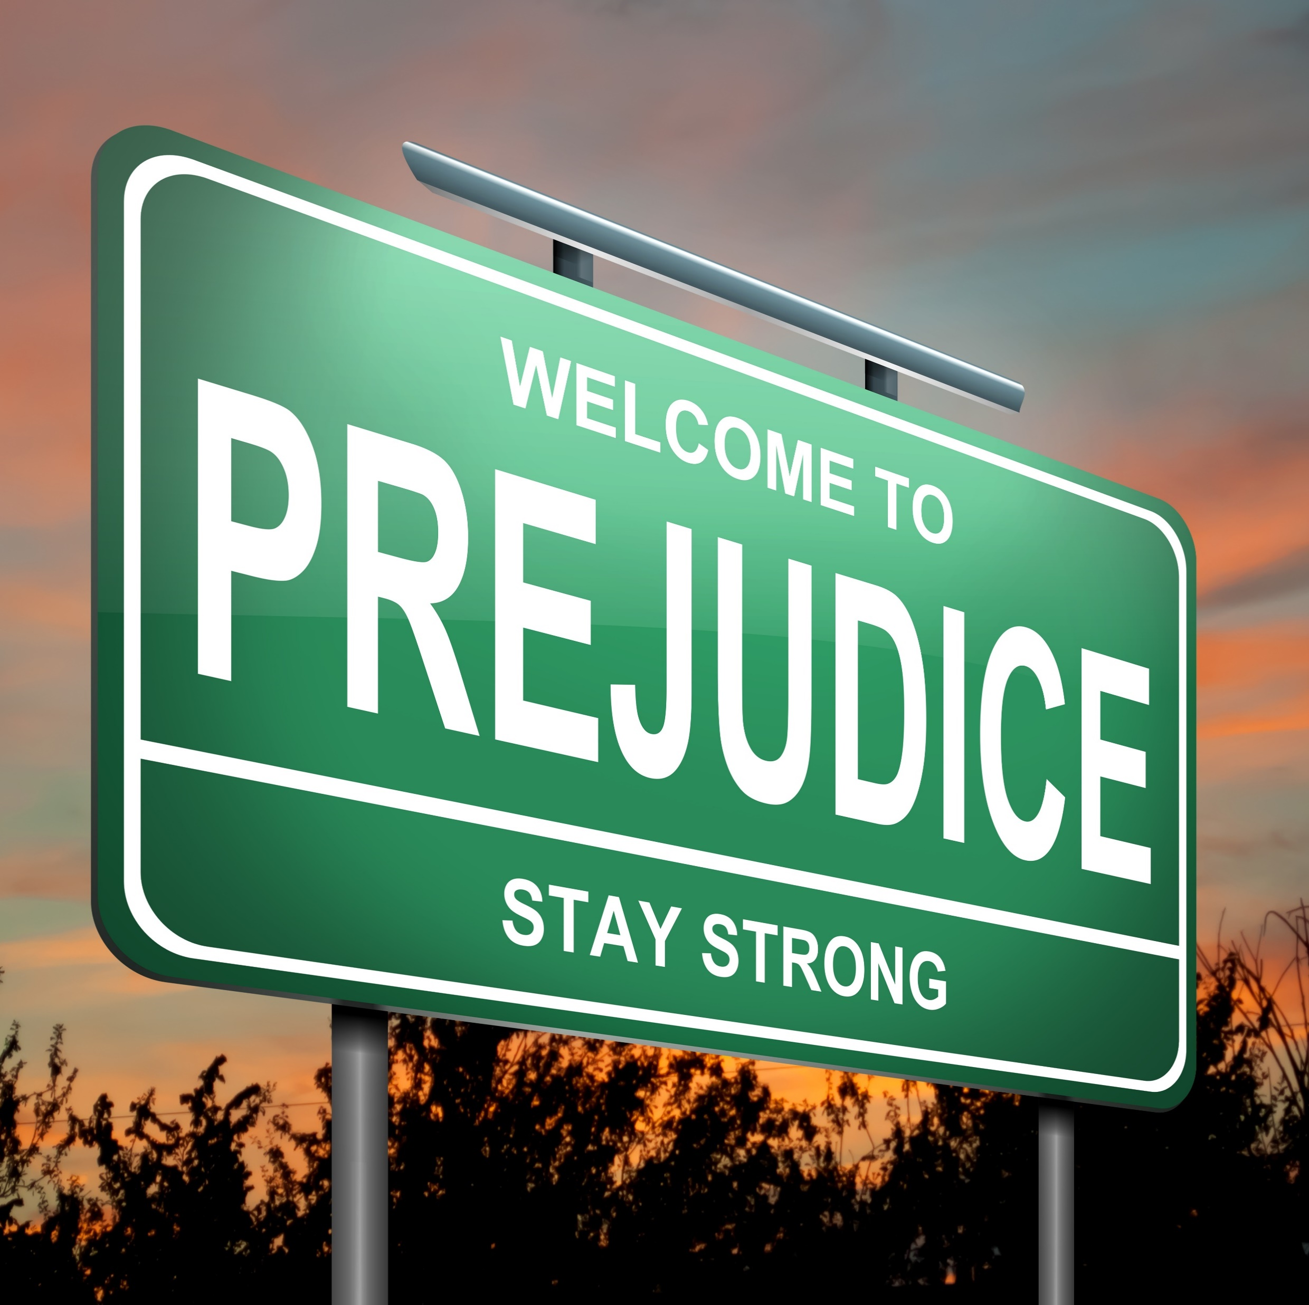
While many of us would like to believe that prejudice is a problem of the past, this is not the case. Incidents of prejudice and discrimination occur every day. For example, on a daily basis:
http://archive.adl.org/what_to_tell/whattotell_intro.html#.V_6Du_krKM8
shutterstock.com

Slide 13
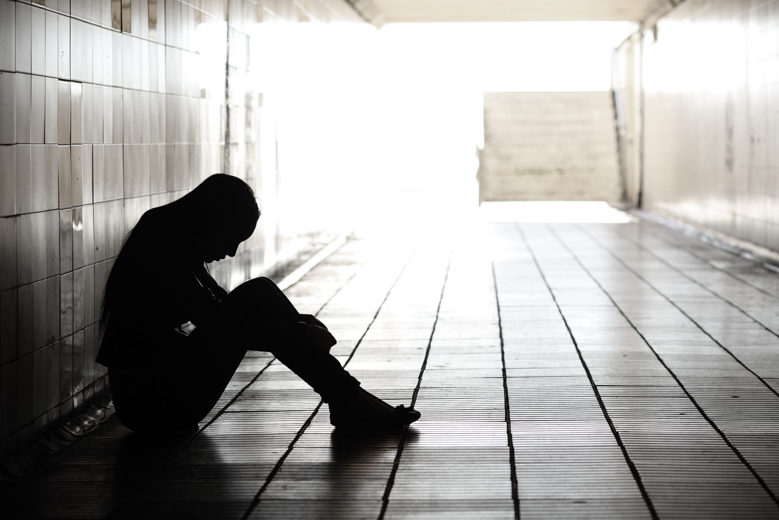
Some people are called hurtful names or are excluded from participating in events;
http://archive.adl.org/what_to_tell/whattotell_intro.html#.V_6Du_krKM8
shutterstock.com

Slide 14
Some people are unfairly excluded from jobs, neighborhoods, bank loans, educational opportunities, social events and clubs.
http://archive.adl.org/what_to_tell/whattotell_intro.html#.V_6Du_krKM8
shutterstock.com

Slide 15
Some people's homes, places of worship, or cemeteries are vandalized.
http://archive.adl.org/what_to_tell/whattotell_intro.html#.V_6Du_krKM8
shutterstock.com

Slide 16
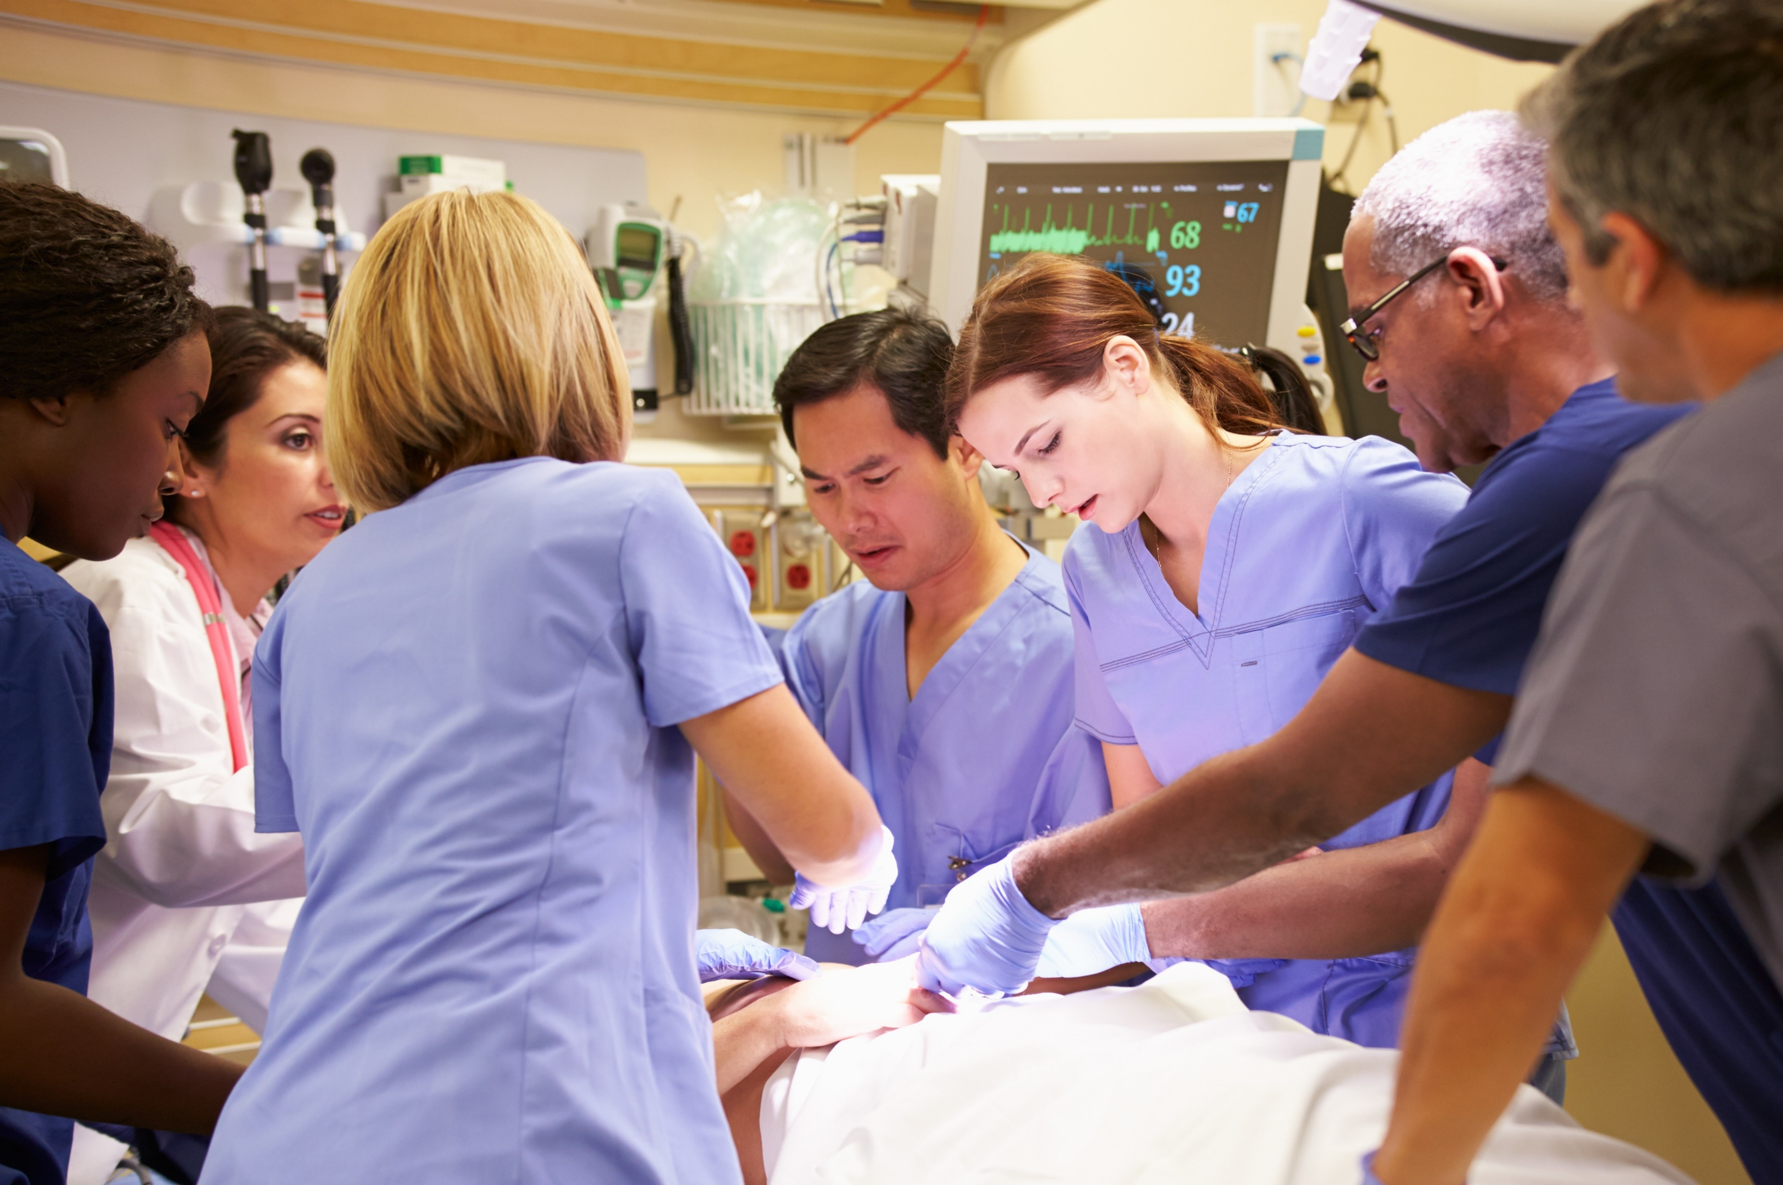
And some people are attacked and beaten;
http://archive.adl.org/what_to_tell/whattotell_intro.html#.V_6Du_krKM8
shutterstock.com

Slide 17
Such instances of discrimination are far from rare. If we are to have a just society, it is up to each of us to take a stand against such unfair practices and attitudes.
We must teach our children that there is no place for prejudice or discrimination in our communities, homes, schools or places of work.
http://archive.adl.org/what_to_tell/whattotell_intro.html#.V_6Du_krKM8
shutterstock.com

Slide 18
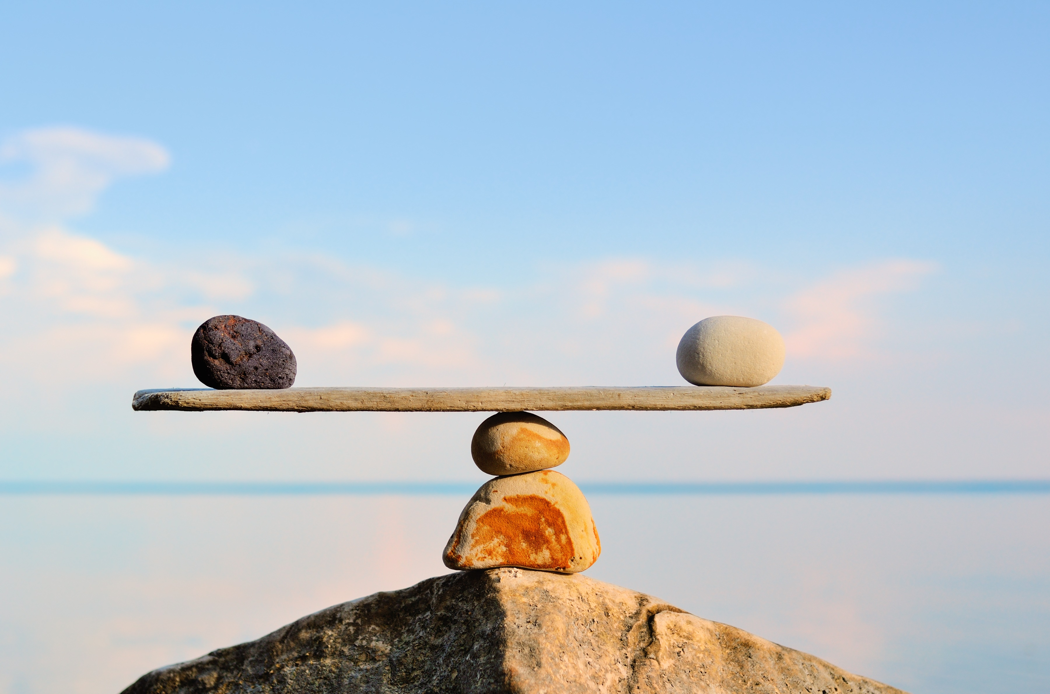
Key Words
discrimination diversity prejudice
Native Americans African slaves bias
unfavorable laws Jim Crow laws assimilate
second class citizens racial segregation pre-judging
balance is shifting cultural groups daily basis
shutterstock.com

