Slide 1
NICKY FIFTH’S NEW JERSEY
N5NJ
SECONDARY PROGRAM
FITNESS
Food Facts

Slide 2
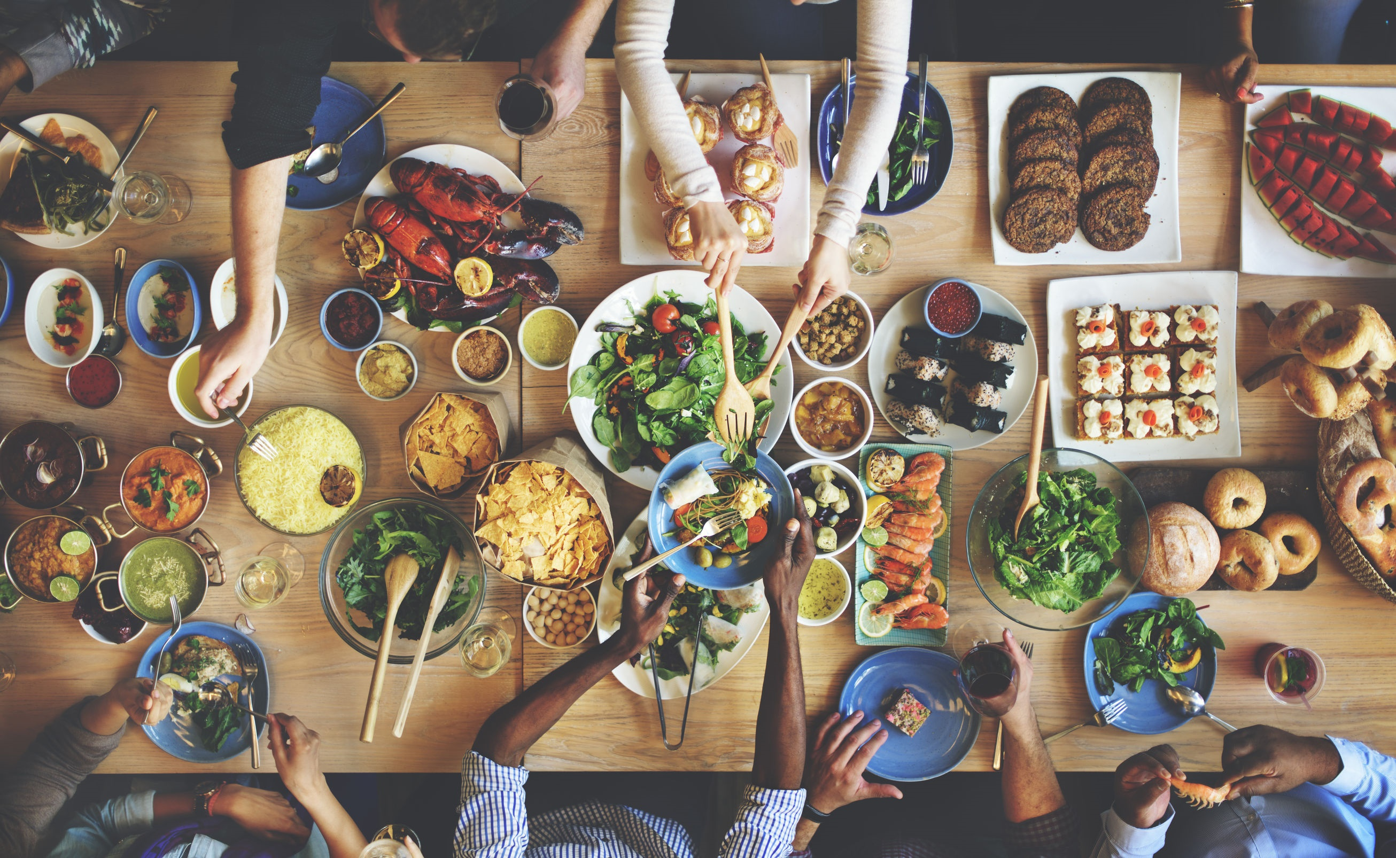
We eat and drink everyday. We crave certain foods, eat some because we know we should, and absolutely avoid many others.
But how much do we really know about food?
Despite all of our technology, we probably know much less about the foods we eat than the colonists in the 17th and 18th centuries knew.
Shutterstock.com

Slide 3
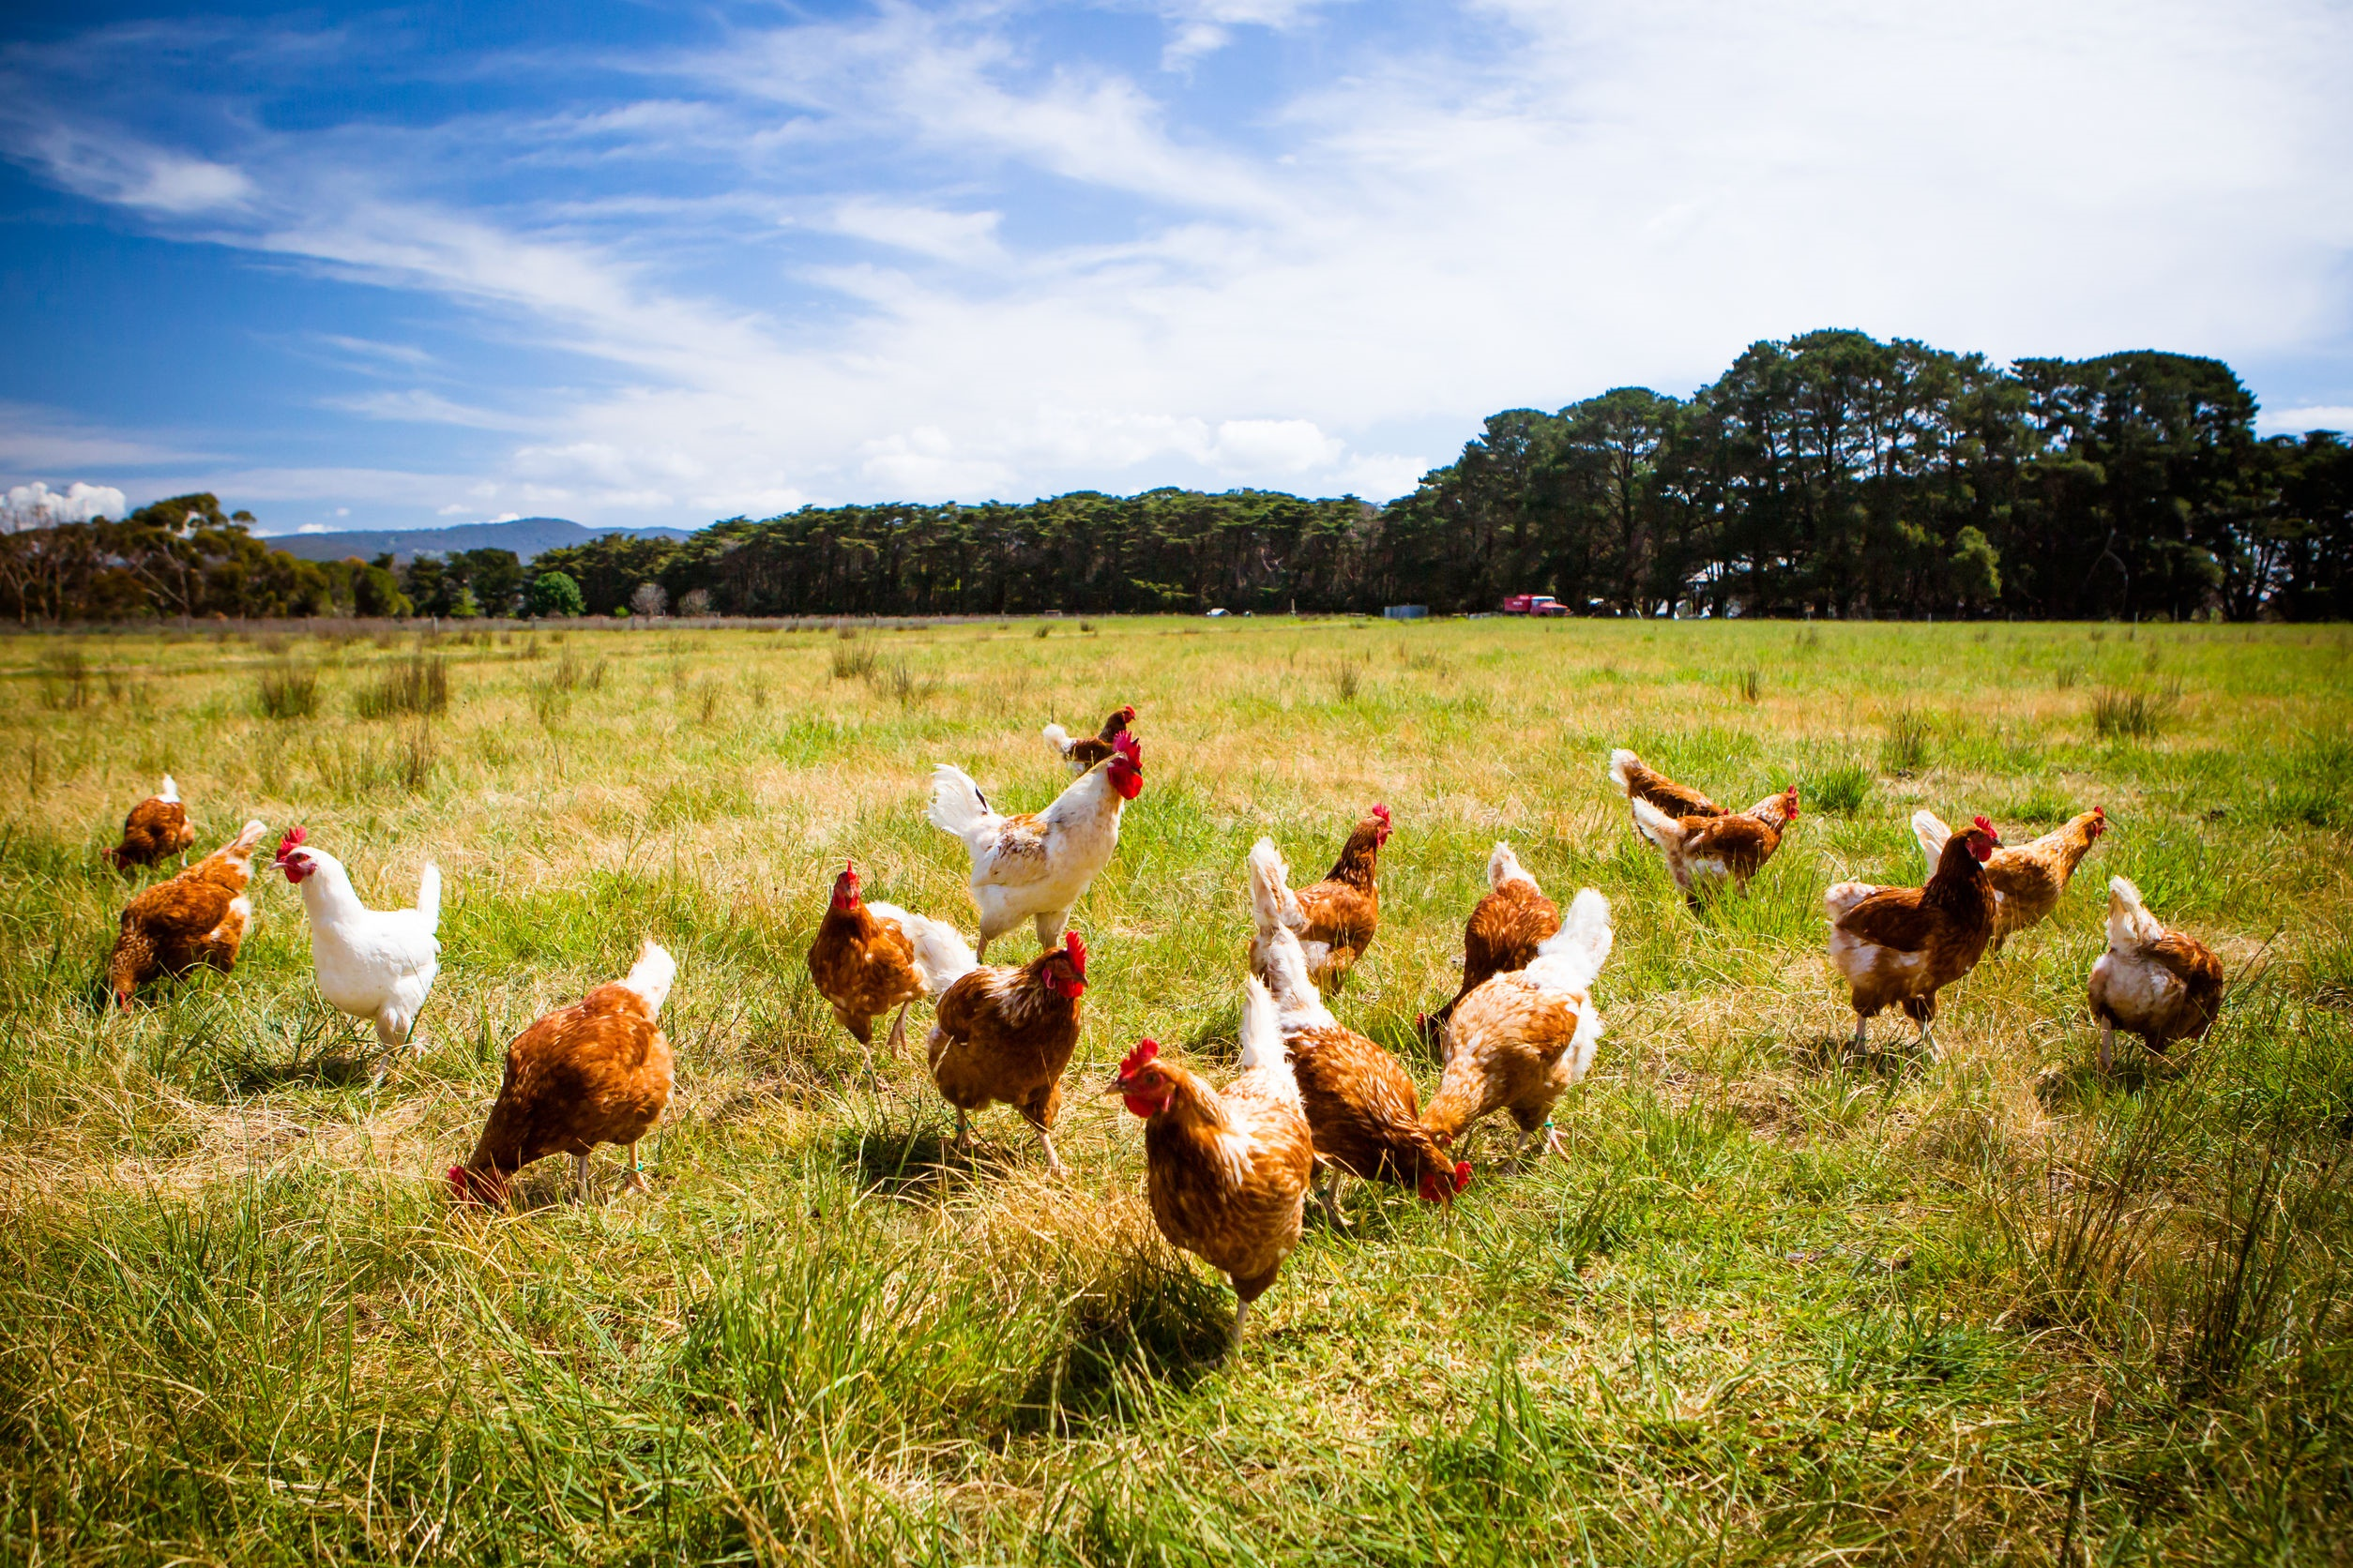
How could we know less about our food?
That’s simple! We have very little exposure to real food. You see, when a colonist wanted chicken, they had to find a chicken, and kill a chicken, and pluck a chicken…you get the picture. We either pick up ready-to-prepare chicken at the meat counter of the grocery store, microwave frozen chicken, or find a restaurant or drive-thru.
Think about everything you eat and drink in a day. Whether it’s fresh produce or processed foods, chances are someone else grew or processed all of it.
Shutterstock.com

Slide 4
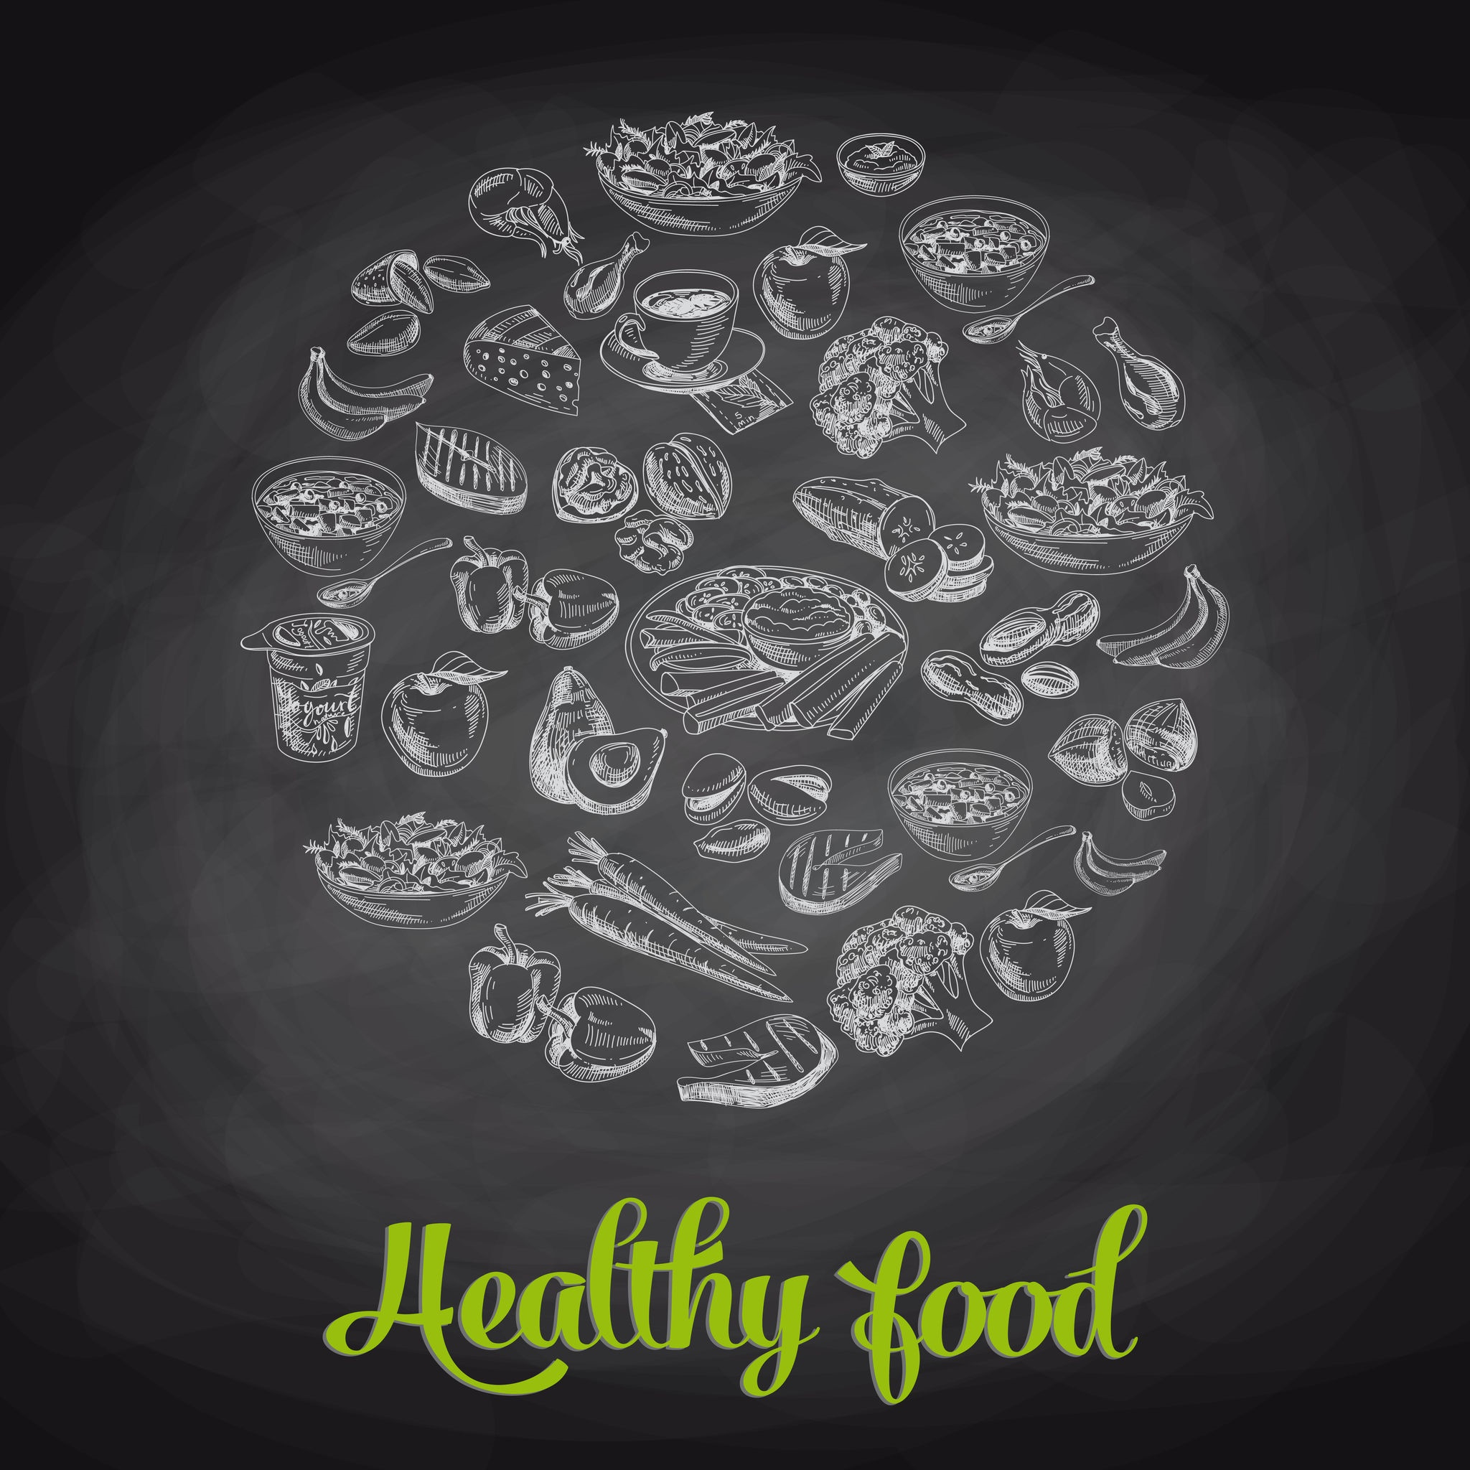
Why should I care?
Well, unlike many things in life, food is an absolute part of your daily routine and, on top of that, the food you eat has a direct, major impact on your health now and your future health. With so much riding on your health, particularly, your immune system, you should absolutely know how different foods and products affect your body. And, of course, you should care.
The first section is basic food safety facts. The second section is basic fun facts.
Shutterstock.com

Slide 5
MYTH: If I microwave food, the microwaves kill the bacteria, so the food is safe.
FACT: Microwaves aren’t what kill bacteria – it’s the heat generated by microwaves that kills bacteria in foods. Microwave ovens are great time-savers and will kill bacteria in foods when heated to a safe internal temperature.
However, foods can cook unevenly because they may be shaped irregularly or vary in thickness. Even microwave ovens equipped with a turntable can cook unevenly and leave cold spots in food, where harmful bacteria can survive.
Be sure to follow package instructions and rotate and stir foods during the cooking process, if the instructions call for it. Observe any stand times as called for in the directions. Check the temperature of microwaved foods with a food thermometer in several spots.
http://www.foodsafetynews.com/2016/09/how-may-do-you-know-top-10-food-safety-myths-and-facts/#.V-_OFPkrKM8
Shutterstock.com

Slide 6
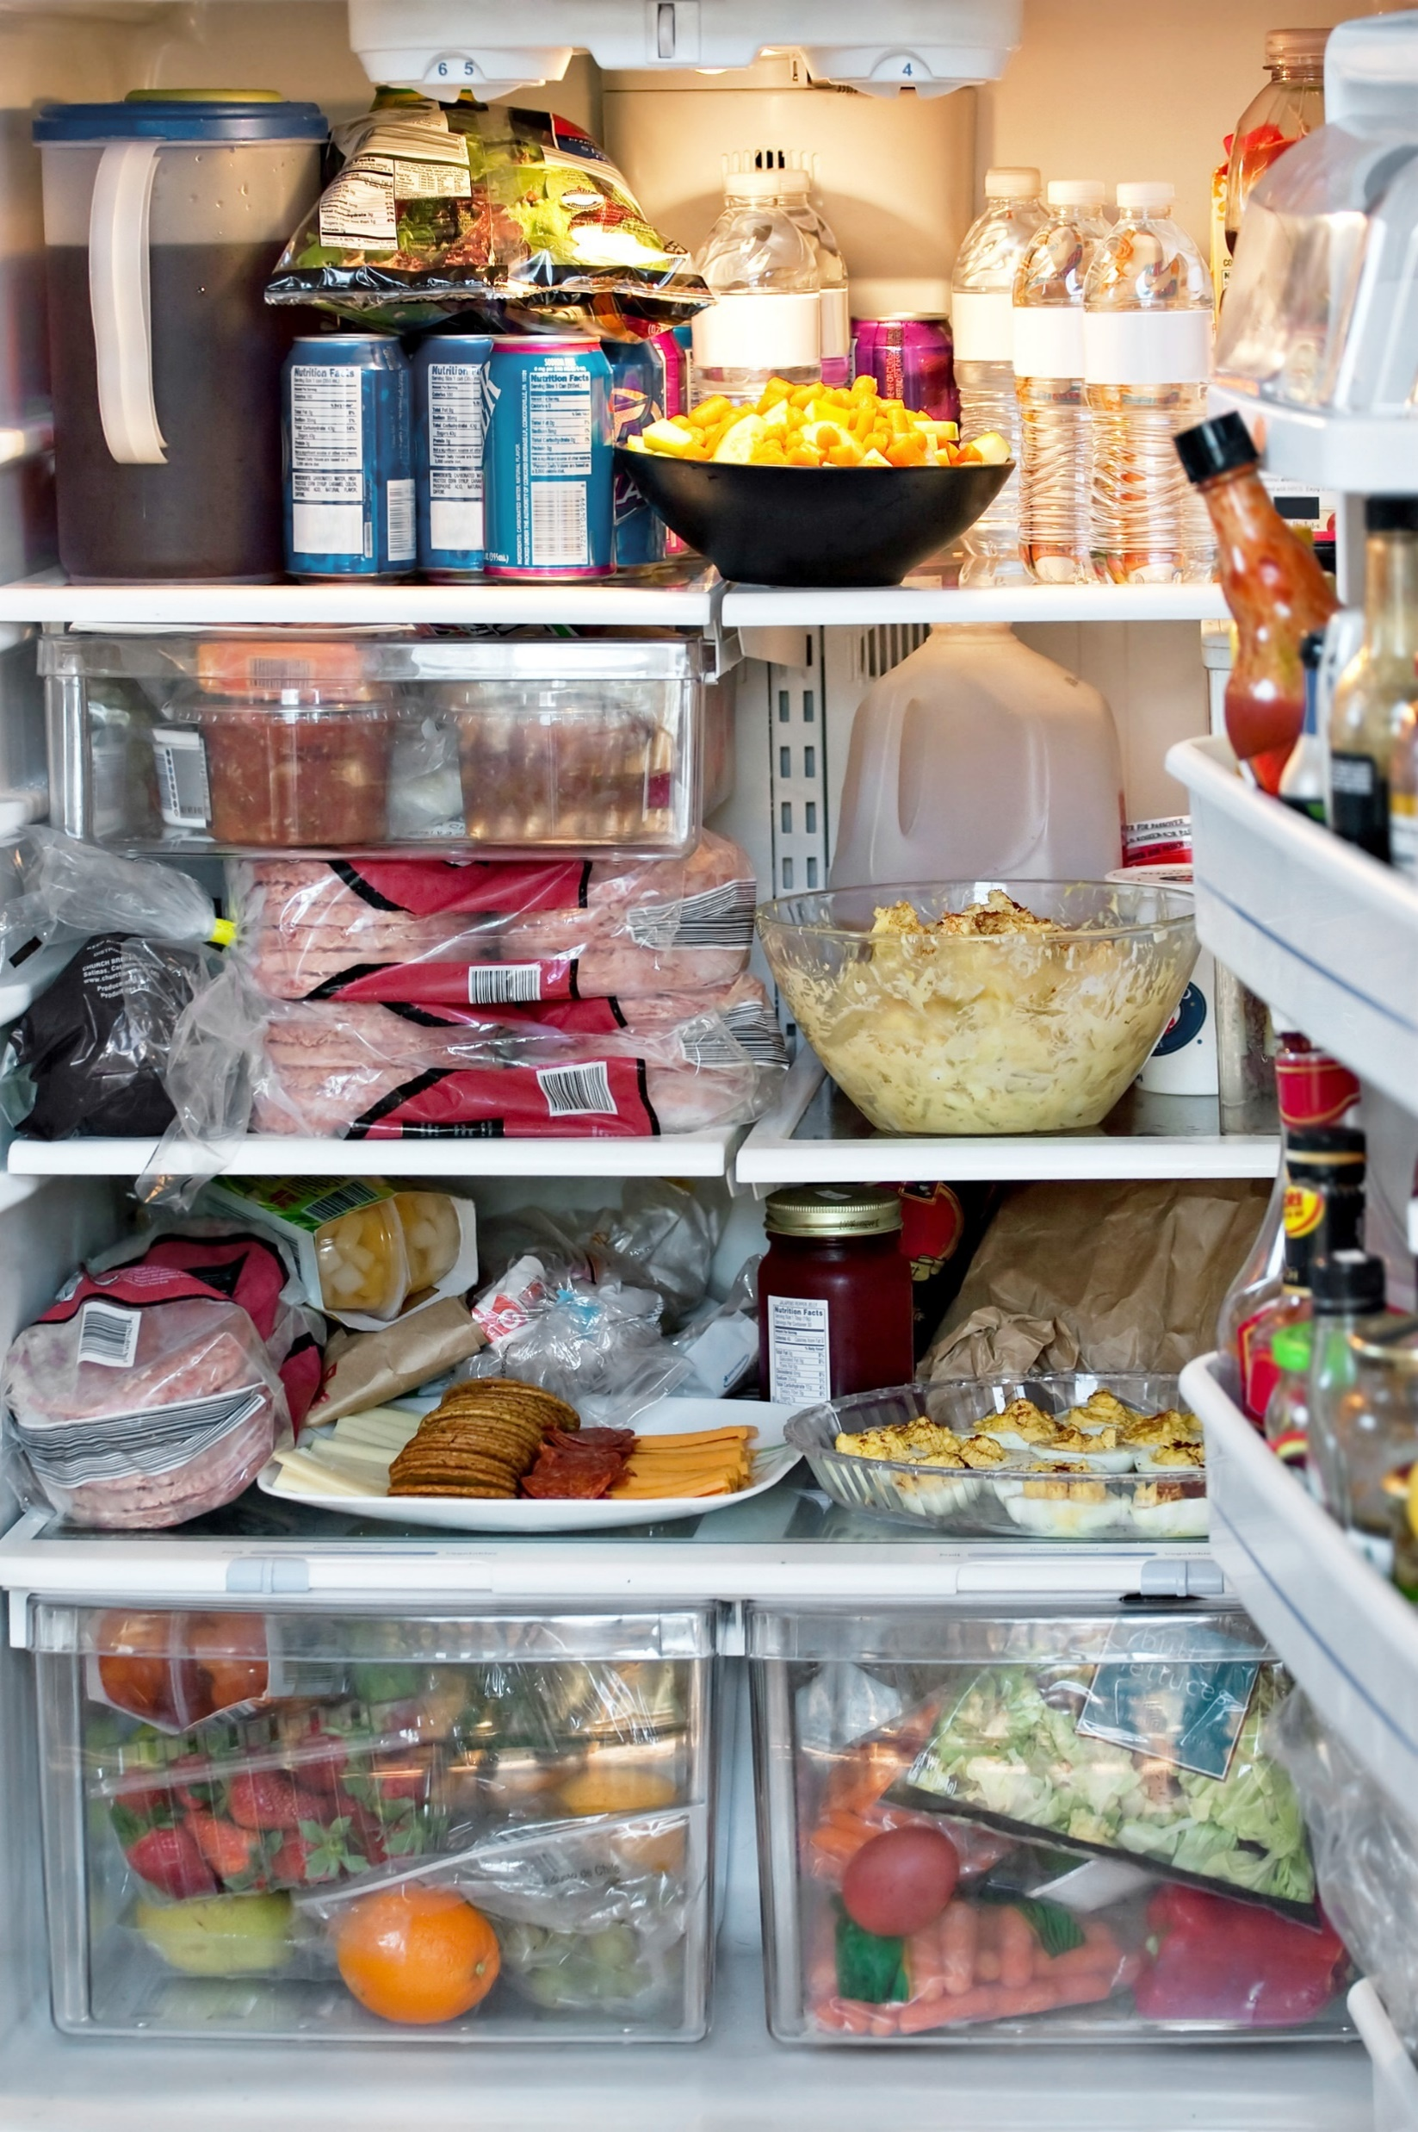
MYTH: Cross-contamination doesn’t happen in the refrigerator — it is too cold in there for germs to survive.
FACT: Some bacteria can survive and even grow in cool, moist environments like the refrigerator. In your refrigerator, keep fresh fruits and vegetables separate from raw meat, poultry, seafood and eggs. Clean your refrigerator regularly with hot water and soap and clean up food and beverage spills immediately to reduce the risk of cross-contamination. Don’t forget to clean refrigerator walls and undersides of shelves.
http://www.foodsafetynews.com/2016/09/how-may-do-you-know-top-10-food-safety-myths-and-facts/#.V-_OFPkrKM8
Shutterstock.com

Slide 7
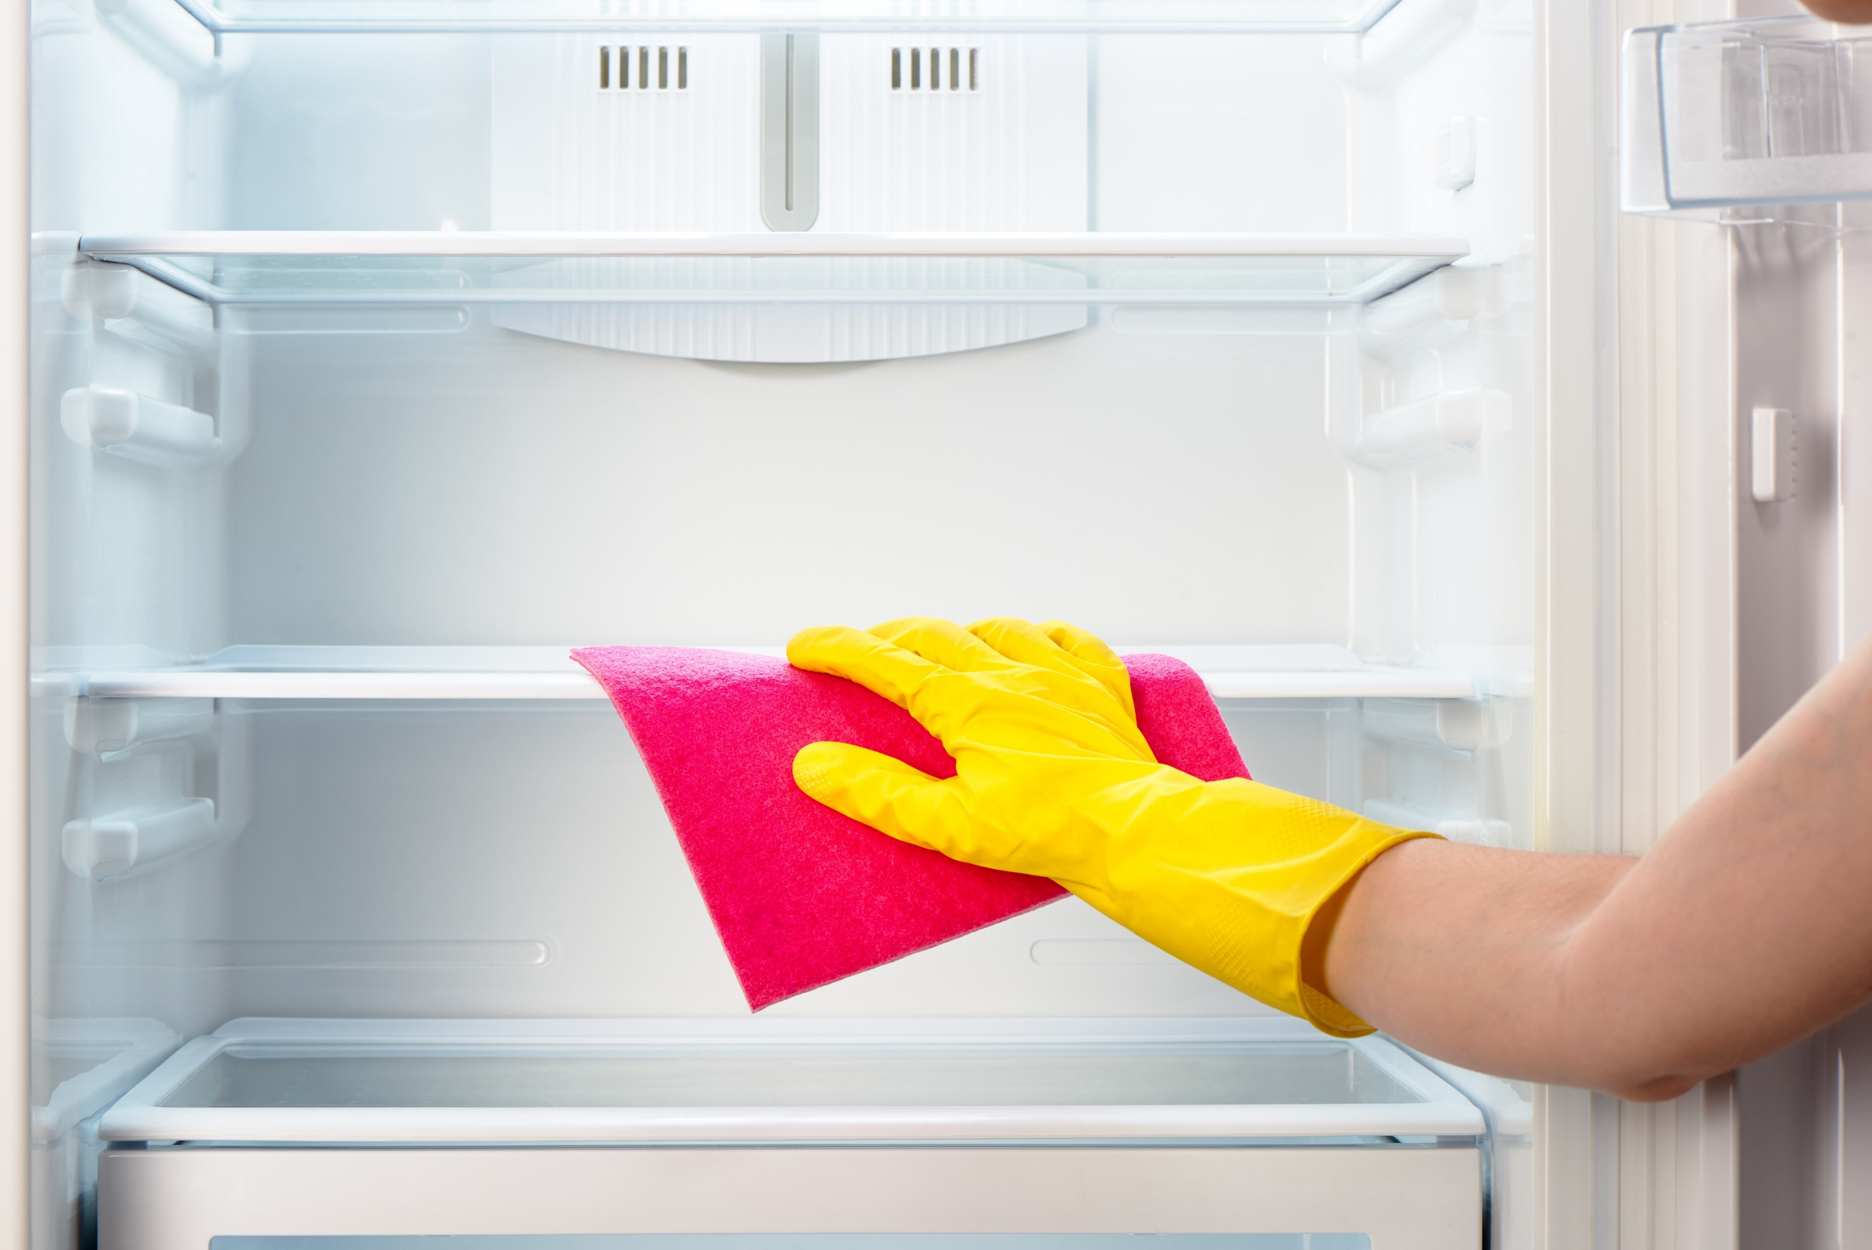
MYTH: I don’t need to clean the refrigerator produce bin because I only put fruit and vegetables in there.
FACT: Naturally occurring bacteria in fresh fruits and vegetables can cause cross-contamination in your refrigerator. A recent NSF International study found that the refrigerator produce compartment was the No. 1 “germiest” area in consumers’ kitchens.
To prevent the buildup of bacteria that can cause food poisoning, it is essential to clean your produce bin and other bins in your refrigerator often with hot water and liquid soap, rinse thoroughly, and dry with a clean cloth towel or allow to air dry outside of the refrigerator.
http://www.foodsafetynews.com/2016/09/how-may-do-you-know-top-10-food-safety-myths-and-facts/#.V-_OFPkrKM8

Slide 8
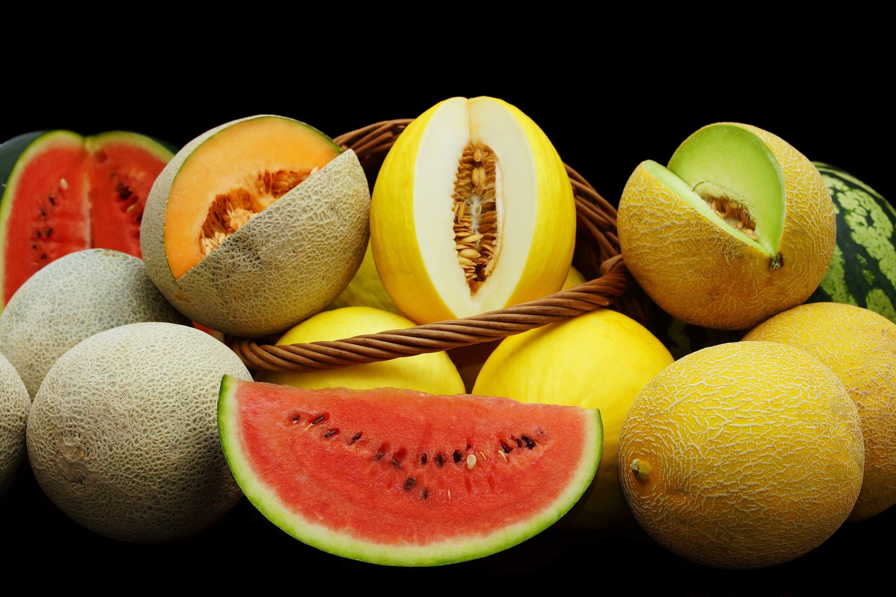
MYTH: I don’t need to rinse this melon for safety — the part I eat is on the inside.
FACT: Sure you’re not eating the rind of the melon, but there are many ways for pathogens on the outside of the melon to contaminate the edible portion. A knife or peeler passing through the rind can carry pathogens from the outside into the flesh of the melon. The rind also touches the edible portion when fruit is arranged or stacked for serving and garnish. Play it safe and rinse your melon under running tap water while rubbing by hand or scrubbing with a clean brush. Dry the melon with a clean cloth or paper towel.
http://www.foodsafetynews.com/2016/09/how-may-do-you-know-top-10-food-safety-myths-and-facts/#.V-_OFPkrKM8
Shutterstock.com

Slide 9
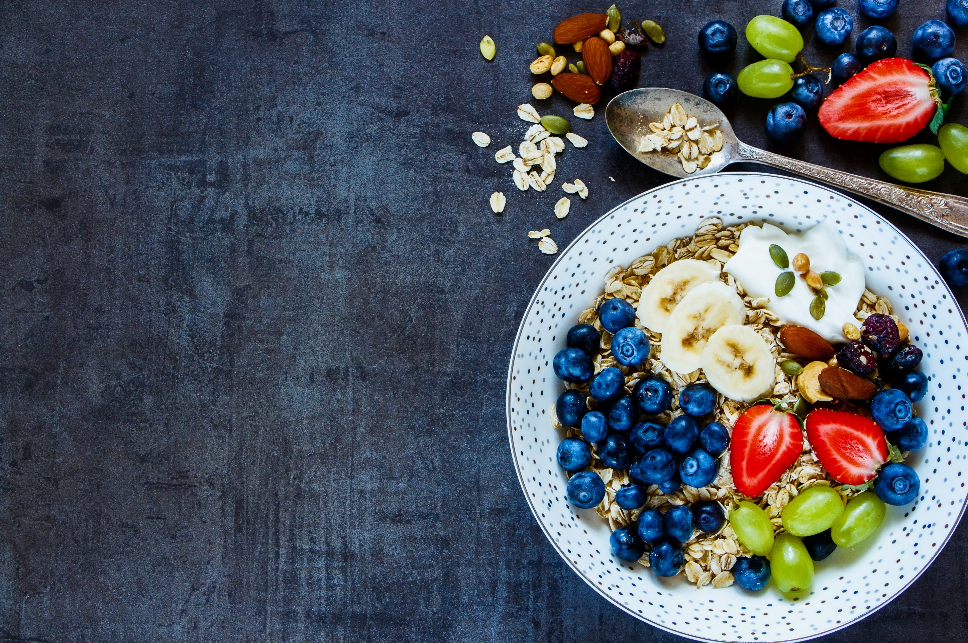
MYTH: I eat a vegetarian diet, so I don’t have to worry about food poisoning.
FACT: Fruits and vegetables are an important part of a healthy diet, but like other foods they may carry a risk of foodborne illness. Always rinse produce under running tap water, including fruits and vegetables with skins and rinds that are not eaten.
Never use detergent or bleach to wash fresh fruits or vegetables as these products are not intended for consumption. Remember, many fruits and vegetables are consumed raw, without a germ-killing step, making that trip to the sink even more crucial.
http://www.foodsafetynews.com/2016/09/how-may-do-you-know-top-10-food-safety-myths-and-facts/#.V-_OFPkrKM8
Shutterstock.com

Slide 10
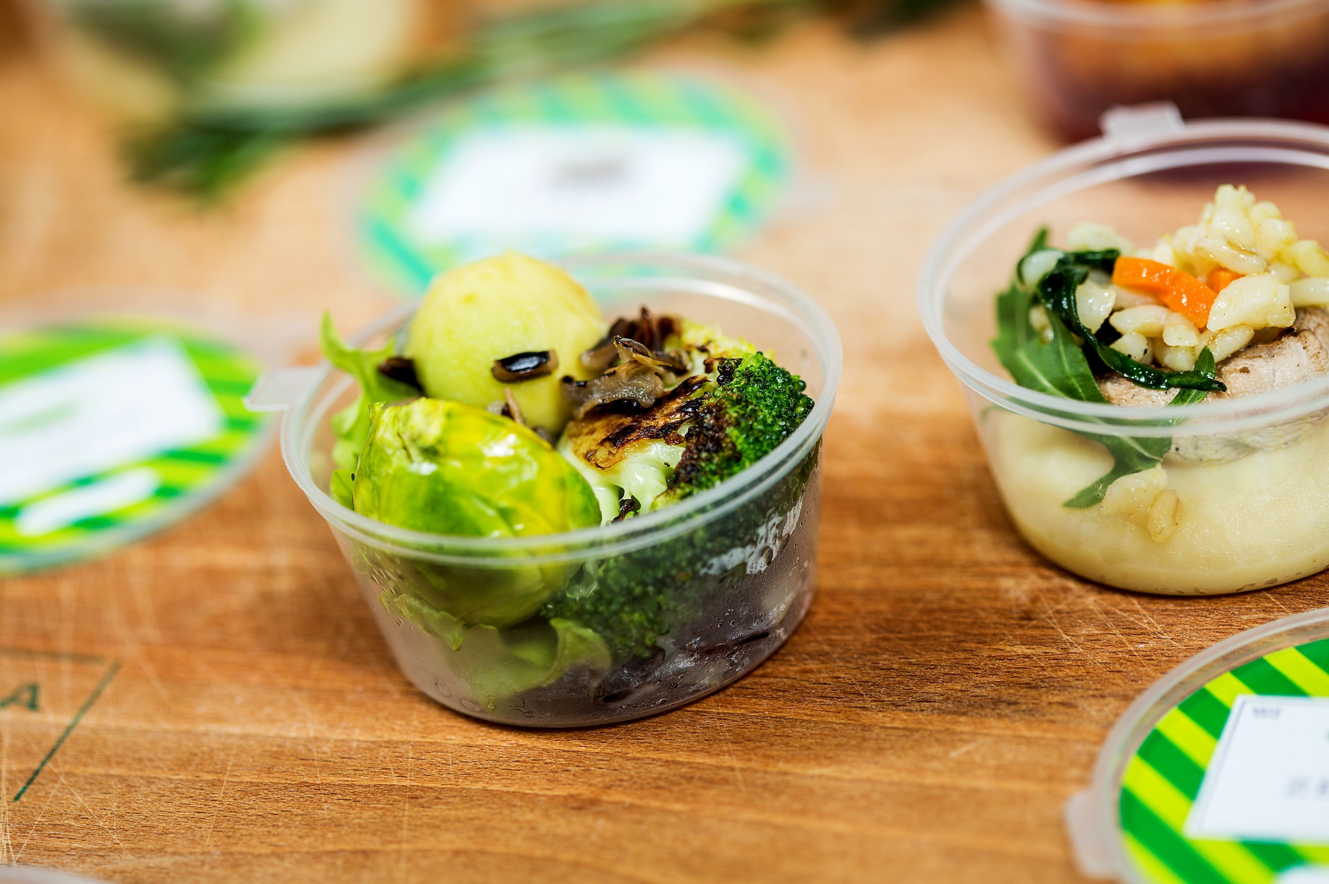
MYTH: Leftovers are safe to eat until they smell bad.
FACT: Smell is not an indication of whether food is safe to eat. There are different types of bacteria, some of which cause illness in people and others that don’t.
The types of bacteria that cause foodborne illness do not affect the taste, smell, or appearance of food. Freeze or toss refrigerated leftovers within three to four days even if they smell and look fine. If you’re not sure how long leftovers have been in the refrigerator, toss them. If you’re not sure how old your leftovers are, remember: when in doubt, throw it out!
http://www.foodsafetynews.com/2016/09/how-may-do-you-know-top-10-food-safety-myths-and-facts/#.V-_OFPkrKM8

Slide 11
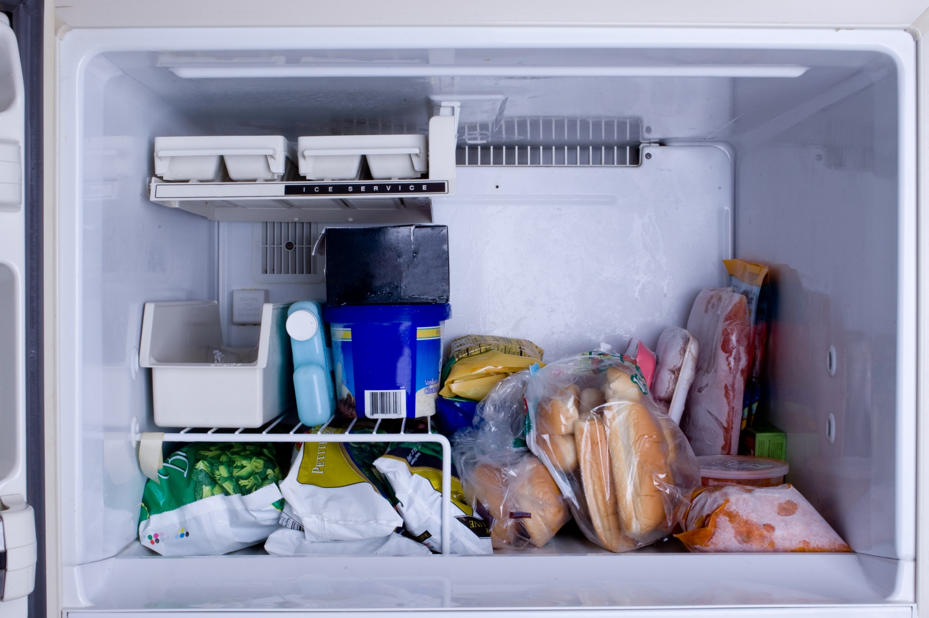
Shutterstock.com
MYTH: Freezing food kills harmful bacteria that can cause food poisoning.
FACT: Bacteria can survive freezing temperatures. Freezing is not a method for making food safe to eat. When food is thawed, bacteria can still be present and may begin to multiply. Listeria monocytogenes and the Hepatitis A virus are two examples of foodborne pathogens that can survive for long periods at freezing temperatures. Cooking food to the proper internal temperature is the best way to kill harmful bacteria. Use a thermometer to measure the temperature of cooked foods.
http://www.foodsafetynews.com/2016/09/how-may-do-you-know-top-10-food-safety-myths-and-facts/#.V-_OFPkrKM8

Slide 12
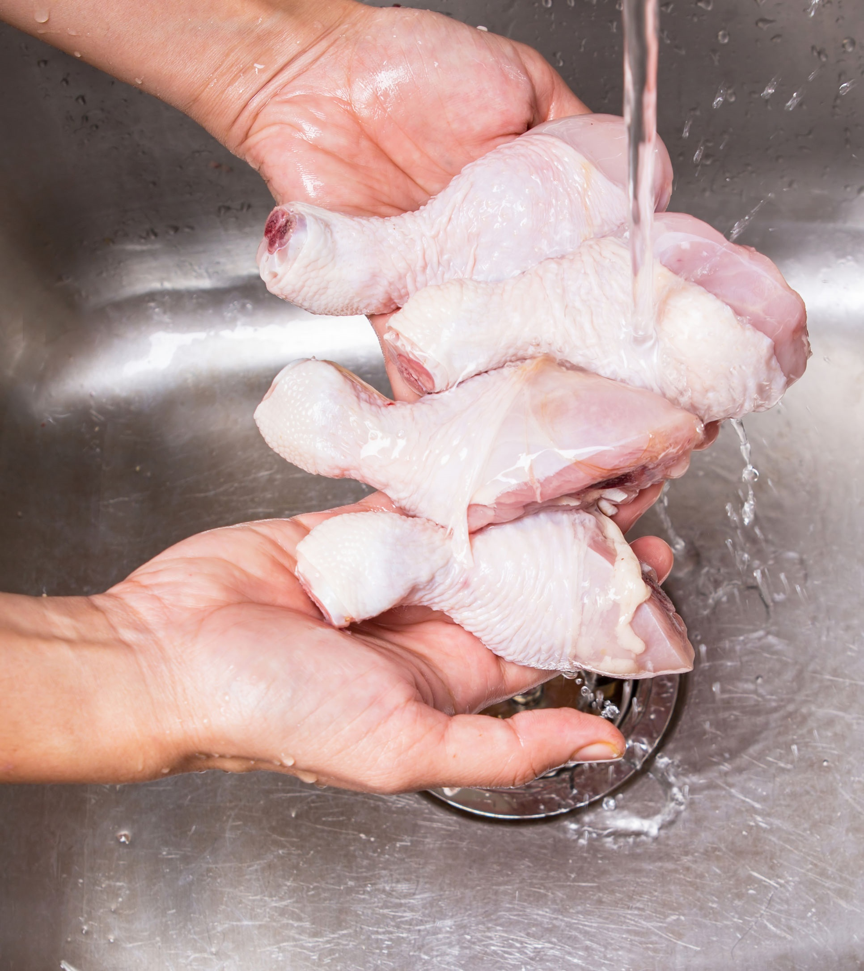
MYTH: Putting chicken in a colander and rinsing it with water will remove bacteria like Salmonella.
FACT: Rinsing chicken in a colander will not remove bacteria. In fact, it can spread raw juices around your sink, onto your counter tops, and onto ready-to-eat foods. Bacteria in raw meat and poultry can only be killed when cooked to a safe minimum internal temperature, which for poultry is 165 degrees F, as measured by a food thermometer.
Save yourself the messiness of rinsing raw poultry and meat. It is not a safety step and can cause cross-contamination. Always use a food thermometer to check the internal temperature of your food.
http://www.foodsafetynews.com/2016/09/how-may-do-you-know-top-10-food-safety-myths-and-facts/#.V-_OFPkrKM8
Shutterstock.com

Slide 13
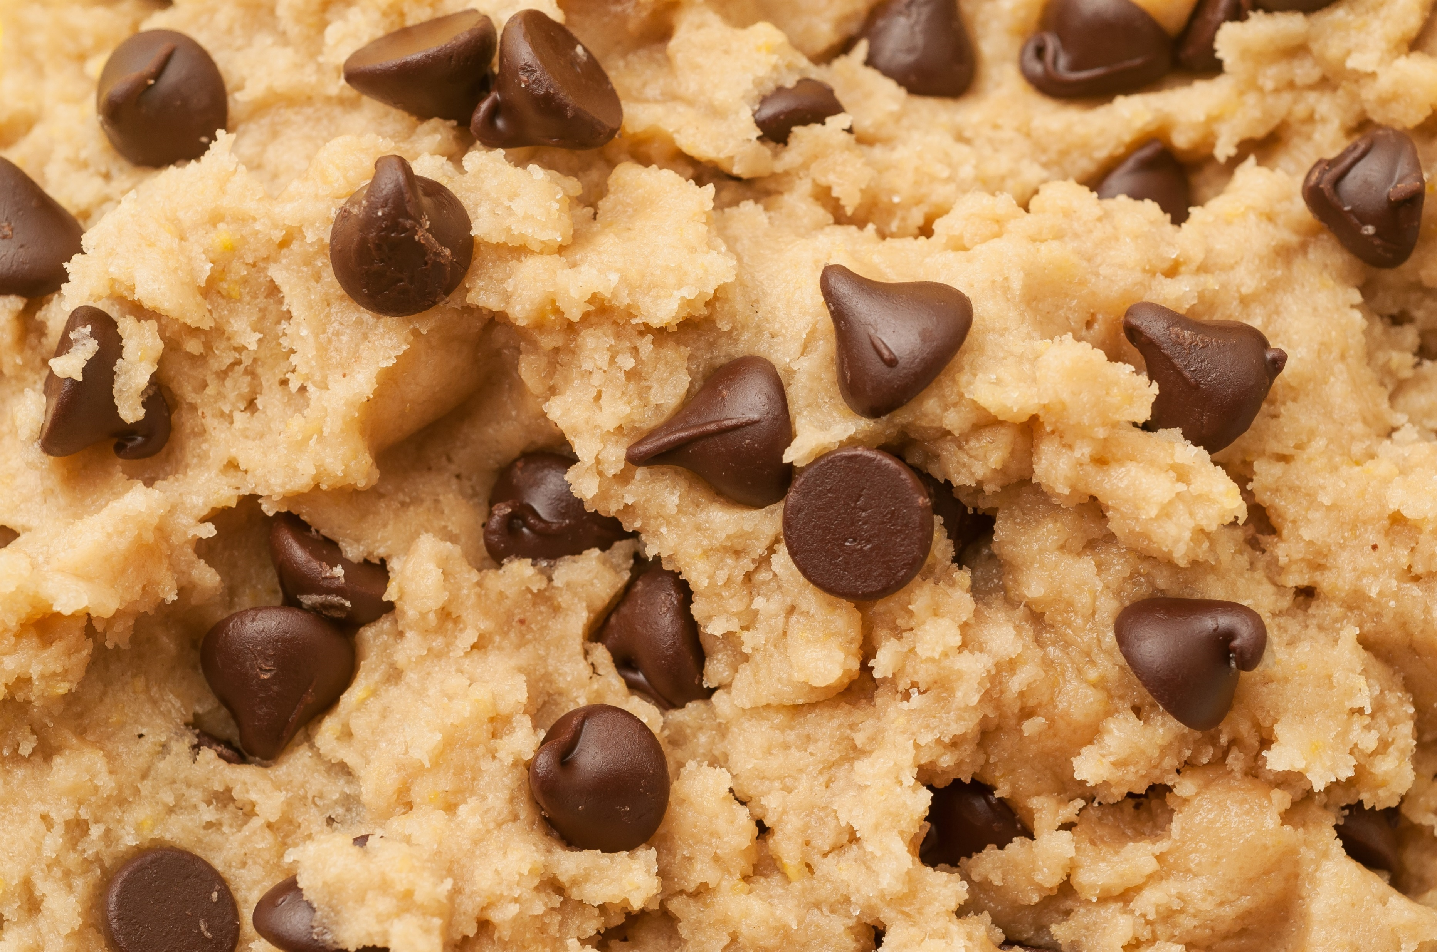
MYTH: Only kids eat raw cookie dough and cake batter. If we just keep kids away from the raw products when adults are baking, there won’t be a problem.
FACT: Just a lick can make you sick. No one of any age should eat raw dough or batter made with raw flour because it could contain germs that cause illness. Whether it’s pre-packaged or homemade, the heat from baking is required to kill germs that might be in the raw ingredients.
The finished, baked, product is far safer – and tastes even better. And remember, kids who eat raw cookie dough and cake batter are at greater risk of getting food poisoning than most adults are because their immune systems are not yet mature.
http://www.foodsafetynews.com/2016/09/how-may-do-you-know-top-10-food-safety-myths-and-facts/#.V-_OFPkrKM8
Shutterstock.com

Slide 14
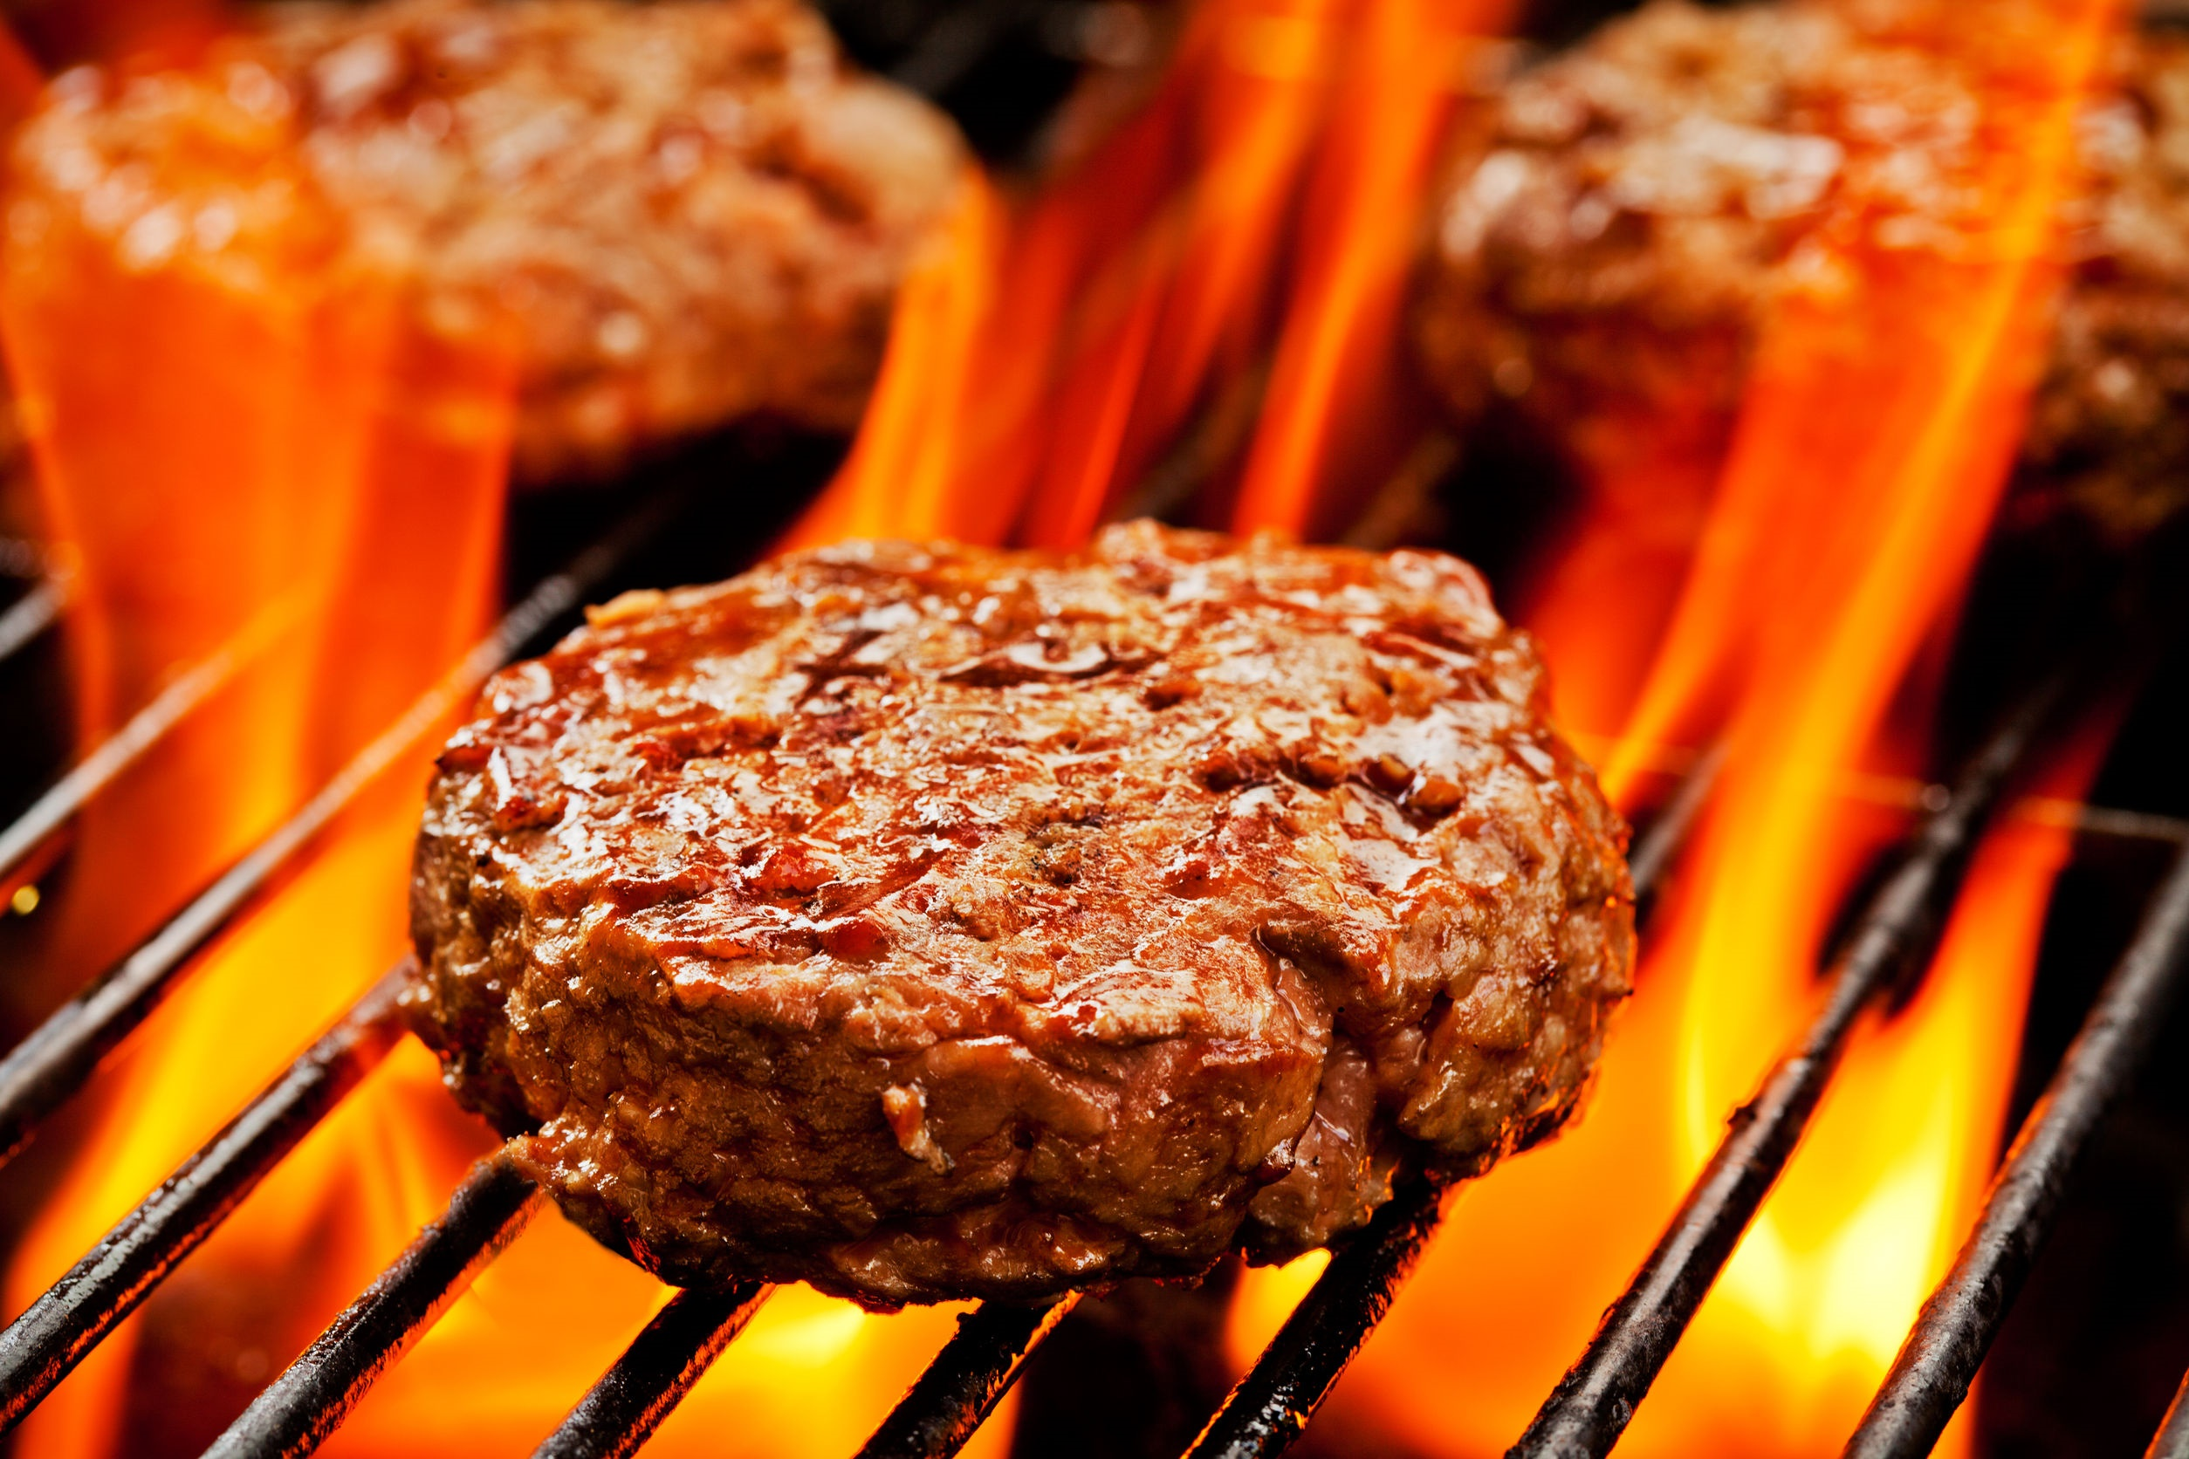
MYTH: Once a hamburger turns brown in the middle, it is cooked to a safe internal temperature.
FACT: You cannot use visual cues to determine whether food has been cooked to a safe minimum internal temperature. The only way to know that food has been cooked to a safe minimum internal temperature is to use a food thermometer. Ground meat should be cooked to a safe minimum internal temperature of 160 degrees F, as measured by a food thermometer.
http://www.foodsafetynews.com/2016/09/how-may-do-you-know-top-10-food-safety-myths-and-facts/#.V-_OFPkrKM8

Slide 15
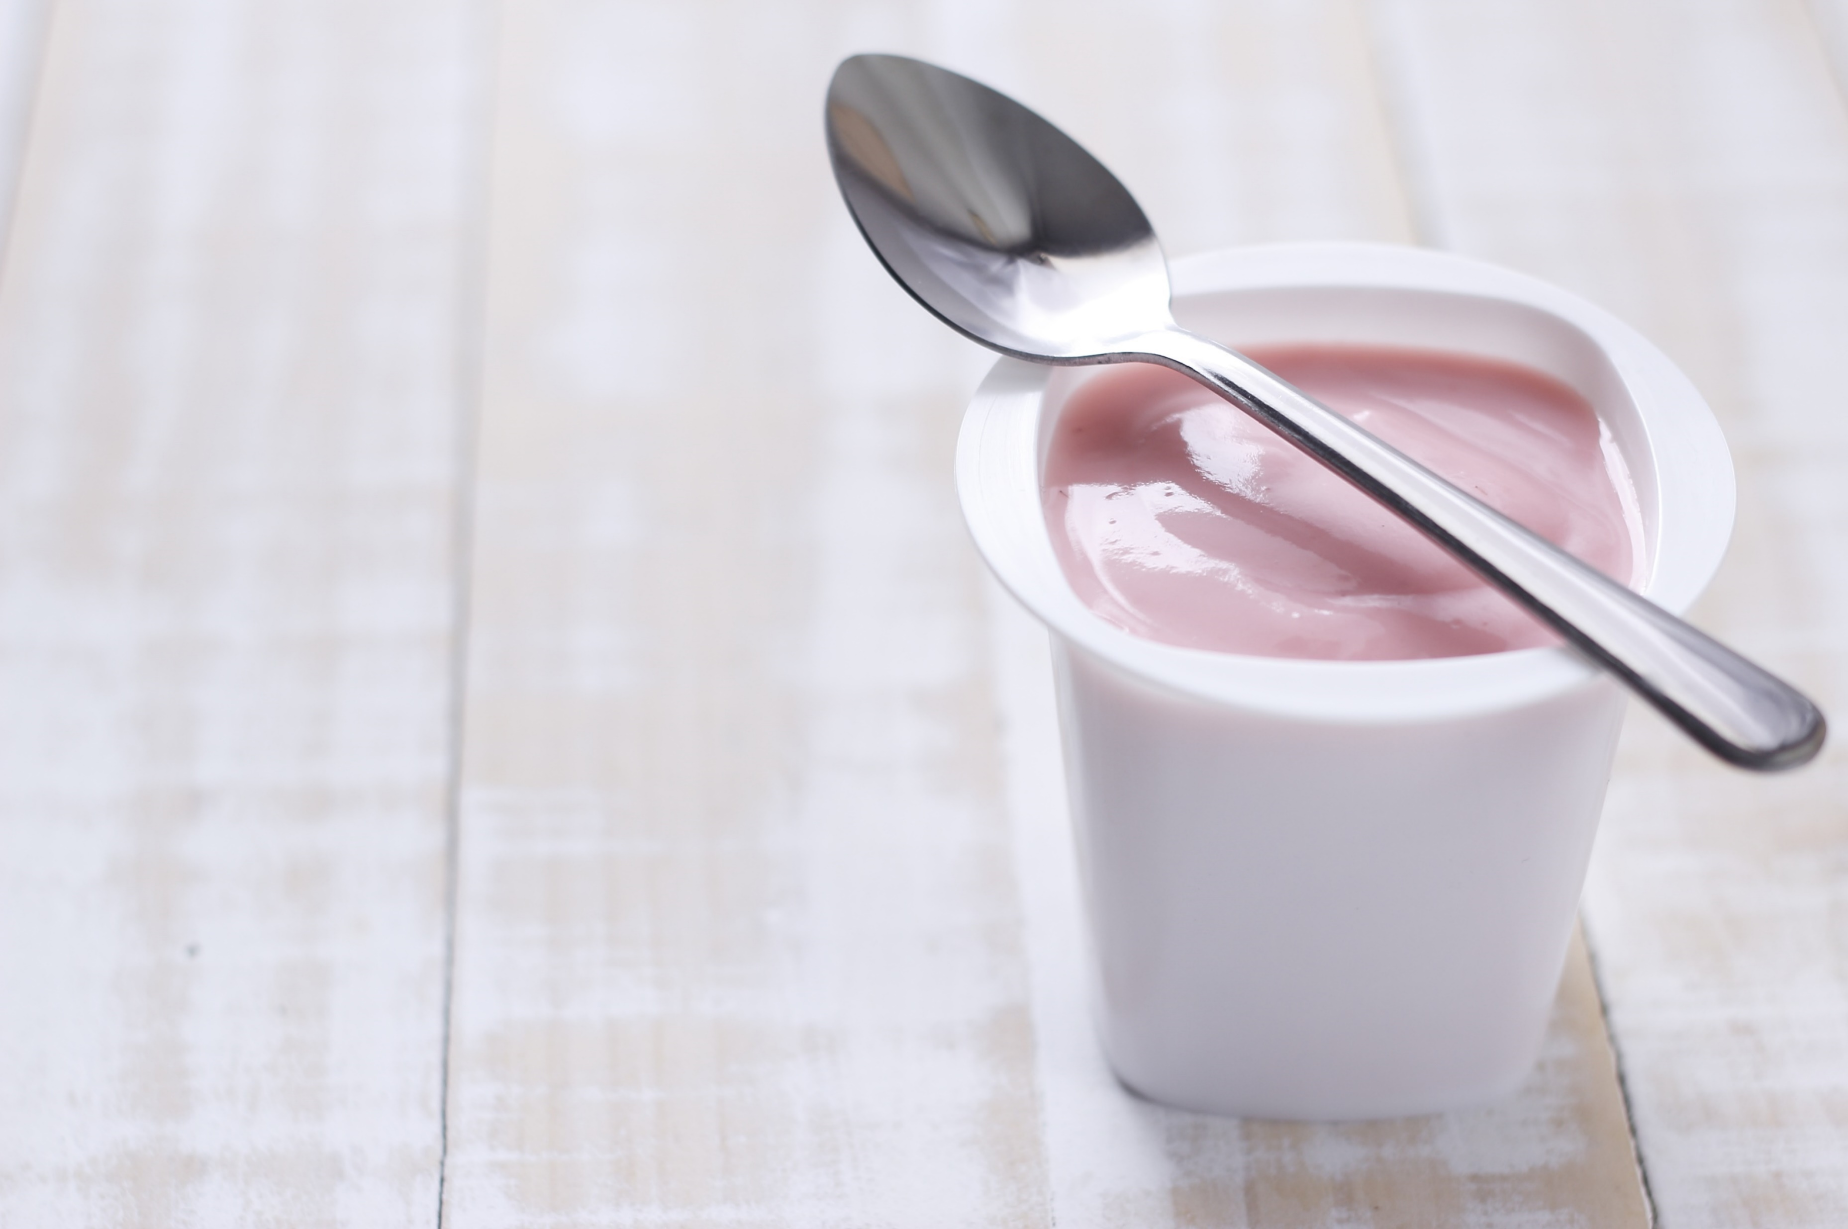
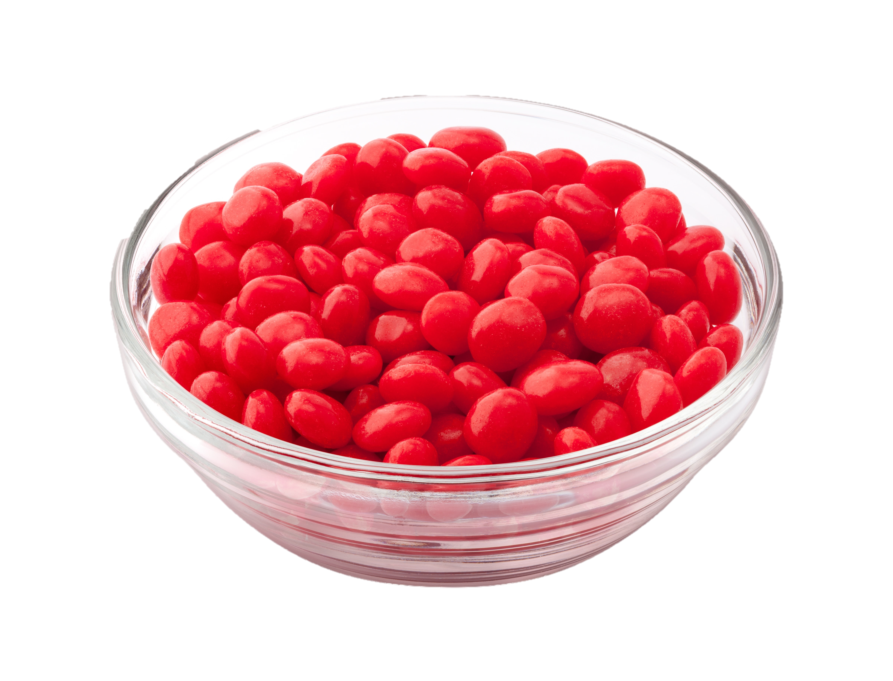
Fun Fact
The red food-coloring carmine — used in things like yogurt and candy — is made from boiled cochineal bugs, a type of beetle.
https://www.buzzfeed.com/justinabarca/food-facts-that-will-blow-your-mind?utm_term=.xrX5qnXN9#.vwLraGdk1
Shutterstock.com

Slide 16
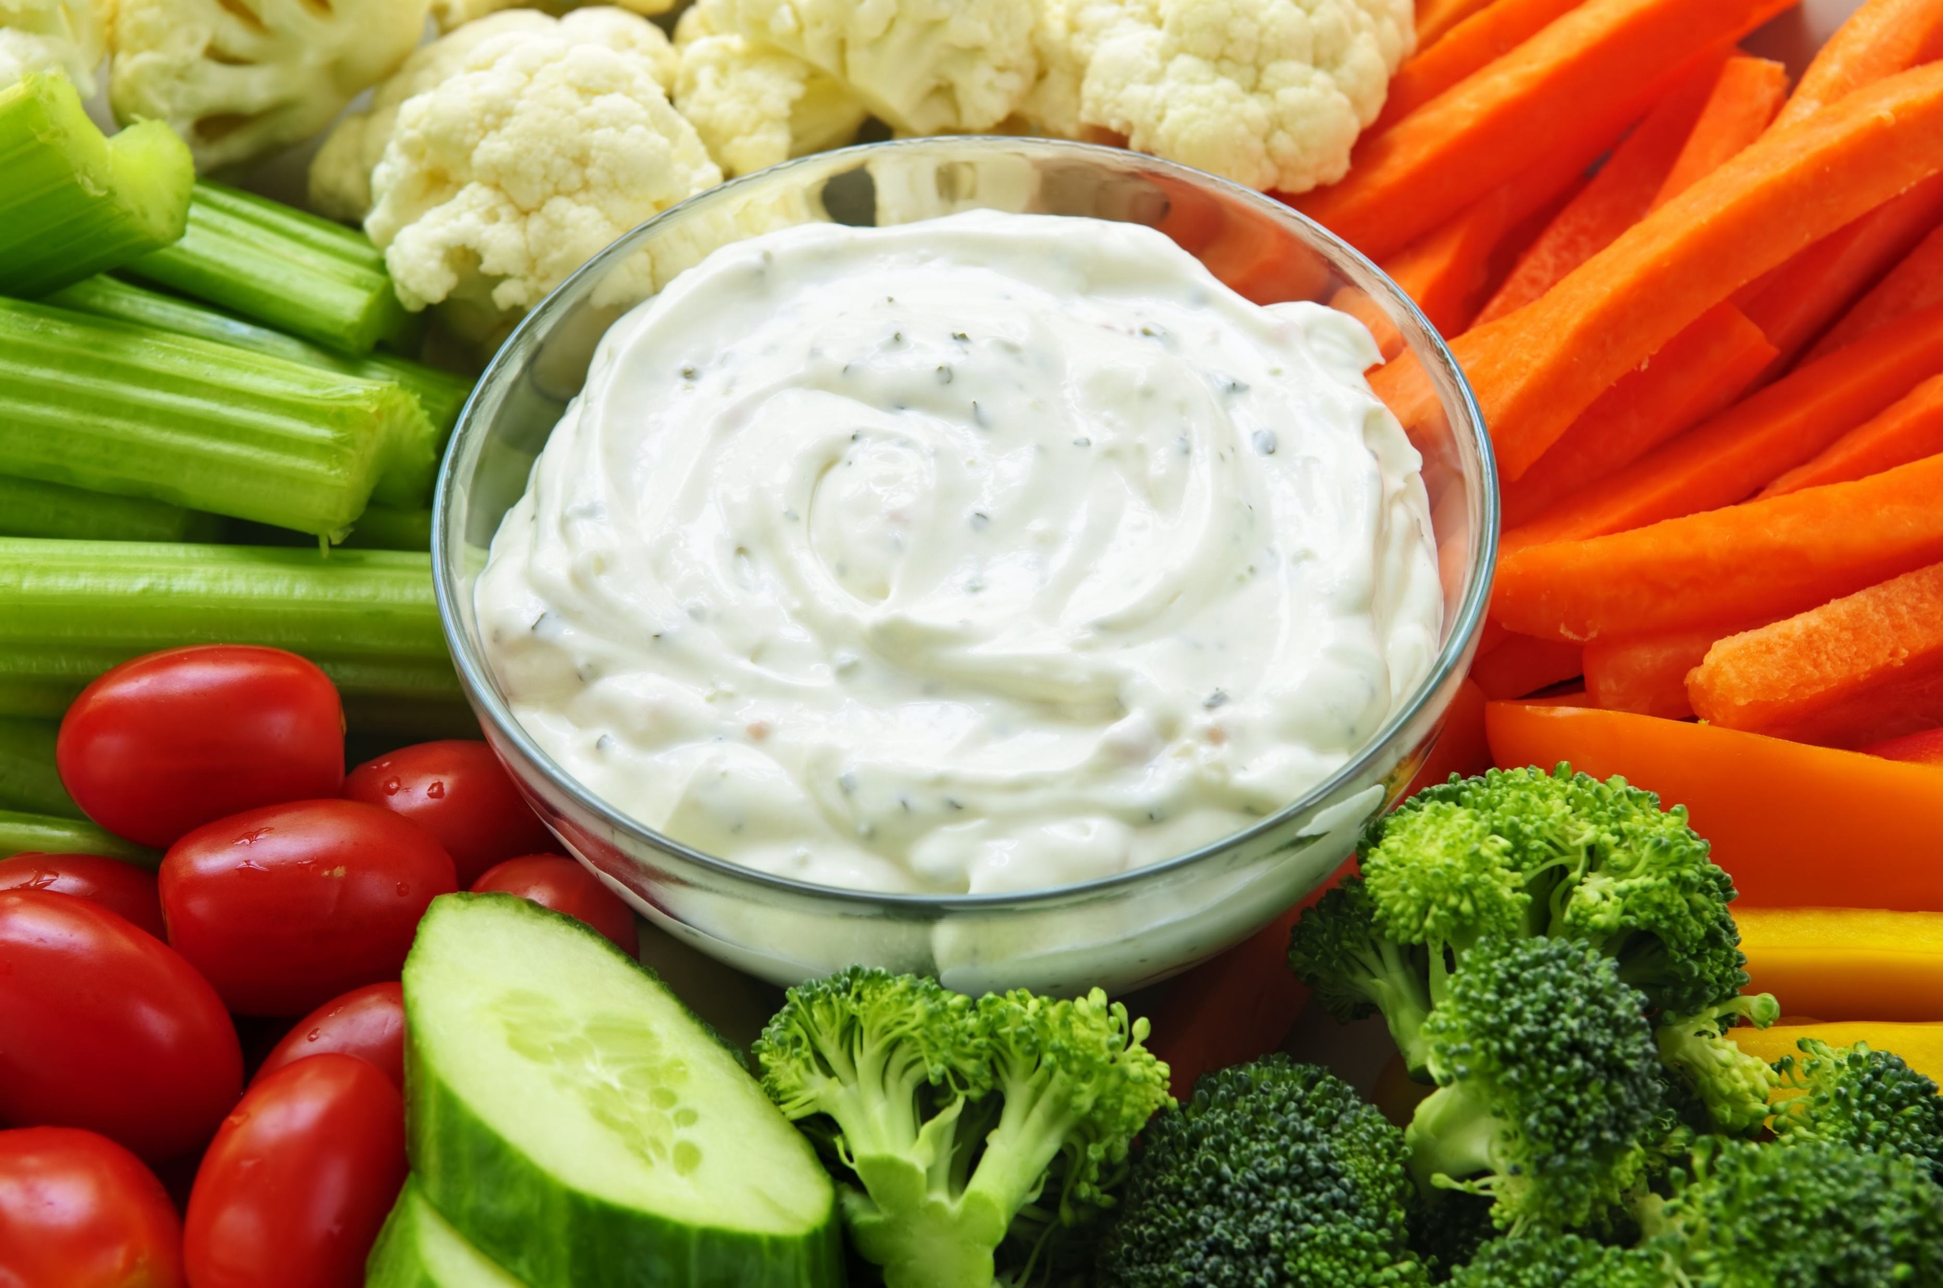
Fun Fact
Ranch dressing contains titanium dioxide, which is used to make it appear whiter. The same ingredient is used in sunscreen and paint for the same effect.
https://www.buzzfeed.com/justinabarca/food-facts-that-will-blow-your-mind?utm_term=.xrX5qnXN9#.vwLraGdk1
Shutterstock.com

Slide 17
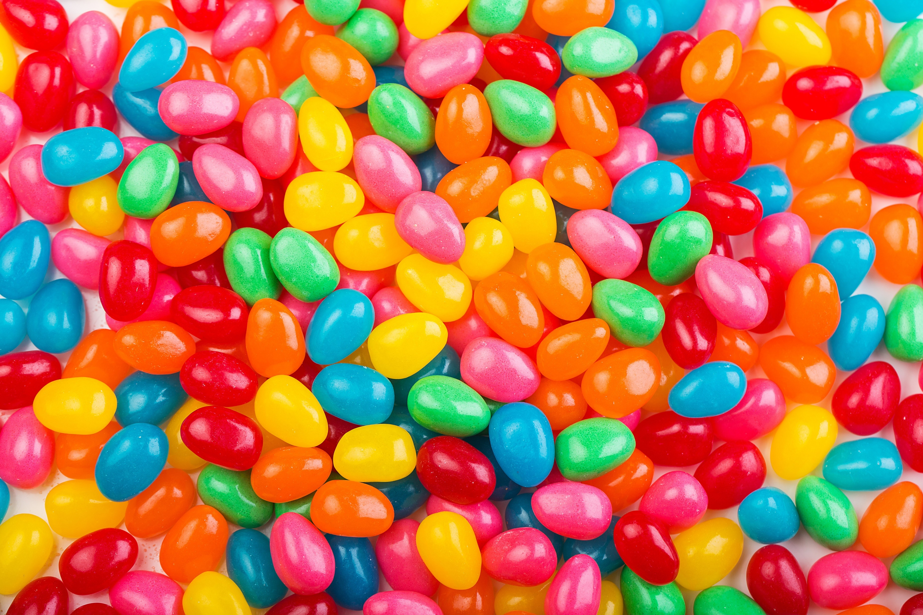
Fun Fact
To make jelly beans shiny, shellac is used, which is made from Kerria lacca insect excretions.
https://www.buzzfeed.com/justinabarca/food-facts-that-will-blow-your-mind?utm_term=.xrX5qnXN9#.vwLraGdk1
Shutterstock.com

Slide 18
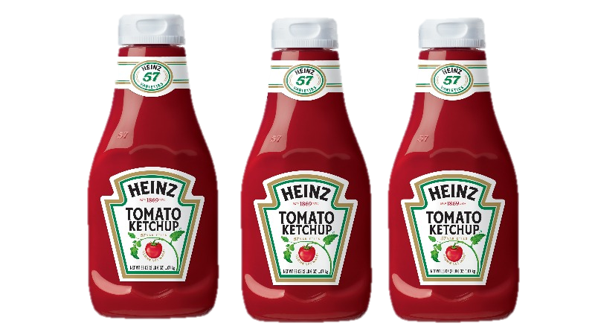
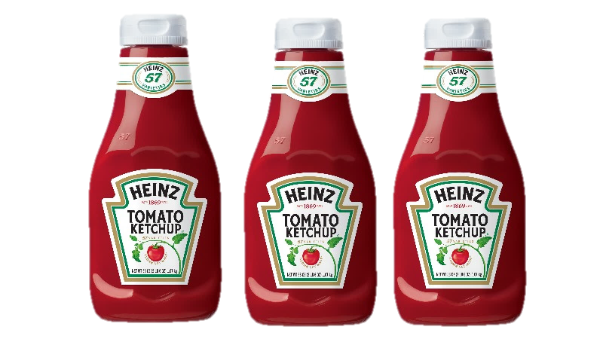
Fun Fact
Ketchup was sold in the 1830’s as medicine. The ’57’ on the Heinz ketchup bottle represents the number of pickle types the company once had.
http://www.thefactsite.com/2012/02/100-random-food-facts.html

Slide 19
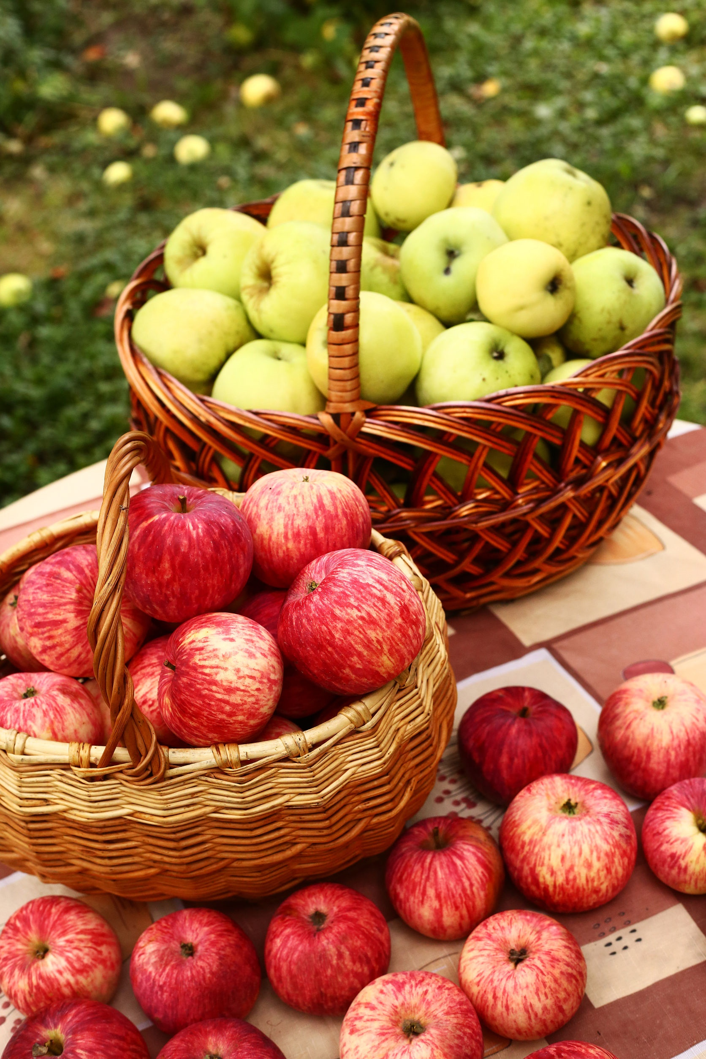
Fun Fact
There are more than 7,000 varieties of apples grown in the world.
Did you know that many are covered in wax? Yes, wax! Search the topic and then learn how to use water and vinegar to remove the wax.
http://www.thefactsite.com/2012/02/100-random-food-facts.html

Slide 20
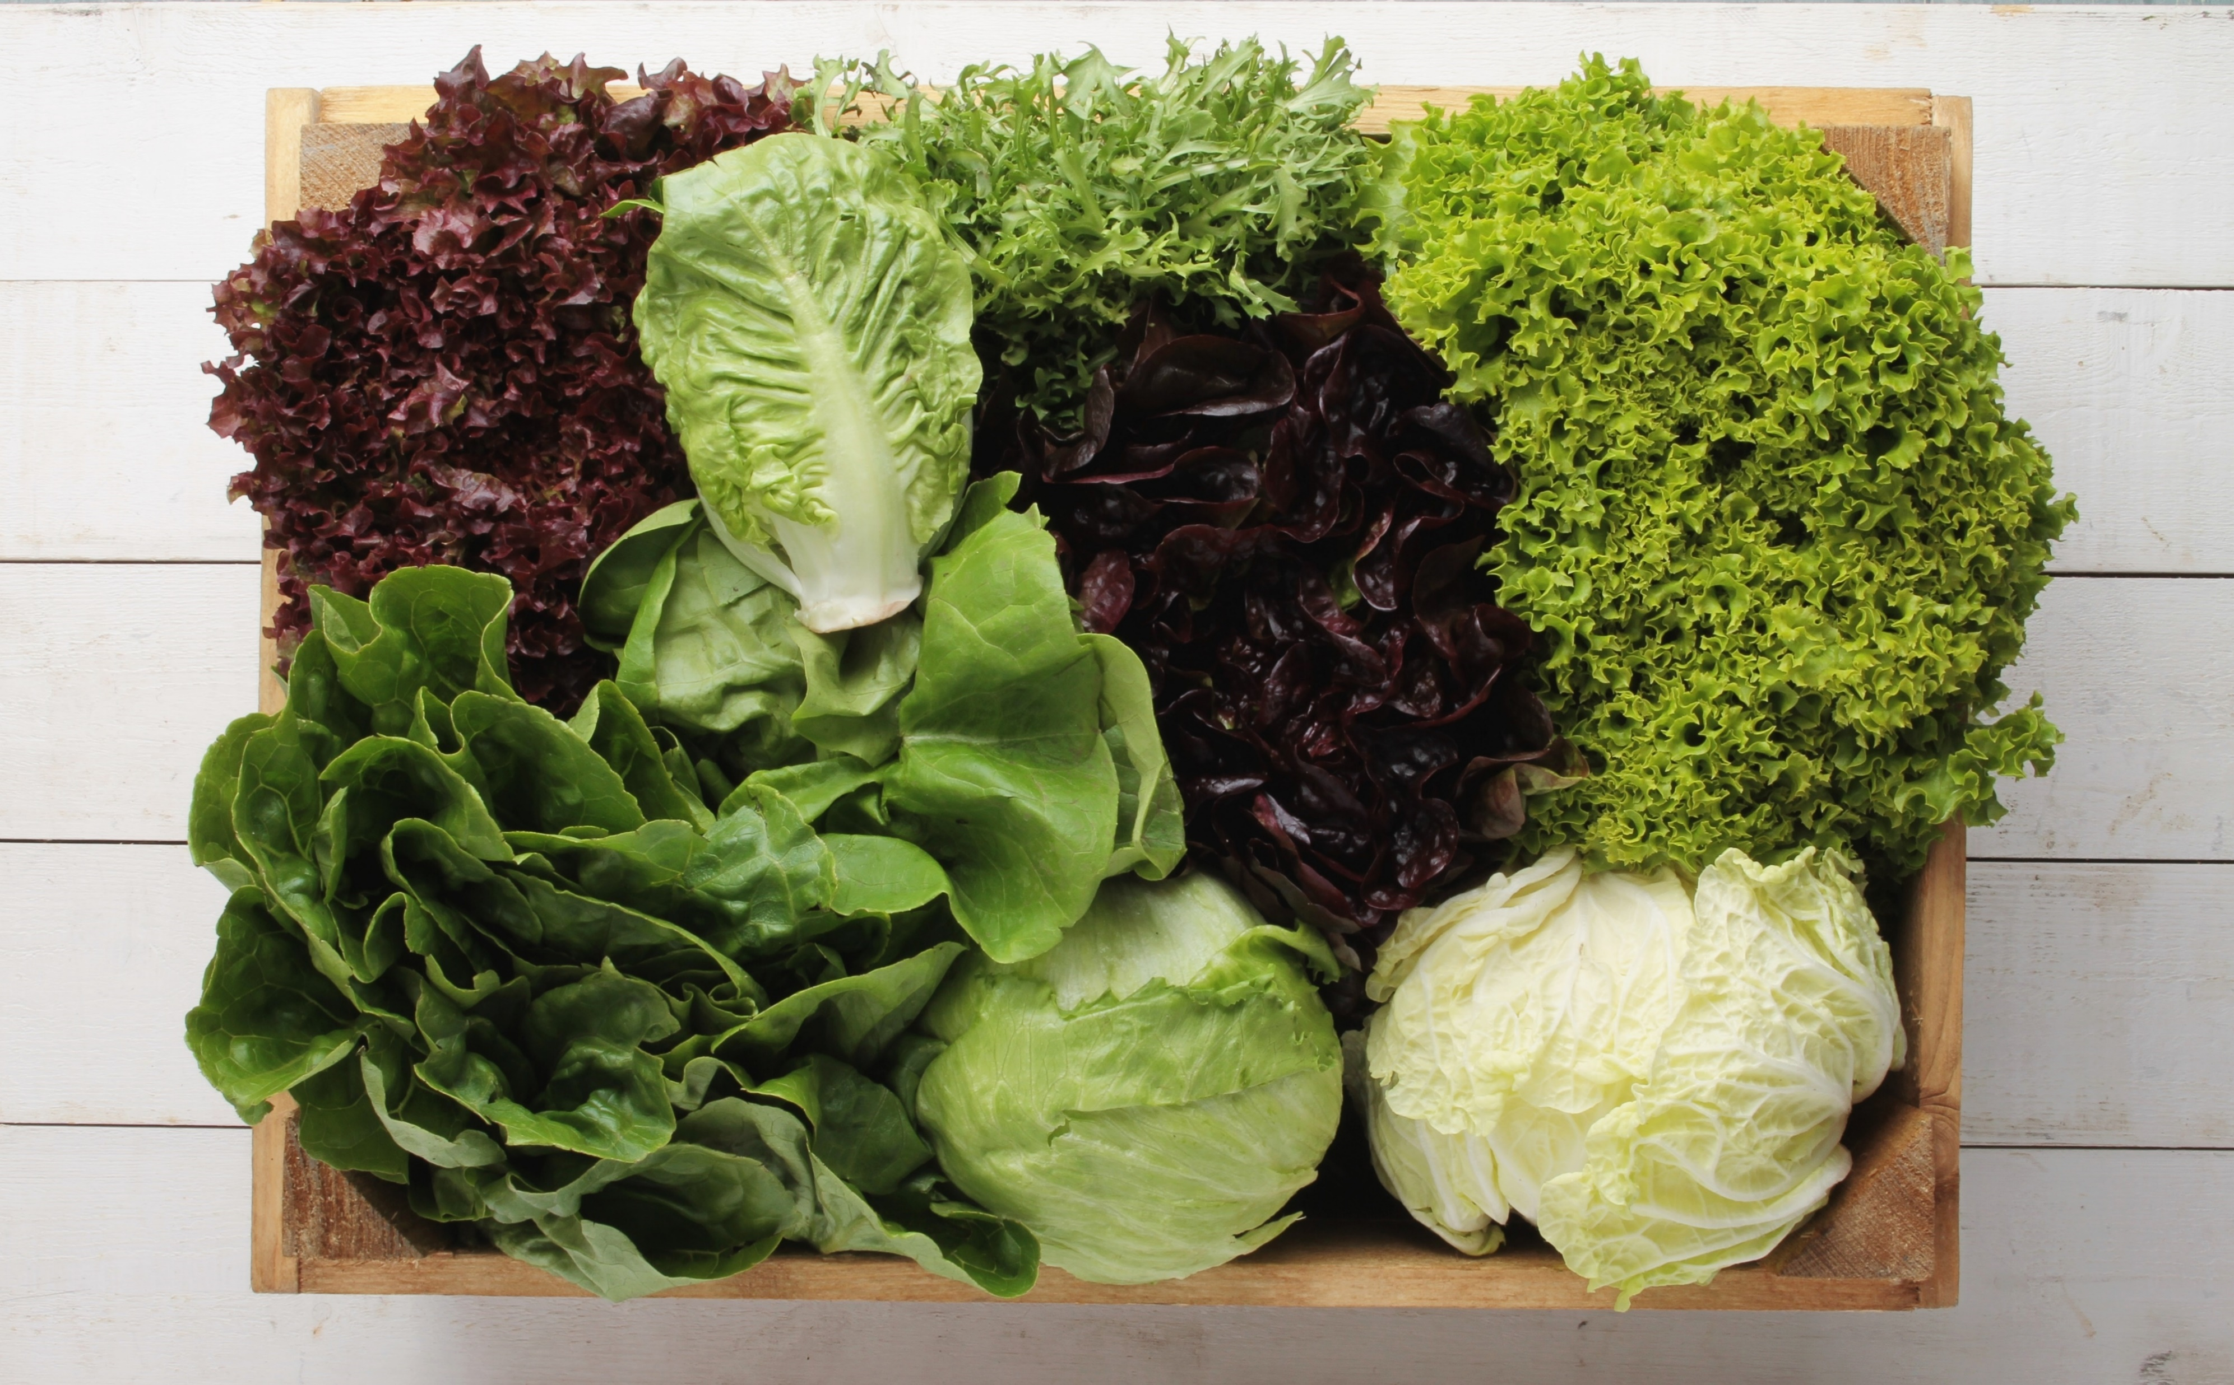
Fun Fact
In the United States, lettuce is the second most popular fresh vegetable.
http://www.thefactsite.com/2012/02/100-random-food-facts.html
Shutterstock.com

Slide 21
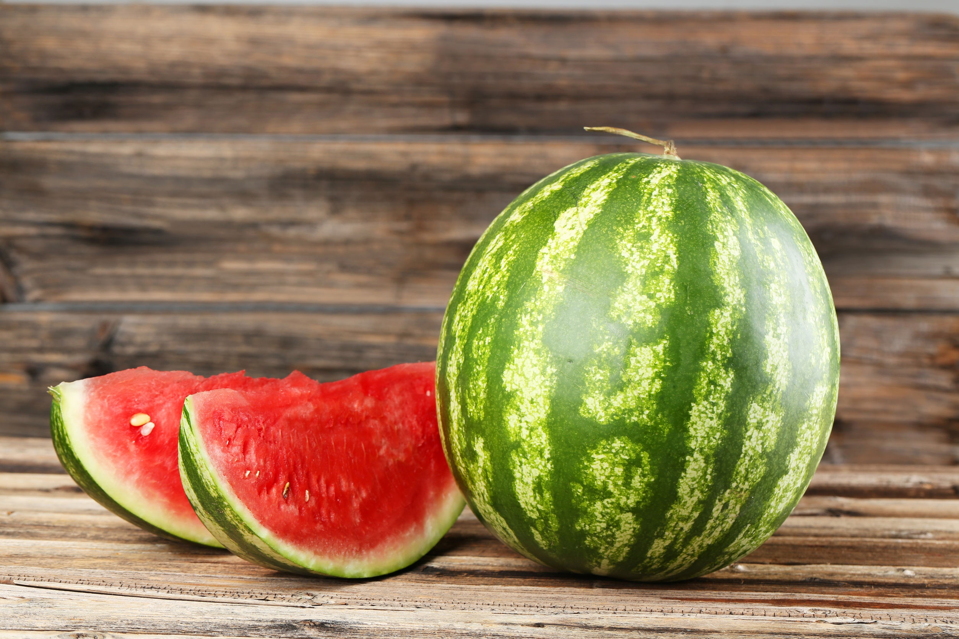
Fun Fact
A watermelon is over 92% water by weight.
http://www.thefactsite.com/2012/02/100-random-food-facts.html
Shutterstock.com

Slide 22
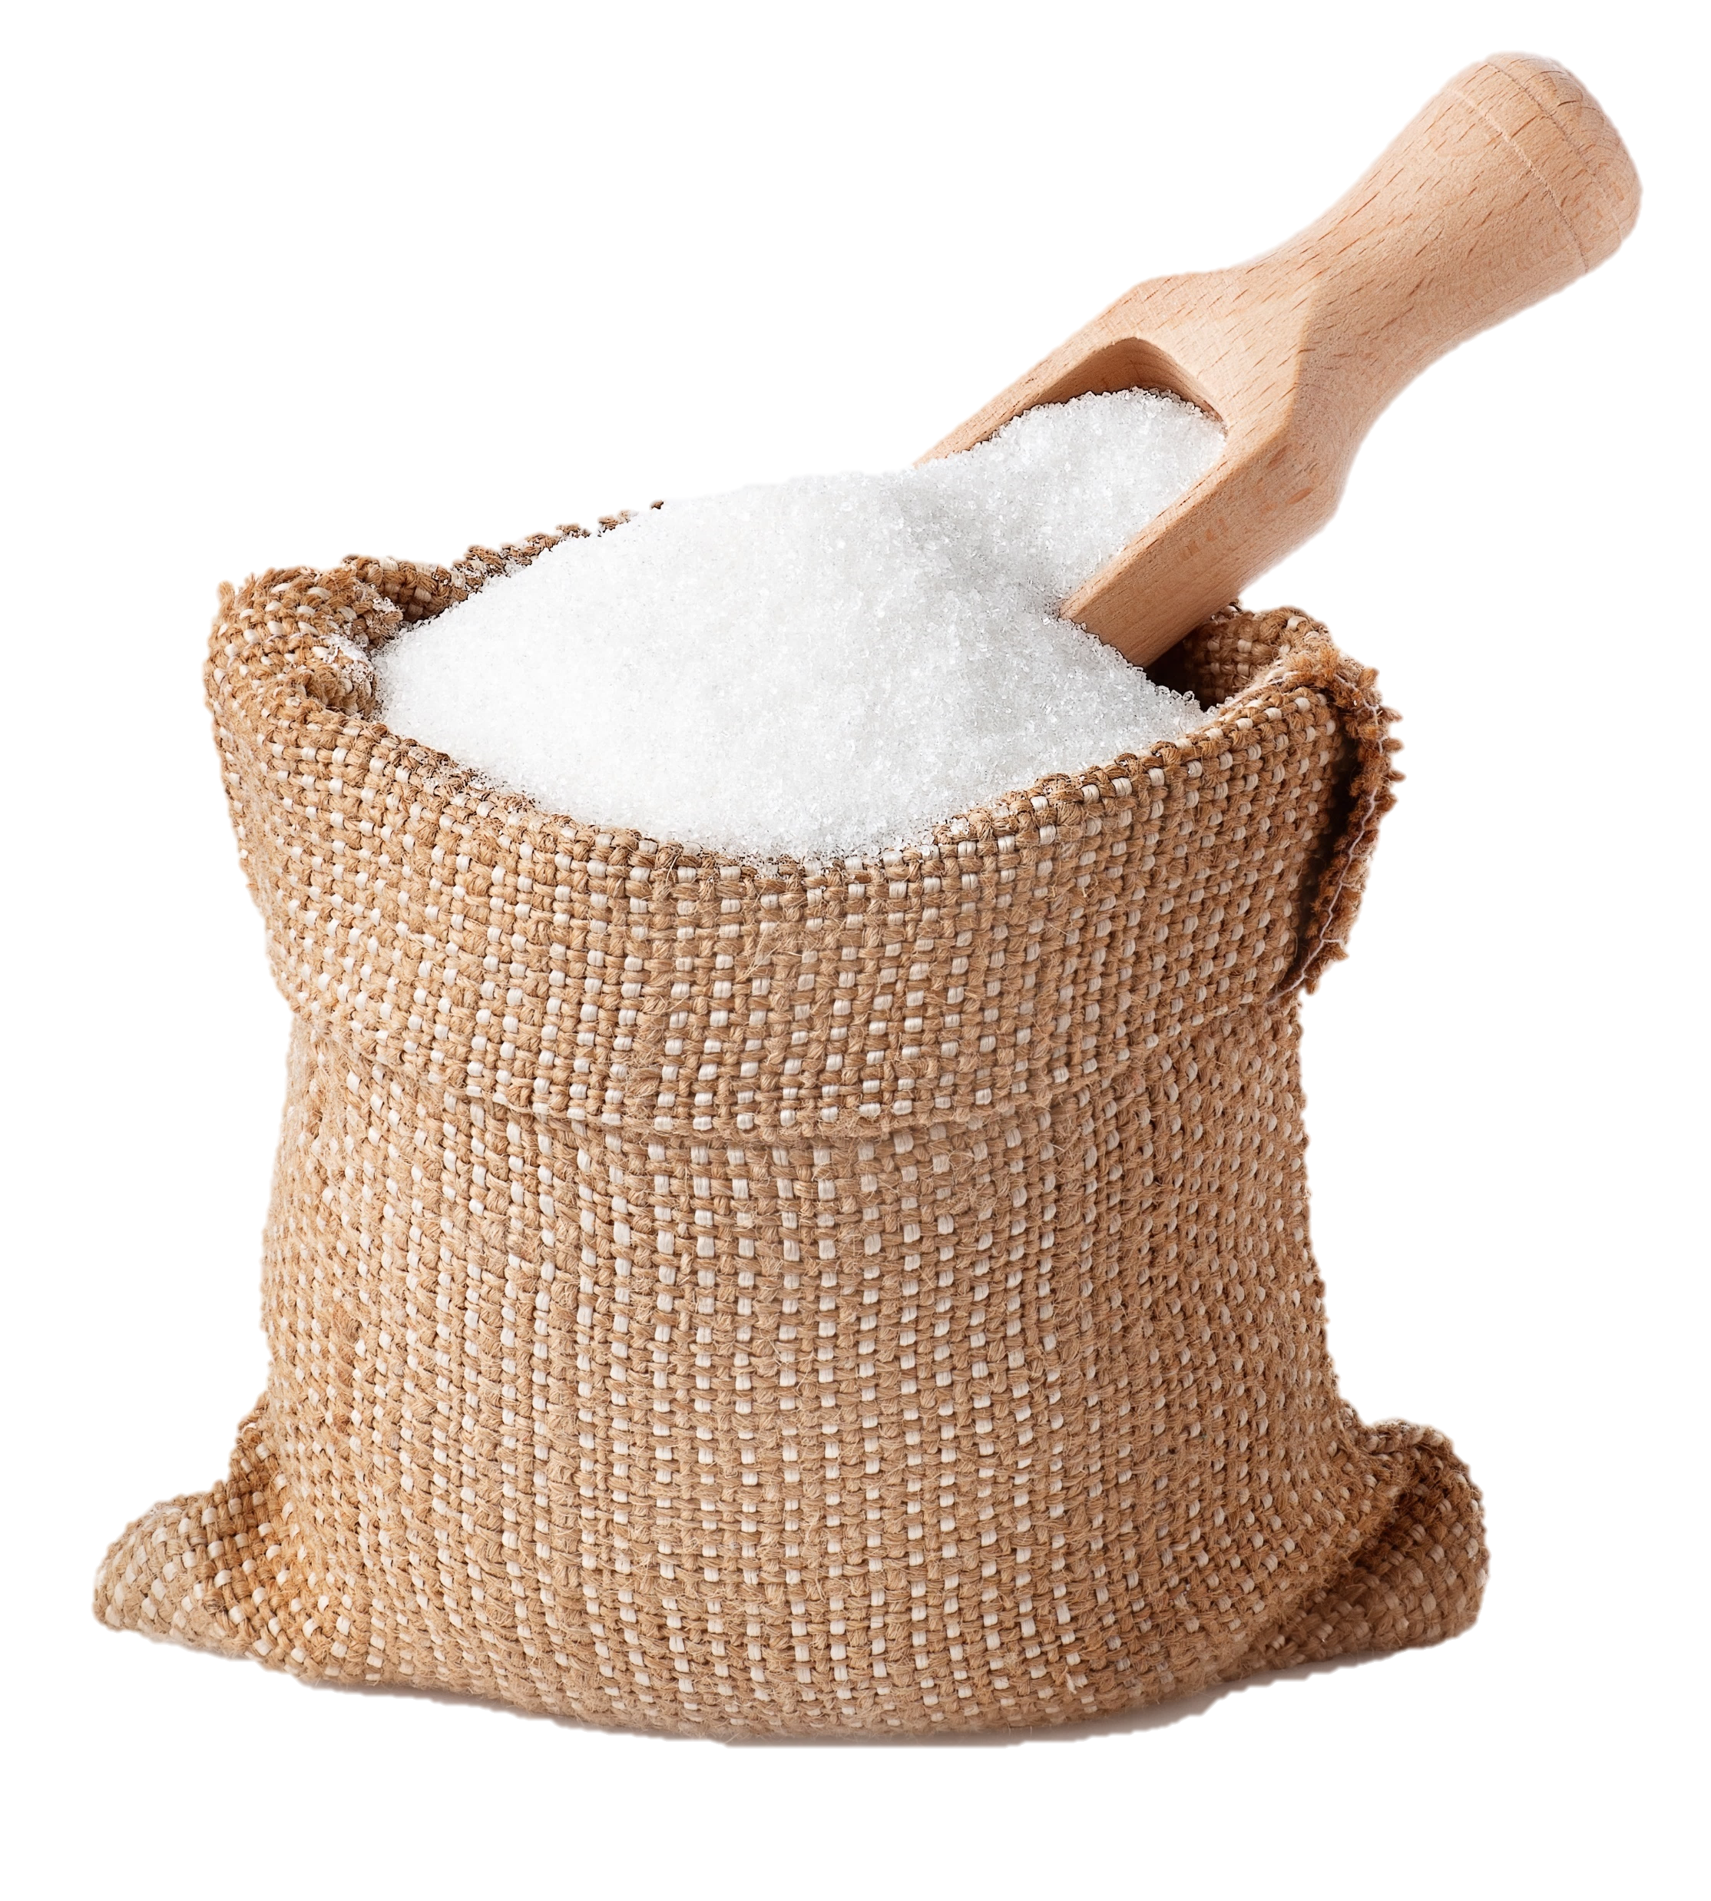
Fun Fact
Sugar is the only taste that humans are born craving.
http://www.thefactsite.com/2012/02/100-random-food-facts.html
Shutterstock.com

Slide 23
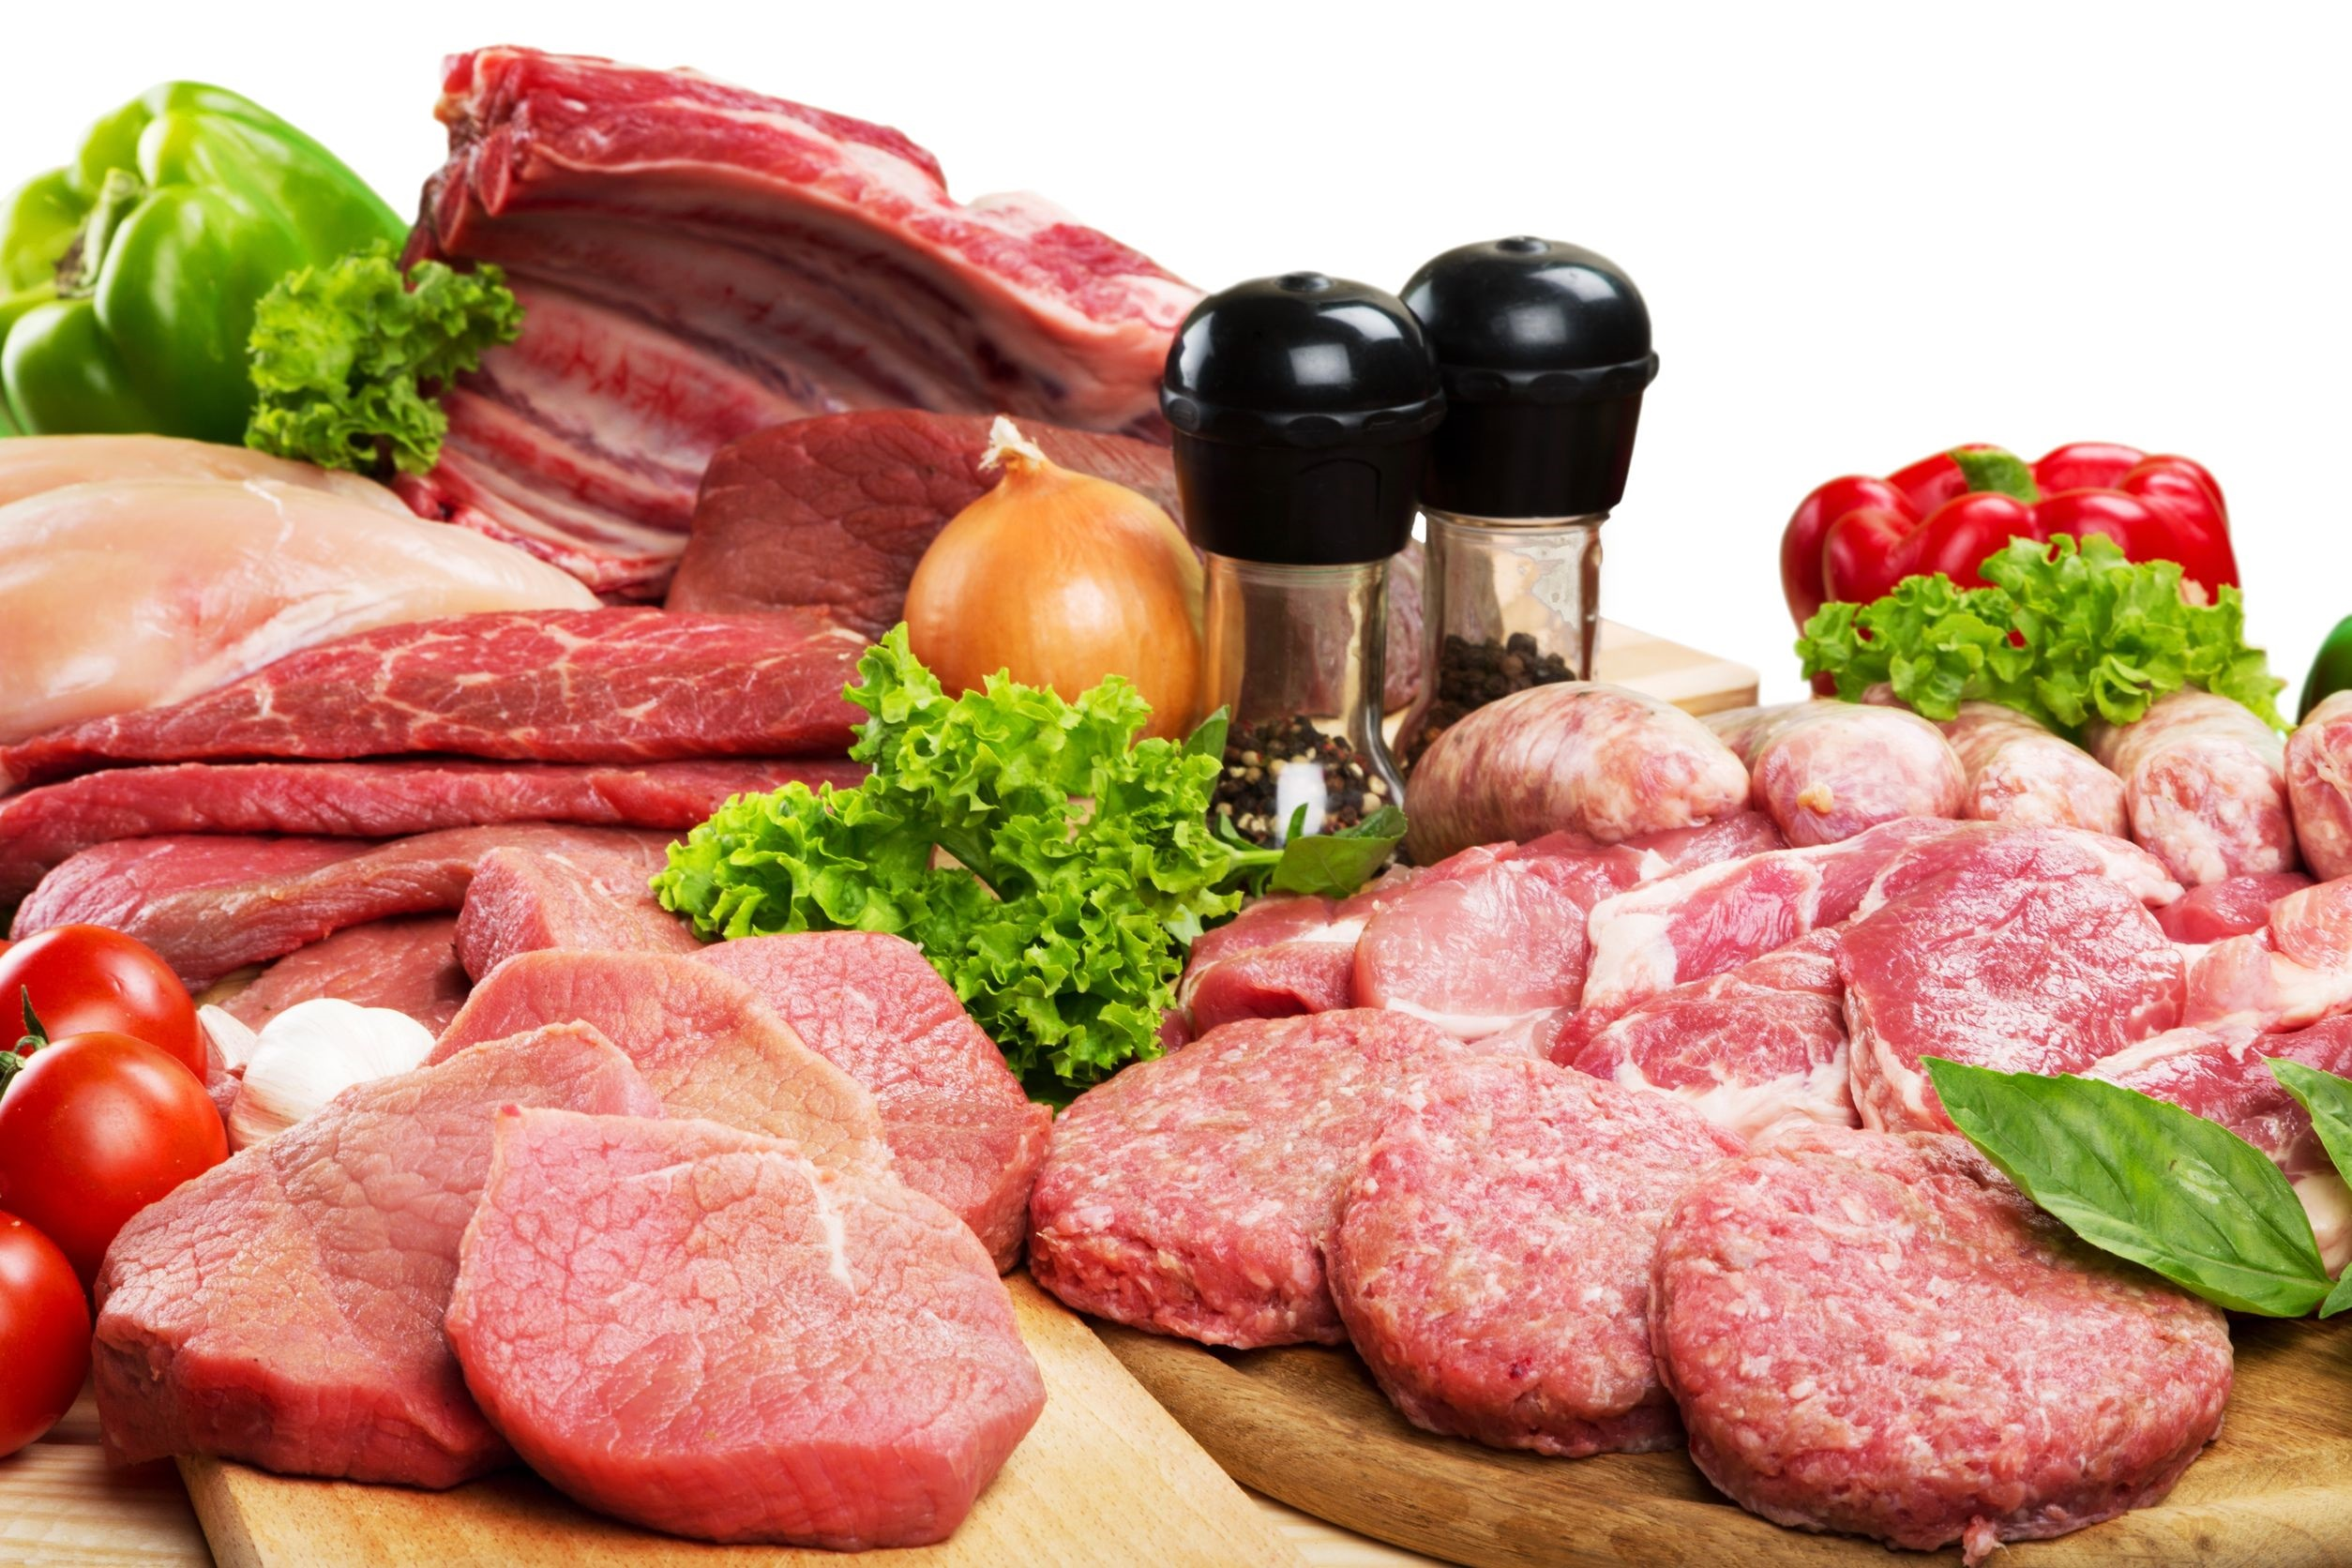
Fun Fact
The world average of the amount of meat eaten per year is: 173 lbs per person.
http://www.thefactsite.com/2012/02/100-random-food-facts.html
Shutterstock.com

Slide 24
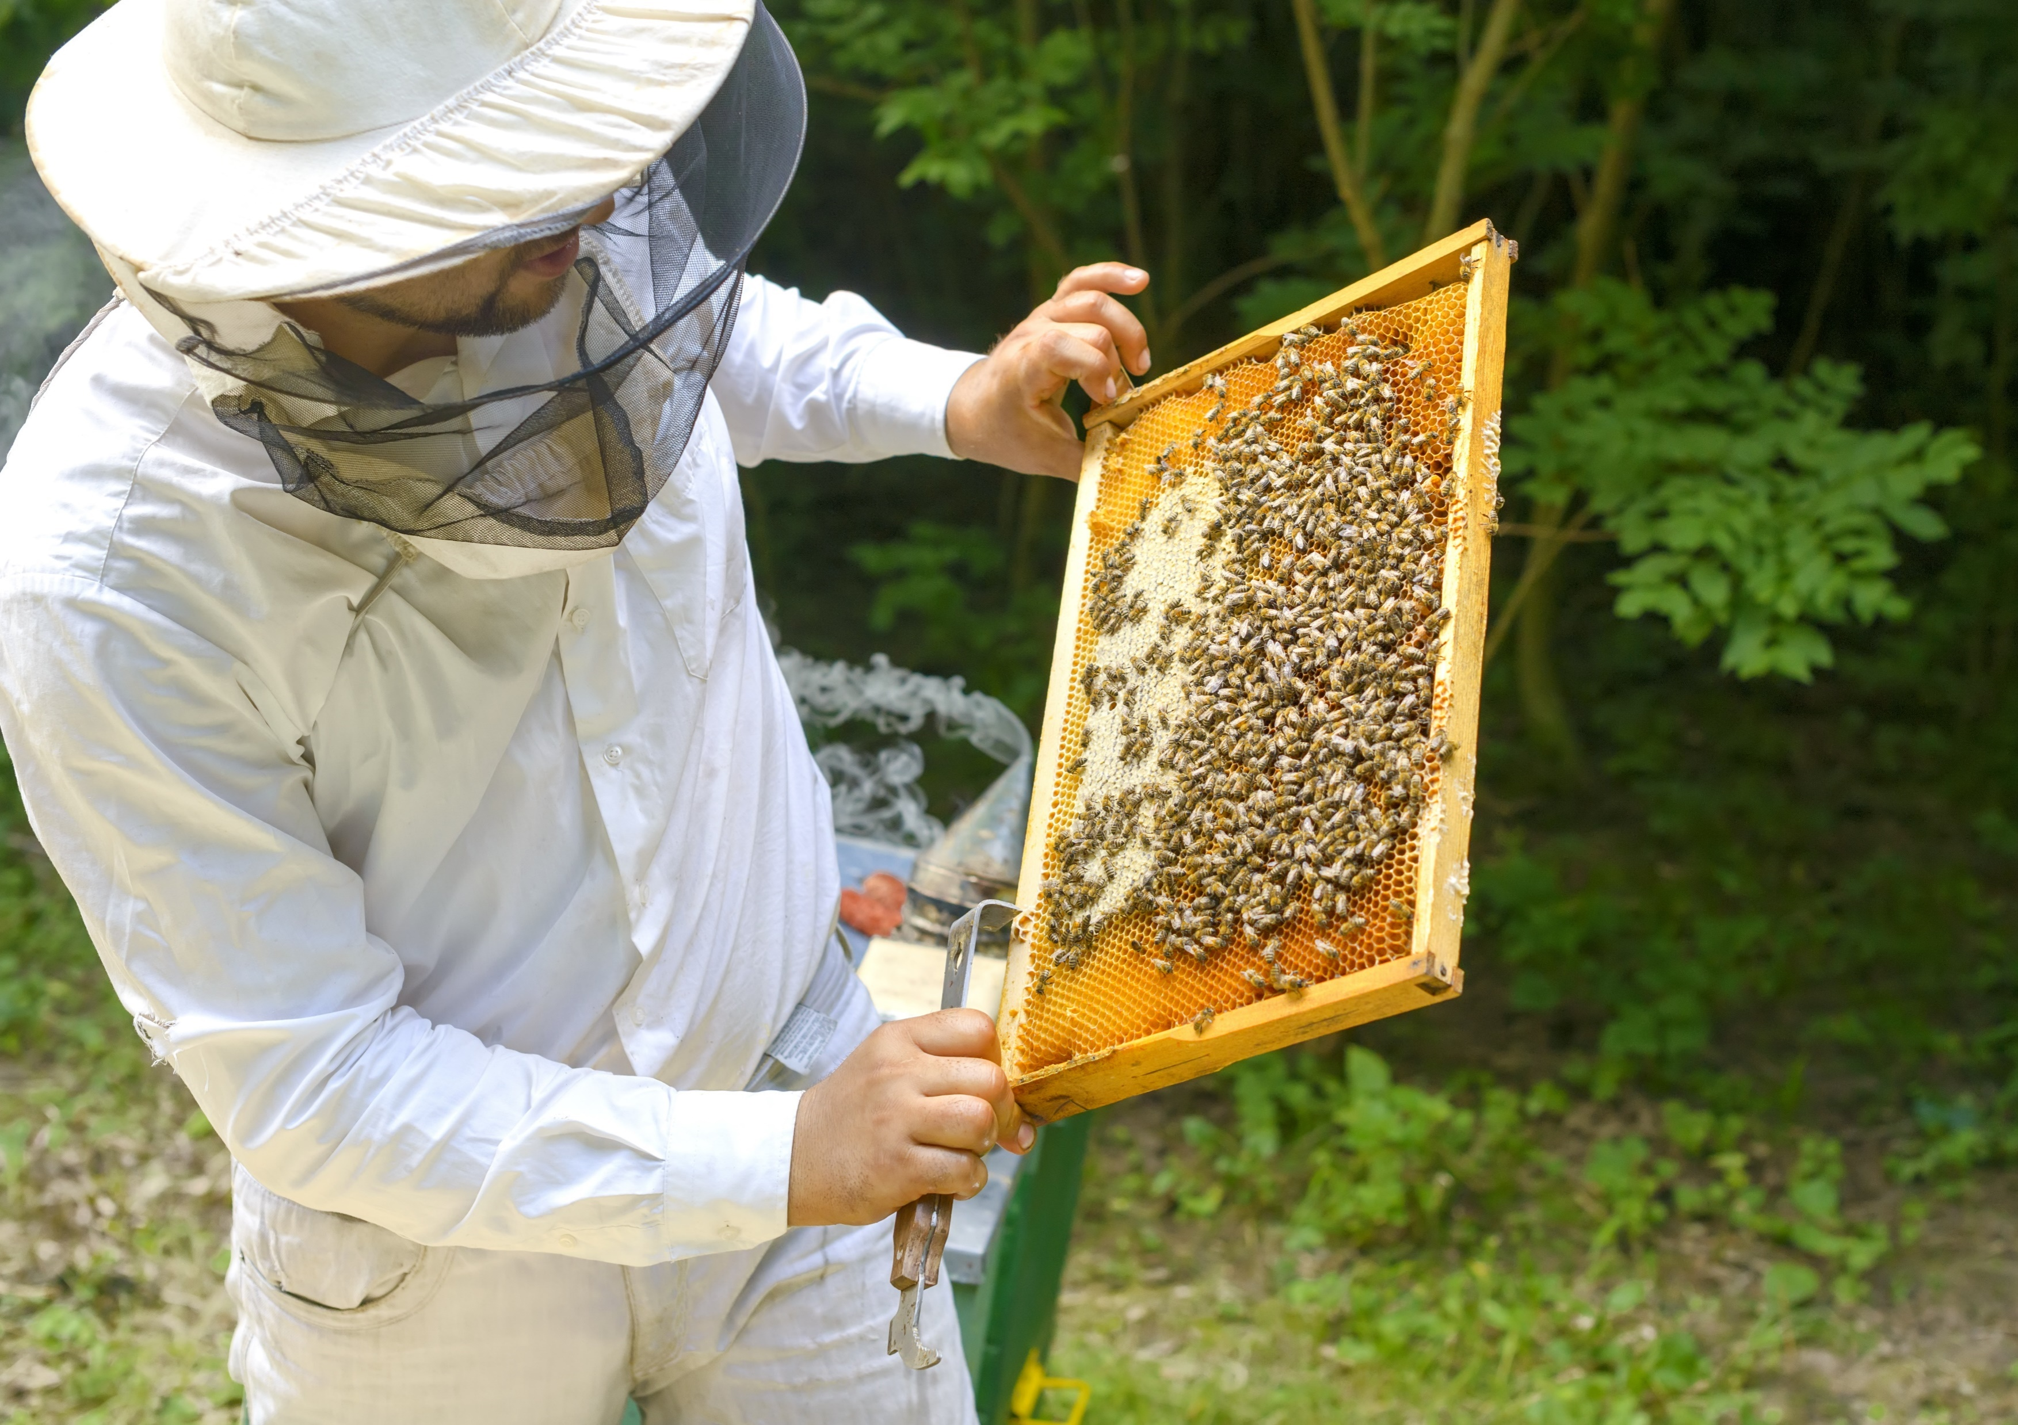
Fun Fact
In order to produce 1 pound of honey, 2 million flowers must be visited. A hive of bees must fly 55,000 miles to produce a pound of honey. One bee colony can produce 60 to 100 pounds of honey per year. An average worker bee makes only about 1/12 teaspoon of honey in its lifetime. That means that it takes twelve bees to make one teaspoon of honey.
www.goldenblossomhoney.com/education_bees.php
Shutterstock.com

Slide 25
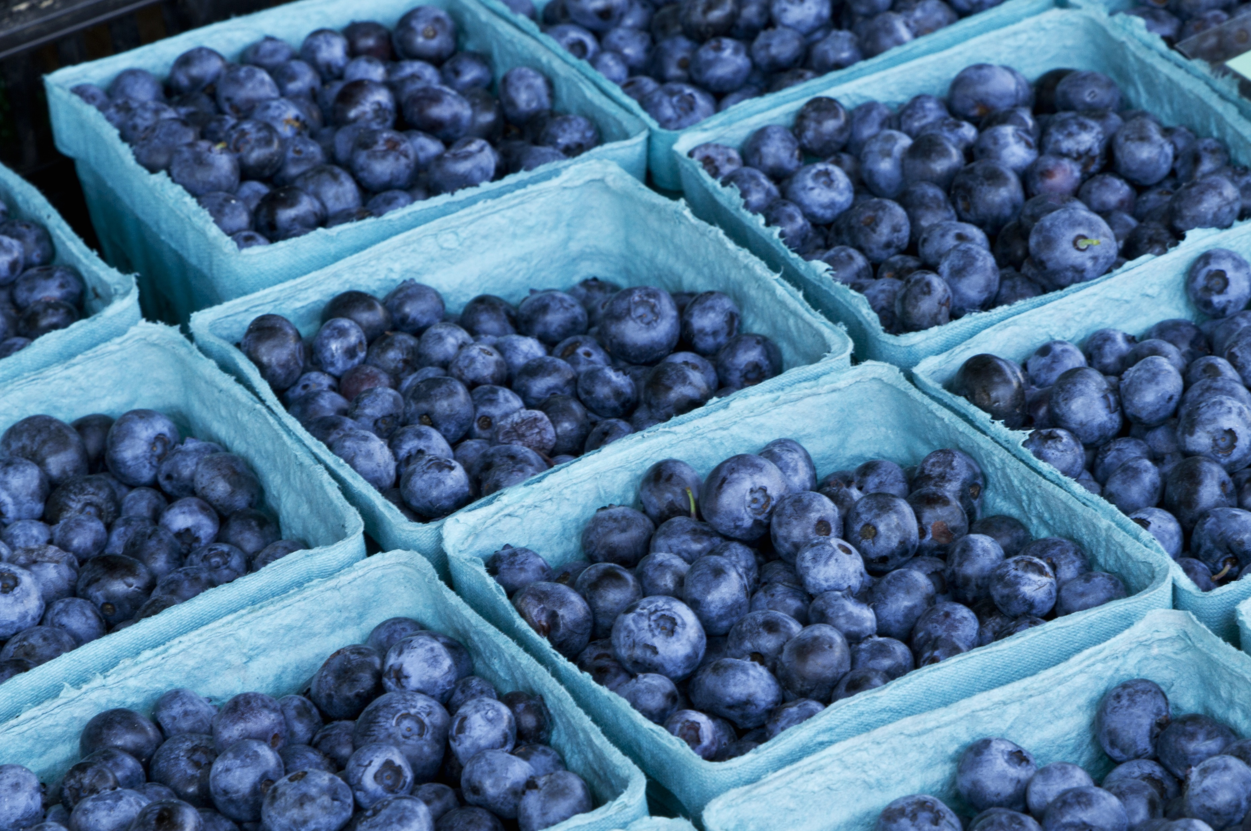
Key Words
very little exposure ready-to-prepare real food
immune system major impact food safety
kill bacteria cook unevenly microwave
cross-contamination clean refrigerator separate
foodborne illness leftovers pathogens
Shutterstock.com

