Slide 1
NICKY FIFTH’S NEW JERSEY
N5NJ
SECONDARY PROGRAM
FITNESS
Relax

Slide 2
Nowadays, it seems like stress levels are through the roof, schedules are bursting at the seams, and relaxation is the long-forgotten art from a long-forgotten time.
Having said that, there is a benefit of some stress. Stress, at a certain level, can keep you alert, keep you on your game, and boost productivity. For stress to work for you, it must be right under the surface, controlled and useful.
Shutterstock.com

Slide 3
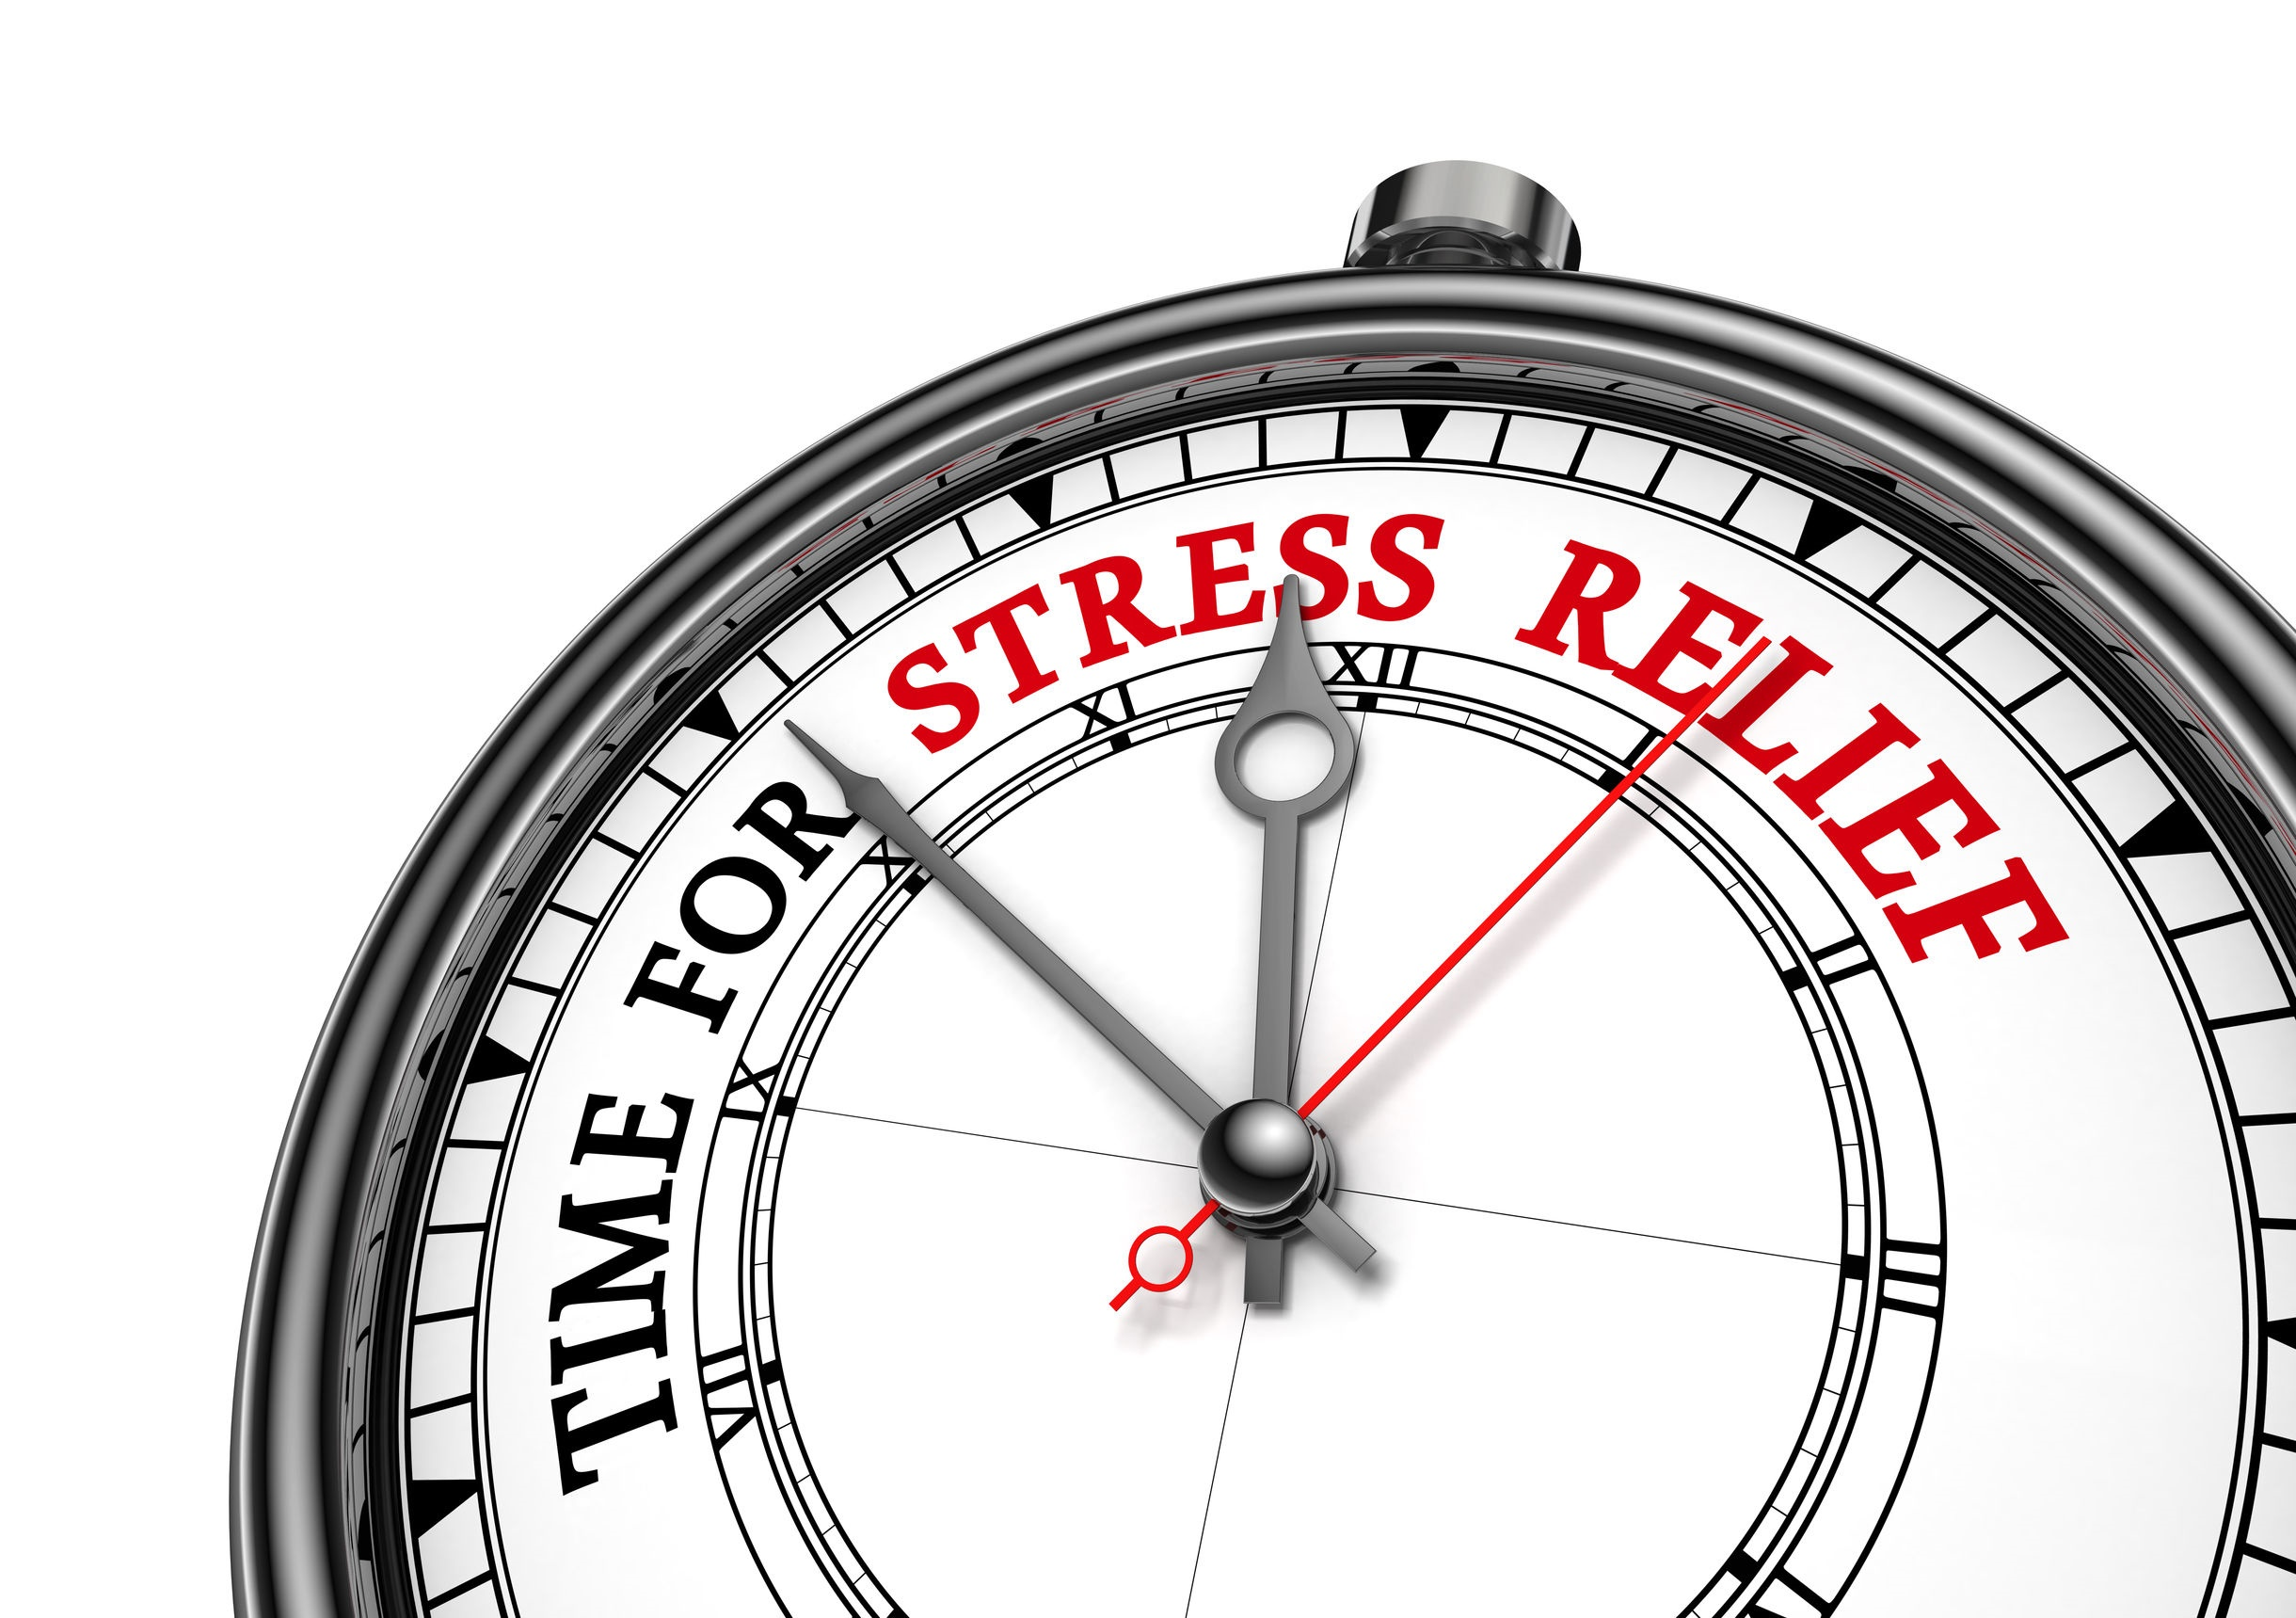
But while it feels good to conquer the day, in the end, it just simply feels better — and is more beneficial to your health — to relax. Some would argue that stress is our biggest health concern, given that it has been linked to so many other complications, from heart problems to dementia. You’ve probably even heard that stress can seriously up your risk of high blood pressure, heart attacks and other heart problems.
http://www.huffingtonpost.com/2014/08/14/stress-awareness-day-relaxation-benefits_n_1424820.html
Shutterstock.com

Slide 4
While researchers aren’t sure exactly why, the research is unanimously in favor of relaxation for your heart’s sake. “There are studies to show that stress is comparable to other risk factors that we traditionally think of as major, like hypertension, poor diet and lack of exercise,” Kathi Heffner, Ph.D., assistant professor of psychiatry at the Rochester Center for Mind-Body Research at the University of Rochester Medical Center in New York, told Health.com.
http://www.huffingtonpost.com/2014/08/14/stress-awareness-day-relaxation-benefits_n_1424820.html
Shutterstock.com

Slide 5
Intense, sudden periods of stress or shock, like a breakup, or even winning the lottery, can trigger such a rush of adrenaline that the heart can’t function properly, resulting in heart failure or heart attack-like symptoms. In the case of a breakup or death of a loved one, this has become known as broken heart syndrome.
http://www.huffingtonpost.com/2014/08/14/stress-awareness-day-relaxation-benefits_n_1424820.htmlv
Shutterstock.com

Slide 6
Now, you may still end up racing to meet deadlines at school today, or handling a stressful personal crisis — life goes on, no matter what kind of day it is.
But relaxing whenever possible, and in whatever way works for you (whether it’s reading a book, taking a walk, meditating, running, you name it!) is healthier for you than you might think. Check out the health benefits of relaxation.
http://www.huffingtonpost.com/2014/08/14/stress-awareness-day-relaxation-benefits_n_1424820.html
Shutterstock.com

Slide 7
Relaxing Can Reduce Your Risk of Catching a Cold
Sheldon Cohen, Ph.D., a psychology professor at Carnegie Mellon University, has been at the forefront of stress research since the 1990s. Early on, he showed that chronic stress lasting more than a month but less than six months doubled a person’s risk of catching a cold. His more recent research has tried to figure out why, and results seem to point to inflammation. It appears that stress hampers the body’s ability to fight inflammation, by making immune cells less sensitive to the hormone that “turns off” inflammation, Healthy Day reported.
http://www.huffingtonpost.com/2014/08/14/stress-awareness-day-relaxation-benefits_n_1424820.html
Shutterstock.com

Slide 8
Relaxing Boosts Your Memory
One study found that, at least in mice, chronic stress impaired the prefrontal cortex, the part of the brain involved in abstract thought, cognitive analysis and detecting the appropriate behavior for a given situation.
Previous research in mice also showed that shorter bursts of stress impaired the centers of the brain involved in memory and learning, and left the mice struggling to remember how to find their way through a maze. A number of studies have also found that stress increases the amount of certain proteins in the brain that have been linked to Alzheimer’s, possibly accelerating the development of the disease.
http://www.huffingtonpost.com/2014/08/14/stress-awareness-day-relaxation-benefits_n_1424820.html
Shutterstock.com

Slide 9
Relaxing Lowers Your Stroke Risk
A 2007 University of Cambridge study found that people who coped the best with stressful life events had a 24 percent lower risk of stroke.
It may be partly due to the fact that people who handle stress well often are healthy in other ways, like exercising regularly and not smoking. A 2011 study examined the specific effects of work-related stress, and found that among middle- and upper-class men, psychological stress caused about 10 percent of strokes.
http://www.huffingtonpost.com/2014/08/14/stress-awareness-day-relaxation-benefits_n_1424820.html
Shutterstock.com

Slide 10
Relaxing Can Keep You Safe From Depression
A 2007 University of Cambridge study found that people who coped the best with stressful life events had a 24 percent lower risk of stroke.
It may be partly due to the fact that people who handle stress well often are healthy in other ways, like exercising regularly and not smoking. A 2011 study examined the specific effects of work-related stress, and found that among middle- and upper-class men, psychological stress caused about 10 percent of strokes.
http://www.huffingtonpost.com/2014/08/14/stress-awareness-day-relaxation-benefits_n_1424820.html
Shutterstock.com

Slide 11
Relaxing Helps You Make Better Decisions
It’s no surprise that when you’re under stress, you might not always be thinking so clearly. But a 2012 study found that stress seems to actually change how we weigh risks and rewards, and can cloud our judgment when we are faced with important decisions. Counterintuitively, stressed-out people actually tend to focus on the positive, and may ignore the cons of the decision they’re about to make, one of the study’s authors, Mara Mather Ph.D., a professor of gerontology and psychology at the University of Southern California, said in a statement. That may also help explain why alcoholics crave a drink more when they’re under pressure. “The compulsion to get that reward becomes stronger and they’re less able to resist it,” Mather said.
http://www.huffingtonpost.com/2014/08/14/stress-awareness-day-relaxation-benefits_n_1424820.html
Shutterstock.com

Slide 12
Relaxing Keeps You Slim
We love a good comfort food every once in a while, but reaching for foods high in fat and sugar too often can pack on the pounds, and stress makes it harder to resist.
Cortisol increases appetite, and may even specifically encourage junk food cravings.
http://www.huffingtonpost.com/2014/08/14/stress-awareness-day-relaxation-benefits_n_1424820.html
Shutterstock.com

Slide 13
Relaxing Eases Acne
It’s a vicious cycle: You’re stressed about that presentation at work, so you break out, and then you’re stressed about the breakout!
Researchers aren’t exactly sure why, but stress seems to up the amount of oil produced by the skin, clogging pores and causing acne, according to WebMD. Flare-ups of other skin problems, like psoriasis, have also been linked to stress, and can be equally stressful themselves. But relaxing really helps: A 1998 study found that psoriasis plaques cleared up more quickly in people who regularly meditated.
http://www.huffingtonpost.com/2014/08/14/stress-awareness-day-relaxation-benefits_n_1424820.html
Shutterstock.com

Slide 14
Relaxation looks different for everyone. One person may enjoy a short nap, another a good book, another an old movie, and yet another a long run with a favorite playlist. It doesn’t matter how you choose to relax, as long as you find some time to kick back and enjoy the benefits of reducing stress.
Shutterstock.com

Slide 15
Key Words
boost productivity relaxation stress
high blood pressure more beneficial meditating
broken heart syndrome hypertension Cortisol
inflammation immune cells positive
boosts Your Memory taking a walk depression
Shutterstock.com

