Slide 1
NICKY FIFTH’S NEW JERSEY
N5NJ
SECONDARY PROGRAM
FITNESS
What’s a Calorie?

Slide 2
Calorie has become a household word, although exactly what a calorie does is a mystery to many. Ask one hundred people what a calorie is and most will tell you it is “the thing in food that makes me fat.”
http://www.superkidsnutrition.com/nw_whatisacalorie/
Shutterstock.com

Slide 3
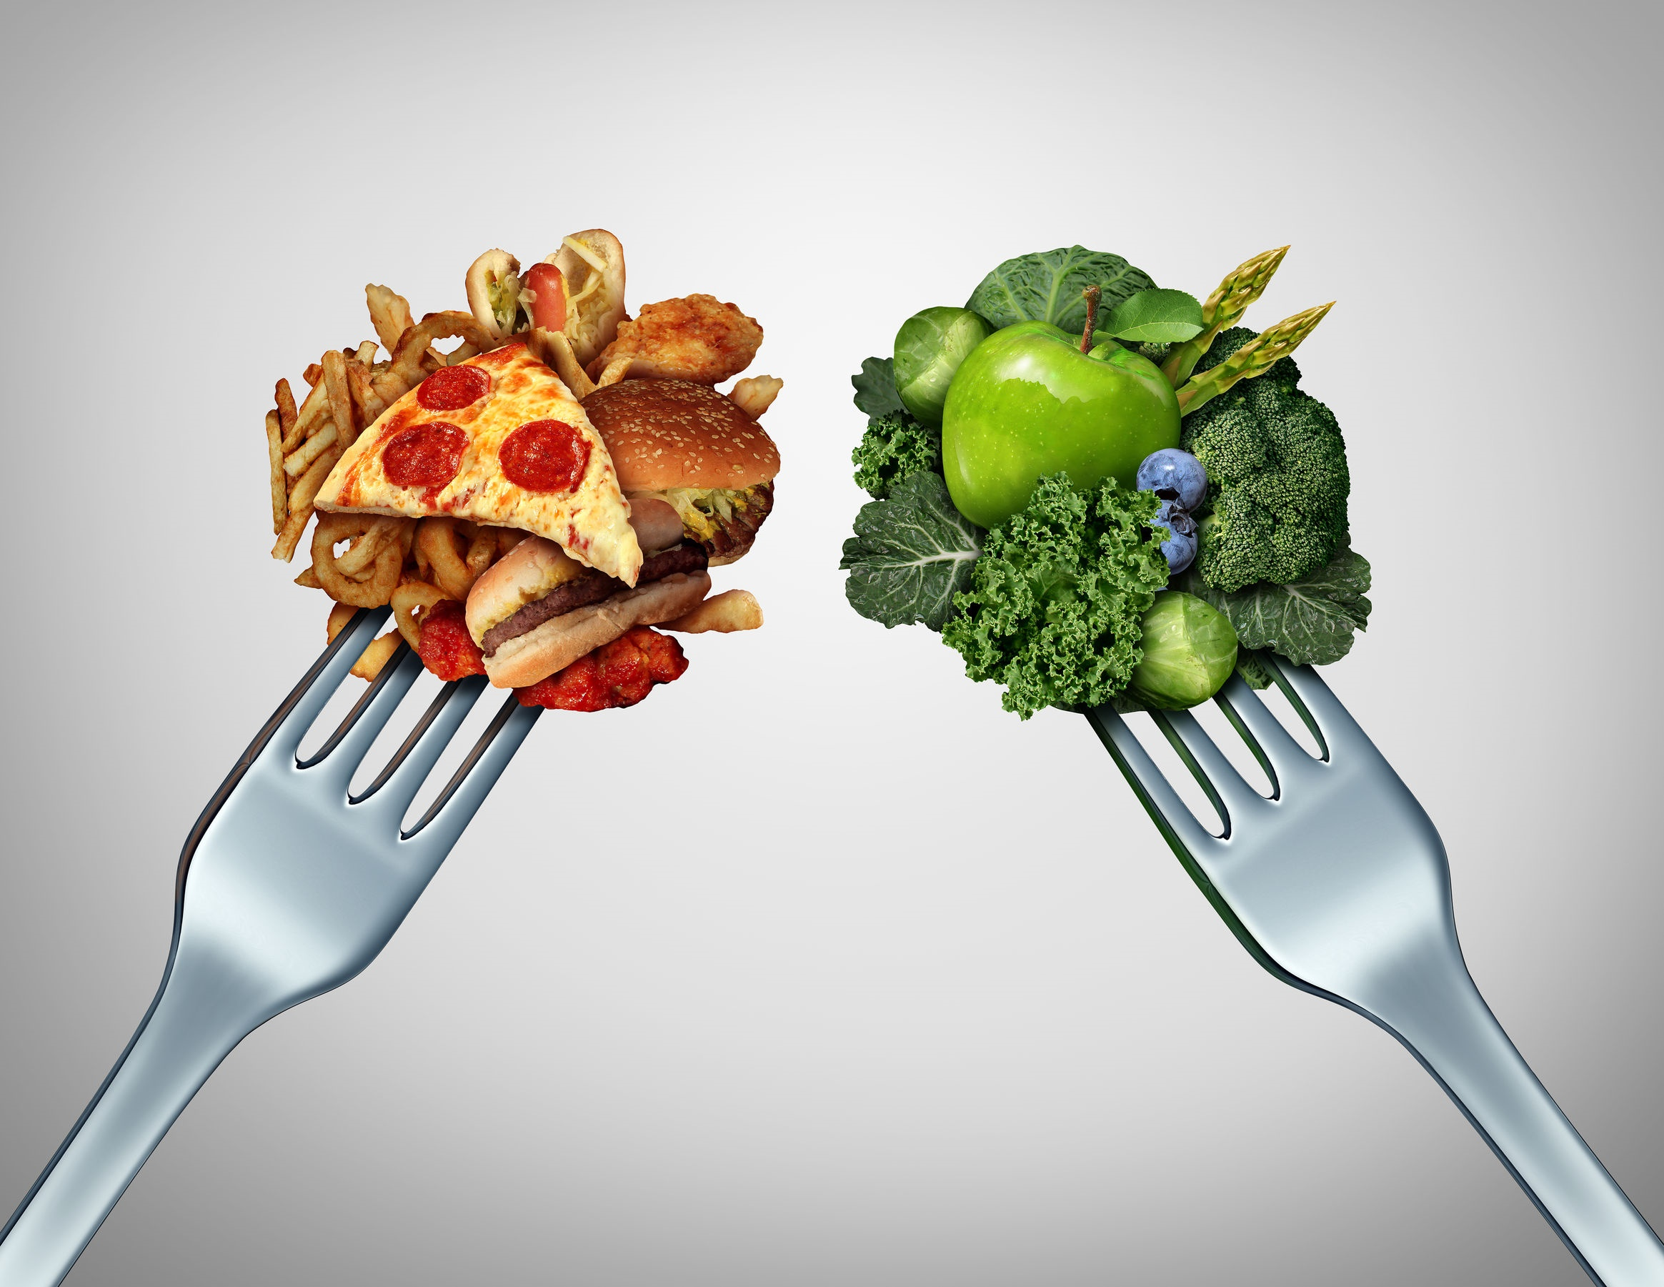
Calories have gotten a bad reputation and are considered by many to be the enemy. Few people truly understand what a calorie is and why it is so important to their bodies.
http://www.superkidsnutrition.com/nw_whatisacalorie/
Shutterstock.com

Slide 4
By definition a calorie is the energy it takes to raise the temperature of 1 gram of water 1 degree Celsius. The important word to take away from this definition is ENERGY.
http://www.superkidsnutrition.com/nw_whatisacalorie/
Shutterstock.com

Slide 5
Calories are ENERGY that fuel our bodies; much like gasoline fuels our cars. Without sufficient calories our heart would not beat, our lungs would not function, and our brain would not work. Many of us have no idea how many calories our body needs just to exist.
http://www.superkidsnutrition.com/nw_whatisacalorie/
Shutterstock.com

Slide 6
In general, an adult body needs at least 1000 to 1400 calories to have enough energy to fuel key organs like the brain, heart, and lungs. This minimum number of calories is called your resting metabolic rate (RMR) and it varies greatly depending on age, sex, weight, and muscle mass.
http://www.superkidsnutrition.com/nw_whatisacalorie/
Shutterstock.com

Slide 7
Shutterstock.com
In order to have enough energy to live your day and be active you need more energy than what’s required from your resting metabolic rate (RMR). This extra energy typically amounts to about 400 to 600 additional calories per day which is the energy you need to move versus just lying still all day. Please note that these numbers are general averages and a Registered Dietitian can help you determine exactly how many calories your body needs. Children’s calories needs vary based on age.
http://www.superkidsnutrition.com/nw_whatisacalorie/

Slide 8
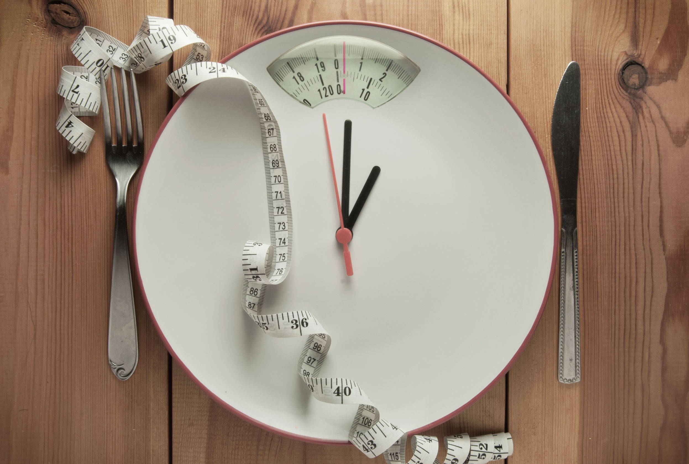
Shutterstock.com
Calories and Weight Gain
If you exceed the number of calories your body requires each day you will eventually gain weight. It takes an excess of 3500 calories to gain 1 lb. of fat. For example, if your body needs 2000 calories a day to maintain its current weight and every day you consume 2500 (one 20 oz Mocha Swirl Latte could add 500 calories) in one week you would gain 1 lb. One day of overindulging does not cause instant weight gain.
http://www.superkidsnutrition.com/nw_whatisacalorie/

Slide 9
Calories and Weight Loss
To lose weight you need to use/burn more calories then you consume. Example: If you eat 2000 calories a day, and are maintaining your weight, you would need to burn 250 calories (30 minutes high impact aerobics for a 150 lb. person) per day to lose a 1/2 lb in one week. If, in addition, you decreased your caloric intake by 250 calories a day (a 20oz soda), a 500 calorie a day total deficit, you could then lose 1 lb per week.
http://www.superkidsnutrition.com/nw_whatisacalorie/
Shutterstock.com

Slide 10
Shutterstock.com
It’s important to remember that although drastically reducing your calories in a short period of time may initially result in dramatic weight loss, the body can rarely continue along this restrictive path, especially if the person is consuming below their resting metabolic rate. Eating later to make up for those missing calories usually results in gaining back the weight lost, plus extra. And, if you force your body to restrict calories for a prolonged amount of time, your metabolism will slow down to compensate–effectively stopping weight loss.
http://www.superkidsnutrition.com/nw_whatisacalorie/

Slide 11
While children are growing, rarely is calorie restriction indicated and only under strict medical and nutritional supervision for children with other health related problems. Overweight children are encouraged to meet with a Registered Dietitian to learn how to eat healthier while growing into their weight.
As with most things in life, moderation is the key. Moderate caloric intake combined with moderate exercise will help you achieve and maintain your natural, healthy weight, and stay there.
http://www.superkidsnutrition.com/nw_whatisacalorie/
Shutterstock.com

Slide 12
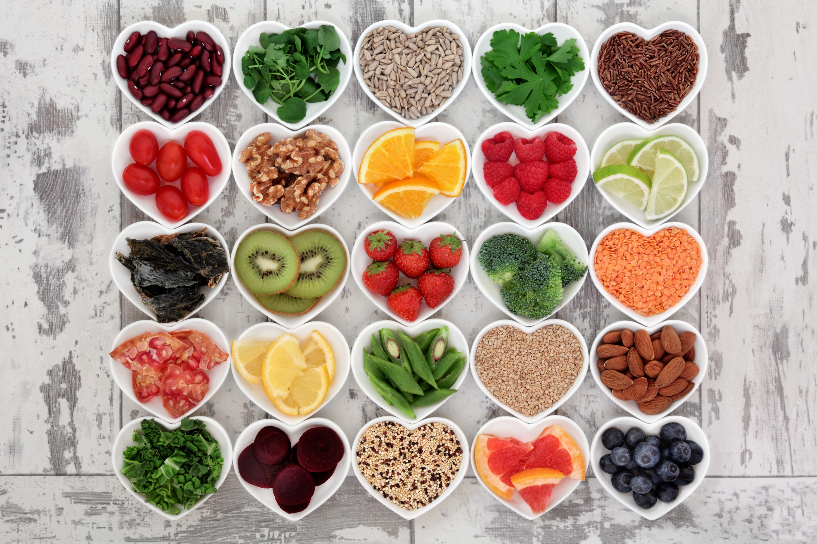
So remember: calories are not the enemy! They are what give us the energy to play with our children, excel in our careers, enjoy our friends and family, and live life to the fullest.
You can’t live without them, but choose healthy foods to make sure your calories are packed with disease fighting nutrients to keep you feeling healthy and young!
http://www.superkidsnutrition.com/nw_whatisacalorie/
Shutterstock.com

Slide 13
Key Words
fuel our bodies calorie energy
fuel key organs extra energy brain
resting metabolic rate muscle mass heart
weight gain body needs lungs
total deficit calorie restriction consume
Shutterstock.com

