Slide 1
NICKY FIFTH’S NEW JERSEY
N5NJ
SECONDARY PROGRAM
ENTREPRENEUR
Bank Services

Slide 2
A bank is an institution that is set up for lending, borrowing, issuing, exchanging , taking deposits, safeguarding, or handling money under the laws and guidelines of the country, state, or municipal jurisdiction in which it is located.
http://moneymatters101.com/banking/
Shutterstock.com

Slide 3
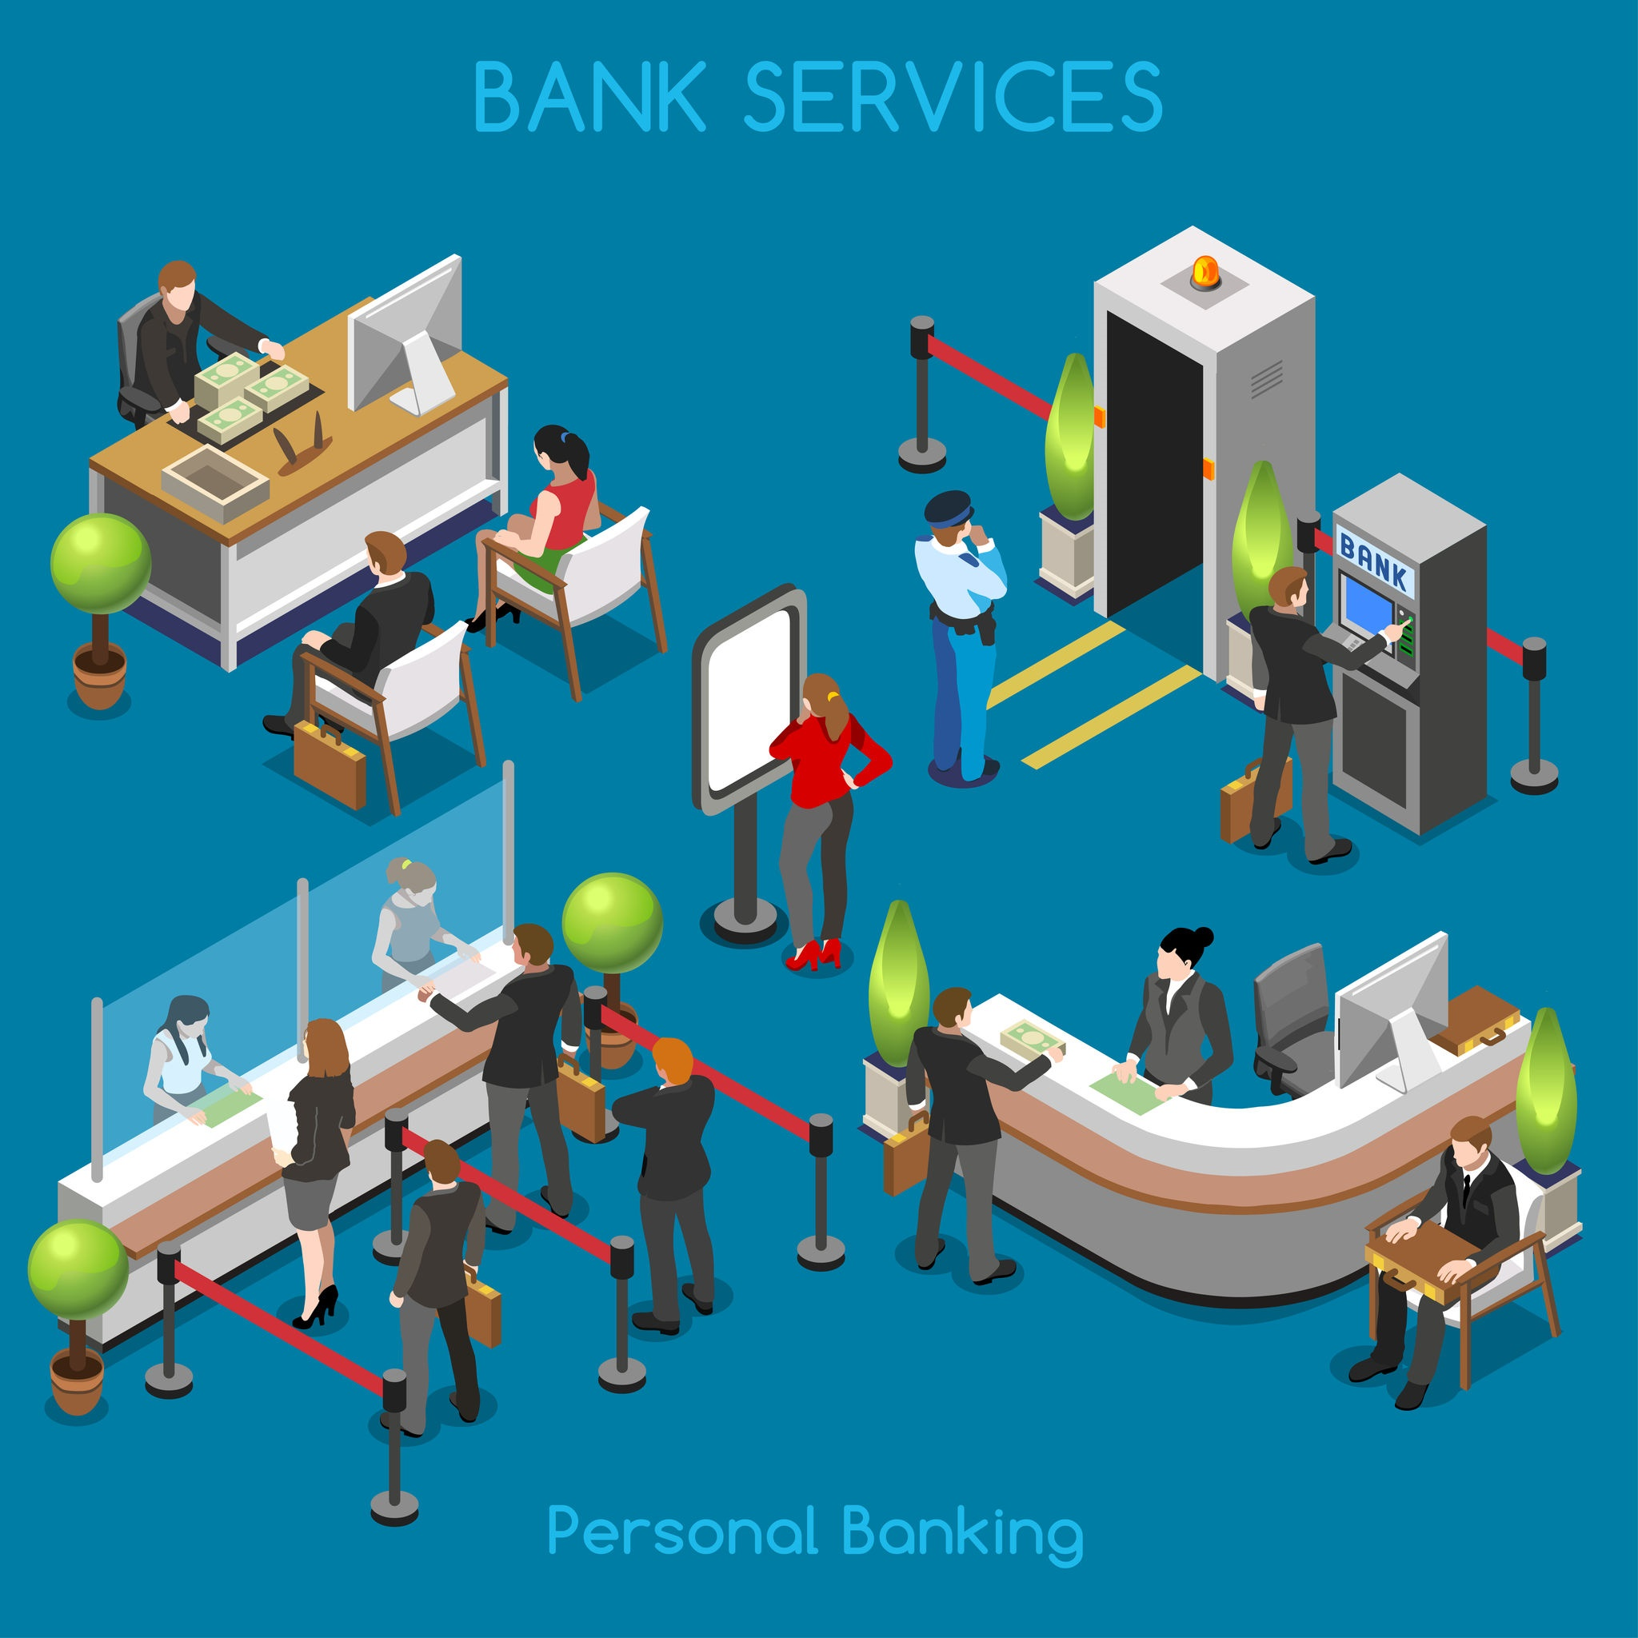
Banks provide an array of services and benefits such as checking accounts and savings accounts, credit cards, ATM machines, home loans, business loans, and equity lines of credit.
http://moneymatters101.com/banking/
Shutterstock.com

Slide 4
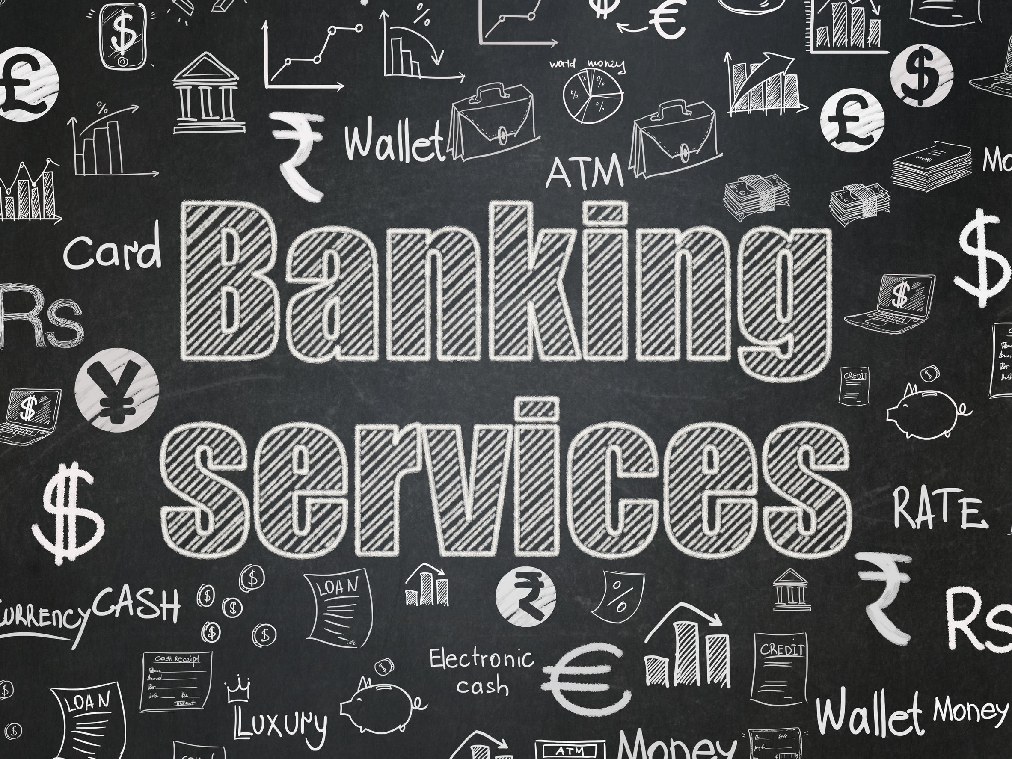
Banks are in business to offer general services to individuals, corporations, and to other businesses, whether the business is large or small.
http://moneymatters101.com/banking/
Shutterstock.com

Slide 5
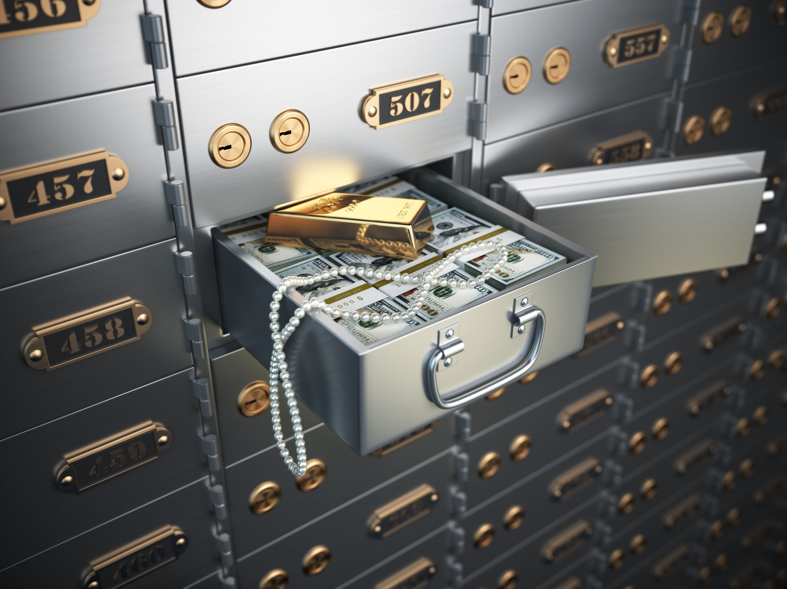
Banks offer safe deposit boxes, electronic banking, electronic transfers of funds, cashiers checks and drafts, manage endowment funds and trust accounts, as well as other banking and related services.
http://moneymatters101.com/banking/
Shutterstock.com

Slide 6
Most people do business with banks because it is a reasonably safe way to save money, pay their bills with checks, and to have use of their money when they need it. Banks can issue credit, deny credit, give loans on homes, farms, and ranches, and make loans to businesses for the purchase of inventory and to meet their payrolls.
http://moneymatters101.com/banking/
Shutterstock.com

Slide 7
Lending money is what banks do. Banks have always been a good source of loans for the purchase of homes, farms, businesses, cars, boats, and other necessities.
http://moneymatters101.com/banking/
Shutterstock.com

Slide 8
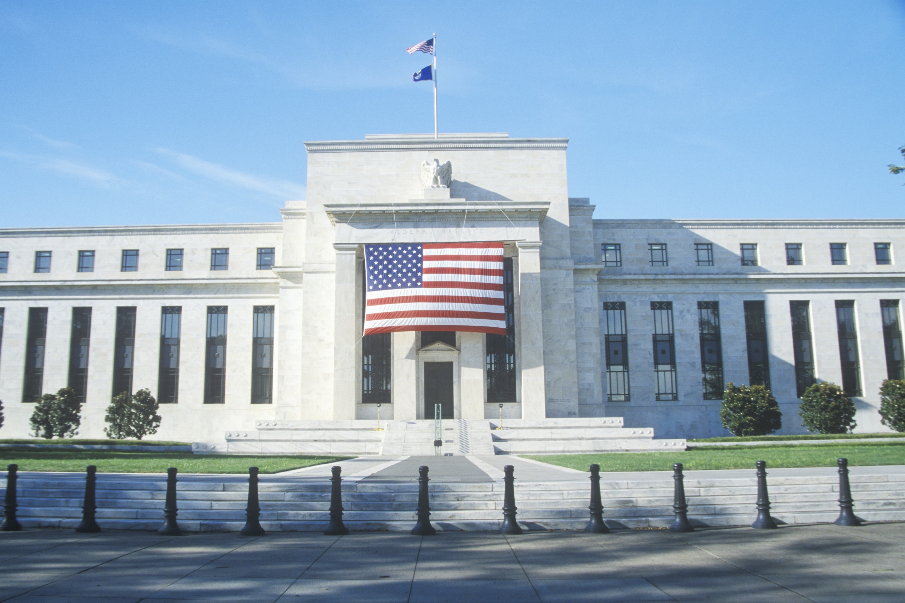
Banks in the United States are regulated by federal and state laws and must follow the guidelines and federal monetary policies set by the Federal Reserve Board. The Federal Deposit Insurance Corporation (FDIC) offers protection by insuring deposits up to $250,000 per account in member banks and savings and loan institutions, so most bank accounts are safe.
http://moneymatters101.com/banking/
Shutterstock.com

Slide 9
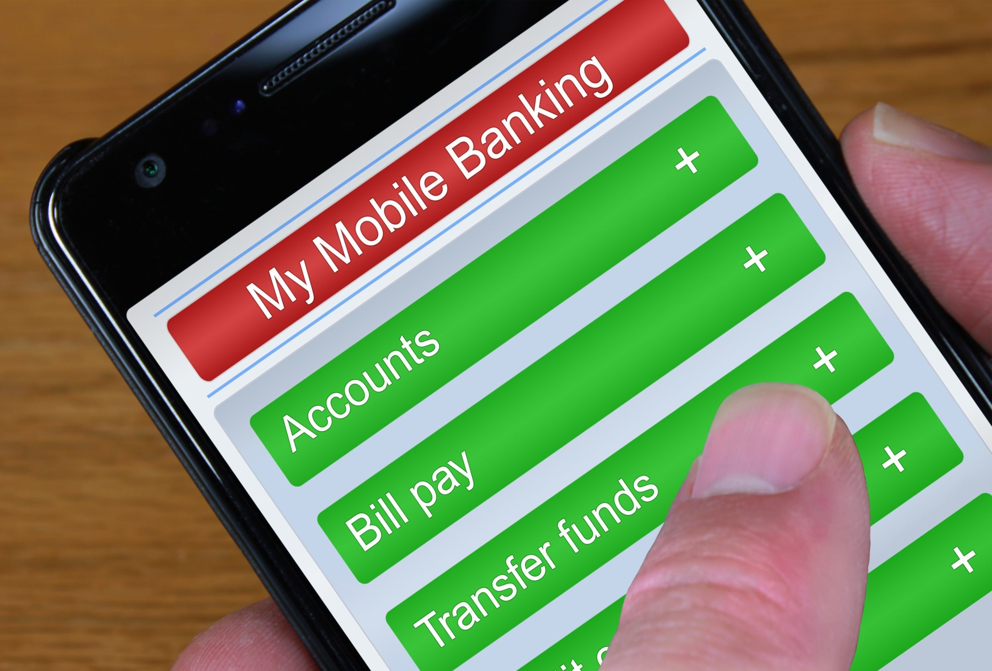
Banks offer different services and some specialize in certain aspects of the banking industry.
Some banks are small and localized, others operate regionally, while some operate nationally and/or internationally.
The fees and costs to do business with banks vary, also. There are differences in interest rates charged for loans and on credit cards, as well as the amount of interest paid on savings accounts, certificates of deposits (CDs), treasury bills (T-bills), and other services that banks offer.
http://moneymatters101.com/banking/
Shutterstock.com

Slide 10
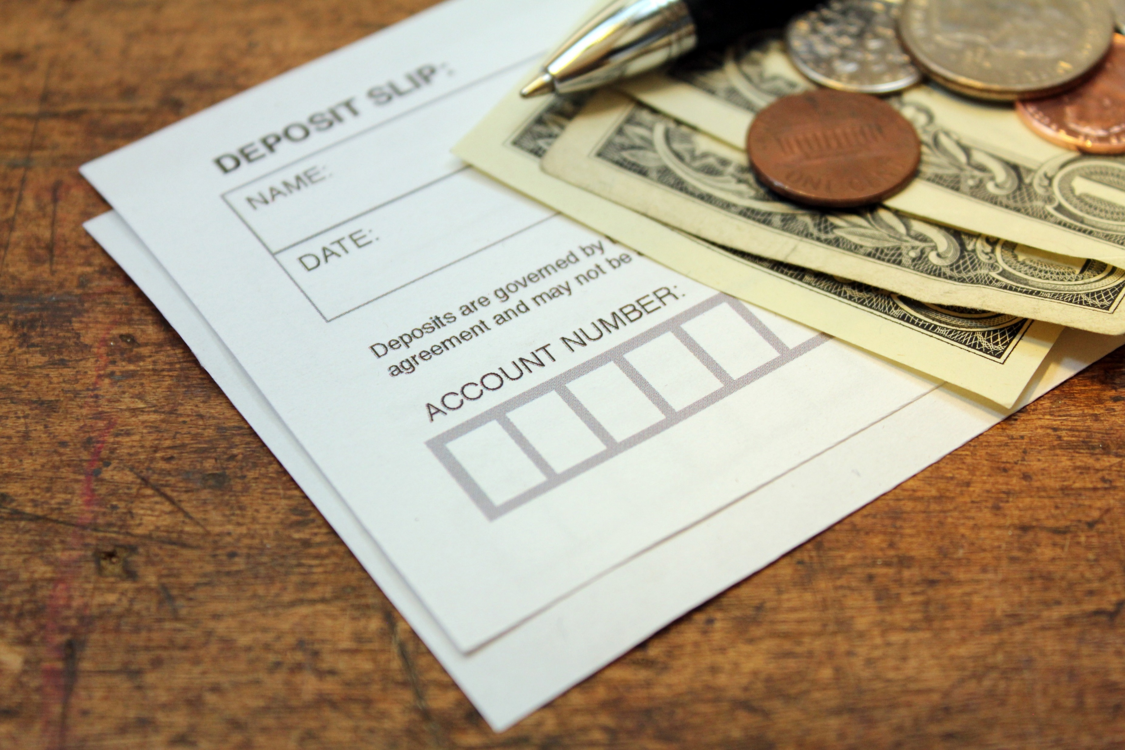
When you give your money to a bank, it’s called a deposit. Banks keep your money safe, and, more importantly, banks will pay you for every dollar you keep in a savings account! The money the bank pays you is called interest. The bank will pay you interest every month you keep the money in your savings account.
http://www.themint.org/kids/how-banks-work.html
Shutterstock.com

Slide 11
If people don’t have enough money saved up to buy something, they often borrow money from the bank to buy big things, like houses and cars. The banks lend them the money to buy these things, but the banks expect people to pay the money back AND pay the bank a little extra money, besides. That’s the interest on the loan and the amount varies.
Let’s say you borrowed $10 from a bank. You get the $10 right away. But when you pay back the $10, the bank will charge you $1 or $2 extra for giving you the money when you needed it. So you pay the bank $11 or $12. That’s how banks earn money.
Without money from people like you, banks wouldn’t have any money to lend. That’s why banks will pay you interest.
http://www.themint.org/kids/how-banks-work.html
Shutterstock.com

Slide 12
Every month, the bank pays you for keeping money in your savings account. And over time, that extra money really adds up.
Imagine if your parents gave you $100 for your birthday every year for ten years. If you keep the money at home, you’d have $1,000. But if you put it in a savings account, in ten years you might have $1,100 or even more. That’s an extra $100, and you didn’t have to lift a finger. That’s why it pays to open up a savings account.
http://www.themint.org/kids/how-banks-work.html
Shutterstock.com

Slide 13
With so many different kinds of banks and so many services offered, there is commonality: banks are a vital aspect of our economy and necessary for our long-term goals as well as our day-to-day lives.
Shutterstock.com

Slide 14
Key Words
institution ATM machines lending
taking deposits handling money interest
array of services checking accounts loans
safe deposit boxes savings accounts credit cards
issue credit electronic banking borrowing
Shutterstock.com

