Slide 1
NICKY FIFTH’S NEW JERSEY
N5NJ
SECONDARY PROGRAM
ENTREPRENEUR
Cash Poor

Slide 2
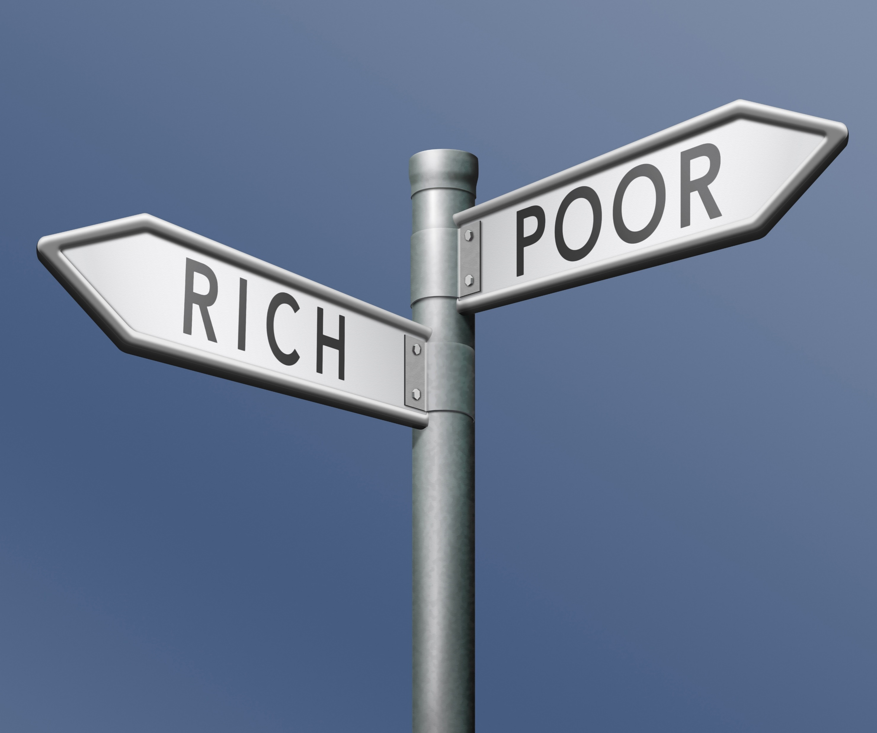
A frequently used, often misunderstood, financial expression is cash poor. While some interpret this to mean someone is basically poor and lacking cash, it actually means the opposite.
Shutterstock.com

Slide 3
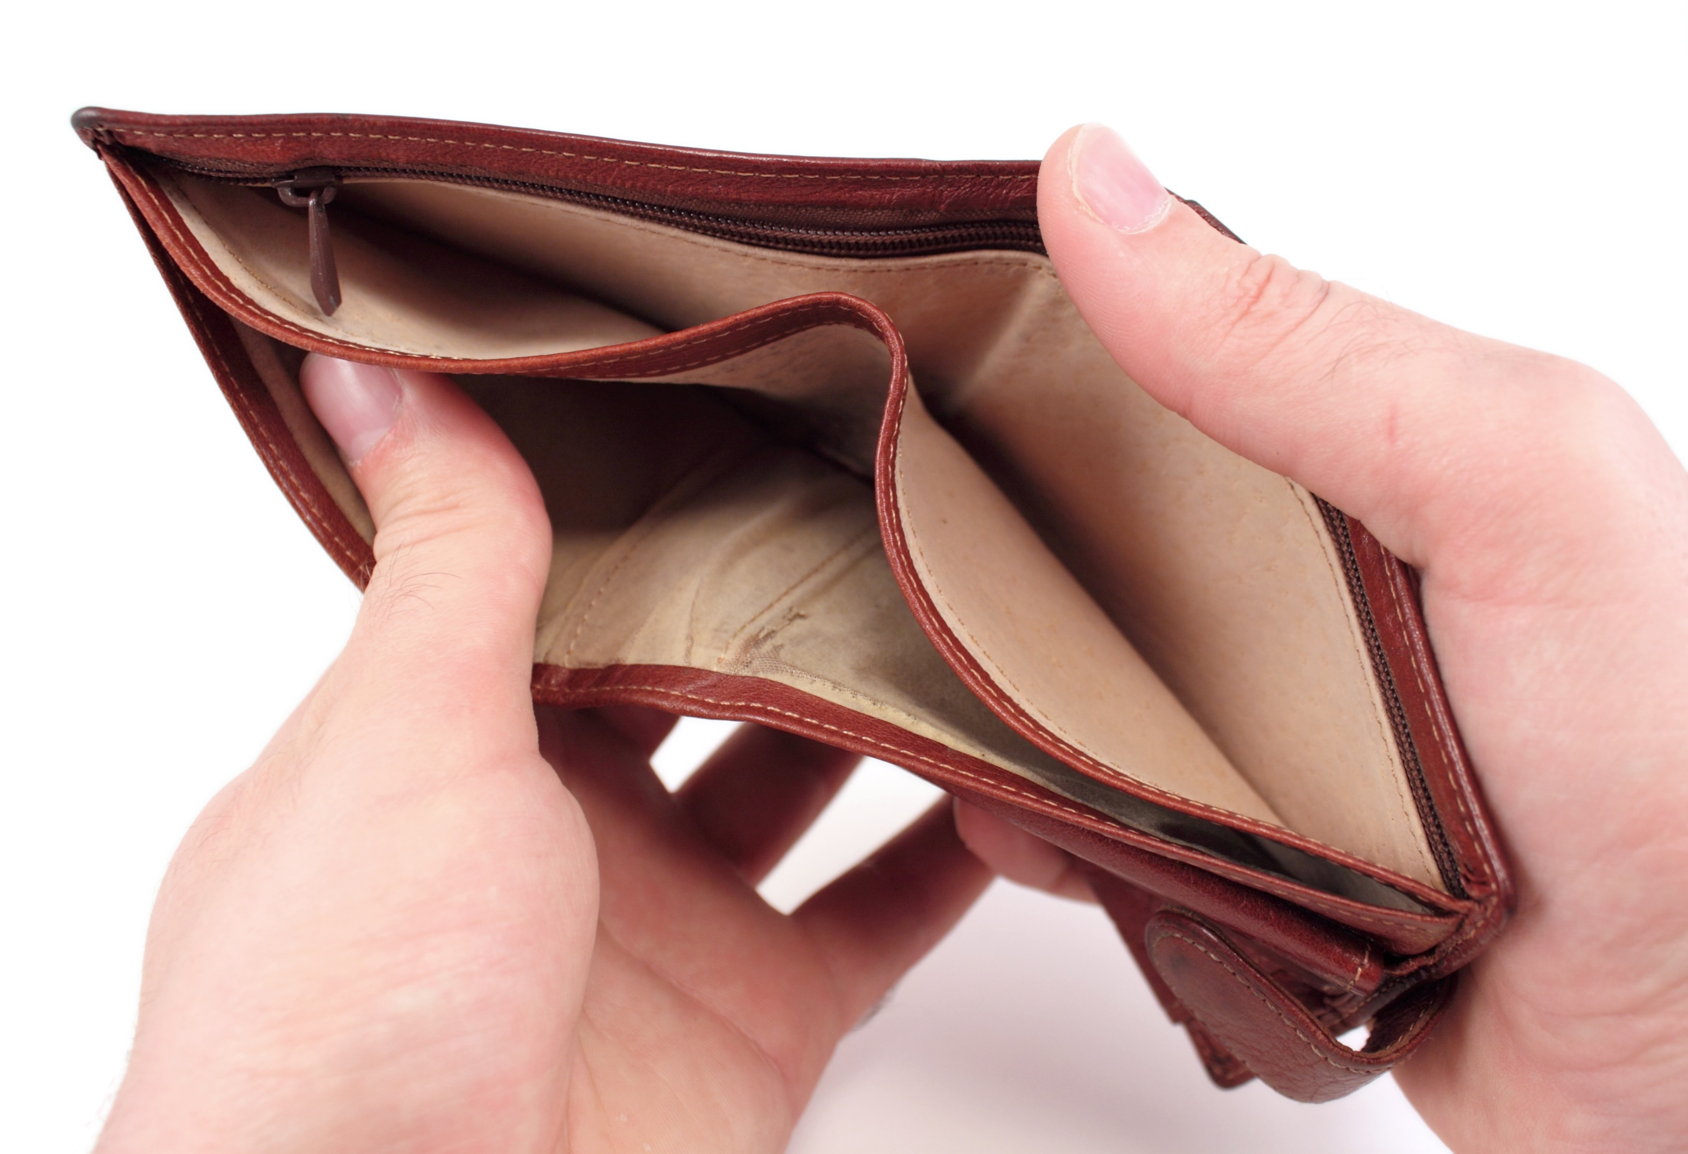
Someone considered cash poor usually has valuable assets, such as a large home or a business. While that asset may be very valuable, they spend most of their available cash on it. The result is limited available funds, often called liquid assets.
Shutterstock.com

Slide 4
Before the housing market crash of 2008, it was considered smart to buy the biggest house with the least amount of money. In fact, many consumers were encouraged to purchase homes they could barely afford, or could not afford at all.
Shutterstock.com

Slide 5
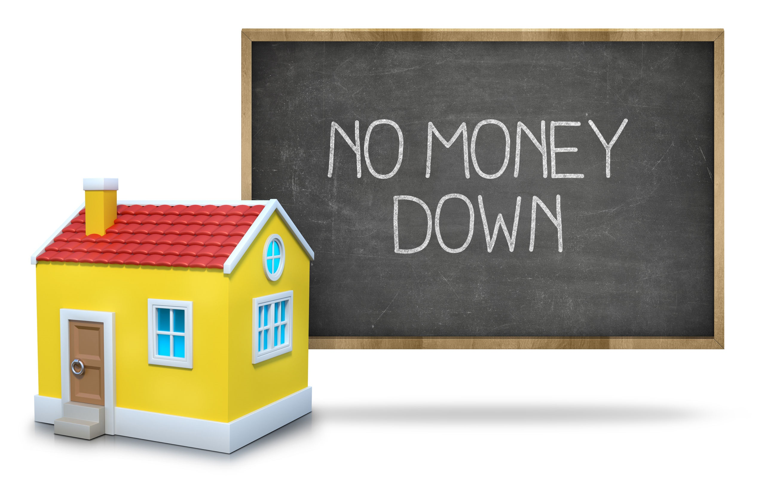
Rules and regulations that guided how much a homeowner could borrow were loosened and many people bought much bigger and more expensive homes than they should have.
Shutterstock.com

Slide 6
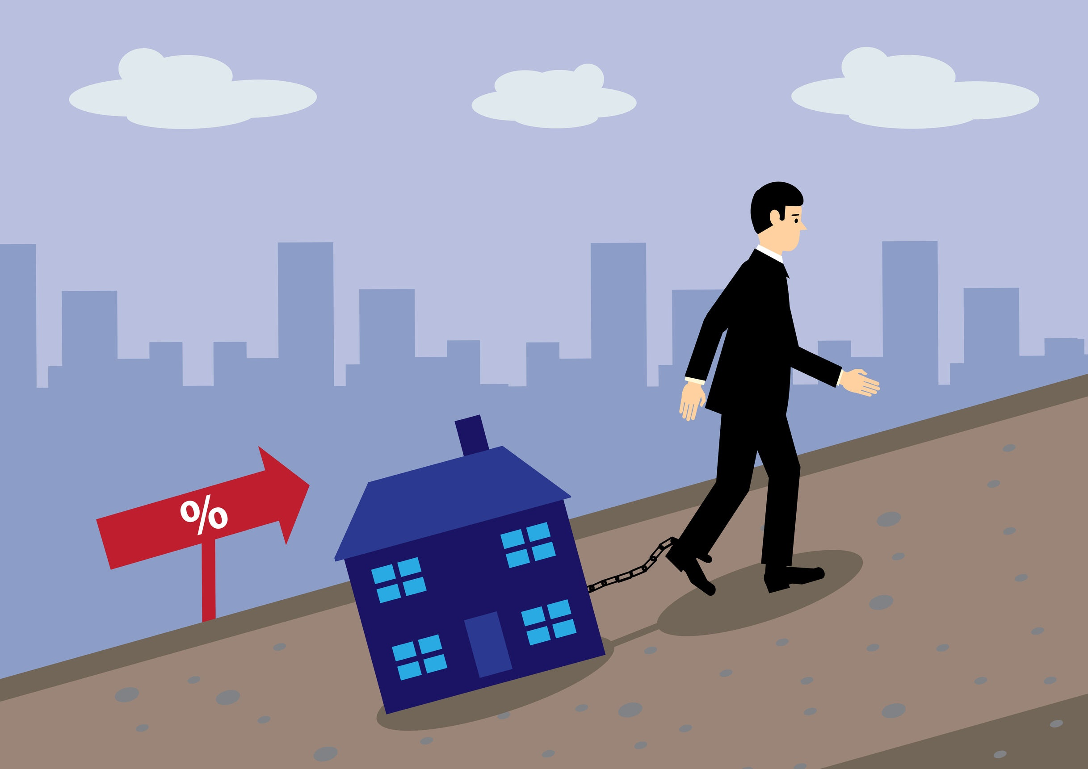
While their home may appear to be a sizable asset, there were two problems with this scenario. You see, until you have paid off the mortgage on your home, it’s not really your asset. The bank holds the deed until the loan is satisfied.
Second, people took out such large loans that they had little money left over for necessities, or saving – they were chained to their house. This became a national recipe for disaster.
Shutterstock.com

Slide 7
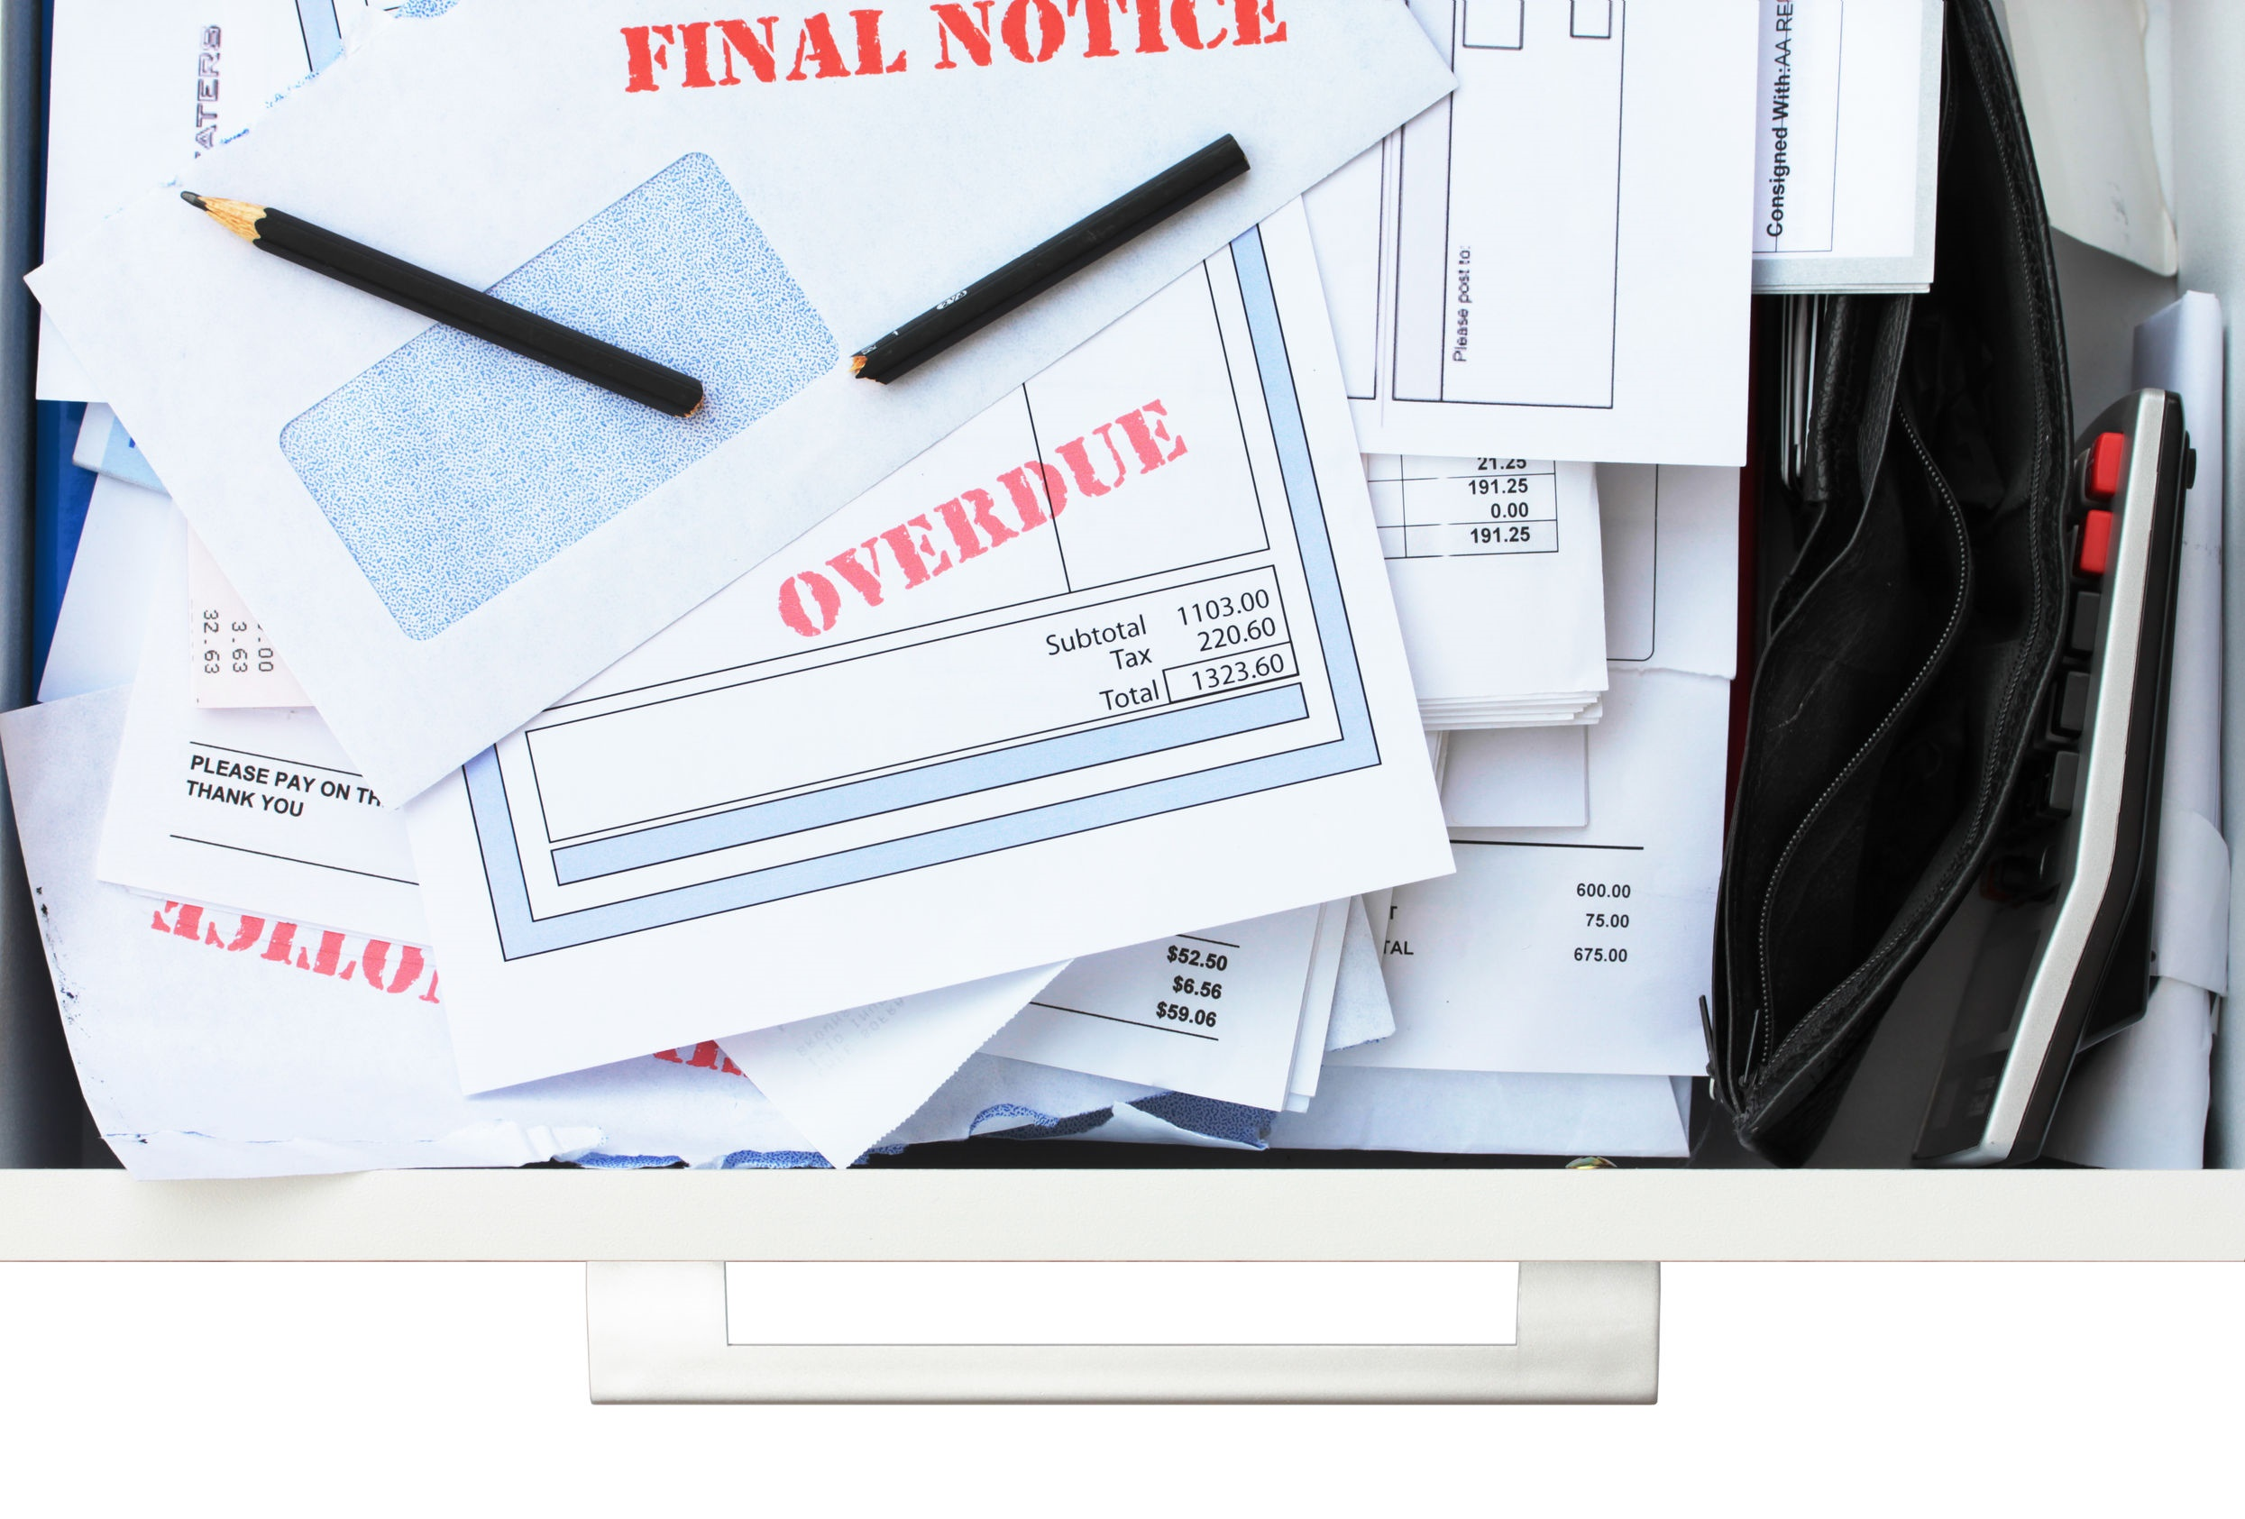
House rich and cash poor is often used to describe people who have acquired so large a house payment that they can’t meet basic needs in other budget categories. According to the U.S. Census Bureau, the average monthly housing cost for homeowners was $1,505 in 2009, with 38% of homeowners spending more than 30% of their income on housing.
http://www.thedigeratilife.com/blog/house-rich-cash-poor/
Shutterstock.com

Slide 8
Another way cash poor is often described is living above your means or over your head. Basically, you are spending more than you can afford. And it doesn’t have to be a house; it can be a car, or even college. If the monthly car payment uses the majority of your monthly income, you will be forced to sacrifice other things, including savings. You even run the risk of not having enough money for gas.
Shutterstock.com

Slide 9
College, can also render you cash poor. If you select a very expensive college that you cannot afford and take out excessive loans, the majority of your income may be dedicated to repaying those loans.
One mistake many prospective students make is assuming they will automatically find a well-paying career immediately after college. When that doesn’t happen, it places an enormous amount of pressure on a new graduate and limits their choices for housing, transportation, and even recreation.
Shutterstock.com

Slide 10
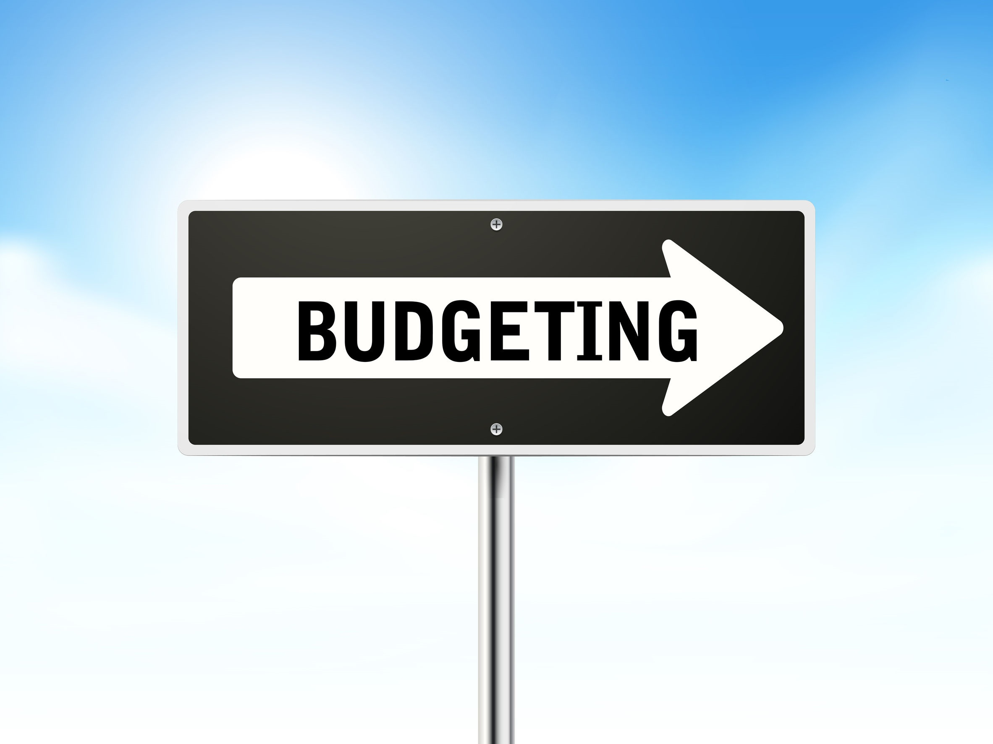
To avoid being cash poor, adhere to the following steps:
Realistically Analyze Your Budget
The key word here is realistic. Do not count on money you haven’t earned or jobs you haven’t secured. Know exactly what your income and expenses are and don’t forget overlooked items such as gas, lunches, gifts, or even spending money.
Shutterstock.com

Slide 11
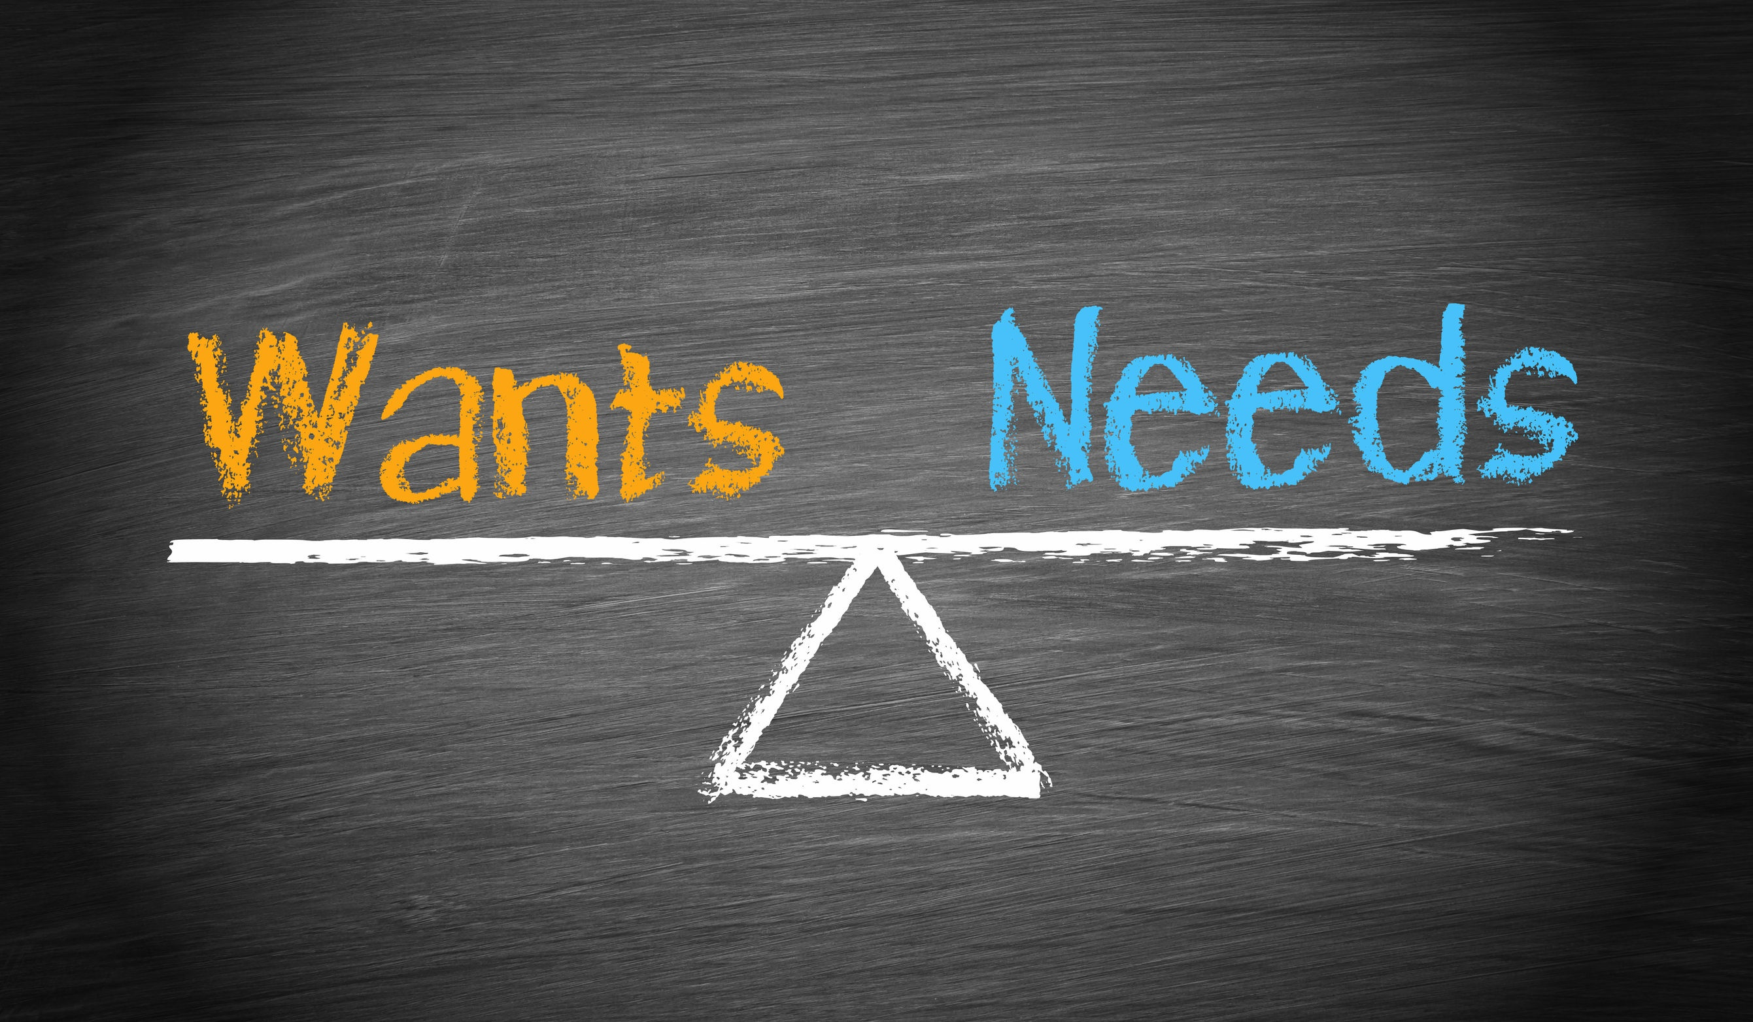
Identify Wants and Needs
We’d all like to have nice things, but they’re not worth if it having them negatively impacts our lives. A car is a need, but a brand new sports cars isn’t. The monthly payment on that car, in addition to the insurance, may be so high that you won’t be able to afford other necessities.
Shutterstock.com

Slide 12
Alternatives and Choices
You may have had your heart set on attending your dream college since you were five years old, however, you now know how expensive it is. This is where maturity must come into play. Rather than wind up with excessive college loans, explore your other choices:
-Community College
-State School
-Commute
-Attend Part-time
The goal shouldn’t be where you attend, but that your choices are as smart as possible.
Shutterstock.com

Slide 13
Buy Now, Pay Now
If there’s something you really want, save the money and then buy it.
Years ago, most stores offered lay-away. You selected the items you would like to purchase and the store held them for you while you made weekly payments.
You didn’t get the merchandise until the bill was paid. This was a great idea because it made people think about what they were spending and it taught them to wait.
Shutterstock.com

Slide 14
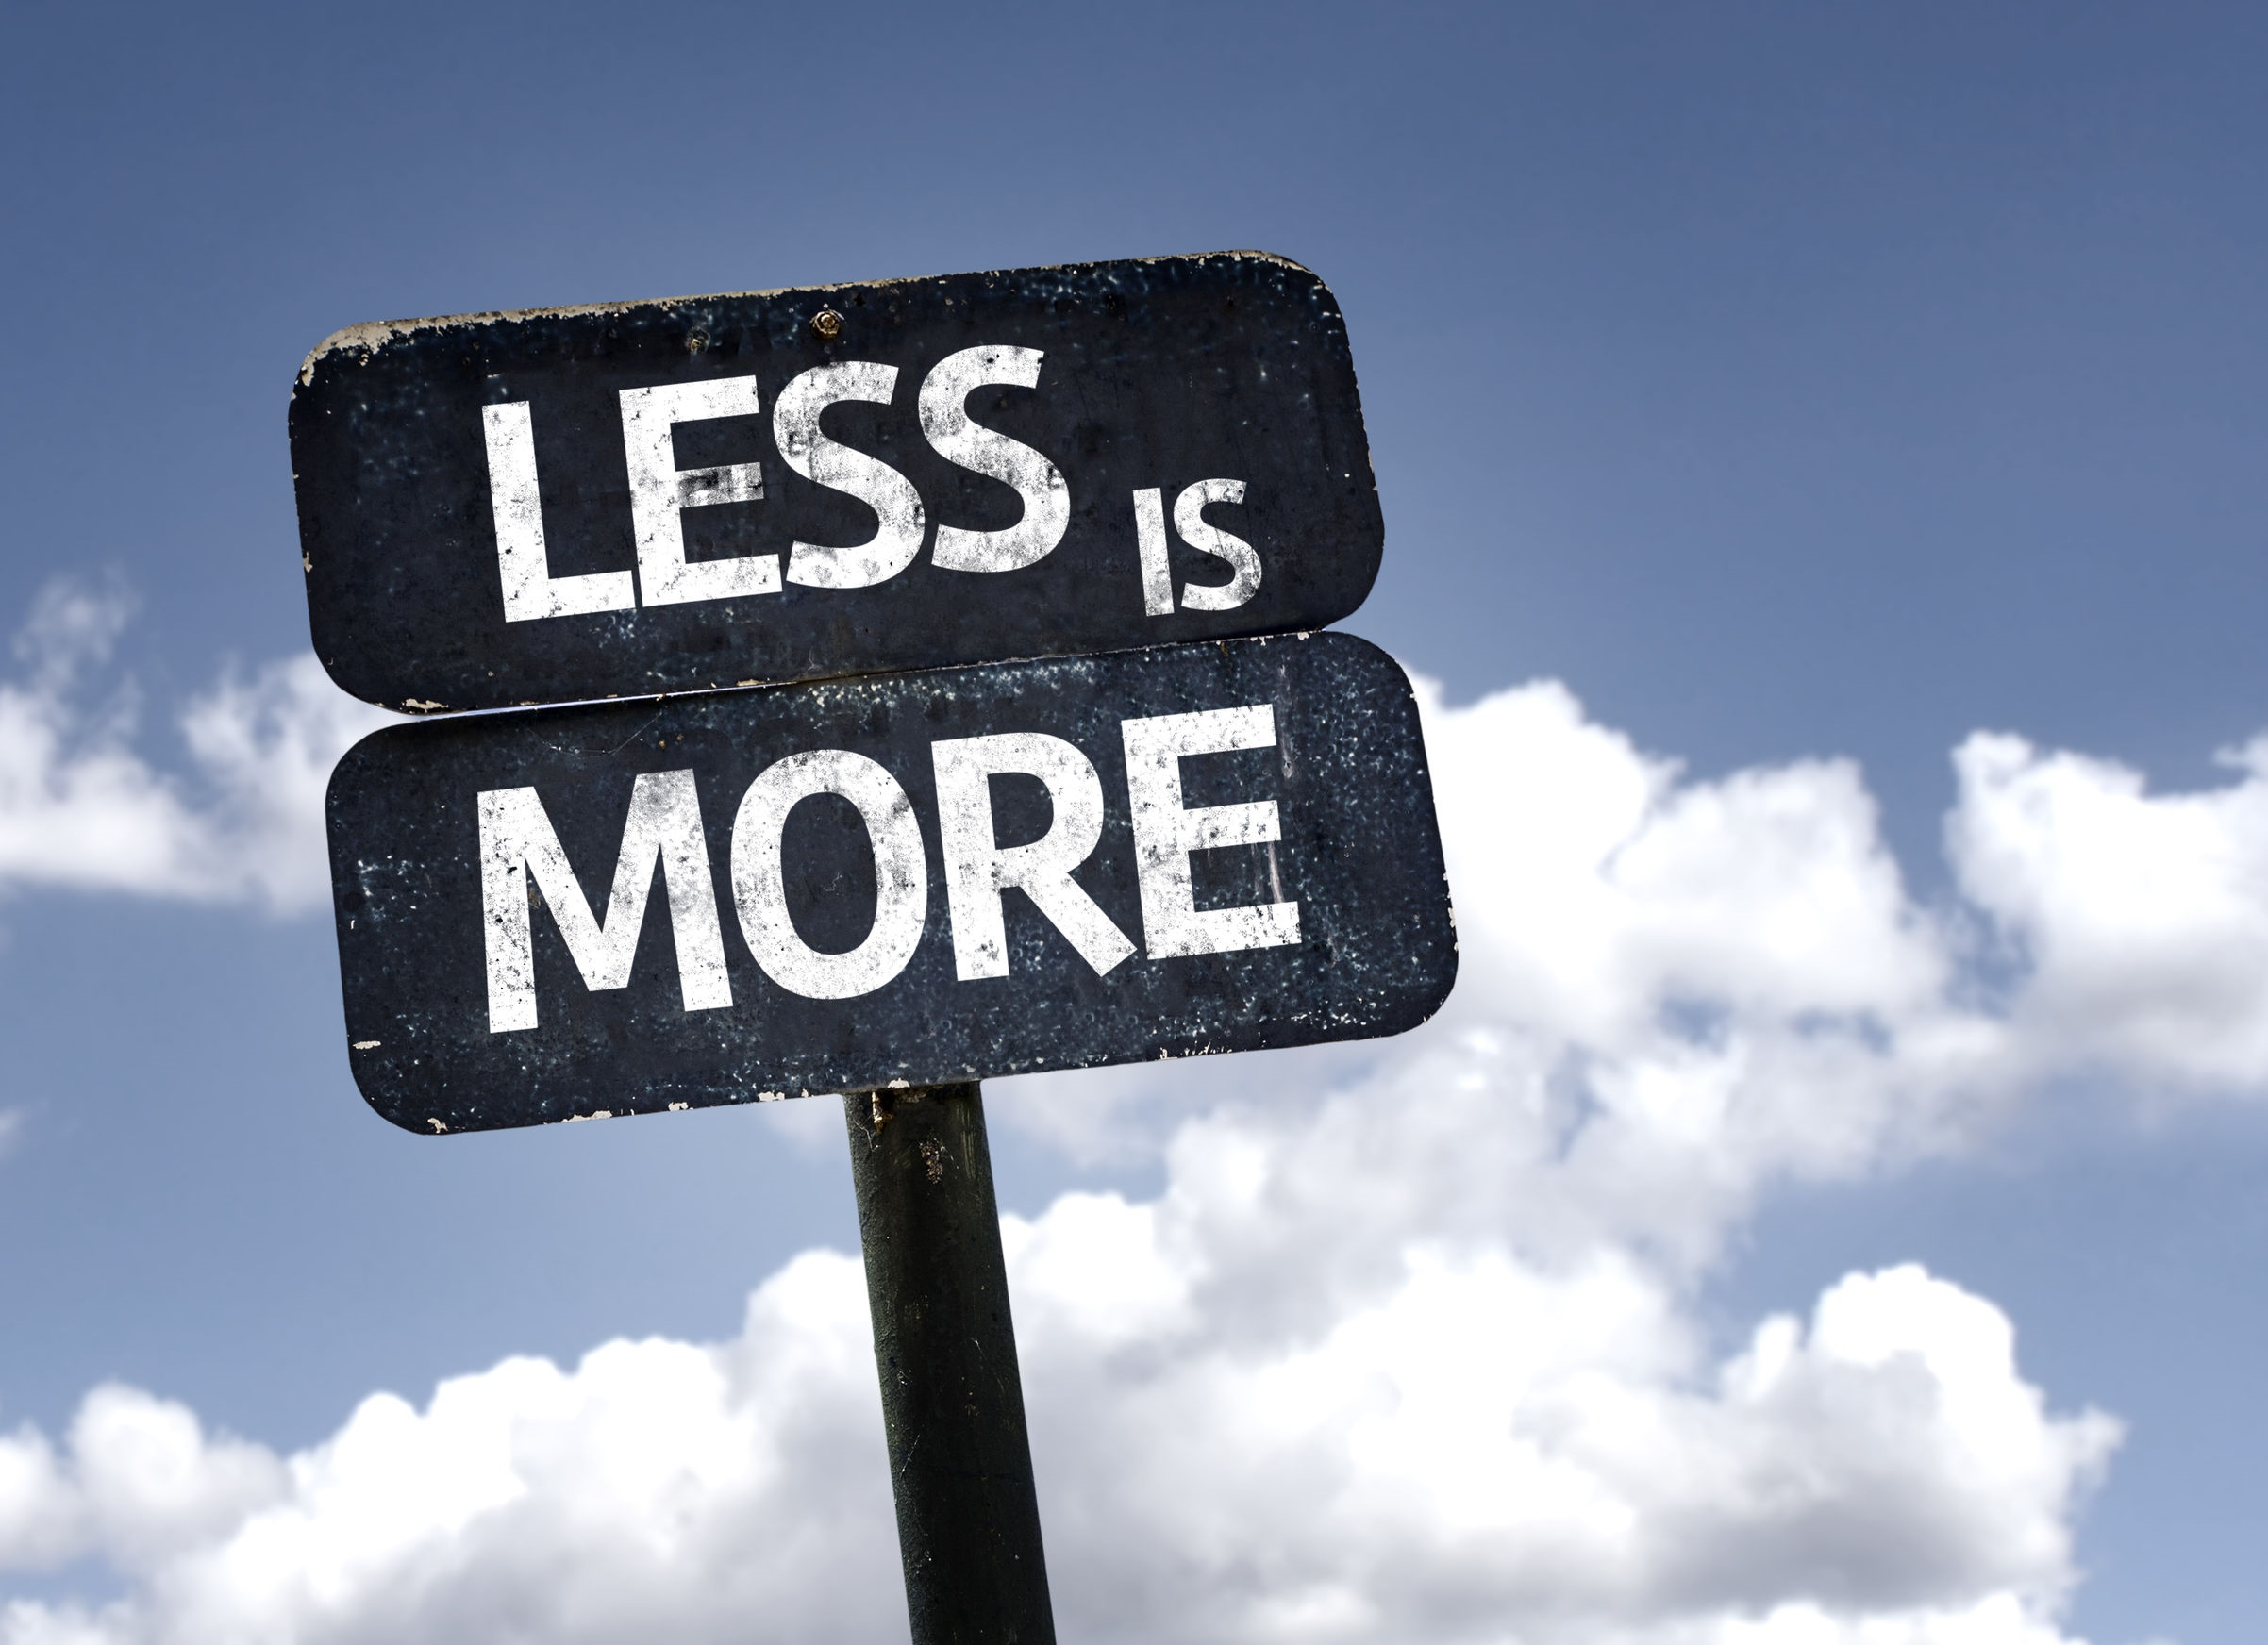
Less is More
Many people find that the stress of living above your means is not worth it. Unfortunately, they often don’t learn that lesson until the damage is done. That damage could be a foreclosure, or a poor credit score.
If you choose less over more, you’ll feel much better about that decision, you’ll sleep better, and you’ll have more financial freedom.
Shutterstock.com

Slide 15
Key Words
limited available funds valuable assets cash poor
expensive homes sizable asset borrow
above your means monthly income mortgage
over your head excessive loans necessities
foreclosure wants and needs sacrifice
Shutterstock.com

