Slide 1
NICKY FIFTH’S NEW JERSEY
N5NJ
SECONDARY PROGRAM
ENTREPRENEUR
NJ Family Businesses

Slide 2
Although you may not know it, family businesses are economic powerhouses. They create jobs, pay taxes and help build vibrant communities.
http://www.familybusinesscenter.com/resources/family-business-facts/

Slide 3
New Jersey, with its history of being an agricultural, industrial, and manufacturing powerhouse, has a long history of successful family businesses. From the wire rope empire of the Roebling family and the diverse contributions of the Kuser family to present contributions of the Valastro family, our family businesses have played an integral role in our success, and America’s success.

Slide 4
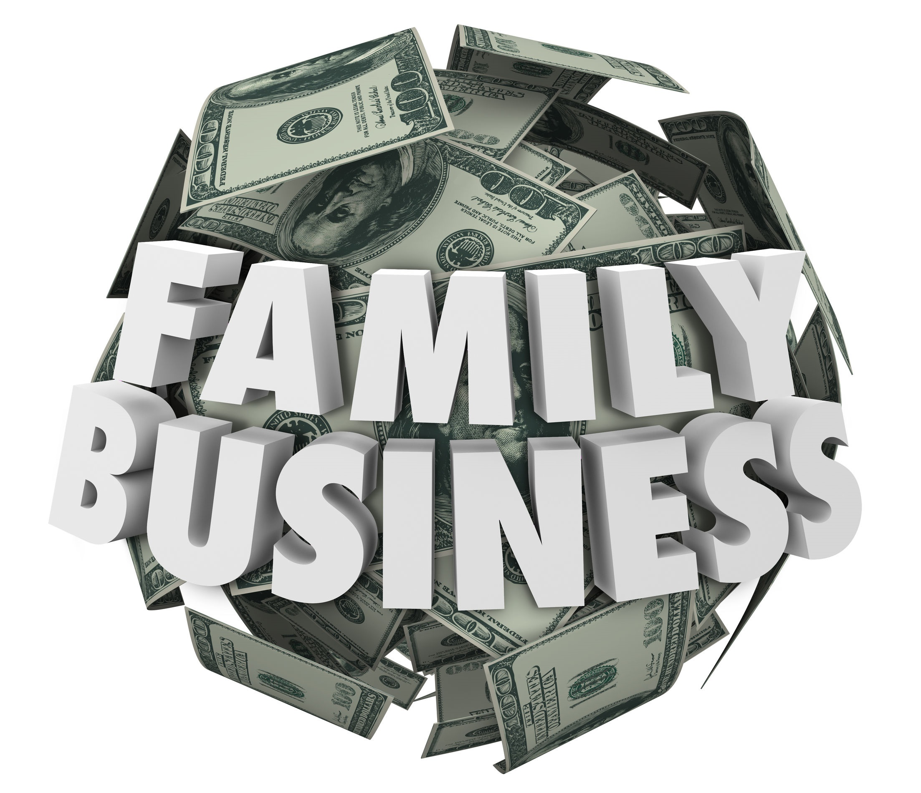
Family-owned businesses are the backbone of the American economy. Studies have shown about 35 percent of Fortune 500 companies are family-controlled and represent the full spectrum of American companies from small business to major corporations.
In addition, family businesses account for 64 percent of U.S. gross domestic product, generate 62 percent of the country’s employment, and account for 78 percent of all new job creation.
http://www.familybusinesscenter.com/resources/family-business-facts/

Slide 5
The greatest part of America’s wealth lies with family-owned businesses. Family firms comprise 80 to 90 percent of all business enterprises in North America.
http://www.familybusinesscenter.com/resources/family-business-facts/

Slide 6
Roughly 90 percent of the families responding to a survey in “From Longevity of Firms to Trans-generational Entrepreneurship of Families: Introducing Family Entrepreneurial Orientation indicated that they control more than a single firm. The results of the survey suggest that there is strong entrepreneurial activity undertaken by controlling families beyond their core (i.e., largest) company.
http://www.familybusinesscenter.com/resources/family-business-facts/

Slide 7
Small businesses, including many family firms, employ just over half of US workers. Of 119.9 million non-farm private sector workers in 2006, small firms with fewer than 500 workers employed 60.2 million and large firms employed 59.7 million. Firms with fewer than 20 employees employed 21.6 million.
http://www.familybusinesscenter.com/resources/family-business-facts/

Slide 8
Research shows that family businesses are less likely to lay off employees regardless of financial performance.
http://www.familybusinesscenter.com/resources/family-business-facts/

Slide 9
Recent research has shown that continued family control can be efficient, since families are, for example, able to positively affect the resource inventory and usage of their firms, apply a long-term perspective allowing for unique strategic positioning, have less human resources problems and higher firm values, or drive new entrepreneurial activity.
http://www.familybusinesscenter.com/resources/family-business-facts/

Slide 10
What truly drives many family businesses is the sense of connection and identity the owners and their family members feel with the business.
http://www.familybusinesscenter.com/resources/family-business-facts/

Slide 11
More than 30% of all family-owned businesses survive into the second generation. Twelve percent will still be viable into the third generation, with 3% of all family businesses operating at the fourth-generation level and beyond.
http://www.familybusinesscenter.com/resources/family-business-facts

Slide 12
Women are increasingly participating in family businesses leadership. Currently, 24 % of family businesses are led by a female CEO or President, and 31.3 % of family businesses surveyed indicate that the next successor is a female. Nearly 60 percent of all family-owned businesses have women in top management team positions.
Over the past five years, woman-owned family businesses have increased by 37%.
Female-owned family firms are typically 10 years younger than male-owned firms and more are first-generation businesses.
http://www.familybusinesscenter.com/resources/family-business-facts/

Slide 13
By 2017, it is estimated that 40.3 percent of family business owners expect to retire, creating a significant transition of ownership in the US.
Less than half of those expecting to retire in five years have selected a successor.
Even though nearly 70% of family businesses would like to pass their business on to the next generation, only 30% will actually be successful at transitioning to the next generation.
http://www.familybusinesscenter.com/resources/family-business-facts/

Slide 14
The value and importance of New Jersey’s thousands of family businesses can not be underestimated. Their contributions to the economy, community, and their employees creates a major impact on our state and the country. While competing with large businesses can seem daunting, finding a niche and working together, as a family, can result in an extremely rewarding and successful venture.
In addition, it is a tradition and legacy that can be passed on for generations, with each generation adding its own touches.

Slide 15
Key Words
family businesses vibrant communities industrial
economic powerhouses agricultural manufacturing
job creation employment backbone
entrepreneurial activities small businesses woman-owned
America’s wealth financial performance successor

